Slide 1
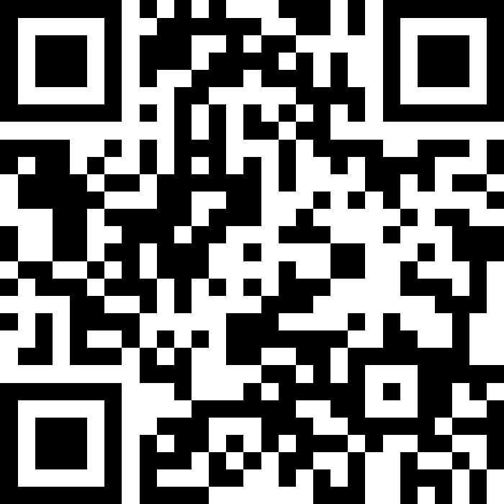
Submit your questions
Slido code #2079 628

