Slide 1
Non-elliptical Cavities
Bob Laxdal, TRIUMF
SRF2025 Tutorial

Slide 2
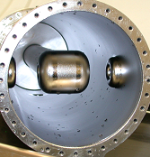

Outline
Non-elliptical cavities
Why do we need them
Low beta evolution
Cavity types
Figures of merit and parametrization
Choosing a cavity type
Examples of TEM cavities
Linac considerations
Beam dynamics issues for low beta
Linac design
Cavity production
Design considerations
Post-fabrication tuning
Surface treatment/processing
Cryomodule issues

Slide 3
Why non-elliptical cavities?

Slide 4
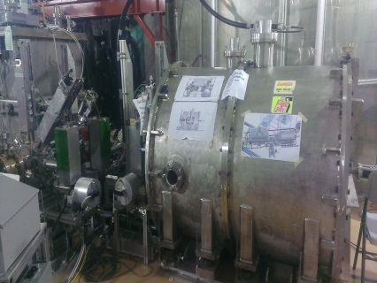
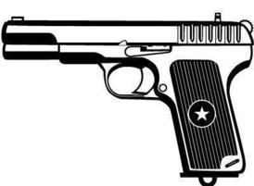
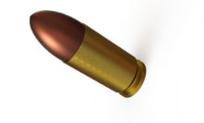
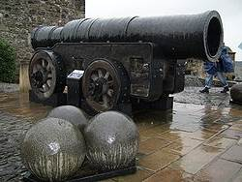
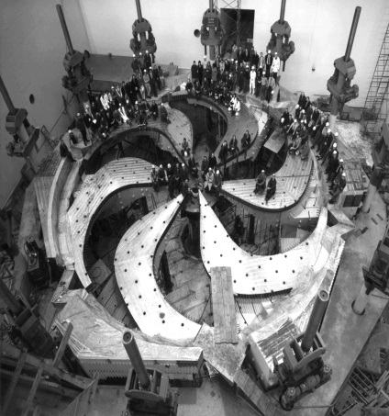
Accelerating Electrons vs Hadrons
Electron and hadron linacs are distinctly different due to the mass of the particles
Electron – 0.511MeV/c²
300kV - γ=1.58, β=0.78
550MeV - γ=1011, β=1
8 gm
ARIEL 300kV e-gun
Protons – 938 MeV/c²
300kV - γ=1.003, β=0.025
550MeV - γ=1.58, β=0.78
160 kgm
TRIUMF 500MeV cyclotron

Slide 5
Linac architecture
RF acceleration depends on synchronization between the rf and the particle bunches so is strongly dependent on velocity
Electron acceleration must be effective at β=1 while hadron acceleration must be effective over a very wide velocity range
source
β~1
Electron linacs – common building blocks all designed for β =1
Hadron linacs – various building blocks – different technologies each optimized to accelerate a given velocity range
SRF section initial energy is dependent on duty factor – for cw applications it is typical to start after the RFQ
β=0.002
β ~0.02
β ~0.05
β >0.05

Slide 6
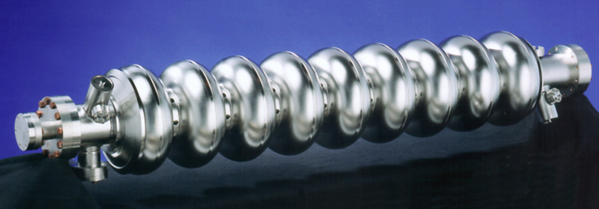
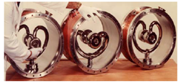
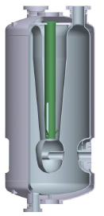
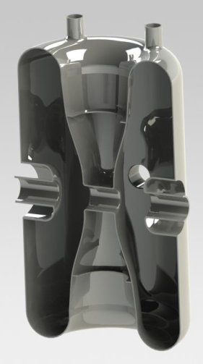
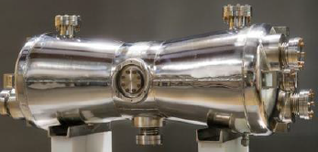
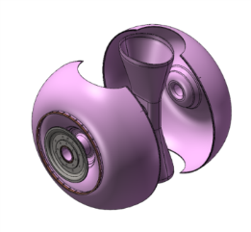
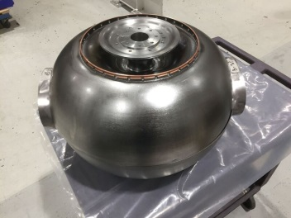
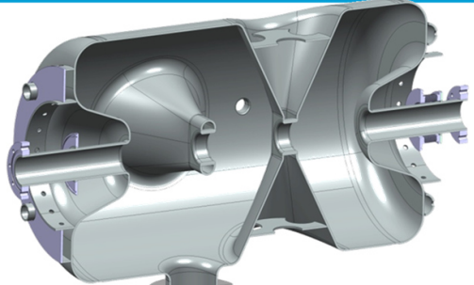
Hadron cavity zoo
Electron linacs – common building blocks all designed for β =1
design has largely converged
Hadron linacs
various building blocks – different cavity types each optimized to accelerate a given velocity range
typically short independently phased resonators with broad velocity acceptance
common building blocks but community still customizing designs

Slide 7
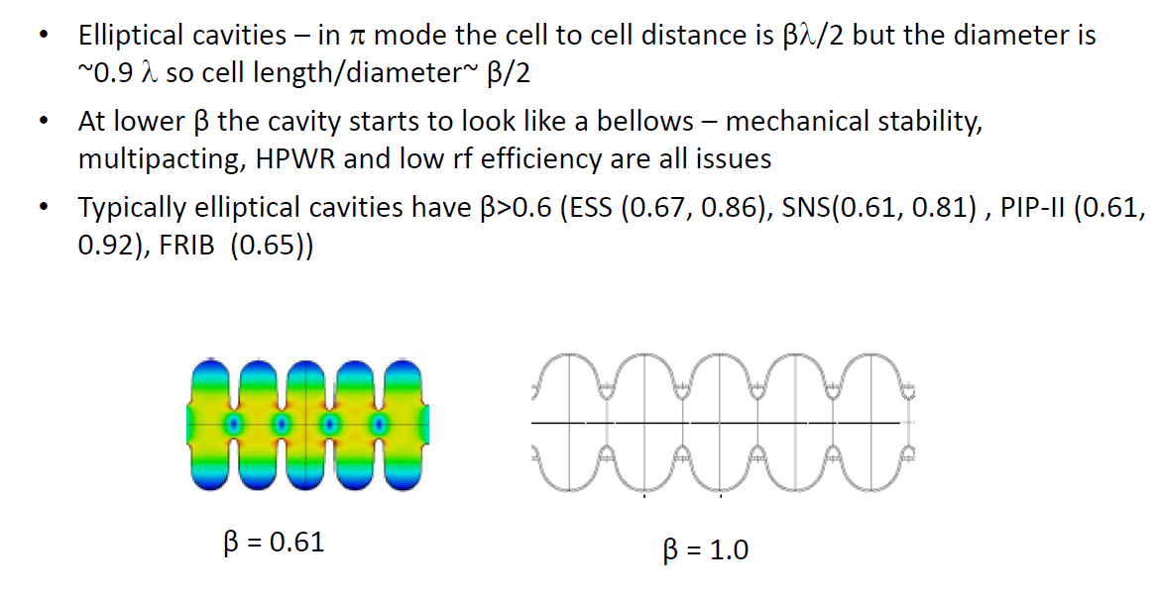
Velocity limitation of elliptical cavities
0.9λ

Slide 8
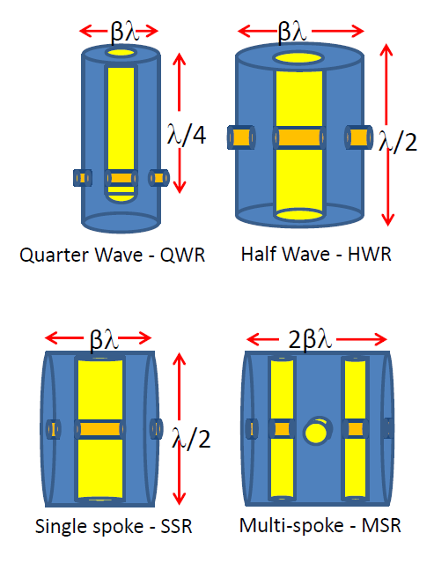
Why TEM mode cavities?
TEM mode cavities produce accelerating fields transverse to the inner conductor axis
For optimal acceleration the gap to gap distances are βλ/2 where β=v/c
For small β then λ must be large enough for reasonable gap dimensions – more later
The cavity height is used to adjust λ (rf frequency) and the dimensions along the beam axis are scaled to match the velocity
TEM cavities allow us to accelerate low and medium beta particles in a multi-gap structure with good efficiency and mechanical stability
Depending on the cavity type TEM mode cavities are 2-4 times smaller transversally than the same frequency elliptical cavity

Slide 9
Low beta evolution

Slide 10
Applications
Traditionally low beta SRF resonators were quarter waves (or split rings) used as boosters for heavy ion tandems (ATLAS, INFN-LNL, IUAC)
Next came low beta cavities for post-accelerators for Radioactive Ion Beams (RIBs) – ISAC-II, NSCL-ReA, HIE-Isolde
High duty cycle driver linacs are now being built with SRF sections beginning at lower beta values (FRIB, SPIRAL-II, PIP-II, C-ADS, IFMIF, …)
Rise in use of half-wave resonators (HWR) and spoke cavities (SSR, DSR)
Clean room assembly, HPWR, heat treatments and separated vacuum cryostats are now standard
Deflecting mode cavities have seen a rise in interest due to new high performance, compact designs for applications such as crabbing cavities for Luminosity upgrades in ring colliders (HiLumi@CERN)

Slide 11
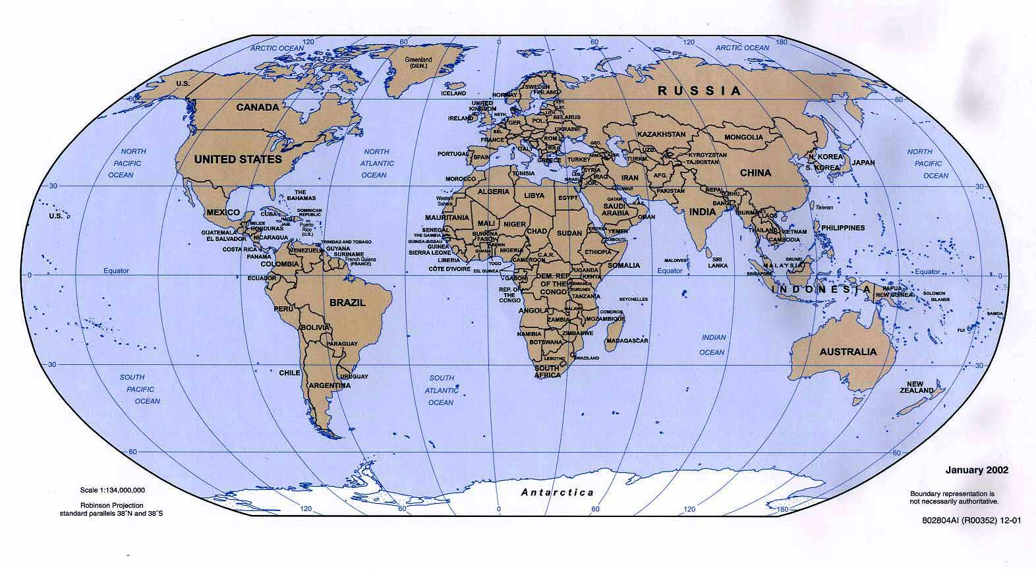
Non-elliptical SRF Community
TRIUMF
Frankfurt
ESS
FRIB
IMP
Orsay
CERN
IHEP
RISP
IUAC
FNAL
Saclay
RIKEN
ANL
ODU
BNL
LNL
SARAF
TIFR
ANU

Slide 12
Non-elliptical Facilities and Projects
Project | Lab | Driver | Post-accelerator | Particle | Structure
ATLAS | ANL |  | √ | HI | Split-ring, QWR
ALPI | LNL |  | √ | P, d / HI | QWR (sputter, bulk)
ISAC-II | TRIUMF |  | √ | HI | QWR
IUAC | IUAC |  | √ | HI | QWR
ReA3/6 | NSCL |  | √ | HI | QWR
HIE-Isolde | CERN |  | √ | HI | QWR (sputter)
SARAF | SOREQ | √ |  | P, d | HWR
SPIRAL-II | GANIL | √ |  | P, d, HI | QWR
IFMIF | Saclay | √ |  | P,d | HWR
FRIB | NSCL | √ |  | HI | QWR, HWR
ESS | ESS | √ |  | P | DSR
RAON | RISP | √ |  | HI | QWR, HWR, SSR
ADS | IMP,IHEP | √ |  | p | HWR, SSR
PIP-2 | FNAL | √ |  | P | HWR, SSR
SRILAC | RIKEN |  | √ | HI | QWR
Hi-Lumi | CERN |  |  | p | Crab cavities - DQWR, RFD

Slide 13
Cavity concepts

Slide 14
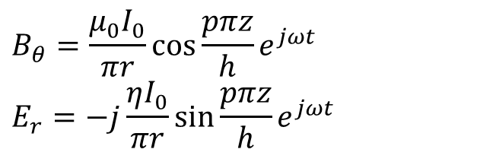
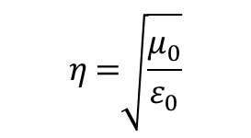
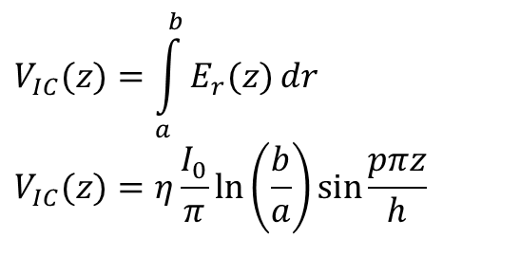
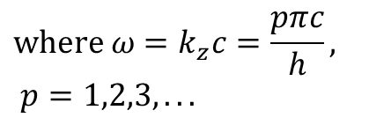
Coaxial resonator (TEM mode)
E
B
0
z
h
Coaxial geometries support TEM modes - assume inner radius a and outer radius b and height h with grounded plates at the ends
A standing wave occurs with the rdial electric field E_{r} vanishing on the end walls at z=0 and z=h
Magnetic fields loop around the inner conductor with peak fields at the shorted ends
E and B are 90 degrees out of phase
b
B_{θ}
E_{r}
a
I
z
h
E
B
ϕ,t
The voltage on the inner conductor
$$η=377 Ω {μ_{0}=4π×{10}^{−7} T m/A}_{}$$

Slide 15
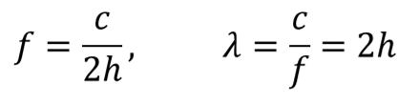
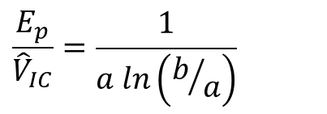
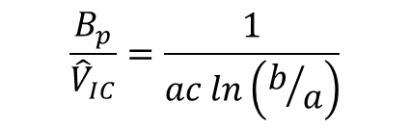
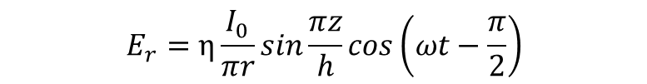
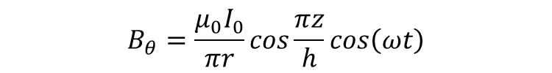
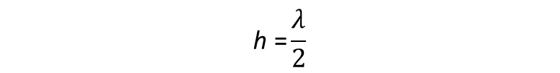
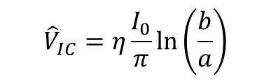
Half Wave Resonator (HWR) p=1
Fundamental mode has p=1 – half wave resonator
b
B_{θ}
E_{r}
$$B_{θ}=\frac{μ_{0}I_{0}}{πr}\cos{\frac{πz}{h}}cos\left(ωt\right)$$
a
I
$$E_{r}=η\frac{I_{0}}{πr}\sin{\frac{πz}{h}}cos\left(ωt−\frac{π}{2}\right)$$
z
With frequency and wavelength
h
$$\text{h} \text{=}\frac{λ}{2}$$
E
B
0
z
h
Peak voltage is at the center z=h/2
$${\hat{V}}_{IC}=η\frac{I_{0}}{π}\ln\left(\frac{b}{a}\right)$$
Peak surface fields are on the inner conductor

Slide 16
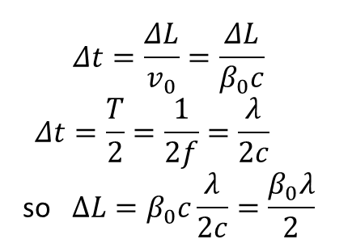
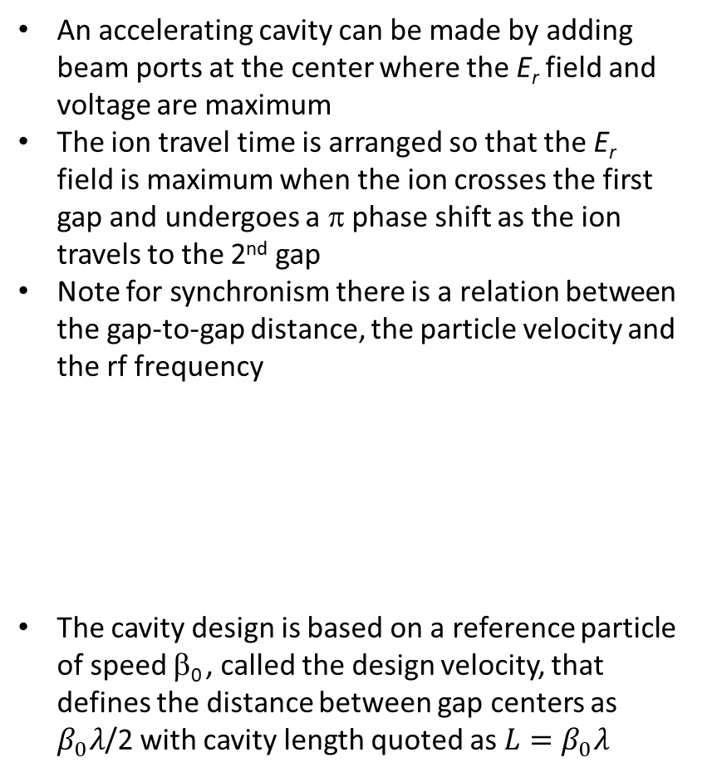
Acceleration with HWR
An accelerating cavity can be made by adding beam ports at the center where the E_{r} field and voltage are maximum
The ion travel time is arranged so that the E_{r} field is maximum when the ion crosses the first gap and undergoes a π phase shift as the ion travels to the 2nd gap
Note for synchronism there is a relation between the gap-to-gap distance, the particle velocity and the rf frequency
The cavity design is based on a reference particle of speed β₀ , called the design velocity, that defines the distance between gap centers as $β_{0}λ$/2 with cavity length quoted as ${L=β}_{0}λ$
V,E
h
I,B
ΔL
ΔL
Example: h = 0.5 m, λ=1m, f=300MHz
If β₀=0.2 then the gap to gap distance must be ΔL=0.1m for synchronism

Slide 17
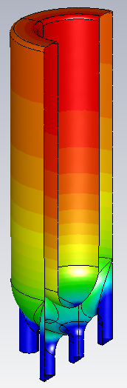
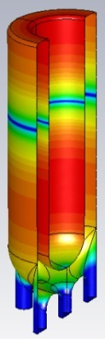
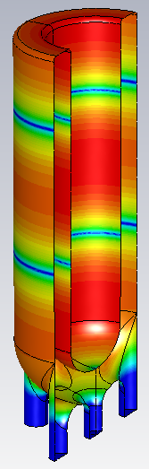
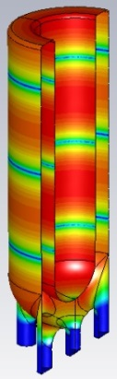



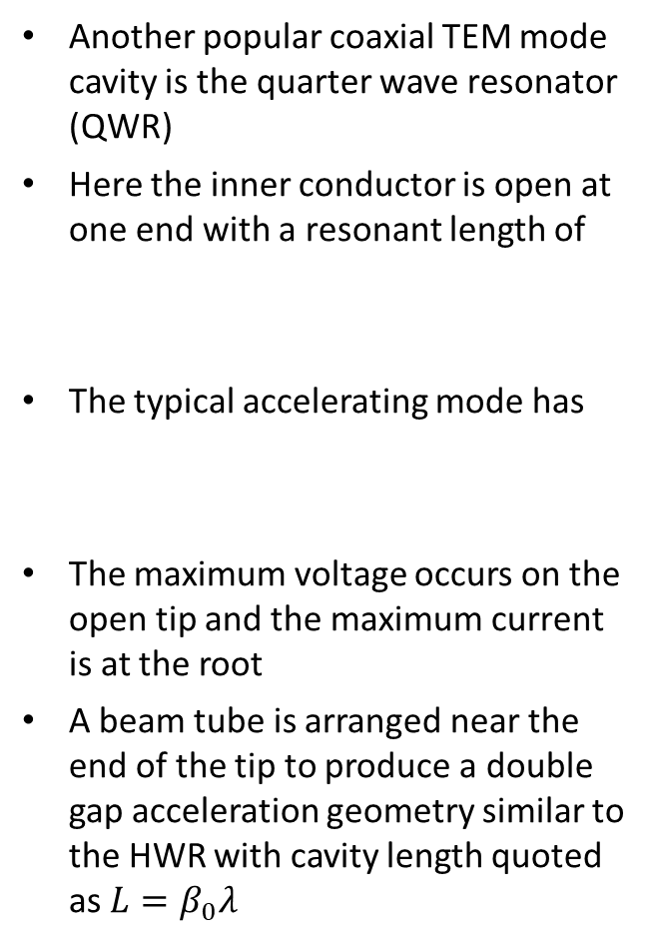
Quarter Wave Resonator (QWR)
Another popular coaxial TEM mode cavity is the quarter wave resonator (QWR)
Here the inner conductor is open at one end with a resonant length of
The typical accelerating mode has
The maximum voltage occurs on the open tip and the maximum current is at the root
A beam tube is arranged near the end of the tip to produce a double gap acceleration geometry similar to the HWR with cavity length quoted as ${L=β}_{0}λ$
h
ΔL
$$\text{h} \text{=}\frac{λ}{4}$$
$$\text{p}\text{=0 }\text{f} \text{=}\frac{c}{4h}$$
V,E
I,B
Example: h = 0.5 m, λ=2m, f₀=150MHz
If β=0.1 then the gap to gap distance must be ΔL=0.1m for synchronism

Slide 18
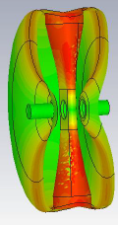
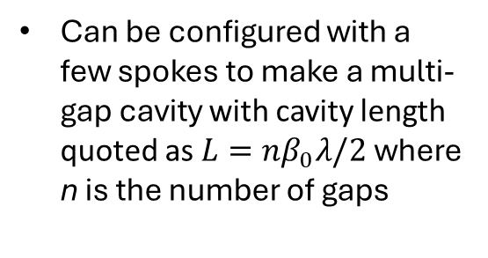
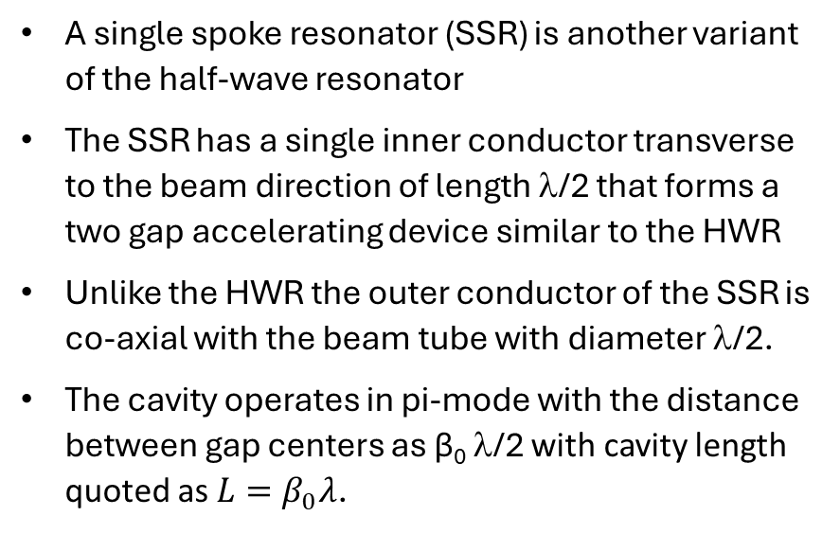
Example: Single Spoke Resonator (SSR)
A single spoke resonator (SSR) is another variant of the half-wave resonator
The SSR has a single inner conductor transverse to the beam direction of length λ/2 that forms a two gap accelerating device similar to the HWR
Unlike the HWR the outer conductor of the SSR is co-axial with the beam tube with diameter λ/2.
The cavity operates in pi-mode with the distance between gap centers as β₀ λ/2 with cavity length quoted as ${L=β}_{0}λ$.
β₀λ
λ/2
SSR – side view
2β₀λ
Can be configured with a few spokes to make a multi-gap cavity with cavity length quoted as ${L=nβ}_{0}λ/2$ where n is the number of gaps
λ/2
SSR-Top view
Multi-spoke - MSR

Slide 19
Figures of merit and parametrization

Slide 20
Reminder: Figures of merit (FoM)
Parametrization – FoM can be applied to the QWR and HWR using the known magnetic fields over the rf volume and surface

Slide 21
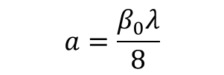
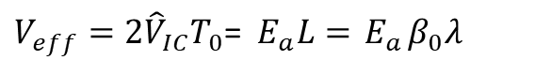

Assumptions for parametrization
Coaxial HWR fields can be used to parameterize both the HWR and QWR variants
HWR is represented well by the coaxial fields presented in slide 15
For QWR we assume the fields of half the HWR – not exact due to the open end of IC –justification is that parametrization uses magnetic field that is concentrated away from open end
V,E
V,E
I,B
I,B
2b= κa
2a
Design velocity, β₀, can be added to the parameterization by noting the dependence of coaxial geometry and β₀
β₀λ/4
β₀λ/2

Slide 22
Figures of Merit for QWR and HWR

Slide 23
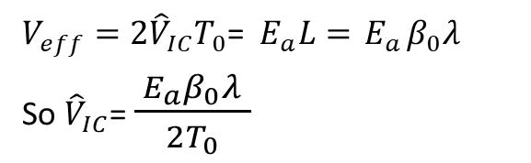

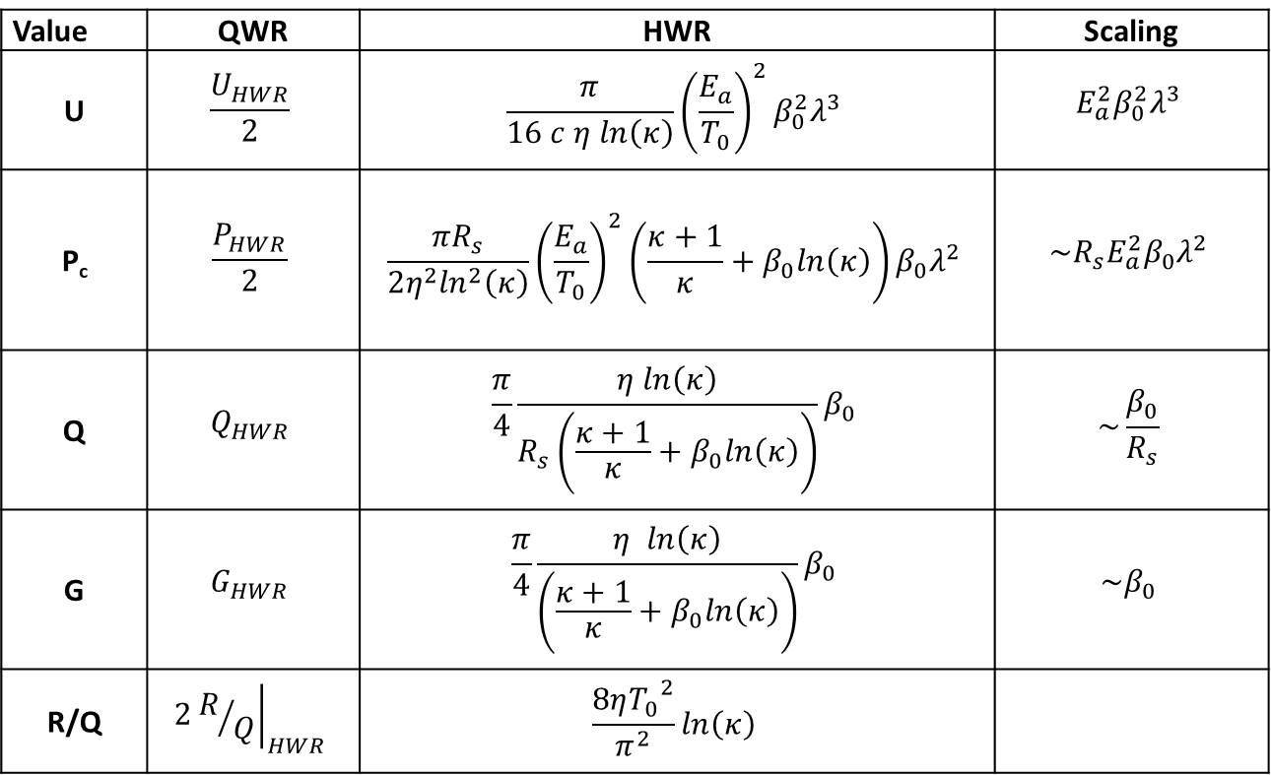

Choosing
$$η=377 Ω$$
Value | QWR | HWR | Scaling
U | $$\frac{U_{HWR}}{2}$$ | $$\frac{π}{16 c η ln\left(κ\right)}{\left(\frac{E_{a}}{T_{0}}\right)}^{2}{β_{0}^{2}λ}^{3}$$ | $$E_{a}^{2}β_{0}^{2}λ^{3}$$
P_{c} | $$\frac{P_{HWR}}{2}$$ | $${\frac{{πR}_{s}}{2η^{2}\ln^{2}\left(κ\right)}\left(\frac{E_{a}}{T_{0}}\right)}^{2}\left(\frac{κ+1}{κ}+β_{0}ln\left(κ\right)\right)β_{0}λ^{2}$$ | $$\sim R_{s}E_{a}^{2}β_{0}λ^{2}$$
Q | $$Q_{HWR}$$ | $$\frac{π}{4}\frac{η ln\left(κ\right)}{R_{s}\left(\frac{κ+1}{κ}+β_{0}ln\left(κ\right)\right)}β_{0}$$ | $$\sim \frac{β_{0}}{R_{s}}$$
G | $$G_{HWR}$$ | $$\frac{π}{4}\frac{η ln\left(κ\right)}{\left(\frac{κ+1}{κ}+β_{0}ln\left(κ\right)\right)}β_{0}$$ | $${\sim β}_{0}$$
R/Q | $$2{\left.R/Q\right|}_{HWR}$$ | $$\frac{8η{T_{0}}^{2}}{π^{2}}ln\left(κ\right)$$

Slide 24
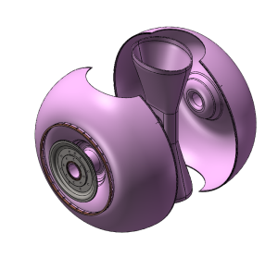
Model vs actual - G
Comparing the analytic model with actual designs
SSRs larger volume

Slide 25
Model vs actual – R/Q
Comparing the analytic model with actual designs

Slide 26
Choosing a cavity type

Slide 27
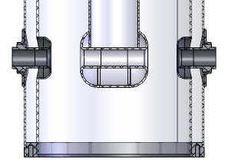
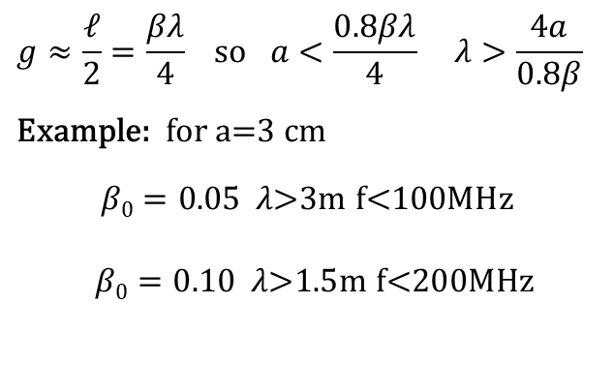
Frequency choice – TEM mode
Longitudinal (beam direction) cavity dimensions are dependent on beam velocity (∝βλ) – transverse cavity dimensions are dependent on λ
Smaller structures are cheaper to fabricate so favour small λ (high frequency)
Lower frequencies increase size of stable region in longitudinal phase space
Lower velocities need lower frequencies
There is β₀λ/2 between gap centers (one cell) and the gap length is typically half a cell or g=β₀λ/4
Drift tube aperture should be less than the gap to improve acceleration efficiency ie a/g<0.8
g
a
g=gap, a=aperture
βλ
βλ
λ/4
λ/2
Quarter Wave - QWR
Half Wave - HWR

Slide 28
Commonality
The typical building blocks are QWR, HWR, SSR and MSR but the community has not coalesced towards common designs as has happened in the high beta community
The main reason is the large parameter space since each project may have different requirements – final energy, ion, existing infrastructure
At least design techniques, principles, ancillaries are converging
However at least two frequency series have emerged as being more common

Slide 29
Actual cavity designs

Slide 30
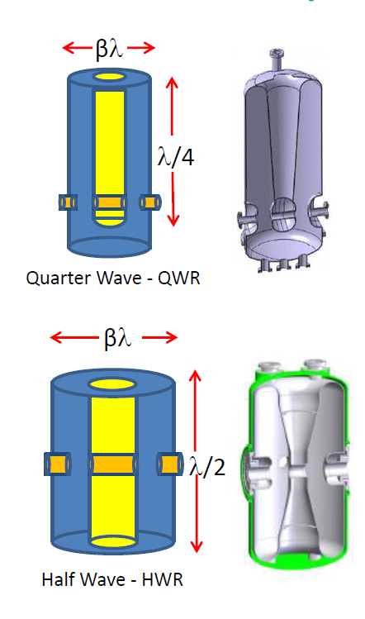
QWR vs HWR
QWR is the cavity of choice for low beta applications (β<0.15)
Pros:
rf power loss is ~50% of HWR for same frequency, energy gain and β₀
Easy tuning at bottom plate
Cons:
asymmetric field pattern can add vertical steering - not suitable for high intensity light ion applications and for higher velocities
less mechanically stable
HWR is chosen in mid-velocity range β>0.15 or where beam steering is an issue
Pros: symmetric field pattern and mechanical stability
Cons: 2x structure and rf losses compared to QWR

Slide 31
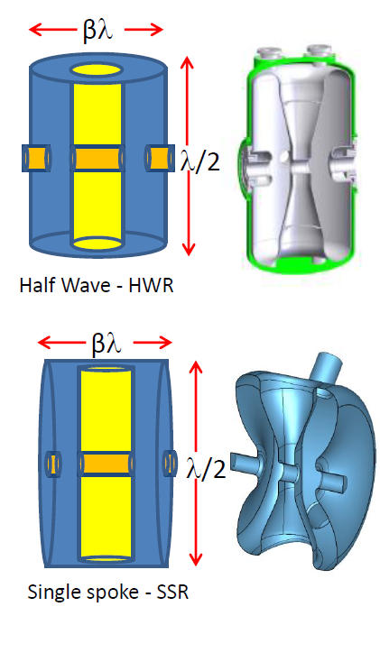
HWR vs Single Spoke (SSR)
A single spoke resonator (SSR) is another variant of the HWR TEM cavity
HWR – the outer conductor is coaxial with the inner conductor with diameter ~β₀λ
SSR – the outer conductor is coaxial with the beam path with diameter λ/2
For β₀ <0.5 the SSR has a larger overall physical envelop than the HWR for the same frequency
For β₀ =0.1->0.25 HWRs are typically chosen for ~160MHz while SSRs are built for ~320MHz
For β₀ =0.25->0.5 HWRs and SSRs adopt typically ~320MHz – with G slightly larger in SSRs
The spoke geometry allows an extension along the beam depth for multiple gaps in a longer cavity

Slide 32
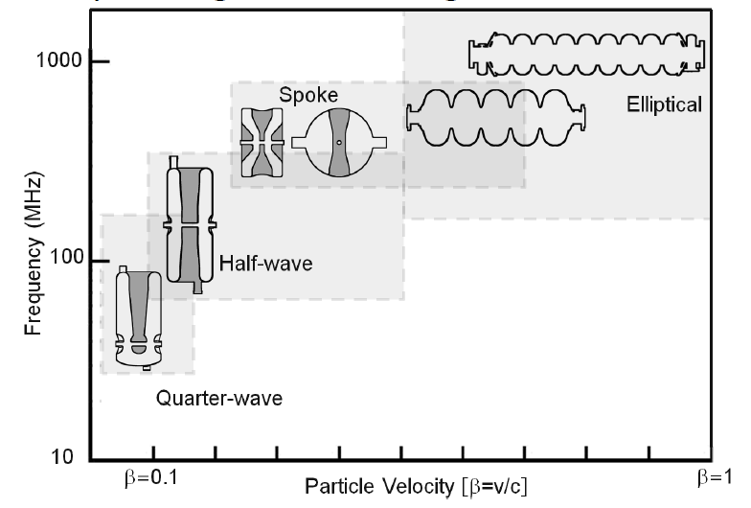
Accelerating cavities – cavity type/ velocity/frequency chart
Elliptical
Deflecting mode

Slide 33
Examples of TEM Cavities

Slide 34
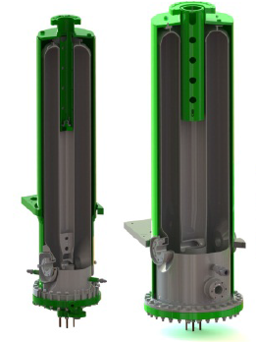





Cavity types – quarter waves
TRIUMF ISAC-II Resonators
FRIB β=0.041, 0.085 80.5MHz
ANL β=0.077, 0.085 72.5MHz
Typical range
β~0.04->0.15
f=50MHz->160MHz
Spiral-2 β=0.007, 0.12 88.05MHz
RAON β=0.047, 81.25 MHz

Slide 35








Cavity types – half waves
FRIB β=0.29, 0.53 f=322MHz
FRIB β=0.29, 0.53 f=322MHz
IMP β=0.10, f=162.5MHz
Typical range
β~0.10->0.5
f=140MHz->325MHz
IFMIF β=0.11, f=175MHz
ANL β=0.112, f=162.5MHz

Slide 36




Cavity types – Single spokes
TRIUMF/RISP β=0.3, f=325MHz
IHEP β=0.12, f=325MHz
FNAL β=0.215, f=325MHz
Typical range
β~0.15->0.7
f=325-700MHz
325 MHz, β₀ = 0.82 Single-Spoke Cavity

Slide 37




Multi-cell
ESS/IPN β=0.50, f=352MHz
ANL β=0.63, f=345MHz
500 MHz, β₀ = 1 Double-Spoke Cavity

Slide 38


Deflecting mode cavities
A sub-set of cavities are designed to provide a phase dependent transverse deflection to the beam using a TE-like (H-mode) dipole electric field
Applications include crab cavities and rf kickers
Deflection from both electric and magnetic fields
Frequency governed by transverse dimension (~ λ/2)
TRIUMF 650MHz H-mode deflecting cavity

Slide 39






Deflecting mode cavities
double quarter wave (DQW) – 400MHz – BNL/CERN
TRIUMF 650MHz
RFD – multi-cell – 953MHz – ODU
RF Dipole (RFD) – 400MHz – ODU/CERN

Slide 40


Cross bar H mode - CH
Another multi-gap variant is the cross-bar H-mode cavity
Spokes stem from four ridges with opposite ridges having the same voltage and adjacent ridges in anti-phase
Designed to give a high accelerating voltage in a fixed velocity regime
360 MHz, β₀~0.1 19 gap CH resonator
E- field
H- field
CH 6 cell fabricaated by IMP – 162.5MHz β=0.067

Slide 41
End of Part I Questions?

Slide 42
Acceleration considerations

Slide 43


RF Acceleration
Consider an electric field in an accelerating gap
The ion travels with velocity βc on axis and experiences a field that is the product of the spatial variation and the time modulation
Where ϕ is a constant (the rf phase) that defines the time of arrival of the particle with respect to the rf time modulation.
A phase of ϕ=0 corresponds to the maximum acceleration that can be given to the particle (`on crest’ acceleration)
the accelerating voltage imparted to the ion is given by
Example: Acceleration gap
g
Ez (z)
For simplicity assume a square profile
z
cos ωt
ϕ=0
βc
t
$$V\left(φ\right)=\left|\int_{−∞}^{∞}{E_{z}\left(ρ=0,z\right)\left(\cos\left(\frac{2πz}{βλ}\right)\right)dz}\right|⋅\cos{φ}$$
Ez (z,t)
$$V\left(φ\right)=V_{eff}⋅\cos{φ}$$
z, t
$$ωt=\frac{2πfz}{v}=\frac{2πcz}{λβc}=\frac{2πz}{βλ}$$

Slide 44




Transit time factor of short (few gap) structures
V_{eff} is called the accelerating voltage or effective voltage – due to the time variation of the fields it is less than integrating through the absolute value of the static field, V₀
The transit time factor is the ratio between actual voltage gain, $V_{eff},$ and the absolute magnitude of the total time independent voltage gain, $V_{0}$
$$V_{eff}=\left|\int_{−∞}^{∞}{E_{z}\left(ρ=0,z\right)\left(\cos\left(\frac{2πz}{βλ}\right)\right)dz}\right|$$
$$T≡\frac{\int_{−∞}^{∞}{E_{z}\left(r=0,z\right)⋅\cos{\frac{2πz}{βλ}}dz}}{\left|\int_{−∞}^{∞}{E_{z}\left(r=0,z\right)⋅dz}\right|}$$
$$V_{eff}=V_{0}⋅T \text{with} T<1$$
A convenient voltage gain formula is
A useful figure of merit called the acceleration gradient is given by

Slide 45






Single Gap Transit time factor (TTF)
Assume an accelerating gap with an accelerating field approximated with a square profile
$$E_{z}(z)={\left.E_{0}\right|}_{−g/2}^{g/2} \text{else} E_{z}(z)=0 \\ \text{so} V_{0}=E_{0}⋅g$$
$$T=\frac{V_{eff}}{V_{0}}=\frac{βλ}{πg}\sin\left(\frac{πg}{βλ}\right) \text{and} V_{eff}=V_{0}T$$
E₀
-g/2
g/2
Here note that as g->0 the TTF -> 1 but small gaps cannot support high fields
The gap geometry is optimized using a number of considerations
typically the gap is ~half a cell where a cell is βλ/2
So g=βλ/4
and $T=\frac{V_{eff}}{V_{0}}=\frac{4}{π}\sin\left(\frac{π}{4}\right)=$0.9
Energy gain
$$ΔW=qV_{eff}⋅\cos{φ} \\ ΔW=qV_{0}T⋅\cos{φ}$$

Slide 46



Realistic Single Gap TTF
In reality the field penetrates into the drift tube and reduces the transit time factor (dependent on aperture to gap ratio f=a/g)
This reduces the transit time factor for on axis particles
Where f=a/g and I₀ is the modified Bessel function of the first kind
Typically try to limit a/g<0.8 for reasonable efficiency T(0)=0.82
Single Gap – Transit time
a=2r₀
$$T(r)=\frac{V_{eff}}{V_{0}}=\frac{βλ}{πg}\sin\left(\frac{πg}{βλ}\right)\frac{I_{0}\left(kr\right)}{I_{0}\left(kr0\right)}$$
$$\text{typically}\text{,} g=\frac{L}{2}=\frac{βλ}{4} \text{and} k=\frac{2π}{βλ}=\frac{π}{2g}$$
$$T\left(r\right)=\frac{V_{eff}}{V_{0}}=\frac{4}{π}\sin\left(\frac{π}{4}\right)\frac{I_{0}\left(\frac{πr}{2g}\right)}{I_{0}\left(\frac{πa}{4g}\right)}=\frac{4}{π}\sin\left(\frac{π}{4}\right)\frac{I_{0}\left(\frac{πr}{4r_{0}}f\right)}{I_{0}\left(\frac{π}{4}f\right)}$$

Slide 47

Two Gap TTF
For a two-gap structure the optimum acceleration occurs when the rf gains 180 degree (π) from gap center to gap center at the design velocity, β₀
Slower or faster particles will get less kick due to reduced synchronization with the rf phase
Assuming a square field distribution of field in the gap the combined two-gap transit time factor is given by
β=β₀
β₀λ/2
cav
β=0.7β₀
V_{IC}
β=1.5β₀
β/β₀
V_{IC}= inner conductor voltage

Slide 48




Energy Gain in a Two-gap structure
For β= β₀ ion is synchronized with the rf
Maximum energy gain in a first gap
$ΔW1=qE0g T\cos{φ}$= $qVIC T\cos{φ}$
Maximum energy gain in a second gap
$ΔW2=qE0g T\cos{φ}$= $qVIC T\cos{φ}$
Total gain
$ΔW=ΔW1+$ $ΔW2$ = 2 $qVIC T\cos{φ}=qV_{eff}\cos{φ}$
where T is the single gap T$TF, T\left(β_{0}\right)= \frac{β0λ}{πg}\sin\left(\frac{πg}{β0λ}\right)$
For other ion velocities, β, the efficiency is reduced
$\text{Total} \text{gain} ΔW= qVeff\frac{T(β)}{T\left(β_{0}\right)}\cos{φ=2qV_{IC}}$ $T(β)\cos{φ}$
where $T(β) ={\frac{sin\left(\frac{πg}{βλ}\right)}{\left(\frac{πg}{βλ}\right)}sin\left(\frac{πβ0}{2β}\right)}$ and $Veff=$2 $VIC T$ $\left(β_{0}\right)$
The effective voltage is $Veff=$V₀T where V₀ is the sum of the voltages that could be gained in each gap assuming no TTF and T is the single gap transit time factor
V_{IC}
g
g
L = $\frac{β_{0}λ}{2}$
$$E0$$
g
g
V_{IC} = the voltage on the inner conductor

Slide 49







Multiple gaps (Normalized Transit time)
$$T_{2−gap}(β)=\frac{\sin\left(\frac{πg}{βλ}\right)}{\frac{πg}{βλ}}\sin{\frac{πβ_{0}}{2β}}$$
T(β)
$${\left.T\right|}_{3−gap}(β)=\frac{βλ}{πg}\sin{\frac{πg}{βλ}}\left[\sin^{2}{\frac{π}{2}}\frac{β_{0}}{β}\right]$$
$$ΔW=qV_{0}T\cos{φ}$$
$V_{eff}=V_{0}T($β₀)
$$ΔW=qV_{eff}\frac{T(β)}{T\left(β_{0}\right)}\cos{φ}$$
For multi-gap structures $V_{eff}=\int_{−∞}^{∞}{E_{z}}(z,t)dz\text{ @ }β=β_{0} \text{and} φ=0^{0}$
Multiple gaps (n) will increase the total voltage gain since ${V_{eff}=E}_{a}L$and $L=n\frac{β_{0}λ}{2}$
But the velocity acceptance of the transit time factor is reduced as n increases

Slide 50
Beam Dynamics Issues for low beta

Slide 51
Linac longitudinal dynamics
It is important to maintain periodic focusing in both transverse and longitudinal planes
An ion linac (v<c) is designed for the acceleration of a single ideal particle which remains in synchronism with the accelerating fields and is called the synchronous particle – the synchronous particle phase is ϕ_{s}
Restoring forces are needed so that an ensemble of particles near the synchronous particle will be accelerated and transported
Longitudinal focusing is provided by an appropriate choice of phase of the synchronous particle
If the synchronous particle crosses the gap center as the field is rising (negative phase), the particle arrives before the peak field is reached
Early particles receive less kick and late particles receive more kick as the field amplitude grows to provide correction
Late particle
Synchronous particle
Early particle

Slide 52




RF Gaps – Transverse motion
Transverse rf forces exist at gaps from E_{r} components of the off-axis fields
For an accelerating phase E_{r} is focusing at the gap entrance and defocusing at the gap exit.
If the field is rising (negative accelerating phase) the focusing kick is weaker than the defocusing kick and overall defocusing occurs with radial kick given by given by
focus
defocus
Ez (z)
$$γβr^{′}=γβ\frac{∆p_{r}}{p}=−\frac{Q}{A}\frac{1}{m_{0}c^{2}}\frac{πE_{a}𝓁}{γ^{2}β^{2}λ}sinφ_{s}∙r=k_{r}r$$
$$k_{r}= −\frac{Q}{A}\frac{1}{m_{0}c^{2}}\frac{πE_{a}𝓁}{γ^{2}β^{2}λ}sinφ_{s}$$
-Er (z)
Leads to a simple transfer matrix of a lens that can be used in simulations – for transverse focusing k_{r}=-abs(k_{r}) so 0<ϕ_{s}<90
$$\left(\begin{matrix}r \\ r^{′}\end{matrix}\right)=\left(\begin{matrix}1 & 0 \\ {k_{r}}/{βγ} & 1\end{matrix}\right)\left(\begin{matrix}r_{0} \\ {r_{0}}^{′}\end{matrix}\right)=M_{rf}\left(\begin{matrix}r_{0} \\ {r_{0}}^{′}\end{matrix}\right)$$

Slide 53

Longitudinal and radial stability - summary
To accelerate and focus the beam longitudinally we need a negative synchronous phase -90<ϕ_{s}<0 so that there is a restoring force to keep the motion stable
When -90<ϕ_{s}<0 the rf gap produces a defocusing force in the transverse dimension$∝\frac{sinφ_{s}}{γ^{2}β^{2}}$
Periodic focussing must be added transversely to counteract the rf defocusing (ie quadrupoles, solenoids)
The rf gap defocusing force is reduced at higher energies and so less transverse focussing is required

Slide 54



Transverse focussing choices
Two basic transverse focussing choices for TEM SRF linacs
Room temperature quadrupoles
Positioned between cryomodules as doublets or triplets
Pros – easier to install, align and replace
Cons – forces shorter modules especially at low β - electrical power
SC solenoids in CMs
Placed between cavities with a periodicity required by beam dynamics
Pros – high electrical efficiency, allows long cryomodules for less static cryo losses
Cons - Require careful alignment, care must be taken to avoid magnetic pollution in cavities

Slide 55






QWR steering
QWRs produce a finite vertical electric field and a non-zero azimuthal magnetic field 90 degrees out of phase that steers the beam
At higher beta, β₀>0.15, where $qv×B$ forces increase, the fields can produce significant vertical steering especially for β < β₀
Mitigations include
Aligning the resonator below the the beam axis to provide a correction from rf defocusing
Modifying gap geometry to correct the steering by means of additional transverse electric field components

Slide 56
Linac design

Slide 57


SRF Hadron Linacs – multiple short cavities
For SRF hadron linacs it is typical to adopt short independently driven TEM cavities:
Very flexible – each cavity has an independent rf system with adjustable phase and voltage
Each cavity has a broad velocity acceptance so that only a few unique cavity designs are required with many of each type deployed
Acceleration can be customized for a particular A/Q value or range of values
Lower A/Q values can be accelerated to higher velocities than higher A/Q values
High number of rf systems increases costs but rf units are typically modest

Slide 58
Linac Design principles
Resonators take time and energy to design and prototype - therefore minimizing the unique number of cavity designs is a design goal
Choosing optimum beta values and frequency based on
Transit time factor T(β) is efficient over velocities from 0.75β₀< β <1.5β₀ for a given β₀
For an n-gap structure the cavity voltage is given by E_{a}*L = E_{a}*nβ₀λ/2
for same frequency more voltage for higher β₀ values.
the rf frequency has to be low enough to provide sufficient longitudinal acceptance and gap dimensions while higher frequencies give smaller (cheaper) resonators (and cryomodules) but lower V_{eff}
For longer linacs a rule of thumb is to maintain a certain cavity type until T(β) lowers the effective voltage below the voltage of the next cavity series
For β>0.5 it is possible to consider multi-gap spokes since the smaller relative velocity change in this regime reduces the impact of the lower velocity acceptance

Slide 59



Example: ISAC-II Heavy Ion Linac (post-accelerator)
Consists of 40 QWRs with three different cavity types of β₀=5.7%, 7.1% and 11% with N= 8, 12 and 20 cavities of each type
All cavities have same outer and inner conductor diameter to reduce fabrication cost
106.1 MHz β₀=5.7%
106.1 MHz β₀ =7.1%
141.4 MHz β₀ =11%
V_{IC}
E_{z}
V₀=2V_{IC}
z
$V_{eff}=V_{0}T($β₀)

Slide 60



Example – ISAC-II
Choice of $β_{0}$ values was made to give efficient acceleration for a range of A/Q values
Typically, all cavities run at maximum voltage
The energy gain from one cavity is
where for two gap TTF
The final energy is given by
$V_{eff}=V_{0}T($β₀)
$$\frac{T(β)}{T(β_{0})}=\frac{β}{β_{0}}\frac{\sin\left(πg/βλ\right)}{\sin\left(πg/β_{0}λ\right)}\sin{\frac{πβ_{0}}{2β}}$$
ISAC-II – three cavity types with β₀=0.057, 0.071 and 0.11 of n = 8, 12 and 20 respectively

Slide 61




FRIB Heavy ion linac
A/q=7
A/q=3
A/q=3
A/q=2

Slide 62
Cavity Design

Slide 63
Cavity design principles
For optimal performance we want to
Increase R_{a}/Q – shunt impedance factor
Increase G – geometry factor
Reduce E_{p}/E_{a} and H_{p}/E_{a} – peak surface fields
Reduce R_{s} – surface resistance – heat treatments, surface processing
For stability during operation we want to
Reduce detuning - df/dp (frequency sensitivity with LHe pressure) and microphonics
Maintain a reasonable rf bandwidth – rf coupling choice
Supply an effective rf tuner

Slide 64

Peak Field Limitations in SRF Resonators
E_{a} is a useful performance metric, but actual performance is limited by peak surface field E_{p} and peak magnetic field B_{p}
Cavities are designed to reduce E_{p}/E_{a} and B_{p}/E_{a}
High surface magnetic fields have high power density (heating) and is fundamentally limited due to SRF state (B_{p}<~180mT for Nb).
Typical design values for Bp
For CW applications is Bp = 70mT.
For pulsed operation is Bp=110mT
High electric surface fields can cause field emission
Typical design values for Ep
for CW application is Ep = 35MV/m
for pulsed application is Ep = 50MV/m
Elliptical cavity Ep/Ea~2 and Bp/Ea~4.3mT/MV/m
Coaxial cavity values depend on customization and are velocity dependent: Ep/Ea=3.5-6 and Bp/Ea=6-11mT/MV/m
64

Slide 65




Ep/Ea – Actual vs model
$$\frac{E_{p}}{E_{a}}=\frac{4}{T_{0} ln\left(κ\right)}$$
For $T_{0}=0.9, κ=4,$
$$\frac{E_{p}}{E_{a}}=3.2$$
In general Ep/Ea is dominated by the inner conductor tip and beam aperture in QWRs or the beam aperture in HWRs and SSRs and so does not follow the analytical model especially at low beta

Slide 66







Bp/Ea – Actual vs model
$$\frac{B_{p}}{E_{a}}=\frac{4}{T_{0 }c ln\left(κ\right)}$$
For $T_{0}=0.9$ and $κ=4$
$$\frac{B_{p}}{E_{a}}=10.6 mT/(\frac{MV}{m})$$
Bp/Ea can be reduced by increasing the inner conductor radius at root end that becomes easier at higher beta
$$\frac{B_{p}}{E_{a}}\sim \frac{a_{gap}}{a_{root}}\frac{4}{T_{0 }c ln\left(κ\right)}$$
$${2a}_{root}$$
$${2a}_{gap}$$

Slide 67
Cavity design steps
All cavities need care in design and implementation
Good simulation tools exist both on the EM and mechanical aspects (CST, HFSS, COMSOL, Ansys, …)
Goal: Optimize rf parameters while giving a stable mechanical structure at reasonable fabrication cost
RF shape design:
Achieve rf frequency and β₀
Increase rf efficiency – optimize R/Q and G and minimize peak surface fields
Check multipacting – simulation tools exist – want to reduce the risk of MP barriers near the operating point where possible
true optimization is a trade-off between practicality/complexity

Slide 68
Cavity design steps
Mechanical Design
Baseline mechanical model
Choose material thickness
Check all pressure differentials throughout cavity life-cycle – maintain safe limits in terms of stress – pressure vessel code compliance
Consider df/dp, Lorentz force detuning, mechanical modes
Consider stiffeners to optimize mechanical performance
Fabrication design
Meet with the vendor to discuss design
Iterate the design for fabrication – variables include performance, complexity, operational requirements, stress analysis, material cost vs machine cost
Establish fabrication steps, rf frequency trim steps, hold points

Slide 69

Mitigating Multipacting – Example SSR
Multipacting can be reduced by careful cavity design –
Example – single spoke resonator designed by TRIUMF for RISP project in Korea – 325MHz beta=0.3
A balloon variant reduces serious MP in operating regime – analogy to pill-box vs TM010 elliptical cavity
Other strategies - the SEC can be reduced by baking and rf processing in situ

Slide 70


With careful design it may be possible to find a geometry that compensates electric and magnetic effects to minimize df/dp

Slide 71


Microphonics
Driven by mechanical vibration in the environment
QWRs
pendulum action of the inner conductor -> low mechanical frequencies (50-100Hz)
need to reduce the RMS detuning to <<10% of the available bandwidth to avoid periodic nuisance unlockings
Can increase bandwidth through decreasing Q_{ext} -> cost implications on rf power
Mitigations
raise the mechanical frequency of the lowest mechanical modes
Center the inner conductor by plastic deformation to minimize detuning for given dx
Add passive dampers in QWR
Reduce environmental noise in and around the cryomodule

Slide 72

RF trim steps
RF trim steps are added during manufacture to adjust the final shape to the right rf frequency
A stack-up fixture holds the parts together to allow frequency measurements before welding
Include weld shrinkages, determined through weld samples, in trim calculations
The goal mechanical frequency should be determined by considering
Final operational frequency
Tuning pre-load
Cooldown shrinkage
External pressure load
Dielectric adjustment – air->vacuum
Surface removal during final processing

Slide 73
Jacket fabrication
Typical jacket materials are Titanium and Stainless steel although reactor grade Nb has been used at ISAC-II and LNL (at least)
Titanium jacket
For Ti it is typical to use NbTi transitioning material from Nb to Ti
NbTi material has also been used for flanges – caution: knife edge NbTi flanges are sensitive to wear after several thermal cycles
Stainless steel jacket
For ss jackets the transition from Nb to SS is typically done through a Cu brazed transition (see for example N. Valverde Alonso, et al, ELECTRON BEAM WELDING AND VACUUM BRAZING CHARACTERIZATION FOR SRF CAVITIES, LINAC2014)
Reactor grade Nb
Transitions are straightforward
The material offers the added benefit of being a Meissner shield of the cavity rf surface from active magnetic elements in the cryomodule

Slide 74
Post-fabrication tuning

Slide 75

Custom Etching
QWR - ISAC-II - differential etching
Etch the inductive (root) half by 100 microns
Δf=-179 kHz
Etch capacitive (beam port) end by 100 microns
Δf=+191 kHz
so differential etch moves the frequency by ~2kHz/µm
ISAC-II chose to fabricate to a goal frequency 20kHz high and etch at the root to bring the cavity to frequency

Slide 76

Frequency Compensation
For QWRs with removable tuning plate a Niobium puck can be welded to the tuning plate - reduces cavity resonant frequency by increasing capacity
Puck can be trimmed after final fabrication – watch rf losses on rf joint (B<1mT is safe)
For closed geometries plastic deformation at the beam ports can be done

Slide 77

Virtual Welding (FRIB)

Slide 78
Surface treatment / processing

Slide 79

A Standard Recipe
Variations like 120C bake are time consuming and the effectiveness is dependent on final operating temperature – the effectiveness should be baselined during prototyping

Slide 80

Q-disease
100K soak test - park the cavity at 100K for four hours and measure any changes in Q
Mitigation is to degas the cavity at 600 – 800C
Temperature choice can be made based on geometry, material and fabrication details
SS to Nb braze joints -> limit degas temp to <650C
Quarter wave treated horizontally -> limit to <650C
Example – heat treatment at FRIB of QWR and HWR is at 600C for 10 hours.
Total cycle time takes 40 hours
Degassing furnaces are not cheap but for a major project the investment is required

Slide 81

120C Bake
Low frequency cavities operating at 4K can benefit from a 120C bake for 24-48 hours in vacuum
The baking lowers the BCS resistance and reduces Q-slope
The treatment tends to slightly degrade the residual resistance – so 4K performance improves and 2K is somewhat degraded
The process only effects the surface so it must be repeated after any etching
Combining the treatment with vertical test can reduce the effects of multipacting by changing SEC
88MHz

Slide 82


Surface Cleaning and Finish
Two common cleaning/finishing techniques
Buffered chemical polish (BCP) with 1:1:2 (HF(48%), HNO3(65%), H3PO4(85%)) acid mixture
Removal rate is ~1μm/minute
Remove typically 120-150 μm after fabrication
Cavity filled during polish and acid recirculated to maintain the temperature
Straightforward but sludge build-up, bubble and turbulence formation need attention
Electropolishing (EP) with 85:10 H2SO4 and HF(40%)
Cavity half-filled and rotated horizontally during polish – aluminum cathode
ANL has developed a full EP process after final weld
Development at FRIB showed improved high field performance of EP
FRIB

Slide 83



High Pressure Water Rinse
Clean assembly and HPWR are fundamental to good SRF performance
The geometry of low beta cavities is more complicated than for elliptical cavities
Need to plan during the design stage – require sufficient ports at the right position to guarantee full coverage – also the nozzle design is important
New robotic arm at FRIB is an interesting new innovation
8˚
30˚

Slide 84
Cryomodule/Facility Issues

Slide 85
Magnetic Pollution from Solenoid
Many low beta linac designs choose superconducting solenoids placed within the cryomodule for periodic transverse focusing – risk of magnetic pollution degrading cavity performance
Possible cures:
Choose materials that are not easily magnetized
316LN ss – although this can become susceptible to magnetization after welding or cold working
Pay attention to hardware – bolts, nuts, especially near high H zones
Develop a degaussing routine
Isolate the cavity from the environment
Add cold mu metal around the cavity
Adds to expense and complication of assembly
Reactor grade Nb jacket can also be used
Isolate the solenoid from the environment
Add an iron return core
Add a shield around the magnet

Slide 86

ISAC-II perspective
In ISAC-II we chose a minimalist strategy – choose non magnetic materials where possible – no shielding between cavity and solenoid – use procedures
Must do a degaussing of the solenoid before any planned warm-up to erase magnet memory
During cryogenic events (1-2 per year) of more than a few hours if cavities warm above transition then the solenoid is degaussed and then heated above transition to release frozen flux
30 min to degauss and 30 min to warm to 25K
60 min to cool everything down
Cavities are insensitive to quench degradation since they have a reactor grade jacket which acts as a Meissner shield

Slide 87


2K or 4K for low beta
4K operation requires less hardware and is three times more efficient than 2K operation
Since BCS resistance scales with ω² cavities with frequencies <200MHz should be more efficient to operate at 4K
However, the Medium Field Q-Slope (MFQS) at 4K may make 2K operation advantageous – 120C bake reduces MFQS
An advantage to operating at 2K is that the helium bath is much quieter (T<T_{λ}) than at 4K and more stable in absolute pressure
FRIB 80.5MHz β=0.085 QWR
K. Saito – SRF2015

Slide 88

Summary
There is now tremendous global interest in non-elliptical SC technology for low to medium energy hadron acceleration as well as for niche applications such as rf deflecting mode cavities
TEM cavities allow acceleration at β<0.5 and at lower frequencies due to more compact geometry with the associated larger longitudinal acceptance
Performance of TEM mode low beta resonators now comparable to high beta TM cavities in terms of peak fields achieved
The community is very active and there is room for new ideas and solutions. Enjoy SRF2025 and keep an eye out for non-elliptical cavity advances!

Slide 89
Questions?

Slide 90

Useful relations

Slide 91






MULTI-FREQUENCY COAXIAL RESONATORS
At TRIUMF two custom built coaxial cavities (QWR and HWR) are used to explore and optimize performance over a broad frequency range by exciting the cavities at different harmonics
Cavities can be excited at fundamental (200MHz) plus higher harmonics to allow direct comparisons of results.
To be answered: What is the dependence of rf surface resistance as a function of frequency and field?
QWR
HWR
RF field distribution of TEM modes

