Slide 1
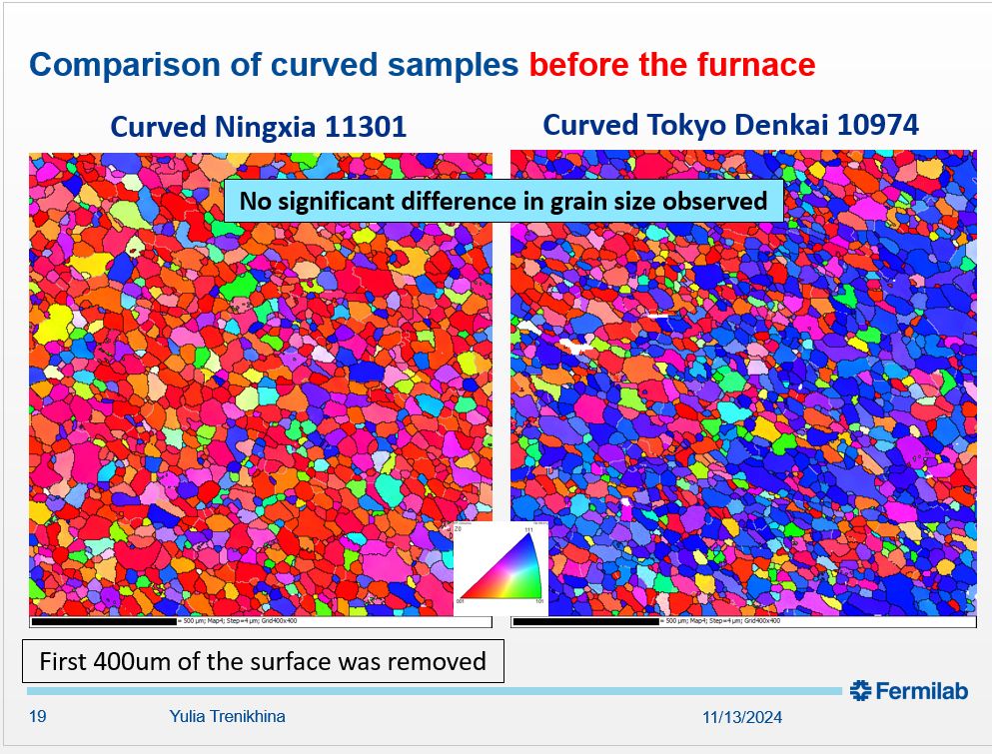
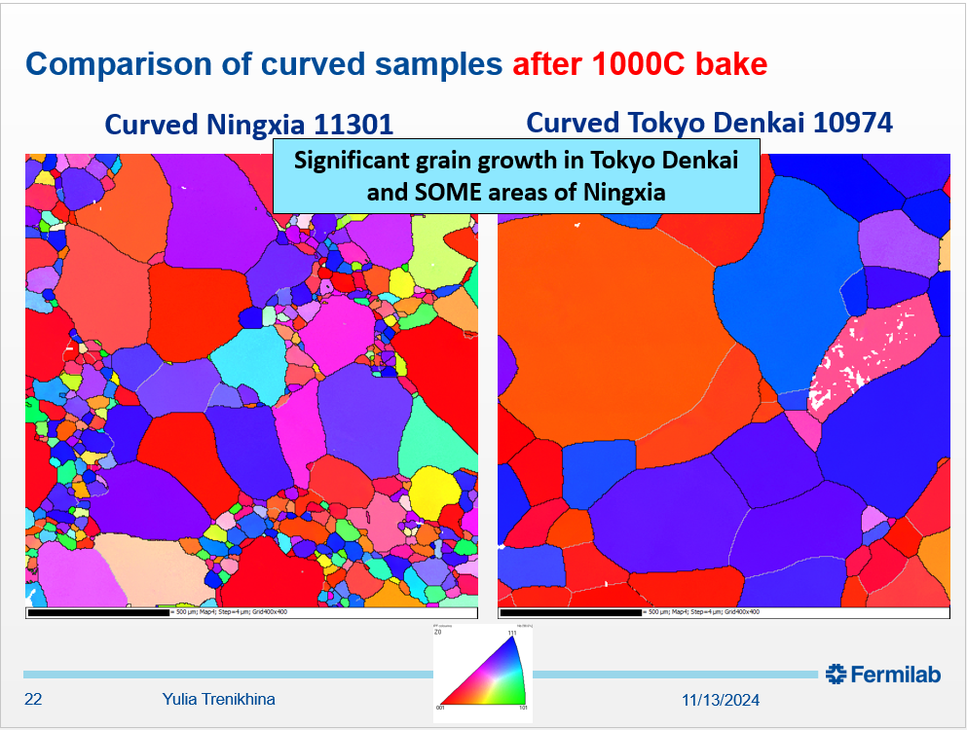
Could we improve Nb sheet specification for more reproducibility ?
No significant difference in:
Grain size
Misorientation
Strain
But not the same recrystallization behavior !?!?
My answer is yes : we should specify “texture”
Here below example presented by S.Posen at TTC 2018 (Milano) https://agenda.infn.it/event/13791/contributions/21011/attachments/14906/16846/Posen-TTC2018-flux.pptx

Slide 2
Could we improve Nb sheet specification for more reproducibility ?
No significant difference in:
Grain size
Misorientation
Strain
But not the same recrystallization behavior !?!?
My answer is yes : we should specify “texture”
Here below example presented by S.Posen at TTC 2018 (Milano) https://agenda.infn.it/event/13791/contributions/21011/attachments/14906/16846/Posen-TTC2018-flux.pptx
Yes, but there is a huge difference in texture (red{100} vs blue{111})!!!

Slide 3
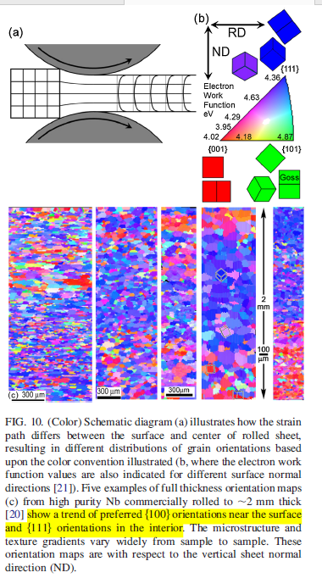
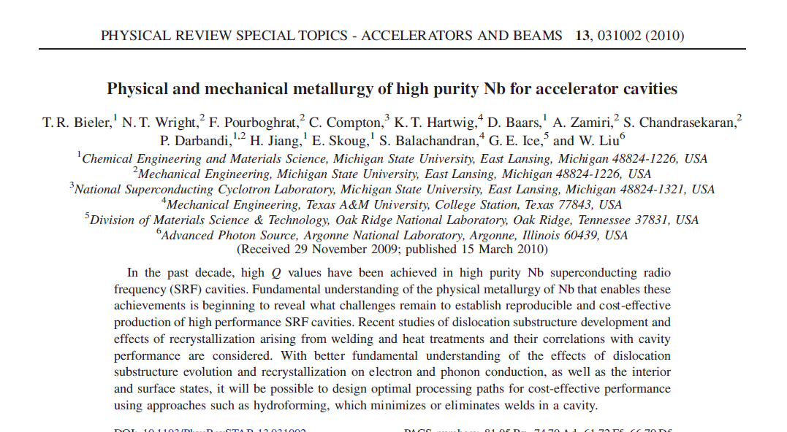
Everything can be found in literature !
Physical metallurgy paper

Slide 4
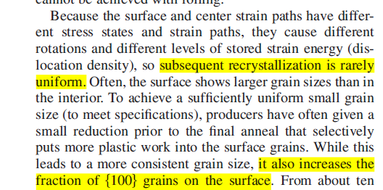
Further extracts from the same paper
And so on…
Very interesting paper!!!

Slide 5
Recommandations
Work with supplier to better master the texture of delivered batches (red is bad, blue is good)
it will cost some money (supplier won’t do it for free)
But once the recipe is fixed => batches = more uniform!
Monitor damage layer (it resists recrystallization)
only way to know what exact thickness should be removed
Other suggestion on specifications (from my presentation TTC Riken (2018) , see slides below)
Use strain hardening coefficient n rather than (in addition to) ranges on YS and UTS
Specify uniform elongation rather than total elongation
….
… train yourselves in metallurgy and/or work with metallurgists

Slide 6
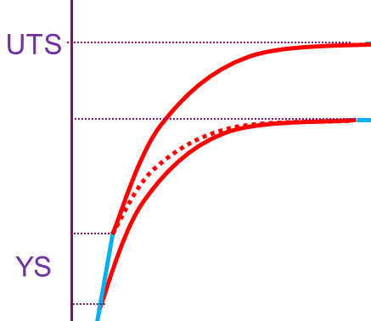

Specification for good forming
YS and UYS depend on grain ∅ => one has to define a range rather than absolute value
Strain hardening parameter n more reliable than YS, UTS
stress
Small grains
UTS
Poor forming
σ ∼ Kε^{n}
YS
Larger grains
strain
Poor forming
Strain hardening coefficient : formability ↑ if n ↑
Bi axial deformation :ε_{max} varies like 4/11(2n+1)
Notes:
Purely metallurgical point of view : smaller grains are better : more uniform deformation (but ask for more forming effort), no risk of orange peel, better mechanical resistance.
From SC point of view, large grains are better : better crystal quality, baking more efficient, more rapidly…
Tradeoff : ASTM #5 : 64 µm or ASTM #4 : 90 µm (uniform grain size is more important than the actual size)
At higher diameter orange peel becomes sensible.
The slope of a logarithmic plot of stress against strain gives the 'n' value
See also
Work hardening – Wikipedia:
In materials science, work hardening, also known as strain hardening, is the strengthening of a metal or polymer by plastic deformation. Work hardening may be desirable, undesirable, or inconsequential, depending on the context.
This strengthening occurs because of dislocation movements and dislocation generation within the crystal structure of the material.[1] Many non-brittle metals with a reasonably high melting point as well as several polymers can be strengthened in this fashion.[2] Alloys not amenable to heat treatment, including low-carbon steel, are often work-hardened. Some materials cannot be work-hardened at low temperatures, such as indium,[3] however others can be strengthened only via work hardening, such as pure copper and aluminum.[4]
…
The strained bonds around a dislocation are characterized by lattice strain fields. For example, there are compressively strained bonds directly next to an edge dislocation and tensilely strained bonds beyond the end of an edge dislocation. These form compressive strain fields and tensile strain fields, respectively. Strain fields are analogous to electric fields in certain ways. Specifically, the strain fields of dislocations obey similar laws of attraction and repulsion; in order to reduce overall strain, compressive strains are attracted to tensile strains, and vice versa.

Slide 7
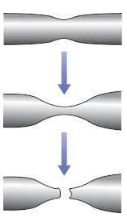
Specification for good forming
YS and UYS depend on grain ∅ => one has to define a range rather than absolute value
Strain hardening parameter n more reliable than YS, UTS
stress
Uniform elongation stops there !
Necking starts there, breaking can occur anytime
Total elongation not very relevant !
Small grains
UTS
Poor forming
σ ∼ Kε^{n}
YS
Larger grains
strain
Strain hardening coefficient : formability ↑ if n ↑
Bi axial deformation :ε_{max} varies like 4/11(2n+1)
Necking
Notes:
Purely metallurgical point of view : smaller grains are better : more uniform deformation (but ask for more forming effort), no risk of orange peel, better mechanical resistance.
From SC point of view, large grains are better : better crystal quality, baking more efficient, more rapidly…
Tradeoff : ASTM #5 : 64 µm or ASTM #4 : 90 µm (uniform grain size is more important than the actual size)
At higher diameter orange peel becomes sensible.
The slope of a logarithmic plot of stress against strain gives the 'n' value
See also
Work hardening – Wikipedia:
In materials science, work hardening, also known as strain hardening, is the strengthening of a metal or polymer by plastic deformation. Work hardening may be desirable, undesirable, or inconsequential, depending on the context.
This strengthening occurs because of dislocation movements and dislocation generation within the crystal structure of the material.[1] Many non-brittle metals with a reasonably high melting point as well as several polymers can be strengthened in this fashion.[2] Alloys not amenable to heat treatment, including low-carbon steel, are often work-hardened. Some materials cannot be work-hardened at low temperatures, such as indium,[3] however others can be strengthened only via work hardening, such as pure copper and aluminum.[4]
…
The strained bonds around a dislocation are characterized by lattice strain fields. For example, there are compressively strained bonds directly next to an edge dislocation and tensilely strained bonds beyond the end of an edge dislocation. These form compressive strain fields and tensile strain fields, respectively. Strain fields are analogous to electric fields in certain ways. Specifically, the strain fields of dislocations obey similar laws of attraction and repulsion; in order to reduce overall strain, compressive strains are attracted to tensile strains, and vice versa.

Slide 8
Specification for good forming
YS and UYS depend on grain ∅ => one has to define a range rather than absolute value
Strain hardening parameter n more reliable than YS, UTS
stress
Uniform elongation stops there !
Necking starts there, breaking can occur anytime
Total elongation not very relevant !
Small grains
UTS
Poor forming
σ ∼ Kε^{n}
YS
Larger grains
strain
Strain hardening coefficient : formability ↑ if n ↑
Bi axial deformation :ε_{max} varies like 4/11(2n+1)
Trade-off: ASTM #5 (64 µm) or ASTM #4 (90 µm)
(uniform grain size is more important than the actual size)
Notes:
Purely metallurgical point of view : smaller grains are better : more uniform deformation (but ask for more forming effort), no risk of orange peel, better mechanical resistance.
From SC point of view, large grains are better : better crystal quality, baking more efficient, more rapidly…
Tradeoff : ASTM #5 : 64 µm or ASTM #4 : 90 µm (uniform grain size is more important than the actual size)
At higher diameter orange peel becomes sensible.
The slope of a logarithmic plot of stress against strain gives the 'n' value
See also
Work hardening – Wikipedia:
In materials science, work hardening, also known as strain hardening, is the strengthening of a metal or polymer by plastic deformation. Work hardening may be desirable, undesirable, or inconsequential, depending on the context.
This strengthening occurs because of dislocation movements and dislocation generation within the crystal structure of the material.[1] Many non-brittle metals with a reasonably high melting point as well as several polymers can be strengthened in this fashion.[2] Alloys not amenable to heat treatment, including low-carbon steel, are often work-hardened. Some materials cannot be work-hardened at low temperatures, such as indium,[3] however others can be strengthened only via work hardening, such as pure copper and aluminum.[4]
…
The strained bonds around a dislocation are characterized by lattice strain fields. For example, there are compressively strained bonds directly next to an edge dislocation and tensilely strained bonds beyond the end of an edge dislocation. These form compressive strain fields and tensile strain fields, respectively. Strain fields are analogous to electric fields in certain ways. Specifically, the strain fields of dislocations obey similar laws of attraction and repulsion; in order to reduce overall strain, compressive strains are attracted to tensile strains, and vice versa.

