Slide 1

ICALEPCS Workshop Summaries
September 26, 2025

Slide 2
Saturday Workshops (5)
EPICS
Tango
PLC Based Control System
Towards Efficiency and Long-Term Sustainability
Controls GUI Strategies

Slide 3

EPICS Collaboration Meeting Andrew Johnson, Argonne National Laboratory, Number of Participants: 96
Objective/Purpose
The EPICS Collaboration holds meetings of our users and developers twice a year, hosted at sites around the world. This was the 14th meeting in conjunction with ICALEPCS, 30 years after the 1st, held at the ICALEPCS Chicago conference in 1995.
Key Topics Covered
24 speakers gave 29 talks on topics about the Core software, IOC Support, Clients and Frameworks, Build and Deployment, Applications, and Status reports.
The lightning-talk sessions were popular, with 18 talks in 3 fast-paced sessions.
Key Outcomes/Takeaways
Facilities continue to choose EPICS; Linux is fast replacing VxWorks and VME.
Secure PVA will be important; there is growing interest in the OPC UA protocol.
Multi-level EPICS training will be a key area for encouraging community growth.
Next Steps
The next EPICS Collaboration Meeting in April 2026 will be at CEA in Saclay, France.
Notes:
REPLACE [xyz] with your information

Slide 4
Tango Controls Workshop Thomas Juerges, SKA Observatory, Number of Participants: 22
Objective/Purpose
Equip the participants with a sound understanding of the concepts of Tango Controls, the framework and its tools for building an object-oriented distributed monitor and control system
Key Topics Covered
Key concepts in Tango Controls
Development of Tango devices in pyTango and code generation for Tango Controls devices in C++, Testing and Debugging
Tango GUIs, Complete SCADA with Tango Controls, Alarms and their GUIs, Archiving of Monitor Data
Key Outcomes/Takeaways
Tango, as a framework for slow control systems is well suited for new projects
The rich tooling allows for time efficient development of Tango devices
Low entry barrier thanks to PyTango and Pogo
Next Steps
Workshop(s) with focus on specific features in Tango Controls (Event system, Archiving, Observability)
Hopefully, participants stay engaged and will connect with Tango community online
Notes:
REPLACE [xyz] with your information

Slide 5

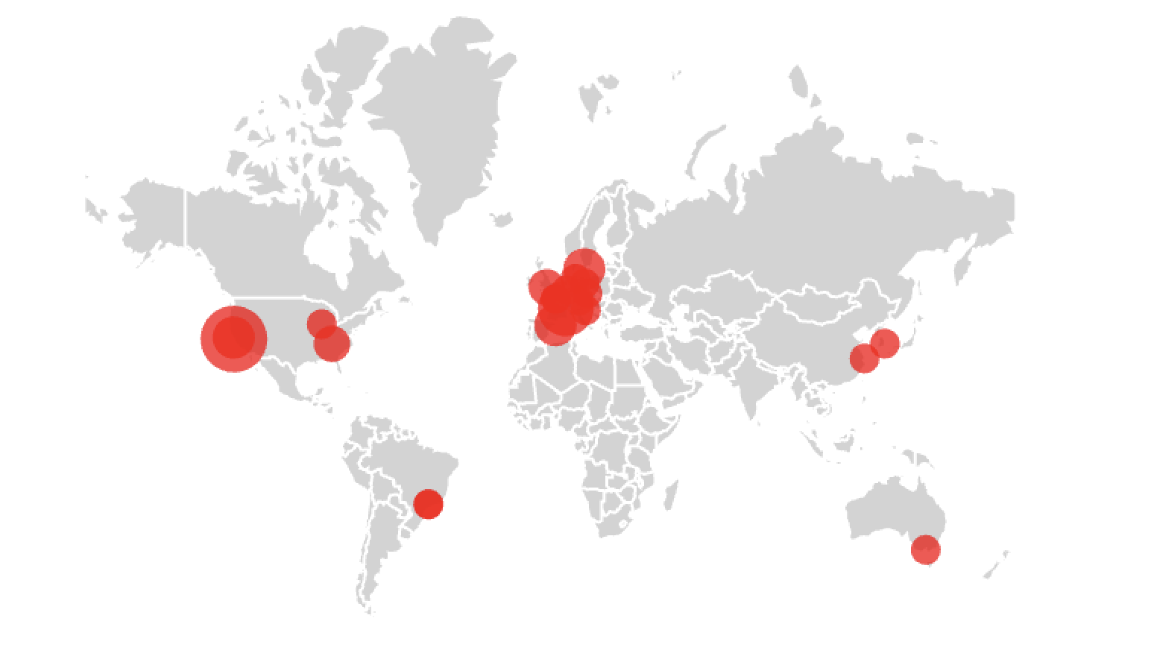
PBCS: PLC-Based Control Systems Enrique & Jeronimo (MIA); CERN | 5th edition | Participants: 56 from 29 Institutes/firms
Objective
Two-fold:
Establish a collaborative forum for sharing best practices and lessons learned.
Map expertise across institutes to stimulate potential partnerships
Key Topics Covered
PLC-related work and ongoing projects across institutes
The engineering lifecycle, especially development and testing approaches
Future-looking technology trends
Key Outcomes
More automation on development & deployment, bringing high-level programming languages (IT-OT convergence)
A formal/unified specification method is still missing – a key need
Multiple PLC suppliers at sites create complexity and hidden costs
Testing practices remain inconsistent and largely best effort
Next Steps
Experts' connections to discuss specific topics (already happening: Success!!)
Launch a shared knowledge hub where experts can exchange methods, tools, and opportunities for collaboration
1st | Barcelona 2017 | 45
2nd | New York 2019 | 34
3rd | Shanghái 2021 | 57
4th | Cape Town 2023 | 55
5th | Chicago 2025 | 56

Slide 6
Towards Efficiency and Long-term Sustainability Lukasz Burdzanowski, CERN, Number of Participants: [49]
Objective/Purpose
Explore practical strategies & use cases: identify inefficiencies, surface challenges, share solutions
Exchange ideas on long-term system sustainability
Key Topics Covered
Strategic Planning: vision, costing, feasibility, execution
Operational & Technical Management: risk, requirements, asset lifecycle
State Assessment: data collection, lifecycle tracking, availability metrics
Standardization & Workflows: process optimization, tools, SW/HW practices
Sustainability: people, processes, responsible AI adoption
Key Outcomes/Takeaways
High engagement: strong interest from day-to-day pain points to long-term strategy
Active participation: rich questions, discussions, and shared insights – thank you!
Momentum for collaboration: participants want shared solutions & early standardization
Next Steps
Launch post-workshop survey to focus future discussions
Host follow-up online event in 2026
Kick off collaborative effort – white paper on fault tracking & efficiency metrics, foundation for a cross-lab availability framework
Notes:
REPLACE [xyz] with your information

Slide 7
Controls GUI Strategies Chris Roderick & Stephane Deghaye, CERN. 63 Participants from 30 institutes
https://indi.to/GUI2025
Objective/Purpose
This 4th workshop on GUI Strategies continued with the aim of uniting interested people, as a community, to share knowledge, discuss ideas, make connections, and get inspired.
Key Topics Covered
Setting the scene: 2 slides per institute (template) on strategy, status, technology, challenges
Doing the right thing: Requirements Capture, Validation, Prioritization; Usage Telemetry
Doing things right: Reusable GUI building blocks; UI Customizations; UX Working Group
Flexibility & efficiency: Zero/low-code solutions; Automated GUI & Synoptics generation
Key Outcomes/Takeaways
Variety of technologies used (but mainly PyQt, Web), common challenges (UX; keeping up-to-date)
Organizational structures play a major role in coherence (or lack-of) of GUI approaches
We should probably engage UX Engineers, but only 4 out of 30 do this
Web is used for most new developments, but existing desktop approaches also remain
Next Steps
5th GUI Strategies Workshop in ~1 year (possibly at DESY as part of NOBUGS 2026?)
should include topic of emerging use of AI to generate GUIs
2nd Accelerator UX Working Group meeting in Q1 2026 (interested? https://tinyurl.com/k57j2rdz)

Slide 8
Sunday Workshops (6)
Control System Cybersecurity
Bluesky
Motion Controls and Robotics
Advancing AI/ML and Generative Models for the Control of Large Complex Systems
Safety Lessons Learned (half-day)
Advanced Control (half-day)

Slide 9
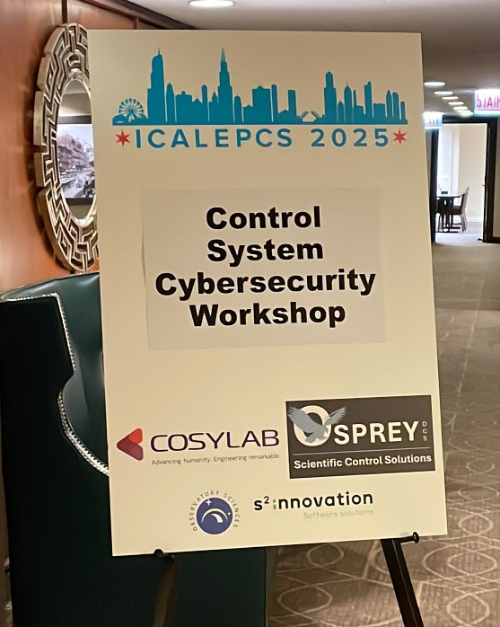
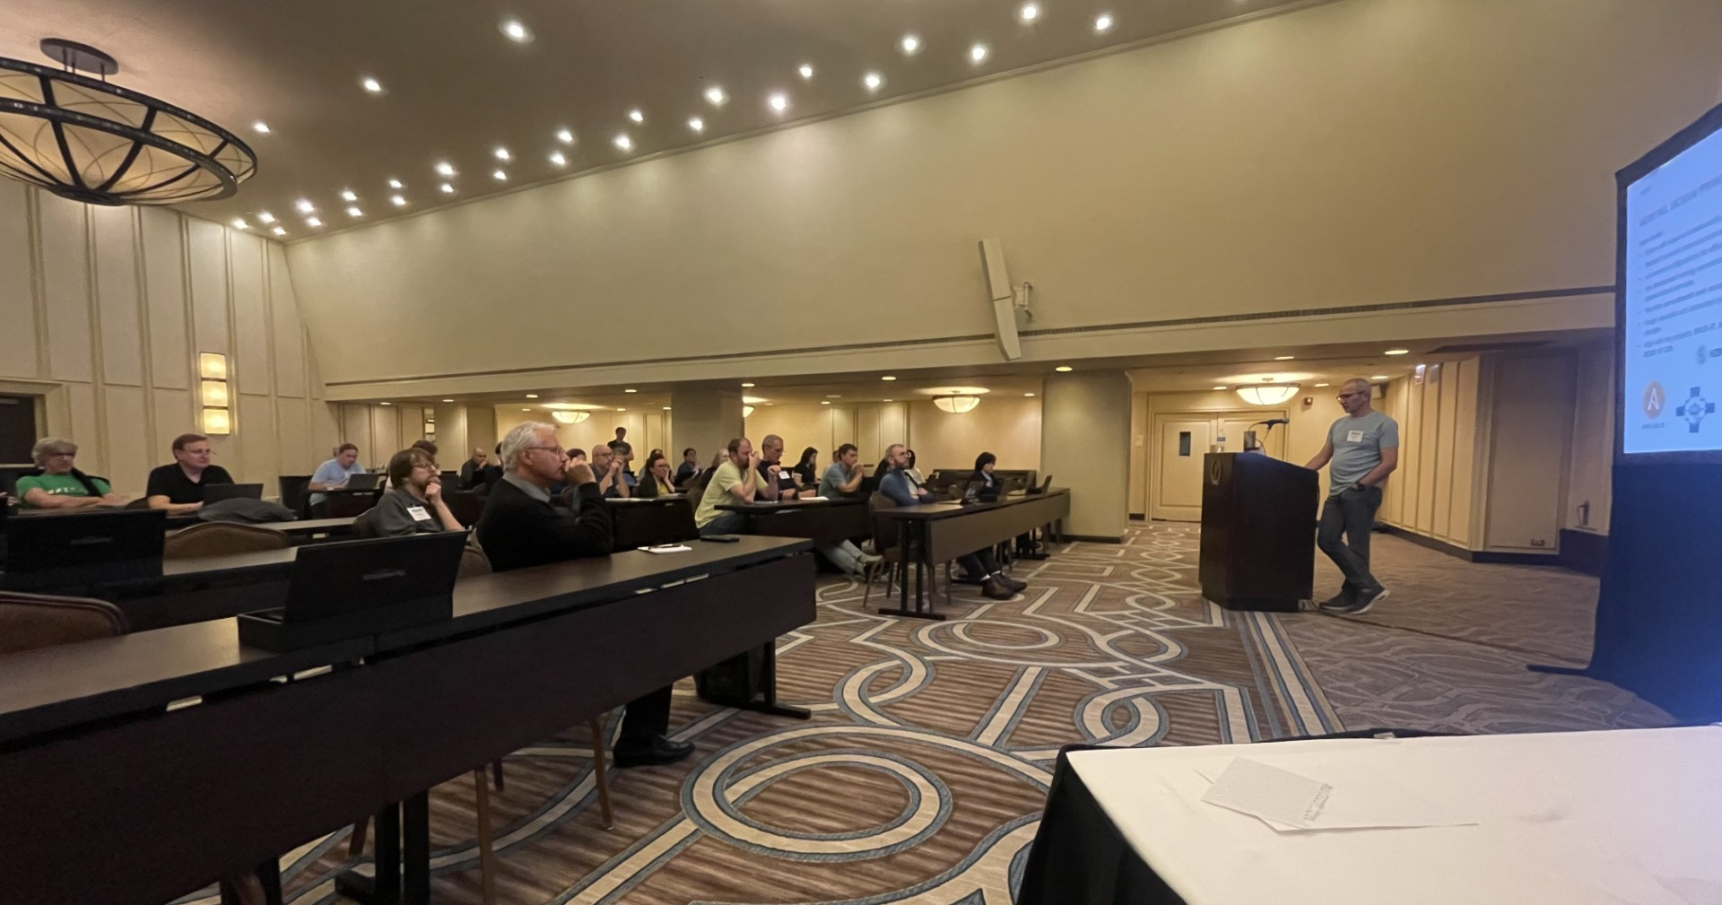
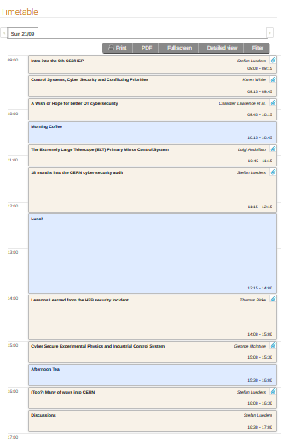
9th Cyber-Security Workshop Thank you, 45 engaged contributors:
Attacks are real: ALMA. HZB. ViceSociety.
Operational Technology goes IT:
Containers. VMs. ML/AI/LLMs The collaboration, support & contribution from your enterprise’s IT department is essential. Hand-in-hand. For synergy & efficiency.
Segregate your network. Control its cross-traffic.
Deploy 2-factor authentication: The silver bullet.
Understand your risk. Have crisis planning. Have immutable back-ups.
Get audited. Follow industry standards: CISv8. NIST 800-82. ISO 25k. IT “Grundschutz”.
Notes:
REPLACE [xyz] with your information

Slide 10
Bluesky Eric Codrea, Argonne National Laboratory, Number of Participants: 26
Objective/Purpose
The goal of the workshop was to allow facilities give updates about their usage of Bluesky, showcase any projects facilities are currently developing or have recently finished developing, and engage with the international Bluesky community to further collaboration.
Key Topics Covered
Bluesky general facility updates and projects being worked on
Deployment of Bluesky at the facility level using BITS
React UI using Finch
Data file writing using tools such as: PyNxtools and Bluesky Nexus
Discussion of OPHYD device integration/testing, queue server operations, and thoughtful integration of AI capabilities without forced adoption
Key Outcomes/Takeaways
Interest in standardizing deployment of Bluesky
Interest in implementing Tiled/Ophyd-async
People are thinking about how/if it would make sense to implement AI
More collaboration between people has been fostered
Next Steps
Follow up meetings: ROCK-IT Bluesky Workshop (5-7 November 2025)
Notes:
REPLACE [xyz] with your information

Slide 11
MOCRAF : Motion Control and Robotic Applications in large Facilities Organizers: Yves-Marie Abiven (SOLEIL), Nicola Coppola (EuXFEL), Mario Di Castro (CERN) ,Xavier Serra Gallifa (Alba), Brian Nutter (Diamond), Maxim Brendike (HZB), Thomas Dehaeze (ESRF). 41 participants from 11 countries , 19 facilities and 4 companies
Objective/Purpose
The workshop aims at maintaining and strengthening the community of motion control and robotic engineers at diverse facilities; keeping in touch, sharing expertise, methods, tools, and exchanging experience, solutions, lessons learned, and initiating collaboration
Key Topics Covered
Challenges in our diverse facilities
Automation, mechatronics and robotics
Maintenance strategies: preventive, corrective, predictive
New technologies
Key Outcomes/Takeaways
Challenges for new mechatronic approach designing instrumentation and control, which requires close contact between mechanical, electrical, motion and metrology teams
Continuous, ‘on-the-fly’ scan applications are still at the heart of the interest of the contributors
EtherCAT protocol for motion control is today a solution under deployment at various facilities
Upgrade of legacy systems is a hard topic to address by many facilities
The survey conducted to help shape future workshop topics revealed that the use of ML/AI and robotics remains limited
Next Steps
Predictive maintenance will be a topic of interest for next workshop
Follow up meeting foreseen in 2026 to discuss the interest of a motion control and robotic school in the coming years
Creation of a mailing list of experts at our facilities to strengthen collaboration and exchange of information
Notes:
REPLACE [xyz] with your information

Slide 12
Advanced AI/ML and Generative Models for the Control of Large Complex Systems Alexander Scheinker, Los Alamos National Laboratory, Number of Participants: 105
Objective/Purpose
To give an overview of the state-of-the-art in generative AI and ML that is being developed for the control of large complex systems such as charged particle accelerators. To show how AI/ML methods are being used to develop virtual diagnostics that can be incorporated together with advanced control algorithms for autonomous system control and tuning.
Key Topics Covered
Convolutional neural network-based autoencoders and variational autoencoders for image detection, classification, and generation.
Transformers for time-series data.
Advanced robust adaptive feedback control algorithms (extremum seeking).
Generative diffusion models for virtual diagnostics of complex dynamic systems.
Large language model (LLM)-based agents for historical document reviews and accelerator studies.
Key Outcomes/Takeaways
Uncertainty quantification, physics constraints, and control theory-based robust adaptive feedback with analytic stability guarantees are all crucial to make generative AI/ML-driven tools robust and safe for autonomous operation of large complex systems.
There is a major disconnect between funding agencies, and the reality of what kind of generative AI/ML is most useful for scientific research: generative diffusion models have been quantifiably the most useful for science, but funding emphasis continues to be on LLMs/agents.
Next Steps
AI/ML has proven to be incredibly useful for tasks such as providing virtual non-invasive diagnostics, however more work is needed on ensuring robustness by adaptive feedback, uncertainty quantification, physics constraints, and interpretability.
Notes:
REPLACE [xyz] with your information

Slide 13
Safety Lessons Learned Barry Fishler, SLAC, Number of Participants: 25
Objective/Purpose
To share critical insights and best practices from past incidents to enhance control systems applied to ensure personnel safety and machine protection during facility operations.
Key Topics Covered
Reviewed machine protection system designs for Alba’s PSS and PPS systems and discussed system hierarchy on a shared PLC with shared sensors.
SLAC presented on management of machine protection overrides and a discussion on approaches
Incident review of a cooling water leak following a manual controls override applied during safety system testing
Reviewed BNL’s RHIC and EIC machine protection system, including techniques for monitoring analog inputs, managing complexity growth, technology, and lessons learned
Discussed best practices and lessons learned for oxygen deficiency failures that were the subject of a DOE safety bulletin
Key Outcomes/Takeaways
Dedicated MPS groups formed at multiple facilities are effective in managing machine protection
Change control processes and monitoring are critical for reviewing MPS changes, bypasses, and chronic bypasses
Controls for managing overrides should not be ignored for operational efficiency. Administrative and engineered control variations (e.g., override timeouts) have been effective.
Emphasized the need for consistent standards and coordination across projects and groups
MPS/PSS systems need to consider maintenance and commissioning operating modes
Next Steps
Need to promote ICALEPCS attendance within our safety systems teams
Future topics could include safety system commissioning and addressing obsolescence.
Notes:
REPLACE [xyz] with your information

Slide 14
Advanced Control Workshop Daniel Tavares, CNPEM / LNLS, Number of Participants: 48 in person + 9 remote
Objective/Purpose
Bring together feedback control practitioners and theorists, beginners and experts, to share experiences on the application of control theory in large experimental physics facilities.
Key Topics Covered
Theory of universal architectures (by Prof. John Doyle)
Orbit feedback
Generalized SVD
FOFB-SOFB interaction (orthogonalization of subspaces of both systems, mid-ranging control)
FOFB-LLRF interaction (synchrotron oscillations)
Model Predictive Control (MPC) applied to SOFB and HVAC systems
Mechatronic systems – loop shaping, system identification, LQG/H-infinity control
Key Outcomes/Takeaways
First step towards building an advanced control community in ICALEPCS
Recognition that ICALEPCS has a gap in covering advanced controls and the community needs to be actively built
The workshop has been recorded and will be made publicly available online for reaching more people
Next Steps
Post-event survey to provide feedback from participants for the next edition of the workshop
Active contact with more diverse feedback communities in tokamaks, telescopes and laser facilities to increase the diversity of applications in the workshop
Notes:
REPLACE [xyz] with your information

Slide 15
Workshop Summary Slides are available under the Closeout Session on the Conference Indico Webpage.

Slide 16
Workshop Organizer Recognition
Thank you for orchestrating such a successful series of workshops.
Your efforts and attention to detail made it both professional and engaging for all attendees.

