Slide 1
Modern Control System Applications at Fermilab with Dart and Flutter
September 22, 2025
JOHN DIAMOND
Fermilab, Accelerator Complex Technology Division, Controls Department

Slide 2
Anyone using Dart / Flutter?

Slide 3
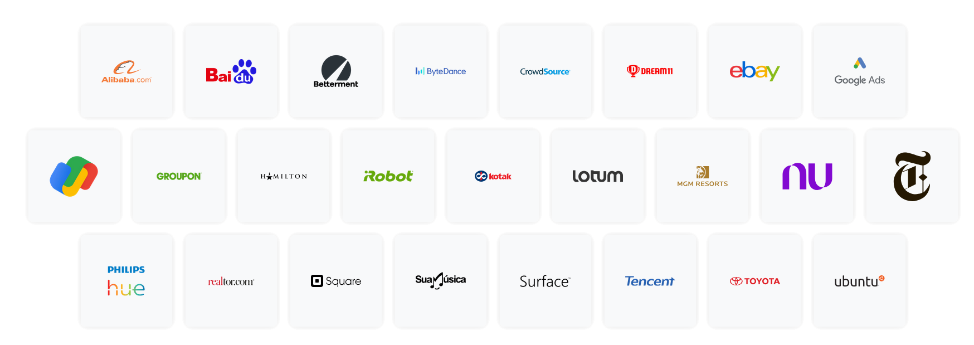
Who’s using Dart / Flutter?

Slide 4
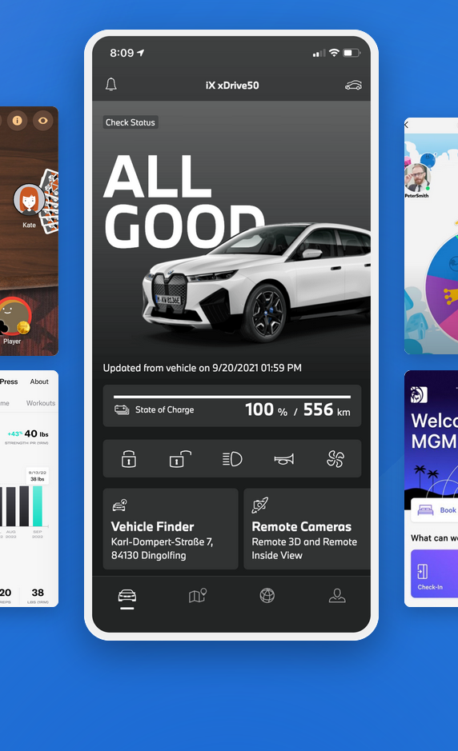
What are Dart & Flutter
A modern, cross-platform development kit
Dart
A modern programming language developed by Google that translates and compiles as native languages such as Kotlin, Swift, JavaScript or Web Assembly.
Flutter
Also developed by Google, a UI toolkit developed in Dart that supports the Material Design language.
Native performance
Dart compiles natively (no byte-code) and Flutter renders widgets directly rather than bridging to native UI components.
www.flutter.dev

Slide 5
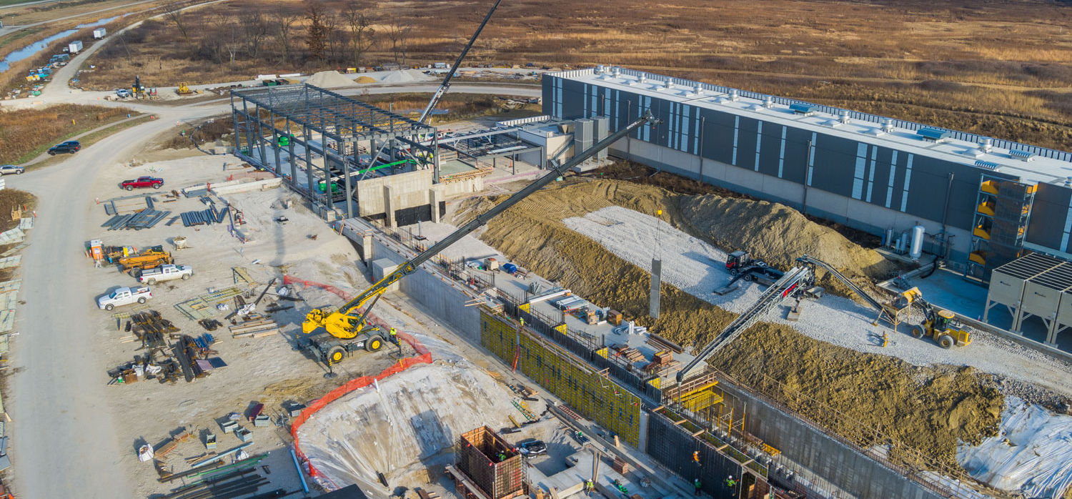

PIP-II & ACORN projects are fueling new application development at Fermilab
Dozens of new applications and hundreds of old applications are to be built and modernized over the next 5 years

Slide 6
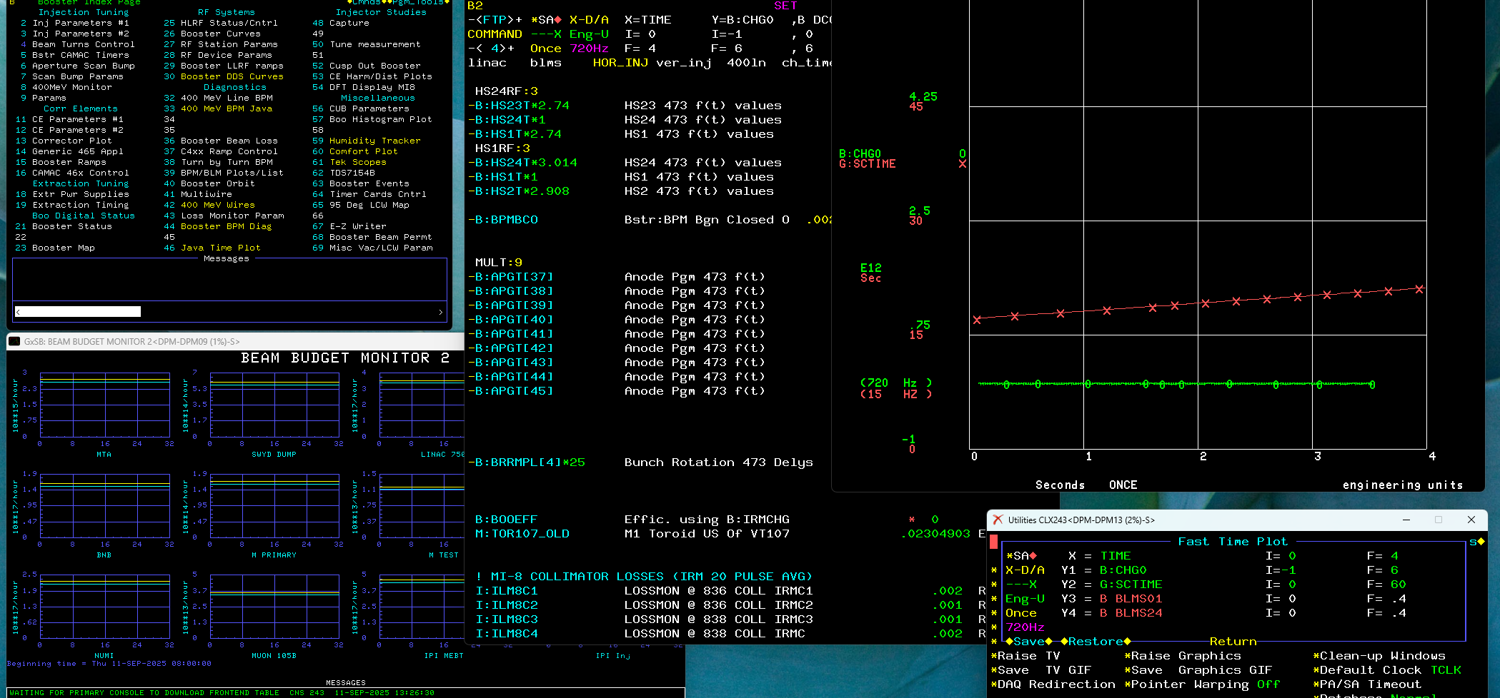
Legacy applications are based on Xlib, which is becoming difficult to support
However, our users are very comfortable in this environment

Slide 7
Why web applications?
Web applications solve the deployment problem and modern web technologies bring the performance to the level of desktop applications.

Slide 8






Decision Process
How did we choose Dart/Flutter?
We knew from ACORN and PIP-II requirements that web applications were the path forward, but there are many frameworks for web application development. It was time to make a decision.
Developers were the key stakeholders here, so we sought a process that was developer focused.
First, evaluate the available open-source frameworks
Then, try them out – develop a prototype in three frameworks
Finally, developers presented and voted, Dart/Flutter was selected

Slide 9

Web Apps and Control System Architecture
Dart/Flutter + GraphQL
Web Applications
Application Tier
Dart/Flutter applications are delivered to the user’s web browser and communicate with the control system through an API Gateway
API Gateway
Central Tier
Control system resources are exposed to the application tier via a GraphQL API. The API curates the services available in this tier and offers a comprehensive interface for application developers.
DPM
Data Tier
ACNET Front Ends or EPICS IOCs provide a common interface to field hardware. The Data Pool Manager (DPM) abstracts and pools data requests.
ACNET
Front End
EPICS IOCs
A simplified architecture for accessing field hardware

Slide 10
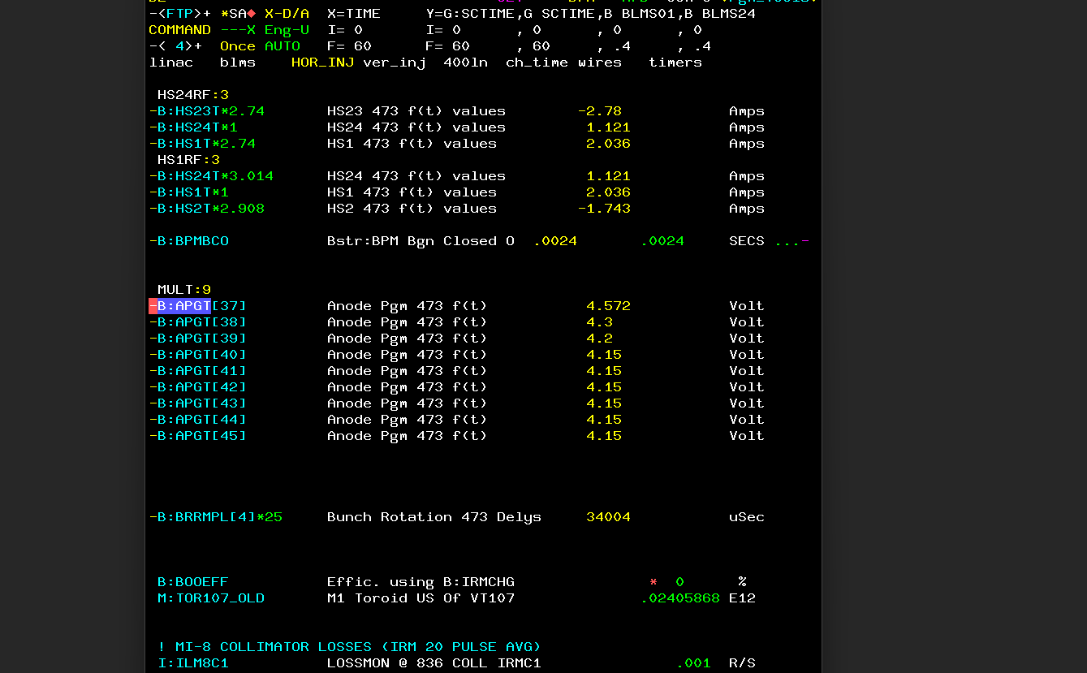
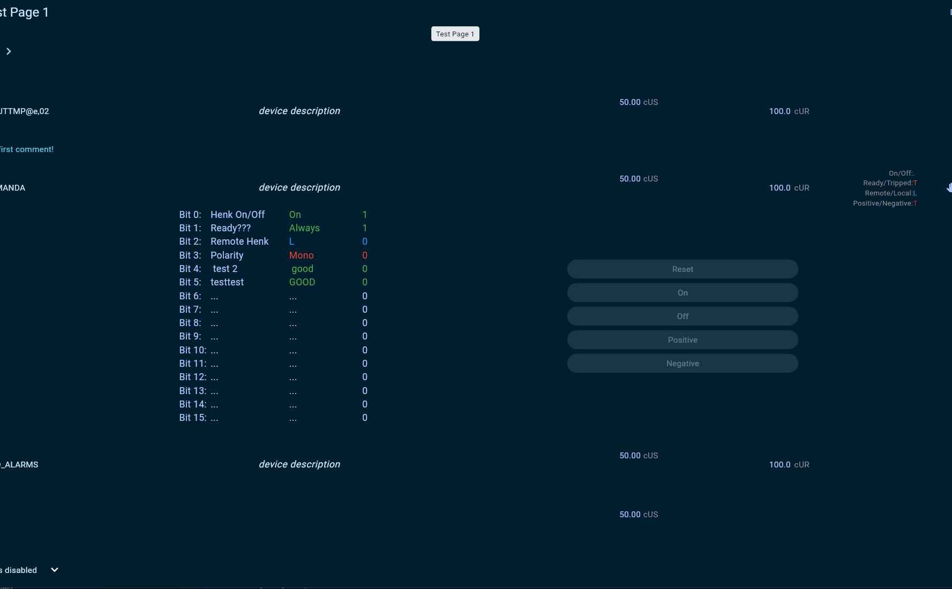
Modern Parameter Page
A tool for organizing and displaying live machine data
The Parameter Page is the most used control system application at Fermilab. PIP-II needed a parameter page capable of displaying ACNET devices and EPICS process variables together.
Development took one year to realize the high-priority features of the existing Parameter Page
We needed to build up infrastructure along the way:
  Authentication & Authorization
  Common widget library
  Data acquisition API
  Database access API
Original Parameter Page
Modern Dart/Flutter Parameter Page

Slide 11
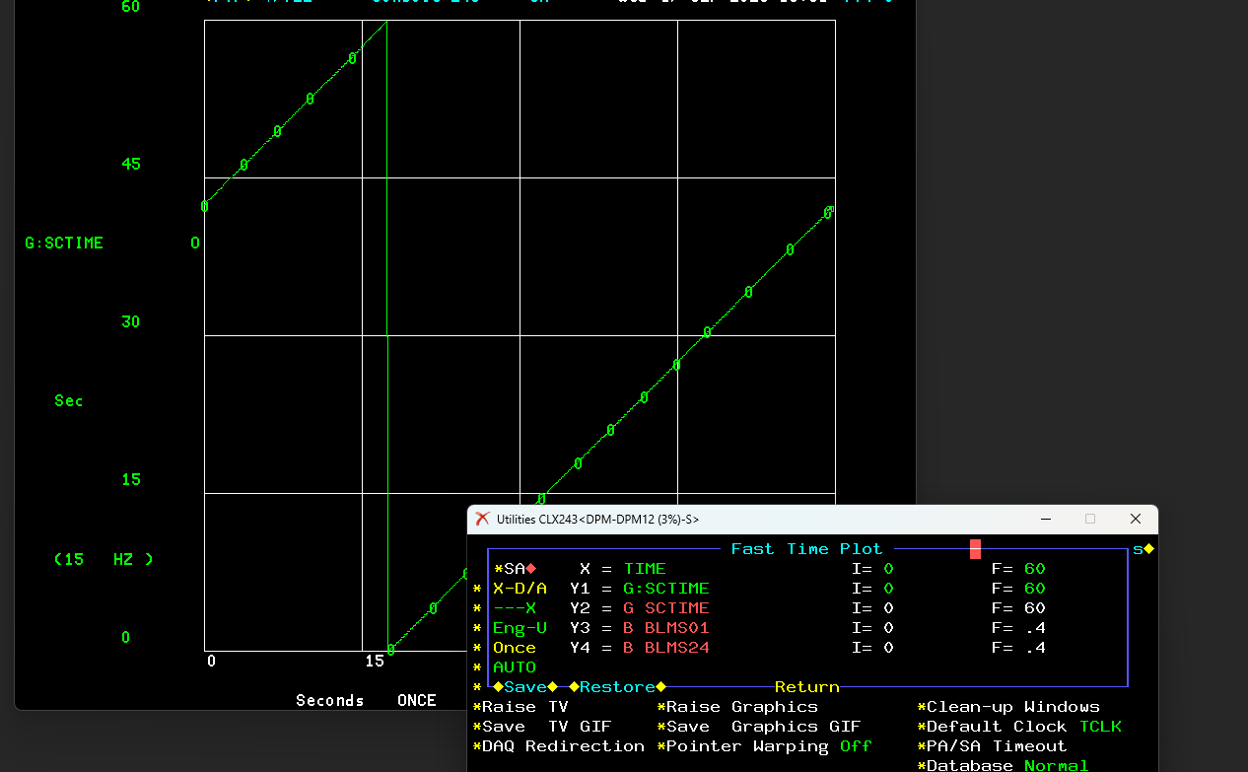
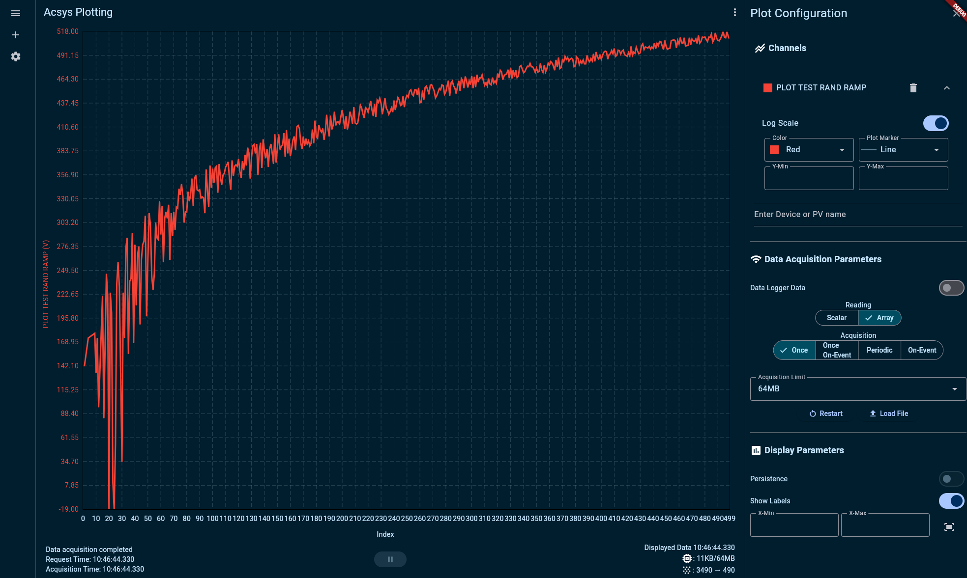

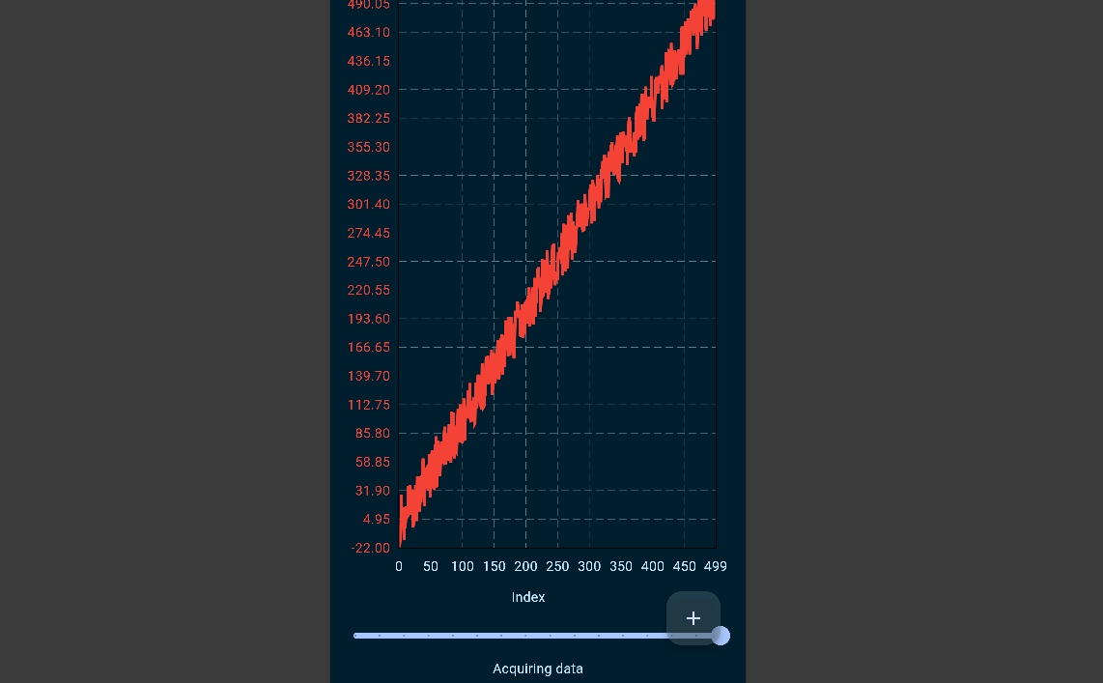
Modern Plotting Application
Diagnostic tool for plotting any live or historical data source
Users need to navigate through three applications right now to plot accelerator data – one for live time series data, another for live wave form data and a third for historical data. PIP-II needs all these applications to plot ACNET and EPICS data.
Desirable to combine these applications into a single interface
This project is ongoing, and we are close to realizing a unified plotting tool for live and historical data using ACNET and EPICS
Built upon FL Chart, an open-source Dart/Flutter plotting library
Original Plotting Applications
Dart/Flutter Plotting App (Desktop)
Dart/Flutter Plotting App (Mobile)

Slide 12
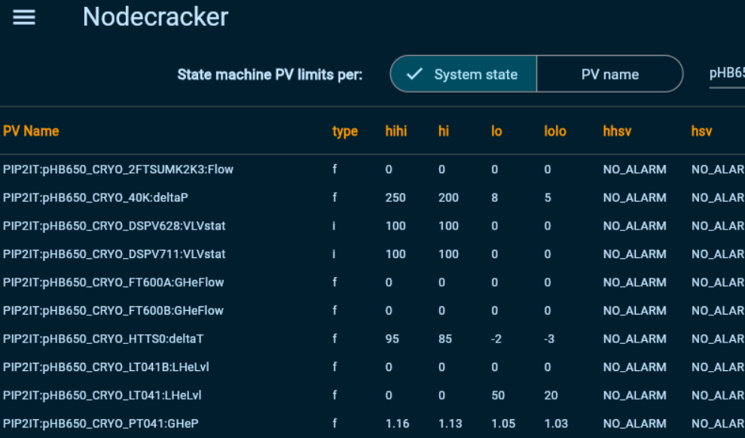
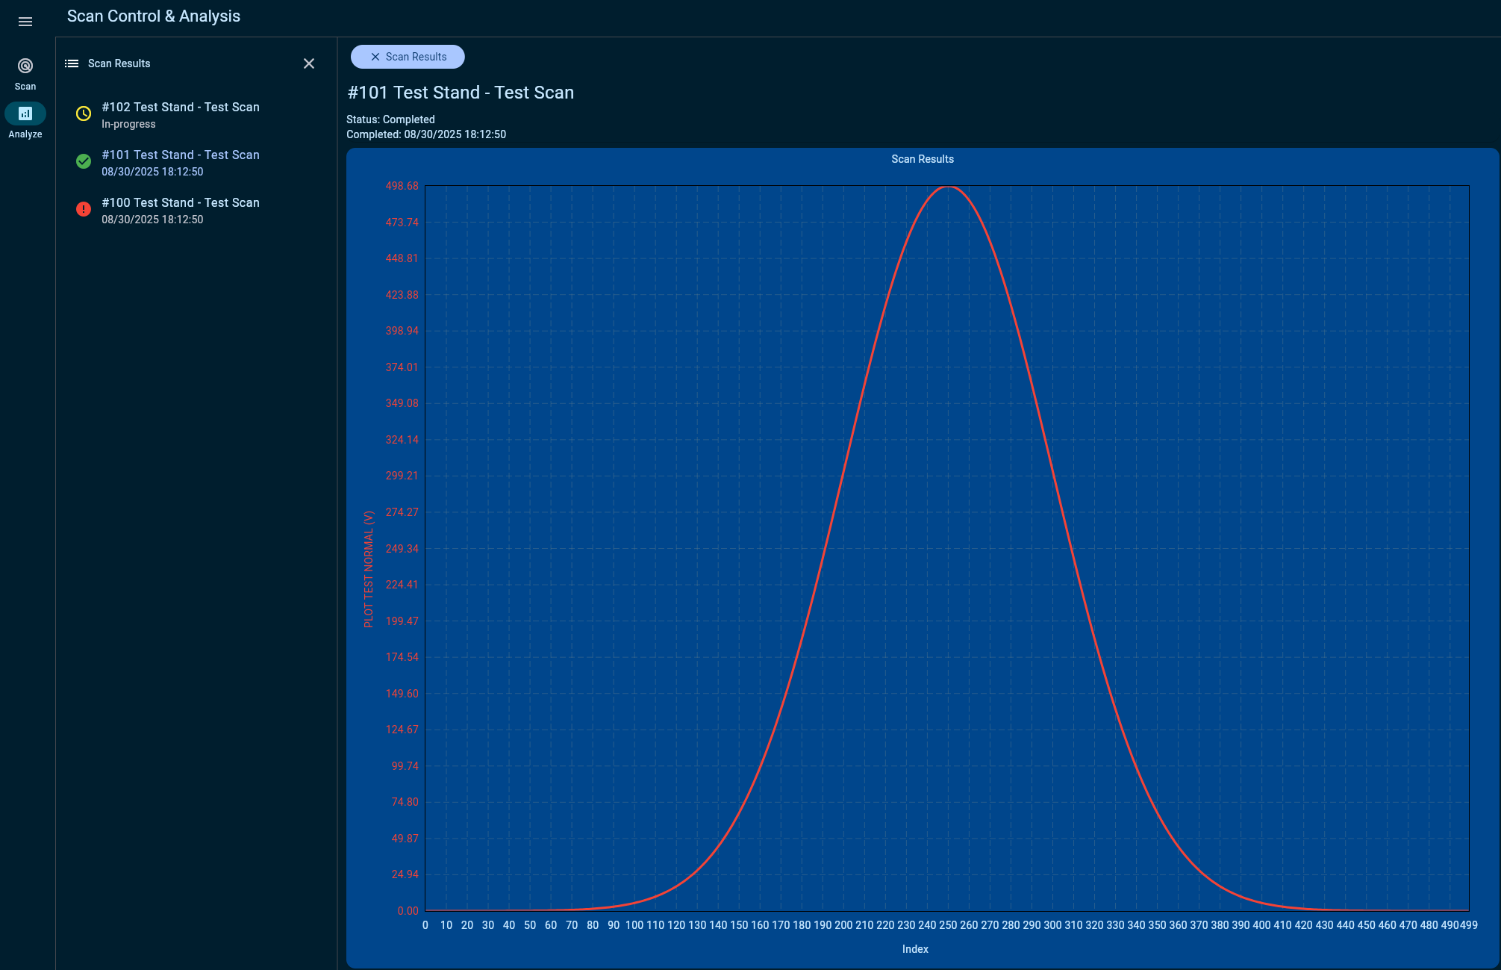
Development Ramping Up
Even more Dart/Flutter development in 2025 and 2026
As we made progress on pilot projects, training and development seminars were held and staff came up to speed on Dart/Flutter development.
Several projects are underway in 2025:
  Modern registration system for front ends and IOCs
  ACNET device & process variable database interface
  Time Line Generator
  PIP-II Wire Scanners, Allison Scanner and other instrumentation interfaces
  Enclosure Status
Expecting even more applications in 2026 to support PIP-II and ACORN
Device / PV Database app
Wire Scanner app

Slide 13
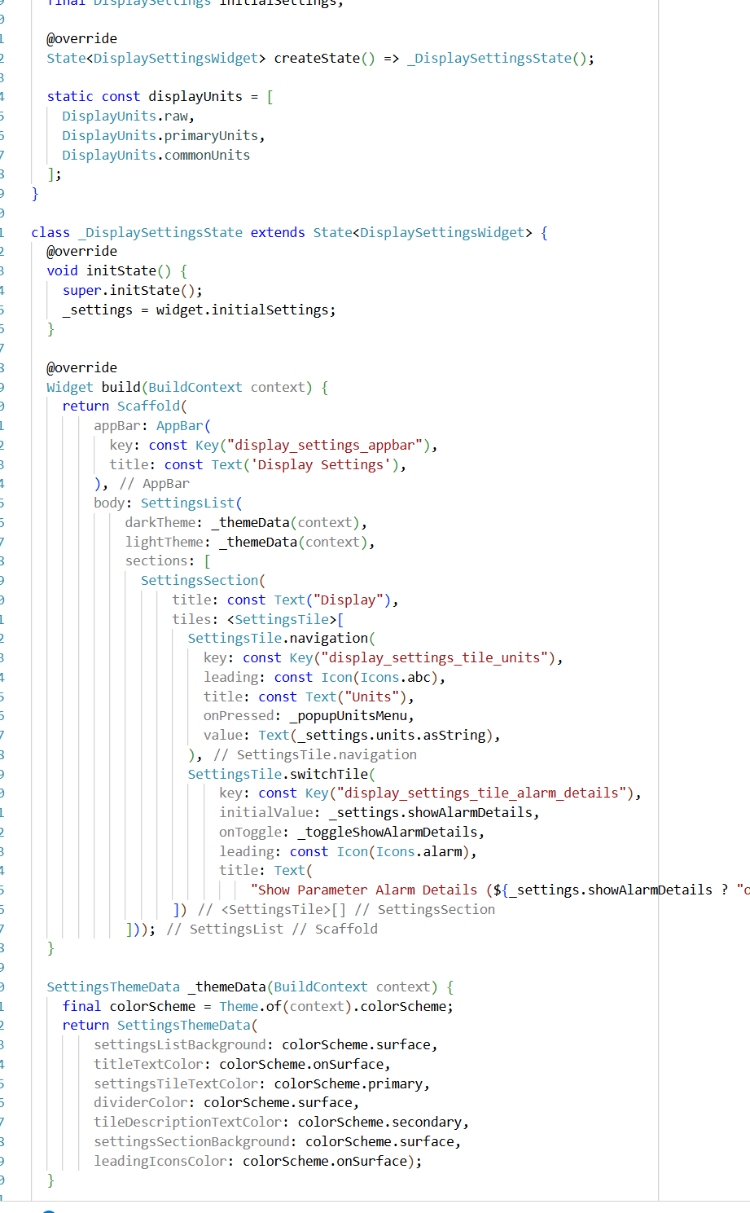
Conclusion
What we have learned after 2 years of experience developing controls applications with Dart/Flutter
Dart is an awesome language
Dart is modern, enjoyable to code in and has a gradual learning curve that our Java and C++ staff has found easy to grasp.
Flutter performs well
Pilot projects have demonstrated that Flutter can handle data-intense control system applications. Flutter’s recent Web Assembly support brings even better performance.
Adaptive and Responsive design
Flutter makes building adaptive and responsive UIs easy.
Optional photo credit/caption

Slide 14
Thank you
Questions?

