Slide 1
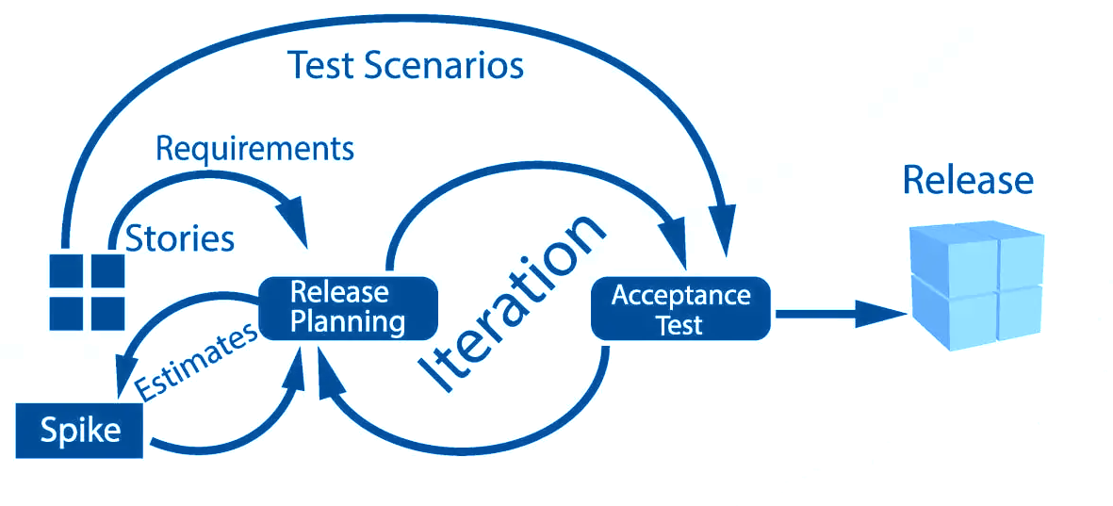
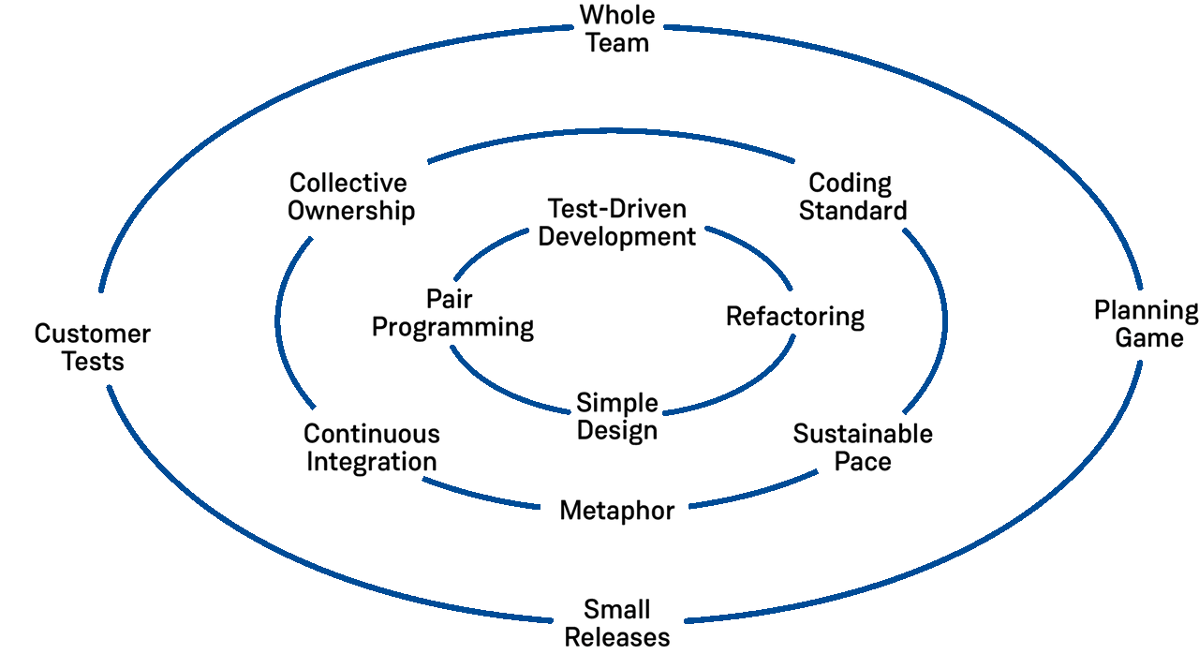
An Agile/XP Software Development Process for Modernizing the Accelerator Controls System at Fermilab
John Diamond, Fermilab – Accelerator Complex Technology Division / Controls Department
Abstract
Adopt Key Practices from eXtreme Programming
Fermilab is undergoing the most ambitious upgrade to its accelerator control system of the 21st century. As part of the ACORN project, hundreds of legacy control system applications written in C/C++ will be re-imagined and developed from the ground up. In addition, applications to support Fermilab’s new super-conducting linear accelerator are already under construction. To manage the development of modern controls applications, the Controls department has adopted an Agile software development process based on eXtreme Programming. In our paper we describe the process and detail our experience applying it to the development of two case studies.
We find that emphasizing the following team and developer practices from XP are the key to success with Agile:
Simple Design – Design only for what you need right now.
Pair Programming – Programming together helps everyone on the development team become familiar with the entire codebase.
Refactoring – Encourage developers to write code with long-term maintainability in mind by constantly refactoring.
Test-Driven Development – Changing code comes with uncertainty and risk. A reliable and comprehensive test-suite enables programmers to refactor and change code without fear. By writing a failing test before writing code to make it pass, we can ensure that our code is always fully tested.
Continuous Integration and Continuous Delivery –
No long-lived feature branches are allowed. Integrate code changes into the main branch daily. Separate release from delivery. Use an automated pipeline to push changes into production once code is integrated.
Avoid the “Caveman Developer” Anti-Pattern
Control system applications at Fermilab are typically small enough to be assigned to a single developer to be developed over a period of 3-9 months. This produces working software and it’s a convincing success for the stakeholders, but there are a couple of problems with this approach that make it an anti-pattern. Most notably, the single developer becomes an owner of the software product for the rest of their tenure. Once that developer moves on, the application is handed to a new developer to be maintained with no context, often no tests, no record of requirements, and no documentation on how to build or deploy the software. This makes long-term sustainability of the software product challenging, and the code slowly rots from that point on.
Organize the Workflow as Two-Week Sprints
What is XP? What about Scrum?
Kent Beck developed eXtreme Programming (XP) in the nineties and published his methodologies in the book eXtreme Programming: Explained. XP emphasizes a set of practices that can be categorized by who adopts them: the project, the team and the developer. Scrum is a popular Agile software development process that focuses more on the project and team practices and places less emphasis on the developer practices.
As with most Agile software development processes, our workflow is organized around time-boxed, two-week Sprints. Each Sprint is structured as follows:
  Week 1
    Monday – planning meeting to select stories and break them down to tasks to be assigned to developers.
    Tuesday & Thursday – Regular mob coding sessions where developers work collectively on a single task.
    Friday – Developers meeting to discuss progress and if necessary, cut stories from the sprint.
  Week 2
    Tuesday & Thursday – More mob coding
    Friday – Status meeting and demo for stakeholders
Sprints continue until the backlog of stories is exhausted or the stakeholders determine that the remaining stories are no longer needed.
Project (outer circle) / Team (middle circle) / Developer (inner circle) Practices from XP

