Slide 1
An Agile/XP Software Development Process for Modernizing the Accelerator Control System at Fermilab
September 25, 2025
John Diamond
Fermilab / Accelerator Complex Technology Division / Controls Department

Slide 2
Who’s doing Agile?
😍 Love it?
🤬 Hate it?
😕 No opinion?
😶 I have no idea what you’re talking about

Slide 3
Come check out THPD084!
Thursday, September 25th 4:30 PM

Slide 4
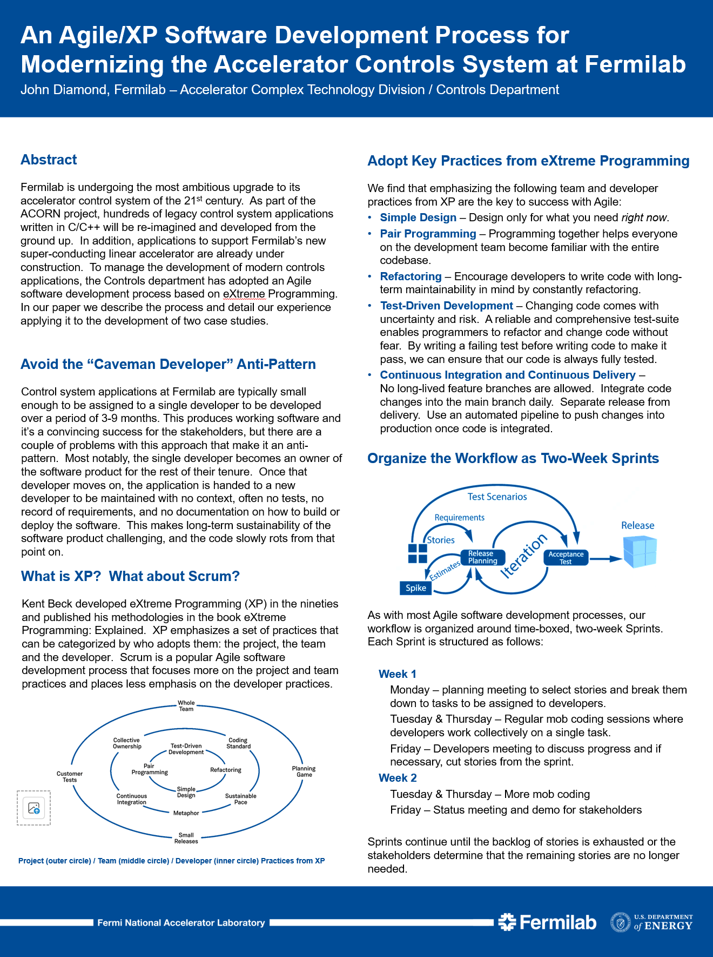
Highlights
Why do we need Agile?
Fermilab is modernizing its controls system and developing applications to support a new super-conducting linear accelerator over the next 2-4 years
What has your experience been like?
We’ve used this process to develop two pilot projects over the last 2 years and are excited to share that success with you
What plans do you have for the future?
We want to continue to iterate on this process as we ramp up development on ACORN and PIP-II and learn more about developing better software
THPD084 – Thursday @ 4:30PM

Slide 5
What we have learned so far…
😁 What we like
😒 What we don’t like
🧪 Test-Driven Development
🚗 Simple Design
♻️ Refactoring
👯 Pair Programming
🔃 Continuous Integration
🚀 Continuous Delivery
👍 Feedback from users
💤 Stand-up meetings
💻 Working in isolation
🤷 Vague requirements
🤔 Analysis Paralysis
🫷 Code Reviews on PRs
🛑 Waiting for other teams
🐢 Long build & release cycles

Slide 6
Thank you!
“Jira”

