Slide 1
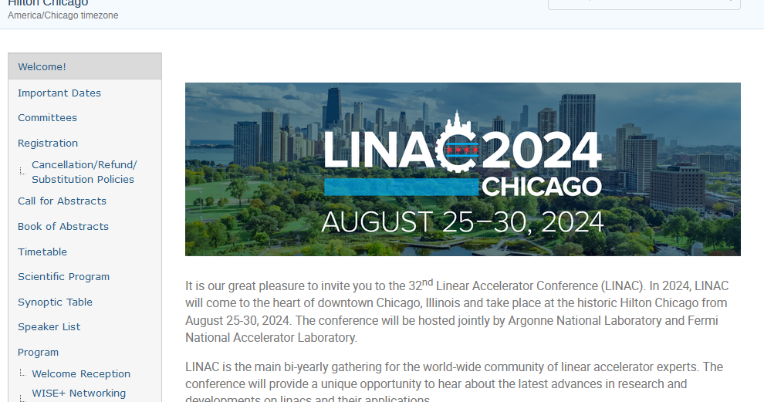
New user’s perspective on indico
Kelly jaje
Kent P. Wootton
Argonne National Laboratory
LINAC’24 Editor-in-Chief
Argonne National Laboratory
LINAC’24 LOC Chair

Slide 2
LINAC2024
LINAC2024 was held August 25-30, 2024, in Chicago, IL USA
One of the first non-IPAC conferences to use Indico
Indico site was used for the conference website

Slide 3
Training for editor-in-chief
Kelly was not able to attend the 2023 Team Meeting, which would have been beneficial.
Kelly edited at IPAC’24, which provided helpful information on the editing workflow.
Kent had Indico experience.

Slide 4
Training for authors
Indico use is new for some authors, so there will be a learning curve.

Slide 5
Thank you!
We had a lot of questions. The JACoW Team was very helpful!
Ivan Andrian – all things Indico
Stefano Deiuri – JICT support
Petr Anisimov – settings in Indico
Duarte Galvao, Michaela Marx, Jan Chrin – presentations
Jana Thomson – general questions
Editorial Team was very patient and understanding with the learning curve.
  Kip Bishofberger, Gustavo Bruno, Jan Chrin, Cathy Eyberger (QA), Maggie Loera (author reception), Denise Skiadopoulos (presentation manager), Ling Wang, and Kent Wootton (Indico site and post-conference editing)

Slide 6
Emails
Unable to send emails from Indico using LINAC@anl.gov (or any @anl.gov) email.
  Anyone or anything that uses CERN as an email provider can forge email to appear to be coming from Argonne.
Used noreply@jacow.org to send from in Indico.
  Not ideal as people sometimes replied to that email instead of the conference email.
Some confusion with filtering for emails to send
  e.g., email to authors who were not yet registered: Suspect that selecting multiple categories uses 'or' logic rather than 'and': that is 'primary speaker' or 'not registered', rather than how we would look at a filter as 'primary speaker' and 'not registered'.

Slide 7
Paper editing
Admins cannot submit papers to contributions
  Must add yourself to the contribution and give yourself rights to submit, upload the paper, and then remove yourself from the contribution
Editing workflow at the conference went well.

Slide 8
presentations
Settings in Indico not set correctly initially (only PDF was marked as publishable)
  Caused issue for editors processing slides, e.g., slides appeared as “ready to review” but editor could not upload a PDF; error received when uploading PDF and judging with yellow.
  “Presentation materials” button was available for all authors (not sure what was setting was incorrect)

Slide 9
JACoW-Indico Conference Toolbox (JICT)
Stefano Deiuri installed JICT for LINAC24 on the jacow.org server
  He had to enable and start cron jobs for us
Initial problems
  Initially had issues with session and paper codes that we needed to correct
  Understanding roles to be set in Indico for various scripts
  Understanding when items would appear on JICT (e.g., proceedings office status needing editing to start first)

Slide 10
Proceedings - PURR
Pre-press
  Had Materials entered before start of the conference, so it was ready to go
  Pre-press released last day of the conference

Slide 11
Proceedings (cont’d)
Final Proceedings
  Followed documentation, e.g., https://ipac-docs.jacow.org/Proceedings/intro/ and the CAT/PURR information https://purr-docs.jacow.org/Functionalities/finalProceedings/. Did not notice in documentation who to contact regarding DOIs and publishing.
  Needed to fix issues in the PDF of full proceedings
    3 papers had issues as a result of PDF created by using the Microsoft Print to PDF instead of Adobe PDF printer (recreated PDFs properly, which fixed the issue)
    Unsure what caused the other 2 issues
      Fixed by replacing the pages with issues in the PDF
    Also modified page numbering and embedded fonts in PDF
    Replaced the PDF of full proceedings in the zip file

Slide 12
Proceedings (cont’D)
DOIs
  Received credentials from Volker Schaa
  Heeded warning not to select DOI until ready
Generation of Final Proceedings
  Ronny Billen (CERN server) and Kazuro Furukawa (KEK server) published
    Provided them with zip file that contained updated PDF
  Went well!

Slide 13
Thanks to all who helped us!

