Slide 1
Proposal for JACoW Team Meeting 2025
(East Lansing, Michigan, USA)
November 2024

Slide 2
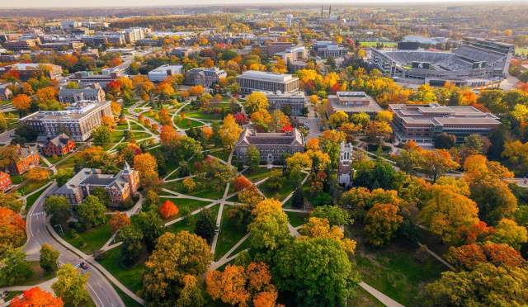
JACoW Team Meeting 2025 proposal
Location: MSU campus, East Lansing, MI
Time: Late October / Early November 2025
Venue
  Kellogg Center, or
  FRIB building
Travel info
  Detroit Airport (DTW), international airport
    88 Miles away from MSU
    Shuttle bus (Michigan Flyer) to/from MSU campus
  Lansing airport (LAN)
    12 Miles away from MSU
  Grand Rapids airport (GRR)
    63 Miles away from MSU
  Free campus bus

Slide 3
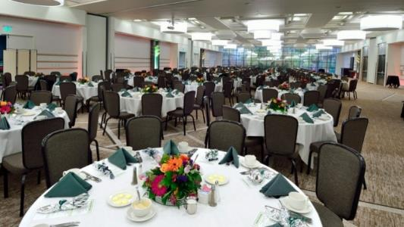
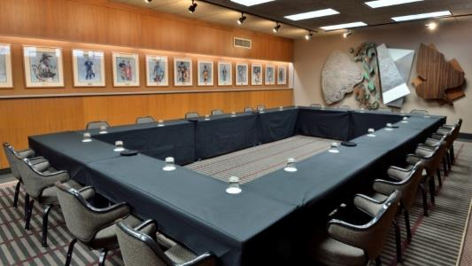
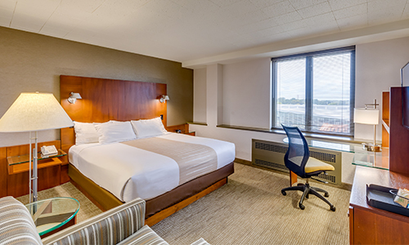
Kellogg Conference Center on MSU’s Campus
The Kellogg Conference Center on MSU campus has full capabilities for conference/event and accommodations
  1 Room host >1000 people; 2 Room host ~300 people
  > 6 rooms host 60-100 people
Big Ten Rooms (Banquet Hall)
Heritage Room (Conference Room)
King bed Room (Guest Room)

Slide 4
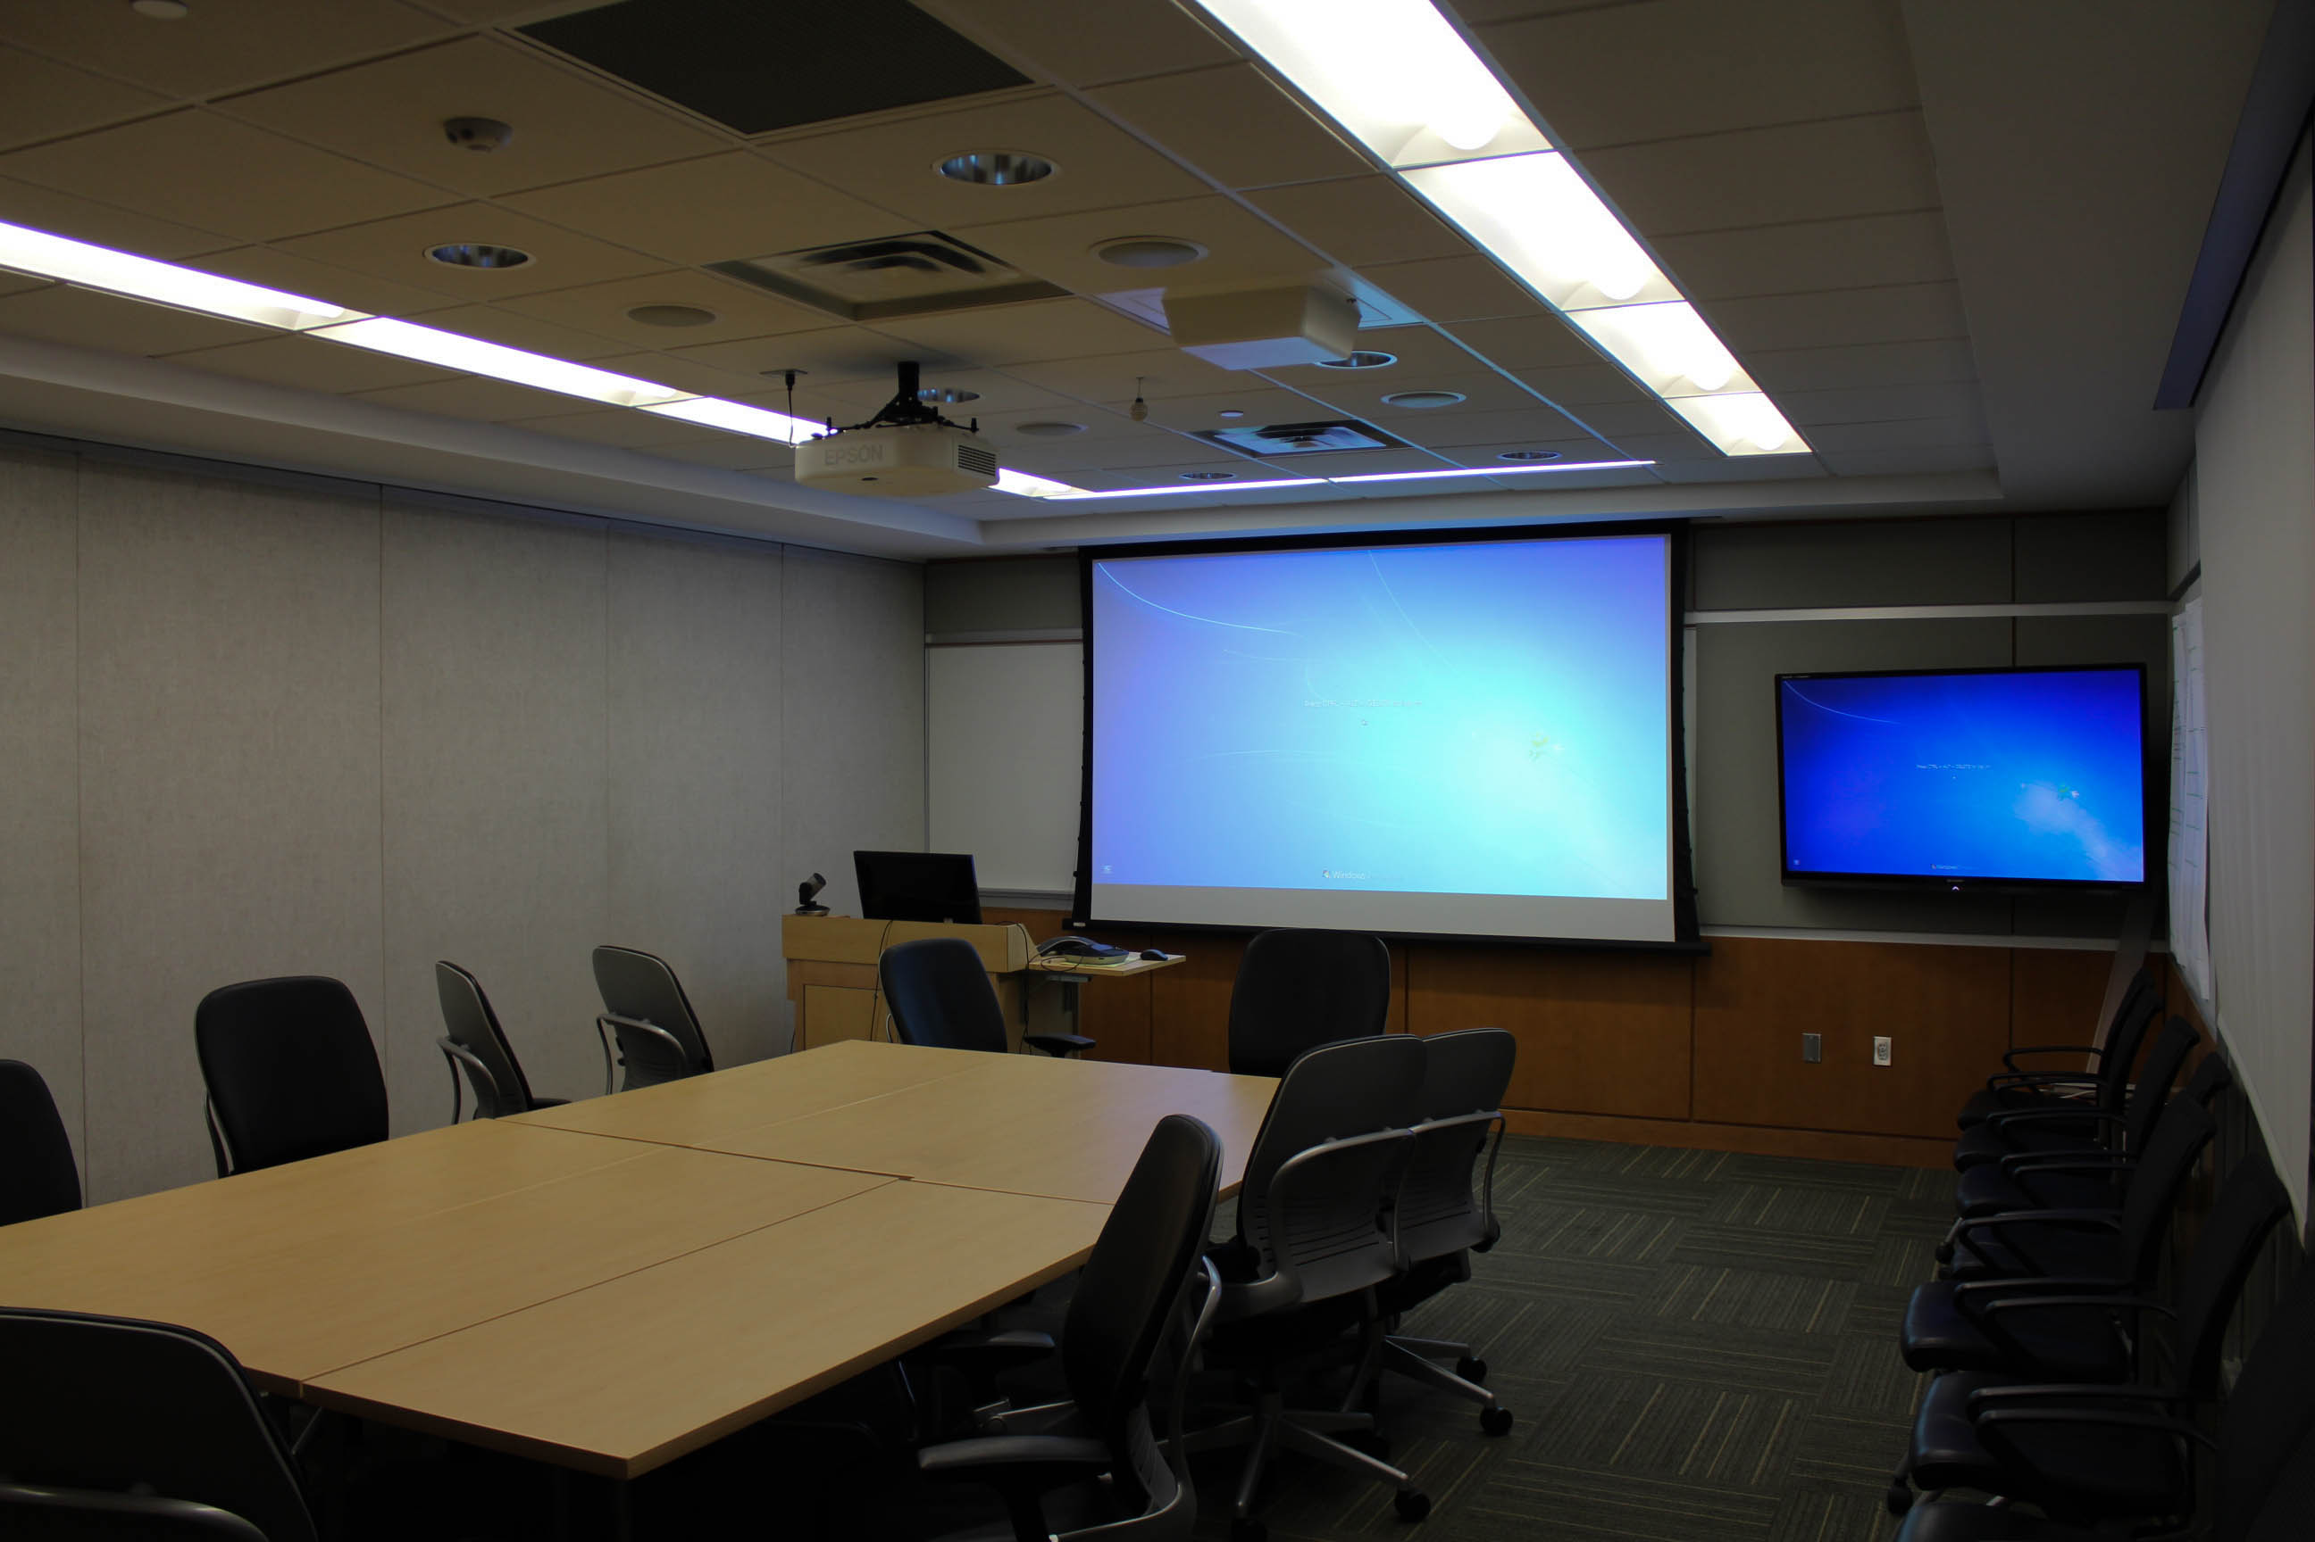
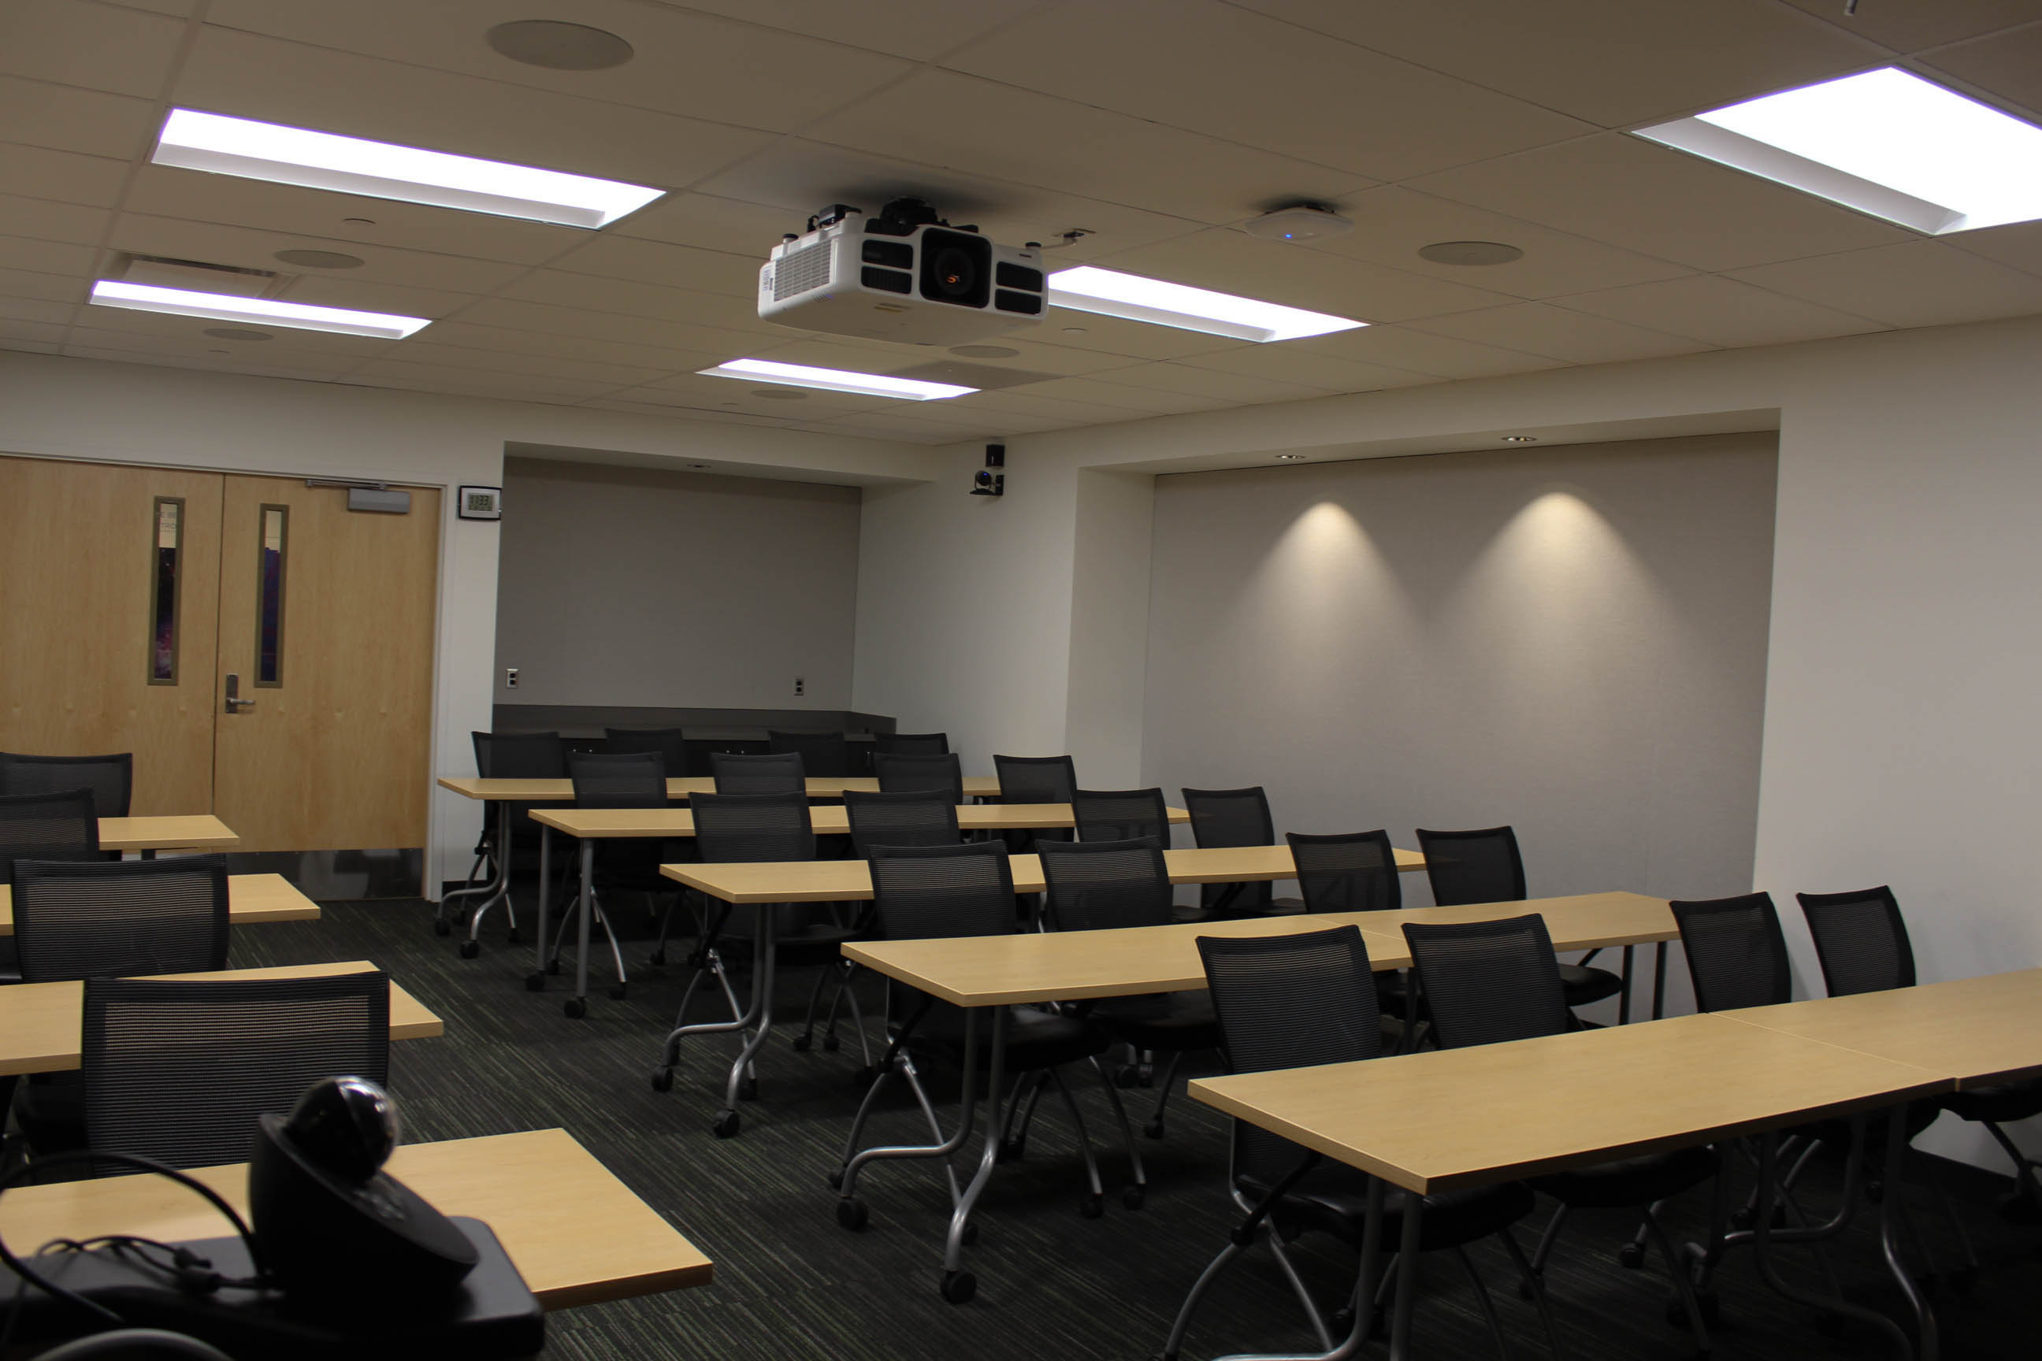
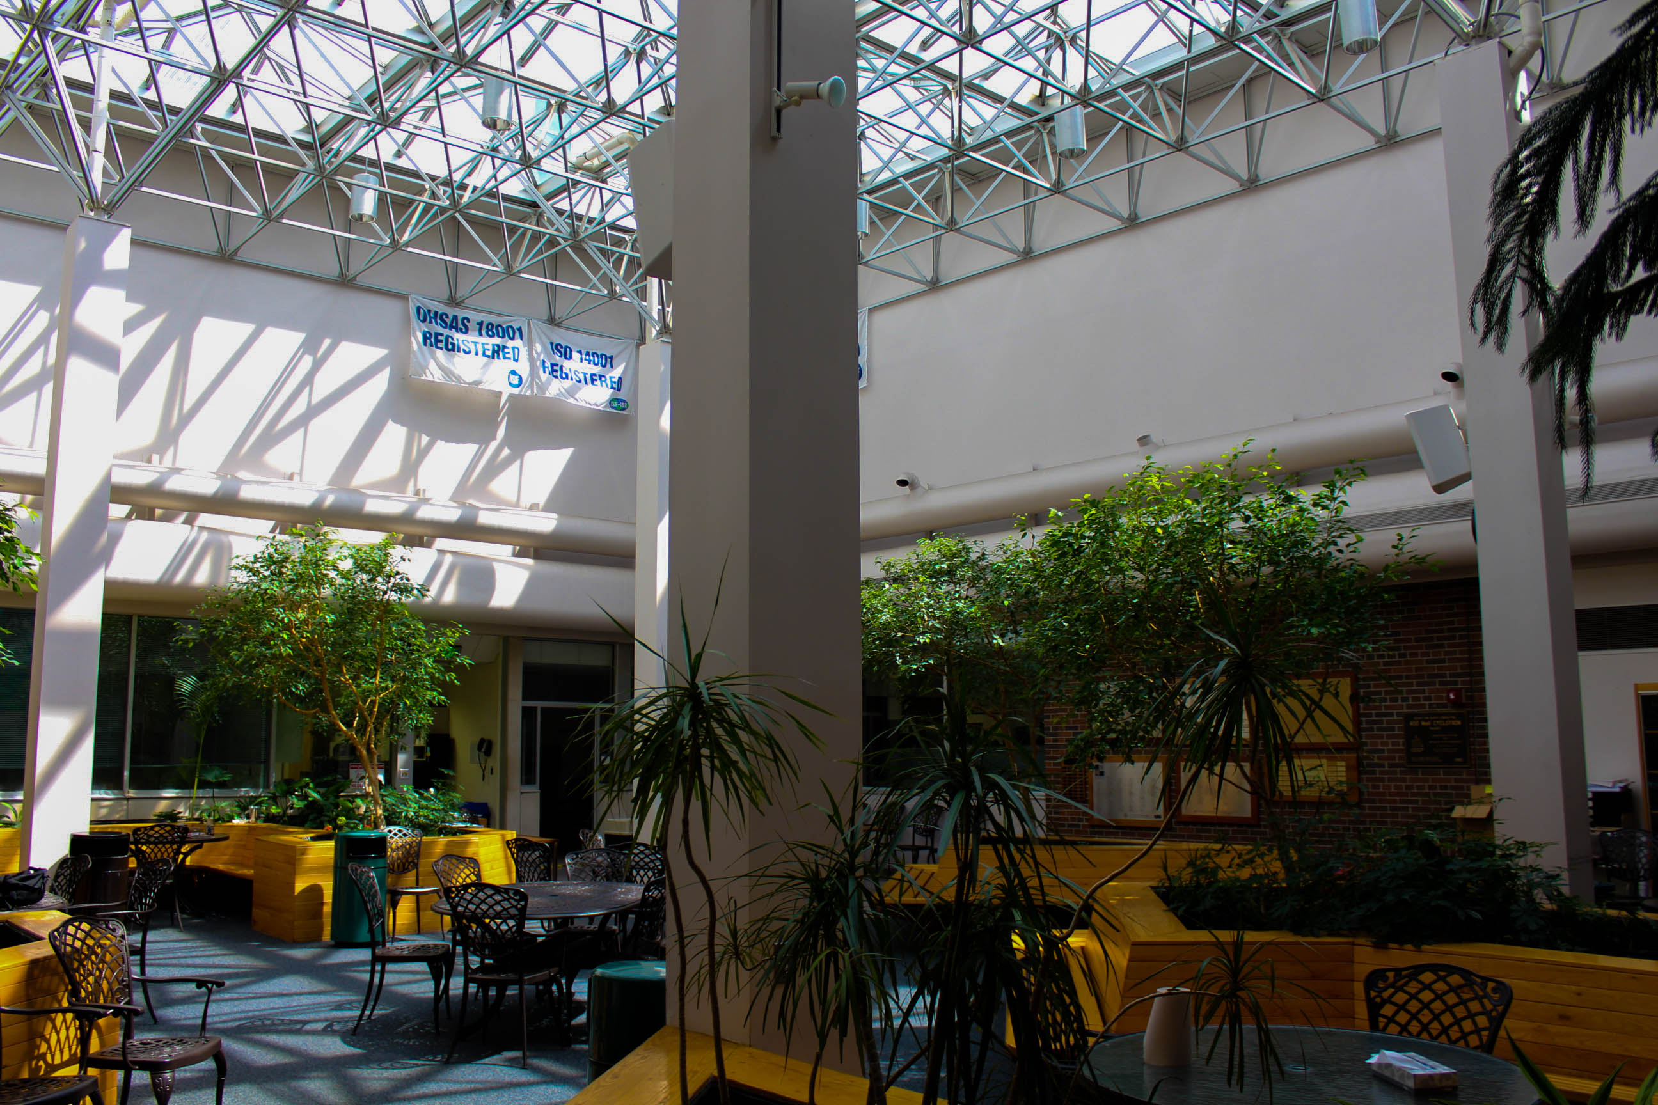
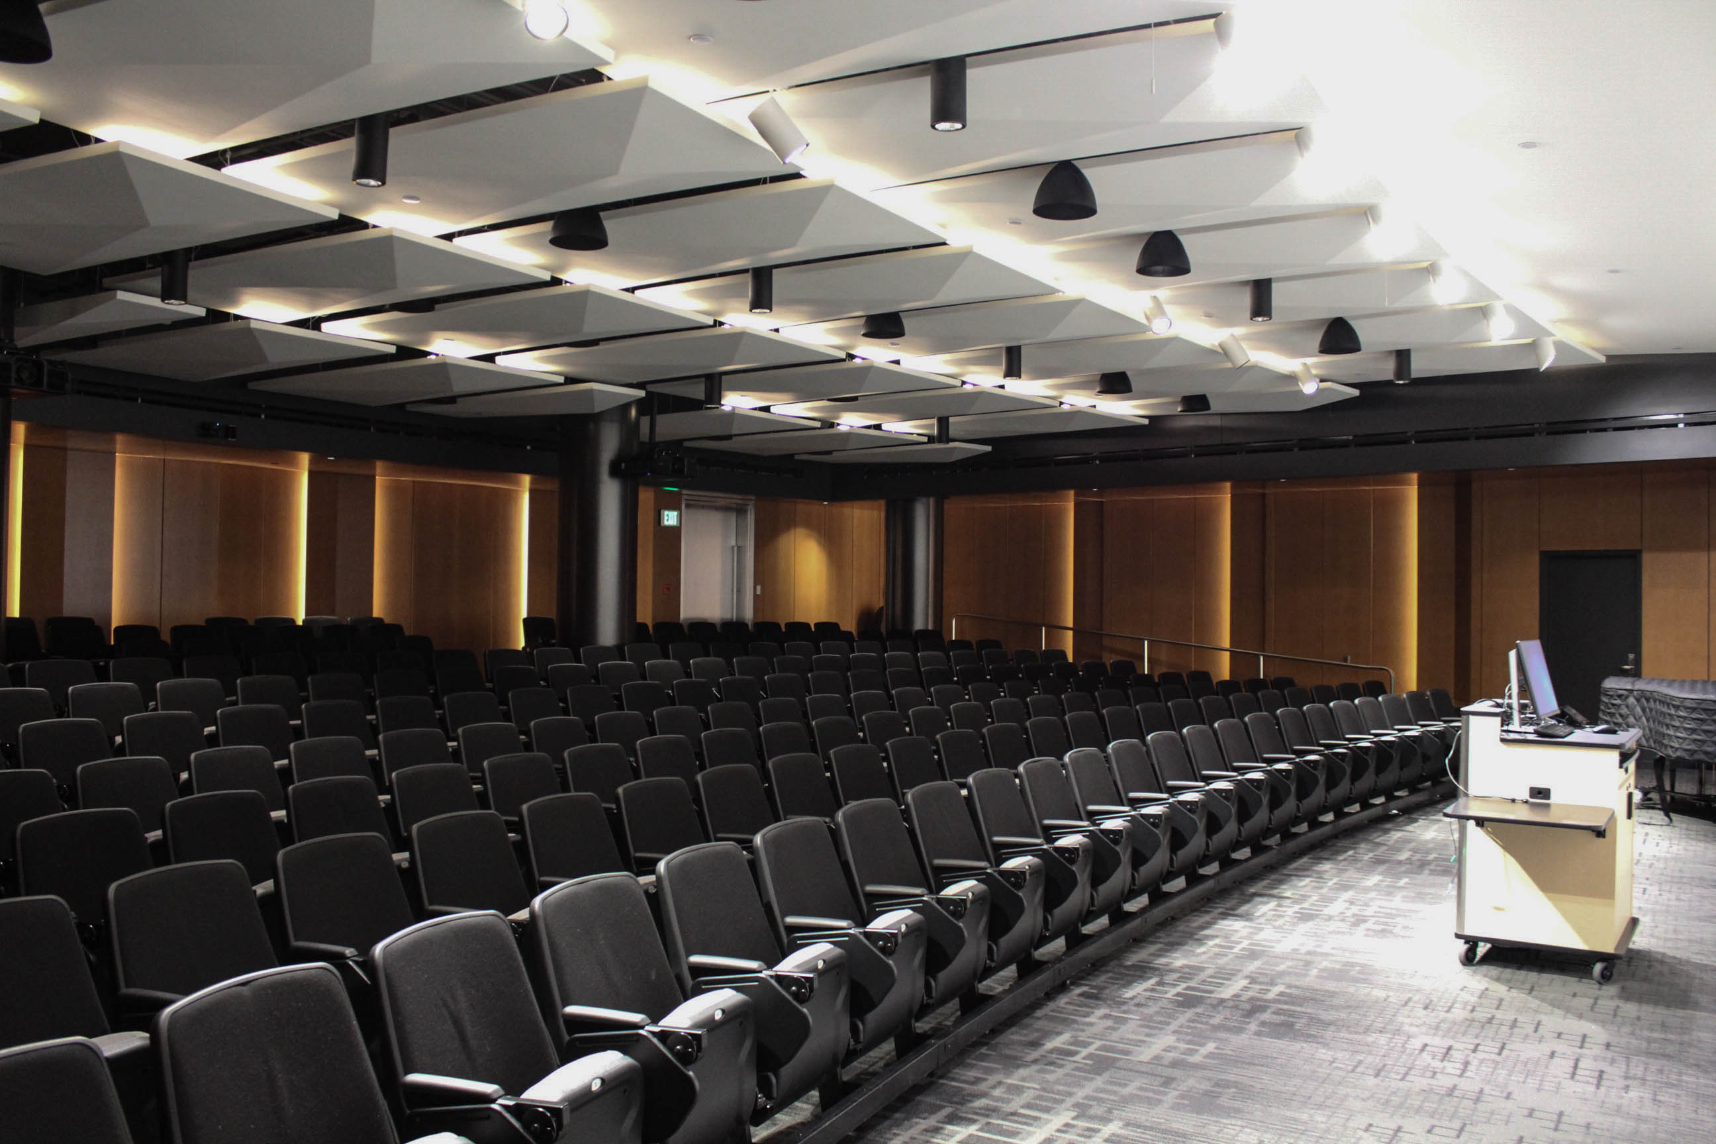
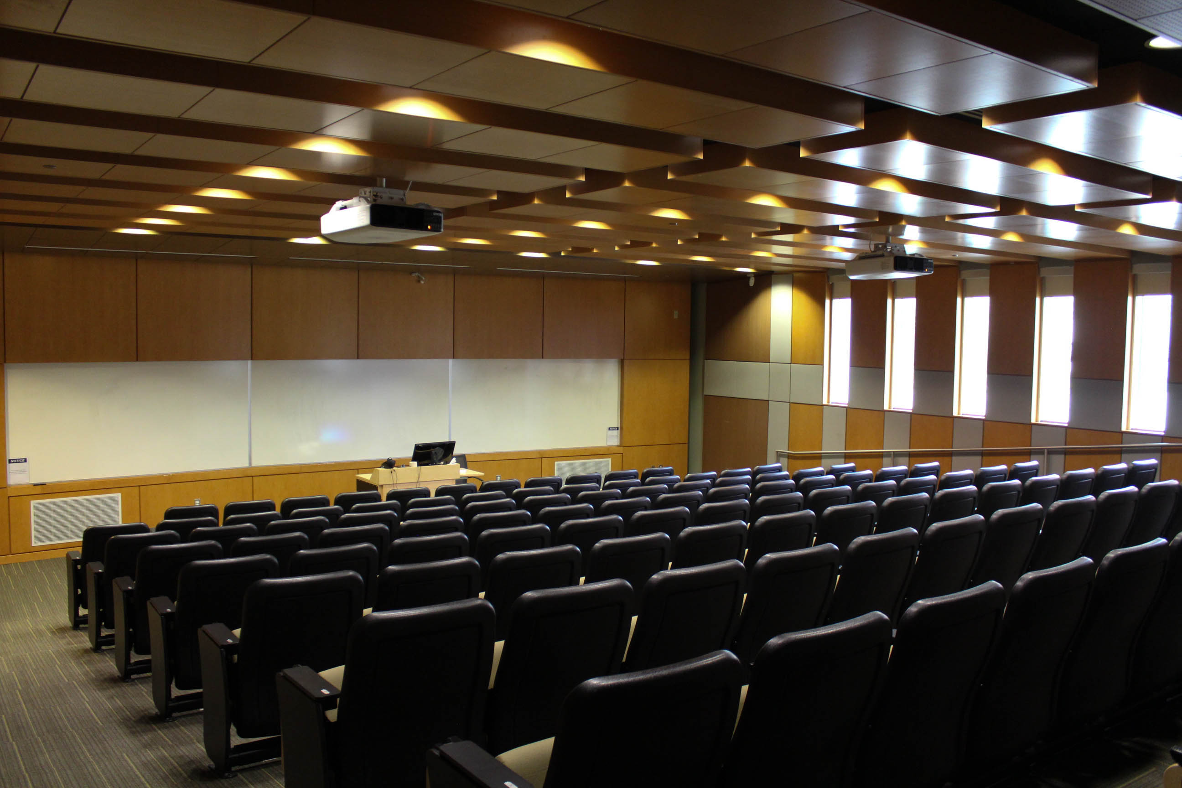
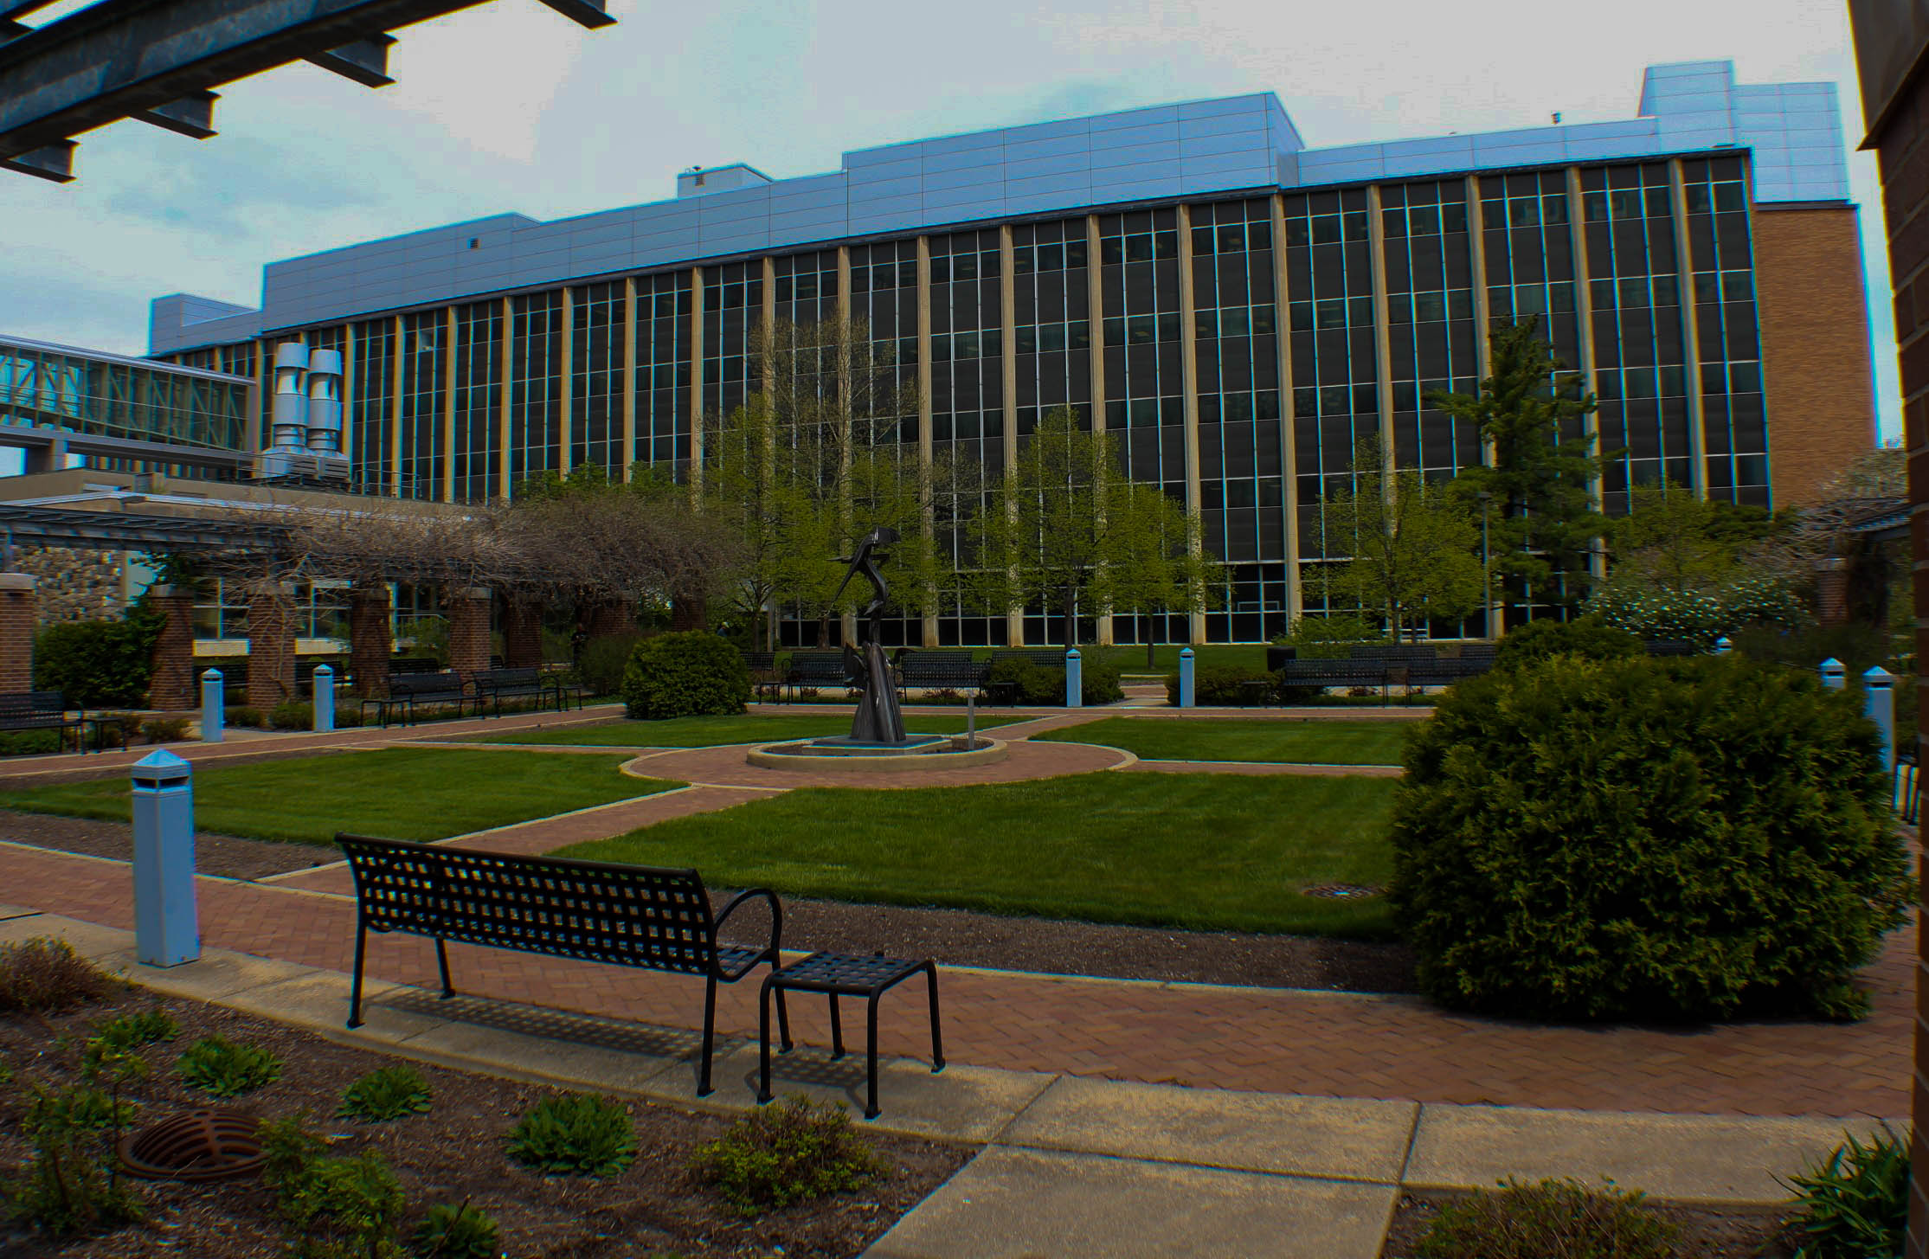
Spaces at FRIB
Alternatively, FRIB has hosting abilities for academic meetings
Breakout Room
20 seats
Breakout Room
40 seats
Atrium
50 seats
Lecture Hall #1
200 seats
Lecture Hall #2
100 seats
Courtyard

Slide 5
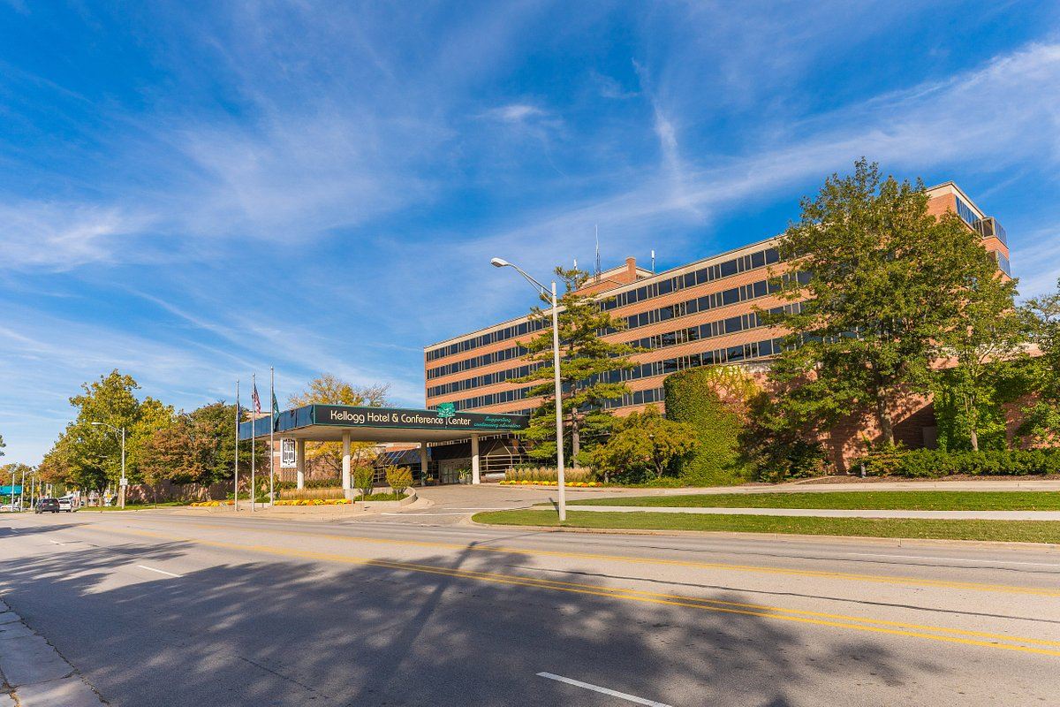
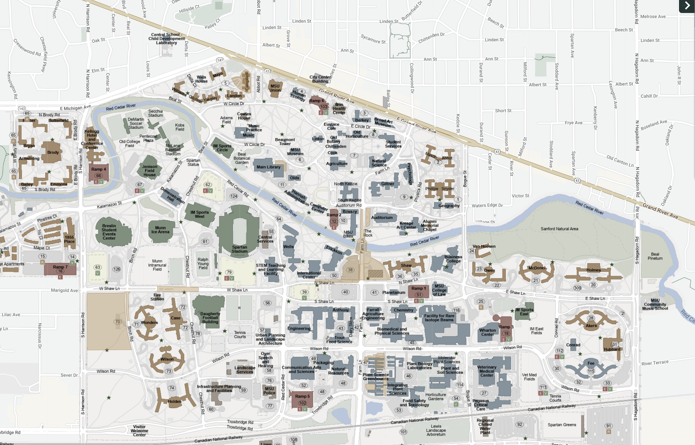
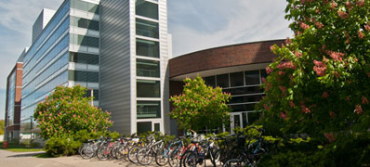
MSU Campus: FRIB to Kellogg
https://maps.msu.edu/interactive/index.php
East Lansing
Downtown
Kellogg
Conference
Center
FRIB
10-minute-walk

Slide 6
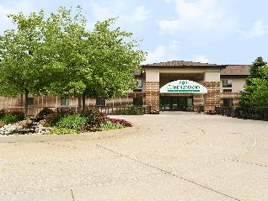
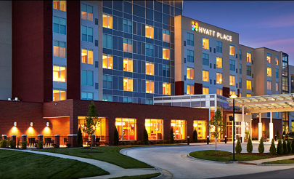
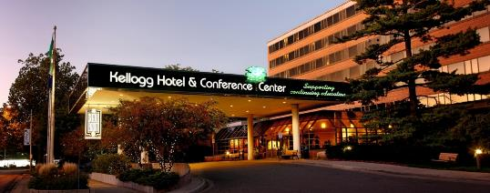
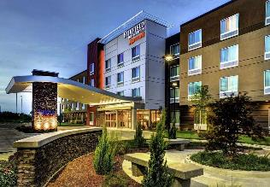
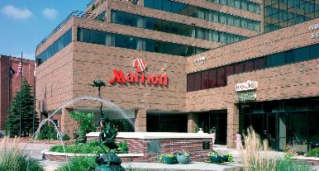
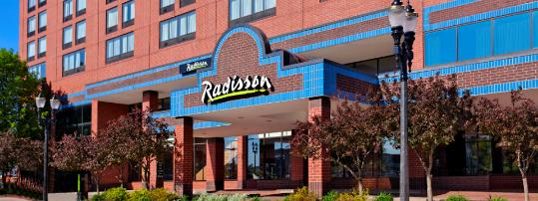
Lodging Near MSU
There are several hotels around MSU campus and East Lansing
Candlewood Suites
Hyatt Place
Kellogg Hotel & Conference Center
Fairfield Inn
Marriott at University Place
Radisson Lansing

Slide 7
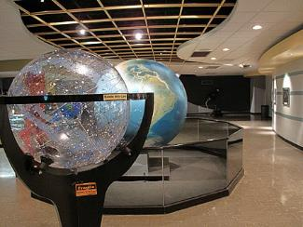
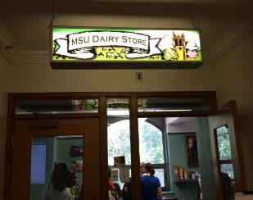
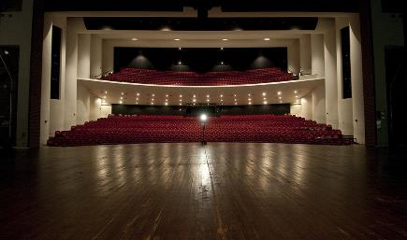
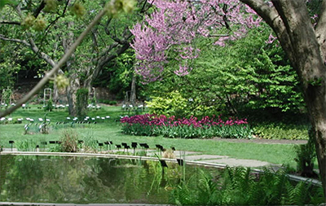
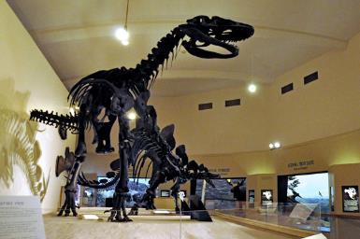
Things to see on MSU’s Campus
MSU is filled with many fun and interesting attractions
See a show at the Abrahms Planetarium
Eat some MSU Dairy Store ice cream!
Watch a performance at the Wharton Center
Visit the W. J. Beal Botanical Gardens
Visit the MSU museum, a Smithsonian Institution affiliate

Slide 8
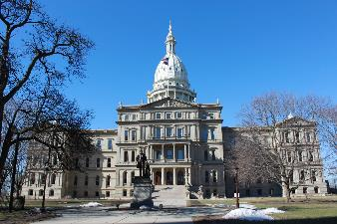
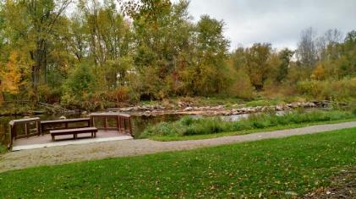
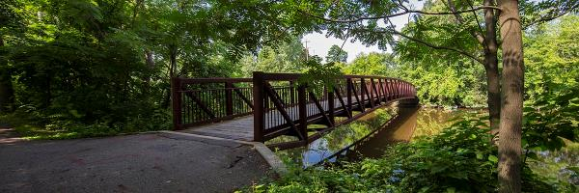
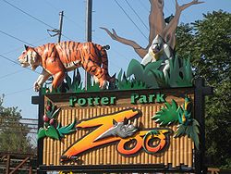
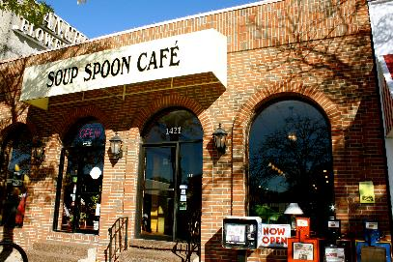
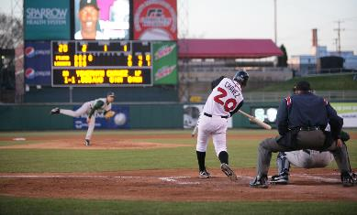
Places to go in East Lansing and Lansing
Lansing is full of fun things to do
Visit the Capitol of Michigan
Visit the Fenner Nature Center or the Woldumar Nature Center
Walk the Lansing River Trail
See the animals at the Potter Park Zoo
Eat at some of Lansing’s most popular restaurants, including the Soup Spoon Café, Meat Southern BBQ & Carnivore Cuisine, Golden Harvest, and many more
Watch the Lansing Lugnuts baseball team

