Slide 1

What is JACoW?
History, present, and future of the collaboration
Meghan McAteer (HZB)
2024 JACoW Annual Team Meeting, Deauville, France

Slide 2
  What is JACoW?
  A collaboration which publishes and archives a vast repository of conference proceedings in accelerator physics and technology
  257 proceedings volumes (dating back as far as 1959)
  +76,000 papers published
  Highly valuable resource for researchers in accelerator-related fields

Slide 3
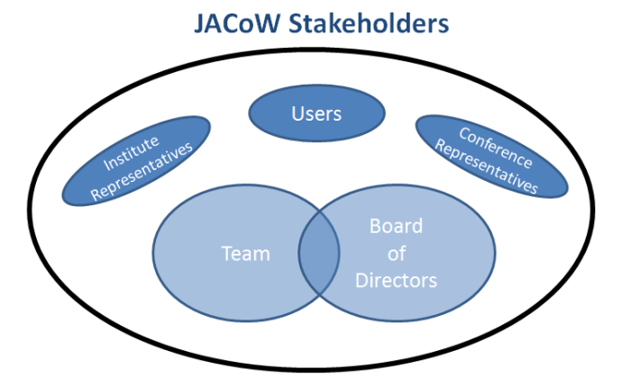
  WHO is JACoW?
  17 conference series are members
    (ie have asked to publish their proceedings with JACoW and agreed to adhere to the collaboration’s boundary conditions)
  Stakeholders: all users, representatives from research institutes, representatives from conferences, JACoW team
  JACoW Team: editors from each conference instance, subject matter experts and officers, Board of Directors
Conference representatives
Institute representatives
BoD
Team
Users

Slide 4
  What are the goals of JACoW?
  Publish high-quality sets of proceedings with access through the custom interface
  Provide long-term archival storage to ensure longevity and access to publication data
  Publish conference metadata for open archives.
  Train and educate authors and editors (includes development of tools for producing proceedings)
  Maintain a set of user profiles for accelerator conferences
  Provide support for conference organizers
  Consistent goals since the founding of the collaboration!

Slide 5
  How do we manage all of this?
  The JACoW collaboration model, according to the Charter and Boundary Conditions:
  Editors from each conference which wishes to publish with JACoW join the JACoW team for three years, to learn how to produce proceedings, contribute to the development of the collaboration, and transfer knowledge; the editor-in-chief is responsible for producing proceedings
  Team also includes subject-matter experts, officers, and co-opted editors
  Board of Directors is the decision-making body which is responsible for ensuring that the collaboration fulfils its mission
  Annual Team Meeting for development and transfer of technical knowledge among team members
  Annual Stakeholders meeting to report activities to, and discuss issues with, wider set of stakeholders (typically during IPAC)

Slide 6




Labs providing infrastructure and services
Proceedings Repository & Search
SPMS Central Repository (Accounts and Profiles)
SPMS Regional Support Centre for Europe
JACoW Indico
Paper File Server for EMEA and Australasia (formerly at PSI)
Proceedings server
SPMS Regional Support Centre for Australasia and the Americas (to be retired end of 2024)
JACoW.org Website Hosting
CWS tools, CAT tools
Indico documentation pages
Reference Search Tool
Cat Scan Tool

Slide 7

  JACoW:
  The origin story
(Slides from Todd Satogata)

Slide 8


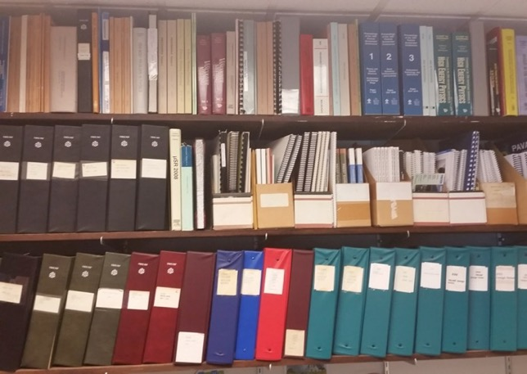

  When I was your age…
  …proceedings were called “books”!
  Conferences once printed all their proceedings
    (Nearly) all the delegates got a printed, shipped copy
    Labs sent people to conferences to get proceedings!
    Printing, shipping was a big piece of the conference budget

Slide 9
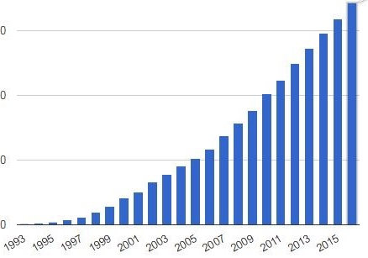

A Confluence of Technologies…
1990-1: World Wide Web (CERN)
1993: PDF and Acroread made free (Adobe)
1993: Commercialization of Linux (redhat)
1994: 100 MHz PC processors (Intel)
1995-2000: Dot Com Boom
  Internet usage/access grows 25x: 15M to 350M
PAC’95 (Dallas): Camera-ready publication (paper)
EPAC’96 (Sitges): Full electronic publication (CERN)
  Templates, on-site editing, dot board (author “education”)
PAC’97 (Vancouver): The birth of JACoW
  Founded by APAC’98, EPAC’98, PAC’99
Internet Users: 1993-2016

Slide 10

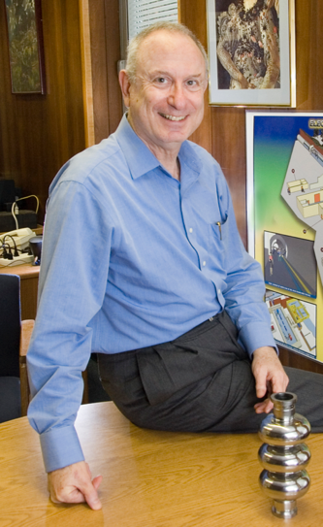
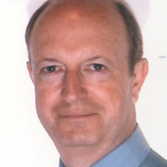
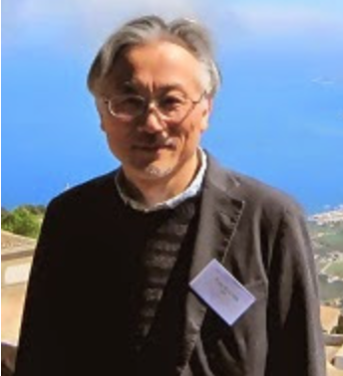
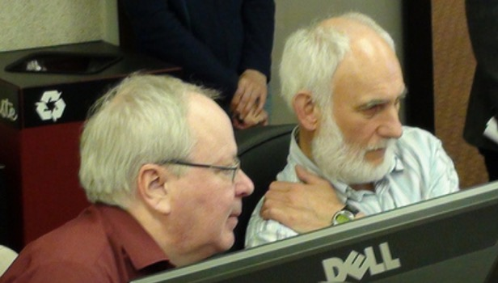
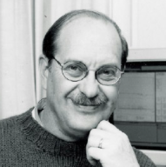
…and a Confluence of Personalities
Christine
Petit-Jean
Genaz
Ilan
Ben-Zvi
EPAC’96...
PAC’99
Yong-Ho
Chin
John
Poole
APAC’98
Bob Siemann
Martin
Comyn
Lief Liljeby
PAC’97
EPAC’98
PAC’95

Slide 11
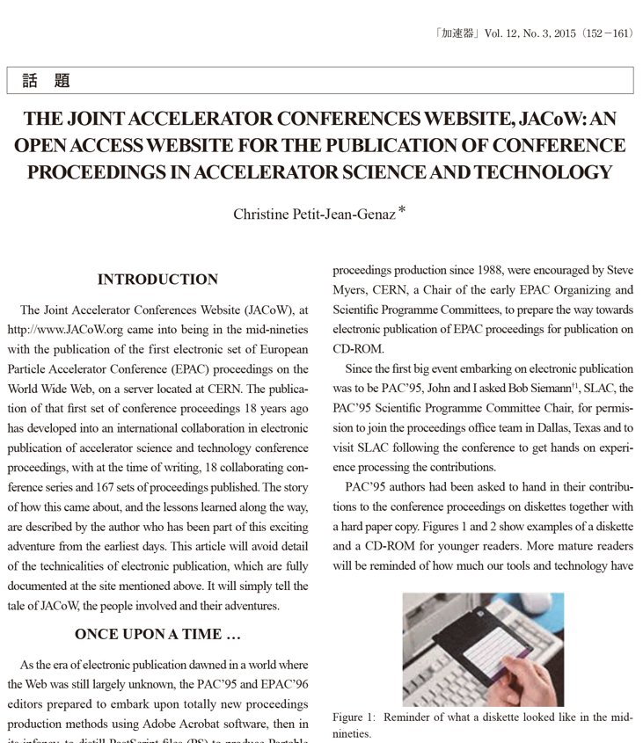
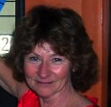
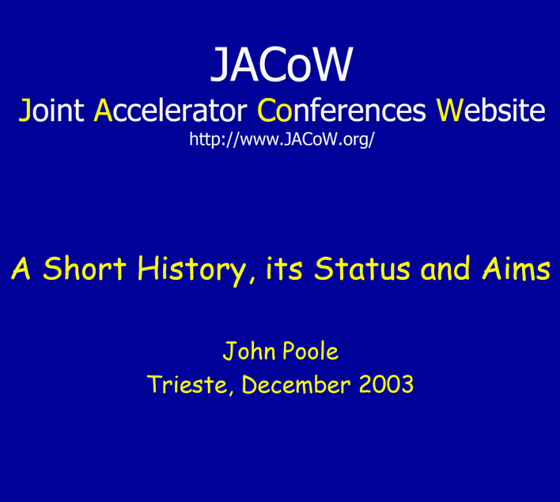
Recommended Reading about the history of JACoW
http://www.jacow.org/uploads/About/Article_KASOKUKI.pdf
http://epaper.kek.jp/jacow/TM_2003_Trieste/slides/Seminar-JP.pdf

Slide 12
  The Evolution
  And Development
  of the
  JACoW Collaboration

Slide 13
A Timeline of JACoW evolution and developments
Development of ‘JACoW model’, formation of the collaboration (EPAC’96, EPAC’98, APAC’98, PAC’99)
1998 JACoW paper size
Development of JPSP (2004, continuing over many years)
2007-08 first discussion about indexing JACoW proceedings
2001 JACoW Steering Committee
2012 JACoW charter adopted, Board of Directors formed
2004 SPMS (PAC’01, EPAC’02, EPAC’04)
Further development of SPMS functionality (FEL’04, FEL’05, IPAC, EPAC’08)
Regional support centers
2012 ISBN numbers
Development of CATscan and reference search tool (IPAC’19)
2017 Start of SPMS-Indico merge project
2015 current version of JACoW charter adopted
2020 end of SPMS development support, closing of FNAL support center
2015 DOIs for all new papers
2020 ISSN numbers for all conferences
2022 Last SPMS instance created
LINAC’24 proceedings published (EiC Kelly Jaje)
Beta test of JACoW- Indico at IPAC’23, then production version rolled out
First test of
JACoW-Indico (FEL’22)
2023 First two sets of proceedings
(LINAC and IBIC) indexed in Scopus
2024 KEK SPMS server will be retired
Development of Indico proceedings module (IPAC’23, IPAC’24, IPAC’25)

Slide 14
A Timeline of JACoW evolution and developments
Development of ‘JACoW model’, formation of the collaboration (EPAC’96, EPAC’98, APAC’98, PAC’99)
2012 JACoW charter adopted
2001 JACoW Steering Committee
Development of JPSP (continuing over many years)
2007-08 first discussion about indexing JACoW proceedings
Development of SPMS (PAC’01, EPAC’02, EPAC’04)
Further development of SPMS functionality (FEL’04, FEL’05, IPAC, EPAC’08)
Regional support centers
Development of CATscan and reference search tool (IPAC’19)
2017 Start of SPMS-Indico merge project
2015 current version of JACoW charter adopted
2020 end of SPMS development support, closing of FNAL support center
2022 Last SPMS instance created
LINAC’24 proceedings published (EiC Kelly Jaje)
Beta test of JACoW- Indico at IPAC’23, then production version rolled out
First test of
JACoW-Indico (FEL’22)
2024 First two sets of proceedings
(LINAC and IBIC) indexed in Scopus
2024 KEK SPMS server will be retired
Development of Indico proceedings module (IPAC’23, IPAC’24, IPAC’25)

Slide 15
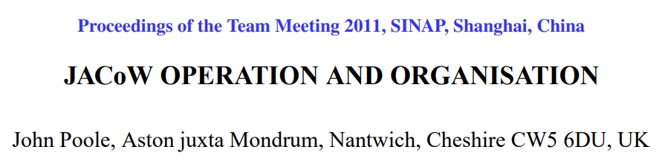
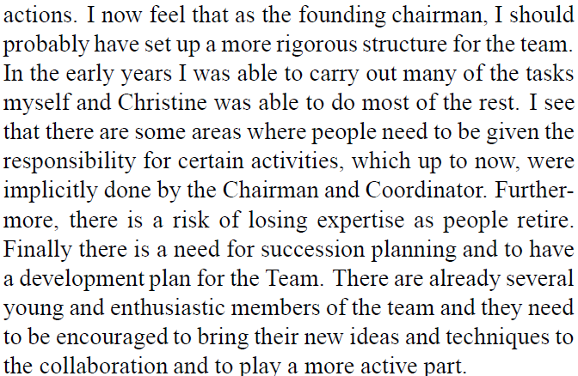
Introduction of Jacow charter

Slide 16
Introduction of Jacow charter
year | chair | deputy chair | secretary/coordinator
1998 | John Poole | - | Christine Petit-Jean-Genaz
1999 | John Poole | - | Christine Petit-Jean-Genaz
2000 | John Poole | - | Christine Petit-Jean-Genaz
2001 | John Poole | - | Christine Petit-Jean-Genaz
2002 | John Poole | - | Christine Petit-Jean-Genaz
2003 | John Poole | - | Christine Petit-Jean-Genaz
2004 | John Poole | - | Christine Petit-Jean-Genaz
2005 | John Poole | - | Christine Petit-Jean-Genaz
2006 | John Poole | - | Christine Petit-Jean-Genaz
2007 | Volker RW Schaa | Ivan Andrian | Christine Petit-Jean-Genaz
2008 | Volker RW Schaa | Ivan Andrian | Christine Petit-Jean-Genaz
2009 | Volker RW Schaa |  | Christine Petit-Jean-Genaz
2010 | Volker RW Schaa | Ivan Andrian | Christine Petit-Jean-Genaz
2011 | Volker RW Schaa | Ivan Andrian | Christine Petit-Jean-Genaz
2012 | Volker RW Schaa | Ivan Andrian | Christine Petit-Jean-Genaz
2013 | Volker RW Schaa | Ivan Andrian | Christine Petit-Jean-Genaz
2014 | Volker RW Schaa | Ivan Andrian | Christine Petit-Jean-Genaz
2015 | Ivan Andrian | Todd Satogata | Christine Petit-Jean-Genaz
2016 | Ivan Andrian | Todd Satogata | Christine Petit-Jean-Genaz
2017 | Ivan Andrian | Todd Satogata | Christine Petit-Jean-Genaz
2018 | Ivan Andrian | Todd Satogata | Christine Petit-Jean-Genaz
2019 | Ivan Andrian | Todd Satogata | Christine Petit-Jean-Genaz
2020 | Ivan Andrian | Dave Button | Christine Petit-Jean-Genaz
2021 | Ivan Andrian | Dave Button | Christine Petit-Jean-Genaz
2022 | Meghan McAteer | Dave Button | Jana Thomson
2023 | Meghan McAteer | Rob Apsimon | Jana Thomson
2024 | Meghan McAteer | Caitlin Hoffman | Jana Thomson

Slide 17
Introduction of Jacow charter
year | chair | deputy chair | secretary/coordinator
1998 | John Poole | - | Christine Petit-Jean-Genaz
1999 | John Poole | - | Christine Petit-Jean-Genaz
2000 | John Poole | - | Christine Petit-Jean-Genaz
2001 | John Poole | - | Christine Petit-Jean-Genaz
2002 | John Poole | - | Christine Petit-Jean-Genaz
2003 | John Poole | - | Christine Petit-Jean-Genaz
2004 | John Poole | - | Christine Petit-Jean-Genaz
2005 | John Poole | - | Christine Petit-Jean-Genaz
2006 | John Poole | - | Christine Petit-Jean-Genaz
2007 | Volker RW Schaa | Ivan Andrian | Christine Petit-Jean-Genaz
2008 | Volker RW Schaa | Ivan Andrian | Christine Petit-Jean-Genaz
2009 | Volker RW Schaa |  | Christine Petit-Jean-Genaz
2010 | Volker RW Schaa | Ivan Andrian | Christine Petit-Jean-Genaz
2011 | Volker RW Schaa | Ivan Andrian | Christine Petit-Jean-Genaz
2012 | Volker RW Schaa | Ivan Andrian | Christine Petit-Jean-Genaz
2013 | Volker RW Schaa | Ivan Andrian | Christine Petit-Jean-Genaz
2014 | Volker RW Schaa | Ivan Andrian | Christine Petit-Jean-Genaz
2015 | Ivan Andrian | Todd Satogata | Christine Petit-Jean-Genaz
2016 | Ivan Andrian | Todd Satogata | Christine Petit-Jean-Genaz
2017 | Ivan Andrian | Todd Satogata | Christine Petit-Jean-Genaz
2018 | Ivan Andrian | Todd Satogata | Christine Petit-Jean-Genaz
2019 | Ivan Andrian | Todd Satogata | Christine Petit-Jean-Genaz
2020 | Ivan Andrian | Dave Button | Christine Petit-Jean-Genaz
2021 | Ivan Andrian | Dave Button | Christine Petit-Jean-Genaz
2022 | Meghan McAteer | Dave Button | Jana Thomson
2023 | Meghan McAteer | Rob Apsimon | Jana Thomson
2024 | Meghan McAteer | Caitlin Hoffman | Jana Thomson

Slide 18
A Timeline of JACoW evolution and developments
Development of ‘JACoW model’, formation of the collaboration (EPAC’96, EPAC’98, APAC’98, PAC’99)
Development of JPSP (continuing over many years)
2007-08 first discussion about indexing JACoW proceedings
Development of SPMS (PAC’01, EPAC’02, EPAC’04)
2012 JACoW charter adopted
2012 ISBN numbers
Further development of SPMS functionality (FEL’04, FEL’05, IPAC, EPAC’08)
Regional support centers
Development of CATscan and reference search tool (IPAC’19)
2017 Start of SPMS-Indico merge project
2015 current version of JACoW charter adopted
2020 end of SPMS development support, closing of FNAL support center
2015 DOIs for all new papers
2020 ISSN numbers for all conferences
2022 Last SPMS instance created
LINAC’24 proceedings published (EiC Kelly Jaje)
Beta test of JACoW- Indico at IPAC’23, then production version rolled out
First test of
JACoW-Indico (FEL’22)
2023 First two sets of proceedings (LINAC and IBIC) indexed in Scopus
2024 KEK SPMS server will be retired
Development of Indico proceedings module (IPAC’23, IPAC’24, IPAC’25)

Slide 19
A Timeline of JACoW evolution and developments
Development of ‘JACoW model’, formation of the collaboration (EPAC’96, EPAC’98, APAC’98, PAC’99)
1998 JACoW paper size
Development of SPMS (PAC’01, EPAC’02, EPAC’04)
Development of JPSP (2004, continuing over many years)
2007-08 first discussion about indexing JACoW proceedings
2012 JACoW charter adopted
Development of JPSP (2004, continuing over many years)
Further development of SPMS functionality (FEL’04, FEL’05, IPAC, EPAC’08)
Regional support centers
2020 end of SPMS development support, closing of FNAL support center
Development of CATscan and reference search tool (IPAC’19)
2017 Start of SPMS-Indico merge project
2015 current version of JACoW charter adopted
2022 Last SPMS instance created
Beta test of JACoW- Indico at IPAC’23, then production version rolled out
LINAC’24 proceedings published (EiC Kelly Jaje)
First test of JACoW-Indico (FEL’22)
2024 KEK SPMS server will be retired
2024 First two sets of proceedings
(LINAC and IBIC) indexed in Scopus
Development of Indico proceedings module (IPAC’23, IPAC’24, IPAC’25)

Slide 20
  What’s next?

Slide 21
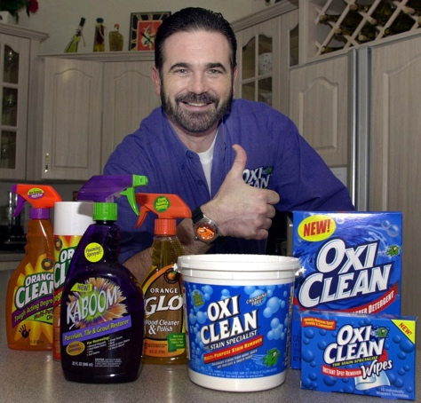


Outlook for JACoW
Value of JACoW is widely recognized and accepted within accelerator physics community
“What is JACoW and What Does It Offer To Your Conference?”

Slide 22
Outlook for JACoW
Value of JACoW is widely recognized and accepted within accelerator physics community
Transition to Indico is a major milestone
  Tools more accessible to all team members, decentralization, elimination of ‘single points of failure’

Slide 23
Outlook for JACoW
Value of JACoW is widely recognized and accepted within the accelerator physics community
Transition to Indico is a major milestone
  Tools more accessible to all team members, decentralization, elimination of ‘single points of failure’
Continuing efforts to strengthen and expand collaboration base

Slide 24
Outlook for JACoW
Value of JACoW is widely recognized and accepted within the accelerator physics community
Transition to Indico is a major milestone
  Tools more accessible to all team members, decentralization, elimination of ‘single points of failure’
Continuing efforts to strengthen and expand collaboration base
Continuing developments to make processes more efficient and cost-effective

Slide 25
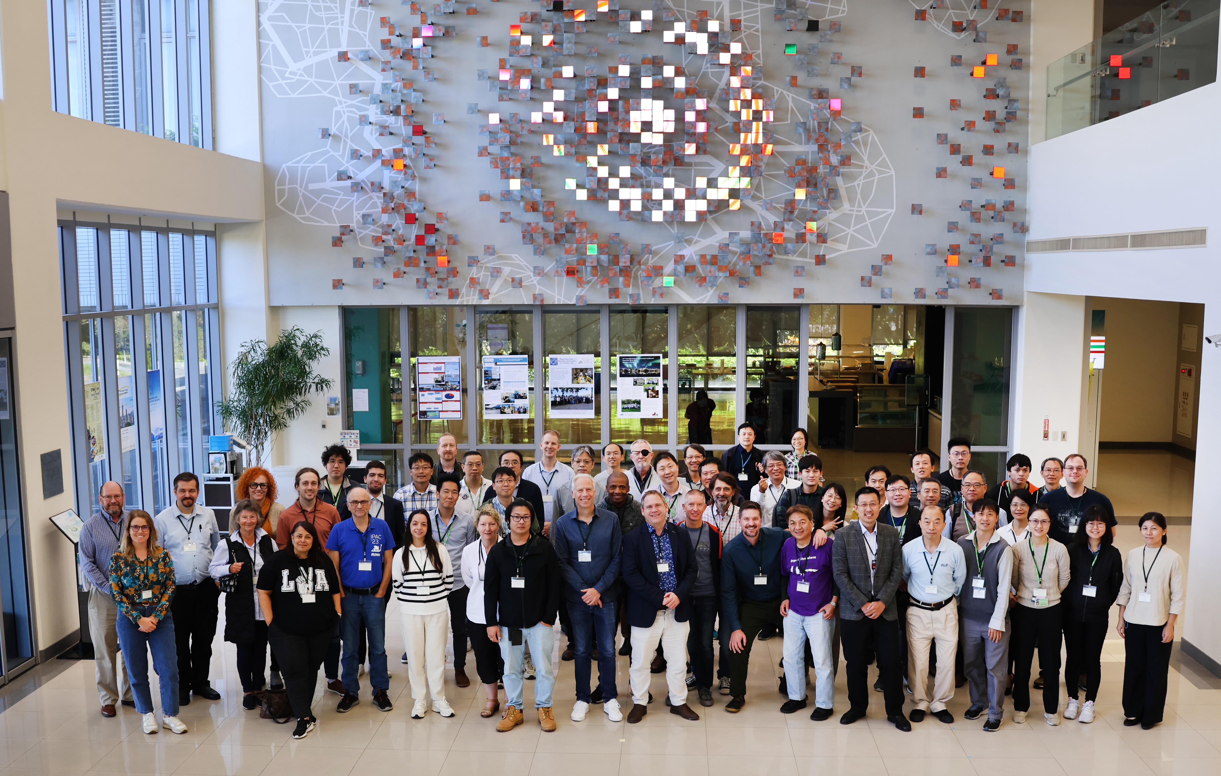
  Questions?

