Slide 1
Summary from the Rapporteur
Jui-Che Huang
IPAC’25 LOC Chair
National SYNCHOTRON RADIATON RESEARCH CENTER

Slide 2
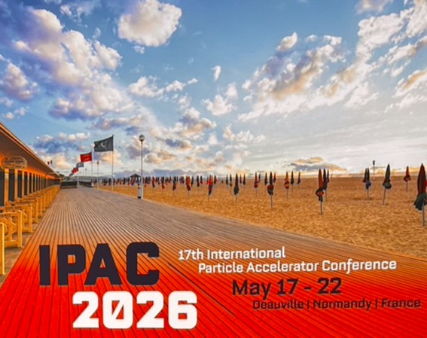
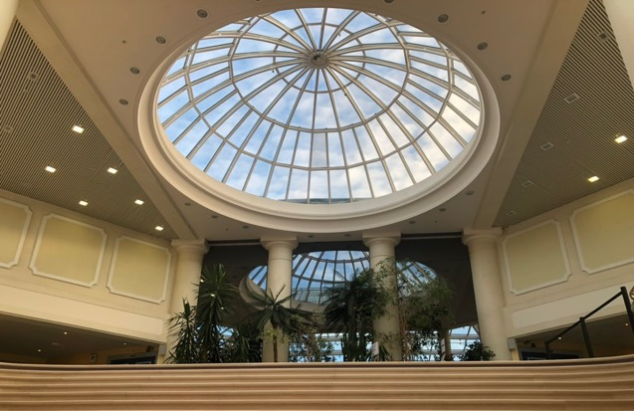
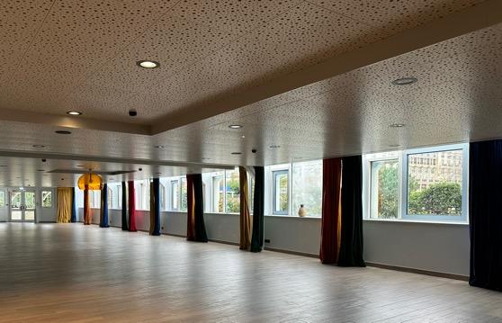
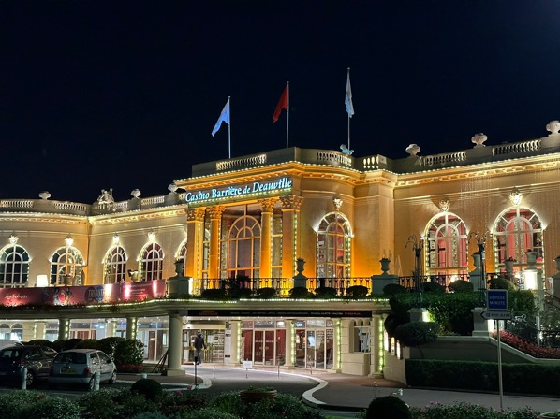
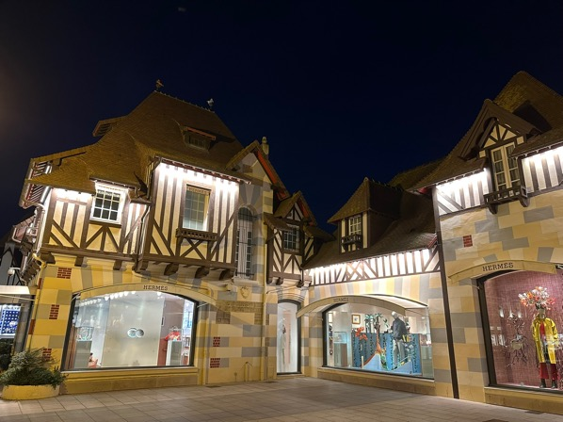
VENUE for JTM24 / IPAC’26
Wonderful Venue for the IPAC'26 Conference, Exhibition, and Editorial Office – Participants Will Have Lots of Fun!

Slide 3
Tuesday Afternoon
” All You Need to Know About JACoW"
Welcome from GANIL
Objectives of JACoW Annual Team Meetings.
WHAT IS JACOW? HISTORY, PRESENT, AND FUTURE OF THE COLLABORATION.
General overview of producing JACoW proceedings.
Activity Report of the Regional Support Centres.
Pre-TM Summary Report

Slide 4
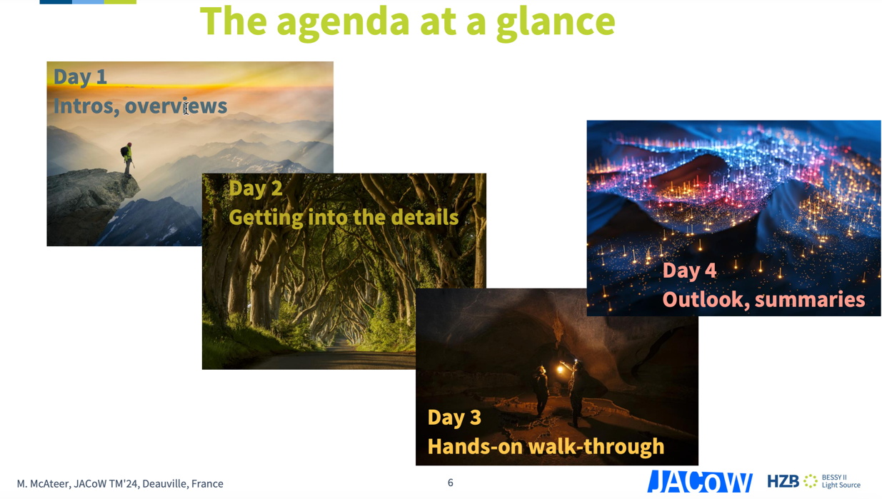
Objectives of JACoW Annual Team Meetings
1. Meeting of subject-matter experts for development work .
2. Knowledge transfer which enables newcomers to produce proceedings.

Slide 5
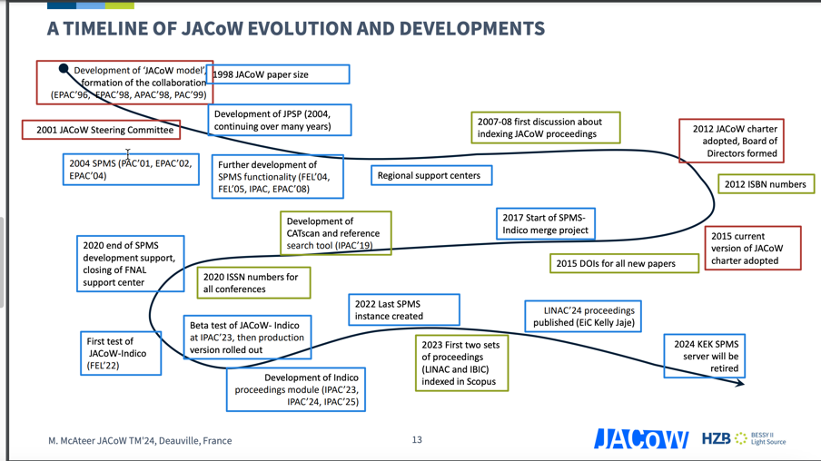
WHAT IS JACOW? HISTORY, PRESENT, AND FUTURE OF THE COLLABORATION
Value of JACoW is widely recognized and accepted within accelerator physics community
Transition to Indico is a major milestone
Continuing efforts to strengthen and expand collaboration base
Continuing developments to make processes more efficient and cost-effective

Slide 6
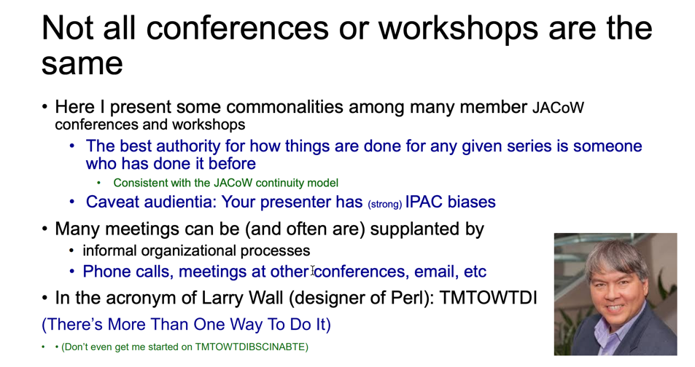
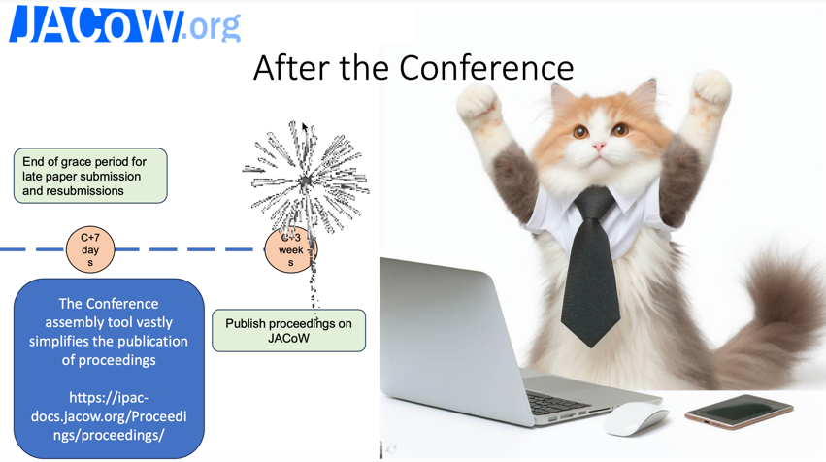
General overview of producing JACoW proceedings
Indico SPMS Merger

Slide 7
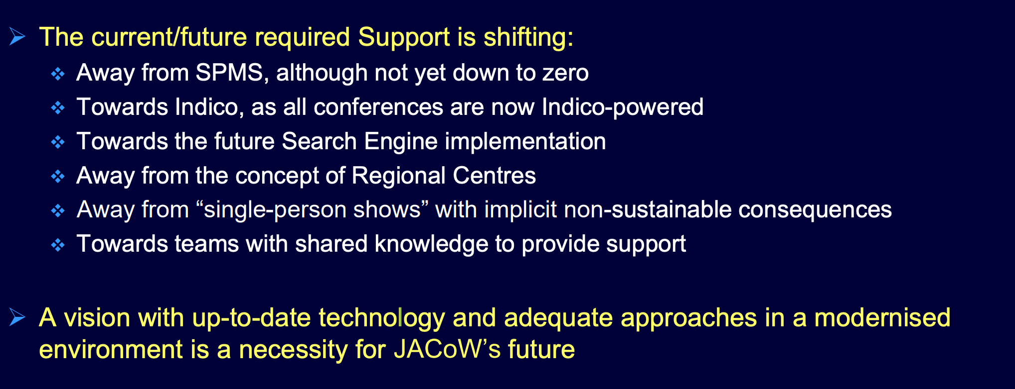
Activity Report of the Regional Support Centres.

Slide 8
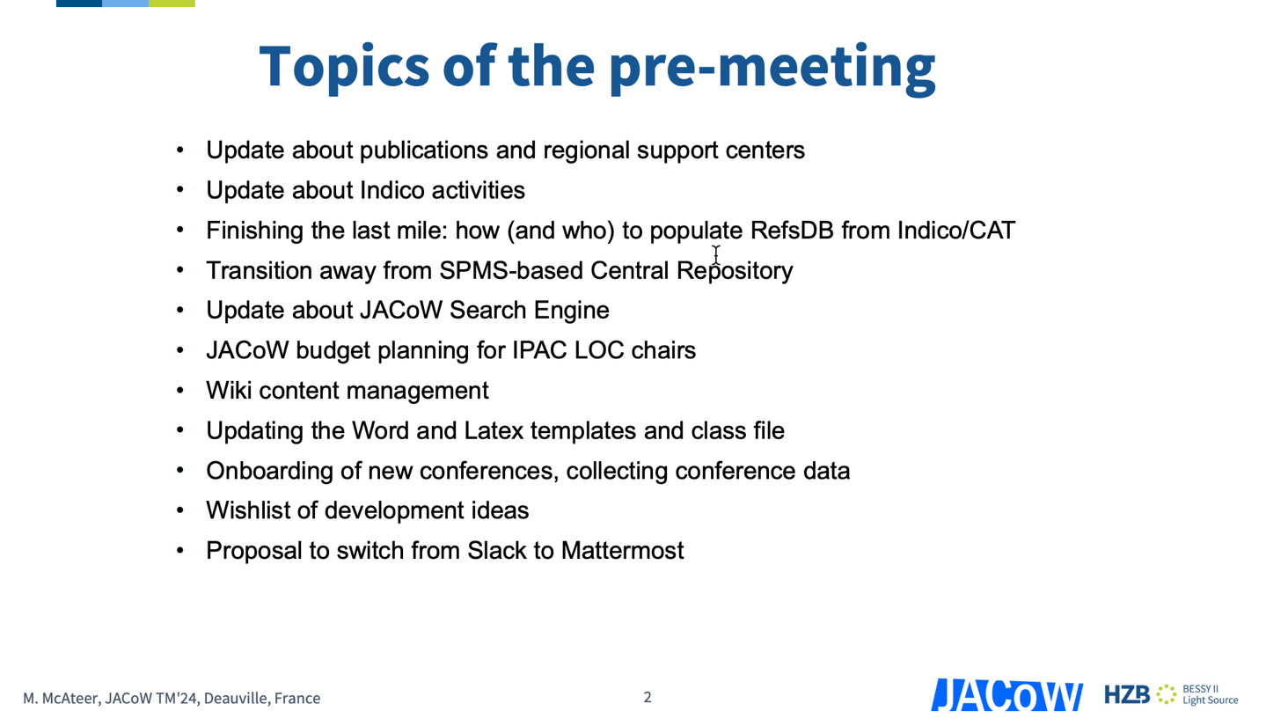
Pre-TM Summary Report

Slide 9
Wednesday Morning
"Conference-Related Topics and Tools: Experiences Shared to organize a Conference"
JACoW-Indico Scientific Program Management
Proceedings Office Workflow
CatScan tool and JACoW reference search tool
IT management for a conference: software requirements, setup, and installation specifications

Slide 10
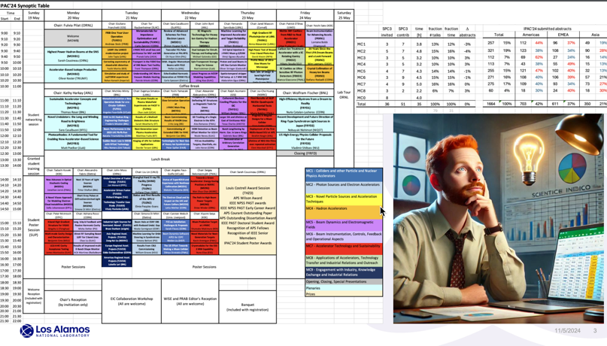
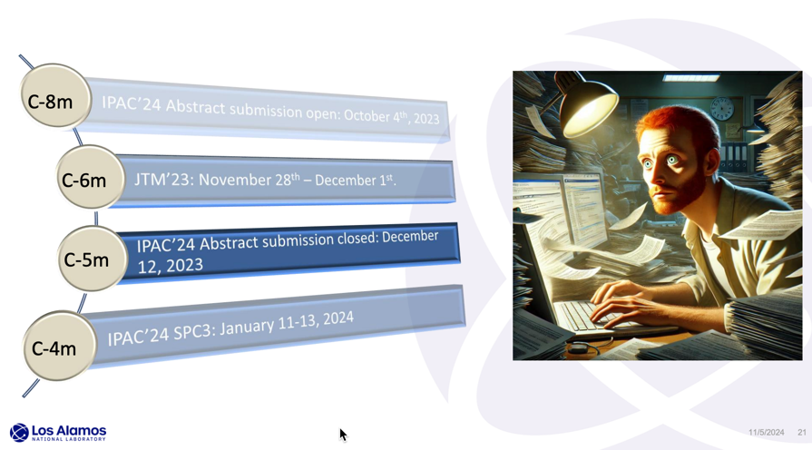

JACoW-Indico Scientific Program Management
The Scientific Secretariate task through JACoW-Indico, managing speaker nominations, abstract submissions, and session scheduling. Key insights included using Indico to track communication and streamline speaker selection for balanced representation across topics, geography, and gender. The presentation underscored the importance of timeline adherence, with Peter sharing practical tips and tools—such as Excel synoptic tables and Mail Merge—for organizing complex tasks efficiently, setting a solid foundation for planning IPAC25.

Slide 11
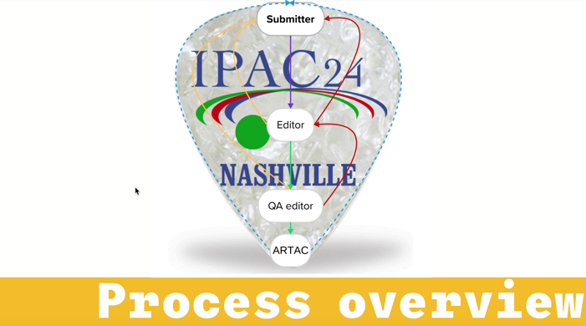
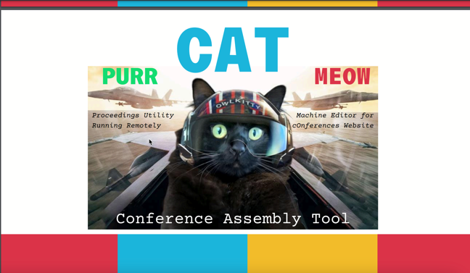
Proceedings Office Workflow
A story of sweat and blood
A new workflow in the Proceedings Office designed to speed up the editing process at IPAC’24. Editors received training two weeks before the conference, helping them quickly handle essential editing and metadata tasks without excessive back-and-forth. The workflow also focused on continuous QA, with real-time feedback loops that reduced the need for revisions later.
Tools like CAT (Conference Assembly Tool) and MEOW (Proceedings Utility Running Remotely) automated repetitive tasks, allowing editors to focus more on quality and content, leading to faster completion times and reduced backlog. This approach not only speed up the overall editing process but also enhanced accountability, as editors were encouraged to take greater responsibility for their work.

Slide 12

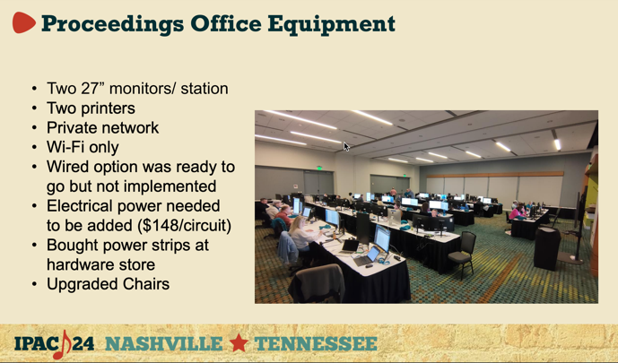
IT management for a conference: software requirements, setup, and installation specifications
An overview of the technical setup and logistics at IPAC24.
Key topics covered include the setup of editorial, author, and speaker rooms, with extensive use of desktops, laptops, and iPads. The network infrastructure supported both Wi-Fi and private LAN, while various software tools, including Adobe Acrobat, Microsoft Office, and JACoW-specific configurations, were deployed across devices for managing conference proceedings.
Equipment considerations also addressed challenges with rentals, setup, and data security, highlighting the role of vendor partnerships. Issues encountered involved delays, mismatched deliveries, and logistical constraints. The report emphasizes the importance of thorough planning, effective vendor communication, and post-conference cleanup to ensure smooth conference operations.

Slide 13
Wednesday Afternoon
"Editor-Related Topics and Tools: Enhancing Editorial Skills"
Editing with Word
Intro to editing with LaTeX
Advanced editing with LaTeX
How to edit transparencies - a saga coloured by GIFs and movies (V)
Editing PDFs with Acrobat and Pitstop
Developments in reference formatting with LaTeX
Running a successful Speaker Ready room
Generating proceedings with Indico
Perspectives from a newer collaboration member

Slide 14
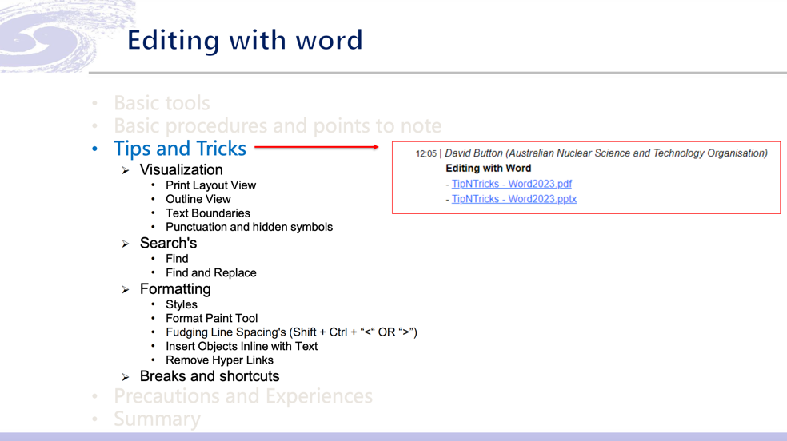
Editing with Word
Using Microsoft Word for editing academic papers in line with JACoW standards. It covers essential tools, procedures, and best practices for formatting, reference management, and layout control. Key sections include using JACoW templates, applying proper citation styles, and leveraging tools like CatScan and the Reference Search Tool.
It emphasizes precision in formatting and offers practical tips to improve document quality, such as shortcuts for formatting adjustments and ensuring consistency in style and structure. The guide is tailored for editors aiming to maintain high standards across JACoW publications.

Slide 15
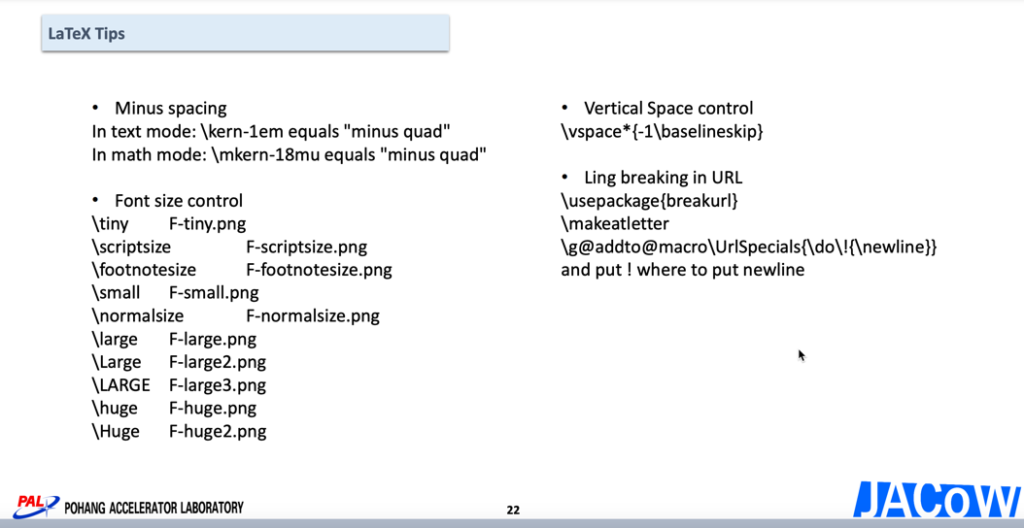
Intro to editing with LaTeX
An introduction to LaTeX editing specifically for JACoW publications, outlining tools, setup, and procedures tailored to conference requirements. It covers the initial setup, including software like MiKTeX and TeXstudio. Emphasizes adherence to the JACoW LaTeX template. Lee details the editing workflow, from paper assignment and assessing edit complexity to specific formatting checks for citations, tables, and figures. Practical LaTeX tips are included, addressing common errors, compiling challenges, and style consistency, with advice on handling citation, unit formatting, and error correction. This guide is intended for editors aiming to maintain high-quality and consistent formatting standards in scientific papers

Slide 16
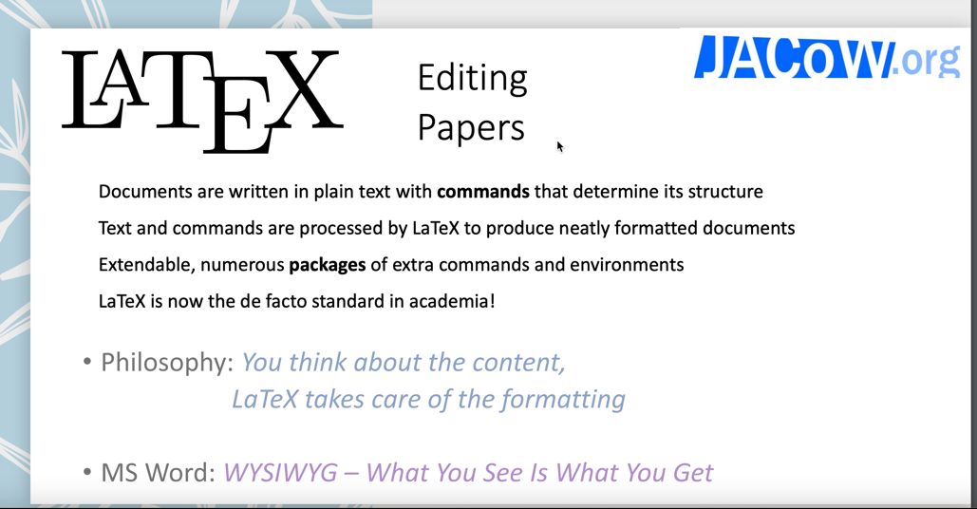
Advanced editing with LaTeX
LaTeX’s growing usage in academic writing, with adoption reaching 67% in recent conferences. the essential jacow.cls class file for JACoW-specific foKey topics include recommended LaTeX distributions, especially MiKTeX for its ease of use, and rmatting. LaTeX editors like TeXstudio are recommended for their user-friendly features, and packages such as siunitx for units and bm for bold math symbols ensure consistent formatting. Guidelines also cover table setup, bibliography management, and standardized author and institution listings, making it a comprehensive resource for document preparation.

Slide 17
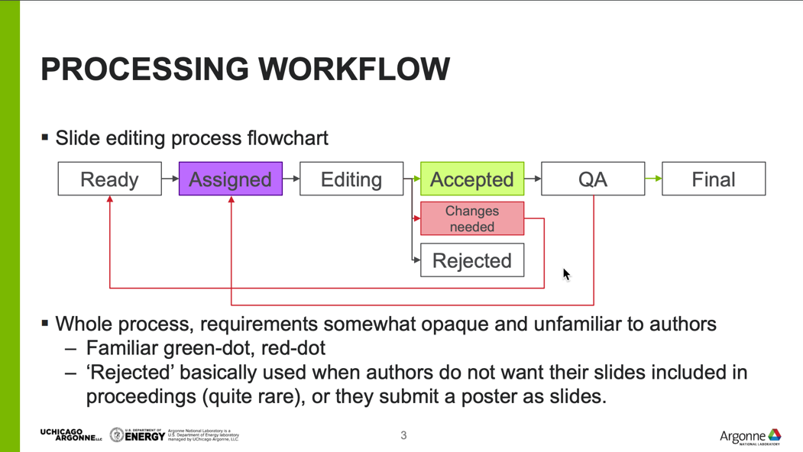
How to edit transparencies - a saga coloured by GIFs and movies
Kent outlines the editing workflow for transparencies at LINAC2024, detailing the process from file preparation to final publication. The workflow includes organizing and editing slides for proceedings, involving tasks such as embedding fonts, managing misplaced content, and ensuring the removal of any backup slides. The document emphasizes quality assurance checks to confirm compliance with formatting standards. A notable part of the process is the technical inclusion of videos and animations, though the utility of these features in the final proceedings is questioned. Overall, the editing process for LINAC2024 is structured but requires attention to detail, particularly in maintaining consistency and clarity in slide presentation

Slide 18
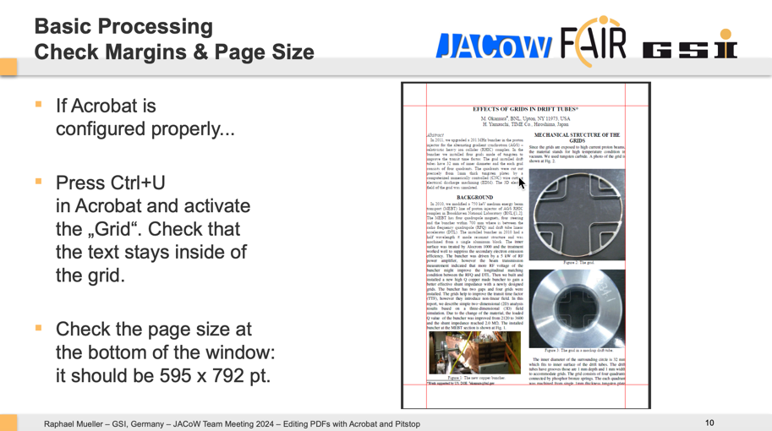
Editing PDFs with Acrobat and Pitstop
Comprehensive guide to editing PDFs using Adobe Acrobat and PitStop. The process is divided into three main stages: Pre-Processing, Processing/Verification, and Post-Processing, with an additional focus on Quality Assurance (QA).
Pre-Processing involves retrieving documents and converting them into PDF if necessary. Processing includes verifying fonts, checking page setup, margins, and embedding fonts if they are missing. Editors also apply the JACoW Crop Box and ensure consistency in formatting and references.
In Post-Processing, editors mark the document status with a color-coded system (green, yellow, or red), indicating readiness or required author revisions.The Quality Assurance stage entails a final review to catch any formatting or technical errors, ensuring compliance with conference standards. Additional tips cover efficient PDF adjustments using PitStop, such as adjusting fonts, margins, and removing unintended elements. The document is a structured guide aimed at ensuring high standards and consistency in conference proceedings.

Slide 19
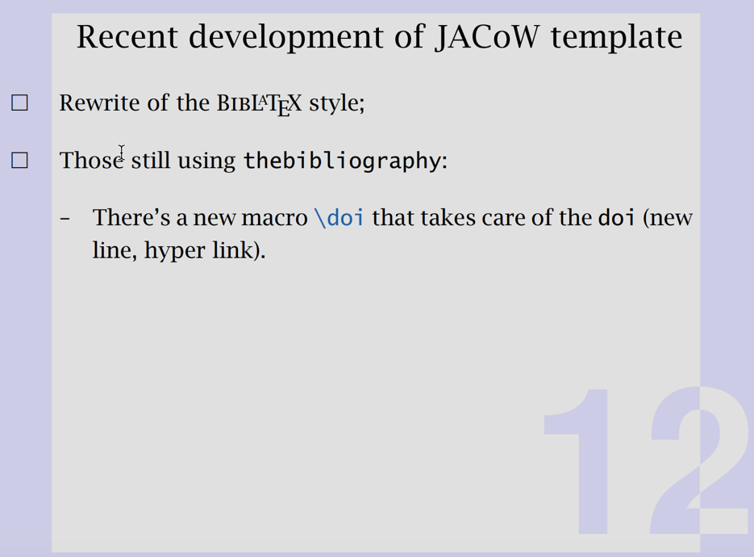
Developments in reference formatting with LaTeX
Ross’s presentation focuses on advancements in reference formatting using LaTeX, specifically addressing challenges and solutions within BibTeX and BibLaTeX. The transition from manual formatting to automated processes with BibLaTeX is highlighted, offering benefits such as Unicode support, remote database access through Biber, and enhanced customization for the JACoW style. Key topics include the structure of BibTeX entries, guidelines for optimal citation formatting, and examples of typical entries (journal articles, proceedings, unpublished work). Future work suggests an online JACoW database to streamline citation management across events. This guide aims to improve efficiency and consistency in scholarly references.

Slide 20
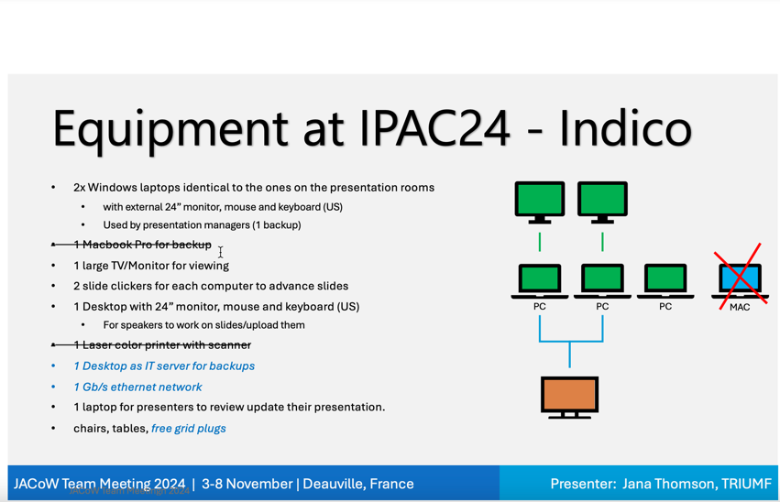
Running a successful Speaker Ready room
Jana’s talk outlines the setup and operations of the Speaker Ready Room. The Speaker Ready Room is integral for ensuring presentations are prepared and tested for quality and functionality before being presented. For IPAC24, the process includes uploading presentations to the Indico platform, where presentation managers verify slide functionality and animations and address any last-minute changes requested by speakers.
Equipment includes Windows and Mac laptops, monitors, and network access to support these tasks. Additionally, editors confirm whether authors wish their slides to be published in proceedings. This structured process has evolved slightly over the years, transitioning from the SPMS to Indico platform, but remains focused on maintaining high presentation standards and smooth conference operations.

Slide 21

Generating proceedings with Indico
Ivan presented on generating conference proceedings using Indico, detailing essential responsibilities and considerations for a chief editor. He emphasized the critical tasks that an editor-in-chief must manage during a conference, including overseeing the editorial process and ensuring quality and consistency across submissions. Ivan also discussed the tools and technologies involved, like the JICT and CAT tools, which support efficient and accurate content preparation. His insights provided valuable guidance on maintaining high standards in conference proceedings and navigating common challenges in editorial workflows.

Slide 22
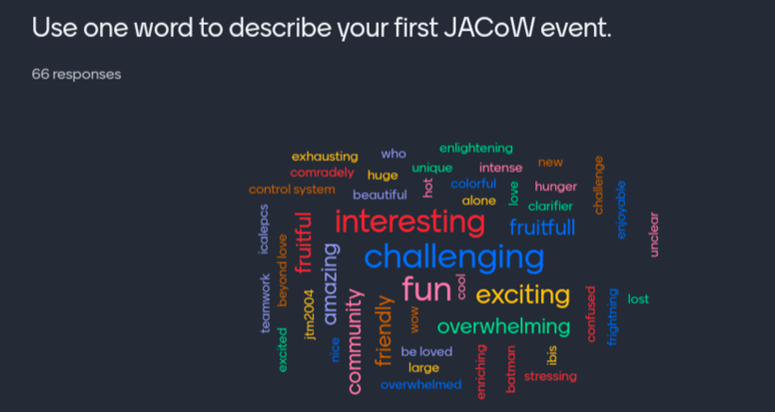
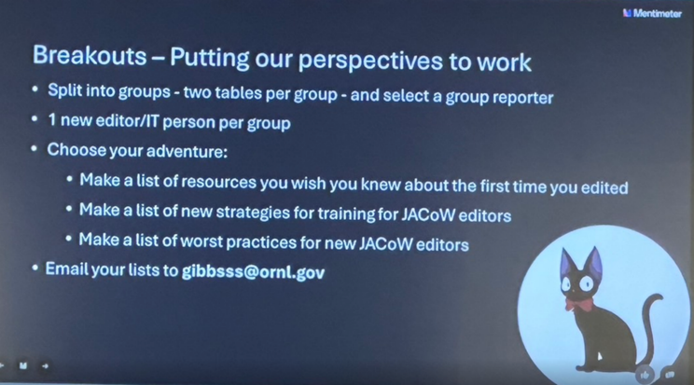
Perspectives from a newer collaboration member
Sumner presented on "Perspectives from a New Editor," addressing the experiences and challenges that new editors encounter within JACoW collaboration. She highlighted how new editors bring fresh perspectives to the editorial process, often raising essential questions that can improve clarity and efficiency in managing conference proceedings. However, she noted that the need to train new editors can sometimes slow down seasoned editors, particularly in a volunteer-driven organization like JACoW. This turnover and the continuous need for onboarding create an ongoing demand for structured training. Gibbs advocated for crowd-sourced recommendations and emphasized the value of integrating new editor insights to enhance the conference workflow for sustained improvement.

Slide 23
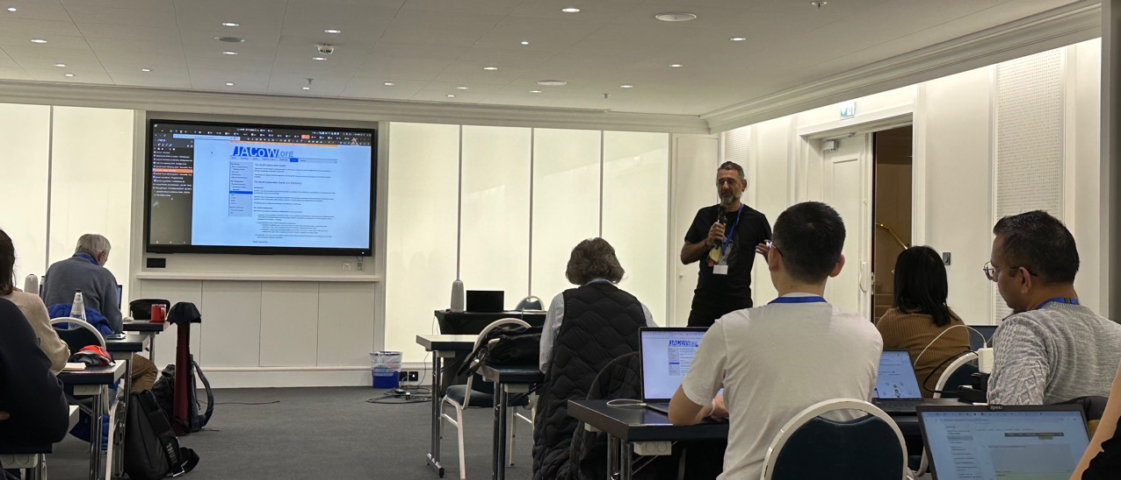
Thursday
Ivan led training sessions covering essential areas for conference preparation, including an Indico tutorial, abstract submission, paper upload, and paper editing.
These courses provided participants with hands-on experience in managing key aspects of conference proceedings, enhancing their understanding of the workflow and their ability to support various stages of the editorial process. This training was especially valuable in ensuring that team members could efficiently handle tasks in Indico, from initial submissions to final paper edits, thereby streamlining the overall process.

Slide 24
Thursday Afternoon
Experience with producing proceedings using Indico at LINAC'24
Trends in paper submission: Types, problems, quality control advice
Kent Wootton shared insights from LINAC2024, a pioneer non-IPAC conference using Indico. They noted that Indico training gaps affected the editorial workflow and that some authors needed extra guidance. Challenges included limitations with using a generic JACoW email, initial PDF upload restrictions, and setup issues with the JACoW-Indico Conference Tool (JICT). For proceedings, documentation gaps on DOIs and PDF formatting required additional support, but with the JACoW team’s help, the final proceedings were successfully published. Their experience highlighted the importance of comprehensive training and configuration support for new Indico users in JACoW conferences.
Volker reviewed 20 years of trends in paper submissions, noting improvements in font and graphics accuracy but ongoing challenges with reference formatting and unit consistency. Virtual conference data showed a rise in common errors due to remote workflows. File type preferences have also shifted across conferences like IPAC and LINAC, reflecting evolving technology and the need for updated error tracking.

Slide 25
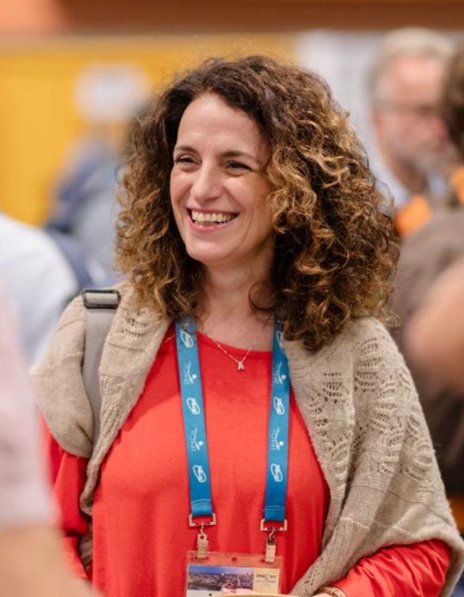
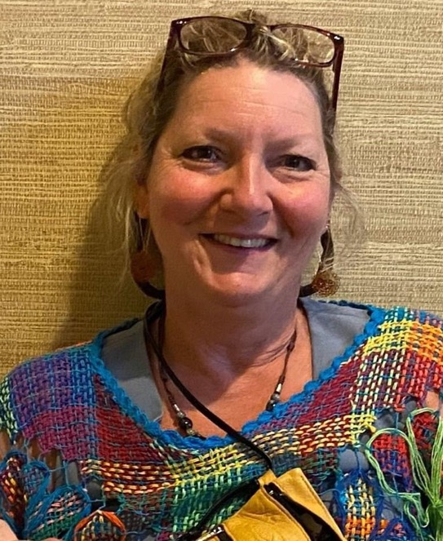
NEW Chair and Coordinator for JACOW team
Chair : Adriana Rossi , CERN
Coordinator : Jana Thomson, TRIUMF

Slide 26
Friday Morning
” Tools and Helps to organize the conference …. Future aspects"
Indico support: who to ask for help, when and how you could help yourself
Indico activities and future directions
JACoW-Indico conference tools and information screens

Slide 27
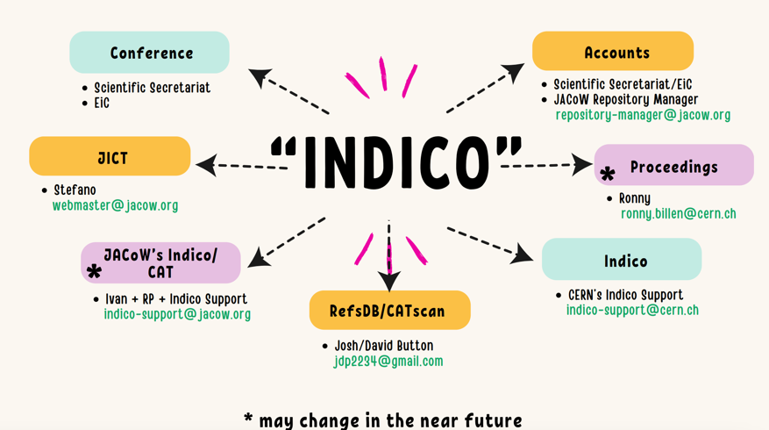
Indico support: who to ask for help, when and how you could help yourself
Ivan Andrian introduced JACoW’s documentation and support resources. Key self-help tools include IT and documentation sites (jacow.org) that cover topics from conference setup to author instructions and technical settings. JACoW also offers a Mattermost chat for team collaboration and access to resources like the conference manual and scientific program templates.
For direct support, contacts include Indico support (indico-support@jacow.org), repository management, and CERN’s Indico team. Additional working groups focus on website documentation and template management. These resources aim to streamline conference preparation and support team collaboration.

Slide 28
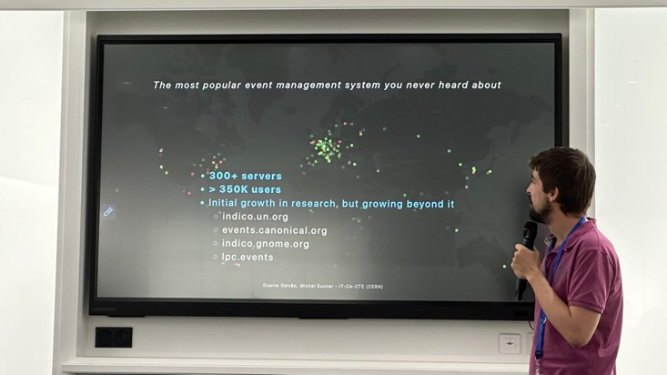
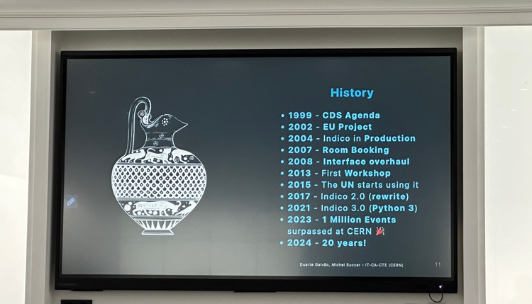
Indico activities and future directions
Duarte provided an overview of the history of the JACoW Indico system and discussed its future directions. He highlighted how the platform has evolved to support conference workflows, from abstract submission to proceedings management, and outlined upcoming improvements aimed at enhancing usability and efficiency for both organizers and participants. His insights emphasized JACoW’s commitment to adapting the Indico system to meet the growing needs of the scientific community.

Slide 29
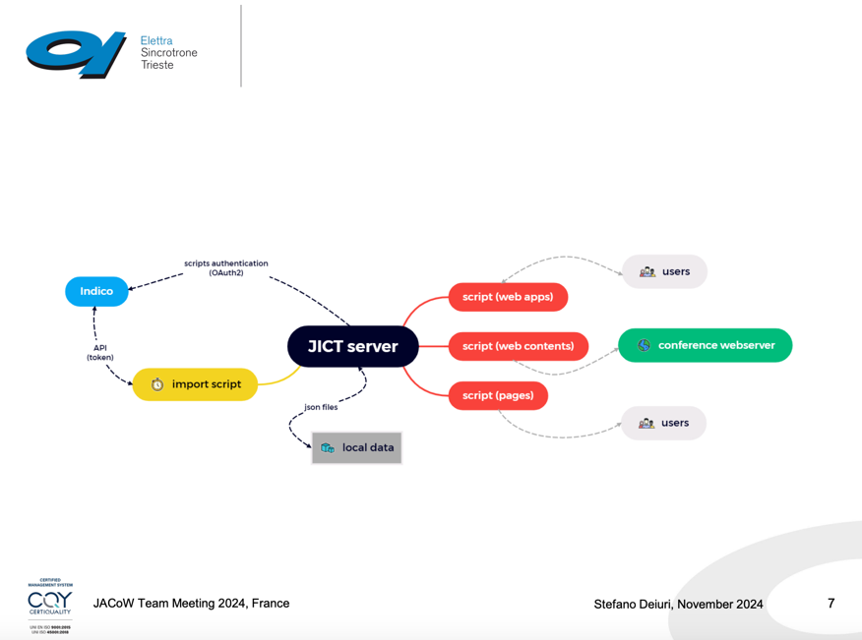
JACoW-Indico conference tools and information screens
Stefano introduced the JACoW-Indico Conference Tools (JICT), a set of scripts that extend Indico’s capabilities for conference organization. JICT offers tools for tracking registration, managing paper and slide statuses, and generating conference statistics. Key features include apps for paper and poster management, a speaker-ready slides tool, and dashboards for monitoring editorial progress. Some conferences use JICT as a hosted service on jacow.org, which eases setup but limits customization. This suite supports efficient conference management by filling gaps in Indico’s native offerings.

Slide 30
Summary
The editors and experts benefit from the annual team meeting, where we see new developments in workflow and tools each year.
The meeting provides a platform to exchange information, experiences, and skills, allowing people to connect in person. This is extremely helpful for new conference organizers and chief editors.
An intensive one-day training session is highly beneficial for the upcoming conference. It is strongly recommended for future conference organizers / editors to attend this meeting.

Slide 31
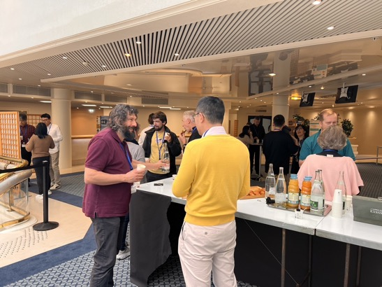
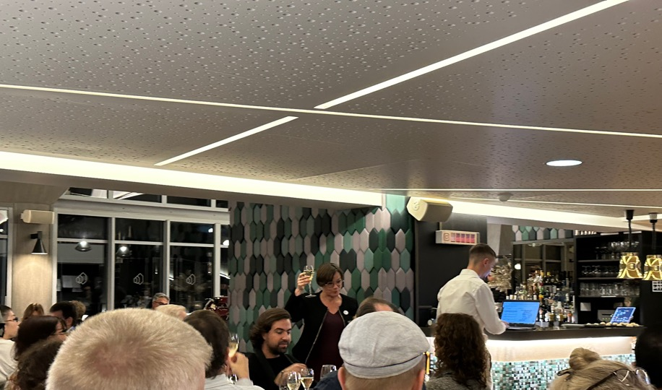
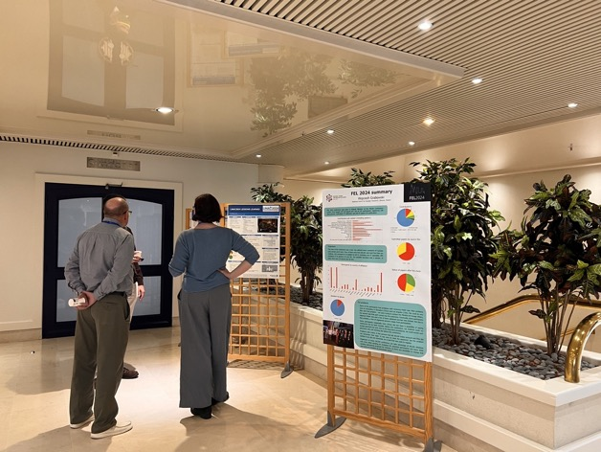
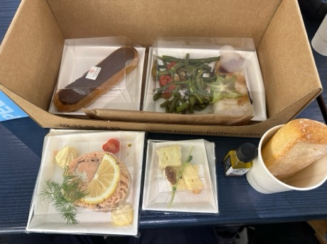
Thank you very much to the JTM24 Organizing Team

Slide 32
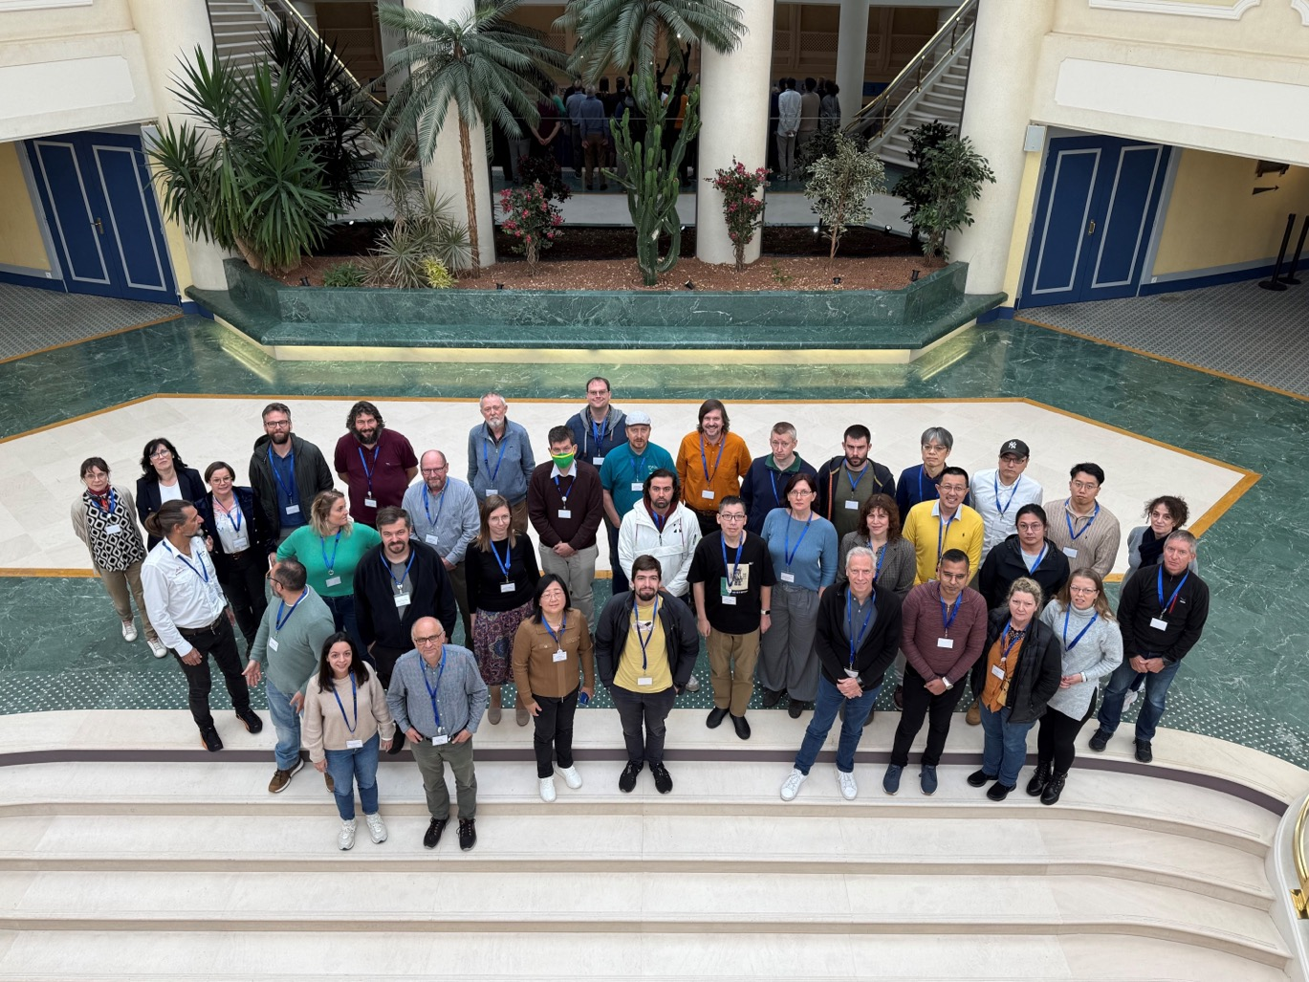
See you in IPAC’25 , Taipei , Taiwan
JTM25 , Michigan, USA

