Slide 1

Closing session
Meghan McAteer, HZB
2024 JACoW Annual Team Meeting, Deauville, France

Slide 2
  Many people to thank…
Local organizers and GANIL
Candidates for BoD
Presenters (new and old)
All of you

Slide 3
  Recent Developments and Milestones
Transition from SPMS to Indico
Cat Scan
Indexing of proceedings in Scopus (LINAC, IBIC)
Reference Search Tool
JICT as a service on jacow.org
IPAC-Docs documentation for technical processes
“One-Click”
proceedings generation
Training videos for editors

Slide 4
  Coming Soon…
Overhaul and updating of wiki
Major reworking of templates
Automation of manual maintenance tasks
New communication channels with JACoW users
Central repository functionality in Indico
Better onboarding info between JACoW and LOCs
Automatic CatScan checks when submitting papers
Improved search engine for proceedings
Fine-tuning of editor workflow interface in Indico
Further developments to Conference Assembly Tool

Slide 5
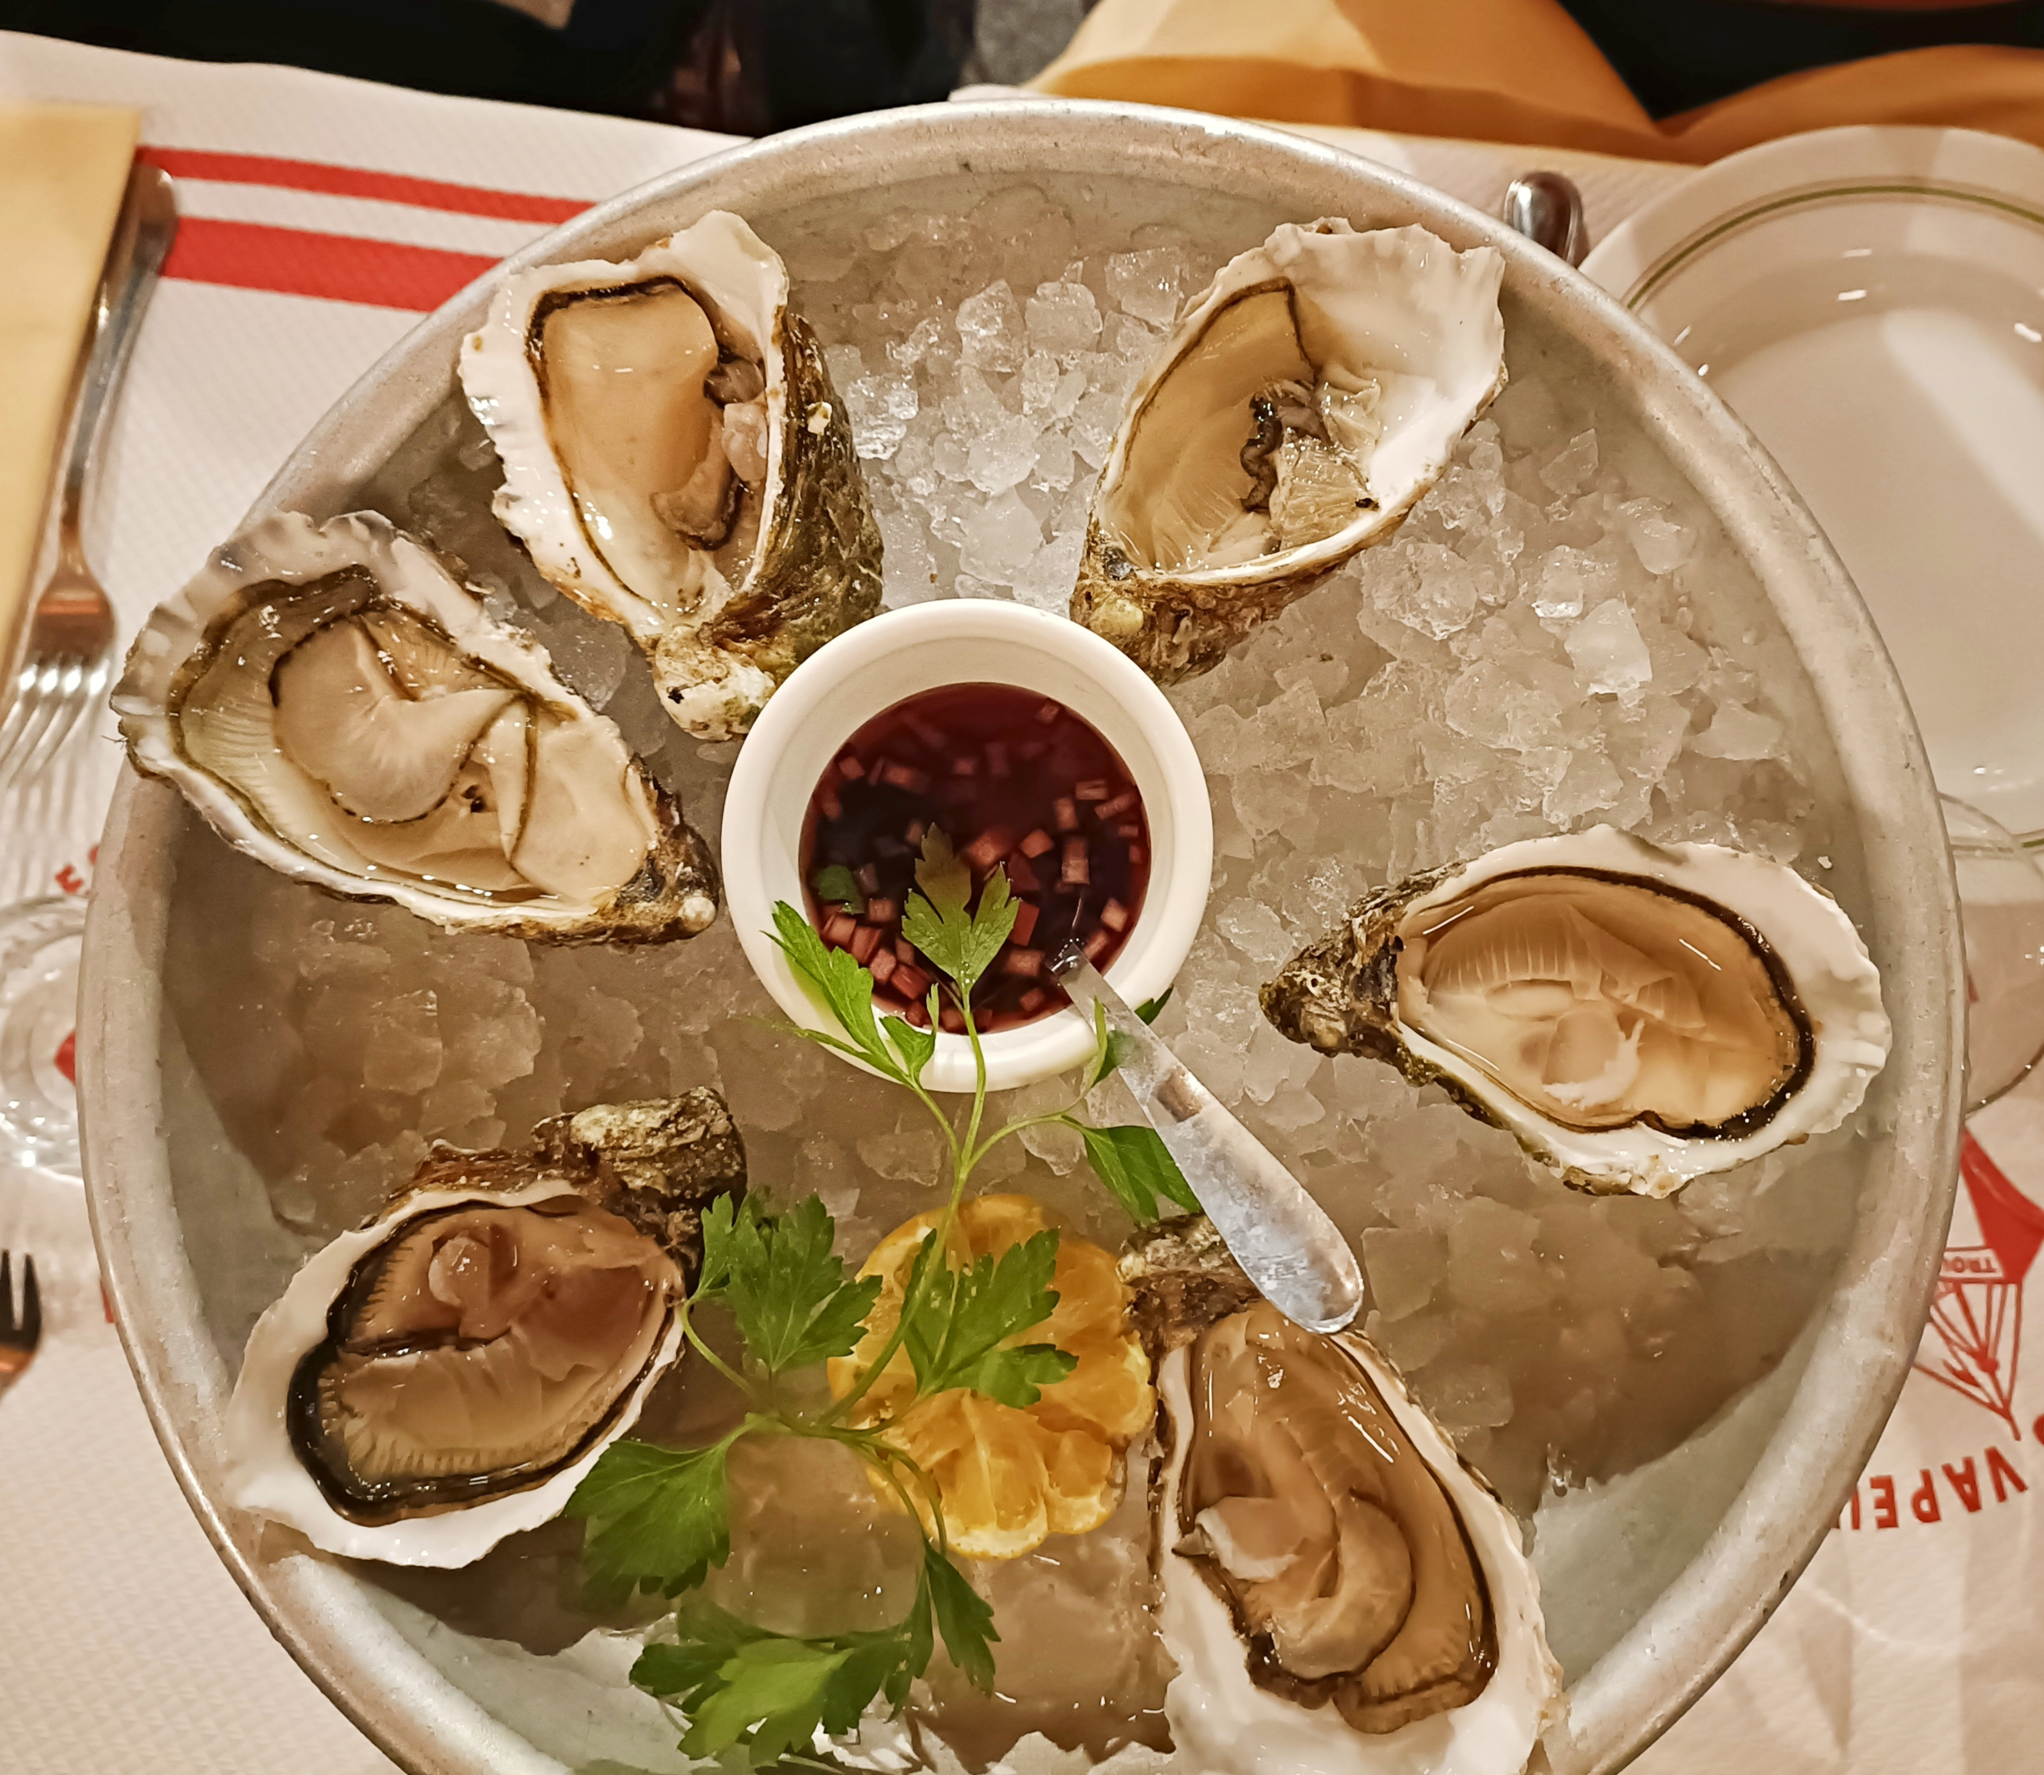
  So long,
  and thanks for all
  the fish!

