Slide 1
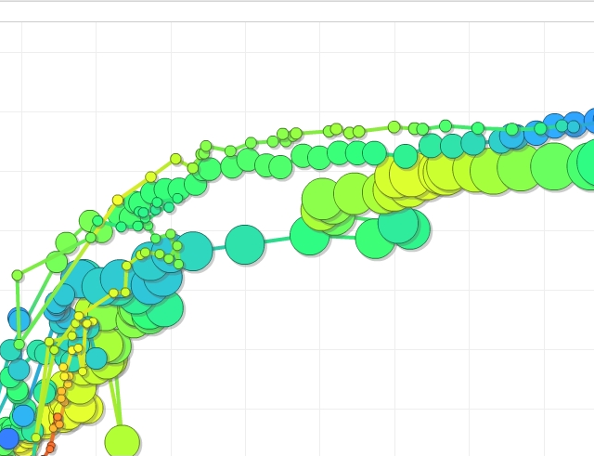
Trends in Paper Submission: Types, Problems, Quality Control
Volker RW Schaa
GSI — Darmstadt, Germany
Team Meeting 2024
Deauville, France

Slide 2
Overview
Over the years within JACoW each conference and their authors saw a shift in preferred platforms, file types, and accuracy of submissions.
This talk will investigate and make comment on these evolving trends in
accuracy of submissions, and
changes in file type for conferences.

Slide 3
Overview
What kind of changes took place will be shown based on data of the last 20 years [2004—2024] (where available) for
accuracy of submissions, and
changes in file type for conference series.
• Data shown for 2020 and 2021 are all from virtual conferences
with editors around the world without the luxury of having
recently attended a Team Meeting or one of the bigger
conferences as trainees. Therefore a tendency to more
‘common’ error descriptions (and codes) can be observed.
Nevertheless problem areas are still identifiable.
• Data for 2024 are from Indico and are hard to interpret as the
summing up is different (e.g. TC06 with 120 %).

Slide 4
Changes
Changes in
accuracy of submissions
⮴ Better and Worse ⮷

Slide 5
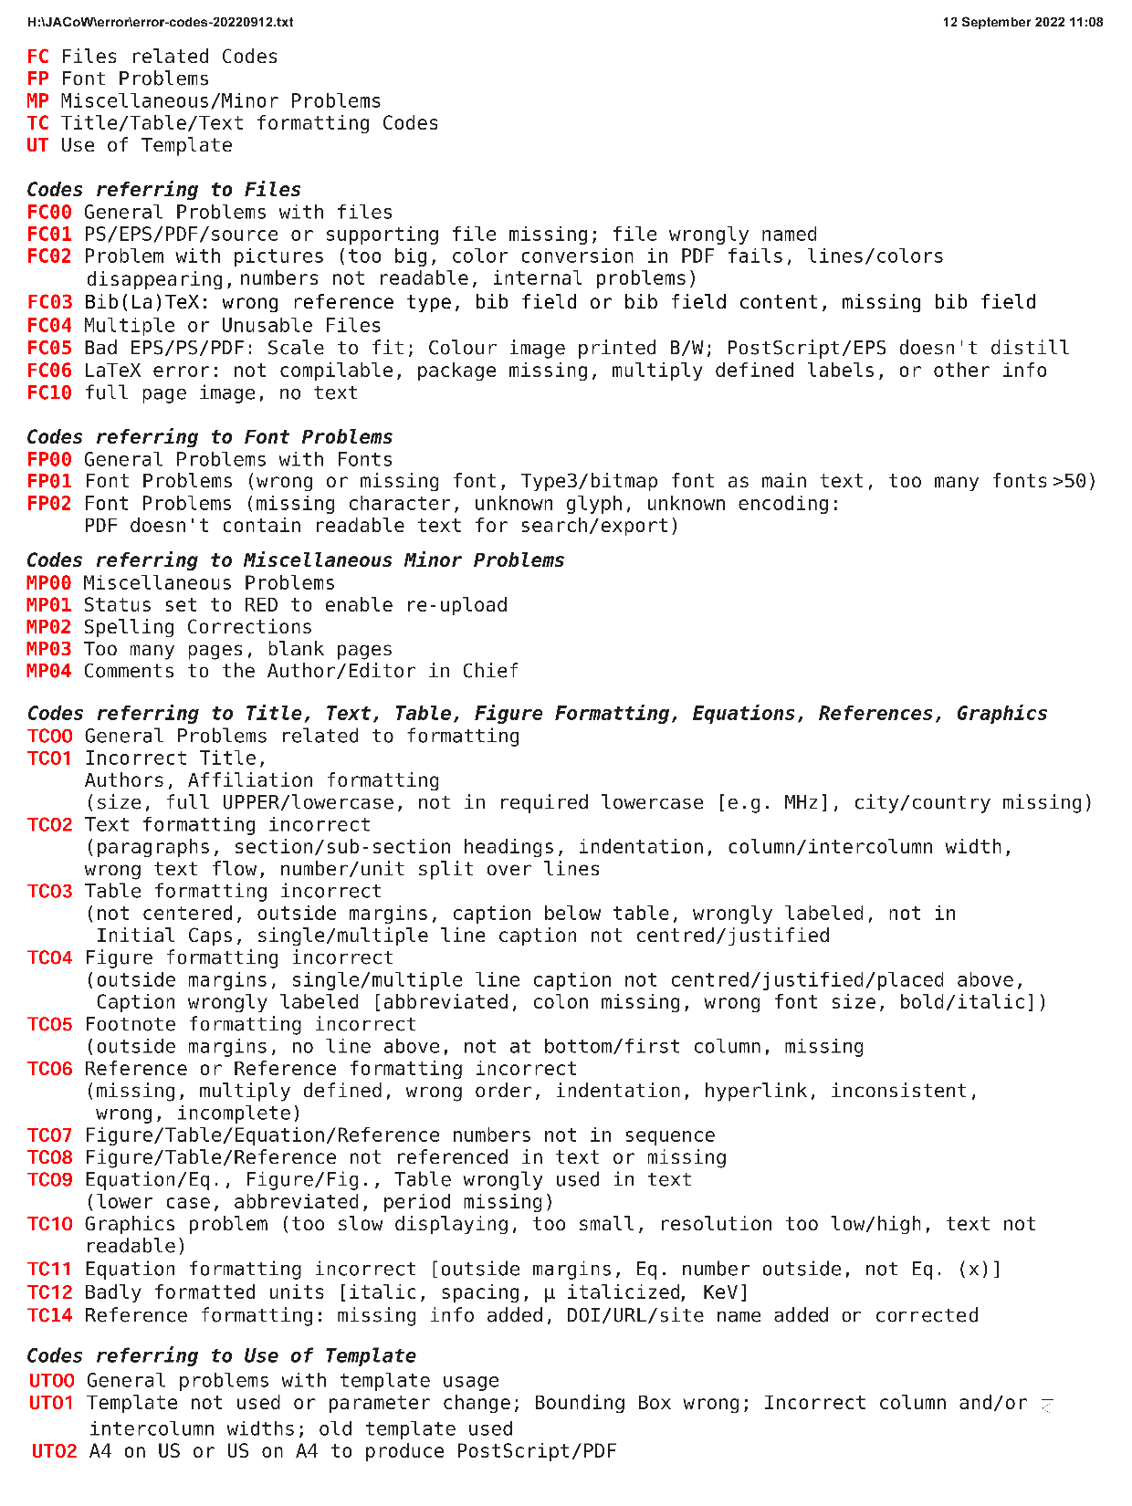
Accuracy of submissions
JACoW maintains a list of Error Codes which is updated when the need arises and were used in SPMS and now also in Indico.
On the left the latest version from 2022-09-12
(new code FC03 introduced for BibLaTeX/BibTeX/Biber)

Slide 6
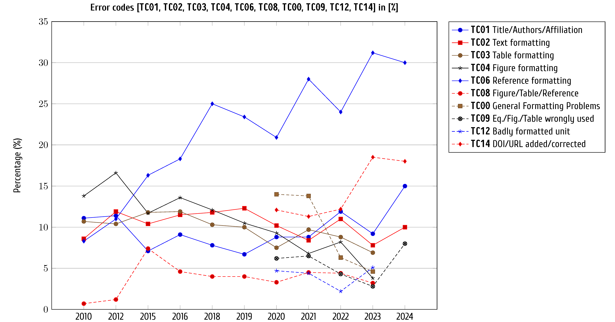
Accuracy of submissions

Slide 7
Accuracy of submissions
Better: some errors which had often been seen between 2004—2014 are nearly gone or below 2%, e.g. Font problems [FPxx], Graphics problems [TC10, FC02], Bad PDF/PS/EPS, Tearing Boxes [FC04, FC05, FC10]
As we are now checking References in more detail, these errors are
mentioned most often: Reference formatting [TC06], DOI problem [TC14]
Code TC12 (Badly formatted units) shows up more often as e.g. spacing or
linebreak between value and unit is checked.
Then there are a number of problems found depending on source format:
  Word & ODF: Wrong text flow after double wide figures and tables
  LaTeX: Use of BibTeX without fitting style information (IEEEtran style does
  not agree with JACoW style requirements ⇒ BibLaTeX & Biber)
  LuaLaTeX: missing BoldMath symbols due to wrong font & encoding selection
  ⇒ log checking necessary (texlogsieve, etc.)

Slide 8
Accuracy of submissions (cont.)
And still the good old formattings errors
  Uppercase units in Title and Section headings
  Acronyms missing their CamelCase
  Figure and Table formatting, caption formatting
  Figures, Tables, References not in sequence or not references in text
The presumed decline of errors in Text, Table, and Figure formatting
is just the compensation of the shift in more
The presumed decline of errors in Text, Table, and Figure formatting
is only due to the strong shift to Reference and DOI type errors.
Only the errors up to a running total of ~75 % are taken
into account for each conference
for Indico all errors above 50% were summed up and each divided
by the total.

Slide 9
Changes
Changes (labelling in the graphs)
file types for conferences
Colors used to signify changes
   increasing
   stable/small variations
   decline/decreasing
  202x (x) remote conference due to COVID
  2022 (x) not published/publishable
  #15: Δ±343(27%) 251<1278<1536
  # number of conferences
  Δ deviation from mean number of pages
  % deviation percentage
  ÷ lowest number of papers (declining)
  < average number of papers (stable)
  < maximum number of papers

Slide 10
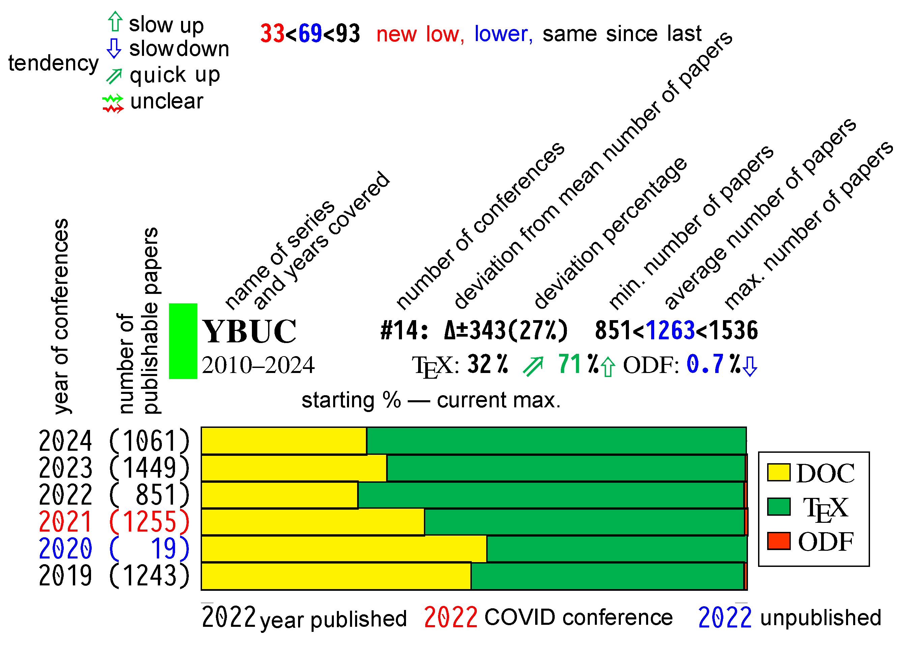
Changes
Changes (labelling in the graphs)

Slide 11
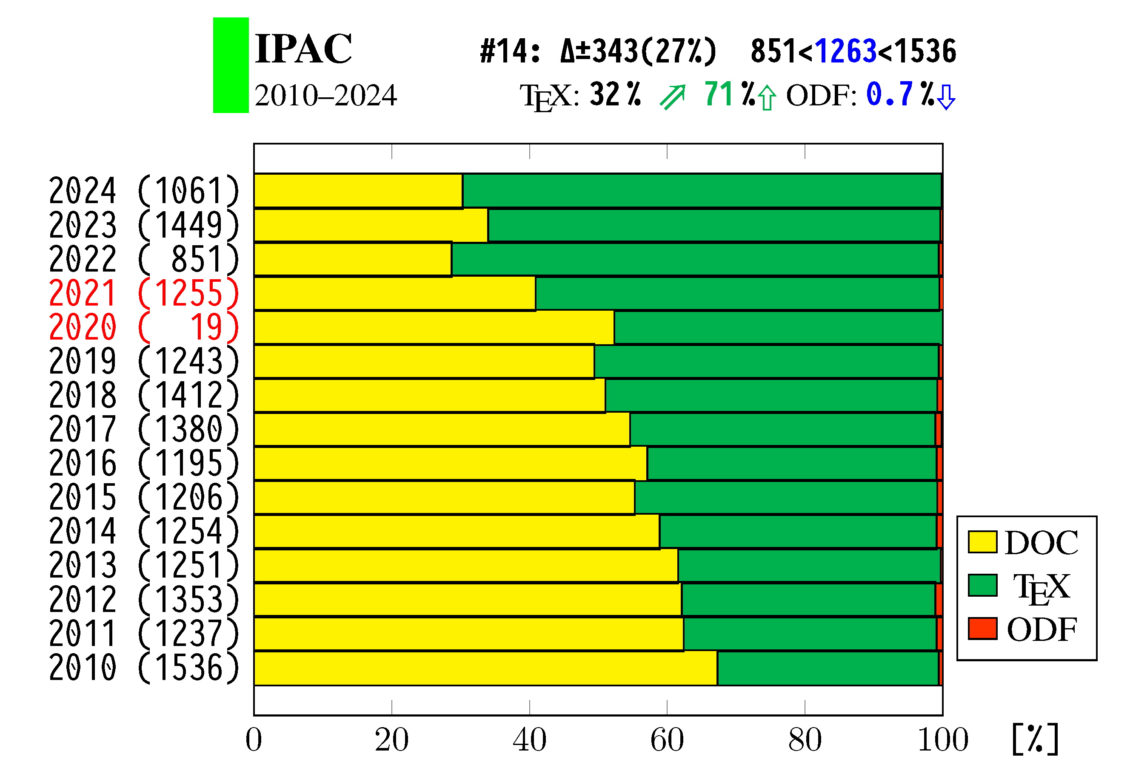
Changes in file type in IPAC

Slide 12
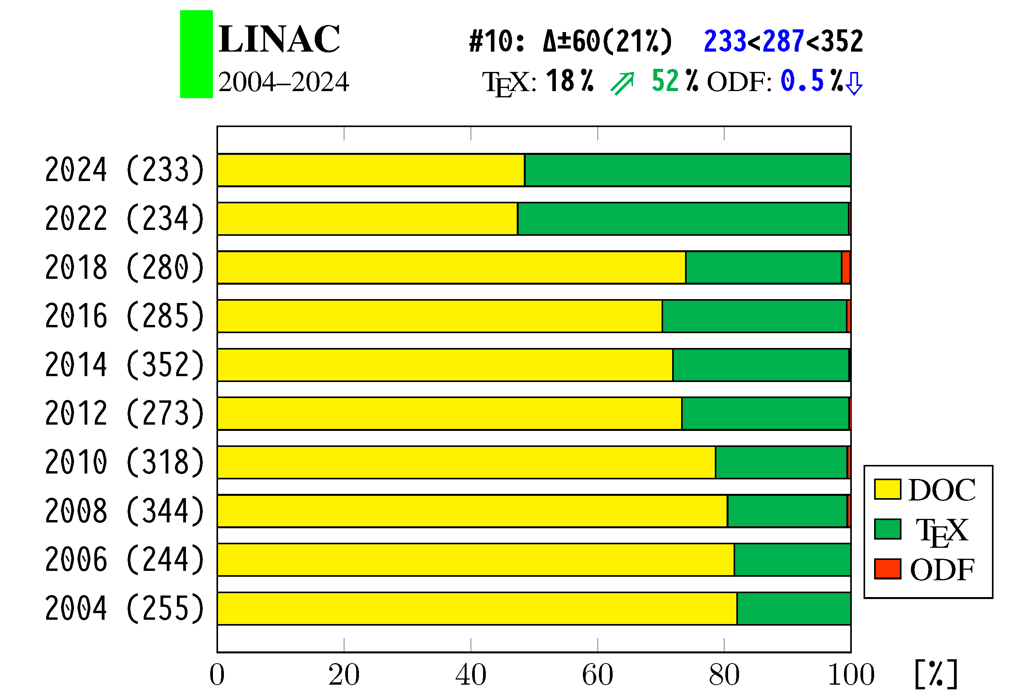
Changes in file type for LINAC

Slide 13
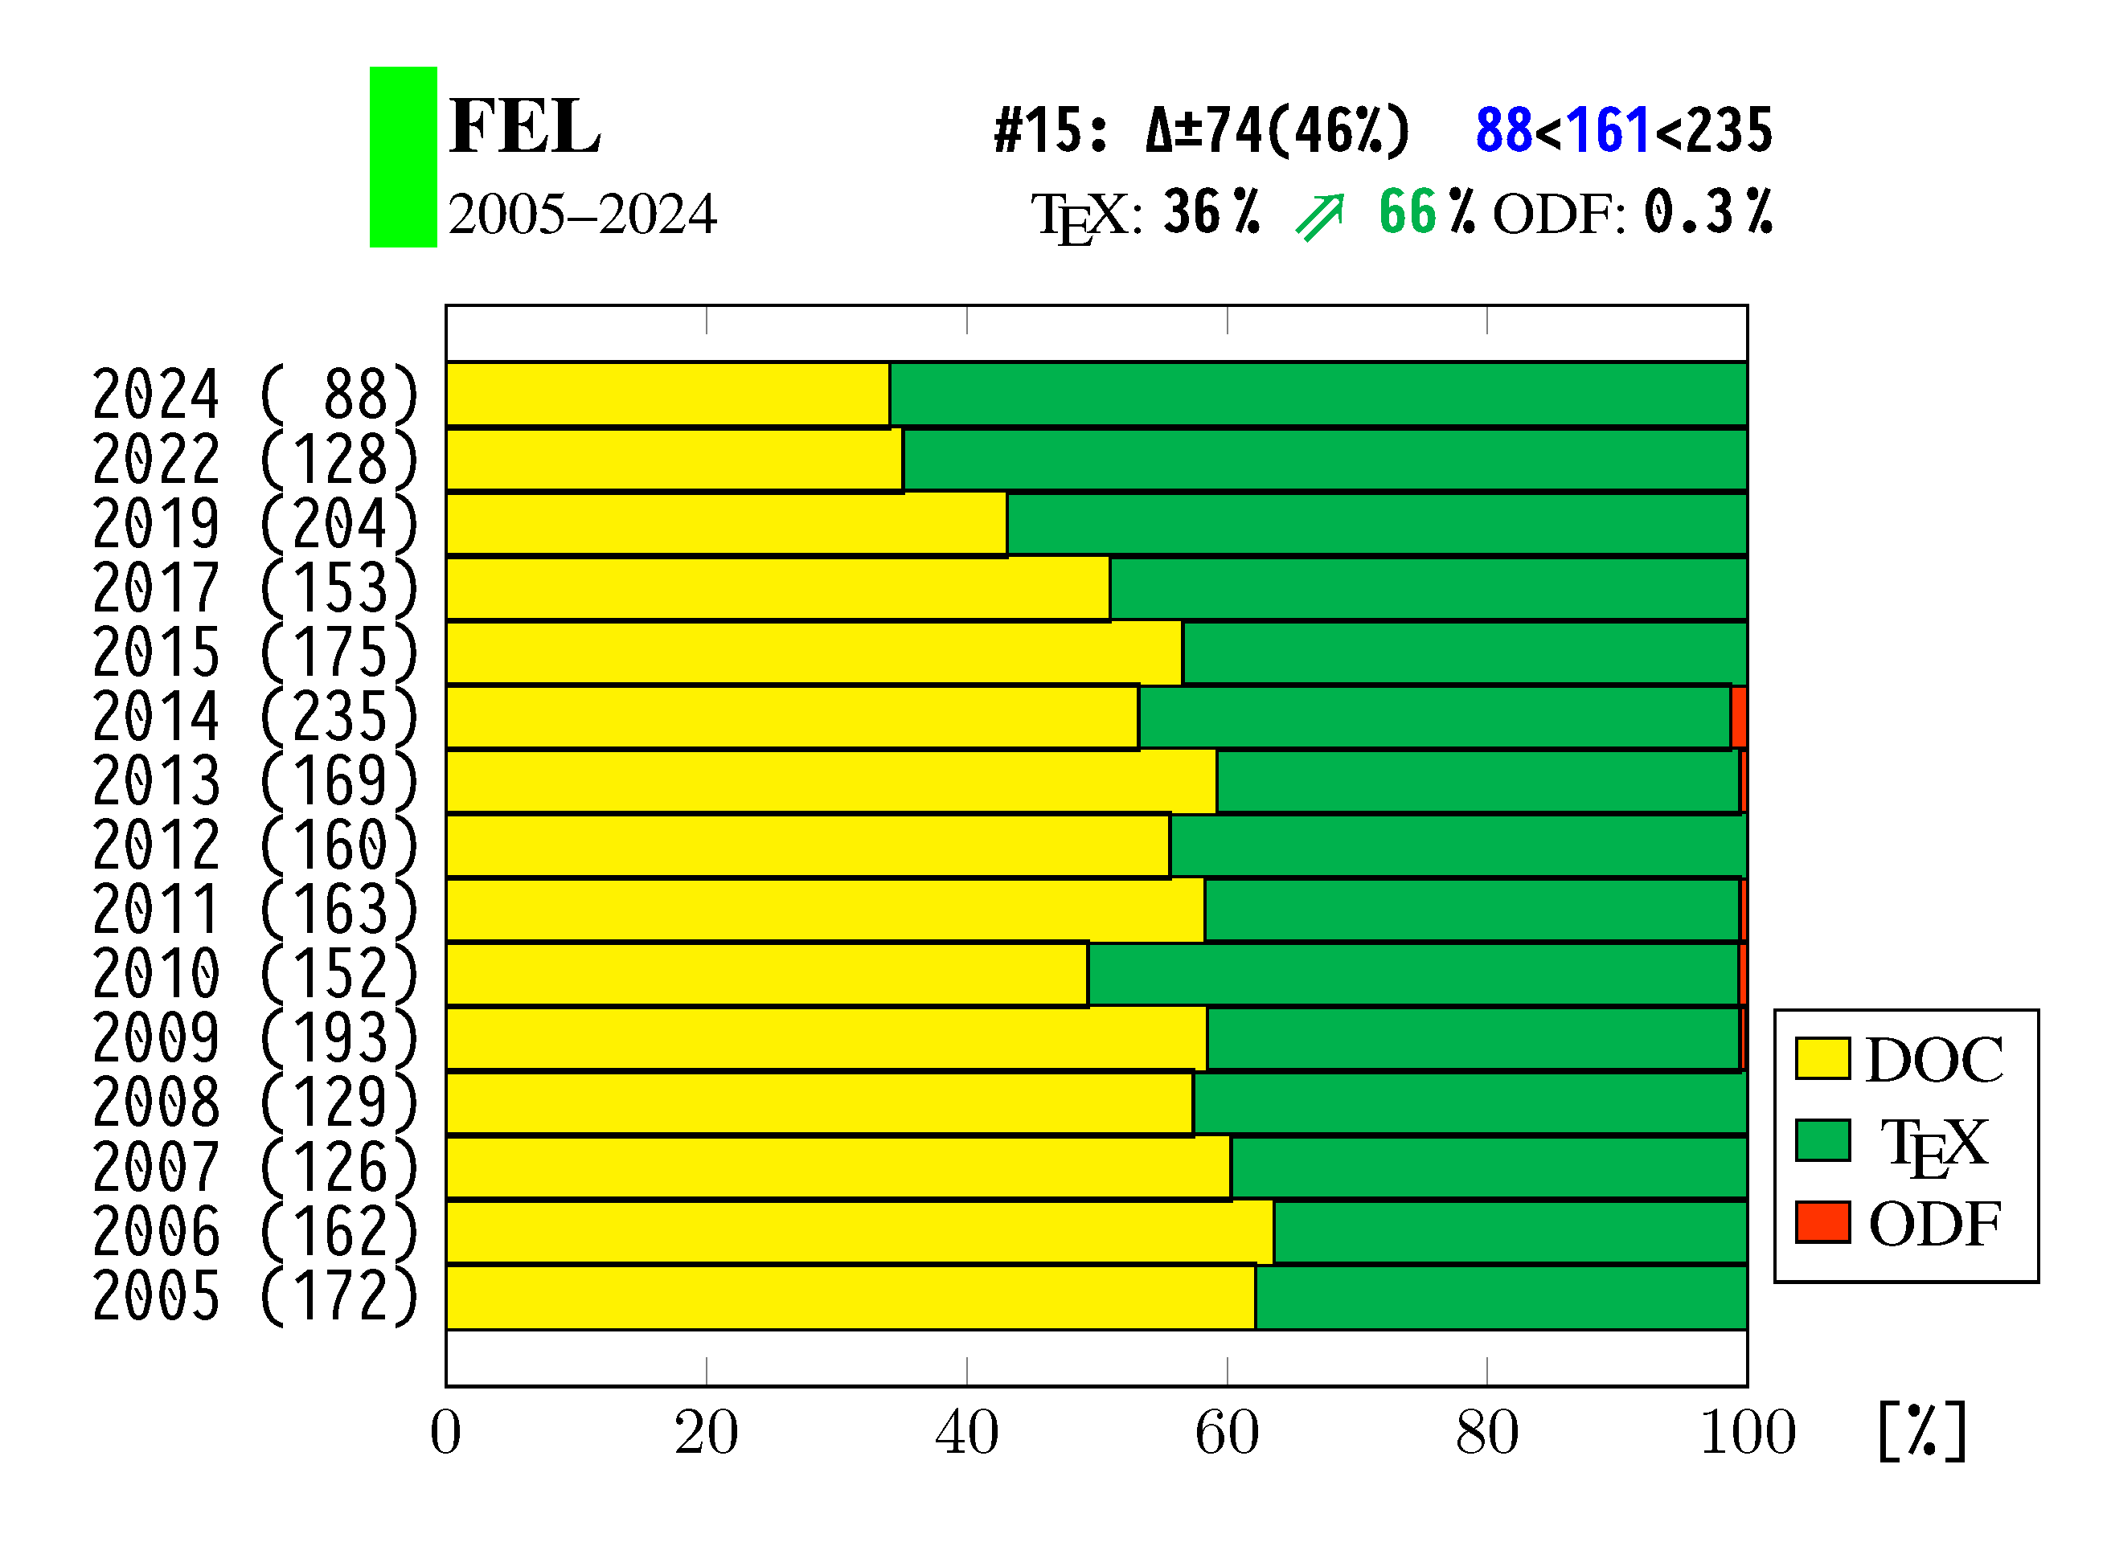
Changes in file type for FEL

Slide 14
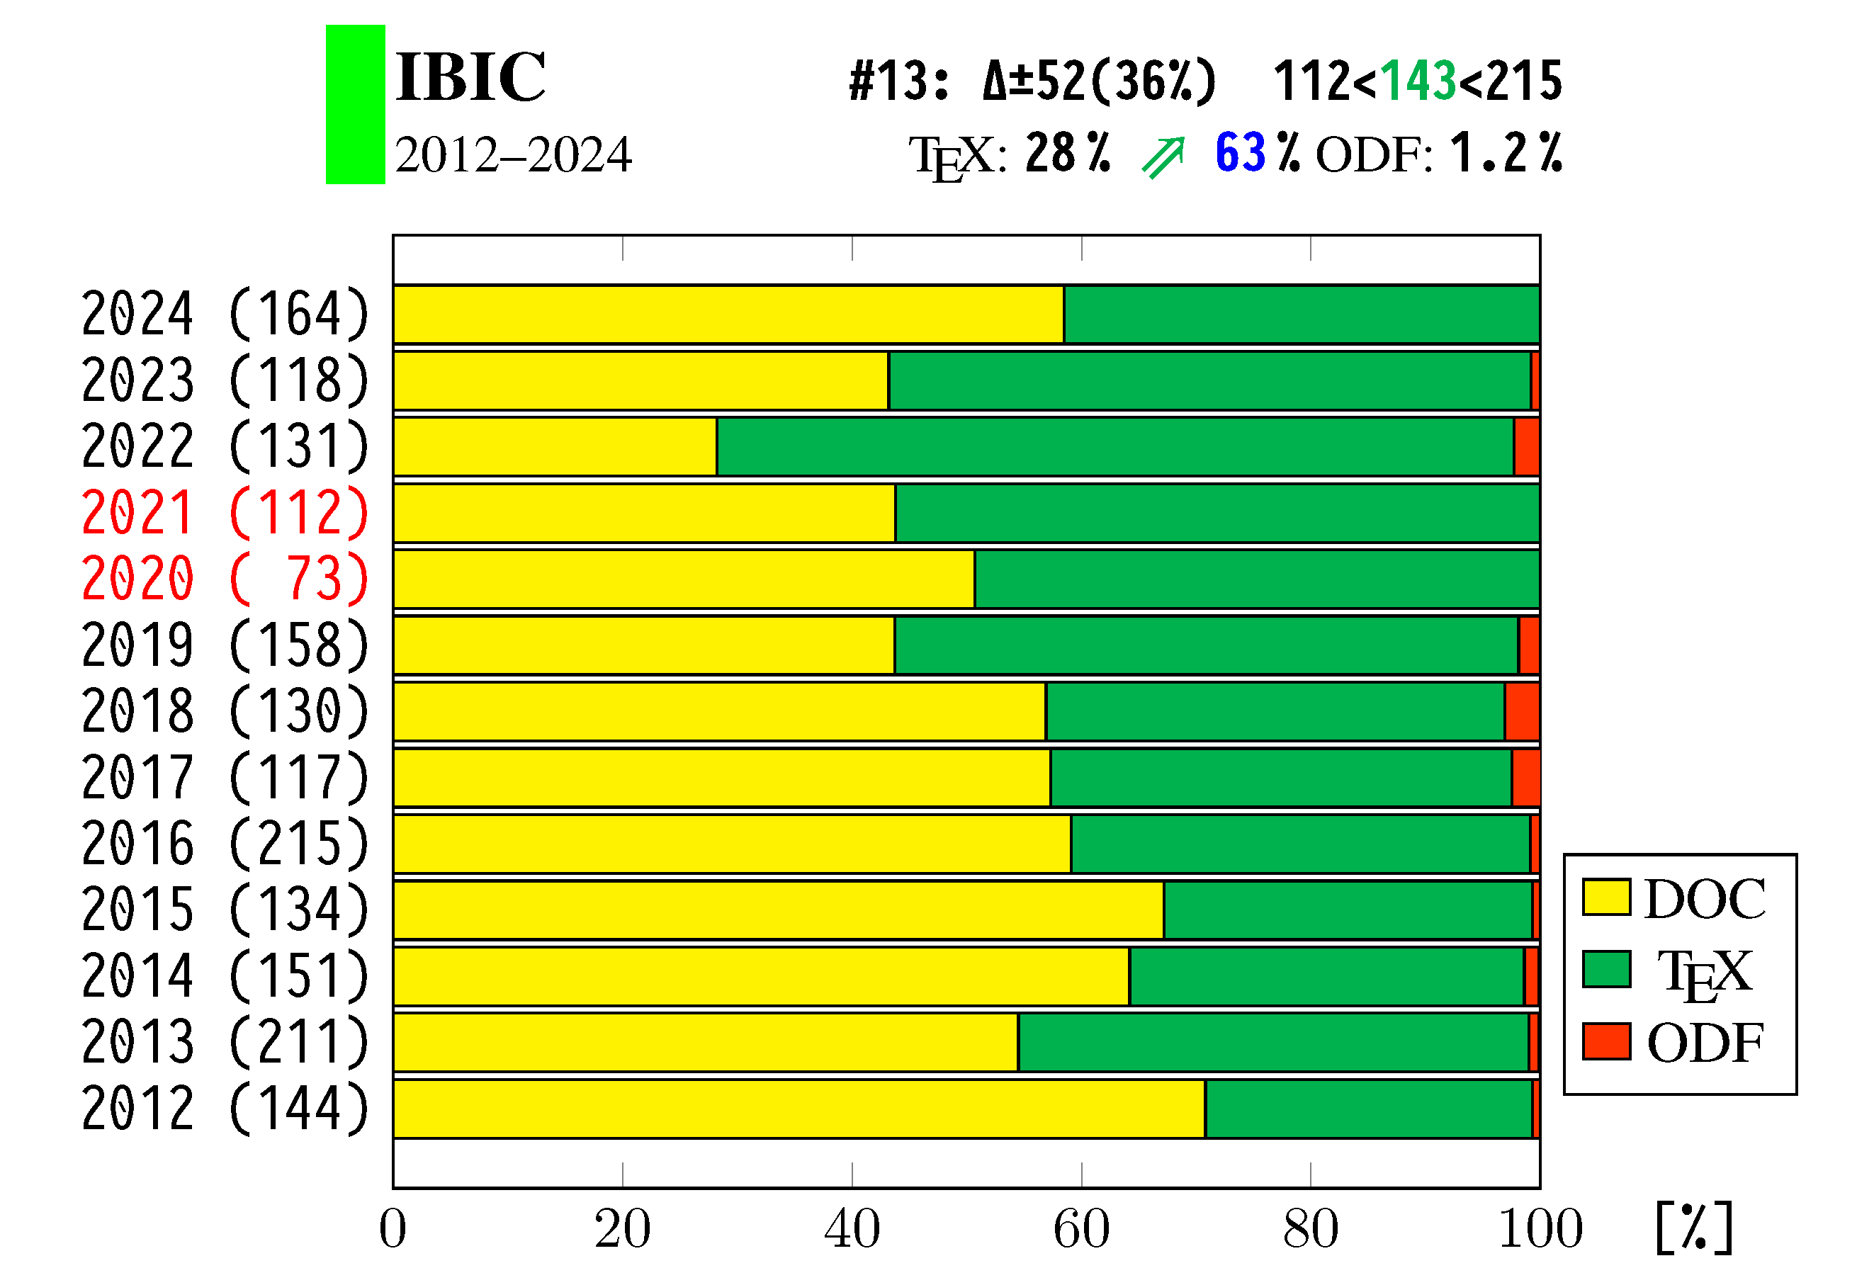
Changes in file type for IBIC

Slide 15
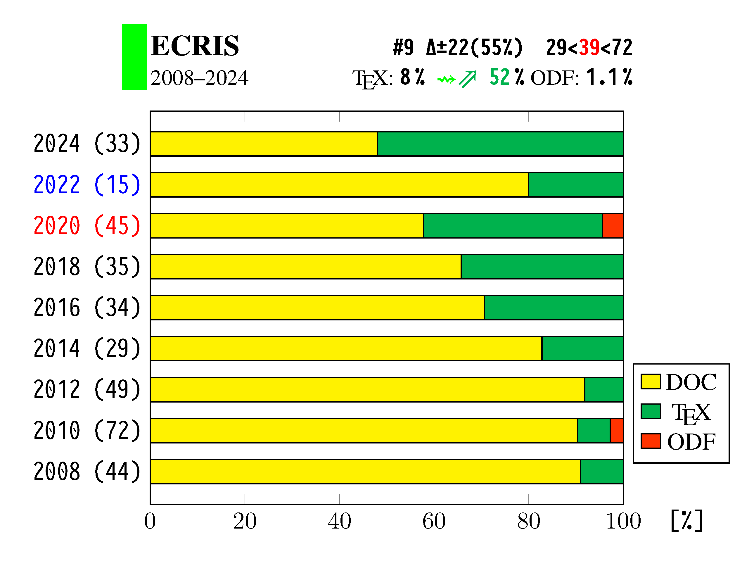
Changes in file type for ECRIS

Slide 16
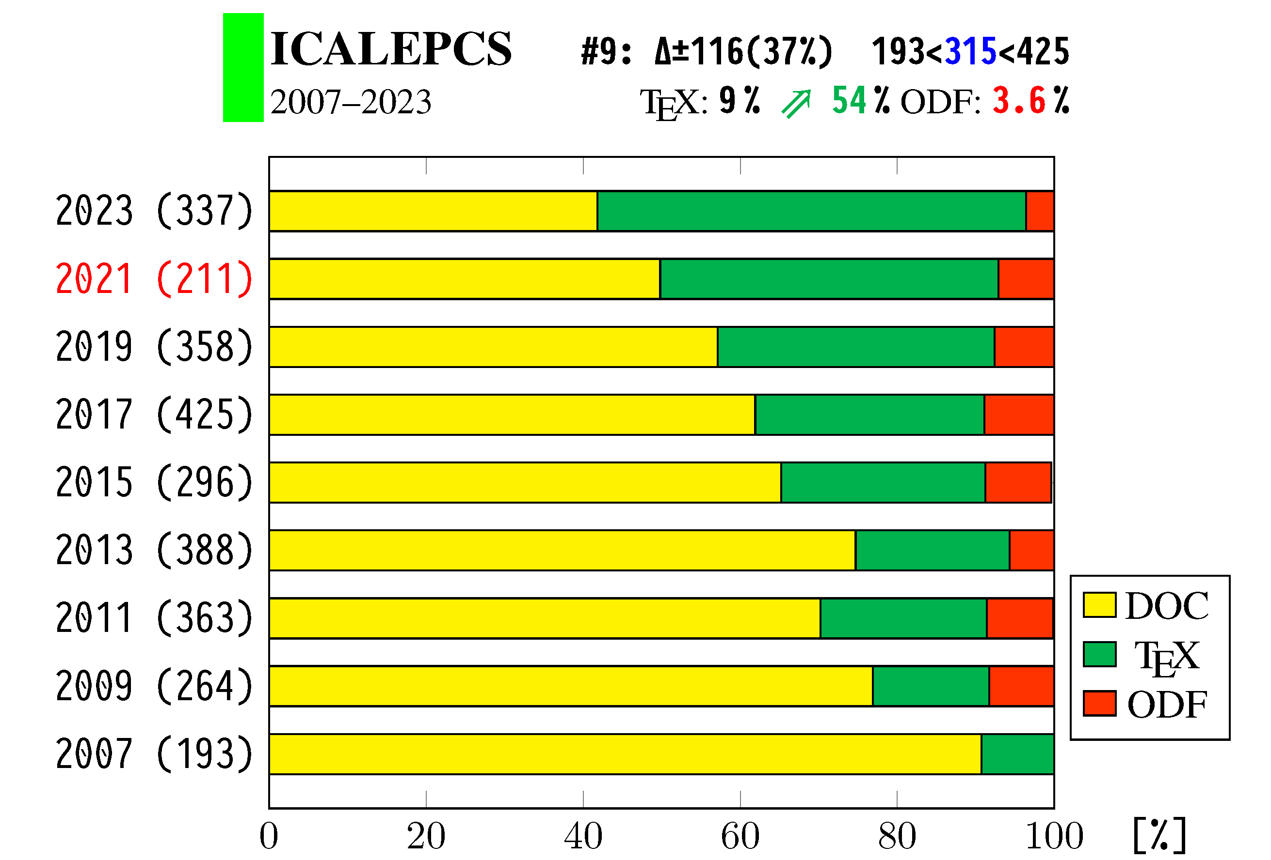
Changes in file type for ICALEPCS

Slide 17
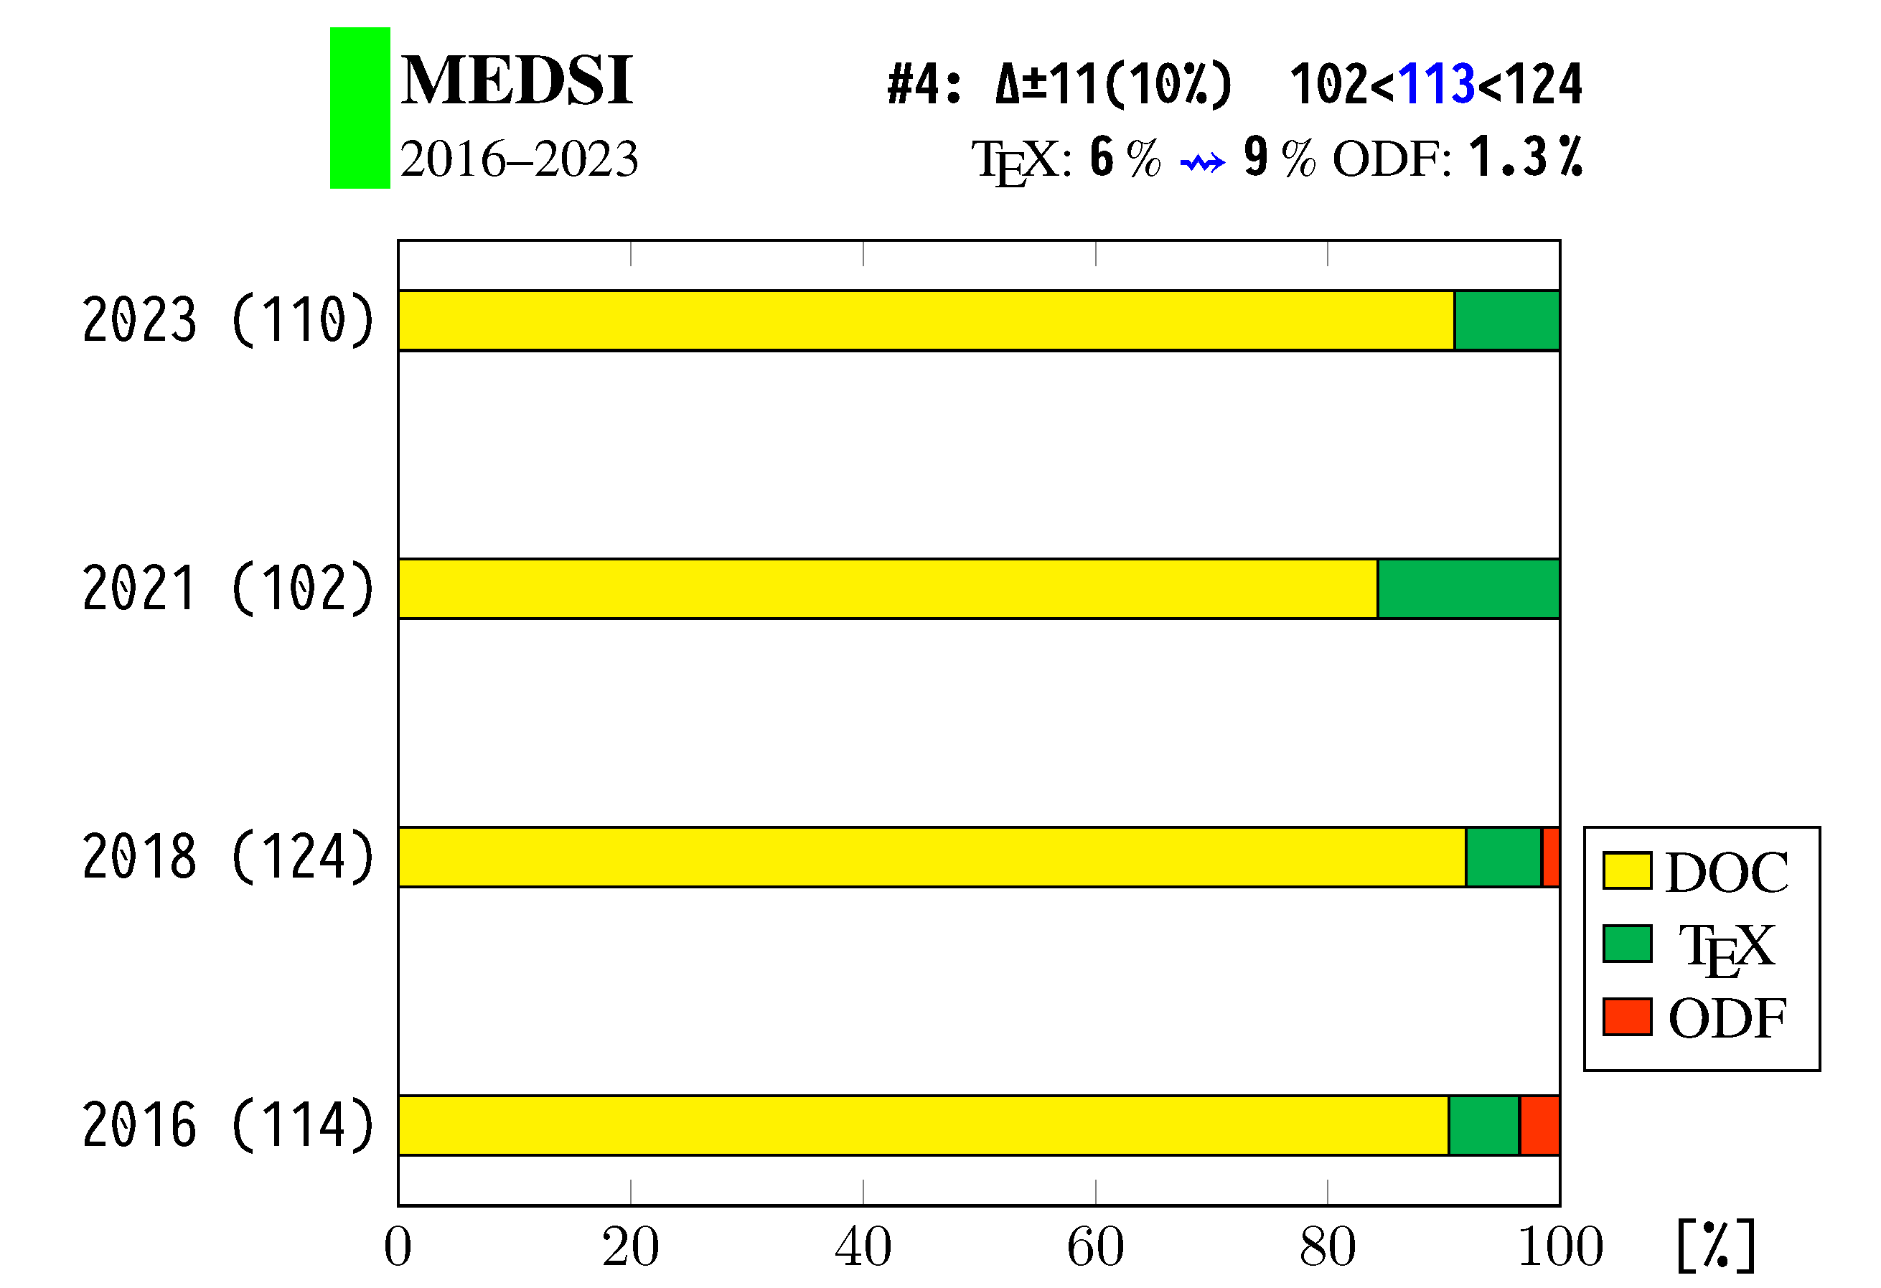
Changes in file type for MEDSI

Slide 18
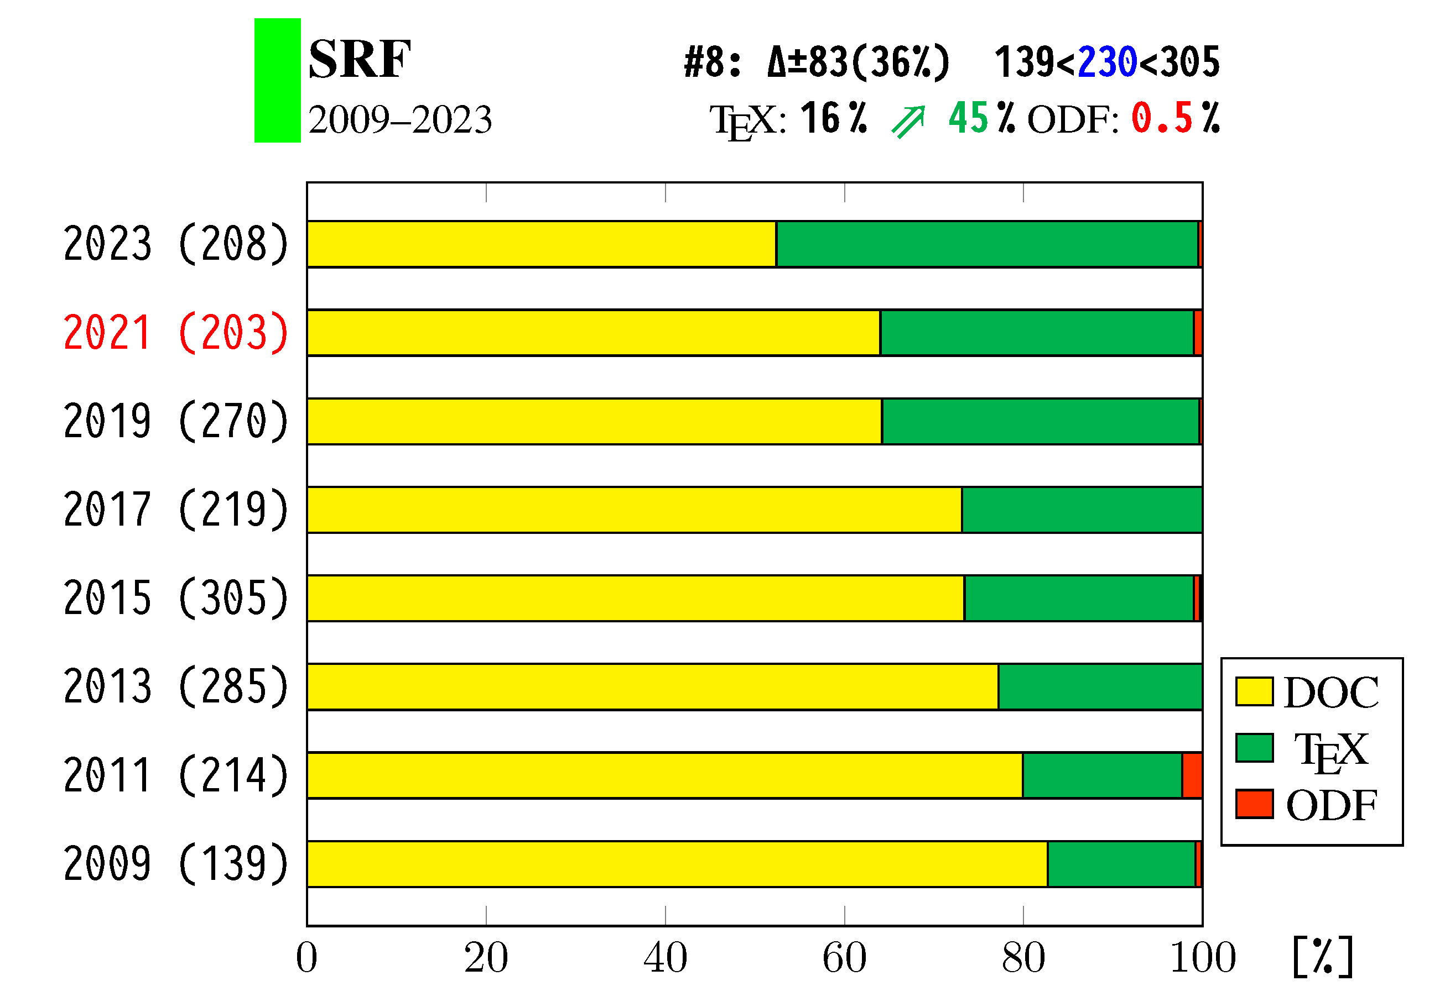
Changes in file type for SRF

Slide 19
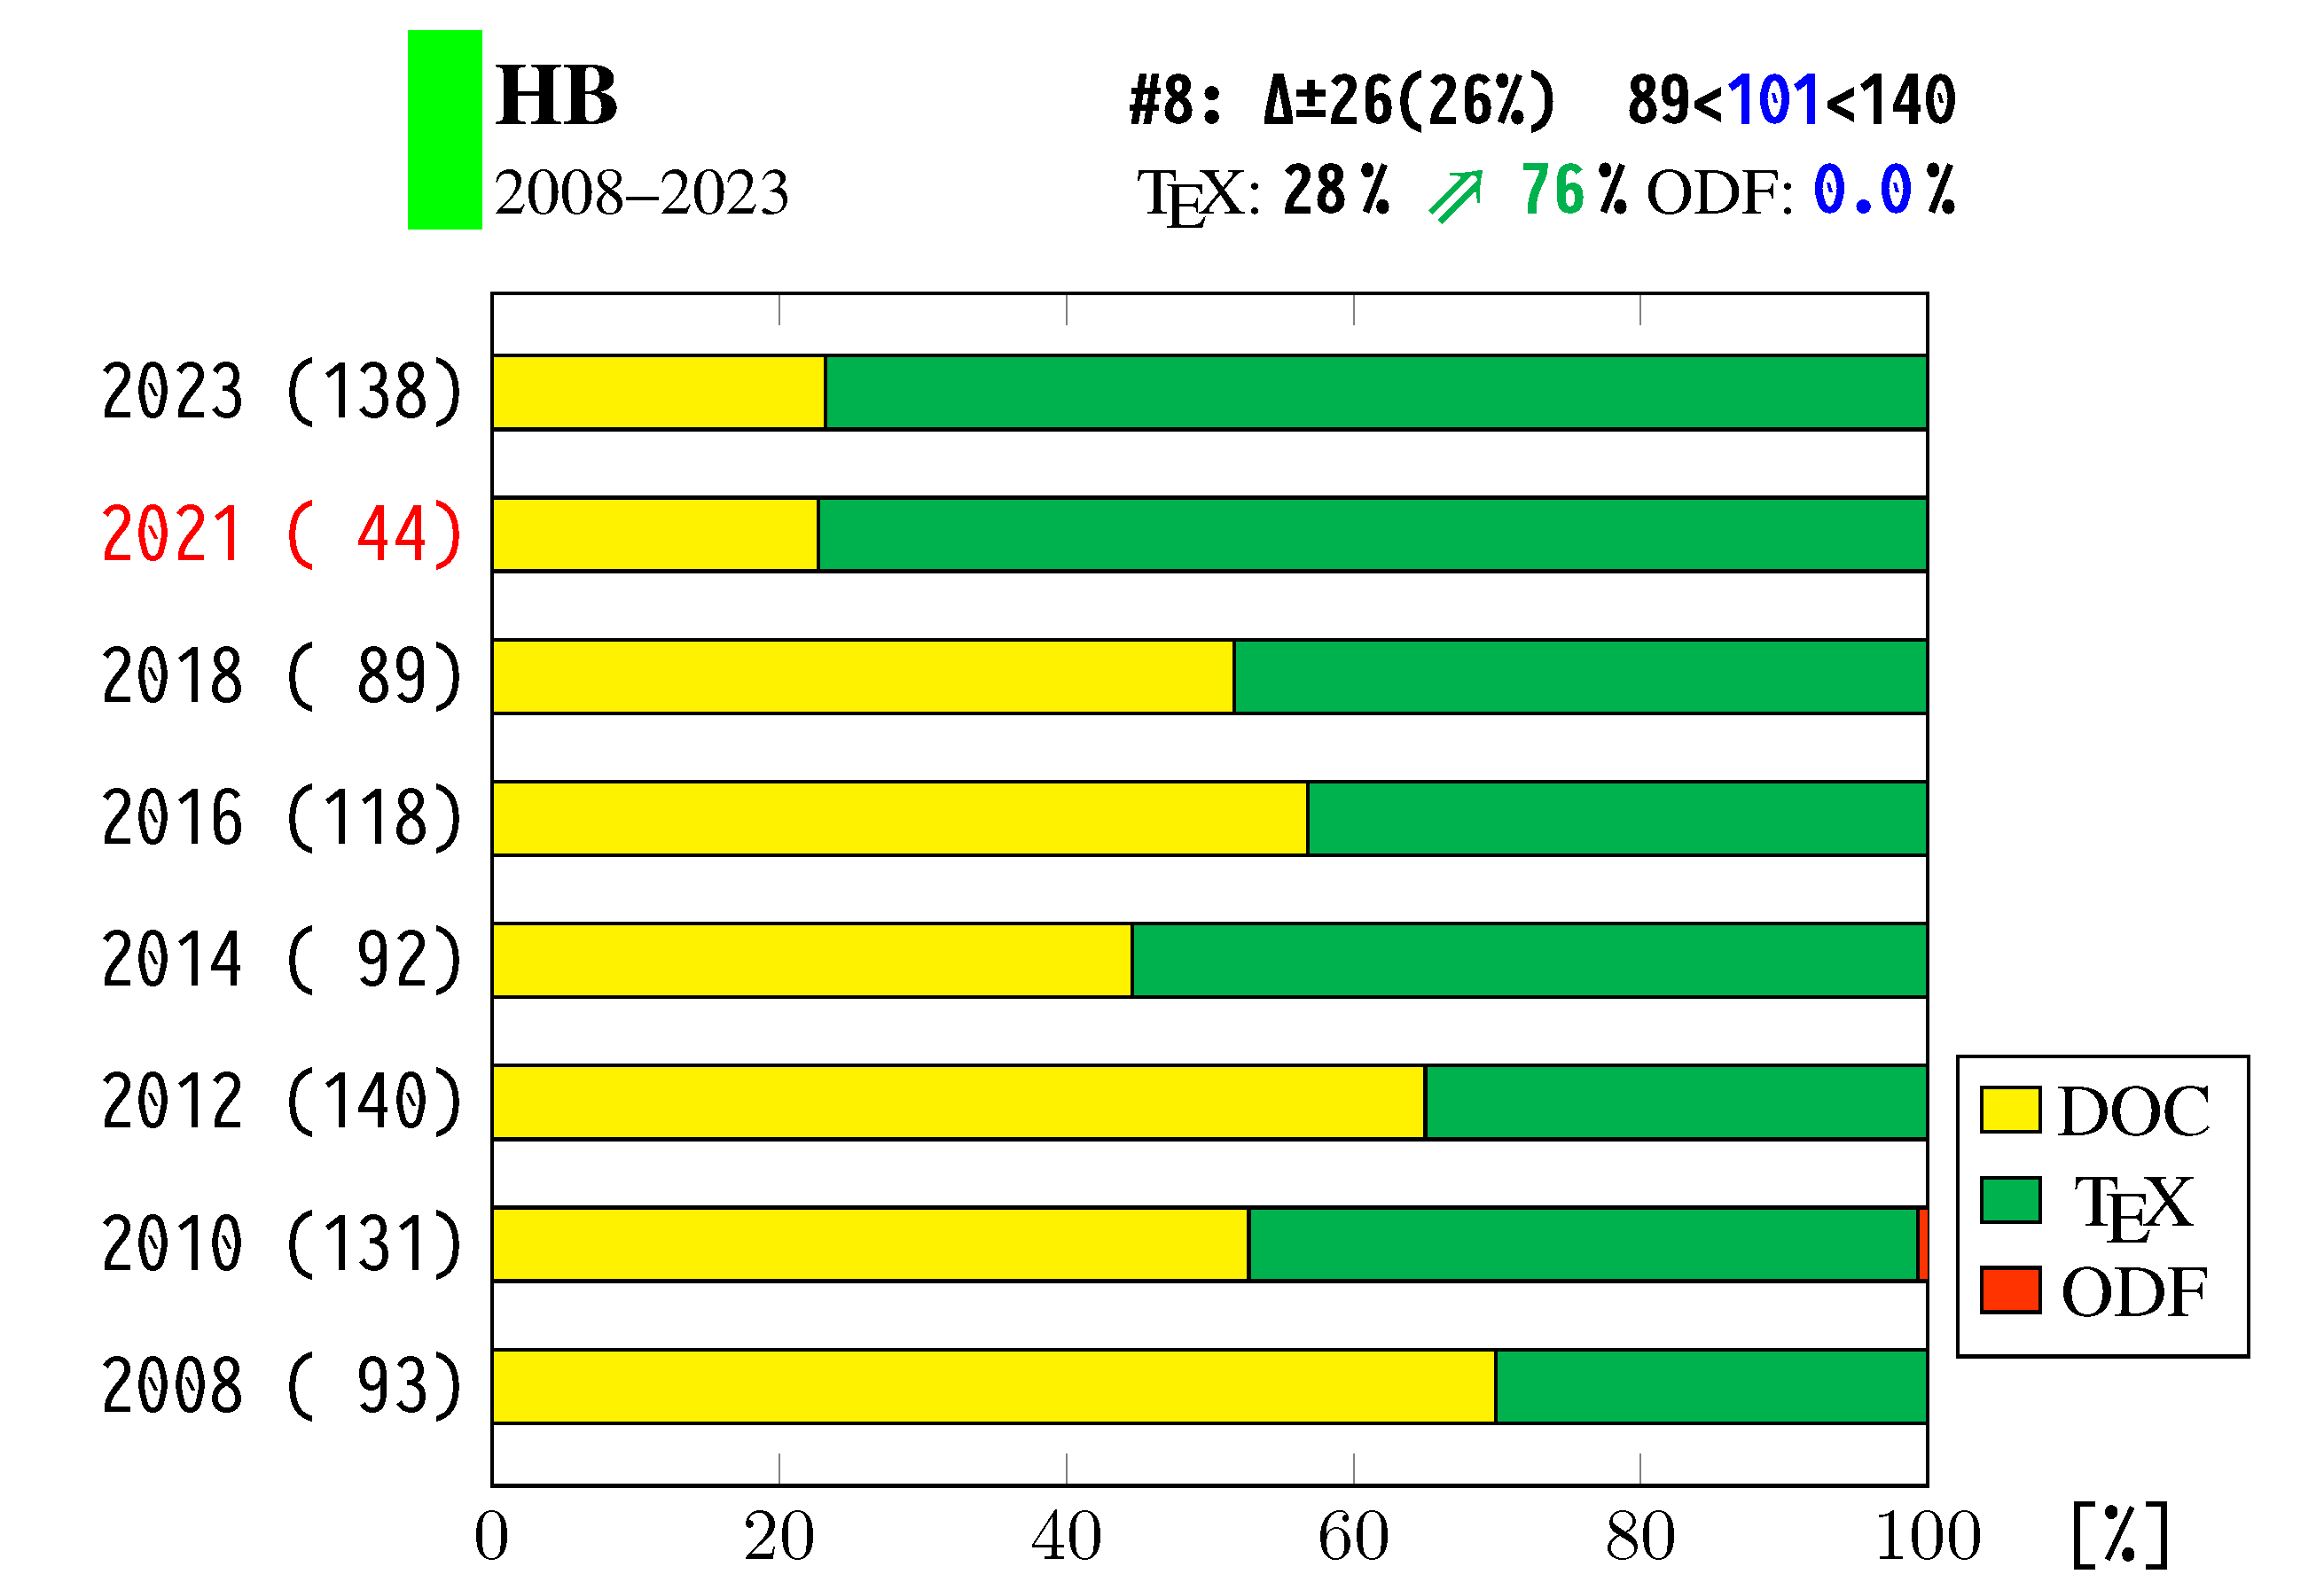
Changes in file type for HB

Slide 20
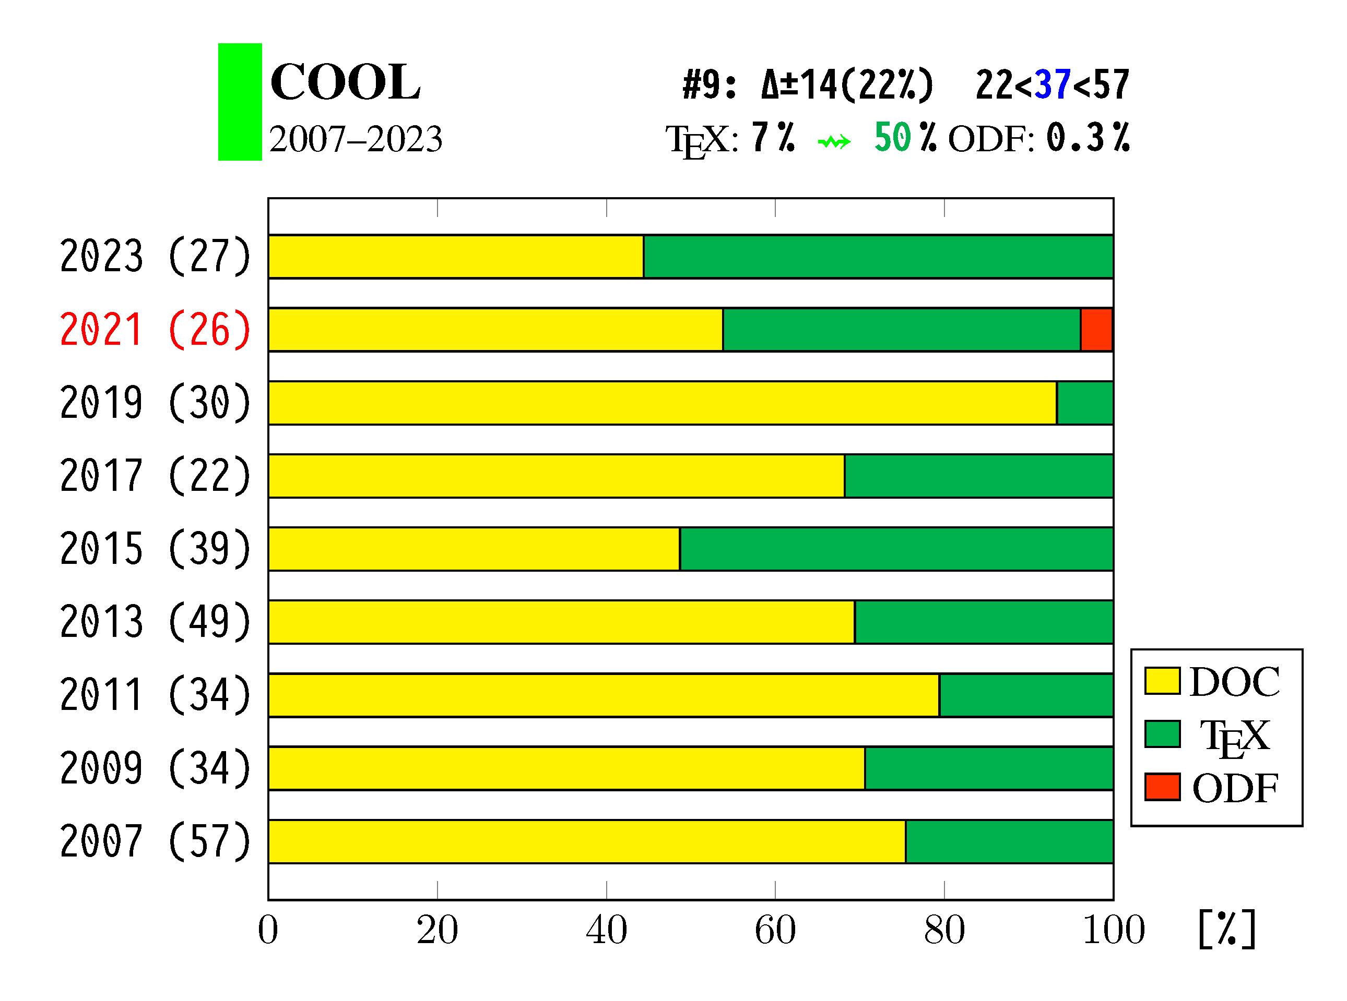
Changes in file type for COOL

Slide 21
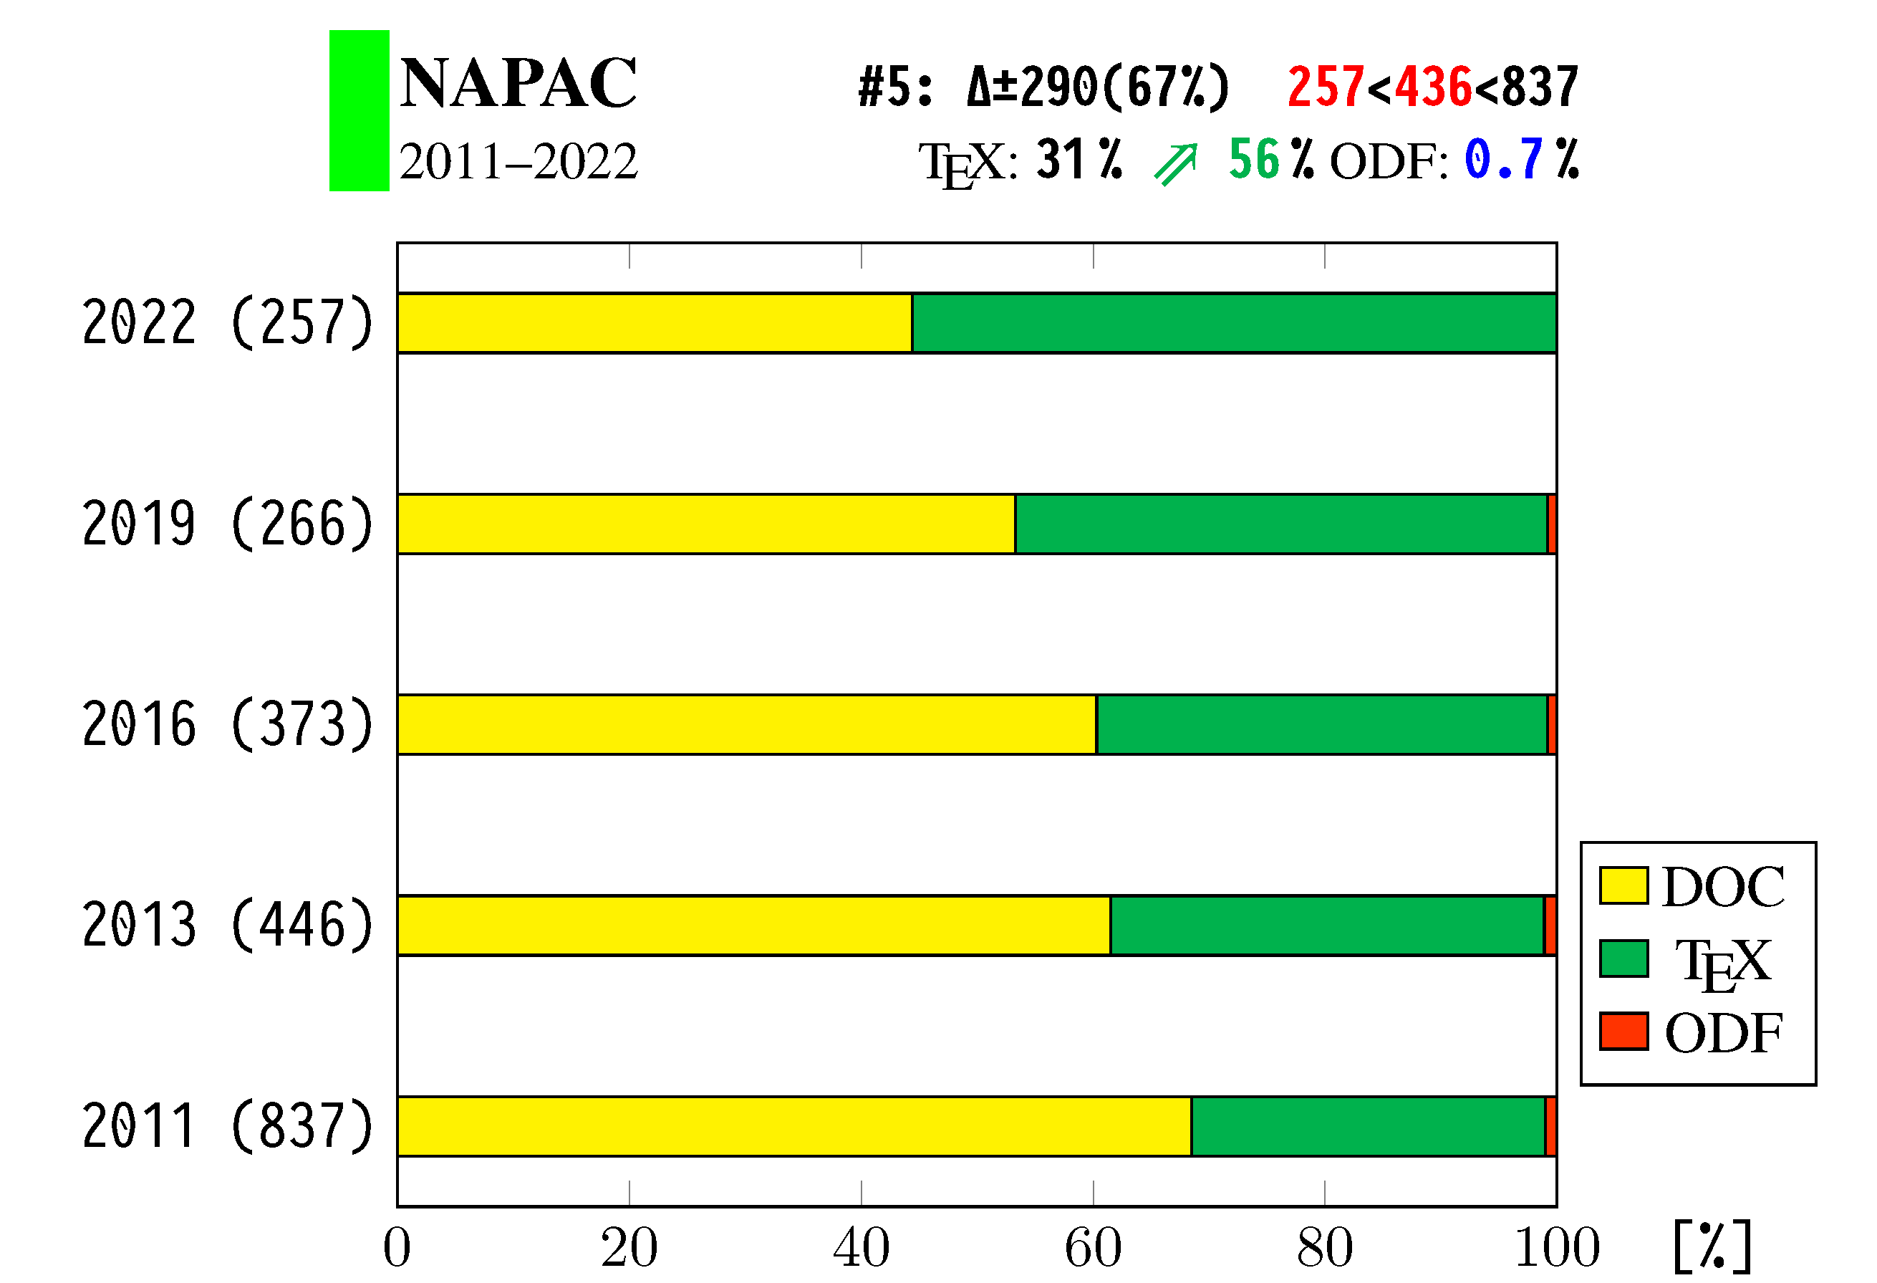
Changes in file type for NAPAC

Slide 22
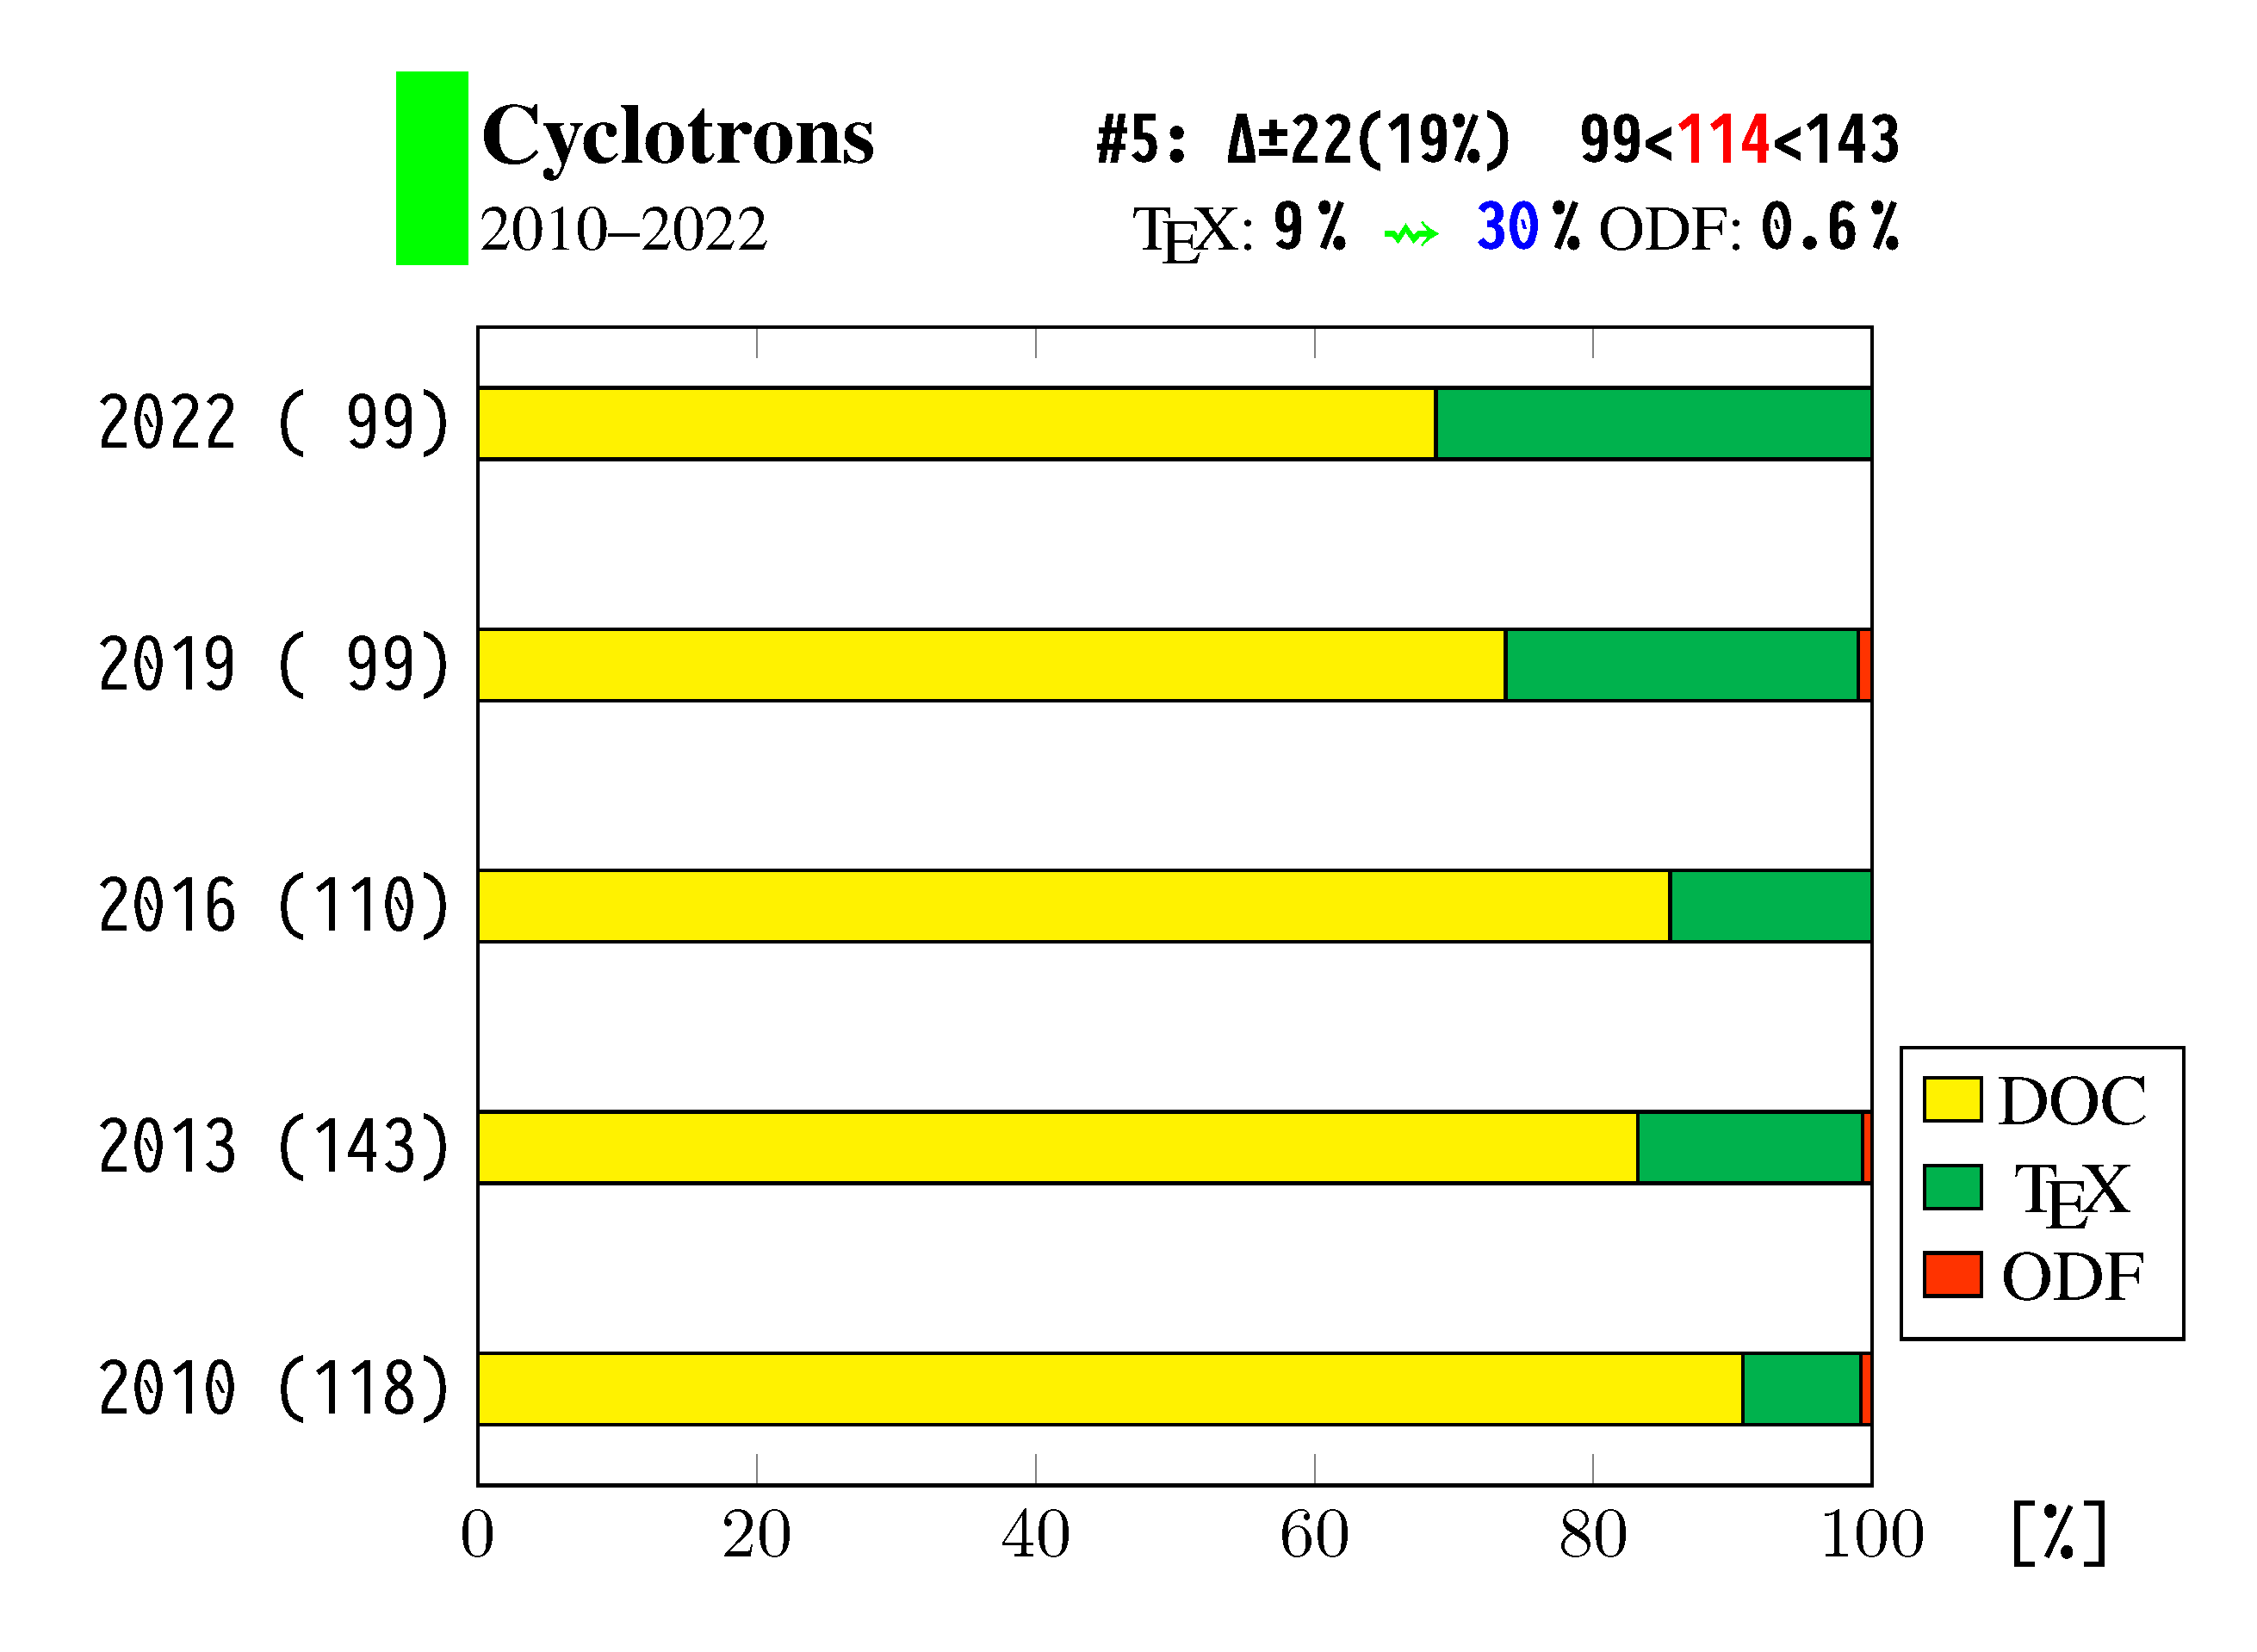
Changes in file type for Cyclotrons

Slide 23
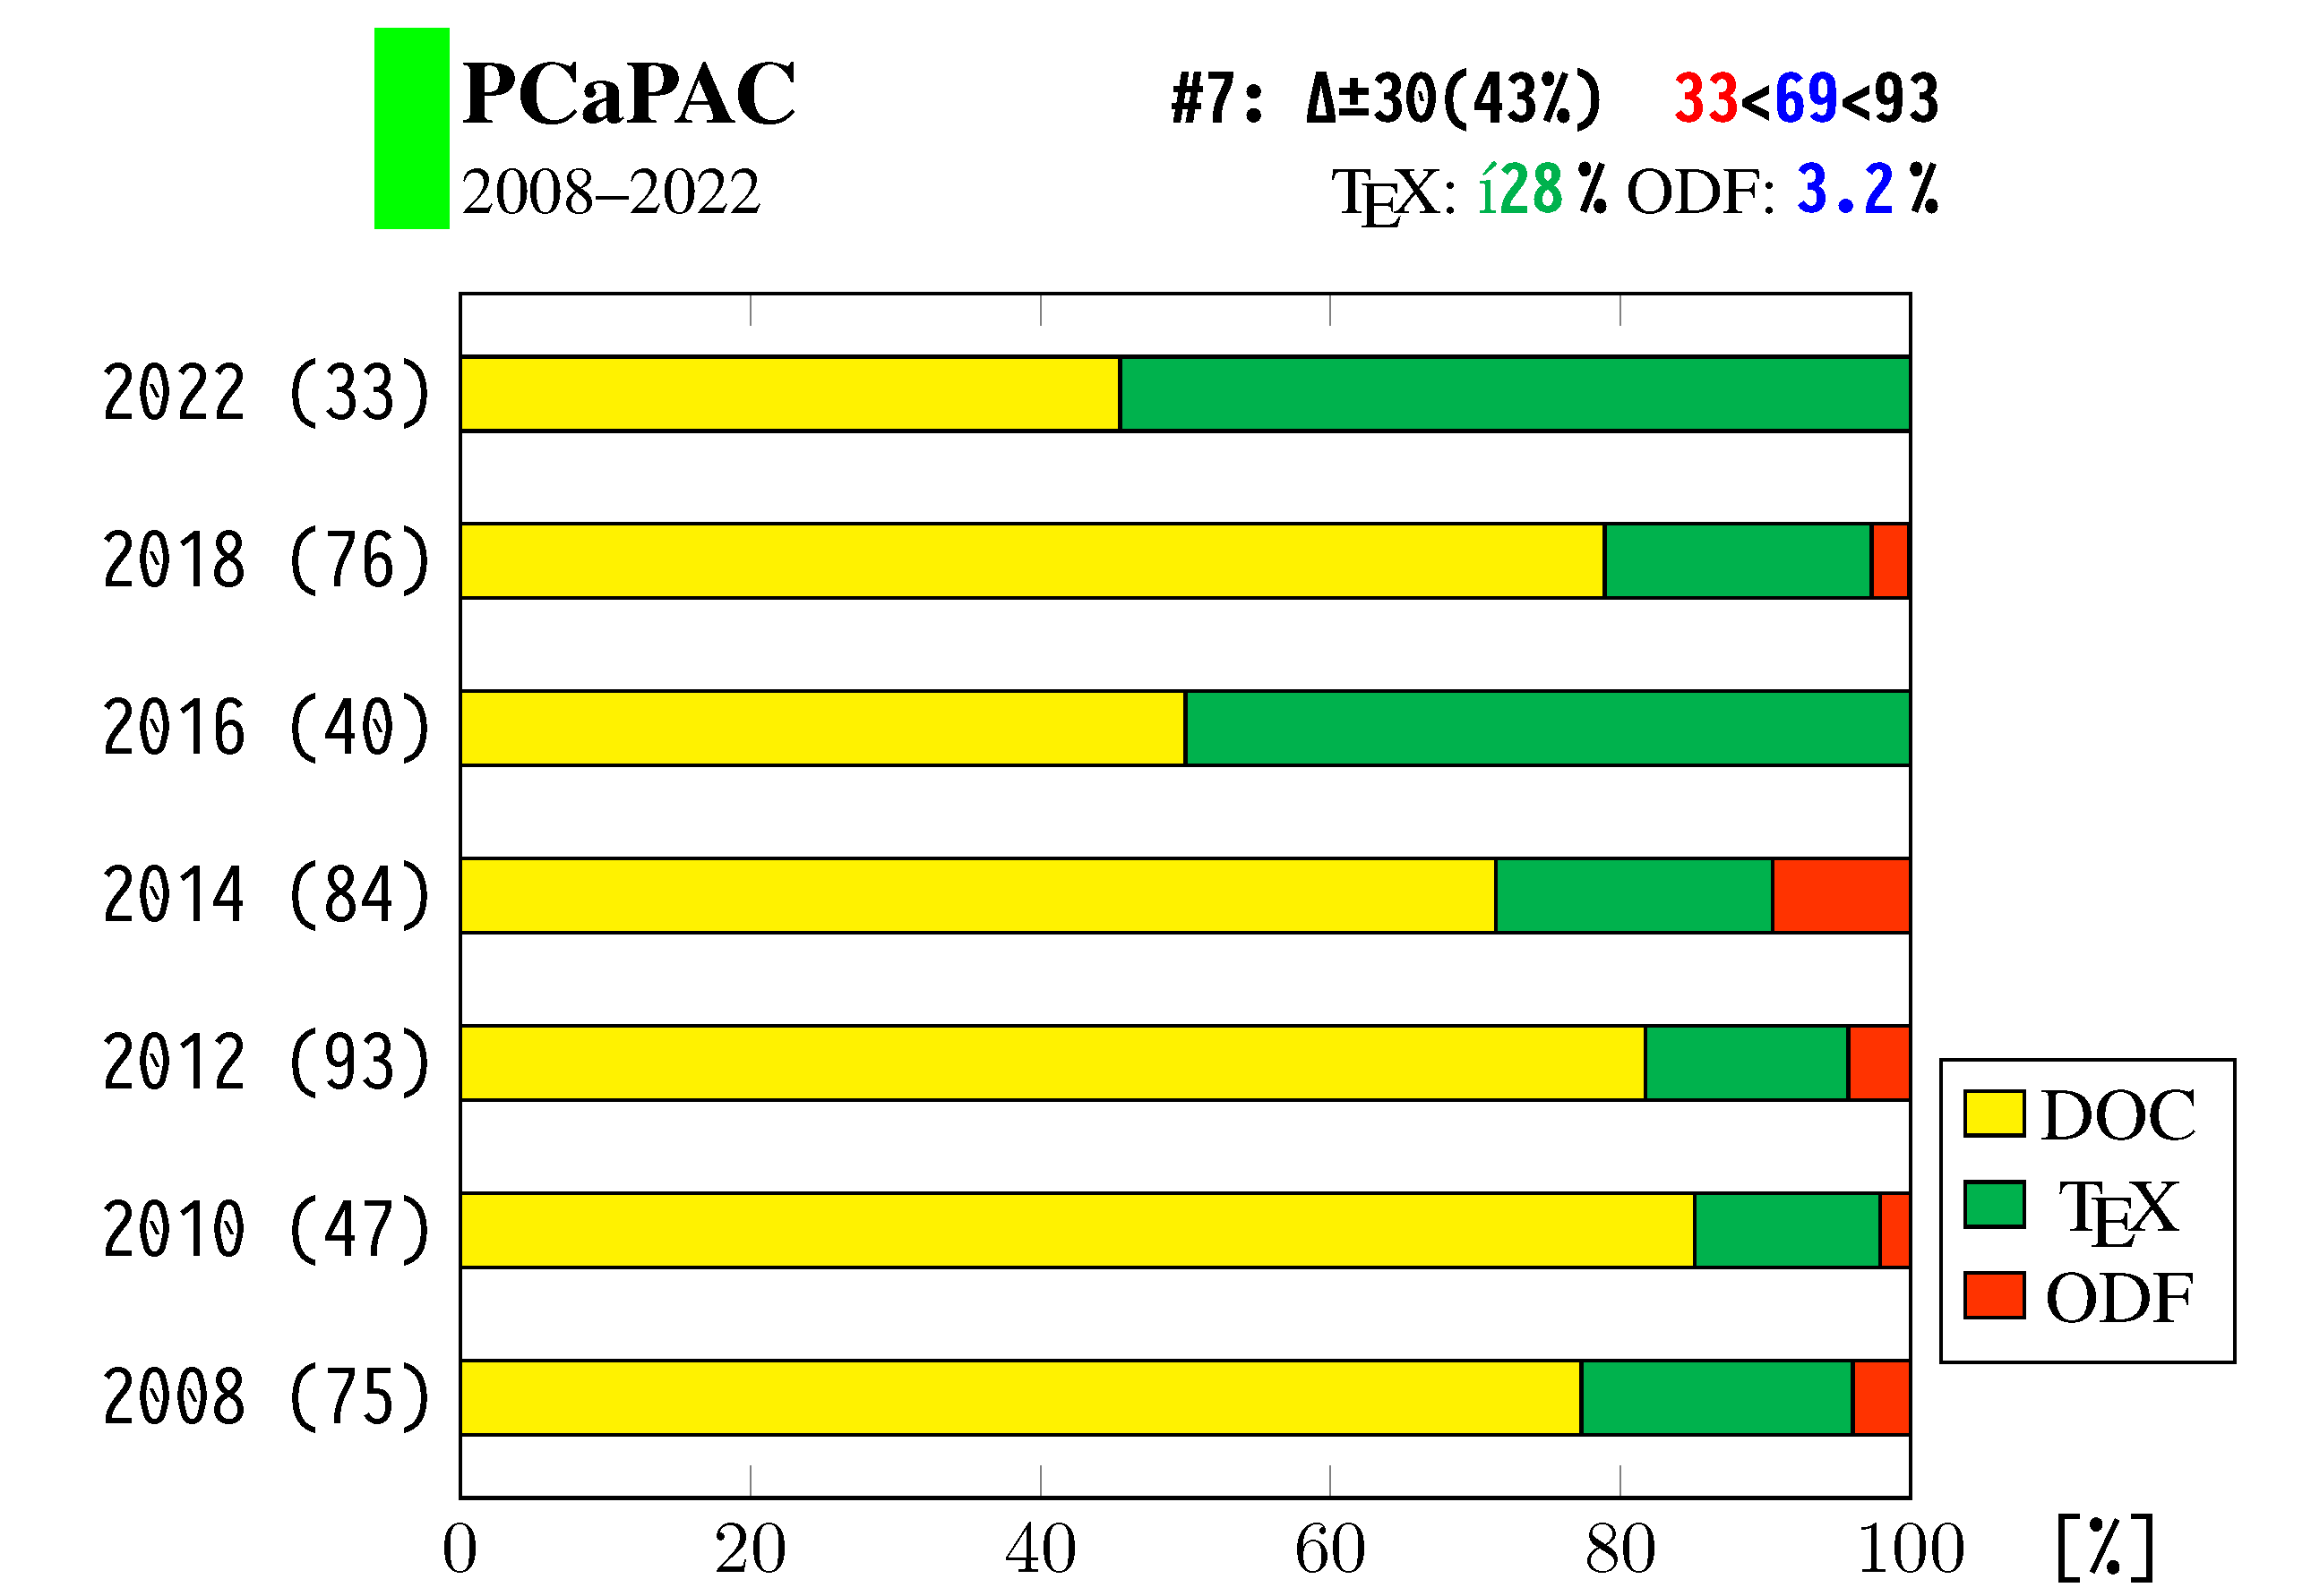
Changes in file type for PCaPAC

Slide 24
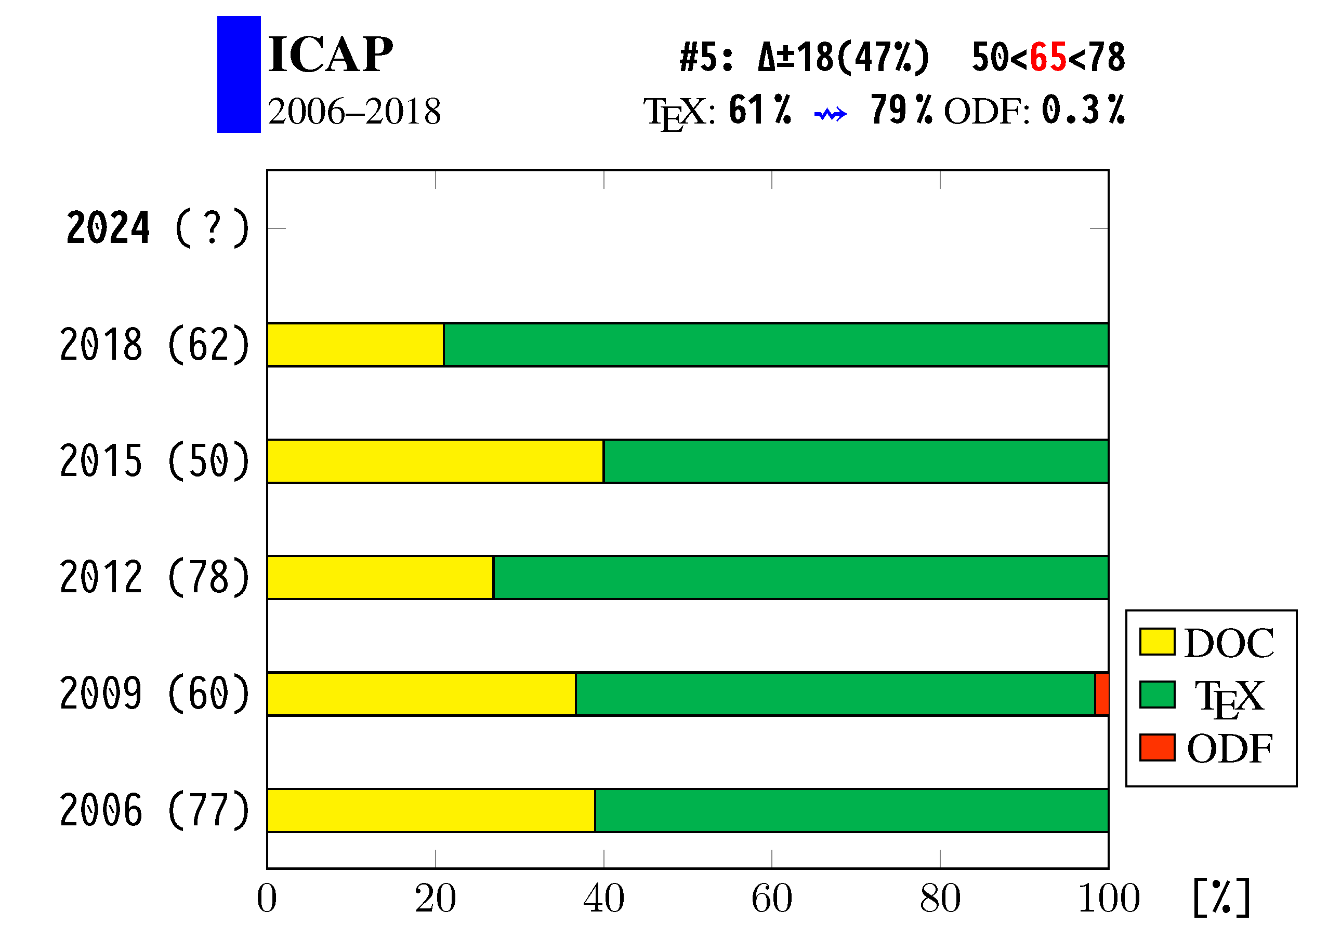
Changes in file type for ICAP

Slide 25
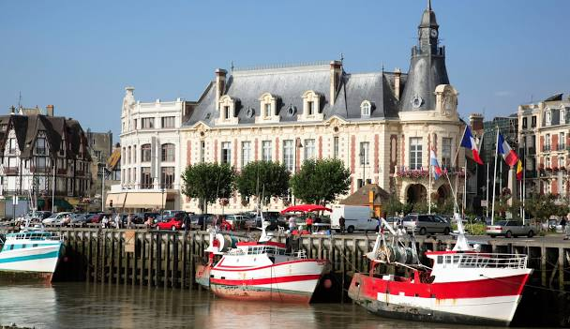

Questions?
Team Meeting 2024
Deauville, France

