Slide 1
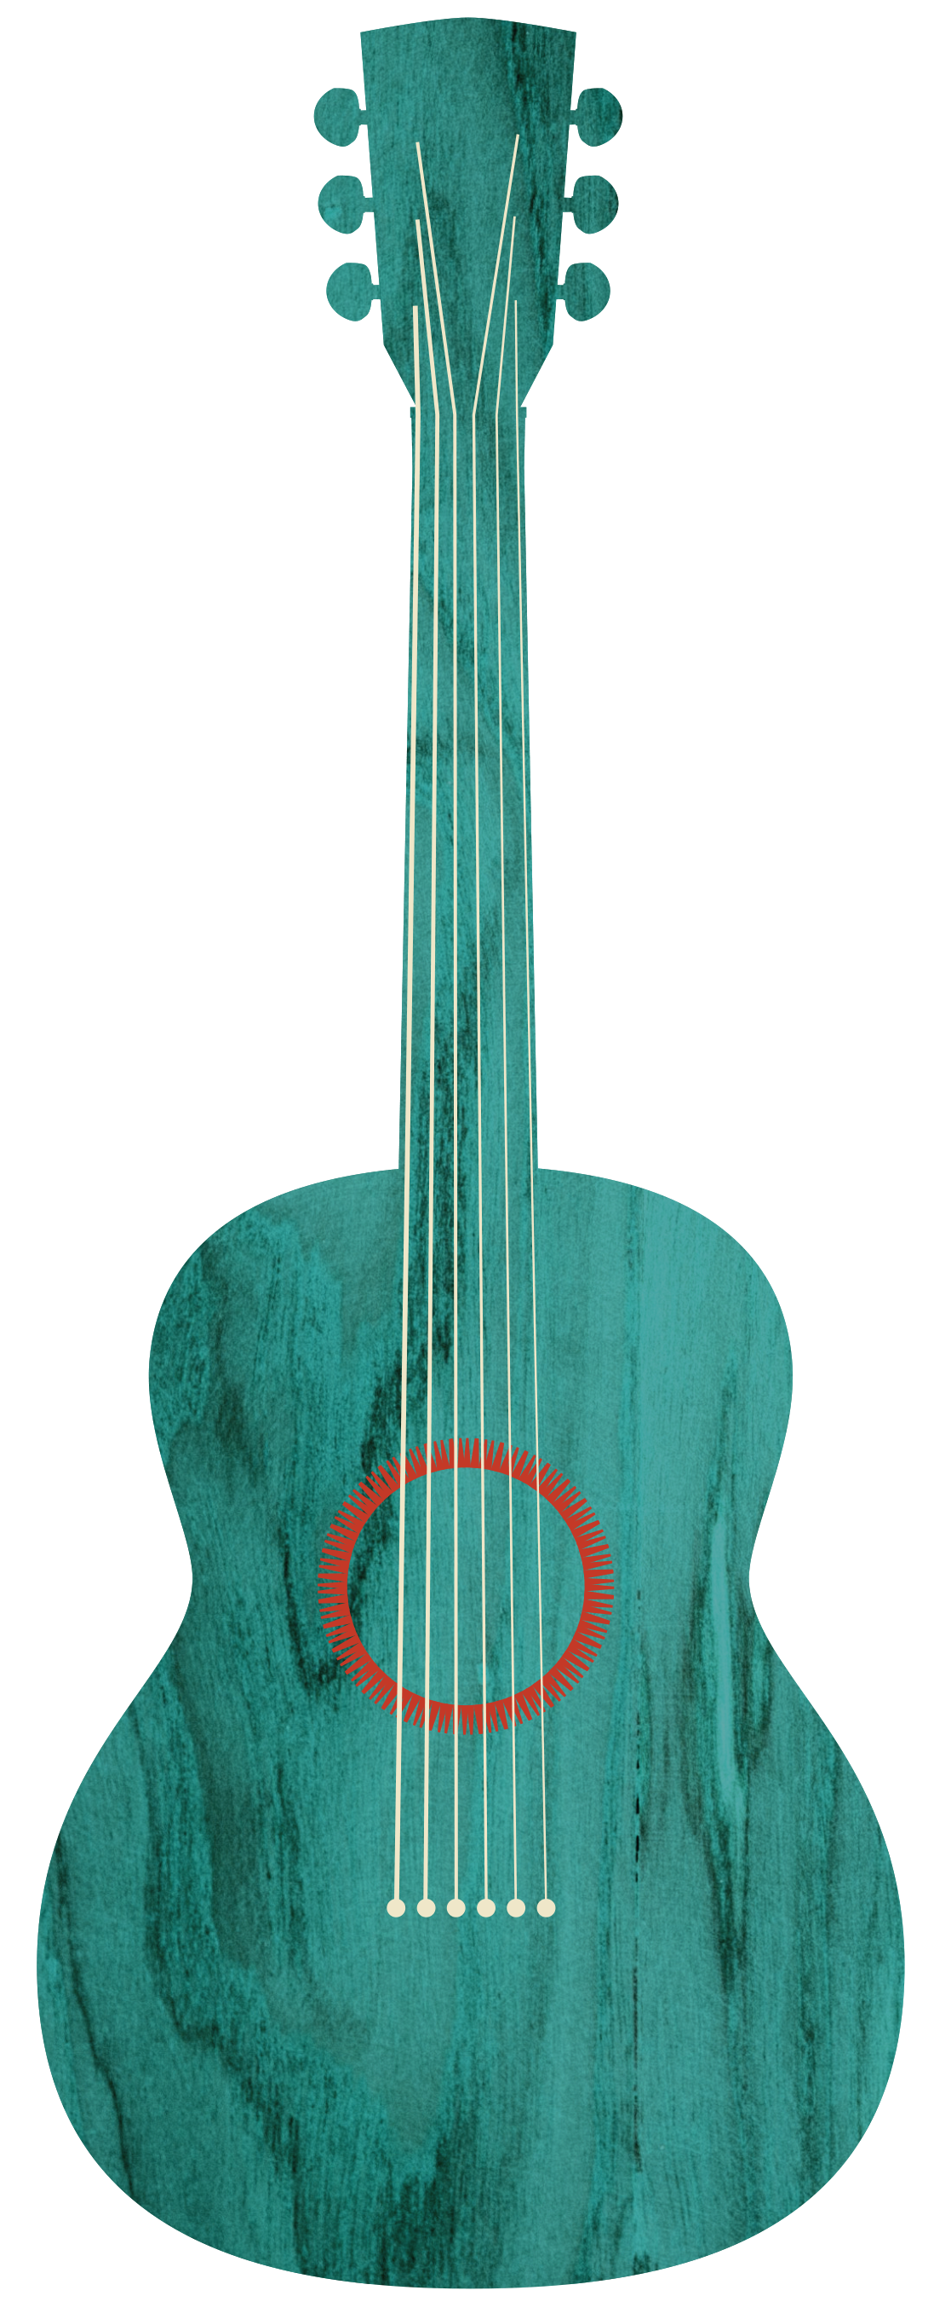




IPAC24 IT Report for JTM’24
Nov. 7, 2024,
May 19-24, 2024
Nashville TN, United States
Fulvia Pilat – Conference Chair
Robert Saethre – Local Organizing Committee Chair

Slide 2

Topics
Editorial, Author, and Speaker Rooms
Equipment
  Desktops, Monitors, Laptops
  Printers
  iPads
  Dotting boards
  Network
  Breakout Session AV
What issues did we encounter?

Slide 3
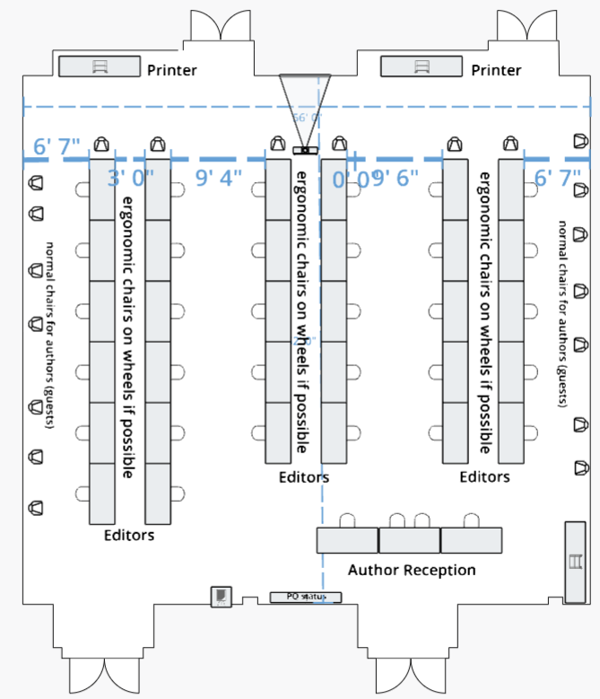
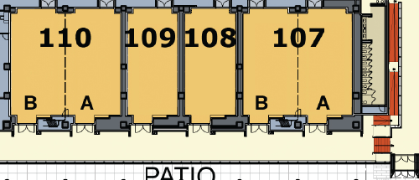
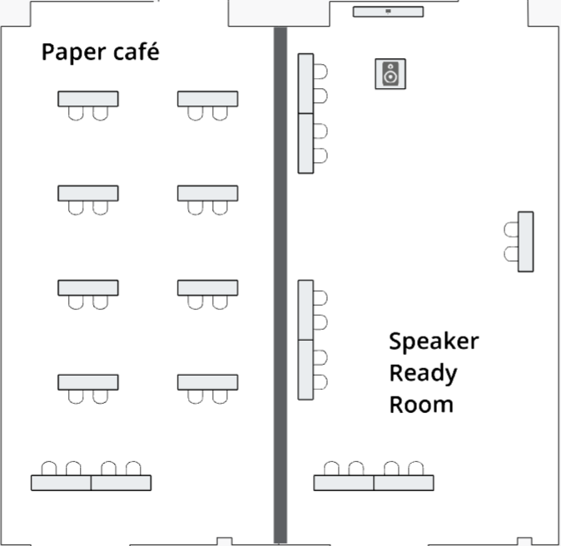
Editorial, Author, and Speaker Rooms
110AB
107AB
Editorial Room
52’
Editors F&B and Storage
LOC Storage
56'
Notes:
107 A-B: U-Shape set with one computer workstation per 6-foot table; 26 ergo chairs
26 computers, power and two printers in the room
Room must be locked at all times with 10 keys
Staff and volunteers to be provided by ORNL
108: two conference tables with workstations facing the door; three conference tables around the perimeter of the room for printers, books and supplies; four ergo chairs
109: rounds with tables for food 35
110A: Six-foot tables around the perimeter of the room to accommodate 20 computers and workstations; 1 printer in the room
110B: Storage for Audio Visual and Anthony

Slide 4
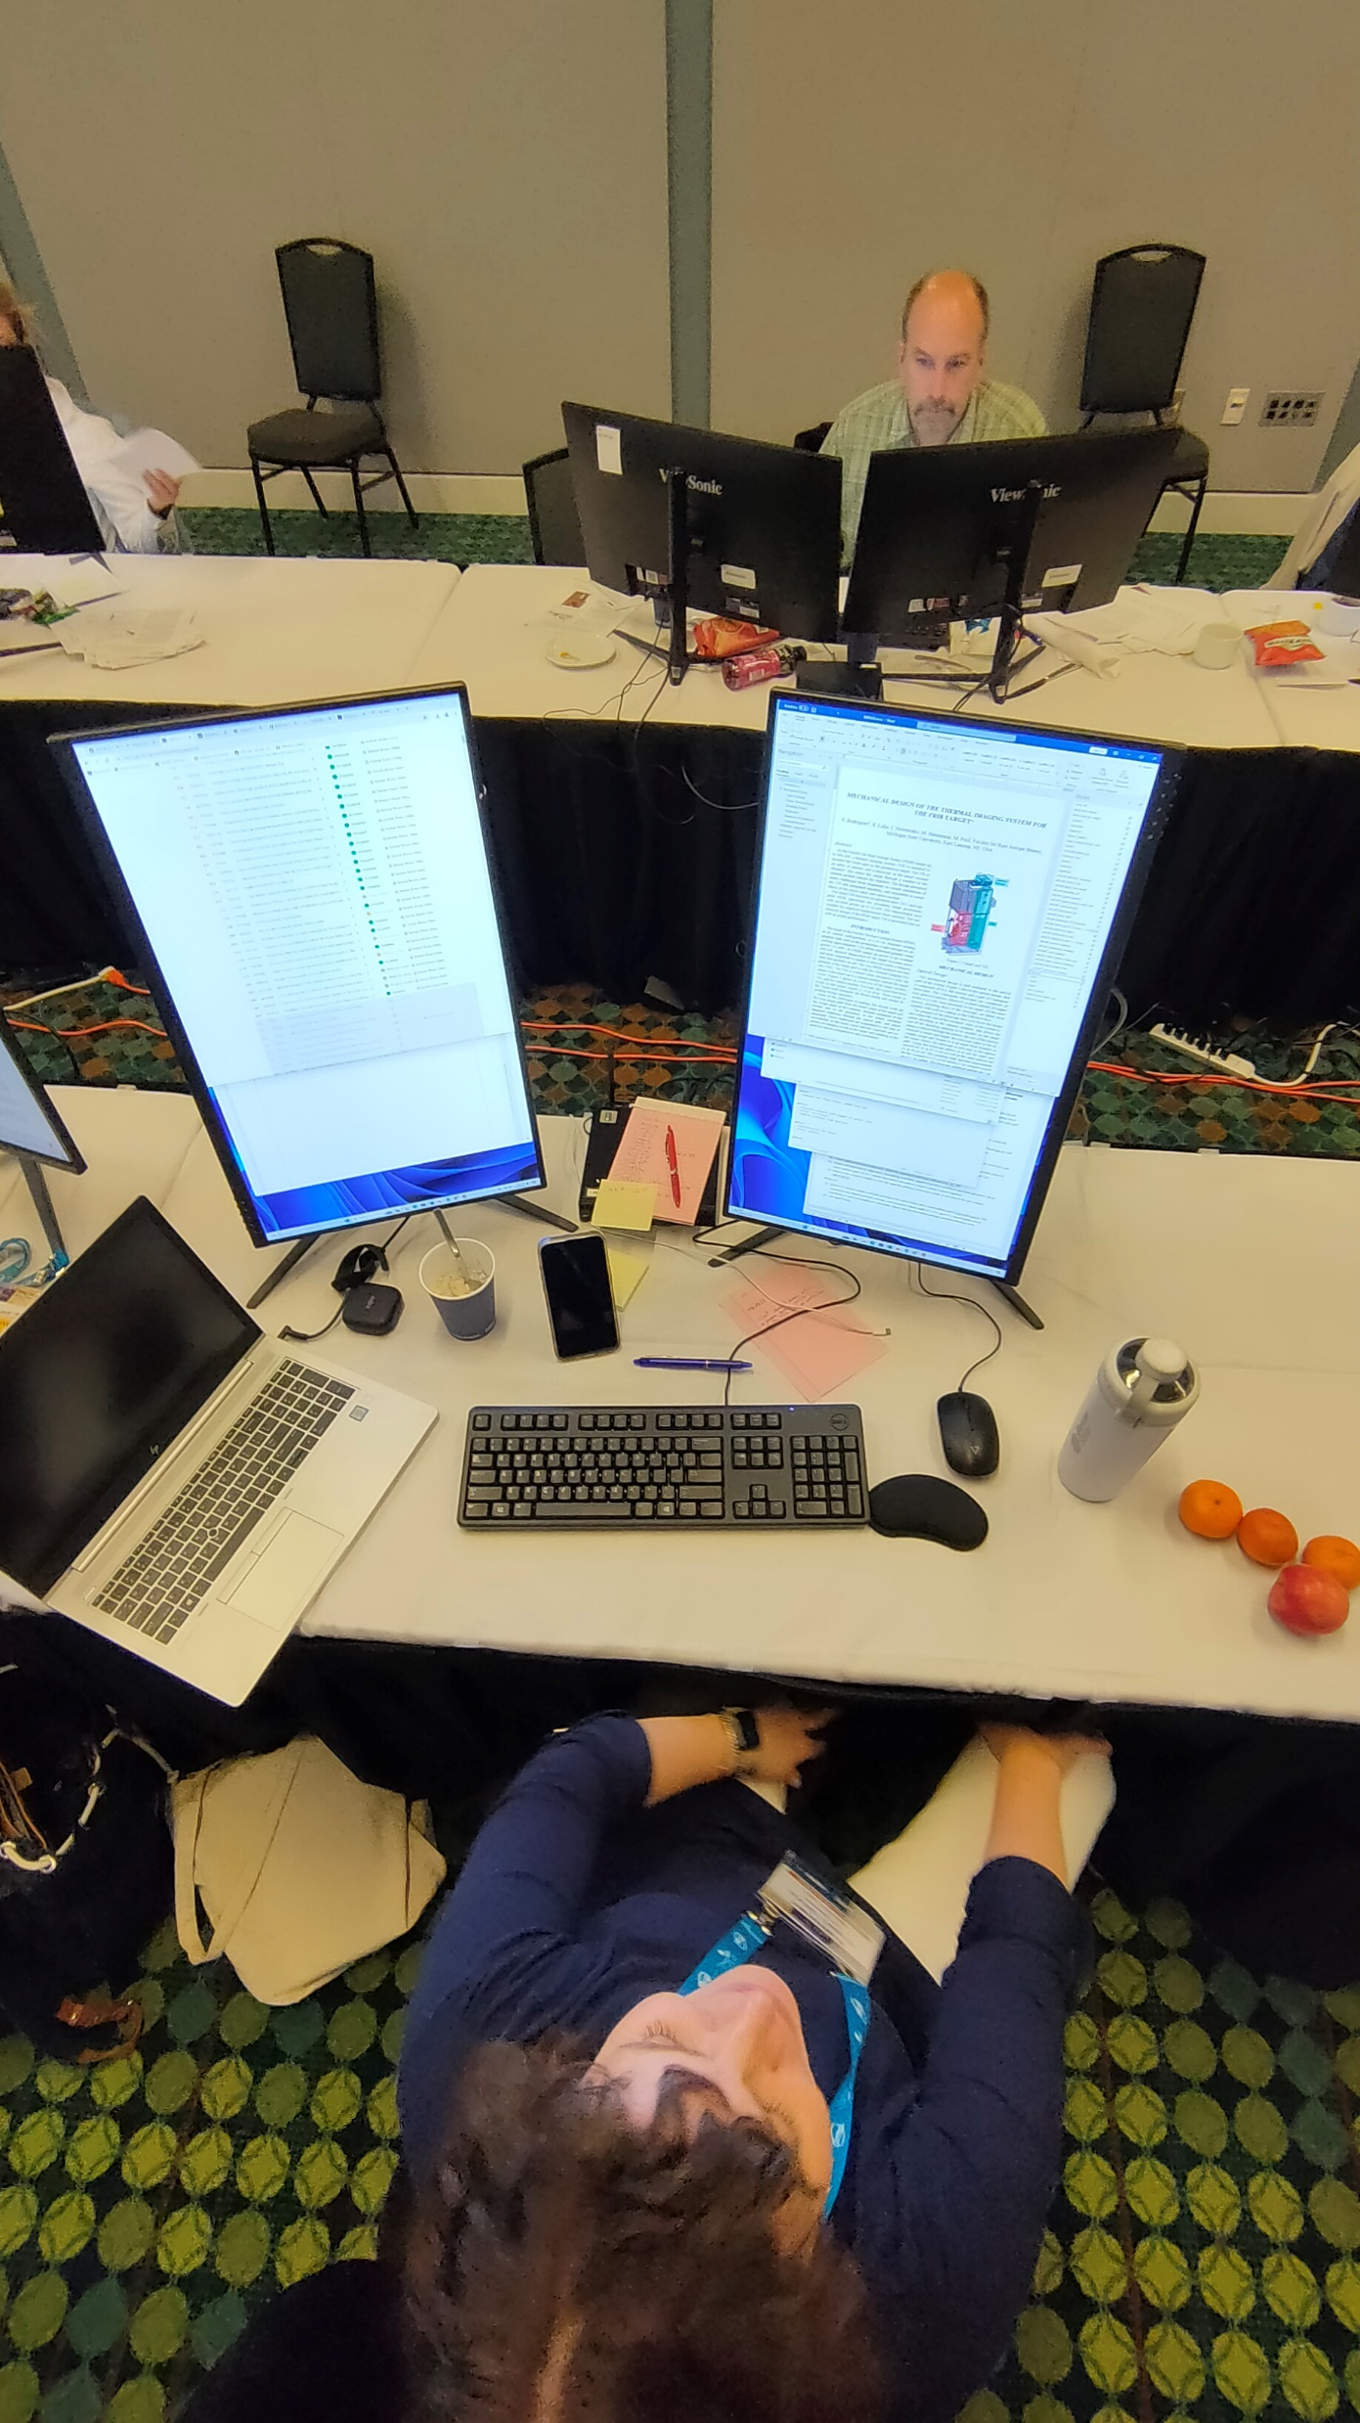
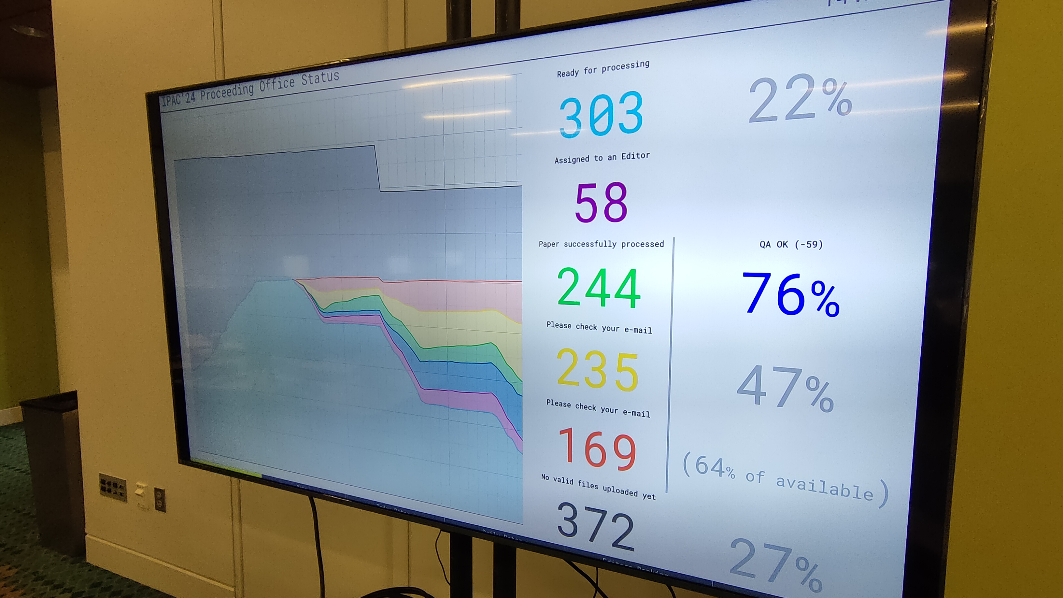
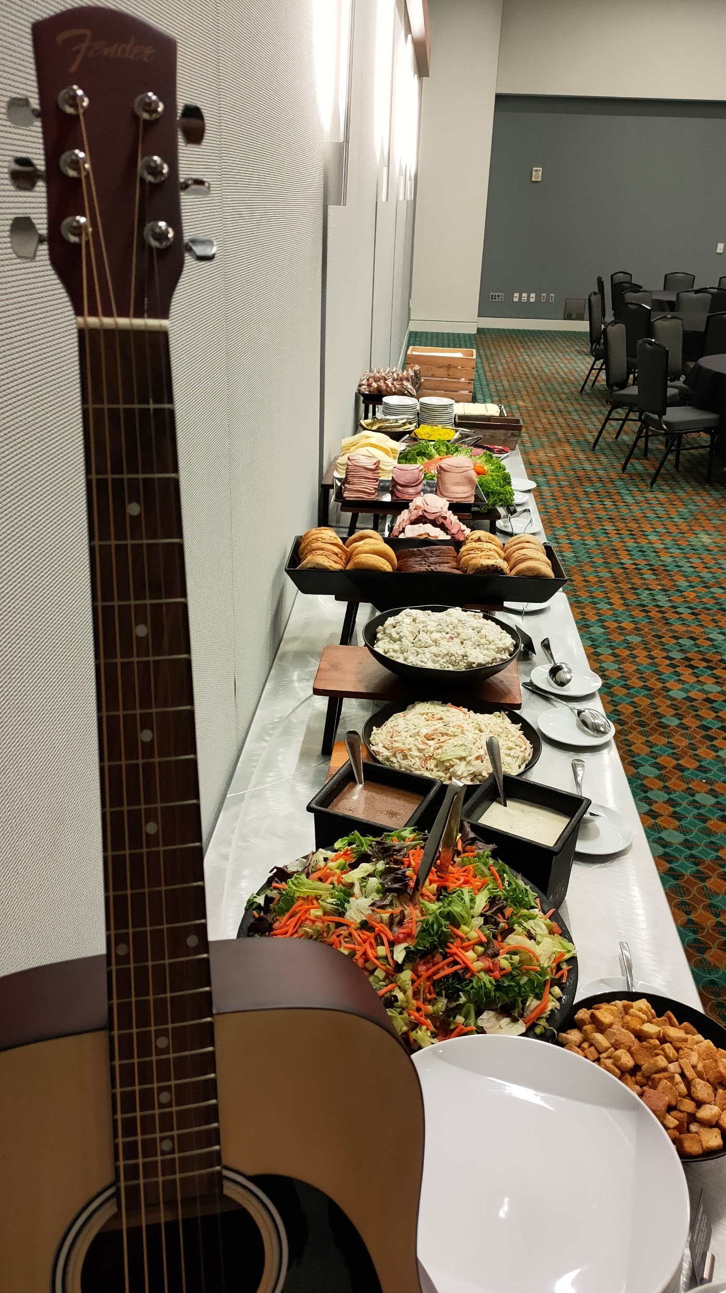
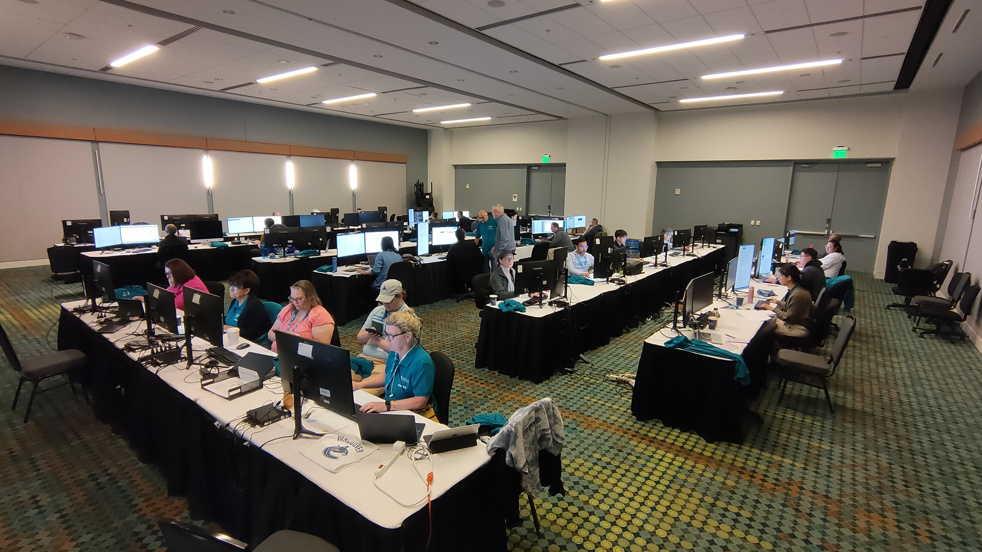
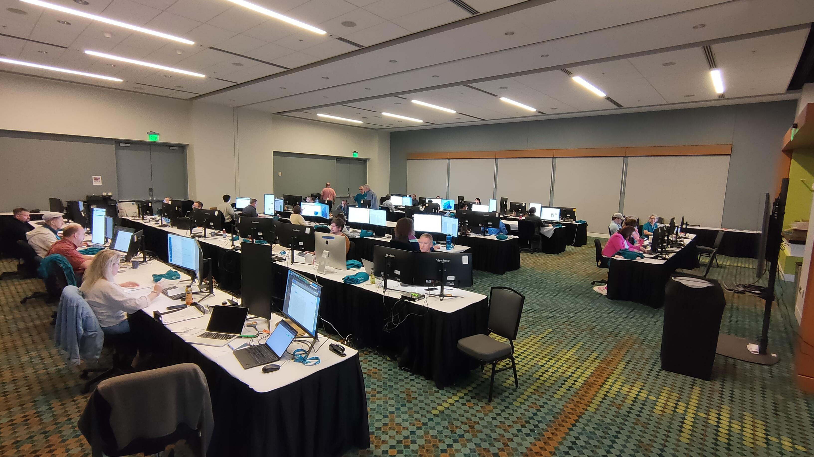
Editors and Author Reception

Slide 5
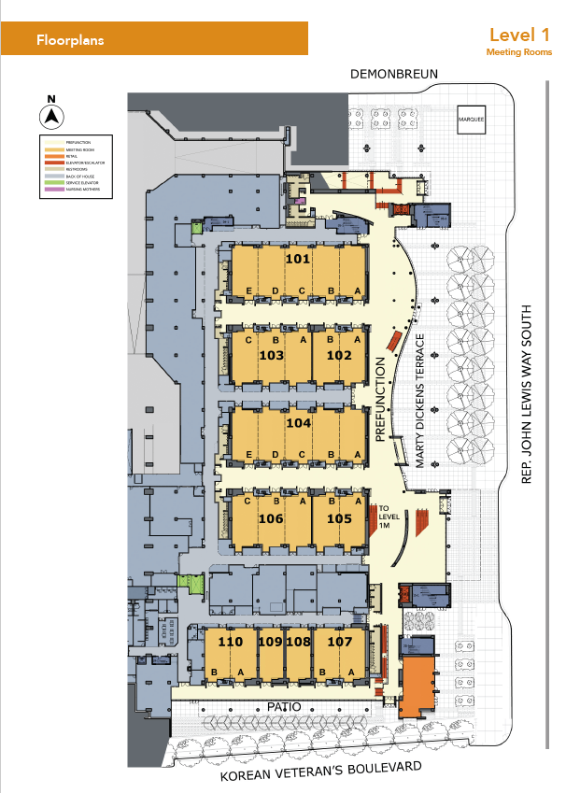
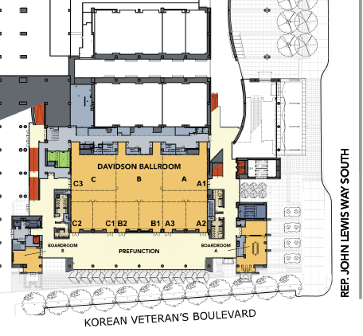
Level 1 and 1M - Breakouts
Breakout A on Level 1M - Davidson
Breakout B
Editors & Speakers
Conference Chair Office
Breakout A

Slide 6
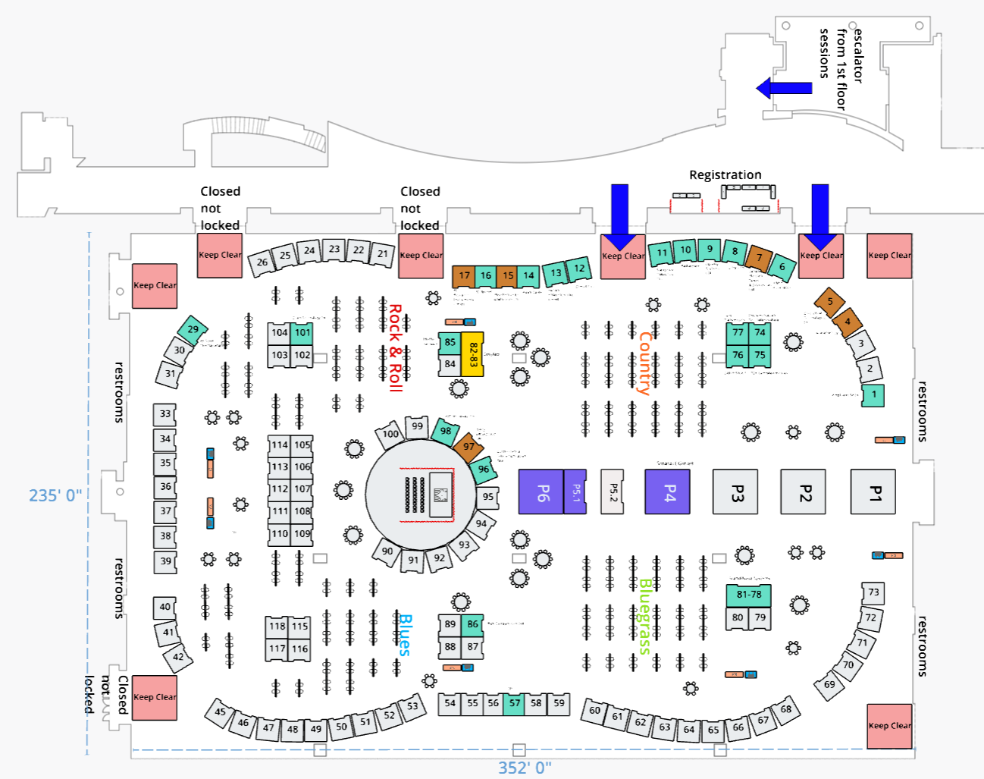
Exhibition Hall A booth layout
Level 3
Registration
110 Exhibitor Booths
6 Pavilions
120 4x8 boards for 480 Posters
LOC Office overlooking show floor
Registration at entrance to hall
LOC Office 3M
Sold 31 as of
August 16, 2023

Slide 8
Proceedings Office Equipment
Two 27” monitors/ station
Two printers
Private network
Wi-Fi only
Wired option was ready to go but not implemented
Electrical power needed to be added ($148/circuit)
Bought power strips at hardware store
Upgraded Chairs

Slide 9
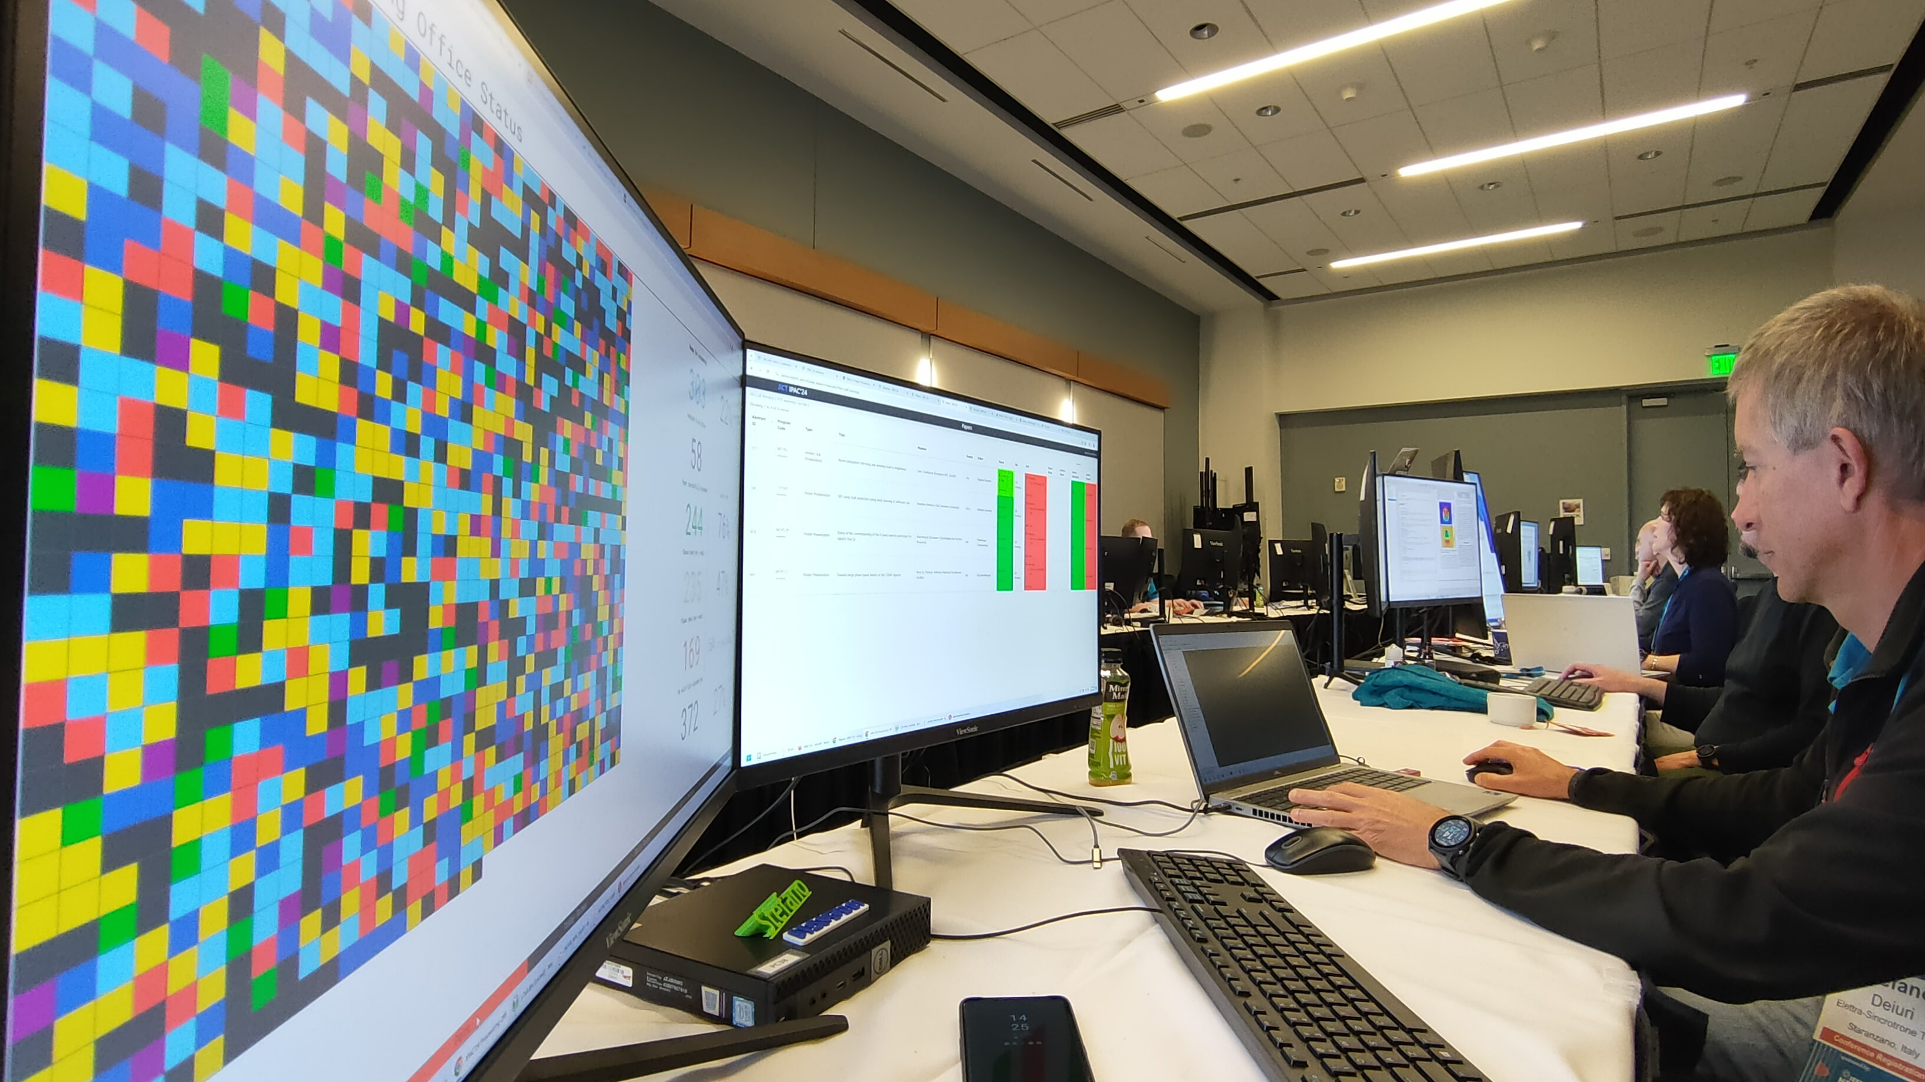
Software
List of software from JACoW
ORNL loaned Adobe licenses to IPAC’24
Vendor supplied MS Office Pro 2021
Custom Image installed by vendor
Initial configuration setup at ORNL
Image created and sent to vendor for install

Slide 10

JACoW Software Lists
Windows 10 64 bit (English)
Microsoft Office 2019/2021
LibreOffice 7.6.5
Firefox
Google Chrome
Adobe Acrobat Professional DC
JACoW Acrobat configuration
JACoW JobOptions (JACoW-11) properly installed in Acrobat Distiller
Enfocus Pitstop Professional 2022 - licenses of 30-day trial (activate trial only before conference)
Will not install until Adobe Acrobat Pro is installed

Slide 11

Text Editors (for keeping notes)
Notepad++
WinEdt (30 day trial)
EditPlus
Gvim for Windows
7Zip
Ghostview, GSView, GhostScript
ssh client: e.g., PuTTY
IrfanView
XnView
MiKTex (User Mode install, not Admin install)
JACoW LaTeX classfile properly installed
TeXStudio (first choice) + TeXnicCenter/TeXmaker as a TeX GUI
Meld (for diff/merge)
VLC
GIMP
Paint.NET
DoubleCommander (OpenSource) or SpeedCommander (30-Day Trial)
Handbrake
VirtualDub
PPspliT - Microsoft Office must be installed before installing PPspliT

Slide 12

Macintosh Computers (less often used since 2019)
Mac OSX (latest)
Microsoft Office 2019/2021
LibreOffice 7.6.5
Firefox
Google Chrome
TeXShop
  JACoW LaTeX classfile properly installed
  uses TeX Live
Ghostview, GSView, GhostScript
GIMP
Adobe Acrobat Professional DC
  JACoW Acrobat configuration
  JACoW JobOptions properly installed in Acrobat Distiller
Enfocus Pitstop Professional 2022 - licenses of 30-day trial (activate trial only before conference)
Will not install until Adobe Acrobat Pro is installed

Slide 13
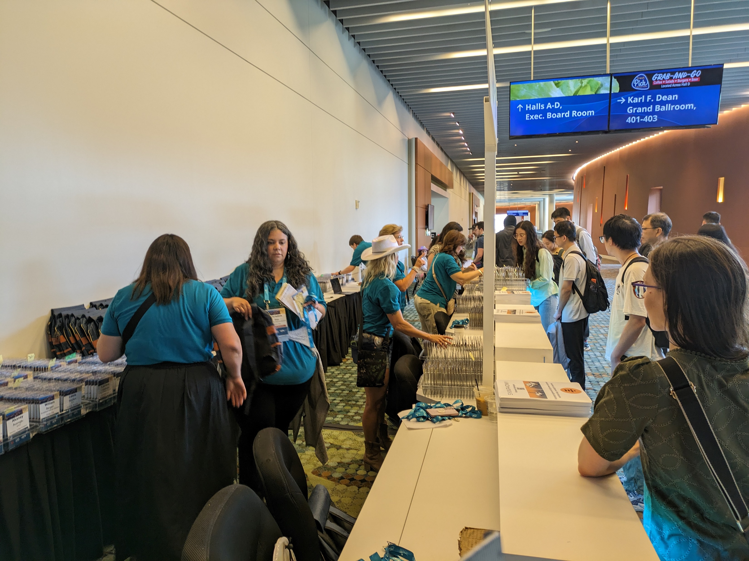
Registration Equipment
Laptops
  Used to lookup registration if badge wasn’t found
  Onsite registration
  Needed one for poster presenters to find their spot
Low-cost color printer for new badges
  Needs card stock capability
  USB connection minimum

Slide 14
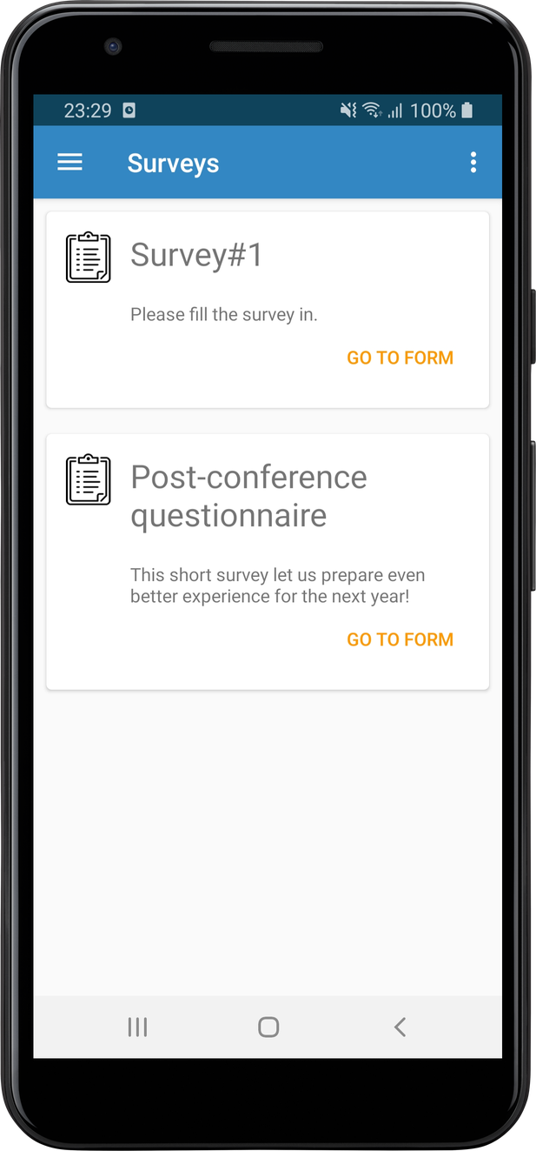
Websites
Main website
  ipac24.org, ipac24.com
Abstract and Paper Submission
  indico.jacow.org/event/63/
Delegate and Exhibitor registration
  web.cvent.com
Paper statistics jict.ipac24.org
Mobile App conference4me.psnc.pl/get/?config=ipac2024

Slide 15
Email
LOC email accounts
  info@ipac24.org
  registration@ipac24.org
  Scientific.secratatiat@ipac24.org
  Student-grant@ipac24.org
  communications@ipac24.org
  exhibition@ipac24.org
  editor-in-chief@ipac24.org
  visa@ipac24.org
  satellite_events@ipac24.org
Staff Shirts
  Registration
  Proceedings Office staff
  Students

Slide 16
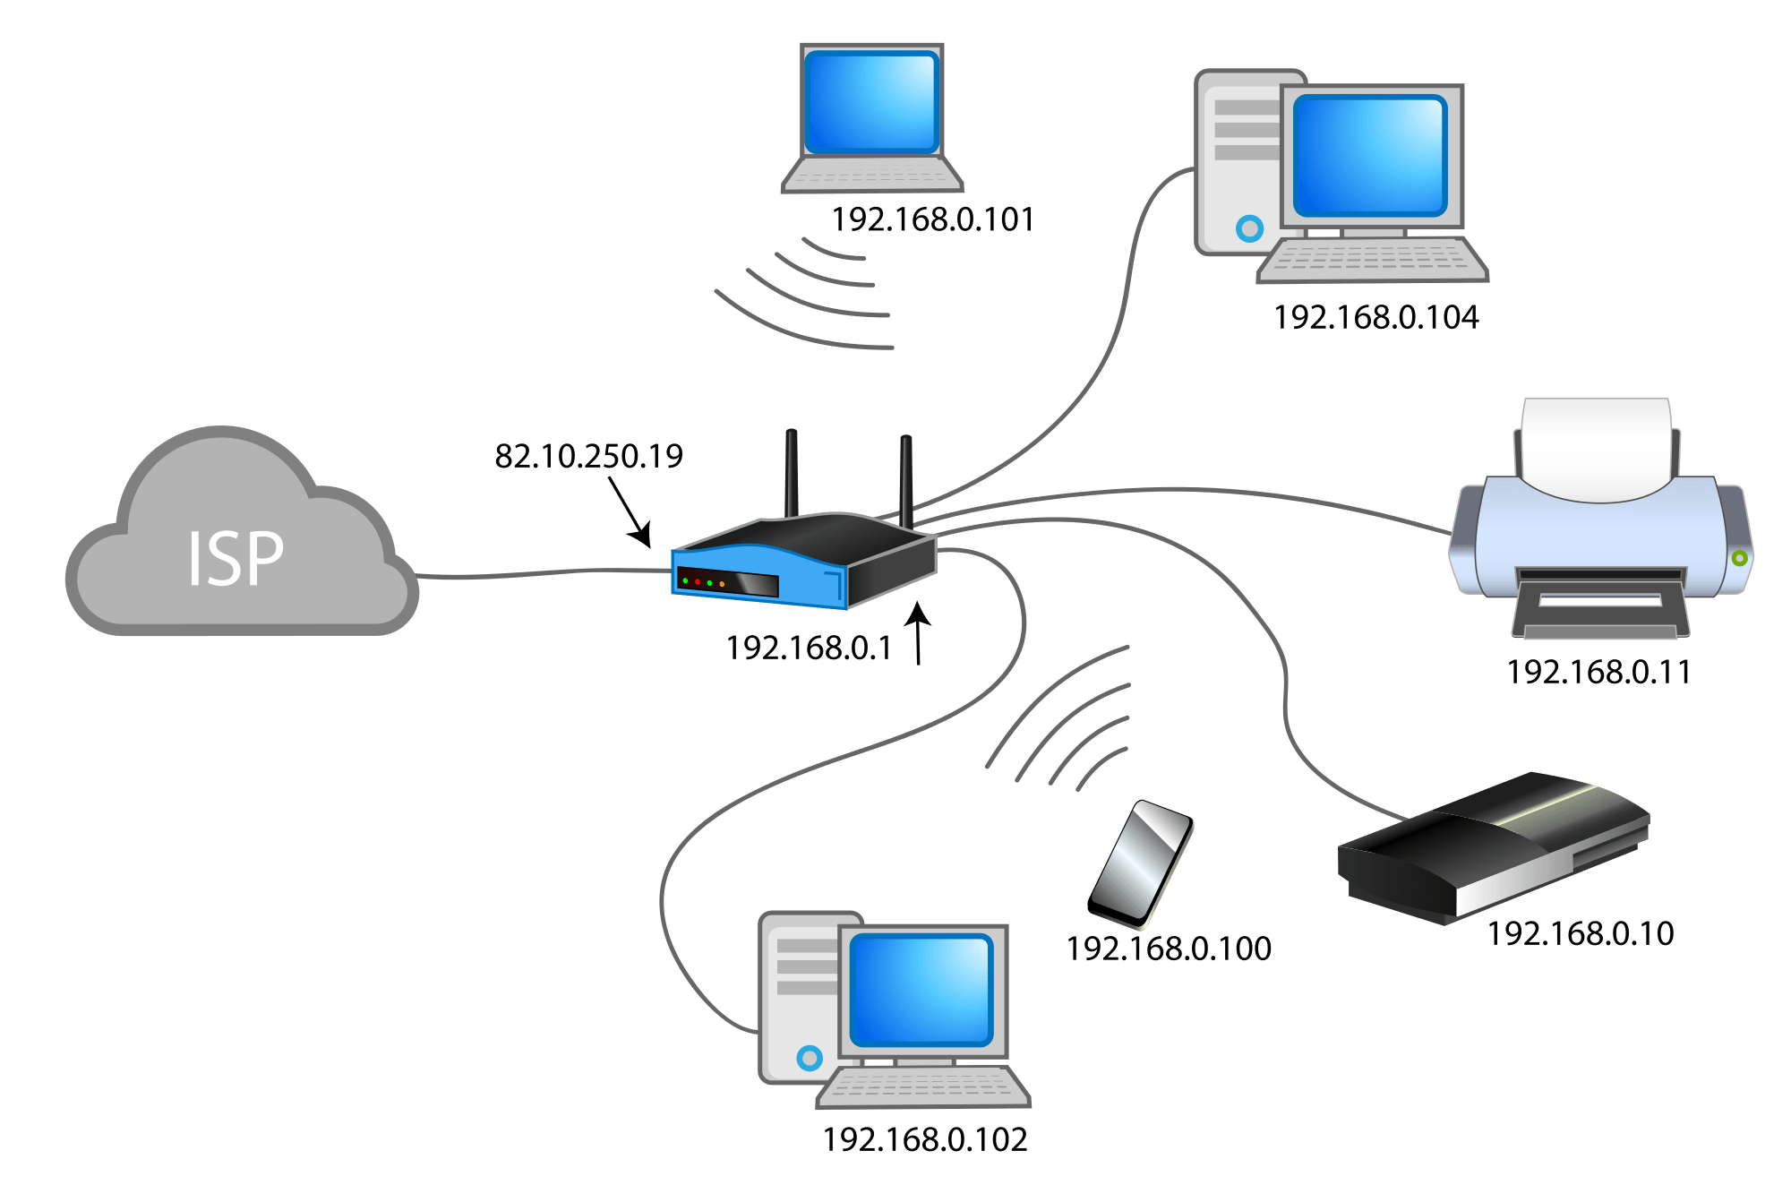
Network/Internet
MCC was a new facility with modern infrastructure
Free general use Wi-Fi throughout
Purchased private Wi-Fi for LOC staff
This Photo by Unknown Author is licensed under CC BY-NC

Slide 17




Should we rent or buy?
Buy
Rent
Computers are low cost
No cost to IPAC
Computers can be bought early and set up
No, too much $ at one time
ORNL buys per need not in bulk
Vendor
  Sets up software
  Manages shipping and storage
  Latest versions available
  Purges data afterwards
Another contract
Poor service

Slide 18
Issues
Vernon Computer
  Delivery
  Communication
  IEEE contract
  Disc Images
  Delivery
    Lost iPads
    Delivered items didn’t match BoL
  Return
    Pickup on Saturday was after venue contract
    Driver didn’t have assistance
We needed more help packing up afterwards
  3 people took 5 hours
Venue contract
  Not included items
  Electrical power drops
  Wired ethernet expensive
AV contracts
  Venue
  Satellite meetings
  Social events

Slide 19
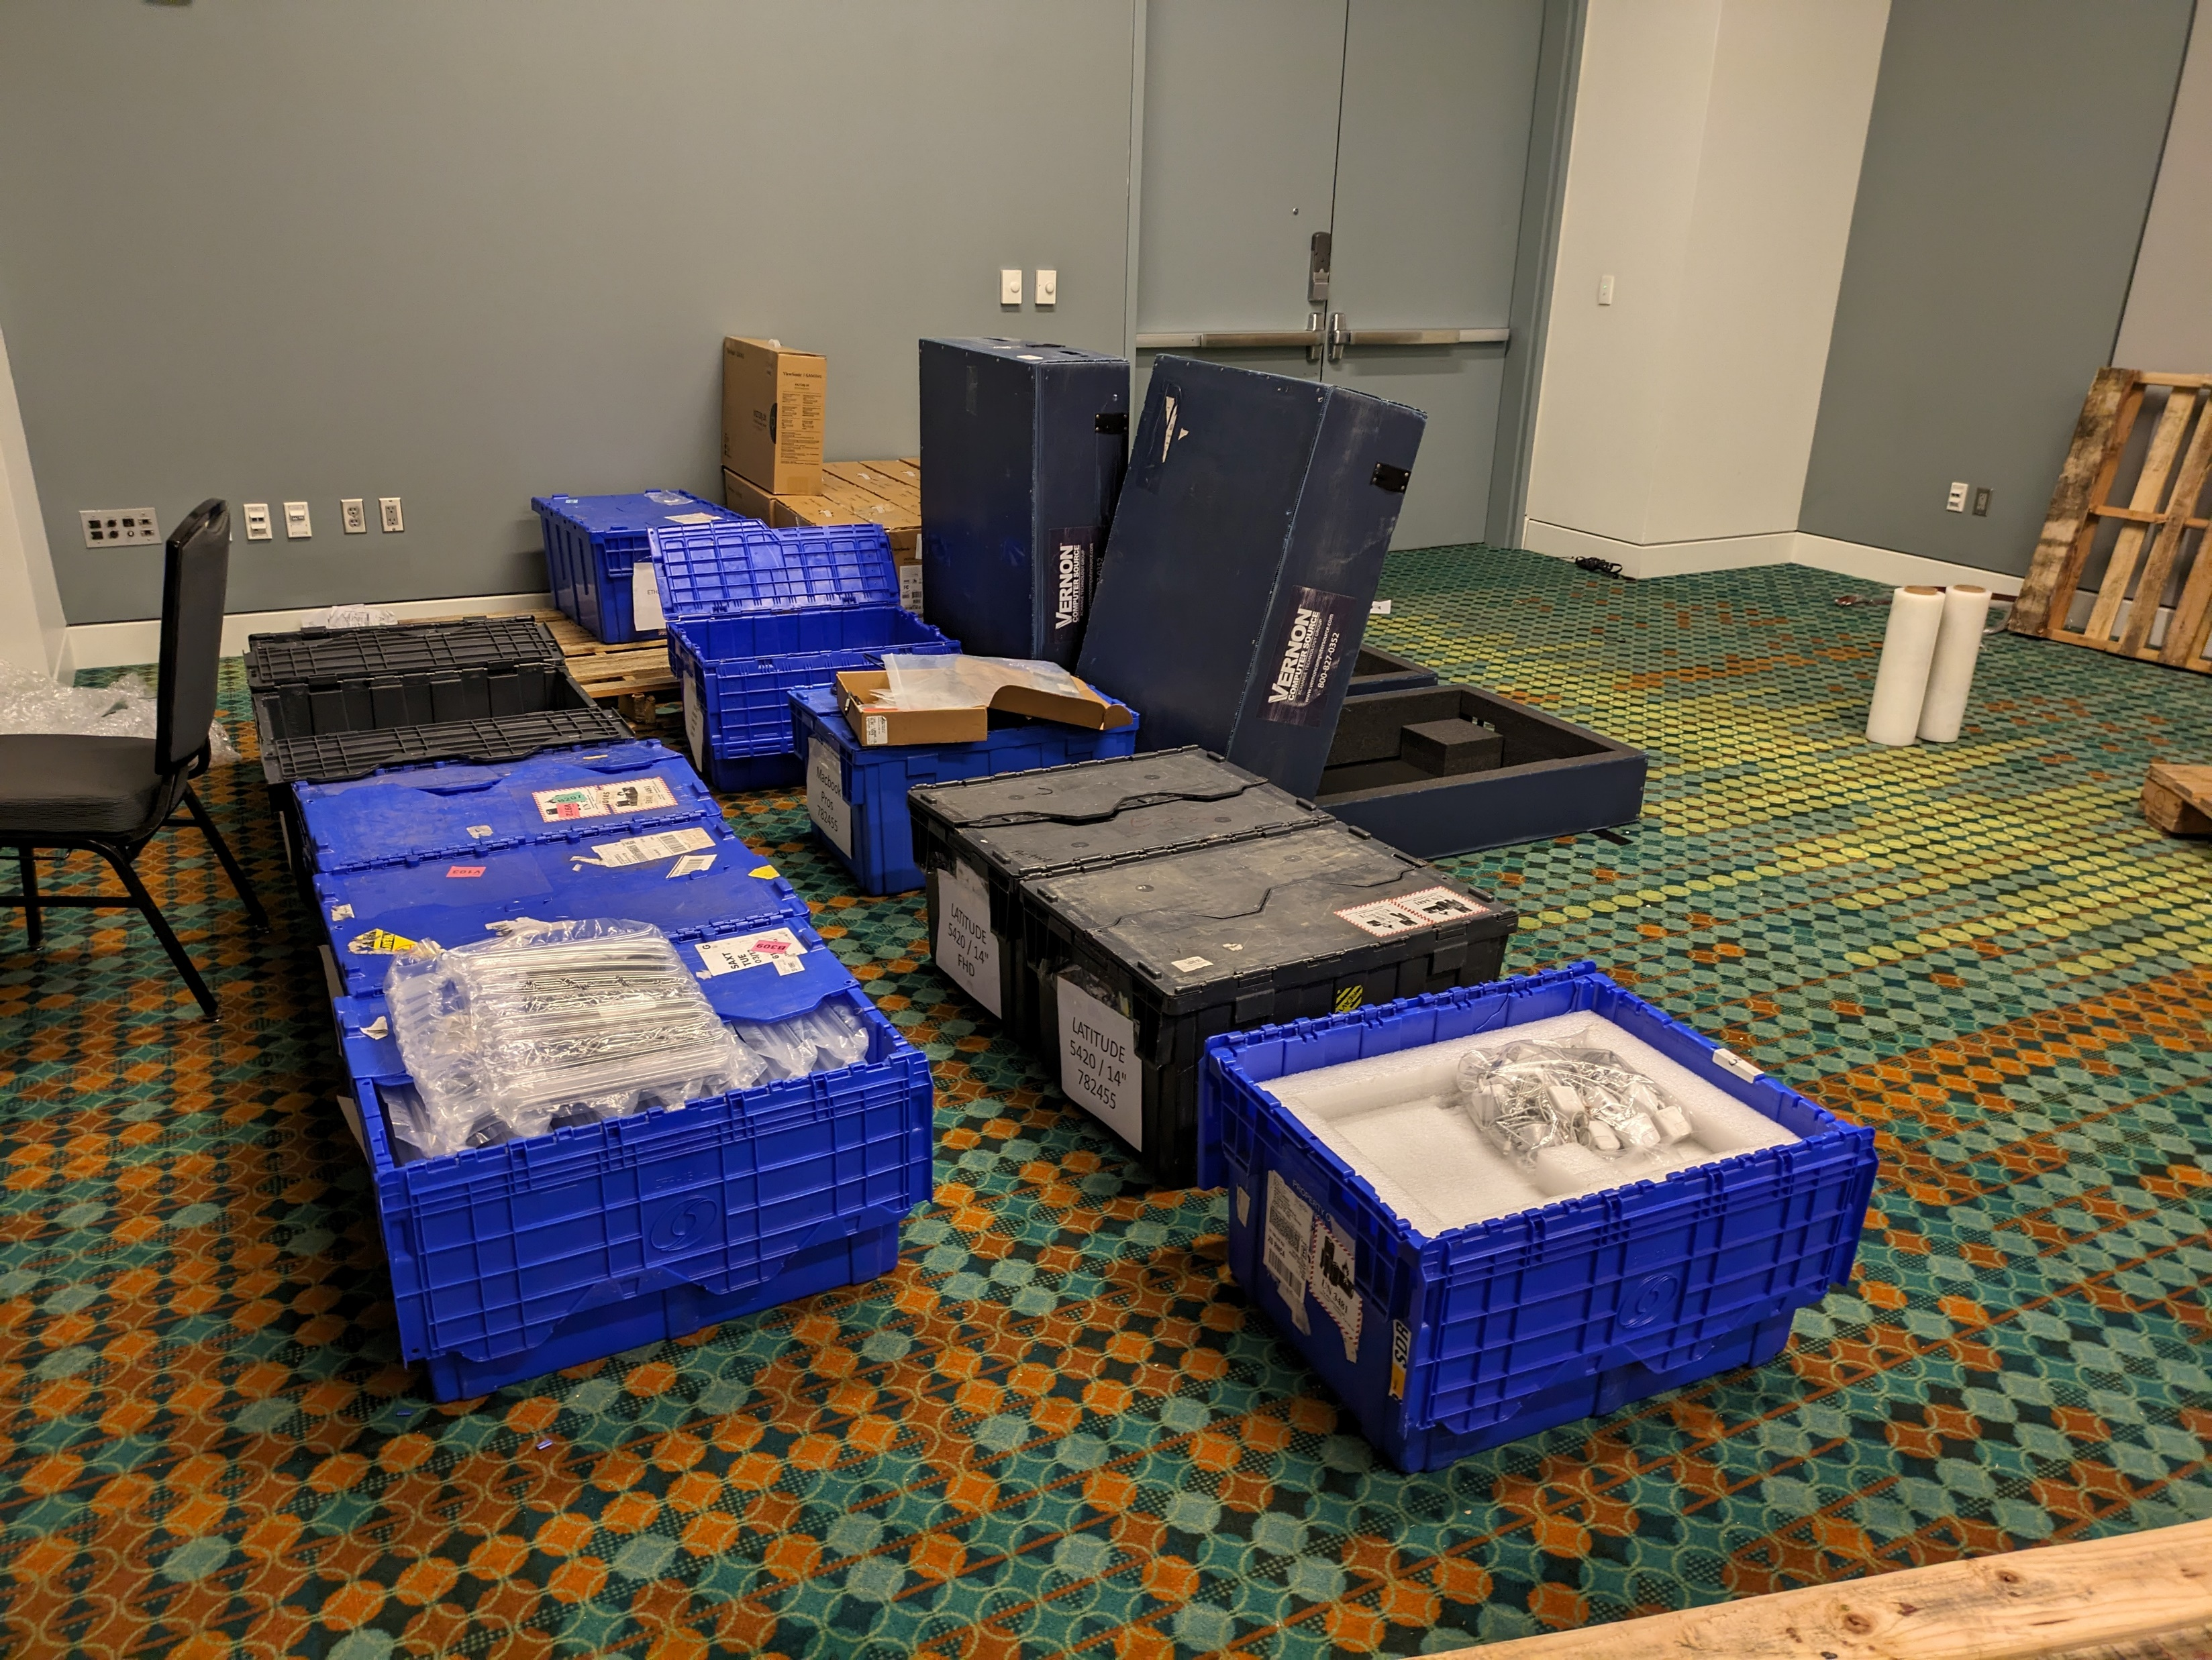
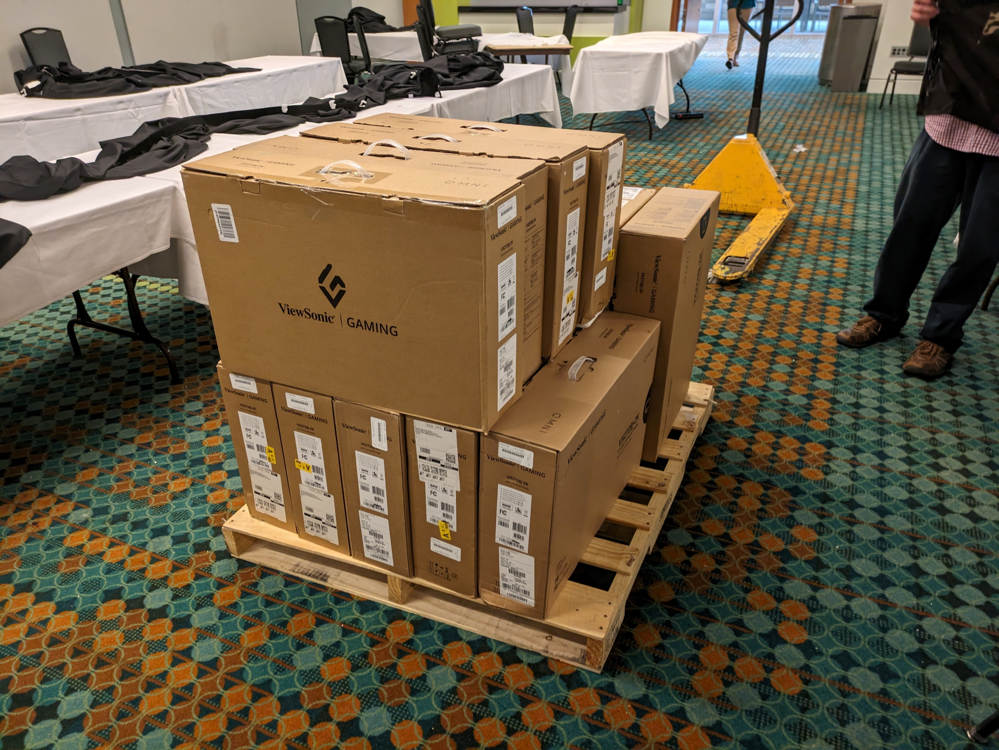
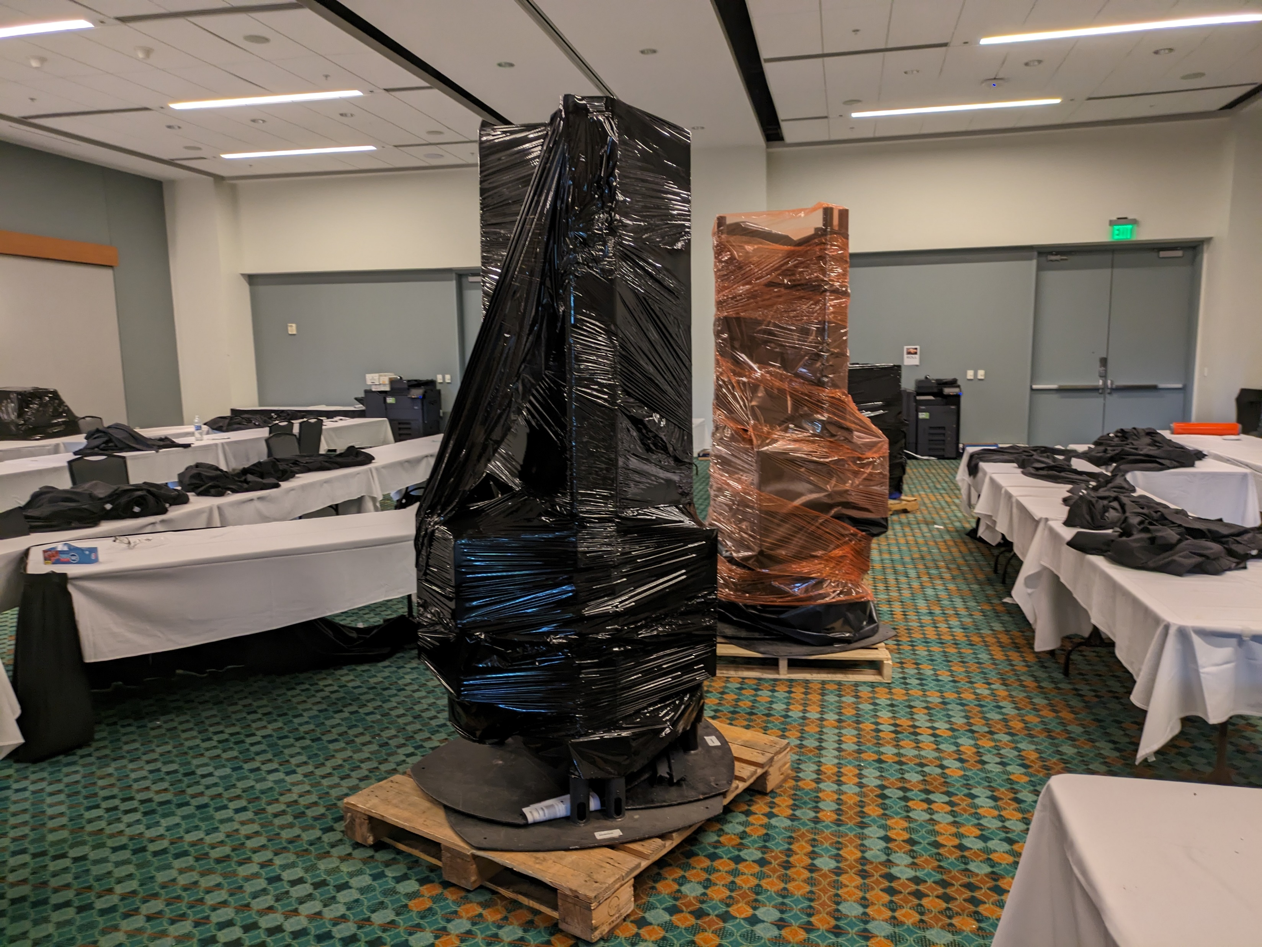
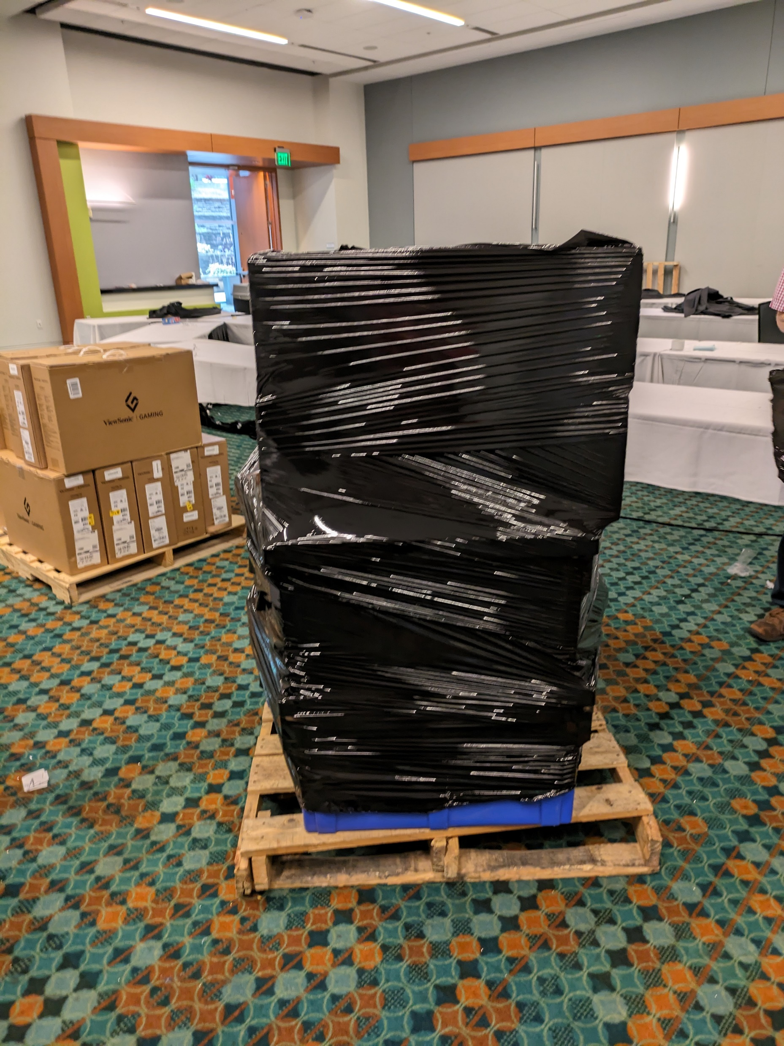
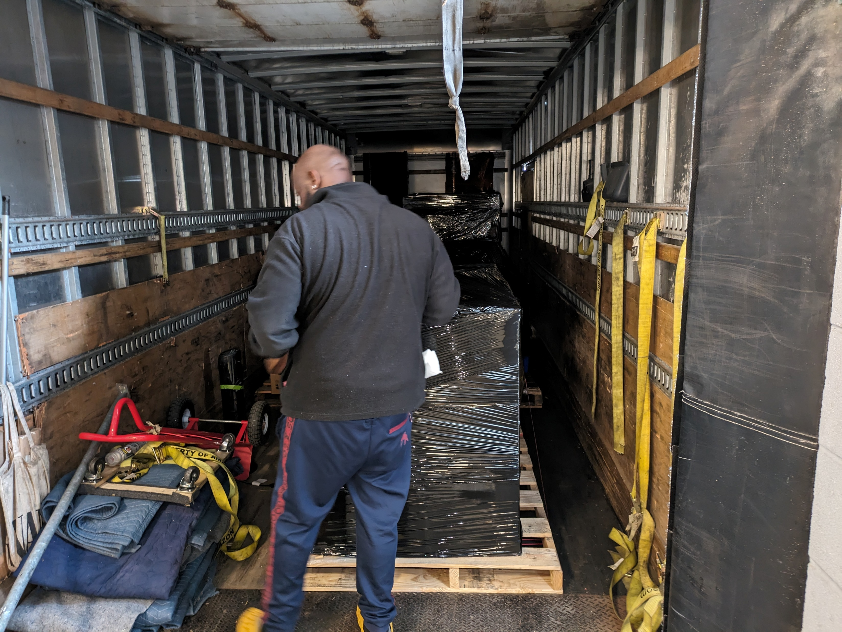
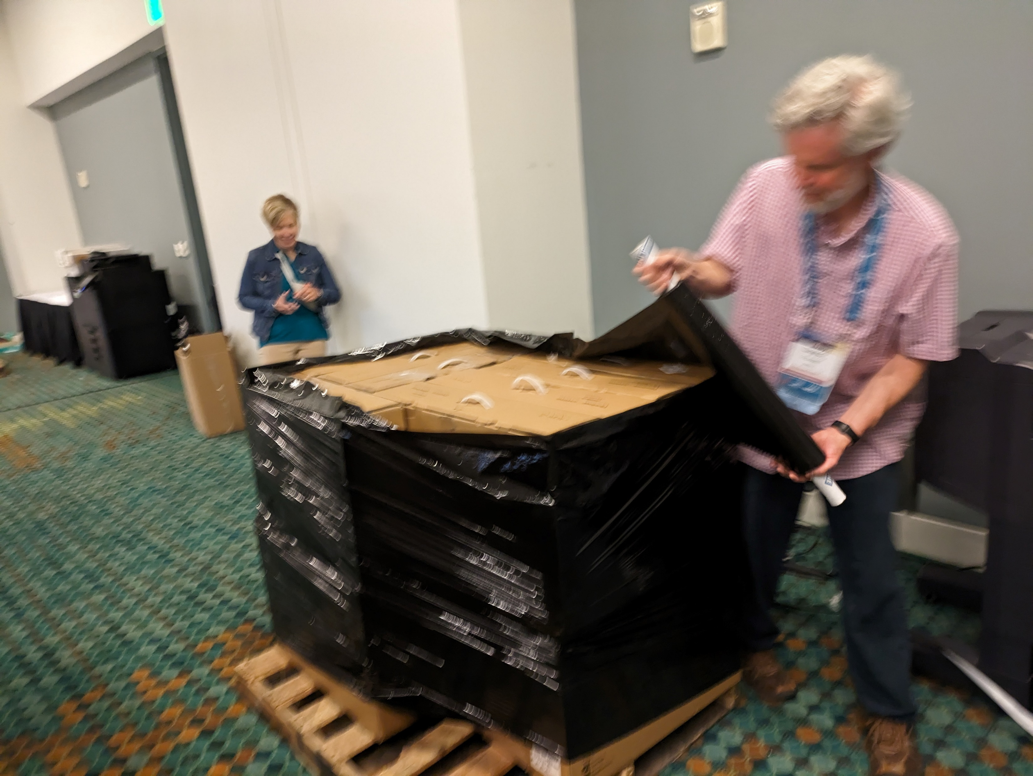
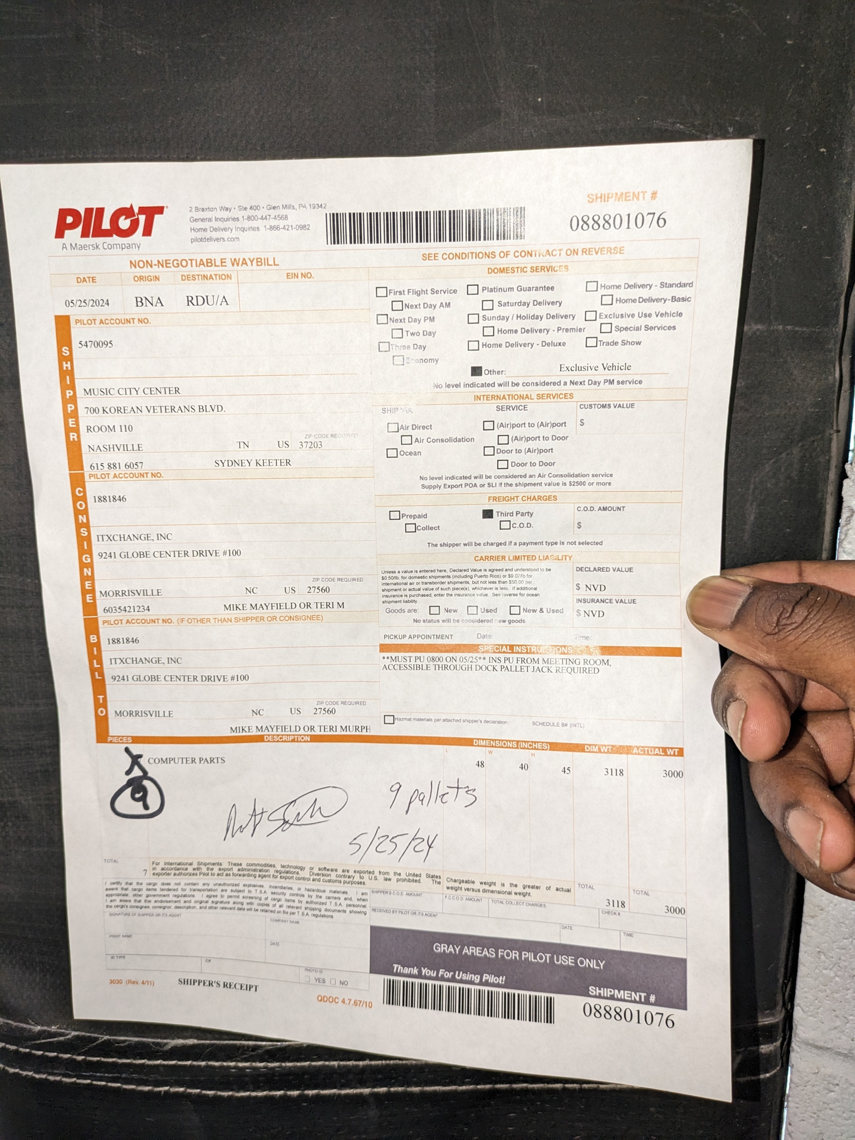
Clean up after conference
Be sure to have staff on hand to help

Slide 20
Thank you!

