Slide 1
JACoW-Indico Scientific Program Management
IPAC’24 Scientific Secretariat Report
Petr M. Anisimov
Wednesday, November 6, 2024
LA-UR-24-31807

Slide 2
JACoW’s Relationship to Committees:
Scientific Program Committee (SPC)
The SPC meets several (~3) times before the conference:
  1st: Advises SPC chair on classifications and
  Organize scientific program, schedule, synoptic table.
  2nd: Recommends, selects, invites invited oral contributions.
  3rd: Selects contributed oral contributions from submitted abstracts and
  Balance scientific program: topic, geography, gender.
SPC interactions are through use of Indico to organize scientific program + emails (responses come to your mailbox) and occasional Excel spreadsheets:
  titan.email for our Wordpress website came with ”Email read” feature.
  Excel version of Synoptic Table was my guiding star!

Slide 3
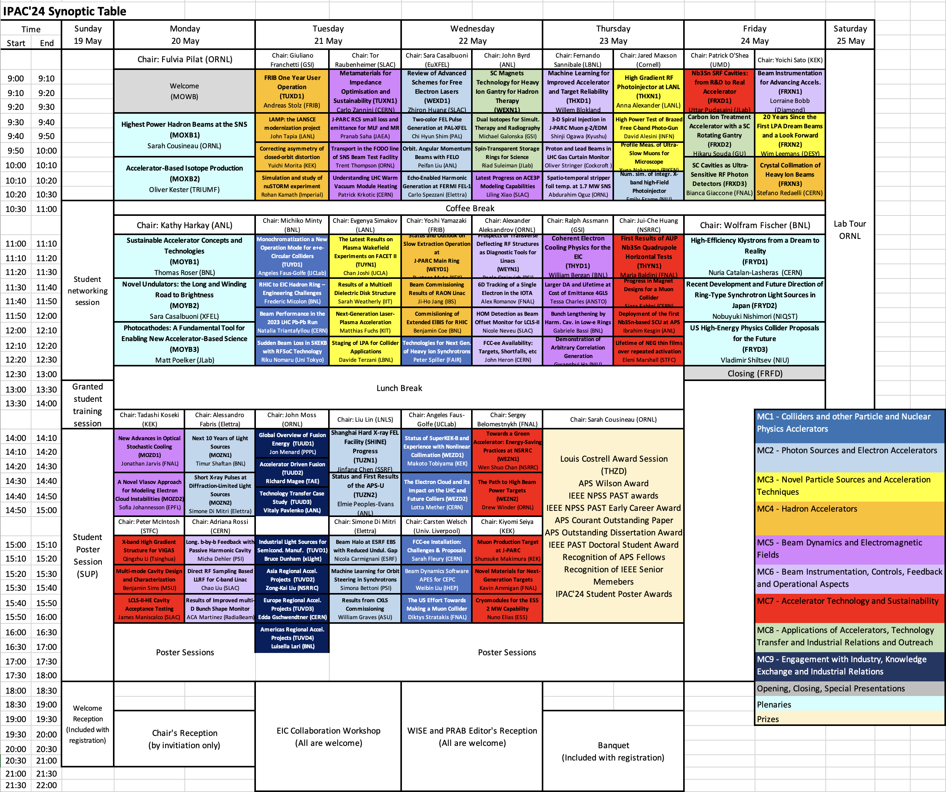
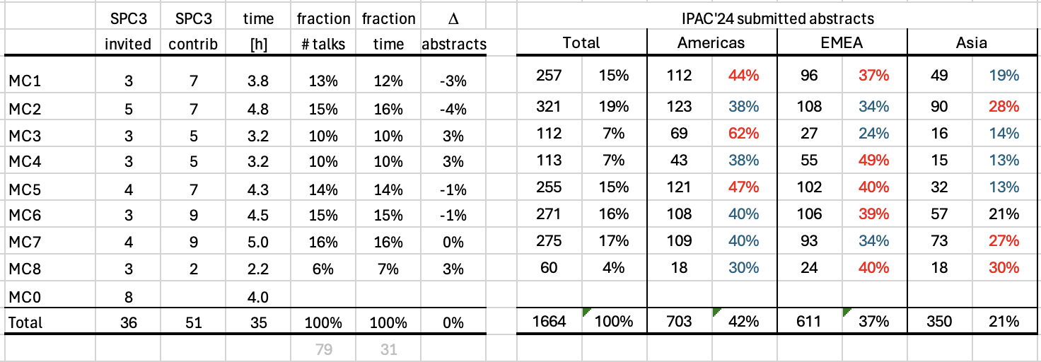


Slide 4
JACoW’s Relationship to Committees:
Scientific Program Committee (SPC)
However, the SPC organizes much of its work through Indico
  Recommendations for and voting on invited speakers
  Abstract submission
  Recommendations for and voting on contributed speakers
  Scientific program organization, including statistical balance
  Paper and presentation submission
  Email organization/tracking with authors and committee members
Indico/SPC coordination is done by the Scientific Secretariat
  Not explicitly a JACoW role but should be JACoW knowledgeable.
Scientific Secretariat is Primary Indico administrator
  Involved in nearly all functions that flow through Indico
  Indico main function: Scientific Program Management

Slide 5
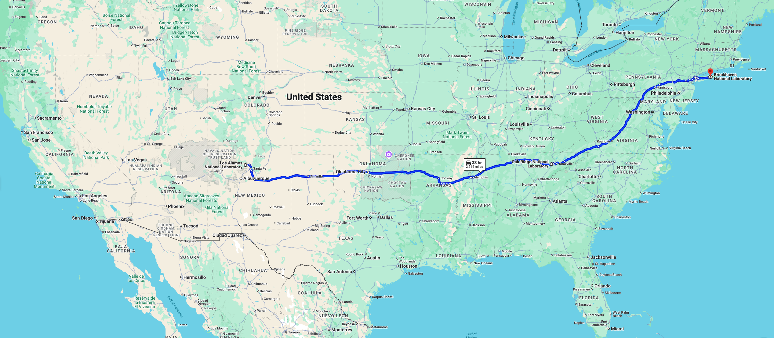
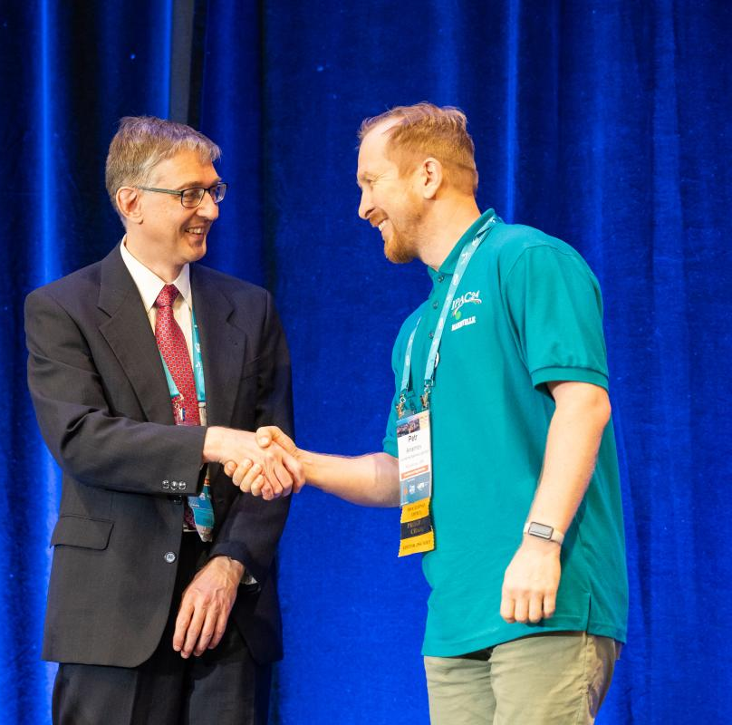
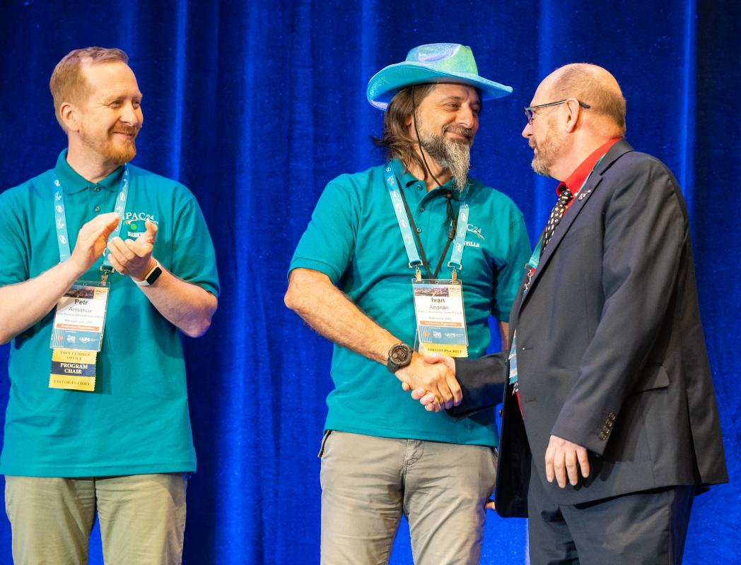
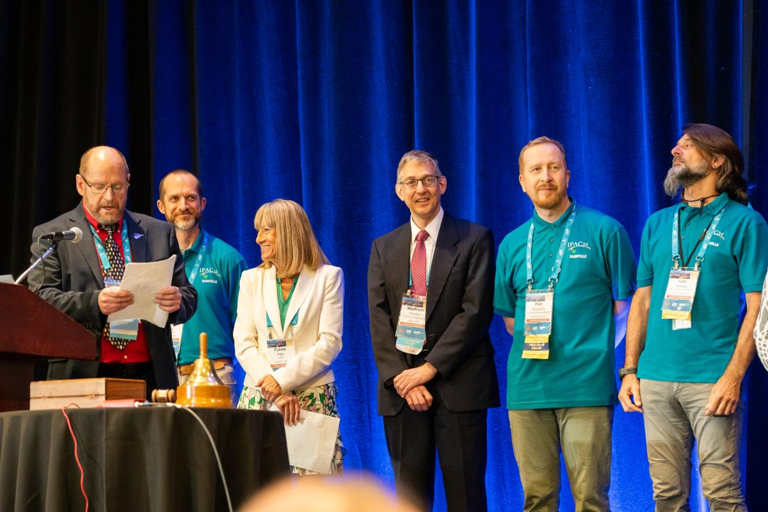
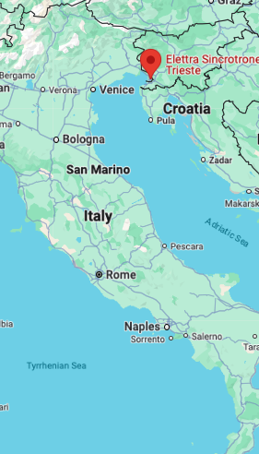
Communications, Communications, … Lots of Emails
read https://ipac-docs.jacow.org/ weekly
SPC
SS
LOC
EiC

Slide 6

NAPAC’22: August 7-12,2022
JTM’22: November 8-11, 2022
IPAC’24 SPC1: January 10-11, 2023
IPAC'23: May 7-12, 2023
C-21m
C-18m
C-16m
C-12m

Slide 7
1st meeting of SPC
SPC Chair for IPAC’23 is sharing insights and passes the baton to IPAC’24 SPC:
  No peer review publications for IPAC’24;
  Simplified workflow for speaker nominations;
  Main classification descriptions were finalized on January 17th;
Follow-ups:
  Indico Instance has been created by Ivan Andrian on January 31st;
  Roles Setup for SPC, SAB-Asia, SAB-Am and SAB-EU has been completed;
  Tracks created on March 3rd, 2023 and updated on March 6th, 2023;
  Email requesting Invited Orals Nominations was sent to SAB members on March 7th with March 27, 2023 deadline:
    1st reminder sent via Indico on March 14th, 2023 since only 25 proposals received;
    2nd reminder sent via Indico on March 24th, 2023 since only 155 proposals received;
    Some SAB members could not submit by March 27th, 2023 – no extension.

Slide 8

JTM’22: November 8-11, 2022
IPAC’24 SPC1: January 10-11, 2023
SAB Nominations by March 27th, 2023
IPAC'23: May 7-12, 2023
C-18m
C-16m
C-14m
C-12m

Slide 9
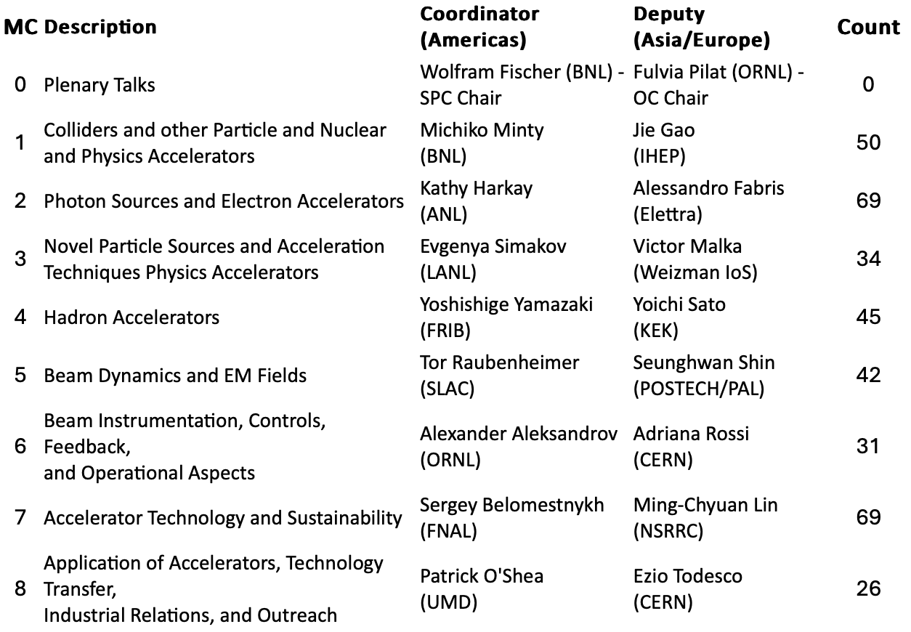
SAB Nominations Collected
MC coordinators based on SPC membership have been added to Indico;
SS has conducted Abstract QA prior to asking SPC members to vote;
Follow-ups:
  Email to SPC members was sent on April 5th
  to review MC and assign priorities for Invited
  Oral proposals (366 total);
  April 18th, 2023 deadline;
  April 13th, 2023 1st reminder sent!
  April 18th, 2023 final reminder sent.
Outcomes:
  Excel spreadsheets for each MC with
  ranking based on votes in Indico.

Slide 10
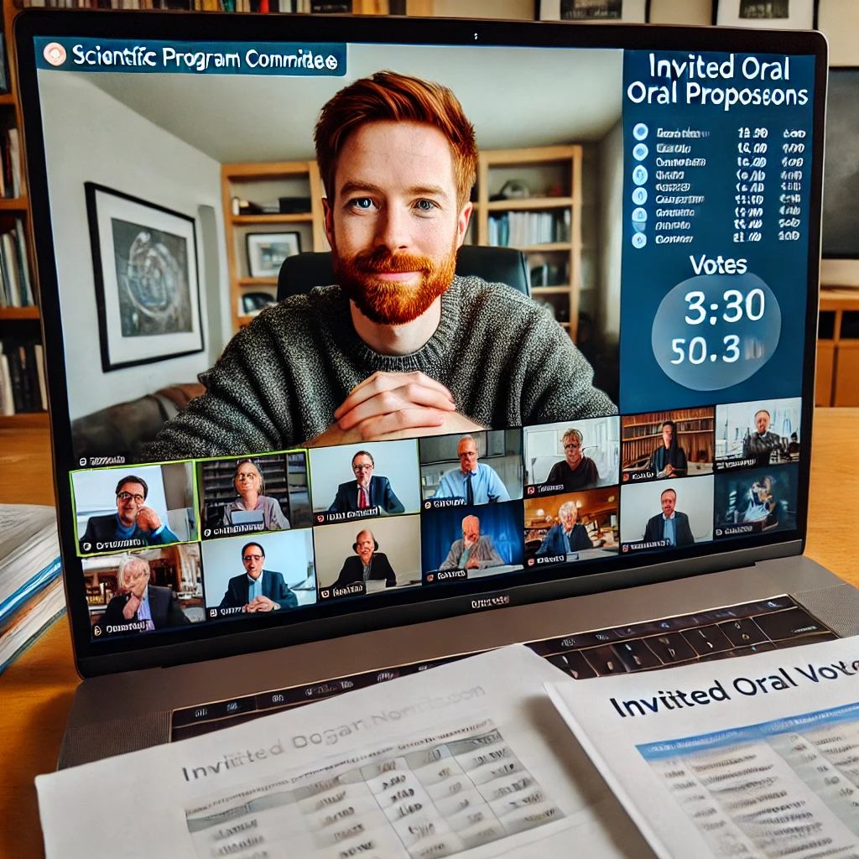
IPAC’24 SPC1: January 10-11, 2023
SAB Nominations by March 27th, 2023
SPC Voting by April 18th, 2023
IPAC'23: May 7-12, 2023
C-16m
C-14m
C-13m
C-12m

Slide 11
SPC Priorities Collected
Some SPC members could not vote by the deadline as they were going over all MC submissions and not just their MC and needed a few days to finish;
Follow-ups:
  Email to SPC members was sent on April 29th, 2023 to get together with their deputies and to decide on the speakers and their backups based on votes;
  May 8th, 2023 deadline;
Outcomes:
  Excel spreadsheets for each MC with ranking based on votes.
  Report of Abstracts per MC.

Slide 12
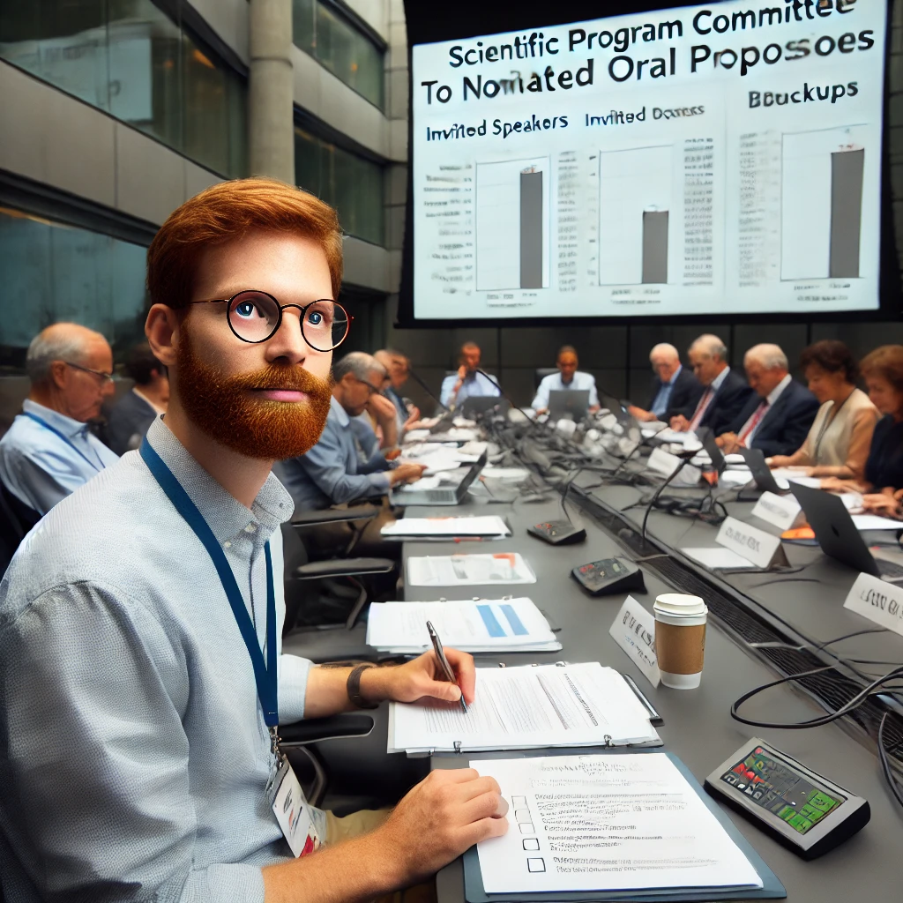
IPAC'23: May 7-12, 2023
Speakers Decision by May 8th, 2023
IPAC’24 SPC2: May 13-14, 2023
Invitations to Speakers sent
C-12m
C-12m
C-12m
C-10m

Slide 13
2nd meeting of SPC
IPAC’24 SPC2 Meeting (in Venice) to develop the Invited Oral program, including plenary and invited talks.
Follow-ups:
  May 14th, 2023 sent Summary from SPC2.
  June 3rd, 2023 creating contributions from abstracts.
  June 15th, 2023 is the deadline for feedback and endorsement on behalf of the IPAC’24 SPC.
Outcomes:
  The SPC chair distributed invited talks into the synoptic table before spending out invitation emails;
  Learn how to create invitation emails using Mail Merge in Word, generating PDFs from a Word template and Excel spreadsheets.

Slide 14

IPAC’24 SPC2: May 13-14, 2023
Synoptic table populated: June 15th, 2023
Invitations to Speakers sent: July 10th, 2023
Hunting speakers down: October 3rd, 2023
C-12m
C-11m
C-10m
C-8m

Slide 15
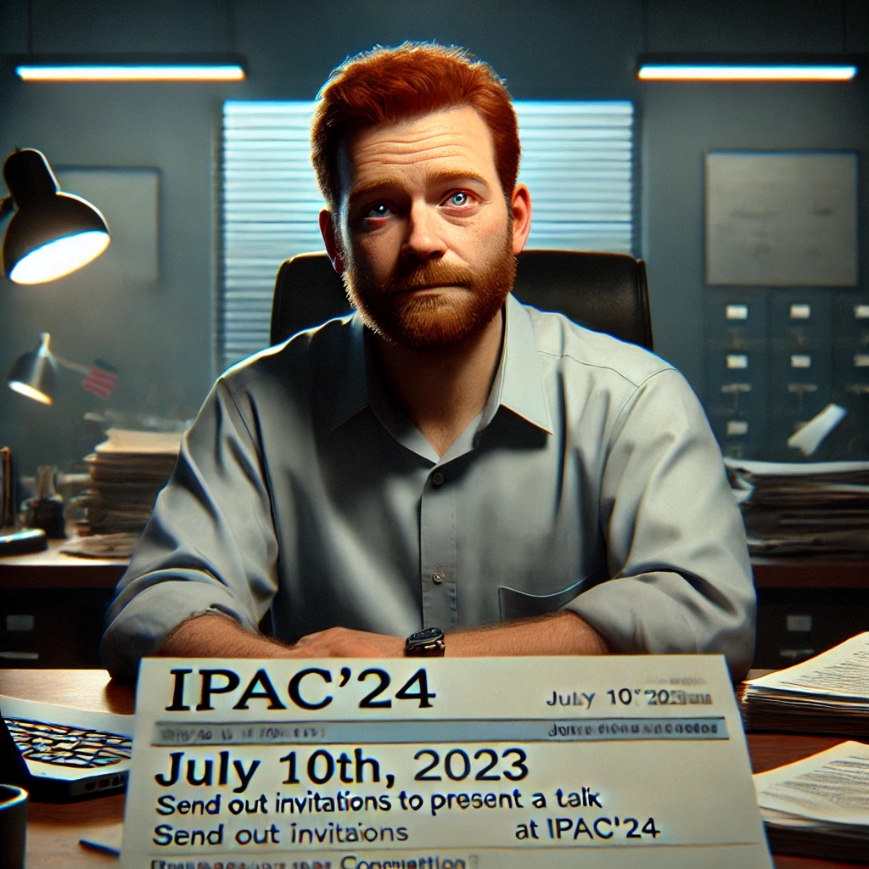
IPAC’24 SPC2: May 13-14, 2023
Synoptic table populated: June 15th, 2023
Invitations to Speakers sent: July 10th, 2023
Hunting speakers down: October 3rd, 2023
C-12m
C-11m
C-10m
C-8m

Slide 16
Scientific Secretariat Insights
Summer is a slow period when Scientists around the world are not checking their emails or not ready to make commitments for the next year!
Follow-ups:
  We sent original invitations via email that has a notification feature about someone opening our emails.
  We had to send reminders about invitations could be done via Indico now.
  Making sure that email addresses are correct.
  Ask speakers to help with sub-classification of their talks within MC.
  Creating Sessions and Timetable in Indico: September 30, 2023 to October 1st, 2023.
Outcomes:
  Be ready with backups and alternative speakers.
  Keep track of changes by updating Synoptic table.
  Place the Synoptic table on ipac24.org before opening abstract submission.

Slide 17
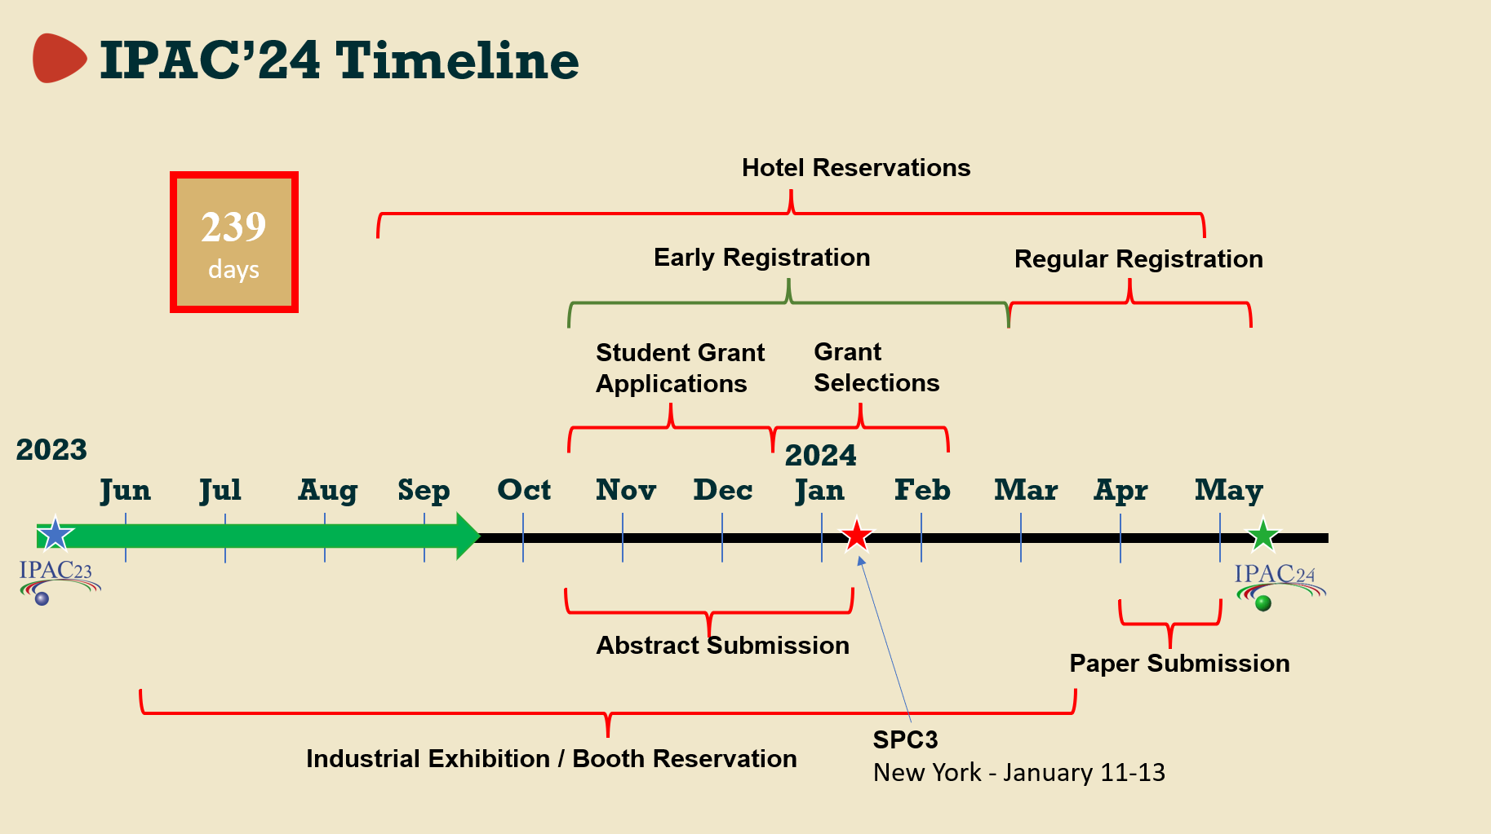

Slide 18
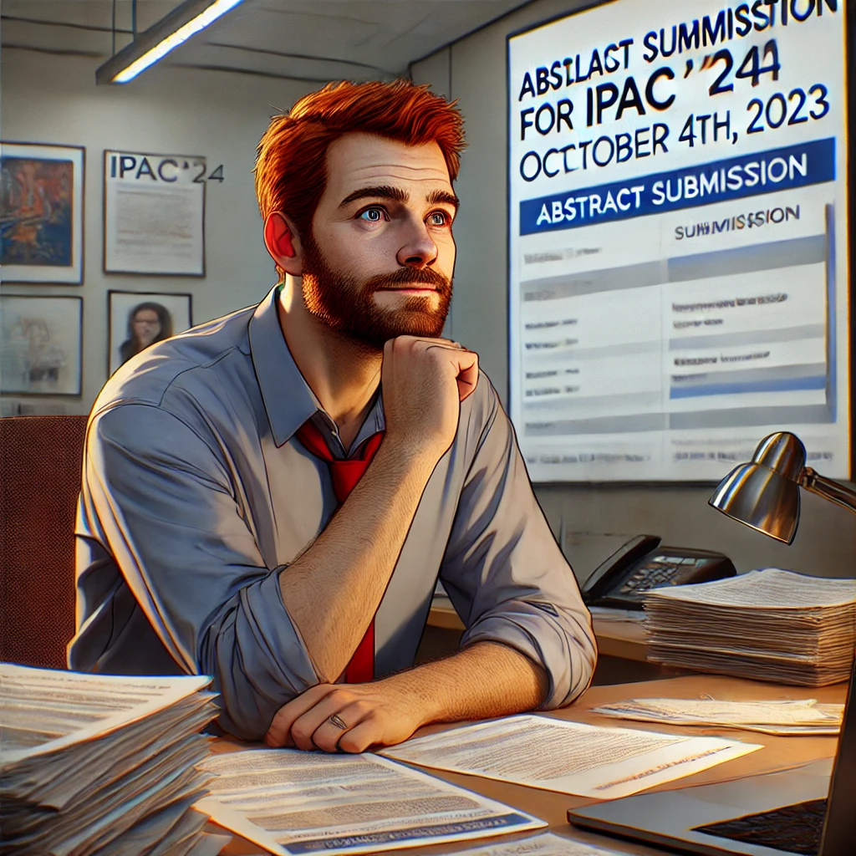
Invitations to Speakers sent: July 10th, 2023
Hunting speakers down: October 3rd, 2023
IPAC’24 Abstract submission open: October 4th, 2023
IPAC’24 Abstract submission closed: December 12, 2023
C-10m
C-8m
C-7m
C-5m

Slide 19
Insights
Remember to delete abstracts submitted by SAB prior to opening abstract submission.
Follow-ups:
  I forgot to create sub Classifications (sub Tracks) for abstracts submission but fixed on October 8th.
Outcomes:
  We started assigning codes to contributions and forming a timetable in Indico;
  Registration in Indico is also open;
  I have created abstract fields to capture information about:
    Region presented for SPC statistics
    Latex/Word publication for Editors Office Stuffing.

Slide 20

Hunting speakers down: October 3rd, 2023
IPAC’24 Abstract submission open: October 4th, 2023
JTM’23: November 28th – December 1st.
IPAC’24 Abstract submission closed: December 12, 2023
C-8m
C-7m
C-6m
C-5m
Take vacation, spend time with your family, rest before …

Slide 21

IPAC’24 Abstract submission open: October 4th, 2023
JTM’23: November 28th – December 1st.
IPAC’24 Abstract submission closed: December 12, 2023
IPAC’24 SPC3: January 11-13, 2024
C-8m
C-6m
C-5m
C-4m

Slide 22
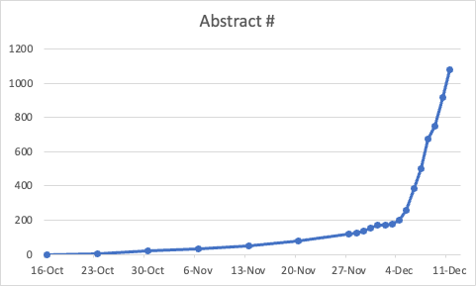
Monday December 11th, abstract report in the morning
We are currently at 1078 abstract submitted.
One can see a change in slop on December 4th.
The abstracts are coming in at about 1 abstract
every 2 minutes.

Slide 23
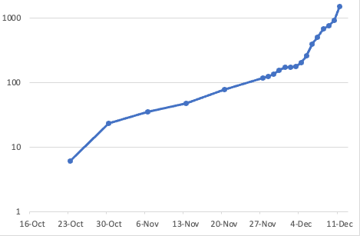
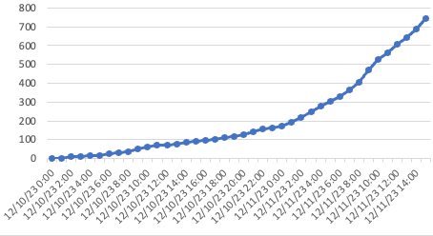
Abstract report 9 hours later
We are at 1500 abstracts point right now!
IPAC’23 had 2219 abstracts.

Slide 24
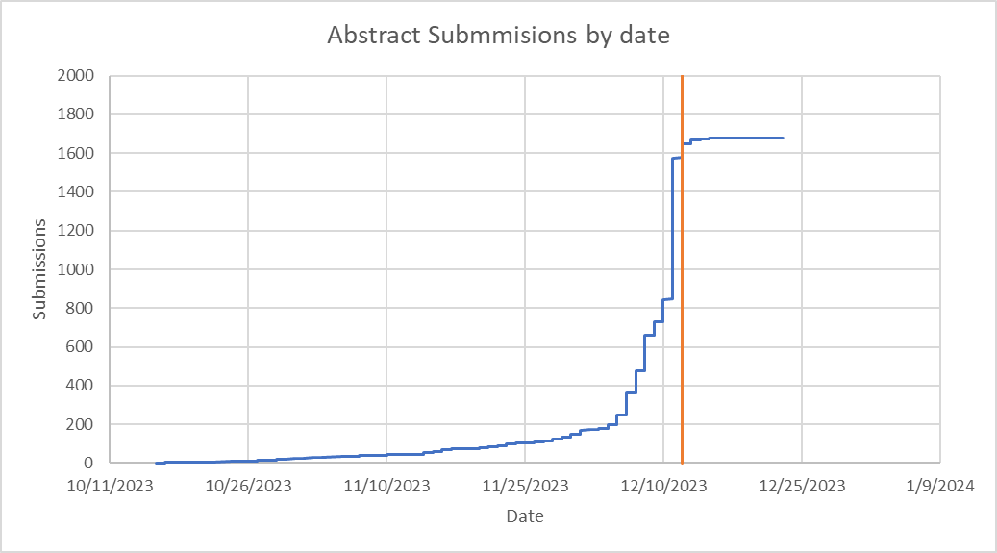
Final Tally of Abstract Submissions
1679 total
236 for the Student Poster Session
195 Grant Applications
We reopened submission for a few days due to requests but did not advertise it ahead of time.
Closed on December 15th.
Notes:
I would actually suggest what IPAC'23 did. Keep the abstracts submission
*closed* and allow any possible late submitter who will explicitly ask
to submit. This is possible since Indico has the "authorized submitters"
setting that will allow people to submit abstracts outside the
submission period

Slide 25
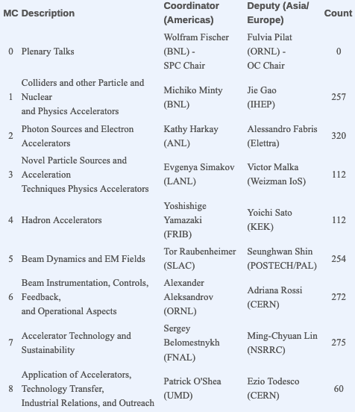
Preparation for 3rd SPC Meeting
We have received 1662 Valid Abstracts.
December 25th: SPC is asked to review abstracts for
SPC3 preparation with January 5th, 2024 deadline:
  During this time, I am doing abstract QA;
  My IPAC’25 colleagues have been doing QA as well;
December 28th, Doctoral Student Award Nomination
with February 15th, 2024 deadline, email sent to all
submitters.

Slide 26
Abstracts per region in different Main Classifications
Classification | North America | Europe | Asia | Total
MC1 | 112 (43.6%) | 96 (37.4%) | 49 (19.1%) | 257 (15.4%)
MC2 | 123 (38.3%) | 108 (33.6%) | 90 (28.0%) | 321 (19.3%)
MC3 | 69 (61.6%) | 27 (24.1%) | 16 (14.3%) | 112 ( 6.7%)
MC4 | 43 (38.1%) | 55 (48.7%) | 15 (13.3%) | 113 ( 6.8%)
MC5 | 121 (47.5%) | 102 (40.0%) | 32 (12.5%) | 255 (15.3%)
MC6 | 108 (39.9%) | 106 (39.1%) | 57 (21.0%) | 271 (16.3%)
MC7 | 109 (39.6%) | 93 (33.8%) | 73 (26.5%) | 275 (16.5%)
MC8 | 18 (30.0%) | 24 (40.0%) | 18 (30.0%) | 60 ( 3.6%)
All | 703 (42.2%) | 611 (36.7%) | 350 (21.0%) | 1664 (100%)

Slide 27

JTM’23: November 28th – December 1st.
IPAC’24 Abstract submission closed: December 12, 2023
IPAC’24 SPC3: January 11-13, 2024
Contributed Talks acceptance: February 12th, 2024
C-6m
C-5m
C-4m
C-3m

Slide 28
Insights
January 6th, 2024: remind SPC to finish their reviews or ask for extension before SS starts generating reports for SPC3 on January 11^{th;}
January 8th: generate Excel reports per each MC with vote counts and ask SPC coordinators to prepare proposals for SPC3;
January 9th: new votes came in, communicate updates to SPC coordinators;
SPC recommended changing MC tracks for some of the abstracts during SPC3 – had to do it overnight during SPC3!
January 17th: Send invitations and receive responses from CO and promoting abstracts to Contributions and scheduling them.
January 22nd: continue abstract QAs;

Slide 29
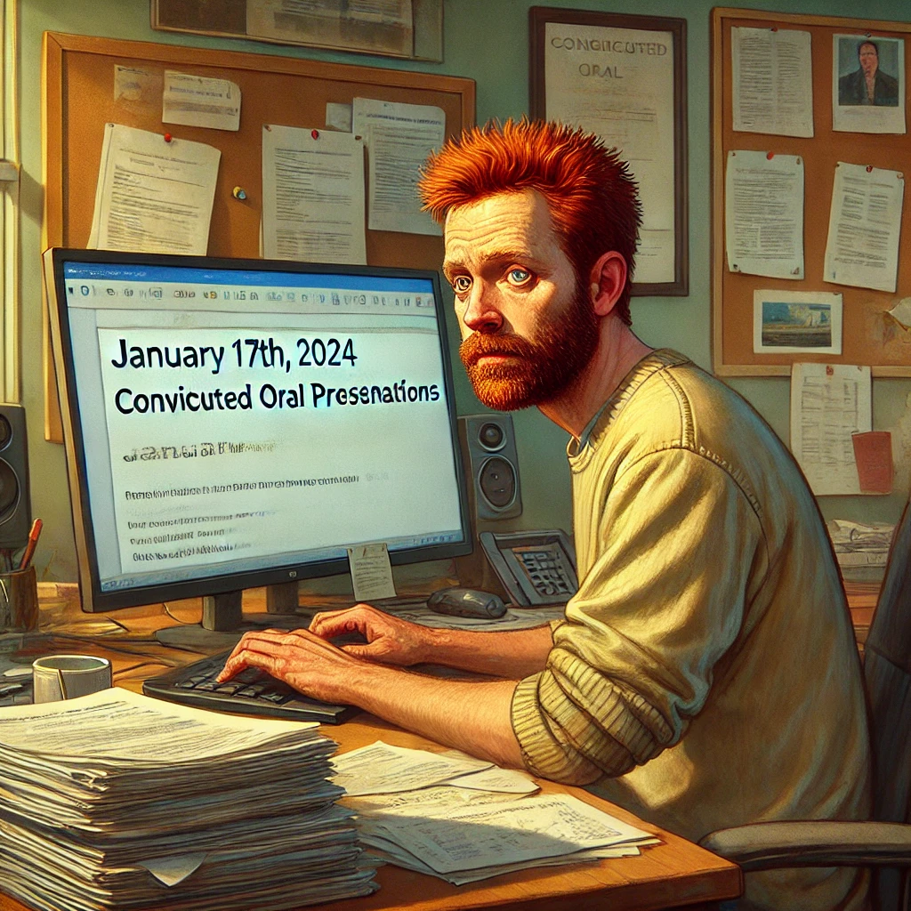
IPAC’24 Abstract submission closed: December 12, 2023
IPAC’24 SPC3: January 11-13, 2024
Contributed Talks acceptance: February 12th, 2024
Acceptance of all abstracts: March 6th, 2024
C-5m
C-4m
C-3m
C-2m

Slide 30
Insights
February 6th, 2024 to remind Contributed oral speakers to accept their talks;
February 8th, populating Prize Session with talks;
February 19th, notification about the status of abstracts to all authors;
February 21st, working with SPC chair to arrange posters
February 24th, converting abstracts to contributions and scheduling them!!!
February 27th, Announcing Travel grants to Early Career Scientists with March 15th deadline.
February 28th, 2024 duplicating contributions to populate student poster session and adding field: CAT_duplicate_of
Notes:
Indico has lots of emails to communicate information about IPAC now!
There are some accounts without any abstract associated with them, so I removed them from “Participant Roles” list so that not to spam them.

Slide 31
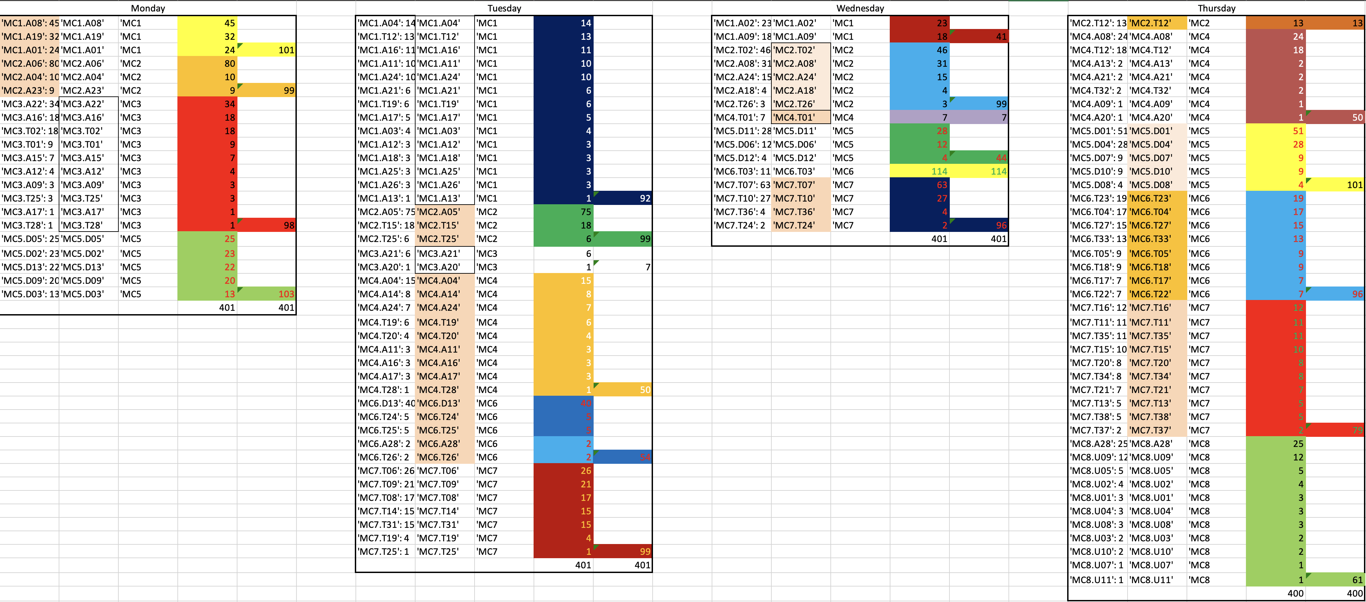

How to distribute posters?
Problem with poster code assignment using village system that prioritizes MC vs authors, so authors ended up all over the place!
https://www.jacow.org/Indico/Utilities

Slide 32

IPAC’24 SPC3: January 11-13, 2024
Contributed Talks acceptance: February 12th, 2024
Acceptance of all abstracts: March 6th, 2024
Assigning codes to contributions: April 15th, 2024
C-4m
C-3m
C-2m
C-1m

Slide 33
March 6th, 2024 poster acceptance and scheduling has been announced.
March 7th, 2024 requests to delete contributions started to come in
March 11th, 2024 double check with students that they still want to present on Sunday.
Contributions deleted, abstracts withdrawn
March 13th, remind that only one speaker per contribution!
March 27th, remind that only one speaker per contribution!
April 15th, remind that only one speaker per contribution!
Assigning codes to poster presentations

Slide 34
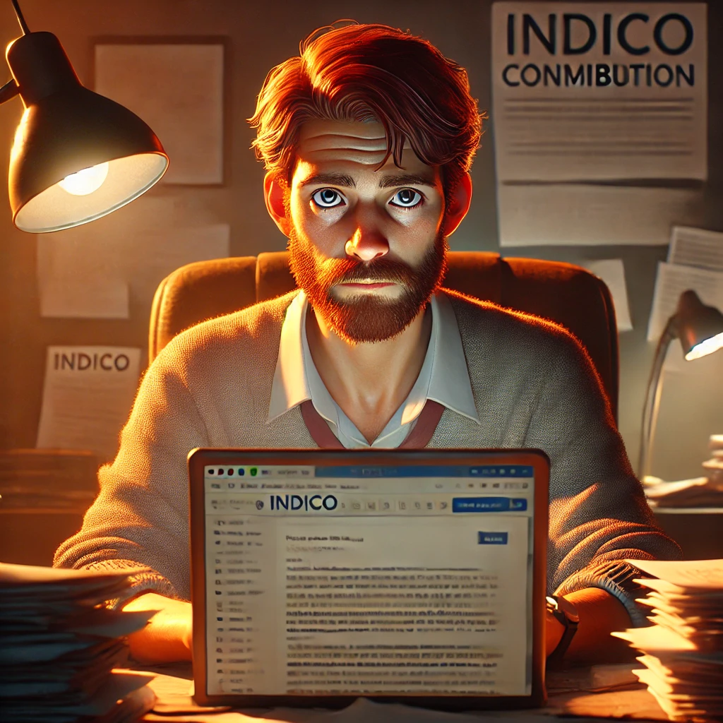
Contributed Talks acceptance: February 12th, 2024
Acceptance of all abstracts: March 6th, 2024
Assigning codes to contributions: April 15th, 2024
Paper submission is open: April 30th, 2024
C-3m
C-2m
C-1m
C-19d

Slide 35
Insights
April 15th:
  Speak confirmation email, request of a short bio about yourself. Deadline is April 26th;
  Chair confirmation email;
  Make sure that PURR and MEOW systems are setup.
April 24th: sent the reminder to withdraw a contribution by April 26th, 2024 if not able to present.
April 26th and 29th: Single speaker email reminder. We need to know how to space posters, so we need to know the presenter!
April 30th: codes assigned again”.
April 30th: paper and slide submission is open – no changes to codes!

Slide 36

Acceptance of all abstracts: March 6th, 2024
Assigning codes to contributions: April 15th, 2024
Paper submission is open: April 30th, 2024
Joined JACoW Editors in Nashville, TN: May 16th, 2024
C-2m
C-1m
C-19d
C-3d

Slide 37
Insights
April 30th: speaker confirmation and bio reminder again!
April 30th: email announcement about paper submission!
May 5th: reminder students that SUP posters do not publish contributions!
May 15th: still confirming chairs for the sessions!
May 16th: Final details for student events at IPAC’24!
May 16th: Joined JACoW Editors in Nashville, TN!
May 18th: still deleting contribution and withdrawing abstracts (22% final rate)!

Slide 38

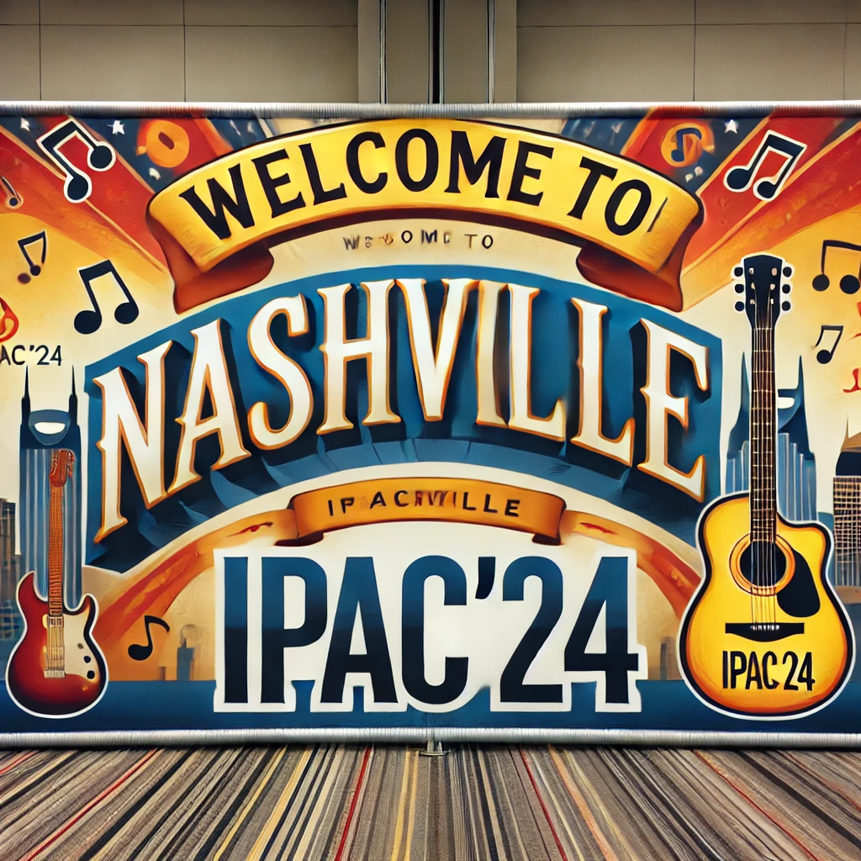

Slide 39
General Statistics
Abstracts submitted by December deadline with a few late submissions was 1691;
As of May 21st only 1329 abstracts (79% of total number) remains;
Total number of contributions in the system is 1572:
  197 (13% of total number) contributions are to Student Session which are duplicates of regular contribution (1375);
  The difference in numbers between abstracts and contributions is because Invited orals and Industry session do not have corresponding abstracts;
1036 (75%) contributions available/processed by authors;
339 contributions have no files to work with
Editorial team has 26 members but we have change the procedure to be more efficient.

Slide 40
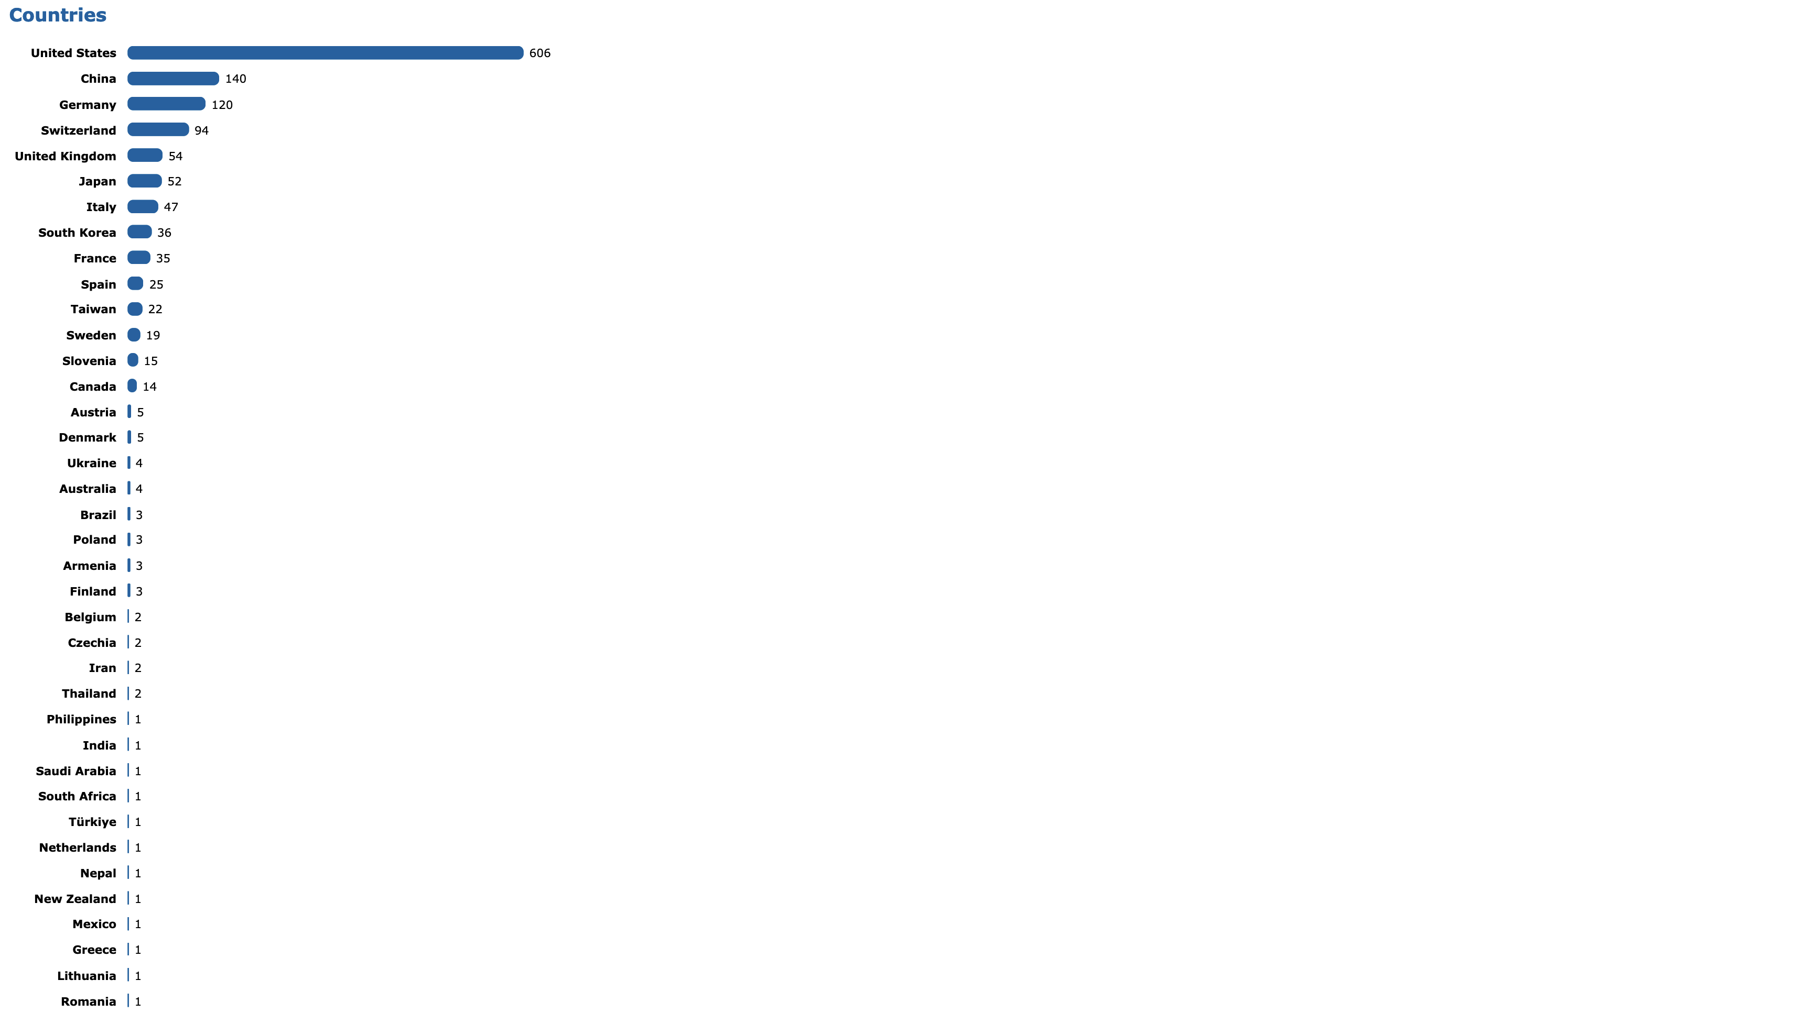
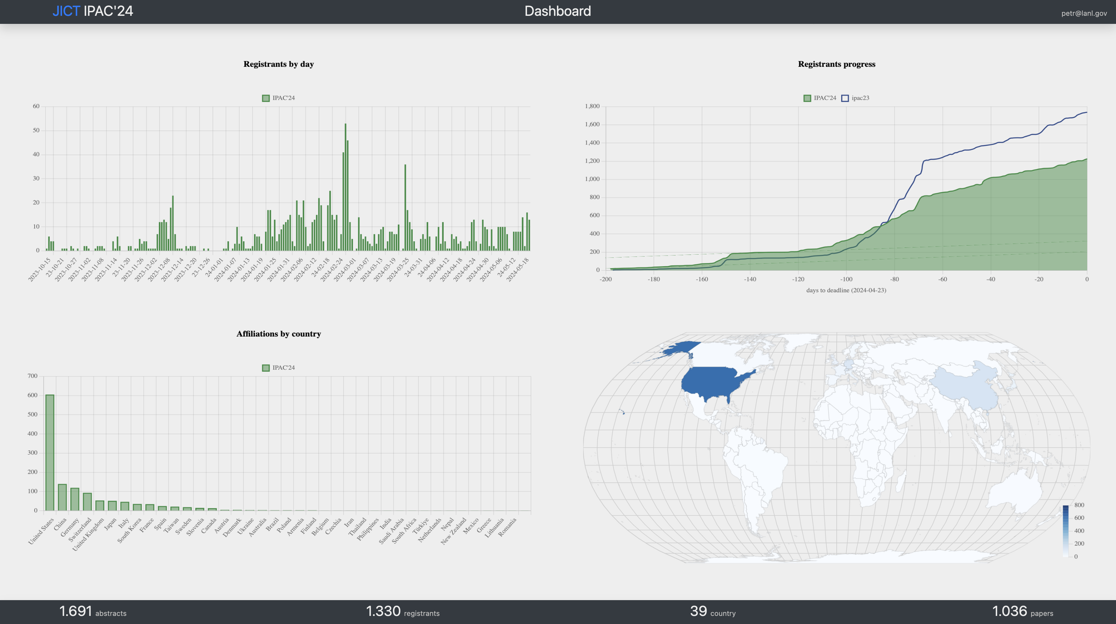
1330 delegates from 39 countries
February 27th IPAC’24
early registration

Slide 41
Abstracts Statistics
Final
Original
Classification | Number
MC1 | 199 (15%)
MC2 | 243 (18%)
MC3 | 101 (7.6%)
MC4 | 92 (6.9%)
MC5 | 199 (15%)
MC6 | 213 (16%)
MC7 | 235 (17%)
MC8 | 48 (3.6%)
Classification | Number
MC1 | 257 (15%)
MC2 | 321 (19%)
MC3 | 112 (6.7%)
MC4 | 113 (6.8%)
MC5 | 255 (15%)
MC6 | 271 (16%)
MC7 | 275 (17%)
MC8 | 60 (3.6%)
Asia 273 Europe 468 North America 589
Asia 350 Europe 611 North America 703
We lost people due to Visa issues, Government meeting in Korea, APS-U delay
Asia lost 77 (22% of original), Europe lost 143 (23% of original) and North America lost 114 (16% of original)

Slide 42
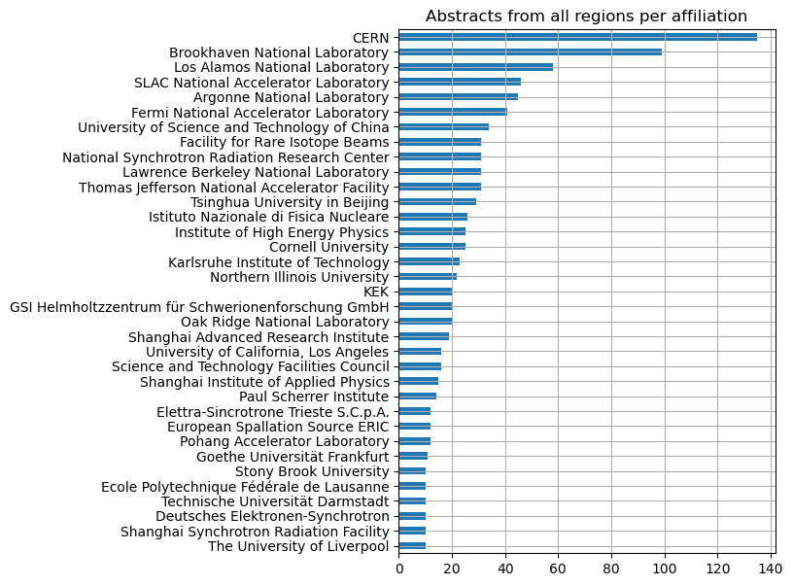
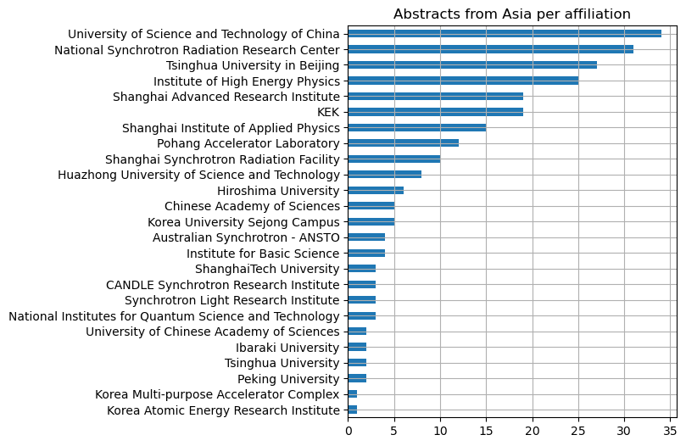
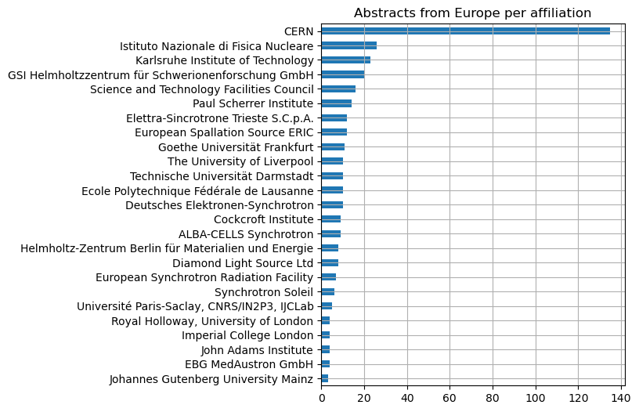
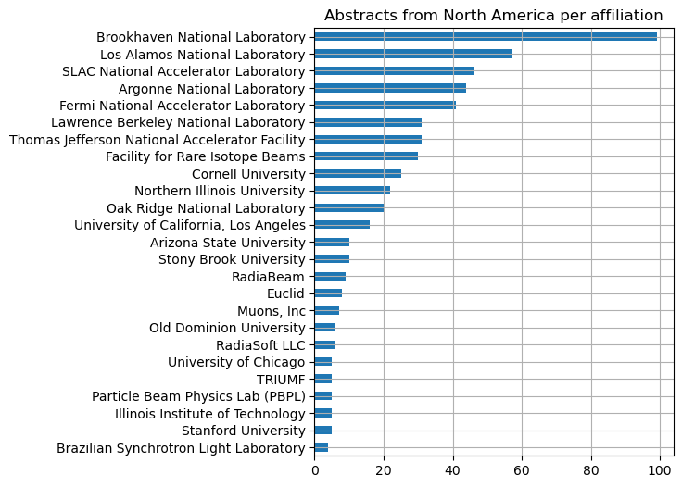
Visual Statistics for Abstract Final

Slide 43
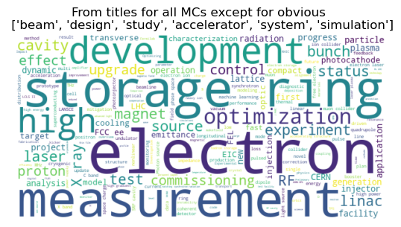

Slide 44
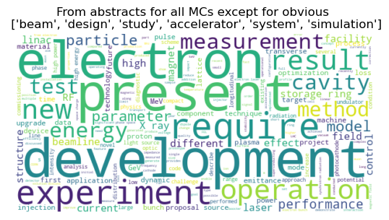

Slide 45
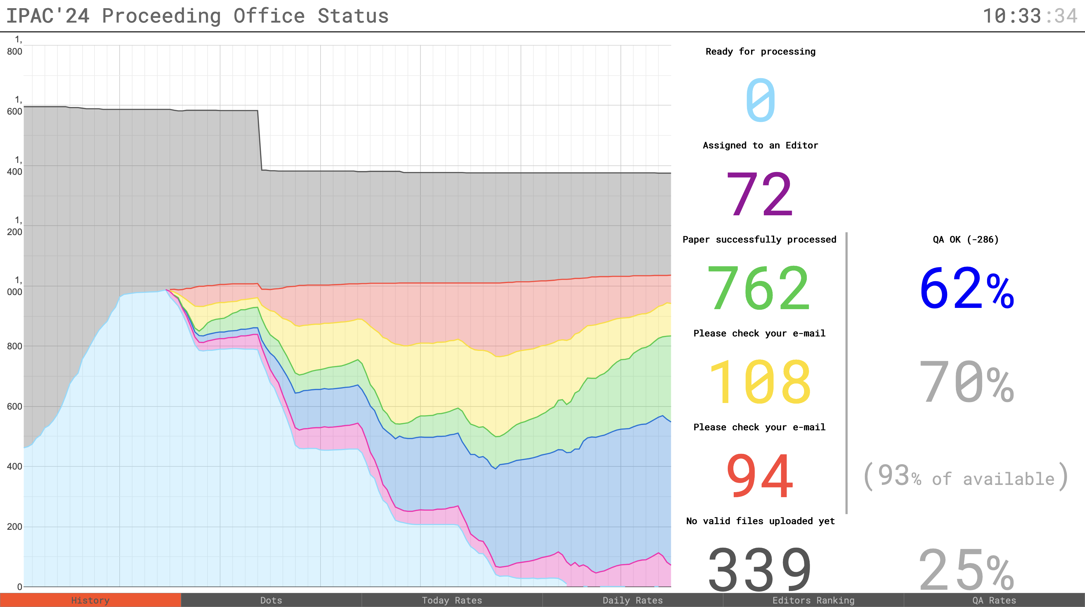
Proceeding Office History (JICT)

Slide 46
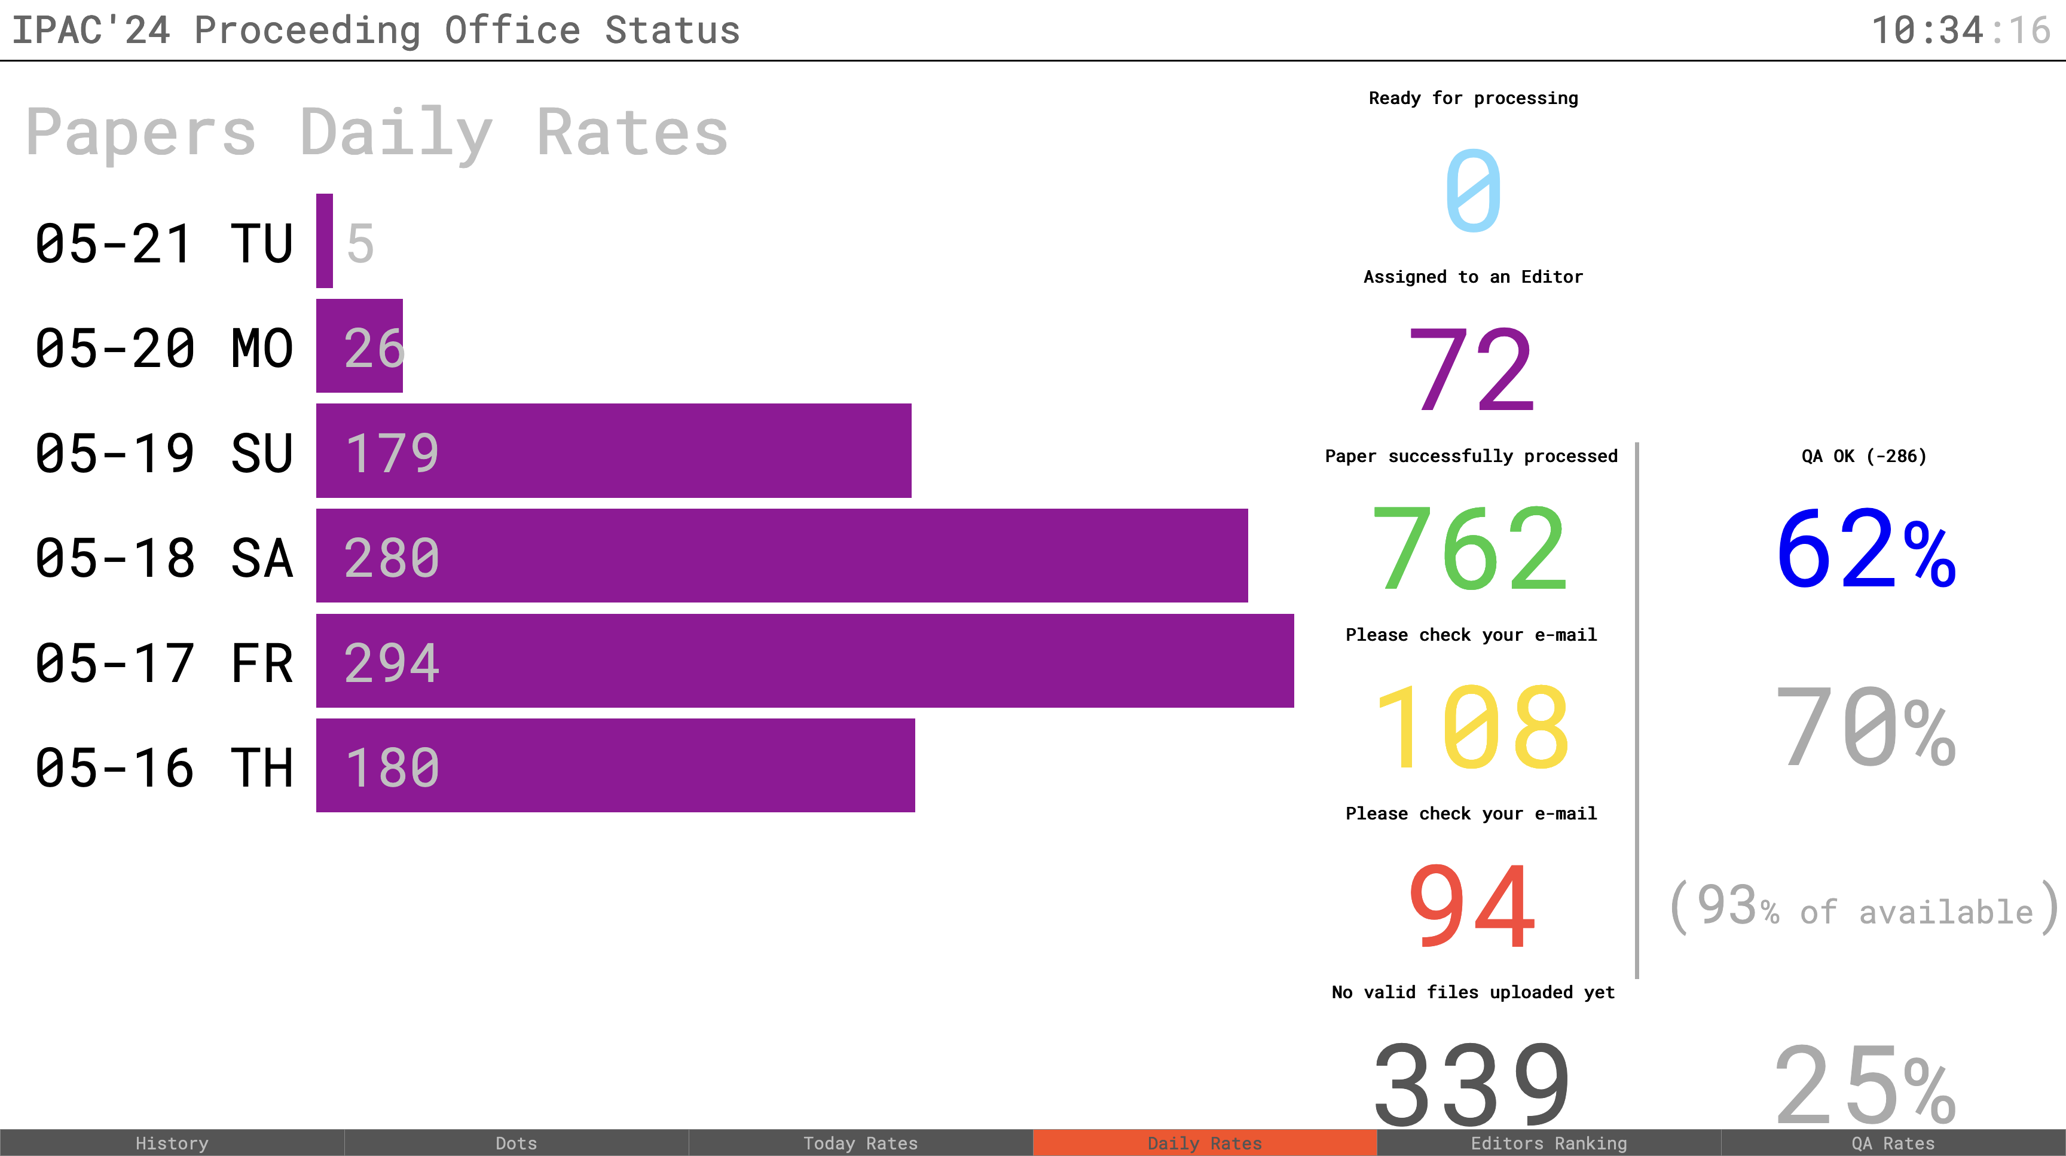
Proceeding Office Daily Rates – Edit (JICT)

Slide 47
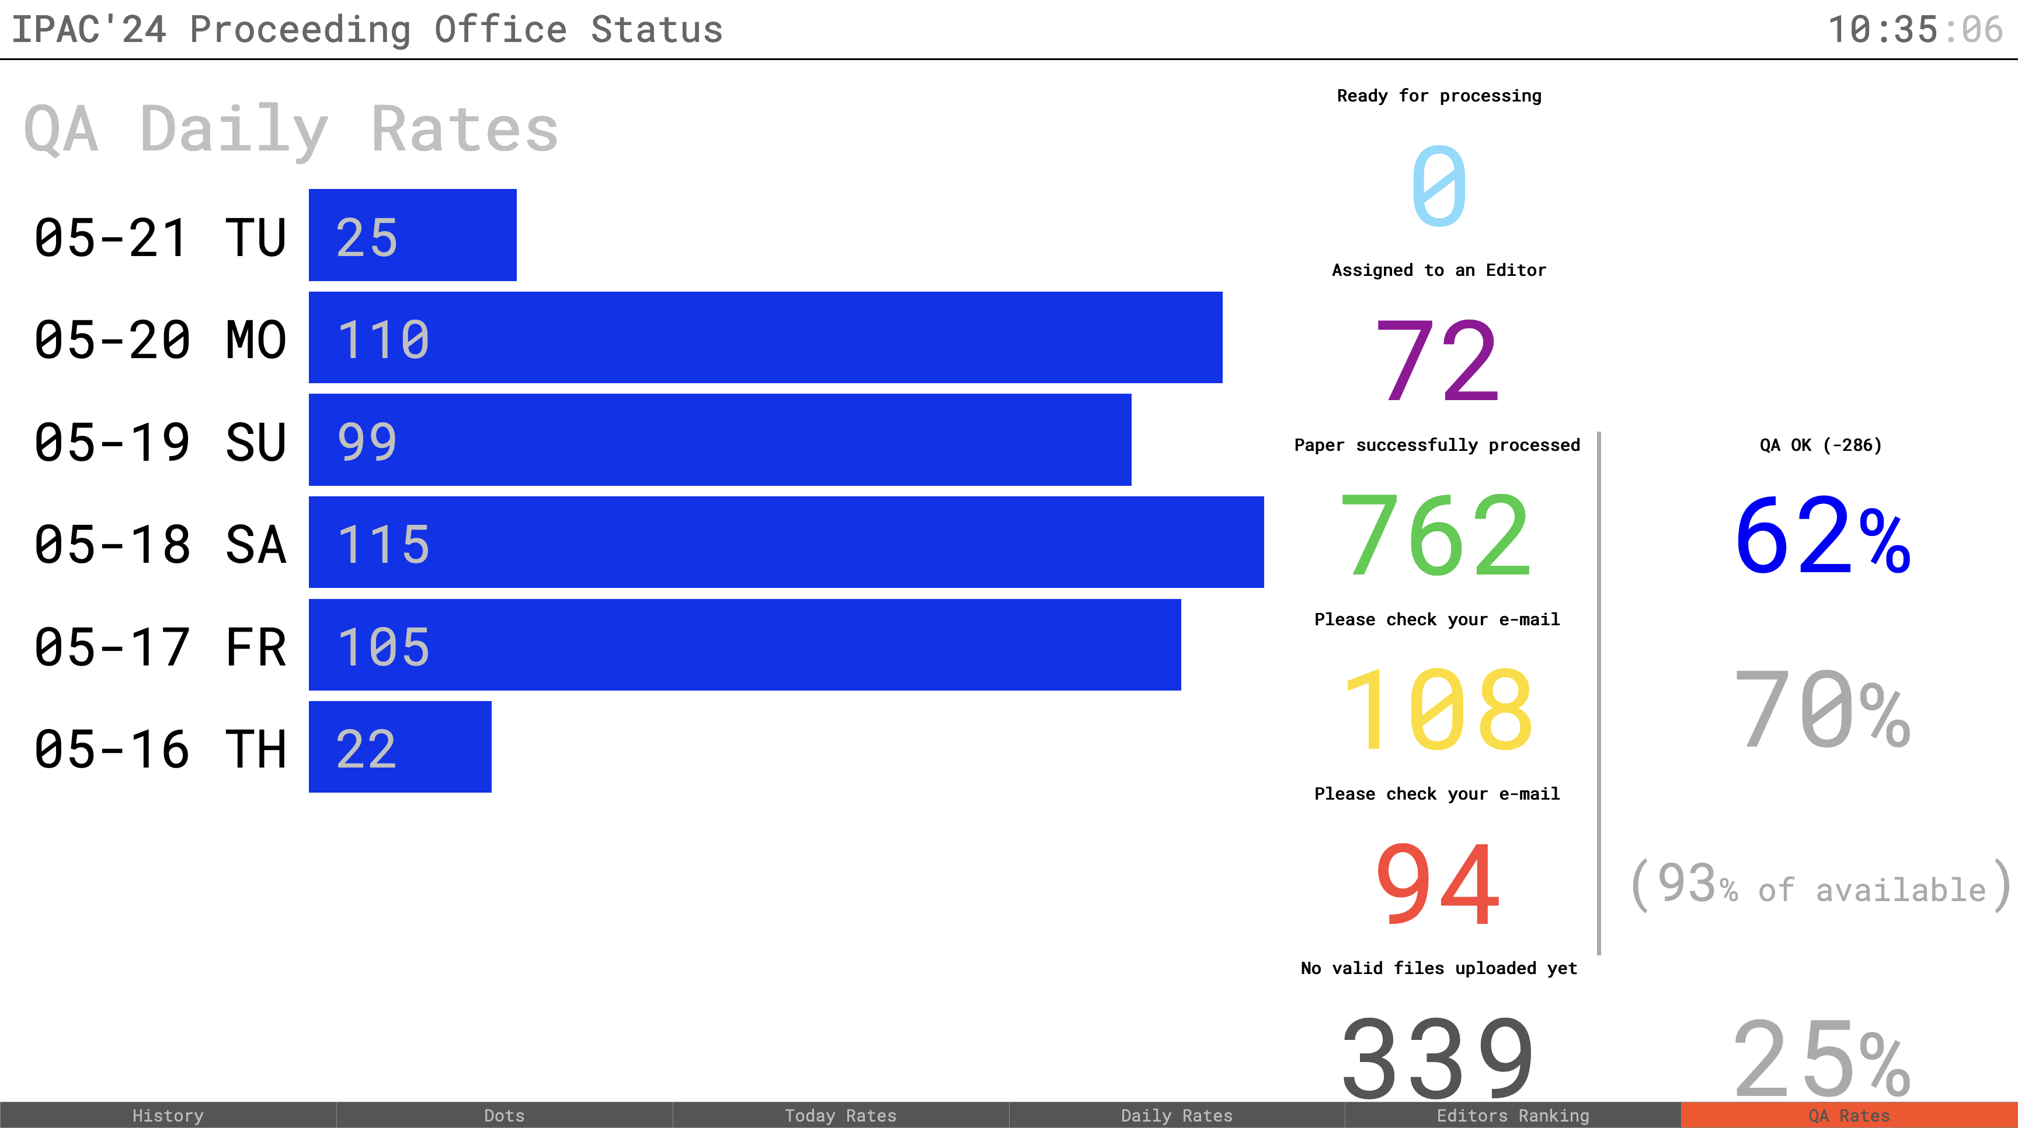
Proceeding Office Daily Rates – QA (JICT)

Slide 48
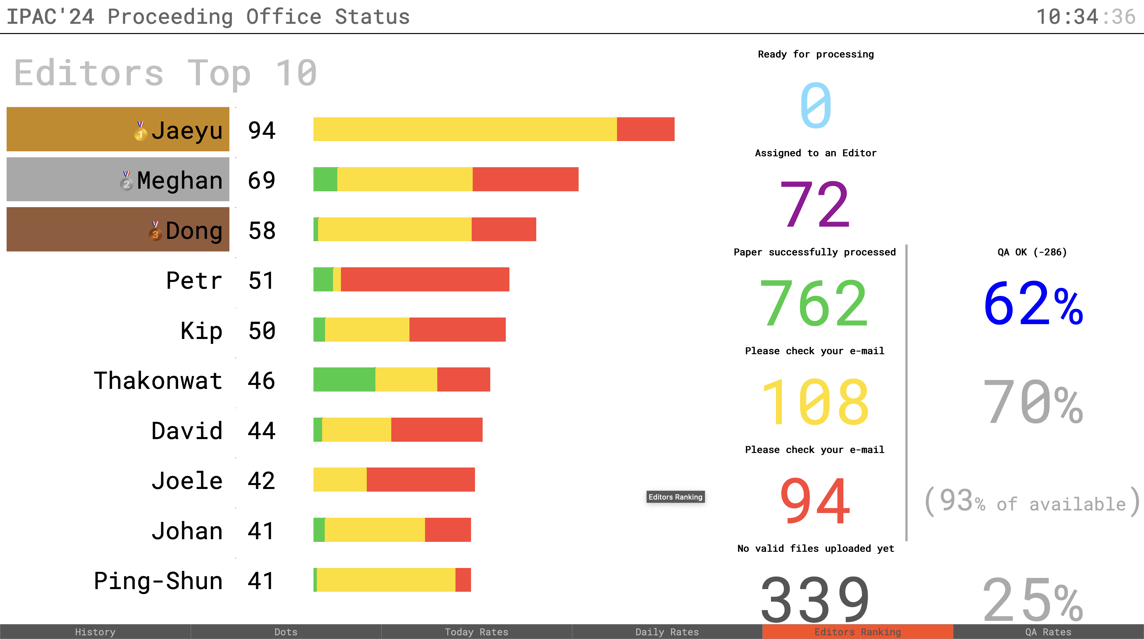
Proceeding Office Editor Competition (JICT)

Slide 49
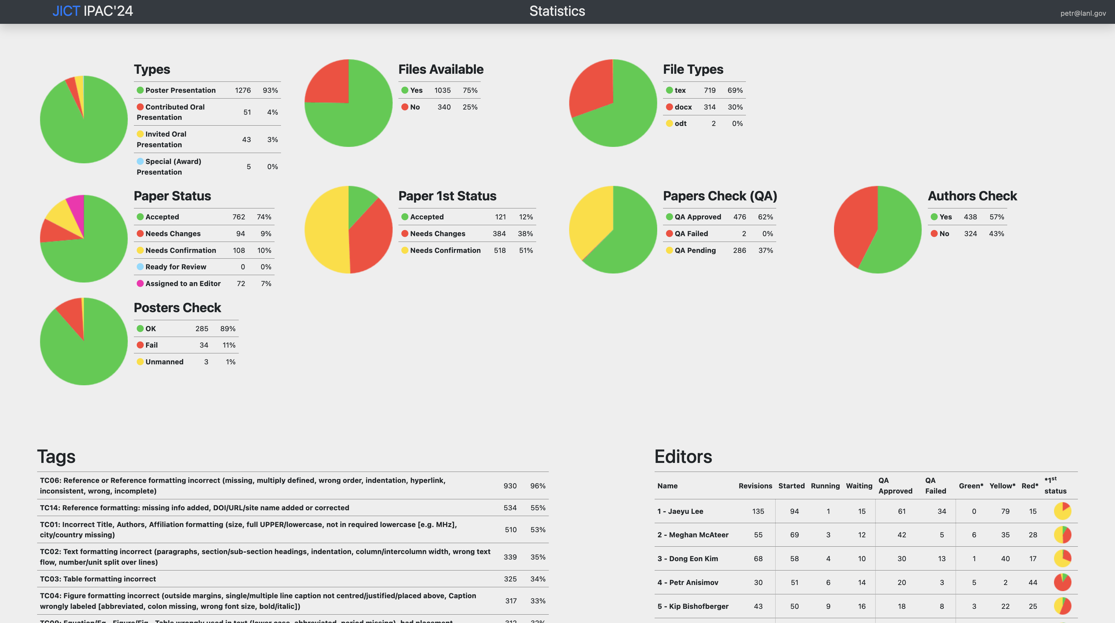
Proceeding Office Statistics (JICT)

Slide 50
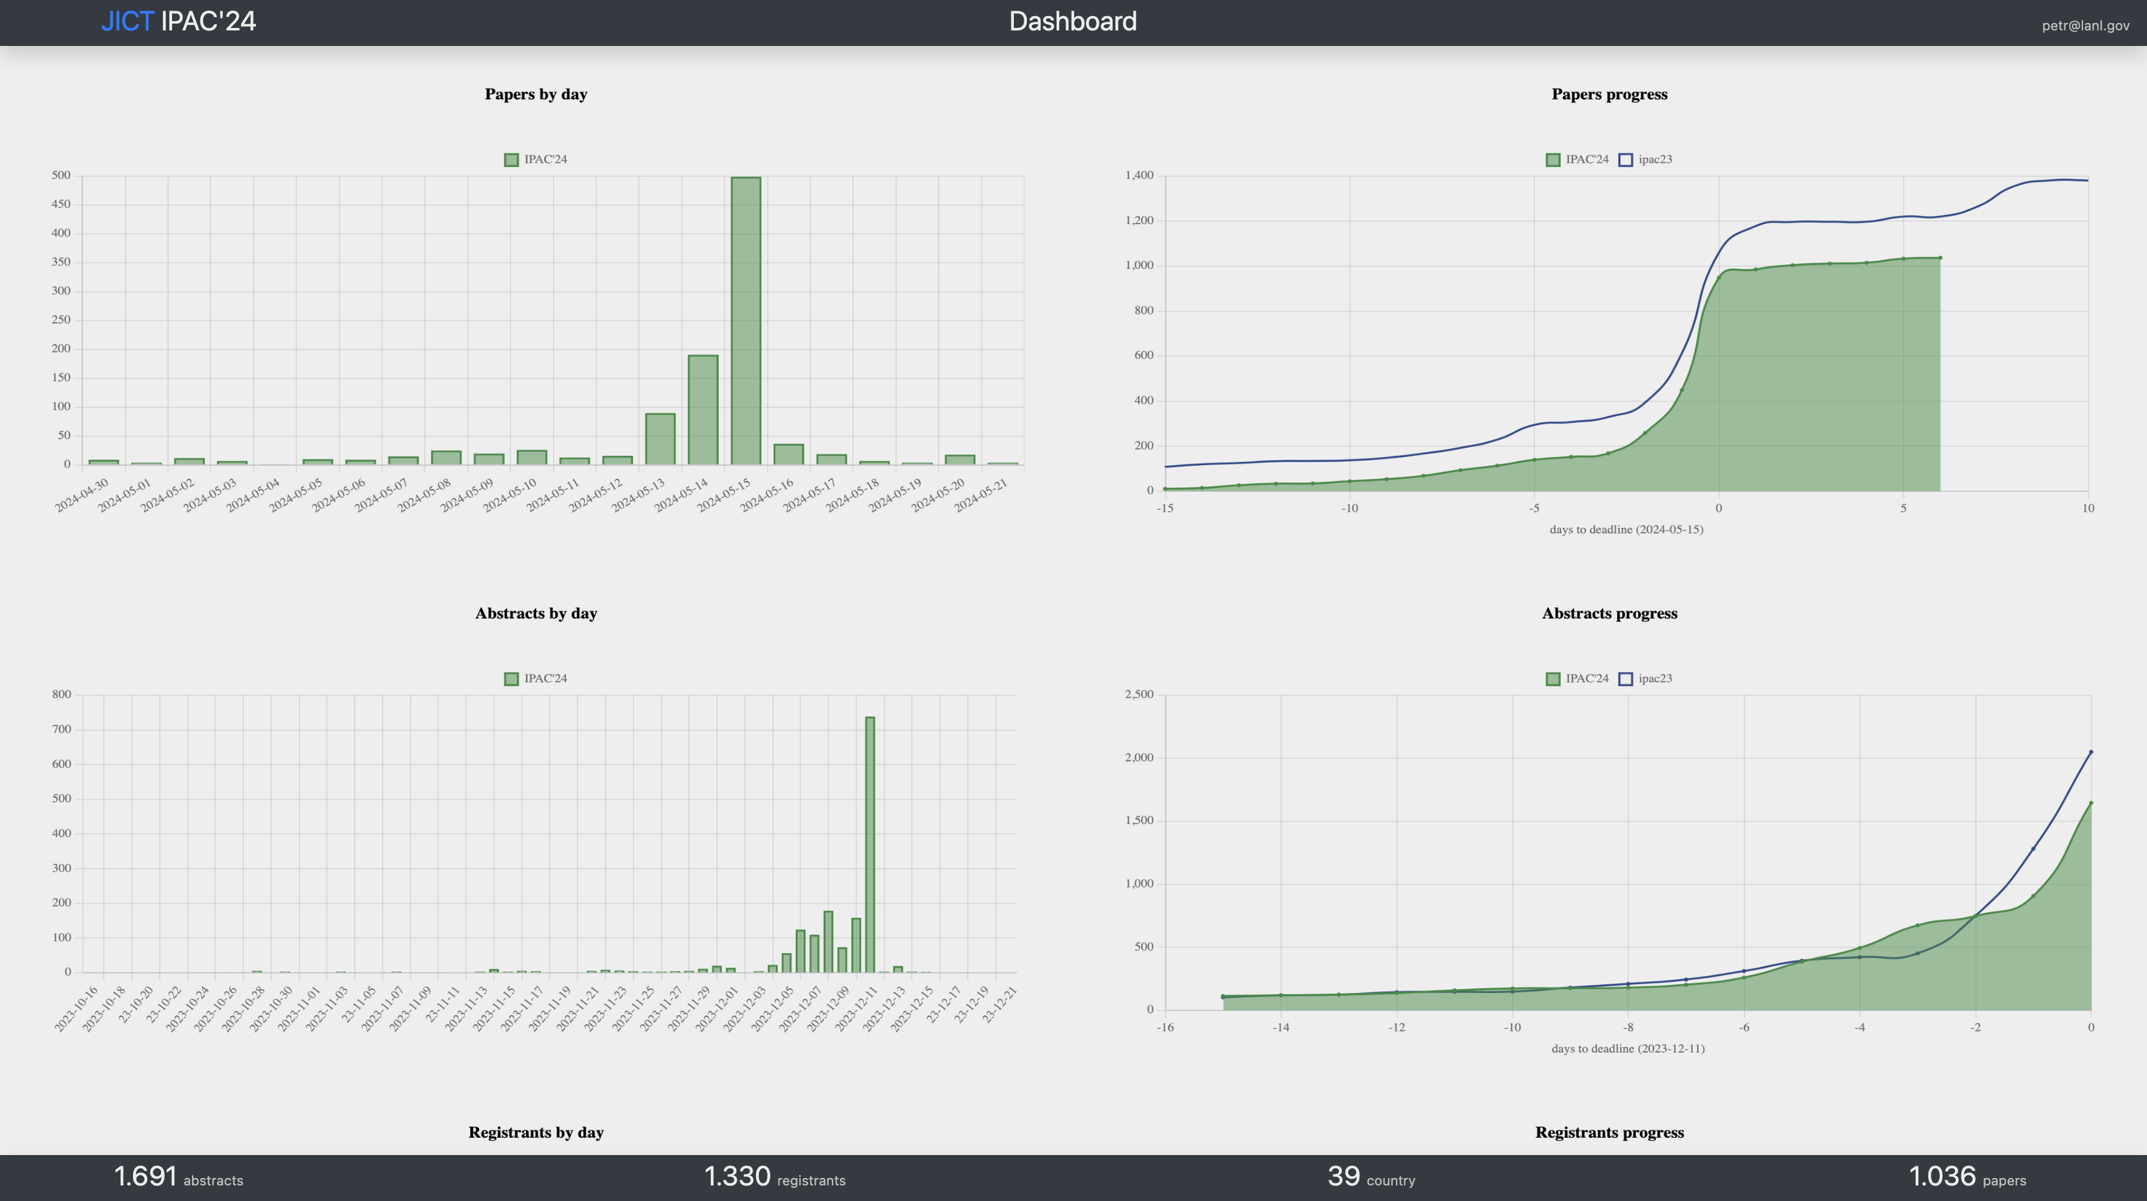
Paper Statistics (JICT)

