Slide 1
Notes:
Slide 1: Company Logo Full Page
Before you start editing the slides of your talk change to the Master Slide view:
Microsoft Office :Menu: View > Slide Master;
Macintosh – View > Master > Slide Master
Edit the following items:
On the Slide Master (first master slide) – lower area
a) On the left Delete the text and write the title of the event/Conference, Location
b) On the right delete the text and write the name and surname of the speaker and the date (day, month , year)
Close Master View

Slide 2
JACoW-Indico Conference Tools and information screens
Notes:
Slide 2: Title of the Presentation
Before you start editing the slides of your talk change to the Master Slide view:
Microsoft Office :Menu: View > Slide Master;
Macintosh – View > Master > Slide Master
Edit the following items:
On the Slide Master (first master slide) – lower area
a) On the left Delete the text and write the title of the event/Conference, Location
b) On the right delete the text and write the name and surname of the speaker and the date (day, month , year)
Close Master View
To start adding slides insert a new slide and select a Layout:
For Title & Subtitle
For text with bullet points
For Text
For Picture, graphs, visuals
Two columns
Blank

Slide 3
What is JICT
JACoW-Indico Conference Tools
JICT is a collection of scripts that interface with Indico to provide tools and information that the system does not offer.
They are designed to help organizers during the various phases of the event.
It is available on github
https://github.com/JACoW-org/JICT
Notes:
Slide 3 – (..) : Content of the presentation
Insert a new slide: Home > “New Slide” and choose a slide Layout:
For Title & Subtitle
For text with bullet points
For Text
For Picture, graphs, visuals
Two columns
Blank
If you want Copy & paste an element from the Clip Board to the particular slide:
1. Click on a box to mark it.
2. Position the mouse pointer on the box frame: Copy!
3. Click on the particular slide: Paste!
How you intend to use the elements is your choice.
You can combine the text block style with the background colour in different manner.

Slide 4
Generated contents
Scripts generate different types of content, such as:
embedable contents: they are primarily intended to be incorporated into the conference website (es. registrants, charts, agenda). They can be easily customized using templates and style sheets.
web app: these allow the collection of data that will be useful for the production of the proceedings (es. poster police, authors check, slides check)
info pages: provides various information through tables and charts (es. authors, papers, statistics, …)

Slide 5


JICT as a service
This year some conferences have requested to use JICT from jacow.org
PRO
  Don’t need a server to run JICT
  Don’t need to configure JICT
CONS
  Limited customization
  No content for conference website

Slide 6
The data
The system works with local data.
The data is periodically imported from Indico and saved in different files (authors, abstracts, papers, posters, slides, ....).
The import procedure takes some time, this is proportional to the number of contributions, for large conferences like IPAC it can take up to a few minutes.
The frequency and other operating parameters are set in the configuration file.
Notes:
Slide 3 – (..) : Content of the presentation
Insert a new slide: Home > “New Slide” and choose a slide Layout:
For Title & Subtitle
For text with bullet points
For Text
For Picture, graphs, visuals
Two columns
Blank
If you want Copy & paste an element from the Clip Board to the particular slide:
1. Click on a box to mark it.
2. Position the mouse pointer on the box frame: Copy!
3. Click on the particular slide: Paste!
How you intend to use the elements is your choice.
You can combine the text block style with the background colour in different manner.

Slide 7
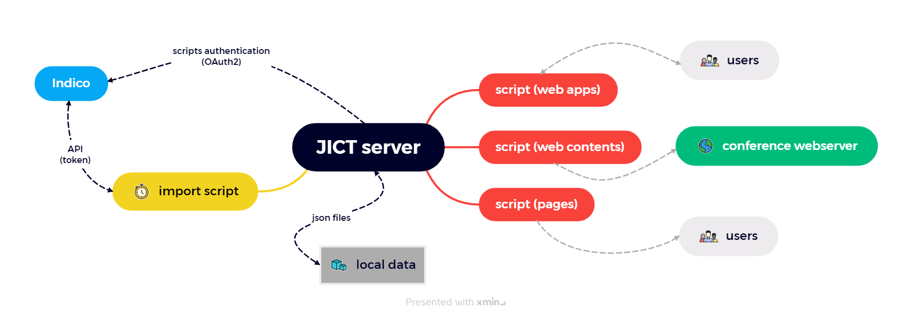

Slide 8
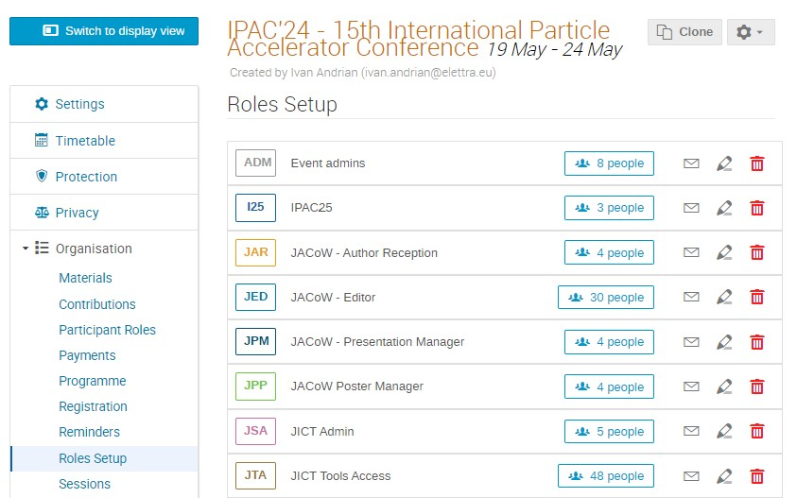
Permissions
The access management is based on Indico accounts and Roles.
in the configuration file, for each script there is the allow_roles option which can be set in the following ways
  allow_roles =>[ ‘JSA’, ‘JTA’ ] // users with these Roles
  allow_roles =>[ ‘*’ ] // all users that have a Role in indico
  allow_roles =>[] // public access

Slide 9
Configuration
The configuration file is config.php
Some mandatory parameters are empty by default and must be set.
$cws_config =[
'global' =>[
'conf_name' =>'', // IPAC XX
'conf_url' =>'', // https://www.ipacXX.org/
'indico_server_url' =>'', // https://indico.jacow.org
'indico_event_id' =>'', // XY
'indico_token' =>'', // indp_....
'indico_oauth' =>[
'client_id' =>"", // ask the Indico Team or leave empty for public access
'client_secret' =>"", // ask the Indico Team
'redirect_uri' =>"" // https://www.ipacXX.org/JICT/indico_oauth.php
],
'root_url' =>'', // https://www.ipacXX.org/JICT
'root_path' =>'', // /var/www/html/ipacXX/JICT';

Slide 10
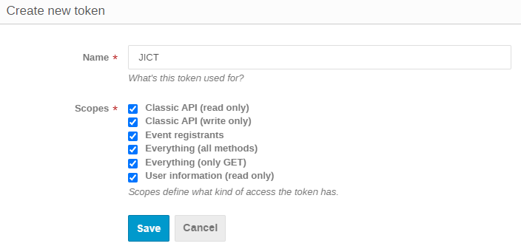
Indico token
To be able to use some Indico APIs, requests must be “signed” with the token of a user with sufficient privileges to read and write data
https://indico.jacow.org/user/tokens/

Slide 11
Server requirements
required software for the server are:
linux OS
web server
php 7
wget
xpdf

Slide 12
the collection updates
Web apps
  App Paper Status
  App Poster Police
  Authors Check (NEW 2022)
  Slides Check (NEW 2023) (UPDATED 2024)
Website contents
  Charts
  Programme
  Registrants
Info pages
  Authors (NEW 2022)
  Dashboard (NEW 2023)
  Dotting Board
  Papers (NEW 2022)
  Proceedings Office Status
  Statistics (NEW 2022) (UPDATED 2024)

Slide 13
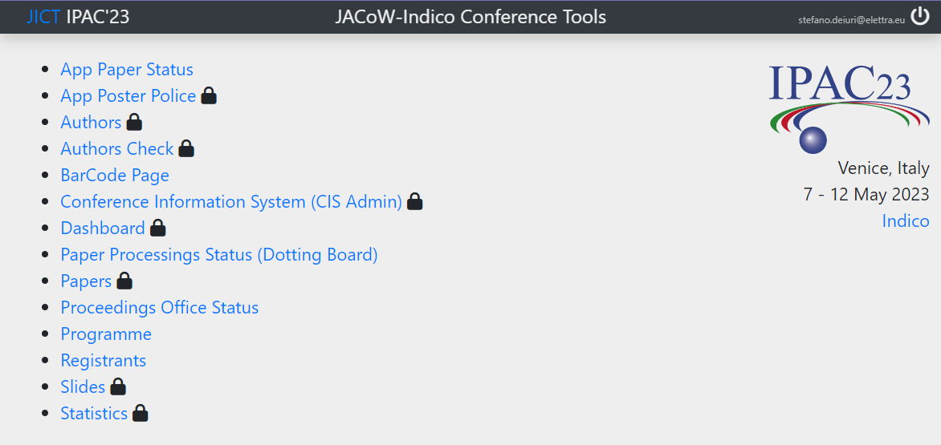
index page

Slide 14
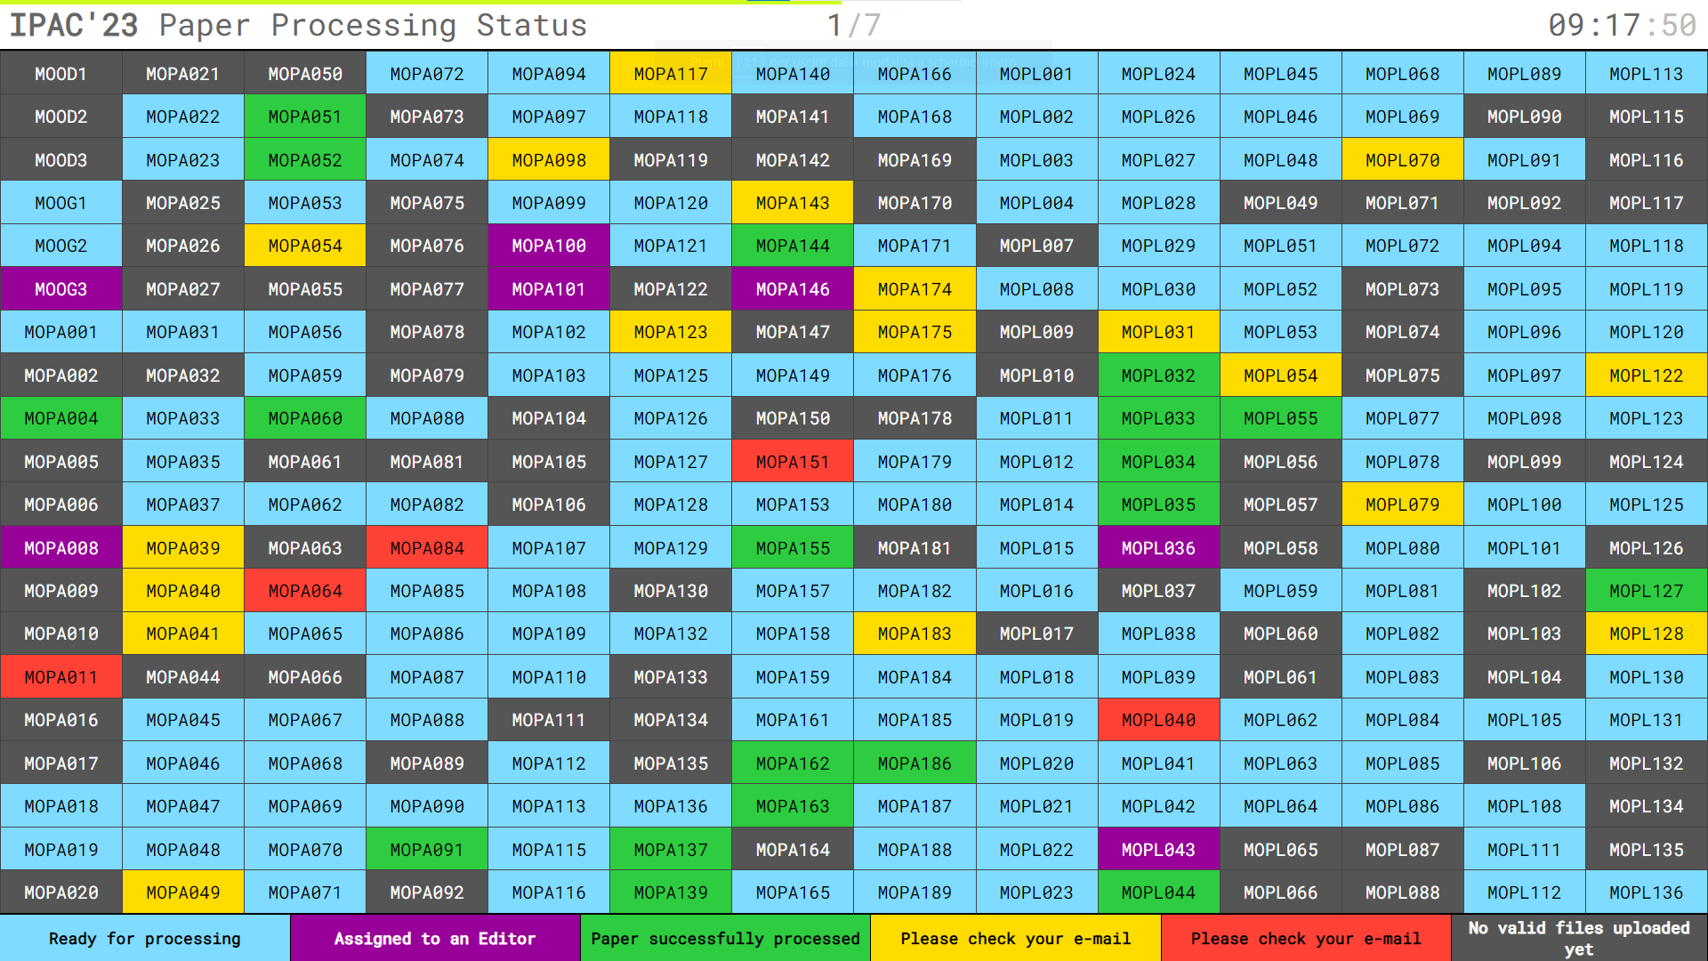
Dotting Board (Paper Processing Status)

Slide 15
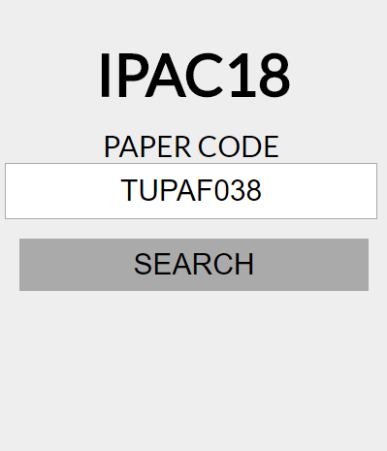
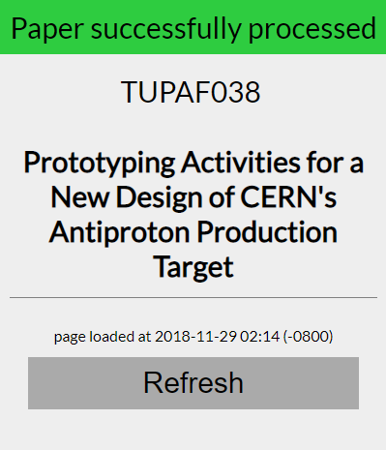
App Paper Status
This app allows participants to quickly check the status of a paper processings
A QRcode available on the screens of the “Dotting Boards” allows easy access to this page

Slide 16
App Poster Police
This is a tool to collect information about the posters - needed for the production of the proceedings
it provides a web interface that works with any browse
the interface is optimised for the tablets
it can be used simultaneously on more than one device

Slide 17
App Poster Police
days
sessions
session’s posters
poster

Slide 18
Proceedings Office Status

Slide 19
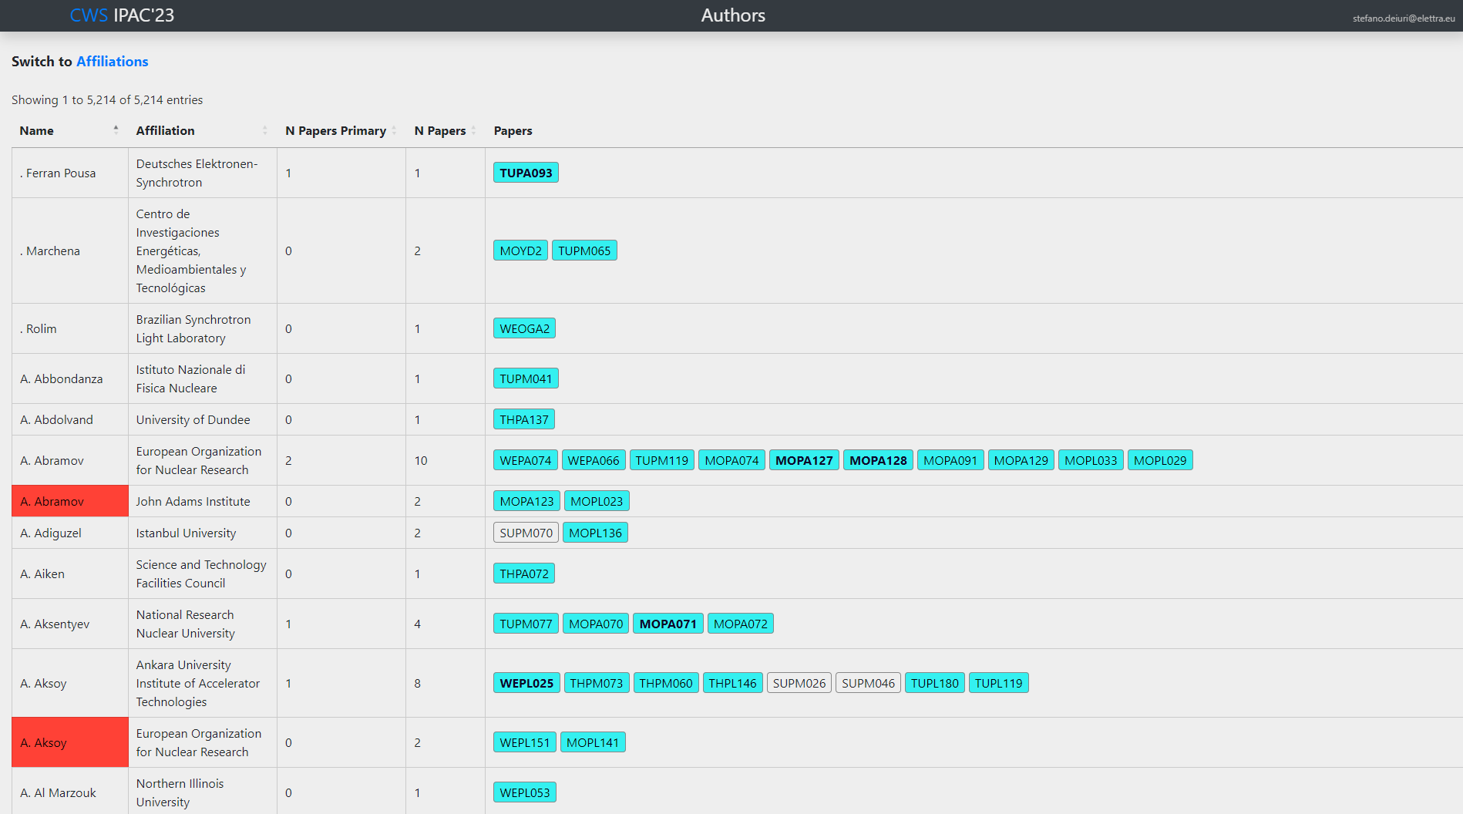
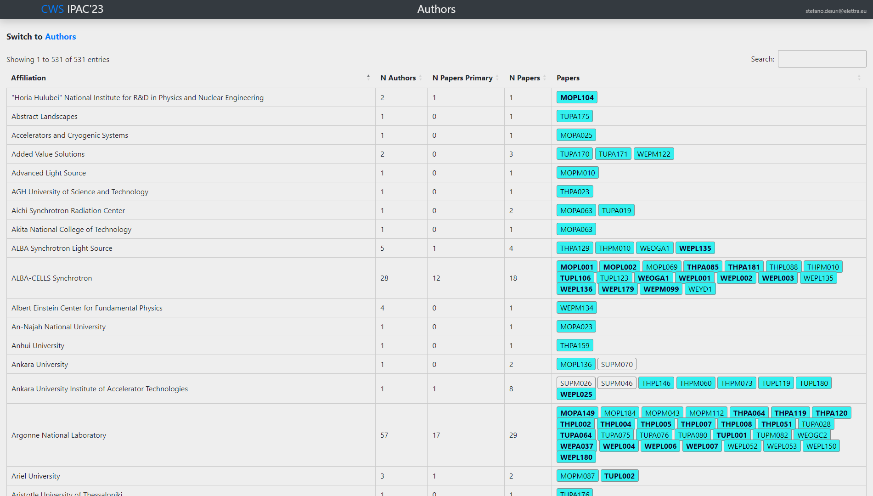
Authors
This page is used to monitor authors and affiliations

Slide 20
Authors Check
This tool is used by the author reception to be able to compare the title and authors between Indico and PDF papers
with this page the verification can also be done on screen widthout the need of print Indico data
It can be used on multiple computers

Slide 21
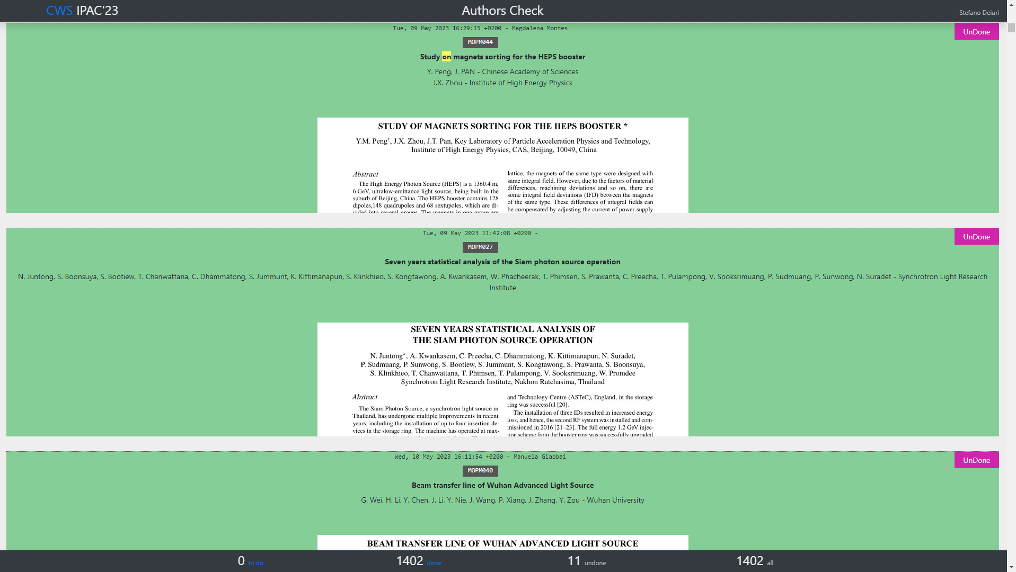
Authors Check

Slide 22


Slide 23
Papers
This tool is used to check whether the papers can be published in the proceedings, in particular it is possible to see: editing status, QA status, PDF OK*, result of the poster police, authors check, authors registered, authors present
The table is filterable and sortable so it is easy to see which papers have problems
* the import script downloads completed papers and performs the following checks:
page size
page number
embedded fonts

Slide 24
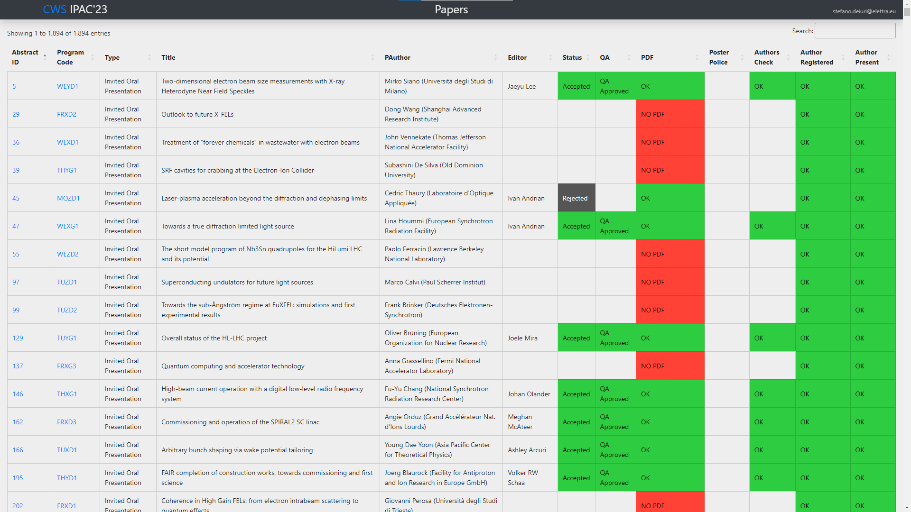

Slide 25
Programme

Slide 26
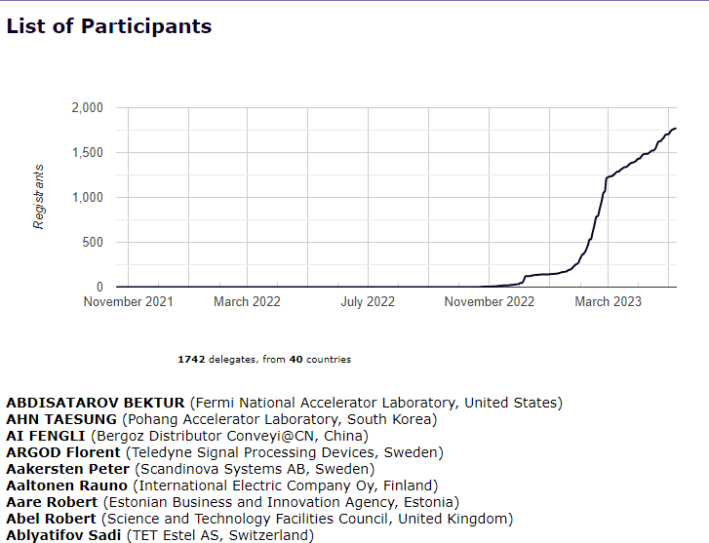
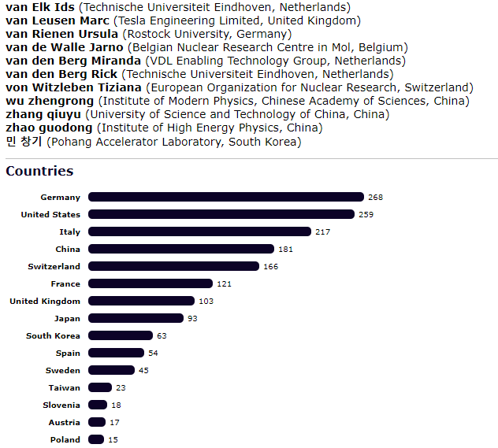
Registrants

Slide 27
Slides
This tool is designed for the Speaker Preparation Room
Provides a view of the slide divided by days
Provides some quick links to open the Indico pages with the contribution information or to download the slides file
Allows to mark presentations that have been verified and are ready to be presented
Allows to mark if the author allow to publish the presentation
Shows the slides QA status
It can be used on multiple computers

Slide 28
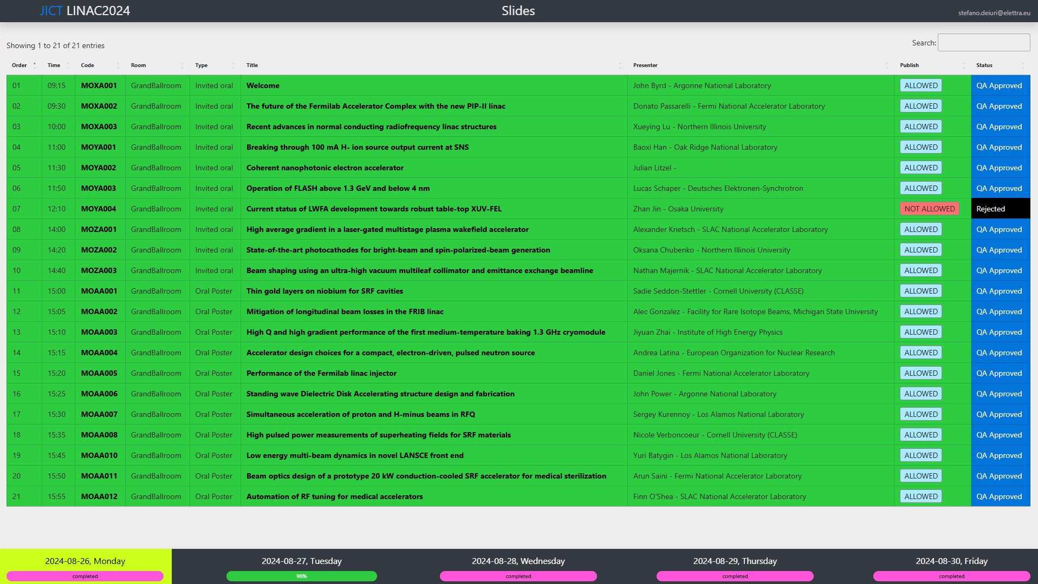

Slide 29
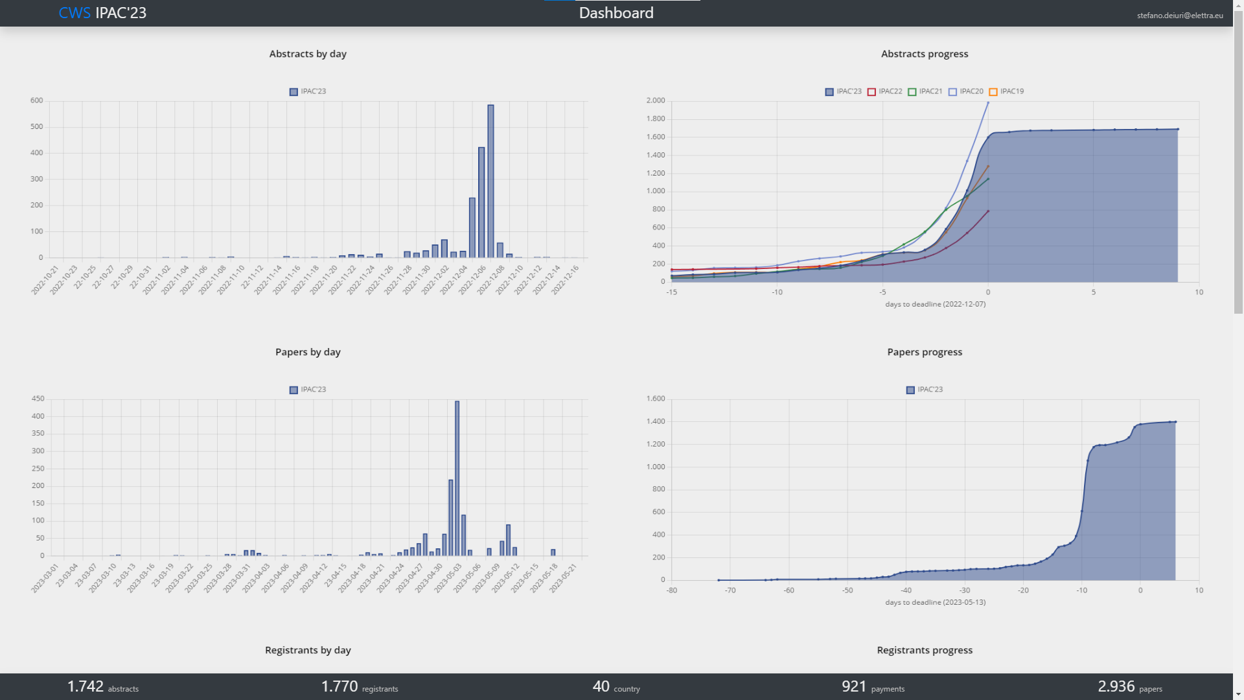
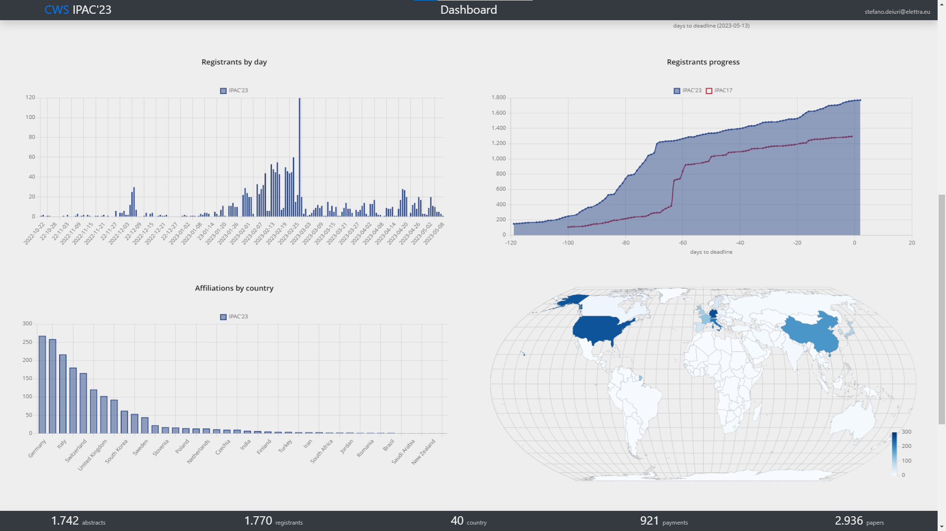
Dashboard
This page is dedicated to the organizers and is designed to be able to monitor the progress of the various phases of the event, such as: abstract submission, registrations, payments, paper submission.

Slide 30
Statistics
this page shows charts and statistics useful for organizing work in the PO
includes statistics about editors and tags

Slide 31
the collection

Slide 32
Notes:
Last Slide 1: Thanks to the audience

Slide 33
Notes:
Last Slide 2: Aerial Photo of Elettra

