Slide 1


Slide 2


Schrodinger’s JACAT
Joint Accelerator Collaboration
AEditor Trainee
If anybody knows the aeditor is in training, are they really in training?
Once you know the aeditor is in training, does that mean they know it all?

Slide 3


Slide 4
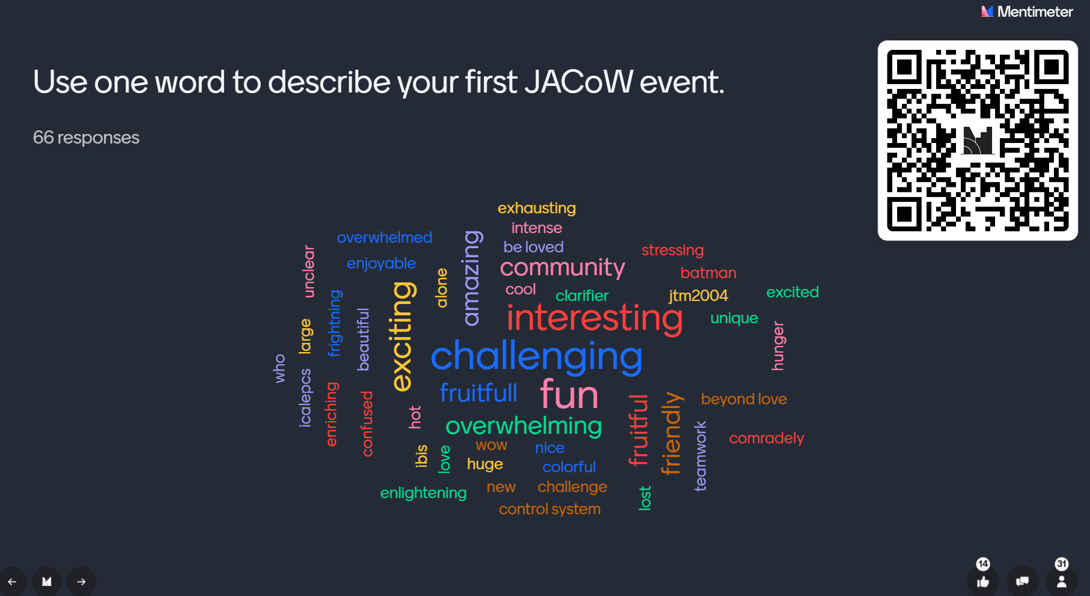

Slide 5
Breakouts – Putting our perspectives to work
Split into groups - two tables per group - and select a group reporter
1 new editor/IT person per group
Choose your adventure:
  Make a list of resources you wish you knew about the first time you edited
  Make a list of new strategies for training for JACoW editors
  Make a list of worst practices for new JACoW editors
  Email your lists to gibbsss@ornl.gov

