Slide 1


Editing
Papers
Documents are written in plain text with commands that determine its structure
Text and commands are processed by LaTeX to produce neatly formatted documents
Extendable, numerous packages of extra commands and environments
LaTeX is now the de facto standard in academia!
Philosophy: You think about the content,
LaTeX takes care of the formatting
MS Word: WYSIWYG – What You See Is What You Get

Slide 2
LaTeX Usage
Conference | Venue | % LaTeX
IPAC’24 | Nashville | 69%
IPAC’23 | Venice | 66%
IPAC’22 | Bangkok | 68%
FEL’24 | Warsaw | 67%
LINAC’24 | Chicago | 52%
HB’23 | CERN | 75%
FLS’23 | Lucerne | 66%
MEDSI’23 | Beijing | 9%
LaTeX usage within the JACoW
community has increased from
~33% to ~67%
over the past ~10 years

Slide 3
Installation
TeX Distributions:
MiKTeX, TeX Live (Windows, Linux, MacOS)
MacTeX (TeX Live distribution for MacOS)
Overleaf (online, ready to use) uses TeX Live
MiKTeX is the installation most used within JACoW Collaboration.
Advantage: easy installation process; automatically loads any missing packages
Current Windows version: 24.1

Slide 4
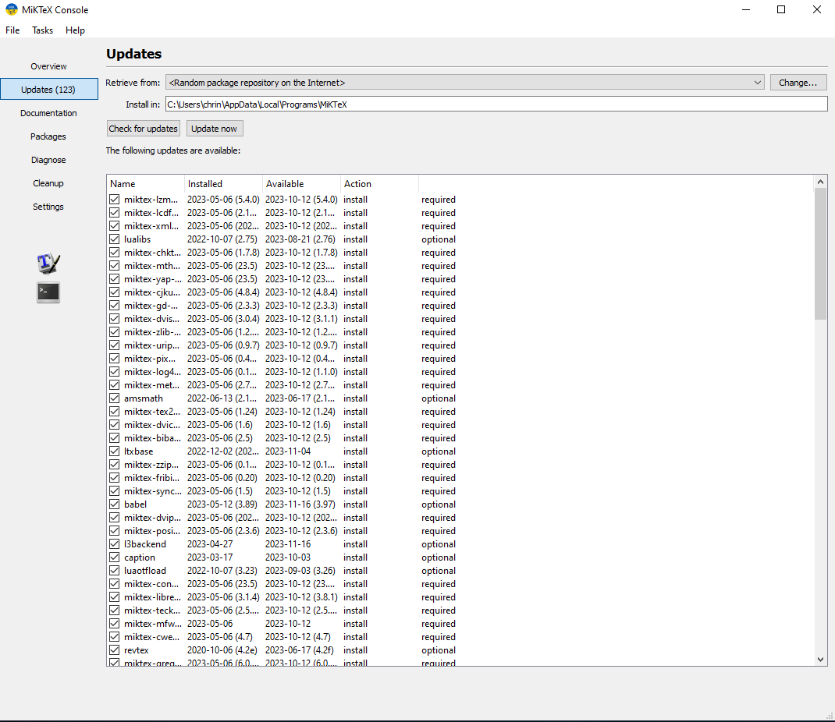
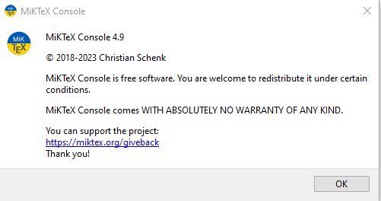
MiKTeX Console

Slide 5
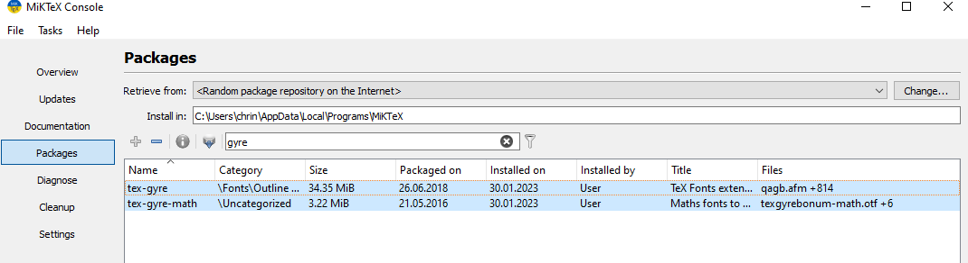
MiKTeX Console
Manage updates, packages manually with MiKTeX console.
tex-gyre and tex-gyre-math packages may need to be specifically sought out.

Slide 6
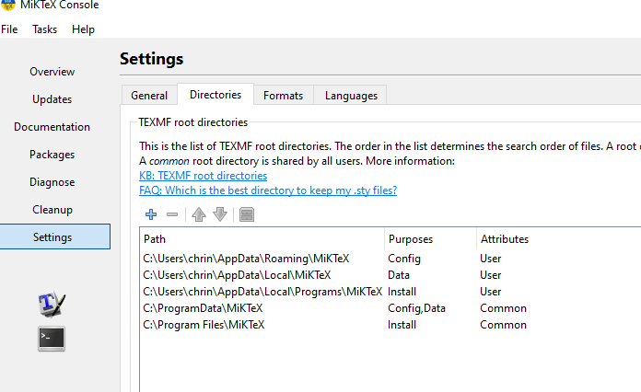
jacow.cls
Current jacow.cls version is v2.98j
https://jacow.org/Authors/LaTeX
MiKTeX installation comes with jacow.cls
but it may not be the latest version
Check that yr Editors are using the latest class file!
Latest jacow.cls file to be copied into user’s
local MiKTeX directory
C:\Users\<user>\AppData\Local\Programs
\MiKTeX\tex\latex
MiKTeX Console -> Settings -> Directories
(Purpose Install)

Slide 7
Editors
TeX Front-ends (i.e., GUI, LaTeX Editors)
Multi-platform, open-source LaTeX editors:
TeXstudio
TeXnicCenter (Windows only)
TeXworks
WinEdt (Windows only)
Visual Studio Code (VS Code)
Overleaf (Web)

Slide 8
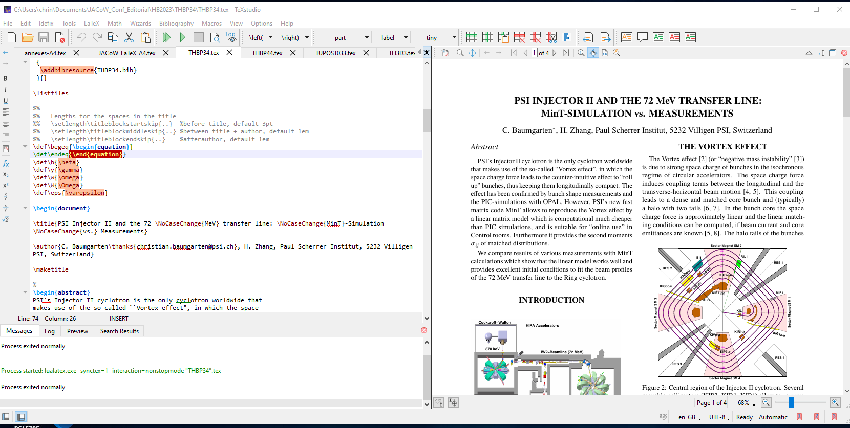
Editors
JACoW favourite:
TeXstudio
user friendly
integrated viewer
errors clearly displayed
…
NB. TeXstudio does not provide LaTeX itself. User must choose a TeX distribution (MiKTeX) and install it first.

Slide 9
Class File
and Packages
The formatting in LaTeX documents is determined by the class.
class file names have the .cls extension.
First line in a LaTeX source file (.tex) is a document class declaration command
\documentclass{article}
article – scientific journals, short reports
report – longer reports with chapters, thesis, etc.
book – novels, manuals
slides – for slides
letter – for writing letters
jacow – for JACoW papers!
The look can be modified, and more functionalities added by means of a package.
(preloaded thru \usepackage{<package-name>} – expect to load several for more refined control)
package file names have the .sty extension.

Slide 10
jacow.cls
\documentclass{jacow}
When you write \documentclass{jacow}in your LaTeX file, you are including the class file jacow.cls
This defines all the commands like \title, \section which go into structuring your document.
\title{A High Brightness Photogun}
renders (capitalized, bold, 14pt, centered): A HIGH BRIGHTNESS PHOTOGUN
\section{RF Shielding in Compact Light Sources}
renders (capitalized, bold, 12pt, centered): RF SHIELDING IN COMPACT LIGHT SOURCES

Slide 11
jacow.cls
Certain words are immutable (units, facilities)
\title{The 3 \NoCaseChange{GeV} Taiwan Light Source}
renders: THE 3 GeV TAIWAN LIGHT SOURCE
\section{RF Shielding at \NoCaseChange{SPring-8}}
Renders: RF SHIELDING AT SPring-8

Slide 12

siunitx package
\usepackage{siunitx} (already preloaded in jacow.cls)
New documents should use \qty in place of the deprecated \SI command
\qty{10}{\um} or \qty{10}{\micro\meter} - required way to get an upright unit 10 µm
\qty{10}{m} will give optimized spacing (thin space) between digit and unit
else use \, to render a thin space between digit and unit: 10\,m (rather than 10 m)
Exceptions: $10^{\circ}$C renders 10°C … but better still, use \qty{10}{\Celsius}
$10^{\circ}$C
\usepackage{gensymb} \degree
\usepackage{textcomp} \textdegree

Slide 13
Units for Emittance
Emittance is typically measured in units of π⋅mm⋅mrad
\qty{1.0}{\textpi}$\cdot$\unit{mm}$\cdot$\unit{\milli\radian}
1.0 π⋅mm⋅mrad
\qty{1.0}{\textpi}$\blank$\unit{mm}$\blank$\unit{\milli\radian}
1.0 π ⋅ mm ⋅ mrad
Define \newcommand in jacow.cls file to render π ⋅ mm ⋅ mrad (?)

Slide 14

Thin, Thick Spaces
Should there be a space before the %? 10% or 10 %? No real consensus – but yes!
Rendering spaces:
Thin: 10\,\% or 10\thinspace \% (1/12em)
Medium: 10\:\%
Full: 10~\%
Thick: 10\;\%

Slide 15
Thin, Thick Spaces
Should there be a space before the %? 10% or 10 %? No real consensus – but…
Rendering spaces:
Thin: 10\,\% or 10\thinspace \% (1/12em)
Medium: 10\:\%
Full: 10~\%
Thick: 10\;\%
VAR
Video Assistant Referee
L'assistance vidéo à l'arbitrage
favourite

Slide 16
textgreek package
Upright Greek characters: \usepackage{textgreek}
\textpi π
\textPi π
\textmu µ or \unit{\micro} from siunitx package
\textmicro µ

Slide 17
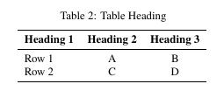
Tables
Formatting Tables – avoid unnecessarily cluttering with horizontal and vertical lines
(see template to learn about \toprule \midrule \bottomrule for thickness of lines)
\begin{table}
\caption{Table Heading}
\centering
\begin{tabular}{l c c }
\toprule
\textbf{Heading 1} & \textbf{Heading 2} & \textbf{Heading 3}
\midrule
1 & 2 & 3 \\
4 & 5 & 6 \\
\bottomrule
\end{tabular}
\label{Tab:Tab1}
\end{table}

Slide 18
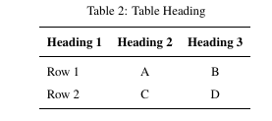
Tables
To increase row spacing in table
\begin{table}
\caption{Table Heading}
\renewcommand{\arraystretch}{1.2}
\centering
\begin{tabular}{l c c }
\toprule
Column 1 Heading & Column 2 Heading & Column 3 Heading
\midrule
1 & 2 & 3 \\
…
\bottomrule
\end{tabular}
\label{Tab:Tab1}
\end{table}

Slide 19

bm package
Column Headings in Tables should be in bold face.
\textbf command does not operate for math mode, e.g., \textbf{$\alpha$}
\usepackage{bm} for bold face for math mode in table
& \textbf{Case textbf $\alpha$} & \textbf{Case bm} \bm{$\alpha$} &

Slide 20
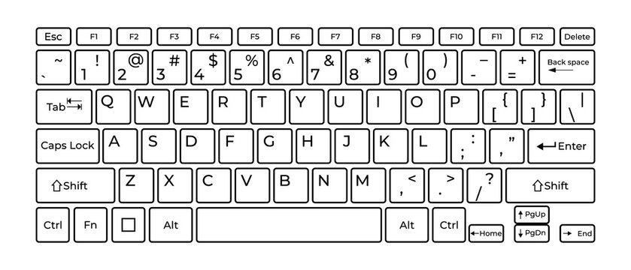
open/close quotes
e.g., in references
Open quotes
``
Two back ticks
Close quotes
’’
Two single quotes
\usepackage{csquotes} (In jacow.cls file)
\textquotedblleft
\textquotedblright
\usepackage{dirtytalk}
\say{Title of paper in \say{sentence} case}
``Title of paper in `sentence’ case’’

Slide 21
Cheating on space
Removing or adding blank space, e.g., after figures
\vspace{0.5 cm}
\vspace{-\baselineskip}
\baselineskip – vertical distance between lines

Slide 22
Bibliography
Terminology
.tex is the LaTeX document source file, e.g., TUP01.tex
.bib file stores all data about the reference (author, journal, year) in a structured way. To use a .bib file/database with the LaTeX (.tex) document, a processor is needed to transform the .bib file into something (.bbl) that the .tex file will understand
bibtex and biber are backend programs that process bibliography information. They are the interface between the .bib file and the LaTeX document
biblatex is a LaTeX package that formats citations and bibliographies; actively being developed with biber, providing a wider array of BibTeX database fields; handles UTF-8 encoded .bib files.

Slide 23
Bibliography
Terminology
.tex is the LaTeX document source file, e.g., TUP01.tex
.bib file stores all data about the reference (author, journal, year) in a structured way. To use a .bib file/database with the LaTeX (.tex) document, a processor is needed to transform the .bib file into something (.bbl) that the .tex file will understand
bibtex and biber are backend programs that process bibliography information. They are the interface between the .bib file and the LaTeX document
biblatex is a LaTeX package that formats citations and bibliographies; actively being developed with biber, providing a wider array of BibTeX database fields; handles UTF-8 encoded .bib files.

Slide 24
Bibliography
Terminology
.tex is the LaTeX document source file, e.g., TUP01.tex
.bib file stores all data about the reference (author, journal, year) in a structured way. To use a .bib file/database with the LaTeX (.tex) document, a processor is needed to transform the .bib file into something (.bbl) that the .tex file will understand
bibtex and biber are backend programs that process bibliography information. They are the interface between the .bib file and the LaTeX document
biblatex is a LaTeX package that formats citations and bibliographies; actively being developed with biber, providing a wider array of BibTeX database fields; handles UTF-8 encoded .bib files.

Slide 25
Bibliography
Terminology
.tex is the LaTeX document source file, e.g., TUP01.tex
.bib file stores all data about the reference (author, journal, year) in a structured way. To use a .bib file/database with the LaTeX (.tex) document, a processor is needed to transform the .bib file into something (.bbl) that the .tex file will understand
bibtex and biber are backend programs that process bibliography information. They are the interface between the .bib file and the LaTeX document
biblatex is a LaTeX package that formats citations and bibliographies; actively being developed with biber, providing a wider array of BibTeX database fields; handles UTF-8 encoded .bib files.

Slide 26
Bibliography
Terminology
.tex is the LaTeX document source file, e.g., TUP01.tex
.bib file stores all data about the reference (author, journal, year) in a structured way. To use a .bib file/database with the LaTeX (.tex) document, a processor is needed to transform the .bib file into something (.bbl) that the .tex file will understand
bibtex and biber are backend programs that process bibliography information. They are the interface between the .bib file and the LaTeX document
biblatex is a LaTeX package that formats citations and bibliographies; actively being developed with biber, providing a wider array of BibTeX database fields; handles UTF-8 encoded .bib files.
The state-of-the-art solution is the biblatex package together with the biber program

Slide 27
Bibliography
Magic comments are comments of the form % !TEX or % !BIB ... that can be used as directives in many tex editors, for example to specify (from within the document body), which tex engine should be used, the encoding, the language for spell checking etc.
% !BIB TS-program = biber/bibtex The TS stands for TeXShop,
% !BIB program = biber/bibtex
% !TeX spellcheck = en_GB/en_US
% !TeX program = pdflatex/lualatex/xelatex
% !TeX encoding = UTF-8 Unicode/IsoLatin
\documentclass[]{jacow}
\usepackage{biblatex}
\addbibresource{MOP01.bib} %Imports the bibtex data file
\begin{document}
\printbibliography %Prints the list of cited references, under title REFERENCES
\end{document}

Slide 28
template
New Editors:
1. Familiarize yourself with the style guide detailed in the template. The devil is in the details!
2. Develop the technical TeX skills to execute changes.
Don’t be scared of error messages! Read ‘em and fix ‘em!

Slide 29
Author, Affiliation Listing
Author, Institute listing (by institute; or by author)
Minimal information to identify the institute (no post codes required)
in a consistent way, while respecting that some institutes require that they be listed in a specific way

Slide 30
Author, Affiliation Listing
M. Marx¹, R. Billen², J. Chrin³, H. Franberg Delahaye⁴, R. Saethre⁵
DESY should be addressed as follows:
¹ Deutsches Elektronen-Synchrotron DESY, Hamburg, Germany
… and NOT
DESY, Hamburg, Germany
or
Deutsches Elektronen-Synchrotron (DESY), Hamburg, Germany

Slide 31
Author, Affiliation Listing
M. Marx¹, R. Billen², J. Chrin³, H. Franberg Delahaye⁴, R. Saethre⁵
DESY should be addressed as follows:
¹ Deutsches Elektronen-Synchrotron DESY, Hamburg, Germany
NOTE! Recent directive from DESY management points to:
Deutsches Elektronen-Synchrotron DESY, Germany
cf. DESY is one lab with two locations – Hamburg and Zeuthen
JACoW template requires that the city be listed!

Slide 32
Author, Affiliation Listing
M. Marx¹, R. Billen², J. Chrin³, H. Franberg Delahaye⁴, R. Saethre⁵
¹ Deutsches Elektronen-Synchrotron DESY, Hamburg, Germany
² CERN, Geneva, Switzerland

Slide 33

Author, Affiliation Listing
M. Marx¹, R. Billen², J. Chrin³, H. Franberg Delahaye⁴, R. Saethre⁵
¹ Deutsches Elektronen-Synchrotron DESY, Hamburg, Germany
² CERN, Geneva, Switzerland
³ PSI Center for Accelerator Science and Engineering, 5232 Villigen PSI, Switzerland
NEW!
previously Paul Scherrer Institut, 5232 Villigen PSI

Slide 34
Author, Affiliation Listing
M. Marx^{1,2}, R. Billen², J. Chrin^{2,3}, H. Franberg Delahaye⁴, R. Saethre⁵
¹ Deutsches Elektronen-Synchrotron DESY, Hamburg, Germany
² CERN, Geneva, Switzerland
³ PSI Center for Accelerator Science and Engineering, 5232 Villigen PSI, Switzerland
⁴ GANIL-CEA/CNRS, Caen, France
⁵ Oak Ridge National Laboratory, Oak Ridge, TN, USA

Slide 35
Author, Affiliation Listing
Lawrence Berkeley National Laboratory, Berkeley, CA, USA
or LBNL, Berkeley, CA, USA
SLAC National Accelerator Laboratory, Menlo Park, CA, USA
or SLAC, Menlo Park, CA, USA
Fermi National Accelerator Laboratory, Batavia, IL, USA
or FNAL, Batavia, IL, USA
or Fermilab, Batavia, IL, USA
Brookhaven National Laboratory, Upton, NY, USA
or BNL, Batavia, IL, USA
Grand Accélérateur National d’Ions Lourds - CEA/CNRS, Caen, France
or GANIL - CEA/CNRS, Caen, France

