Slide 1


Activity Report
Regional Support Centres
Ronny Billen
JACoW Regional Support Manager – EMEA
JACoW Conference Proceedings Web-Publisher - EMEA
Also on behalf of
Kazuro Furukawa
JACoW Conference Proceedings Web-Publisher - ASIA
Takashi Kosuge
JACoW Regional ASIA Manager – ASIA
JACoW Team Meeting - November 2024

Slide 2
Our beloved SPMS is dead… or almost
Out-phasing of SPMS
  Since 2022, no new SPMS instances were set up
  All new conferences are deployed as Indico events
  The last SPMS-powered conferences took place in 2023
  The SPMS user-interface functionality is generated by code inside the Oracle database
  The SPMS functionality is required up to the publication of the proceedings, after which some of the conference data can be repatriated to the Central Repository
Central Repository
  Oracle database with people’s profiles, institutes,…
  Used for JACoW login, announcements by email,…
  SPMS web interface on the Central Repository is still used by administrators
Nevertheless, technical support was still required throughout the year for several issues, minor and major (security)
Discussed in depth during the pre-meeting yesterday
Only very limited set of data and functionality is still required
Data migration and Indico development envisaged with a priority level
Oracle-based Central Repository will remain without SPMS user interface

Slide 3
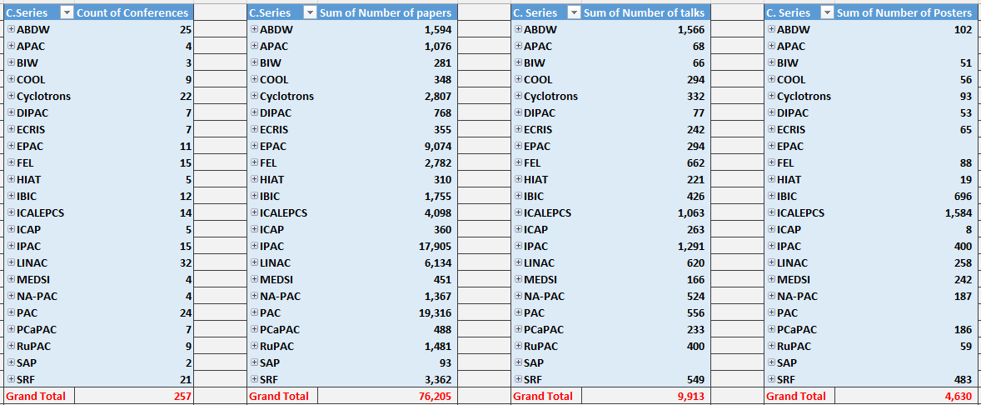
JACoW Publications
JACoW’s Mission = Publishing Conference Proceedings
  Currently 257 conferences published; +76’000 papers
  9 proceedings since the 2023 JACoW Team Meeting

Slide 4

JACoW Publications 2024
Conference proceedings are normally generated and provided by the Conference “Editor-in-Chief”
The final QA check and web-publication is done by Kazuro Furukawa (KEK server) and Ronny Billen (CERN server)
Publication Date | Conference | Papers (count) | Talks (count) | Posters (count) | Photos / Videos (MB) | Total (MB) | Proceedings Generation
22-Dec-2023 | IBIC-2023 | 111 | 40 | 61 | 4 | 1625 | Volker Schaa
30-Jan-2024 | ICALEPCS-2023 | 338 | 152 | 189 | 5 | 2189 | Volker Schaa
12-Feb-2024 | FLS-2023 | 65 | 89 | 8 | 8 | 686 | Volker Schaa
28-Feb-2024 | ICALEPCS-1991 | 149 | 0 | 0 | 65 | 174 | Volker Schaa, scanned
4-Apr-2024 | HB-2023 | 142 | 118 | 50 | 0 | 1560 | Volker Schaa
8-Jul-2024 | IPAC-2024 | 1054 | 87 | 0 | 22 | 4915 | Ivan Andrian (CAT tool)
22-Jul-2024 | MEDSI-2023 | 107 | 41 | 49 | 0 | 1545 | Volker Schaa
3-Sep-2024 | COOL-2023 | 29 | 30 | 13 | 0 | 375 | Volker Schaa
28-Oct-2024 | LINAC-2024 | 231 | 82 | 0 | 0 | 1572 | Kelly Jaje (CAT)
Note:
Due to the technological obsolescence of the CERN/JACoW Search Engine, certain functionalities have disappeared (e.g. keyword search)
More importantly, papers generated by the CAT tool are not found by the CERN/JACoW Search Engine
The use of the new CERN search engine for JACoW is under discussion

Slide 5
Another Significant Issue to Follow Up
Out-phasing JACoW Search Engine
  Obsolete technology and underlying file management system
  Discussed between IT experts from CERN and Elettra to establish implementation roadmap
  New API to be implemented to reproduce JACoW Search functionality
CAT generated conference proceedings
  Currently 4 published proceedings, will be used for all future conferences
  Proceedings can be (easily) generated by non-experts
  Current JACoW Search Engine cannot find CAT generated proceedings papers
Discussed in depth during the pre-meeting yesterday
Development work required, “not rocket science”
Resource availability to be confirmed in the coming weeks
Physical hosting to be decided with inherent maintenance and support

Slide 6
Conclusions
The current/future required Support is shifting:
  Away from SPMS, although not yet down to zero
  Towards Indico, as all conferences are now Indico-powered
  Towards the future Search Engine implementation
  Away from the concept of Regional Centres
  Away from “single-person shows” with implicit non-sustainable consequences
  Towards teams with shared knowledge to provide support
A vision with up-to-date technology and adequate approaches in a modernised environment is a necessity for JACoW’s future

