Slide 1

General overview of producing JACoW proceedings
A reference to the coming topics from a timing perspective

Slide 2

From 2022 - Indico SPMS Merger
Editorial Module
Publication
Migration Road Map
Phase 1 start 2016
Scientific Secretariat Module
Peer Review Module
Phase 2 start 2020
Phase 1 of project has concluded; full specifications are available at https://codimd.web.cern.ch/s/d2XPNF5L9
Significant progress during the pandemic
  Scientific secretariat testing carried out during 2021
  Editorial testing started, to be concluded
During Team meeting 2021 a priority list was agreed between the Indico team and JACoW, which is captured in phase 2
Phase 2 project closure expected 2023, with 1 FTE provided from Indico

Slide 3
From 2023: Indico SPMS Merger
Editorial Module
Publication
Migration Road Map
Phase 1 start 2016
Scientific Secretariat Module
Peer Review Module
Phase 2 start 2020
FEL successful ”beta” test for Indico as the primary JACoW tool
IPAC’23 first major conference
  Using Indico
  New mobile appliction based on Indico
  Proceedings will be generated with new tool
Phase 2 project closure still expected 2023, with 1 FTE provided from Indico.
No more SPMS conferences will be created, currently there are 6 that are in planning

Slide 4
Indico SPMS Merger
Editorial Module
Publication
Migration Road Map
Phase 1 start 2016
Scientific Secretariat Module
Peer Review Module
Phase 2 start 2020
IPAC’23 second conference executed in Indico
  Published with CAT tool
Only remaining item to migrate is the last SPMS instance, commonly referred to as the Central Repository

Slide 5
Indico SPMS Merger
Editorial Module
Publication
Migration Road Map
Phase 1 start 2016
Scientific Secretariat Module
Peer Review Module
Phase 2 start 2020
Central Repository replacement
First conference published with CAT tool by the local editor
Work ongoing to migrate the Central Repository
  Use cases validated
  Targeted towards the end of this year
Peer Review module still not complete, not used past IPAC

Slide 6
General overview of producing JACoW proceedings
A reference to the coming topics from a timing perspective

Slide 7
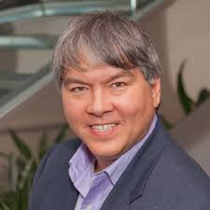
Not all conferences or workshops are the same
Here I present some commonalities among many member JACoW conferences and workshops
  The best authority for how things are done for any given series is someone who has done it before
    Consistent with the JACoW continuity model
  Caveat audientia: Your presenter has (strong) IPAC biases
Many meetings can be (and often are) supplanted by
  informal organizational processes
  Phone calls, meetings at other conferences, email, etc
In the acronym of Larry Wall (designer of Perl): TMTOWTDI
(There’s More Than One Way To Do It)
• (Don’t even get me started on TMTOWTDIBSCINABTE)

Slide 8
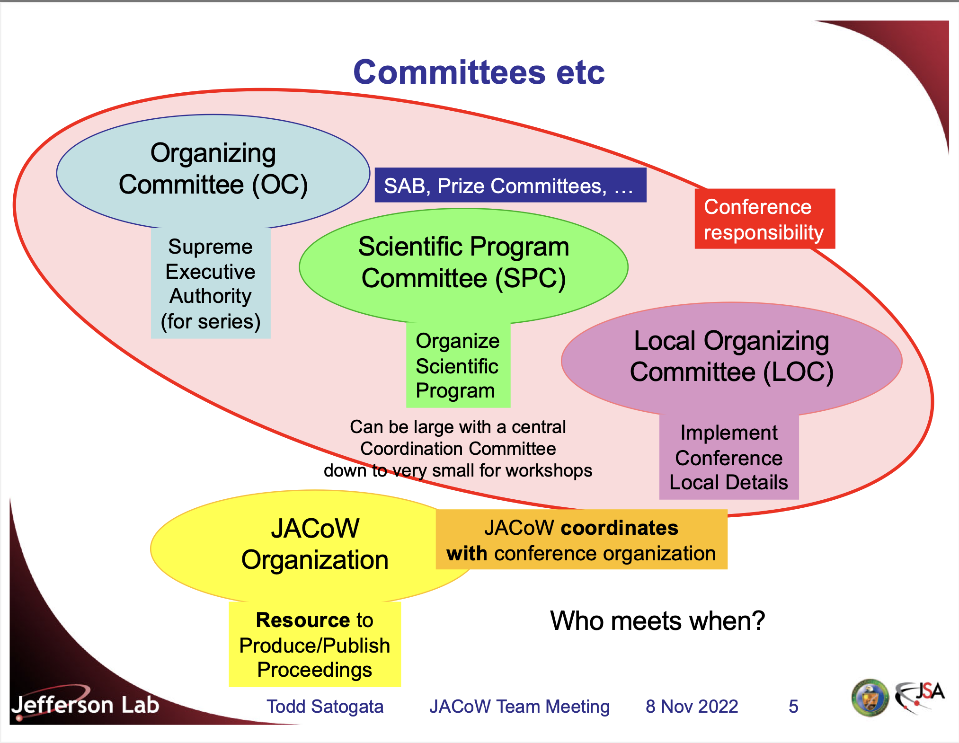

Slide 9
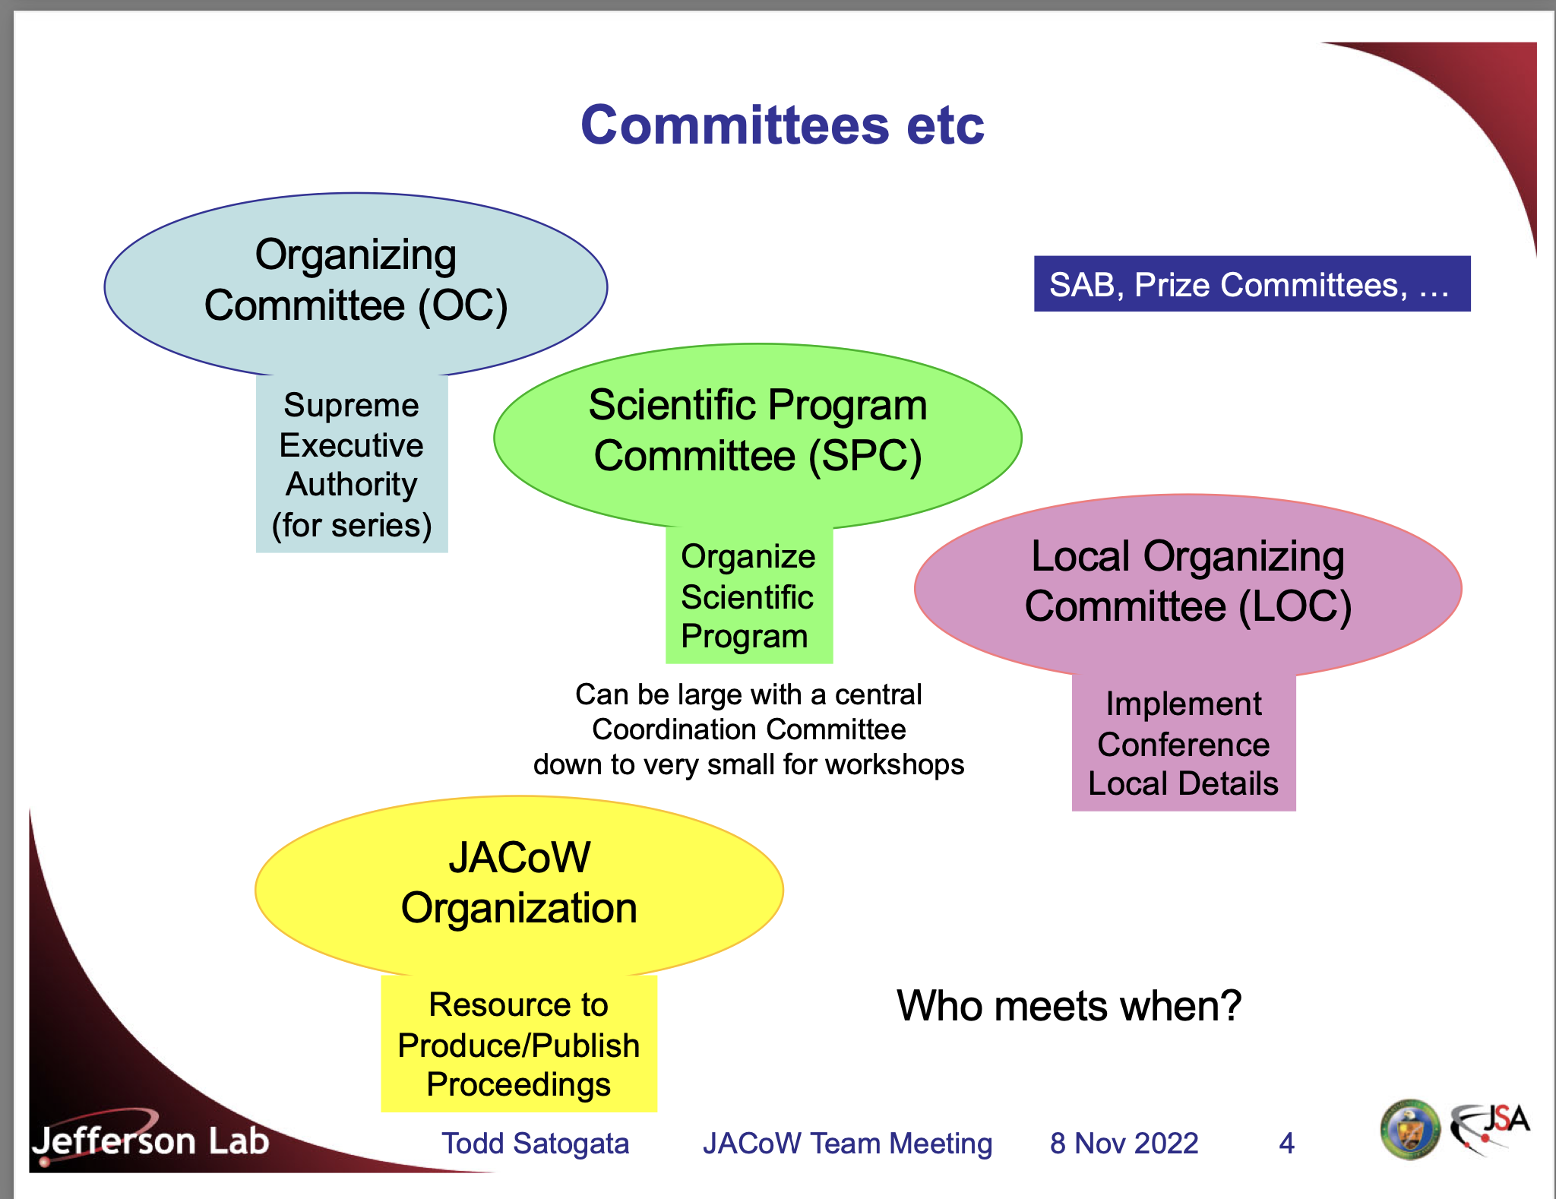

Slide 10
Committees and Chronology
The OC meets at least once before the conference
  Tours venue, provides conference mandate, etc
The SPC meets several (~3) times before the conference
  Advises SPC chair on classifications
  Organize scientific program, schedule, synoptic table
  Recommends, selects, invites invited oral contributions
  Selects contributed oral contributions from submitted abstracts
  Balance scientific program: topic, geography, gender
The LOC meets many times before the conference
  Organizes all venue and local items
  Organizes workforce, budget, registration, web pages, IT, etc

Slide 11
JACoW interacts with portions of all three committees
The OC agrees to JACoW Policies
§ Abide by SPMS/Indico agreement (signed by conference chair)
§ Editors (and preferably also IT) participate in JACoW Team Meetings for least a three-year cycle
• Maintains continuity, distributes load and information
§ JACoW publishing constraints as detailed at JACoW.org
The SPC organizes much of its work through Indico
§ Recommendations for and voting on invited speakers
§ Abstract submission
§ Recommendations for and voting on contributed speakers
§ Scientific program organization, including statistical balance
§ Paper and presentation submission
§ Email organization/tracking with authors and committee members

Slide 12
JACoW’s Relationship to Committees: LOC
LOC has greatest interaction with JACoW
§ Personnel and resource management, and budgets, are
LOC responsibilities
§ There are many, many roles before, during, and after the conference that are necessary to support the final JACoW objective of producing quality proceedings in timely fashion
(SPMS/Indico DBA)
Scientific Secretariat
Conference IT
Editor / QA
Transparency Editor
Poster Session Manager
Exhibition Manager
Referees
Student Session Organizer
Conference Administrator
Editor / Editorial Board
Repository Manager
Author Reception
Presentations Manager
Registration Manager
Registration Staff
Conference Webmaster

Slide 13
~24 Months before
Request Conference Event
Decide on main and subclassifications
Send invitations to invited speakers
C-24
C-15
C-14
C-12
Form OC/SPC/LOC
Send invitations to join SAB
Industry Announcement
Invite SAB to submit proposals for invited orals

Slide 14
~24 Months before
Request Conference Event
Decide on main and subclassifications
Send invitations to invited speakers
The JACoW Events Manager, or a JACoW Officer with Admin privileges on the JACoW-Indico site creates JACoW-Indico instances (events) upon receipt of a formal request to the JACoW Chair or Coordinator.
https://ipac-docs.jacow.org/InitialSetup/intro/
Many JACoW accelerator conferences have adopted a combination of Main plus Sub-classifications to enable a finer tuning of content, facilitating the scheduling of posters across numerous sessions and days.
https://ipac-docs.jacow.org/InitialSetup/mgmt_area_02/
C-24
C-15
C-14
C-12

Slide 15
~12 Months before
Set up an Editor PC
Abstract submission deadline
Call for abstracts
Initial QA
Invite proceedings office staff
C-12
C-10
C-9
C-4
SPC2
Deadline for Prize and Student Grant Applications
SPC3
Industry Exhibition Registration
Notes:
SPC3:
Determine contributed talks and backups from abstract list • Includes geographic, institutional, gender balances
• Includes review of classification, reclassification if necessary
Poster session layout, organization (based on abstract numbers)
Determine session chairs; Report from LOC, student session
Finalize synoptic table

Slide 16
~12 Months before
Abstract submission deadline
Initial QA
Set up an Editor PC
Conference programmes are generally composed of three types of presentation: Invited Oral, Contributed Oral and Poster.
https://ipac-docs.jacow.org/InvitedOrals/intro/#normal-ipac-workflow
https://ipac-docs.jacow.org/InvitedOrals/SPCtrackreview/
Prior to handing over all proposals to the SPC to decide contributed oral presentations, the Scientific Secretariat/Editor-in-Chief/Admin quality assures all proposals. In JACoW jargon this is known as Abstract Initial QA.
https://ipac-docs.jacow.org/ContributedAbstracts/SSinitialQA/
This is documented, but not in a central location. Raphael will give a talk on the topic, and you have all received an email to prepare your computer as well
In the future, it should be published:
https://docs.jacow.org
C-12
C-10
C-9
C-4
Notes:
SPC3:
Determine contributed talks and backups from abstract list • Includes geographic, institutional, gender balances
• Includes review of classification, reclassification if necessary
Poster session layout, organization (based on abstract numbers)
Determine session chairs; Report from LOC, student session
Finalize synoptic table

Slide 17
~3 Months before
Set up server for paper upload
Clone software setup to computers for proceedings office
Enable paper submission
C-3
C-2
C-1
Notify authors of program codes for papers
Number posters to work with conference space and assign program codes
Notes:
SPC3:
Determine contributed talks and backups from abstract list • Includes geographic, institutional, gender balances
• Includes review of classification, reclassification if necessary
Poster session layout, organization (based on abstract numbers)
Determine session chairs; Report from LOC, student session
Finalize synoptic table

Slide 18
~3 Months before
Notify authors of program codes for papers
Clone software setup to computers for proceedings office
Set up server for paper upload
Number posters to work with conference space and assign program codes
Enable paper submission
Indico replaces the JACoW File server(s) and hosts all submissions.
https://ipac-docs.jacow.org/Paper/submit/#submission-of-files-for-general-jacow-editing-and-publication
Programme codes are used as a unique identifier for a contribution scheduled in the scientific programme. The programme code has until now been used to:
to provide when/what/where information
to name the files uploaded for contributions to the proceedings
for assigning DOIs
https://ipac-docs.jacow.org/InvitedOrals/SSpcodes/
C-3
C-2
C-1
Notes:
SPC3:
Determine contributed talks and backups from abstract list • Includes geographic, institutional, gender balances
• Includes review of classification, reclassification if necessary
Poster session layout, organization (based on abstract numbers)
Determine session chairs; Report from LOC, student session
Finalize synoptic table

Slide 19
During the Conference
Core editors arrive at venue
Arrival of remaining staff
Prepublication
IT setup of network, computers, etc.
QA
Core editors decide criteria and level of "pickiness"
Wed
Thu
Sun
Sun
Fri
Speaker prep & Author reception start
Midnight deadline for upload of papers
Registration & Welcome
Start of Conference

Slide 20
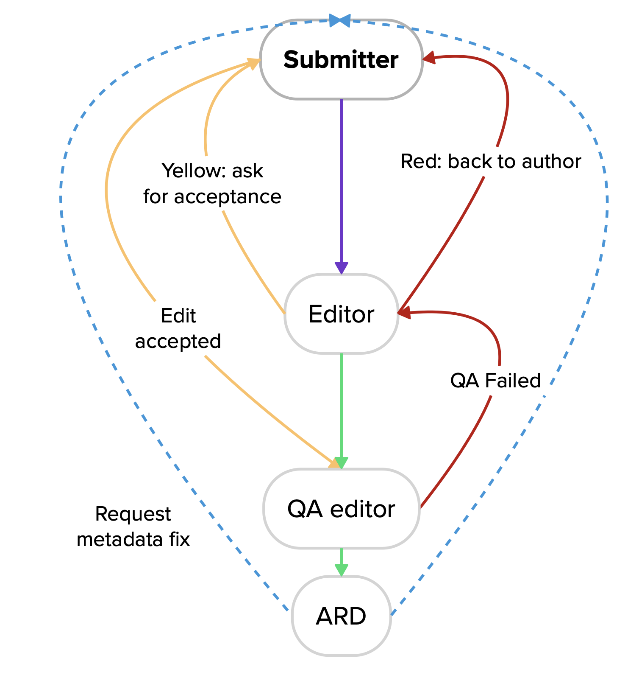
During the Conference
Core editors decide criteria and level of "pickiness"
Prepublication
IT setup of network, computers, etc.
Core Editors arrive at venue
Speaker prep & Author reception start
QA
IPAC’24 prototyped a new editorial workflow this year. Ivan Adrian gave a great presentation of the rationale and the setup last years team meeting.
https://indico.jacow.org/event/65/contributions/3148/attachments/351/1323/New%20paper%20processing%20and%20QA%20workflow.pdf
Wed
Thu
Sun
Sun
Fri

Slide 21


After the Conference
End of grace period for late paper submission and resubmissions
C+7 days
C+3 weeks
The Conference assembly tool vastly simplifies the publication of proceedings
https://ipac-docs.jacow.org/Proceedings/proceedings/
Publish proceedings on JACoW

Slide 22
https://www.jacow.org/Editors/JACoWConferencesOverview
Psst, this is a great presentation!
https://www.jacow.org//uploads/Editors/2022-11-08-GeneralOverviewJACoWConf.pdf

