Slide 1

JACoW Annual Team Meeting 2024
Welcome, with roadmap
Meghan McAteer, HZB
JACoW Annual Team Meeting 2024, Deauville, France

Slide 2
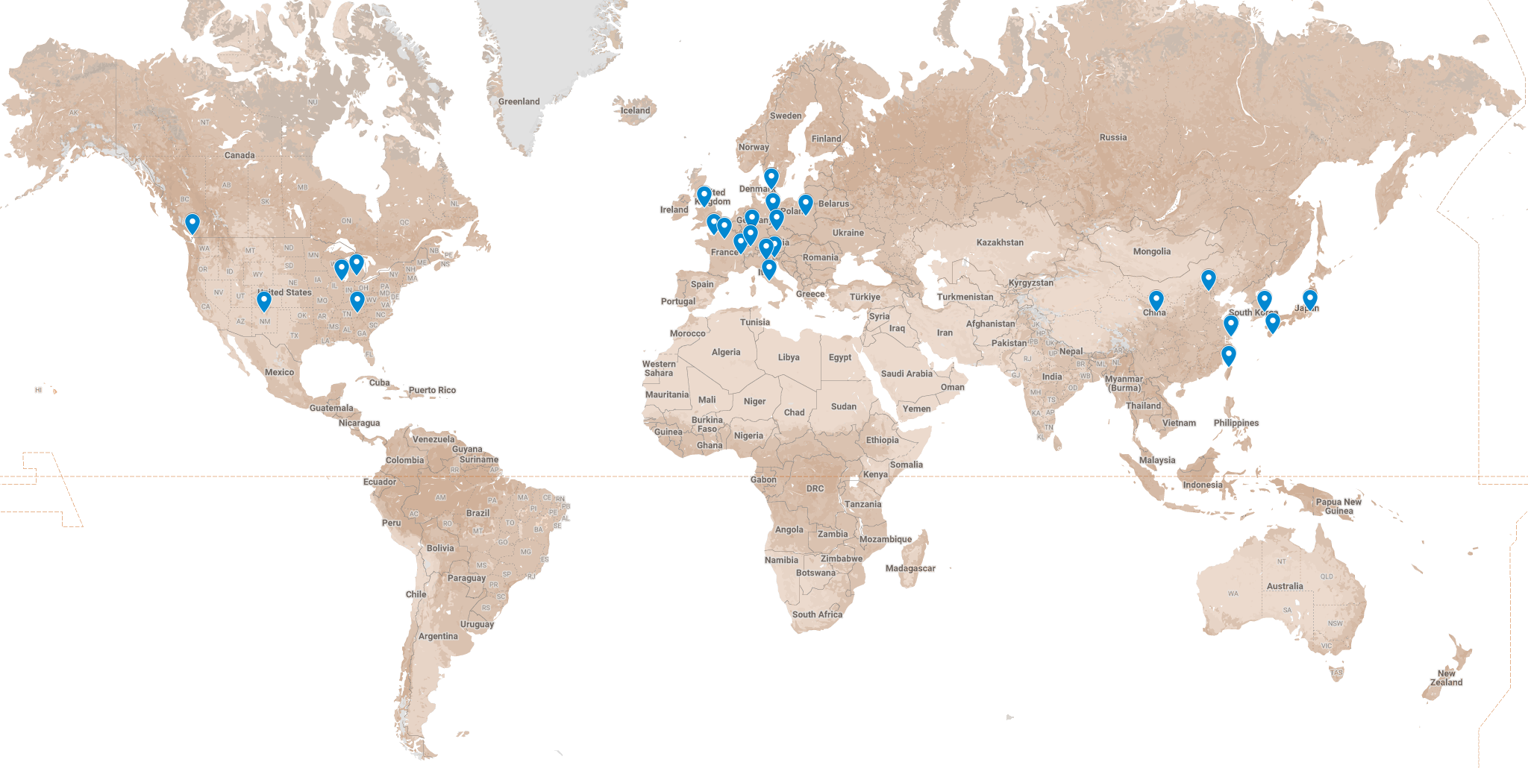
  We’ve come from far and wide…

Slide 3
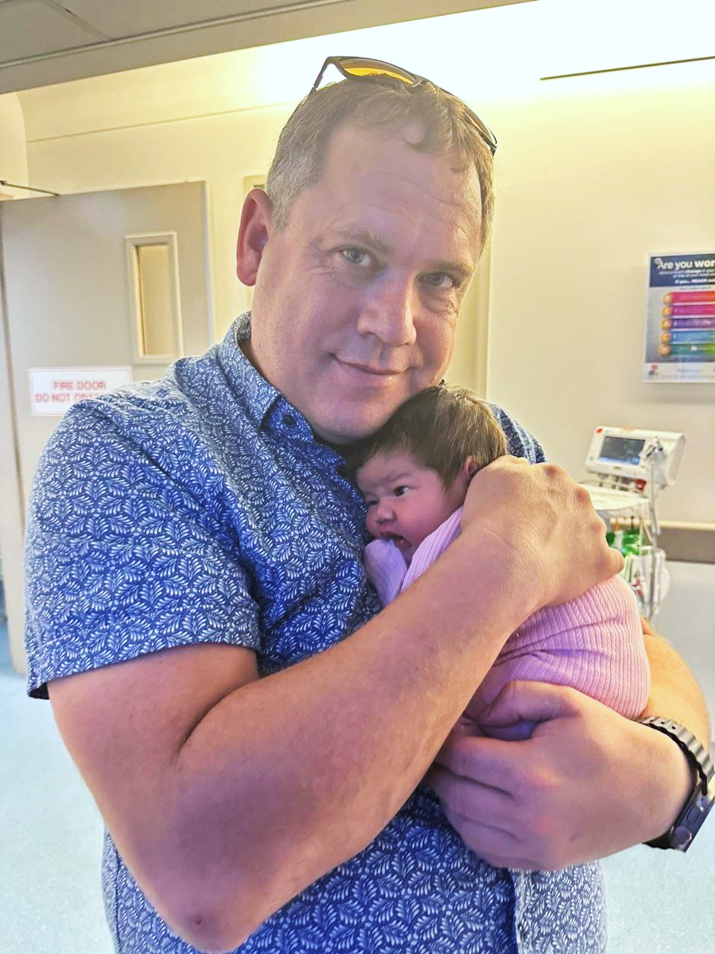
  We’ve come from far and wide…
Kaylee Taylor Button
30 October 2024

Slide 4
  We’ve come from far and wide…
  …but why exactly are we here?

Slide 5
  Two main objectives of JACoW Annual Team Meetings:
  Meeting of subject-matter experts for development work
  Knowledge transfer which enables newcomers to produce proceedings

Slide 6


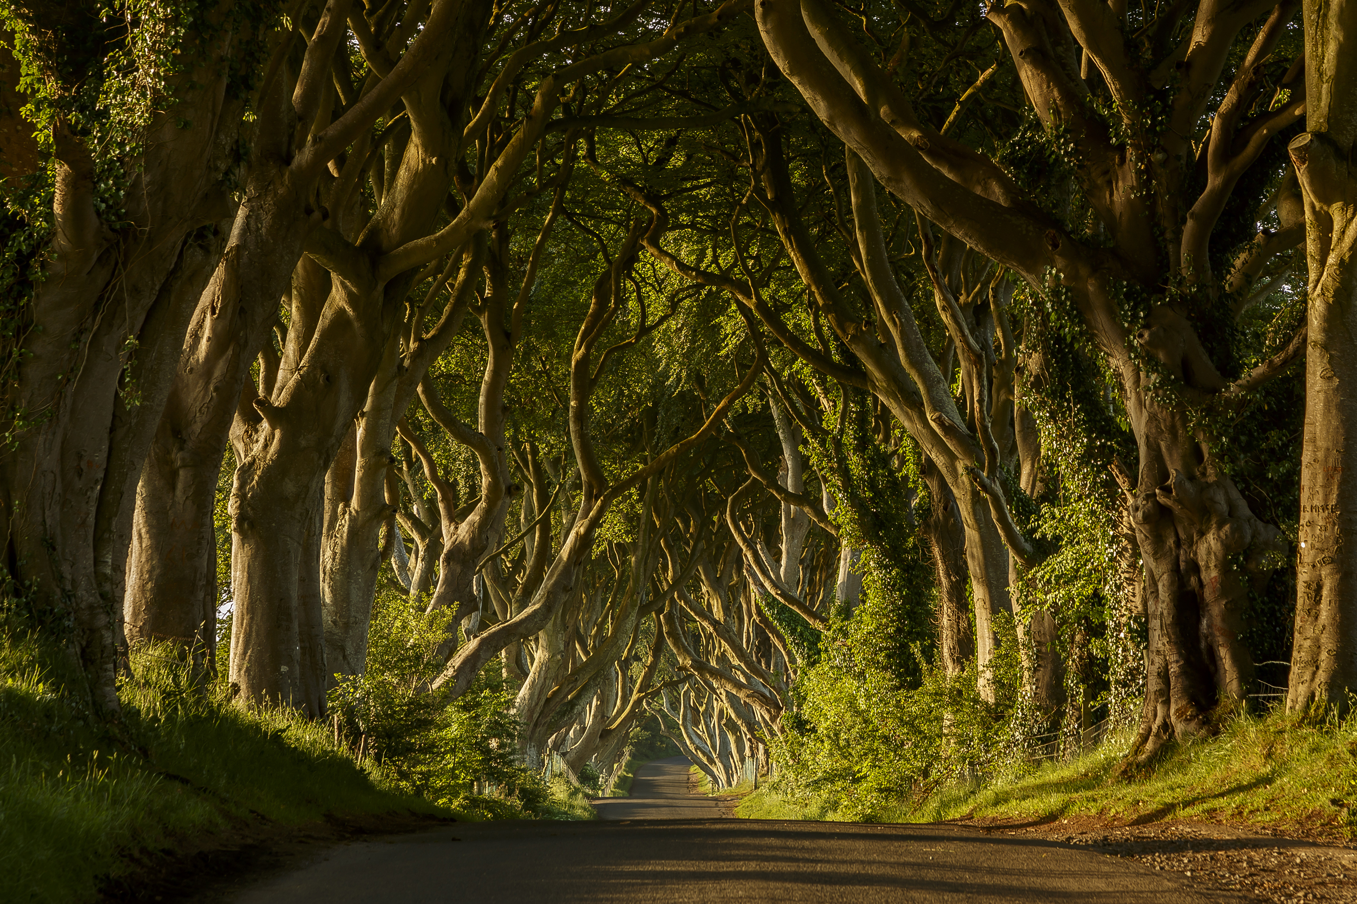
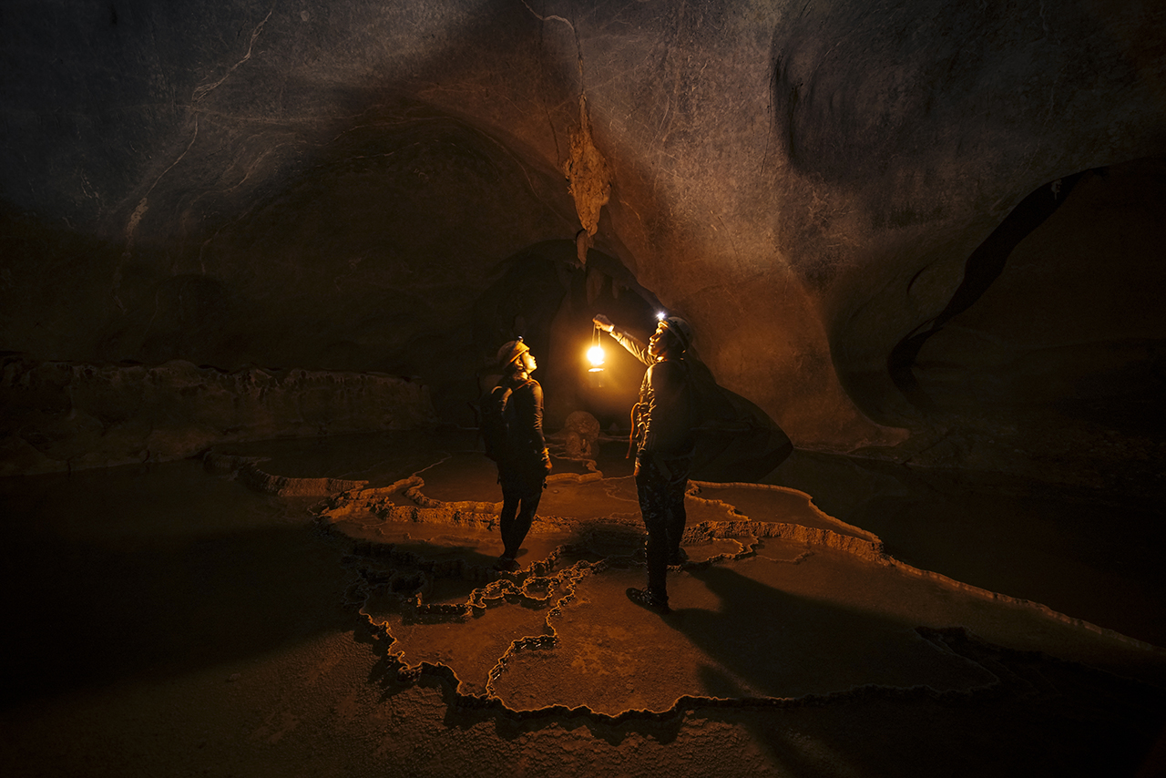
  The agenda at a glance
  Day 1
  Intros, overviews
  Day 2
  Getting into the details
  Day 4
  Outlook, summaries
  Day 3
  Hands-on walk-through

Slide 7
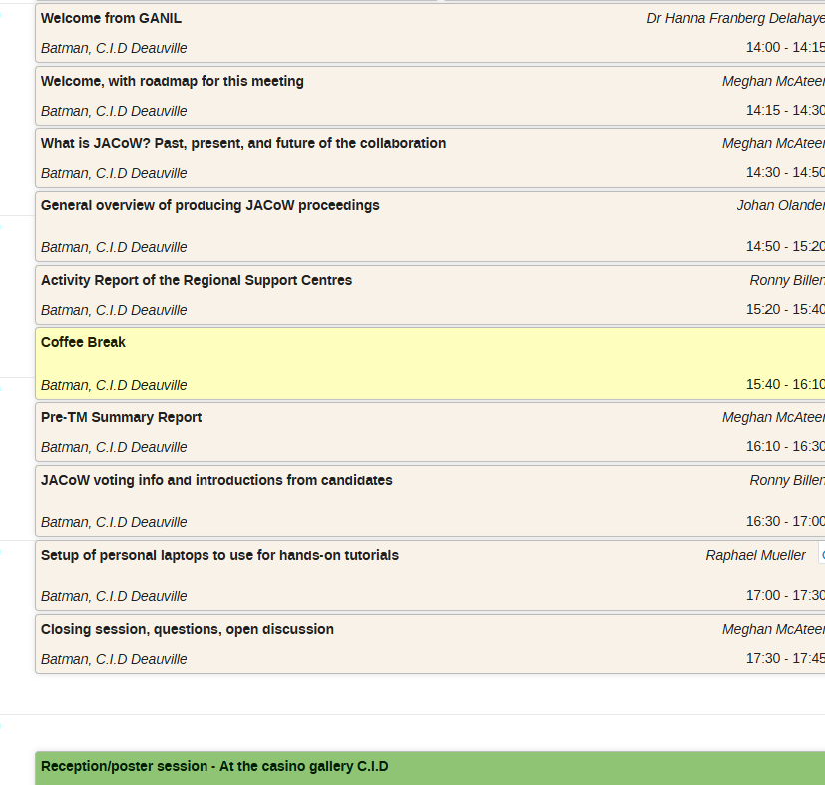
  Today

Slide 8
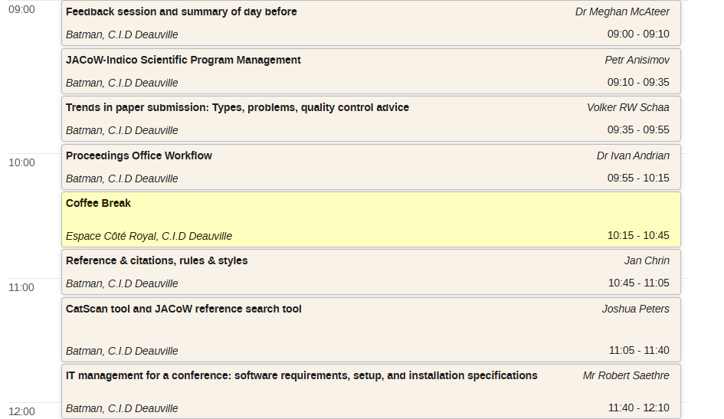
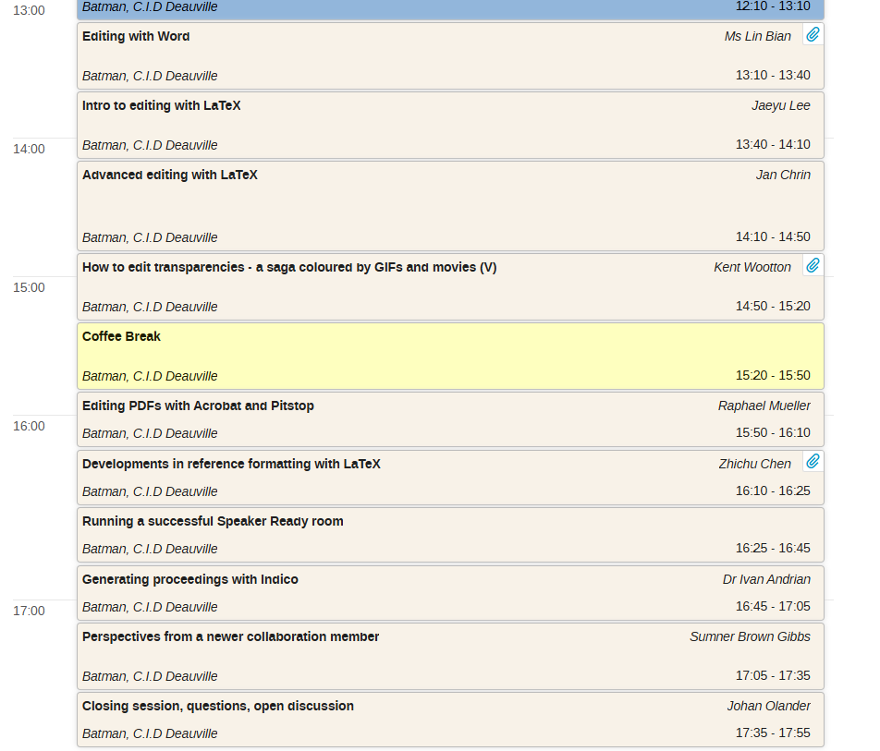
  Wednesday

Slide 9
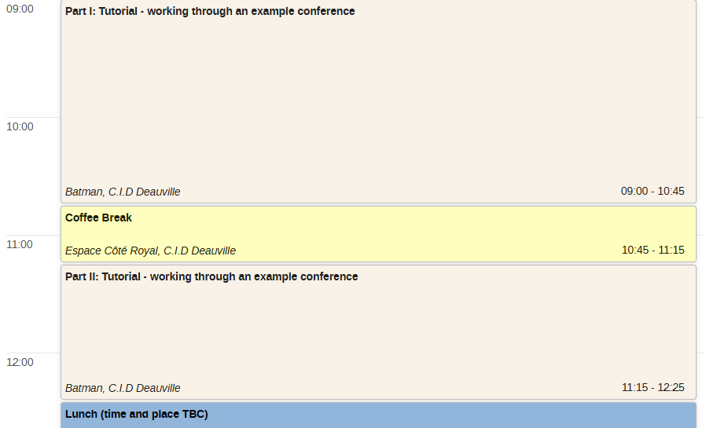
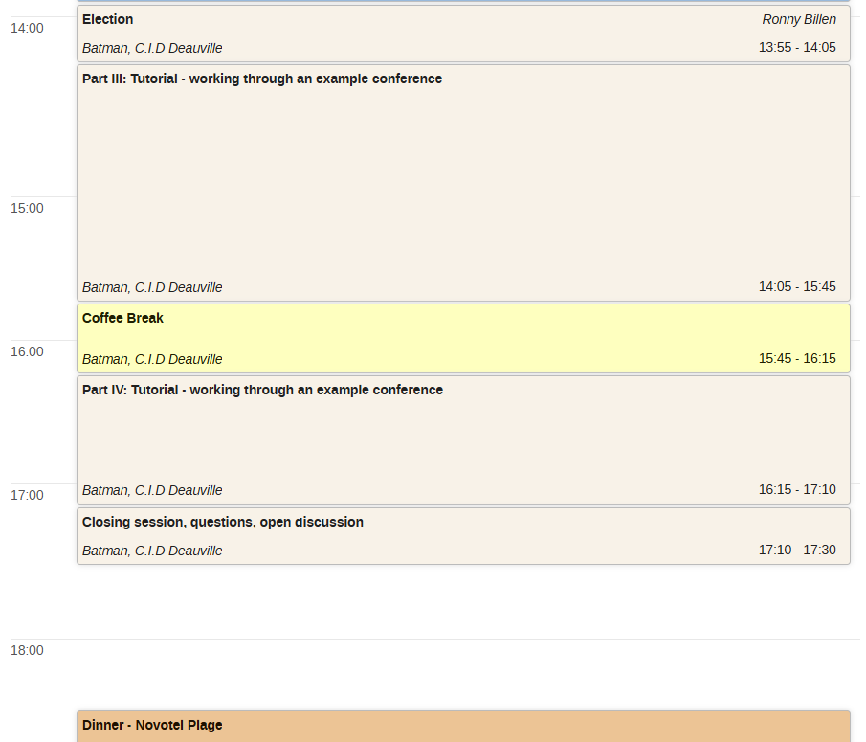
  Thursday

Slide 10
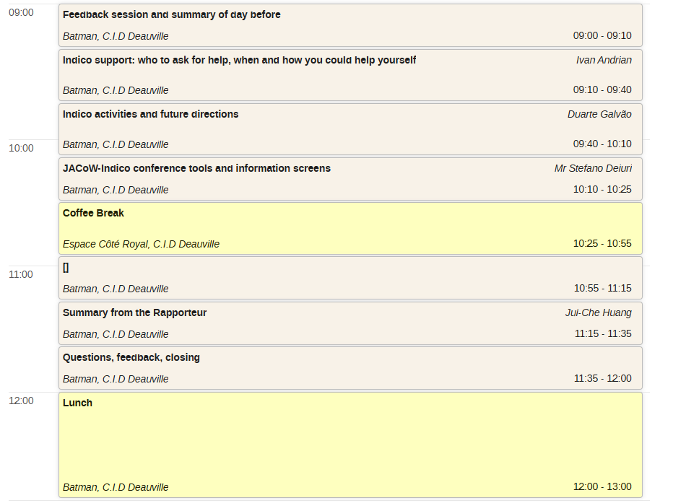
  Friday

Slide 11
  Many thanks to
  our GANIL hosts
  and to everyone for joining us here!

