Slide 1


Future e+e- Colliders using
Recycling Energy-Recovery Linacs (ERLs)
Vladimir N Litvinenko
Department of Physics and Astronomy, Stony Brook University
Energy-Recovery and Particle Recycling for boosting luminosity to O(10³⁷ cm⁻²sec⁻¹) level
Energy-Recovery offers high energy efficiency measured in luminosity/AC power
Recycling collided particles and their recuperations
  Eliminates insane ILC/CLIC appetite for fresh positions
  Offers high degrees of polarization in colliding beams
  Offers low energy spread by reducing beamstrahlung
There are currently three concept which I have time to describe very briefly
Recycling colliders can become more attractive with possible future technical breakthroughs
IPAC’25, Taipei International Convention Center, Taipei, Taiwan, June 2, 2025

Slide 2
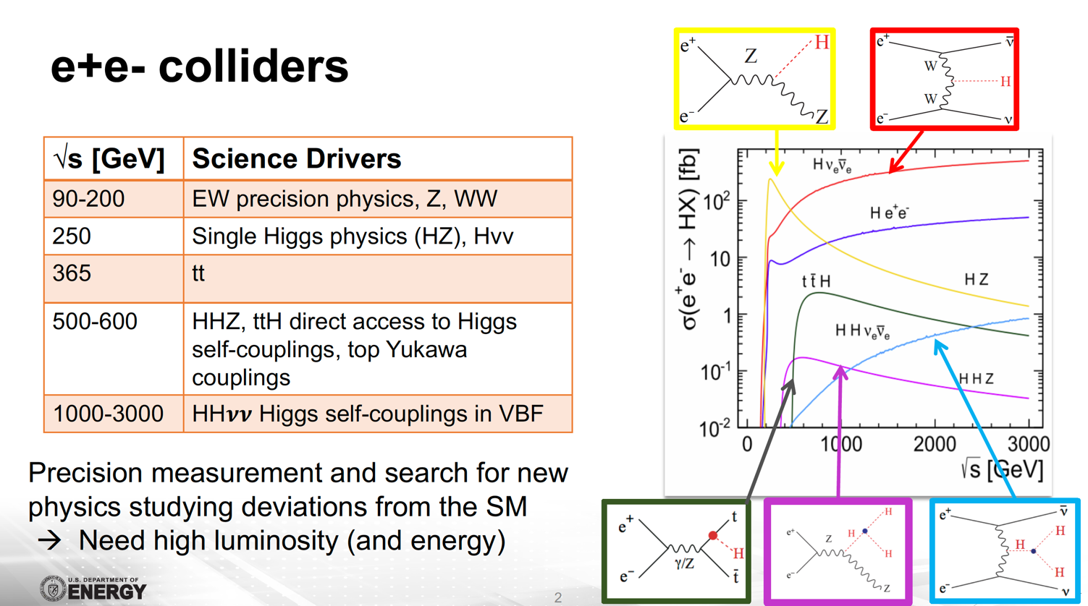
Physics: Energy and Luminosities reach
Recycling could offer luminosity boosts ~ 200 in HIGS sector
100 km CERC
FCC ee
ReLiC
FCC
ERLC
@FCC
LHC CERC 30 MW / ERLC
LHC CERC 100
Recycling offers potential for high degree of polarization in e⁺e⁻ beams
Example: The proper combination of polarization for electrons and positrons will significantly enhance the production cross section or will suppress it: great tool to control systematics

Slide 3
Three types of recycling e⁺e⁻ collider concepts
There are currently three known concepts of recycling linear colliders (listed in order of first appearances), which have significant differences :
CERC – Circular Energy and particle Recovery e⁺e⁻ Collider (Sept. 2019)
  Using multi-turn ERL located in a large semi-circular tunnel (such as FCC or LHC)
  Collided particles are decelerated, cooled in damping rings and re-used
  High luminosity is attained by high beam-beam disruption parameter, typical of linear colliders
ERLC – Energy Recovery Linear e⁺e⁻ Collider (December 2021)
  Using dual linear accelerators to accelerate, collide and decelerate both e⁺ and e⁻ beams
  Collided particles are decelerated, slightly cooled in a wiggler channel and re-used
  High luminosity is attained by high beam current and rep-rate – beam’s collision occurs at low disruption,
  and it is better described by the tune-shift typical for ring e⁺e⁻ colliders
ReLiC – Recycling e⁺e⁻ Linear Collider (March 2022)
  Using single linear accelerators to accelerate, collide and decelerate both e⁺ and e⁻ beams
  Trains of accelerating and decelerating particles avoid parasitic collisions is separators
  Collided particles are decelerated, cooled in damping rings and re-used
  High luminosity is attained by high beam-beam disruption parameter, typical of linear colliders
  All three concept assume colliding flat beams to control beamstrahlung

Slide 4
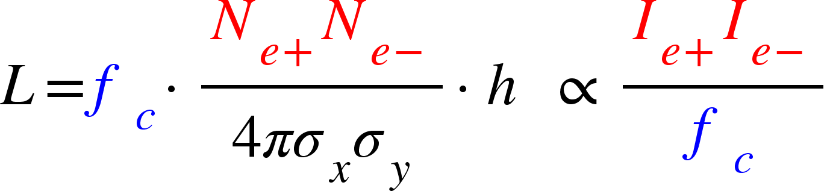
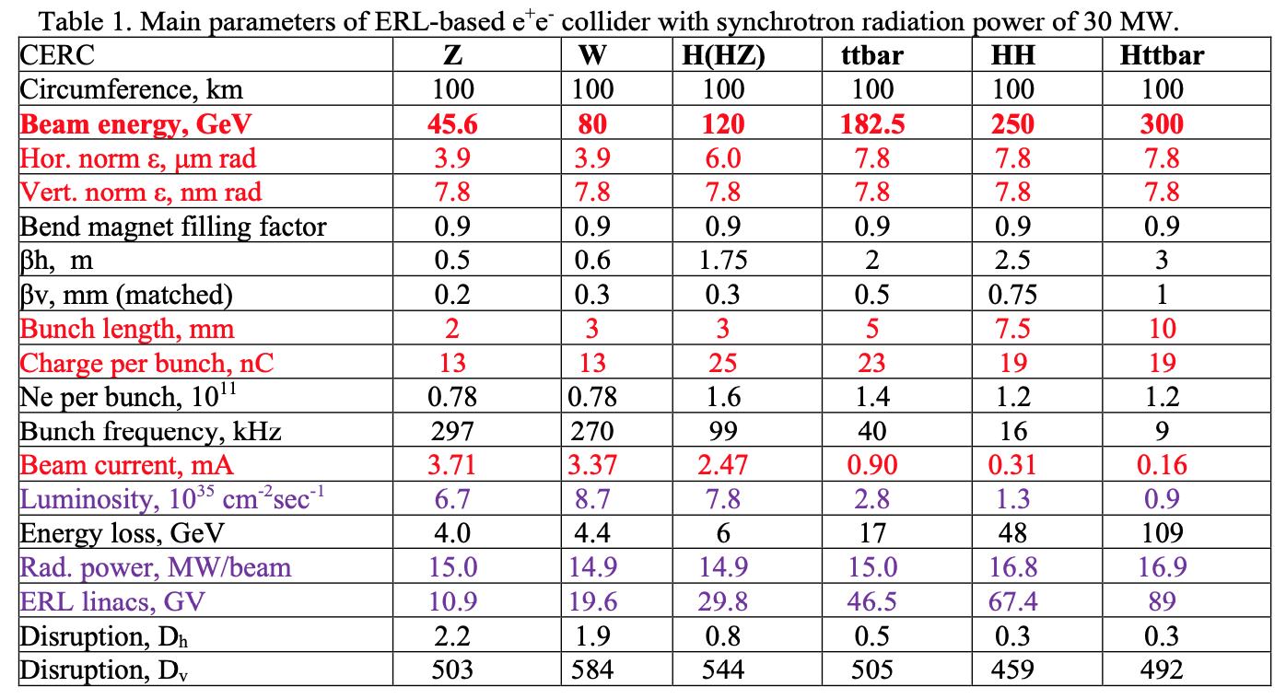
CERC - Circular ERL recycling e⁺e⁻ Collider
In FCC 100 km tunnel – 4 passes
Beams accelerated by SRF linacs in number of (2 to 4) turns
Only beams at top energy pass through detectors, the rest of beams bypass them
After collision at top energy RF phases are changed to deceleration returning most energy – minus that lost for SR - to SRF linac
After deceleration, all electrons and positrons are reinjected into the cooling rings
Only beam losses compensated by top-off injection
In few damping times flat beams are prepared and ejected with collision frequency
In case of multiple detectors, luminosity can be shared in any desirable ratio
Main idea: low current and low collision frequency
In LHC tunnel – 2 passes
Synchrotron radiation energy loss is 5.22 GeV. Total SR power is 30 MW
4-pass CERC with 500 GeV c.m. energy
  VNL, T. Roser, M. Chamizo-Llatas, Phys. Lett. B 804,135394, (2020)
Important advantages:
    Using N passes and the same linacs for both positions and electron reduces required linac length by 2N-fold
Important limitations:
  Energy loss for synchrotron radiation is proportional to E⁴ – the same as in ring-ring circular colliders
  This make achievable luminosity directly proportion to the power lost for synchrotron radiation
  And even in case of 100-km FCC type tunnel it limits collider c.m. energy well below 1 TeV

Slide 5
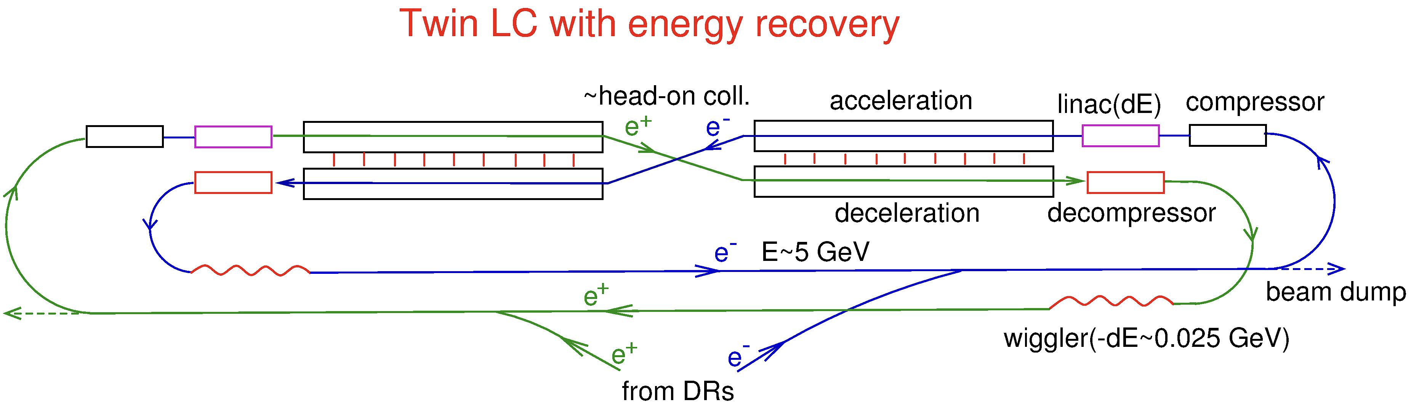
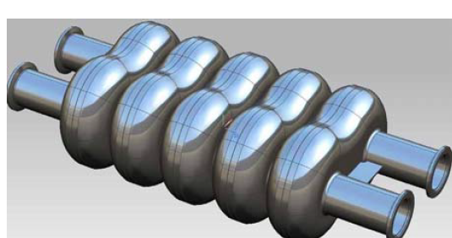
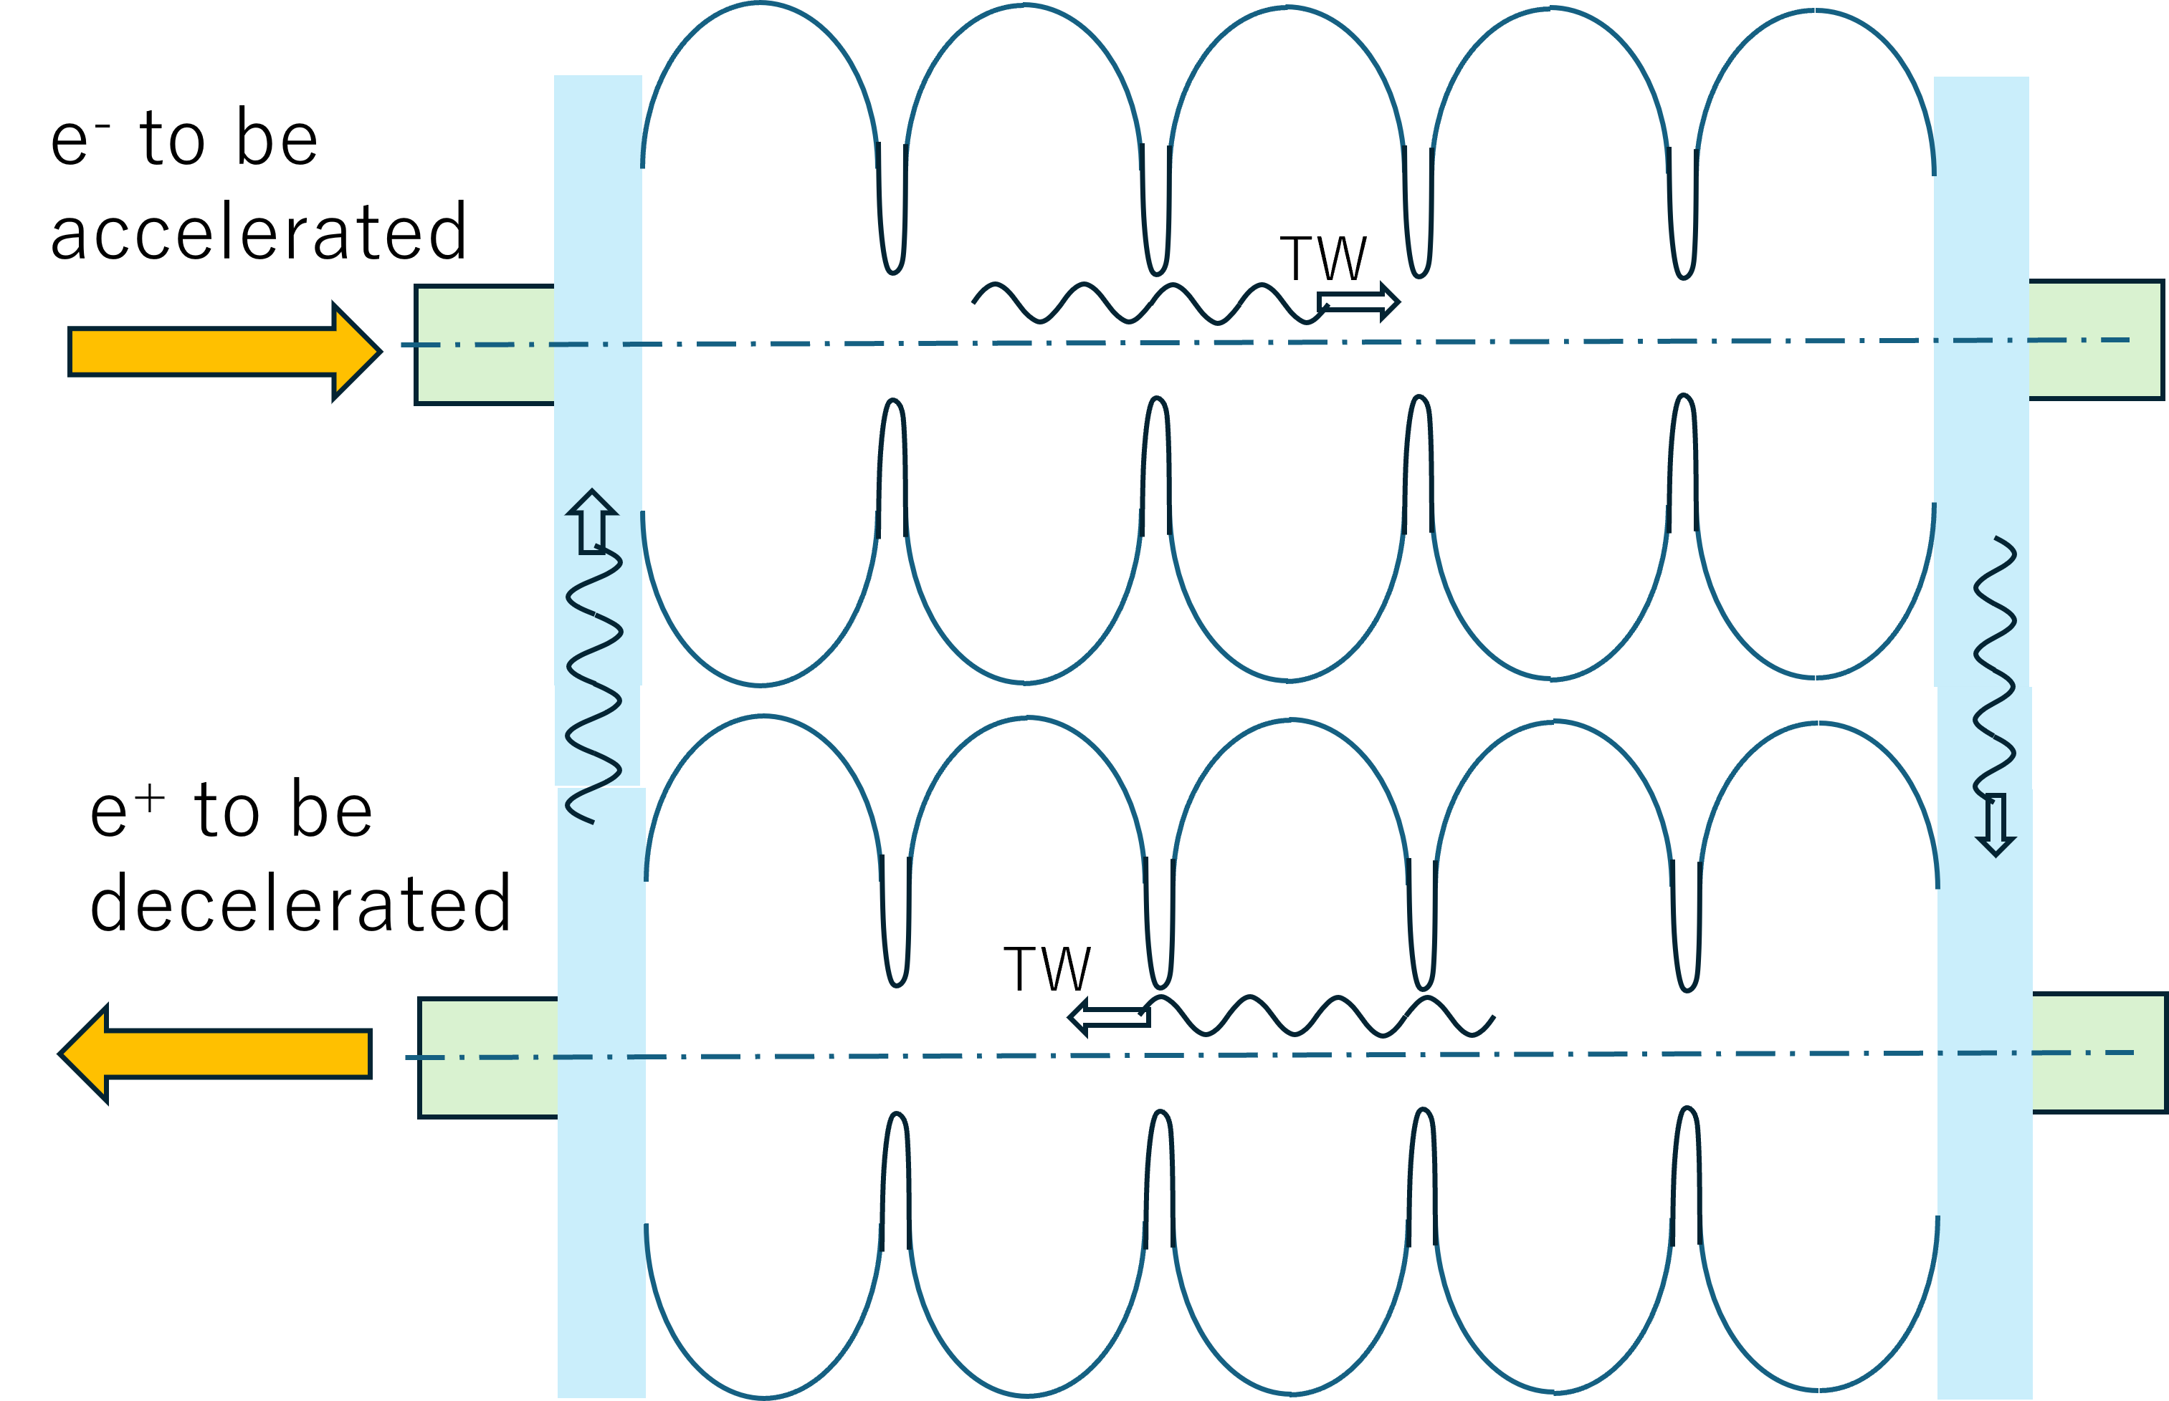
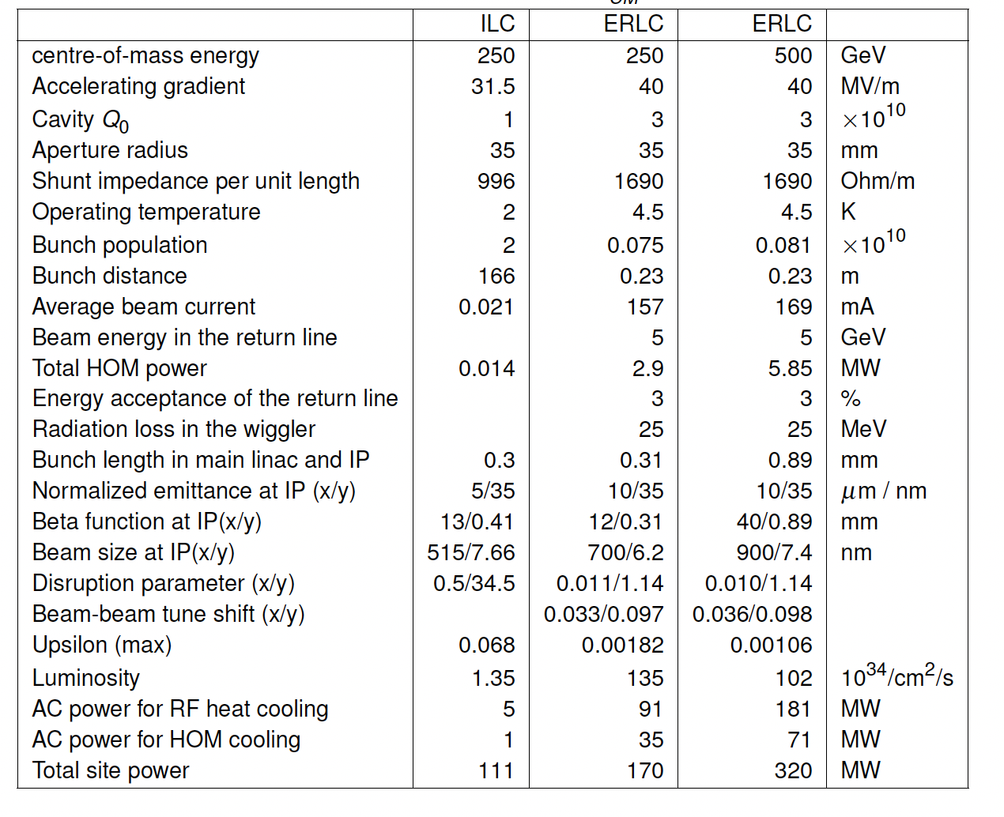
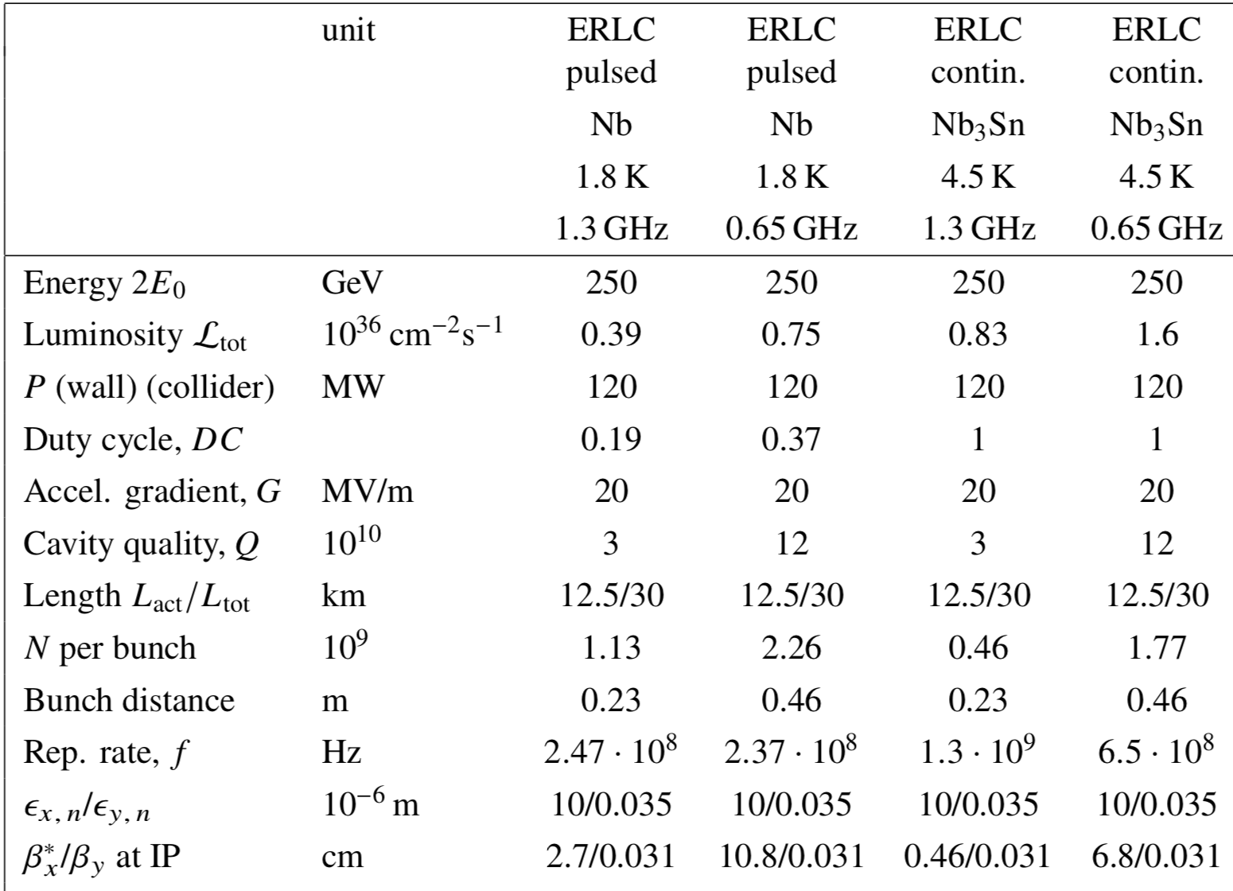
ERLC – Energy Recovery Linear e⁺e⁻ Collider original concept with twin-cavities is by V. Telnov (BINP, Russia), Traveling Wave linac option is by K. Yokoya (KEK, Japan)
Traveling Wave (TW) SRF linac with energy circulation
ILC Upgrade with Energy Recovery, Kaoru Yokoya, talk at LCWS, University of Tokyo, July 10, 2024
V. Telnov, A high-luminosity superconducting twin e+e- linear collider with energy recovery, Journal of Instrumentation 16 (2021) 12025
Table for ERLC performance, by Kaoru Yokoya in “A Linear Collider Vision for the Future of Particle Physics”, arXiv:2503.19983v2 31 Mar 2025
ERLC consists of two parallel superconducting dual-axis linacs equalizing accelerating and decelerating fields
Collision do occur with beam-beam tune shift ~ 0.1 typical for ring colliders
Damping is provided by wigglers in the 5-GeV return lines with energy loss per turn is ~0.5%
Duration of the cycle is ~ few second and is determined by the LiHe refrigerator
Main idea of the concept: Low charge per bunch, high rep-rate and very high average currents
Important advantage:
Low beamstrahlung loss and induced energy spread in collisions
Important limitations:
Use of dual linacs require 2X higher power of LiHe refrigerator
Both dual-axis and TW SRF linacs are in R&D phase
ERLC assumes futuristic 4K Nb₃Sn SRF cavities operating at 40 MV/m gradient with Q from 3×10¹⁰ to 1.2×10¹¹
Average currents at excess 100 mA would require strong suppression of transverse HOMs to avoid well known TBBU instability in ERLs
Most of the data shown in this slide is taken from materials developed by V. Telnov and K. Yokoya, except comments inside the area indicated by a dashed red rectangle

Slide 6
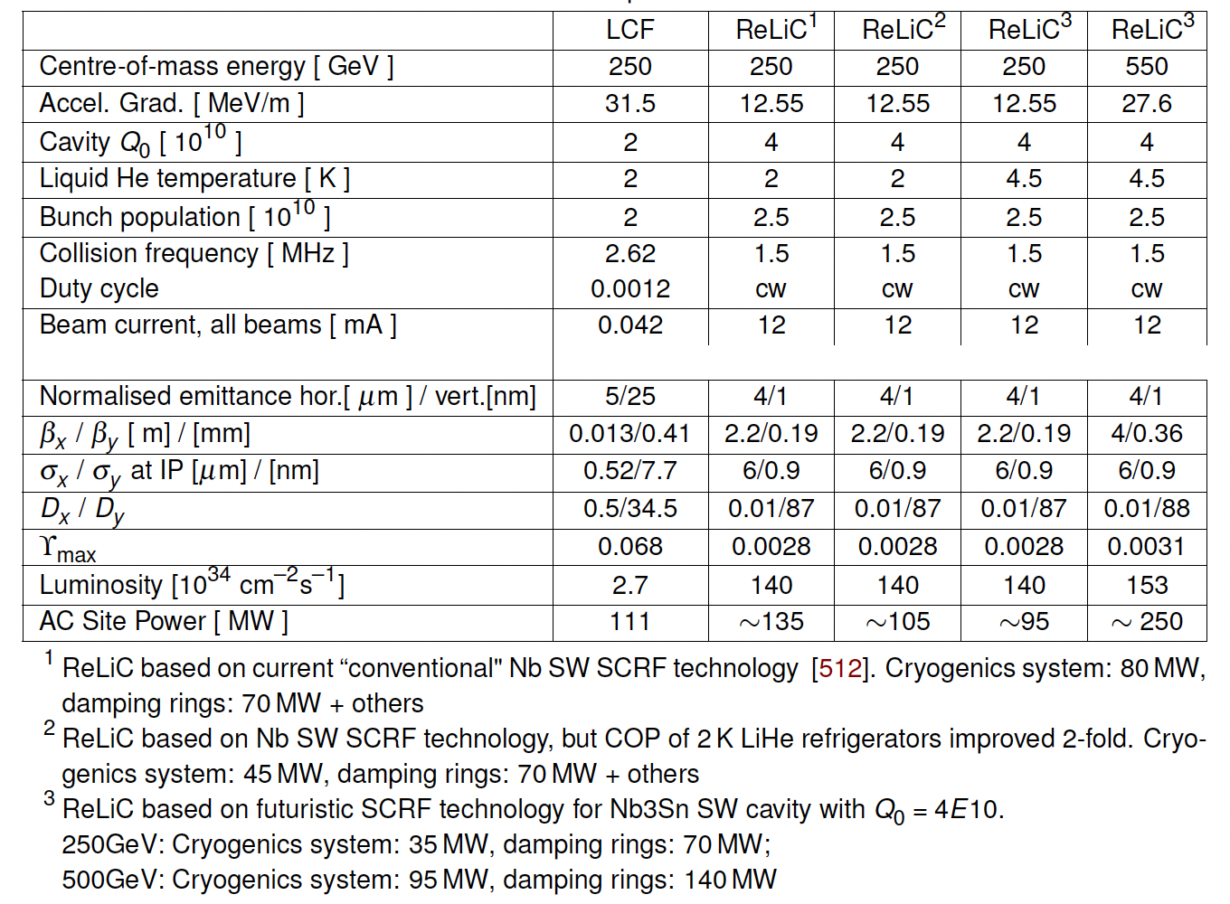
ReLiC – Recycling Linear Collider
Table for ReLiC performance, by VL in “A Linear Collider Vision for the Future of Particle Physics”, arXiv:2503.19983v2 31 Mar 2025
Flat beams cooled in damping rings with “top off” to replace burned-off particles
Bunch trains are ejected with collision frequency, determined by the distance between beam separators
Beams are accelerated on-axis in SRF linacs collide in one of detectors
After collision at the top energy, they are decelerated in the opposite linacs
Bunch trains are periodically separated from opposite beam, with accelerating beam propagating on-axis
Decelerated beams are injected into cooling rings
After few damping times the trip repeats in the opposite direction and beams collide in a detector located in the opposite branch of the final separator
Reusing electron and positron beams beam cooled in damping rings provides for natural polarization of both beam via Sokolov-Ternov process. Depolarization in the trip between damping ring is minuscular, which would provide for high degree of polarization.
With lifetime ~ 10 hours, necessary replacement of electrons and positrons is at 1 nA level
Main idea: moderate beam currents and collision frequency
ReLiC luminosity is reducing at high c.m. energies: the main limitation the beamstrahlung
Important advantage:
Low beamstrahlung loss and induced energy spread in collisions (required for particle recycling!)
Modest beam currents (~ 10 mA total) and collision frequency (~ 1 MHz)
Potential to extend c.m. energy into TeV range with reasonable loss in luminosity
Important limitations:
Relatively low accelerating gradient and correspondingly longer tunnels
Would require either 4K Nb₃Sn SRF technology or strongly improved LiHe refrigerator efficiency to fit 550 GeV c.m. ReLiC in LHC tunnel with reasonable power consumption
Requires very flat (1:6,000) beams at IP to control beamstrahlung and low energy tail in the decelerated beams
Requires high frequency injection and ejection kickers

Slide 7
Summary
ERL-based colliders promise significant luminosity boost in collision of polarized e⁺e⁻ beam in c.m. energy range from Z-pole to 1 TeV, with main advantages offered in Higgs sector
C.m. energy of ReLiC/ERLC can be extended into TeV range
Multi-pass CERC reduces length of SRF linacs, but limits c.m. energy to ~600 GeV in FCC tunnel, and to ~250 GeV in the LHC tunnel
All ERL-based concepts could be very effective for direct HIGS production e⁺e⁻→H at √s=125 GeV
All ERL schemes can be staged, starting from operating at √s=90 GeV, then as HZ factory using current technology and extended further with advances in SRF R&D
R&D is needed on high quality SRF linacs (including, but not limited to Nb₃Sn), flat beams and high efficiency LiHe refrigerators. Breakthrough in efficiency of LiHe refrigerators (from 900 W/W closer to Carnot cycle 150 W/W at 2Kº) is probably the most important investment for progress with all SRF accelerators.
There is a lot of synergy with ERL R&D for EIC hadron cooler (BNL), PERLE (France), Berlin-pro, Darmstadt ERL, MESA (Germany), Test ERL (Japan) and Cbeta (Cornell) …
I would like to thank my colleagues Nikhil Bachhawat Yichao Jing, Francois Meot, Maria Chamizo Llatas and Thomas Roser for their contribution in CERC studies
I would like to especially thank Dr. Kaoru Yokoya (KEK) for his friendly criticism and pointing out inaccuracies in ReLiC concepts. His thoughtful comments allowed me to refine the concept.
Collider efficiency :
Luminosity/AC Power
ERLC
Recycling collider’s efficiency is orders of magnitude above that of FCC-ee, linear collider designs and muon collider at c.m. energies below few TeV
Only at c.m. energy ~ 10 TeV, the muon collider concept could come close to the efficiency offered by recycling e⁺e⁻ colliders
Investing in relevant LiHe technologies and SRF R&D can bring this exciting possibilities closer to reality
7

Slide 8
Back-up slides

Slide 9
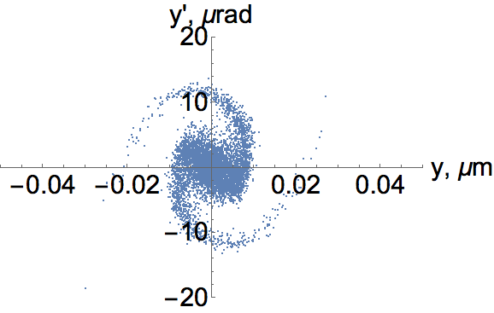
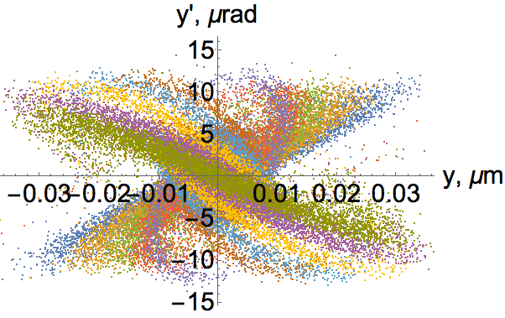
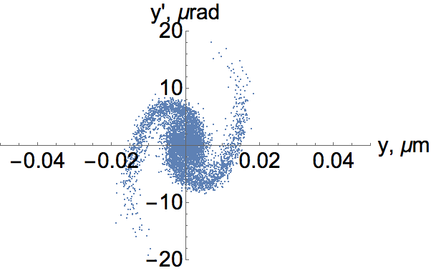
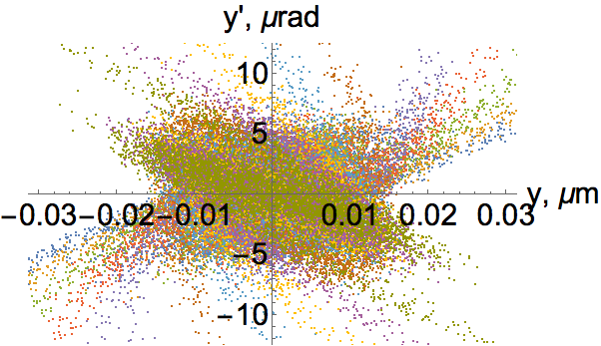
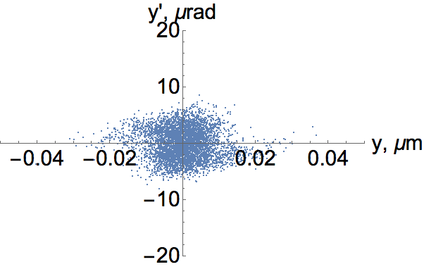
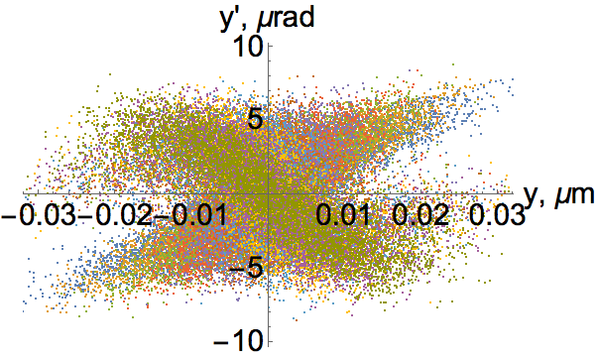
Strong-strong collisions of flat beams in ERL e⁺e⁻ collider: D_{y}=142
(a) (b)
(c) (d)
(e) (f)
Beam distribution in the vertical phase space after the collision. Distributions of the central slice are on the left and combinations of 10 slices covering evenly -3σ_{z} < z< 3σ_{z} , are on the right: (a-b) are for center particles at x=0; (c-d) are for those at x= σ_{x}, (e-f) is for that at x= 2σ_{x}. The horizontal axes are the vertical coordinate and the vertical axes are vertical angle of the particle

Slide 10
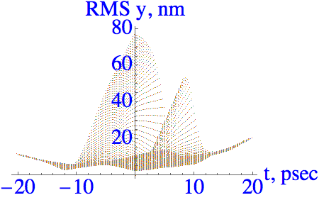
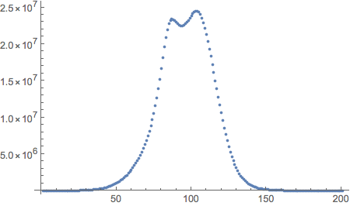
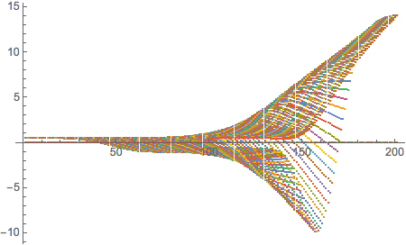
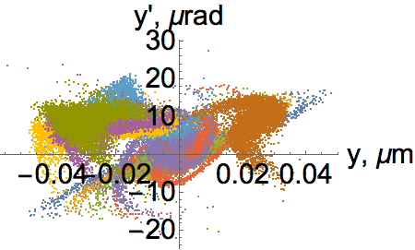
Effects of orbits offsets in IP
Initial beam axis separation is Δy=1σ_{y}
Beam centroids evolution in units
of σ_{y} at the beam waist.
Instantaneous luminosity (a.u.)
Faster drop
after the IP
center
L/L_{max}
Δy/σ_{y}
Main effect from offsets: RMS vertical beam emittance increases ~ 10X after collisions. It does not present any problems for the energy and particles recovery. It may require to increased time in the cooling rings to three-to-four damping times – this should be optimized for actual orbit deviations
Reduction of the luminosity is modest – actually the pinch effect continued delivering significant gain at all deviations of beam orbits

Slide 11
ReLiC for direct HIGS production e⁺e⁻ -> H
C.M. energy | GeV | 125.0
Length of accelerator | km | 5
Particles per bunch | 10 ¹¹ | 1.0
Beam current | mA | 38
εx, norm | mm mrad | 4.0
εy, norm | μm mrad | 1.0
Relative beam spread in IR | σE/E | 1.6x10⁻⁴
βx | m | 0.05
βy, matched | mm | 0.2
Dx | m | 0.08
σ_{z} | mm | 1
Disruption, Dx |  | 0.0
Dy |  | 109
Total luminosity | 10³⁶ cm⁻²sec⁻¹ | 4.5
There is no luminosity loss because we kept horizontal beam size the same, but now it is dominated by dispersion and energy spread
3-fold bunch decompression is sufficient to recover all collider particles in 1.5 GeV damping ring. Typical relative energy spread in damping ring is ~ 10⁻³, i.e. σ_{Ε}~ 1.5 MeV
After 3-fold compression σ_{Ε} becomes ~ 4.5 MeV.
Curvature of RF adds total ±3.75 MeV of correlated energy spread
I assume σ_{Ε}~ 10 MeV in IR, which likely is an overestimation of the wakefields and other effects. If real simulation will show that σ_{Ε} is too small, a correlated spread can be added by running one of cavities off-crest
1 year - 2x10 ⁷ sec - 90 ab⁻¹

Slide 12

Specifics for $\sqrt{S}$=125 GeV
From the onset of our studies, we focused on high energy reach of e⁺e⁻ collisions where beamstrahlung effects are critically important both for the energy spread in collisions and for recovery of particles in damping rings. A 10-x bunch compression and decompression is needed for TeV scale operations.
62.5 GeV/beam energy is relatively low, which warrants completely different approach to the IR. As an example, a very modest 2-x to 3-x bunch compression/decompression is sufficient for lossless particles recovery
Less then 1% of particles radiate beamstrahlung photons, which reduces mono-energetic collisions by ~2%
Since ERL-based colliders uses fresh beams, necessary dispersion can be introduced in IR for monoenergetic collisions without adverse effect on beam emittance.
Since electron and positrons beams propagate through different (left and right) accelerator structures, dispersion with opposition signs of electrons and positrons D_{e+}=-D_{e-} can be created using magnets – no electrostatic elements are needed.
Using D_{x}=12 cm in IR with β*_{x}=5 cm will provide for energy spread in e⁺e⁻ collision of less then 1 MeV. This mode can be achieved in ReLiC and CERC without loss of luminosity.
In this presentation I am giving estimates, which are based on reasonable assumptions about beam dynamics.

Slide 13
QED effects

Slide 14
Main parameters of ReLiC
Parameters are not fully optimized

Slide 15
Recycling collided electrons and positrons
Advantages
Potential for high degree of polarization in colliding beams
Possibility to operate with relatively high average currents and high polarization (removing insane appetite for polarized positron in linear colliders)
Reduction of the power consumption
Eliminating high power beam dumps and related radiative waste
Challenges
Eliminating particles loss caused by low energy tail induces by the beamstrahlung
Damping rings with large energy acceptance
Bunch compressing and decompression to fit into the damping ring energy acceptance
High rep-rate injection and ejection kickers

Slide 16
Comparison of Linac and Ring type colliders
In ring and ring-type colliders there are strong limitations on maximum allowable beam-beam tune shift and IP chromaticity (e.g. how small is β*). It favors larger emittances, higher collision frequencies and higher beam currents to reach the same luminosity
Linear and ERL colliders, where beams collide only once, do not have such limitations!
Example: “ring type” ERLC and “linac-type” ReLiC colliders
ReLiC produces 22.4 fold higher luminosity per unit of beam current and has 84-fold higher efficiency in generating luminosity

Slide 17
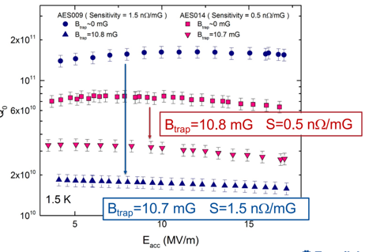
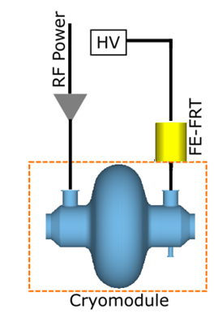
Accelerator designs and challenges
On-axis acceleration and deceleration of high energy beams is main advantage of CERC and ReLiC, allowing using existing SRF linac technology and other conventional equipment
But still there are a lot of challenges:
High efficiency LiHe refrigerators
1.5 GHz SRF cavities with quality factor Q > 10¹¹ at 1.5 K (or 2 K)
N₃Sb 4K SRF cavities with quality factor
Reactive tuners to reduce power to suppressing microphonics
Damping rings with very flat beams (ε_{h}/ε_{v} ~2,000-4,000)
Damping rings with 10% energy acceptance
10-to-40 fold bunch decompressors
MHz scale rate injection/ejection kickers
Vertical beam stabilization at the Ips
FoM ~75

