Slide 1

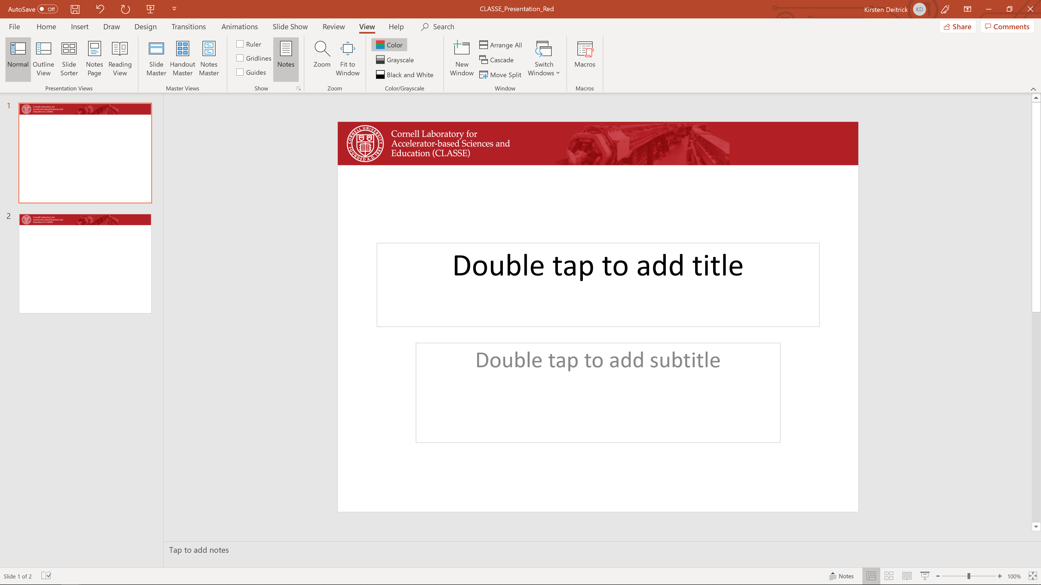
Physical processes in Bmad
Eiad Hamwi
PhD Candidate, Cornell ERL/EIC Group
PI: Georg Hoffstaetter de Torquat

Slide 2
Simulated physical phenomena
Nonlinear dynamics ■ ▲
Space charge/CSR ■
Beam-beam (strong-weak) ■
Wakefield (short/long) ■
Beam break-up ▲
Intra-beam scattering ▲
Touscheck scattering ▲
Synchrotron radiation (+ damping) ■ ▲
■ can be combined!
■ → Tracking
▲ → Analysis

Slide 3
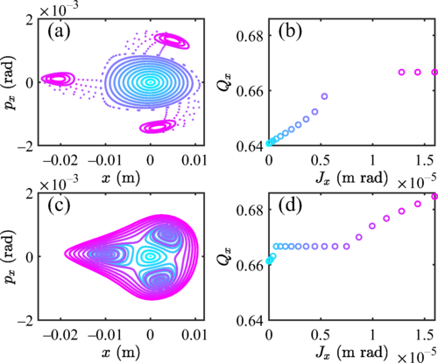
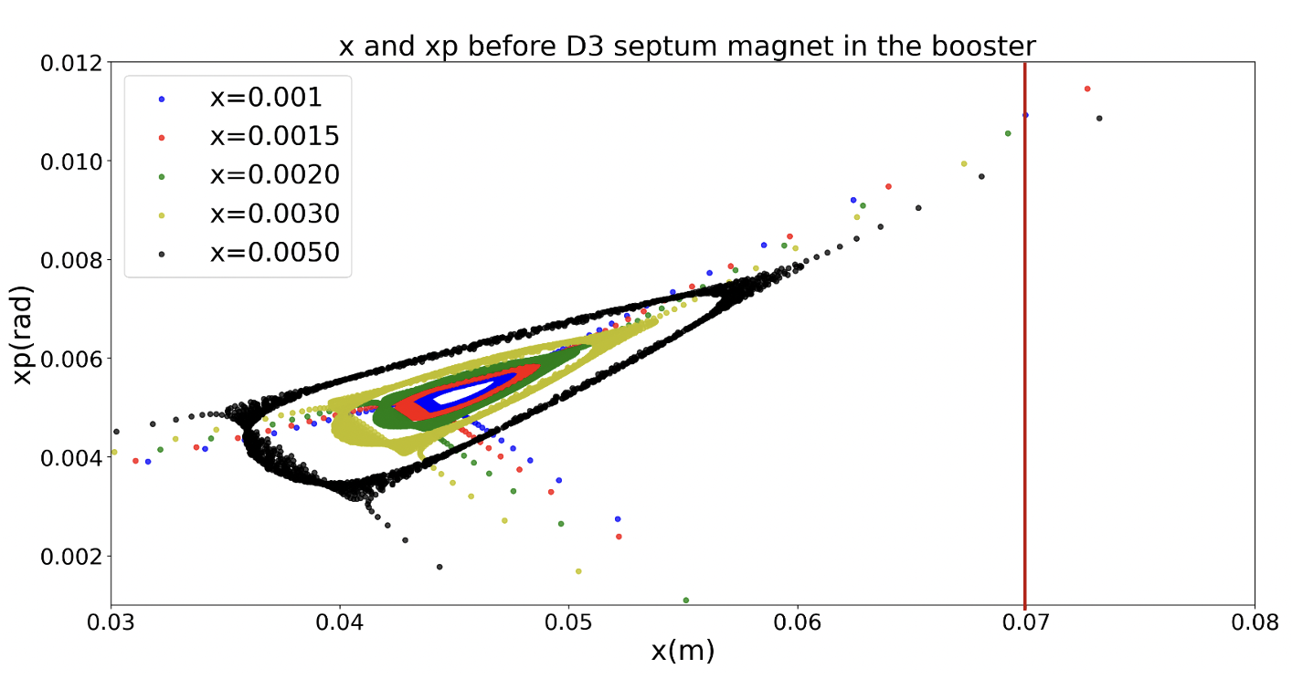
Nonlinear Dynamics
Tracking
  Symplectic tracking from Hamiltonian
  Normal form map-tracking from PTC
Map analysis
  Normal form map from PTC
  Resonance strength tune-scan
TRIBs at CESR
Wang, S., Khachatryan, V., & Nishikawa, P. (2023). Lattice design and experimental studies of nonlinear resonance at the Cornell Electron Storage Ring. Phys. Rev. Accel. Beams, 26, 104001.
Booster third-integer slow extraction

Slide 4
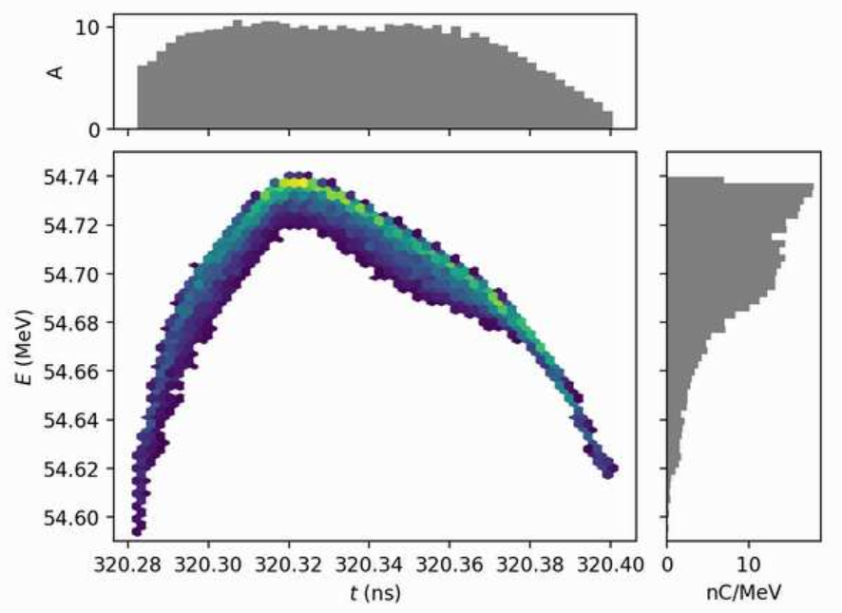
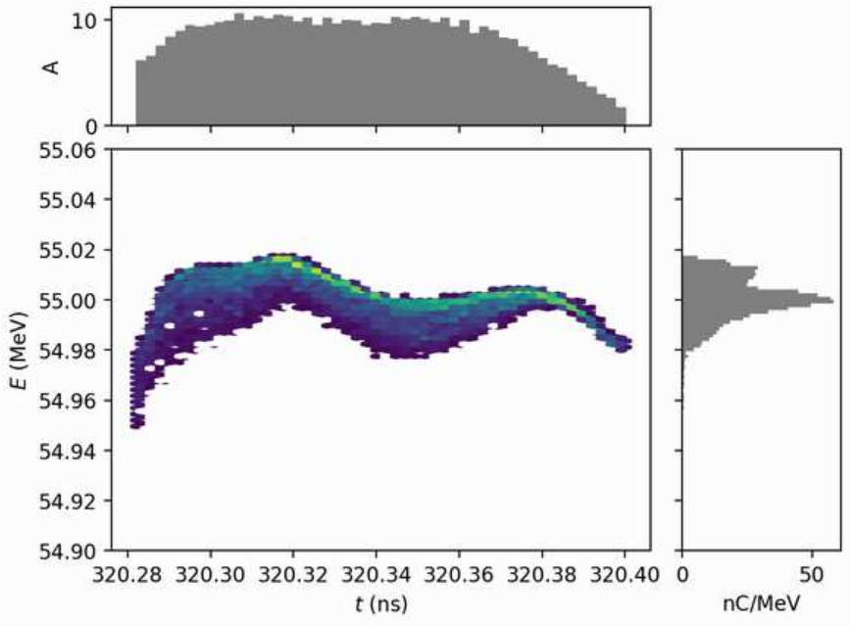
Space Charge / CSR
Slice method (2D SC / 1D CSR)
  Binning charges into slices
  Bassetti-Erskine formula
3D FFT
  FFT convolution of charges and fields
  Cathode image charge
  Adaptive time-steps
Courtesy: Ningdong Wang
Optimization of energy spread of cathode discharge with space charge

Slide 5
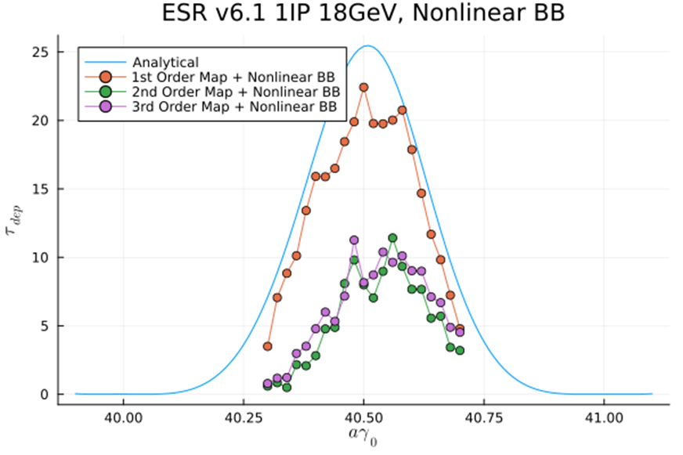
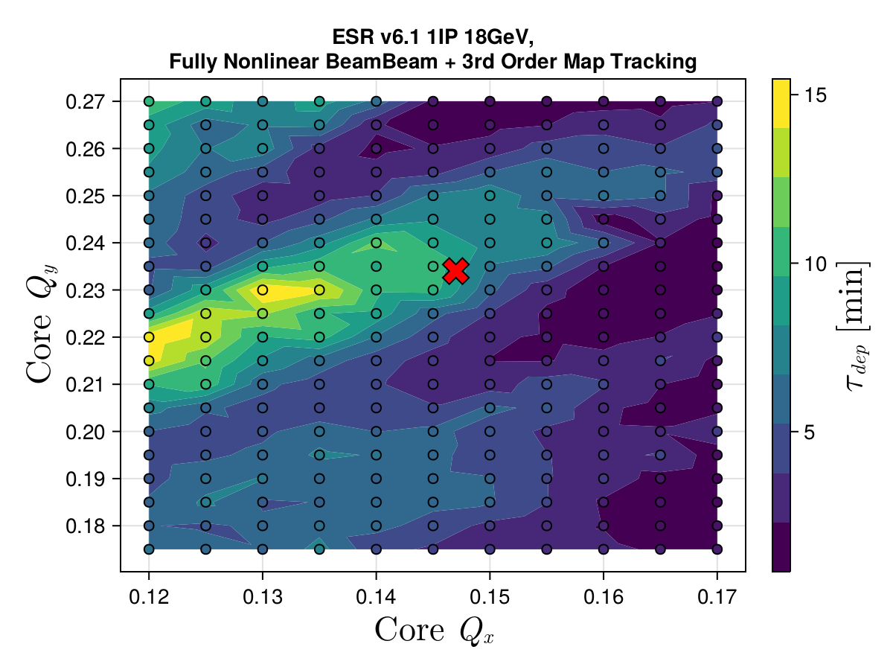
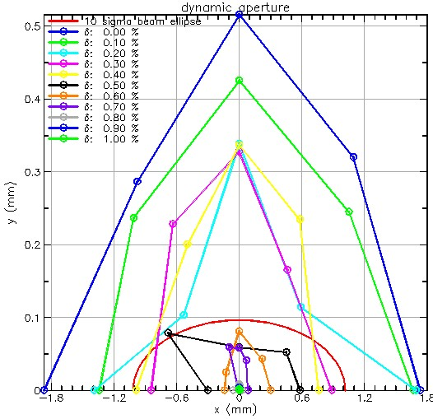
Beam-beam (weak-strong)
Slice method
  Binning charges into slices
  Bassetti-Erskine formula
Courtesy: Matthew Signorelli (Pol)
Courtesy: Jonathan Unger (DA)
ESR DA with beam-beam

Slide 6
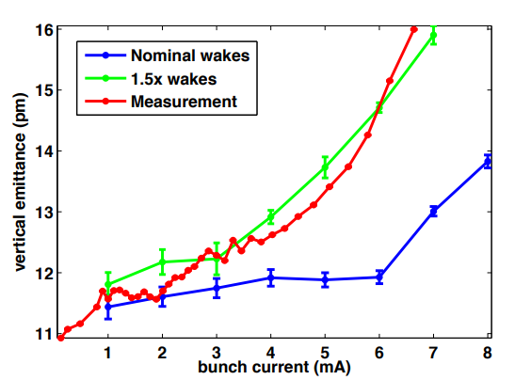
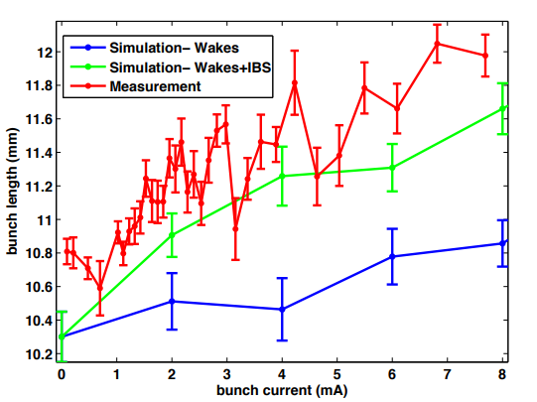
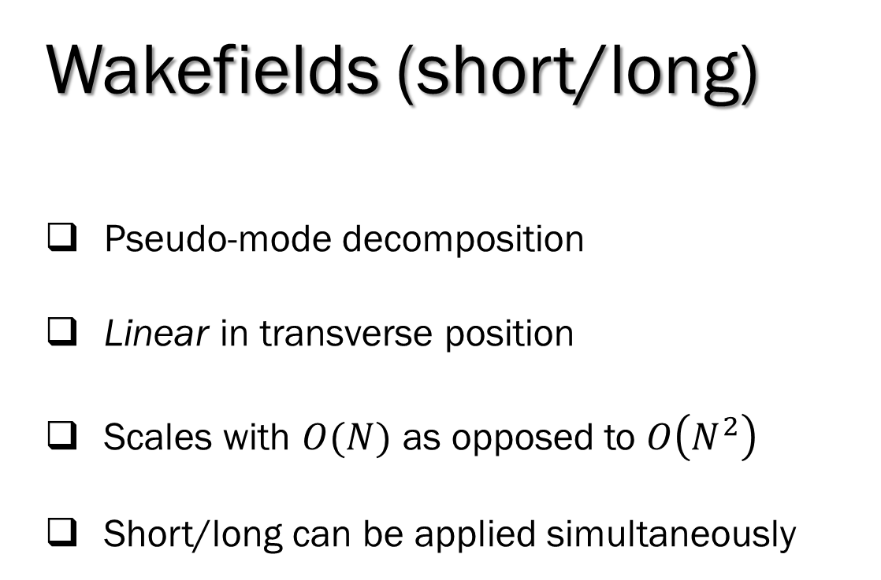
Wakefields (short/long)
Pseudo-mode decomposition
Linear in transverse position
Scales with $O(N)$ as opposed to $O\left(N^{2}\right)$
Short/long can be applied simultaneously
CESR bunch vertical emittance
J. R. Calvey et al. (2015). Measurement and Modeling of Single Bunch Wake Field Effects in CESR, in Proc. IPAC'15, Richmond, VA, USA.
CESR single bunch length vs current

Slide 7
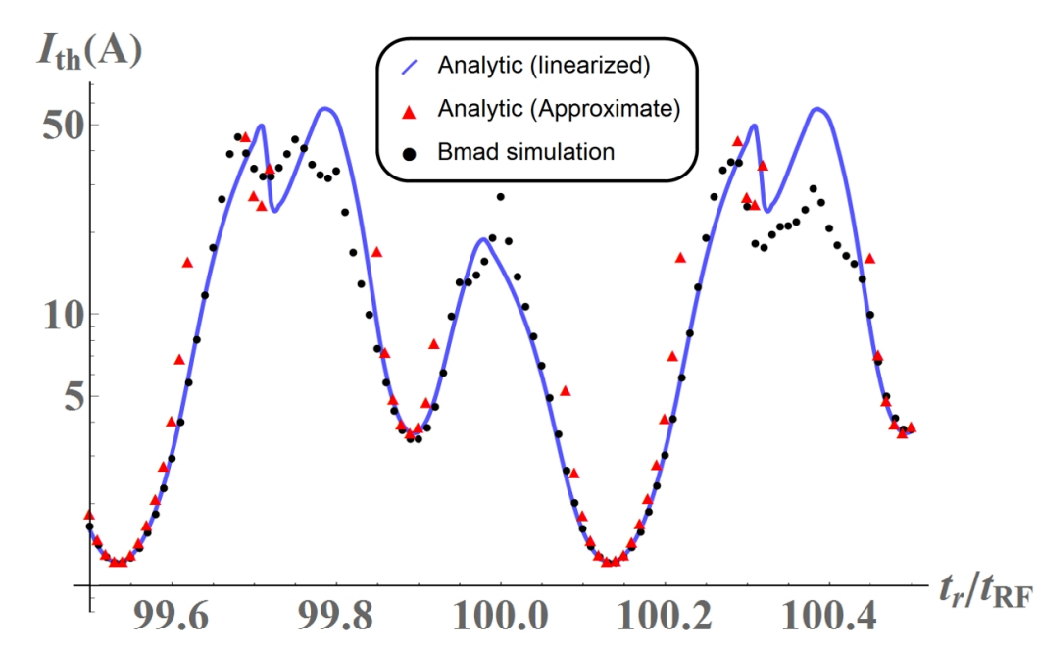
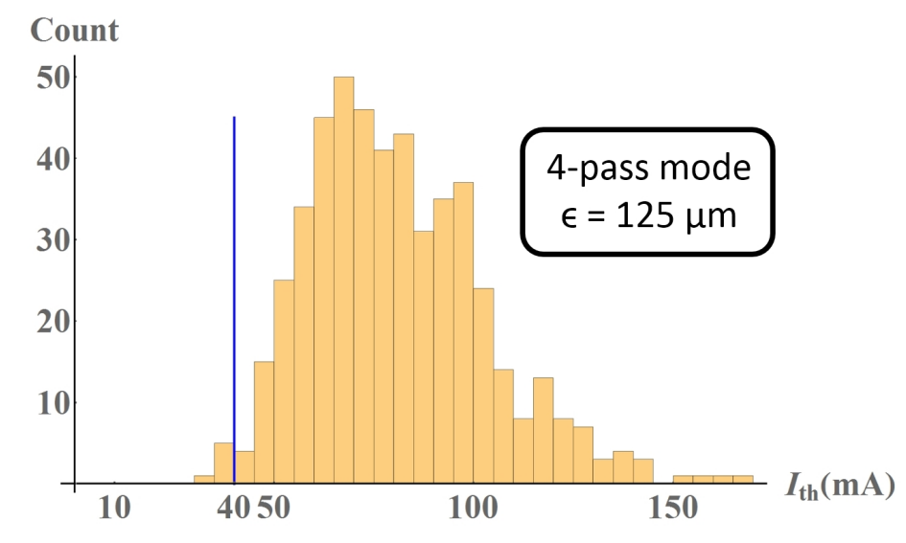
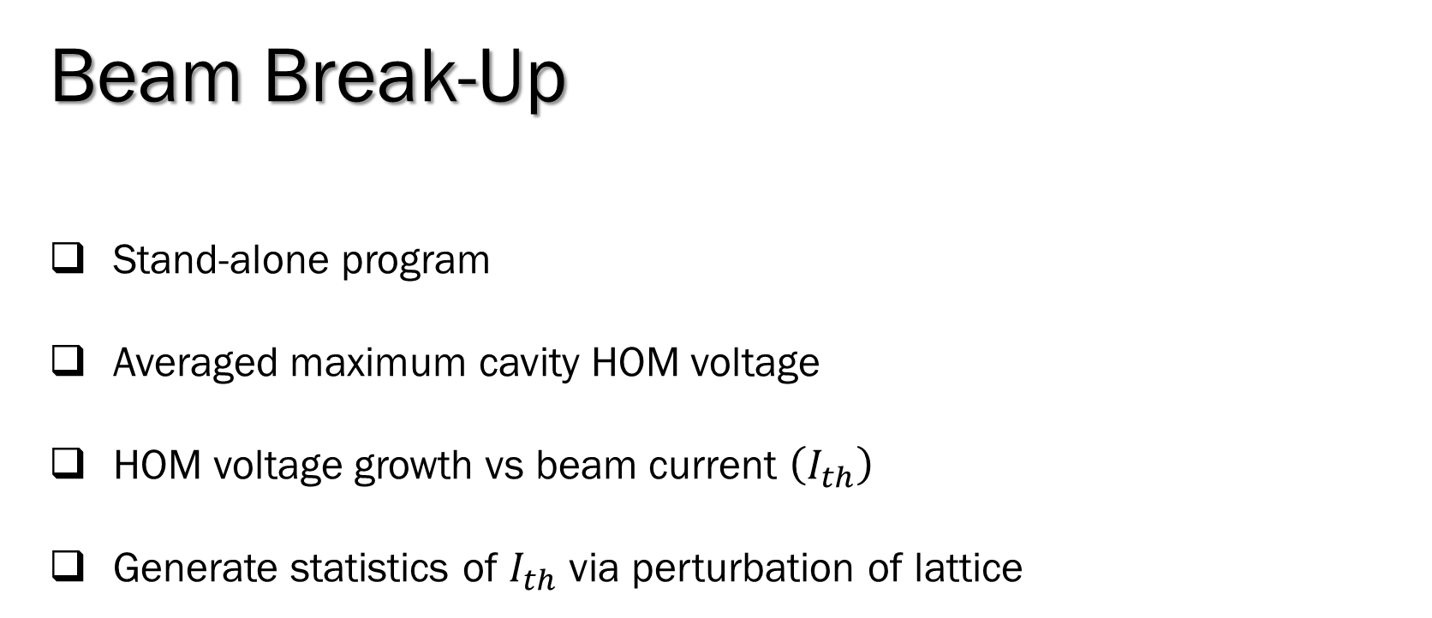
Beam Break-Up
Stand-alone program
Averaged maximum cavity HOM voltage
HOM voltage growth vs beam current $\left(I_{th}\right)$
Generate statistics of $I_{th}$ via perturbation of lattice
Lou, W., Hoffstaetter, G. H., (2018). “Beam break-up current limit in multi-turn ERLs and CBETA”. arXiv:1812.09356.

Slide 8
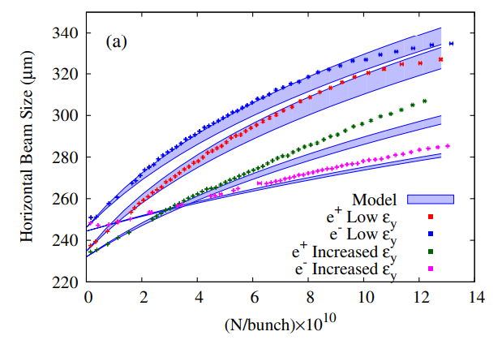
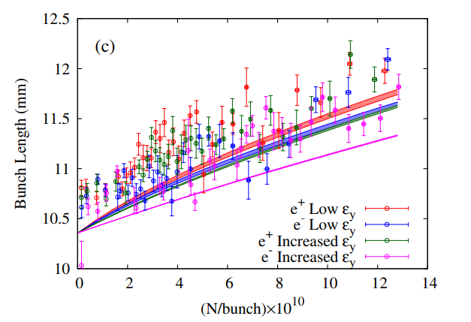
IBS/Touschek Scattering
IBS
  Stand-alone program
  Growth rates via Twiss or beam matrix (Piwinski/Kubo)
Touschek
  Stand-alone program
  Calculates loss rates per element via Twiss (Piwinski)
Ehrlichman, M., et al. (2013). Intrabeam scattering studies at the Cornell Electron Storage Ring Test Accelerator. Phys. Rev. ST Accel. Beams, 16, 104401.

Slide 9
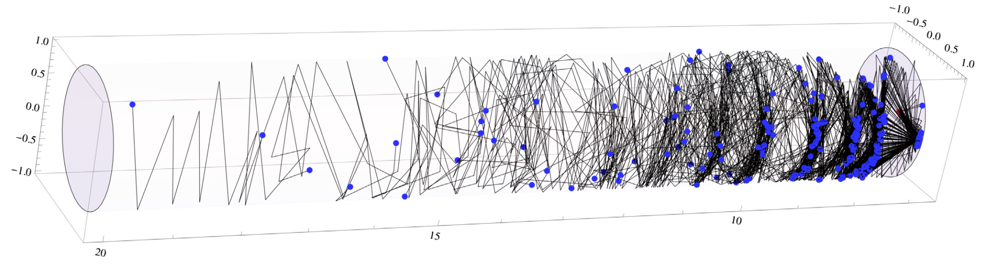
Synchrotron Radiation
Tracking
  Radiation damping (deterministic)
  Radiation kicks (stochastic, split bends)
Analysis
  One-turn map including radiation
  Radiation integrals
  Polarization effects
Chamber power loss (SynRad & SynRad3D)
  Radiation deposition on chamber (2D / 3D)
  Radiation multiple scattering from walls
Radiation scattering/absorption in a dipole
Dugan, G., & Sagan, D. (2017). Simulating synchrotron radiation in accelerators including diffuse and specular reflections. Phys. Rev. Accel. Beams, 20, 020708.

Slide 10

SciBmad - Features
Modular Julia library with Python interface/wrapper
Fully differentiable using automatic differentiation
Parallelizable with CPU and GPU (CUDA)
Compatible with all relevant Julia packages
  DifferentialEquations.jl
  ForwardDiff.jl
  ReverseDiff.jl
  CUDA.jl
  Etc
Fully polymorphic
https://github.com/bmad-sim

Slide 11
SciBmad - Packages
Stable, officially-registered, ready for use:
  GTPSA.jl
In development:
  AcceleratorLattice.jl
  NonlinearNormalForm.jl
  AtomicAndPhysicalConstants.jl
  BeamTracking.jl (CPU/GPU)

Slide 12
SciBmad - Contributors
Dan Abell (UMD)
J. Scott Berg (BNL)
Oleksii Beznozov (LANL)
Alex Coxe (VCU)
Laurent Deniau (CERN)
Auralee Edelen (SLAC)
Etienne Forest (KEK)
Juan-Pablo Gonzalez (UChicago)
Georg Hoffstaetter de Torquat (Cornell)
Gavin Hunsche (SDSU)
Lixing Li (Cornell)
Chris Mayes (SLAC/xLight)
Ryan Roussel (SLAC)
David Sagan (Cornell)
Matt Signorelli (Cornell)
Sophia Yang (Cornell)

Slide 13
Summary
It is currently possible to simulate these processes in a unified framework using the Bmad toolkit.
With SciBmad, modeling and analysis of the combined effects of these processes will become even more streamlined.
Bmad has the (unique) capability of simultaneously simulating lattice nonlinearity, weak-strong beam-beam, adaptive particle-in-cell space-charge, wakefield models, and synchrotron radiation altogether in a unified tracking framework.
The caveat is that the different processes all have drastically differing speeds for simulation, so sacrifices in accuracy must be made to achieve reasonable speed.
To incorporate a certain variety of these effects, a constant accuracy is necessary in each process.
Requires different levels of simulation complexity for each process in the same framework.

