Slide 1
2025 eeFACT workshop - Tsukuba
Status and outlook of FCCee transverse diagnostic systems
Daniele Butti, Stefano Mazzoni, CERN – Beam Instrumentation group
with many thanks to
B. Paroli, M. A. C. Potenza, M. Siano (Università degli Studi di Milano)
U. Iriso, A. A. Nosych, J. Nunez, E. Solano, L. Torino (ALBA-CELLS)
T. Lefevre, G. Trad (CERN)
3rd February 2025

Slide 2
Outline
Requirements for FCC-ee transverse diagnostics
Implementation scenarios
Synchrotron Radiation based techniques
pinhole camera
X-ray interferometry and X-ray Heterodyne Near Field speckles
Outlook and conclusion

Slide 3
Requirements for transverse diagnostics
Real-time precise measurement is top priority for commissioning
IMPACT
Precision
±1%
On-demand accurate measurements required for machine optimization
Redundancy
2x beam
Single bunch
Accuracy
±15%
Multiple techniques likely required to meet all specifications
Requirements summary from feasibility study report
EFFORT
Synchrotron radiation natural choice for non-invasive transverse diagnostics

Slide 4
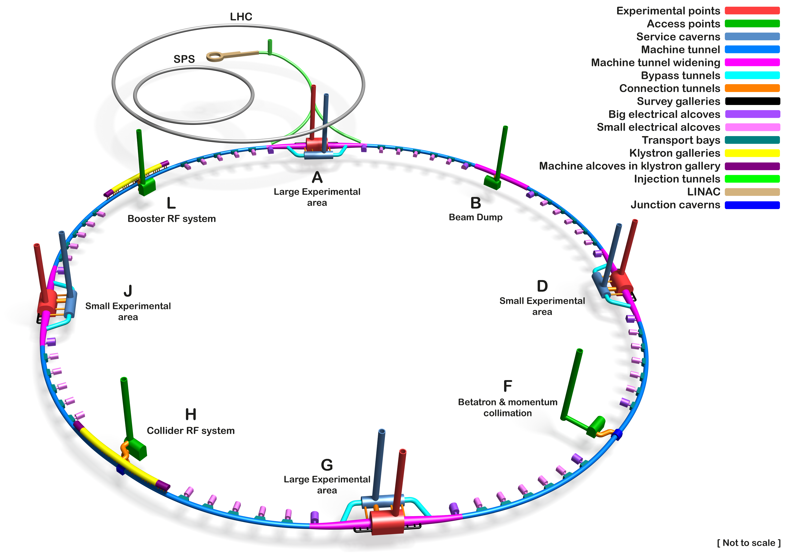
Implementation scenarios
Diagnostic challenges
small vertical beam sizes
high photon energy
Integration challenges
high radiation and power load
large bending radius (long extraction lines)
Options for SR source
arc dipoles: maximum flexibility but harsh environmental conditions
exp/tech site dipoles: limited choice but more favorable beam sizes

Slide 5
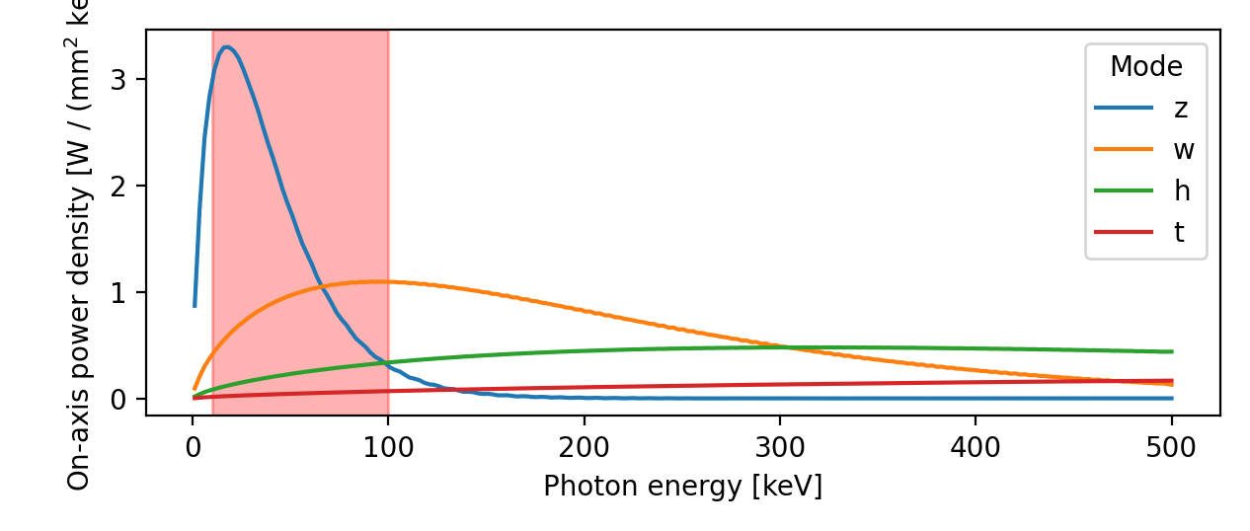
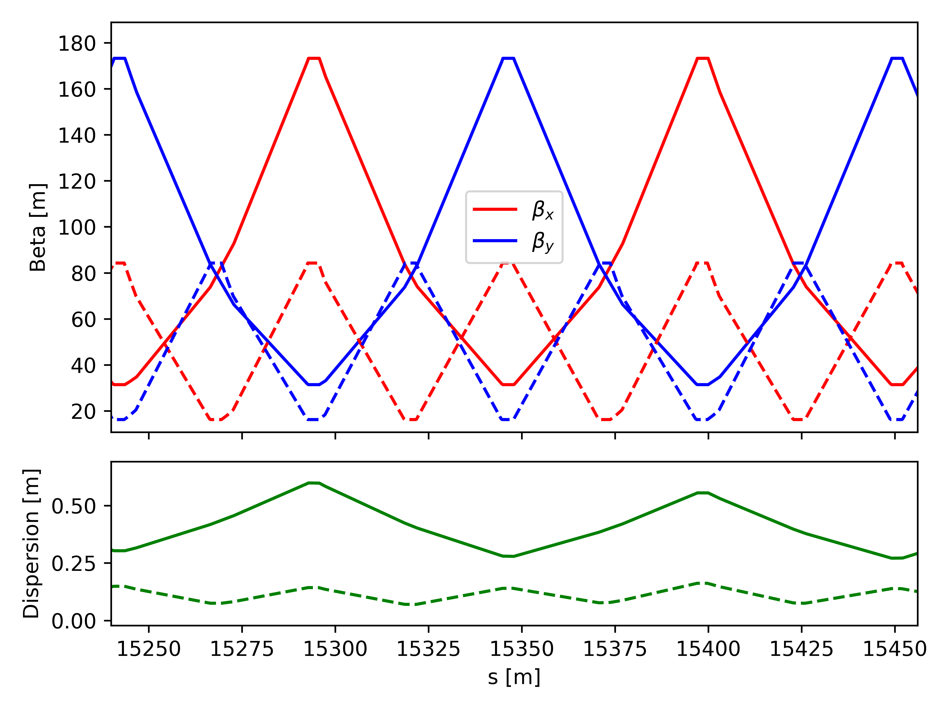








Arc dipoles
diagnostics
region
Challenging radiation conditions
high power load ~8kW/mrad
photon spectrum too hard for diagnostics in higher-energy operation modes
Challenging beam conditions
small beam sizes
limited flexibility in machine optics
V24 GHC
$$Z$$
$$t\overline{t}$$
$$β_{y}\sim β_{x}\sim 100 m$$
$$β_{y}\sim β_{x}\sim 50 m$$
z
$$ε_{(y)}\sim 1.9 pm$$
ttbar
$$ε_{(y)}\sim 1.4 pm$$
$$σ_{\min{ (y)}}\sim 14 um$$
$$σ_{\min{ (y)}}\sim 8 um$$

Slide 6
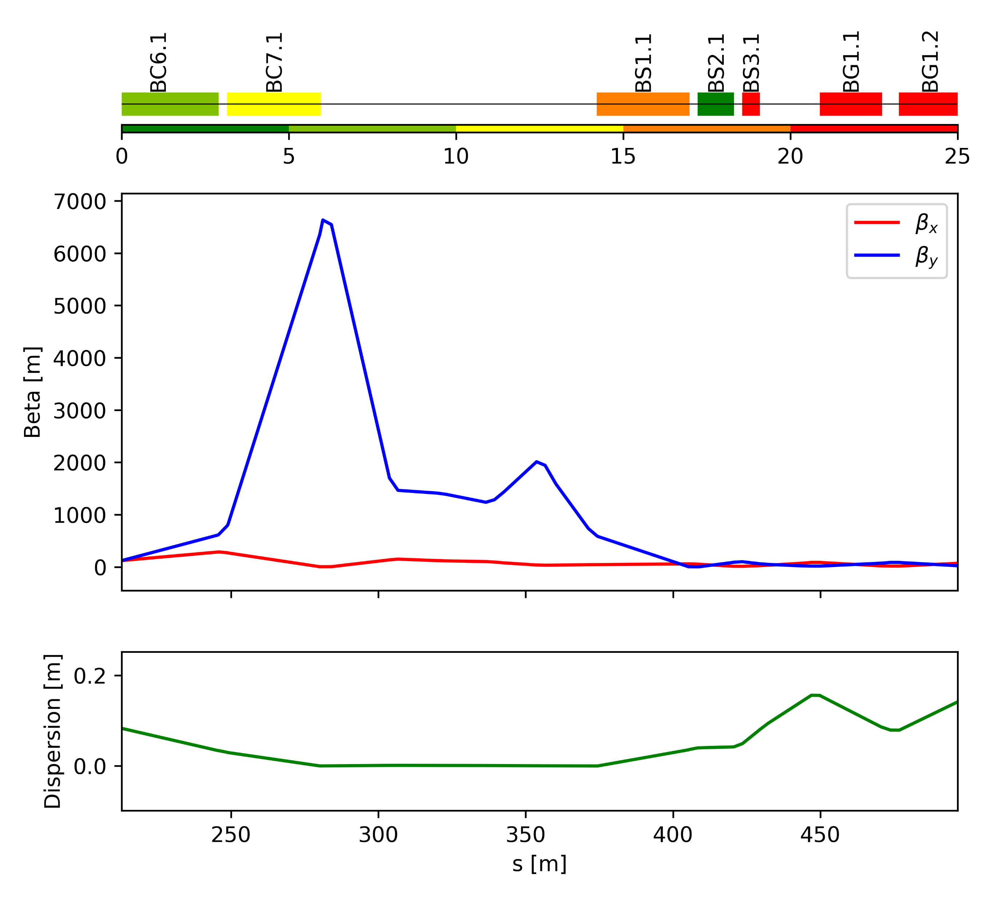
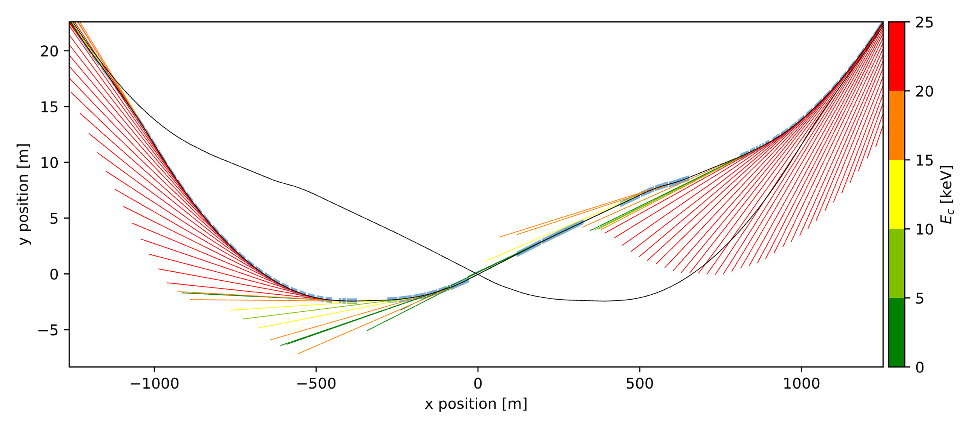





Region downstream of Interaction Points
$$B1$$
More suitable conditions downstream of IPs
“soft” bend dipoles for source
more relaxed beam size constraints
upstream of strong bend, good for fast light-beam separation
→ present baseline for transverse diagnostics
V24 GHC
$$Mode Z$$
$$β_{y}\sim 1000 m$$
($σ_{y}\sim 45 um$)
$$B1$$
$$IP$$

Slide 7





Synchrotron radiation techniques for transverse diagnostics
SR imaging
$$σ_{image}$$
$$σ_{beam}⟺ σ_{image}$$
optics
SR interferometry
$$σ_{beam}⟺visibility$$
monochromator
interference target
$$visibility$$
Imaging and interferometry often combined in synchrotron radiation diagnostics
imaging provides robust and precise relative measurements
interferometry used for accurate absolute measurements

Slide 8


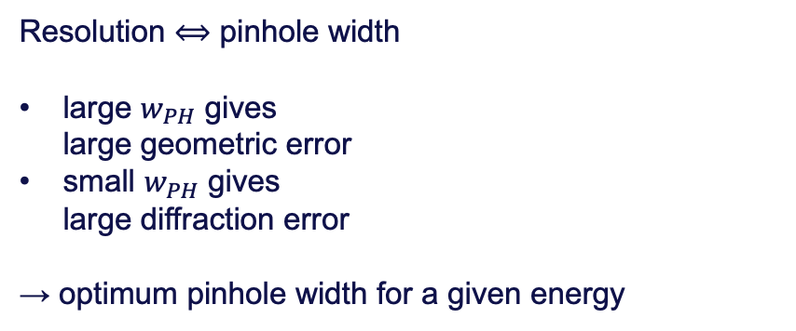
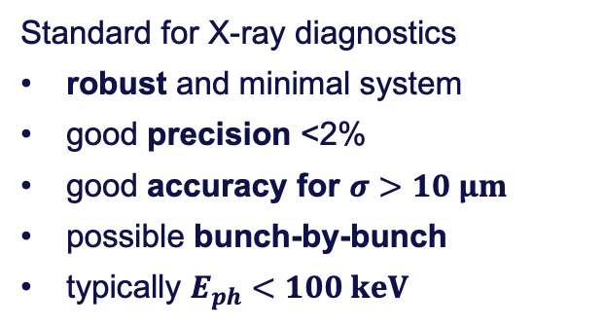





Pinhole camera
$$M=D/d$$
$$d$$
$$D$$
$$σ_{beam}$$
$$σ_{beam}^{2}=f\left(σ_{light}^{2}\right)−σ_{resolution}^{2}$$
$$w_{PH}$$
$$σ_{light}$$
Standard for X-ray diagnostics
robust and minimal system
good precision <2%
good accuracy for $σ>10 μm$
possible bunch-by-bunch
typically $E_{ph}<100 keV$
Resolution ⟺ pinhole width
large $w_{PH}$ gives
large geometric error
small $w_{PH}$ gives
large diffraction error
→ optimum pinhole width for a given energy

Slide 9
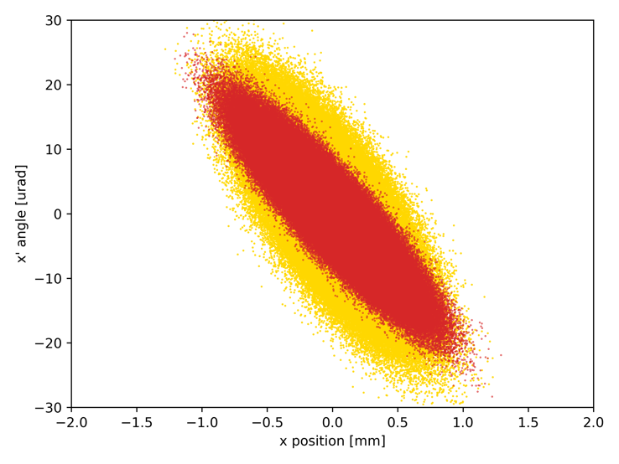
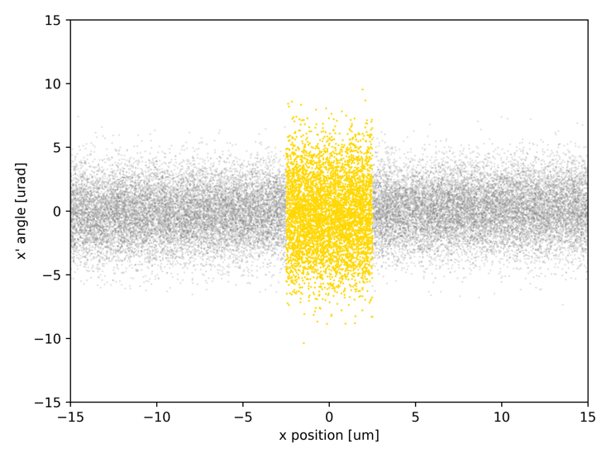
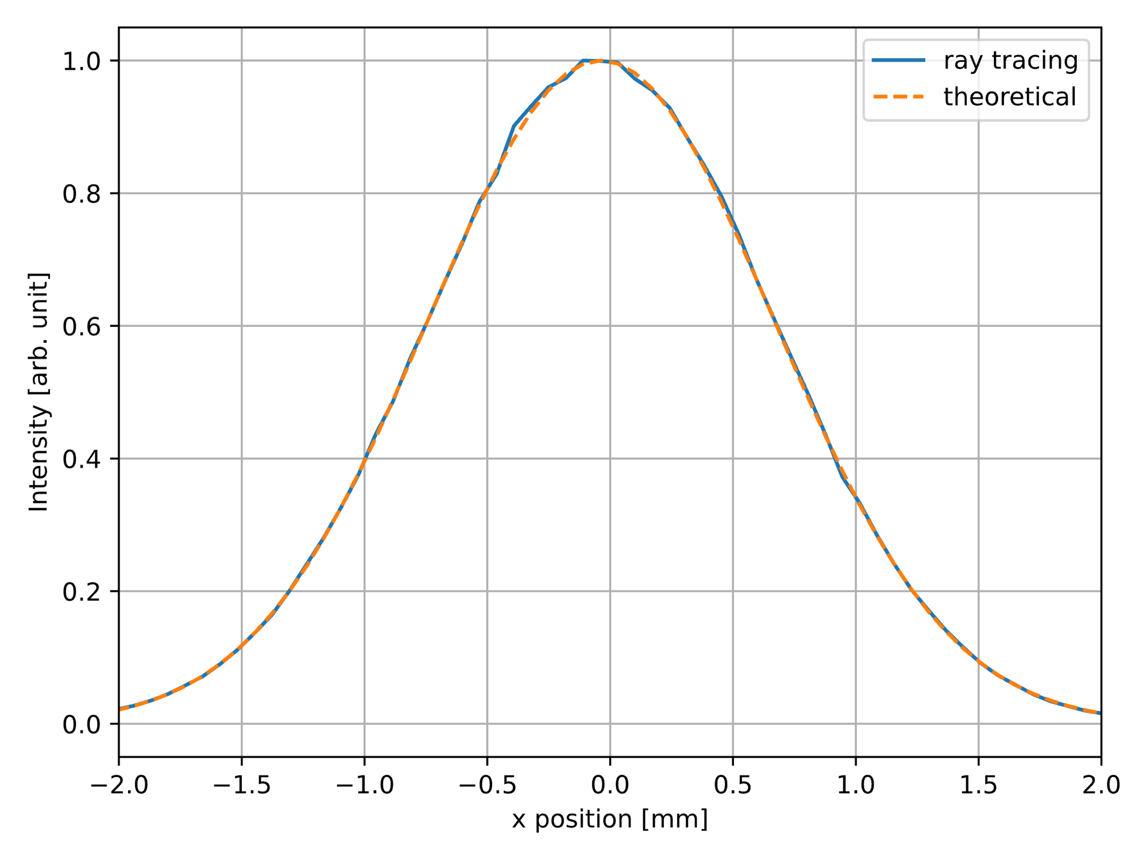
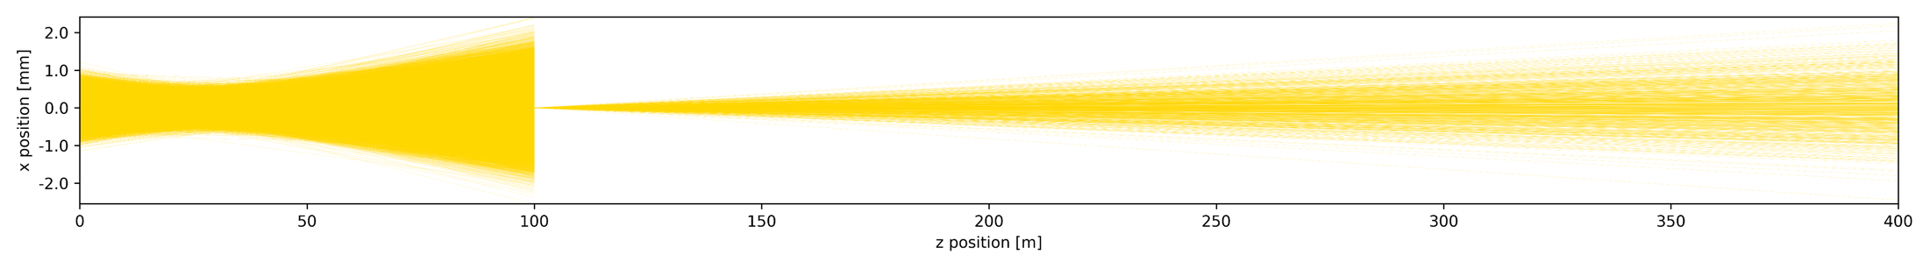

Ray tracing simulations of pinhole camera
particle beam
(incl. bend)
$$w_{PH}$$
Effective profile
blocked
photon beam
diffracted

Slide 10
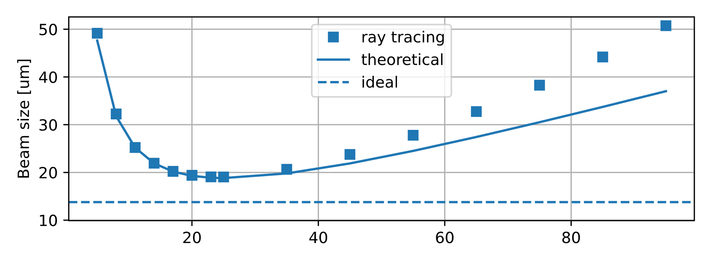
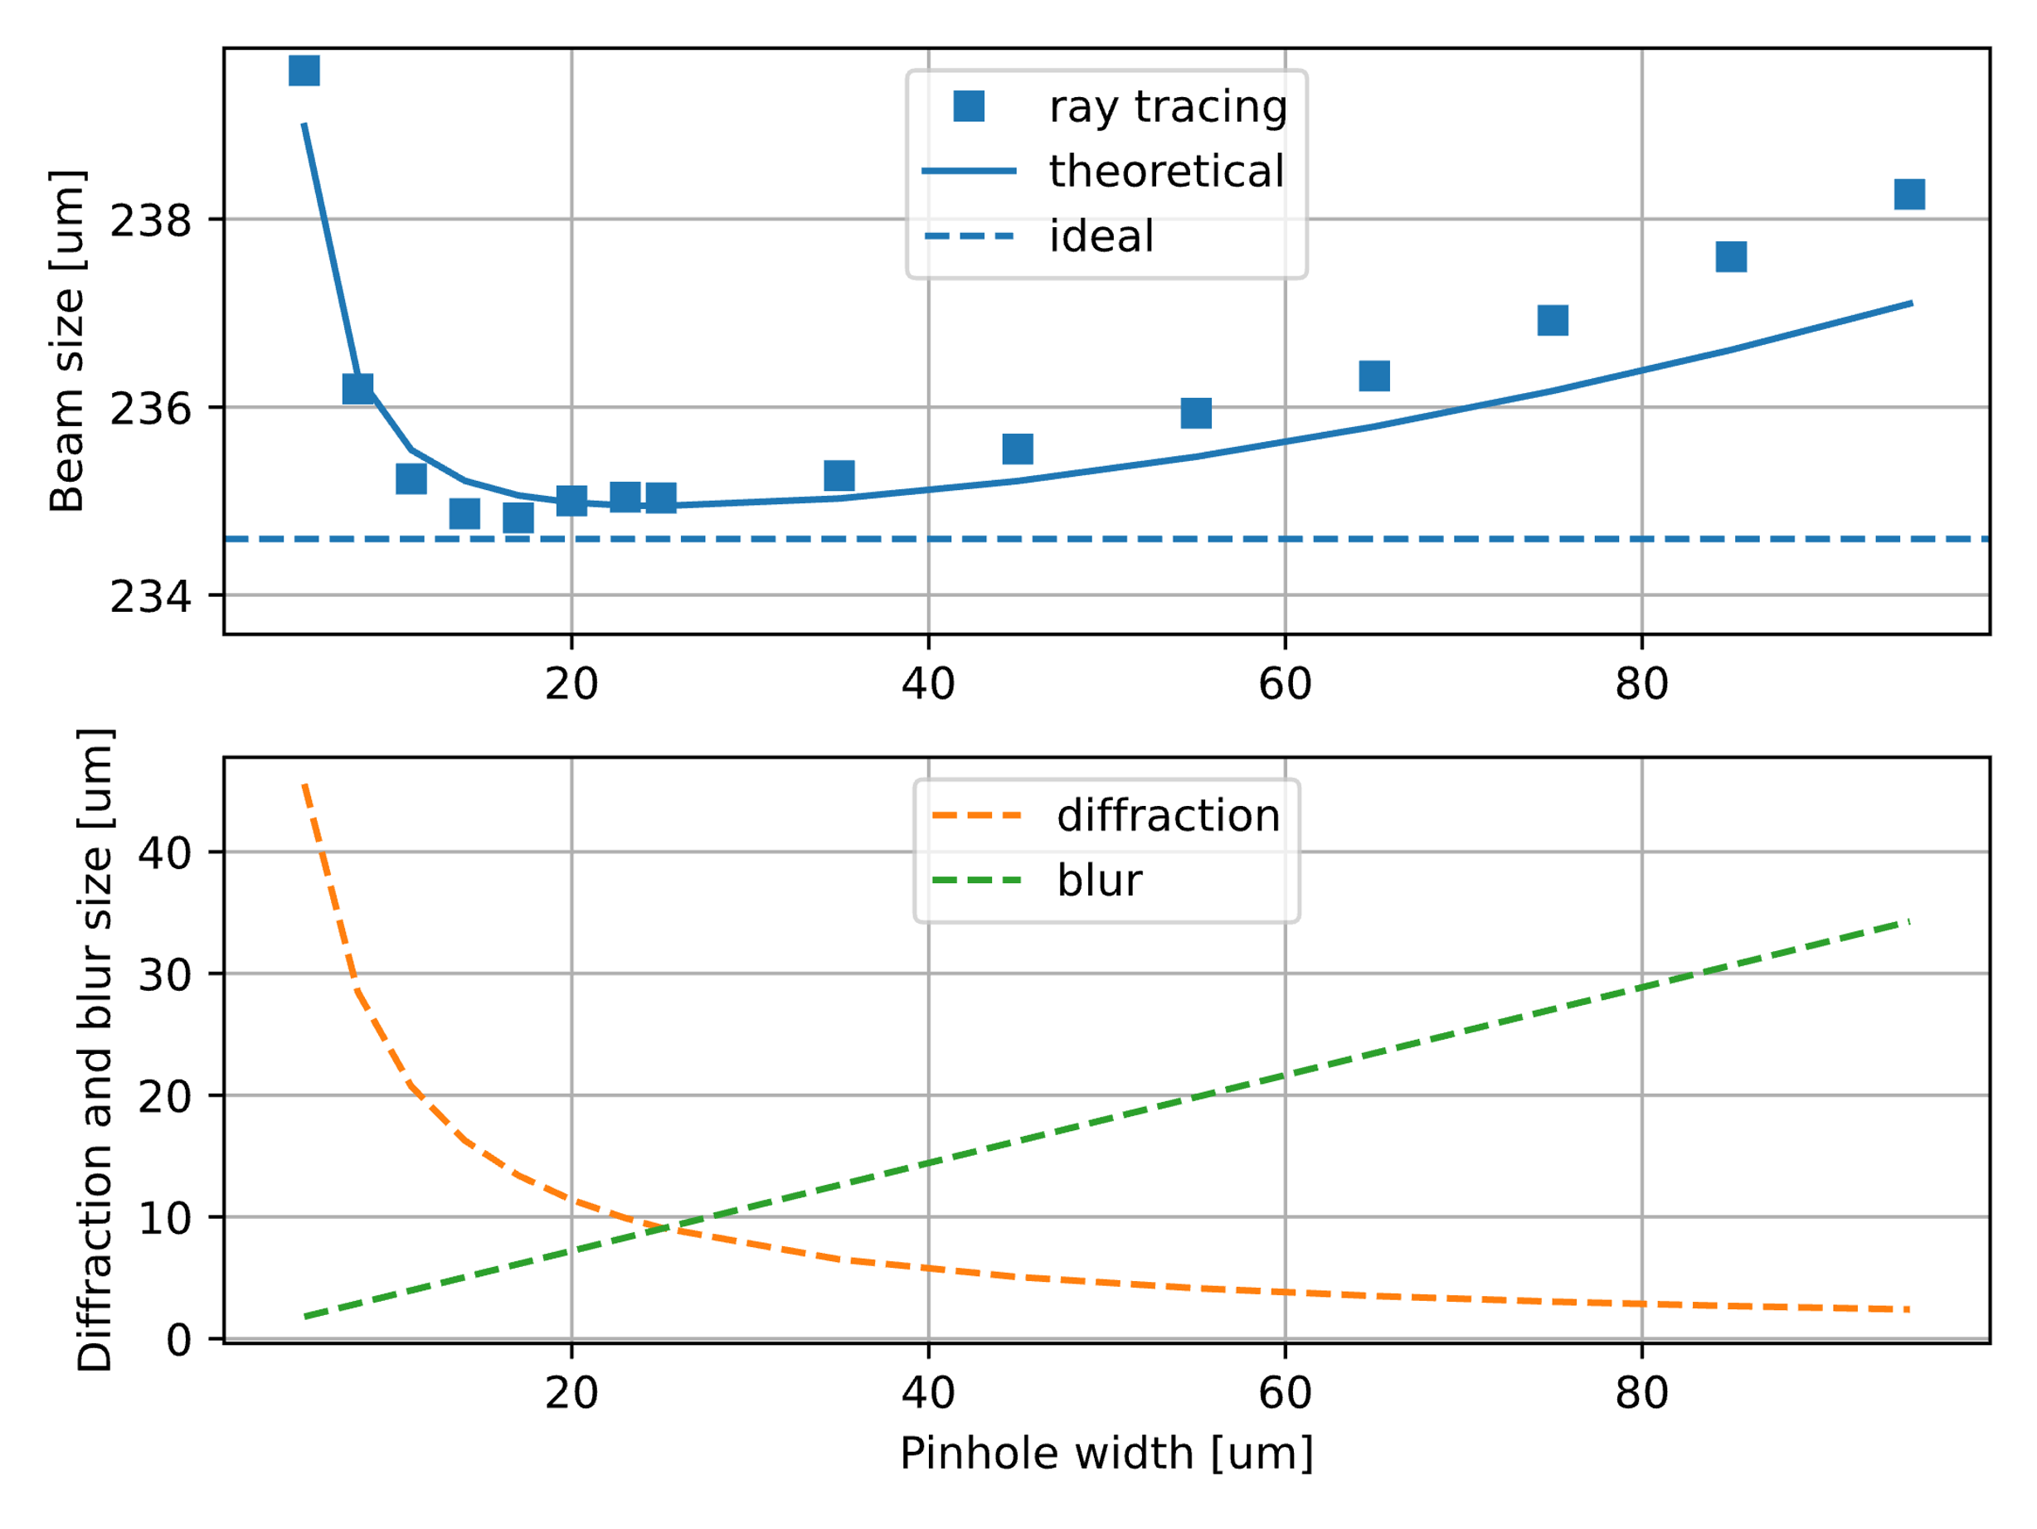


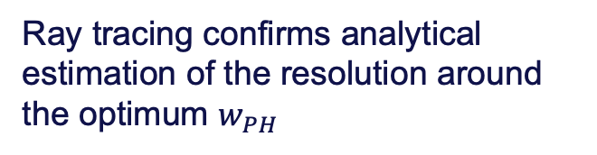
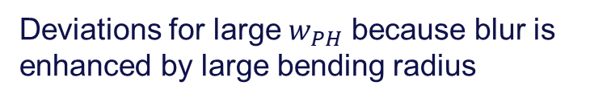

Ray tracing simulations of pinhole camera
Vertical
Ray tracing confirms analytical estimation of the resolution around the optimum $w_{PH}$
$$σ_{resolution}\sim σ_{ideal}$$
Horizontal
Deviations for large $w_{PH}$ because blur is enhanced by large bending radius
$$σ_{resolution}≪σ_{ideal}$$
$$σ_{eff}^{2}=σ_{ideal}^{2}+σ_{resolution}^{2}$$

Slide 11
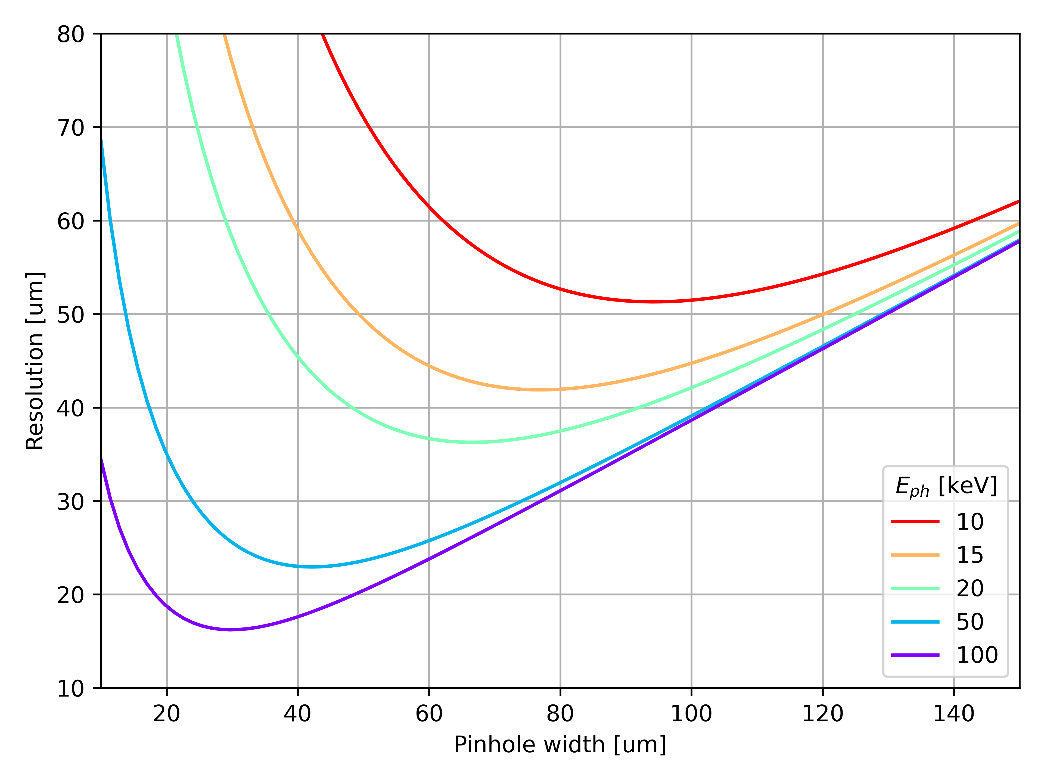
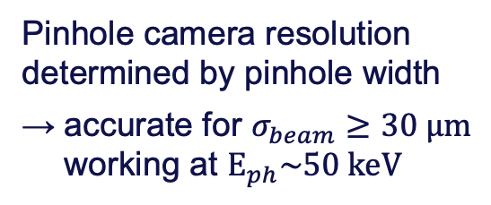
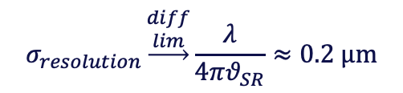

Resolution of pinhole camera
$$σ_{beam}^{2}=f\left(σ_{light}^{2}\right)−σ_{resolution}^{2}$$
Pinhole camera resolution determined by pinhole width
accurate for $σ_{beam}≥30 μm$ working at $E_{ph}\sim 50 keV$
best resolution
Measurements of smaller beam sizes limited by resolution
$$σ_{resolution}\underset{→}{\begin{aligned}diff \\ lim\end{aligned}}\frac{λ}{4πθ_{SR}}≈0.2 μm$$
Ultimate resolution of SR diagnostics is diffraction limit
*
*realistic 50 keV photons and $θ_{SR}≈0.1ρ^{1/3}λ^{2/3}≈10 μrad$

Slide 12

X-ray interferometry
filament beam
extended beam
Interferometry is complementary technique to imaging
→ assess beam size from contrast of interference fringes
interference target
Variety of targets
apertures/slits
scattering fibers
nanostructured materials
better resolution than pinhole...
detector
monochromator
…but with common challenges
require monochromatic light
highly sensitive to distortions
increased setup complexity
Imaging and interferometry can coexist on same extraction line, often with same detector

Slide 13



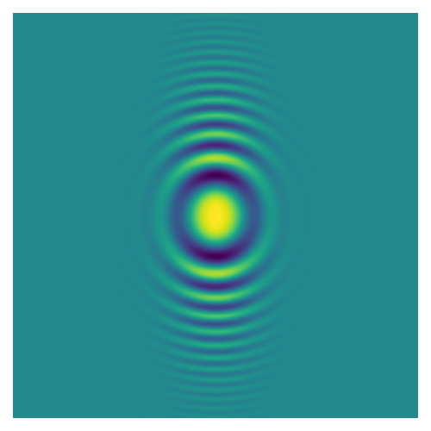
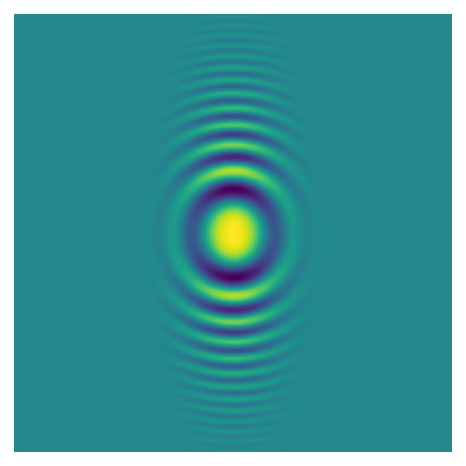
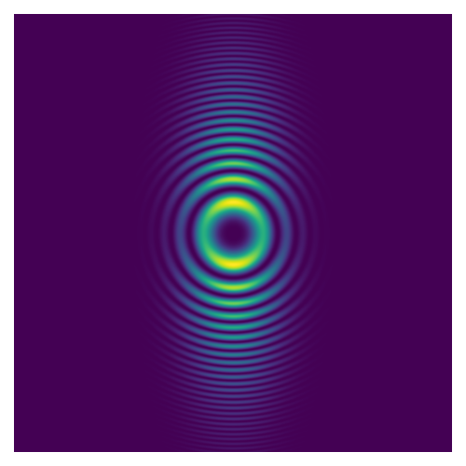
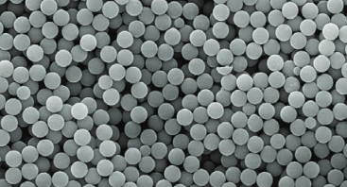





X-ray Heterodyne Near Field Speckles (HNFS)
Interference target is a dispersion of light-scattering nanospheres
$$\sim 1/σ_{y}$$
$$\sim 1/σ_{y}$$
$$ℱ$$
$$\sim 1/σ_{x}$$
$$\sim 1/σ_{x}$$
monochromator
scatterers
single scatterer
many scatterers
power spectrum
Key features for implementation in FCCee
intrinsically two-dimensional measurement
compact, no need of long distances downstream of target
Silica spheres (500 nm)

Slide 14
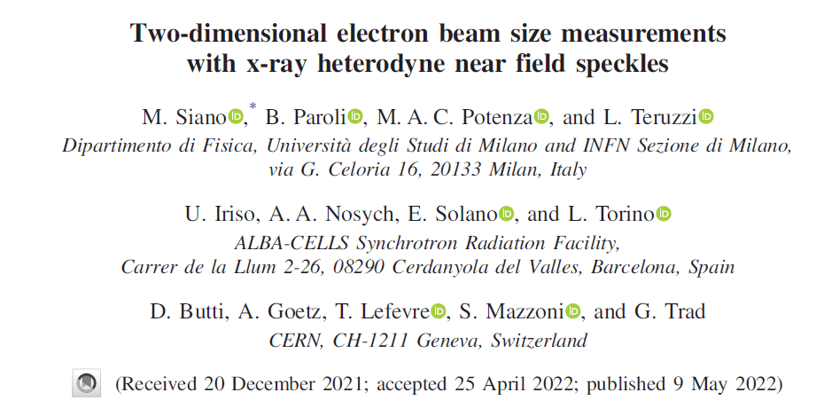
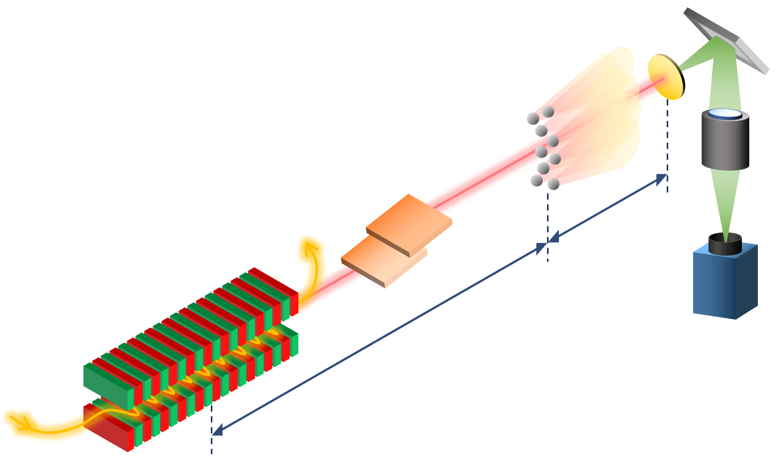
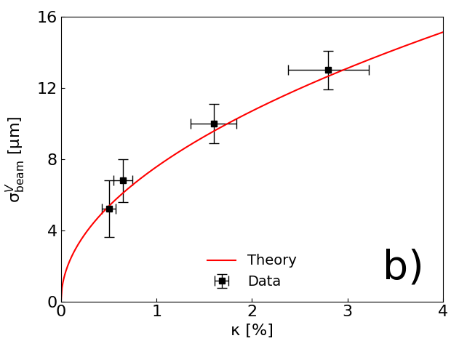
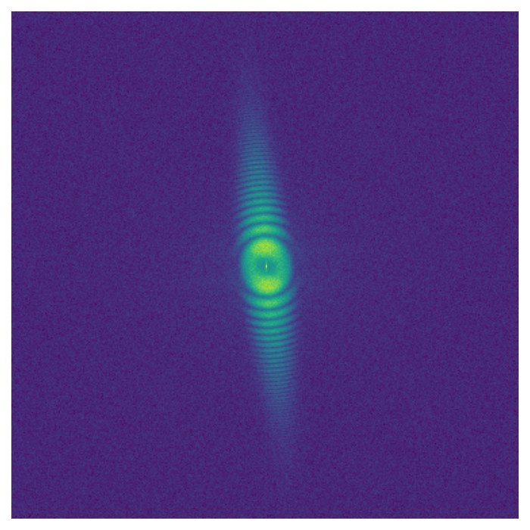
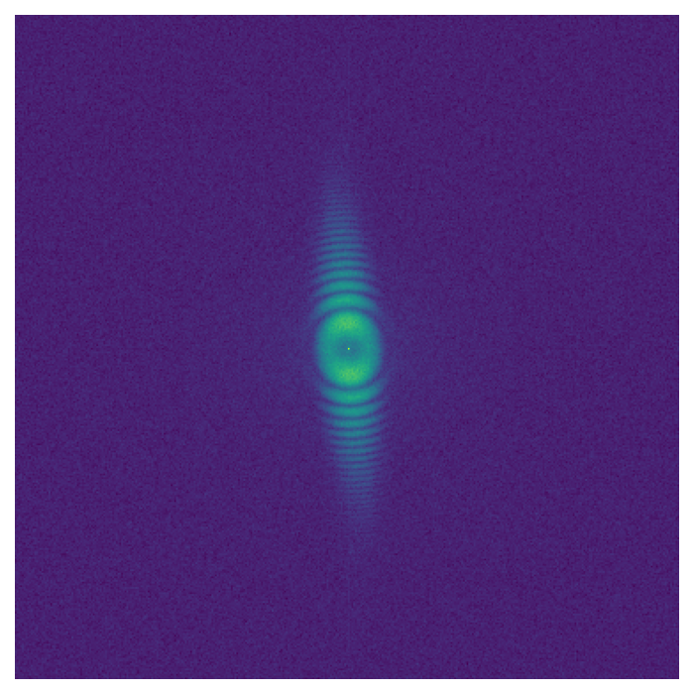
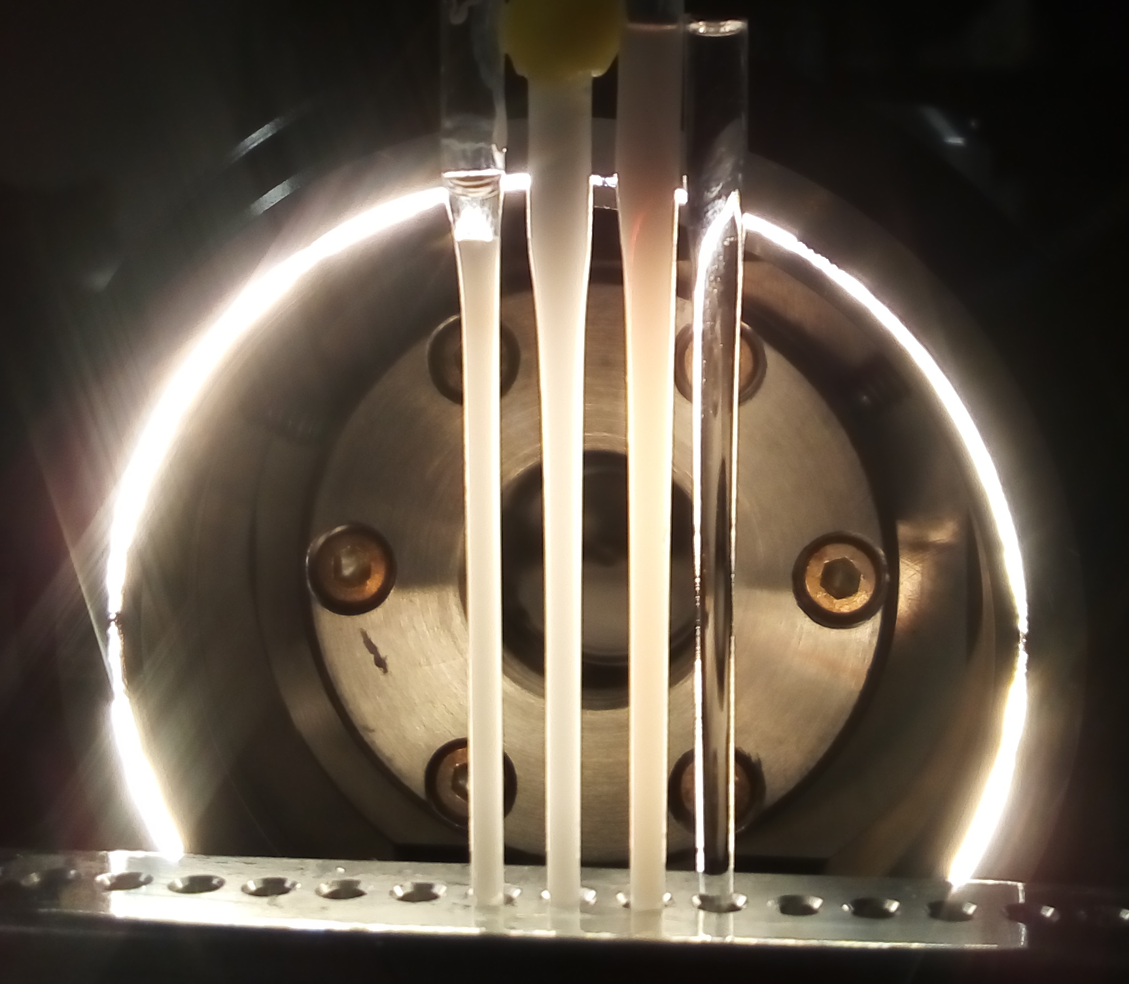





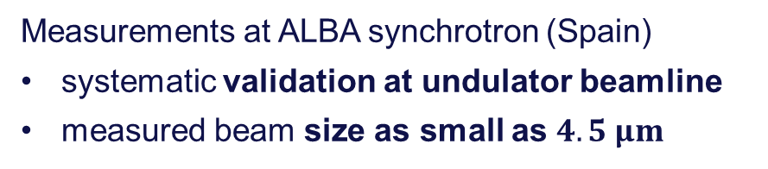
Beam size measurements with x-ray HNFS
Measurements at ALBA synchrotron (Spain)
systematic validation at undulator beamline
measured beam size as small as $4.5 μm$
nanospheres
Si(111) monochromator
$$E_{ph}≃12 keV$$
$$1.2 m$$
$κ=0.50$ %
undulator source
$$33 m$$
$κ=2.80$ %
Credit: M. Siano

Slide 15

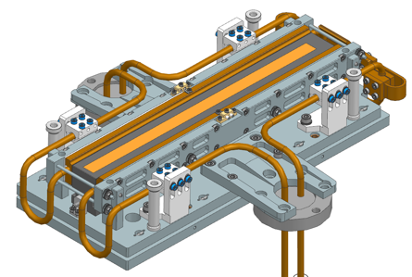
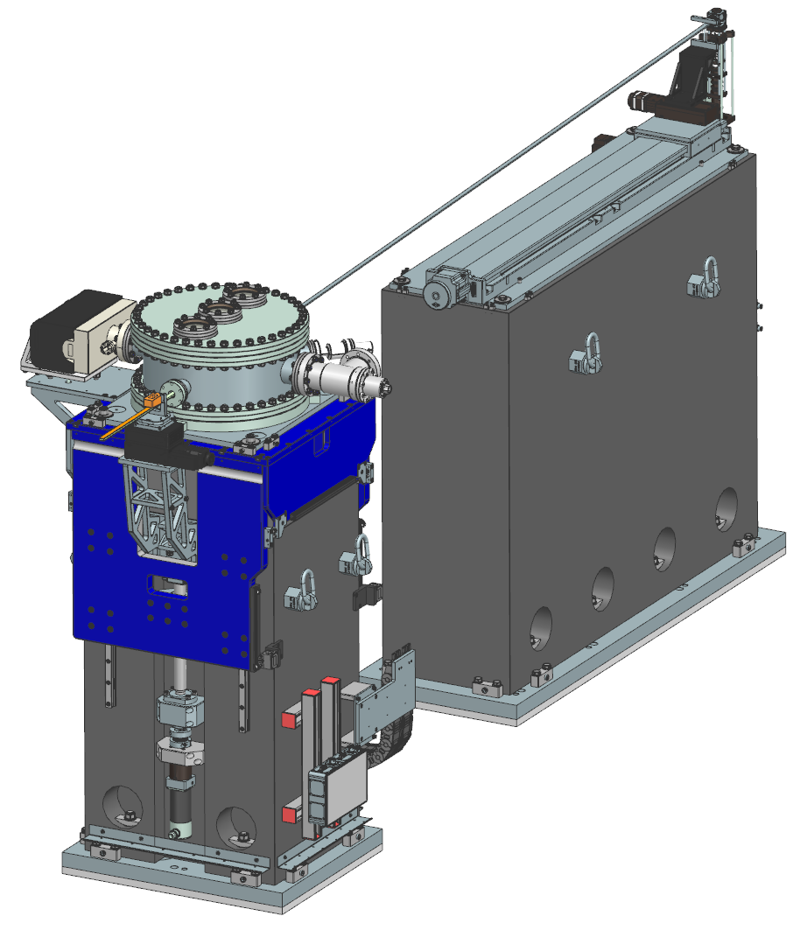
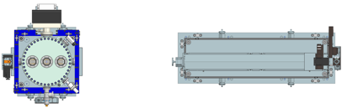
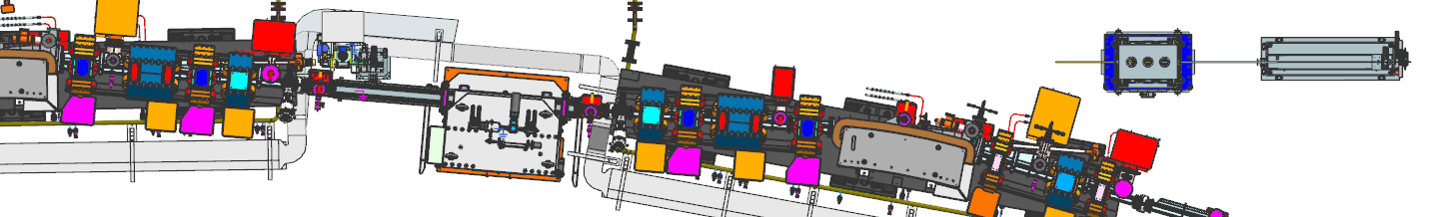
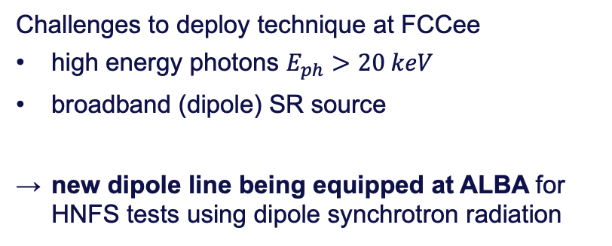
Future tests with dipole source
In-vacuum multilayer monochromator
Challenges to deploy technique at FCCee
high energy photons $E_{ph}>20 keV$
broadband (dipole) SR source
new dipole line being equipped at ALBA for HNFS tests using dipole synchrotron radiation
Detector
Scatterers
Layout of FE21 at ALBA, equipped for HNFS studies
Credit: U. Iriso

Slide 16
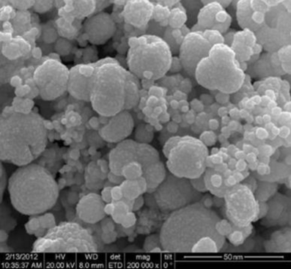
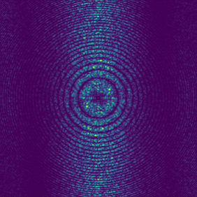
Development of new target materials
Nanostructured gold target
Silica nanospheres not usable in regular FCC operation
poor contrast of SiO₂ with hard x-rays
stability issues such as sedimentation and aggregation of colloids
need to develop and study novel target materials
Credit: S. Mazzoni
Numerical simulations
(SRW, preliminary)
Ongoing R&D to design and manufacture gold-based scatterers, optimized for FCC applications, to be tested in new ALBA beamline
Credit: J. Nunez

Slide 17
Outlook
Main focus of upcoming pre-TDR stage is engineering of diagnostics systems
technical design and integration of extraction lines
detailed study of thermal loads along the lines
detailed study of critical components (e.g. monochromator)
Ongoing R&D on technological aspects of proposed techniques
production and characterization of novel HNFS targets at ALBA beam-line
study of detector options (e.g. scintillators, TimePix…)
Preserve flexibility on changes of machine design
further optimize present scenarios (e.g. adapt machine optics, tunable magnets…)
consider additional/alternative locations and possible synergies with longitudinal diagnostics extracting UV-VIS radiation

Slide 18
Conclusion
Baseline scenario for transverse diagnostics at end of feasibility study
synchrotron radiation source downstream of main IPs
pinhole cameras for machine commissioning and precise tuning
interferometric techniques for accurate measurements
Technical implementation is main objective of Technical Design Report phase
X-ray Heterodyne Near Field Speckles successfully tested at ALBA light source,
new dedicated line soon ready for tests of novel targets with dipole radiation

Slide 19
Thank you for your attention!
19

Slide 20
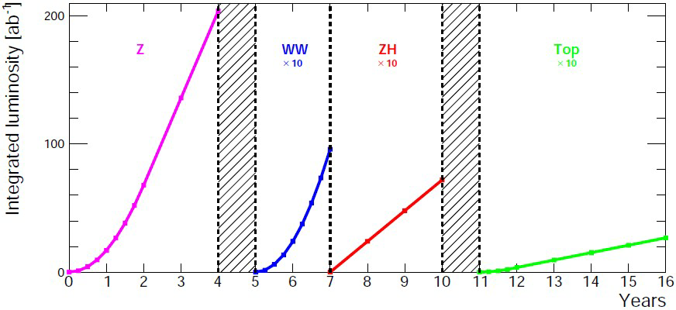
FCCee machine parameters
Four operational modes to maximize physics output
→ changing energy (and current) at fixed SR power
Parameter | Unit | Z | WW | HZ | ttbar
synchrotron radiation power | MW | 50
beam energy | GeV | 45.6 | 80 | 120 | 182.5
beam current | mA | 1270 | 137 | 26.7 | 4.9
number bunches |  | 11200 | 1780 | 440 | 60
horizontal emittance | nm | 0.71 | 2.17 | 0.71 | 1.59
vertical emittance | pm | 1.9 | 2.2 | 1.4 | 1.6
bunch length with SR / BS | mm | 5.6 / 15.5 | 3.5 / 5.4 | 3.4 / 4.7 | 1.8 / 2.2
luminosity | 10³⁴ cm⁻²s⁻¹ | 140 | 20 | 5.0 | 1.25
integrated luminosity | ab⁻¹/yr/IP | 17 | 2.4 | 0.6 | 0.15
4 years
5x10¹² Z
LEP x10⁵
2 years
>10⁸ WW
LEP x10⁴
3 years
2x10⁶ H
5 years
2x10⁶ tt pairs
M. Benedikt
FCC week 2024

Slide 21
Ray tracing
particle beam
(incl. bend)
$$w_{PH}$$
Effective profile
blocked
photon beam
diffracted

Slide 22
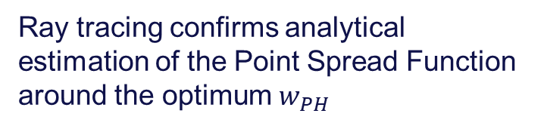
Ray tracing
Vertical
Ray tracing confirms analytical estimation of the Point Spread Function around the optimum $w_{PH}$
$$σ_{resolution}\sim σ_{ideal}$$
Horizontal
Deviations for large $w_{PH}$ because blur is enhanced by large bending radius
$$σ_{resolution}≪σ_{ideal}$$
$$σ_{eff}^{2}=σ_{ideal}^{2}+σ_{resolution}^{2}$$

Slide 23
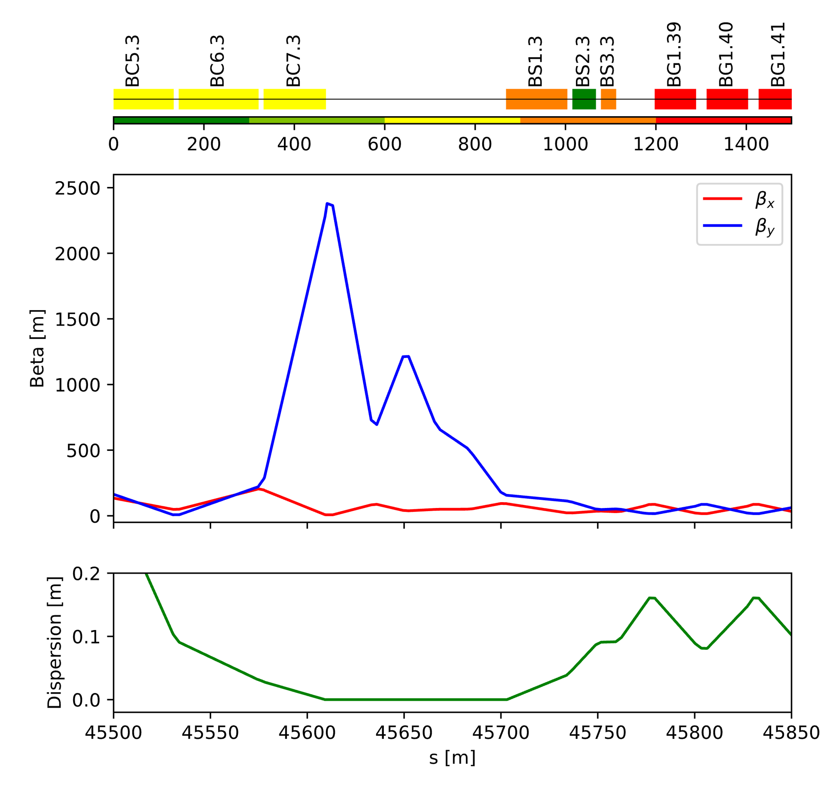





Dipole magnets around IPs (ttbar mode)
$$B1$$
Critical energies of most dipoles too high (>1 MeV) for diagnostics at tt mode
→ working in low frequency tail of spectrum
V23
$$Mode t\overline{t}$$
Example centre of BC7
$$β_{y}\sim 1500 m$$
with $σ_{PSF}^{2}\sim 15 μm$ for pinhole at $E_{ph}=150 keV$
$$σ_{y}\sim 50 um$$

Slide 24
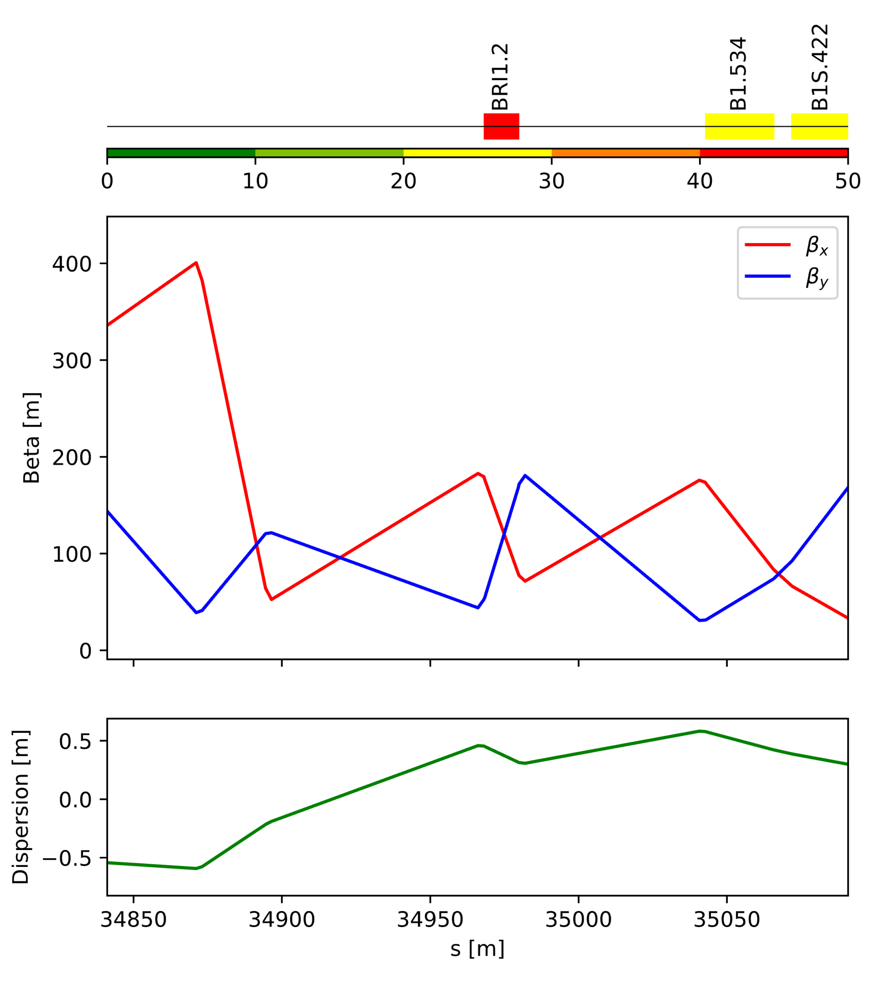

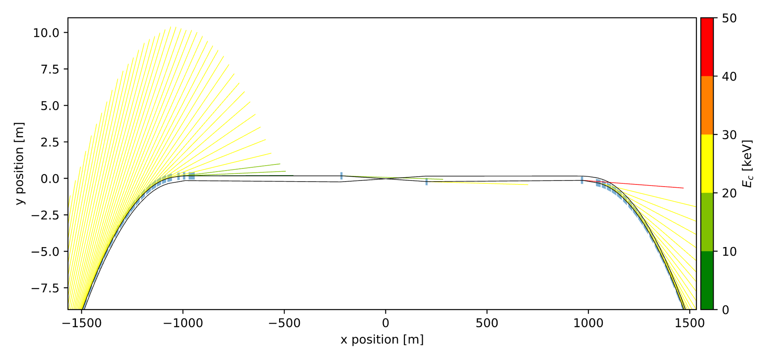







Dipole magnets around RF
Pro:
less SR power
Cons:
integration (inside ring and layout changes with mode)
similar beam sizes as arcs
$$B1$$
Example centre of BRI1
V23
$$Mode Z$$
$$β_{y}\sim 100 m$$
with $σ_{PSF}^{2}\sim 25 μm$ for pinhole at $E_{c}=50 keV$
$$σ_{y}\sim 14 um$$
$$Mode Z$$
$$d+D=500 m$$
$$B1$$
$$RF straight section$$

Slide 25
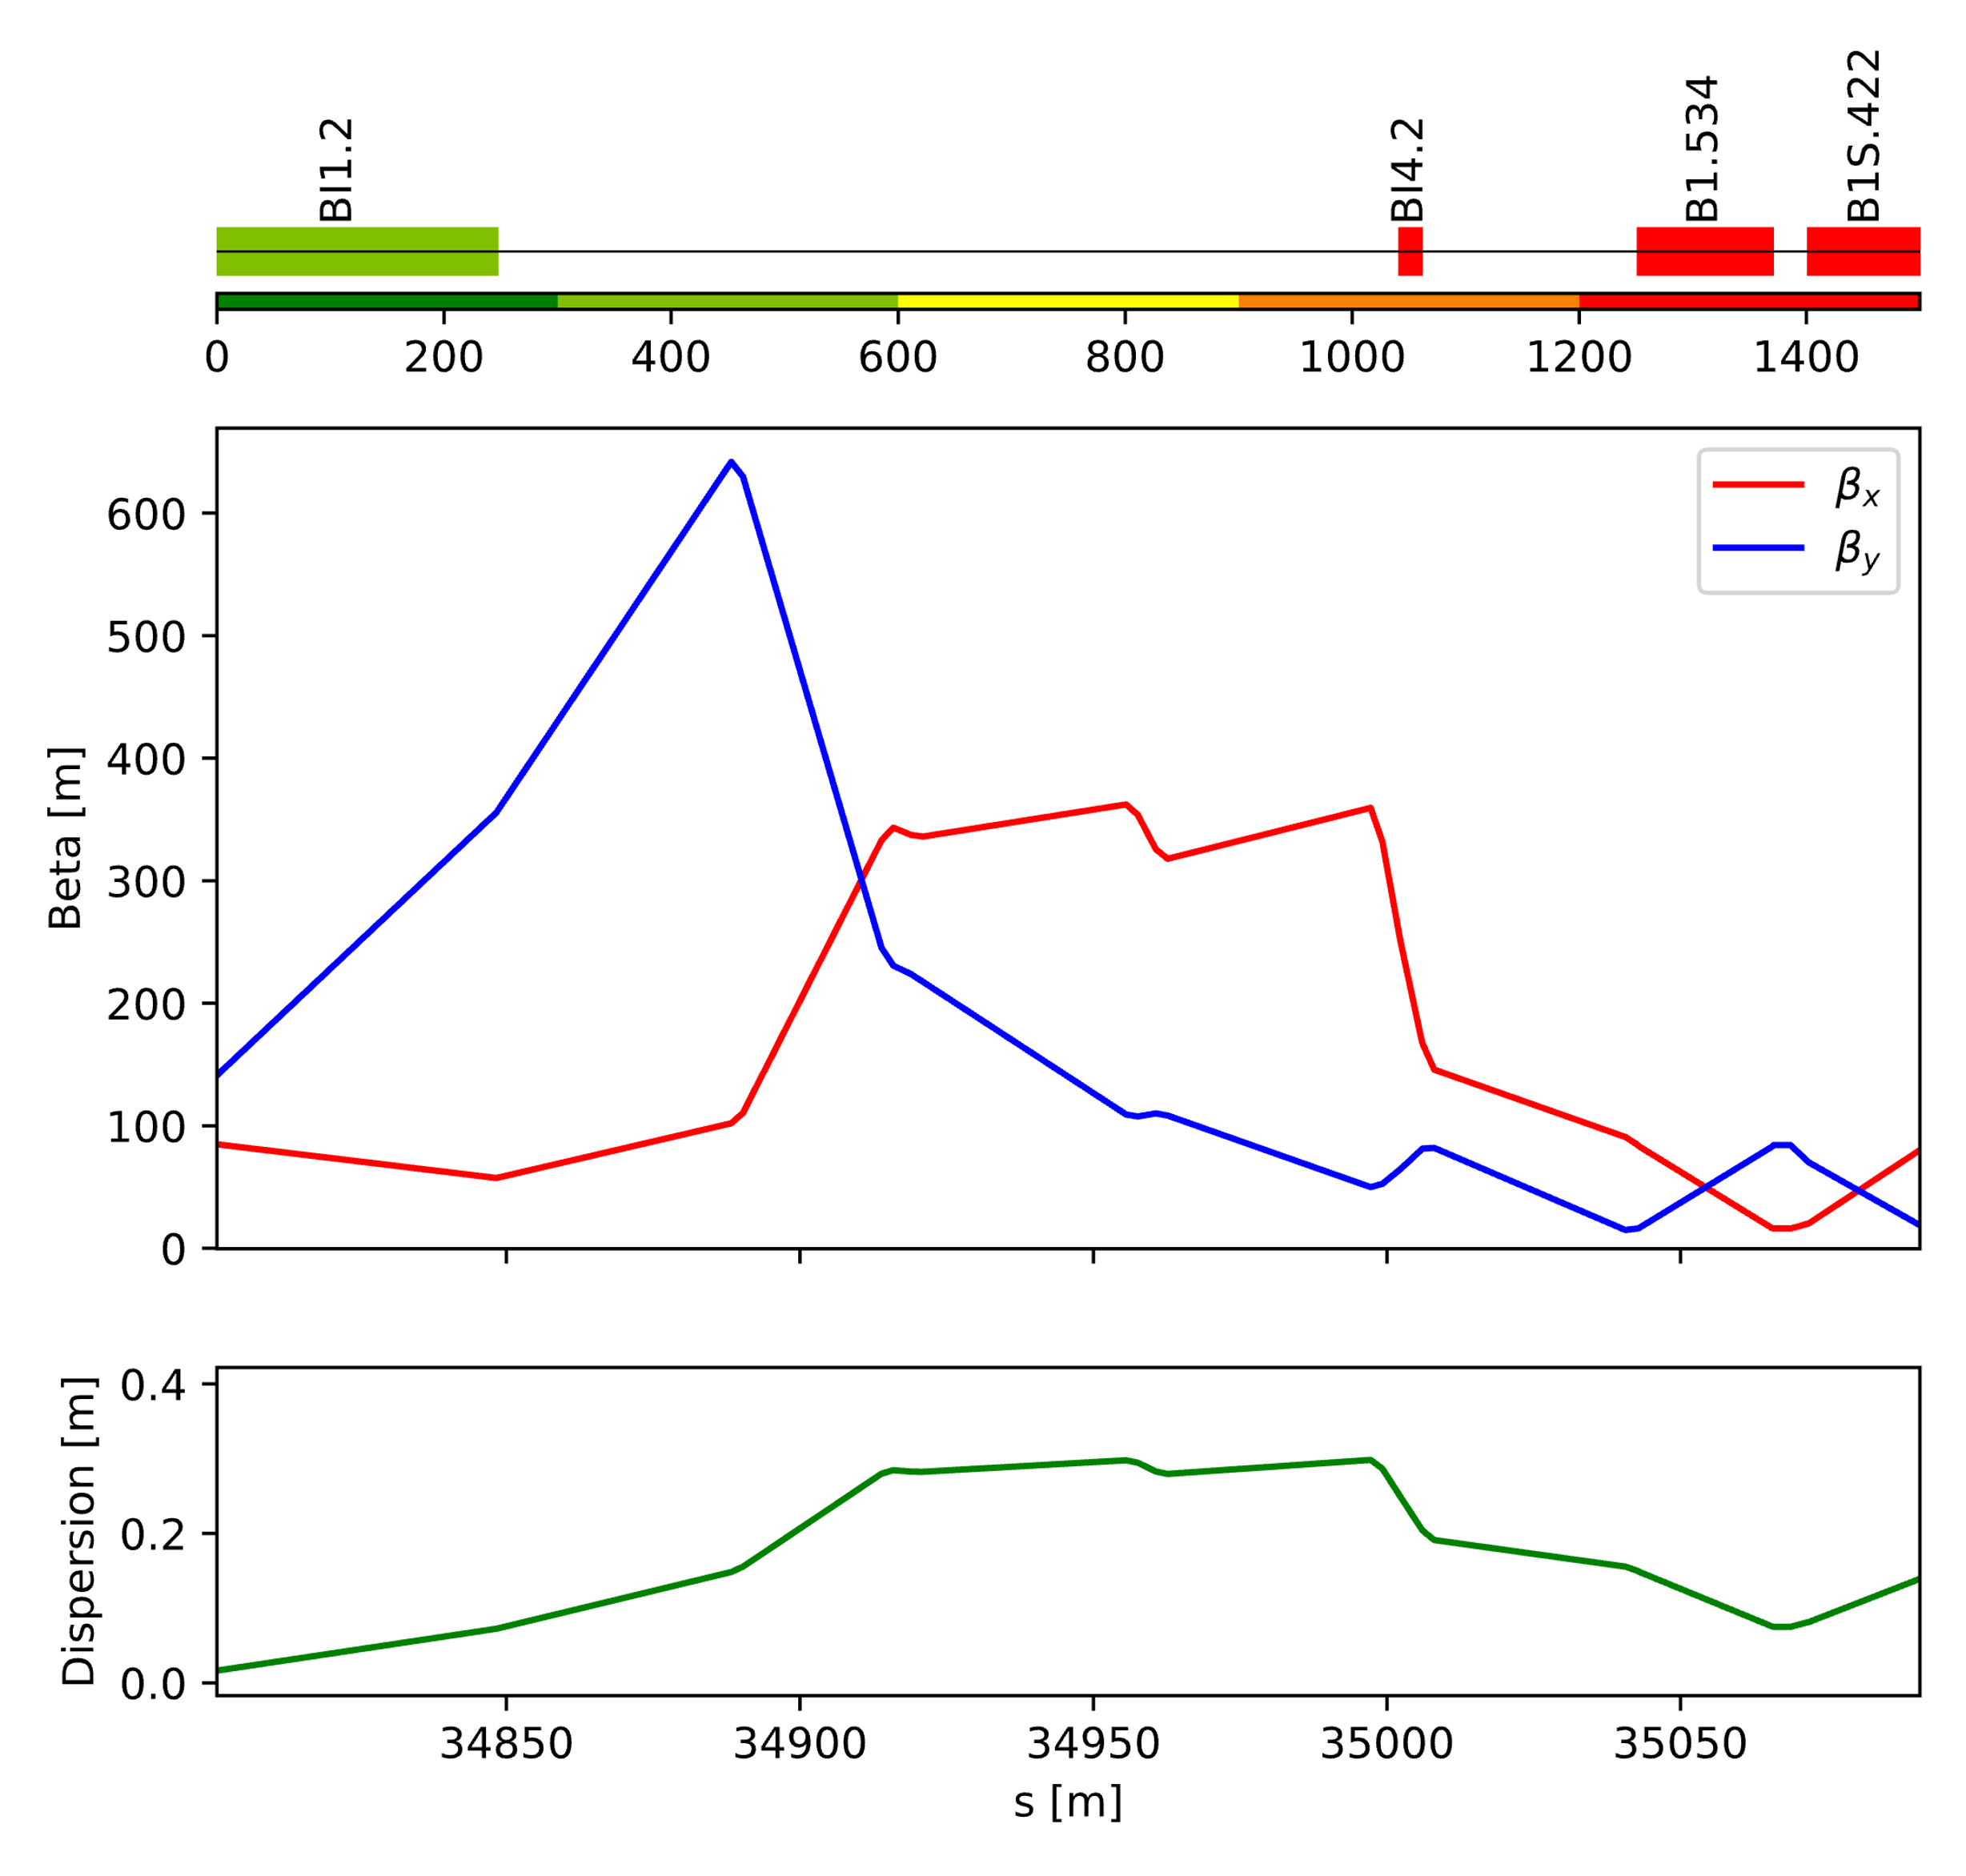

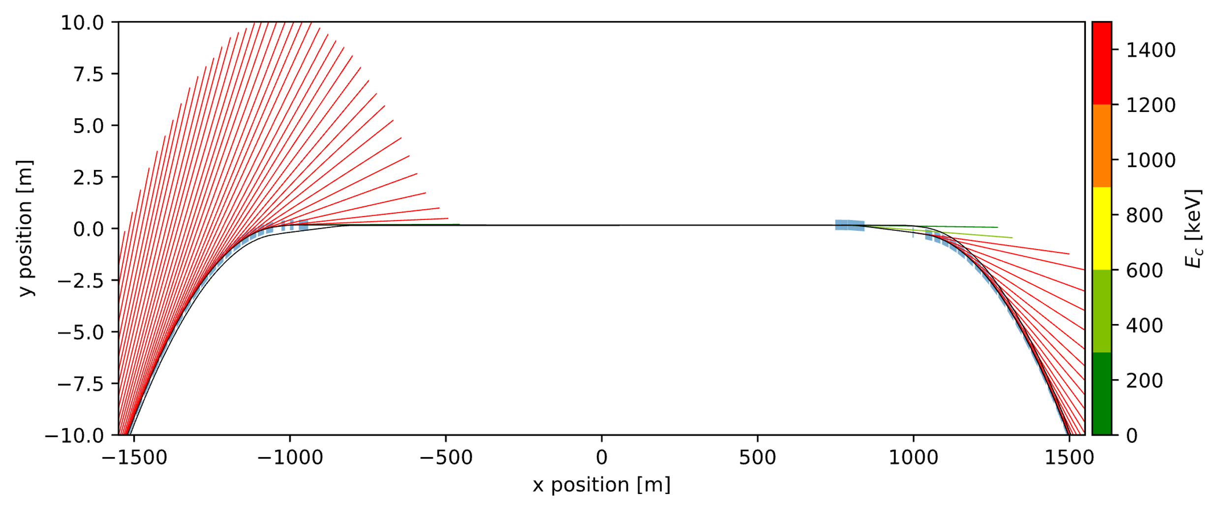






Dipole magnets around RF (ttbar mode)
$$B1$$
Example centre of BI1
V23
$$Mode t\overline{t}$$
$$β_{y}\sim 250 m$$
with $σ_{PSF}^{2}\sim 15 μm$ for pinhole at $E_{ph}=150 keV$
$$σ_{y}\sim 20 um$$
$$Mode t\overline{t}$$
$$d+D=500 m$$
$$B1$$
$$RF straight section$$

Slide 26
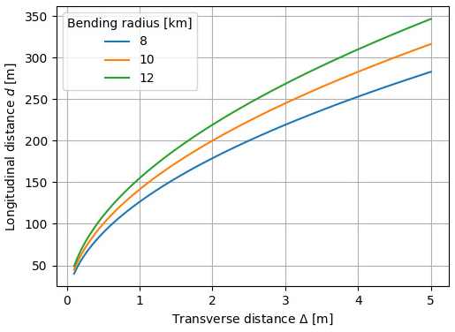



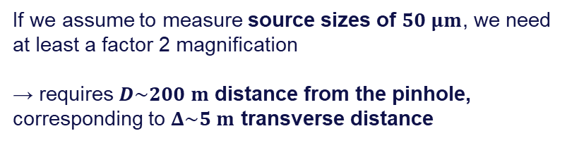






Synchrotron radiation extraction geometry
$$ρ=10 km$$
light sampling
$$d$$
$$D$$
detector
$$M=D/d$$
$$z\sim 100 m$$
$$z\sim 300 m$$
light
$$Δ\sim 0.5 m$$
beam
$$Δ\sim 5 m$$
$$Δ\sim \frac{z^{2}}{2ρ}$$
If we assume to measure source sizes of $50 μm$, we need at least a factor 2 magnification
→ requires $D\sim 200 m$ distance from the pinhole, corresponding to $Δ\sim 5 m$ transverse distance

