Slide 1
Effect of Bunch Feedback system to the luminosity of e+e- collider
Makoto Tobiyama
KEK Accelerator Laboratory

Slide 2
High beam current colliders
Complicated, many-mode coupled-bunch instabilities(CBI)
  Ion trapping, Fast Ion instability(HER electron)
  Electron Cloud Instability (LER positron)
  Trapped modes, HOMs of the vacuum components
  Mode coupling instabilities from beam collimators
Suppress the CBI using BxB feedback
  Detect individual oscillations of all the bunches, calculate the feedback kick, then kick back individual bunch.
  Transverse plane (Horizontal, Vertical)
  Longitudinal plane

Slide 3
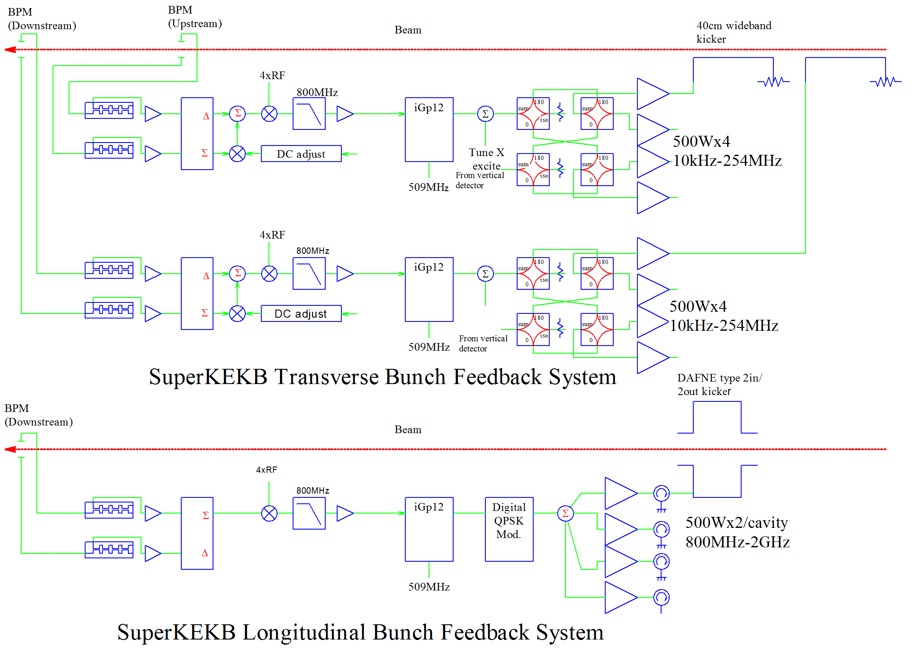
Bunch feedback systems (original)
2-loops / plane for transverse FB

Slide 4
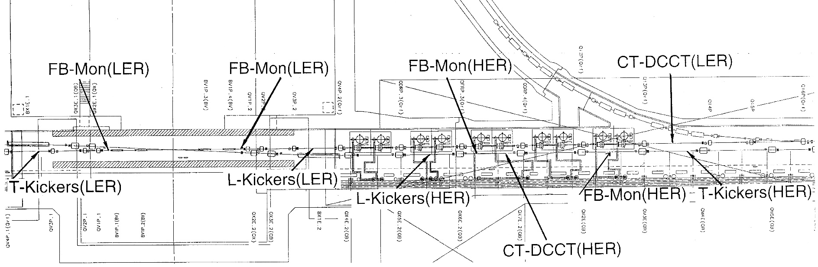
SuperKEKB Fuji straight section

Slide 5
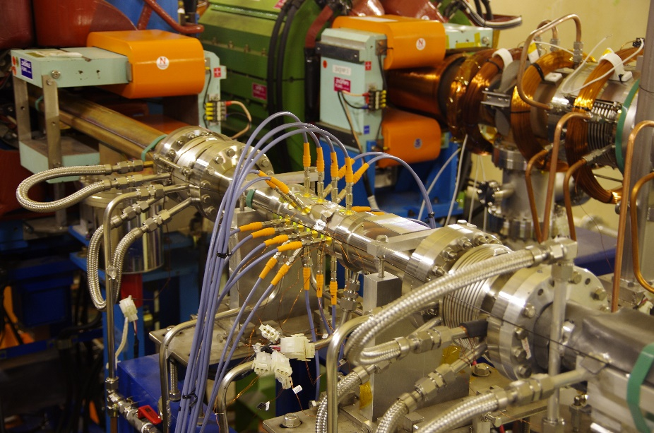
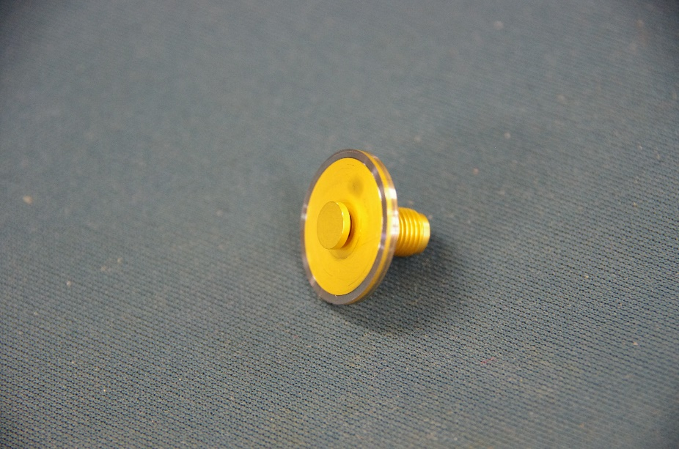
SuperKEKB Fuji straight section
Glass sealed (er=4) SMA button electrodes (Diameter=6mm)
24 buttons×2 / Ring

Slide 6
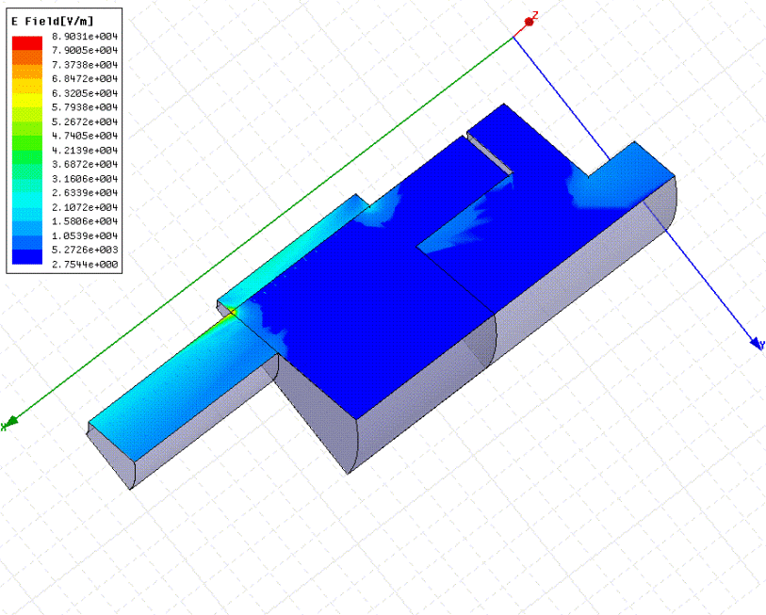
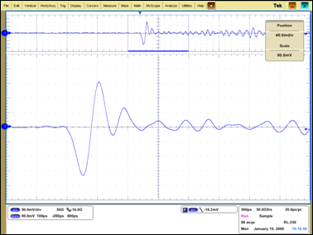
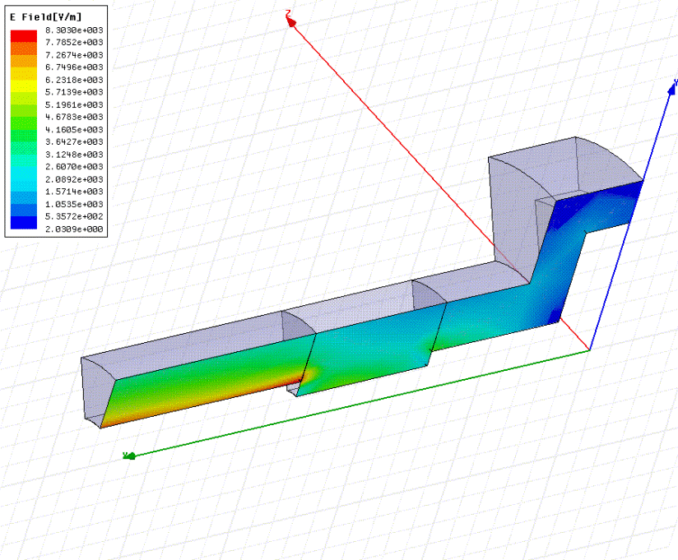
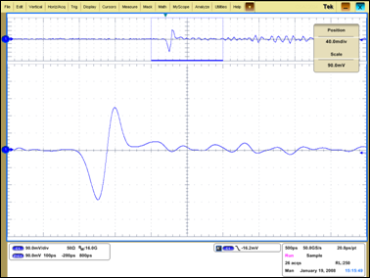
KEKB feedthrough for FB
SuperKEKB FT for FB

Slide 7
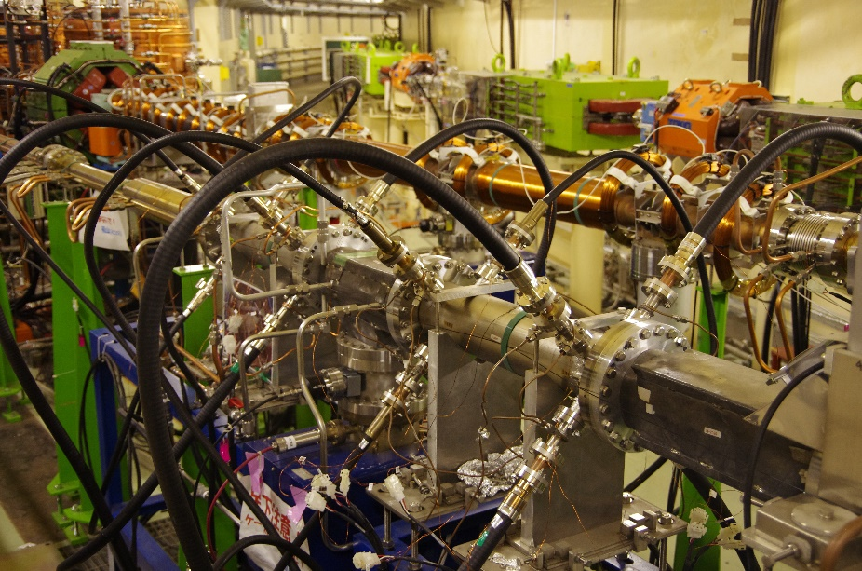
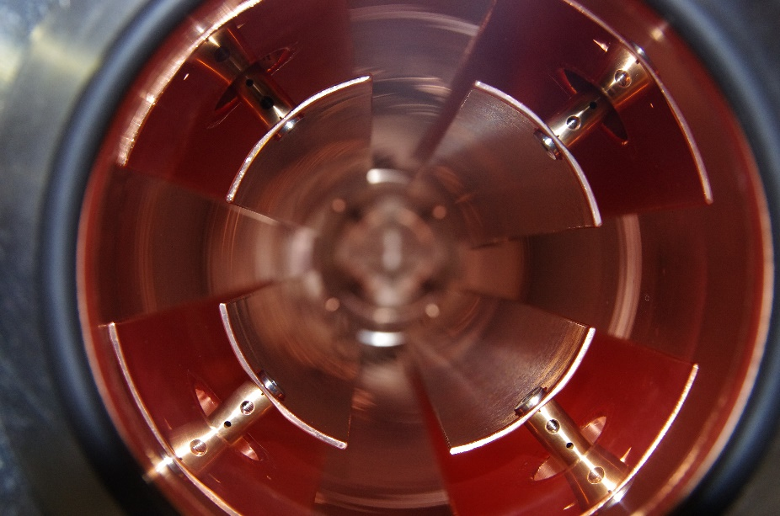
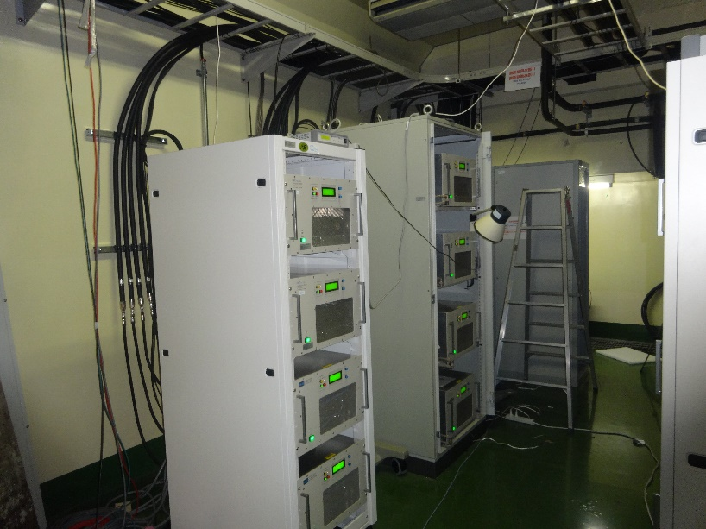
SuperKEKB Fuji straight section
Transverse stlipline FB kickers (L=40cm 2/ring)
ガラスシール型φ6mm電極
24個×2 / Ring
VHF Amplifires (10k-254MHz, 500W), 8 /ring for transverse FB

Slide 8
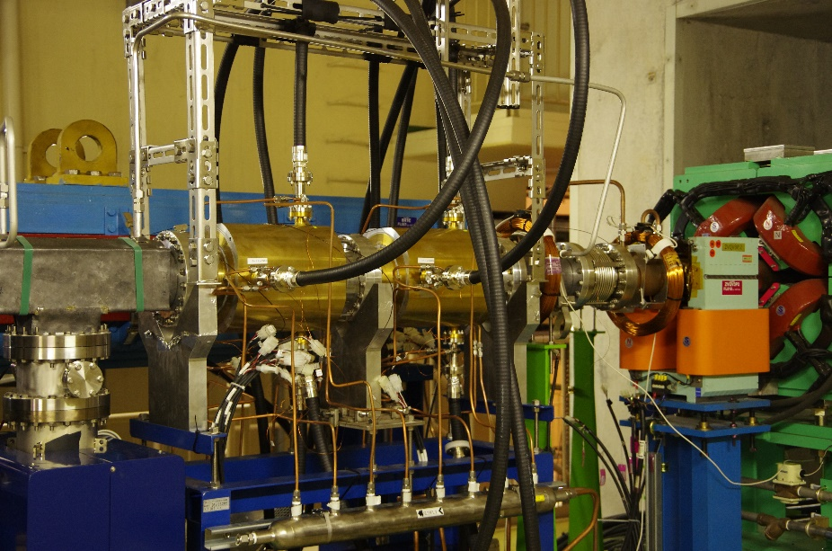
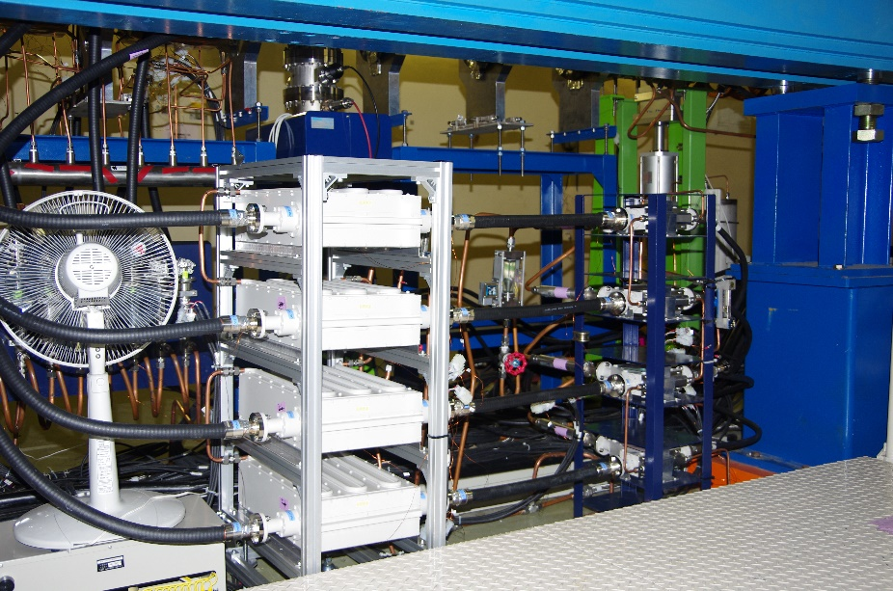
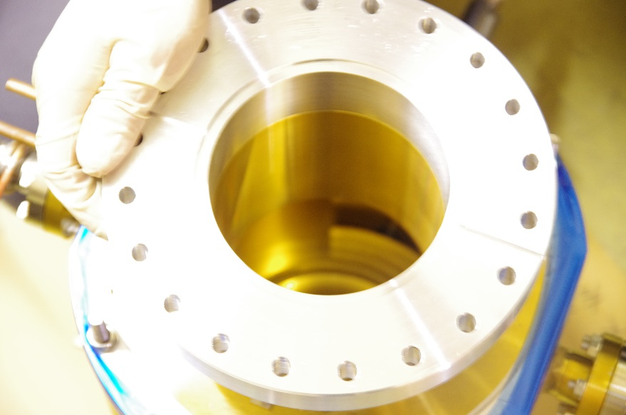
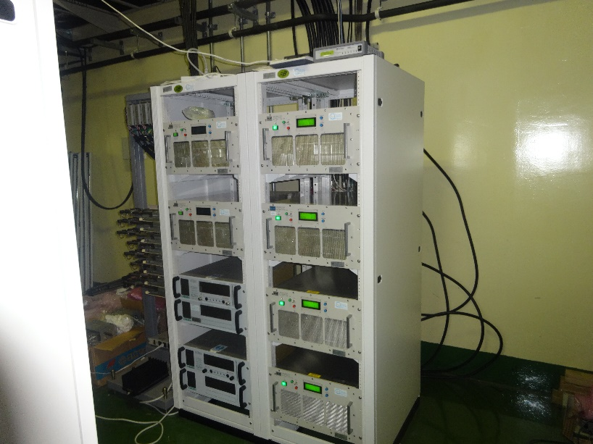
SuperKEKB Fuji straight section
Absorptive type LPF and wide-band circulators
Overdamped-type Longitudinal kickers (LER)
Rsh~1.6kΩ、Ｑ~5 x4
ガラスシール型φ6mm電極
24個×2 / Ring
UHF Amplifiers (800M-2GHz, 500W) for L-FB (8 for LER)

Slide 9
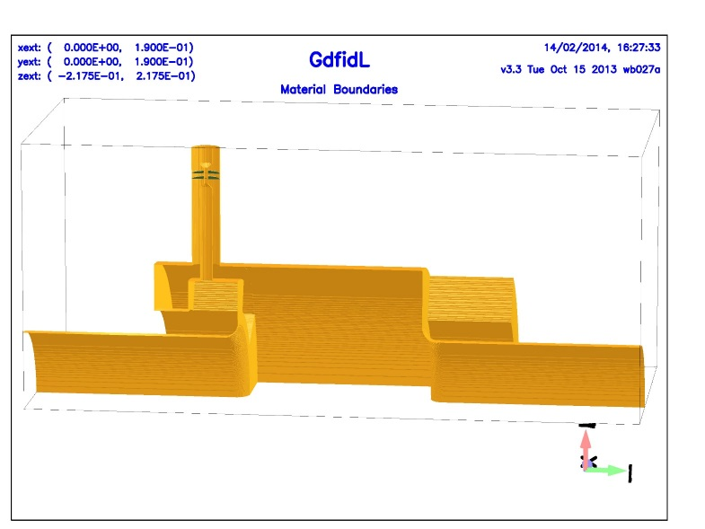
Longitudinal kicker
2-input, 2-output, DAFNE type kicker.
center frequency =2.25 x fRF (1150 MHz)
Bandwidth ~ 250MHz
8 wideband UHF amplifiers (R&K) are working (800M-1.8GHz, Po=500W).
Q~ 5, Rsh ~ 1.6kΩ by HFSS calculation

Slide 10
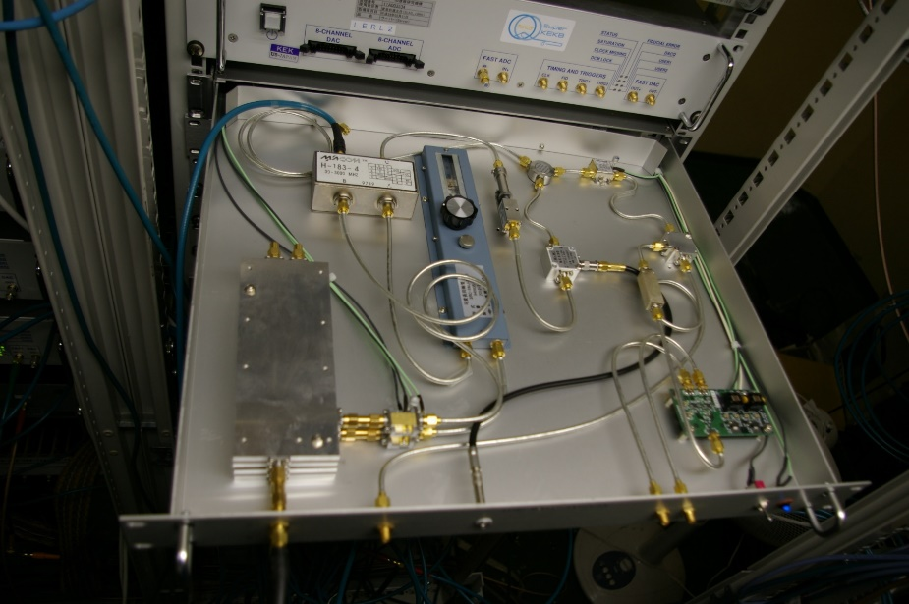
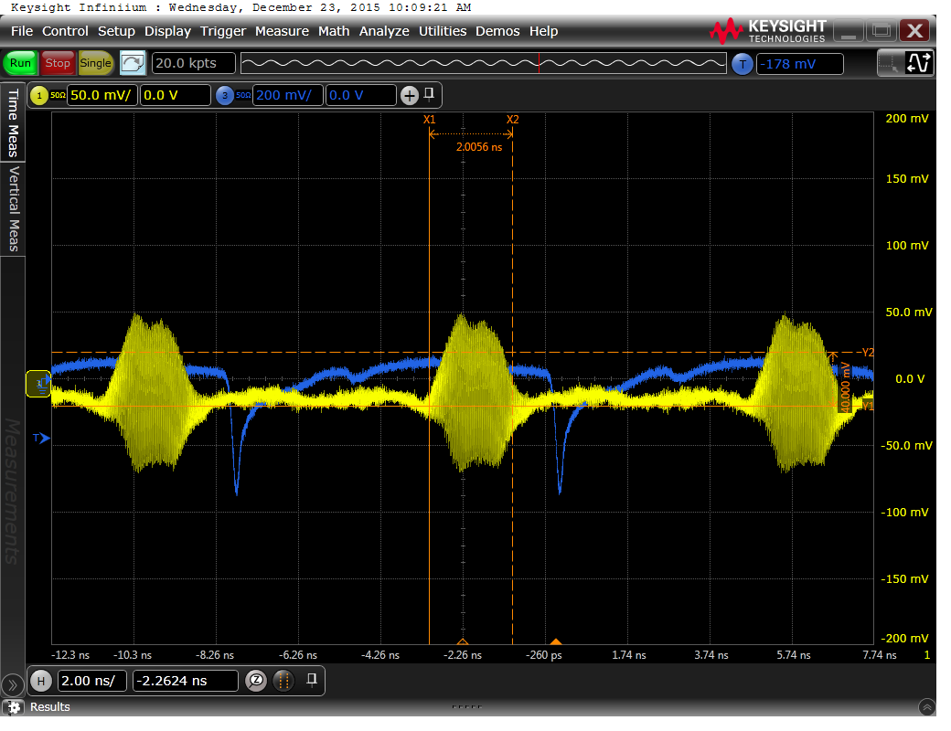
Original FB detector
Extract 2GHz(4xf_{RF}) components of a bunch using 3-tap comb filter
Adjust the timing of two signals, subtract using H-184-3 Hybrid.
Offset cancel circuit by adding sum signal to the differential signal
Downconvert by 4xf_{RF}

Slide 11
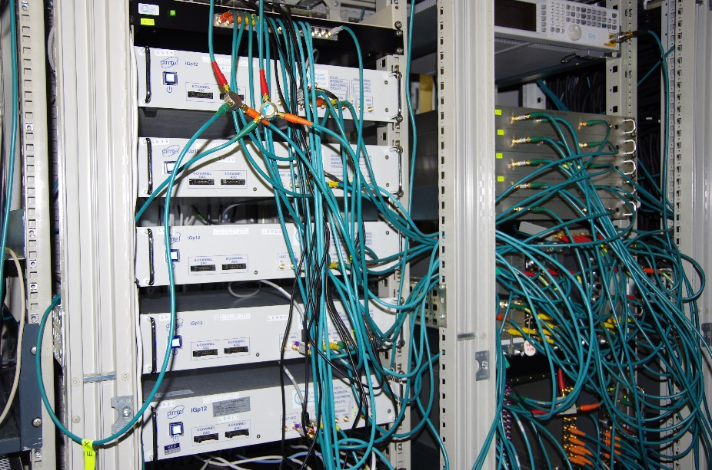
iGp12 Feedback processors (DimTel)
12bit ADC/DAC
Virtex5 FPGA
  VXS95T
17 tap FIR(h=5120)
12MB SRAM (transient-domain analysis)
Single bunch beam transfer function measurements (using non-colliding bunch)
5 for LER (UH UV DH DV L)
5 for HER (UH UV DH DV L)
2 for positron DR (H V): VXS50T

Slide 12
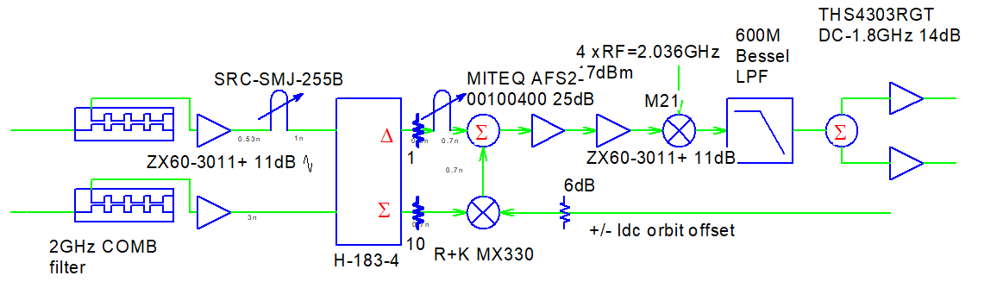
Original FB detector(transverse)
Large insertion loss (~22dB) and need additional broadband amplifiers

Slide 13
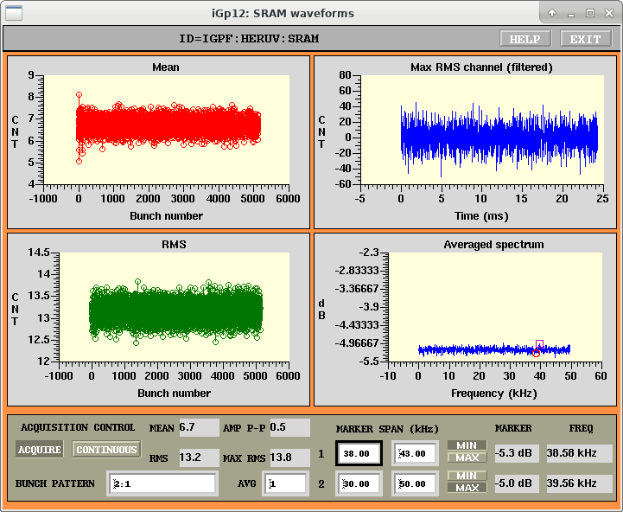
Original broadband noise level
~13.2 counts in ADC of iGp12 (without beam)

Slide 14
Frequency response of KEKB LER during collision

Slide 15
KEKB Luminosity drop with LER excitation

Slide 16
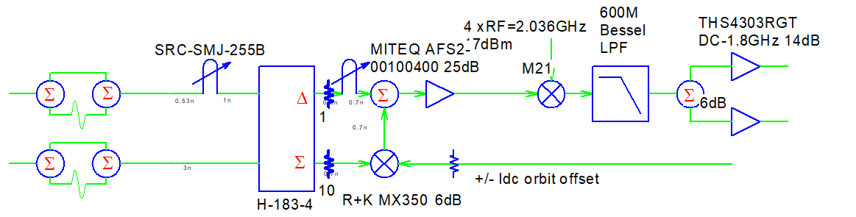
Updated FB Detector

Slide 17
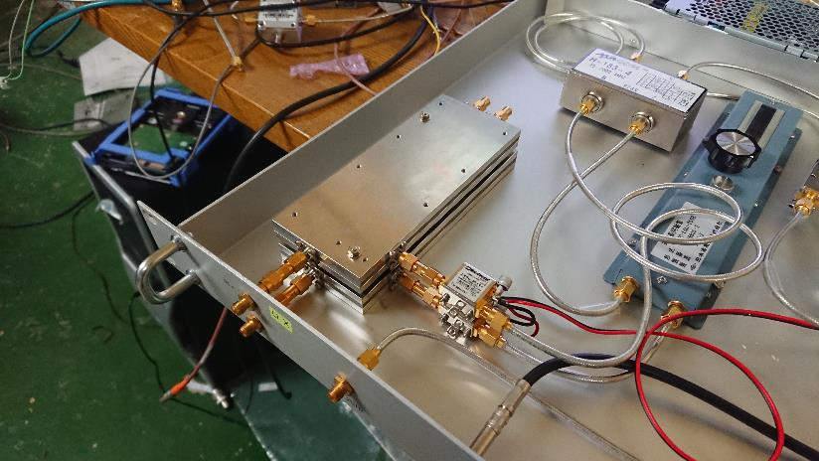
Original comb filter+amplifire

Slide 18
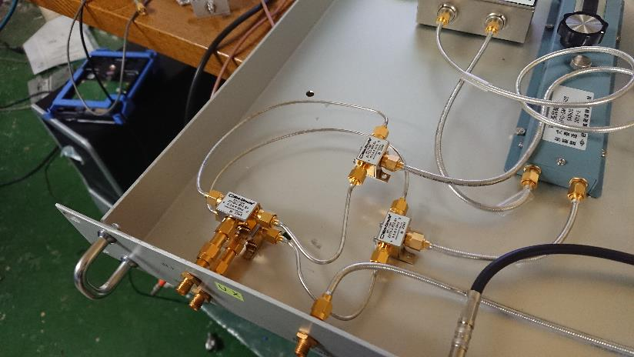
Cable type 2TAP BPF

Slide 19
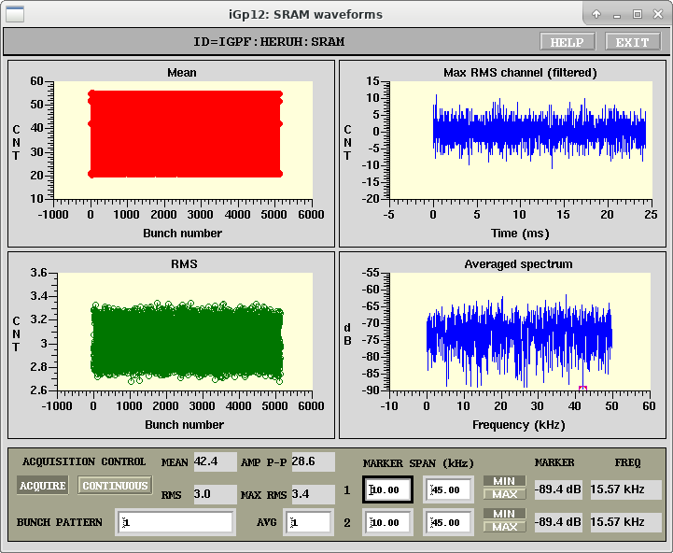
New noise level
Improved RMS 13->3

Slide 20
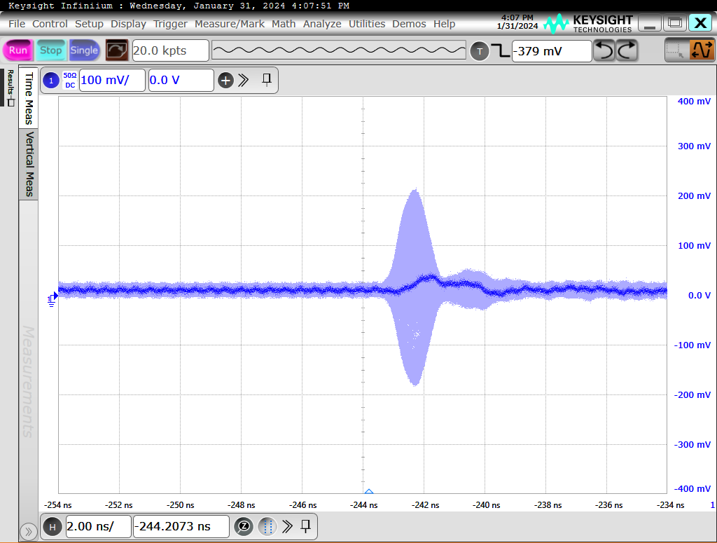
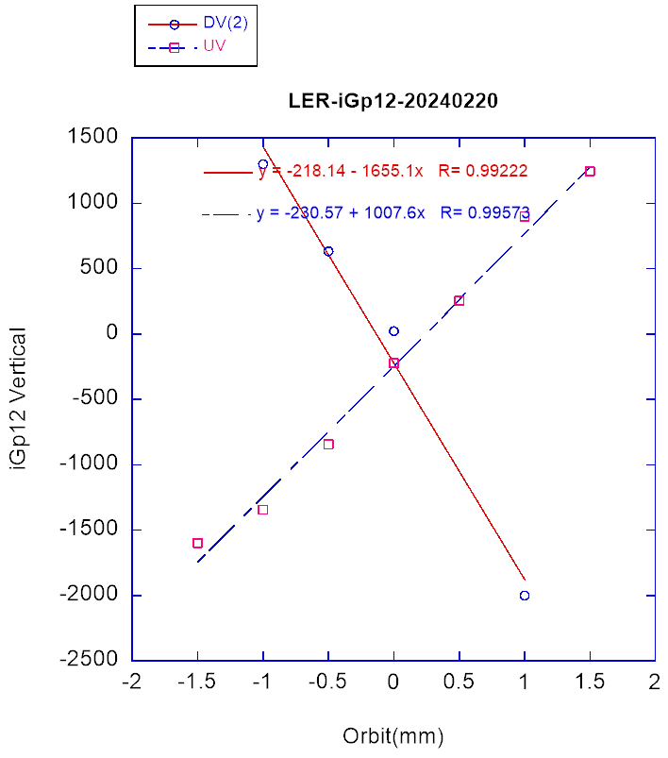
Detector output/sensitivities
Dynamic range <+- 1.5mm /0.4mA @FB detector

Slide 21
Tuning transverse FB
Tune FIR filters to be resistive, but not excite unwanted unstable modes such as coming mode coupling (not so visible this time), strange near half tune mode (imaginary tune split mode??)
Tune the feedback gain to increase luminosity
  Exceed vertical feedback gain usually increases vertical beam size and reduce luminosity (LER)
  Too low feedback gain also increase beam size and reduce luminosity (HER)

Slide 22
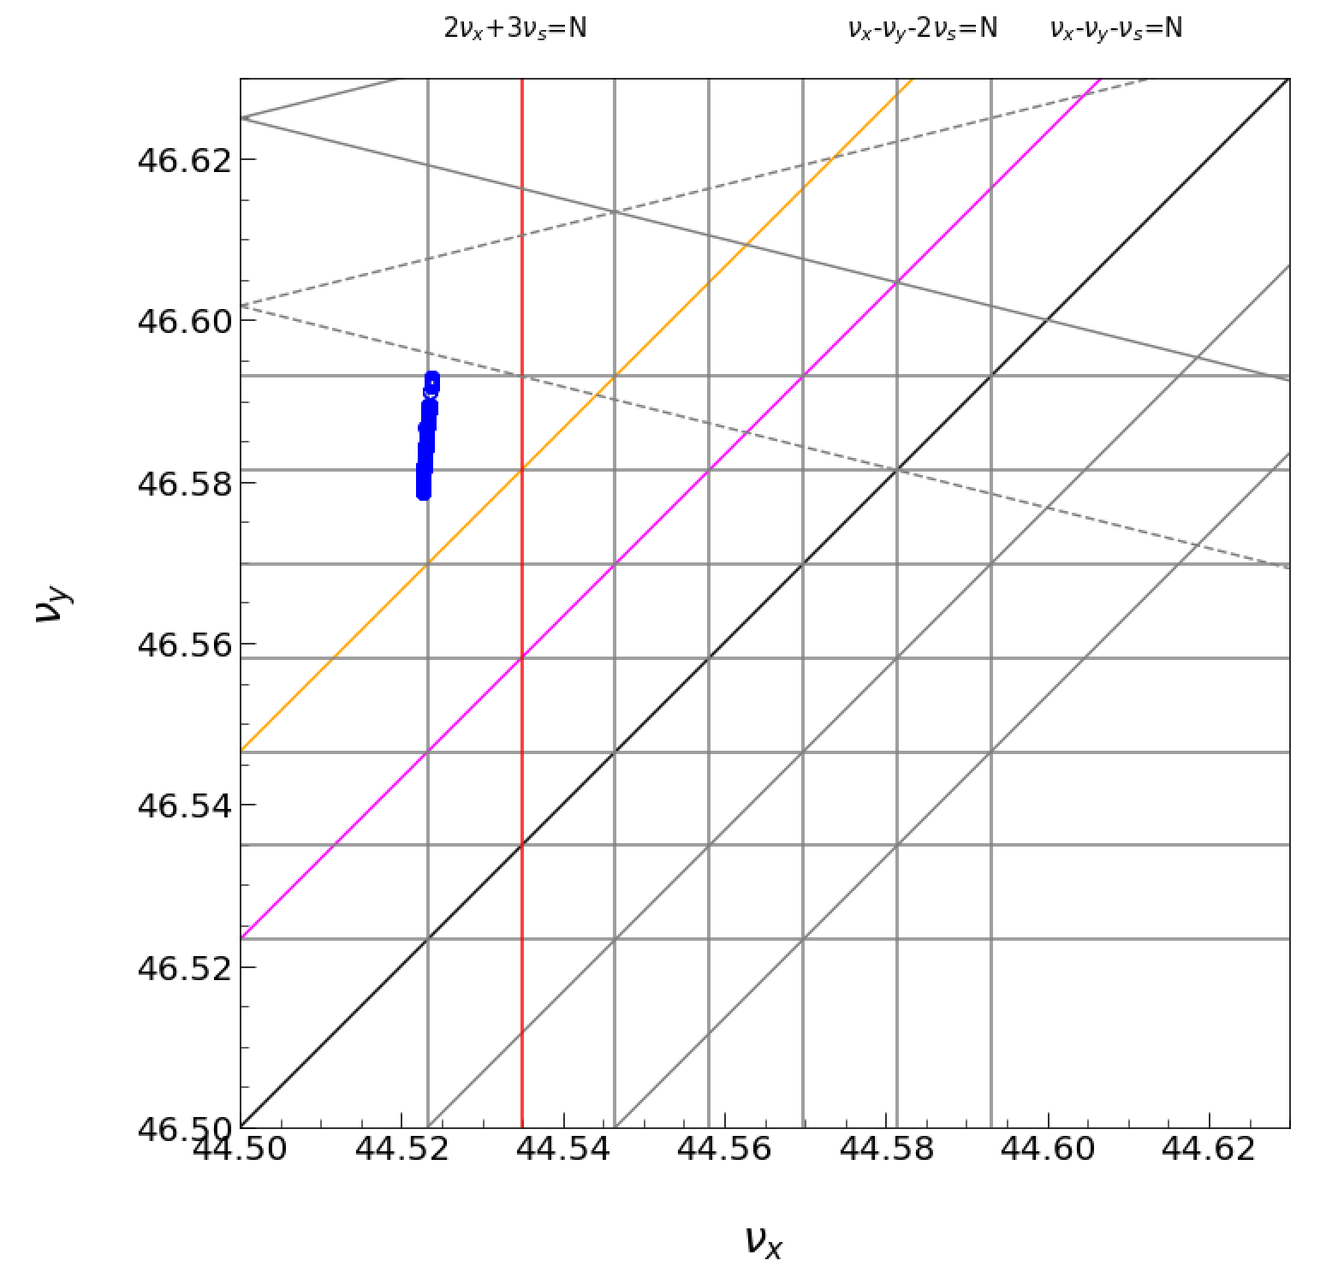
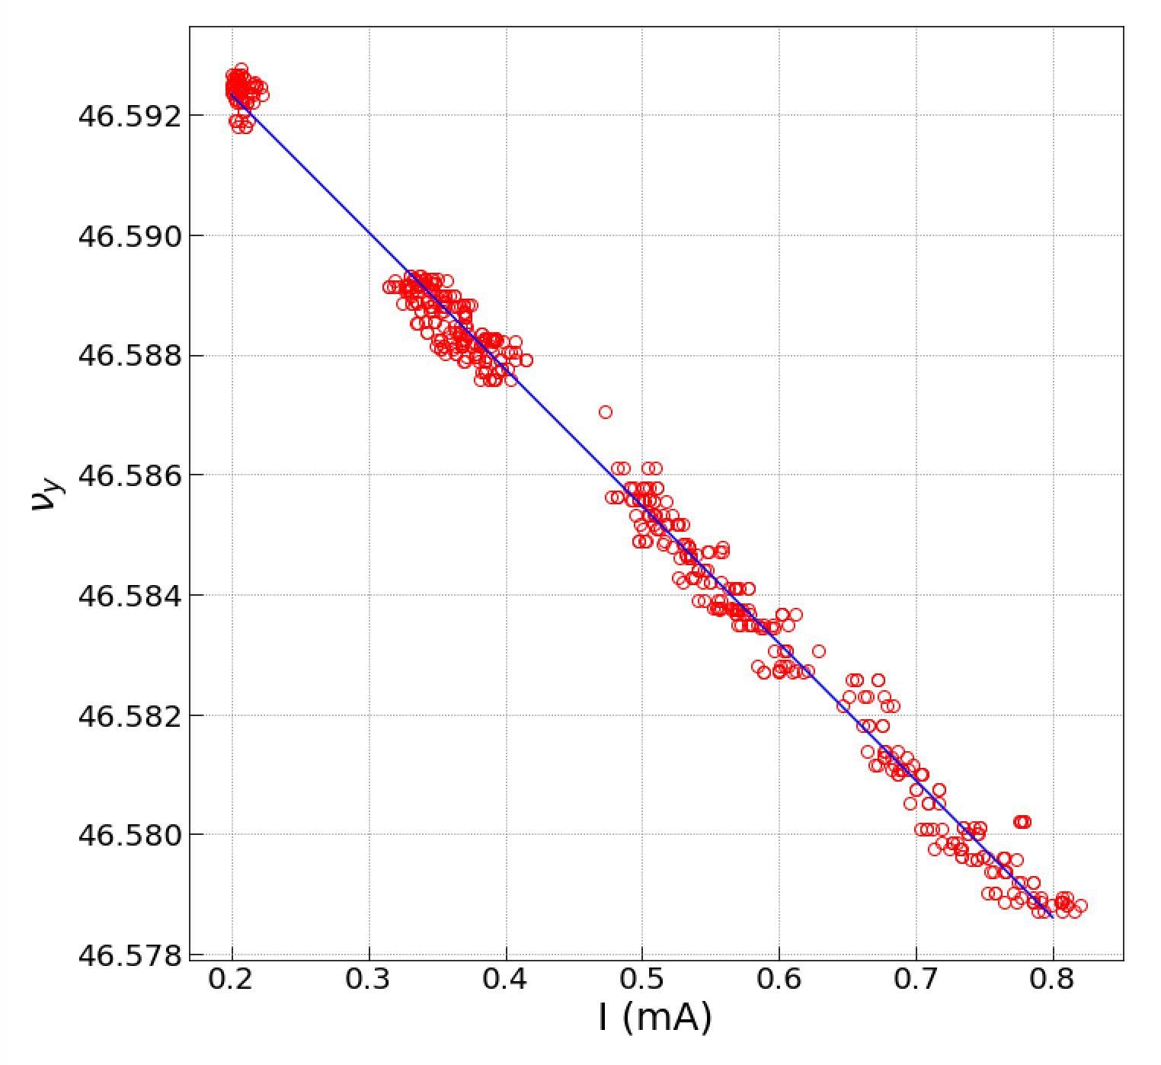
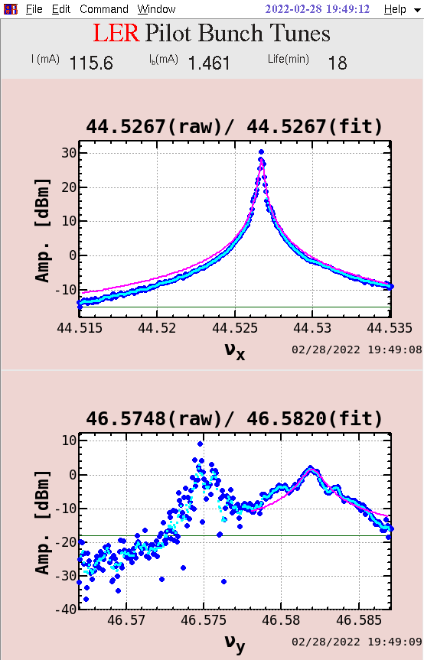
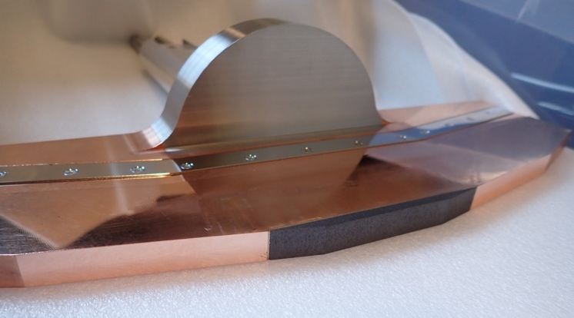
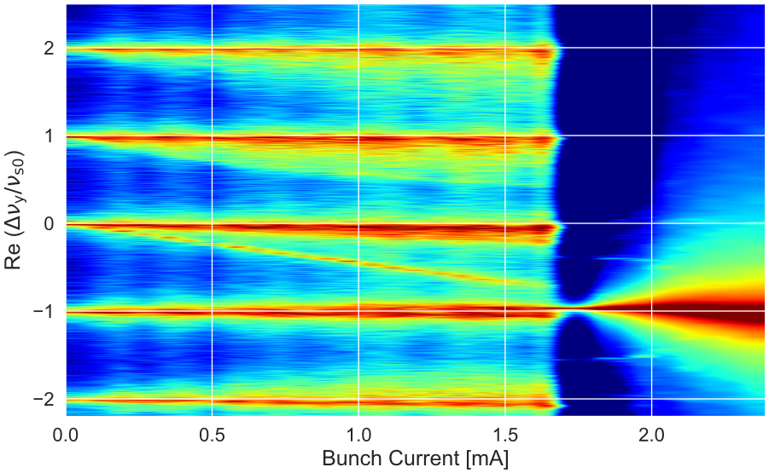
TMCI Observation at SuperKEKB
LER
$$Δν_{y}/ΔI=−0.02286mA^{−1}$$
$$ν_{s}=−0.0233$$
Beam loss
during injection
single bunch operation
2020
Simulation: PyHEADTAIL ($Δν_{y}/ΔI∼ν_{s}/2$)
Tune measurement:
side band was observed
at high bunch current.
We observed TMCI at SuperKEKB when we used a carbon head for one of the vertical collimators.
The tune shift was similar to the synchrotron tune and the threshold was 0.85 mA/bunch. (2020)
We control the vertical collimator aperture to keep the tune shift less than half of $ν_{s}$.
The TMCT threshold becomes 1.7 mA/bunch in the LER for the normal operation.
T. Ishibashi
* We replaced the carbon head with tantalum after this experiment.

Slide 23
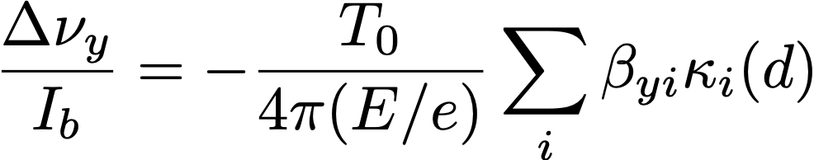
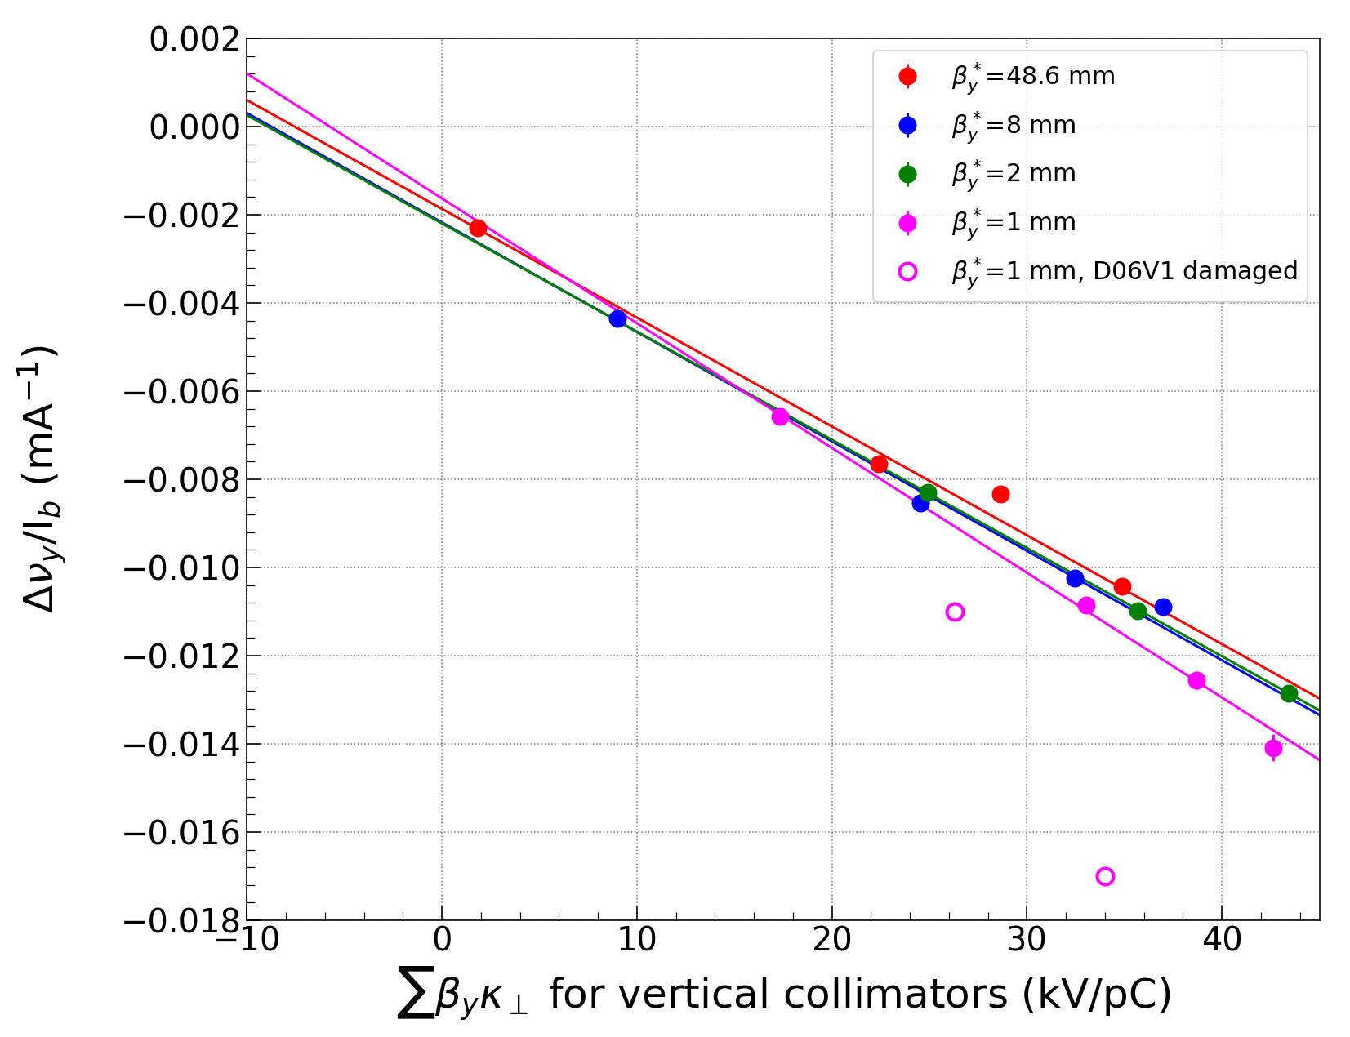
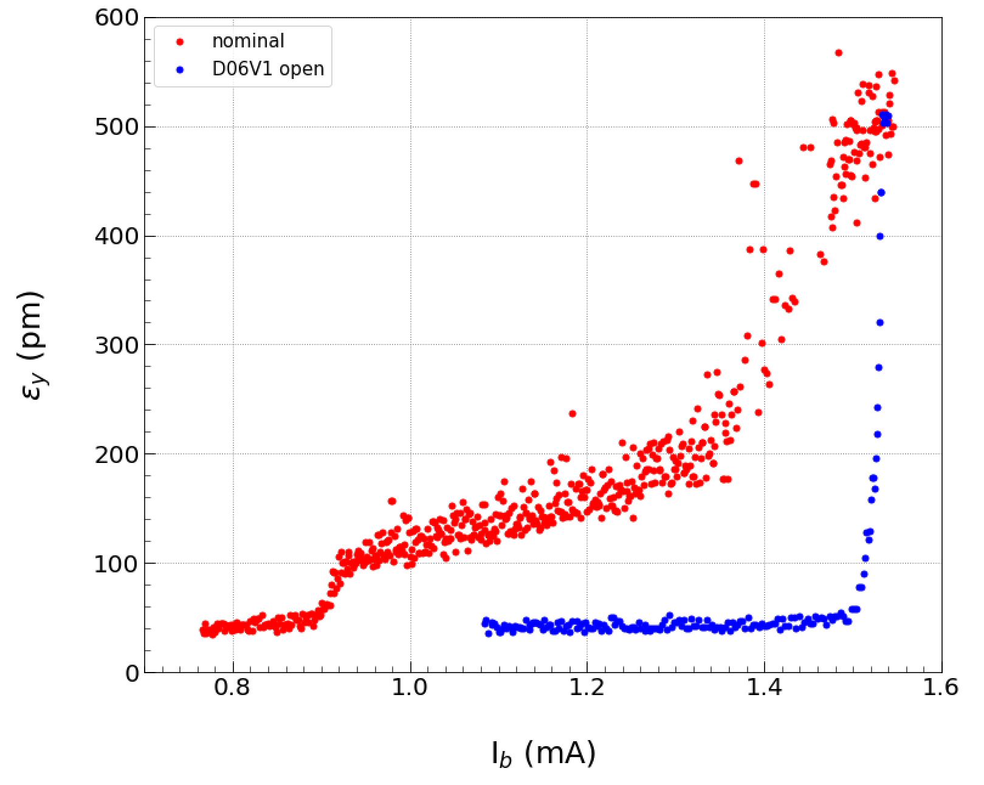
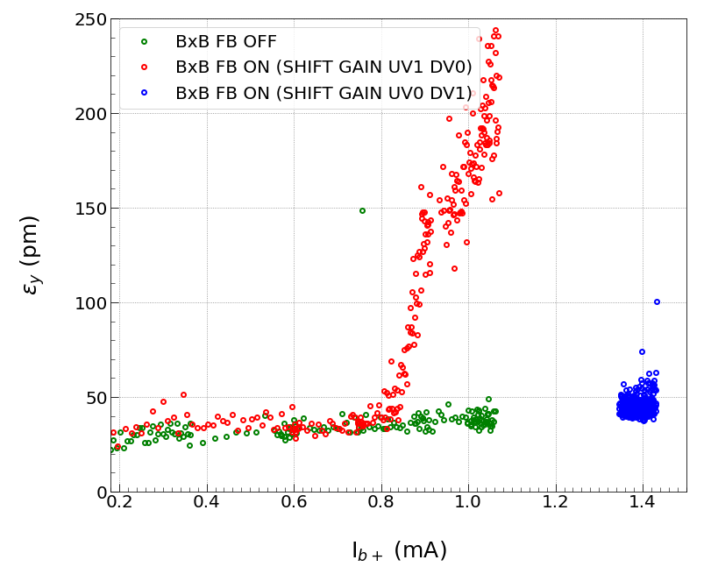
Single Bunch Tune Shift and Impedance
Tune shift is equivalent to impedance.
Larger circumference (larger T0) makes larger tune shift.
→ $\frac{T_{0}}{4π(E/e)}=0.2(ps/kV)$
for SuperKEKB
Kick factors of vertical collimators are calculated by GdfidL (and ECHO3D).
The vertical collimators contribute approximately 70 %
of the total impedance.
LER
other
impedance
Vetical beam size blowup was observed at much smaller than the TMCI threshold.
"-1 mode instability" $←$ impedance and BxB FB tuning
nominal
operation
collimator
close
BxB FB ON
after tuning
damaged
collimator
BxB FB ON
open
BxB FB OFF
0.9 mA/bunch
$$∑β_{y}κ=33.3(kV/pC)$$

Slide 24
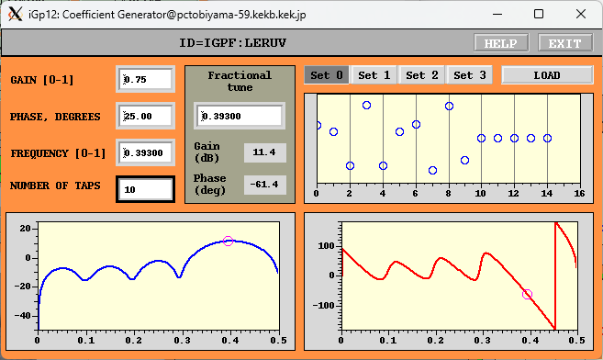
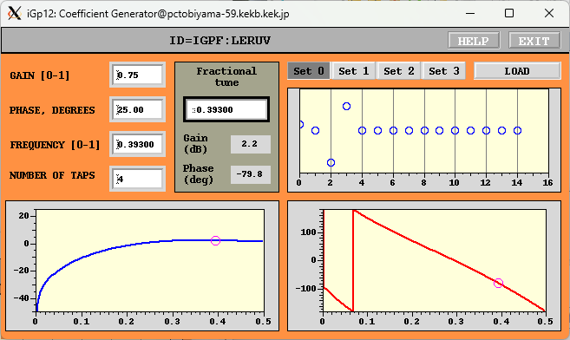
Length of FIR filter
10 Tap FIR filter
Digital gain 11.4dB
FB phase diff@-1kHz : 18.7 deg
This could excite sideband coming from mode -1 related instability.
4 Tap FIR filter
Digital gain 2.2dB
FB phase diff@-1kHz : 8.7 deg

Slide 25
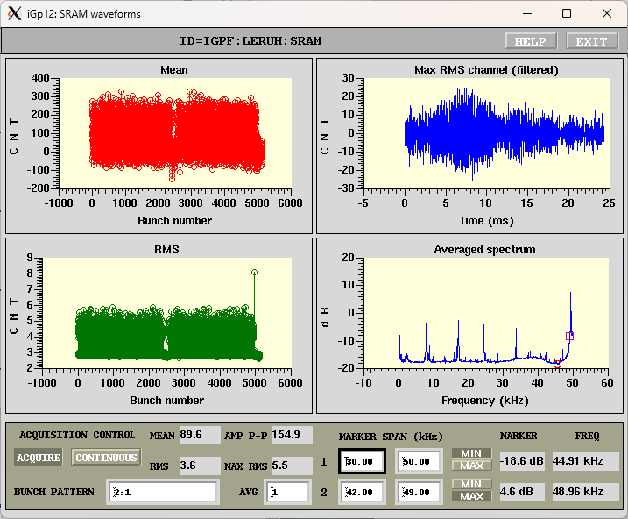
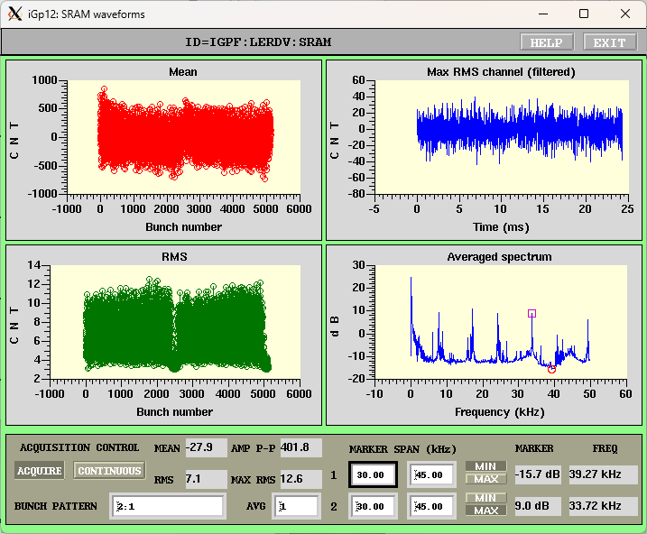
Noize related lines (8kHz) appears in all the LER FB detectors. RMS noise level has greatly reduced from 30 to 5 counts
Sharp horizontal spectrum near half integer?? (LERUX) which greatly restricts the tuning range of FIR filter
Mode coupling related instabilities were not so obvious.

Slide 26
Summary
Bunch by bunch feedback systems for SuperKEKB rings are working.
  Contributing to suppress the CBI (which could observe less than 30mA of total current)– enabling to store more than 1A with by 2 filling pattern.
  Feedback noise effect (to enlarge /excite) the bunch in vertical plane has been observed. We have replaced the bunch detector with low NF structure. The rms noise level reduced, as expected.
Still observed the luminosity drop with vertical FB gain in LER
  Tune the FIR phase/phase shift to suppress excitation.
  Reduced the V-FB gain.
  Hunting noise source (RF? Power supplies?)
  In HER, reducing the V FB gain resulted the increase of vertical beam size and luminosity drop.

Slide 27
Backup

Slide 28
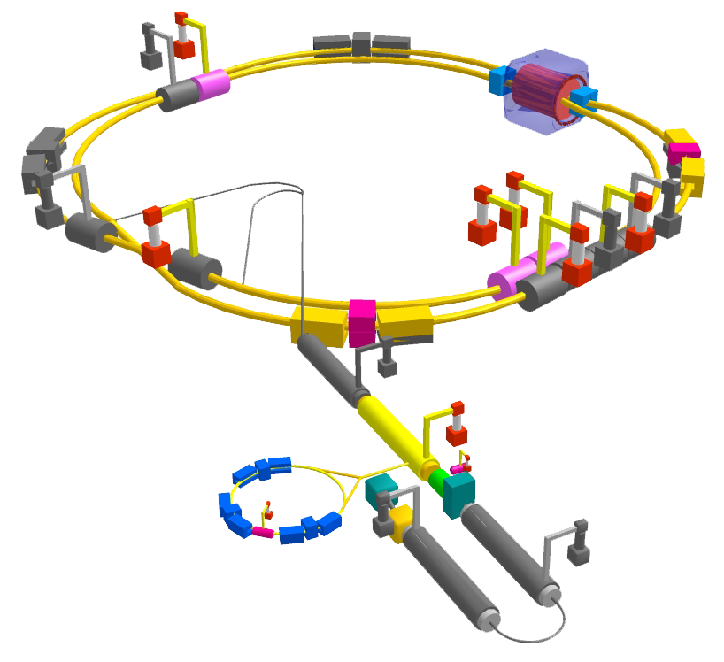
SuperKEKB accelerators
Circumference 3km
LER:e⁺ 4GeV 3.6A
HER:e⁻ 7GeV 2.6A
f_{RF}=508.886MHz
h=5120
Low emittance 3.2/4.6nm with ~0.28% xy-coupling
Bunch length 6/5 mm @1mA/bunch
β* at IP H/V 32/0.27mm 25/0.3mm
Luminosity ~60x10³⁵
  x30 of KEKB

Slide 29
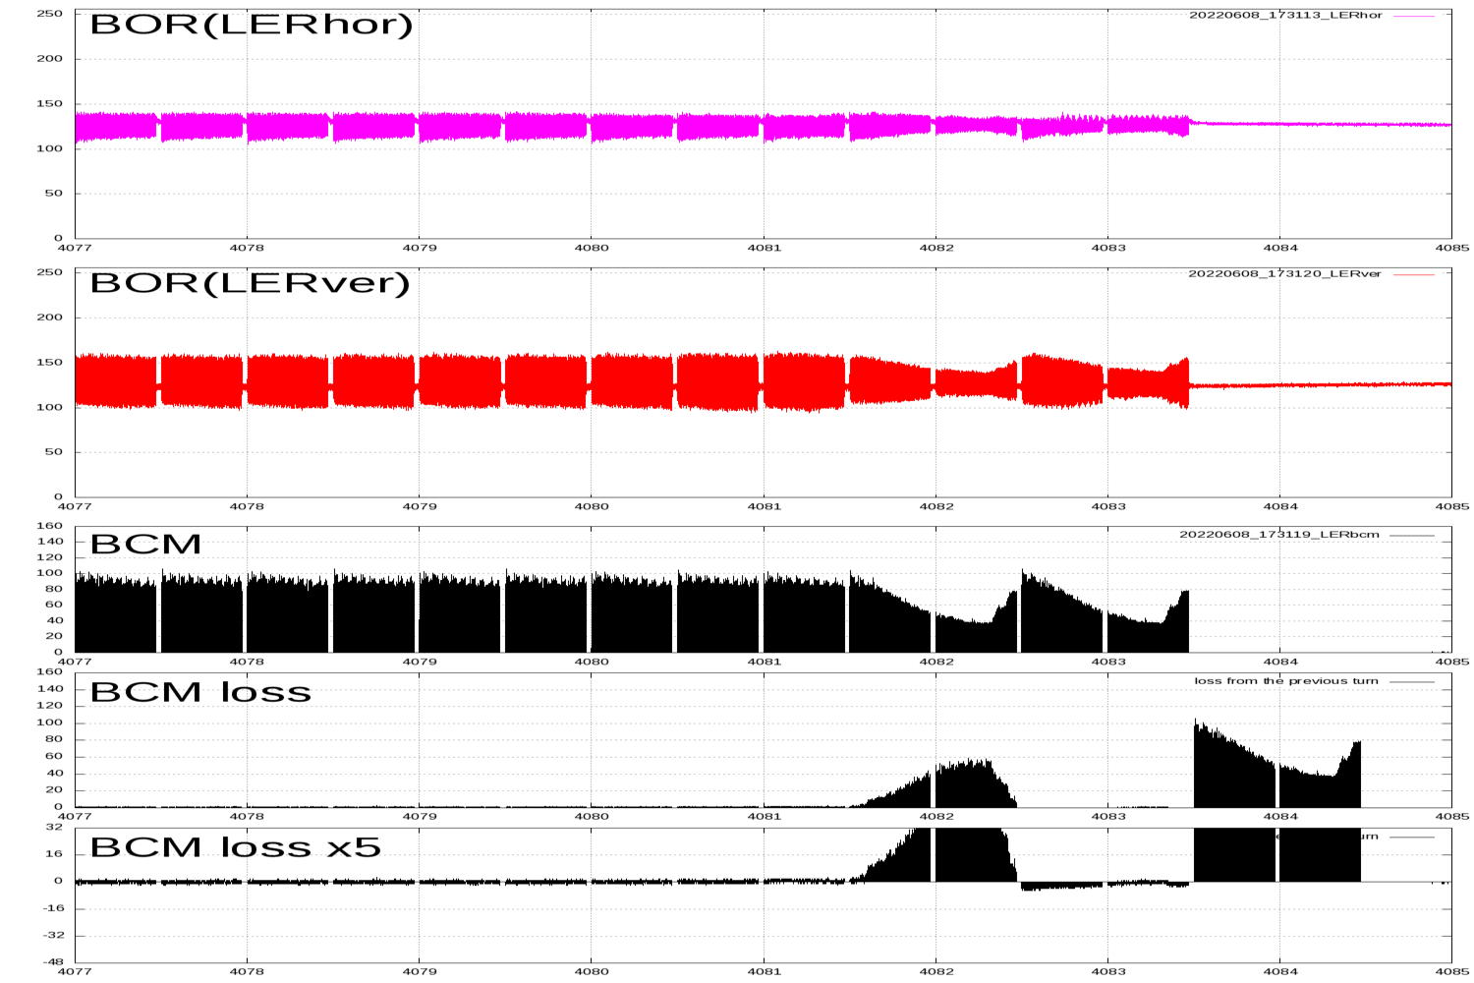
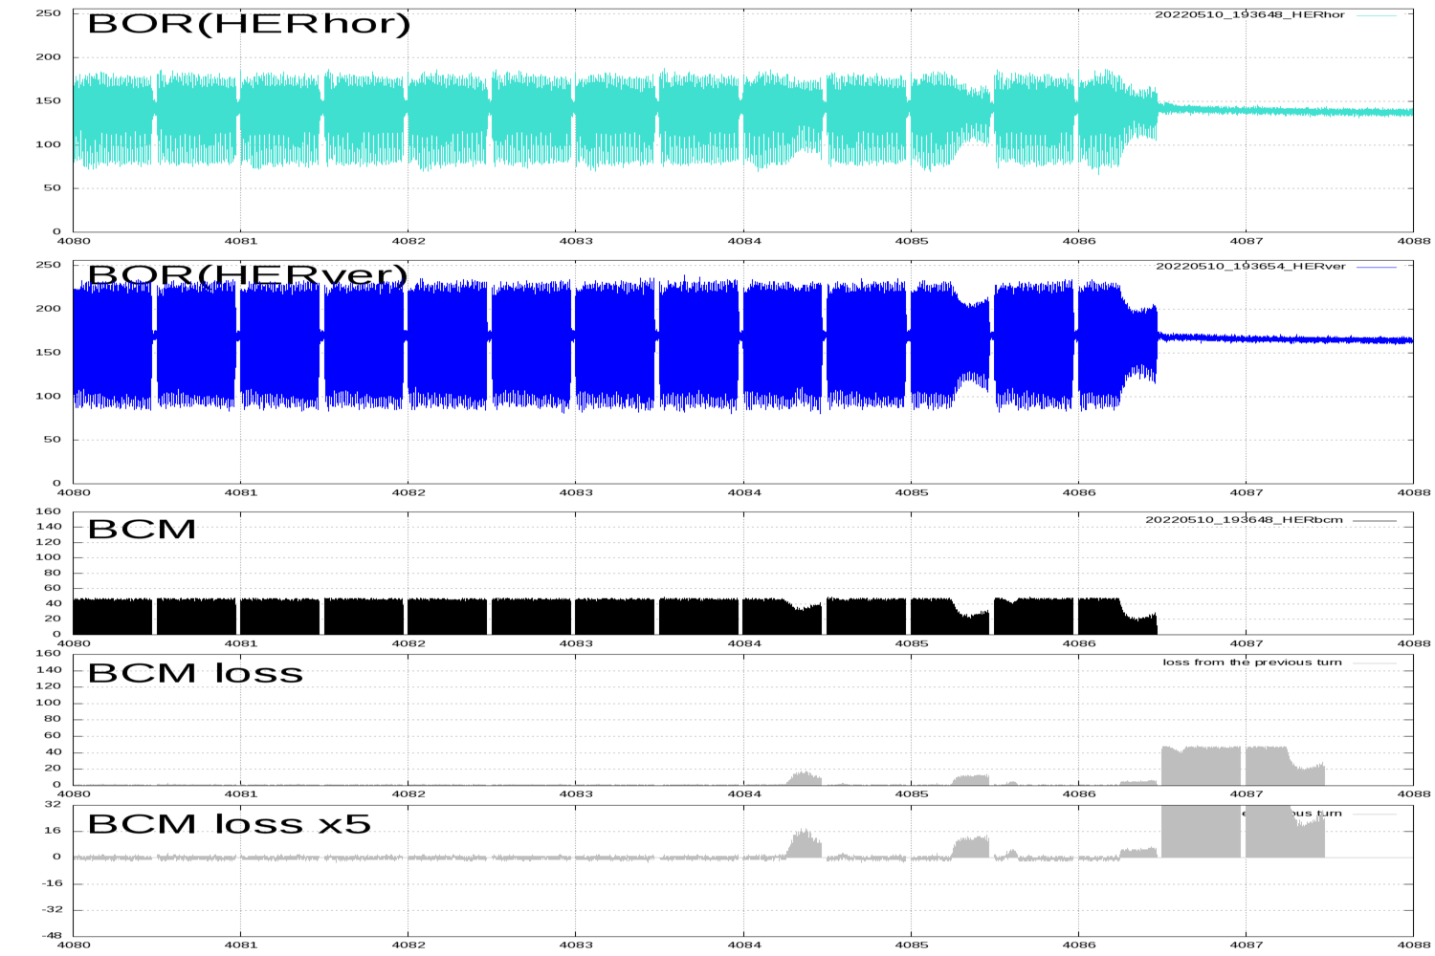
Sudden beam loss
Without growing the transverse motion, some part of bunches drops within 1-2 turns.
  Occurs in both LER and HER, but the damage in LER is much greater (QCS quench, vertical collimator damage, etc)
  After damaging the collimator heads, many unwanted side-effects happen.
    Much larger background.
    Larger transverse beam impedance.
Several discussions on ITF-sudden beam loss subgroup.

Slide 30
Broadband noise in the FB system (KEKB time)
The effect has first observed during the KEKB operation
  Final amplifier in the 2GHz phase shifters (all HER and LER) were modified during long maintenance time– the output power had (significantly) increased. This caused the increase of the noise level of the FB detectors (also caused the increase of the feedback power).
  After the maintenance, the luminosity had decreased.
  Occasionally, one electrode of LER transverse feedback kicker had failed--- I’ve turned off one final power amplifier and observed the jumping up of the luminosity (to almost the original luminosity level)!
  We’ve adjusted the level of the output of 2GHz phase shifter and lowered the V-FB gain.

Slide 31
Noise effect study at KEKB
With the systematic study of the relations between the trans-verse feedback gains and the luminosity, we have found only LER vertical feedback gain affected the luminosity and the vertical beam size; other transverse feedback gain, LER-H, HER-H and HER-V had no obvious relation to the luminosity.
Though the vertical beam size slowly increased (~10%) with the feedback gain during single-beam condition, it jumped up more than 40% with small change of the feedback gain during collision. The resulting luminosity decreased around 10 to 20% with the blowup of the vertical beam size.
We have injected pure sinusoidal signals or band-limited white noises from a function generator to the V-FB system. The amplitudes of the excited oscillation of the LER beam were detected with the bunch oscillation recorders (BOR).
Reported at DIPAC2011 (MOPD73).

Slide 32
Single frequency response (collision) at KEKB LER
Larger response from tune (0.58) to 0.63 (tune + beam-beam tune shift)

Slide 33
same excitation voltage @ KEKB LER

Slide 34
Luminosity drop @ KEKB LER

Slide 35
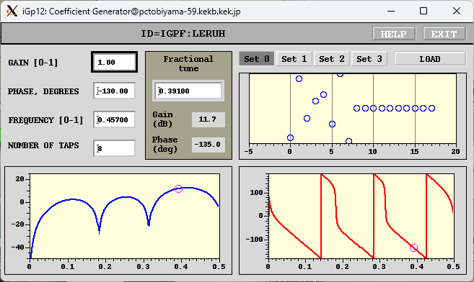
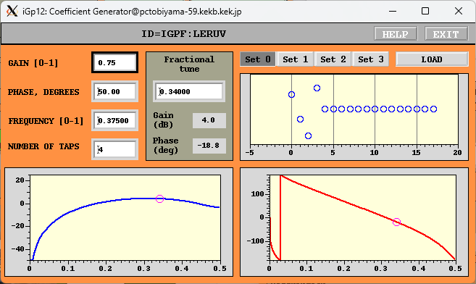
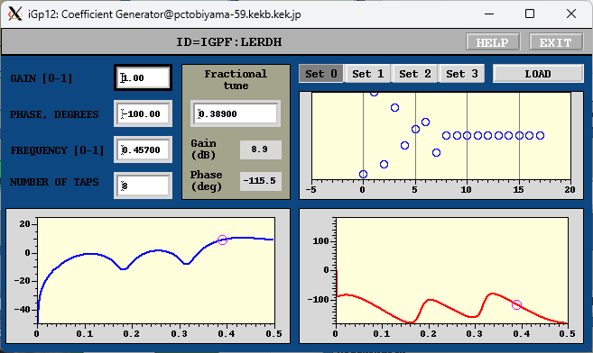
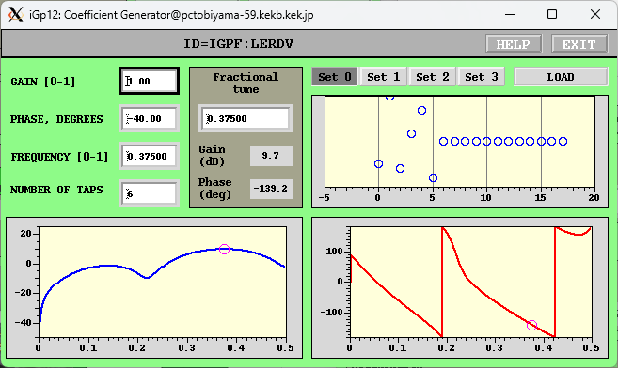
LER Transverse FIR filter

Slide 36
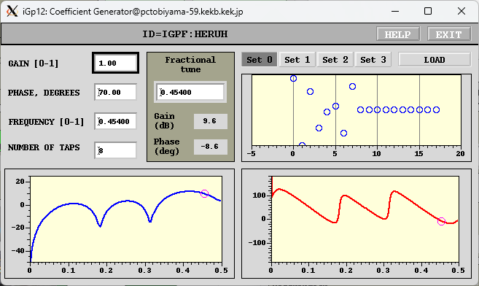
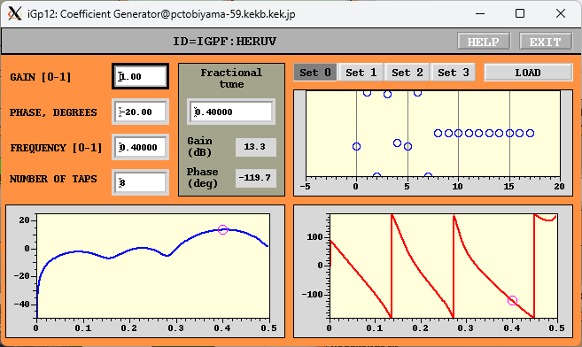
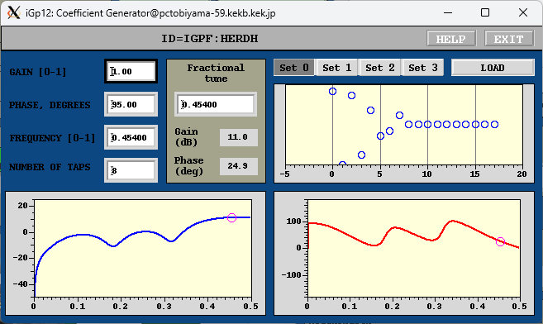

HER Transverse FIR filter

Slide 37

LER Longitudinal

Slide 38
LER ECI Unstable mode

Slide 39

永久磁石設置前の例
By 2, 300mA Vertical方向

Slide 40


Slide 41




Betatron tune monitor (1)
On high beam current

Slide 42


Example of direct use of FB detector signal
Observe FB signal using wideband oscilloscope– useful to tune the residual of injection kicker bump

Slide 43


Betatron tune monitor using non-colliding bunch (pilot bunch)
Non-colliding bunch (pilot bunch) to measure betatron tune

Slide 44



Bunch current monitor
Longitudinal (intensity) detection using same L-FB detection circuit
MAX108 8-bit ADC/Spartan6 FPGA capable to store more than 80MB(BOR) data.
Transfer bunch current data to bucket selection system using reflective memory (VME) synchronized with injection trigger (Max 50 Hz).

Slide 45
Transient-domain analysis
Open the feedback loop (few ms) and re-capture the oscillation by closing the loop.
  Could observe the “clean” unstable modes and their growthrate.
  Understand the feedback damping rate.

Slide 46
Mode analysis
Make FFT of base 5 for the oscillation data of 256 turns (5120 bunches x 256 data points) to obtain the whole spectrum.
Extract amplitude of the spectrum that corresponds to the betatron frequencies (fb+m x frev), where m represents the mode of the oscillation.
Align the amplitude by increasing order of the mode-id.
Repeat the above the procedure while adavancing the starting-point of the data by 128 turns.

Slide 47



G-D example for HER (e- 7GeV)
8 Tap FIR filter
732mA, by 3 filling, 0.5mA/bunch
Vertical
Growth~0.9ms
FB damping~0.5ms

Slide 48



Example of by 2 LER vertical (200mA)
By2 200mA Vertical
Growth time~ 2.0ms
Damp < 0.5ms

Slide 49



By 2 (300mA) LER Horizontal
By 2 Horizontal mode
Growth ~ 0.6ms
Damp < 0.5ms

Slide 50

Longitudinal plane
Excite-damp (by 2 pattern, 500 mA)

Slide 51

LFB Gain and damping rate

