Slide 1

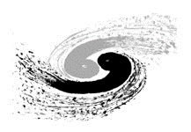
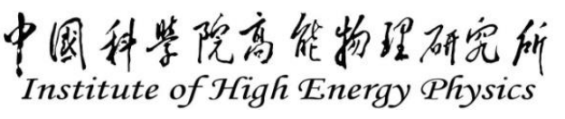
Online reinforcement learning control of beam collision at IP for BEPCII
Jiaqi Fan, Institute of High energy physics
Using RL to maximize luminosity at BEPCII
eeFACT2025, 2023.03.06
Notes:
Hello everyone ,my name is Fanjiaqi , a Doctoral students from Institute of High energy physics. I’m glad to share my experience of the using of RL to optimize luminosity at BEPCII.

Slide 2
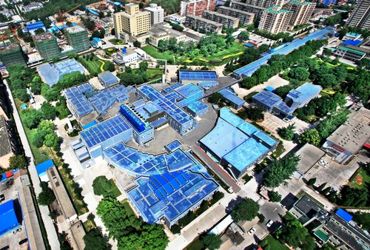
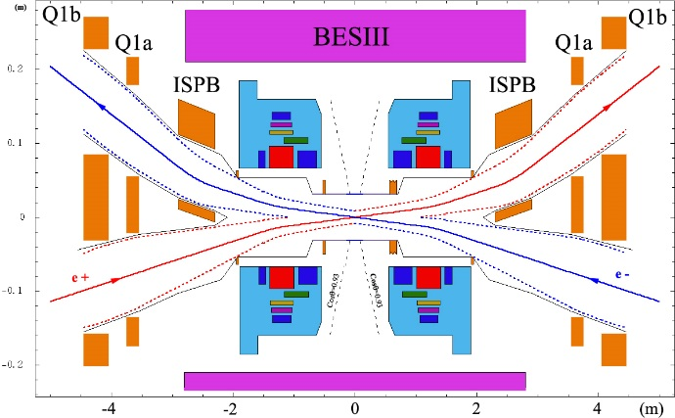
Introduction
The upgrade project of Beijing Electron–Positron Collider (BEPCII)
linear accelerator
Beijing Spectrometer(BESIII)
Storage Ring
Notes:
BEPCII is a two-ring collider running in the tau-charm energy region.here shows the main structure of BEPCII, the two beams Collide at the center of Beijing Spectrometer with a horizonal crossing angle of ±11 mrad.(milliradian)

Slide 3
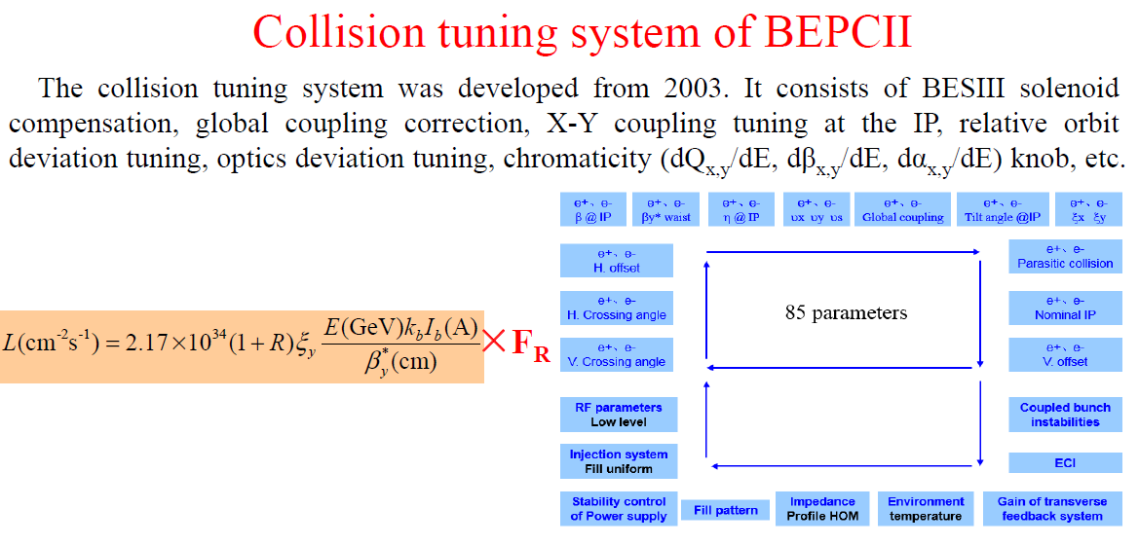
Introduction
The upgrade project of Beijing Electron–Positron Collider (BEPCII)
Parameters that affect Luminosity:
Chenghui Yu
The Luminosity of BEPCII is affected by about 85 parameters.
Some of these are rarely adjusted.
Some of these parameters need to be adjusted frequently, but since there is no suitable automatic tuning method, they can only be tuned manually, such as offset tunning.
Notes:
Luminosity is the most important performance factor.and luminosity optimization can be seen as a complicate control problem with a large number of control parameters. For BEPCII,the Luminosity is affected by about 85 parameters. Some of these are rarely adjusted, and some other need to be adjusted frequently. but since there is no suitable automatic tuning method, they can only be tuned manually, such as the offset tunning. The purpose of using reinforcement learning is just to achieve automatic tuning of these knobs.

Slide 4
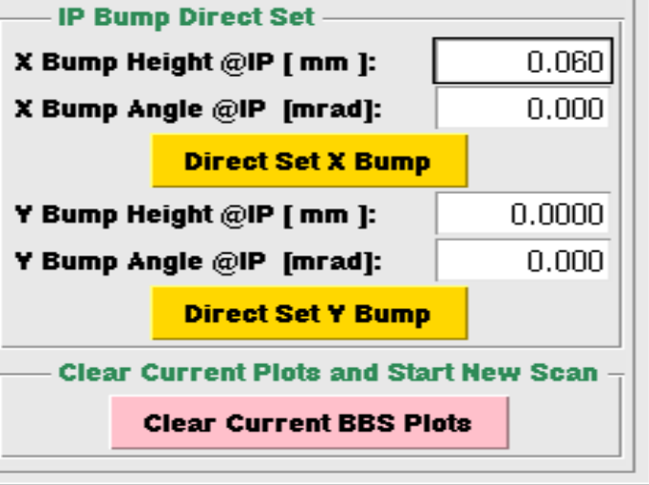
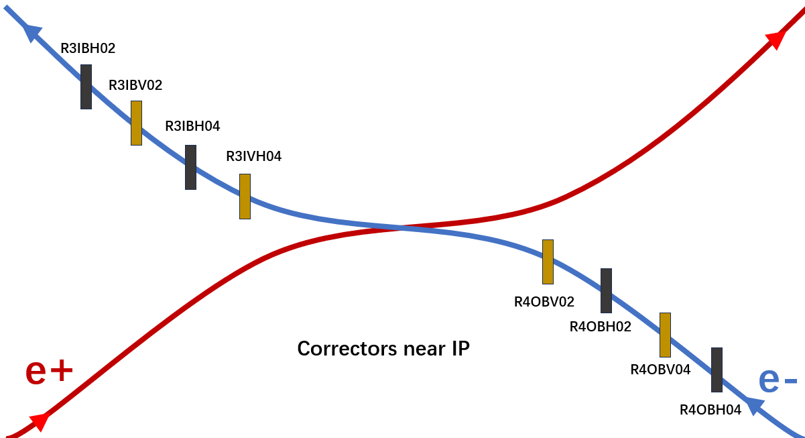

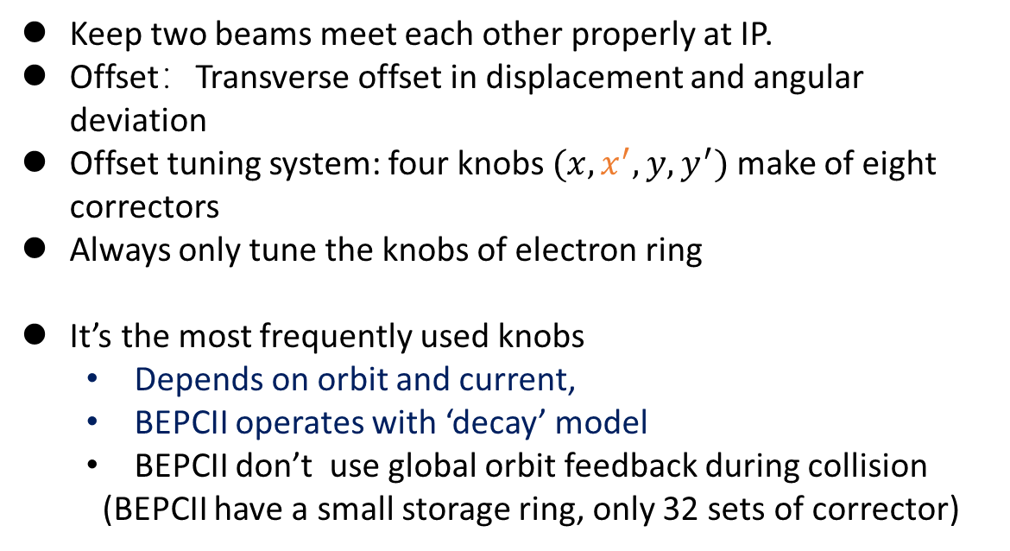
Introduction
Offset tuning:
Keep two beams meet each other properly at IP.
Offset：Transverse offset in displacement and angular deviation
Offset tuning system: four knobs $(x,x^{′},y,y^{′})$ make of eight correctors
Always only tune the knobs of electron ring
It’s the most frequently used knobs
  Depends on orbit and current,
  BEPCII operates with ‘decay’ model
  BEPCII don’t use global orbit feedback during collision
  (BEPCII have a small storage ring, only 32 sets of corrector)
Offset knobs of $e^{−}$ ring
  Manual operation, Scan the knobs one by one based on luminosity reading. Combine with a linear model.
Notes:
Like all double-ring colliders ,to maintain optimum beam collision conditions, we need two beams meet each other properly at the Interaction Point. For BEPCII we use four knobs control the displacement and angular deviation for each ring.but we do not care about the horizontal crossing angle because we have already introduced a large horizontal crossing angle of ±11mrad. And we only tune the knobs of the electron ring because two rings is of Symmetrical structure.

Slide 5
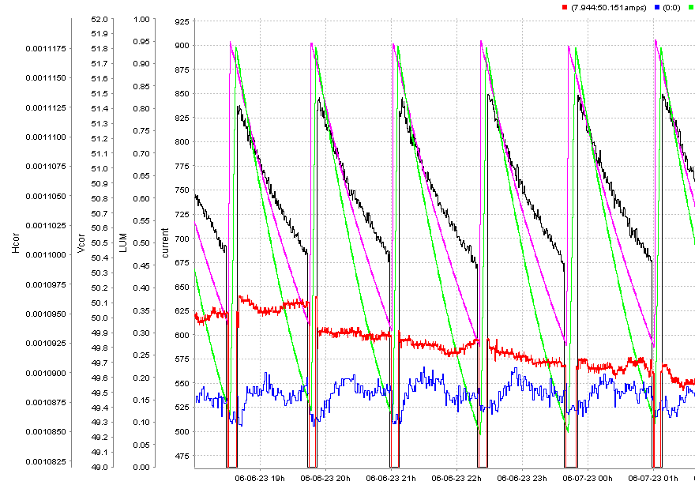
Introduction
Offset tuning:
A physics run
Keep two beams meet each other properly at IP.
Offset：Transverse offset in displacement and angular deviation
Offset tuning system: four knobs $(x,x^{′},y,y^{′})$ make of eight correctors
Always only tune the knobs of electron ring
It’s the most frequently used knobs
  Depends on orbit and current,
  BEPCII operates with ‘decay’ model
  BEPCII don’t use global orbit feedback during collision
  (BEPCII have a small storage ring, only 32 sets of corrector)
Offset knobs of $e^{−}$ ring
  Manual operation, Scan the knobs one by one based on luminosity reading. Combine with a linear model.
Y plane offset
X plane Offset
Notes:
The Offset is the most frequently used knobs
BEPCII run in the decay model. Each physics run takes about one hour. Because the orbit will shift when current decays, and BEPCII don not use global orbit feedback during collision, the optimal position of the offset knobs will change as well. So we need to tune these knobs continuously. Most of the operation is done manually . The tuning method is obverse the luminosity and scan the parameters one by one to optimize it. Tuning with this method is laborious, so the operators always use a linear algorithm to tune the knobs linearly with the beam current, but the effect is limited.

Slide 6
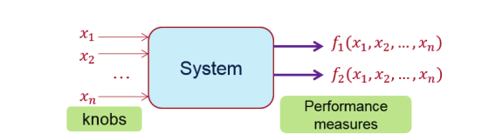
Introduction
Automate control method:
Feedback Method:
  Control beam orbits around the IP directly to maintain high luminosity
  KEKB’s orbit feedback at IP: Can suppresses the luminosity loss due to the vertical orbit drift to below 1%.
  Need the response model and a clear target (‘golden’ orbit).
  For BEPCII, without the global orbit feedback, the ‘golden’ orbit will drift as beam current decays.
Optimization Method:
  luminosity-driven
  Operators’ manual scanning
  Require exploration,
  Luminosity optimization: exploration lead to luminosity loss
  Optimize luminosity while minimize exploration loss?
Machine learning:
  Data-driven method, Reinforcement learning
Notes:
For automate control methods.
The feedback method is widely used in machine control, and it has been used to control the offset successfully. Such as KEKB’s orbit feedback at IP. Can suppresses the luminosity loss due to the vertical orbit drift to below 1%. The feedback method need the response model and a clear target (for orbit feedback, is the ‘golden’ orbit). But for BEPCII we do not have a clear target, because without the global orbit feedback, the ‘golden’ orbit will drift as beam current decays.
Another method widely used is the optimization which do not require a response model nor a target. it is more suitable to solve our problem, the operators’ manual scanning is just a optimization method. The limitation of the optimization method is the exploration, because the optimization can only find a temporary optimal result in a dynamic environment, when we need continuous optimization, such as Luminosity: exploration will finally result in luminosity losses
RL is a concept of data-driven ML method,,it a novel method always used to handle control problems,

Slide 7
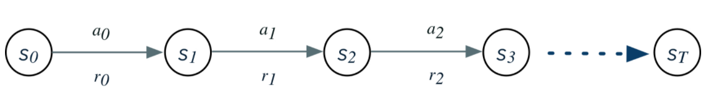
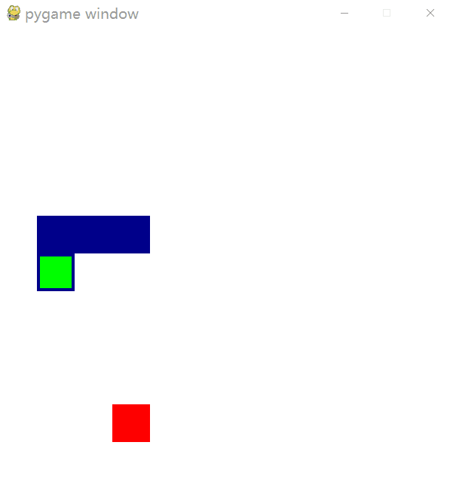
Reinforcement learning
RL: Train an Agent to make the decision of what action to take to get more reward from environment
Target of RL: take actions to get more reward from the environment.
Target of collision tuning: adjust the control knobs to get more integral luminosity.
After training: The Agent can choose the best actions based on the current state without exploration!
Components of the Environment: State; action; reward
By constructing different environments,
RL can handle any complex control problem.
Reward: luminosity
State: state parameters of collider
Action: adjust the offset knob
Control the offset knobs
to optimize luminosity
Notes:
The purpose of the RL is Train an Agent to make a sequence of decisions of what action to take to get more reward from environment.
The target of the collision tuning consist the offset control is adjust the control knobs to get more integral luminosity. This is very similar to the target of RL.
And once the agent is trained, the Agent can choose the best actions based on the current state without exploration, like this snake.
The environment of RL have three components: State; action; reward. By constructing different environments, RL can handle any complex control problem.
Such as we take luminosity as reward, take state parameters of collider as state, and take actions to adjust the offset knobs, then we will get a environment of Control the offset knobs to optimize luminosity

Slide 8
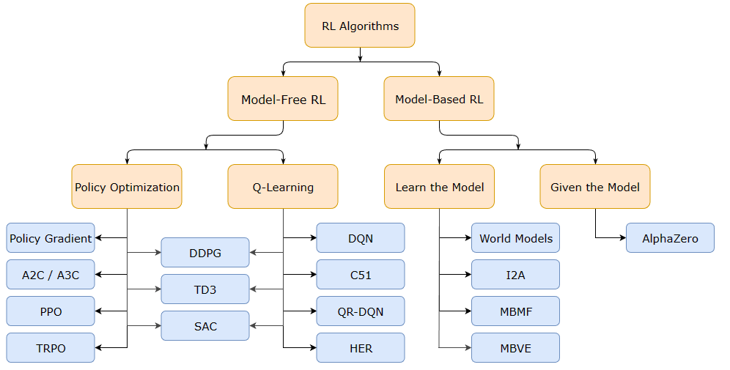
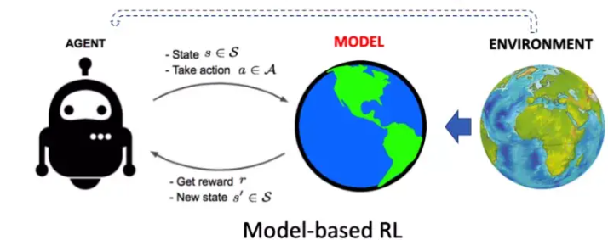
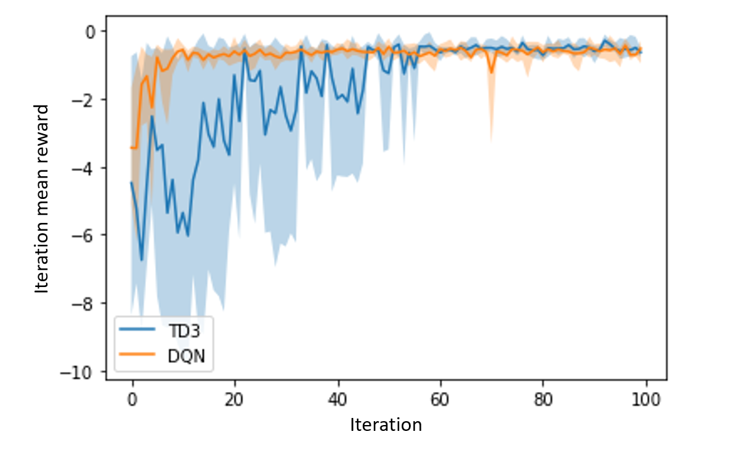

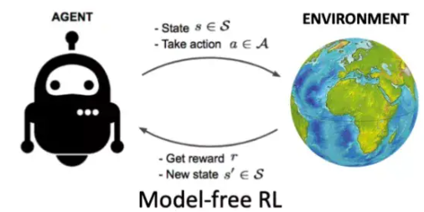

Reinforcement learning
RL for real colliders:
Real machines are subject to various errors and deviations, machine states will inevitably change gradually over time, so the environment cannot remain as stable as in a simulated environment.
Interacting with real machines is time-consuming, cannot provide massive amounts of training data as quickly as simulated environments.
strong adaptability; high data efficiency
Notes:
The ML and RL is mostly used in simulation environments, when comes to real world, there will be some difficulties
Real machines are subject to various errors and deviations, machine states will change gradually over time, so the environment cannot remain as stable as in a simulated environment.
Interacting with real machines is time-consuming, cannot provide massive amounts of training data as quickly as simulated environments.
So the algorithm we use online must have strong adaptability and high data-efficiency. Which means require less data for training.
RL can be devided into model-based and model-free,
Model-based reinforcement learning algorithms are more sample efficiency but only efficiency in stable and noise-free environments. Comes to model free RL, Q-learning is a kind of model-free algorithm only works in discrete action space, but Its more data efficient and easy to adjust. Compare to the policy optimization algorithms TD3 which can operate in a continuous action space, it shows about 5 times of data efficiency. So we use q-learning as the main algorithm

Slide 9
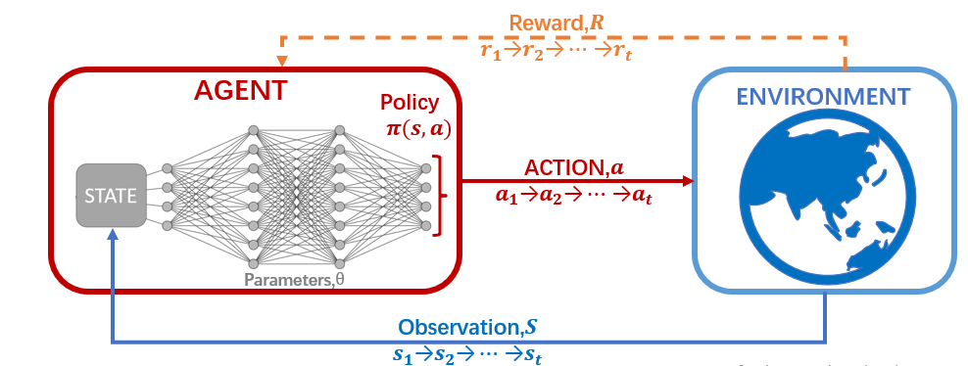
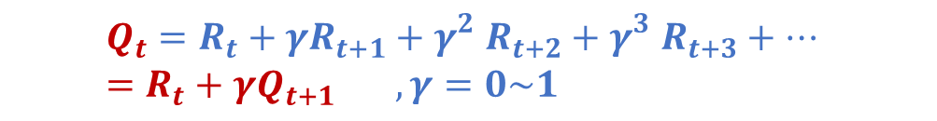
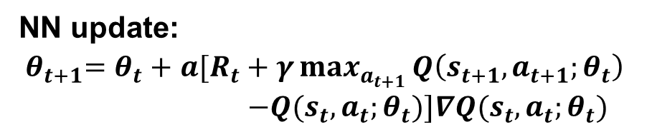
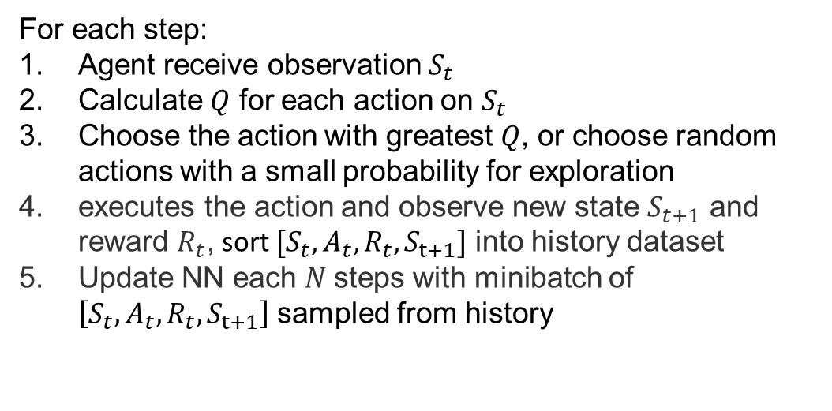
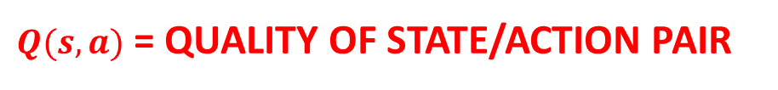
Deep Q-Network(DQN)
For each step:
Agent receive observation $S_{t}$
Calculate $Q$ for each action on $S_{t}$
Choose the action with greatest $Q$, or choose random actions with a small probability for exploration
executes the action and observe new state $S_{t+1}$ and reward $R_{t}$, sort $[S_{t},A_{t},R_{t},S_{t+1}]$ into history dataset
Update NN each $N$steps with minibatch of $\left[S_{t},A_{t},R_{t},S_{t+1}\right]$ sampled from history
$Q(s,a)$ = QUALITY OF STATE/ACTION PAIR
$$Q_{t}=R_{t}+{γR}_{t+1}+{γ_{}^{2}R}_{t+2}+{γ_{}^{3}R}_{t+3}+… =R_{t}+{γQ}_{t+1} ,γ=0\sim 1$$
NN update:
${ θ}_{t+1}=θ_{t}+$ $a[R_{t}+γ\max_{a_{t+1}}^{}{Q\left(s_{t+1},a_{t+1};θ_{t}\right)}$
$$−Q(s_{t},a_{t};θ_{t})]∇Q(s_{t},a_{t};θ_{t})$$
Notes:
The algorithm we use is Deep Q learning. The kernel of Deep-Q-learning is a Q-neural Network.The neural network input with the observation state and output with Q-value for each action at observed state, For each step ,The agent take a observation and calculate Q-value of each action , Choose the action with greatest $Qvalue$, or choose random actions for exploration。
after take the action ,we will get a new state and a reward. then get a set of training data
,the NN will be update follow the updata Equation using the sorted history data.

Slide 10
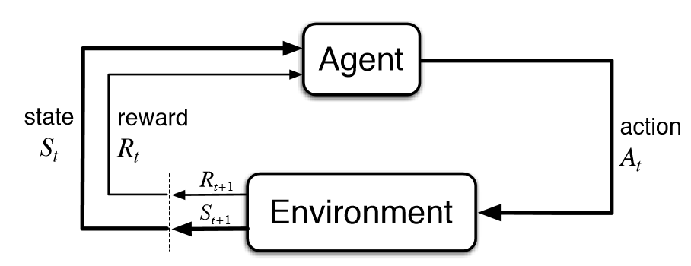
Deep Q-Network(DQN)
Environment design:
State: provide appropriate information for the agent to choose action
Too much information would make the training overly complex,
while too little information would fail to provide adequate information.
[current ,offset value ,orbit value] – 18 dims
Action: [x, y, y’] → [a1,a2,a3,a4,a5,a6]
Reward: fast response and low noise
small-angle luminosity (2s)
Give extra rewards for good actions (Actions that increase luminosity)
target
Step size
start
Discretize the action space.
Notes:
When used to specific problems, The first question is environment design, how to choose the State\action and reward used in the algorithm. For State, it must provide enough information for the agent to choose actions, but too much information would make the training overly complex, while too little information would fail to provide enough information, and result in an ever-changing environment. To make the environment relatively stable but not very complex, eighteen parameters is used include current 、offset values、and orbit values.
For action, We use actions with number 1-6 Represents one step forward or backward for three knobs to discretize the action space.
For reward, it must have fast response with low noise. small-angle luminosity is used because it has a much shorter update time,which is about 2 seconds.
And To encourage the good actions, we will Give an extra reward.

Slide 11
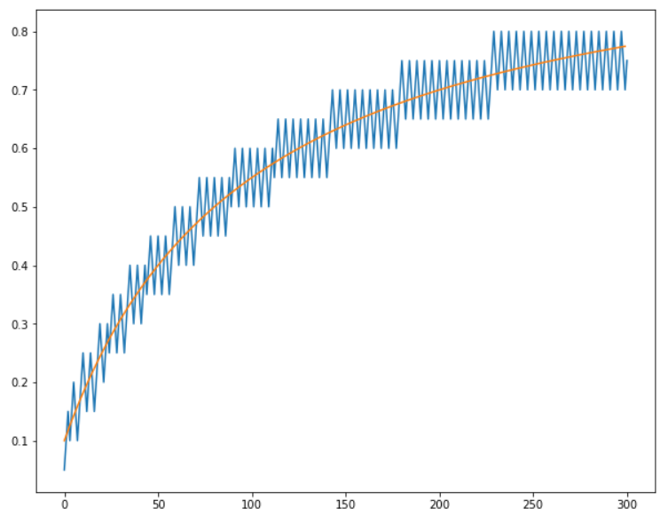
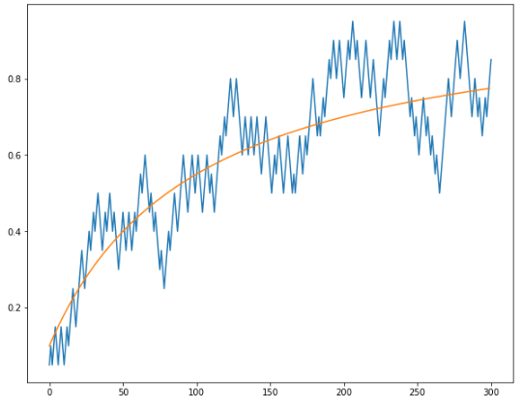

RL control for BEPCII
How to get enough training data? —— Dithering search method
Random policy search; from simulation; history data of manual operation
A dither method: Adjust each knob alternately and tune
the adjustment direction based on the luminosity.
The action of the dither model is same as DQN, so the operation history
can be used for DQN training.
Dither model is essentially an optimization algorithm. Compared to
random search, it produces historical data with much lower cost.
The historical data only covers a small portion of the state space…
  Need to exploration.
Algorithm 2: Dithering Search
Initialize replay memory $D$ to capacity $N$
Initialize step length array $M$ with the same dimensions as knobs
Observe initial state $S_{0}$initial reward $R_{0}$ and action $A=A_{0}$
For $t=1, T$do
Initialize activate dimension pointer $d=0$
Set $A\left[d\right]=A\left[d\right]+M\left[d\right]$ #run a step on dimension d
Execute action $A$ and observe reward $R_{t}$and new state $s_{t+1}$
Sort transition ($s_{t},A,s_{t+1},R_{t}$) in $D$
If $R_{t}<R_{0}$ do #If target falls, turn around and continue
$M\left[d\right]=−M[d]$
Else do #If target improve, jump to another dimension
d=d+1
End If
End For
Stable env
Noisy env
Optimal setting
Knob setting
step
step
Notes:
Another problem is how to train our model and how to get enough training data，Training directly online with random policy search will consume a lot of time and cause losses on luminosity. It's best to use additional data for pre-training.
Many other works use simulated data for training, but luminosity simulation here is too difficult.
The history of manual operation can be used but it is not enough for training.
So we porpose a dither method to get extra data in a safe way.
Here is the code of the dither method, it only do the simple job that Adjust each knob alternately and tune the adjustment direction based on the luminosity.
The action of the dither model is same as DQN, so the operation history can be used for DQN training. Dither model is essentially an optimization algorithm. But compared to random search, it produces historical data with much lower cost.
Here shows the effect of the dither method in a one-dimension problem, it can control the knob setting dither around the optimal.
As shown in the picture, the historical data of dither method only covers a small portion of the state space, so only use these data for training is Risky. The DQN need to exploration more to stable.

Slide 12
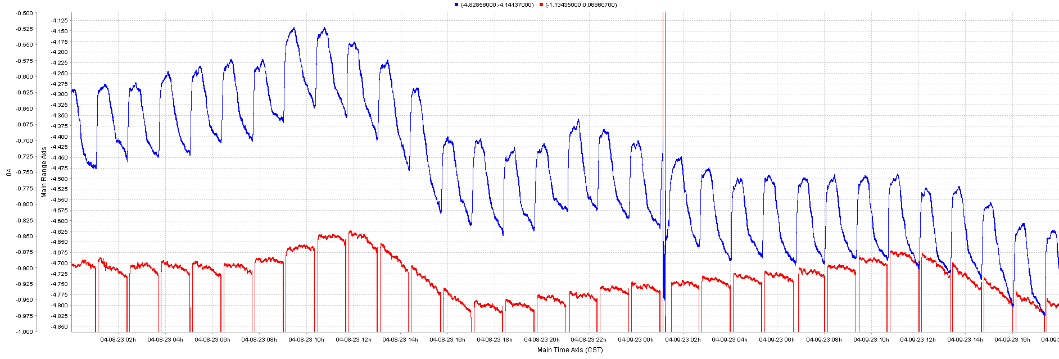
RL control for BEPCII
How to achieve long-term deployment?
The machine state will change with time
We can never get a perfect stable environment, except we take all parameters into account
Retrain: Retrain the DQN-agent after each run.
Exploration： DQN-agent choose random actions with the probability of 20% for exploration unfamiliar state to enhance its ability to adapt to environmental changes.
To prevent DQN from being trapped
in unfamiliar environments, we set
certain limits on the exploration range.
Actions that exceed the range and
cause luminosity reduction will be set
back in the next step.
The orbit drift
Notes:
The last question is how to achieve long term deployment,
As we metioned, The machine state will change with time, and We can never get a perfect stable environment, except we take all parameters into account.
The figure here shows the global orbit drift over two days, it could reflect the machine state changes.
To achieve long-term deployment, we will retrain the DQN-agent after each run using the newly generated data. And we also let the DQN-agent choose random actions with the probability of 20% for exploration unfamiliar state to enhance its ability to adapt to environmental changes.
To prevent DQN from being trapped in unfamiliar environments, we set certain limits on the exploration range. Actions that exceed the range and cause luminosity reduction will be set back in the next step.

Slide 13
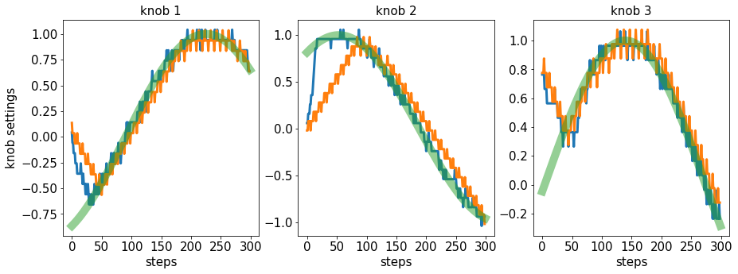
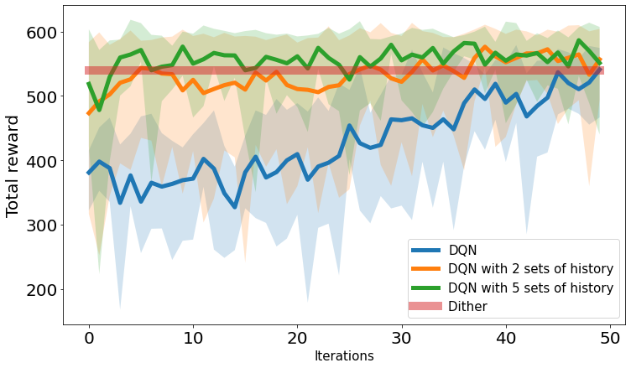
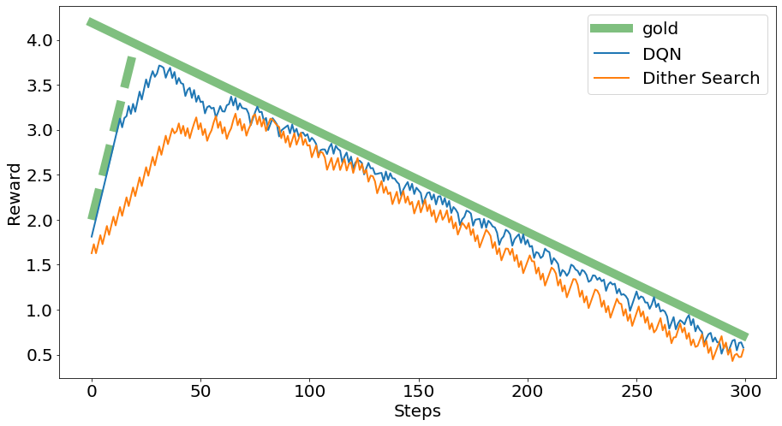
RL control for BEPCII
Simulation:
Run dither method for several run.
Using the collected data train DQN.
Run DQN and retrain DQN after each run.
Dither data can accelerate the training of DQN, and the trained DQN can far exceed the effects of dither optimization.
Notes:
We test this method in simulated environment ,at first Run dither method for several runs .then Using the collected data train DQN.Run DQN and retrain DQN after each run. Here show the total reward of each run, the DQN without any extra data require fivety runs to reach the effect of the dither method, and DQN pre-trained with 5sets of dither data only take less than ten iterations.
Here shows the reward and action of a single run, the green line shows the optimal value of the knobs and reward, and it shows that The DQN can make it faster and get higher reward.

Slide 14
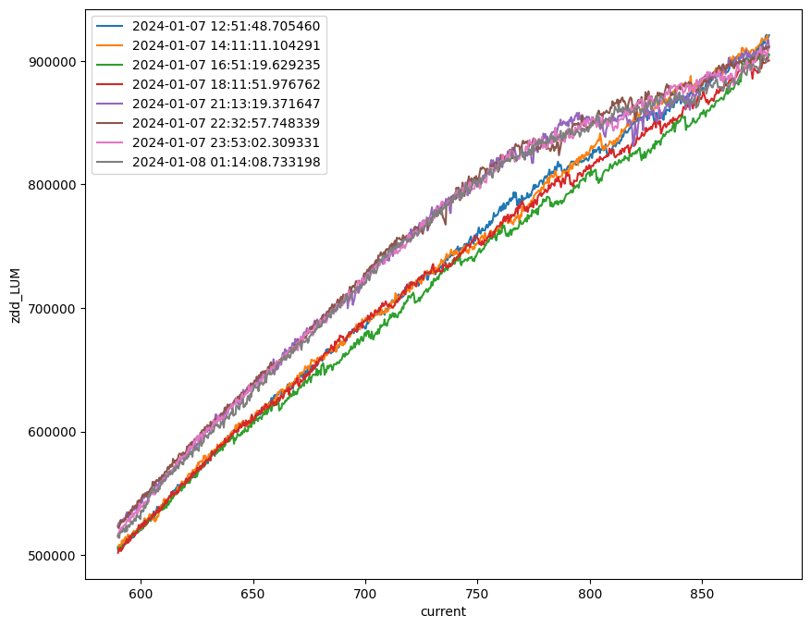
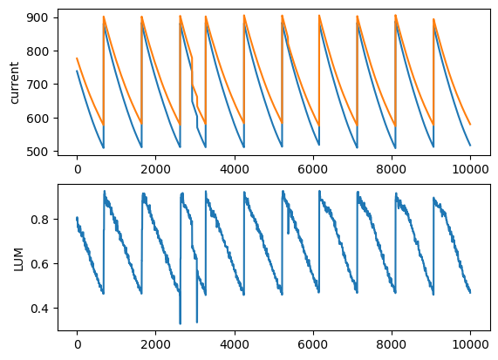
Results
The experiment result of the dither model:
Linear method
Dither method
Dither method
Linear method
Notes:
Here show the online test of the dither method, the first four runs is using operator operation combine with the linear method, and the last four runs is using the dither method, the luminosity got by dither method about 4% higher

Slide 15
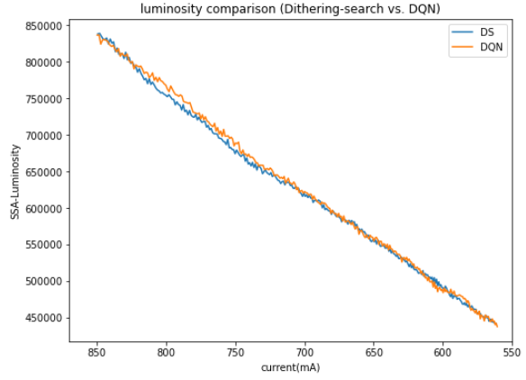
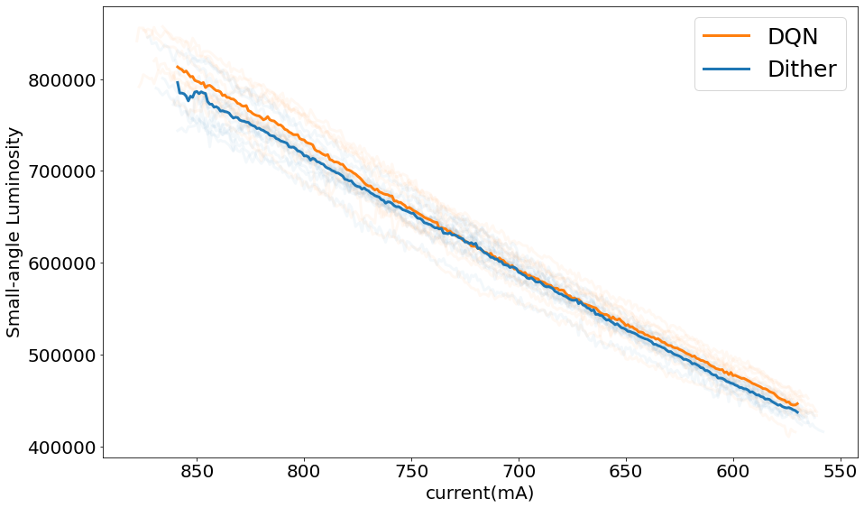
Results
DQN training and deploy:
Run dither model for 3 runs.
Using the collected data train DQN.
Run DQN with exploration rate of 0.2 and retrain DQN after each run.
The luminosity of the first DQN run. Compared to the dither model, it does not seem to perform better or worse.
After a period of training, DQN has a certain luminosity improvement compared to the dither method (1.2% in statistical results)
Notes:
Here shows the online result of DQN, we use 3 sets of dither data for DQN pre-training and then put in to online use. Here shows the luminosity of the first run of DQN, compared to the dither method, it does not seem to perform better or worse.
After a period of self-training, DQN has a certain luminosity improvement compared to the dither method ( shows only 1.2% in statistical results)

Slide 16
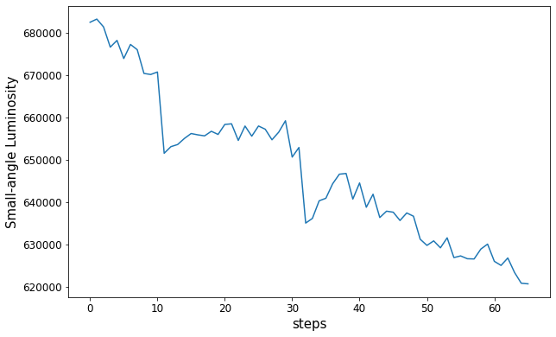
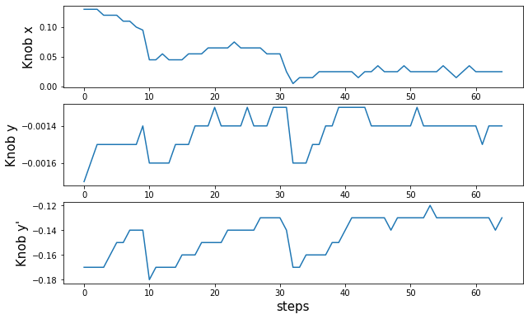
Results
Make a disturbance
Dither method
DQN
6 steps
DQN can searching for the optimal more quickly.
Why DQN does not bring much improvement:
The dither method has already give a quite good solution
Limited by the discrete action space, the luminosity improvement is also limited
Rarely requires extensive adjustment
DQN need to keep exploration
Search every direction
Focus on X
Notes:
The biggest advantage of DQN is can searching for the optimal more quickly. To prove that we Make a disturbance and use two algorithms to recorver the luminosity. The result shows the well trained DQN algorithm can Move directly towards the optimal and take less steps.
#This will allow the algorithm instead of the manual operation.
About why DQN does not bring much improvement, only about 1% in integral luminosity: the reason may be the dither method has already give a quite good solution and we Rarely requires extensive adjustment like this, so the advantage of DQN cannot fully present.

Slide 17
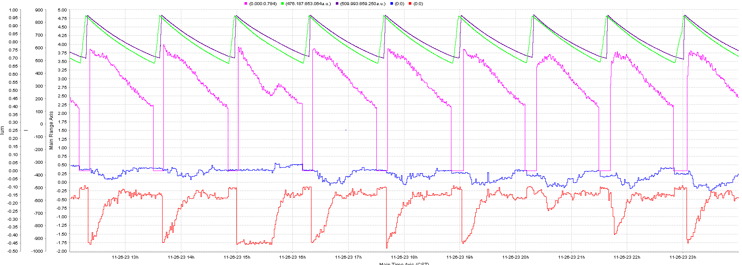
Results
Luminosity recovery
Luminosity recovery
CUR
LUM
H corrector
V corrector
Notes:
Here is the DQN used for daily operation to optimize luminosity. And recovery the luminosity from uncorrect offset settings. It only take 2 minis for DQN to optimize the luminosity to the optimal. It is comparable to the manual tuning by the operator.

Slide 18
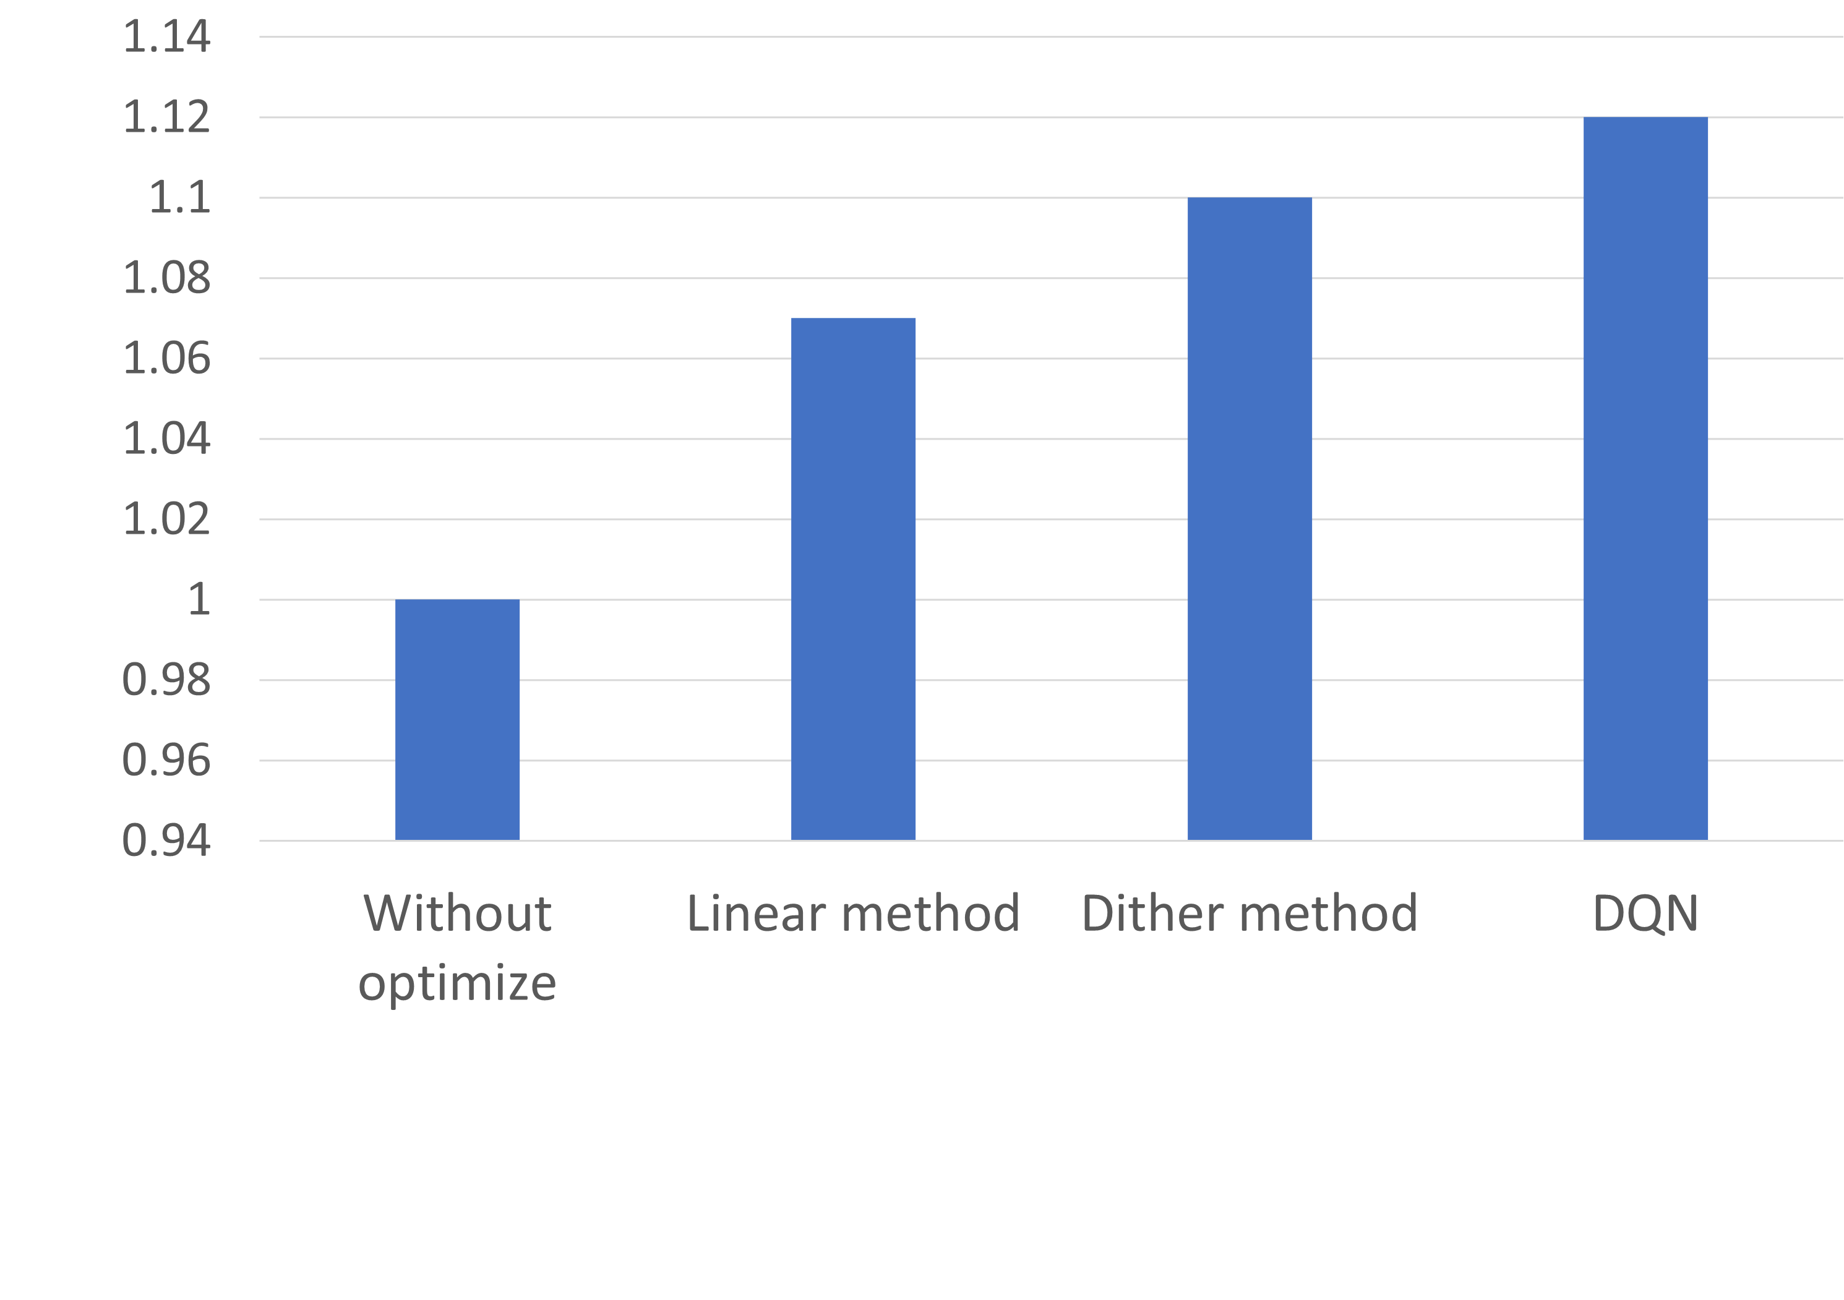
Results
Increase on Luminosity.
In summary, the linear method makes about 5%∼10% improvement compared no optimization is applied.
The dither method makes about 2%∼4% improvement with linear method
The DQN method makes 1.2% improvement with the dither method.
Linear method: Depend on the initial value and the setting of the linear slope, both of which are set by the operators. Variations in operator experience or decision-making capabilities can result in substantial variance in the result.
Dither method and DQN can perform automatic optimization operations, which partially mitigate the discrepancies arising from variations in operator abilities.
Variance 0.42 0.2 0.12
Notes:
In summary, the linear method makes about 5%∼10% improvement compared no optimization is applied.
The dither method makes about 2%∼4% improvement with linear method
The DQN method makes 1.2% improvement with the dither method.
The error bar reflects the variance of the results obtained from different physical runs using the same control method. The linear method is heavily dependent on the setting of the initial value and the setting of the linear slope, they are both set by the operators. Variations in operator experience can result in substantial variation in the results obtained. Both the dither method and DQN can perform automatic optimization operations, it will mitigate the variance in operator abilities. and, the faster optimization speed of DQN leads to higher luminosity while also smaller variance.

Slide 19
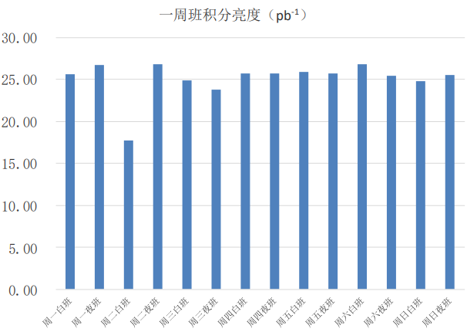
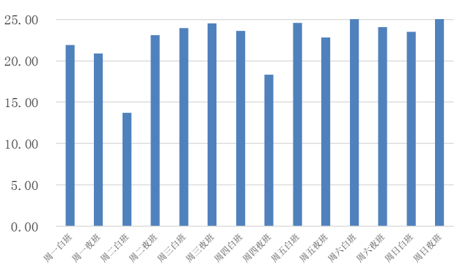
Result
Make different operator to reach the same operation level
Before After
Notes:
Here shows the integral luminosity of 12h in a week, After use the automated algorithms, the fluctuation become smaller than before .

Slide 20
Reinforcement learning control for BEPCII
Hyperparameter Tuning：
Hyperparameters are important factors affecting algorithm performance
Online hyperparameter tuning is difficult
Testing a new set of hyper-parameters requires at least one complete physics run (an hour).
The variations in the state of each physics run will lead to unavoidable variance in luminosity between individual runs.
Only several parameters that are considered to have a significant impact on performance were roughly adjusted online. (step size, training data amount, Action frequency…)
Most of the hyper-parameters were determined within the simulation environment or based on empirical knowledge.
Hyper-parameters:
Training data num
Exploration rate: 0.2
Gamma: 0.5
Learning rate
Neural Network construction
Step size
Environment (state、action、reward)
Action frequency
Additional reward
……
Notes:
Then I would like to talk about the hyper parameter tuning , Hyperparameters are important factors affecting algorithm performance and we have lots of parameters can be adjusted. But Online hyperparameter tuning is difficult.
As Testing a new set of hyper-parameters requires at least one complete physics run (and take an hour).
The variations in the state of each physics run will lead to unavoidable variance in integral luminosity between individual runs. Make it harder to Distinguish which sets of hyper–parameter is better.
Only several parameters that are considered to have a significant impact on performance were roughly adjusted online. (step size, training data amount, Action frequency…)and Most of the hyper-parameters were determined within the simulation environment or based on empirical knowledge.

Slide 21
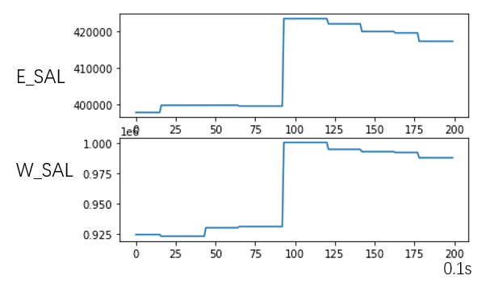
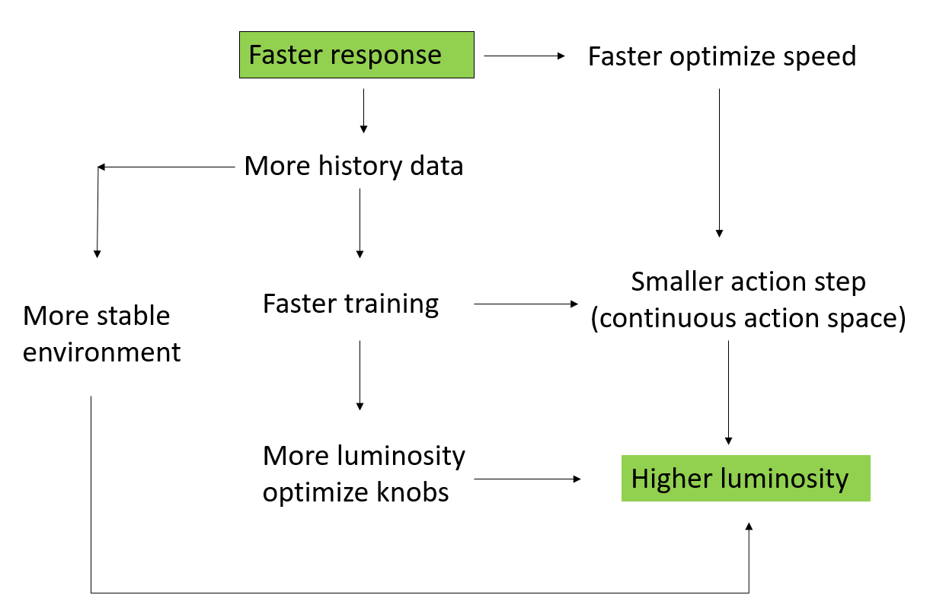
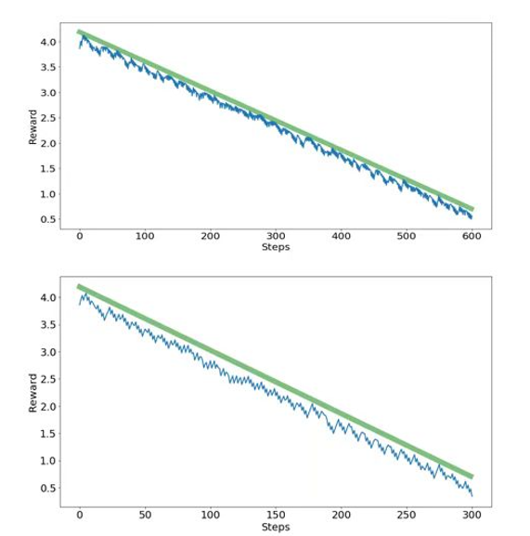
Summary and outlook
Limitations: DATA
response time (10s)
Discreate action space
Notes:
And here shows the outlook, on bepcii, the RL method is limited by the response time, it takes about ten seconds to get the luminosity response to an action, so each run we can only take about 300steps of actions, and get 300 sets of training data. That’s why we made great efforts to reduce the data requirements for training, such as choose DQN algorithm, use a big step size, Reduce the amount of state input…… the first thing we need to do is to speed up the response, so we can get more training data, then we can build more stable enviromnents, use smaller actions steps, or add more tuning knobs, all these will lead to imporvent control of luminosity

Slide 22
Summary and outlook
RL provide a new approach to solve control problems.
Implementing machine learning or RL applications online is difficult.
The most important thing is data: data-driven method.
How to get enough high-quality training data?
The RL control program has been used as a daily tuning method for BEPCII, saving a lot of human labor.
The RL used on BEPCII is limited by the response time, severely limits our data access.
We have made great efforts to reduce the data requirements for training, such as choose DQN algorithm, use a big step size, Reduce the amount of state input……
More experiments will be conducted on BEPCII-U, which will have a faster response time.
Notes:
Here is a summary, RL provide a new approach to solve control problems. They can solve lots of difficlut problems, but Implementing machine learning or RL applications online is difficult. The most important thing is data: that’s why they are called data-driven method. When you want to implement it online you should first consider about How to get enough high-quality training data?
And although we have successfully used the RL to optimize the luminosity, but this is only a simple job, only tune three knobs, and do not shows significant impovement on luminosity. And More experiments will be conducted on BEPCII-U, which will have a faster response time.

Slide 23
Thank you!
Notes:
Thanks for lesening

