Slide 1


CEPC Vacuum system development progress
Yongsheng Ma
Vacuum group, IHEP,CAS
March 4th 2025

Slide 2
Content
Preview of CEPC vacuum system
Collider rings, Booster ring, Linac Vacuum
Production line development of NEG coating/ Spray for heating film in EDR
Components development in EDR
Summary

Slide 3

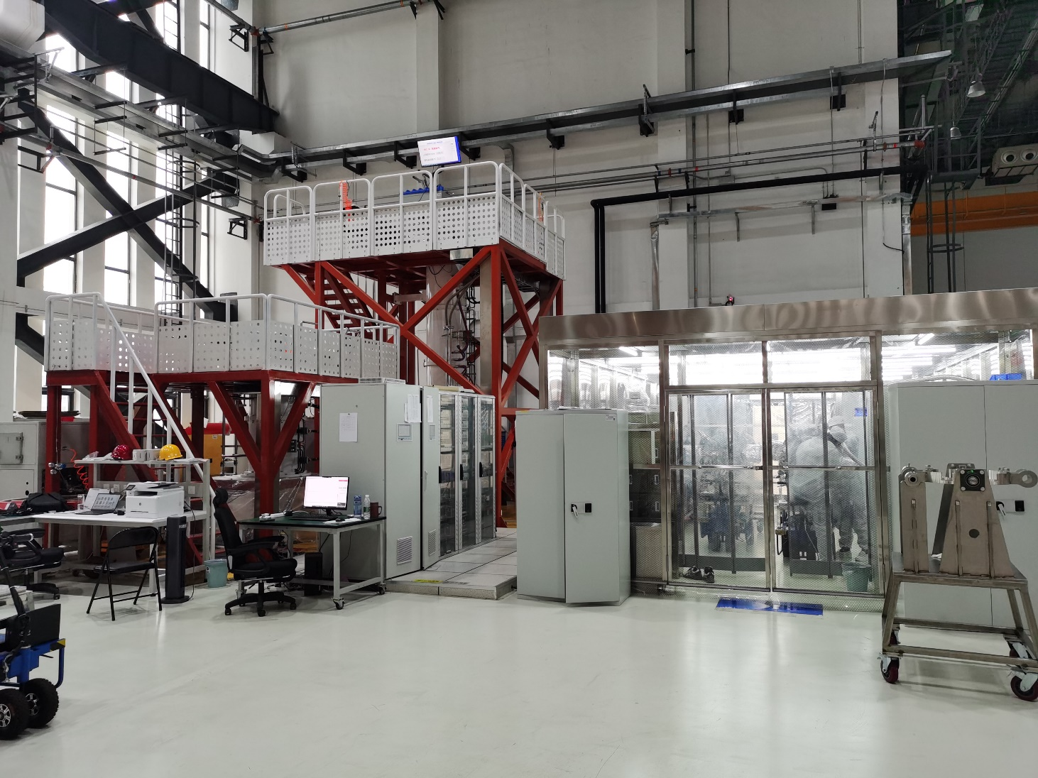
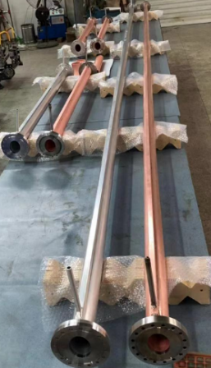
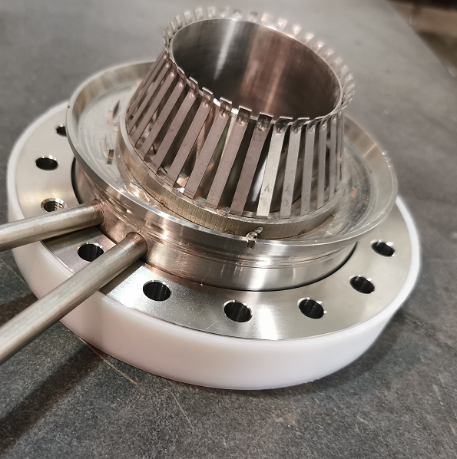
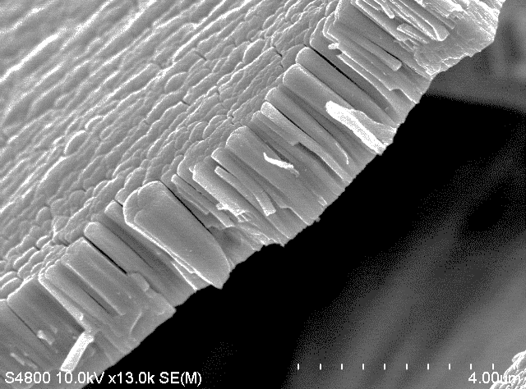
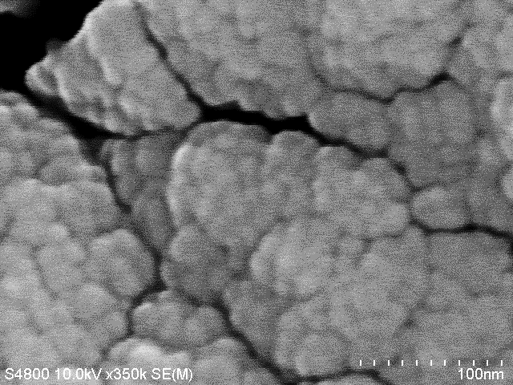
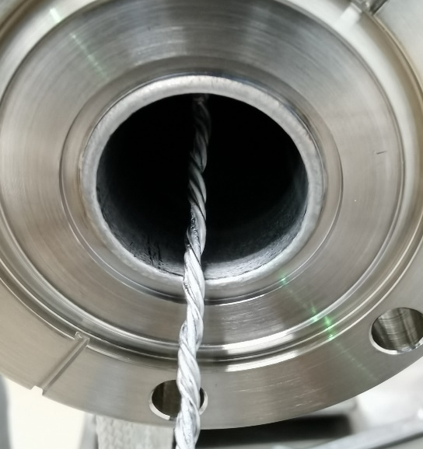
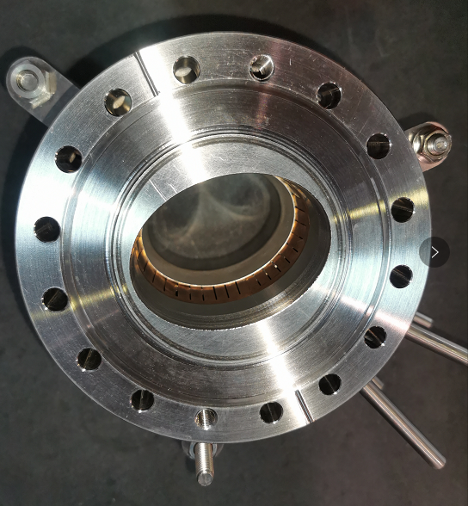
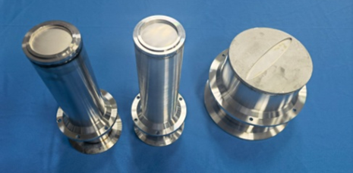
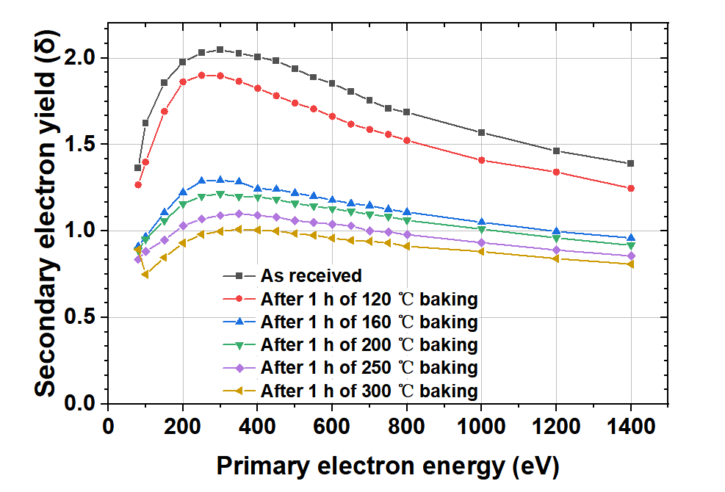
Preview of CEPC vacuum system
Technical developments in TDR
Machine and Vacuum Parameters
 | E | I | ρ
 | Gev | A | m
Higgs | 120 | 0.0167 | 10700
W | 80 | 0.084 | 10700
Z | 45.5 | 0.803 | 10700
tt | 180 | 0.0033 | 10700
Accelerator | length/m
LINAC | 1,601+335
Damping ring | 147
Booster | 100,000
Collider | 200,000
Transport line | 4,680
Total length/m | 306,763
Those prototypes have a good application in HEPS.

Slide 4
Vacuum requirements and configuration
 | Energy | Material | Cross Section/mm | Length/m | Dynamic pressure /Torr
LINAC | 30 GeV | Stainless steel, copper | Φ20~30 | 1,601+ 335 (BTL) | Acc <2×10⁻⁷ E-gun<2×10⁻⁸
Damping ring | 1.1 GeV | Extruded aluminum 6061 | Φ30/Al 6061 | 147 | <2×10⁻⁸
Booster | 30 to 180 GeV | Extruded aluminum 6061 | Φ56/thickness of 2mm | 100,000 | <3×10⁻⁸ tt<4×10⁻⁸
Collider | 45.5~180 GeV | Extruded copper, NEG film SEY<1.2 | Φ56/thickness of 2mm | 100,000×2 | Z<8×10⁻¹⁰ tt<1×10⁻⁸
MDI | 45.5~180 GeV | Copper/tungsten alloy, NEG film | Φ20 | 12 | <3×10⁻⁹
LTB | 30 GeV | Stainless steel | Φ56 | 3,000 | <1×10⁻⁷
BTC(CTB) | 6 GeV | Stainless steel | Φ56 | 240×6 | <1×10⁻⁷
DL | 1.1 GeV | Stainless steel | Φ30 | 240 | <1×10⁻⁷

Slide 5
Layout & configuration of Collider
collider | Classification | length/m
 | Arc beam pipe | 78752
 | Straight section beam pipe | 8456
 | RF Substitute pipe | 1192
 | RF system | 352
 | Insertion and extraction | 286
 | Manifold for SIP | 1333
 | Bellows | 2082
 | BPM | 300
 | Manifold for Gauge & RGA | 247
 | Detector 1 | 12
 | Detector 2 | 12
 | Collider section | 7000
 | Total length | 100000
Parameter | e⁺ & e–
Energy [GeV] | 45.5~180
Beam current [A] | 0.0033~1.39
Circumference [m] | 100,000 ×2
Bending radius [m] | 10,700
Beam pipe material | Extruded copper (water-cooled) NEG coating
Beam pipe shape (mm) | Φ56/thickness of 2mm
Pump type in arcs | SIP
Modes | E (Gev) | Beam gas scattering lifetime (h) | Vacuum requirement (Torr)
Higgs | 120 | 10 | 2 × 10⁻⁹
W | 80 | 5 | 1.5 × 10⁻⁹
Z | 45.5 | 3 | 8 × 10⁻¹⁰
tt | 180 | 15 | 1 × 10⁻⁸

Slide 6
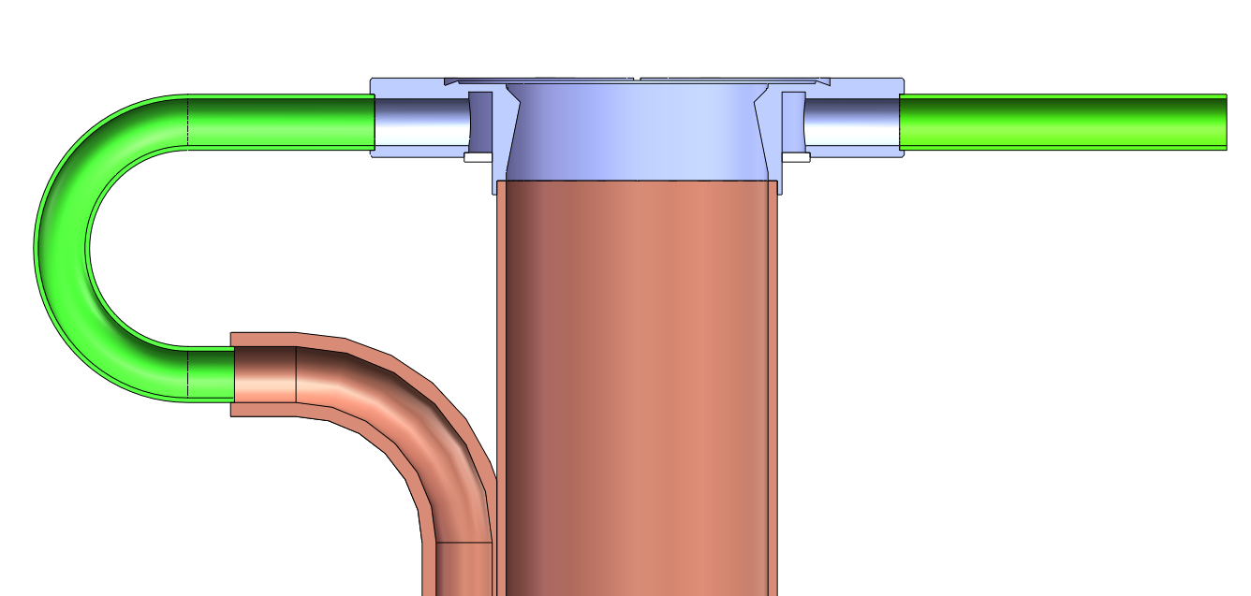
Collider rings Vacuum requirements and configuration
      Good beam lifetime must be achieved soon after the initial start-up with a stored beam.
      The vacuum system must be capable of quick recovery after sections are exposed to air for maintenance or repairs.
      The chamber wall must be as smooth as possible to minimize electromagnetic fields induced by the beam.
      NEG coating of 200nm is employed to suppress e-cloud of positron ring and absorb residual gases simultaneously. SEY will blow 1.2 after 24h activation of 180℃ and could even lower under higher activation temperature.
      Similar to positron ring, NEG coating is proposed to vacuum chamber of electron storage ring to absorb extra gas load.
Mask
On-line mask
NEG coating
RF shielding bellows

Slide 7
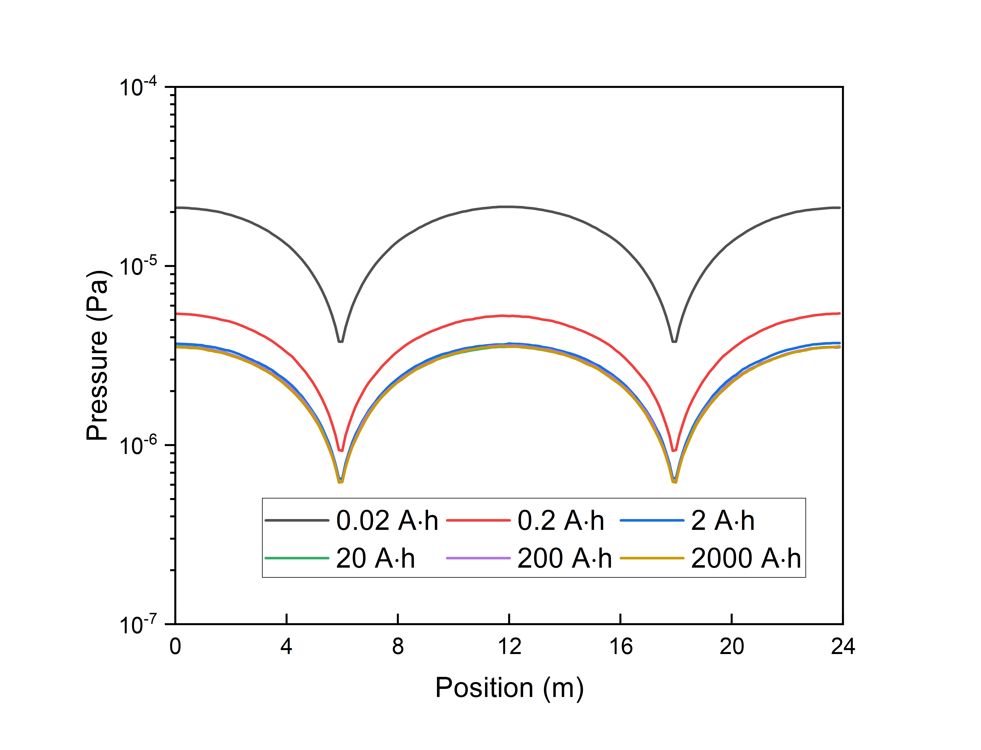
Layout & configuration of Booster
Booster will work in four modes of higgs, W, Z, tt under 30MW and 50MW alternatively. 50MW is given to calculate the vacuum parameters as it has the highest energy and gas load.
The main pumping process will then be followed by ion pumps distributed around the circumference at intervals of about 12 m.
Parameter | e⁺ & e–
Energy [GeV] | 30~180
Beam current [A] | 0.11~14.4×10⁻³
Circumference [m] | 100,000
Bending radius [m] | 11,380.8
Beam pipe material | Extruded Al
Beam pipe shape (mm) | Φ56/thickness of 2mm
Pump type in arcs | SIP
Dynamic pressure /Torr | <3×10⁻⁸ tt<4×10⁻⁸
 | Classification | length/m
booster | arc beam pipe | 78428
 | Straight section beam pipe | 17010
 | RF Substitute pipe | 384
 | RF system | 96
 | insertion and extraction | 198
 | Manifold for SIP | 1250
 | Bellows | 850
 | BPM | 240
 | Manifold for Gauge & RGA | 1544
 | total length | 100000
Pressure(Torr) 7.5×10⁻²

Slide 8
Linac vacuum system
The Linac vacuum system with a length of 1936m is divided into 59 sections. it consists of electron gun, bunching system, accelerating structures .
Sputter ion pumps: 3431; Vacuum gauges: 1352; Gate valves: 60
Section | Static pressure /Torr | Dynamic pressure /Torr
E-gun | <1×10⁻⁹ | <2×10⁻⁸
Buncher | <5×10⁻⁸ | <2×10⁻⁷
Accelerating structure | <5×10⁻⁸ | <2×10⁻⁷
Waveguide | <5×10⁻⁸ | <5×10⁻⁷
Most of the components are made of oxygen-free copper . The thermal outgassing rate is 1×10⁻¹¹ Torr·l/s·cm².
The static pressure distribution of a accelerator structure
Vacuum diagram of klystron and accelerator structures
Notes:
conventional technology

Slide 9
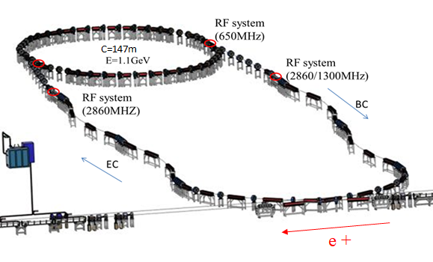
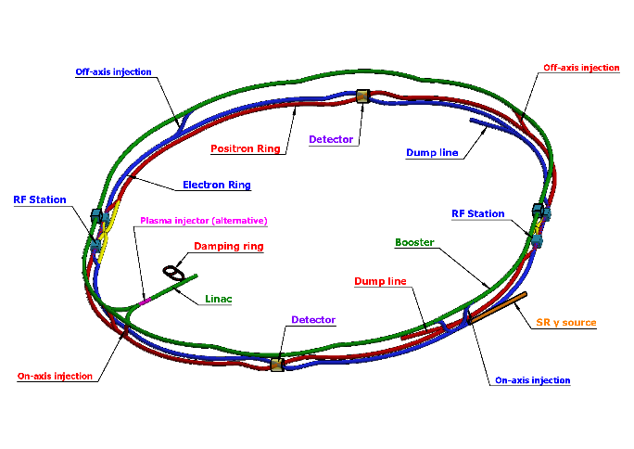
Layout of Damping ring, Transport line
DR | Classification | length/m
 | arc beam pipe | 119.0
 | Straight section beam pipe | 14.0
 | RF Substitute pipe | 0.0
 | RF system | 3.0
 | insertion and extraction | 2.8
 | Manifold for SIP | 1.5
 | Bellows | 1.5
 | BPM | 4.0
 | Manifold for Gauge & RGA | 1.5
 | total length | 147.3
Parameter | e⁺ & e–
Energy [GeV] | 1.1
Beam current [A] | 0.012~0.024
Circumference [m] | 147
Bending radius [m] | 2.87
Beam pipe material | Extruded Al
Beam pipe shape (mm) | Φ30/thickness of 1
Pump type in arcs | SIP
Dynamic pressure /Torr | 2×10⁻⁸
transport line | Classification | length/m | Note
transport line | linac to booster | 3000 | e- & e+ 1500 m
 | booster to colider | 960 | On axis：e- & e+ 240 m Off axis: e- & e+ 240 m
 | colider to booster | 480 | e- & e+ 240 m
 | damping ring | 240 | In & ex 120 m
 | total length | 4680
Parameter | e⁺ & e–
Linac to Damping Ring | e+/e-
Energy (GeV) | 1.1 GeV
Linac to Booster
Energy (GeV) | 30 GeV
Booster to Collider
Energy (GeV) | 45 GeV~180 GeV
Dynamic Pressure (Torr) | 2e-8

Slide 10
Damping ring vacuum system
For the DR, with values of E = 1.1 GeV, I = 0.012~0.024 A, and ρ = 2.87 m, these equations give a total synchrotron radiation power of P_{SR} = 1.08 kW and a linear power density of P_{L} = 60.1 W/m.
The gas load under different beam energy and beam density
Mode | E | I | PSD | P_{L} | Q_{gas} | Q_{LSR} | P_{ave}
 | Gev | A | Molecules/photon | W/m | Torr·L/s | Torr·L/s·m | Torr
 | 1.1 | 0.024 | 2.00E-06 | 60.1 | 1.28E-06 | 7.09E-8 | 1.78E-08
With an effective pumping speed of 15 L/s and a distribution of 2 meters sputtering ion pumps, the vacuum value of 1.78×10^{–8} Torr will be reached.
Due to the beam current of damping ring is low enough, SEY of aluminium vacuum chamber which do not need NEG coating or TiN coating could meet the requirement of physics.
RF shielding Bellows with spring and contact fingers made of stainless steel will be employed to absorb the extension and the misalignment of vacuum chambers and other vacuum devices during installation.

Slide 11
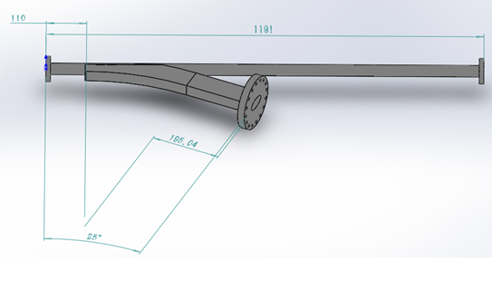
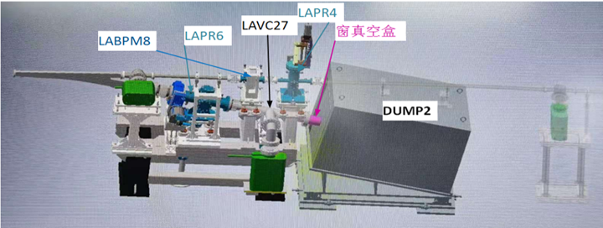
Protypes of Dump chamber and membrane window
The elliptical Ti thin membrane window of 170×10 mm with a thickness of 0.1 mm was welded on the s. s. plate with a diameter of 183 mm and a thickness of 5mm.
membrane windows
Inner cross section of ellipse in 60 × 30 mm
Outer cross section of rectangle in 62 × 32 mm
Membrane windows
The thickness of Ti window is 0.1mm
Deformation test under vacuum: elliptical window is 0.4mm, circle window is 2.3mm;
ultimate vacuum<5 ×10⁻¹⁰ Torr。
Notes:
材料的选择→加工工艺→样件试制→检漏→变形测量→极限真空测试
对0.1mm厚的钛膜进行电子束焊和钎焊试验；
钛窗真空下变形实验，椭圆窗0.4mm，圆窗2.3mm，打压1MPa未发现有漏；
极限真空小于5 ×10⁻⁸Pa。

Slide 12
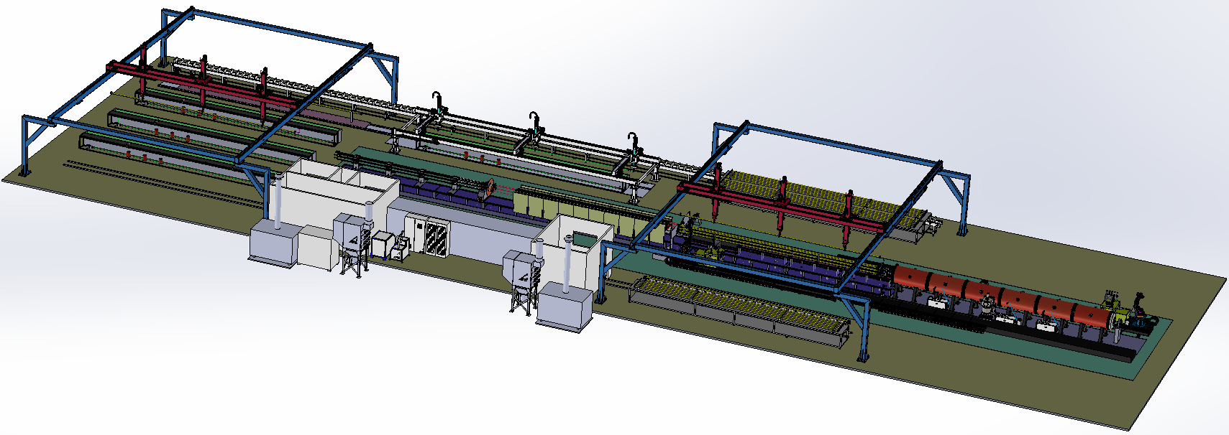
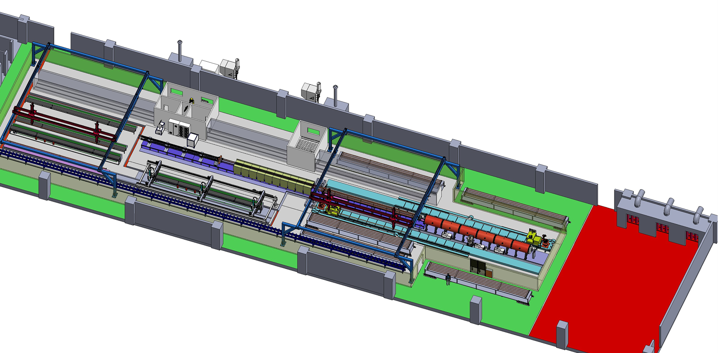
CEPC vacuum chamber production line
Requirement
Due to the difference in length, two production lines will be used to complete the production of vacuum chambers for the CEPC collider. The quantity of NEG coating and spraying facilities for the two lines varies to match the production speed.
With two production lines, the all vacuum chambers of collider will be finished in 5 years.
Advantages
More stable process, less manpower, less NEG coating facility, more adaptive capacity in production, etc.
Important nodes and progress
Technical scheme review
Procurement bidding
Heating layer spraying
2024.10
2024.12
Items | Specifications
Dimension | L 11400-d56-D62
Weight | 50~100kg
NEG coating | Thickness：200nm±30% SEY<1.1 S、Q、life-times
Spraying heating | Thickness<0.5mm Heating temperature <300℃
Cleaning
NEG coating

Slide 13
Production line composition
Classification | Sub-devices | Parameters | Note
Electron-beam welder | Electron-beam gun Power supply Vacuum chamber | Meets the Length of 11.4m vacuum chamber 6 working position | Design and manufacturing
Brazing | Mechanical holder Power supply | 350℃ 11.4m long | Low temperature brazing in air by conductivity heating, expecting stead by double hole copper tube
Heating film spraying facility | Electron-beam gun Power supply Controller Mechanical Structure | Meets the Length of 11.4m vacuum chamber Multilayer Spray Ceramic and conductivity layer | R&D
NEG coating tower | Pumping system Vacuum measurement Power supply Vacuum chambers Discharge Gas Cathode、controller | Meets the Length of 11.4m vacuum chamber 6 working position Background vacuum <5e-7Pa Baking temperature 200℃ | Developing to be more fitted the production line
Measurement and testing | Dimension measurement Leakage testing | Dimension measurement 11.5m/0.1mm Leakage testing 1e-10 mbar·L/s | Design and manufacturing
Cleaning | rinsing | deionized water rinsing | Design and manufacturing
Production line auxiliary equipment | Moving band robot arm system controller | Meets the Length of 11.4m vacuum chamber | Design and manufacturing

Slide 14
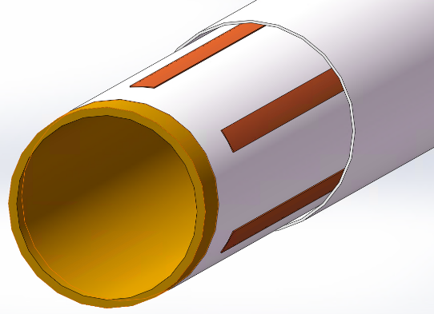
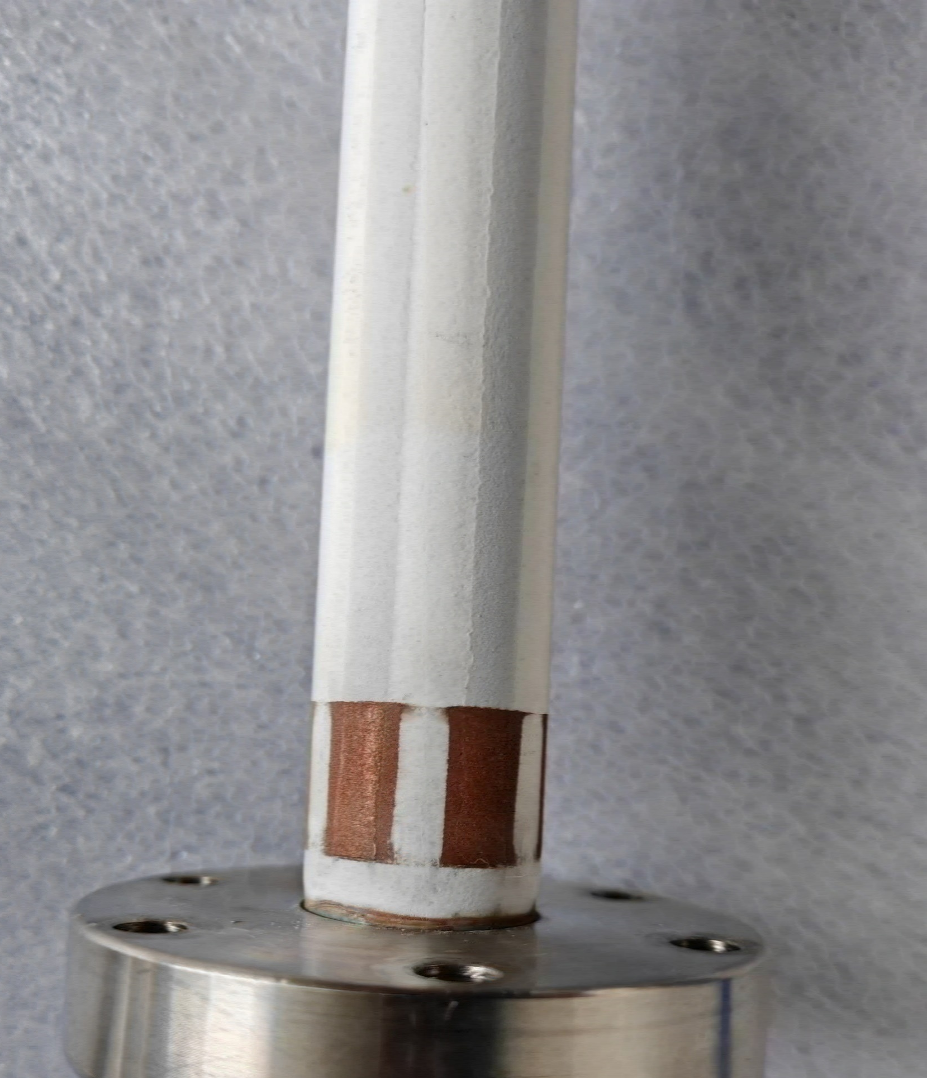
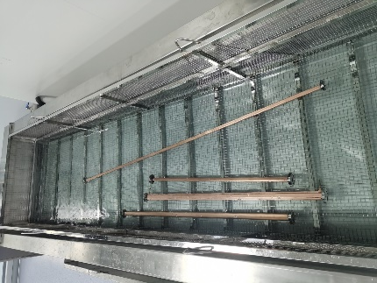
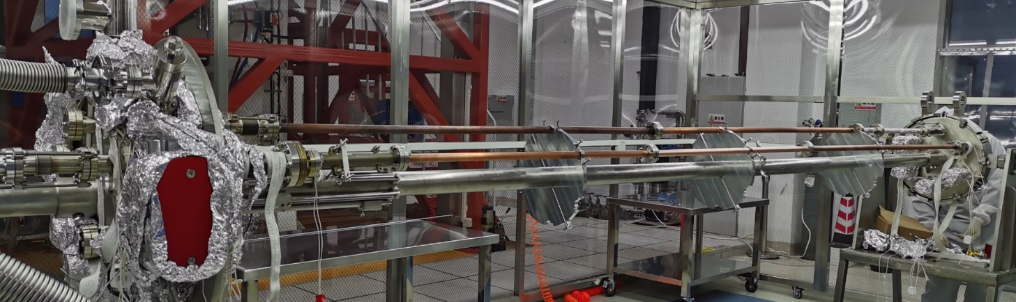
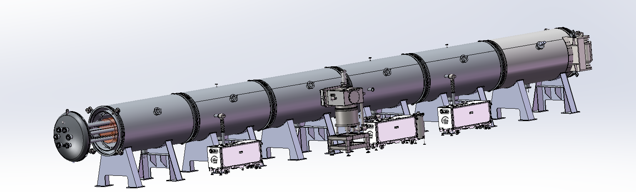
Procedure of NEG coating, spraying
Spraying
Sandblasting
Spraying_Isolation_layer
Spraying_Conductivity-layer
Spraying_Isolation-layer
Spraying_Contactor-layer
Cleaning
Outside
Inside
NEG coating
vacuum chambers, cathodes assembling by mechanical arms (flanges sealing).
Leakage testing.
Deliver the assembles to vacuum oven/ baking/ NEG coating;
Disassembly the vacuum chambers
Function | Materials | Thichness/um
Transition-layer | MCrAlY alloy | 50~100
Isolation-layer | Al2O3 cermic | ~150
Conductivity-layer | NiCr alloy | ~100~200
Isolation-layer | Al2O3 cermic | ~150
Contactor-layer | Copper | ~50

Slide 15
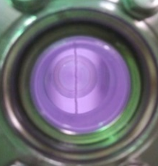
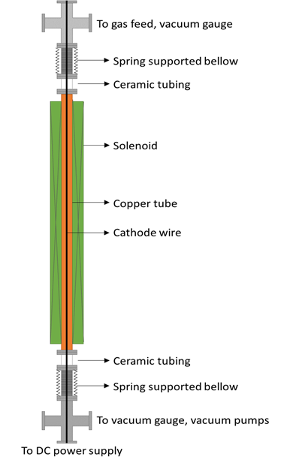
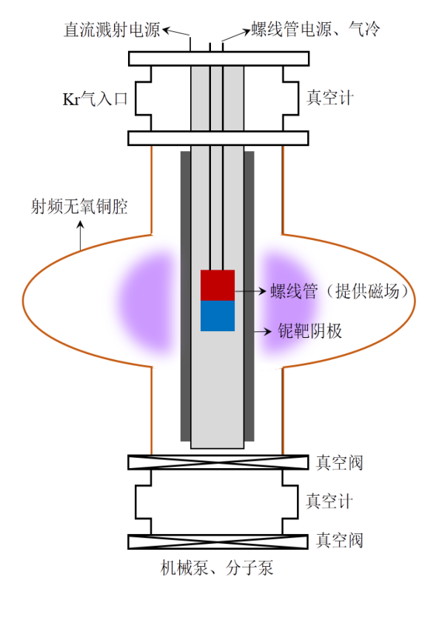
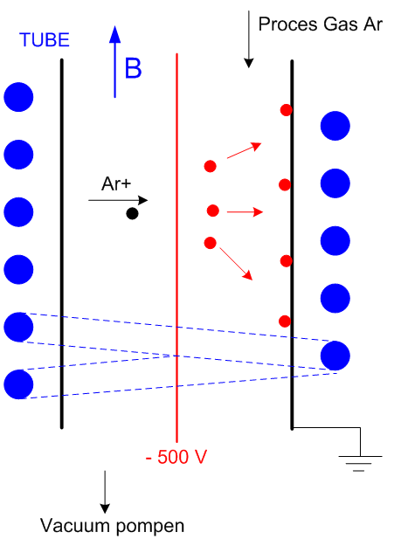
NEG coating mechanism & method
HEPS, LHC, MAX IV, SIRIUS, APS_U etc.
CSNS, BEPCII vacuum chambers;
Nb coating;
磁环
Kr+
Outside magnet （solenoid）
Inside magnet
Cathode wire
Magnetron sputtering cathode
Notes:
在磁场的约束下，形成等离子体。Kr原子被等离子体电离形成Kr+，在电场加速作用下打向阴极靶，从而形成溅射作用。TiZrV原子沉积到铜基底表面形成NEG薄膜

Slide 16
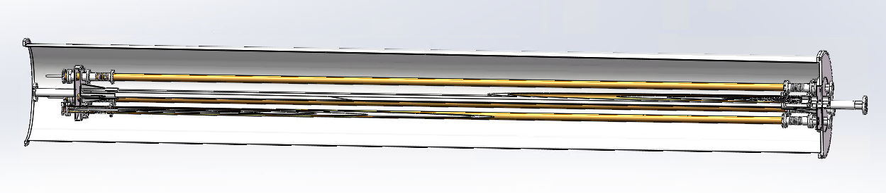
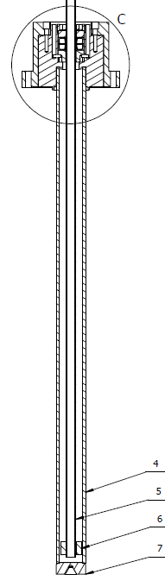
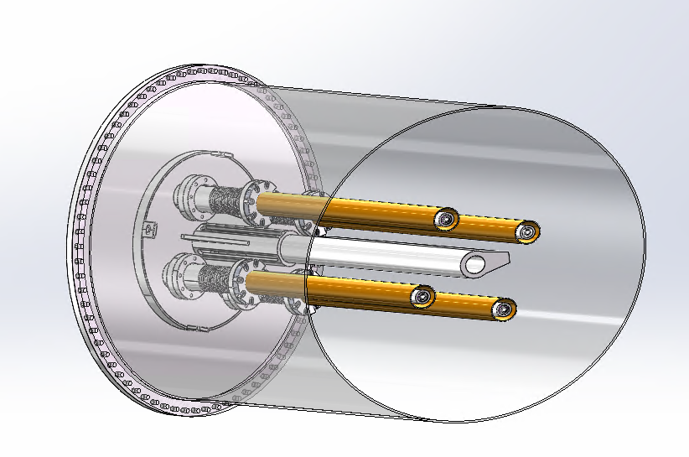
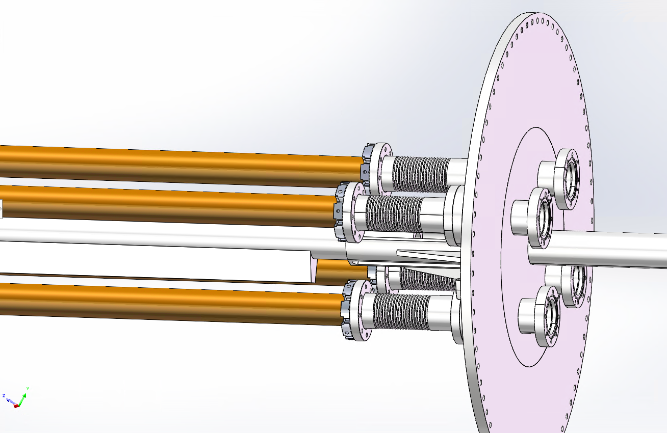
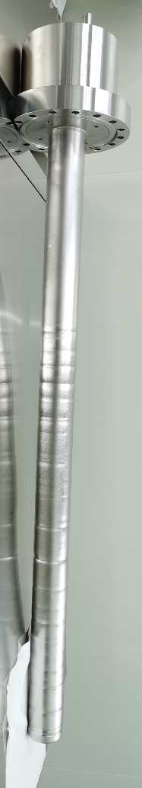
Massive production of NEG coating for CEPC——Upgrade plan
Due to the diameter of CEPC is D56, we plan to replace the cathode wire with a magnetron sputtering cathode
Permanent magnet instead of the solenoid which supplies magnetic field for DCMS;
By combining the low vacuum chamber outside of the vacuum chambers to be coated with NEG, the high vacuum process is simplified;

Slide 17
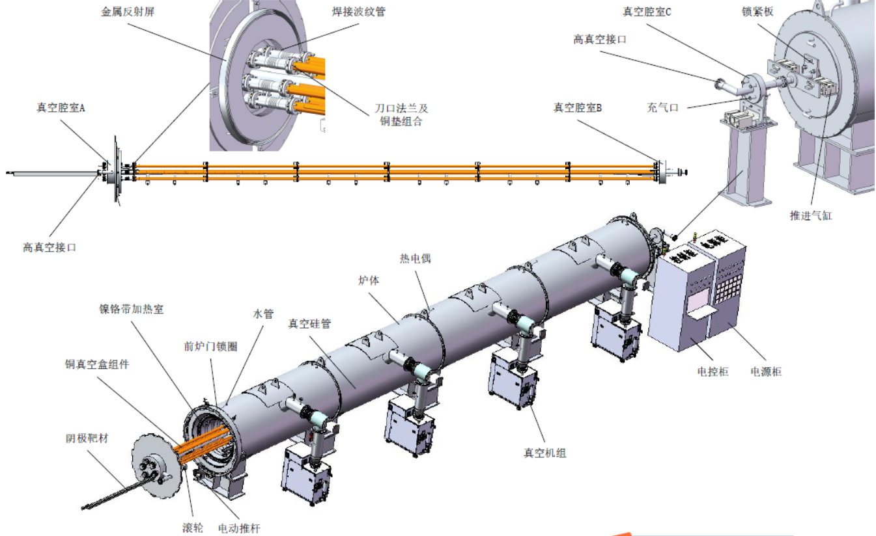
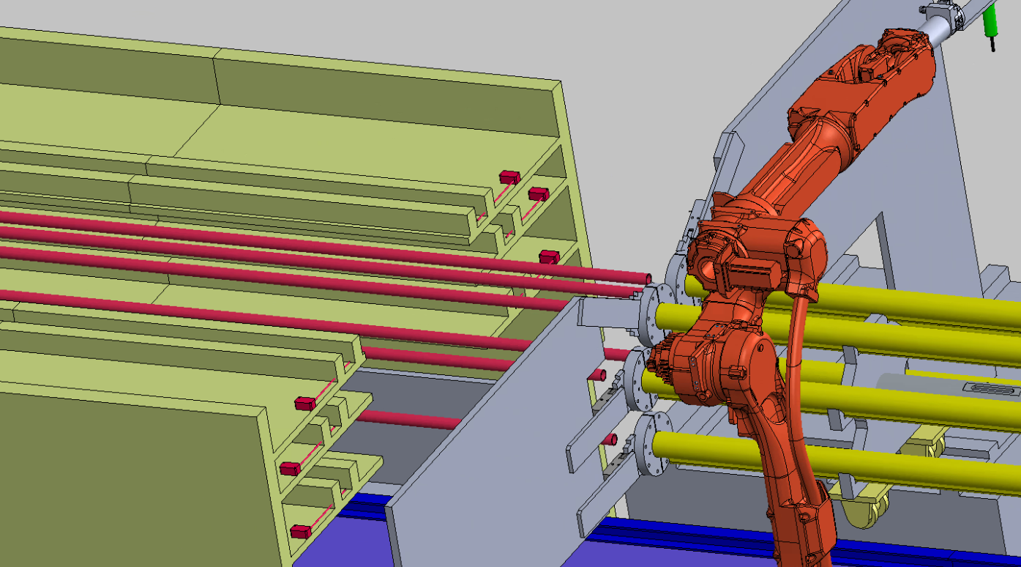
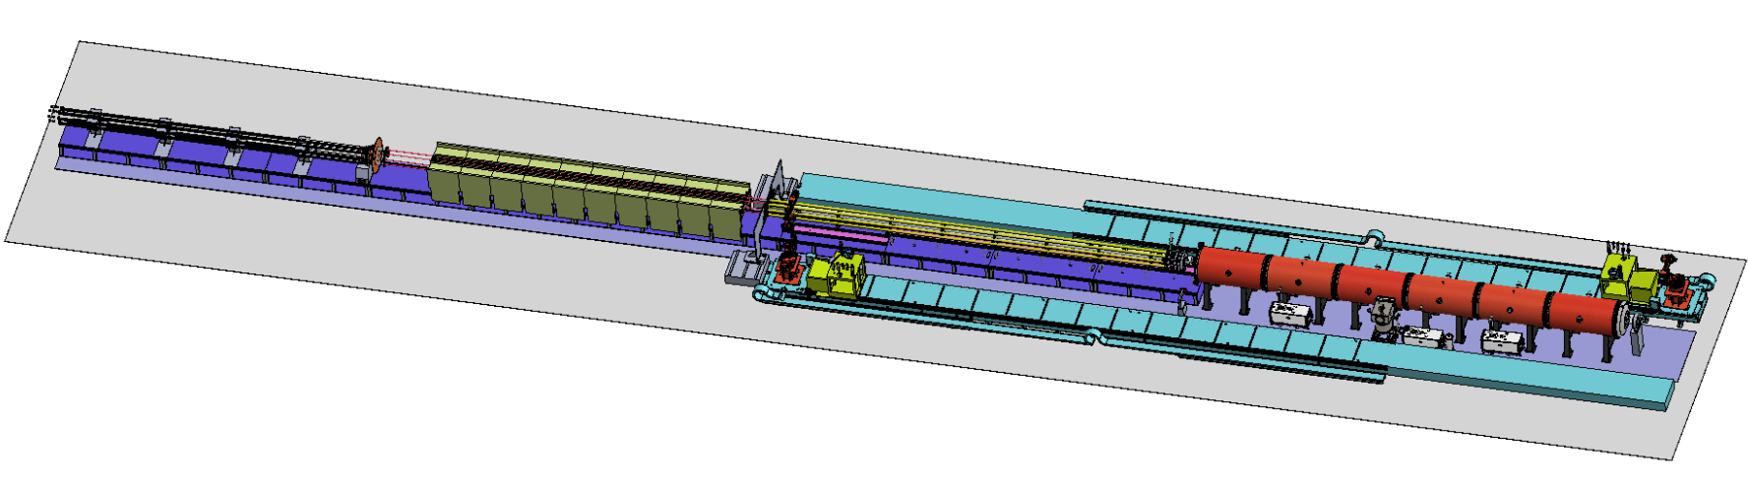
layout & composition of NEG coating facility
NEG coating, VC assembly and disassembly with automatic robot arms.
Cathodes driven
Cathodes
VC assembly
Vacuum oven

Slide 18
Prototype of vacuum chambers assembly

Slide 19
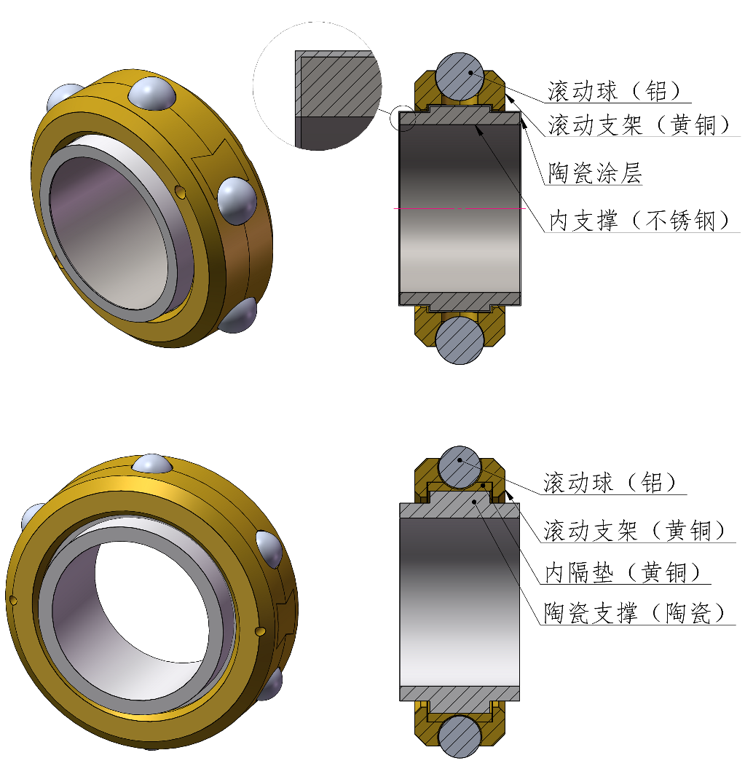
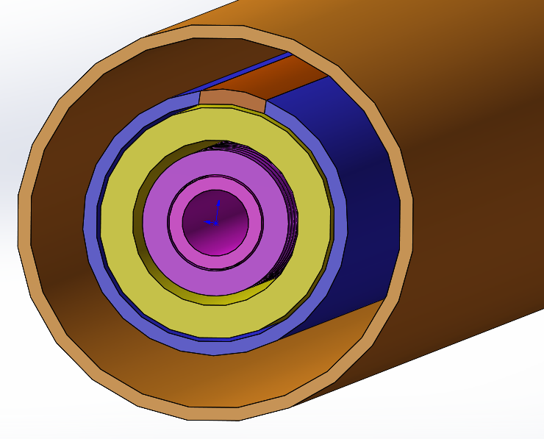
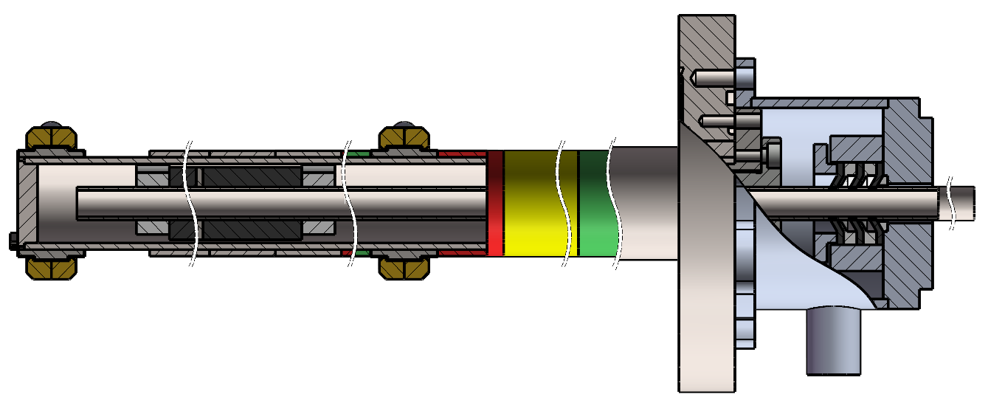
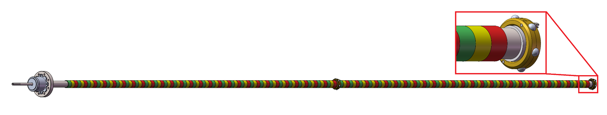
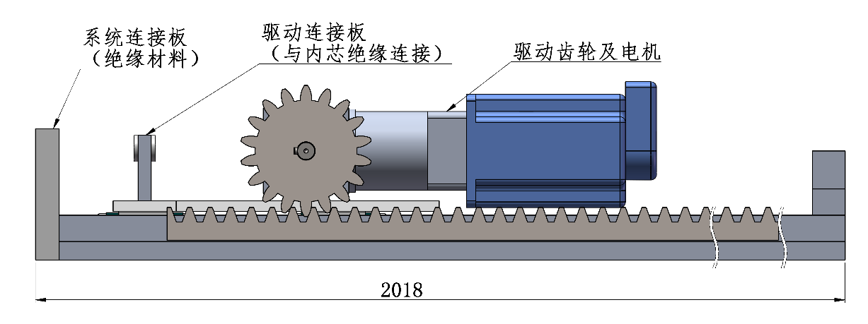
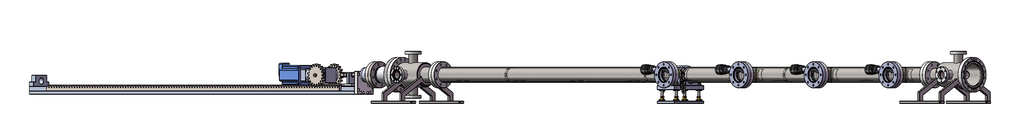
Prototype of cathode for NEG coating
dynamic sealing for water pipe
Magnets
Isolating and supporting ring
Water cooling pipe
~12000mm(12 meters)
Magnetron Cathode
The magnets will be driven by motor when NEG coating
Motor for magnets driven
23000mm(23 meters)

Slide 20
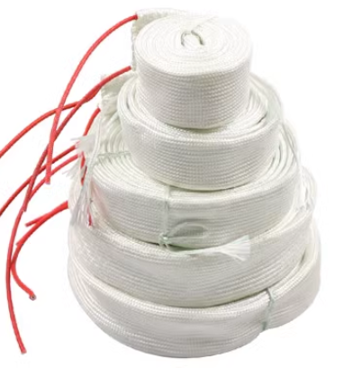
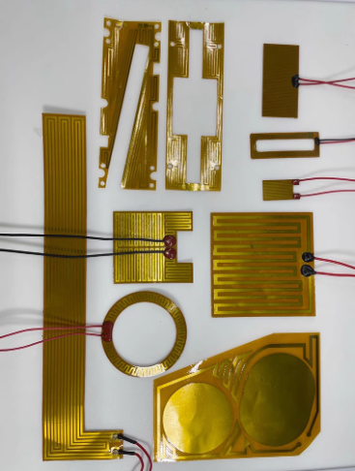
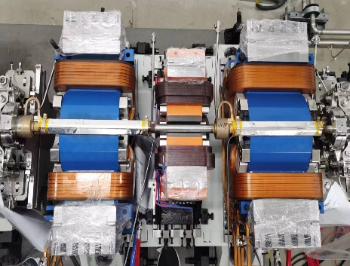
VC baking & Why spray heating film
The baking is the most crucial procedure in achieving ultra-high vacuum
Necessity:
In order to meet the ultra-high vacuum requirement of achieving a dynamic vacuum level of 3.0E-10 mbar.
NEG coating reactivation
Too thick
Lifetime is very short under SR of CEPC
N₂
N₂
H₂
H₂
O₂
MO
O₂
Heat
O
High
vacuum
or
inert gas
H₂O
C
MC
CO
H₂O
CO₂
CO₂

Slide 21
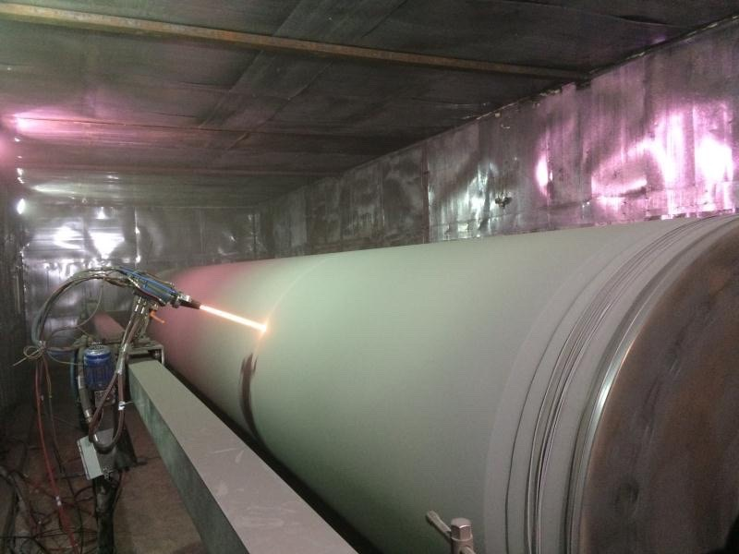
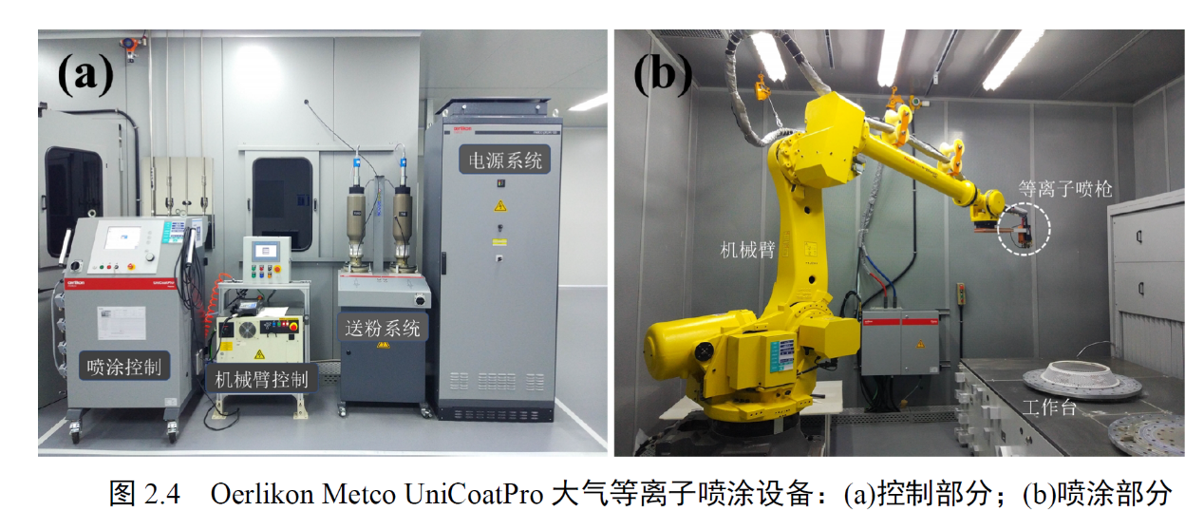
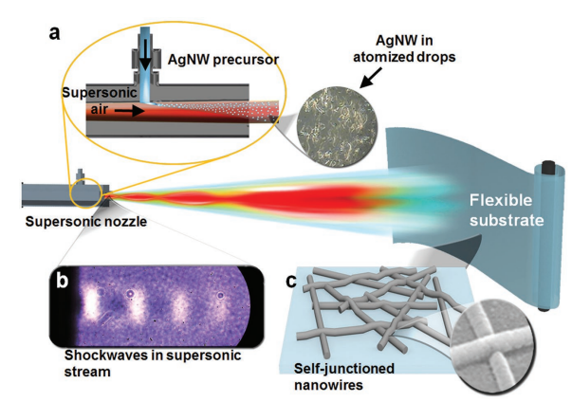
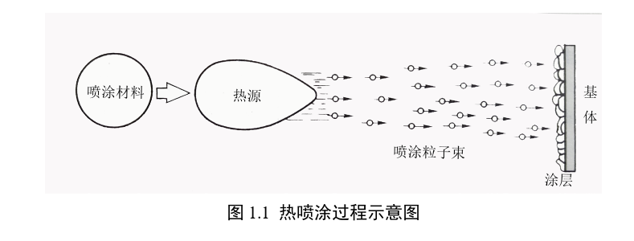
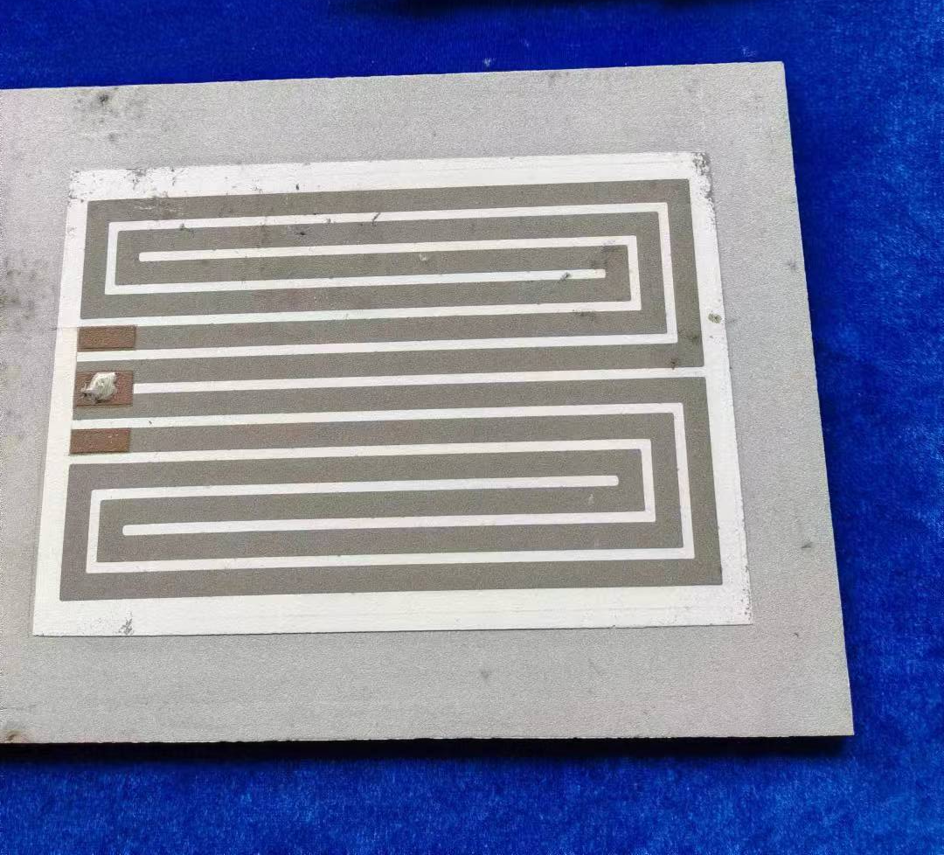
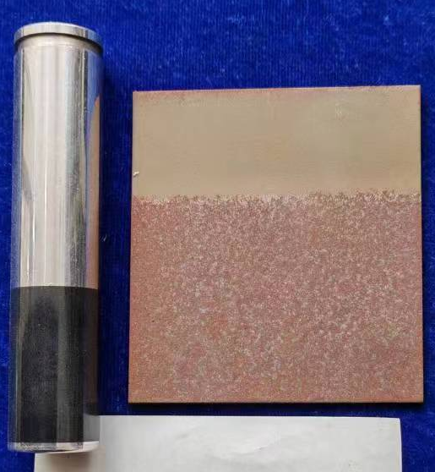
Spraying for heating film
Multilayer heating film will be coated outside of the vacuum chamber which composited by ceramic and conductivity layer
The heating temperature could reach 250℃
Heating layer
Thickness： 0.5mm
Ceramic layer
Convection
Radiation
Conductivity layer
I
solution
Conduction
Ceramic layer
Cu/ceramic transition layer
Vacuum chamber
Related commercial products
Cu/Ag NW
Processing of spray
Plasma spraying
Electric heating circuit
De-icing for airplane

Slide 22
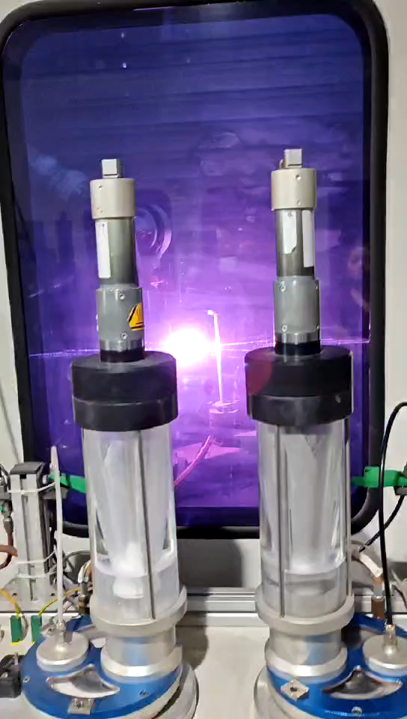
Spraying for heating film

Slide 23




Prototype of Spraying heating film and tests
Reheating test more than 12 times
Adhesion test in ultrasonic resining
Dimension: L400*D24 Substrate: copper
Function | Materials | Thichness/um
Transition-layer | MCrAlY alloy | 50~100
Isolation-layer | Al2O3 cermic | ~150
Conductivity-layer | NiCr alloy | ~100~200
Isolation-layer | Al2O3 cermic | ~150
Contactor-layer | Copper | ~50
Temperature/℃
Power density W/cm2

Slide 24
NEG coating optimization in EDR
Impedence
Round pipe of Copper (2~3mm) with NEG coating (200nm)
Strictly control on the coating thickness for impedance source to restrain the instability!【1】
Reactivation life-times
1um
Problems: 200nm NEG coating, pumping performance (pumping speed and life) rapidly decreased
【1】Liu Yu Dong .Modification suggestion of vacuum chamber for the collider ring. 2021/3/25

Slide 25



NEG coating optimization _ Next step
Multilayer NEG coating: improve lifetimes, conductivity.
The application of a thin palladium (Pd) layer to a getter film has been proposed as a means of preventing oxidation of the getter layer so as to address the issue of limited operational lifespans.[1]
Add Pd、Cu、Ag
Pd、Cu、Ag 20~50nm [2]
TiZrV （Hf）~0.2$μm$
chamber
DCMS
Direct Current Magnet Sputtering
[1] C. Benvenuti, P. Chiggiato, F. Cicoira, Y. L’Aminot, V. Ruzinov, Vacuum properties of pallium thin film coatings, Vacuum 73 (2004) 139–144.
[2] JIN X, TANIMOTO Y, UCHIYAMA T, et al. Synchrotron radiation-stimulated desorption from Pd or Pd/TiZrV coated copper tubes [J]. Vacuum, 2021, 192(110445.
Notes:
四元吸气薄膜已经有人提出，并得出结论：抽速大、激活温度更低

Slide 26






Full-scaled size RF shielding bellows development
RF shielding Bellows for ultra Expansion/contraction：Ultra Expansion/contraction RF bellows to meet the 11.5m long vacuum chambers.
Mask is designed on the upstream of RF bellows to absorb the SR
The all RF bellows were produced by local company in China, and massive used in HEPS.
Prototypes in TDR & HEPS
Notes:
Vacuum bellow modules are needed to compensate the mechanical misalignments of the vacuum chambers during installation and to absorb their thermal expansion during the bake-out. In order to reduce the beam impedance during operation with beams these modules are equipped with RF bridges to carry the image current.[1]
Ultra Expansion/contraction RF bellows to meet the 11.4m long vacuum chambers and component for mock up line.

Slide 27
Conclusion
Vacuum chambers with Al, Copper alloy materials have been conducted in BEPC II, HEPS, and also NEG coating have been applicated in HEPS with thickness of 1 um, For CEPC, 0.2 um NEG coating is a curial technology, due to its short time life-cycles.
Production line of vacuum chambers NEG coating and spraying heating will be R&D in 2 years;
NEG coating by magnetron sputtering cathode method R&D will be carried out to adapt the production line;
Prototype of Spraying heating film and tests have been carried out, which shows a good results;
NEG coating optimization for low impedance film, Spraying for heating film plan to be carried out ;

Slide 28
Acknowledgement
A significant amount of work has been completed in the CDR and TDR, and I would like to thank all those who have contributed to these efforts.
Thanks for the HEPS, FCC-ee project;
Thanks for your attention

