Slide 1


Circular Electron Positron Collider
CEPC Polarization Status
Zhe Duan
On behalf of the CEPC Polarization Working Group
March 6th 2025, eeFACT 2025, Tsukuba, Japan, email: duanz@ihep.ac.cn

Slide 2
Outline
Beam polarization studies
R&D in the Engineering Design Phase
Summary

Slide 3
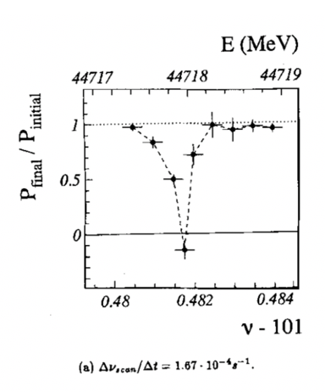
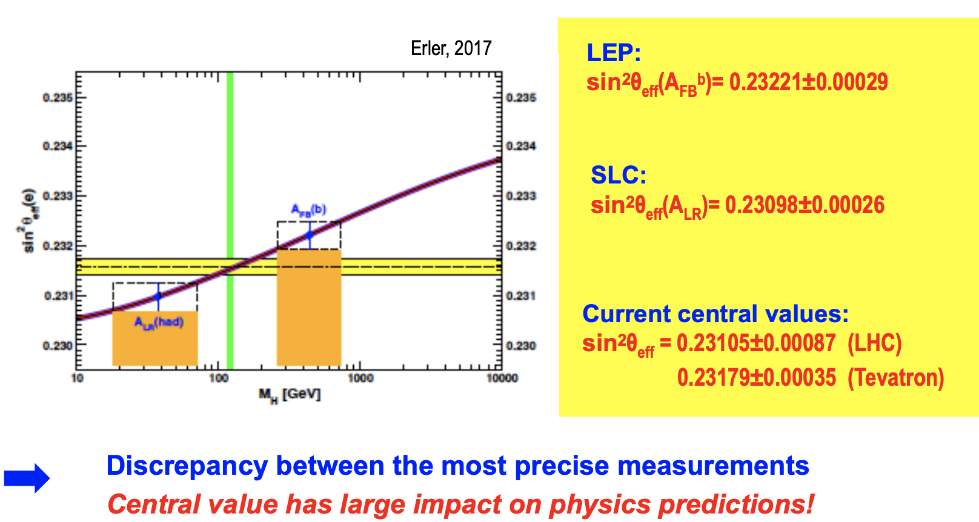
Physics motivation of polarized beams @ CEPC
Precision beam energy calibration @ Z, W (~100keV)
  resonant depolarization with vertically polarized beams
Precision measurement of weak mixing angle @ Z
  Longitudinally polarized colliding beams for measuring A_{LR}
  could resolve the tension between A_{FB} & A_{LR}, by measuring both in the same experiement
CPV with polarized beams in e+e- → HZ. H → ττ etc
ECFA meeting on e+e- to ZH angular measurements
Polarized beam applications @ ILC,
arXiv:2105.09691, 2111.06687, 2202.07385
L. Arnaudon, et al., Z. Phys. C 66, 45-62 (1995).
G. Moortgat-Pick’s talk on CEPC Workshop EU @ Marseille, 2024 April

Slide 4
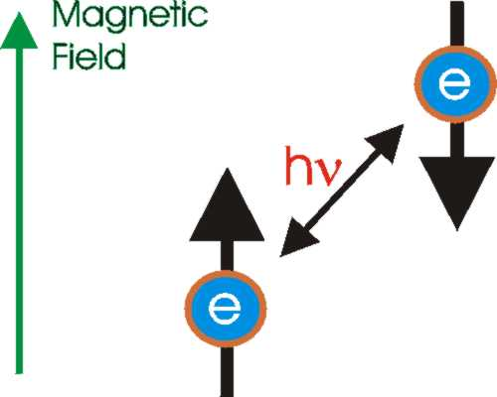
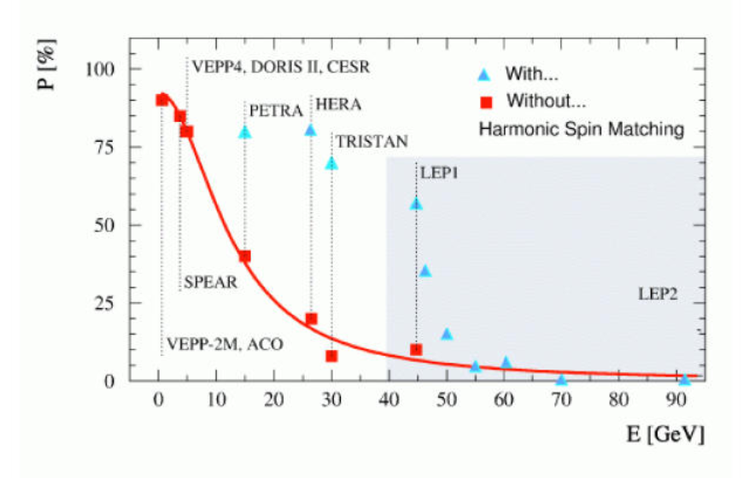
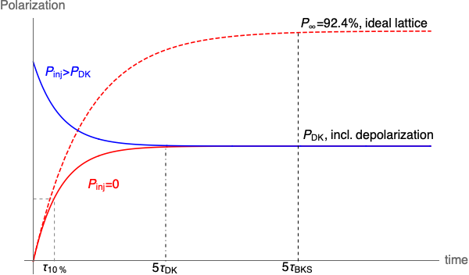
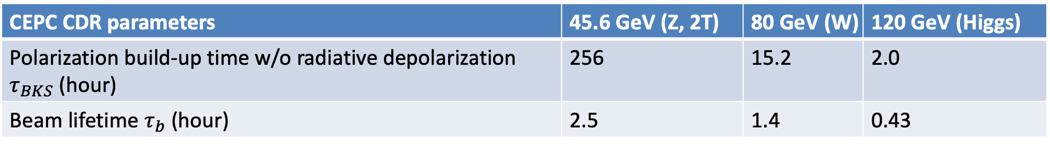
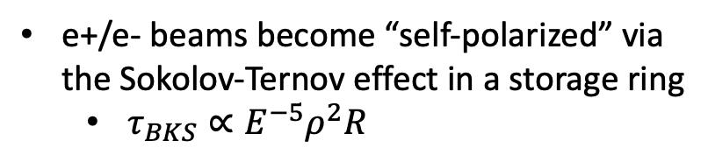
Self-polarization in the CEPC
e+/e- beams become “self-polarized” via the Sokolov-Ternov effect in a storage ring
  $τ_{BKS}∝E^{−5}ρ^{2}R$
Polarization build-up rate << beam decay rate @ Z
  Asymmetric wigglers in the Collider (see FCC EPOL presentation)
  Hard to achieve a high-level polarization
  In conflict with a high luminosity
R. Assmann, et al, AIP Conference Proceeding, 570, 169 (2001).
CEPC CDR parameters | 45.6 GeV (Z, 2T) | 80 GeV (W) | 120 GeV (Higgs)
Polarization build-up time w/o radiative depolarization $τ_{BKS}$ (hour) | 256 | 15.2 | 2.0
Beam lifetime $τ_{b}$ (hour) | 2.5 | 1.4 | 0.43

Slide 5
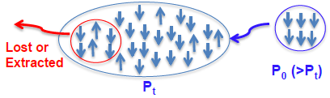
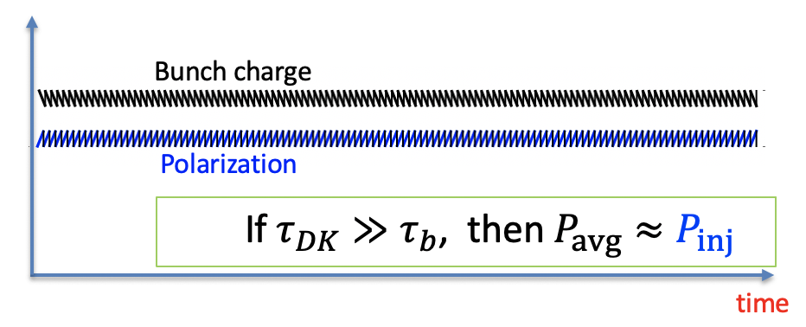
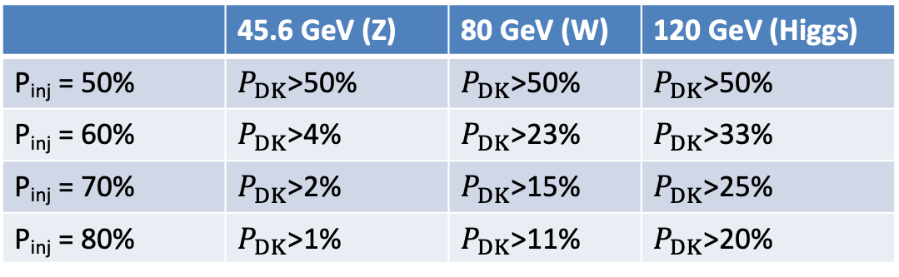
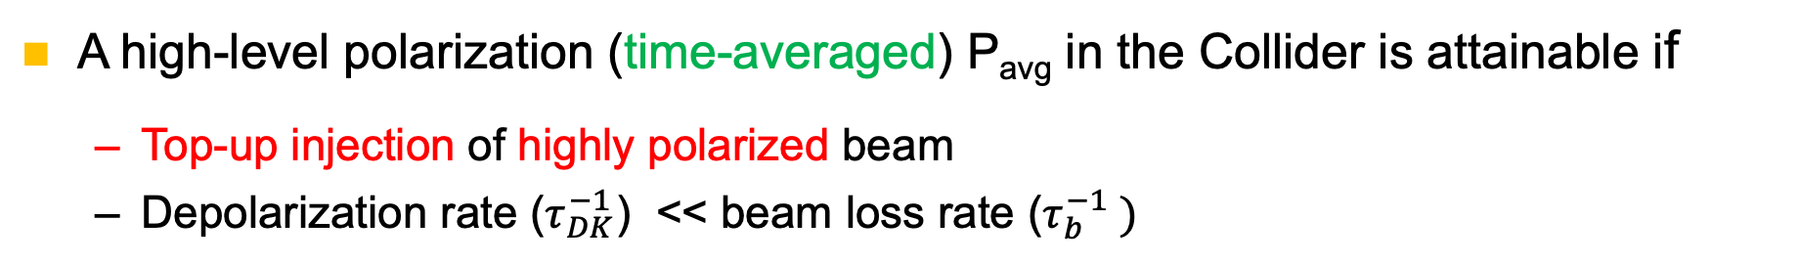
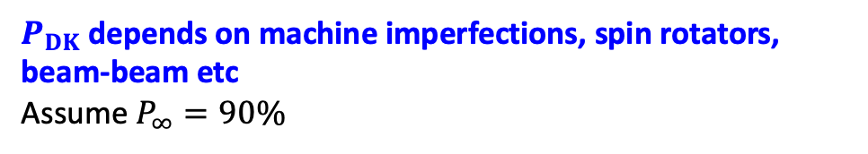

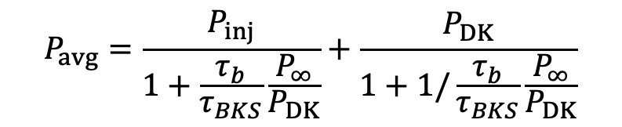

How to achieve a high-level polarization?
A high-level polarization (time-averaged) P_{avg} in the Collider is attainable if
  Top-up injection of highly polarized beam
  Depolarization rate ($τ_{DK}^{−1}$) << beam loss rate ($τ_{b}^{−1} )$
$$P_{avg}=\frac{P_{inj}}{1+\frac{τ_{b}}{τ_{BKS}}\frac{P_{∞}}{P_{DK}}}+\frac{P_{DK}}{1+1/\frac{τ_{b}}{τ_{BKS}}\frac{P_{∞}}{P_{DK}}}$$
$P_{DK}$depends on machine imperfections, spin rotators, beam-beam etc
Assume $P_{∞}=90\%$
Injected beam
P_{inj} > P_{DK}
$P_{avg}$> 50% requires a minimum value of $P_{DK}$
Sawtooth-shape evolution during top-up injection
 | 45.6 GeV (Z) | 80 GeV (W) | 120 GeV (Higgs)
P_{inj} = 50% | $P_{DK}$>50% | $P_{DK}$>50% | $P_{DK}$>50%
P_{inj} = 60% | $P_{DK}$>4% | $P_{DK}$>23% | $P_{DK}$>33%
P_{inj} = 70% | $P_{DK}$>2% | $P_{DK}$>15% | $P_{DK}$>25%
P_{inj} = 80% | $P_{DK}$>1% | $P_{DK}$>11% | $P_{DK}$>20%
$$\frac{|P_{inj}−P_{DK}|}{{(τ}_{b}+τ_{DK})/dt}$$
Amplitude of sawtooth ~

Slide 6
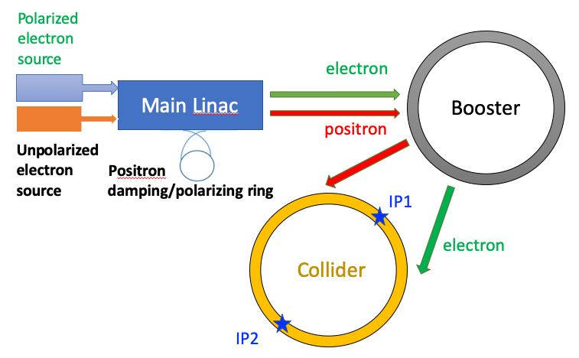
Polarized injector for CEPC
Polarized source
  Polarized electron gun w/ GaAs cathode
  Positron damping/polarizing ring
Linac & Transport lines
  spin direction matching @ injection/extraction
  helicity adjustment for e+
Booster
  free from intrinsic spin resonances
T. Chen, Z. Duan, D. H. Ji, D. Wang, Phys. Rev. Accel. Beams, 26, 051003 (2023).
Collider
  solenoid spin rotators @ 45.6 GeV
> 70% polarization transmission in the injector chain for Z & W operation.
W. Xia et al., Investigation of spin rotators in CEPC at the Z-pole,
Radiat. Det. Tech. Meth. 6:490 (2022).

Slide 7
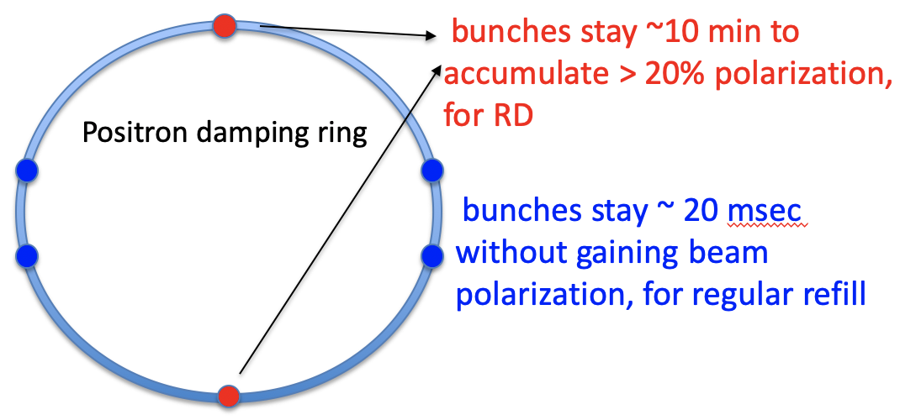
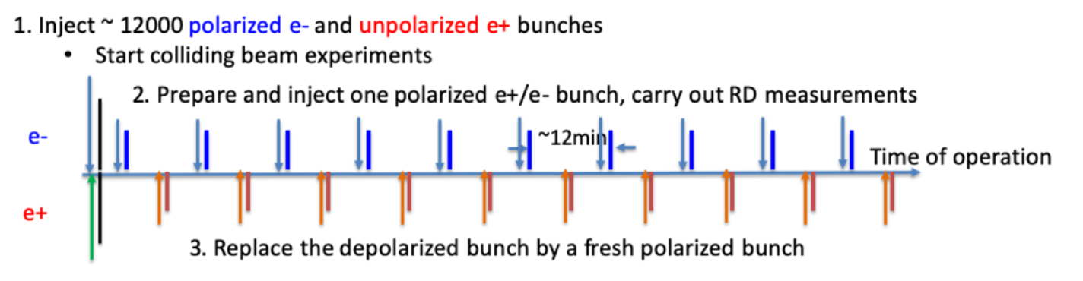
Polarized sources for resonant depolarization
Polarized e- source
  polarized electron gun w/ GaAs cathode, polarization > 85%
Polarized e+ source
  e+ damping/polarizing ring
  extracted beam polarization @ 10min ~ 44%
DR V4.0 | unpolarized e+ | polarized e+
Energy (Gev) | 1.983
Circumference (m) | 144.2
Number of trains | 2(4)
Number of bunches/trian | 1(2)
Total current (mA) | 12.4
Dipole strength B₀ (T) | 1.92
U₀ (kev/turn) | 397.9
Damping time x/y/z (ms) | 4.8/4.8/2.4
Momentum compaction | 0.0078
Storage time | 20 ms | 10 min
δ₀ (%) | 0.0917
ε₀ (mm.mrad) | 132
injection σ_{z} (mm) | 6
Extract σ_{z} (mm) | 6.7 | 6.6
ε_{inj} (mm.mrad) | 2500
ε_{ext x/y} (mm.mrad) | 133/13 | 132/13
δ_{inj} /δ_{ext} (%) | 0.18 /0.092
RF acceptance (%) | 1.85
Longitudinal tune | 0.025

Slide 8
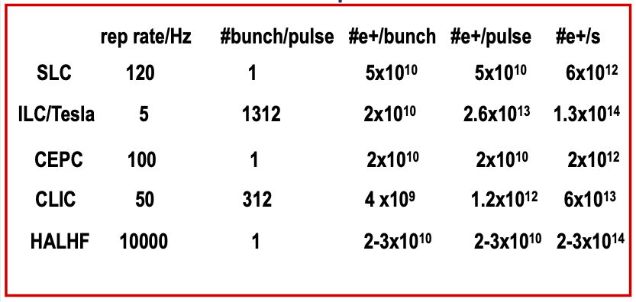
Polarized sources for colliding beams
Polarized e- source
  polarized electron gun w/ GaAs cathode, polarization > 85%
Polarized e+ source
  more demanding polarizing ring design
  plan to revisit the schemes for ILC/CLIC

Slide 9
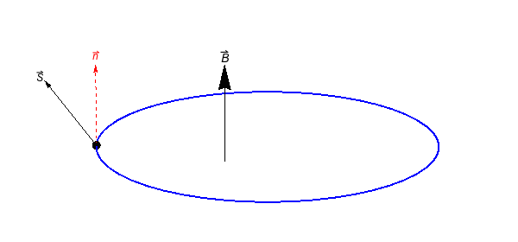
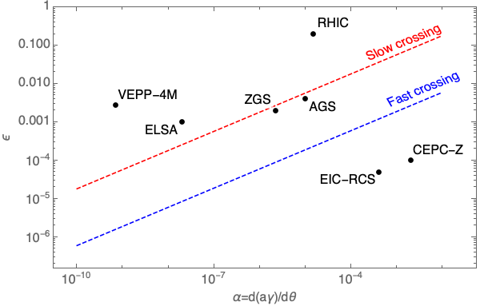
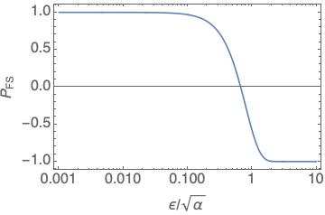
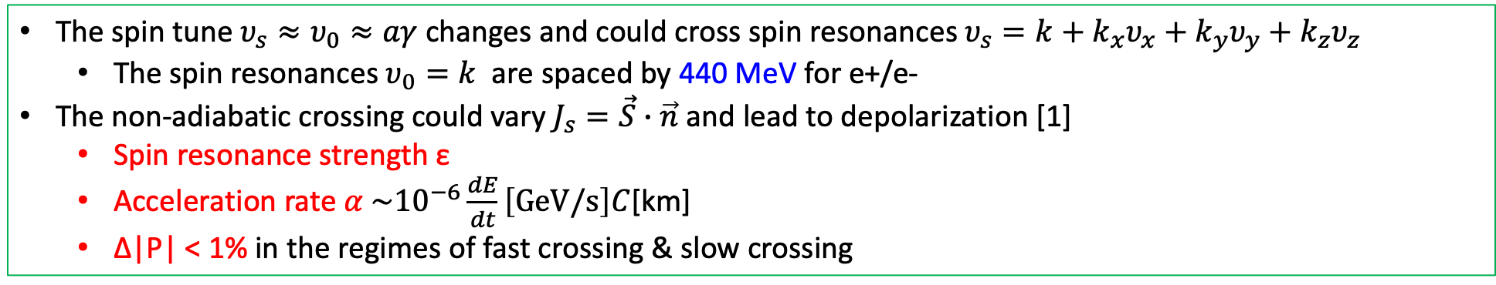
Depolarization in the booster
The spin tune $υ_{s}≈υ_{0}≈aγ$ changes and could cross spin resonances $υ_{s}=k+k_{x}υ_{x}+k_{y}υ_{y}+k_{z}υ_{z}$
  The spin resonances $υ_{0}=k$ are spaced by 440 MeV for e+/e-
The non-adiabatic crossing could vary $J_{s}=\vec{S}∙\vec{n}$ and lead to depolarization [1]
  Spin resonance strength ε
  Acceleration rate $α \sim {10}^{−6}\frac{dE}{dt}\left[GeV/s\right]C$[km]
  Δ|P| < 1% in the regimes of fast crossing & slow crossing
Fast crossing
Slow crossing
Spin precession
[1] Froissart and Stora, NIM 7, 297 (1960) [2] A. K. Barladyan, et al., PRAB 22, 112804, (2019)
[3] S. Nakamura, et al., NIM A 411, 93 (1998) [4] T. Khoe et al., Part. Accel. 6, 213 (1975)
[5] Configuration Manual: Polarized Proton Collider at RHIC, 2006 [6] V. Ranjbar, et al., PRAB 21, 111003 (2018)
Data from Ref [2-6]

Slide 10
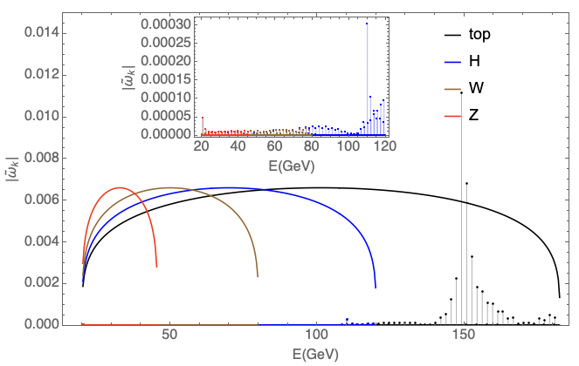
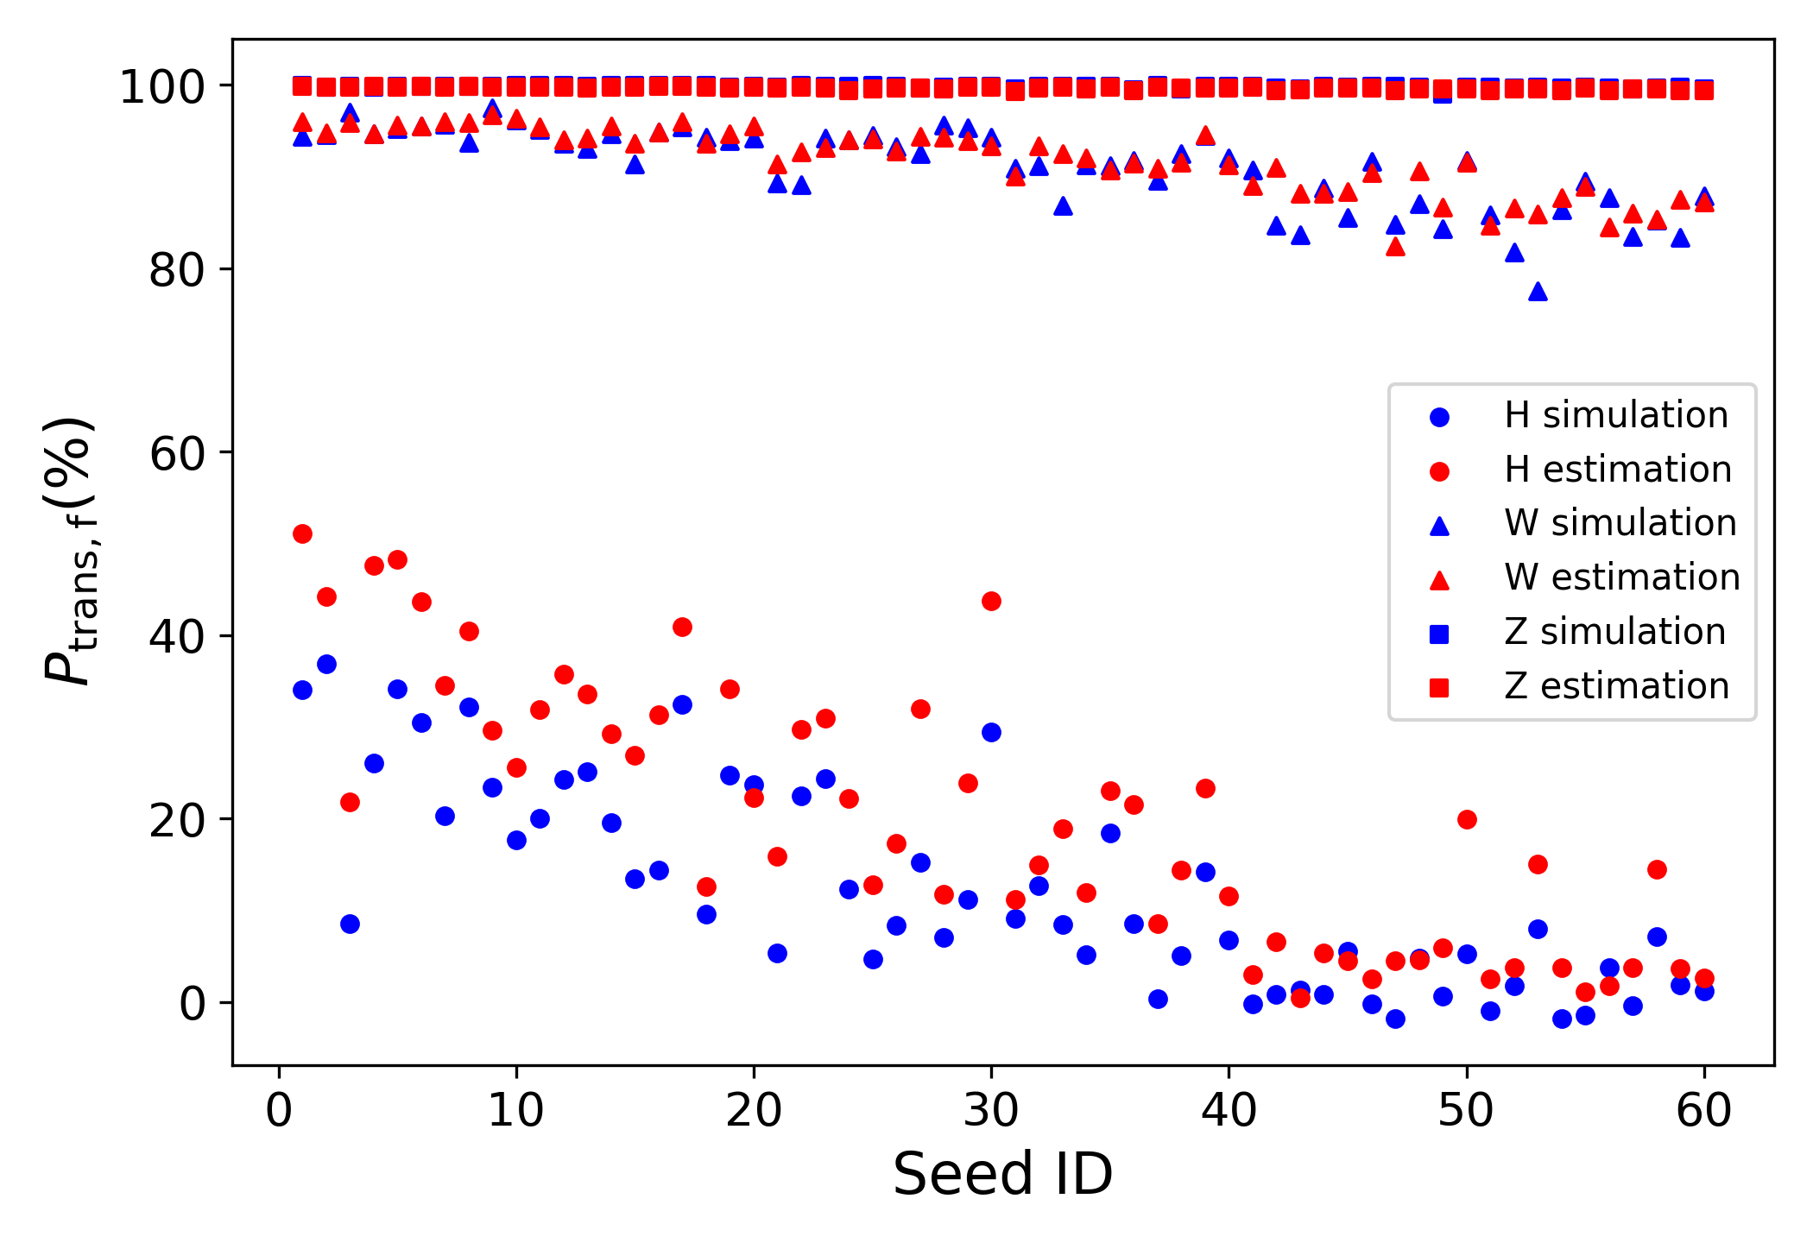
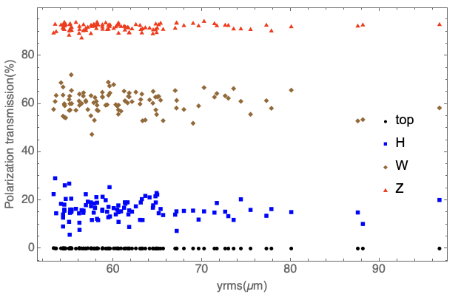
Polarization transmission in the booster
Highly periodic lattice -> relatively weak spin resonances in the working beam energy range
 | CEPC FODO 90 alternative design | FCC-ee Booster HFD lattice
Number of arcs (P) | 8 | 8
Number of standard arc cells (M) | 140 | 175
Total bending angle of standard arc cells (2π * η_{arc}) | 2π * 0.9859 | 0.745 rad * 8 = 2π * 0.9486
Vertical betatron tune ν_{y} | 353.28 | 382.29
Vertical betatron tune from standard arc cells ν_{B} | ¼ * 175 * 8 = 350 | ~ 40 * 8 = 320
location of first super strong resonance ν_{B}/η_{arc} | ~ 369 (162.6 GeV) | ~ 337 (148.5 GeV)
FCC-ee Booster HFD lattice
An alternative lattice for CEPC Booster
FCC-ee Booster HFD lattice
T. Chen, Z. Duan, D. H. Ji, D. Wang, Phys. Rev. Accel. Beams, 26, 051003 (2023).

Slide 11
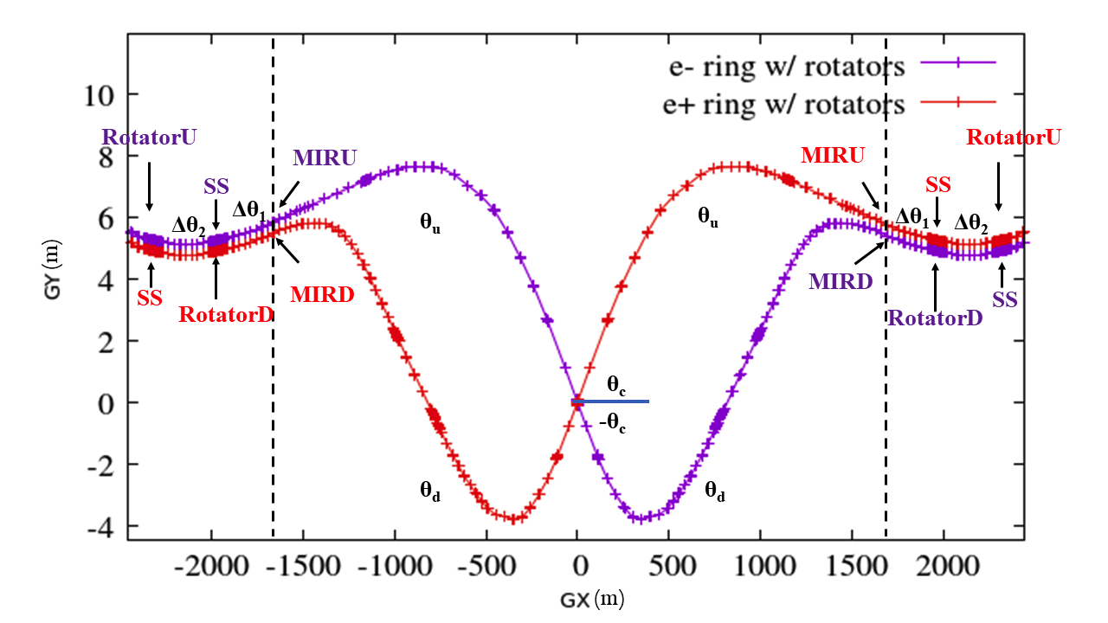
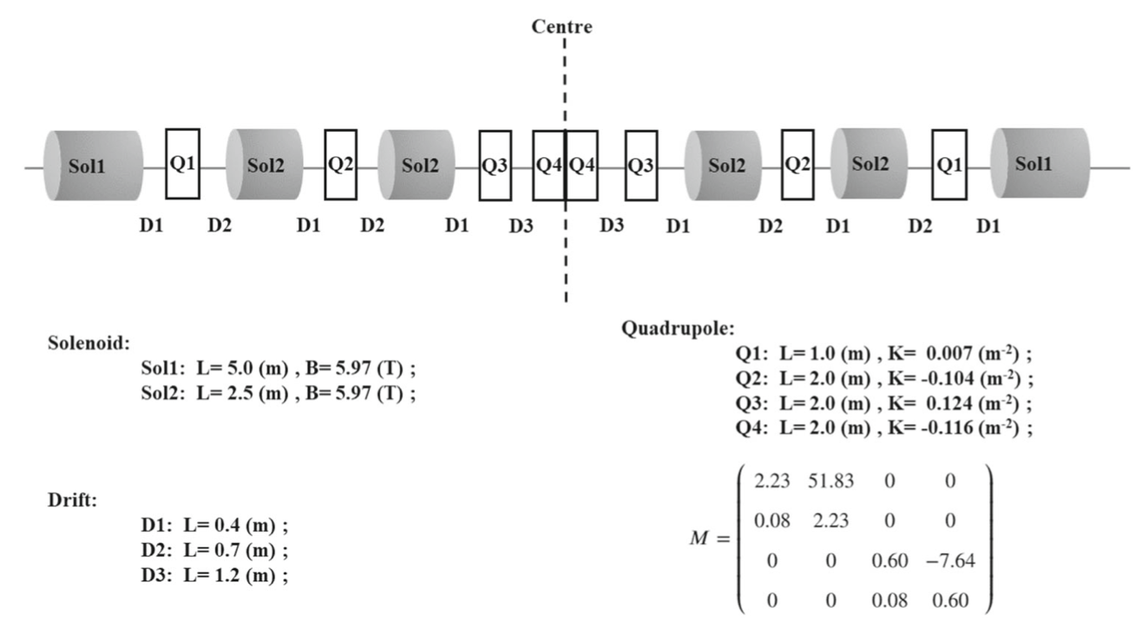
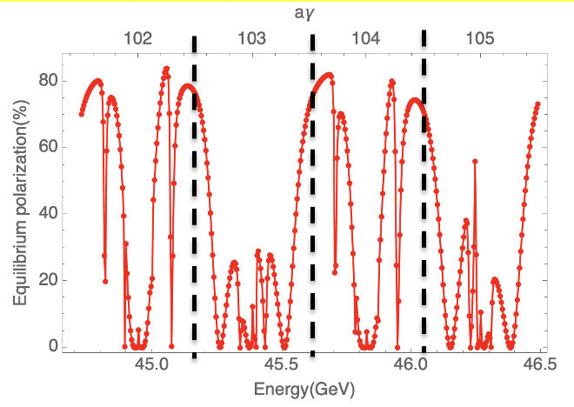
A high-level longitudinal polarization @ Z-pole
50%-70% longitudinal polarization for e- bunches is a reasonable goal
P_{inj} > 70%, P_{DK} > 70% w/ spin rotators
leaving a large margin for effects not yet covered.
Implementation of the spin rotators adjacent to the IR
It is also possible to attain a decent longitudinal polarization for 62.5 GeV (Higgs, monochromatization) & 80 GeV (W)
  solenoid strength scales ~linearly with energy
Simulated equilibrium polarization for an imperfect lattice w/ rotators after closed orbit correction w/ SLIM
Interleaved solenoids & quads for spin rotation & coupling compensation
480T.m integral solenoid field for two rotators around each IP

Slide 12
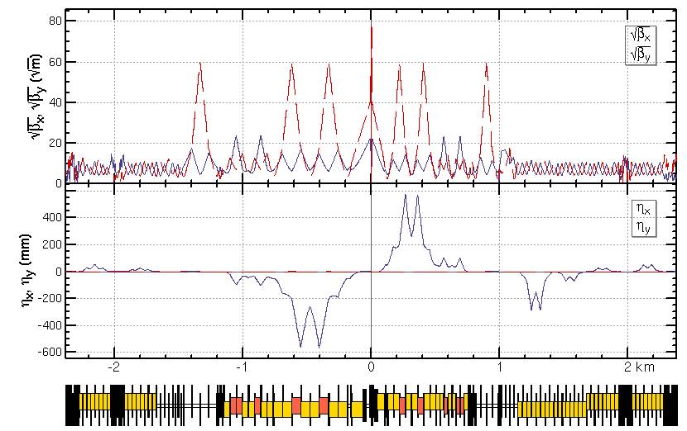
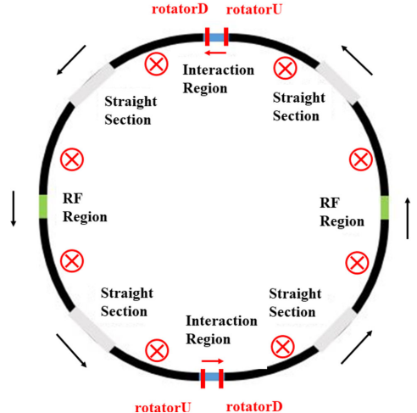
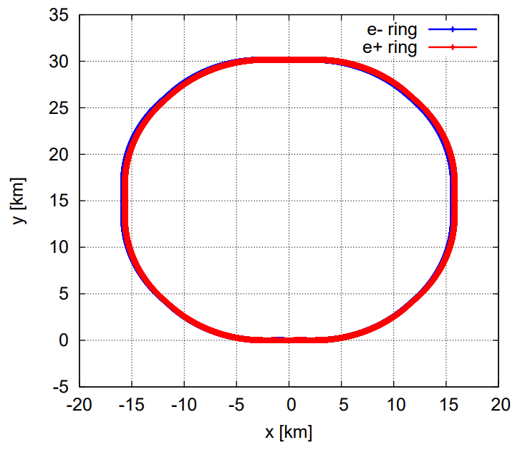
Updates on spin rotator implementation
Spin rotators have been implemented into the TDR lattice
  Inserted into the regions between IR and ARC
  The deflection angles and lengths of ARC dipoles are reduced
  The circumference of the whole ring is 99.913km
  More detailed optics matching & optimization is under way

Slide 13
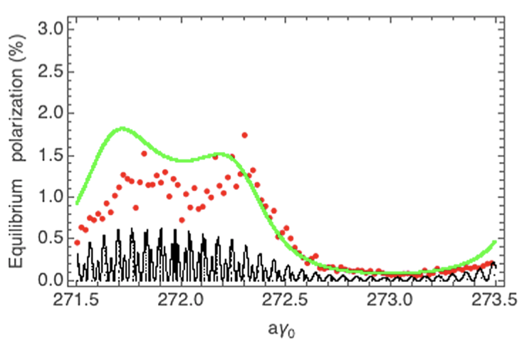
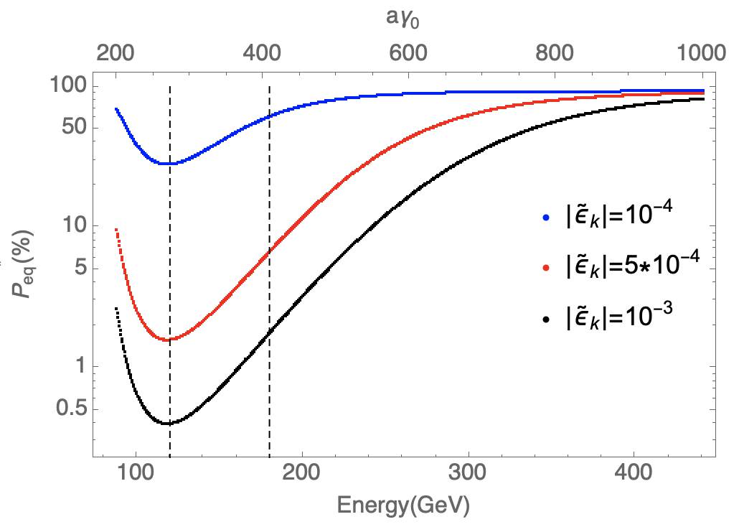
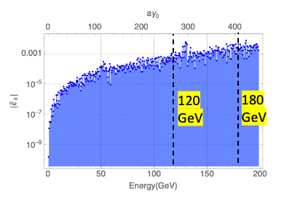
Useful polarization level at Higgs?
More challenging but possible at Higgs
  Simulated injected polarization < 30% -> improvements in Booster lattice design & mitigation of machine imperfections
  Simulated equilibrium polarization ~ 1% -> mitigate depolarization by spin matching
Need to understand how well spin matching can be done
  BAGELS & machine learning provide new approach (see EIC presentations)
  Better to be tested in real machines
Simulated equilibrium polarization of Collider at Higgs
Prediction of resonant spin diffusion theory at ultra-high energies
The key is to reduce the spin
resonance strength by a factor of 10 ~ 100
W. H. Xia, et al, Evaluation of radiative depolarization in the future circular electron-positron collider, Phys. Rev. Accel. Beams, 26, 091001, (2023).

Slide 14
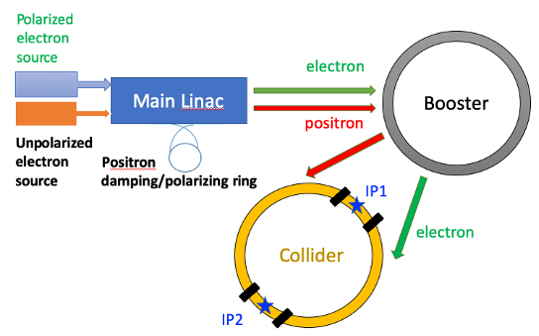
Key aspects of polarization R&D in the EDR phase
Key aspects | Figure of merit | R&D goal
Design study | > 50% polarization for both beams | improve pol e- design, study pol e+ scheme
Polarized electron source | polarization > 85% | polarized DC gun @ PAPS, polarization > 85%
Compton polarimeter | 3D measurements ~ 0.1% | vertical polarization measurement @ BEPCII, ~1%
Resonant depolarization-based beam energy calibration | ~1e-6 for Z & W | demonstration @ BEPCII
Solenoid spin rotator for longitudinal polarization @ Z-pole | Solenid integral field ~ 1000 T.m per IP | HTS SC solenoid, B ~ 12 T, BL > 10 T.m beam test @ a future test facility
Hardware R&D and beam tests
Enable
IP/detector
Experimental studies
Verify
IP/detector
polarimeter
Physics design

Slide 15
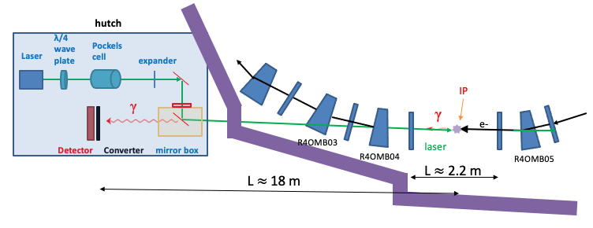
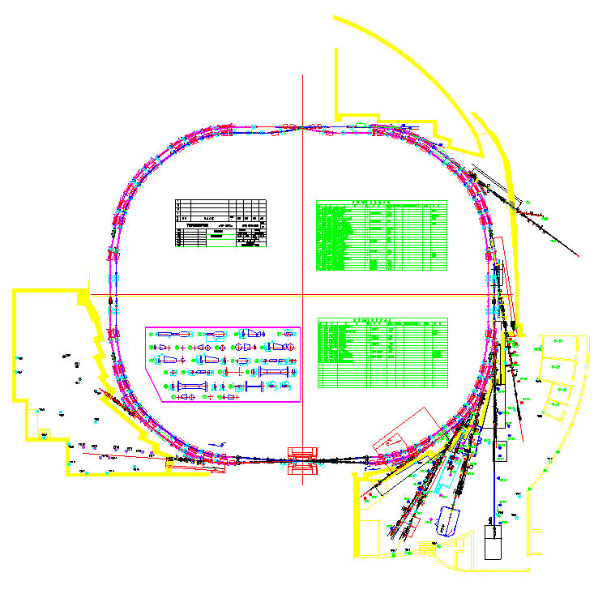
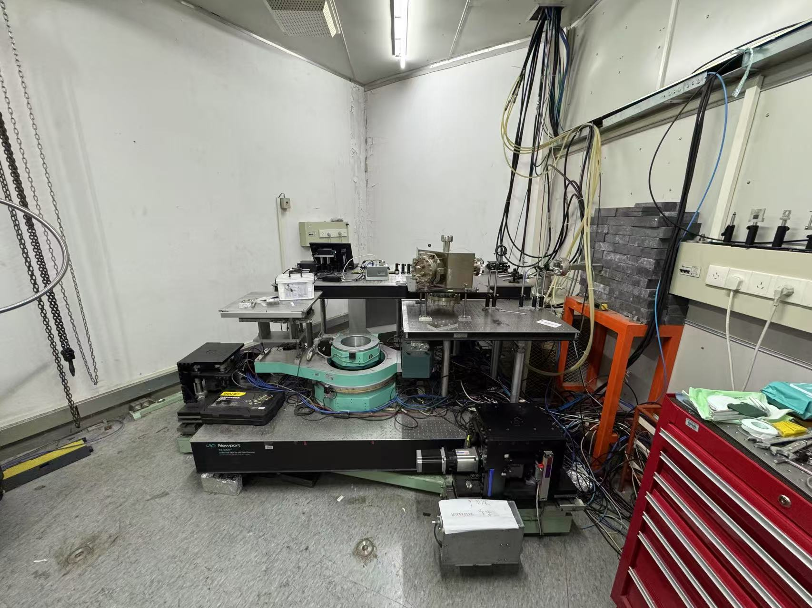
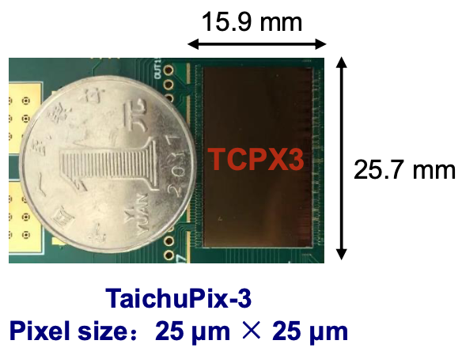
Compton polarimeter @ BEPCII
Measurement of electron vertical polarization
  Modify the beamline and hutch of a dismantled wiggler 4W2
  detection of backscattered γ position with CEPC vertex detector prototype
  In collaboration with A. Martens (IJCLab) with support from FCPPN/L.
experimental hutch
NIMA 1059 (2024) 168945

Slide 16
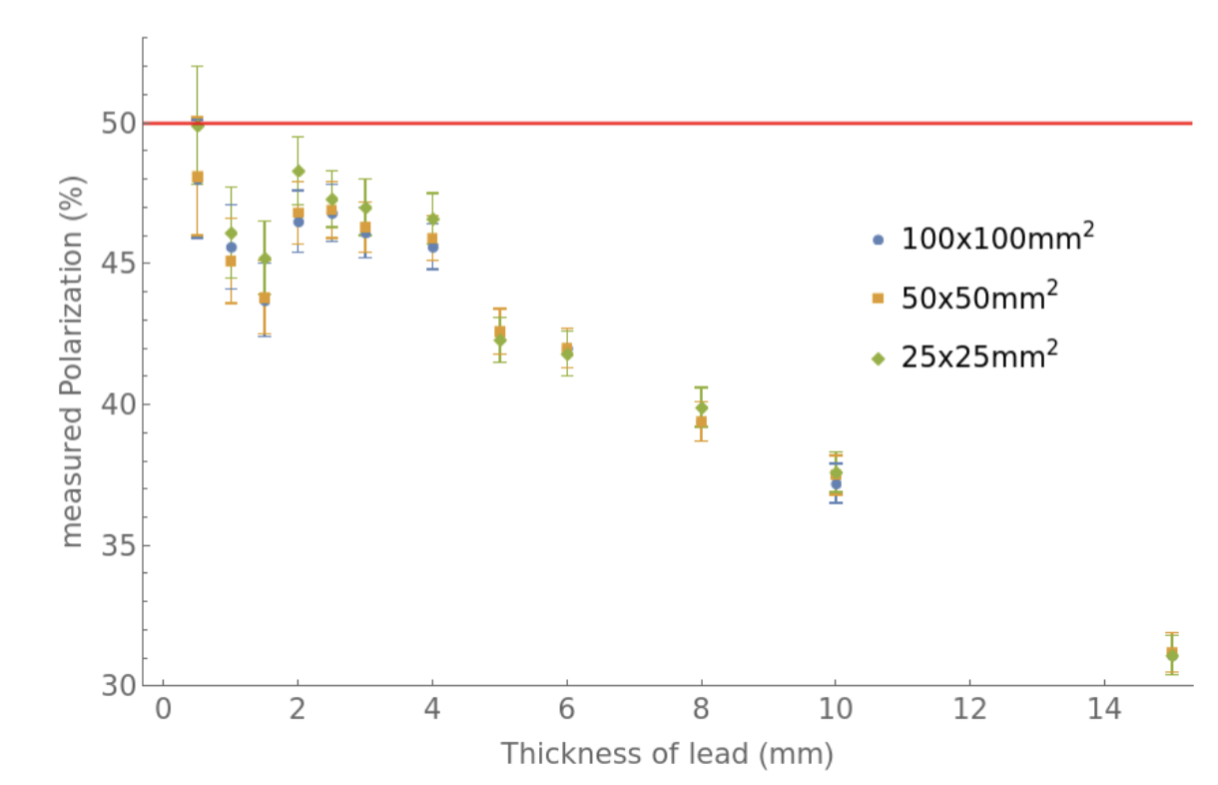
Compton polarimeter @ BEPCII
Simulated performance
  stats uncertainty: ~1% within 20 second for 3mm lead
  systematic uncertainty relates to the thickness of lead preshower
Potential background sources:
  SR (critical energy ~ 2.8keV), likely stopped by lead
  bremstrahlung, good vacuum level near IP is required (<< 1 mbar)
  spurious electrons: a permanent dipole planed in the front end
Asymmetry
Electron beam | value | Q-switch laser | value
Energy (GeV) | 2.35 | wavelength(nm) | 532
bunch charge (nC) | 5.92 | Pulse energy (mJ) | 2
repetition rate (kHz) | 1.26e3 | repetition rate (kHz) | 4.5
Pulse length(ps) | 50 | pulse length(ps) | 2000
rms emittance (nm) | 157/0.53 | laser waist @ IP(mm) | 1
Crossing angle (mrad) | ~0.5 (horizontal)
Luminosity (barn⁻¹s⁻¹) | 2.07e7
Cross section (barn) | 0.615
γ-yield rate | 12.8 MHz, i.e., 2845 per crossing
vertical coordinate on detector(mm)
Assume 50% vertical polarization
Measured polarization (%)
Thickness of lead (mm)

Slide 17
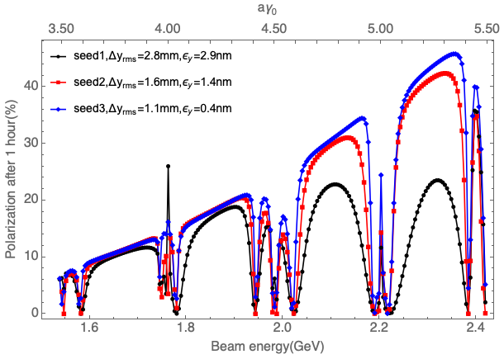
Compton polarimeter @ BEPCII
BEPCII energy upgrade (2025-2030, up to 2.8 GeV)
  Started commissioning yesterday @ 1.84 GeV
  Will start operation at 2.35 GeV from Sep 2025
Laser system ready by late March
First polarization measurement experiment in April
An ideal testbed of polarization studies for future colliders
Simulated self-polarization level after 1 hour, for typical imperfect lattices
Aspects | R&D item
Compton polarimeter | laser polarization measure/control, silicon pixel detector
Resonant depolarization | Beam energies of pilot bunch vs colliding bunch
Beam-beam depolarization | Rich data of parameter dependence: energy scan, beam current etc
Online polarization tuning | spin matching (HSM, new approaches like BAGELS), machine learning techniques

Slide 18
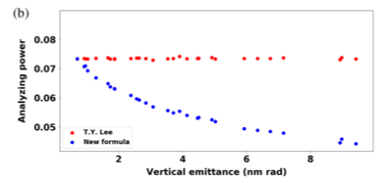
Influence of electron beam polarization to Touschek lifetime
Touschek lifetime as a polarimeter
Vertical emittance has nontrivial influence over measurement sensitivity, overlooked by previous studies
Code modification submitted to Bmad authors
Effects | Piwinski formula | T. Y. Lee formula | New formula
Spin polarization | ✕ | ✓ | ✓
relativistic electron motion in COM system | ✓ | ✕ | ✕
dispersion function | ✓ | ✕ | ✓
particle loss due to vertical momentum transfer | ✓ | ✕ | ✓
Hongjin Fu, Zhe Duan and Jiuqing Wang, New analytical formula on the Touschek lifetime of the polarized electron beam in electron storage rings, Phys. Rev. Accel. Beams 27, 124401 (2024)

Slide 19
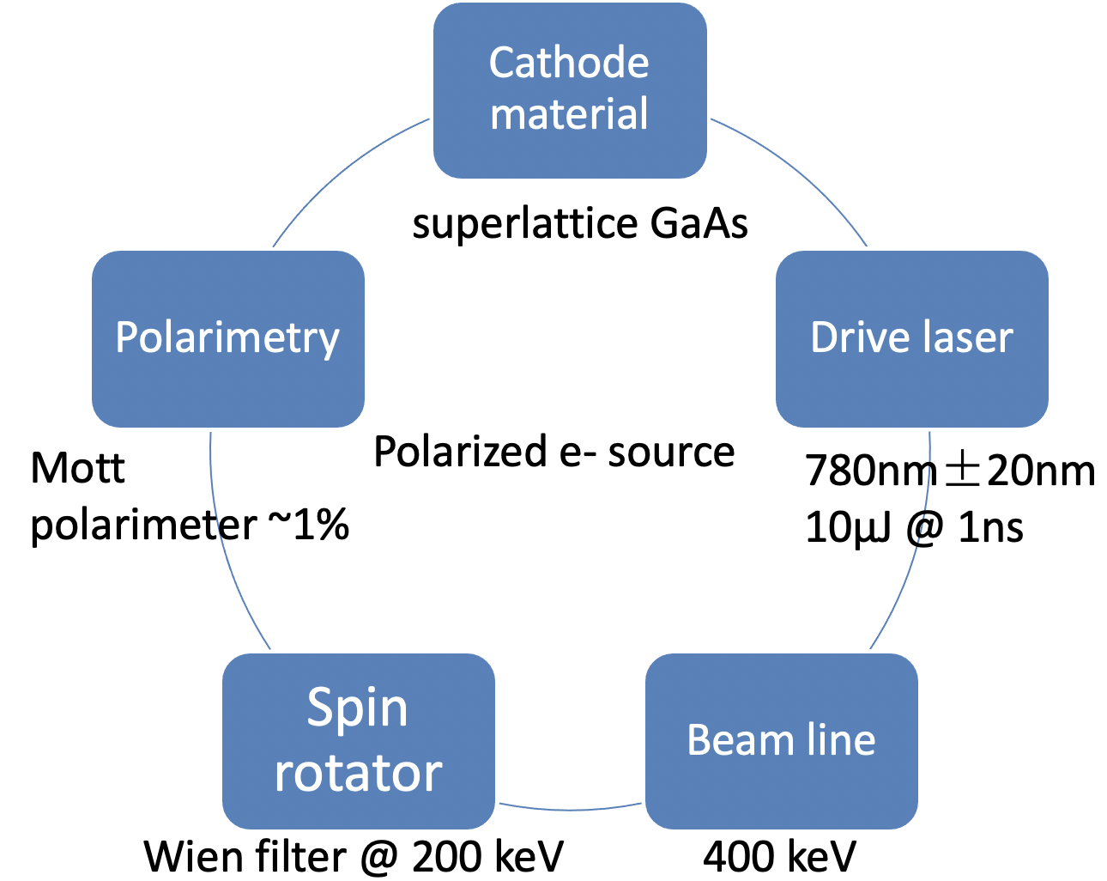
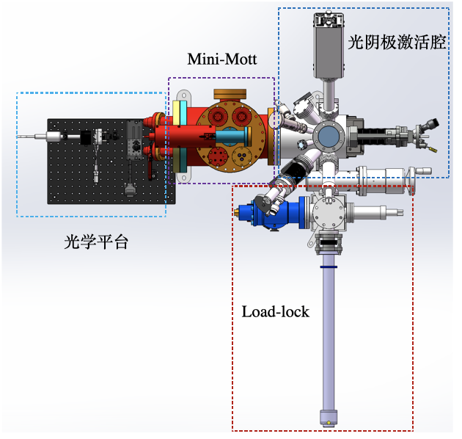
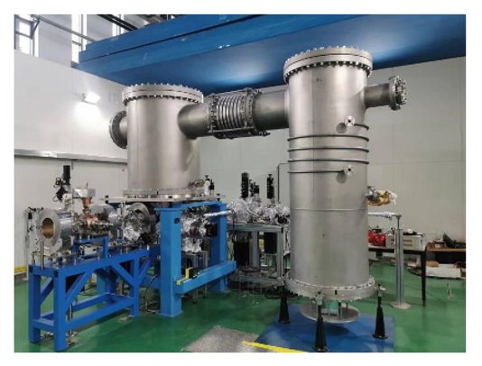
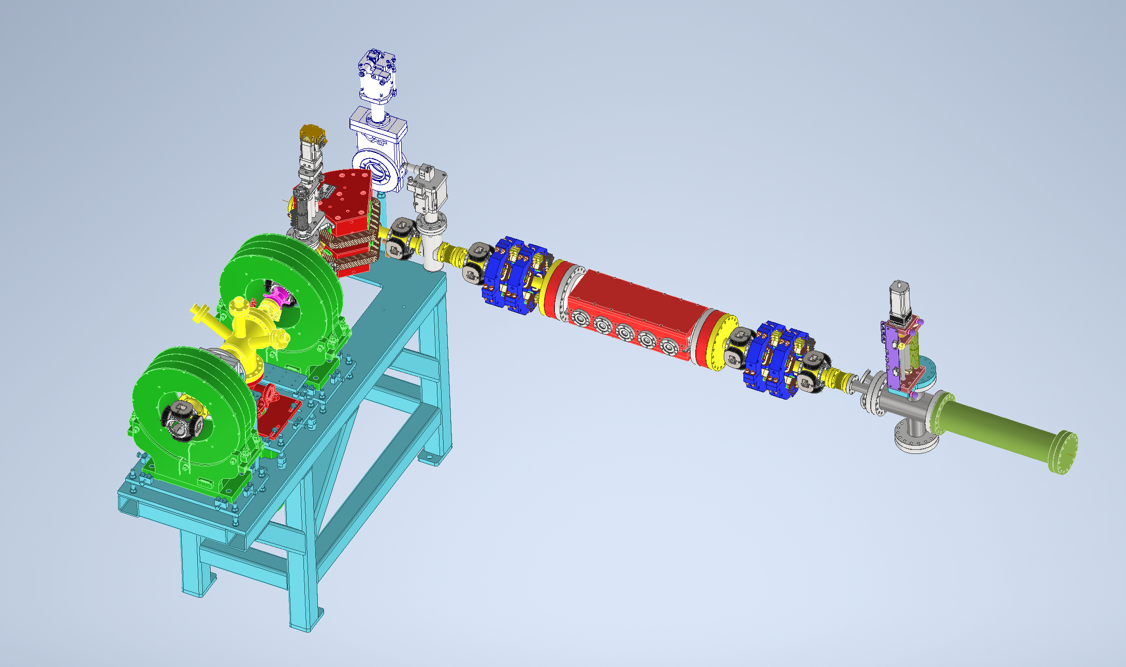
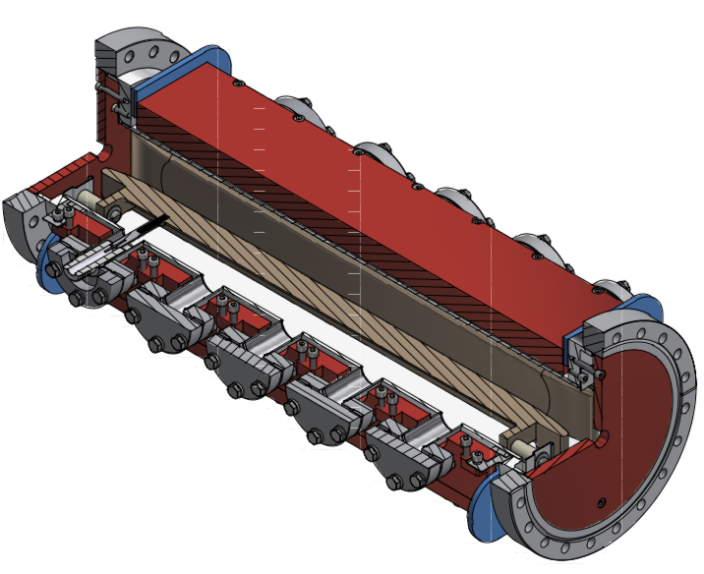
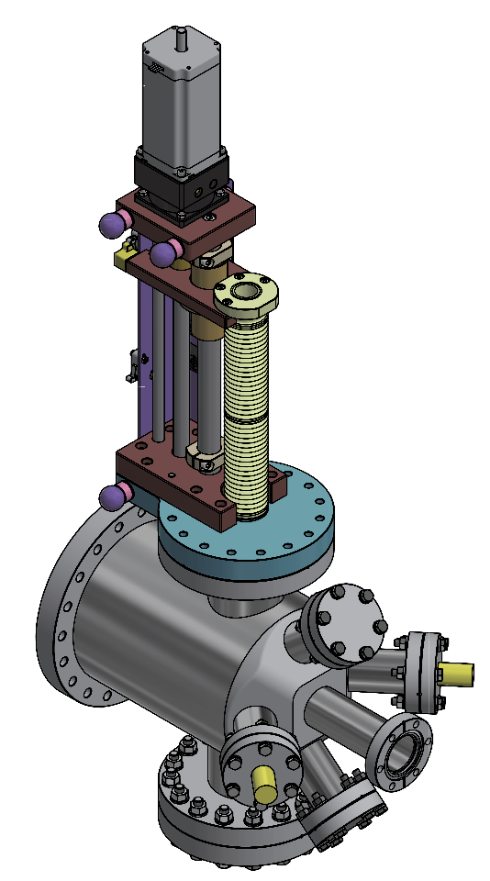
A test facility for polarized electron source
Convert a HV DC gun to a polarized electron source
  Domestic R&D on superlattice GaAs cathode, goal: polarization > 85%, QE > 0.8%, in collaboration w/ Acken, Wei Liu (CQU)
  Design of Wien filter & Mott polarimeter and the beamline modification, in collaboration with V. Tyukin (JGU-Mainz) supported by PIFI
  Beam commissioning scheduled in 2027
Platform for cathode test:
ESP & QE
500kV photocathode DC gun @ PAPS
Wien filter
Mott polarimeter
Li Xiaoping, Liu Wei, Meng Cai, Wang Jianli, Wang Haijing, Liu Jindong, Liang Zhijun, Zhang Shu etc

Slide 20
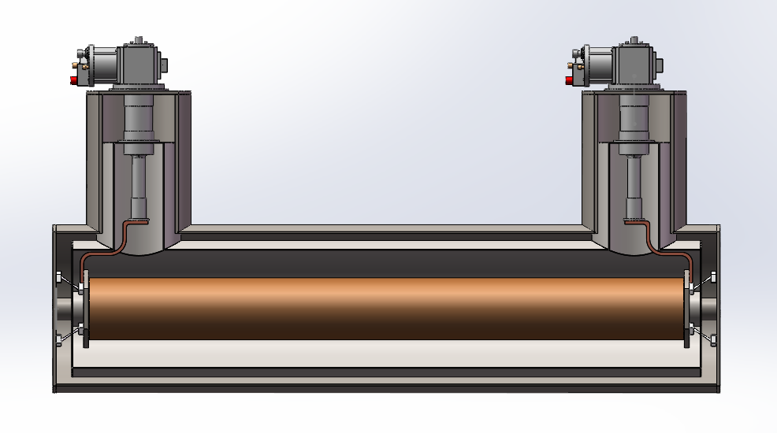
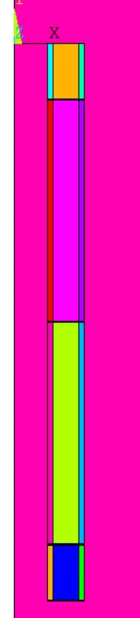
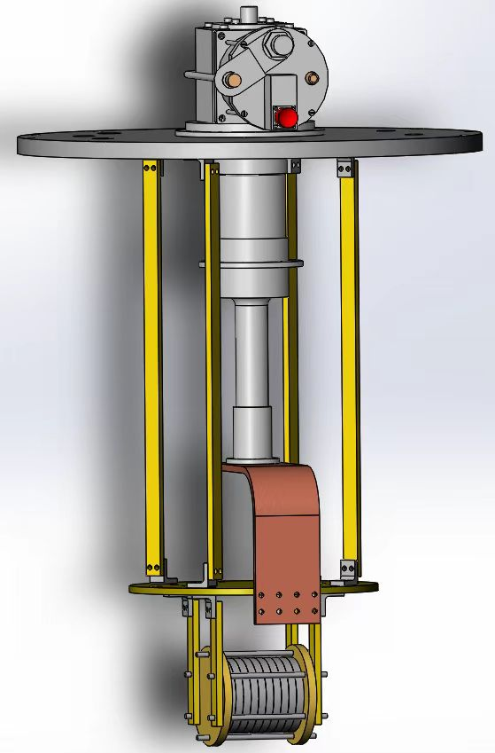


YBCO Superconducting solenoid spin rotator R&D
Concept
  Application of HTS with conduction-cooling
Coil design and optimization
  integral field meets spec
  max strain lower than limit
Experiment studies
  Temperature homogeniety
  Stability of YBCO coils
Measurements & tests scheduled in 2027
Design specs：
Peak field: 12 T
Integral field：10.26T.m
Length：1.018m
Working current：300A
Coil aperture：140mm
magnet aperture > 64mm
Cryo-cooler
Vacuum Dewar
Solenoid
10 Double-winding（12mm宽）
80 Double-winding（4.8mm宽）
10 Double-winding（12mm宽）
Zhao Ling, Xu Qingjin, Hou Zhilong, Zhou Jin, Liu Zhongxiu etc
Experiment studies of key issues with the conduction cooling and YBCO coils

Slide 21
Summary
A scheme with a polarized lepton injector is promising for polarized beam applications at CEPC.
50% ~ 70% longitudinal polarization for e- beam is attainable at Z-pole, and also possible to extend up to W energy.
A Compton polarimeter at BEPCII will start experiment very soon.
A test facility for polarized electron source is under development.
A prototype of a HTS solenoid spin rotator is under design.
Thank you for your attention!

