Slide 1
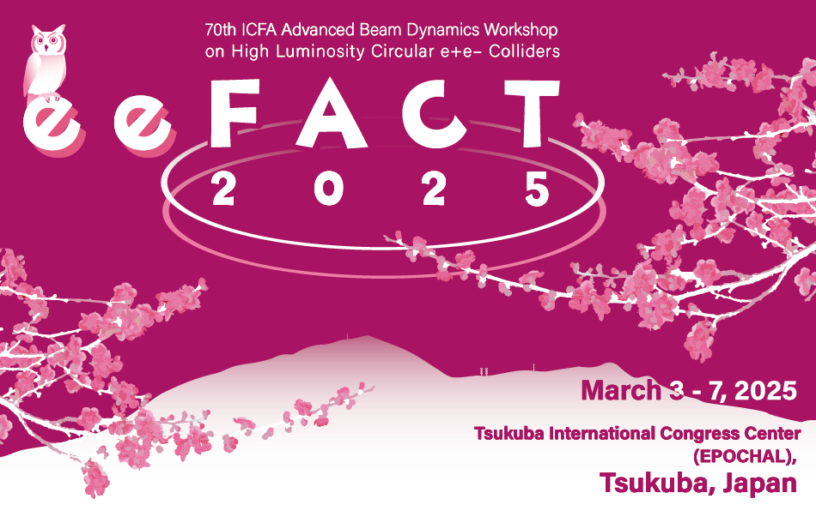
Research Activities Aimed at Decarbonizing the Life Cycle of Accelerator Facilities
Masakazu Yoshioka (Iwate University)

Slide 2
Abstract
There is no doubt that global warming is accelerating due to greenhouse gas emissions from human activities.
All industries are now required to work toward achieving carbon neutrality by 2050. Accelerator facilities are no exception.
In particular, life cycle assessment, including construction, operation, and decommissioning periods, is necessary to achieve carbon neutrality.
Researchers around the world who are planning large accelerators are actively addressing this issue.
For example, during the construction period, the decarbonization of steel products and concrete used there must be considered.
During the operation period, the electricity used should be as low carbon emission as possible.
This presentation will describe global trends and the Japanese situation regarding this activity, based on the authors' recent work on the case for an ILC to be located in Japan.

Slide 3
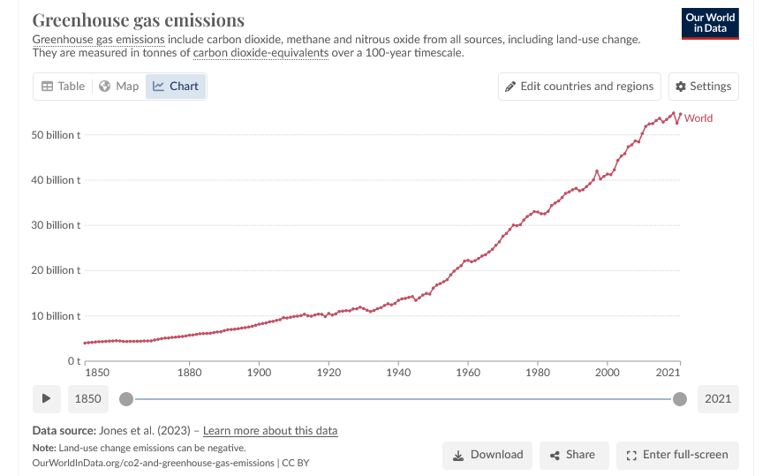
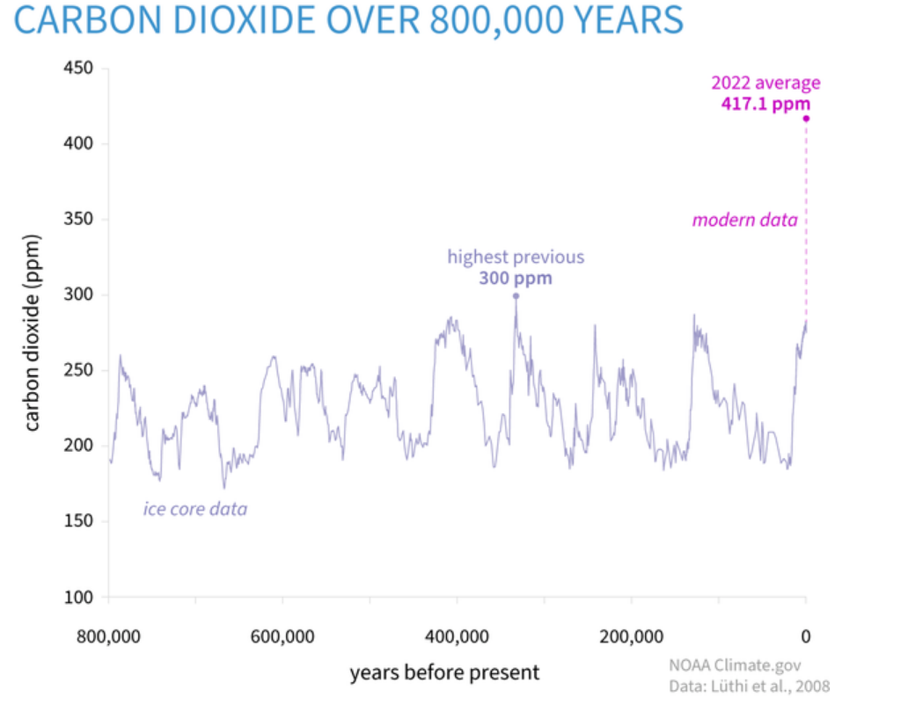


Since the Industrial Revolution.
It now exceeds 50 bilion tones.
Before the Industrial Revolution, CO₂ concentrations were cyclically fluctuating
However ➔ It is increasing at an alarming rate, and exceeding over 400 ppm
https://ourworldindata.org/greenhouse-gas-emissions
Let me clarify my understandings.
The Earth is currently warming due to cyclic variations in the precession of the Earth's orbital and rotational axes (Milankovitch cycle) and natural cycles such as biogenesis and eruptive activity.
Anthropogenic emissions of global greenhouse gases are accelerating this trend.
The rate of warming is so rapid that changes can occur within a short human lifetime, and scientists must work to halt it.
Accelerator facilities are no exception and should be taken seriously, including those of you in this hall.

Slide 4
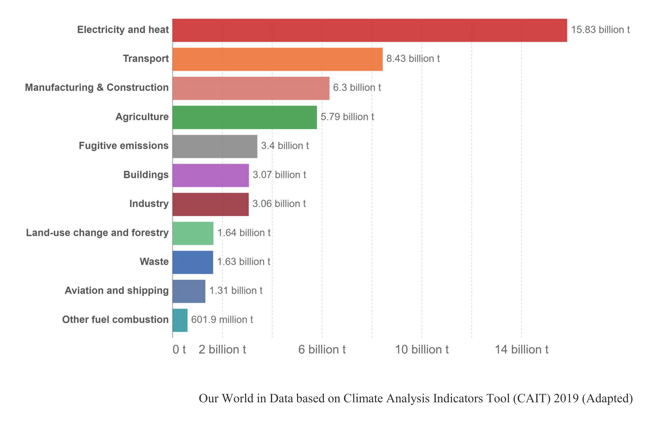
Breakdown of Global GHG Emissions by human activities.
This data shows that it is necessary to evaluate CO₂ emissions over the life cycle of an accelerator facility, not just over its operational period.
Presentation by Suzanne Evans of ARUP, WSFA2023 in Morioka

Slide 5
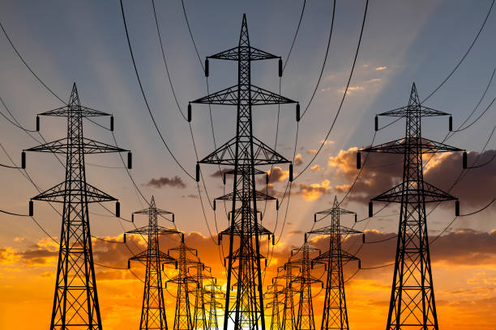
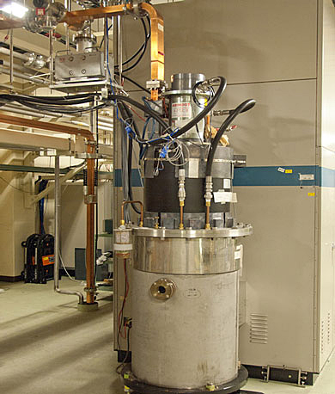
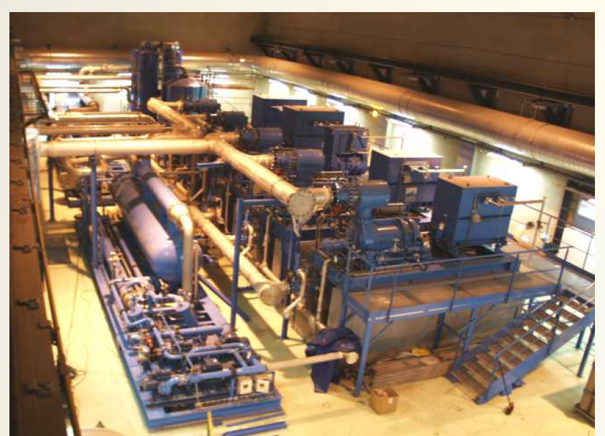
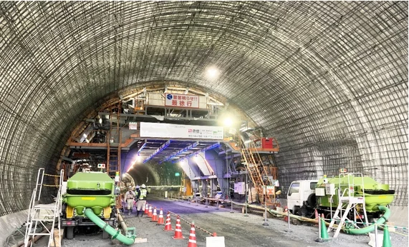
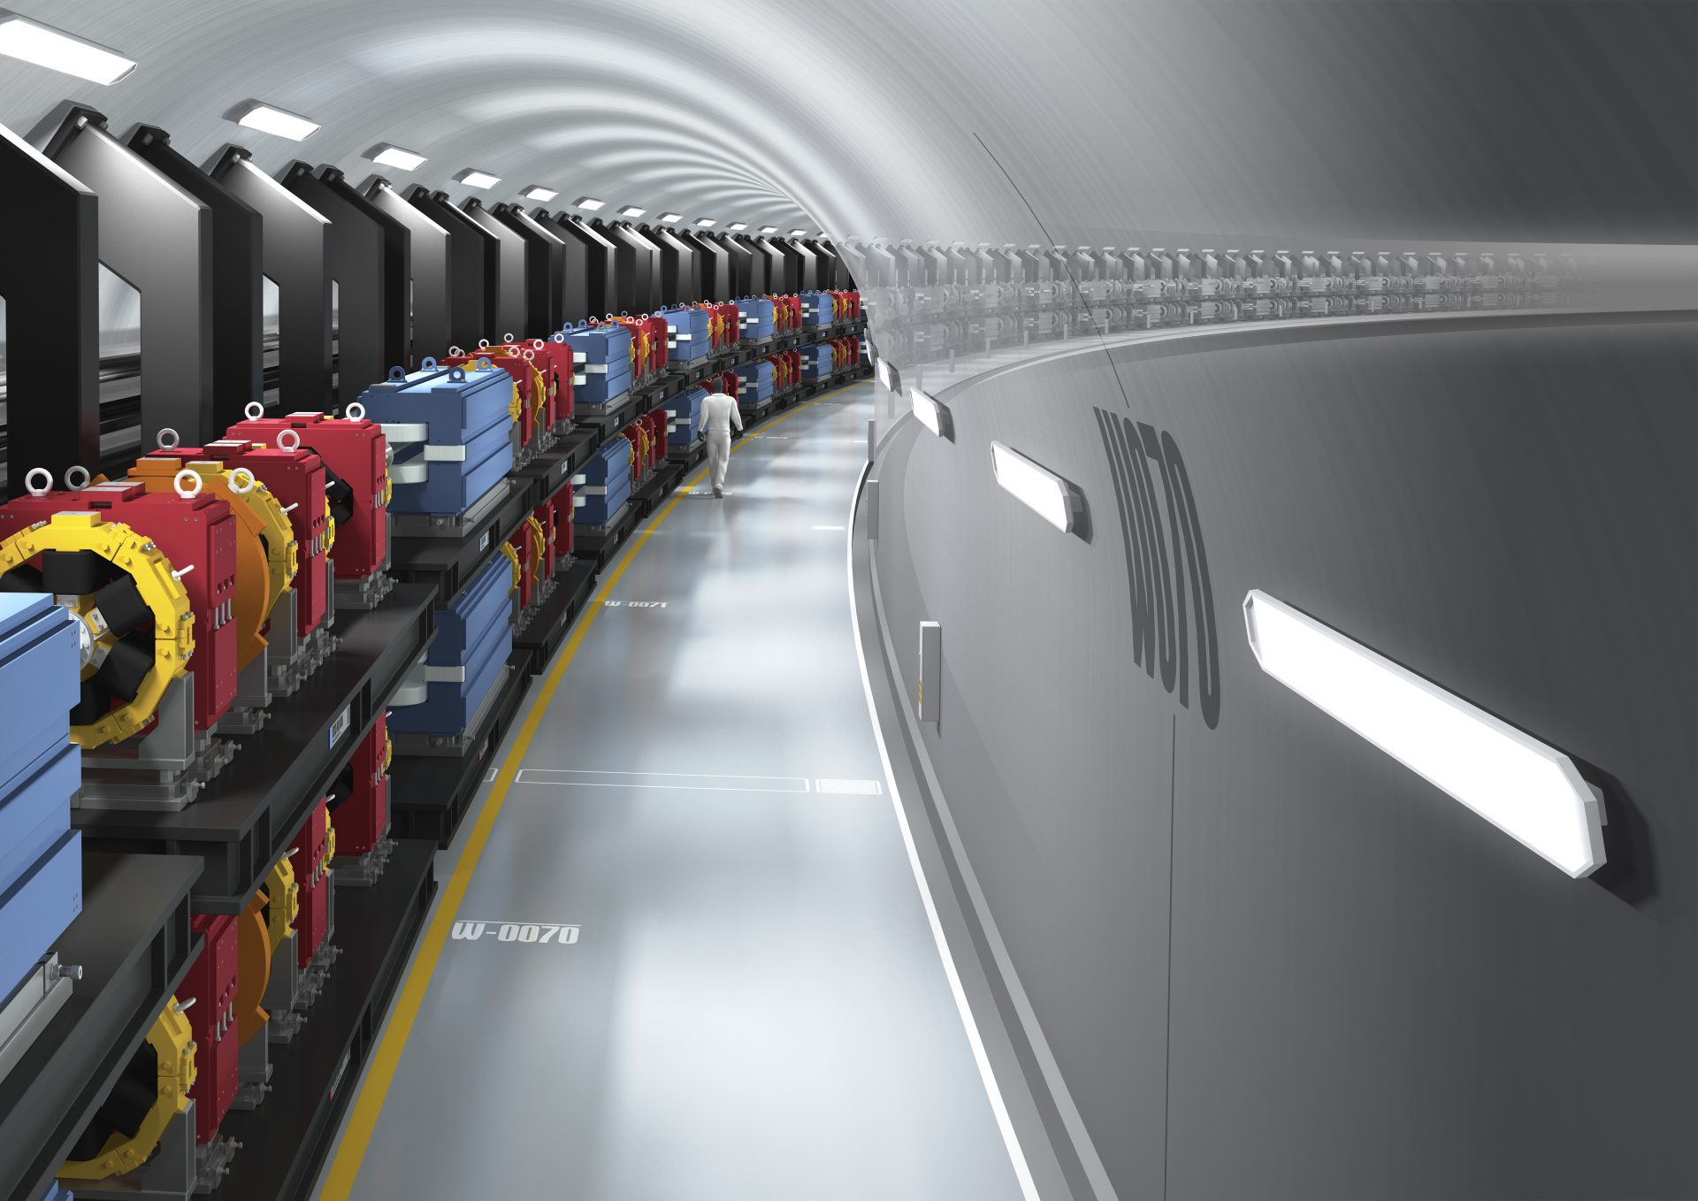
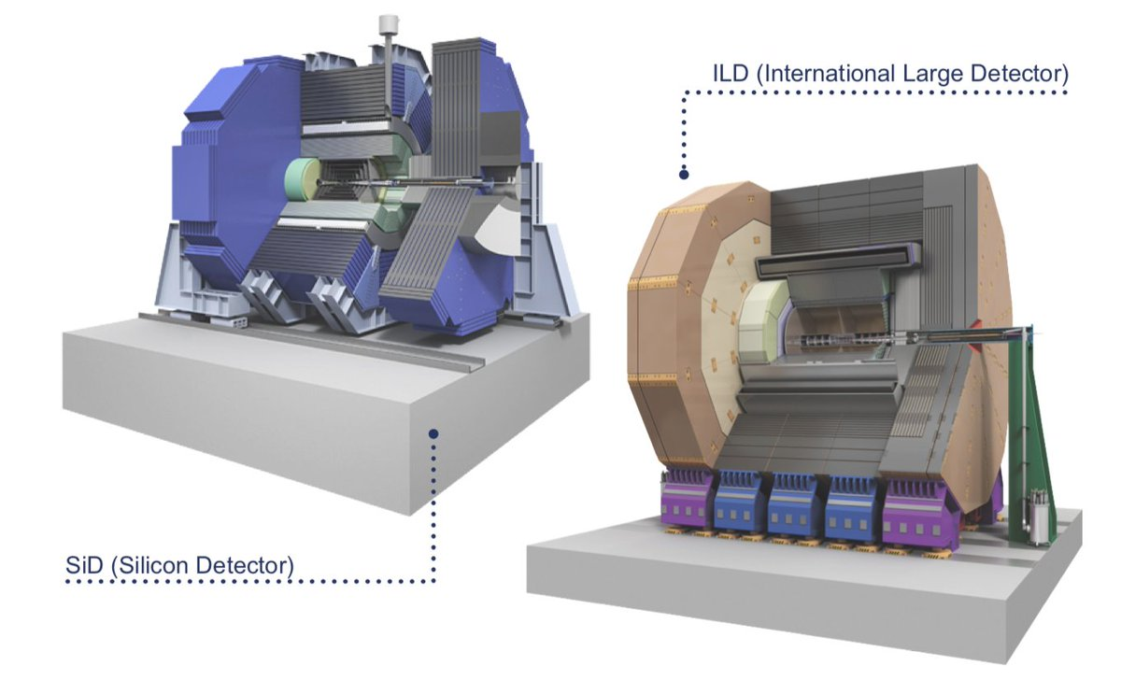
RF
Helium refrigerator
Civil Engineering
Damping
Ring
Accelerators are electric power-loading facilities and their construction uses a lot of concrete and steal. CO₂ emissions for the production of 1 ton of blast furnace iron amount to 2 tons, and 0.7 tons for the production of 1 ton of cement.
Reducing life-cycle global GHG emissions from construction to decommissioning of accelerator facilities is an important issue.

Slide 6
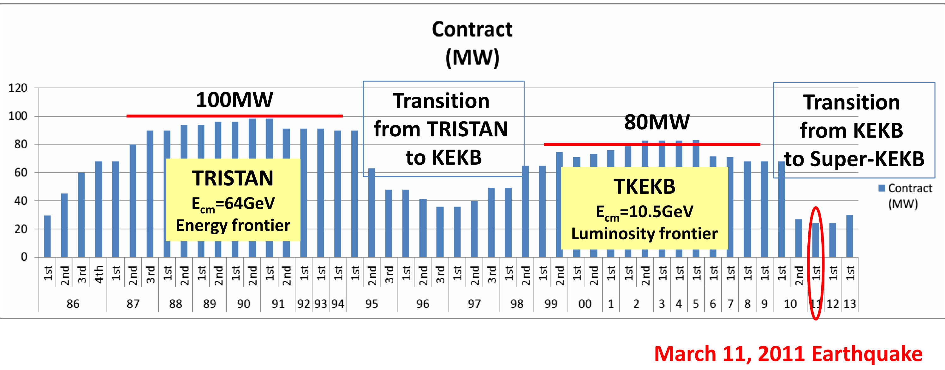
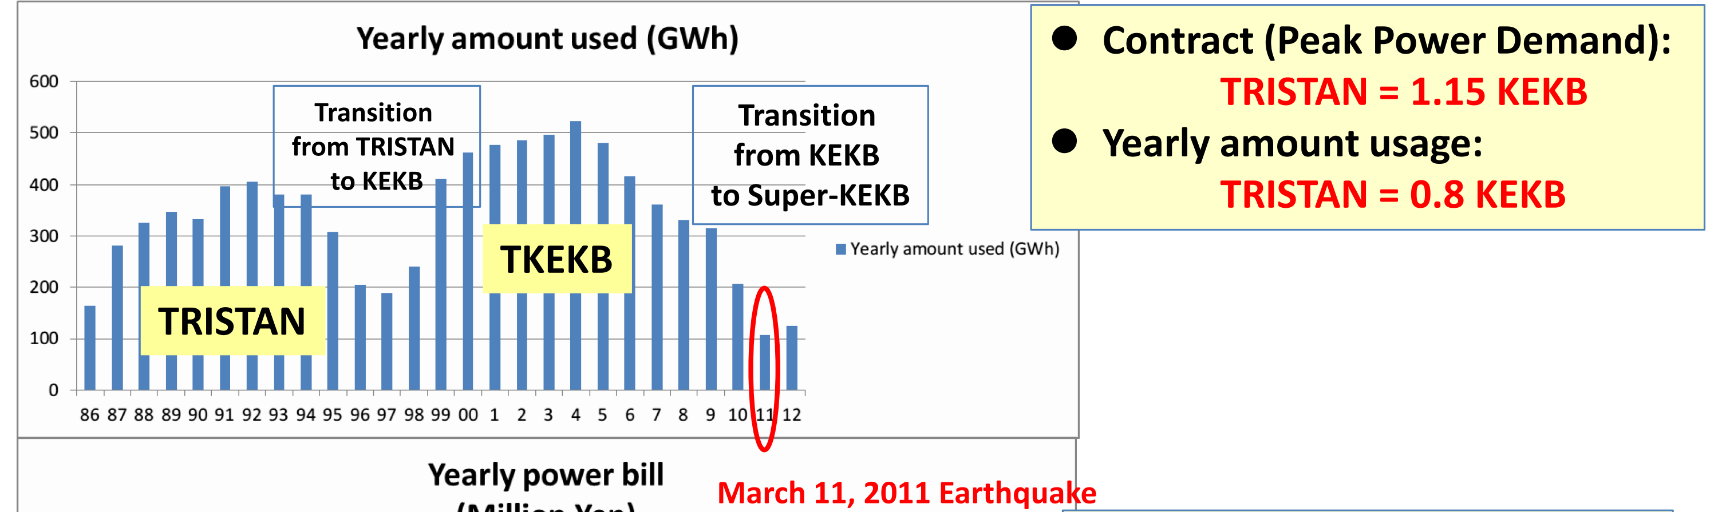
These figures show data from when I was in charge of power contracts at KEK during TRISTAN and KEKB operation. Old but helpful to understand.
Energy-oriented TRISTAN has greater peak power than KEKB, but luminosity-oriented KEKB has greater annual power use than TRISTAN

Slide 7
This table shows how energy-efficient the ILC based on a superconducting accelerator is. Beam energy is 4 times higher than TRISTAN, but only 30% more electric power
Super-KEKB, currently in operation at KEK, is also an eco-friendly design (nanobeam scheme) and achieves more than twice the luminosity at half the current of KEKB.

Slide 8
Accelerator researchers should make the following efforts to achieve sustainable accelerator facilities. And all efforts will be made in cooperation with industry and the community.
Improve power efficiency and performance of accelerator components.
Ensure that power used by accelerators is from sustainable sources whenever possible. To this end, we will help increase the amount of sustainable electricity in the region.
Recovering as much of the waste heat energy emitted from the accelerator facilities as possible and making it available for local use. To this end, we should create regional energy management projects using waste heat.
Help increase the amount of green carbon (CO₂ absorption by forests), blue carbon (CO₂ absorption by seaweed), and white carbon (CO₂ fixation by increasing the number of wooden buildings) in the region to increase CO₂ . absorption.

Slide 9

Much information was exchanged at the Workshop on Sustainability of Future Accelerators held in Morioka in September 2023. Here are some highlights from the workshop.
CO₂ emitted when generating 1 kWh of electricity in each country or region of the world.
In particular, the situation in Nordic countries has already achieved almost carbon neutrality.
CERN’s sustainability strategy.
Japan's strategy to achieve carbon neutrality by 2050.

Slide 10

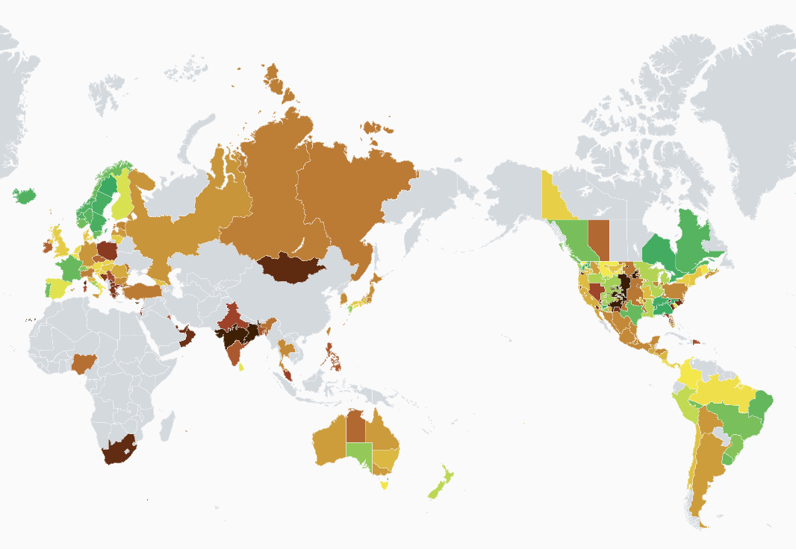
https://app.electricitymaps.com/zone/
This site was taught by Steiner Stapnes
World Map of CO₂ Emissions/kWh: The greener the better, the darker the worse
Data not AVAILABLE for gray countries or regions. Data displayed in real time.
This information is very helpful in understanding the global situation, so please take a look!

Slide 11
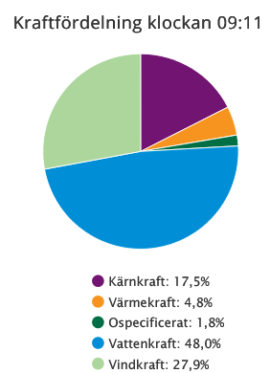
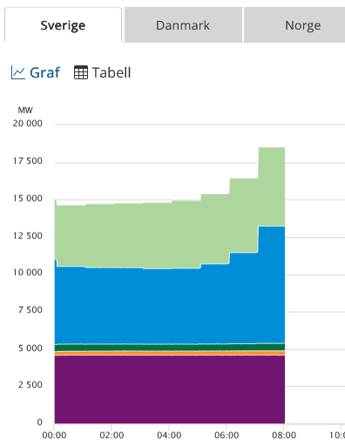
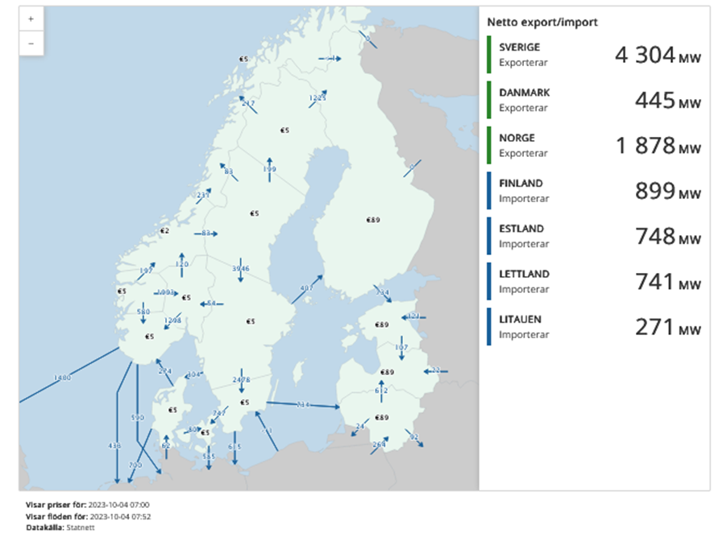
② The situation in Nordic countries
Nuclear
wind
Thermal
Others
wind
Hydro
Hydro
Power mix varies by country.
  Denmark 90% wind,
  Norway 90% hydro,
  Finland 51% nuclear.
The power grid is controlled across borders to achieve the best energy mix
Thermal power is less than 5%, renewable energy 75.9%, nuclear 17.5%
Nordic countries are a good model for achieving carbon neutrality in 2050
Nuclear
Changes in electricity demand over time and the amount of electricity generation that follows.
When electricity demand increases in the morning, wind and hydroelectric power generation follows.
Nuclear power is the base power source
Electricity composition at a given moment in time in seven Nordic countries
This information was given to us by Anders Sunesson (ESS Institute) from Sweden

Slide 12

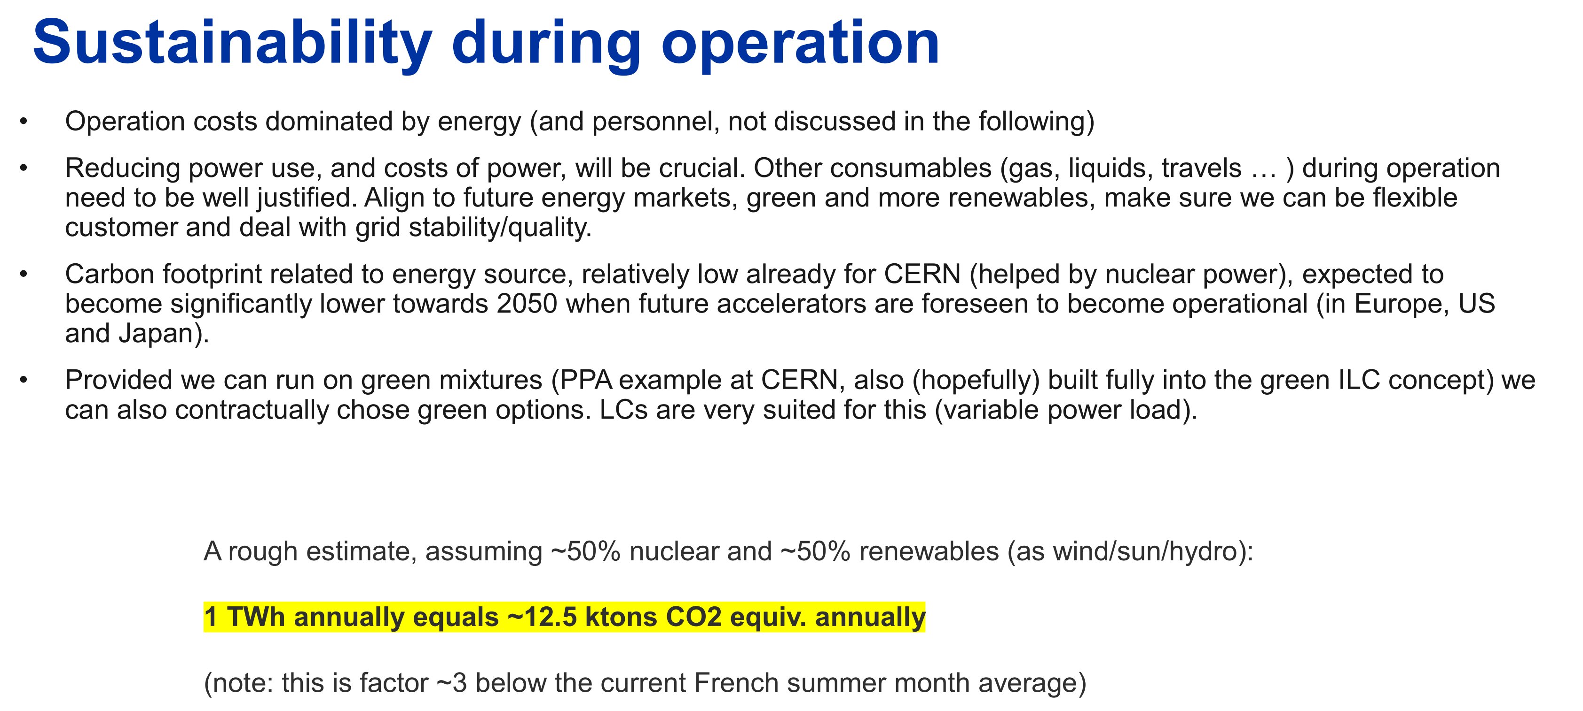
③ CERN’s sustainability strategy.
In this presentation, CO₂e/kWh = 5g for nuclear power and 20g/kWh for renewable electricity.
Since CERN plans to use 50% nuclear and 50% renewable energy for electricity, CO₂e/1TWh = 12.5 kton (12.5 g/kWh) when 1 TWh (1 billion kWh) is used per year

Slide 13
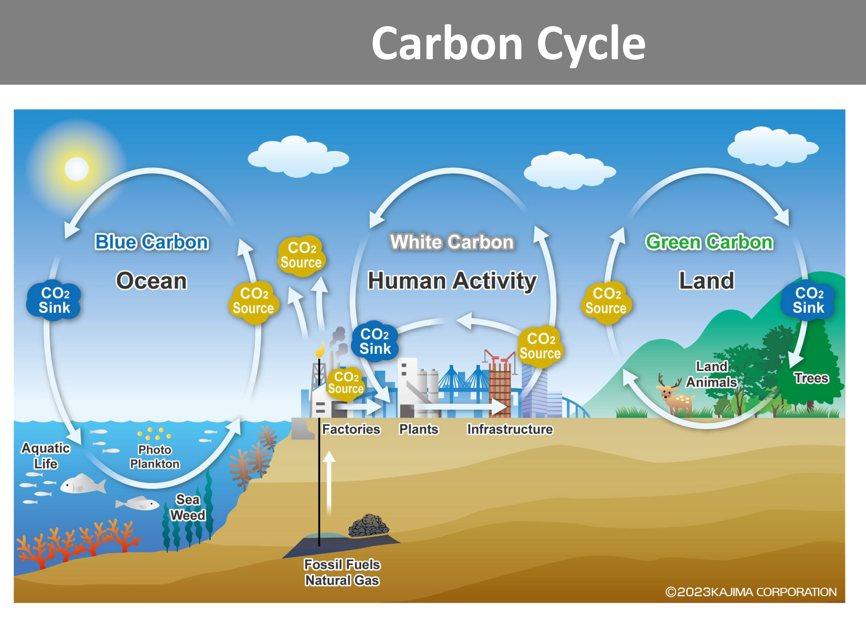
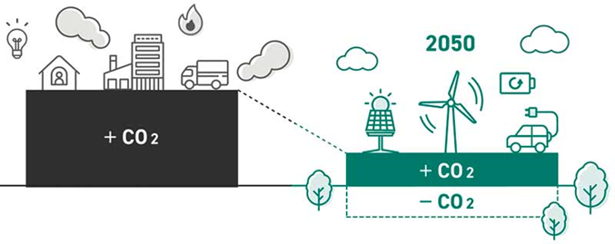
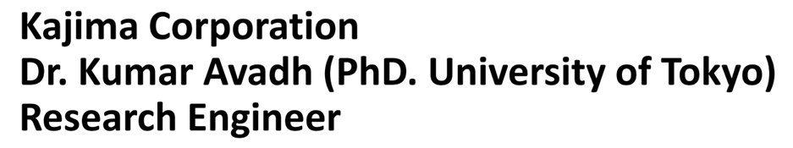
④ Japan's strategy to achieve carbon neutrality by 2050.
Japan is an island nation and must be a closed scenario in one country.
Japan will strive to reduce CO₂ emissions as much as possible by 2050.
On the other hand, it will be difficult to achieve complete fossil fuel phase-out, and an “offset” scenario with abundant renewable biomass will be adopted.

Slide 14
Next, I will discuss the carbon neutral strategy for the ILC to be located in the Kitakami Highlands in northeastern Japan.
First, I will discuss Japan's 7th Basic Energy Policy, which was approved by the Cabinet in February 2025.
Next, I describe the situation in Iwate Prefecture, where the ILC candidate site is located, which is blessed with renewable energy.
Finally, we propose a zero-carbon strategy for the ILC if it is located in the Kitakami Highlands.

Slide 15
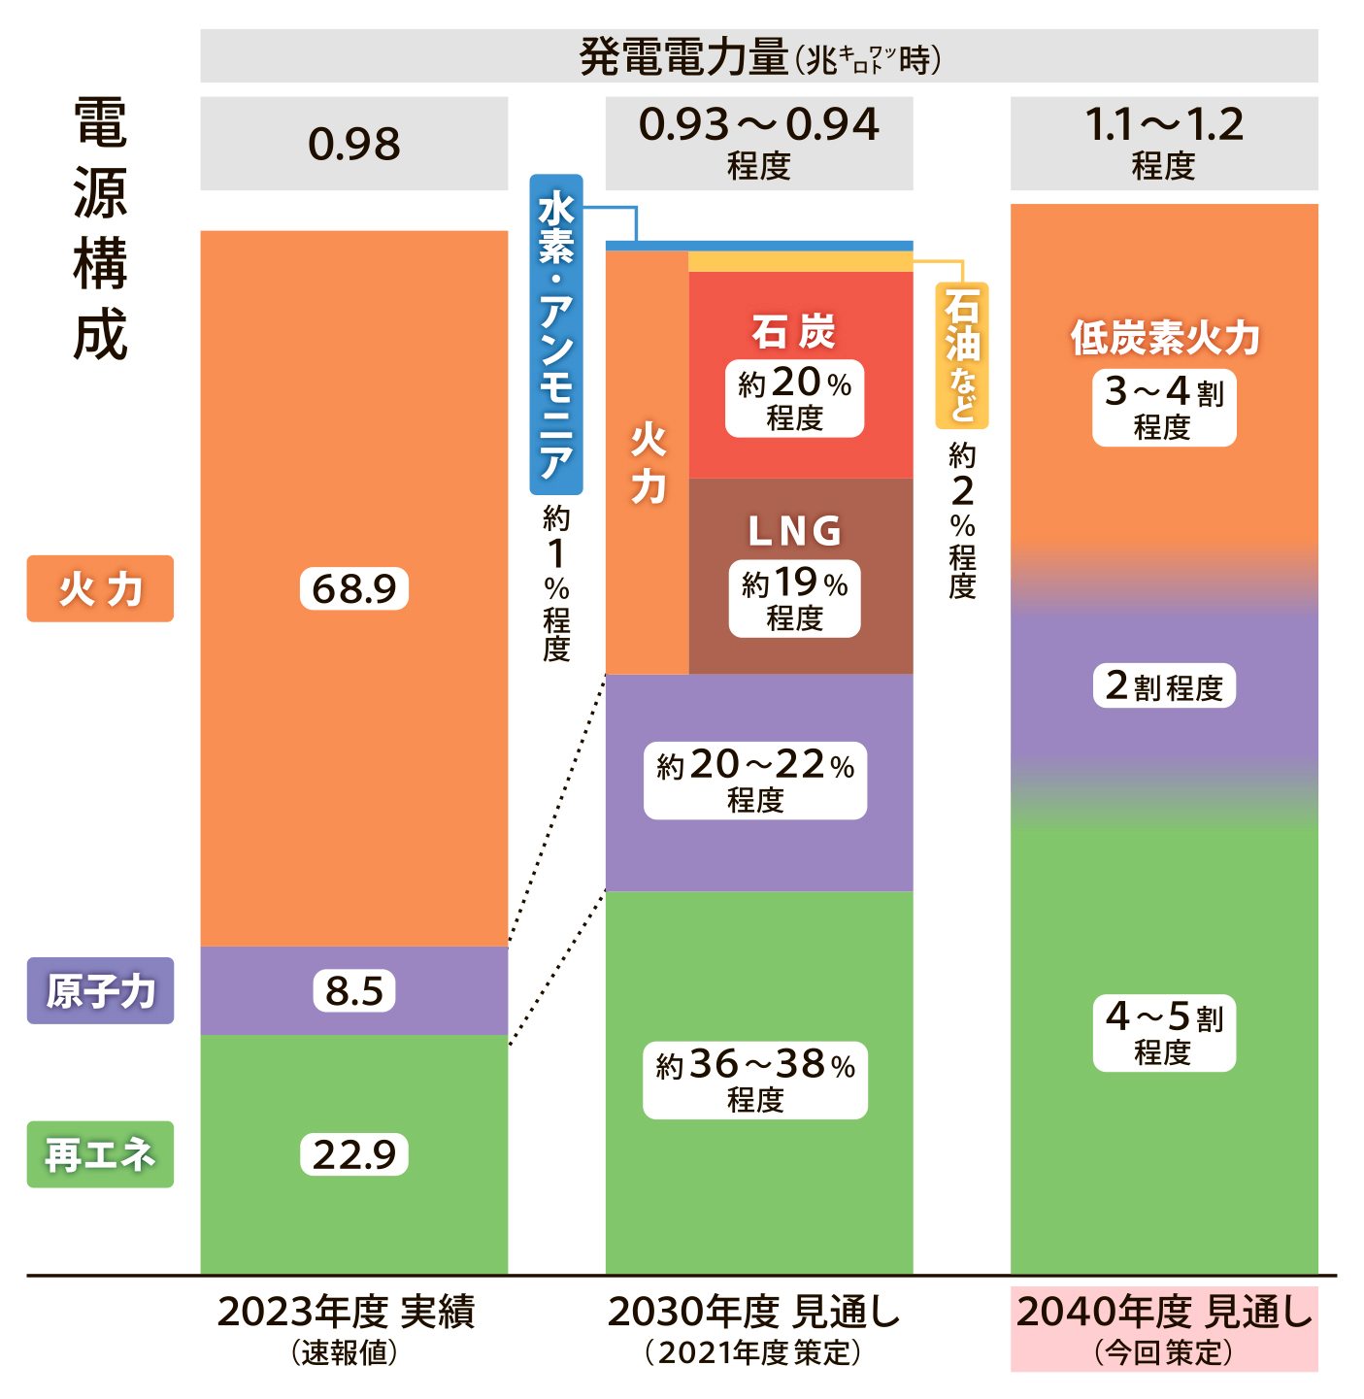
Total electric power generated in Japan
Power source composition
980 TWh
930~940 TWh
1100~1200 TWh
Hydrogen, ammonia
① Japan’s 7th Basic Energy Plan.
It was approved by the Cabinet in February 2025.
Goal:
to achieve up to 40~50% renewable
reduce fossil fuels to 30~40%.
Coal
Oil
30~40%
Thermal
20%
40~50%
Nuclear
Renewable
2023 actual results
2030 Target
6th Plan
2040 Target
7th Plan

Slide 16
Let's estimate the CO₂ emitted by the power source structure in the 7th Basic Energy Plan
I assume following CO₂ emission intensity by power source
(this is a working hypothesis for this time, and of course these figures must be verified)
Thermal 340g/kWh
Nuclear 5g/kWh
Renewable energy 20g/kWh
CERN‘s plan for CO₂ emissions for 1 TWh/year is 12.5 k-ton.
On the other hand, the 7th Basic Energy Plan of Japan is 113~15 k-ton.
In order to reduce this value, we will rework the scenario on the next page.

Slide 17
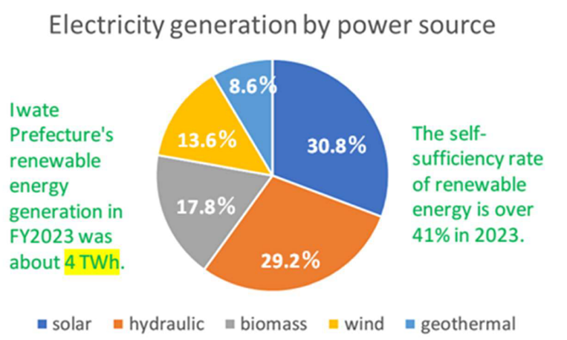
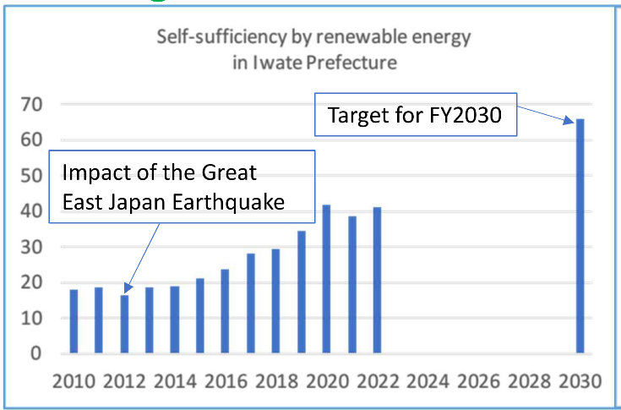
Consideration is based on the electricity situation in Iwate Prefecture, not the target for Japan as a whole.
These graphs are based on “Iwate Prefecture's Renewable Energy Electricity Status (2023) and Target for 2030” prepared by the Iwate Prefecture Environmental Living Department in September 2023
Since Iwate Prefecture is still actively increasing renewable energy, the 66% renewable energy target for 2030 will be achievable.

Slide 18
Next, I estimate the amount of CO₂ emitted by the ILC in 2040, assuming that the ILC is located in the Kitakami Highlands and that the ILC's electricity mix is as follows
70% Renewable energy power producers in Iwate Prefecture
  CO₂ emissions are assumed to be 20 g/kWh
20% Major electric power companies
  CO₂ emissions are assumed to be 113-145 g/kWh as per the 7th Basic Energy Plan
10% Private power generation (Co-generation)
  Conventional LNG-fired power generation cogeneration 145g/kWh
This assumption of power supply composition is my personal idea and has no authority.
The actual power supply configuration should be determined by the ILC Lab, taking into consideration the following three points：
Power system redundancy
Cost of power
Sustainability
0.7TWh

Slide 19
Conclusion: Assuming that the annual power consumption of the ILC is 0.7 TWh, the annual CO₂ emissions are less than 60 k-ton/0.7TWh when operating with the above power configuration.

Slide 20

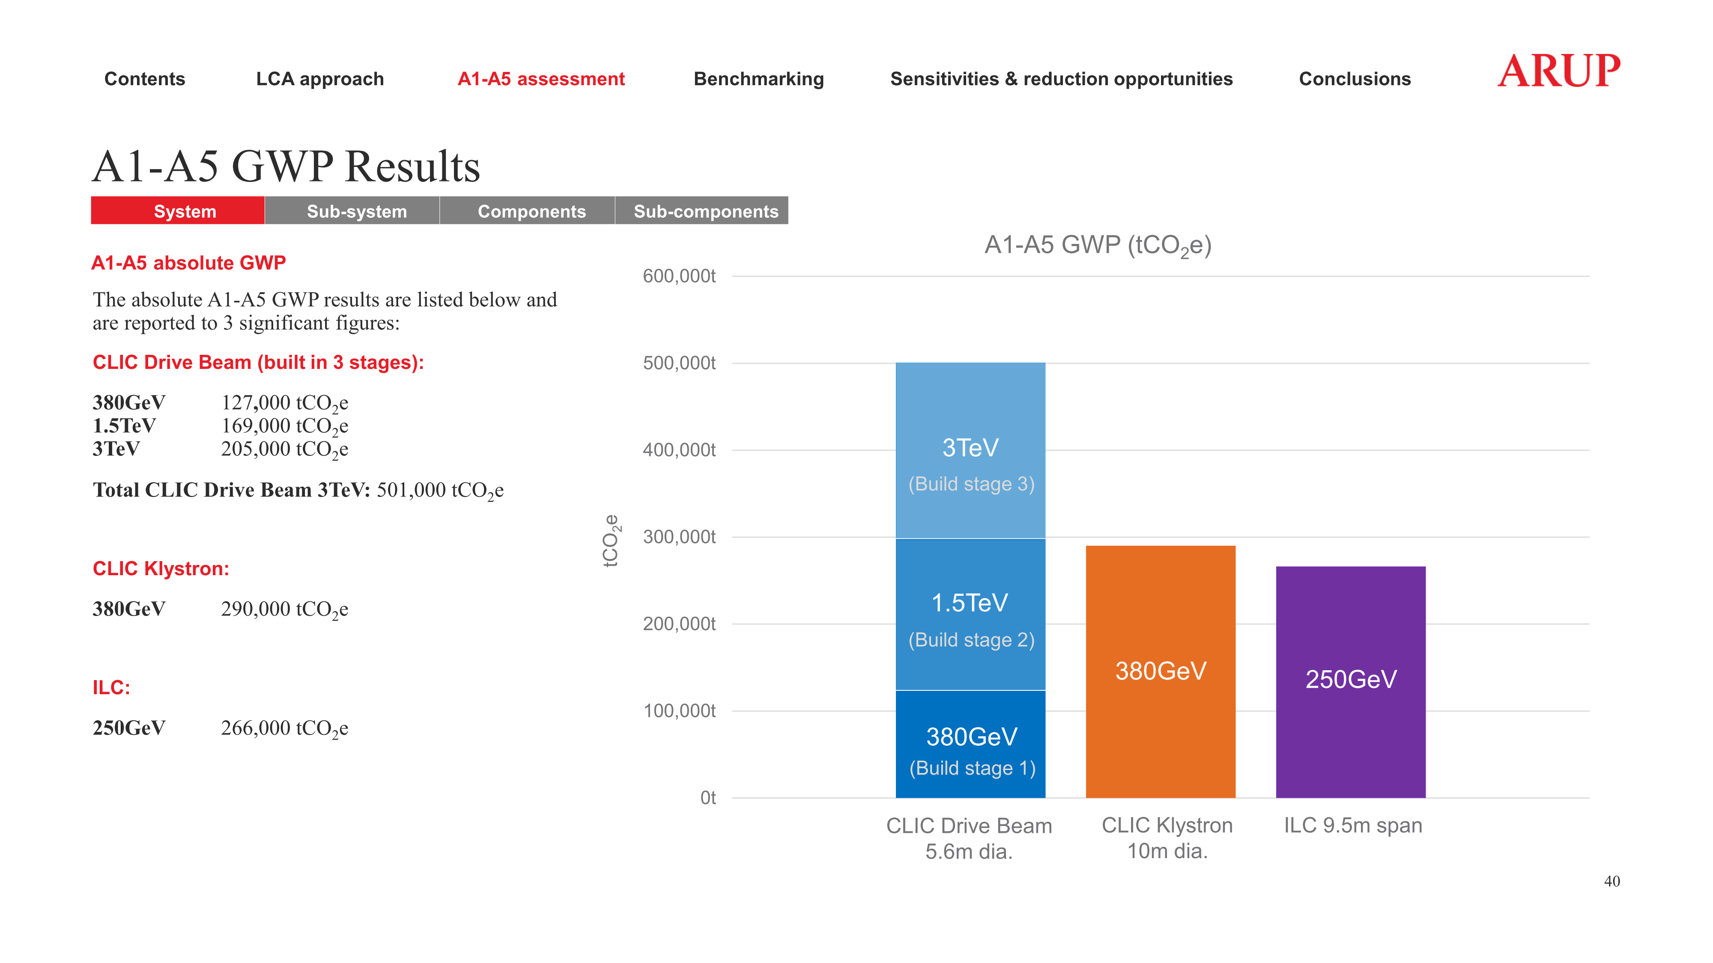
Presentation by Suzanne Evans of ARUP, WSFA2023 in Morioka
Suzannne‘s work is extremely important because it provides a methodology for LCA of CO₂ emissions from accelerator construction, in which she has already mentioned the choice of steel and cement materials with the lowest possible CO₂ emissions.
In my presentation today I will not go into details, but only use the conclusion of the ILC (266 k-tons of CO₂ emissions).

Slide 21
Rounded numerical targets:
construction period ➔ Less than 30 k-tons/year
operation period ➔ Less than 60 k-tons/year
The challenge is to offset these numbers with carbon credits in accordance with Japanese policy.

Slide 22
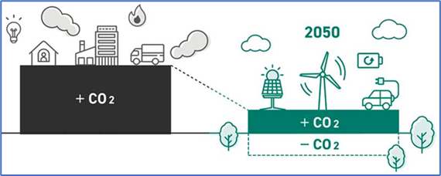
Again, Japan's strategy is to reduce CO₂ emissions while simultaneously increasing and ultimately offsetting CO₂ absorption.
Negative CO₂ emission
Green Carbon: CO₂ absorption by forests
Blue Carbon: CO₂ absorption by coastal seaweed
White Carbon: Long-term fixation of CO₂ by wooden buildings
By the time the ILC starts operation in 2040, we would like to be able to credit these CO₂ absorptions.
Waste heat utilization business using HASClay will be described in next pages, in detail.

Slide 23
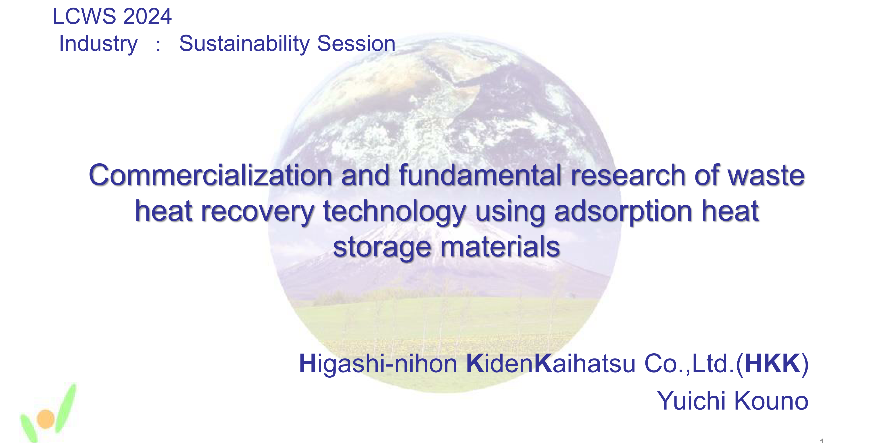
As a final topic, I would like to discuss a study on the commercialization of waste heat recovery from accelerator facilities.
We have established an industry-government-academia joint research system led by East Japan Mechanical & Electric Development Co (HKK).
I will explain using part of HKK’s presentation at LCWS2024 in July last year.

Slide 24
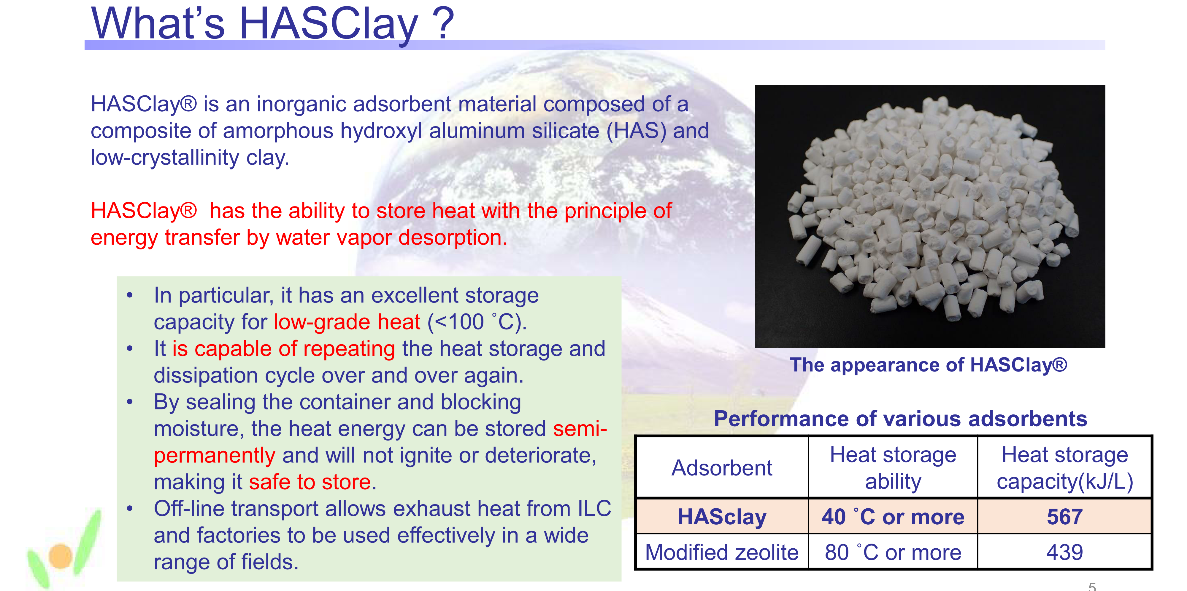
HASClay is a super-porous material (specific surface property is more than 500m²/g).
It can store heat by sending hot air (50~100℃)through the wet material to expel adsorbed water molecules.
Conversely, if moist air is sent to a material in a dry state, water vapor is adsorbed and hot air with low humidity comes out.
The dry state can store 560 MJ/m³ of energy.

Slide 25
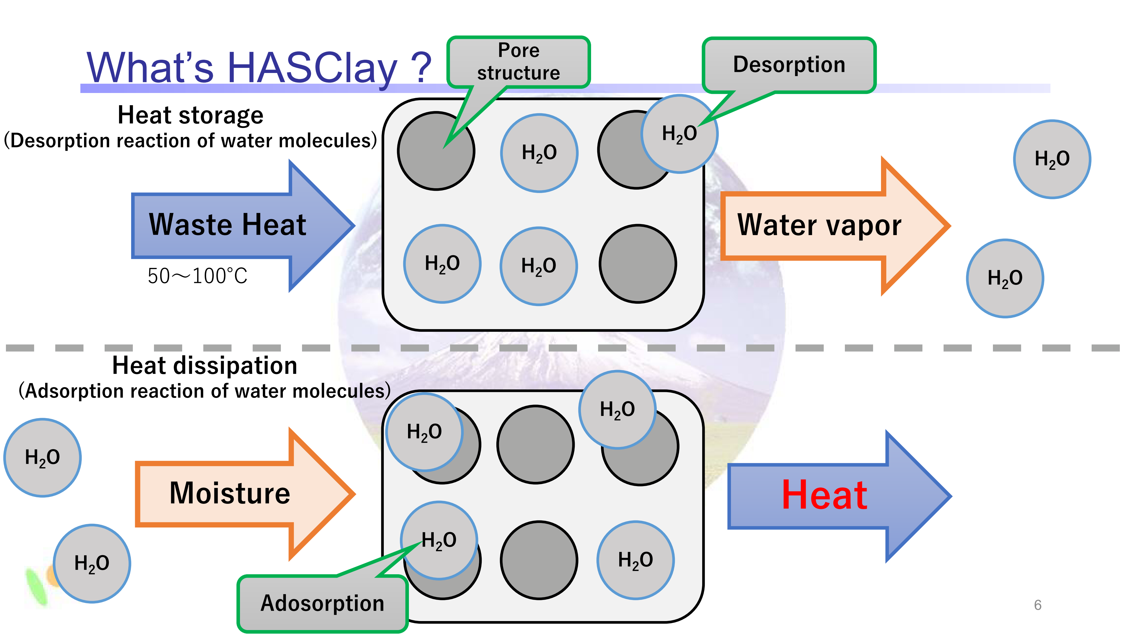
This is the illustration of the heat storage process (above) and the heat dissipation process (below)
It is suitable for low-grade waste heat recovery below 100℃.

Slide 26
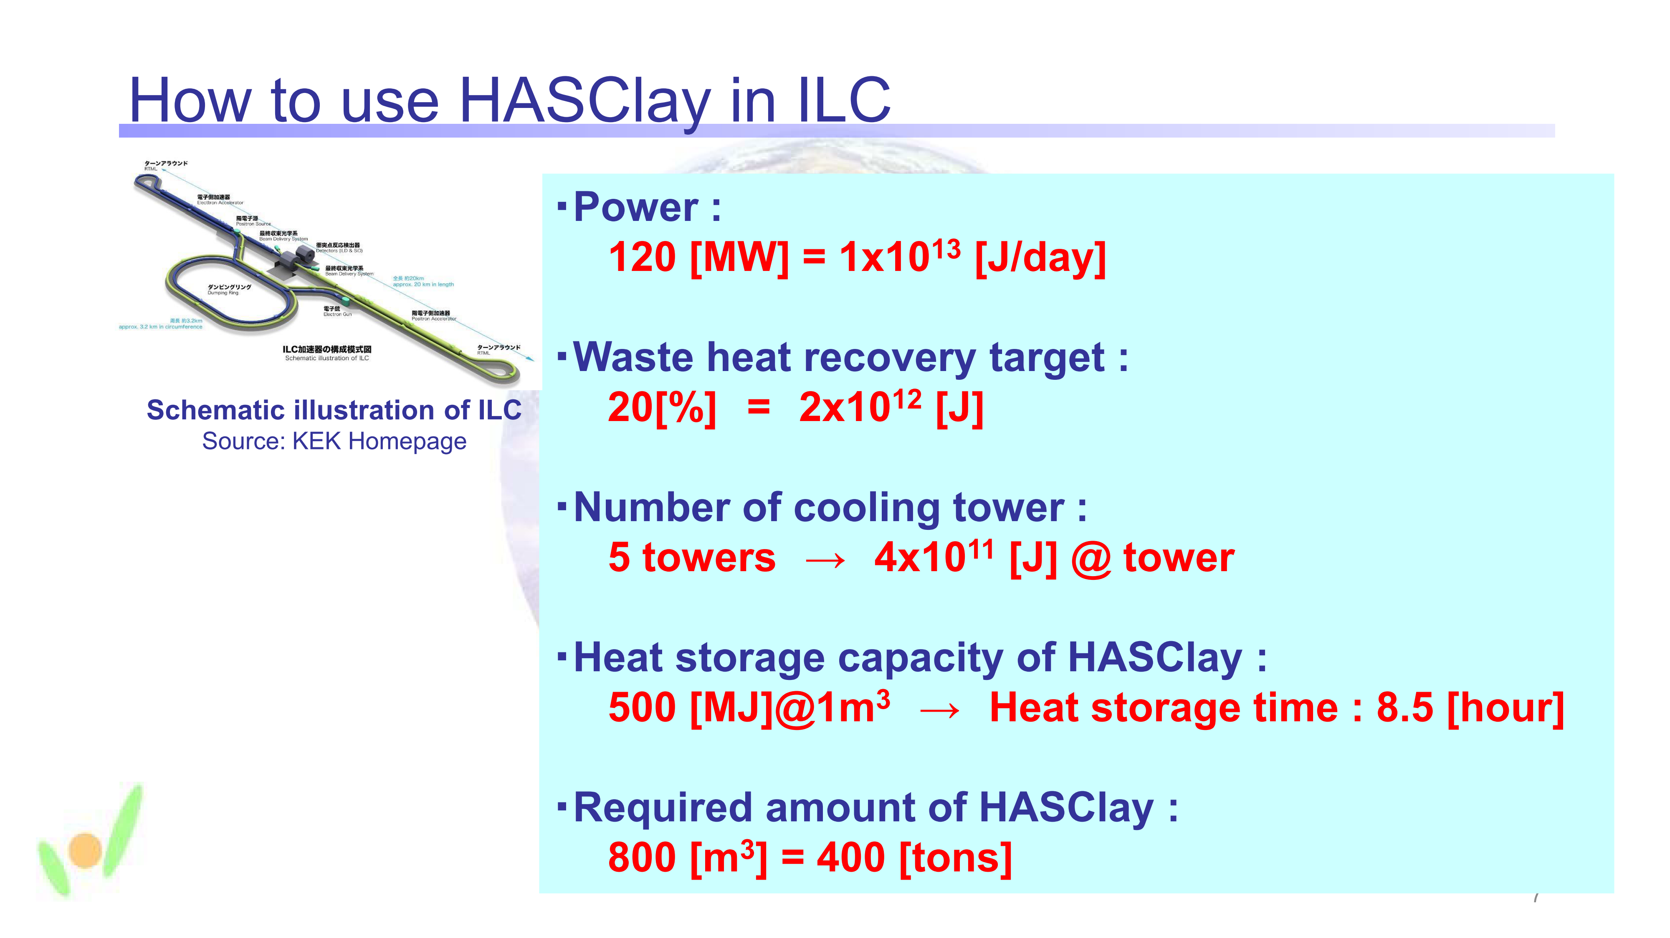
Assuming the cooling towers are installed at five ground stations, the heat release per station is 4X10¹¹ joules.
The HASClay required to recover 20% of that thermal energy is 400 tons.
A realistic design of this magnitude is possible.

Slide 27
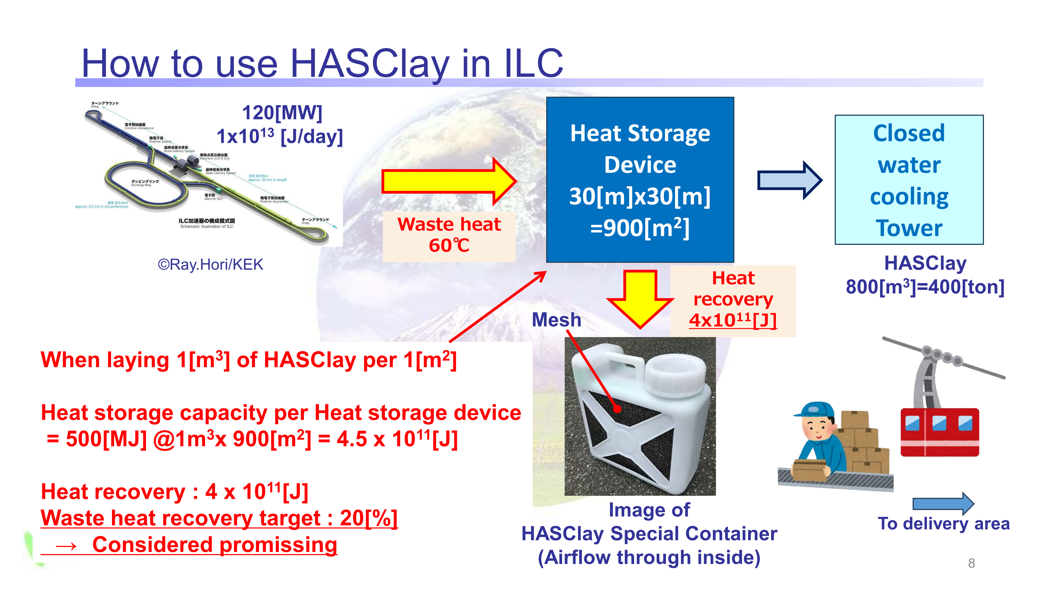
An air-cooled cooling tower is installed as a preliminary step to a closed water-cooled cooling tower to generate a rising air flow without using power to dry HASClay.
We are planning a facility for waste heat recovery and utilization in agriculture, forestry, and fisheries using factory waste heat and hot spring waste heat using this method.

Slide 28
Green ILC Summary
Once the ILC lab is established, further efforts should be made to improve energy-saving technologies.
Meanwhile, we, the group of communities with candidate sites, will continue our efforts to achieve sustainable communities by the time construction of the “ILC in Japan” begins.
To this end, we will make efforts to deepen cooperation between the ILC and local primary industries (agriculture, forestry, and fisheries).
Research on the commercialization of ILC waste heat recovery technology is progressing well, and within a few years it should be possible to recover the waste heat from factories and the many hot springs in Iwate Prefecture and build a regional thermal energy circulation system. Once the ILC is operational, waste heat recovery from the ILC will also be incorporated into this project.
ご清聴ありがとうございます
Thank you for your attention

