Slide 1
Electron Ion Collider project and design updates
Andrei Seryi, Jefferson Lab
on behalf of the EIC project and EIC accelerator collaboration
eeFACT Workshop, Tsukuba, Japan
March 3, 2025

Slide 2
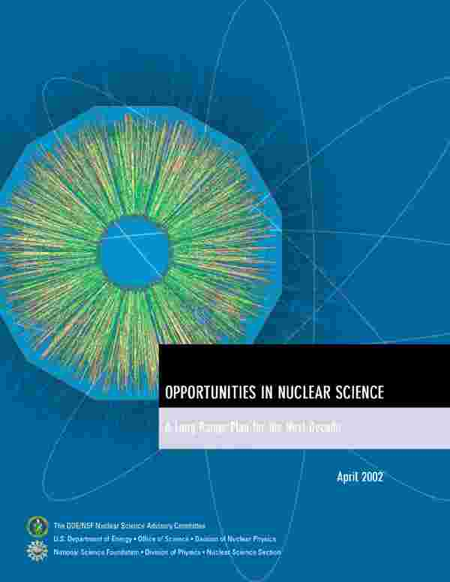
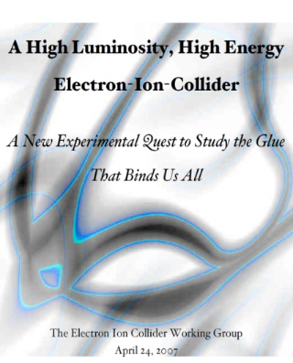
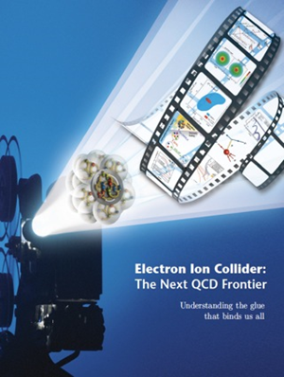

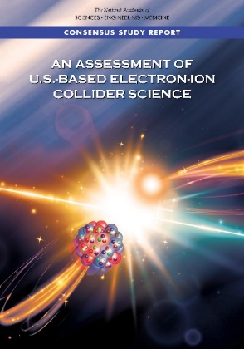

EIC Scientific Case Built Over Decades
2002
2007
2009
“We recommend the expeditious completion of the EIC as the highest priority for facility construction.” (Nuclear Science Advisory Committee, 2023)
2010
2012
Gluons and the Quark Sea at High Energies
2013
NSAC
2015
Major Nuclear Physics Facilities for the Next Decade
2018
2021
2023
March 14, 2013
“The science questions that an EIC will answer are central to completing an understanding of atoms as well as being integral to the agenda of nuclear physics today.” (National Academy of Sciences, 2018)
arXiv:2103.05419
EIC will be the only operating particle collider in the U.S. and likely the only large collider
to be built and run in the world in the next decade
2

Slide 3
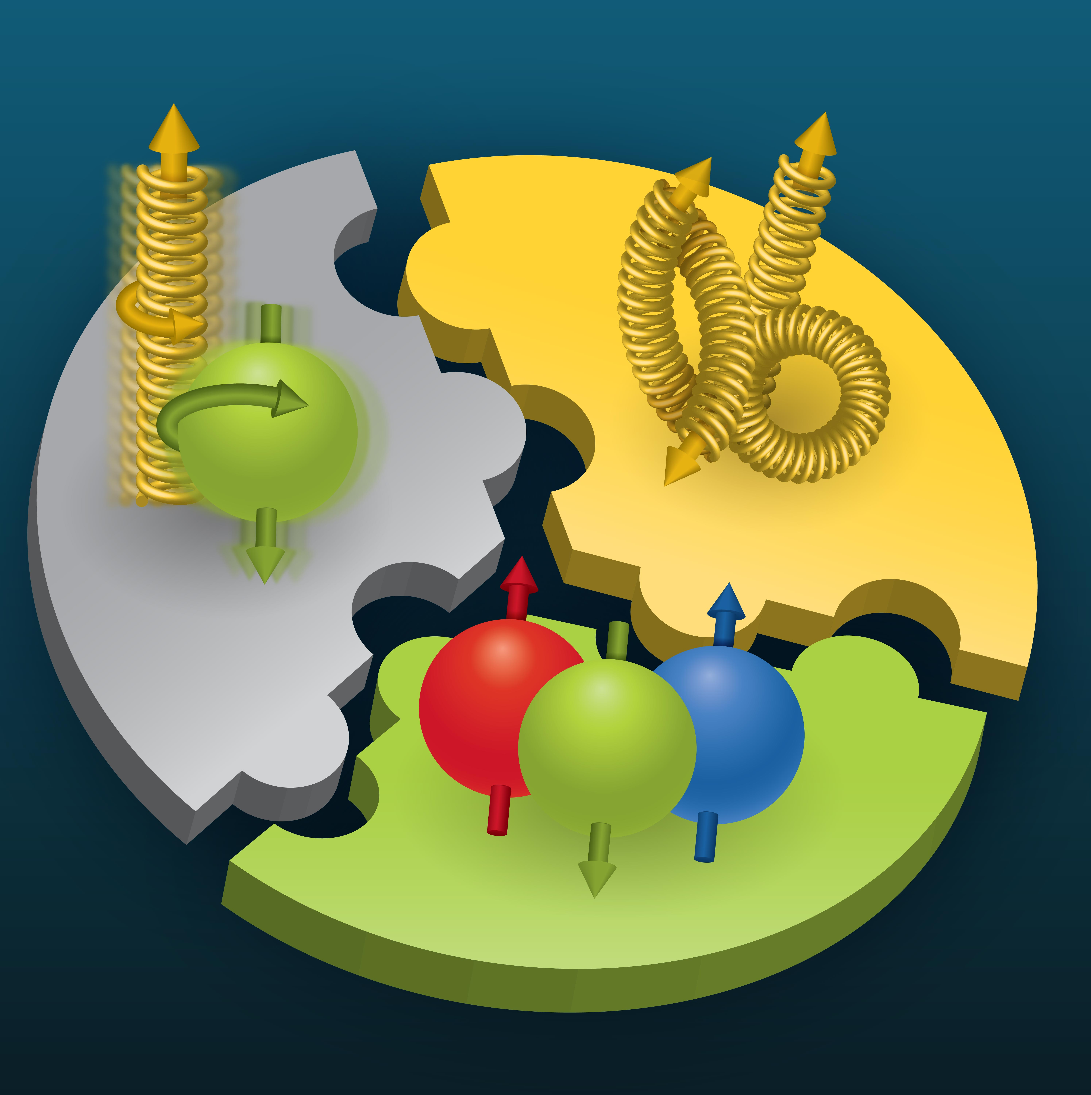

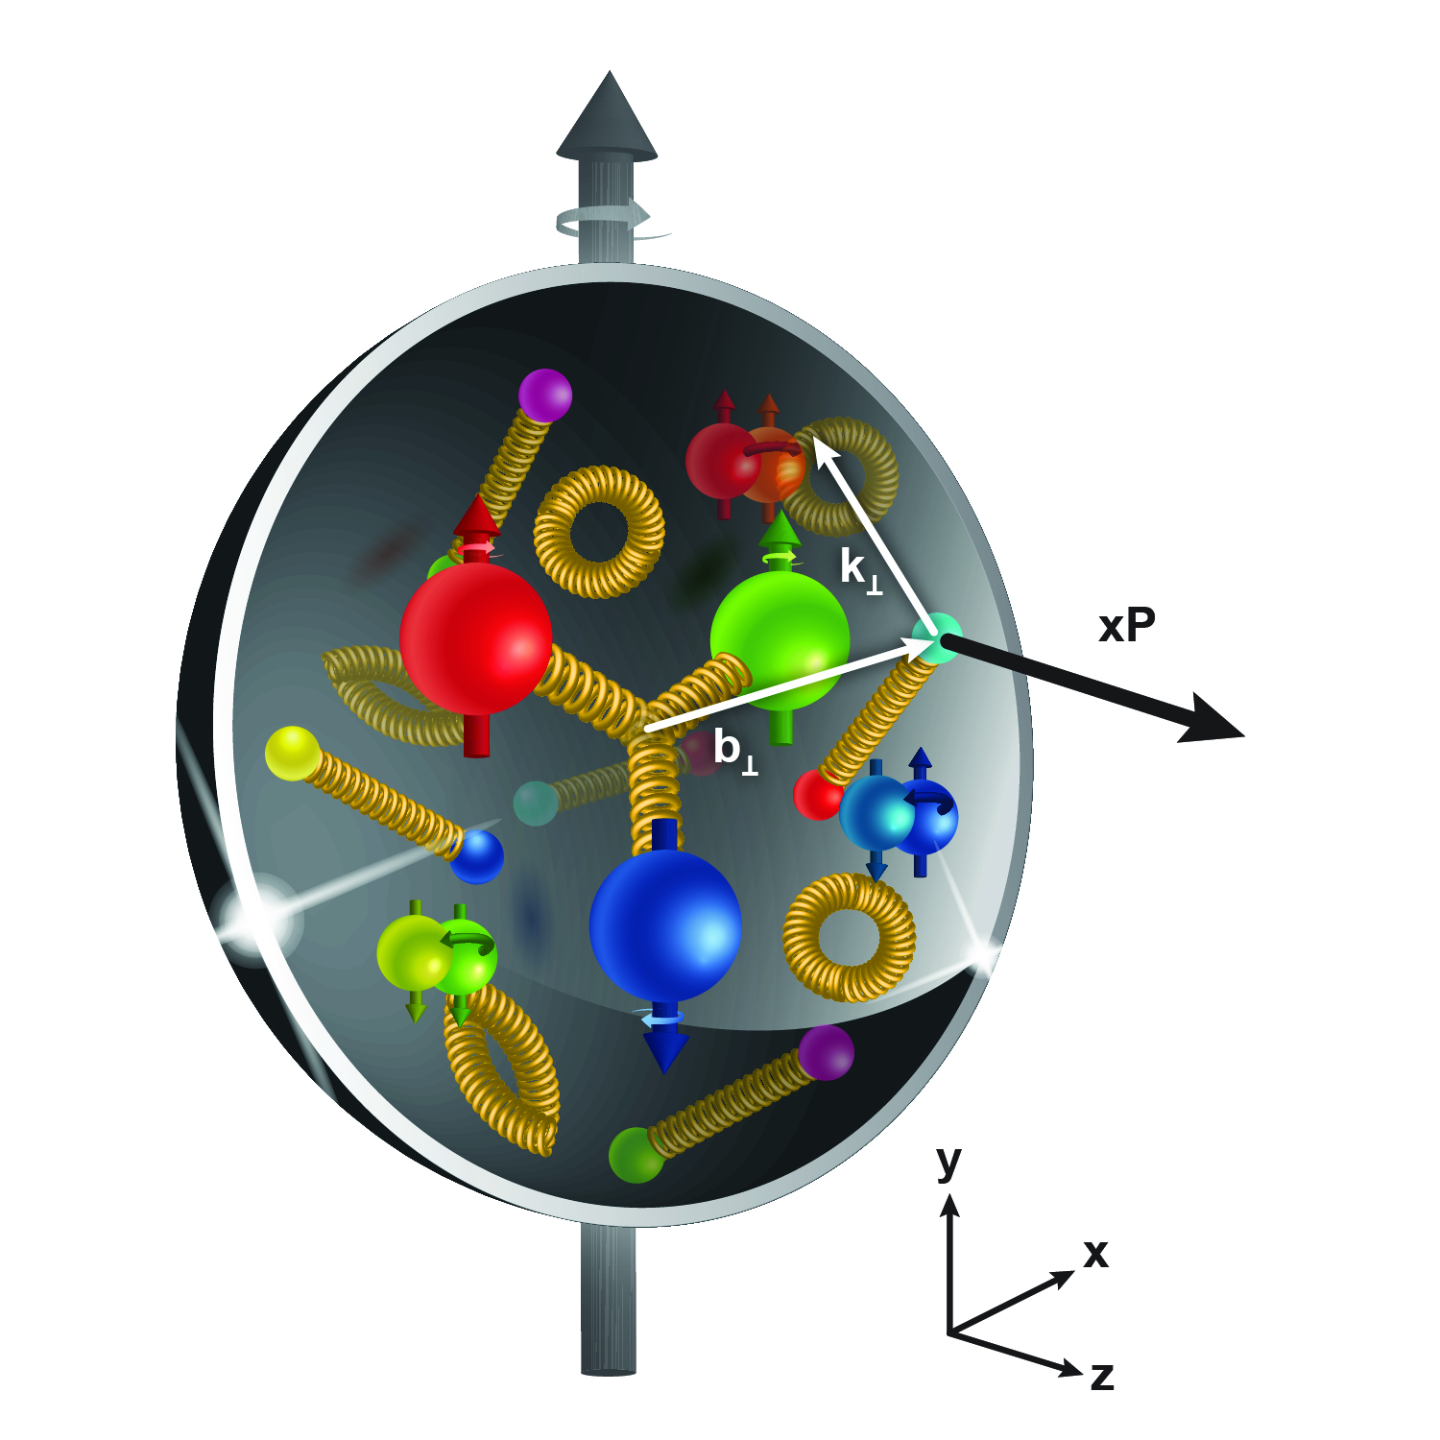
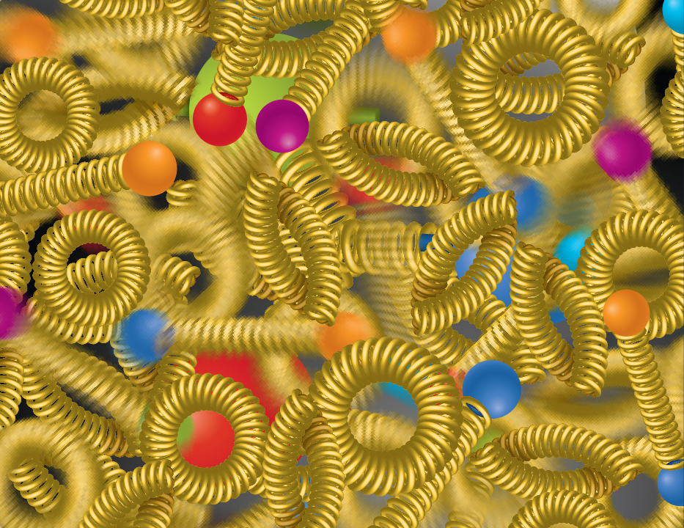
Compelling EIC Science (National Academy Report)
How do quarks, gluons, and orbital angular momentum contribute to proton spin?
Spin is a fundamental property of matter.
All elementary particles,
but the Higgs, carry spin.
Spin cannot be explained by a static picture, rather the interplay between the properties and interactions of quarks and gluons inside
the proton.
Does the mass of visible matter emerge from quark-gluon interactions?
Atom: Binding/Mass = 0.00000001
Nucleus: Binding/Mass = 0.01
Proton: Binding/Mass = 100
The EIC will determine an important term contributing to the proton mass, the so-called quantum chromodynamics (QCD) trace anomaly.
How can we understand QCD dynamics and the relation to confinement?
EIC will image quarks and gluons in 3D in space and momentum inside the nucleon and nuclei and uncover how the nucleon properties emerge from quarks and gluons and their interactions.
How do quark-gluon interactions create nuclear binding?
Is the structure of a free and bound nucleon the same?
How do quarks and gluons, interact with a nuclear medium?
How do the confined hadronic states emerge from these quarks and gluons?
Does gluon density in nuclei saturate at high energy?
How many gluons can fit in a proton?
How does a dense nuclear environment affect the quarks and gluons, their correlations and interactions?
=
gluon
splitting
?
gluon
recombination

Slide 4
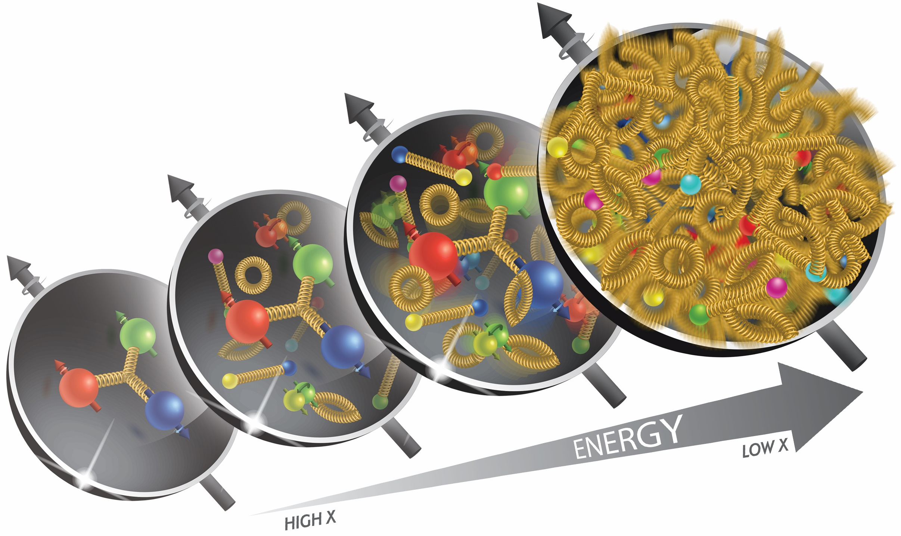
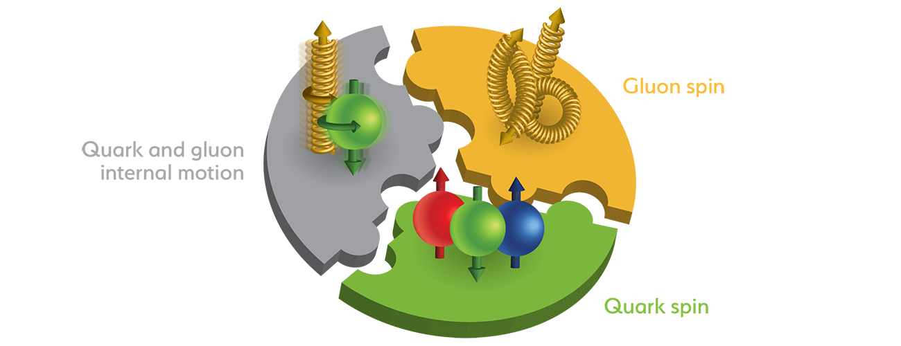
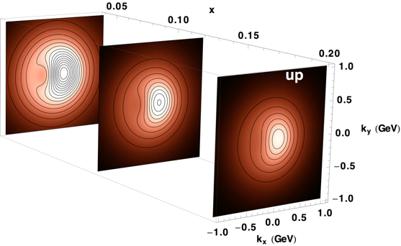
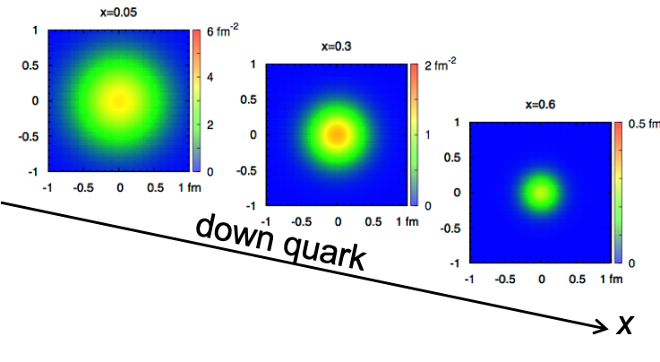
EIC Accelerator Performance Needs
wide center-of-mass energy √s: 20 – 140 GeV :
map the out nucleon and nuclei structure from high to low x
polarized electron and hadron (p, He-3) beams:
access to spin structure of nucleons and nuclei
Spin vehicle to access the spatial and momentum structure of the nucleon in 3d
Full specification of initial and final states to probe q-g structure of NN and NNN interaction in light nuclei
nuclear beams: d to Pb
accessing the highest gluon densities → saturation
quark and gluon interact with a nuclear medium
high luminosity 10³³-10³⁴ cm⁻²s⁻¹ :
mapping the spatial and momentum structure of nucleons and nuclei in 3d
access to rare probes, i.e. Ws
large acceptance (0.2 – 1.3 GeV) through forward focusing IR magnets
spatial imaging of nucleons and nuclei
gluon emission
gluon recombination
?
=

Slide 5
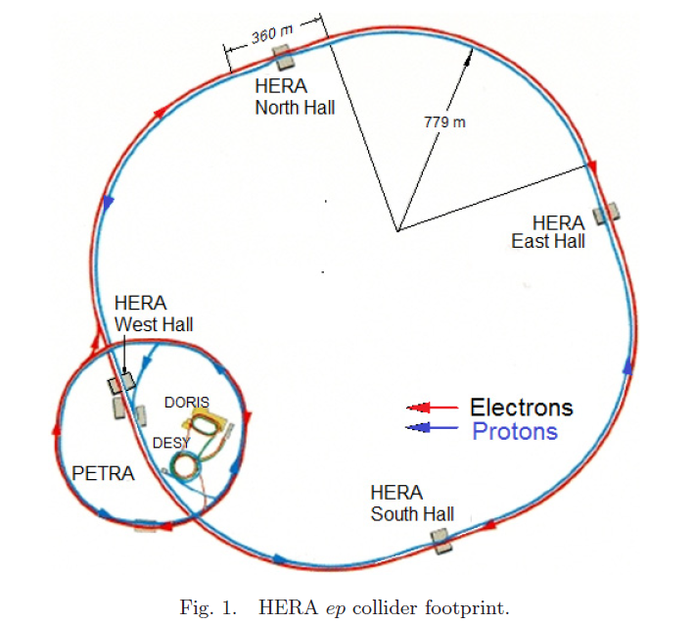
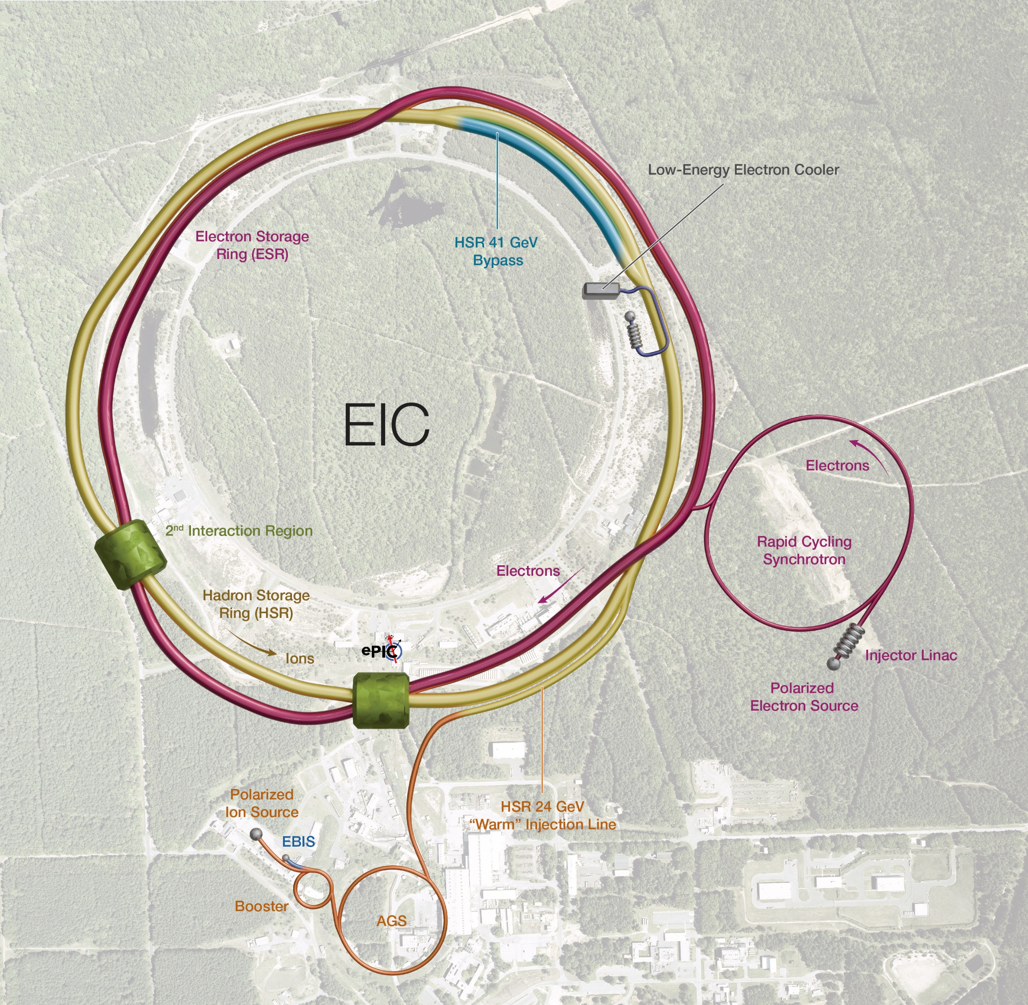
EIC: present concept
HERA (1992 – 2007)
2025
1
3
4
2
920 GeV protons (unpolarized)
27.5 GeV electrons (self-polarized by Sokolov-Ternov)
Peak luminosity: ~5x10³¹ cm⁻²s⁻¹
Protons: ~40 – 275 GeV
Electrons: 5 – 18 GeV

Slide 6
HERA vs EIC: key parameters
HERA EIC FACTOR
Circumference (km) 6.3 3.8 1.7
Number of bunches 174 1160 6.7
Proton bunch charge (nC) 11.7 11 1
Electron bunch charge (nC) 5.3 28 5.3
Bunch length (cm), p/e 16/0.9 6/0.7
Beta at IP (cm), proton H/V (cm) 245/18 80/7.2
Beta at IP (cm), electron H/V (cm) 62/26 45/5.6
Proton emittance, (nm, rms) 4/4 11/1
Electron emittance, (nm, rms) 20/3 20/1.3
Energy (COM), GeV 320 105
Luminosity, x10³¹ cm⁻²s⁻¹ 5.3 1000 190
60
~3

Slide 7
Key EIC accelerator physics concepts
Flat hadron bunches (~10:1 emittance ratio)
Large crossing angle (25 mrad)
Beam-beam limits for both beams (~0.1 e/ ~0.01 p)
Spin preservation from source to collisions (protons and electrons)
Upgrade path: hadron cooling at collisions
These are the key concepts that allow to attain luminosity of ~10³⁴ cm⁻²s⁻¹ and maintain high polarization at collisions

Slide 8
Key EIC Accelerator Technology Areas
Hadron Beam Cooling
Spin-transparent optics
  High polarization for both beams from source to collisions
  Swap-out injection for electron bunches (at 1 Hz) to maintain high polarization
Crab cavities
  Large-size, complex geometries;
  Very tight phase and amplitude noise requirements
IR magnets (large aperture, 2K SC magnets)

Slide 9
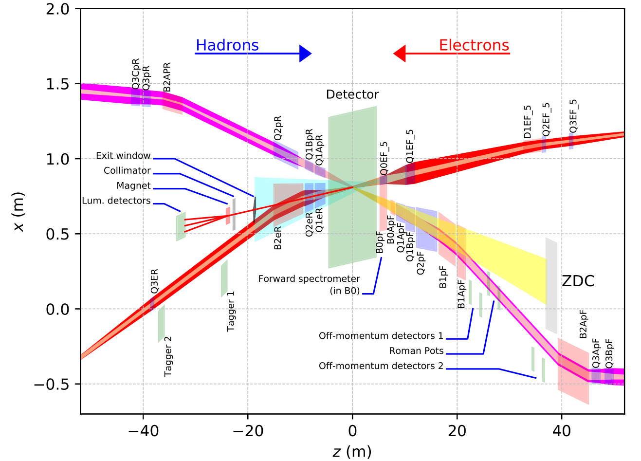
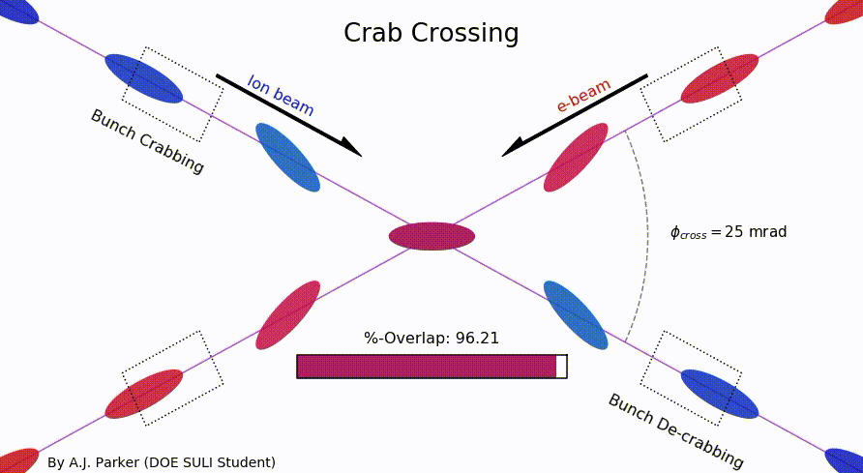
EIC IR Layout
High Luminosity:
  25 mrad crossing angle
  Small β* for high luminosity
  with limited IR chromaticity contributions
  Large final focus quadrupole aperture
  Machine Detector Interface
  Large detector acceptance
  Forward spectrometer
  No magnets within - 4.5 / +5 m from IP
  Space for luminosity detector, neutron detector, “Roman Pots”

Slide 10
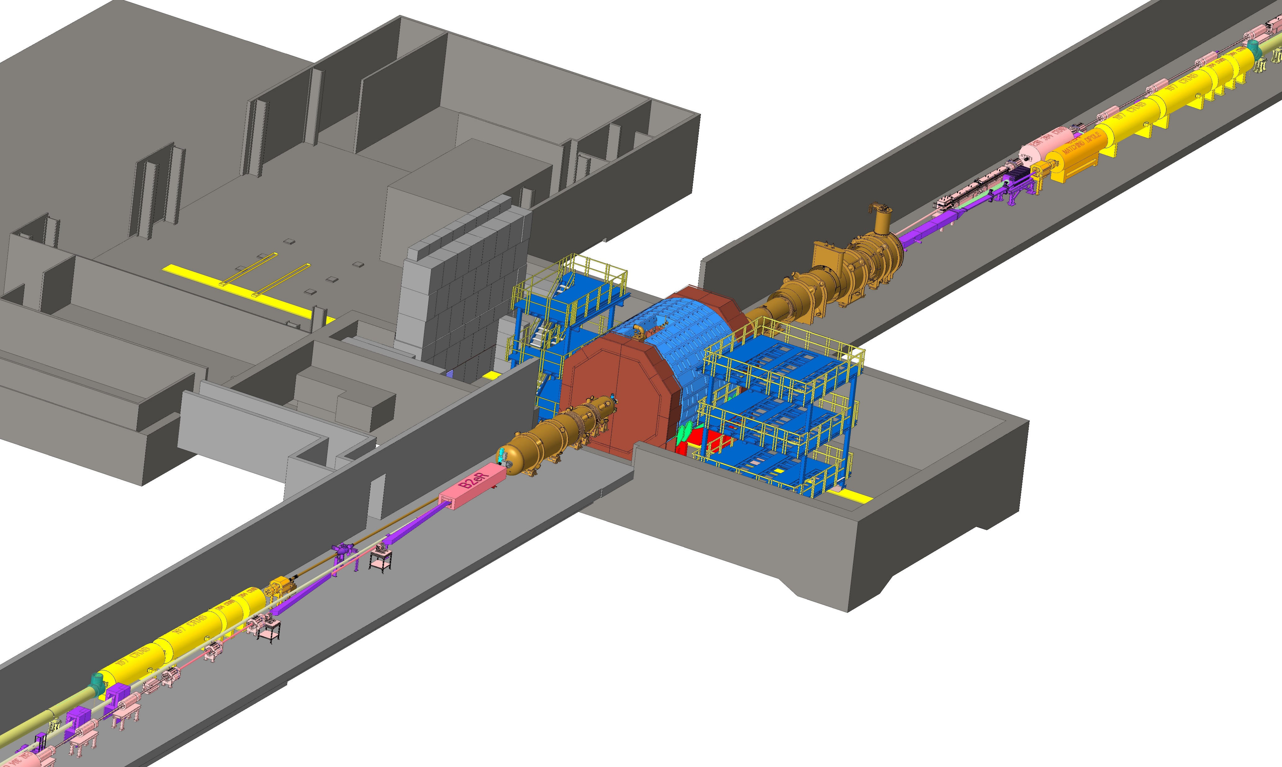
EIC Near-detector IR Layout

Slide 11

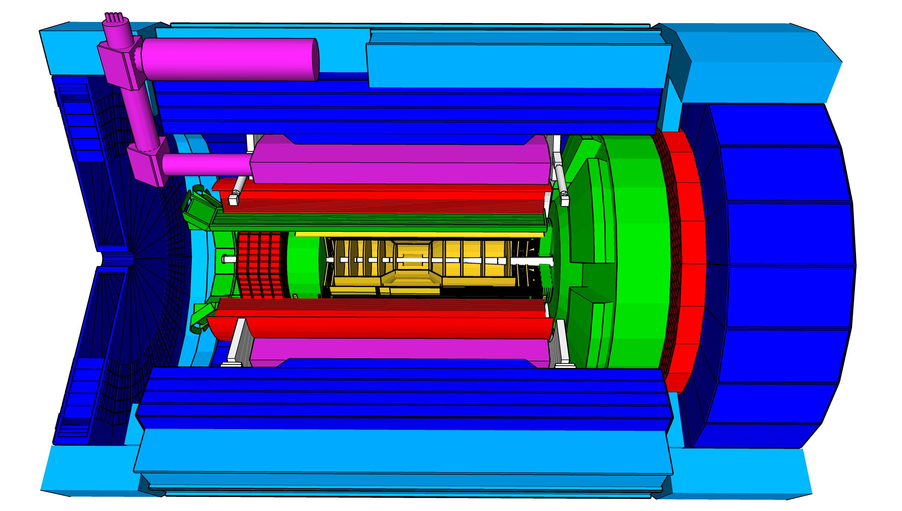
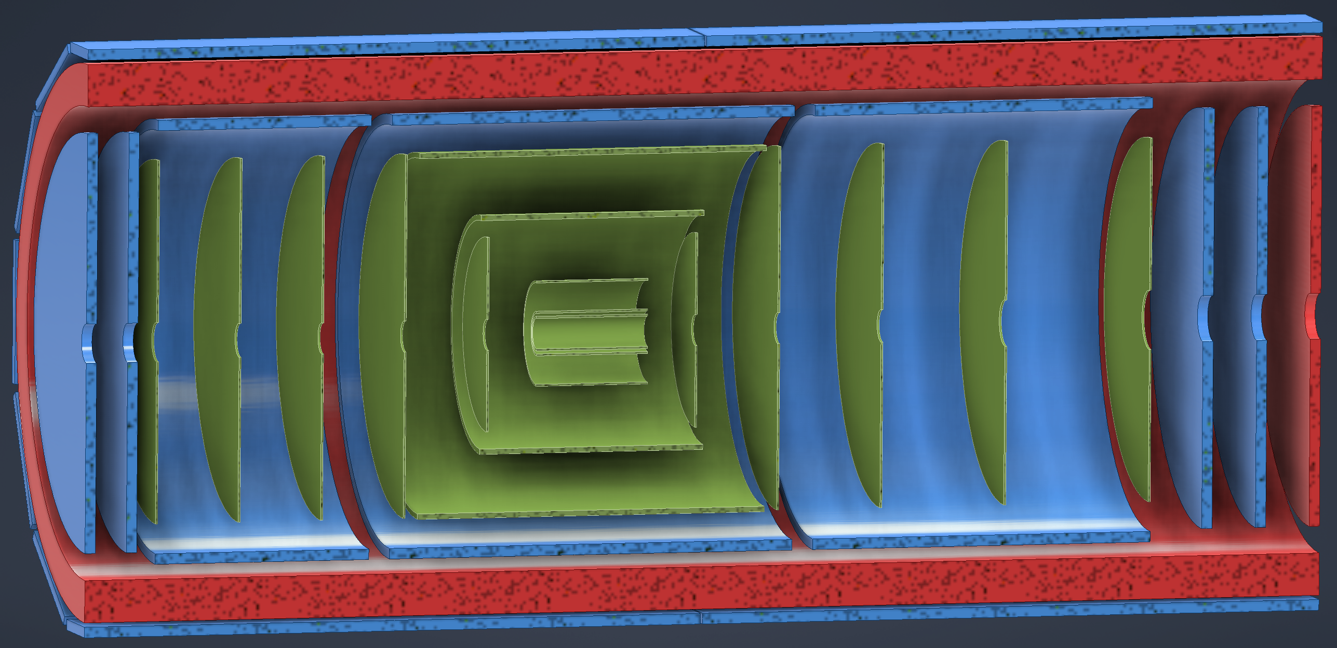
ePIC Baseline Technologies
Vertex detector → Identify primary and secondary vertices,
  Low material budget: 0.05% X/X₀ per layer;
  High spatial resolution: 10 mm pitch CMOS Monolithic Active Pixel Sensor
Central tracker → Measure charged track momenta
  MAPS – tracking layers in combination with micro pattern gas detectors
  MPGD: m-RWell or MicroMegas
electron and hadron endcap tracker → Measure charged track momenta
  MAPS – disks in combination with micro pattern gas detector disks
Particle Identification → pion, kaon, proton separation on track level
  RICH detectors (modular and dual radiator RICH, DIRC) & Time-of-Flight
  high resolution timing detectors (LAPPS, LGAD) 10 – 30 ps
  novel photon sensors for RICHs: LAPPD & SiPMs
Electromagnetic calorimeter → Measure photons (E, angle), identify electrons
  PbWO₄ Crystals (backward) with SiPM readout,
  W/SciFi Spacal (forward), Barrel: Pb/SciFi+imaging part using ASTROPIX
Hadron calorimeter → Measure charged hadrons, neutrons and K_{L}⁰
  challenge achieve ~50%/√E + 10% for low E hadrons (<E> ~ 20 GeV)
  Steel/Sc & W/Sc sandwich sandwich with longitudinal segmentation & SiPM readout
DAQ & Readout Electronics: trigger-less / streaming DAQ
  Integrate AI into DAQ → cognizant Detector
Very forward and backward detectors → scattered particles under very small angles
  Silicon tracking layers in lepton and hadron beam vacuum
  Zero – degree high resolution electromagnetic and hadronic calorimeter
Polarimetry
  Lepton: integrated transverse and longitudinal Compton polarimeter
  Hadron: absolute and relative hadron polarimetry in the CNI region
hadronic calorimeters
solenoid coils
ToF, DIRC,
RICH detectors
world’s first
at
e/m calorimeters
MPG & MAPS trackers
Radius/Distance from IP
world’s first
at
world’s first
at
world’s first
at
world’s first
at
9.5m
MAPS Barrel + Disks
MPGD Barrels + Disks
AC-LGAD based ToF

Slide 12
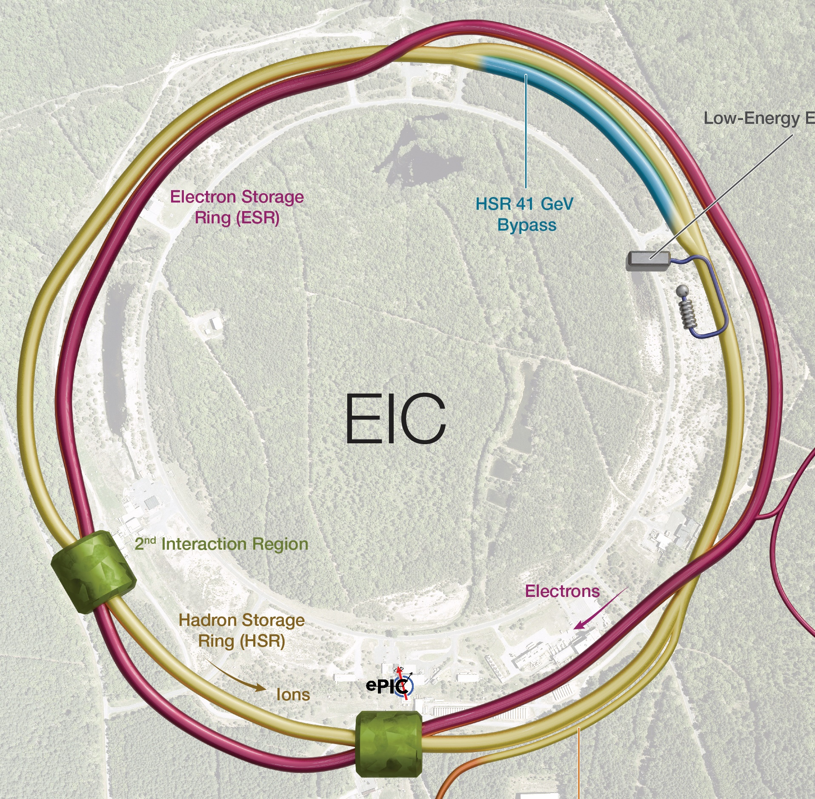
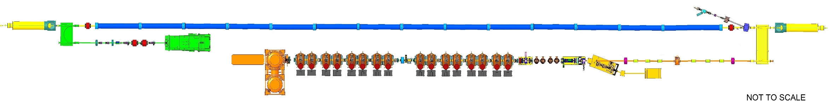
Electron cooling to produce ‘Flat’ Proton Bunches
RF diagnostics line with Deflecting cavity
180°Dipole
(U-turn)
LEReC
Cooling Solenoids
180° Dipole
Spectrometer
Mu-metal shielding
Quad
cooling
RF diagnostic
hadron
hadron
hadron
e⁻
HSR
e⁻
HSR
e⁻
extraction
transport
IR2 layout
(all within the
existing RHIC
Tunnel)
Injector test
injection
SC Quad
PM
Cathode transport
PM
PM
Solenoids
Laser
197 MHz
130 kW Beam Dump
Extraction line
900 kW Beam Dump
4x 591 MHz
NCRF correction Cavities
DC Gun
400kV
Injector/linac
Test line
24MHz
RF cavity
16x 197 MHz
NCRF LINAC
Not to scale

Slide 13
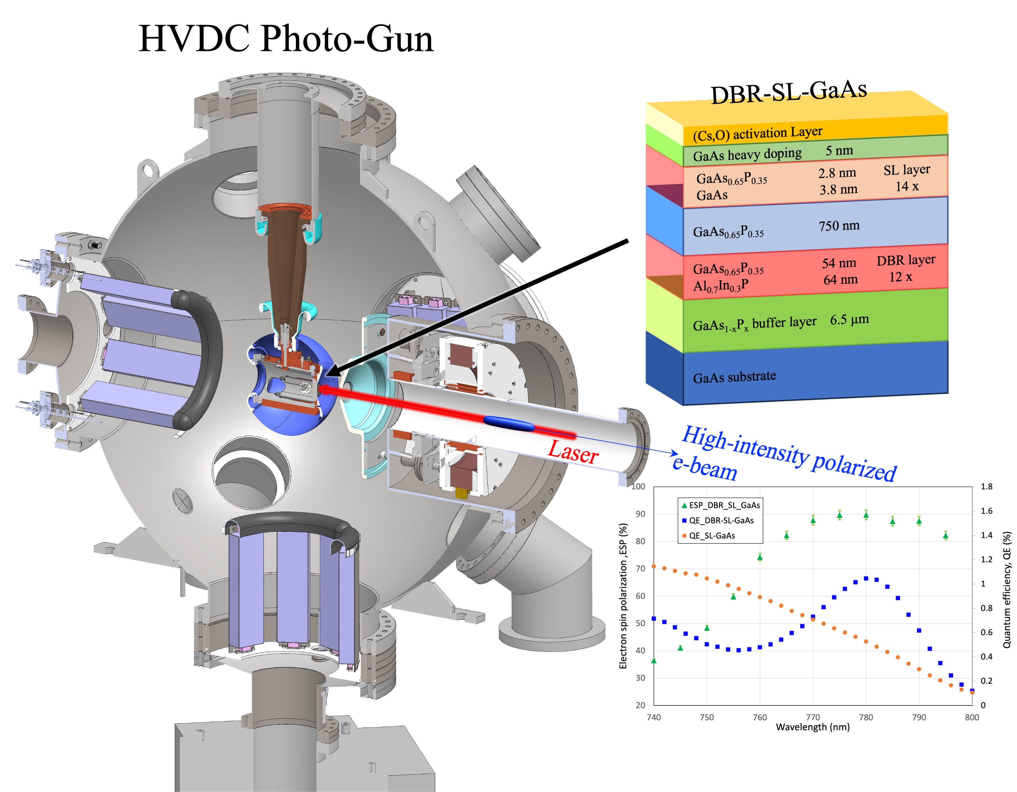
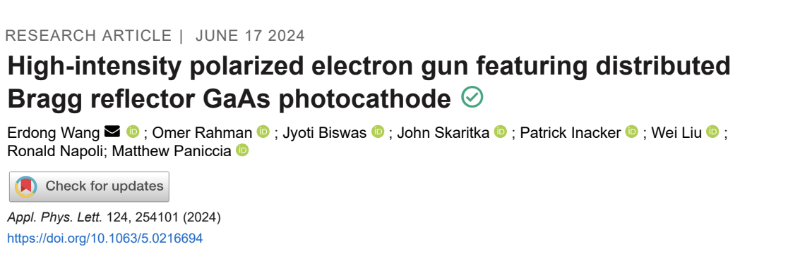
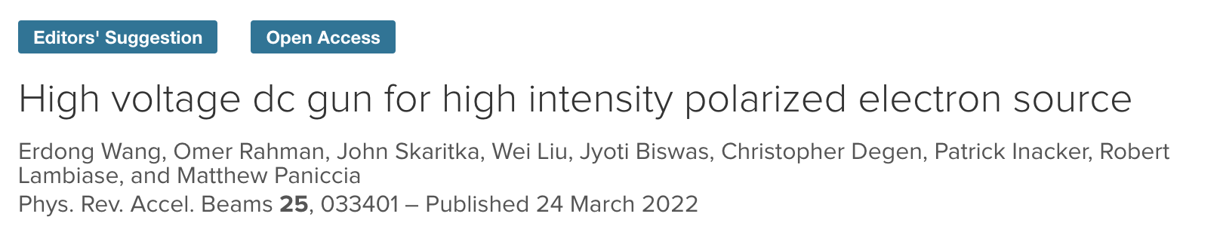
High Intensity Polarized HVDC Gun
High intensity polarized HVDC gun
  R&D achievements

Slide 14
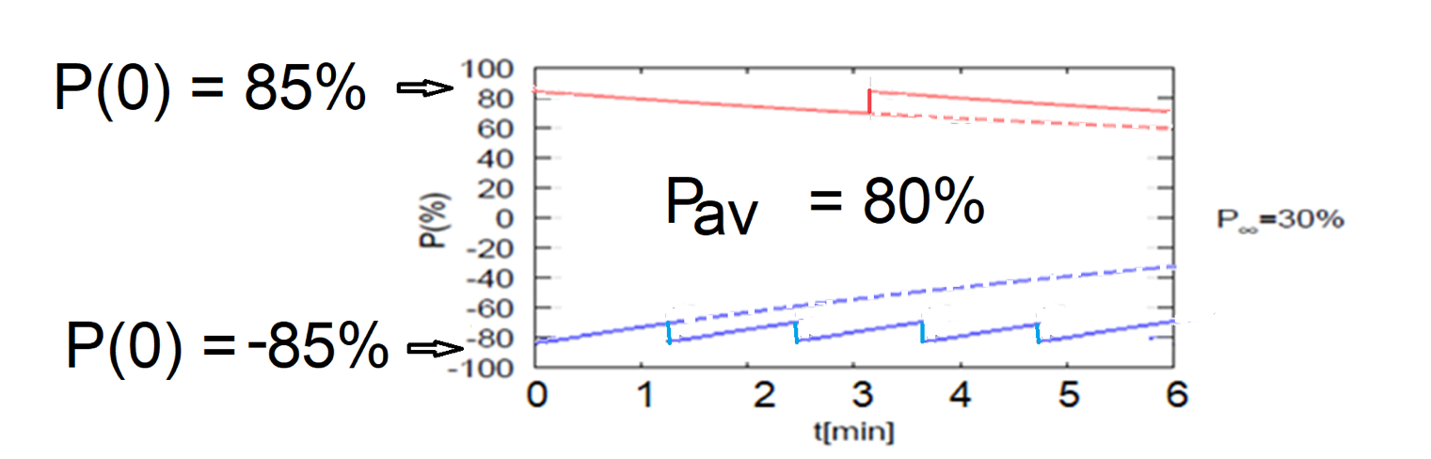
Electron polarization loss in the ESR
Frequent injection of bunches with high initial polarization of 85%
Initial polarization decays towards P∞
At 18 GeV, every bunch is replaced (on average) after 2.2 min with RCS cycling rate of 1Hz
B P
B P
Refilled every 3.2 minutes
Refilled every 1.2 minutes
Re-injection
P_{av}=80%
P∞= 30%
(conservative)
P_{av}=80%
Re-injections

Slide 15
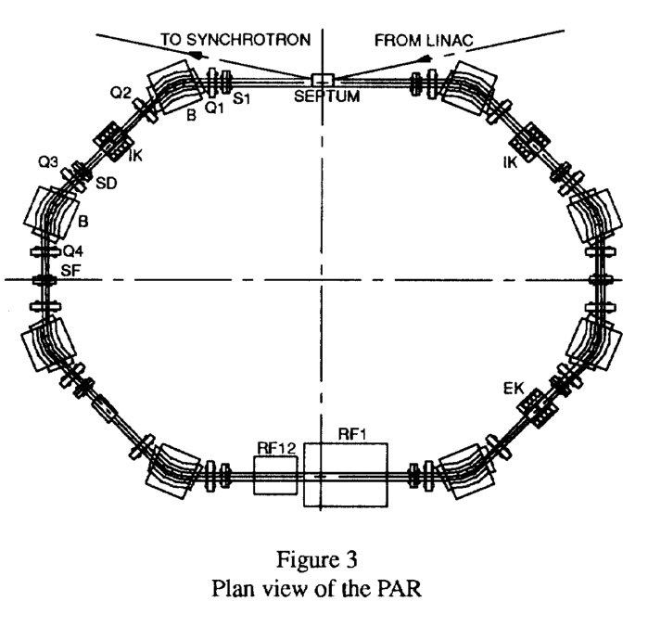
Electron Injector & its upgrade path
750 MeV linac @ 1.3 GHz SC (or 3 GHz NC)
7 nC single bunch at 5 Hz
0.75 to 18 GeV at 1 Hz
4 x 7nC after upgrade
ESR
Initial configuration
750 MeV linac, 7nC
10 GeV RCS & ECR, 7nC
Upgrade path
  Add RCS rf cavities: = > 18 GeV
    Add a ~30-m long BAR (Bunch Accumulation Ring) to accumulate 4 x 7-nC bunches = 28 nC/bunch
RCS
1.4 km circ.
In RHIC tunnel
Swap out
BAR
28 nC/bunch
accumulator
ring
f_{RF} = 591 MHz
RF
RF
APS PAR ring
30 m long
The APS Particle Accumulator Ring (PAR) is similar to BAR

Slide 16



Present EIC Concept (2025) - summary
Ultimate EIC Performance Parameters:
High Luminosity: L= 10³³ – 10³⁴cm⁻²sec⁻¹
Highly Polarized Beams: 70%
Large Center of Mass Energy Range: Ecm = 28 – 140 GeV
Large Ion Species Range: protons – Uranium
Large Detector Forward Acceptance and Low-Background Conditions
Possibility to Implement a Second Interaction Region (IR)
Accelerator Status in a glance:
Polarized ion/proton source
Ion injection and initial acceleration systems – Linac (200 MeV), Booster (1.5 GeV), AGS (25 GeV)
Hadron Storage Ring (40-275 GeV) – HSR
Electron Pre-Injector (750 MeV linac) – EPI
Electron Rapid Cycling Synchrotron (0.75 GeV – top energy) – RCS
Electron Storage Ring (5 GeV – 18 GeV) – ESR
Interaction Region(s) – IR
Hadron Injection Cooling System

Slide 17
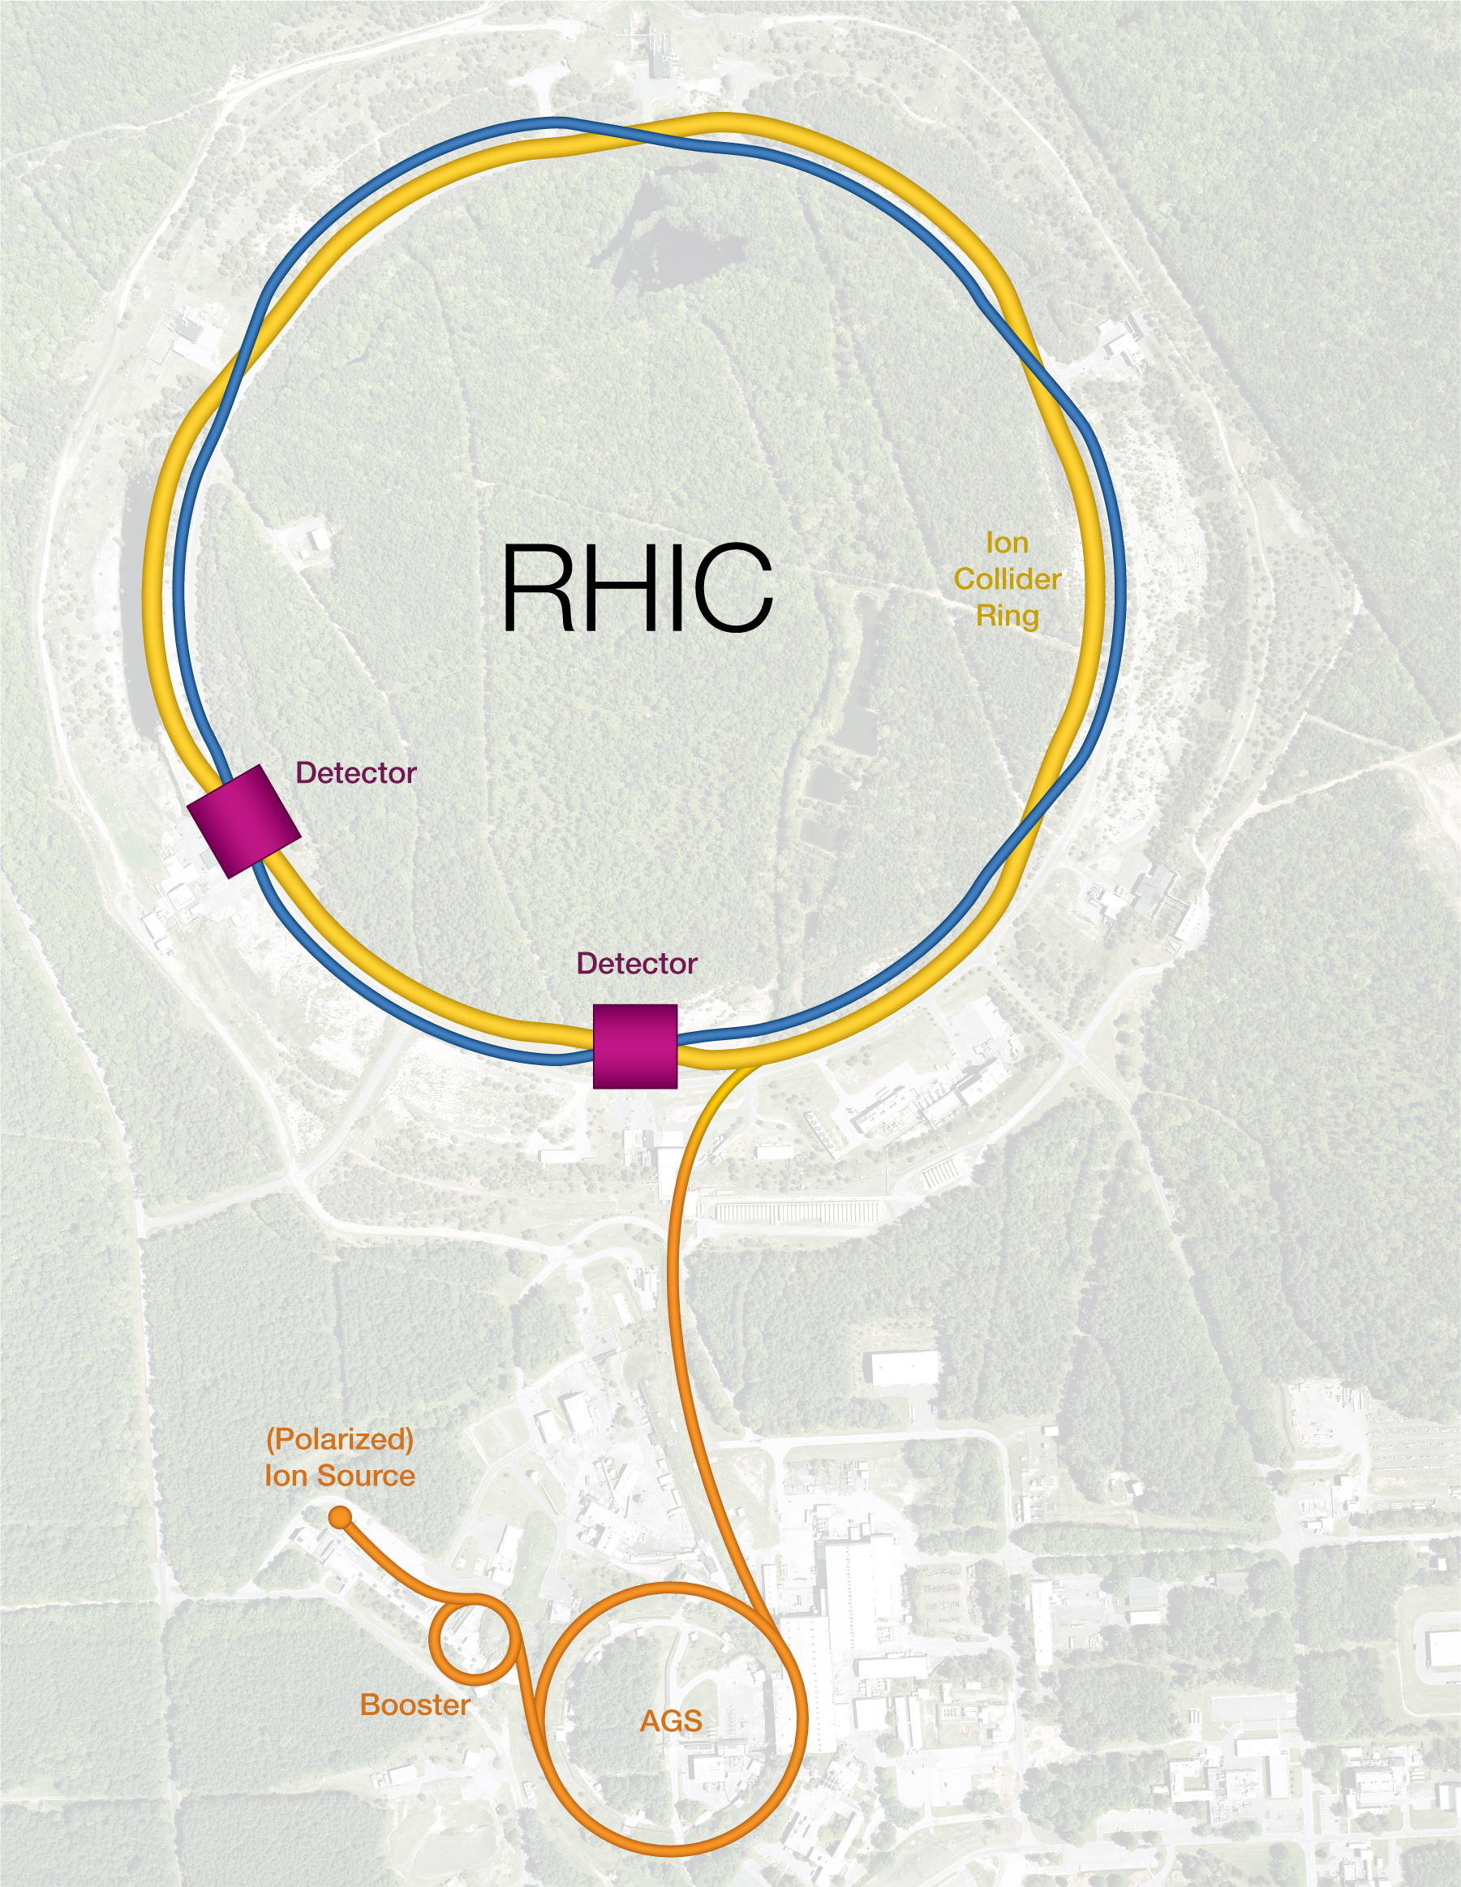
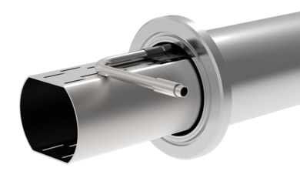
From RHIC to EIC
EIC HSR to be composed of existing arcs of the Yellow RHIC ring (remove unused magnets)
Insert sleeves coated with Cu and amorphous C into SC magnet beam pipes to improve conductivity & reduce SEY (i.e. mitigate e-cloud)
Add new RF cavities
Add hadron cooling to create ‘flat’ bunches
Add crab cavities, new IR SC magnets
Add a collimation system
EIC is based on the existing RHIC facility
RHIC: Two SC storage rings, 3.8km circumference
Energy up to 255 GeV protons, or 100 GeV/n gold,
111 bunches/beam. Ion species from protons to uranium. 60% proton polarization. Exceeded Au+Au design luminosity by a factor of 44. In operation since 2001; operations will end in 2025.

Slide 18
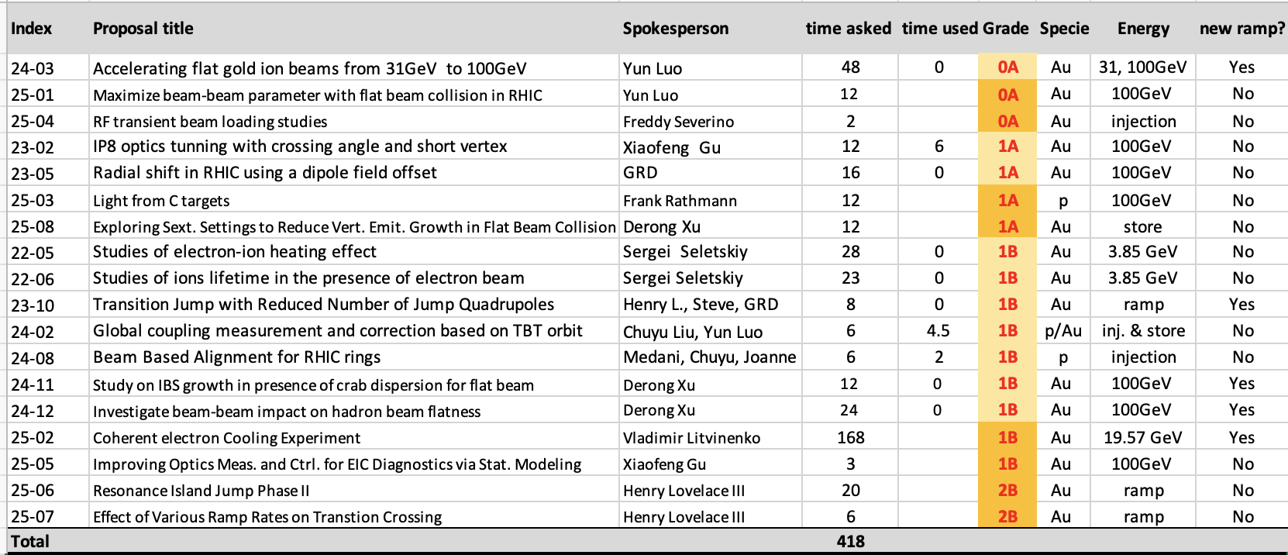
RHIC end of the game runs for EIC
RHIC APEX – Accelerator Physics EXperiment program aimed at beam experiments related to Accelerator Physics
Run25 plans include experiments aimed at EIC beam physics
Currently submitted proposals:
Schedule being optimized
APEX runs will strongly
contribute for validating
EIC designs and for
preparations for EIC
commissioning and operations

Slide 19
EIC talks at eeFACT, in parallel sessions
Beam dynamics studies to address EIC challenges - Christoph Montag
  Mon March 3, 4:40 PM - 5:10 PM, 300
EIC vacuum system - Charles Hetzel
  Tue March 4, 3:20 PM - 3:50 PM, 300
EIC Interaction Region Design and Magnets - Christoph Montag
  Tue March 4, 4:10 PM - 4:40 PM, 304
Recent Advances in Beam-Related Background Studies at EIC - Andrii Natochii
  Wed March 5, 11:20 AM - 11:50 AM, 300
Polarization status at the EIC - Vahid Ranjbar
  Thu March 6, 11:50 AM - 12:20 PM, 300
Beam-beam simulation studies for the Electron-Ion Collider - Yun Luo
  Thu March 6, 2:50 PM - 3:20 PM, 300
Beam-Ion Instability in the EIC electron storage ring - Boris Podobedov
  Fri March 7, 11:50 AM - 12:20 PM, 300

Slide 20
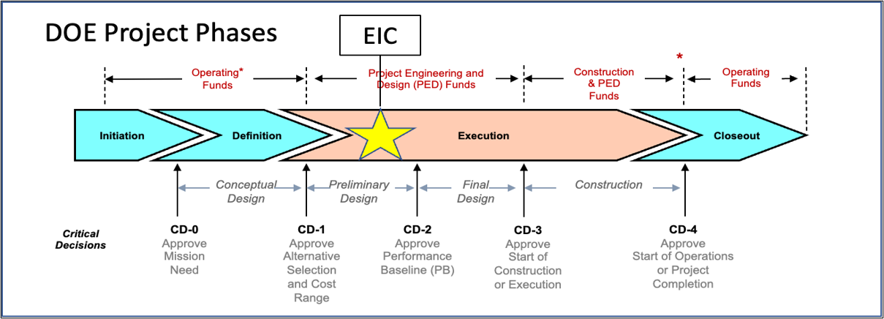
EIC Project-Critical Decisions and Plans
2019
2021
CD-2 and CD-3 in Preparation
CD-4 EF = 2034
CD-3A, Long-Lead Procurement, approved March 2024. Excellent use of IRA (Inflation Reduction Act) funding.
CD-3B, Long-Lead Procurement, approval planned for March 2025.

Slide 21
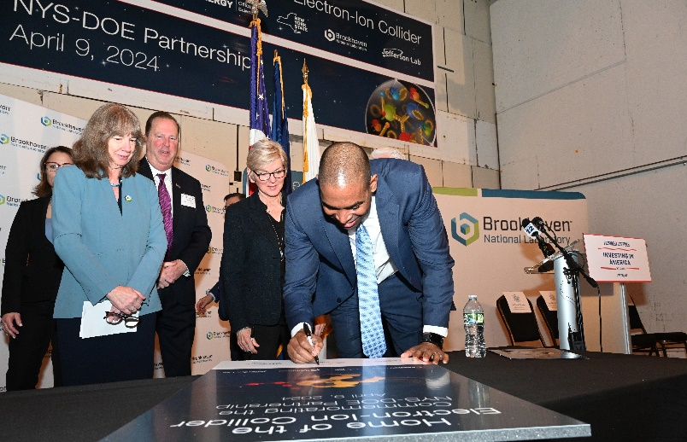
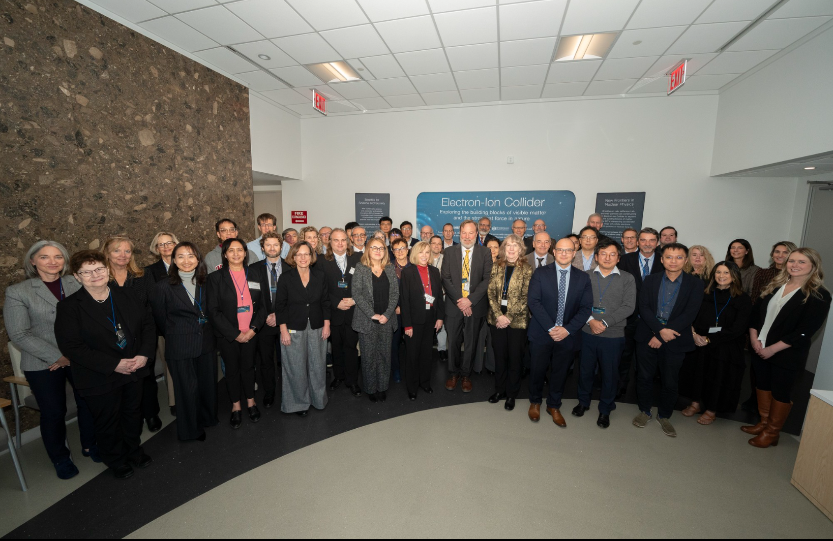

Strong Support from Partners & Collaborators
New York State committed $100M toward construction of EIC buildings and infrastructure.
EIC Accelerator Collaboration kicked off at the International Particle Accelerator Conference with over 150 participants expressing interest in contributing to the global EIC effort.
UK announced £58 million ($75M) for the EIC.
EIC Resource Review Board Meetings in Rome in May 2024 and at BNL in Oct. 2024. Strong participation from Canada, Czech Republic, France, India, Israel, Italy, Japan, Poland, South Korea, United Kingdom, and Taiwan. Next meeting to be held in Prague in June 2025.
In-kind contribution goals represent ~30% of the Detector and ~5% of the Accelerator
21
21

Slide 22
EIC Accelerator Collaboration
The EIC design, construction, and future upgrades offer exciting scientific and technical challenges, creating opportunities for closely connected worldwide accelerator R&D
The EIC Accelerator Collaboration will help realize the full potential of these opportunities
This will benefit the EIC project, collaboration partners, and the wider accelerator community. It will also help maximize the ultimate performance of the EIC facility on the long-term
EIC AC launched at IPAC 2024 kick-off meeting
EIC AC Institutional Collaboration Board: 24 members, 24 Institutes, 9 countries
EIC AC Working Groups on several key topics
Co-Chairs of EIC AC : Tatiana Pieloni (EPFL) and Andrei Seryi (Jefferson Lab)
https://eicac.org/

Slide 23
Summary
EIC is a unique, high-energy, high-luminosity, polarized beam collider that will be one of the most challenging and exciting accelerator complexes ever built – the only new large collider that will be in construction by the end of this decade
EIC offer unique collaboration opportunities
  In Scientific Research, Accelerator Technology, Educational Exchange
The Electron-Ion Collider presents a unique opportunity for collaboration in a project that promises to deliver groundbreaking insights into the fundamental forces of nature
By participating in the EIC, collaborating researchers and institutions can contribute to and benefit from a deeper understanding of QCD, advancements in accelerator technology, and the cultivation of a globally connected scientific community
Such collaboration would not only advance the field of particle physics but also strengthen the bonds between international research communities, fostering a spirit of shared discovery and innovation

Slide 24
Acknowledgement
Thanks to the entire EIC project team, and in particular to EIC Technical Director Sergei Nagaitsev for materials presented at these slides
Thanks to Carsten Welsch (University of Liverpool), who served as the first inaugural international co-chair of EIC Accelerator Collaboration till Oct 2024, for efforts on launching the EIC AC
Thanks to Tatiana Pieloni (EPFL) who is serving as the international co-chair of EIC Accelerator Collaboration, for efforts to further develop EIC AC

