Slide 1
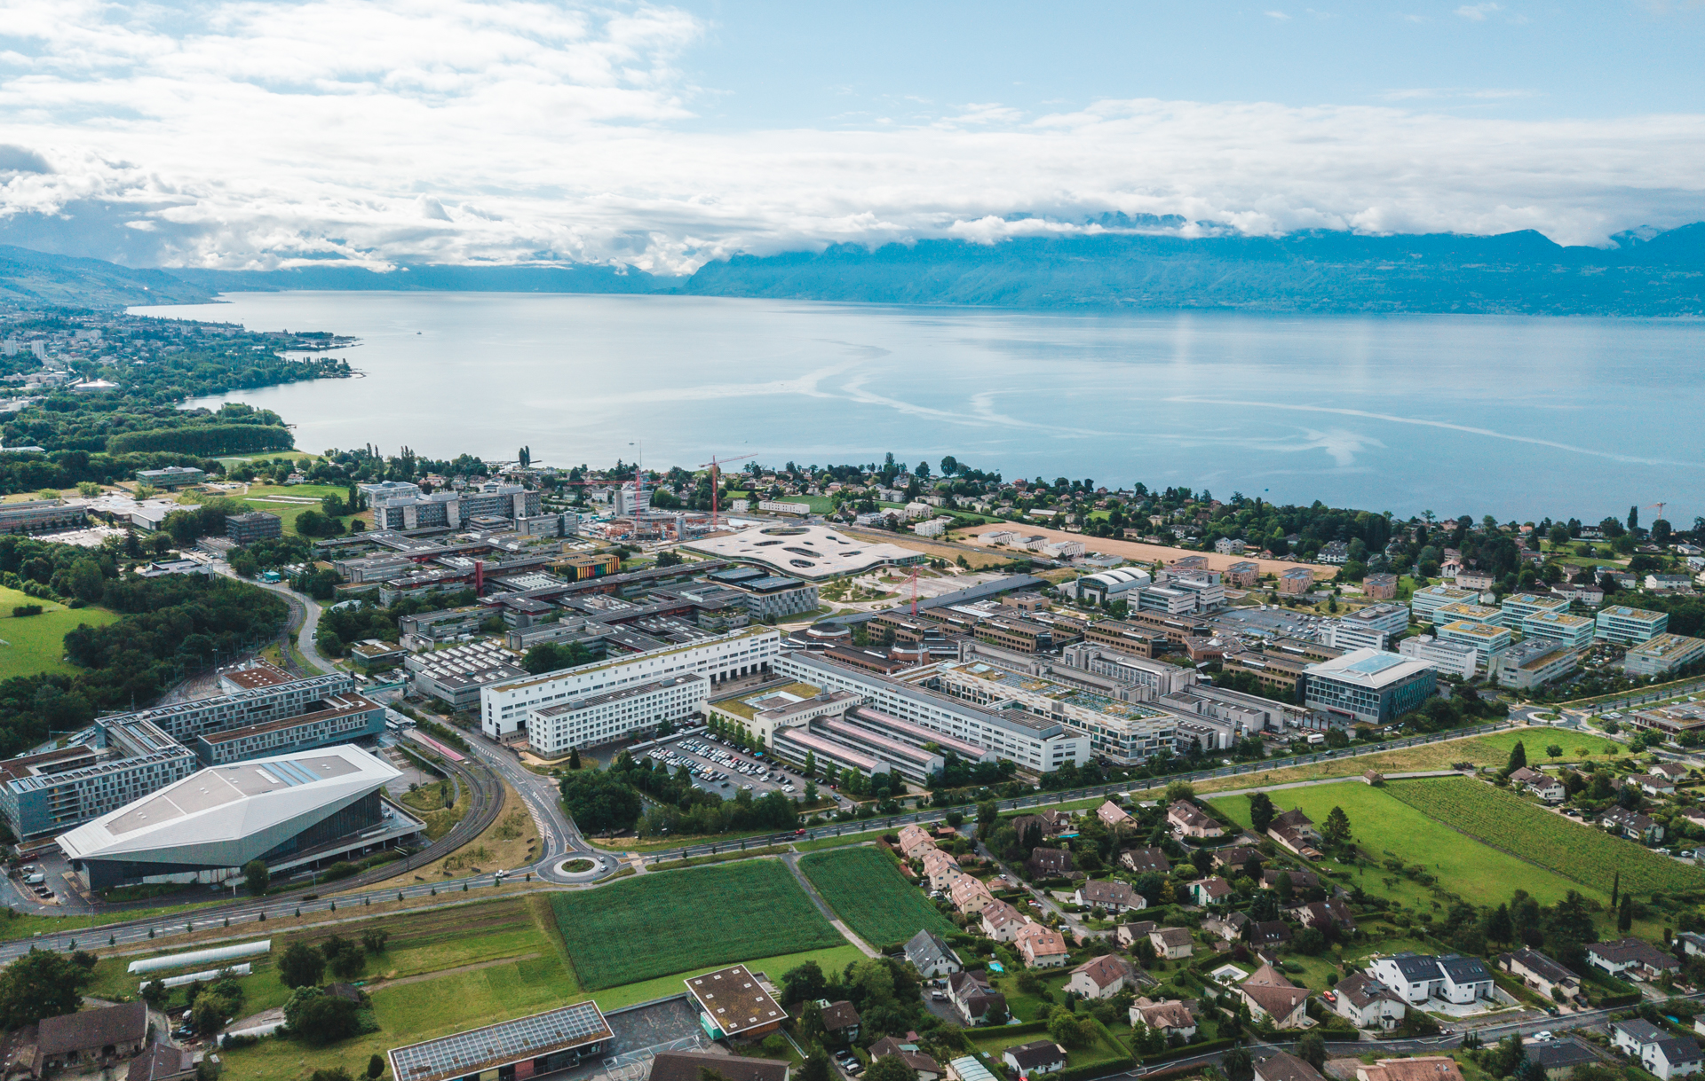


Impact of lattice errors and correction with beam-beam
L. van Riesen-Haupt, P. Kicsiny, Y. Wu, X. Buffat, T. Pieloni, R. Tomas
7th March 2025
Work supported by the Swiss Accelerator Research and Technology (CHART)

Slide 2
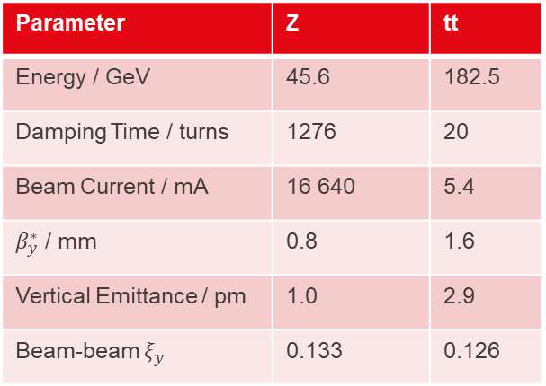
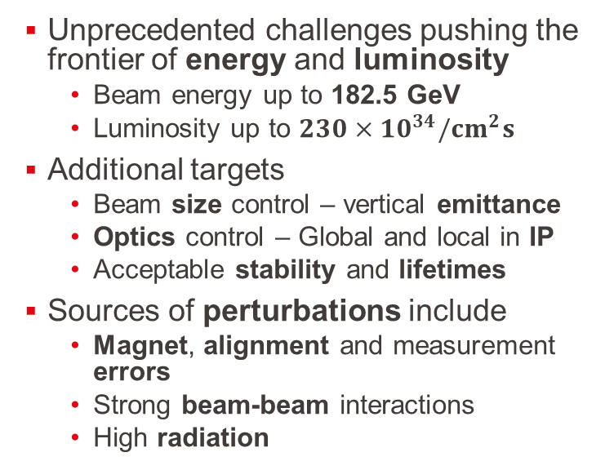
FCC-ee Challenges
Unprecedented challenges pushing the frontier of energy and luminosity
  Beam energy up to 182.5 GeV
  Luminosity up to $230×{10}^{34}/{cm}^{2}s$
Additional targets
  Beam size control – vertical emittance
  Optics control – Global and local in IP
  Acceptable stability and lifetimes
Sources of perturbations include
  Magnet, alignment and measurement errors
  Strong beam-beam interactions
  High radiation
Parameter | Z | tt
Energy / GeV | 45.6 | 182.5
Damping Time / turns | 1276 | 20
Beam Current / mA | 16 640 | 5.4
$β_{y}^{∗}$ / mm | 0.8 | 1.6
Vertical Emittance / pm | 1.0 | 2.9
Beam-beam $ξ_{y}$ | 0.133 | 0.126

Slide 3
Xsuite
Require software tools that can reliably simulate
  The performance indicators
  Under the influence of most/all required perturbations (simultaneously)
New Xsuite software capable of most of these tasks
  Development in CERN in close exchange with FCC-ee team
Thoroughly benchmarked ensuring accurate simulation of
  Radiation (vs SAD and MADX)
  Lattice errors (vs SAD and MADX)
  Beam-beam effects
Software enables beam dynamics simulations but needs input and experience to
  Set up meaningful simulations with perturbations
  Compute performance indicators from tracking data
    Including creating adequate tracking data
    Post processing
  Interpret results

Slide 4
Performance Indicators
Some indicators directly describe the performance of the collider
  Luminosity and Lifetime
  Often computationally intensive
Others relate to and are indicative of the performance
  Optics – especially at interaction point
  Equilibrium emittances
  Dynamic aperture
  Momentum acceptance
Computing time varies largely (seconds – days)
  Use fast(er) indicators during design and optimisation iterations
  Comprehensive simulations at waypoints
  Requires solid understanding of predictive power of indicators

Slide 5
Performance Indicators

Slide 6



Optics and Orbit
$$β$$
Accelerator optics for quick approximations by linearising motion
  E.g. for estimate of local beam sizes
Computed almost instantaneously
  Dependent on closed orbit
  In highly damped FCC-ee additional complication of adjusting magnet strength to compensate for radiation
    “Tapering” implemented in SAD, MAD-X, Xsuite
Cannot include
  Non-linear effects
  Collective effects
Can only estimate stochastic effects
$$w$$
$$β_{w}$$
s

Slide 7
Equilibrium Emittance Simulations
Equilibrium emittances contribute to beam size
  Affecting luminosity
  Driven by radiation effects, optics perturbations and coupling
Various methods to compute equilibrium emittances:
  Summation methods
    Fast approximation in error-free lattices
    Summations of linear optics functions
  Matrix methods
    For coupled motion with errors
  Tracking
    Tracking of particles with radiation
      1000s particles over several damping times (50-5000 turns)
    Allows to include other effects such as beam-beam
Fast
First estimate
Slow
Full picture

Slide 8


Dynamic Aperture
Identify dynamically stable area in phase space
  Initiate particles at different coordinates
  Track for a few damping times (~50-5000 turns)
    Average radiation – particles damped afterwards
  Identify which particles survive and which ones don’t
  Single particle per point (~few 100 points)
Indicate size of perturbation needed for particle to be lost
  Can be parametrised by area or ellipse
Can include non-linear behaviour
No stochastic effects
$$b$$
$$a$$

Slide 9

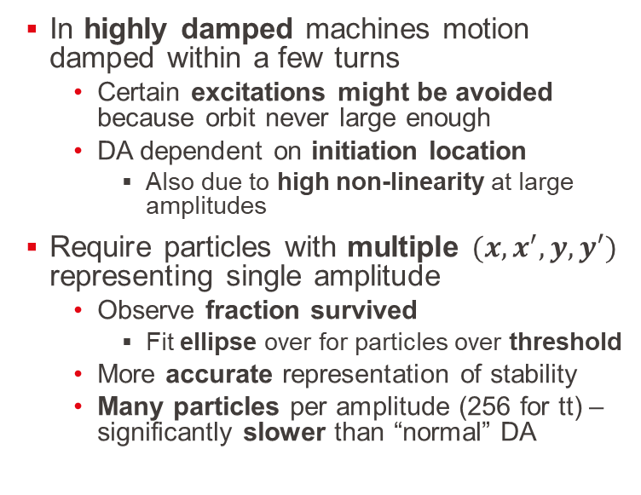



Highly Damped Dynamic Aperture
$$x_{N}′$$
$$x_{N}$$
In highly damped machines motion damped within a few turns
  Certain excitations might be avoided because orbit never large enough
  DA dependent on initiation location
    Also due to high non-linearity at large amplitudes
Require particles with multiple $(x,x^{′},y,y′)$ representing single amplitude
  Observe fraction survived
    Fit ellipse over for particles over threshold
  More accurate representation of stability
  Many particles per amplitude (256 for tt) – significantly slower than “normal” DA
$$N_{y}σ_{y}$$
$$N_{x}σ_{x}$$

Slide 10

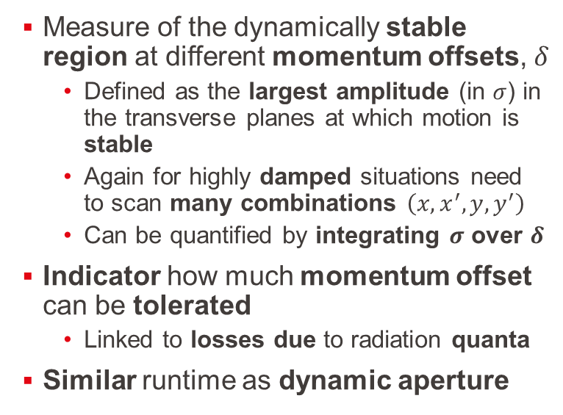

Momentum Acceptance
$$x,y [σ]$$
Measure of the dynamically stable region at different momentum offsets, $δ$
  Defined as the largest amplitude (in $σ$) in the transverse planes at which motion is stable
  Again for highly damped situations need to scan many combinations $\left(x,x^{′},y,y^{′}\right)$
  Can be quantified by integrating $σ$ over $δ$
Indicator how much momentum offset can be tolerated
  Linked to losses due to radiation quanta
Similar runtime as dynamic aperture
$$δ$$

Slide 11



Luminosity
Track multiple macro particles representing a fraction of the bunch charge each
Track location of each macro particle at the interaction point at every turn
  Compute particle density at the location of each macro particle
    Assuming gaussian distribution of second bunch
  Compute luminosity due to each macro particle and integrate
Typically require about 10,000 particles for accurate luminosity estimate
  Require tracking until equilibrium is reached (~50-5000 turns)
$$ρ(x,y)$$
$$y$$
$$x$$

Slide 12
Lifetime
Measure how long particles survive in ring
  Describes intensity that can be sustained
  Required for top-up schemes and current variance
Computed by tracking particles
  Starting at equilibrium distributions
  Recording loss rates
    Due to perturbations of particles (e.g. radiating large quanta) out of stable region
  Relatively rare events – requires high statistics
    Typically 20,000 particles over 100,000 turns
    Detailed description and radiation generation
    Not feasible during optimisation

Slide 13
Overview
Simulation | Number of Particles | Number of Turns
Optics | ~1 | ~few
Emittance – Matrix | ~1 | ~few
Dynamic Aperture | ~100 | ~few damping times (50-5000)
Emittance – Tracking | ~1k | ~few damping times (50-5000)
Damped Dynamic Aperture | ~10k | ~few damping times (50-5000)
Momentum Acceptance | ~10k | ~few damping times (50-5000)
Luminosity | ~10k | ~few damping times (50-5000)
Lifetime | ~100k | ~20k

Slide 14
Lattices with Errors

Slide 15
Introduction
Simulations with global lattice errors
  Opportunity to introduce one type of error at a time
    Understand individual interplay with beam-beam effects
  Develop and test methods of lattice setup and performance indicators simulations
    Provide input to understand correlation between indicators
  Limited input on targets for residual error after correction
    Realistic corrections will include IP tuning
Simulated various types of errors
  Misalignment errors
    Quadrupoles and Sextupoles
  Multipole errors
Simulation of a broad range of indicators
Simulations with K. Oide’s lattice – can be extended to other lattices

Slide 16
Case Study: Sextupole Misalignments
Representative example of studies
  Full lattice description
    Element-by-element tracking
    Synchrotron radiation (average and quantum)
    Vertically misaligned sextupoles
  Beam-beam effects
    Weak-Strong
    Beamstrahlung (average and quantum)
Determining multiple indicators

Slide 17
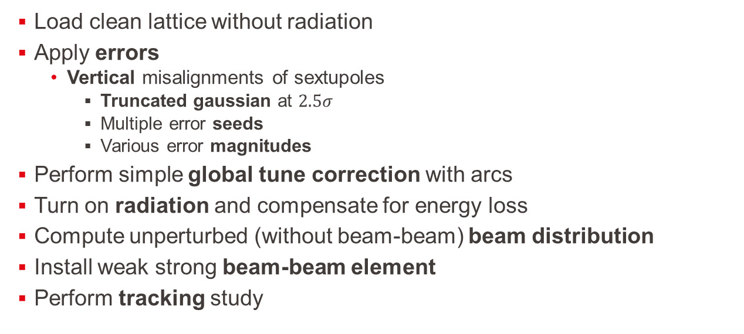
Sextupole Errors – Lattice Setup
Load clean lattice without radiation
Apply errors
  Vertical misalignments of sextupoles
    Truncated gaussian at $2.5σ$
    Multiple error seeds
    Various error magnitudes
Perform simple global tune correction with arcs
Turn on radiation and compensate for energy loss
Compute unperturbed (without beam-beam) beam distribution
Install weak strong beam-beam element
Perform tracking study

Slide 18
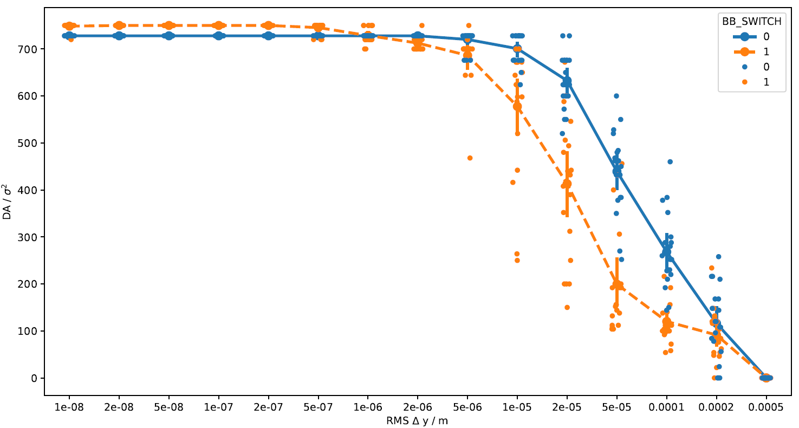
Sextupole Errors – Dynamic Aperture
Dynamic aperture vs RMS error size
  Using largest ellipse method
  Work out average and spread over 20 seeds
  With and without beam-beam (including average beamstrahlung)
Clearly observe impact of beam-beam effect
  Reduces dynamic aperture significantly when errors have an impact
    Low impact at large amplitudes

Slide 19
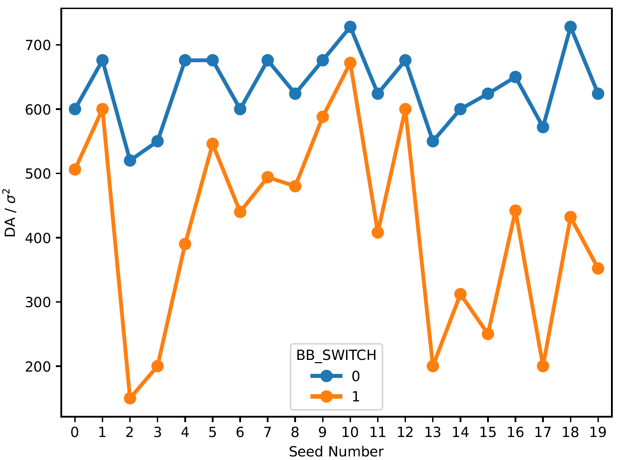
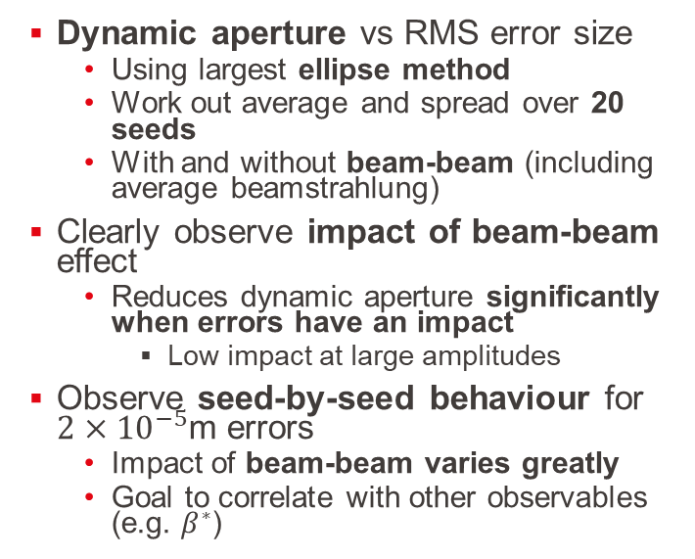
Sextupole Errors – Dynamic Aperture
Dynamic aperture vs RMS error size
  Using largest ellipse method
  Work out average and spread over 20 seeds
  With and without beam-beam (including average beamstrahlung)
Clearly observe impact of beam-beam effect
  Reduces dynamic aperture significantly when errors have an impact
    Low impact at large amplitudes
Observe seed-by-seed behaviour for $2×{10}^{−5}$m errors
  Impact of beam-beam varies greatly
  Goal to correlate with other observables (e.g. $β^{∗}$)

Slide 20
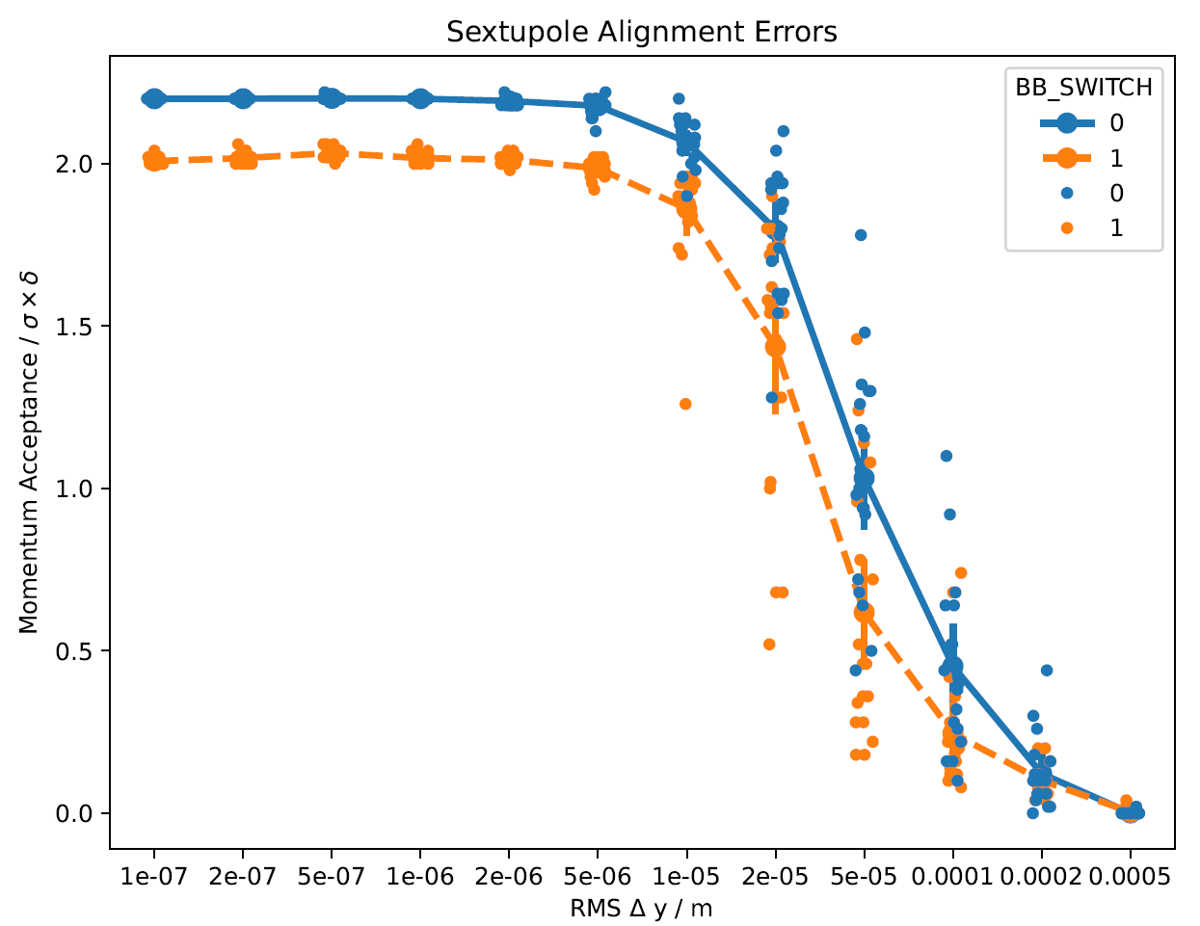
Sextupole Errors – Momentum Acceptance
Momentum acceptance vs RMS error size
  Identical error seeds as in other study
  Integrating largest circular amplitude
  With and without beam-beam (including average beamstrahlung)
Observe impact of beam-beam effect
  Already at lowest threshold
  Reduces acceptance in all cases
  Different impact at different seeds

Slide 21
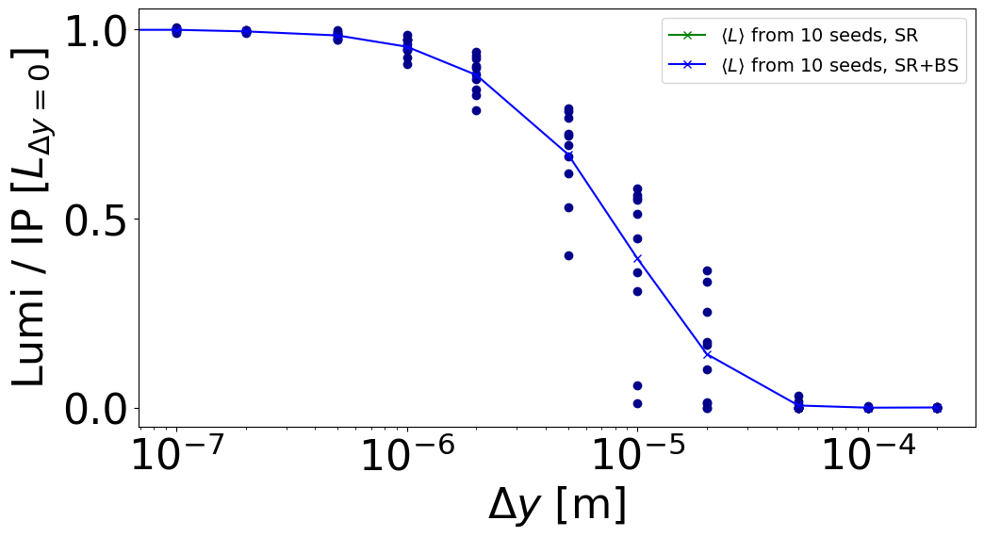
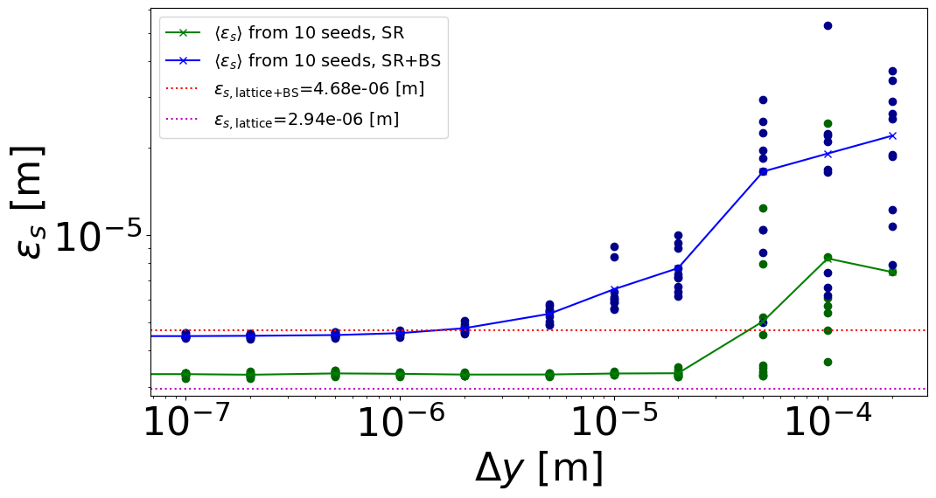
Sextupole Errors – Emittance and Luminosity
P. Kicsiny
Track and observe particles in lattice with beam-beam and sextupole errors
  Same error seeds and setup as previous studies
  Initially matched to unperturbed conditions
  Tracked until new equilibrium is reached
  With and without beam-beam element (and beamstrahlung)
Observe luminosity at interaction point
  Only computed in case with beambeam element
New equilibrium emittance computed after blow-up

Slide 22
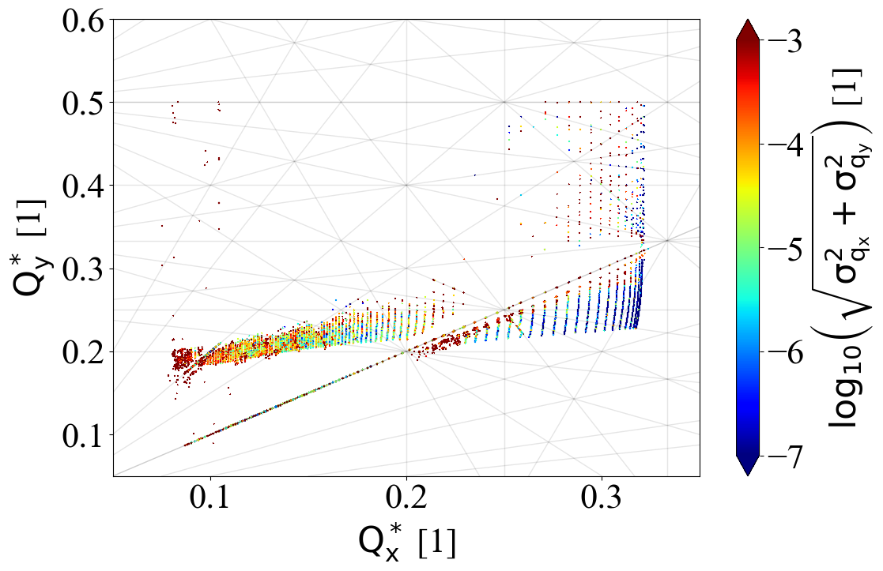
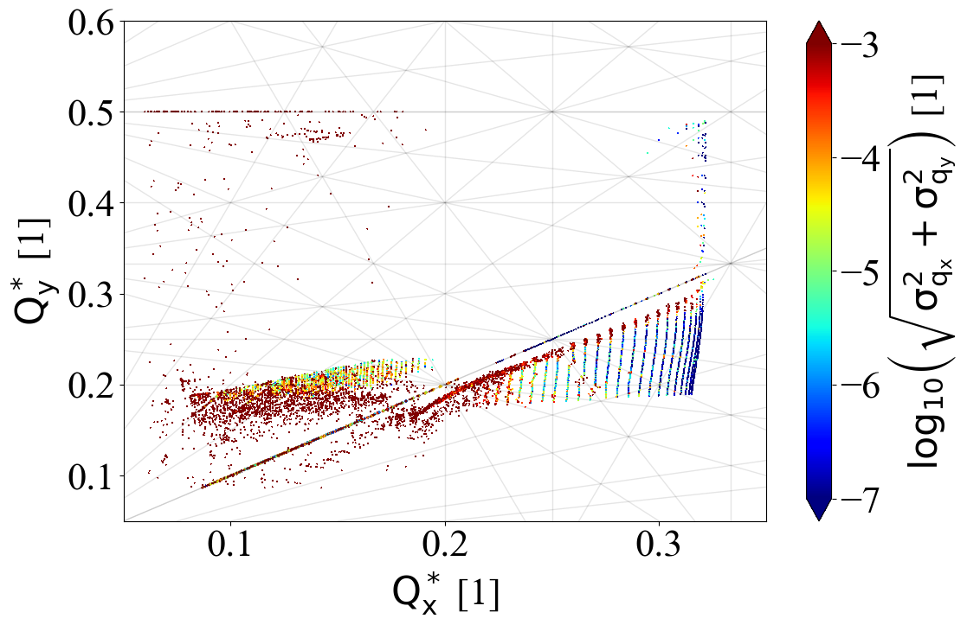
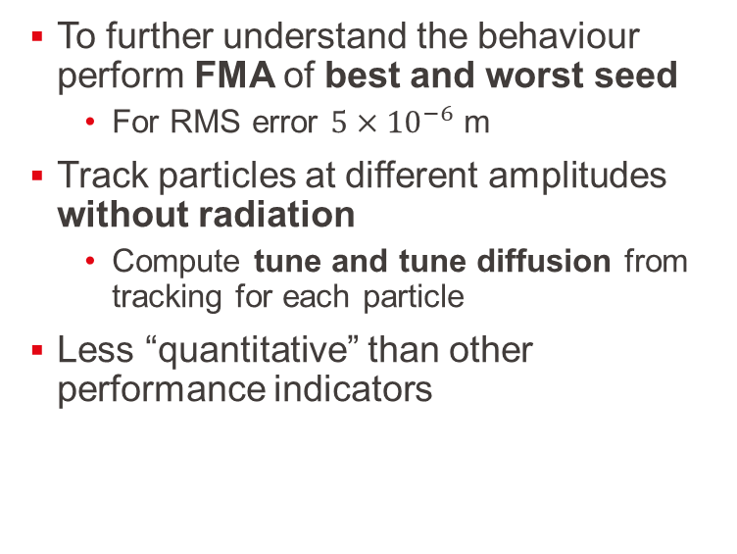
Sextupole Errors – Frequency Map Analysis
P. Kicsiny
To further understand the behaviour perform FMA of best and worst seed
  For RMS error $5×{10}^{−6}$ m
Track particles at different amplitudes without radiation
  Compute tune and tune diffusion from tracking for each particle
Less “quantitative” than other performance indicators

Slide 23
Correlation of Performance Indicators
Computed extensive set of performance indicators under controlled conditions
  Different error sizes and seeds
  Significant spread of performance indicators
Aim to understand correlations and relationships between behaviours
  Enable use of faster indicators during optimisation and correction
  Further understand behaviour leading to worse results under similar conditions
To be augmented with similar studies with different perturbations under controlled conditions

Slide 24
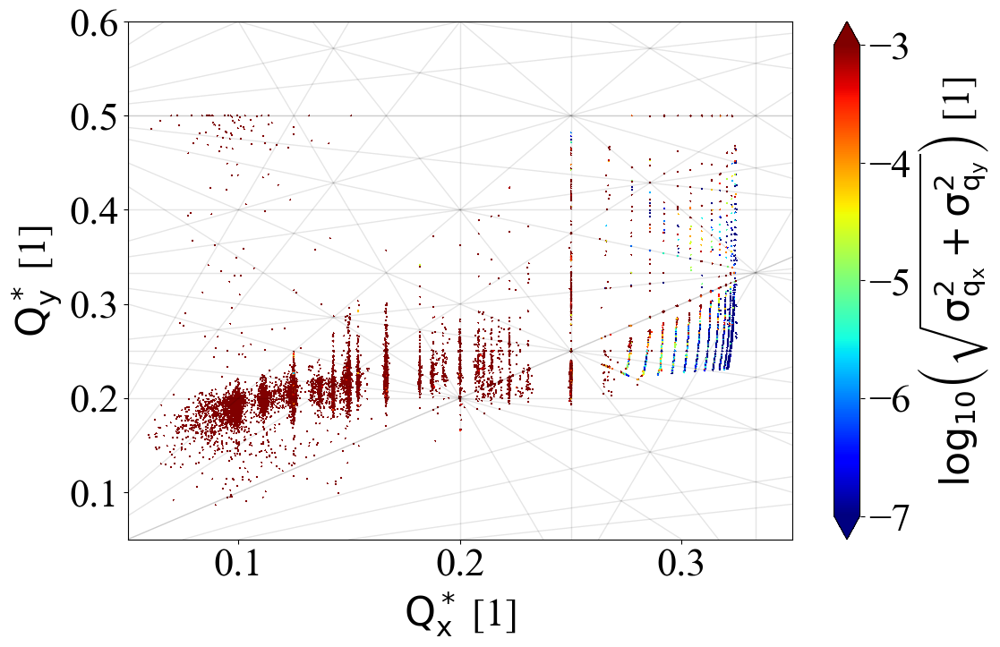
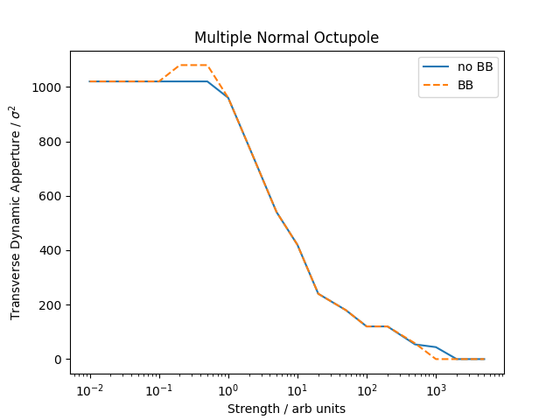
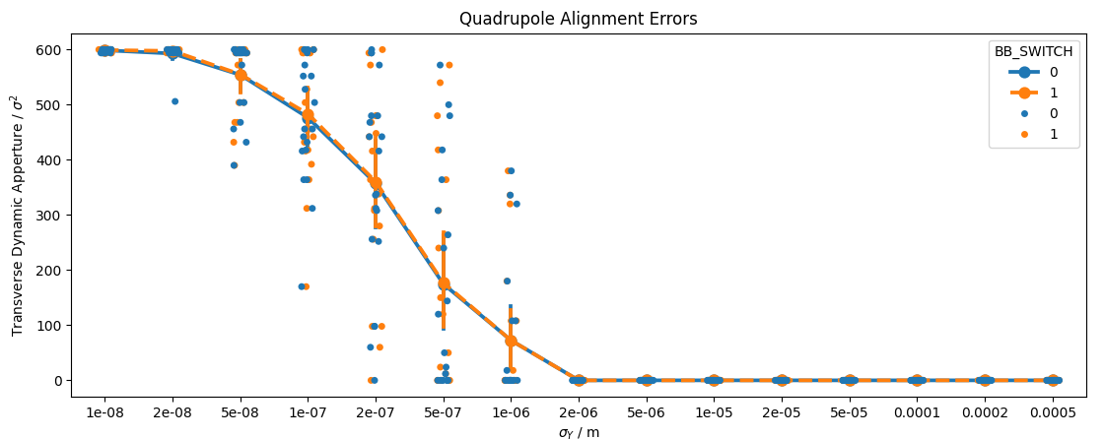
Further Perturbations
Studies scanning different types of errors performed or underway
  Horizontal misalignments of sextupoles
  Multipole error sources
  Misaligned quadrupoles
As well as other lattices and energies

Slide 25
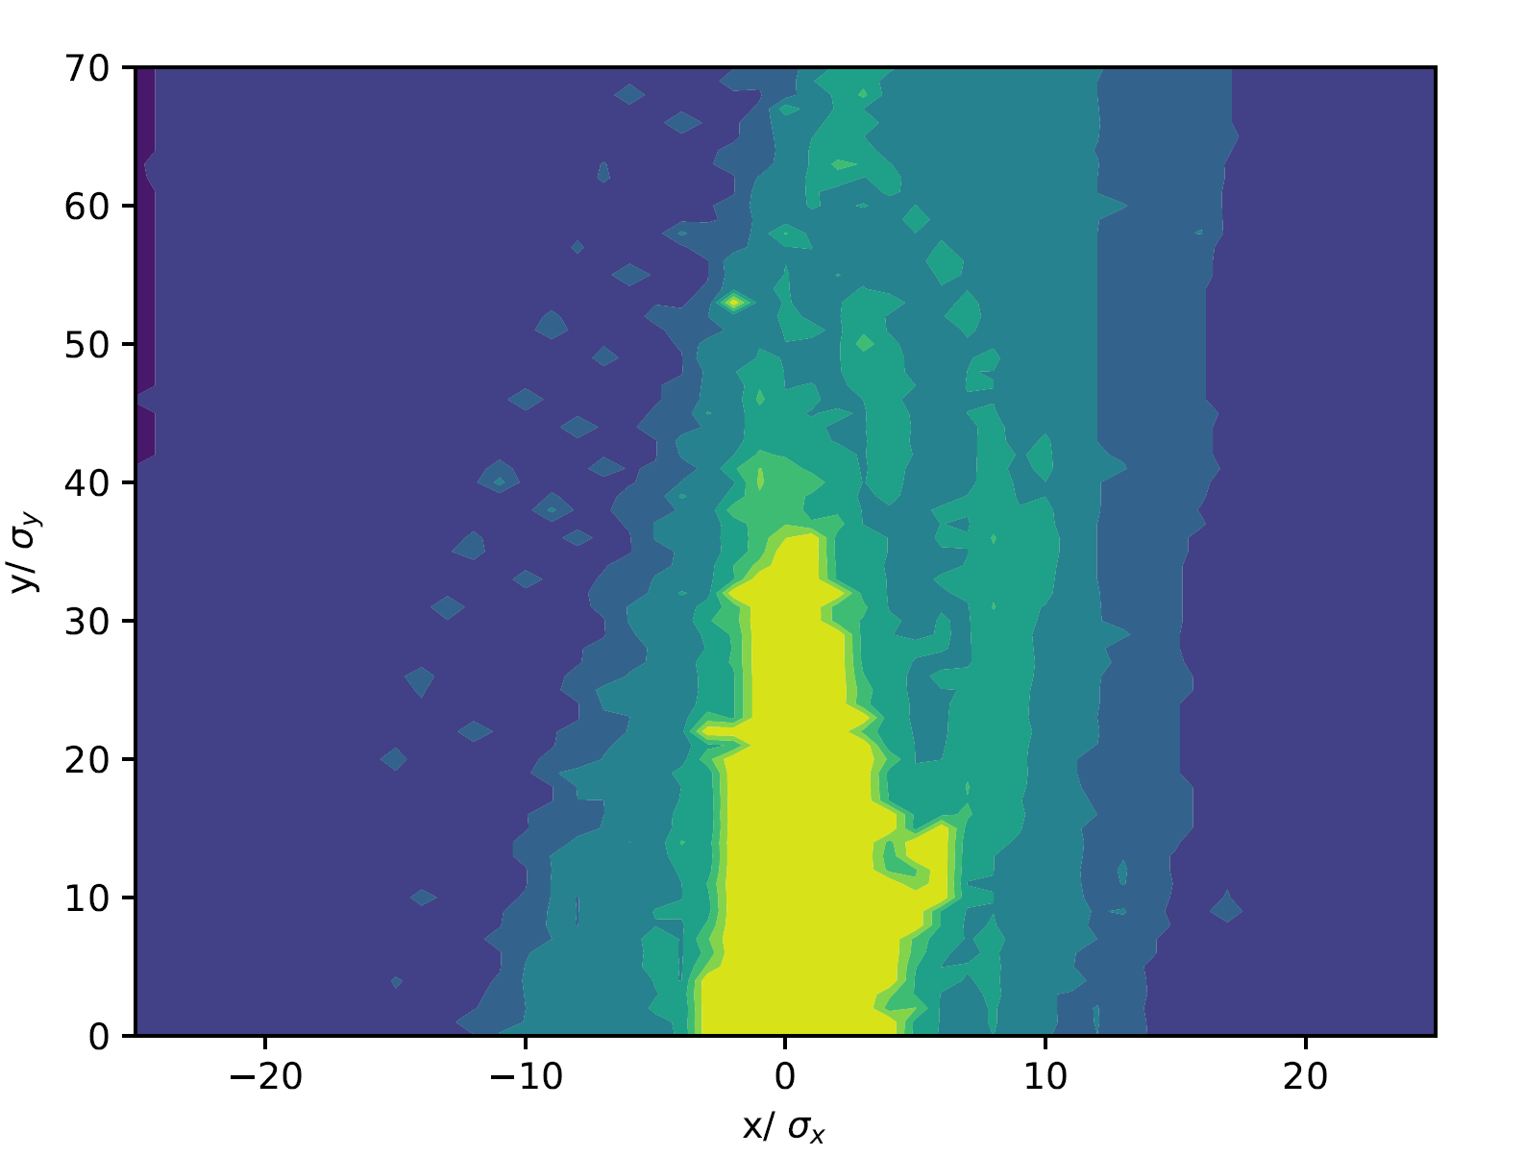
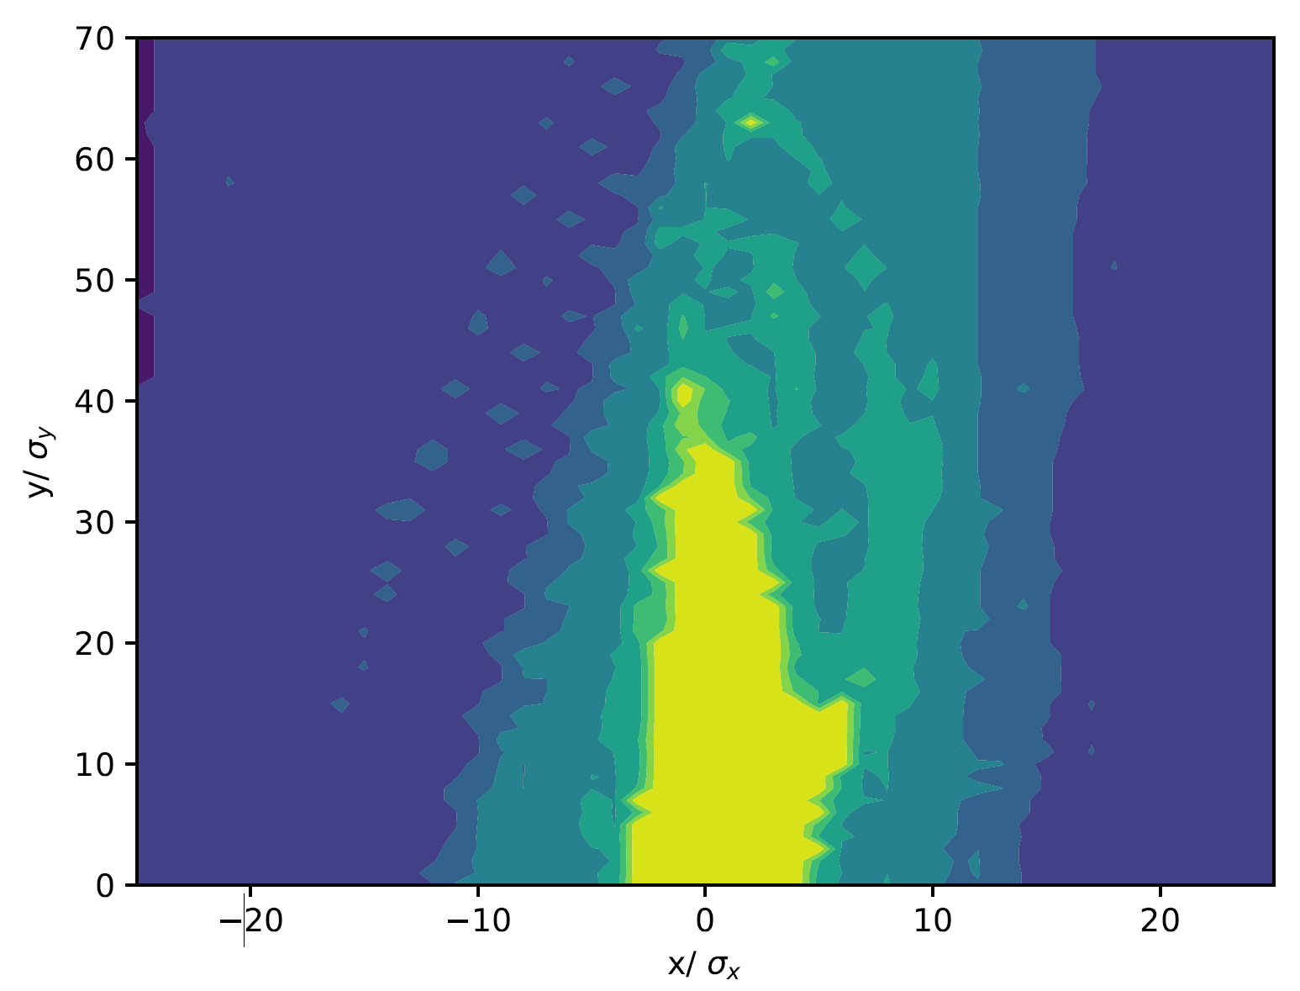
Errors and Correction
Without Beam-Beam
First efforts applying beam-beam perturbations to lattices with global errors and corrections
Lattice with arc errors and corrections provided by Yi Wu
  Errors applied and thorough global correction applied in MADX
    Interleaved optics and orbit corrections
    Ramping of sextupoles
    Details in talk
  Acceptable dynamic aperture but only 2 seconds lifetime
Aim to test on lattices corrected using LOCO by E Musa et al.
  Requires translations from pyAT (and appropriate benchmarking)
With Beam-Beam

Slide 26
IP Perturbations

Slide 27
IP Optics Perturbation - Motivation
Beam-beam effects especially dependent on conditions at the interaction point
  Beam waist, dispersion etc.
  Final correction strategies to include dedicated IP tuning after global corrections (see talks by V. Gawas, S. Sai)
  Dedicated tuning knobs and measurement techniques
Controlled perturbations to IP parameters can help establish tolerances
  Targets for IP tuning goals
  Direct input for alignment and instrumentations tolerances

Slide 28
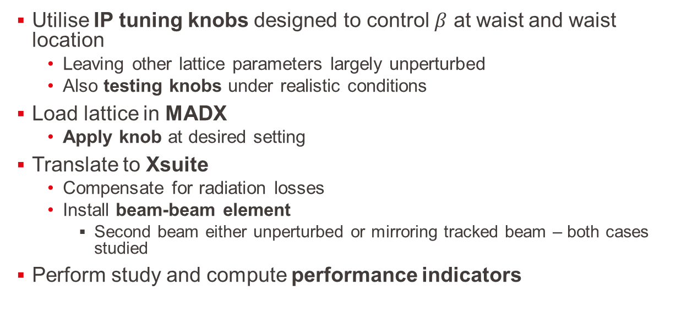
Optics Perturbation – Setup
Utilise IP tuning knobs designed to control $β$ at waist and waist location
  Leaving other lattice parameters largely unperturbed
  Also testing knobs under realistic conditions
Load lattice in MADX
  Apply knob at desired setting
Translate to Xsuite
  Compensate for radiation losses
  Install beam-beam element
    Second beam either unperturbed or mirroring tracked beam – both cases studied
Perform study and compute performance indicators

Slide 29
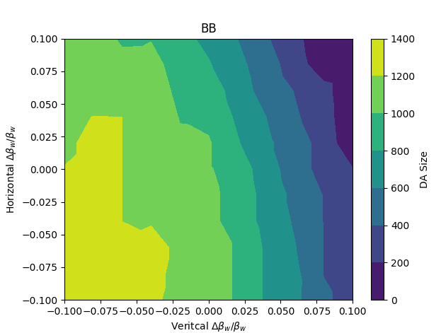
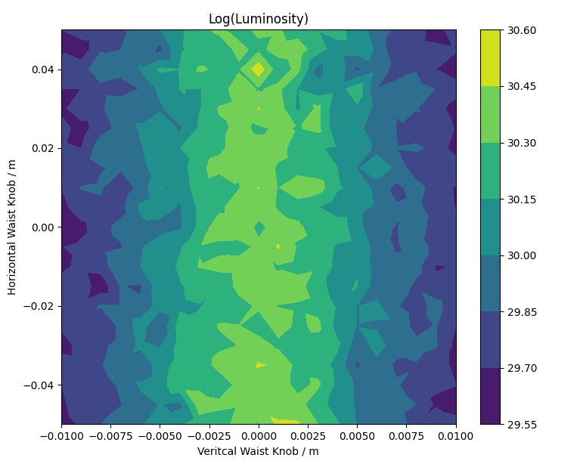
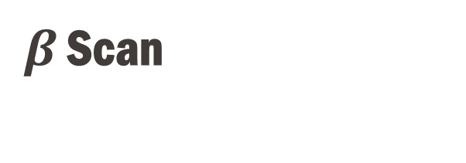
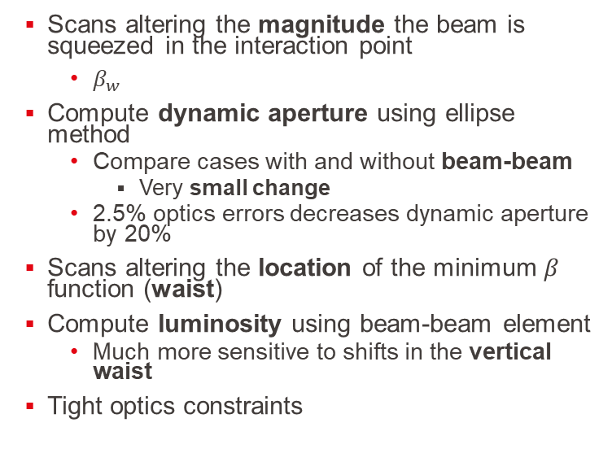
$β$ Scan
Scans altering the magnitude the beam is squeezed in the interaction point
  $β_{w}$
Compute dynamic aperture using ellipse method
  Compare cases with and without beam-beam
    Very small change
  2.5% optics errors decreases dynamic aperture by 20%
Scans altering the location of the minimum $β$ function (waist)
Compute luminosity using beam-beam element
  Much more sensitive to shifts in the vertical waist
Tight optics constraints

Slide 30
Vertical Dispersion Setup
Vertical dispersion in the IP potentially has a large interplay with beam-beam interactions
  Large energy loss from beamstrahlung can push particles on dispersive larger amplitudes
    Results in vertical emittance blow up and reduction in luminosity
    Potential reduction in momentum acceptance and lifetime
Introduce vertical dispersion via dipole chicane around all IPs
  Dipole pair either side of IP
    Sector bends to not reduce machine length and trajectories
  Closed dispersion bump with dispersion in IP but flat outside
Scan dispersion in steps of factor 10 to determine thresholds

Slide 31
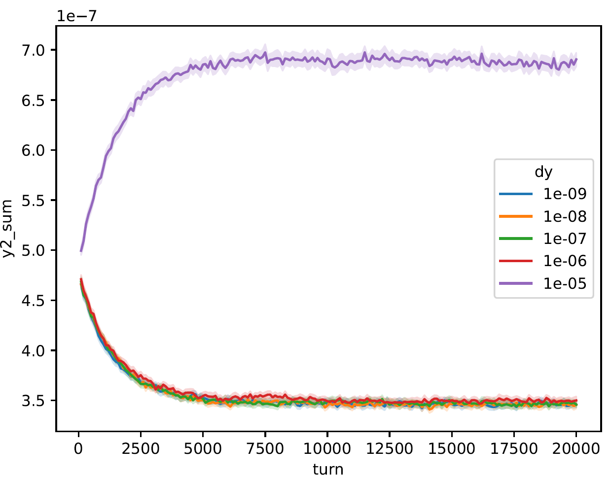
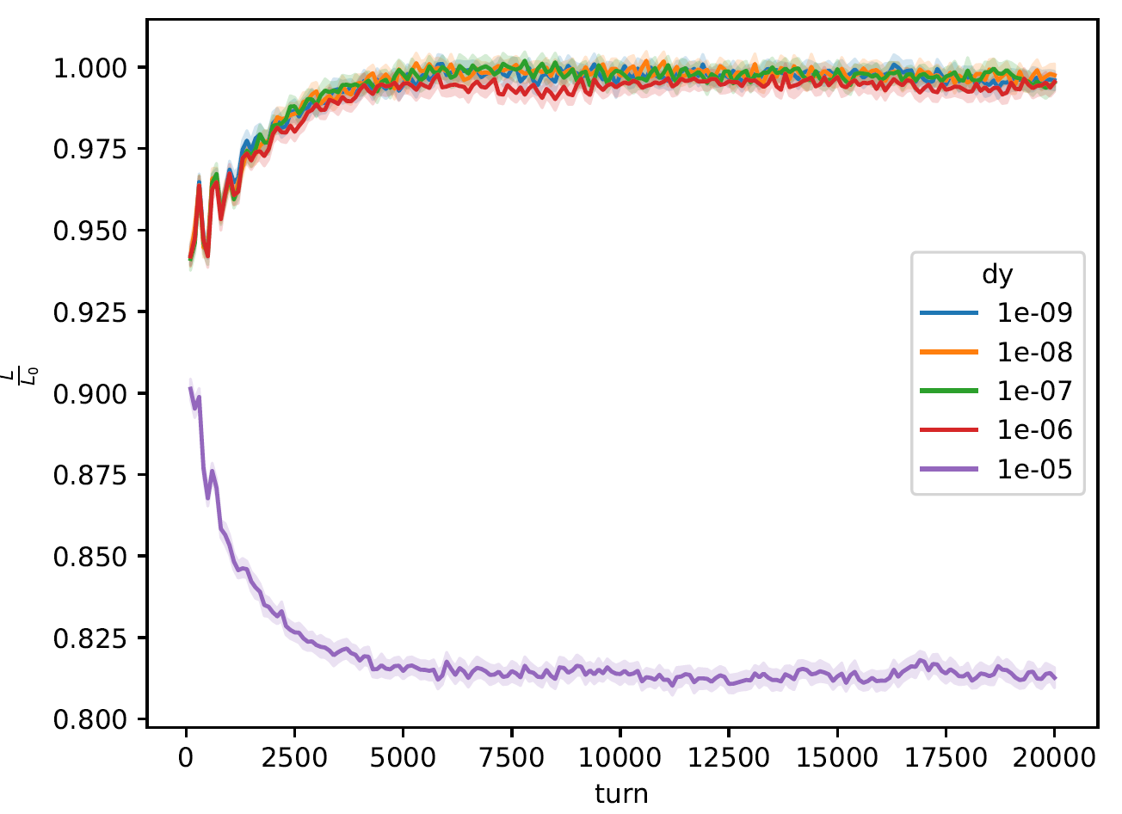
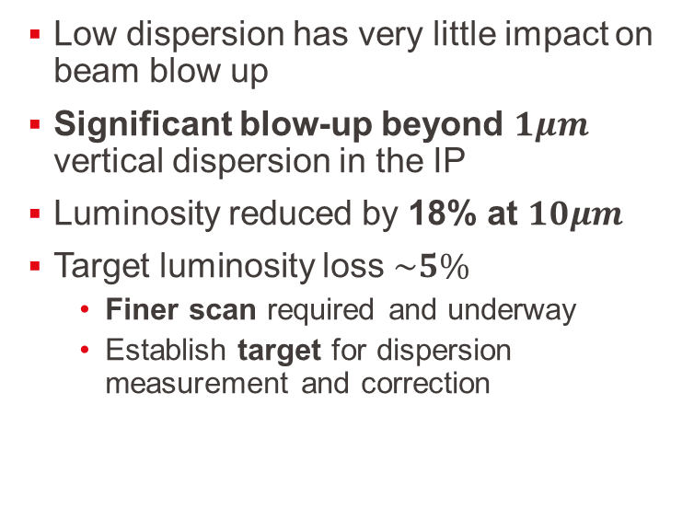
Vertical Dispersion – Beam Distribution and Luminosity
Low dispersion has very little impact on beam blow up
Significant blow-up beyond $1μm$ vertical dispersion in the IP
Luminosity reduced by 18% at $10μm$
Target luminosity loss $\sim 5\%$
  Finer scan required and underway
  Establish target for dispersion measurement and correction

Slide 32
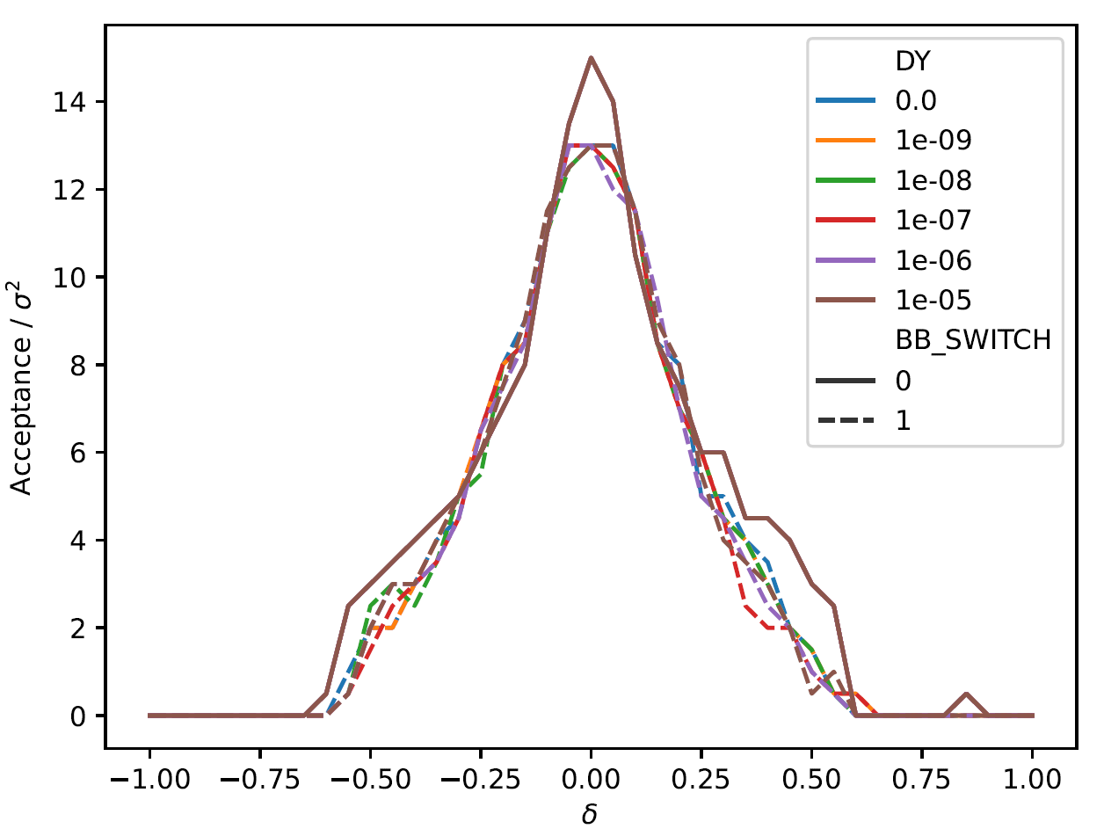
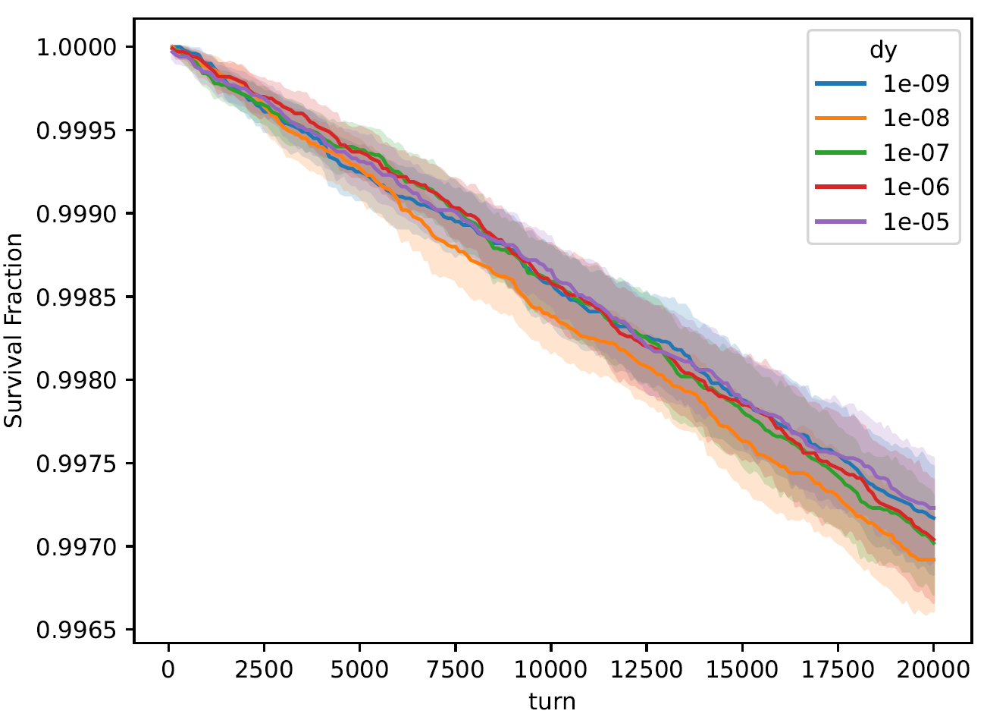
Vertical Dispersion – Lifetime and Acceptance
Momentum acceptance slightly impacted by beam-beam interactions
  Consistent for all dispersion values
Overall increased dispersion has very little impact on momentum acceptance and lifetimes
  At magnitudes where luminosity is affected
Vertical dispersion less of a concern for beam stability

Slide 33
Conclusion and Outlook

Slide 34
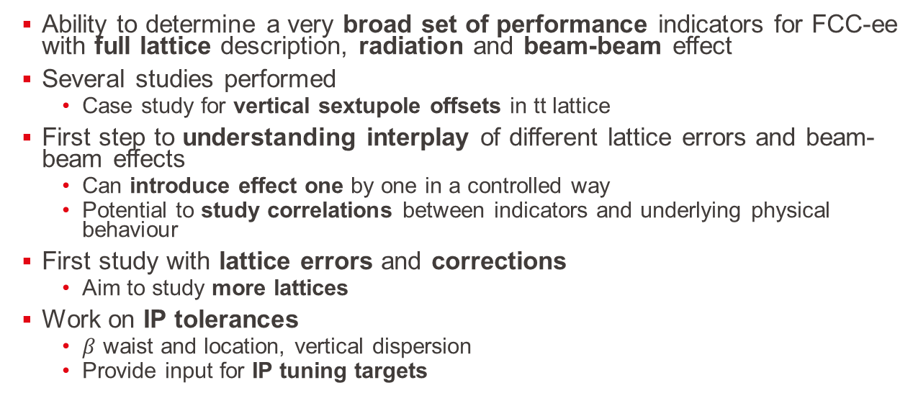
Conclusions
Ability to determine a very broad set of performance indicators for FCC-ee with full lattice description, radiation and beam-beam effect
Several studies performed
  Case study for vertical sextupole offsets in tt lattice
First step to understanding interplay of different lattice errors and beam-beam effects
  Can introduce effect one by one in a controlled way
  Potential to study correlations between indicators and underlying physical behaviour
First study with lattice errors and corrections
  Aim to study more lattices
Work on IP tolerances
  $β$ waist and location, vertical dispersion
  Provide input for IP tuning targets

Slide 35
Outlook
Systematically study different errors and collect data on performance indicators under different conditions
  Determine correlations and relationships
  Aim to be able to use faster indicators whenever possible with higher confidence
Increase realism by including
  Larger scope of errors
  Corrections
  Other perturbations e.g. tilted solenoids
Work closely with IP tuning team to
  Set correction targets based on machine performance
  Test fully corrected lattices with tuned IPs

Slide 36
Thank you!

