Slide 1


Circular Electron Positron Collider
Single beam collective effects at CEPC
Na Wang
Institute of High Energy physics
Contributors:
Haisheng Xu, Yuan Zhang, Yudong Liu, Saike Tian, Jintao Li, Xiaoyu Liu
70th ICFA Advanced Beam Dynamics Workshop on High Luminosity Circular e+e- Colliders, Mar. 3-7, 2025, Tsukuba, Japan

Slide 2
CEPC beam parameters (30MW)
Parameter [unit] | Higgs | Z | W | tt
Beam energy E_{k} [GeV] | 120 | 45.5 | 80 | 180
L_{max}/IP (10³⁴cm⁻²s⁻¹) | 5 | 115 | 16 | 0.5
Emittance (H/V) [nm/pm] | 0.64/1.3 | 0.27/1.4 | 0.87/1.7 | 1.4/4.7
Beam current [mA] | 16.7 | 803.5 | 84.1 | 3.3
Bunch number | 268 | 11934 | 1297 | 35
Bunch Population [10¹⁰] | 13 | 14 | 13.5 | 20
Momentum compaction α_{p} [10⁻⁵] | 0.71 | 1.43 | 1.43 | 0.71
Bunch length σ_{z} (natural/total) [mm] | 2.3/4.1 | 2.5/8.7 | 2.5/4.9 | 2.2/2.9
Energy spread (natural/total) [10⁻⁴] | 10/17 | 4/13 | 7/14 | 15/20
Betatron tune ν_{x}/ν_{y} | 445.10/445.22 | 317.10/317.22 | 317.10/317.22 | 445.10/445.22
Synchrotron tune | 0.049 | 0.035 | 0.062 | 0.078
Radiation damping [ms] | 44/44/22 | 816/816/408 | 150/150/75 | 14/14/7
Design queries
Small α_{p}
Short natural σ_{z}
Slow damping at low E_{k}

Slide 3
Impedance modeling
Impedance modeling of the key vacuum components has been evolving.
  Resistive wall, collimators, RF cavities, flanges, BPMs, bellows, gate valves, pumping ports, masks, IP chambers, electrostatic-separators, feedback kickers, taper transitions
Dominant impedance contributors are identified.
However, the impedance contributions from the injection and extraction elements are missing.
Some of the components, such as the collimators, electrostatic-separators, are still under optimization and development.

Slide 4
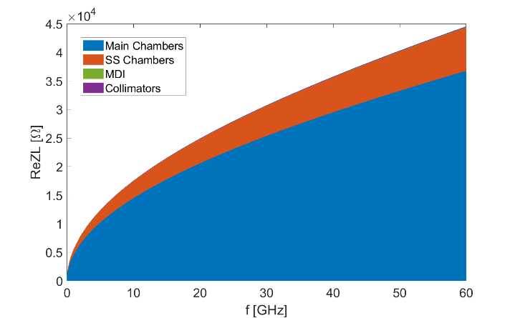
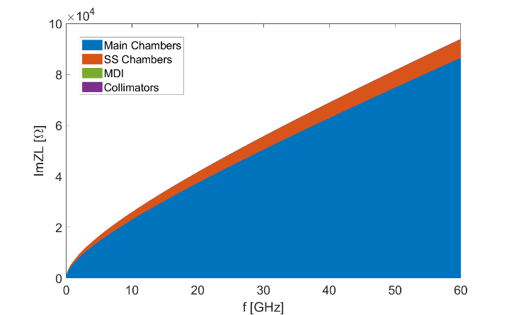
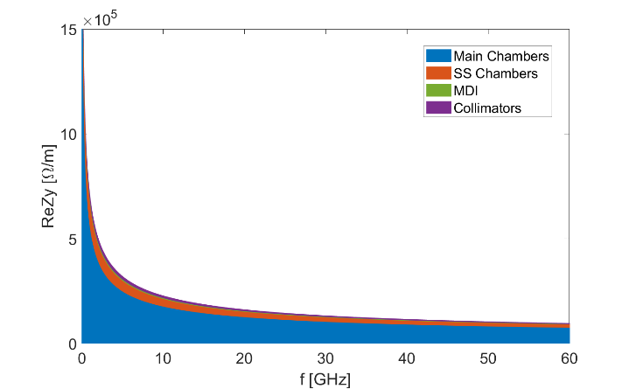
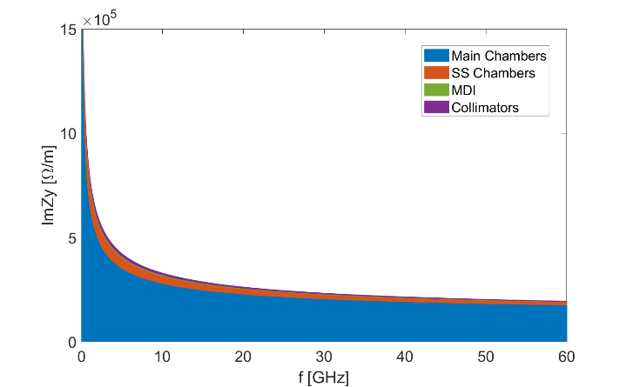
Resistive wall impedance
Resistive wall impedance is calculated considering different type of vacuum chambers
  main vacuum chamber with NEG coating, IP chamber, collimators and stainless steel chamber (flanges, bellows, BPMs)) ⇒ The impedance contributed by the main vacuum chamber dominates both the longitudinal and transverse RW impedance (>80%)
Broadband effective impedance @σ_{z}=3mm
ReZL
ImZL
Components | Z||/n, mΩ | k_{loss}, V/pC | k_{y}, kV/pC/m
Main chamber | 6.1 | 355.7 | 11.3
SS chamber | 0.7 | 73.4 | 1.7
IP chamber | 6.9E-3 | 0.7 | 0.2
Collimators | 1.4E-2 | 1.4 | 0.6
RW Total | 6.8 | 431.2 | 13.8
Ring Total | 16.5 | 876.9 | 64.2
ReZy
ImZy
RW takes ~40% of the total ZL, ~50% of the total k_{loss}, ~20% of the total ky @σ_{z}=3mm
Heat load deposition on the main vacuum chamber: ~15W/m @σ_{z}=8.7mm (SR power=30MW/beam)

Slide 5
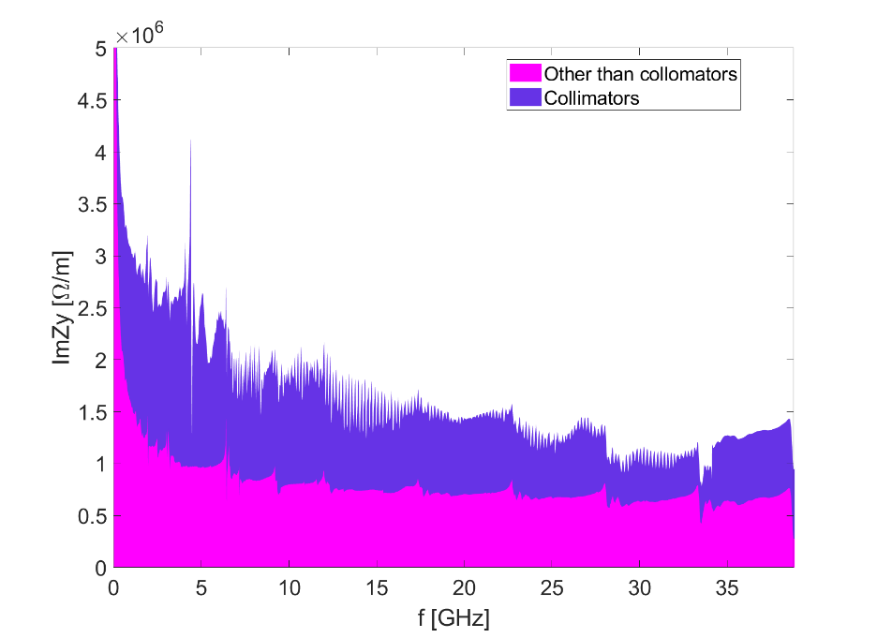
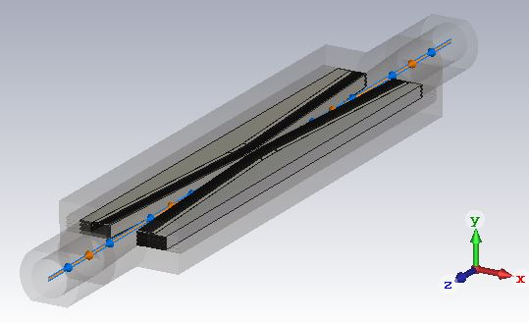
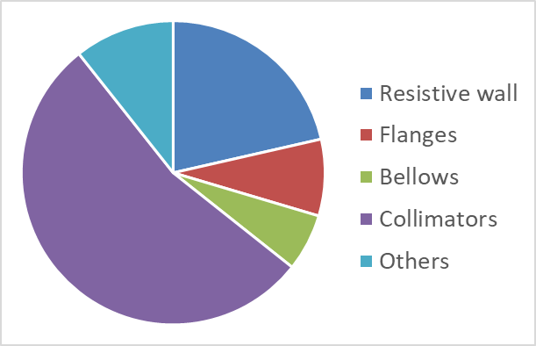
Collimator
Preliminary design of the collimation system has 58 collimators for both background reduction in the detectors and machine protection from beam losses.
Horizontal/Vertical:
flattop=40mm
Half aperture=6~8mm
Taper angle=0.06
Sliding fingers for the RF shielding
Transverse impedance occupation for different components
Dominant contribution to the transverse impedance
Small contribution to the longitudinal impedance

Slide 6
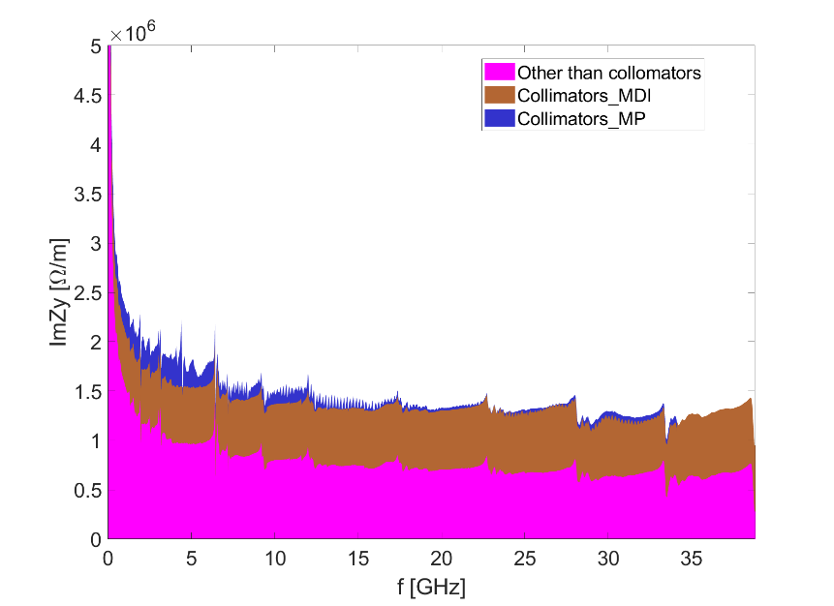
Impedance reduction of the collimator
Push the optimization of the collimation system, the iterative version has total of 34 collimators
The transverse impedance contribution from the collimators is decreased by ~40%
The transverse impedance of the whole ring reduced by ~20%
Use nonlinear collimators as proposed in SuperKEKB is another candidate solution to further reduce the collimator impedance.
Impedance budget
k_{y,coll}, kV/pC/m | 34.5
k_{y,total}, kV/pC/m | 64.2
Previous design
Current design with reduced num. of colls
Impedance budget
k_{y,coll}, kV/pC/m | 21.1
k_{y,total}, kV/pC/m | 50.8
The collimation system design is currently undergoing continuous development and refinement.

Slide 7
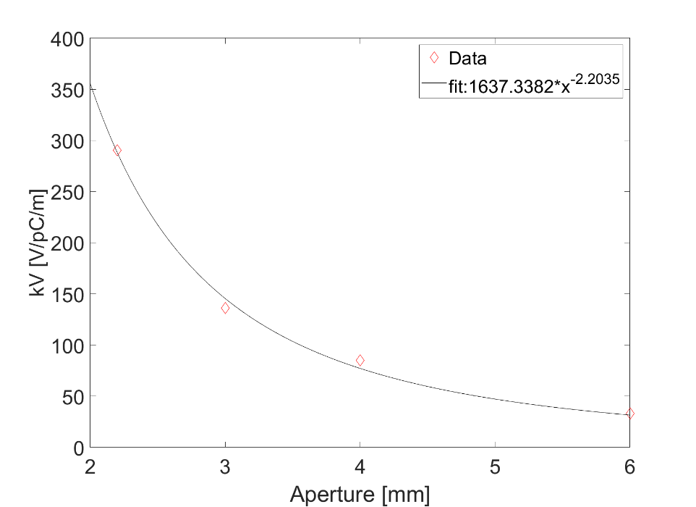

Dependence of collimator impedance on beta function
Collimation design usually chose location with high β to have large beam size and high collimation efficiency ⇒ Roughly, if we take $Aperture∝\sqrt{βε}$ → Lower impedance & high beta function weighting
⇒ We have the betatron weighted kick factor k_{y}$∝β∗$kV$∝β∗Aperture$^{-2.2}$∝β$^{-0.1}
⇒ Further impedance reduction by choosing proper β function may not easy.
Impedance without β weighting:
Aperture [mm] | kV [V/pC/m] | kH [V/pC/m]
2.2 | 290.5 | 43.7
3 | 136.2 | 21.6
4 | 85.2 | 15.9
6 | 33.1 | 8.4
kH and kV are not weighted by beta function
kV: kick factor in the direction of jaws

Slide 8
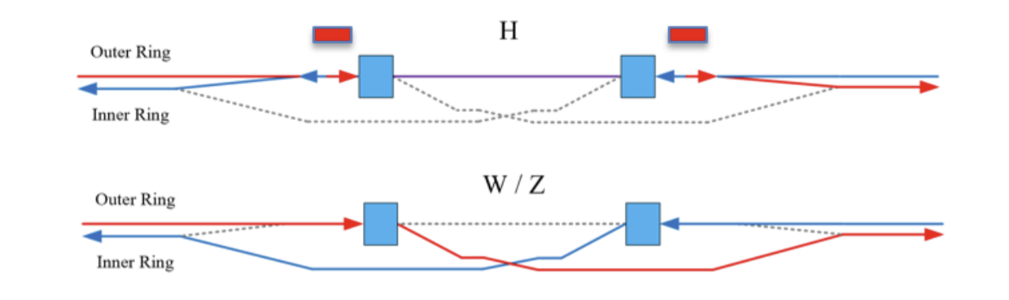
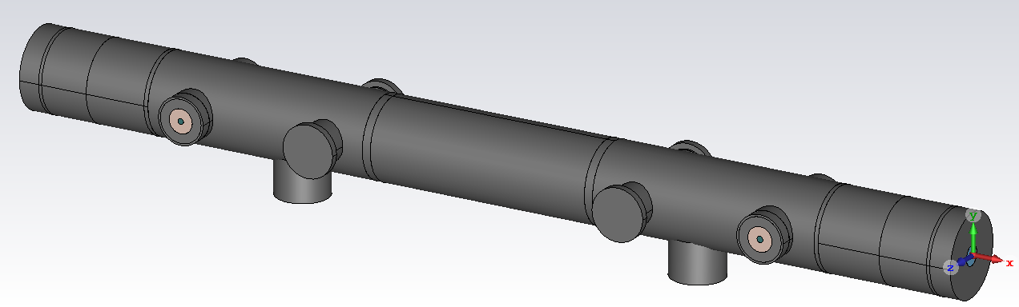
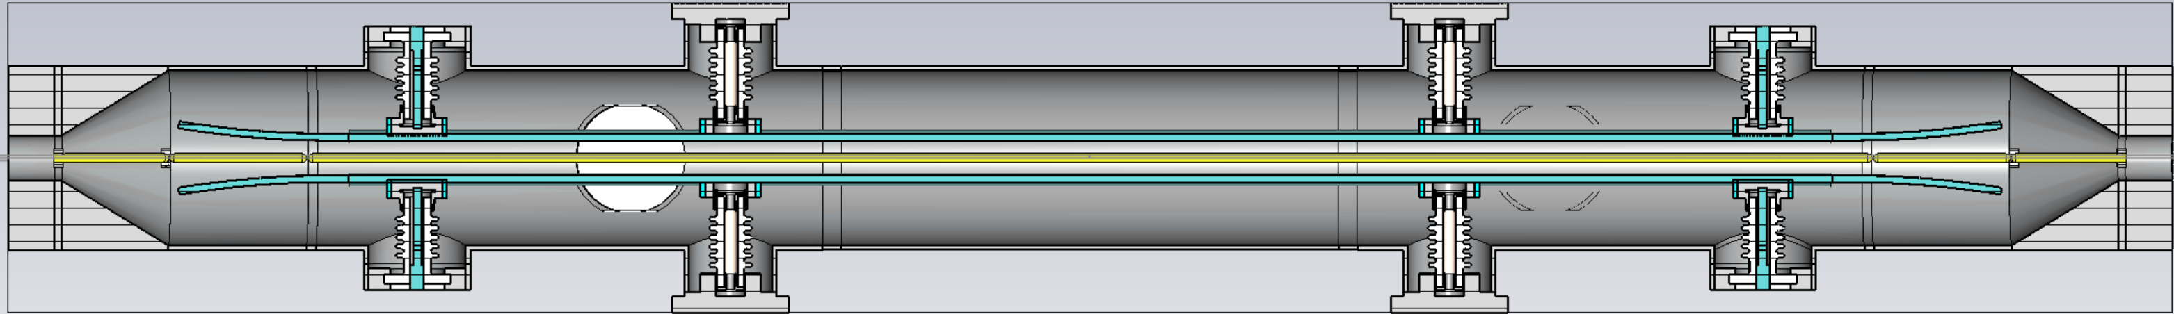
Electrostatic-separator
Electrostatic separators have been used extensively in the days when the e- and e+ sharing the vacuum chamber, because their ability to generate opposite beam deflections depending on the charge of the beam.
They are essential components for the CEPC, enabling the two beams to share the RF cavities.
The shearing scheme utilize both electrostatic-separator and bending magnets to deflect beams in the RF regions.
Supporting parts and HV feedthroughs are included
Actual materials are considered

Slide 9
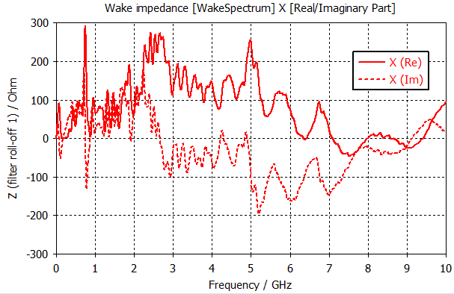
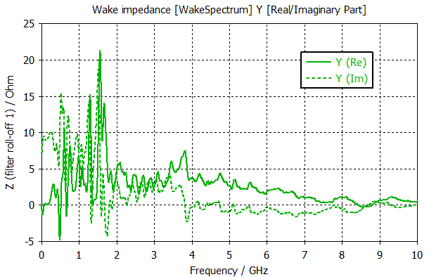
Electrostatic-separator
Contributions to the broadband impedances are considerably low
Reach of HOMs → could induce CBI ⇒ Quite dependent on the termination of the feedthroughs, further investigation on the HOMs and possible mitigations are needed.
Longitudinal impedance:
Vertical impedance: (shift=3mm)
(wake fields are not converged, with length of 5m)
High beam power loss
 | Higgs-30MW |  | Z-30MW
 | with ZL | with ZL&BB | with ZL | with ZL&BB
Beam current [mA] | 16.7 | 16.7 | 803.5 | 803.5
Bunch length [mm] | 3.0 | 4.1 | 6.0 | 8.7
kloss [V/pC] | 1.7 | 1.4 | 1.0 | 0.8
Ploss per beam [W] | 590 | 486 | 18045 | 14436
High power loss deposition can induce：
High voltage arcing/breakdown
Burning of energy absorbing resistors
Increased outgassing which would raise the electron background in the experiments
→ Water cooling is implemented in the design

Slide 10
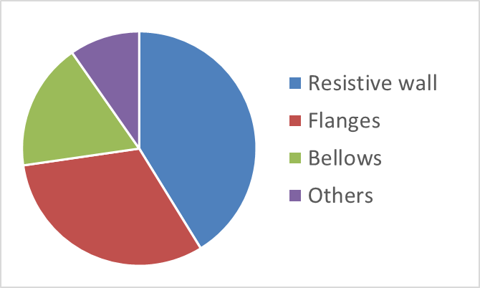
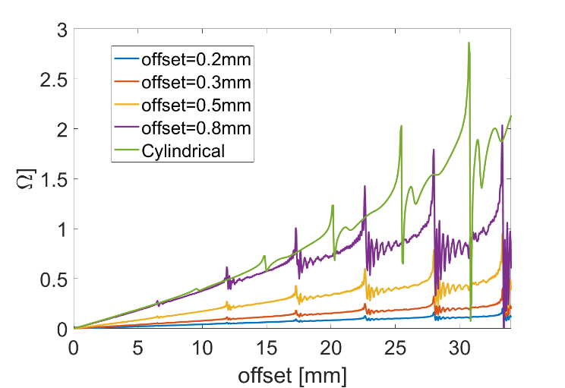
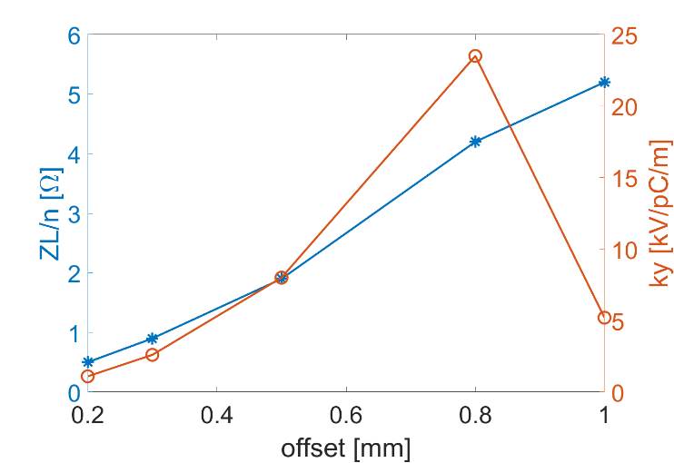
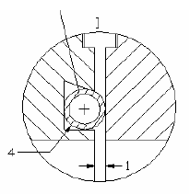
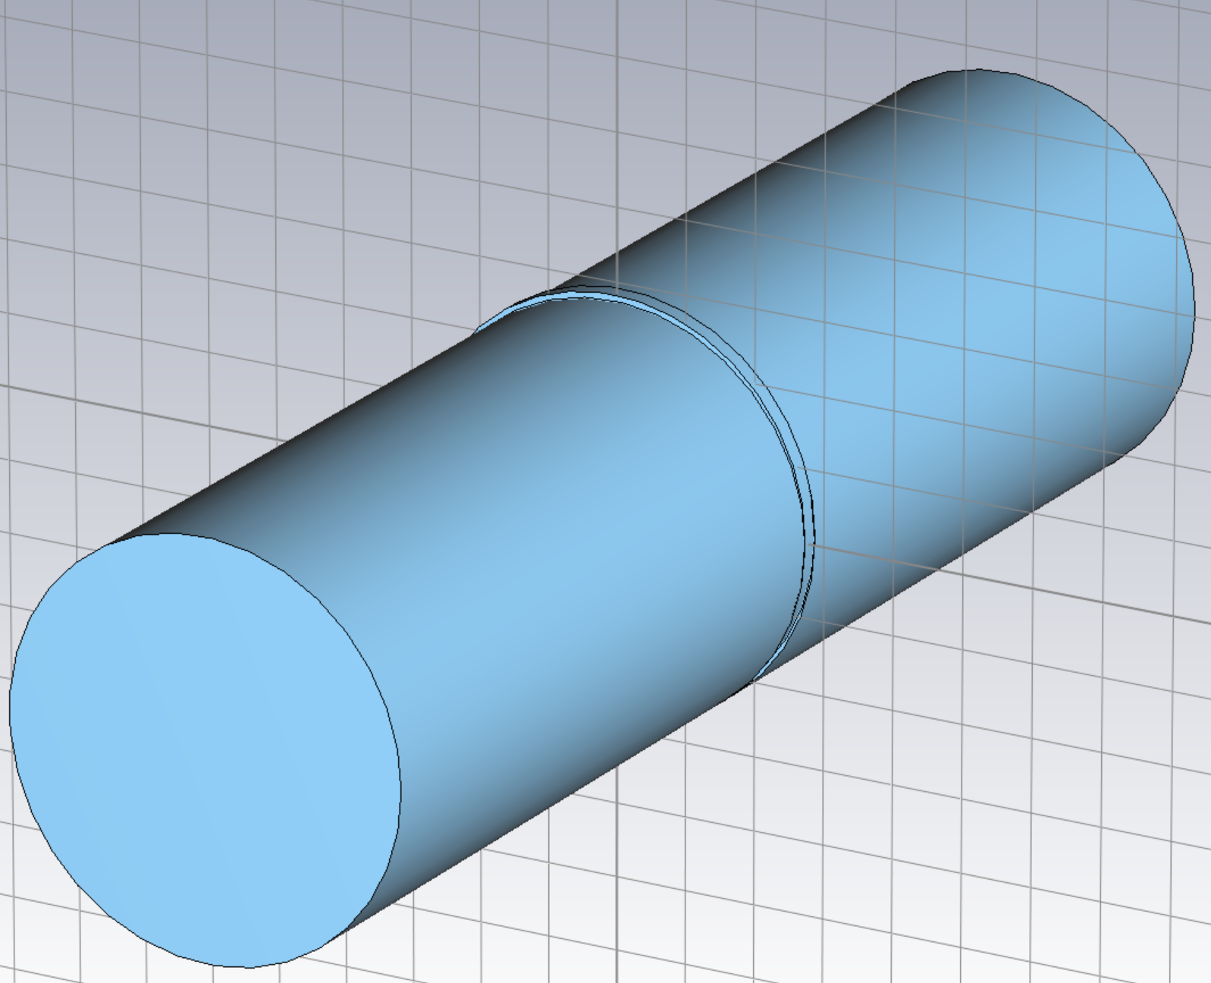
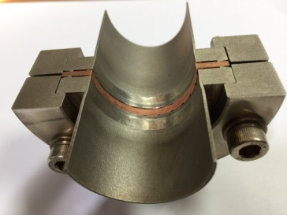
Flanges
Previous model
Adopted in BEPCII
One cylindrical gap:
width = 1mm
depth = 1mm
Cylindrical
Current model
Imaginary part of longitudinal impedance
Effective impedance with offset of the gasket
With the previous model, the flanges show the dominate contribution to the total longitudinal broadband impedance (nearly 1/3), due to the large quantity (~38k).
The dependence of impedance on the extent of construction or mounting errors are studied ⇒ The current model effectively reduces impedance with error tolerance constrained to <0.3 mm.
The edge of the flange facing the gasket need to be flat, to avoid bump or cavity structures at the connection.
Impedance is mainly contributed by the construction or mounting errors.

Slide 11
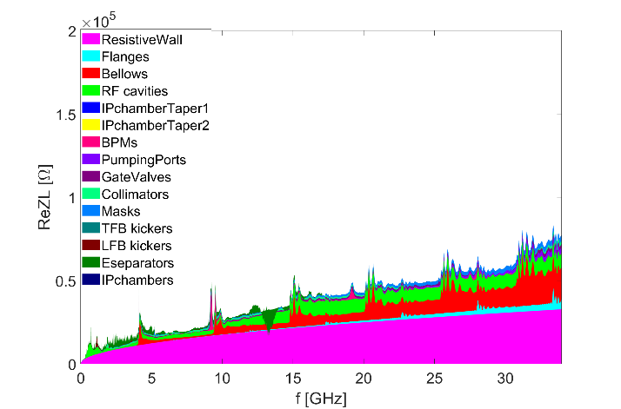
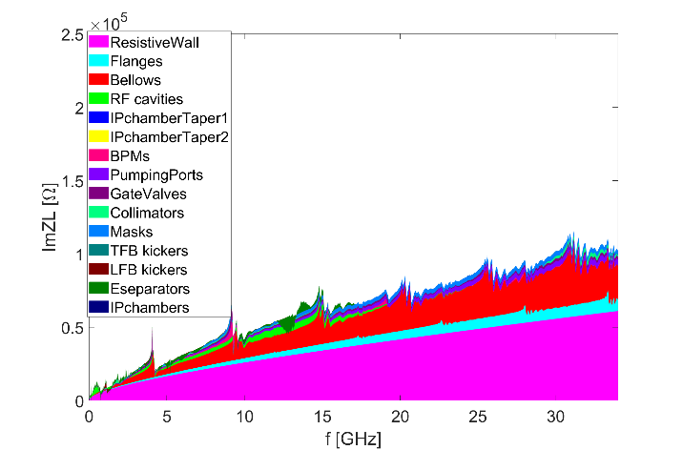
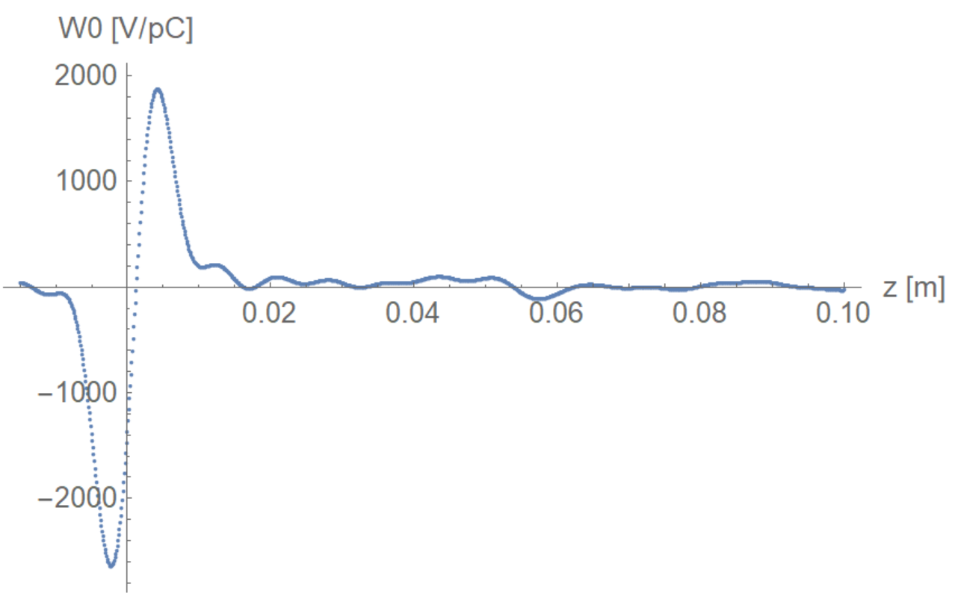
Summary on impedance budget
Effective impedance evaluated with σz=3mm
Components | Number | Z||/n, mΩ | L, nH | k_{loss}, V/pC | k_{y}, kV/pC/m
Resistive wall | - | 6.8 | 361.0 | 431.2 | 13.8
RF cavities | 60 | 0.5 | 24.8 | 101.2 | 0.5
Flanges | 37714 | 0.9 | 44.6 | 9.2 | 2.6
BPMs | 1808 | 0.04 | 2.0 | 9.5 | 0.2
Bellows | 15949 | 2.9 | 154.6 | 87.4 | 3.9
Gate Valves | 520 | 0.2 | 11.4 | 14.5 | 0.4
Pumping ports | 5316 | 0.3 | 18.4 | 2.3 | 0.2
Collimators | 34 | 0.1 | 6.9 | 22.2 | 21.1
Masks | 17757 | 0.5 | 24.6 | 19.5 | 0.8
Feedback kickers | 8 | -0.04 | -1.9 | 5.2 | 0.1
IP chambers | 2 | 0.004 | 0.2 | 0.3 | 2.9
Electro-separators | 20 | -0.1 | -5.4 | 34.5 | 0.1
Taper transitions | 48 | 0.04 | 2.3 | 2.5 | 0.09
Total |  | 12.2 | 643.4 | 739.5 | 48.2
Longitudinal impedance:
ReZL
ImZL
Total wake potential with σz=3mm

Slide 12
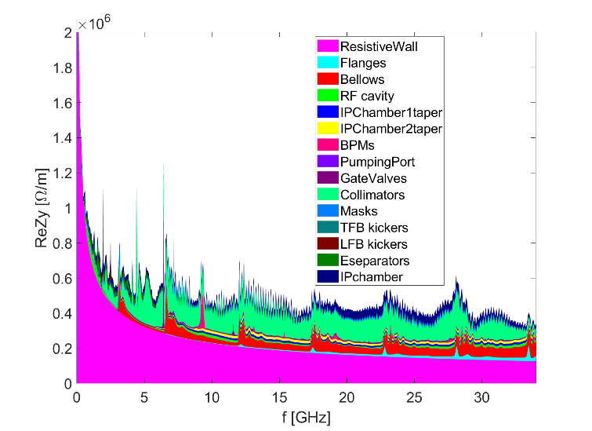
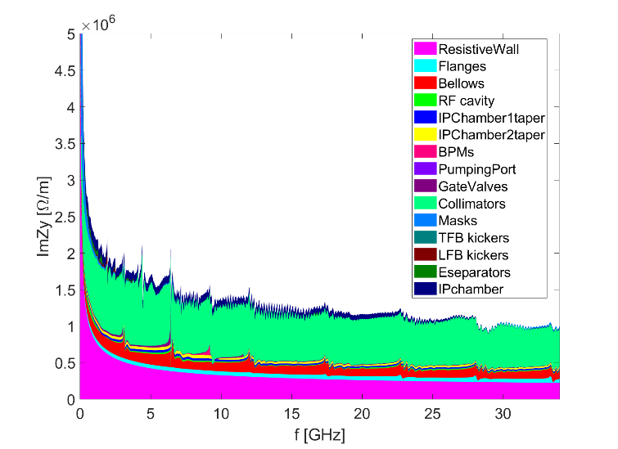
Summary on impedance budget
Effective impedance evaluated with σz=3mm
Components | Number | Z||/n, mΩ | L, nH | k_{loss}, V/pC | k_{y}, kV/pC/m
Resistive wall | - | 6.8 | 361.0 | 431.2 | 13.8
RF cavities | 60 | 0.5 | 24.8 | 101.2 | 0.5
Flanges | 37714 | 0.9 | 44.6 | 9.2 | 2.6
BPMs | 1808 | 0.04 | 2.0 | 9.5 | 0.2
Bellows | 15949 | 2.9 | 154.6 | 87.4 | 3.9
Gate Valves | 520 | 0.2 | 11.4 | 14.5 | 0.4
Pumping ports | 5316 | 0.3 | 18.4 | 2.3 | 0.2
Collimators | 34 | 0.1 | 6.9 | 22.2 | 21.1
Masks | 17757 | 0.5 | 24.6 | 19.5 | 0.8
Feedback kickers | 8 | -0.04 | -1.9 | 5.2 | 0.1
IP chambers | 2 | 0.004 | 0.2 | 0.3 | 2.9
Electro-separators | 20 | -0.1 | -5.4 | 34.5 | 0.1
Taper transitions | 48 | 0.04 | 2.3 | 2.5 | 0.09
Total |  | 12.2 | 643.4 | 739.5 | 48.2
Transverse impedance:
ReZy
ImZy

Slide 13
Impedance evolution
The longitudinal impedance is about stable, however, the transverse impedance increased dramatically with the development of the collimation system.
We will keep tracking and control the impedance along with the hardware development.
2018
Elliptical cross section (CDR)
Circular cross section
More contributors included (TDR)
2021
2023_V1
More detailed chamber material, collimator updated,β weighing
2023_V2
Collimators for machine protection, masks and feedback kickers included
More detailed collimator design, resistive wall and Electrostatic-separator updated
2024_V1
Collimator and flange updated
Evaluate with rms bunch length of 3mm
2024_V2

Slide 14
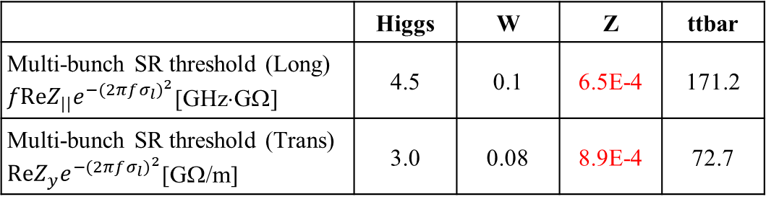
Rough estimations on the instability threshold
Broadband imp. → beam distortion/centroid oscillation → bunch current threshold
Narrowband imp. → coupled bunch oscillation → restrict total beam current
luminosity
(beam energy loss→ heat load）
Impedance budget
Z||/n, mΩ | 12.2
k_{y}, kV/pC/m | 48.2
 | Higgs | W | Z | ttbar
Single bunch threshold (Long) Z||/n [mΩ] | 6.5 | 4.1 | 0.7 | 14.4
Single bunch threshold (Trans) k_{y} [kV/pC/m] | 69.7 | 40.2 | 12.4 | 109.8
Longitudinal distortion
Luminosity limitations
TMCI unstable
 | Higgs | W | Z | ttbar
Multi-bunch SR threshold (Long) $fReZ_{||}e^{−{(2πfσ_{l})}^{2}}$[GHz⋅GΩ] | 4.5 | 0.1 | 6.5E-4 | 171.2
Multi-bunch SR threshold (Trans) $ReZ_{y}e^{−{(2πfσ_{l})}^{2}}$[GΩ/m] | 3.0 | 0.08 | 8.9E-4 | 72.7
In the following, the instability studies are mainly focused on the Z energy.
Tight narrowband impedance requirements for Z (at least ~two orders higher for the other energies)

Slide 15
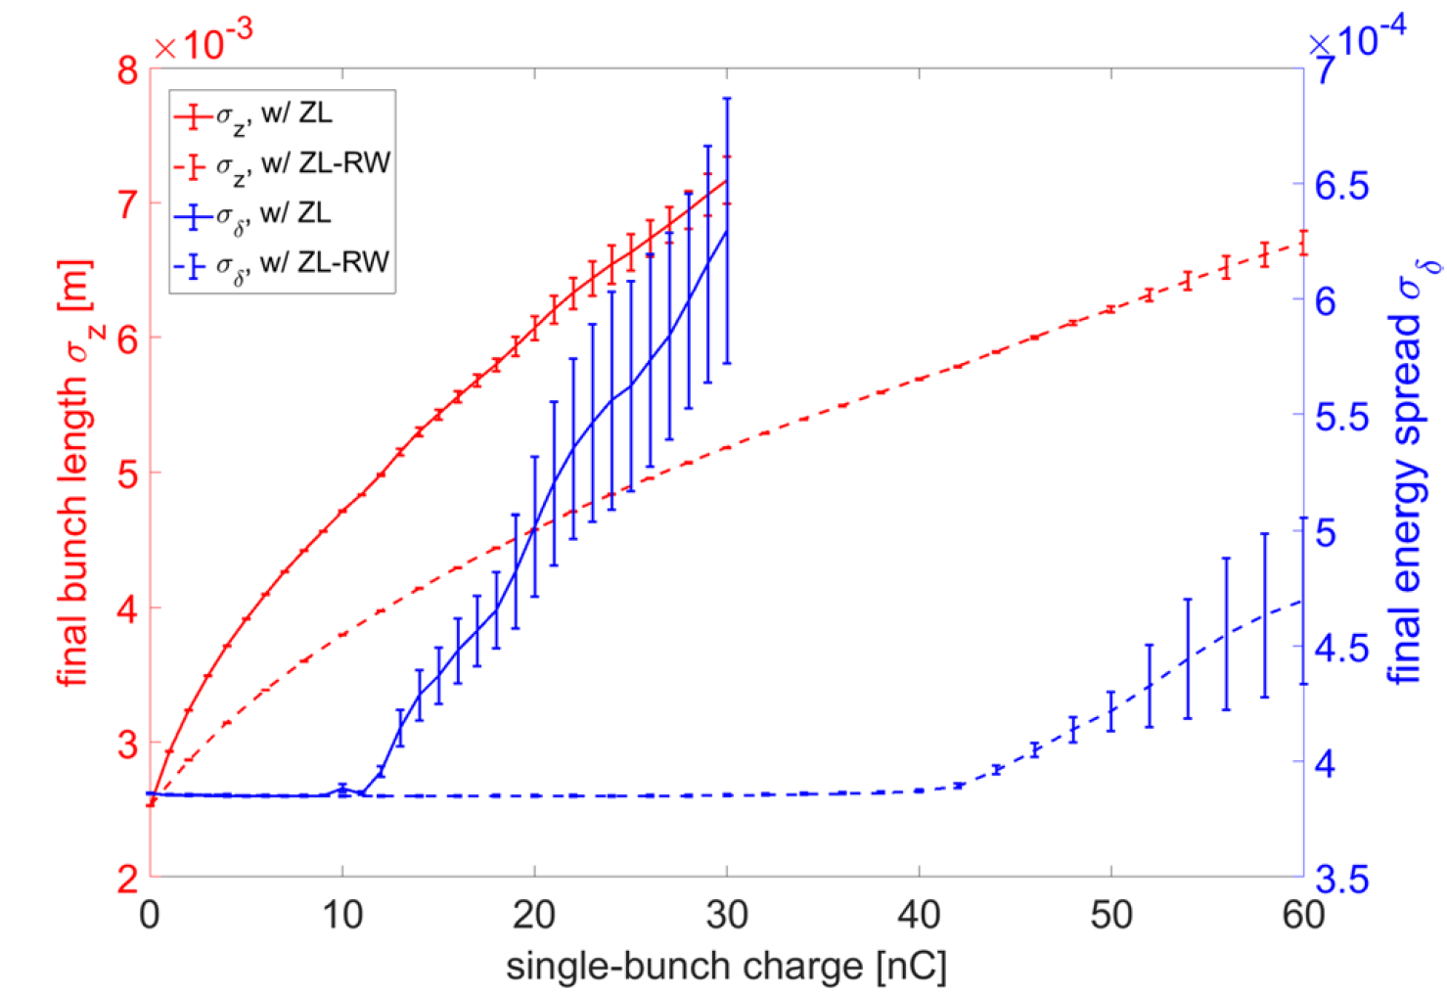
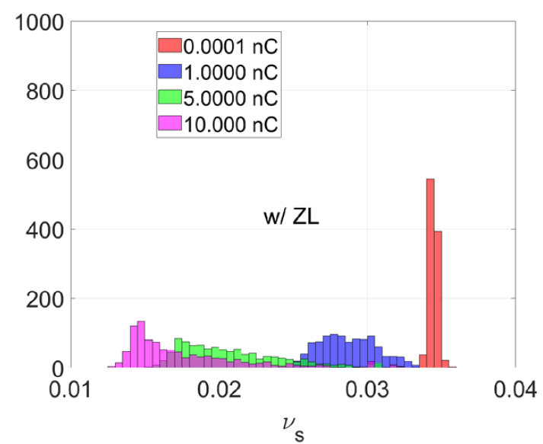
Bunch lengthening and microwave instability
With the total longitudinal impedance and only resistive wall impedance, the microwave instability thresholds are 10nC and 40nC, respectively.
The threshold is lower than the design bunch intensity, at the design bunch current, the bunch length is increased by ~150% and the beam energy spread is increased by ~40%.
22.4nC
Lower synchrotron tune & increased tune spread
⇨ Further influence the transverse mode coupling instability and beam-beam interaction

Slide 16
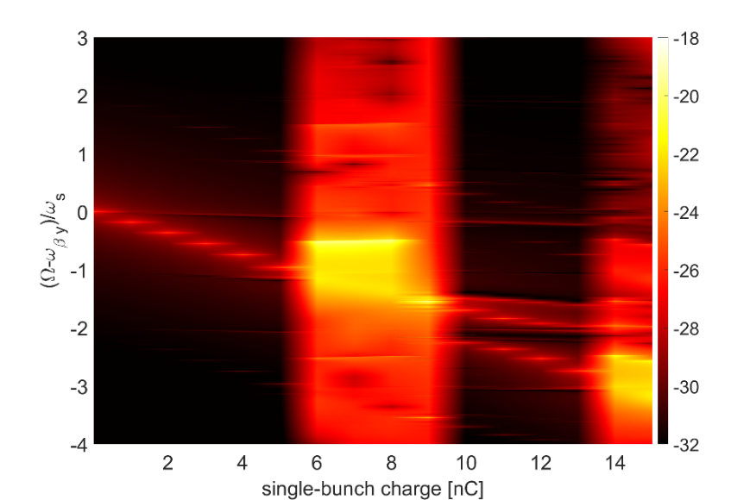
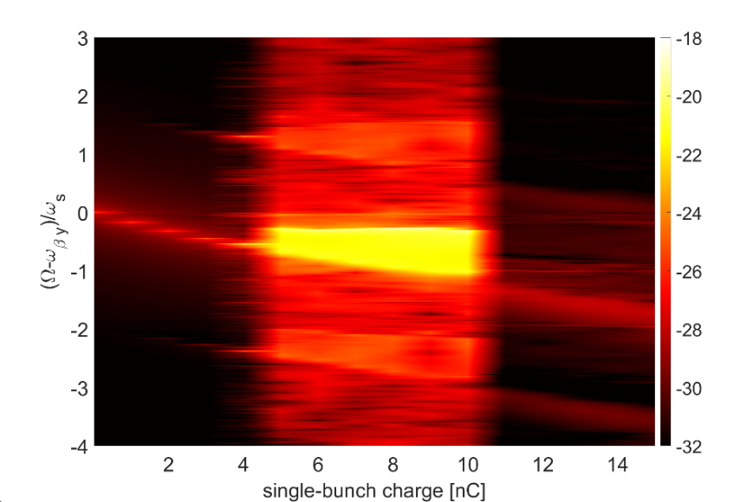
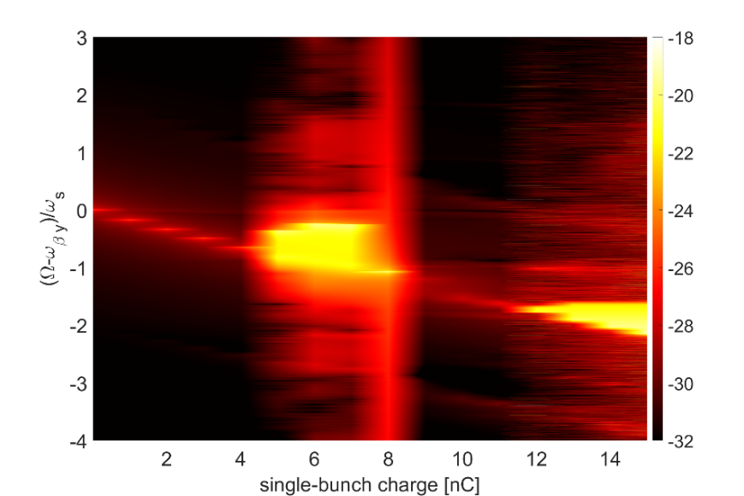
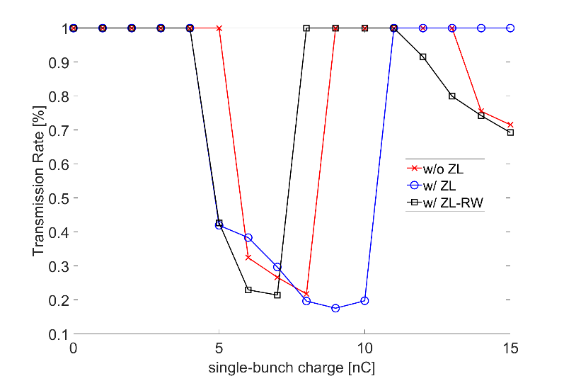
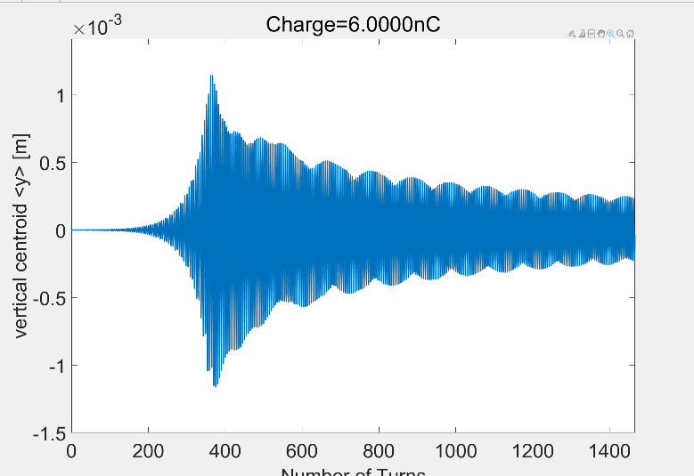
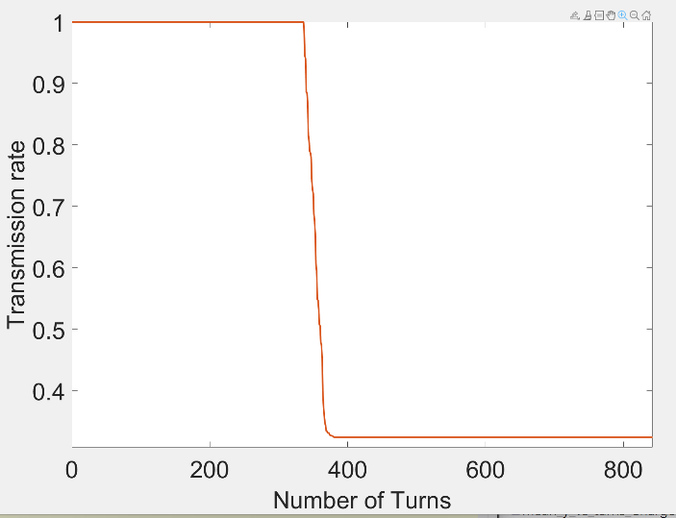
Transverse mode coupling instability
Mode coupling changes with ZL; the beam gets unstable in certain bunch charge range; with ZL, the threshold decreased 6nC->5nC, and unstable bunch charge range increased or shifted.
W/O ZL
W/ ZL
W/ ZL-RW
W/O ZL, 6nC
W/O ZL, 6nC

Slide 17

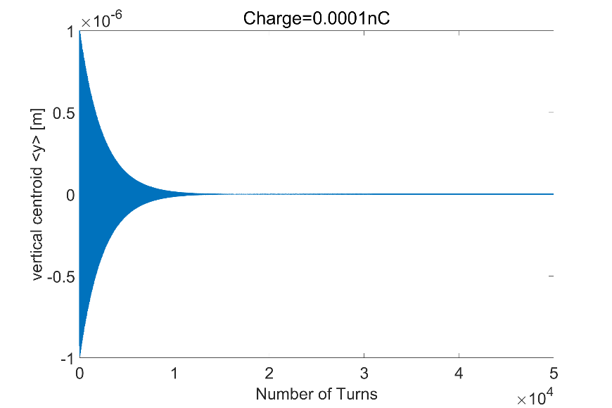
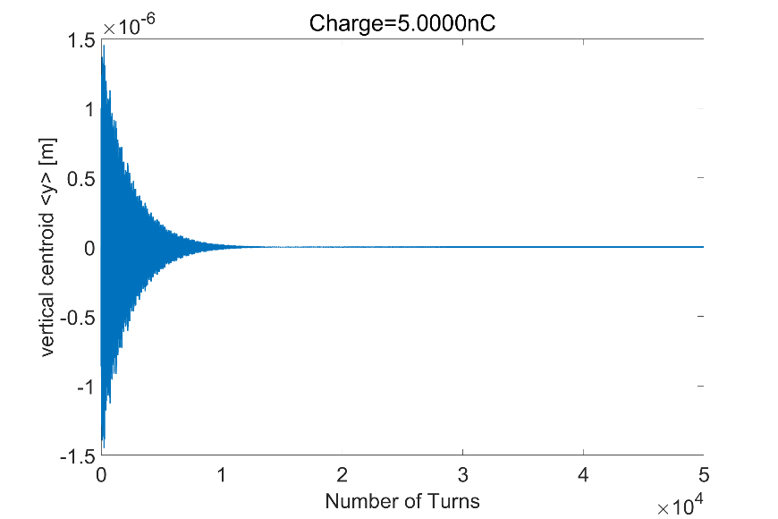
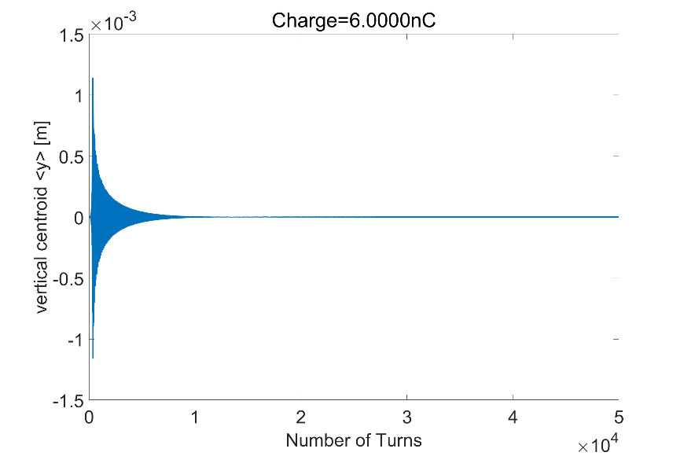
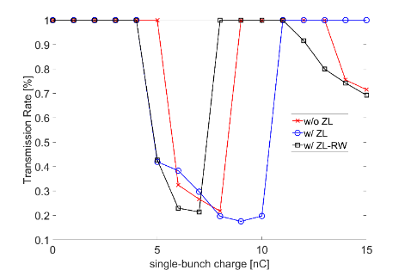
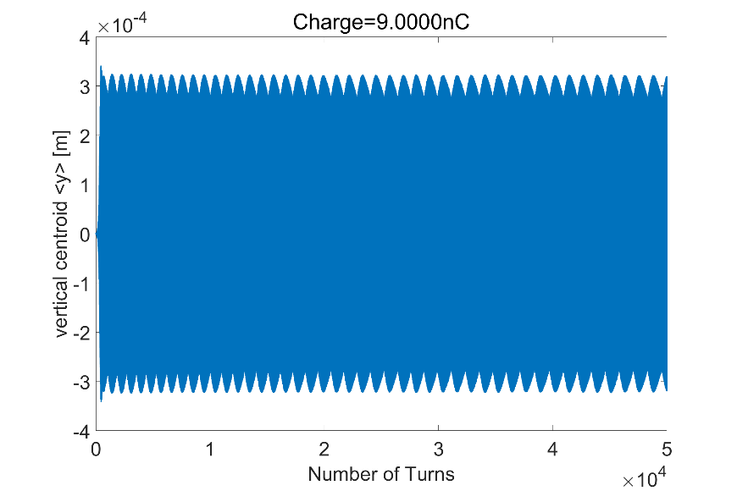
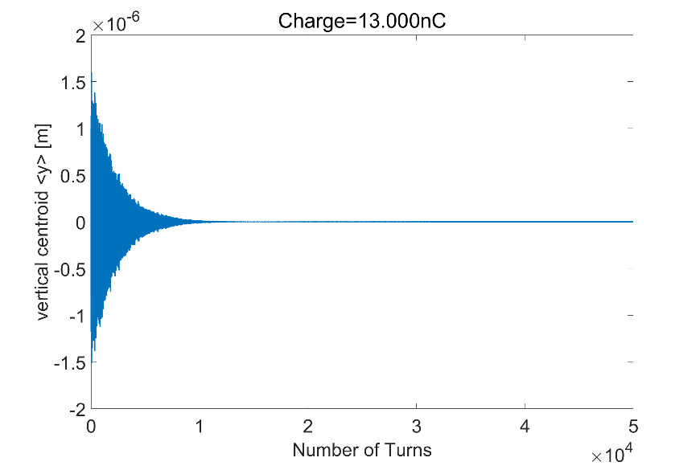
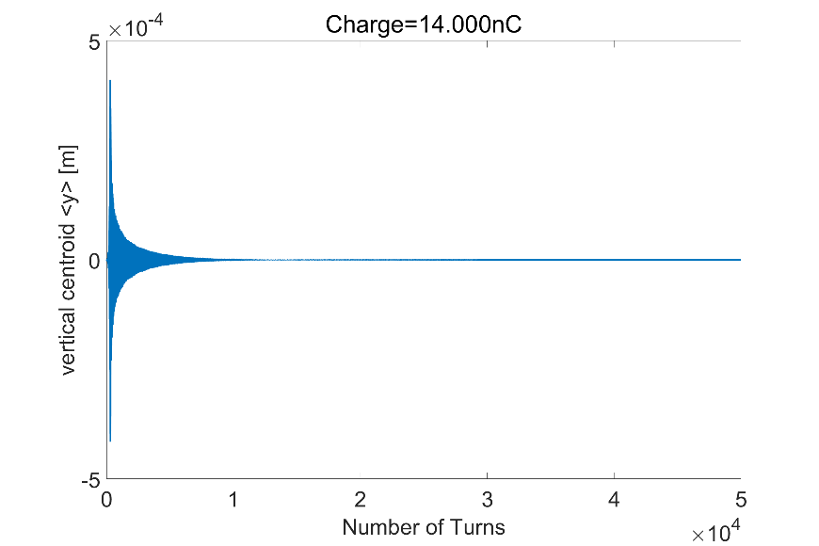
Bunch centroid oscillation for different bunch charges
(Without ZL)
Unstable with obvious beam loss
Stable
Stable
Stable again
Unstable with higher mode coupling, less beam loss
At the edge of decoupling without beam loss

Slide 18
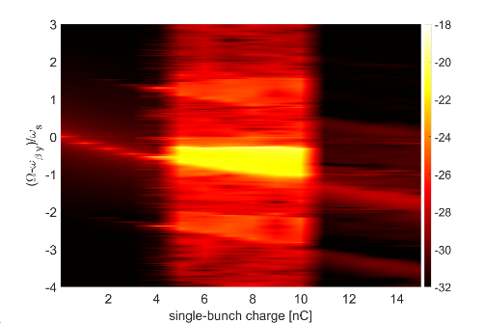
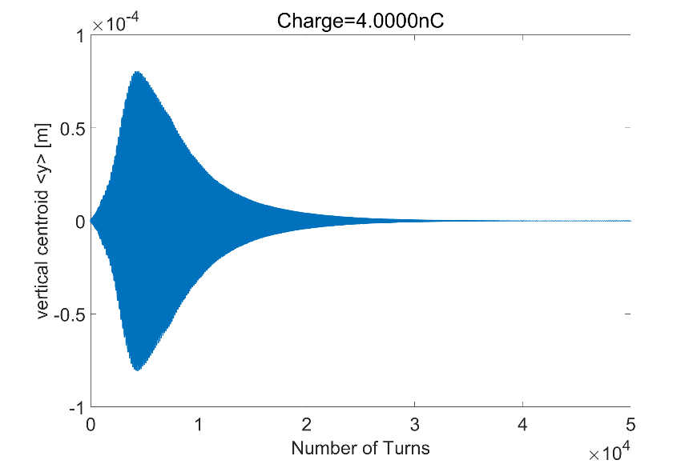
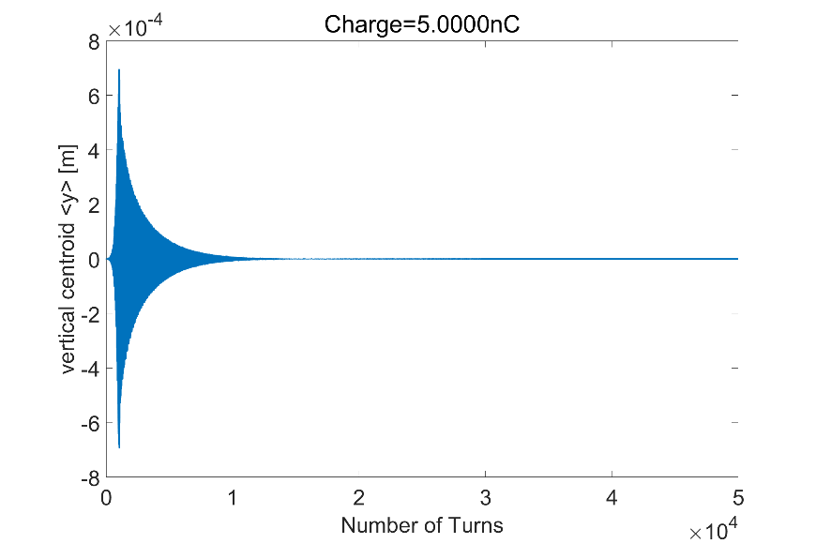
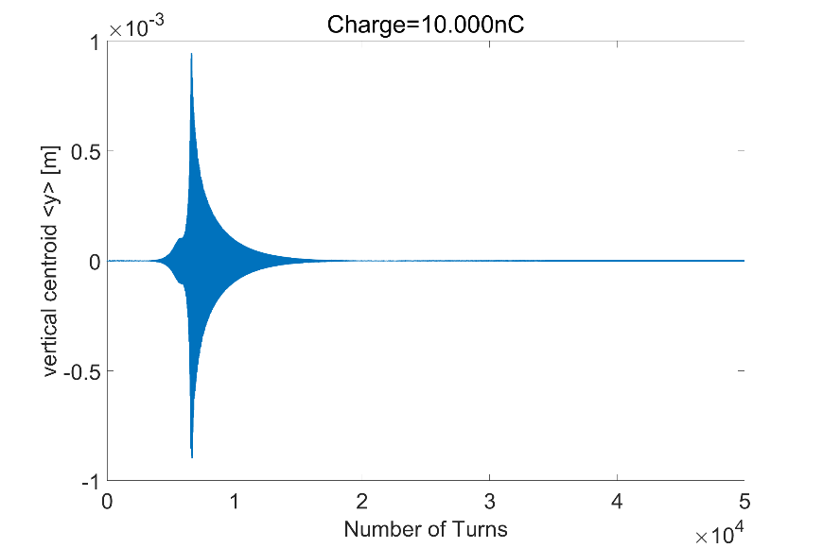
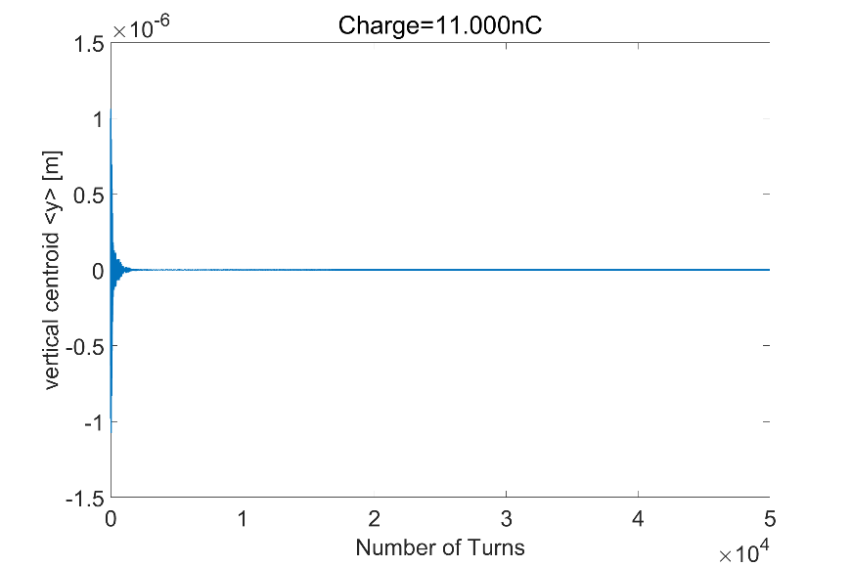
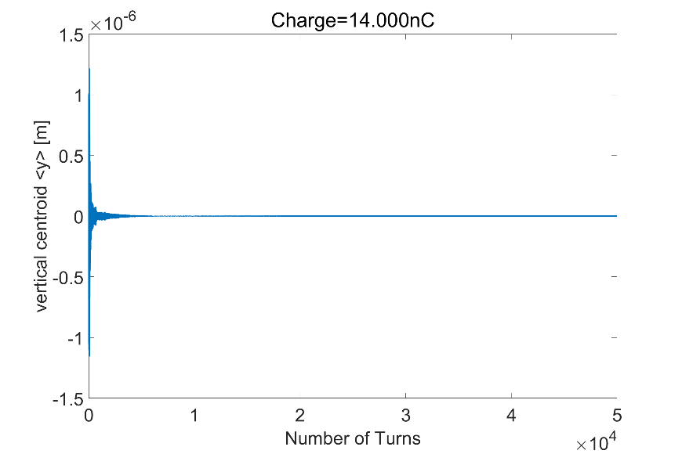
Bunch centroid oscillation for different bunch charges
(With ZL)
At the edge of coupling without beam loss
Unstable with obvious beam loss
Stable
Unstable with obvious beam loss
Stable again
Stable

Slide 19
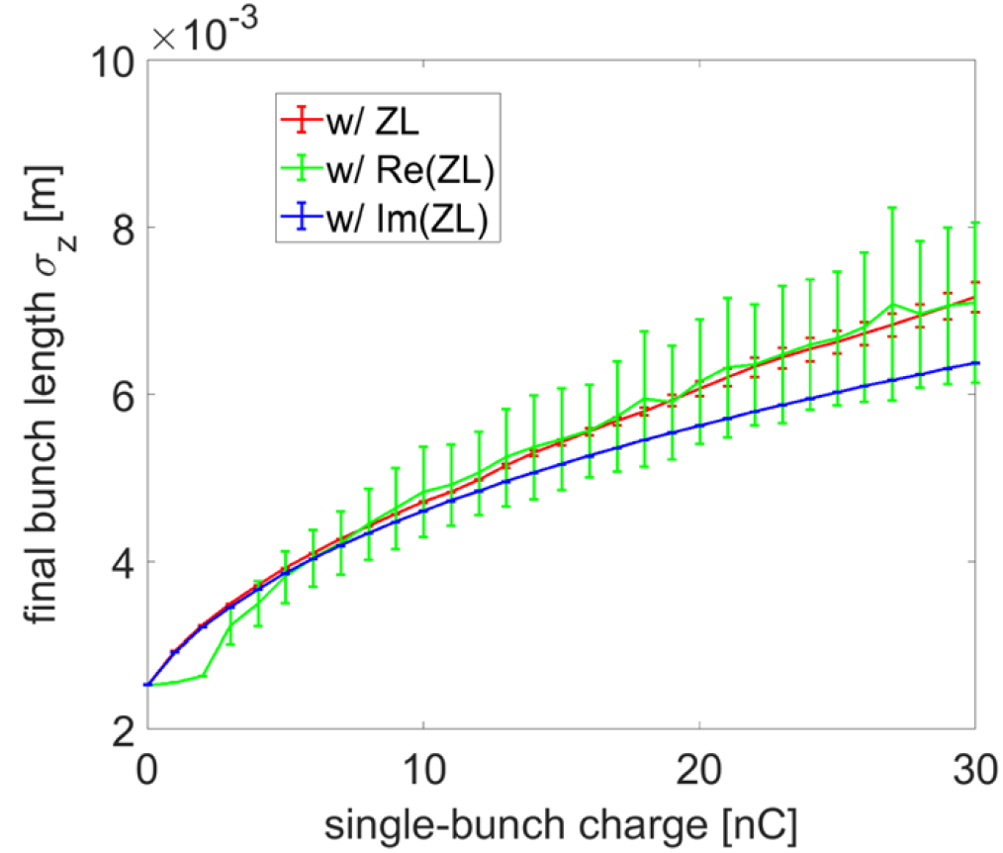
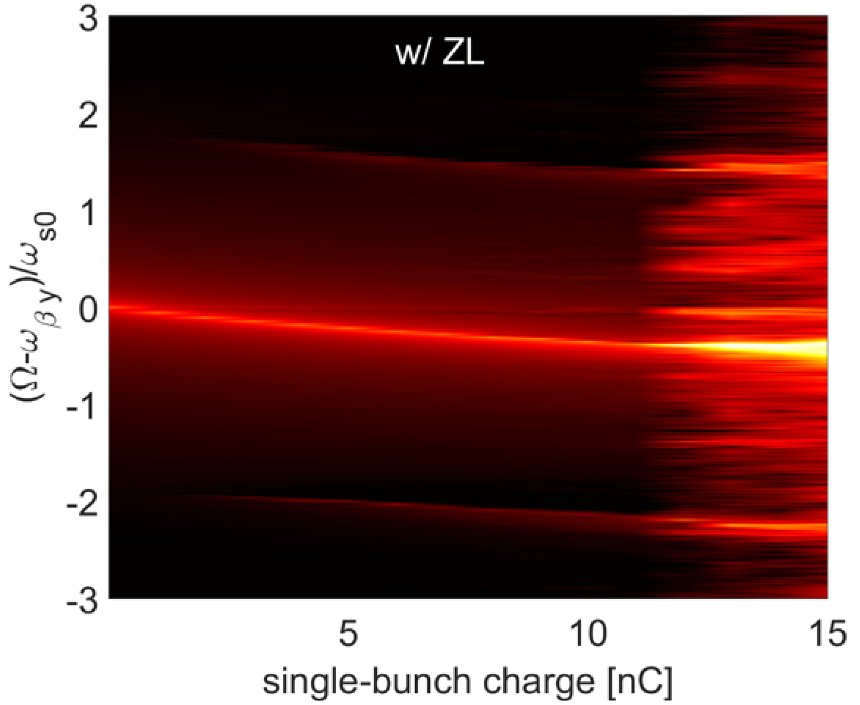






Influence of the real and imaginary parts of the longitudinal impedance
With a lower ZY, multiparticle simulations by either include only the real or imaginary part of ZL ⇒ TMCI threshold increases with Re(ZL) and decreases with Im(ZL): imaginary part of ZL is the main reason for the reduction of TMCI threshold.

Slide 20

Resistive wall instabilities
Mainly determined by the zero-frequency resonance of the transverse RW impedance.
The main vacuum chambers show the dominant contribution to the instability.
Several modes are unstable, and the most dangerous mode has a growth rate of ~1.7 ms, along with many unstable modes above synchrotron radiation damping.
Tough requirement on feedback damping.
n=11615
n=11618
n=11616
n=11617

Slide 21

CBI from Electrostatic-separator
The HOMs are quite related to the termination of the feedthroughs
  For direct termination with electric boundary, there are strong horizontal modes below 100 MHz (R_{s}=15.3MΩ/m per ES, CBI threshold from SR: 0.9MΩ/m), the growth rate is a factor of two higher than the feedback damping of 1ms (assume resonant case, all ES are identical)

Slide 22



CBI from Electrostatic-separator
The HOMs are quite related to the termination of the feedthroughs
  For direct termination with electric boundary, there are strong horizontal modes below 100 MHz (R_{s}=15.3MΩ/m per ES, CBI threshold from SR: 0.9MΩ/m), the growth rate is a factor of two higher than the feedback damping of 1ms (assume resonant case, all ES are identical)
  For termination with waveguide ports (absorbing boundary/without reflection), the low frequency modes can be well damped.

Slide 23




CBI from Electrostatic-separator
The HOMs are quite related to the termination of the feedthroughs
For the poor termination case, damping with absorbing materials is studied.
Absorber rings
Primary studies show that the modes can be well damped by adding absorbers at the supporting rods. Further studies are underway.
electrodes
Supporting rods
feedthroughs

Slide 24
Summary and outlook
Impedances of the key vacuum components are evaluated, while some elements such as the injection&extraction components are still missing. The impedance model will be continuously updated along with the development of the hardware designs.
Considering the elements been missing, an increment is expected in the transverse plane, while less influence in longitudinal.
Limited influence on the transverse resistive wall instability, which is dominated by the main vacuum chamber.
n=11615
n=11618
n=11616
n=11617
TMCI restriction could be met
Well impedance control and mitigations with bunch-by-bunch feedback & positive ξ are needed.

Slide 25

Summary and outlook
Impedances of the key vacuum components are evaluated, while some elements such as the injection&extraction components are still missing. The impedance model will be continuously updated along with the development of the hardware designs.
Based on the current impedance model, the main constraints from instabilities are focused on Z, some safety margin is reserved for Higgs.
Single beam collective effects for Z energy are discussed in detail:
Mechanism | Status and mitigation strategies
Microwave instability | ${ N}_{b, th}≈$ 0.5$N_{b, design}$ ⇒ bunch lengthening and beam energy spread increase of 150% and 40%, couple with TMCI.
TMCI | $N_{b, th}≈1/4 N_{b, design}$ ⇒ Restrict bunch current threshold, mitigation with bunch-by-bunch feedback and positive is foreseen.
Transverse resistive wall instability | τ⊥ = 1.7ms << SR damping ⇒ Restrict total beam current threshold, robust bunch-by-bunch feedback is required
CBI from HOMs | τ⊥ = 0.5ms from ES (on resonance, poor cable termination) << SR damping ⇒ Restrict beam current → mitigations: HOM damper, bunch-by-bunch feedback

Slide 26
Thank you for your attention!

