Slide 1
Machine Learning for polarization improvement of RHIC and EIC injectors
ML / AI proposal supported by DOE
Eiad Hamwi
For the ML/AI towards more polarization collaboration
PI: Georg Hoffstaetter de Torquat
BNL, Cornell, JLab, SLAC, Stony Brook, RPI
eeFACT25 March 6th, 2025
Notes:
Add other institutions, Stony Brook, SLAC, RPI, JLab

Slide 2
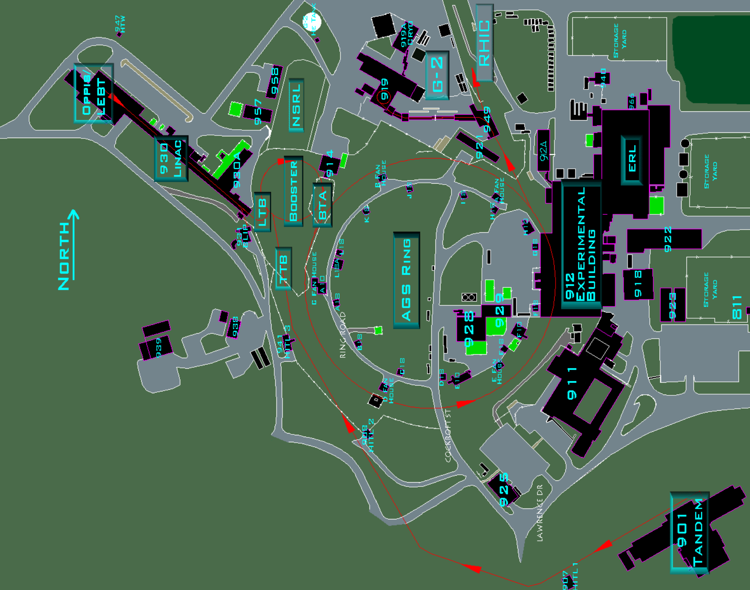
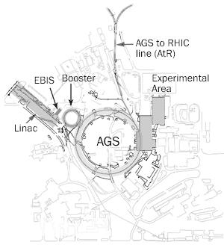
RHIC Injector Complex
OPPIS
LEBT
Linac
HEBT
LtB
Booster
BtA
AGS
AtR
RHIC/HSR
* BNL CADOPS

Slide 3
RHIC Polarized Beam Complex
 | Max Energy [GeV] | Pol. At Max Energy [%] | Polarimeter
Source+Linac | 1.1 | 84-85
Booster | 2.5 | ~80-84
AGS | 23.8 | 65-70 | p-Carbon
RHIC | 255 | 58-60 | P-Carbon avg*
2 Siberian Snakes/ring
Spin flipper
Absolute Polarimeter (H jet)
RHIC pC Polarimeters
PHENIX
* Includes both ramp loss and store decay
STAR
Spin Rotators
(longitudinal polarization)
Spin Rotators
(longitudinal polarization)
LINAC
BOOSTER
Pol. H⁻ Source
Helical Partial
Siberian Snake
 | Absolute Ramp Polarization Loss (Run 17, full run avg)
AGS | 17 %
RHIC | 8 %
200 MeV Polarimeter
AGS
AGS Polarimeter
Strong AGS Snake
Courtesy
Vincent Schoefer

Slide 4
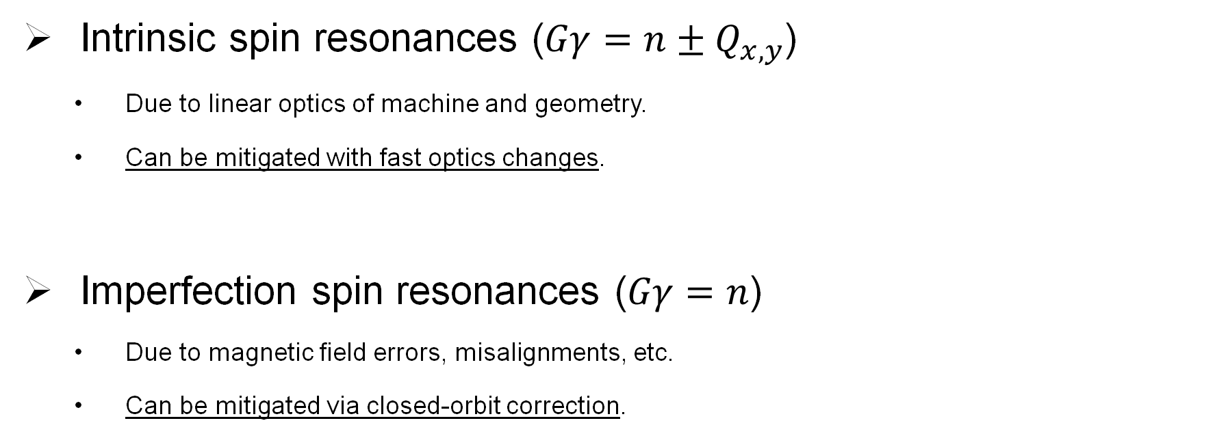
Main Depolarization Mechanisms
Intrinsic spin resonances ($Gγ=n±Q_{x,y}$)
  Due to linear optics of machine and geometry.
  Can be mitigated with fast optics changes.
Imperfection spin resonances ($Gγ=n$)
  Due to magnetic field errors, misalignments, etc.
  Can be mitigated via closed-orbit correction.

Slide 5
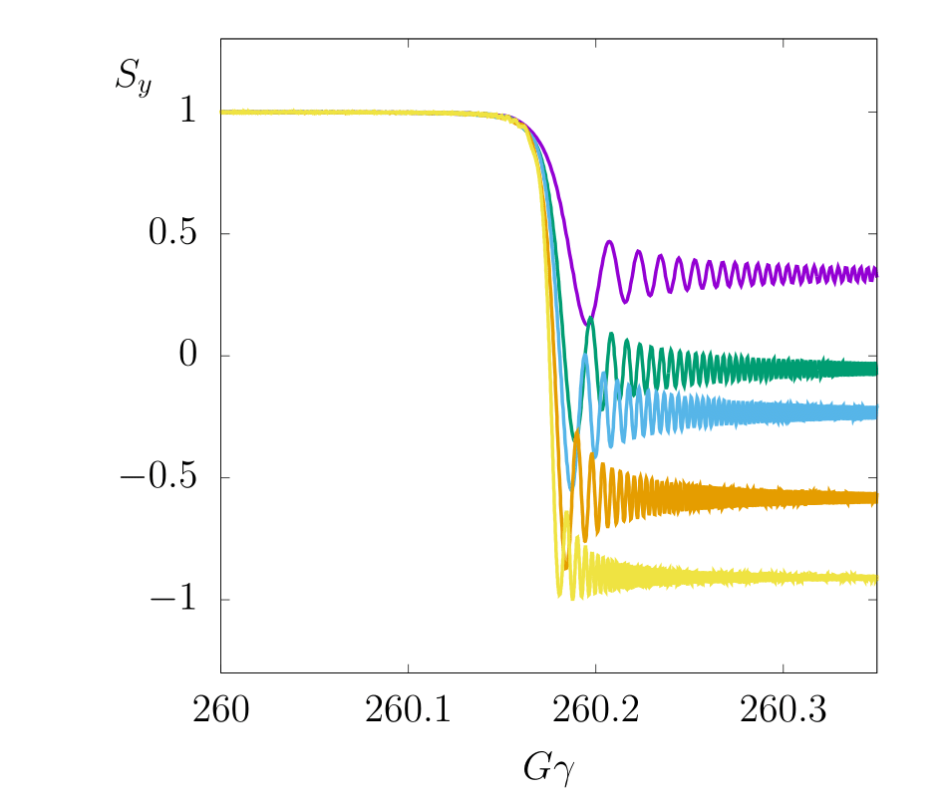
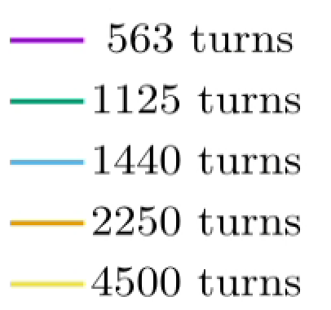


Intrinsic resonances
Occur when spin precessions synchronize with betatron oscillations.
Spin-orbit coupling $I_{x,y}^{n±}$
    Scale with rate of spin precession $Gγ$.
    Scale with square-root of betatron amplitude $J_{x,y}$.
    $I_{x,y}^{n±} ∝ Gγ\sqrt{J_{x,y}} ∝\sqrt{γ/β}$
$$\left[Q_{y}\right]=0.18$$

Slide 6
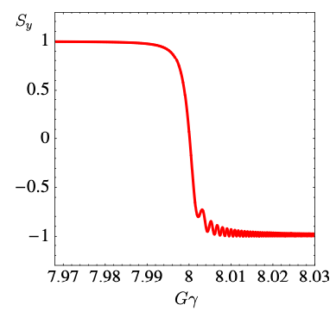
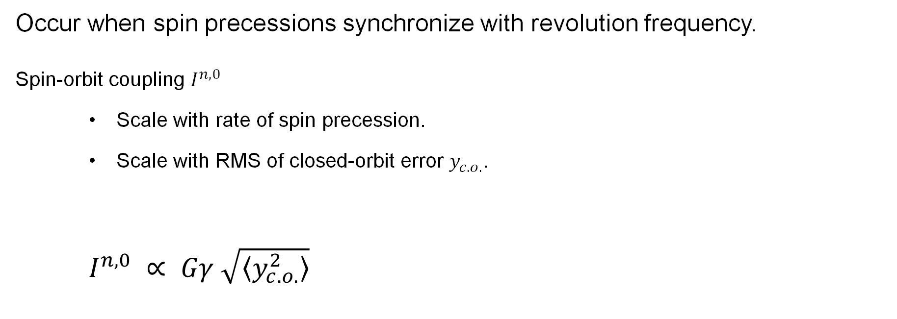
Imperfection resonances
Occur when spin precessions synchronize with revolution frequency.
Spin-orbit coupling $I^{n,0}$
    Scale with rate of spin precession.
    Scale with RMS of closed-orbit error $y_{c.o.}$.
    $I^{n,0} ∝ Gγ \sqrt{\left\langle y_{c.o.}^{2}\right\rangle }$

Slide 7
Paths to improve polarization
Emittance reduction
Closed-orbit correction
Direct reduction of resonance driving terms

Slide 8
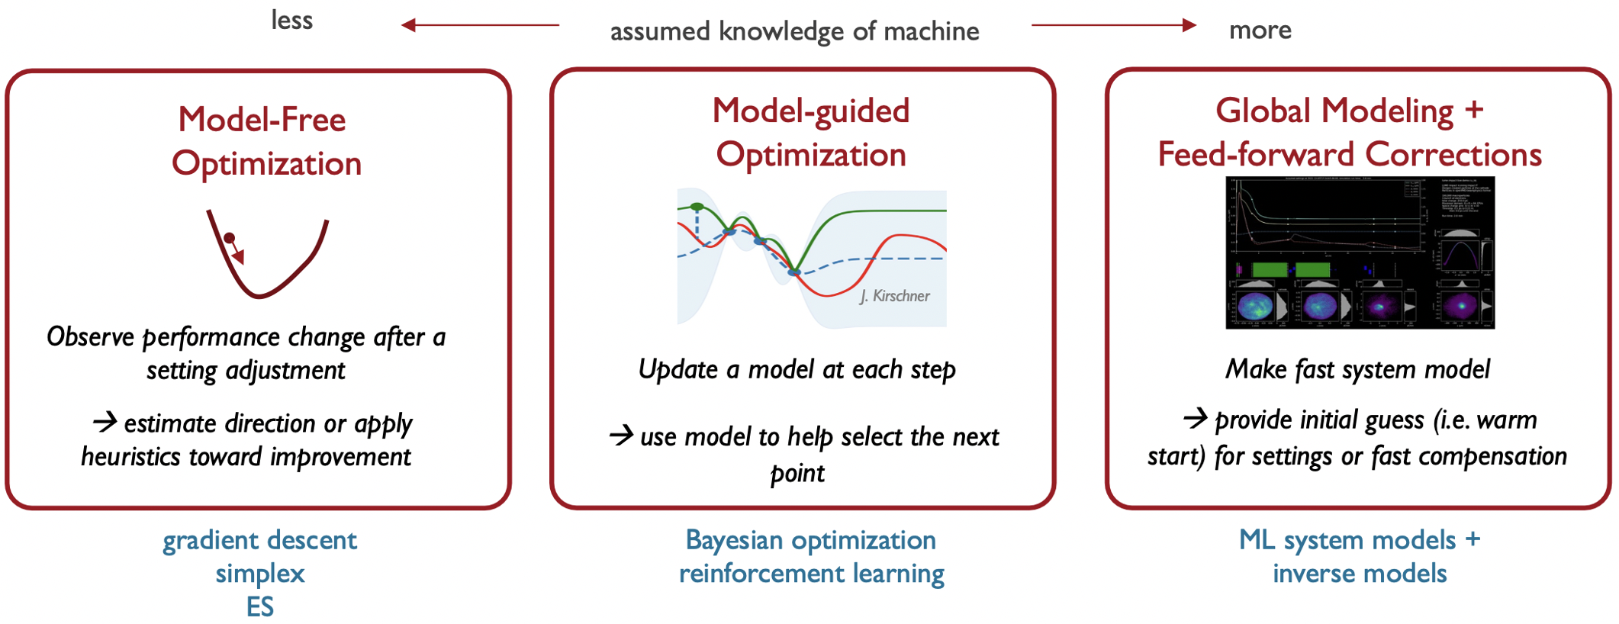
Spectrum of optimization
Courtesy Auralee Edelen

Slide 9
Characteristics of involved optimizations
Optimal parameter settings are hard to find, and the optimum is difficult to maintain.
The data to optimize on has significant uncertainties.
Models of the accelerator exist.
A history of much data is available and can be stored.
Is this type of problem suitable for Machine Learning?
Why would ML be better suited than other optimizers and feedbacks?

Slide 10
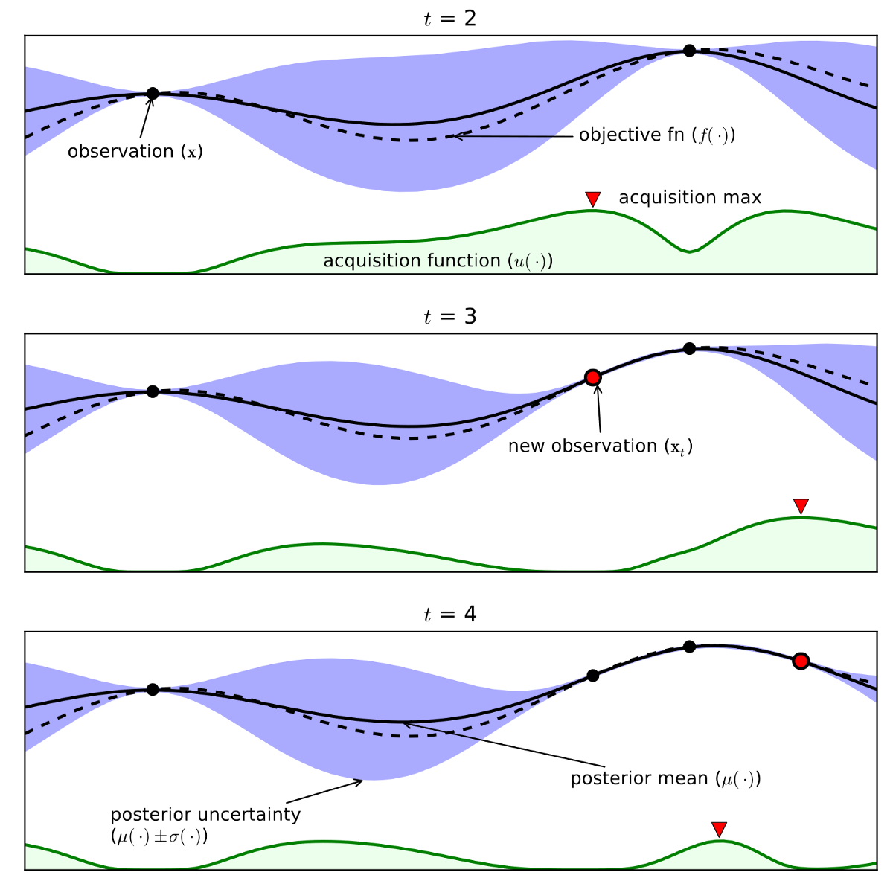
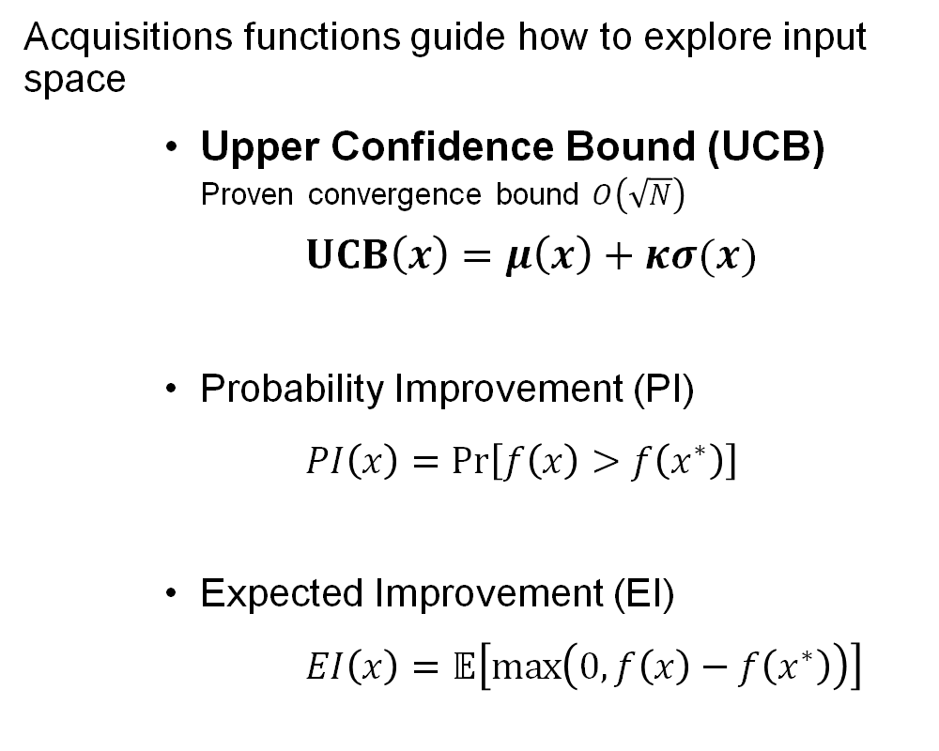
Bayesian optimization
[Image by R. Chandradevan on Medium]
Acquisitions functions guide how to explore input space
    Upper Confidence Bound (UCB)
    Proven convergence bound $O\left(\sqrt{N}\right)$
    $UCB\left(x\right)=μ\left(x\right)+κσ(x)$
    Probability Improvement (PI)
  $PI\left(x\right)=Pr\left[f\left(x\right)>f\left(x^{∗}\right)\right]$
    Expected Improvement (EI)
    $EI\left(x\right)=𝔼\left[\max\left(0,f\left(x\right)−f\left(x^{∗}\right)\right)\right]$

Slide 11
Why is Bayesian Optimization suitable?
Insensitive to local minima (important for nonlinear processes)
Efficient sample usage (data is expensive)
Does not require gradient information (data cost / model inaccuracy)
Physics-informed through kernel function and prior mean

Slide 12
When to use Reinforcement Learning?
Optimal parameters change over time (i.e. drift).
  RL is a continuous control algorithm, not a one-time optimization.
High-dimensional parameter space.
Cheap function evaluation (fast model / very large data available).

Slide 13
Paths to improve polarization
Emittance reduction
Closed-orbit correction
Direct reduction of resonance driving terms

Slide 14
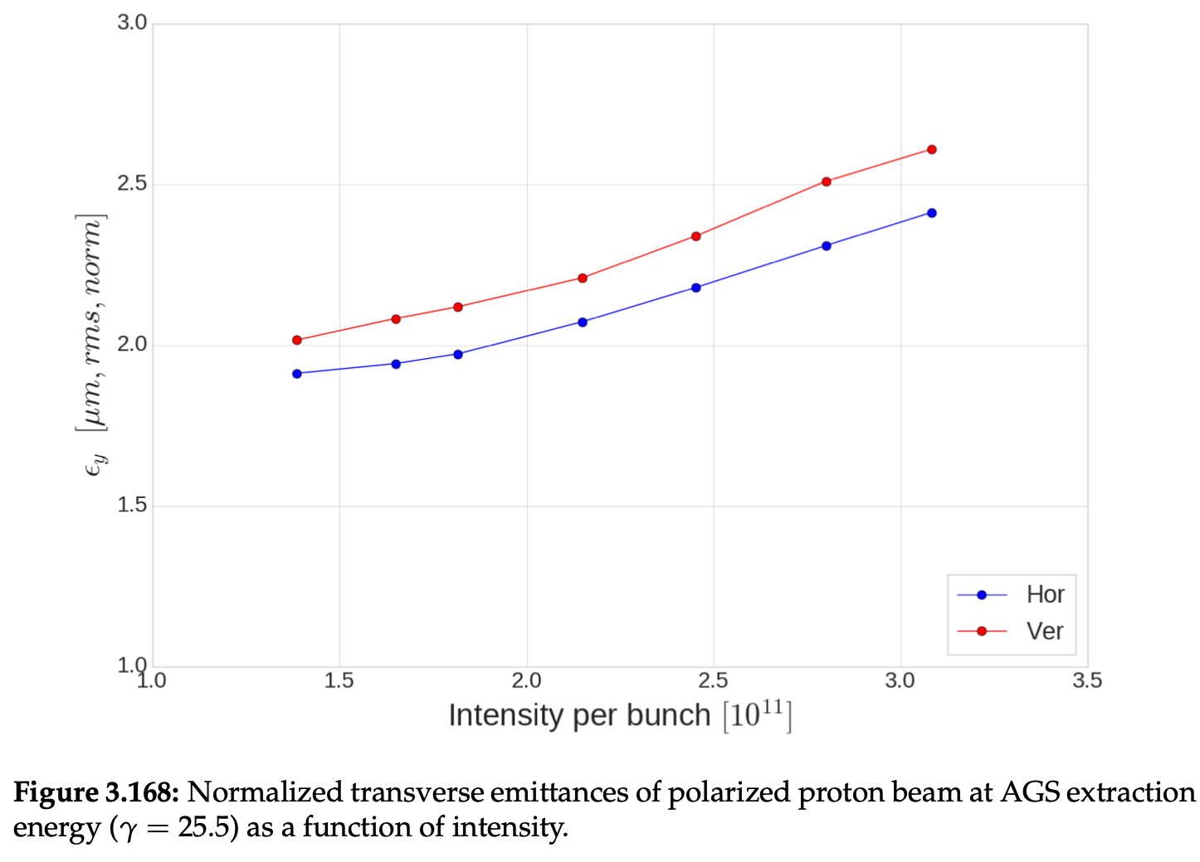
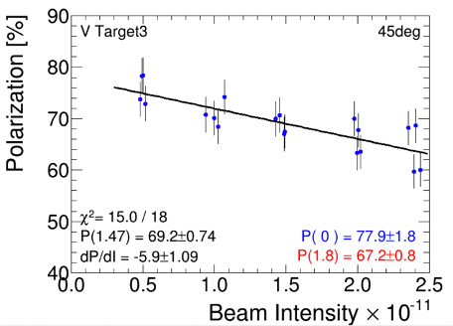
Effect of space-charge on emittance and polarization

Slide 15
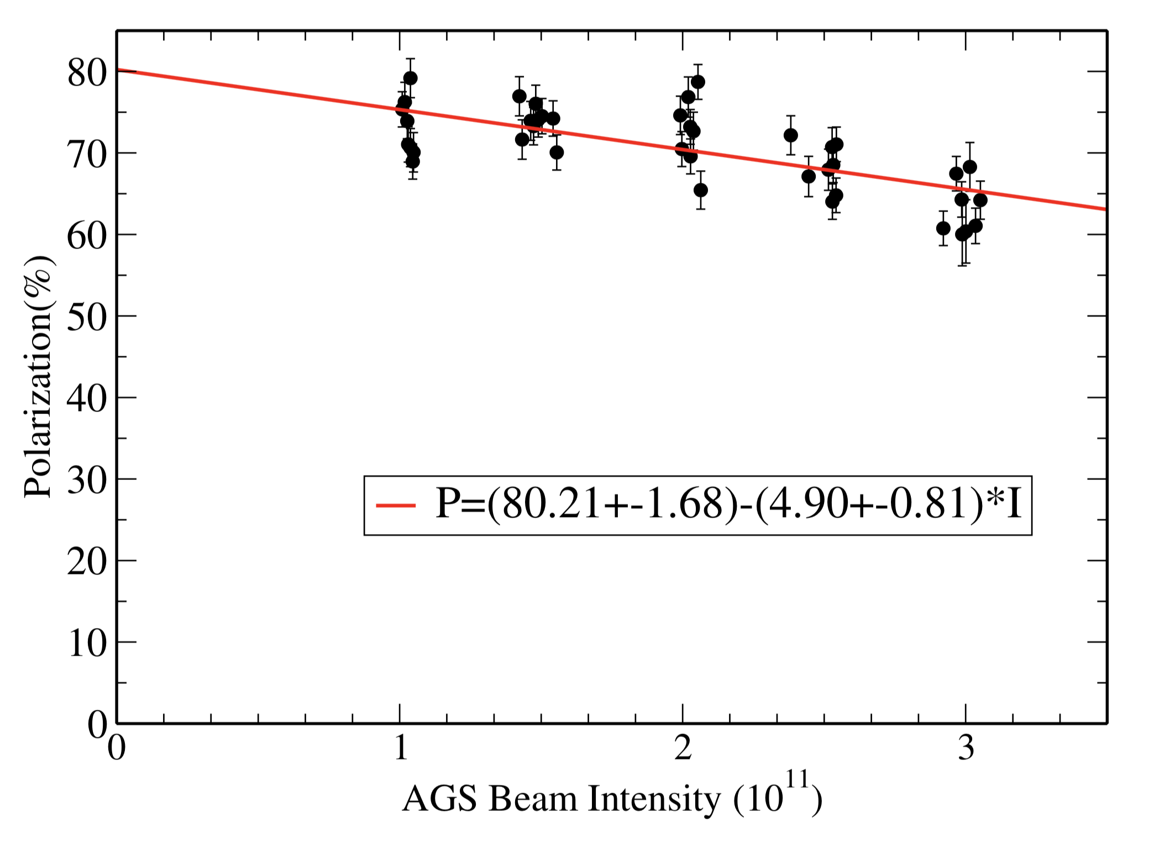
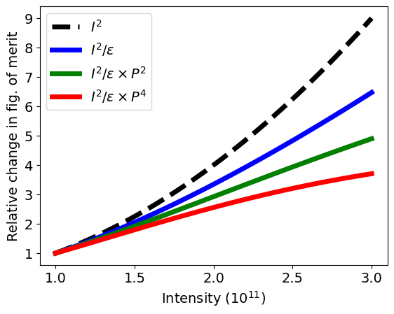
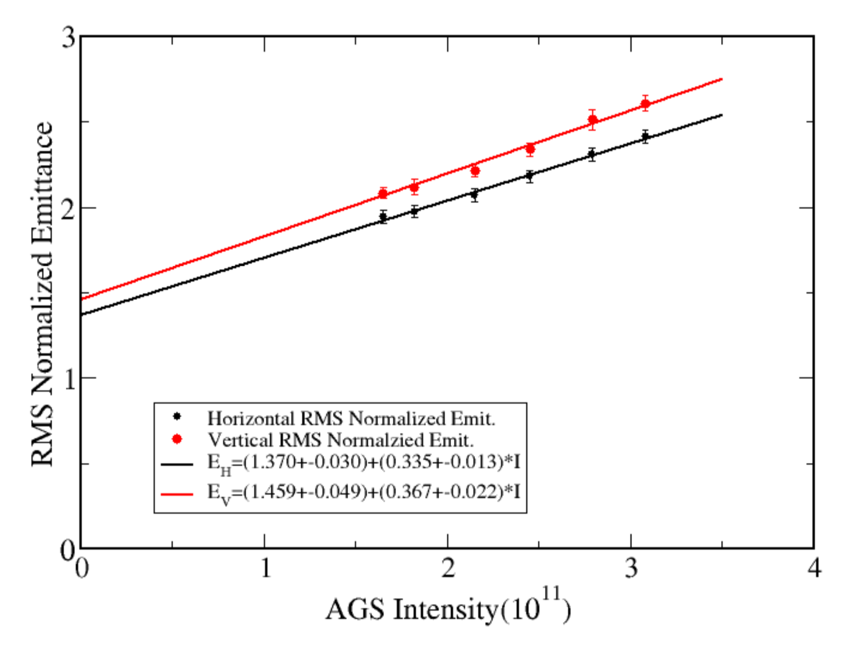
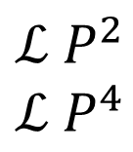
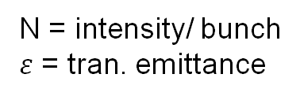


Polarized collider performance
AGS extraction
Collider luminosity, $ℒ$
Pol vs Intensity
$$ℒ∝\frac{N^{2}}{ε}$$
N = intensity/ bunch
$ε$ = tran. emittance
Polarized beam collider FOM
Polarized collider figure of merit (for polarization P):
$$ℒ P^{2}$$
$$ℒ P^{4}$$
transverse spin
FOM =
longitudinal spin
Emittance vs Intensity
Since both emittance and polarization degrade with intensity figure of merit decreases rapidly
FOM dependence on intensity closer to linear in N than quadratic.
Impact of intensity increase on FOM given emittance and polarization dependence at AGS extraction

Slide 16
Emittance reduction
Bunch splitting in the Booster for space charge reduction
Bunch merging at AGS top energy.
Optimized Linac to Booster (LtB) transfer
Notes:
Proposition of bunch splitting/merging, not standard practice

Slide 17
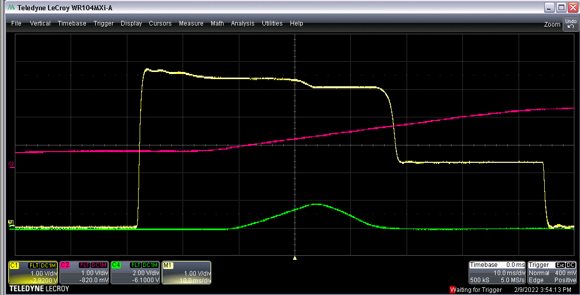
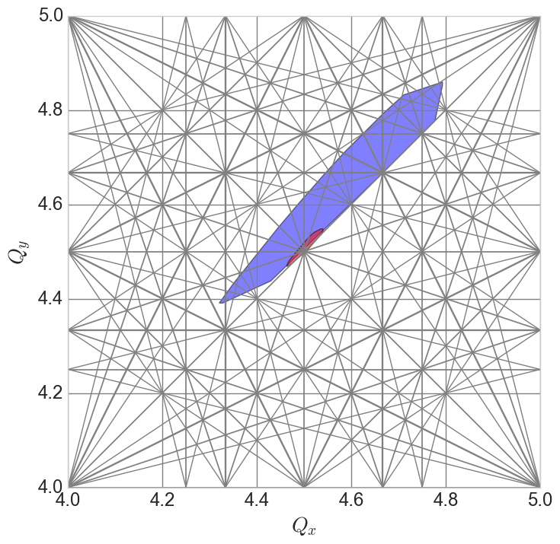
Booster injection
Intensity
Main mag
Many “knobs”
  Linac to Booster trajectory/optics matching
  Optimization of time on foil
  Linac RF phases affect capture and acceleration efficiencies
  Booster RF capture rate affects longitudinal emittance (and transverse, via space charge)
  Booster orbit and optics affect foil scattering, matching and intensity transmission.
  Betatron ‘stop band’ correctors for intensity, emittance preservation.
Difficult instrumentation
  WCM, BPMs don’t work until after capture
  No transverse profile monitor in Booster
    Scraping efficiency as proxy
    Measurable in the extraction line via multiwire
Difficult model
  Linac to Booster longitudinal effects
  Space charge
  Stripping foil
Injection
V scrape
Extraction
Capture
H scrape
Space charge tune spreads
Capture/Early acc
Injection

Slide 18
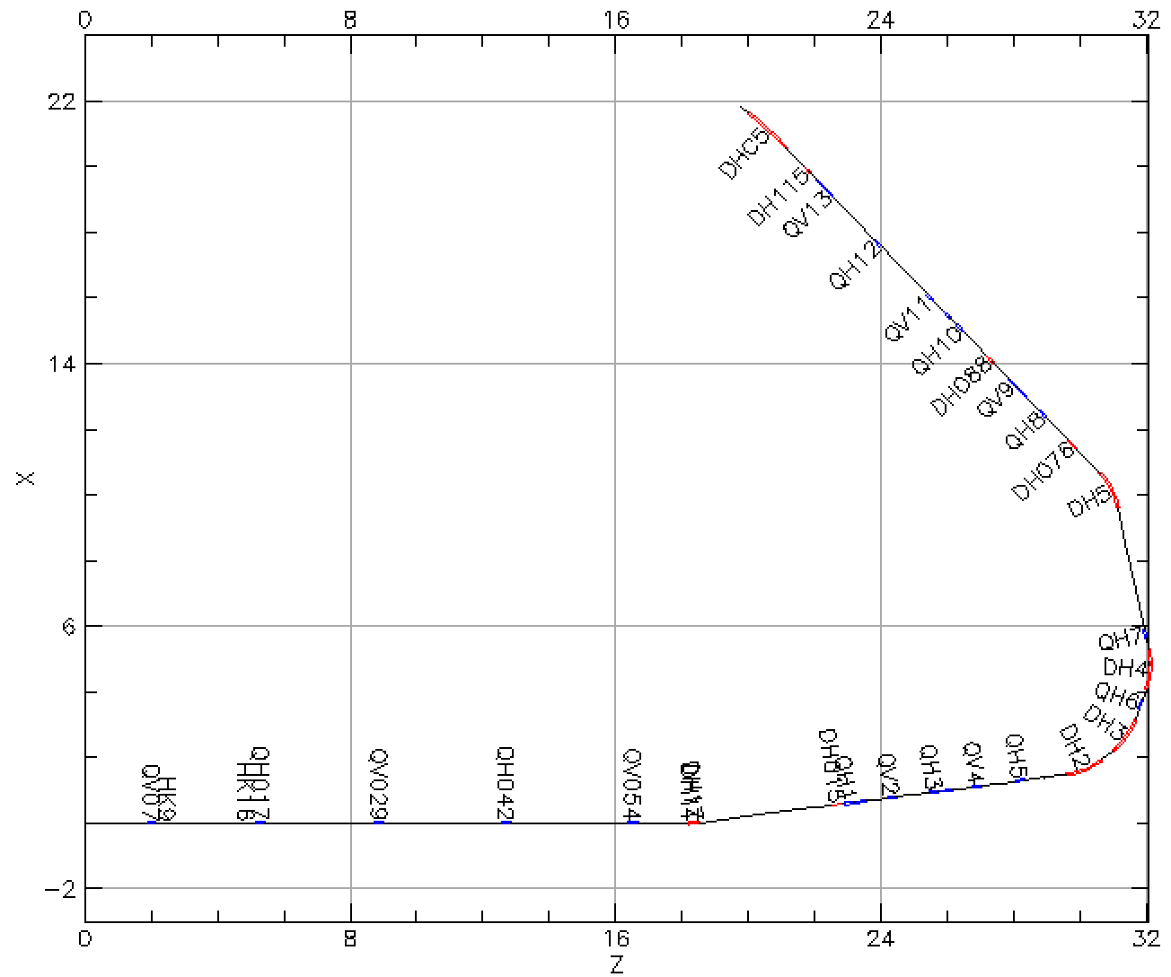
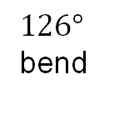
Booster injection
scrape
Booster injection process sets maximum beam brightness for rest of acceleration through RHIC
Known emittance effect on polarization loss
Intentional horizontal and vertical scraping
Goal: minimize emittance / maximize beam intensity after scraping
Controls: Linac to Booster (LtB) transfer line optics
Method: Xopt Bayesian optimization package (BO)
To Booster
$126°$
bend
From Linac

Slide 19
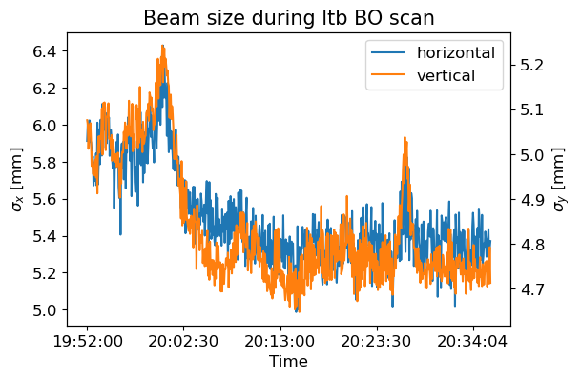
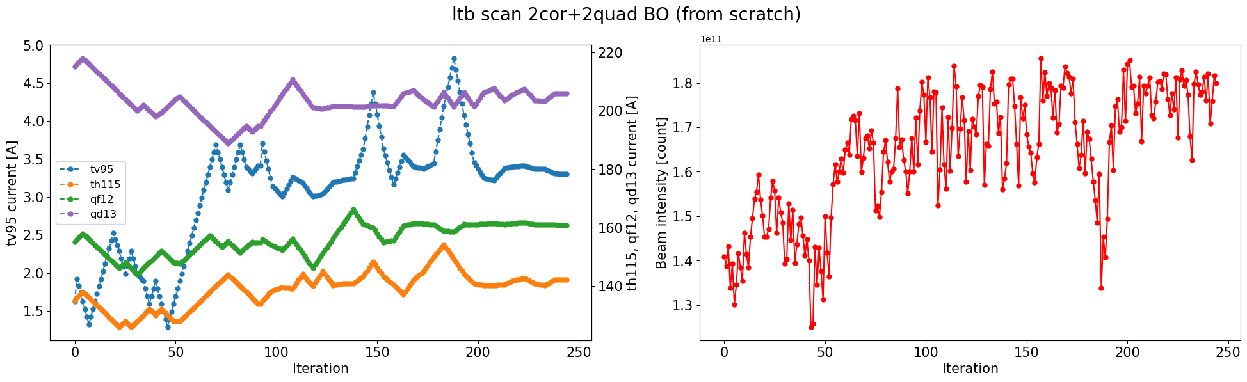
LtB optimization: 2 correctors + 2 quadrupoles
Controls: Power supply currents of two correctors and two quadrupoles at the end of the LtB line
Beam size decrease in both planes in the BtA line in correspondence with intensity increase

Slide 20
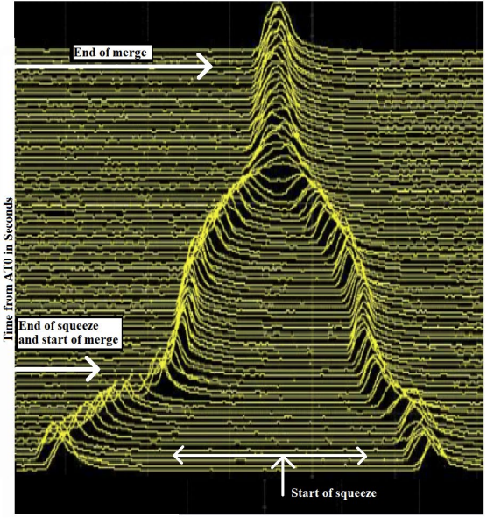
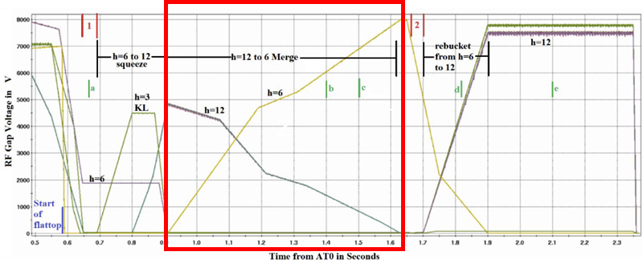
Bunch splitting / merging
Splitting in the booster and merging after AGS accelerator reduces space charge and emittance growth ➔ more polarization

Slide 21
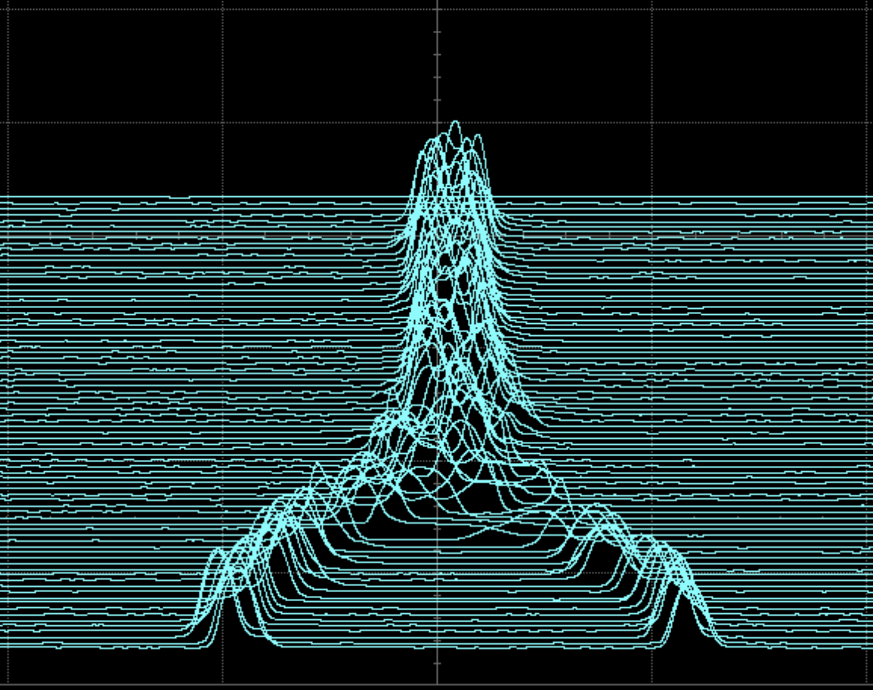
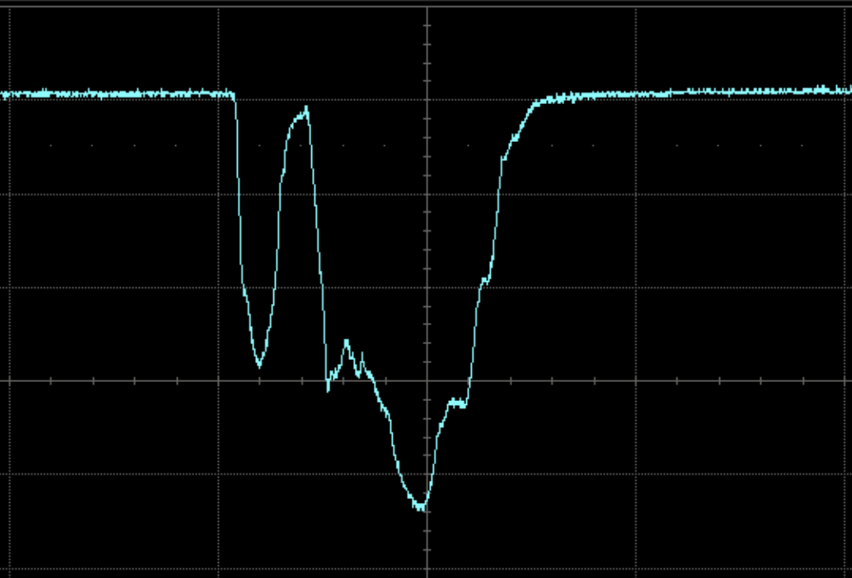
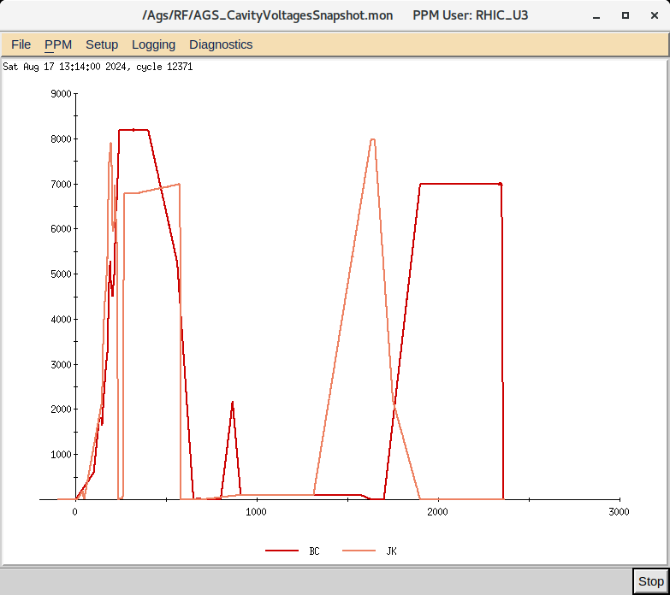
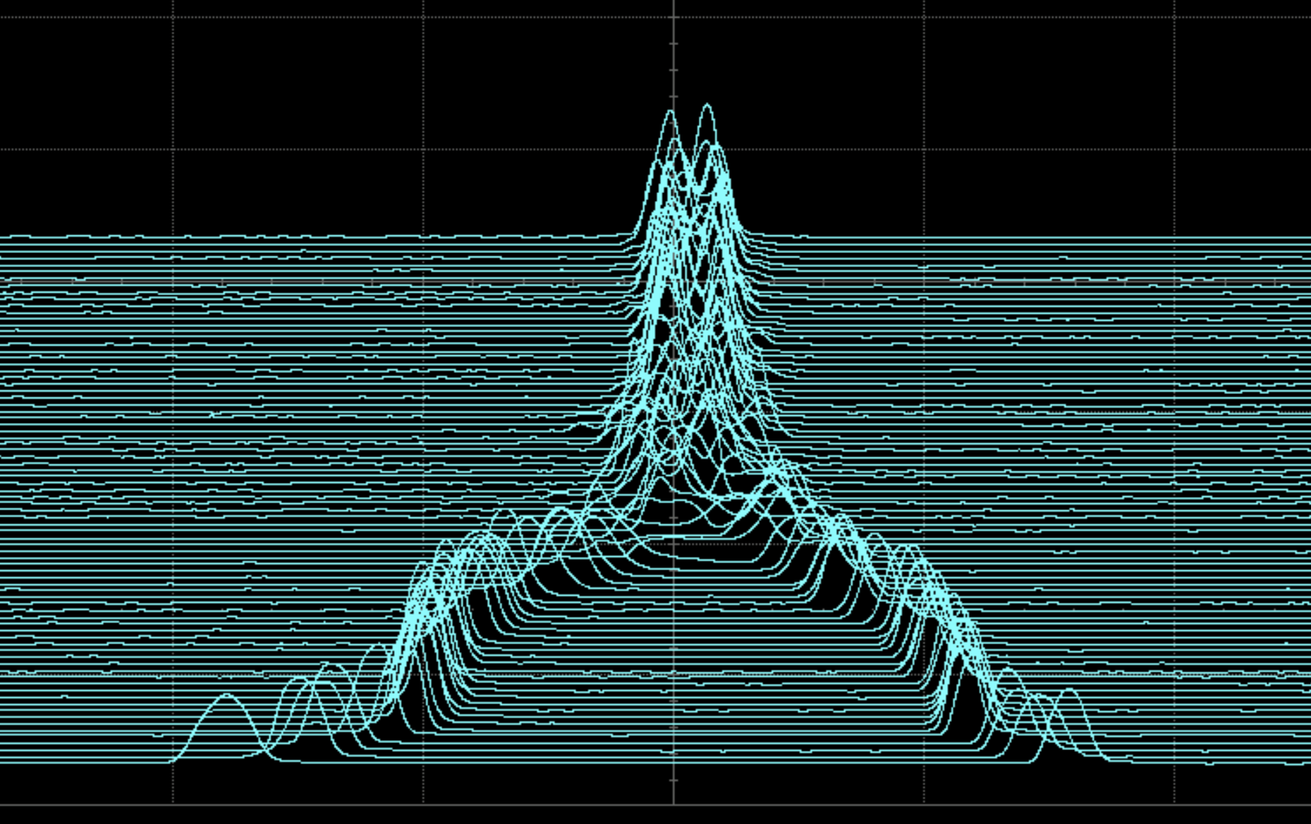
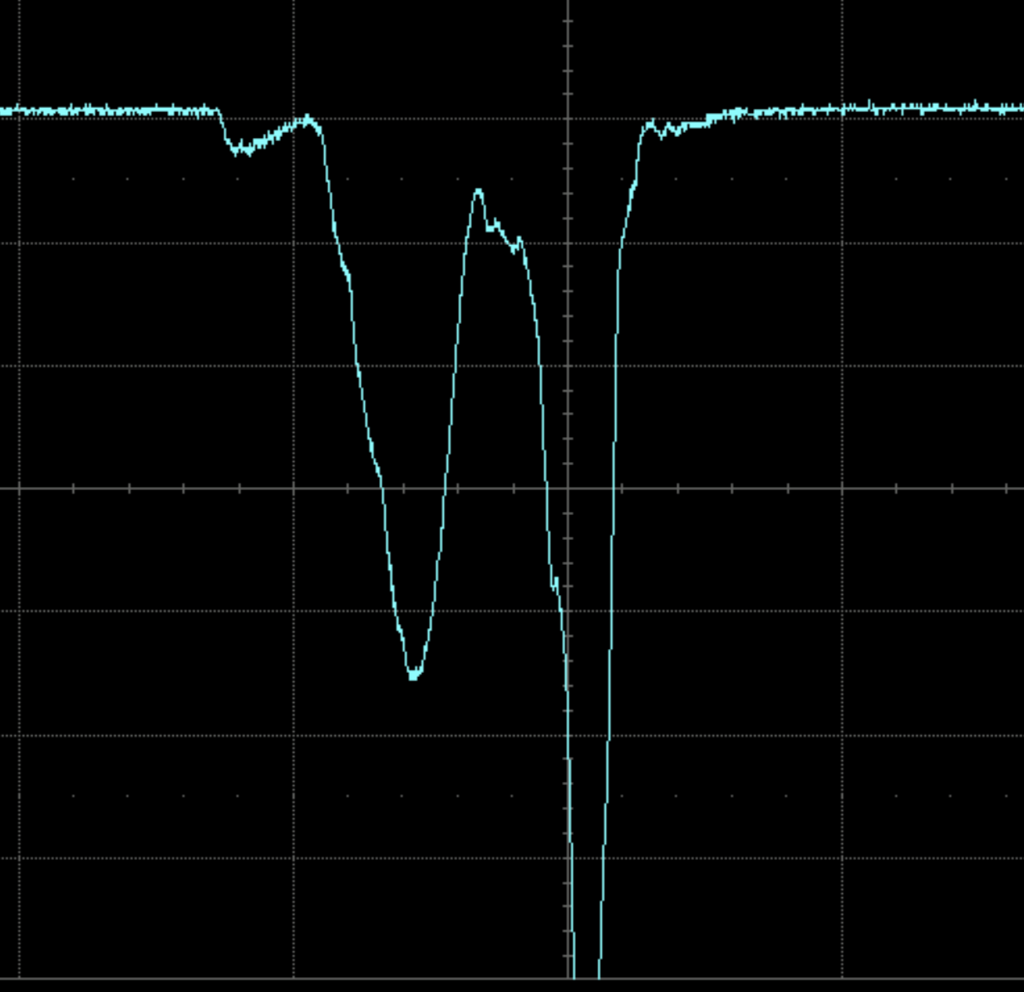
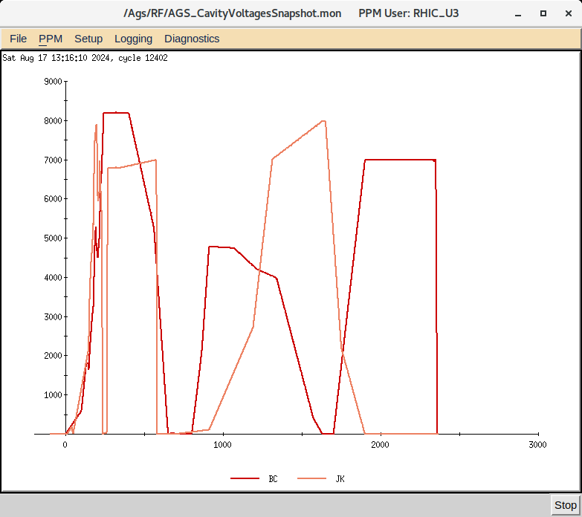
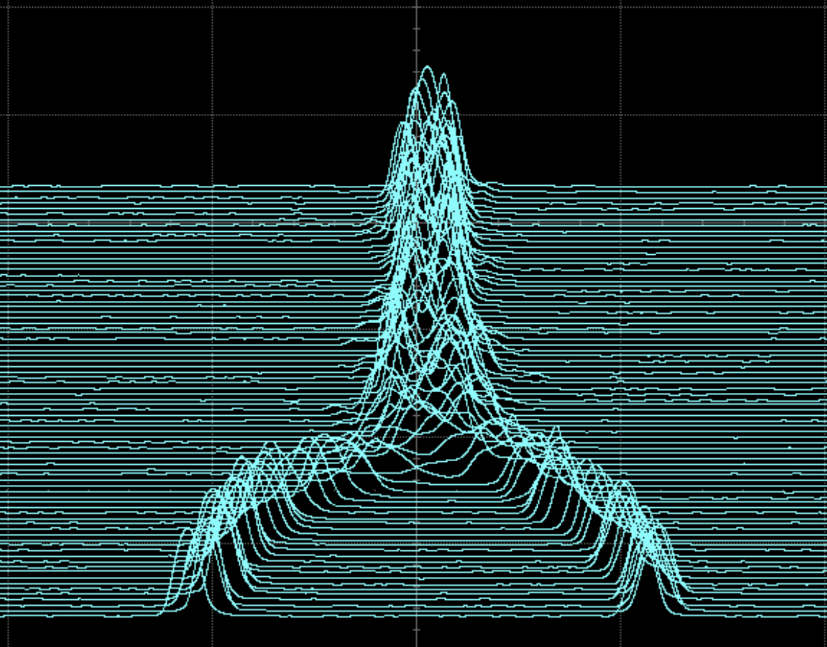
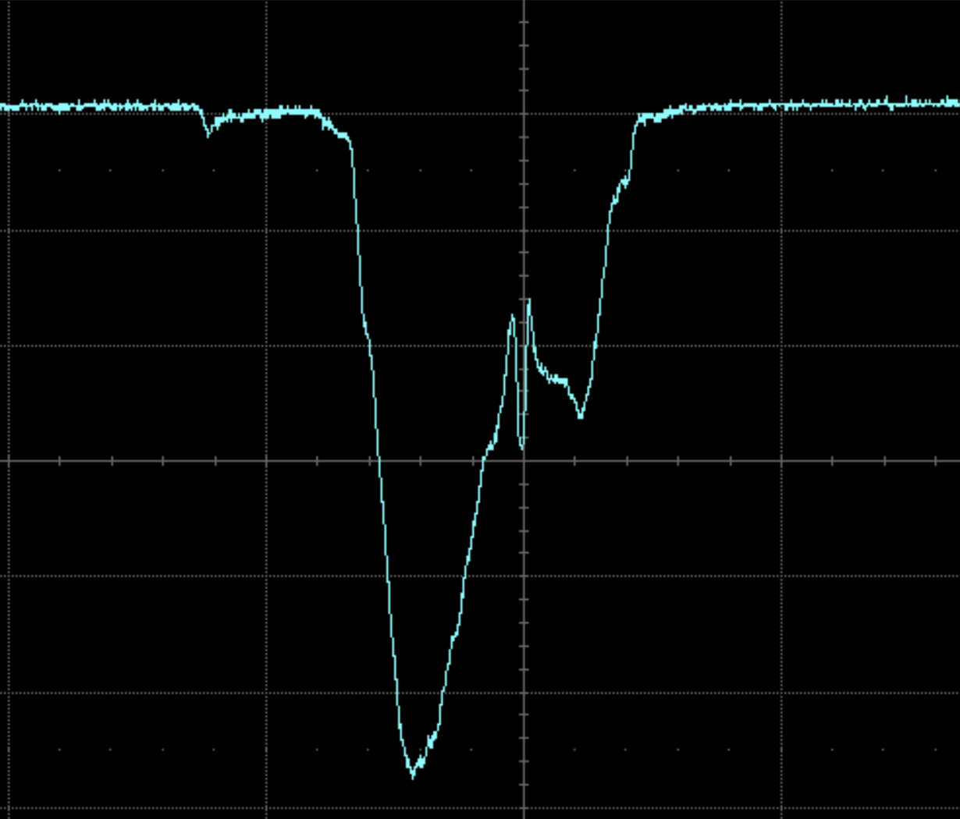
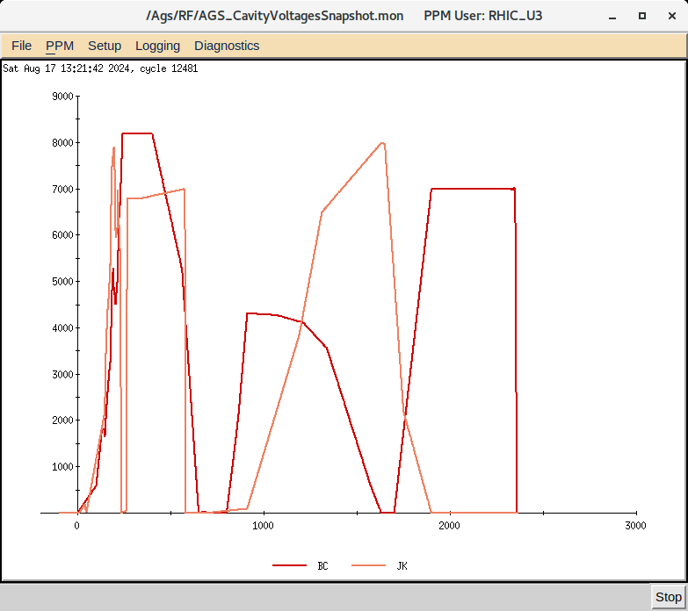
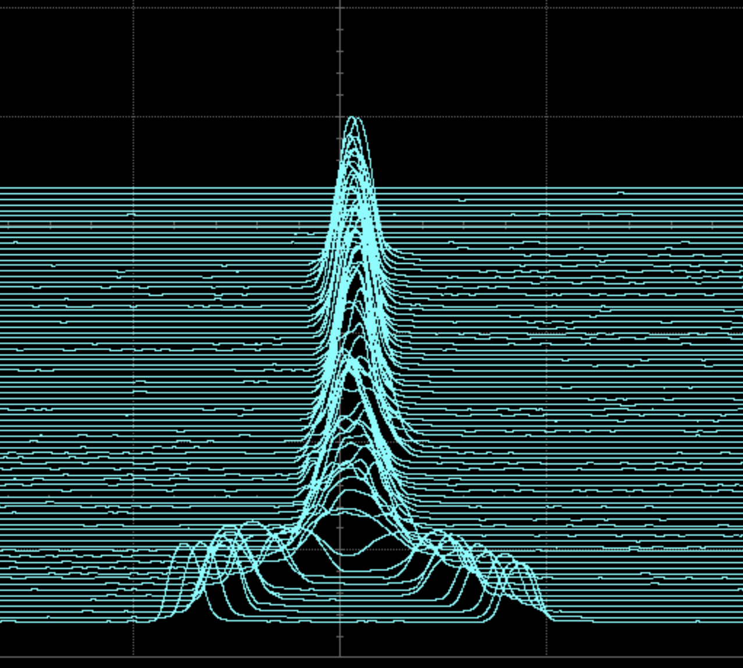
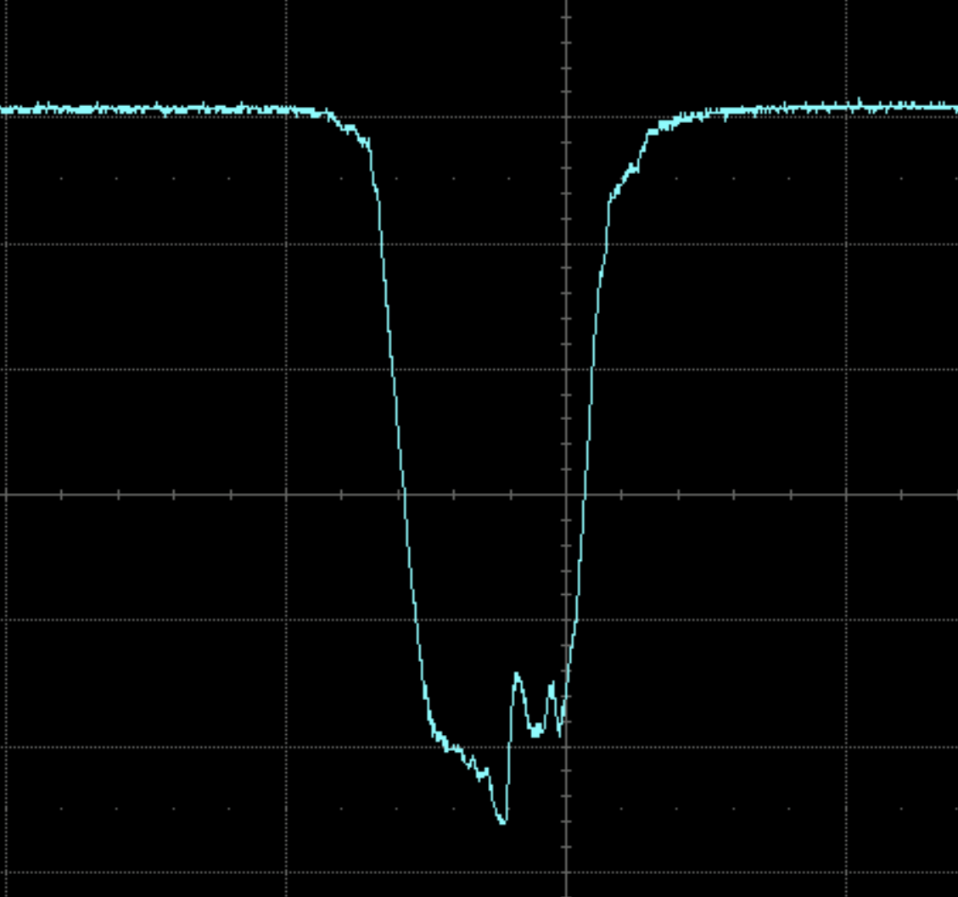
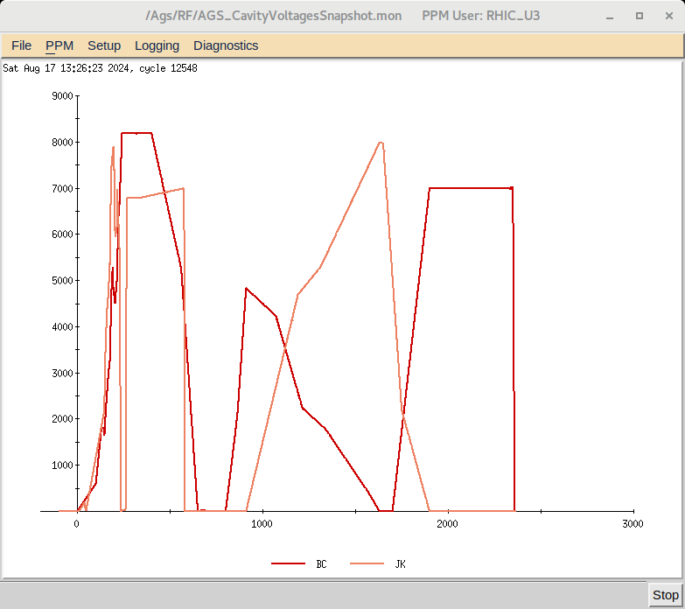
Reinforcement Learning Tuning (Soft Actor-Critic)
Varying 6 voltage points for each RF system
RF voltages
Bunch traces
Last trace
Initial
Plans to minimize the longitudinal emittance after bunch merging
Include RF phases as actors (parameters to be optimized)
Determine useful system parameters
  measurable
  related to the reward
Confirm RL more appropriate than BO.
1st step
5th step
Original

Slide 22
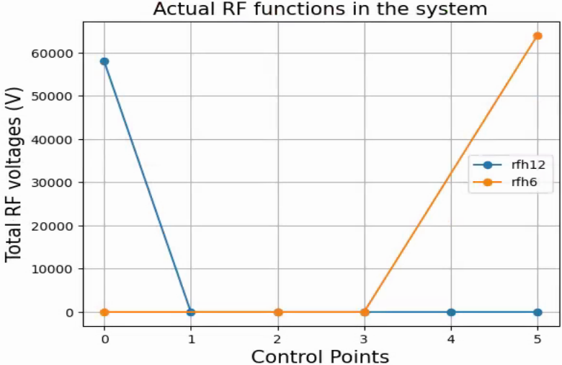
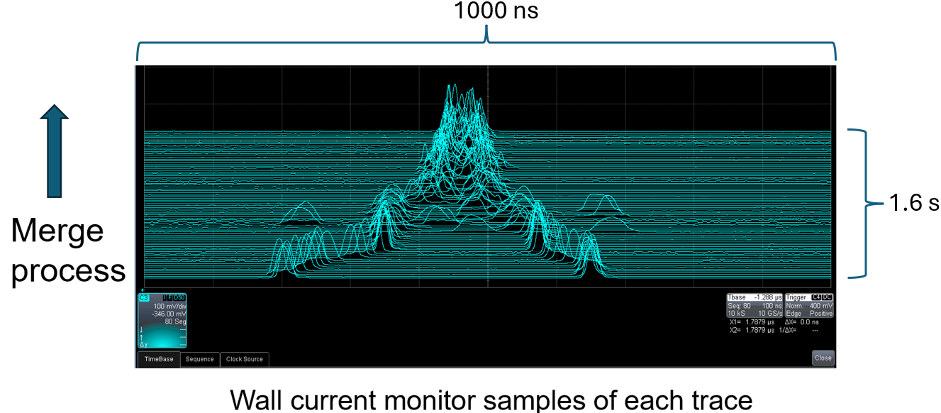
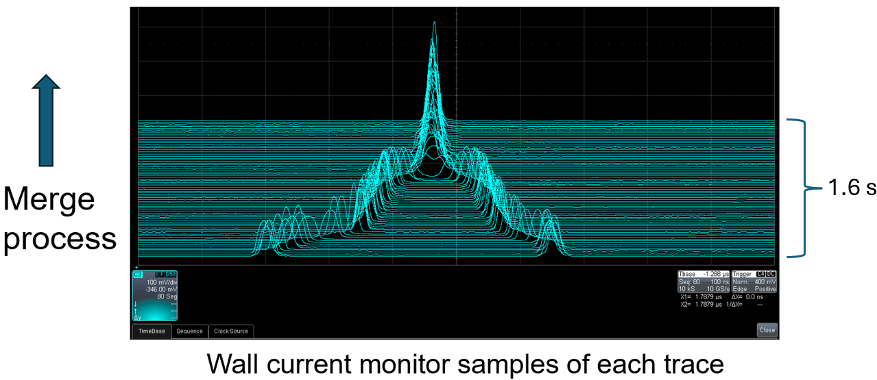
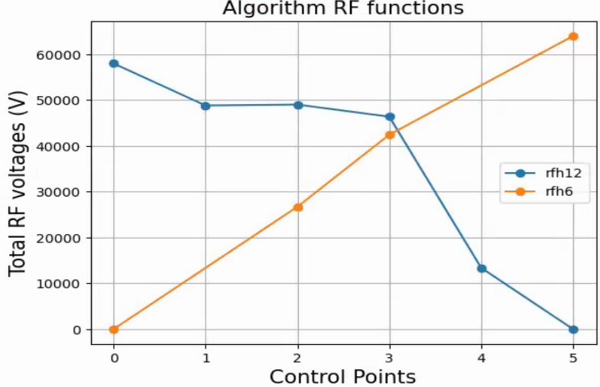
Reinforcement Learning Tuning (Soft Actor-Critic) – Training on faster Julia model
RF voltages
Bunch traces
Initial
1st step

Slide 23
Paths to improve polarization
Emittance reduction
Closed-orbit correction
Direct reduction of resonance driving terms

Slide 24
Closed-orbit correction
Optimized Booster to AGS (BtA) transfer
Optics and orbit correction in Booster and AGS

Slide 25
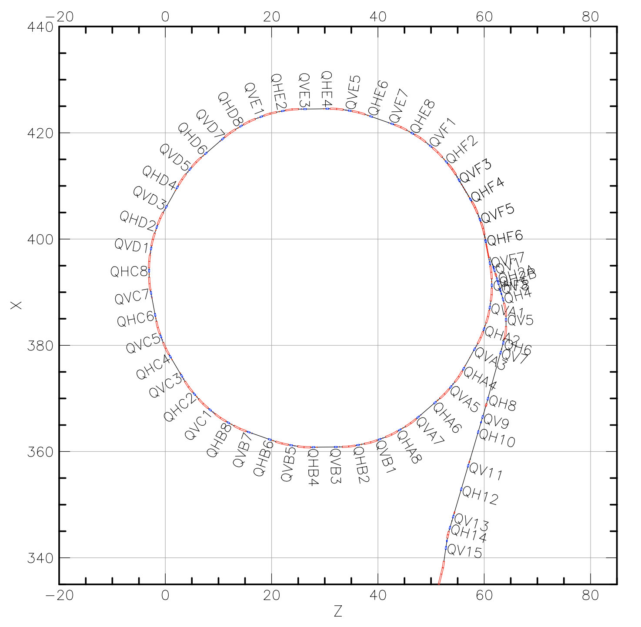
AGS injection
Many “knobs”
  Orbit matching
  Optics matching
  RF capture
Instrumentation
  Multiwires in BtA transfer line
  BPMs and IPMs in AGS
  No scraping possible
Difficult model
  Injection optics stability
  Gamma transition
  Orbit capture
  RF capture

Slide 26
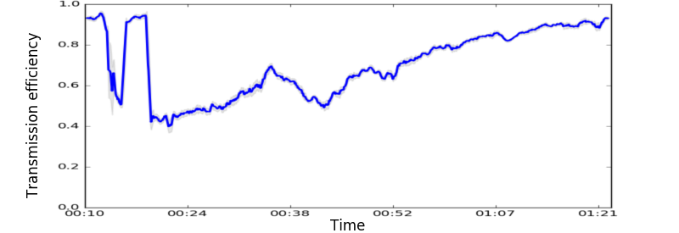
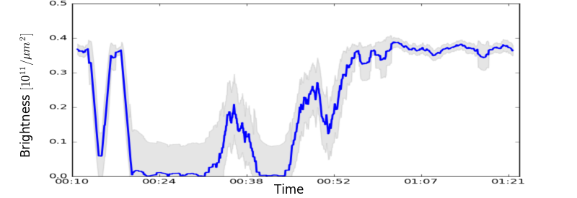
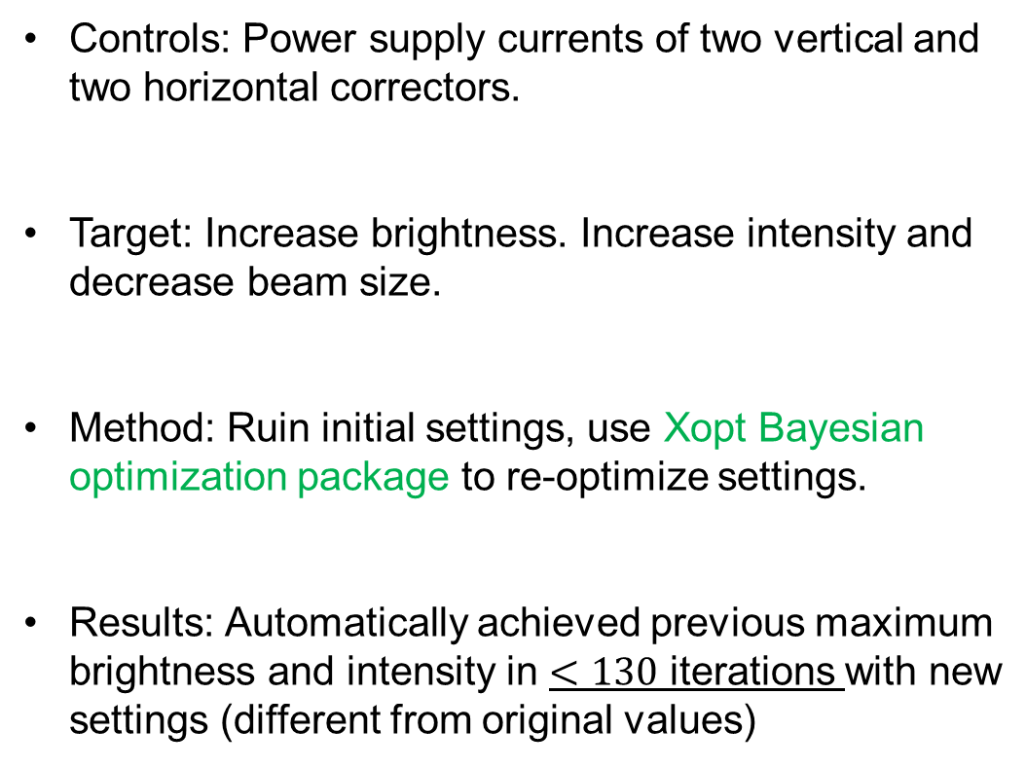
BtA optimization: 4 correctors
Controls: Power supply currents of two vertical and two horizontal correctors.
Target: Increase brightness. Increase intensity and decrease beam size.
Method: Ruin initial settings, use Xopt Bayesian optimization package to re-optimize settings.
Results: Automatically achieved previous maximum brightness and intensity in $<130$ iterations with new settings (different from original values)

Slide 27
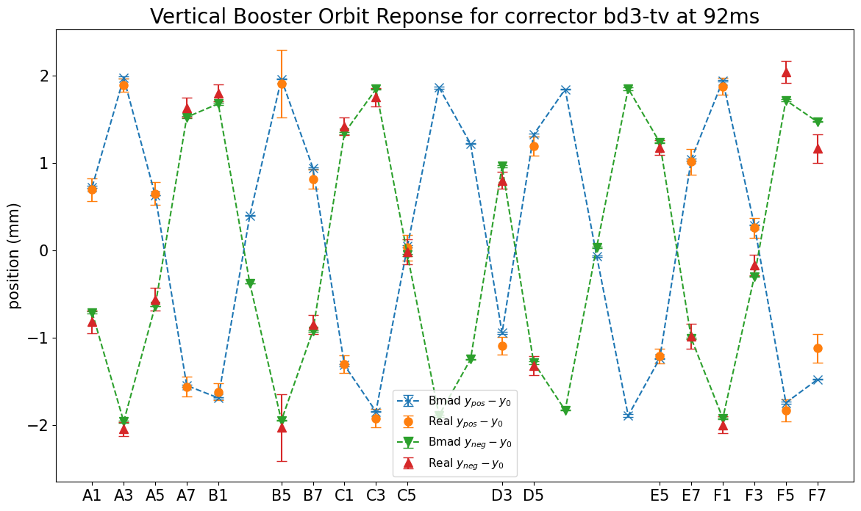
Orbit response data in AGS Booster
Orbit response data can be used to find and quantify unknown parameters (e.g., power supply scaling factors, magnet misalignment etc.) in real accelerators
Good agreements between AGS Booster data and Bmad model are reached.

Slide 28
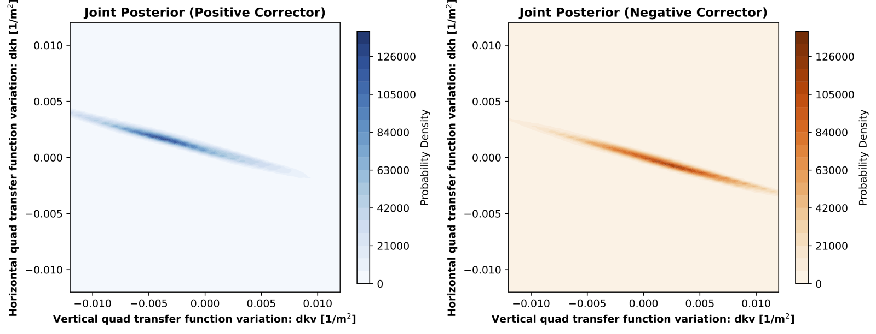
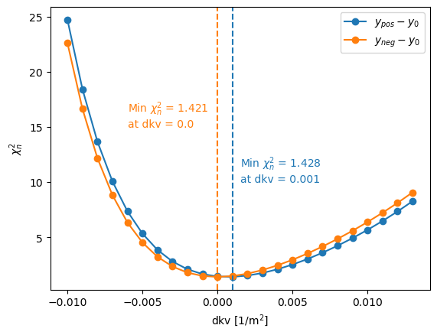
ORM Uncertainty quantification for booster
Xi-squared/DF = 1.3 – physics reasons for discrepancy were explored.
Likely due to parameters that are hard to measure directly:
  BPM calibrations
  Magnet alignments
  Magnet nonlinearities

Slide 29
Paths to improve polarization
Emittance reduction
Closed-orbit correction
Direct reduction of resonance driving terms

Slide 30
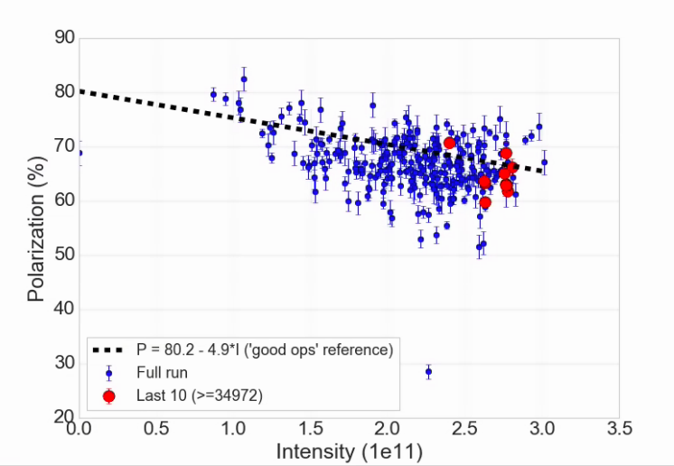
AGS Performance
AGS Polarization vs intensity for RHIC fills (Run 24)
Highest AGS performance is difficult to achieve and to maintain.
Value in just holding a known optimum
A combination of maintaining emittances and direct polarization interventions
Known good performance line
(Not a fit)
Good performance achievable, but hard to keep

Slide 31



AGS skew quads
Partial snakes in the AGS helps avoiding vertical resonances
Provides spin tune ‘gap’ where imperfection and vertical intrinsic resonance condition are never met
  $ν_{s} ≠ N$(full spin flips)
  $ν_{s} ≠ N±Q_{y}$
Horizontal resonance condition still met
  $ν_{s} =N±Q_{x}$
  Horizontal resonance are weak, but many (82 crossings)
  Currently handled with fast tune jump
  $ΔQ_{x}= 0.04$
  $Δt =100 μs$
Goal: compensate 82 horizontal resonances with 15 pulsed skew quadrupoles

Slide 32


AGS Spin Resonance Correction Skew Quadrupoles
Skew quad current pulses
Skew quad current pulses
15 knobs, 82 different resonances
  Expected effect is 15-20% gain in polarization
  A +/-2% measurement takes 5-10 minutes
Run 24: Observation of polarization gain factor (+15%) during acceleration (better than existing tune jump +12%)
Further improvements (enabling more pulses, +5-10% gain):
  Addressing model inaccuracies at low energy
  Iteration on orbit centering
  Possible optimizations based on ML methods:
    Reinforcement learning model
    Bayesian optimization of specific resonances
    Bayesian optimization through systematic effects (rolls)
Correction amplitude scan
Partial correction
Zero correction

Slide 33





Bmad-Julia a ML-oriented Toolkits (Libraries)
Toolkit
Dynamic Aperture Program
Advantages the toolkit:
Fully differentiable (reverse and forward)
➔ excellent for Neural Network optimizations
➔ Excellent for Bayesian optimization with slope information
Cuts down on the time needed to develop programs.
Cuts down on programming errors (via module reuse).
Provides a simple mechanism for lattice function calculations from within control system programs.
Standardizes sharing of lattice information between programs.
Increased safety: Modular code provides a firewall. For example, a buggy module introduced into the toolkit will not affect programs that do not use it.
Lattice Design Program
Control System Programs
This project is
funded by DOE-HEP
has a growing list of collaborators
has a weekly wise people meetings
➔ is looking for collaborators
IBS Simulation Programs
Etc.

Slide 34


Motivation: Digital twin at CBETA
Had success in building digital-twins for CBETA: combine custom version of Bmad/Tao with EPICS
CBETA-V: measure beam trajectories and compare to the digital twin in real time on control-system screens
Neural network can be trained to predict orbit response using Bmad simulation data
NN model can predict beam behavior due to both linear (correctors) and non-linear (cavity) relationships

Slide 35
Dominant Participants
BNL: Kevin Brown, Weinin Dai, Bhawin Dhital, Yuan Gao, Levente Hajdu, Kiel Hock, Bohong Huang, Lucy Lin, Nguyen Linh, Chuyu Liu, Vincent Schoefer, Nathan Urban
Cornell: Georg Hoffstaetter de Torquat, Eiad Hamwi, David Sagan, Matt Signorelli
SLAC: Auralee Edelen
JLAB: Malachi Schram, Armen Kasparian
RPI: Yinan Wang
Radiasoft: Nathan Cook, Jon Edelen, Chris Hall

Slide 36
Publications
ML/AI efforts at BNL/CAD
B. Huang, C. González-Zacarías, S. Sosa Güitrón, A. Aslam, S. G. Biedron, K. Brown, T. Bolin, Artificial Intelligence-Assisted Design and Virtual Diagnostic for the Initial Condition of a Storage-Ring-Based Quantum Information System, IEEE Access, Volume 10, 2022, pp.14350-14358
Y. Gao, W. Lin, K. A. Brown, X. Gu, G. H. Hoffstaetter, J. Morris, and S. Seletskiy, Bayesian optimization experiment for trajectory alignment at the low energy RHIC electron cooling system, Phys. Rev. Accel. Beams 25, 014601 – Published 7 January 2022
Y. Gao, J. Chen, T. Robertazzi, and K. A. Brown, Reinforcement learning based schemes to manage client activities in large distributed control systems, Phys. Rev. Accel. Beams 22, 014601 – Published 2 January 2019
W. Lin, M. A. Sampson, Y.C. Jing, K. Shih, G. H. Hoffstaetter, J. A. Crittenden, Simulation Studies and Machine Learning Applications at the Coherent Electron Cooling Experiment at RHIC, IPAC2022, Bangkok, Thailand
Y. Gao, K. A. Brown, X. Gu, J. Morris, S. Seletskiy, W. Lin, G. H. Hoffstaetter, J. A. Crittenden, Experiment Of Bayesian Optimization For Trajectory Alignment At Low Energy RHIC Electron Cooler, IPAC2022, Bangkok, Thailand
Y. Gao, K. A. Brown, P. Dyer, S. Seletskiy, H. Zhao, Applying Machine Learning to Optimization of Cooling Rate at Low Energy RHIC Electron Cooler, IPAC2021, Campinas, SP, Brazil
Polarized proton beams at BNL
K. Zeno, An overview of Booster and AGS Polarized Proton Operations during Run 17, BNL-114742-2017-TECH (10/2017)
K. Zeno, Run 16 Tandem gold performance in the injectors and possible improvement with AGS type 6:3:1 bunch merge in the Booster, C-A/AP/576, (10/2016)
V. H. Ranjbar, Approximations for crossing two nearby spin resonances, Phys. Rev. ST-AB 18, 014001 (2015)
Y. Dutheil, L. Ahrens, H. Huang, F. Méot, A. Poblaguev, V. Schoefer, K. Yip, Energy Calibration and Tune Jumps Efficiency in the PP APS, in Proc. PAC2014, Dresden/Germany (2014)
V. H. Ranjbar, M. Bai, H. Huang, A. Marusic, M. Minty, V. Ptitsyn, Experimental Effects of Orbit on Polarization Loss in RHIC, Proc. IPAC2012, New Orleans/LA (2012)
V. Schoefer, L. Ahrens, K.A. Brown, J.W. Glenn, H. Huang, Optics Error Measurements in the AGS for Polarized Proton Operation, Proc. PAC2011, New York/NY (2011)
V. Schoefer, Using betatron coupling to suppress horizontal intrinsic spin resonances driven by partial snakes, Phys. Rev. AB 24, 031001 (2021)
V. Schoefer, AGS Horizontal Resonance Compensation Overview, Presentation at BNL (2022)

Slide 37
Summary
DOE-NP funded project for the enhancement of proton polarization using ML/AI. Goal: 5%.
Several accelerator optimizations can impact polarization.
These topics are of the type suitable for physics- informed Bayesian Optimization and for Reinforcement Learning.
Excellent team has formed, items being addressed:
Emittance reduction (orbit, optics, bunch splitting) already works in the Booster, AGS
Improved model building and programing of digital twins of all parts
Reduction of resonance driving terms already works above transition energy
Accelerator studies show the utility of ML for the pre-accelerator chain.

Slide 38
Thank you and Questions?

Slide 39


Advantages of Bayesian Optimization

Slide 40



AGS, Polarization and Snakes
AGS Warm snake
Proton energy range 2.5 GeV -> 23 GeV
Polarization preserved using
  helical dipole snakes
  + horizontal tune jump
  Resonance correction in development (would replace tune jump)
AGS Cold snake
Requires “near integer” tune
  Orbit, optics unusually sensitive to errors
Helical dipoles are complicated magnets
  Large optical effects at low energy
  Many related magnetic elements for compensation orbit/optics
The complex fields and lattice + high tune requirements are a challenge to modeling
AGS Optics (low energy)
No snakes
Snakes +compensation

Slide 41




AGS Siberian Snakes modeling
Horizontal
Vertical
AGS Siberian snake field maps violates symplecticity, especially at AGS injection energy
Symplectic tracking (green) is stable for over 10,000 turns

