Slide 1







Impedance and beam-beam effects for FCC-ee
Roxána SOÓS, Xavier Buffat, Angeles Faus-Golfe
Thursday 6 of March 2025
Work funded, in parts, by the EU under Horizon-Europe Grant agreement nr. 101086276 (EAJADE)

Slide 2
Impedance and beam-beam effects for FCC-ee
Table of contents:
Motivation: Study intensity limitations due to beam-beam and wakefields effects in FCC-ee to understand limiting parameters and find mitigation methods.
Introduction
Vertical plane instabilities due to impedance and beam-beam
  Transverse mode repulsion instability mechanism
  Mitigation methods
Horizontal plane instability driven by beam-beam
Summary and outlook
Roxána SOÓS
Thursday 6 of March 2025

Slide 3
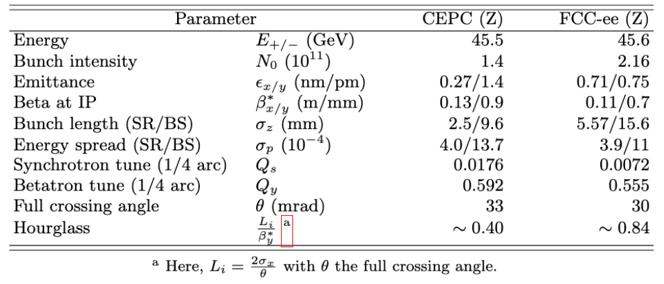
Impedance and beam-beam effects for FCC-ee
Introduction
All following simulations will be given for FCC-ee, September 2024 parameters table at Z energy.
All simulations have been carried out by either multiparticle tracking using Xsuite [1], or a linear algebraic model: the Circulant Matrix Model (CMM) [2].
Roxána SOÓS
Thursday 6 of March 2025

Slide 4
Impedance and beam-beam effects for FCC-ee
Introduction
Xsuite is using element by element tracking, nonlinear forces included
Linear transfer map
(avoid complicated effects from the non-linear lattice)
  Transverse wakefields
SEXTUPOLE
  Crab sextupoles
  as thin multipole elements
  Simulation of a quarter ring
  exploiting the four-fold symmetry
  Strong-strong beam-beam
  model at the IP
SEXTUPOLE
Roxána SOÓS
Thursday 6 of March 2025

Slide 5
Impedance and beam-beam effects for FCC-ee
Introduction
Xsuite is using element by element tracking, nonlinear forces included
Linear transfer map
(avoid complicated effects from the non-linear lattice)
  Transverse wakefields
SEXTUPOLE
  Crab sextupoles
  as thin multipole elements
  Simulation of a quarter ring
  exploiting the four-fold symmetry
  Strong-strong beam-beam
  model at the IP
SEXTUPOLE
Roxána SOÓS
Thursday 6 of March 2025
Notes:
For PDF export only

Slide 6
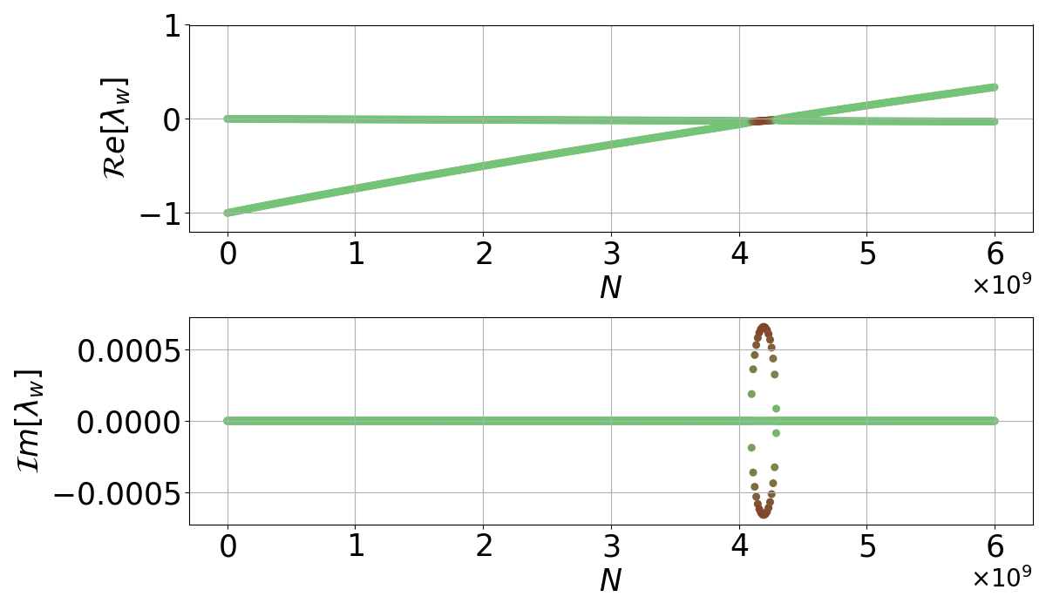

Impedance and beam-beam effects for FCC-ee
Introduction
The Circulant Matrix Model (CMM) [2] is a linear mode analysis method based on the discretisation of the longitudinal phase space.
Real part = oscillation mode
One can highlight
instable modes
Imaginary part = growth rate
Diagonalisation gives eigenvalues
Linear transfer matrix
Beam-beam force
Transverse impedance force
Space charge
Longitudinal impedance force
Linearized forces in the transverse plane applied to:
Roxána SOÓS
Thursday 6 of March 2025

Slide 7
Impedance and beam-beam effects for FCC-ee
Introduction
The Circulant Matrix Model (CMM) [2] is a linear mode analysis method based on the discretisation of the longitudinal phase space.
Real part = oscillation mode
One can highlight
instable modes
Imaginary part = growth rate
Diagonalisation gives eigenvalues
Linear transfer matrix
Beam-beam force
Transverse impedance force
Space charge
Longitudinal impedance force
Linearized forces in the transverse plane applied to:
Roxána SOÓS
Thursday 6 of March 2025
Notes:
For pdf export only

Slide 8
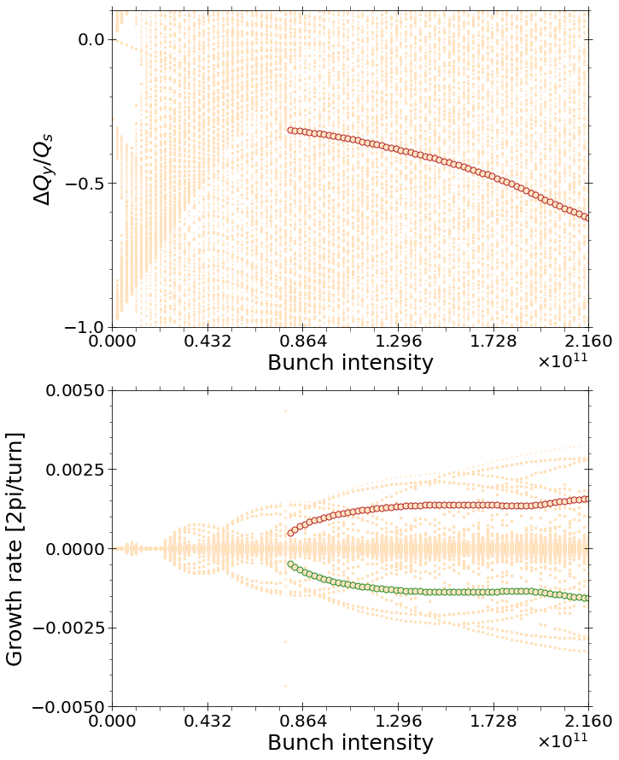
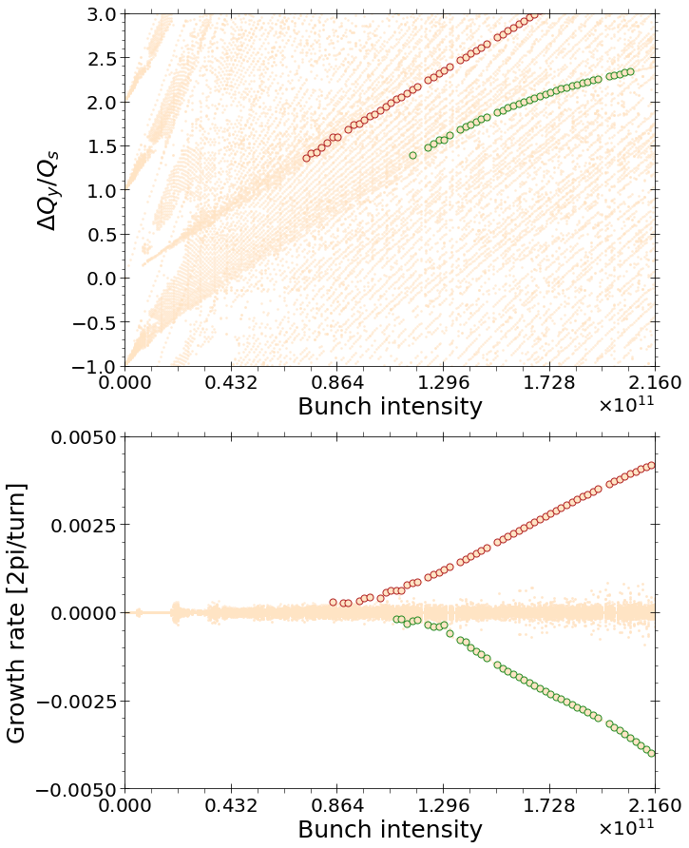
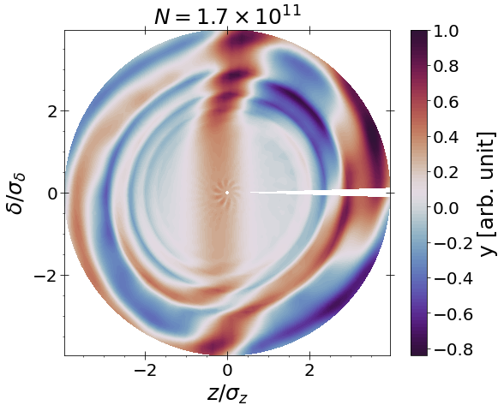
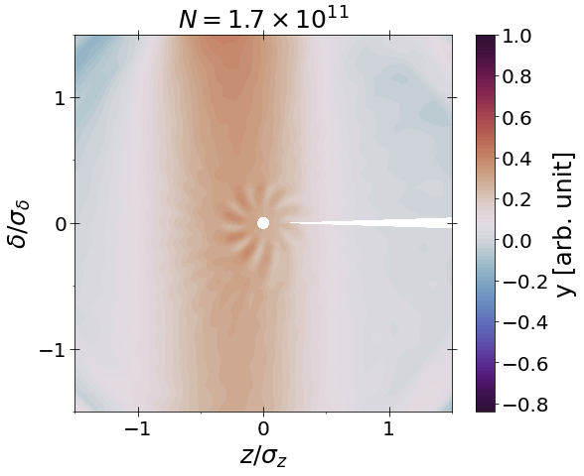
Impedance and beam-beam effects for FCC-ee
Introduction
The dominant instability due to beam-beam and transverse wakefields for the FCC-ee at Z energy, in the vertical plane, is the transverse mode repulsion instability (TMRI).
CMM
See [3,7], for more details
CMM
0mode
Phase advance
Strong hourglass
Large crossing angle
0mode
-1 mode
-1 mode
TMRI is a very low order instability.
Roxána SOÓS
Thursday 6 of March 2025

Slide 9
Impedance and beam-beam effects for FCC-ee
Vertical plane instabilities due to impedance and beam-beam
  Transverse mode repulsion instability mechanism
  (2 particles model)
Vertical linearised coherent beam-beam kick matrix for two charges per beam. No phase advance considered.
Vertical coordinates of two charges per beam, at a given turn n.
y_{2,B2}
y_{2,B1}
y_{1,B2}
y_{1,B1}
Interaction point (IP)
Arc matrix with synchro-betatron motion.
Roxána SOÓS
Thursday 6 of March 2025

Slide 10
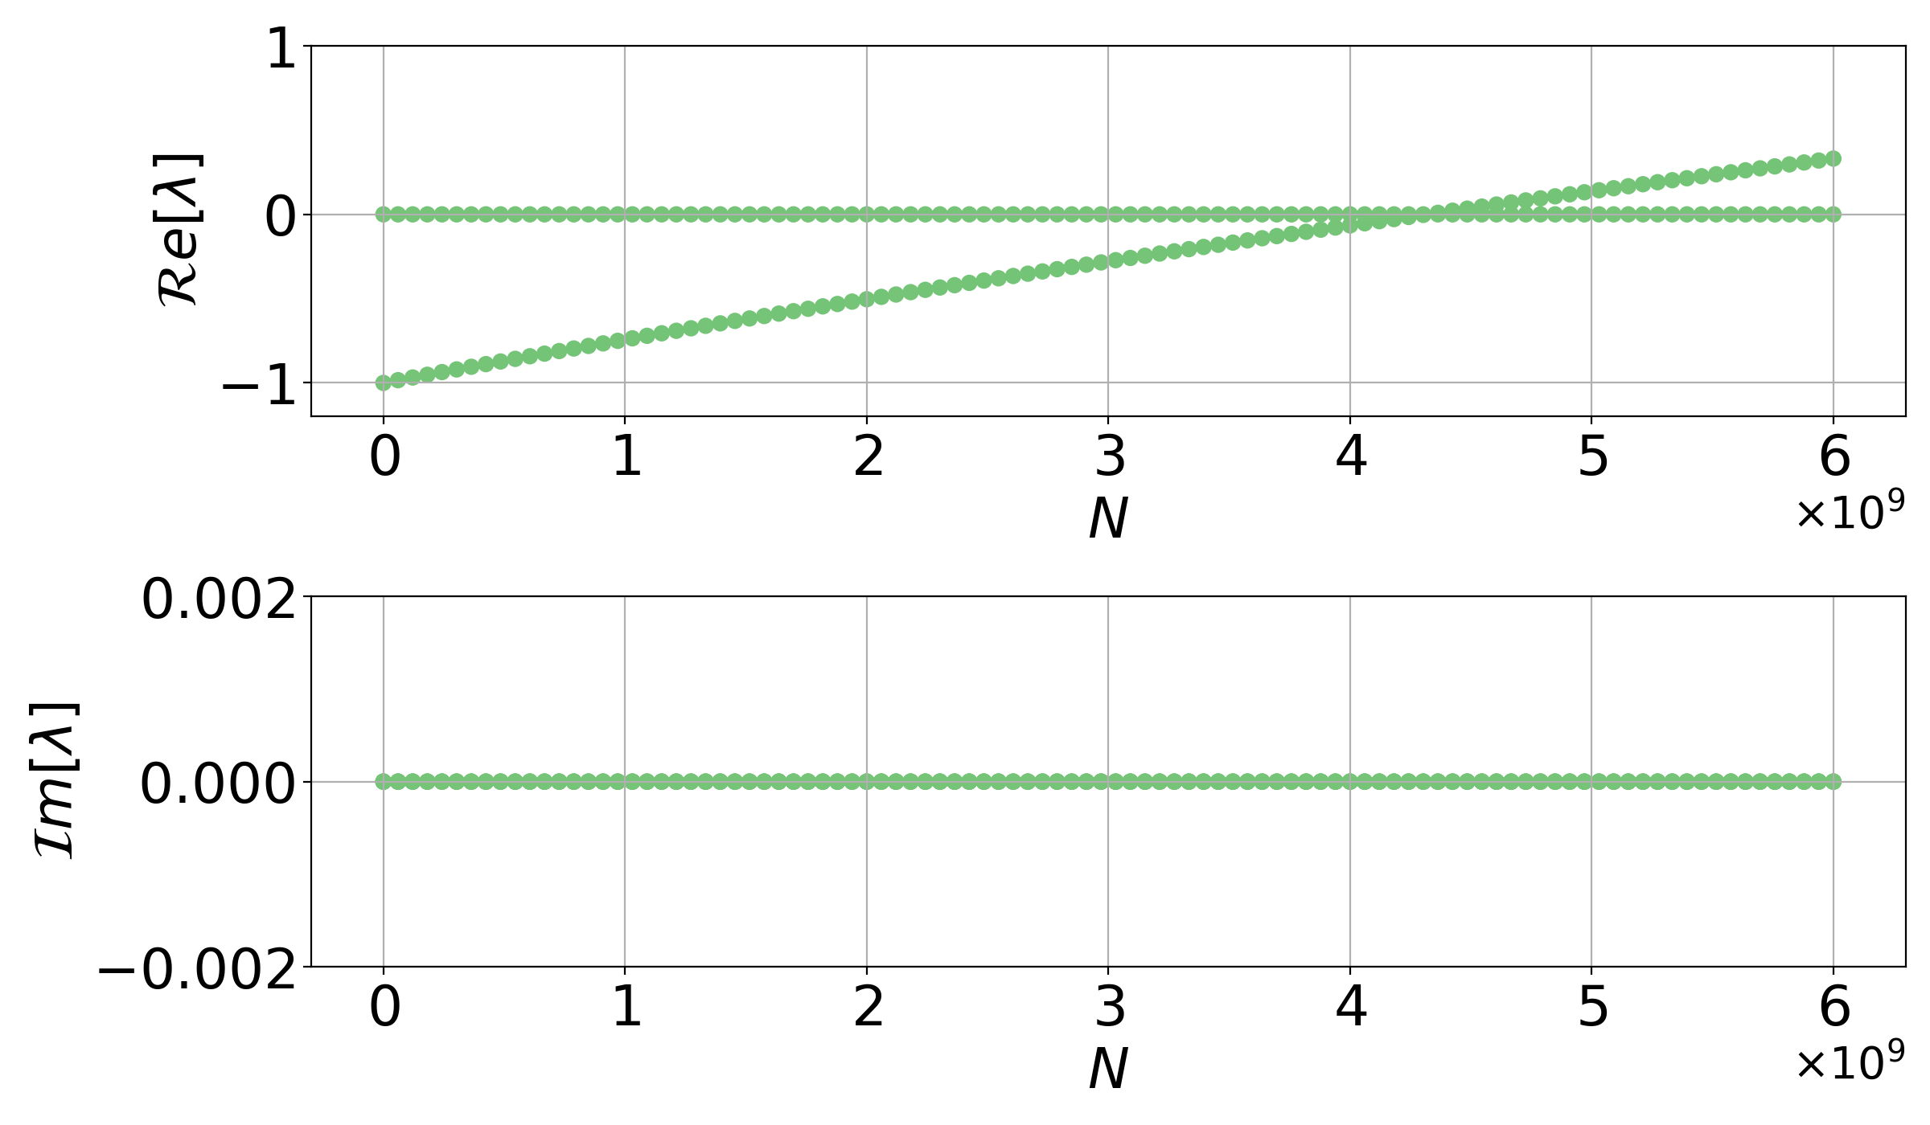
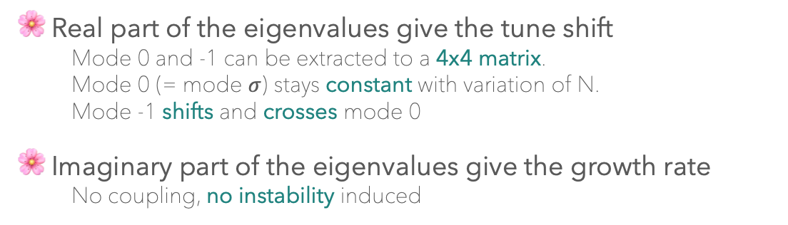
Impedance and beam-beam effects for FCC-ee
Vertical plane instabilities due to impedance and beam-beam
  Transverse mode repulsion instability mechanism
  (2 particles model)
Diagonalise and get the eigenvalues $λ$ . One can vary the weight of the charges (~ N particles) in the beam-beam force.
Real part of the eigenvalues give the tune shift
  Mode 0 and -1 can be extracted to a 4x4 matrix.
  Mode 0 (= mode $σ$) stays constant with variation of N.
  Mode -1 shifts and crosses mode 0
Imaginary part of the eigenvalues give the growth rate
  No coupling, no instability induced
Roxána SOÓS
Thursday 6 of March 2025

Slide 11
Impedance and beam-beam effects for FCC-ee
Vertical plane instabilities due to impedance and beam-beam
  Transverse mode repulsion instability mechanism
  (2 particles model)
Vertical linearised coherent beam-beam kick matrix for two charges per beam. No phase advance considered.
Vertical coordinates of two charges per beam, at a given turn n.
y_{2,B2}
y_{2,B1}
y_{1,B2}
y_{1,B1}
Interaction point (IP)
Arc matrix with synchro-betatron motion.
Transverse wakefield matrix with dipolar and quadrupolar wakefields.
Roxána SOÓS
Thursday 6 of March 2025

Slide 12
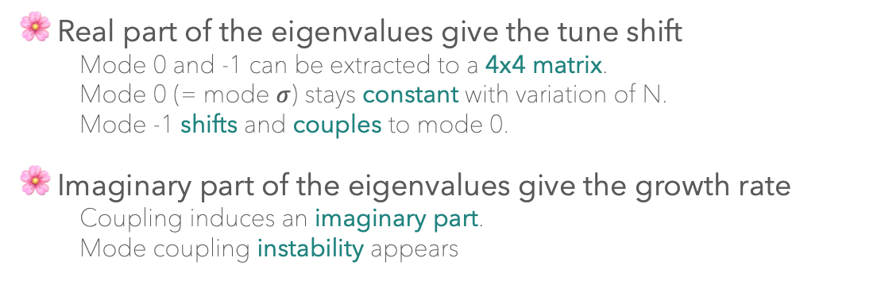
Impedance and beam-beam effects for FCC-ee
Vertical plane instabilities due to impedance and beam-beam
  Transverse mode repulsion instability mechanism
  (2 particles model)
Diagonalise and get the eigenvalues $λ$ . One can vary the weight of the charges (~ N particles) in the beam-beam force and the wake functions
Real part of the eigenvalues give the tune shift
  Mode 0 and -1 can be extracted to a 4x4 matrix.
  Mode 0 (= mode $σ$) stays constant with variation of N.
  Mode -1 shifts and couples to mode 0.
Imaginary part of the eigenvalues give the growth rate
  Coupling induces an imaginary part.
  Mode coupling instability appears
Roxána SOÓS
Thursday 6 of March 2025

Slide 13
Impedance and beam-beam effects for FCC-ee
Vertical plane instabilities due to impedance and beam-beam
  Transverse mode repulsion instability mechanism
  (2 particles model)
Phase advance at the interaction point considered using the kick and drift model [4].
Vertical coordinates of two charges per beam, at a given turn n.
y_{2,B2}
y_{2,B1}
y_{1,B2}
y_{1,B1}
Interaction point (IP)
Arc matrix with synchro-betatron motion.
Roxána SOÓS
Thursday 6 of March 2025

Slide 14
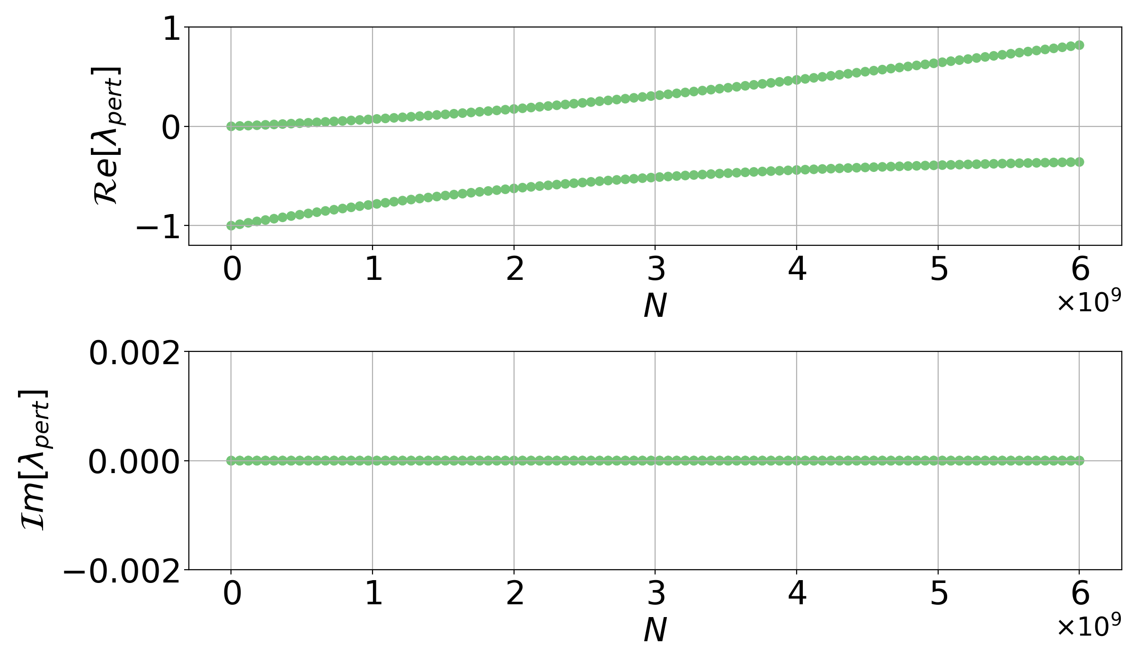
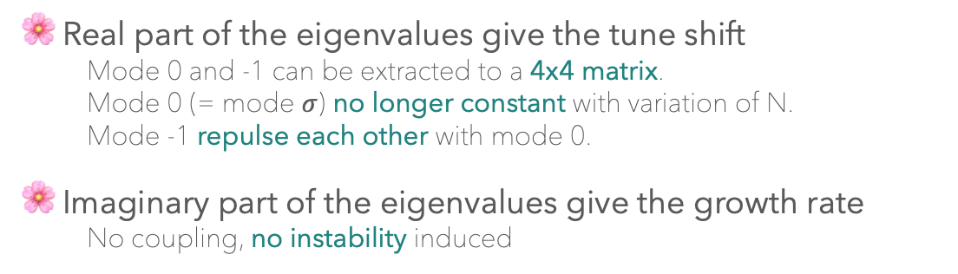
Impedance and beam-beam effects for FCC-ee
Vertical plane instabilities due to impedance and beam-beam
  Transverse mode repulsion instability mechanism
  (2 particles model)
Diagonalise and get the eigenvalues $λ$ . One can vary the weight of the charges (~ N particles) in the beam-beam force.
Real part of the eigenvalues give the tune shift
  Mode 0 and -1 can be extracted to a 4x4 matrix.
  Mode 0 (= mode $σ$) no longer constant with variation of N.
  Mode -1 repulse each other with mode 0.
Imaginary part of the eigenvalues give the growth rate
  No coupling, no instability induced
Roxána SOÓS
Thursday 6 of March 2025

Slide 15
Impedance and beam-beam effects for FCC-ee
Vertical plane instabilities due to impedance and beam-beam
  Transverse mode repulsion instability mechanism
  (2 particles model)
Phase advance at the interaction point considered using the kick and drift model [4].
Vertical coordinates of two charges per beam, at a given turn n.
y_{2,B2}
y_{2,B1}
y_{1,B2}
y_{1,B1}
Interaction point (IP)
Arc matrix with synchro-betatron motion.
Transverse wakefield matrix with dipolar and quadrupolar wakefields.
Roxána SOÓS
Thursday 6 of March 2025

Slide 16
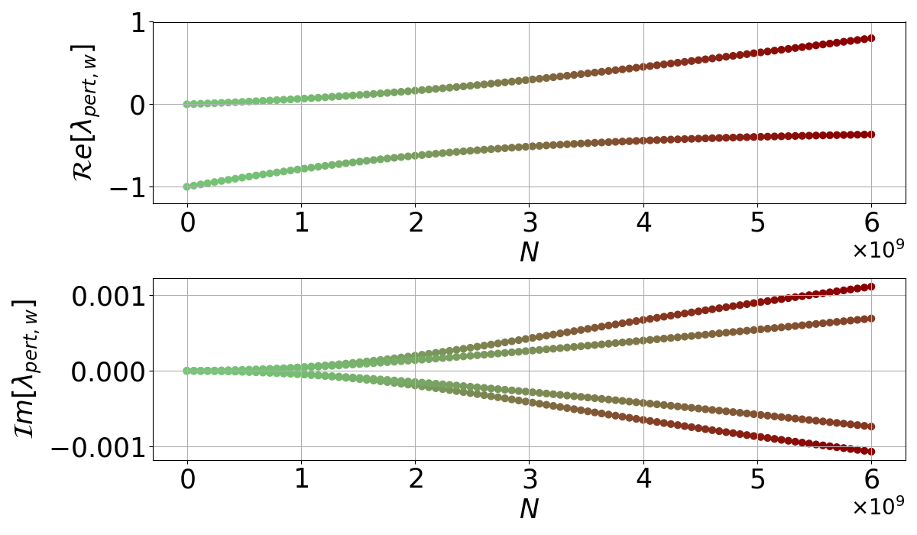
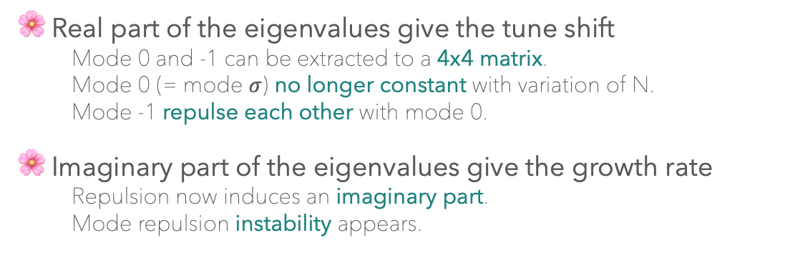
Impedance and beam-beam effects for FCC-ee
Vertical plane instabilities due to impedance and beam-beam
  Transverse mode repulsion instability mechanism
  (2 particles model)
Diagonalise and get the eigenvalues $λ$ . One can vary the weight of the charges (~ N particles) in the beam-beam force and the wake functions
Real part of the eigenvalues give the tune shift
  Mode 0 and -1 can be extracted to a 4x4 matrix.
  Mode 0 (= mode $σ$) no longer constant with variation of N.
  Mode -1 repulse each other with mode 0.
Imaginary part of the eigenvalues give the growth rate
  Repulsion now induces an imaginary part.
  Mode repulsion instability appears.
Roxána SOÓS
Thursday 6 of March 2025

Slide 17
Impedance and beam-beam effects for FCC-ee
Vertical plane instabilities due to impedance and beam-beam
  Transverse mode repulsion instability mechanism
  (2 particles model)
beam-beam, NO phase advance
beam-beam, phase advance
Phase advance
Strong hourglass
Large crossing angle
Instability can be analytically described!
beam-beam + wakes, NO phase advance
beam-beam + wakes, phase advance
Transverse mode repulsion instability (TMRI) has no clear threshold because there is no coupling!
Roxána SOÓS
Thursday 6 of March 2025

Slide 18
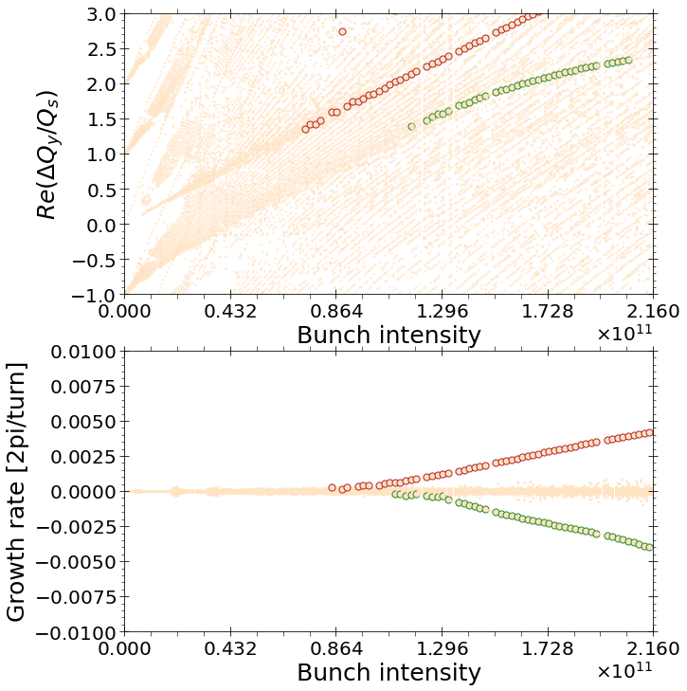
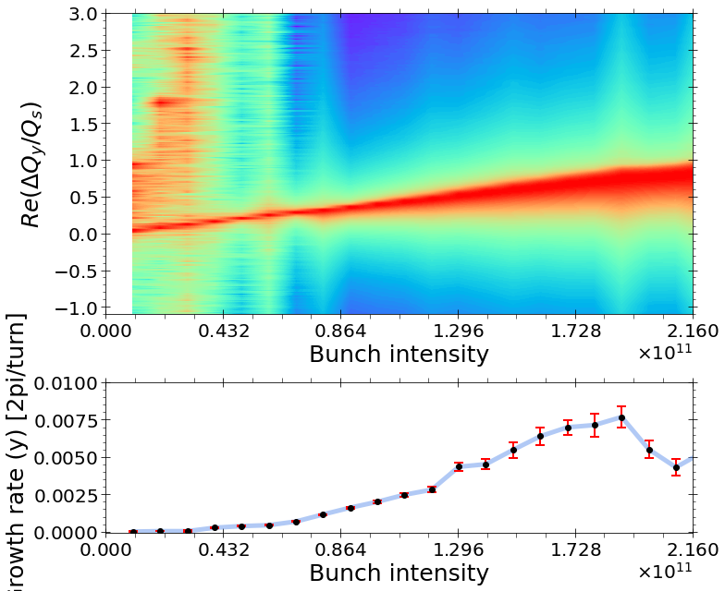
Impedance and beam-beam effects for FCC-ee
Vertical plane instabilities due to impedance and beam-beam
  Mitigation methods
Tracking: crab sextupoles have an impact on the tune shift, but instability growth rate is correct. If no crab sextupole is set, tune shift is correctly predicted. Growth rate cannot be extracted because of instant blow up.
CMM
Xsuite, crab sextupoles
Roxána SOÓS
Thursday 6 of March 2025

Slide 19
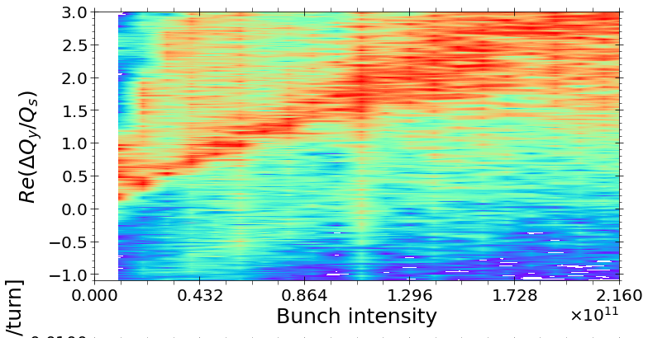
Impedance and beam-beam effects for FCC-ee
Vertical plane instabilities due to impedance and beam-beam
  Mitigation methods
Tracking: crab sextupoles have an impact on the tune shift, but instability growth rate is correct. If no crab sextupole is set, tune shift is correctly predicted. Growth rate cannot be extracted because of instant blow up.
CMM
Xsuite, NO crab sextupoles
Xsuite, crab sextupoles
Growth rate not available because of blow up due to the missing crab sextupole
Roxána SOÓS
Thursday 6 of March 2025

Slide 20
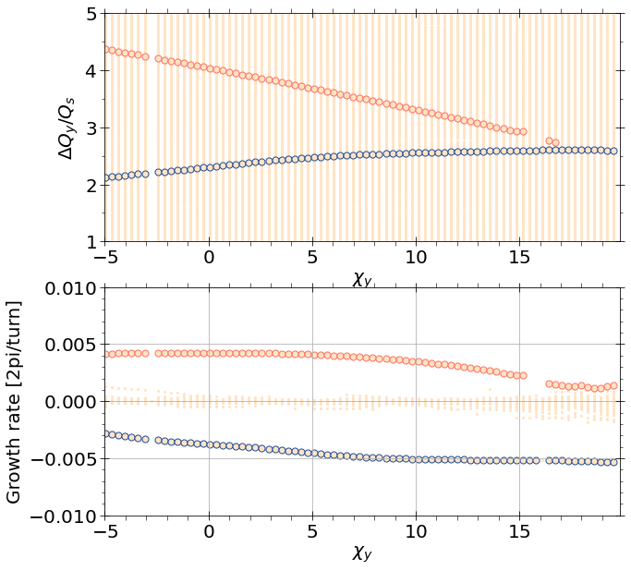
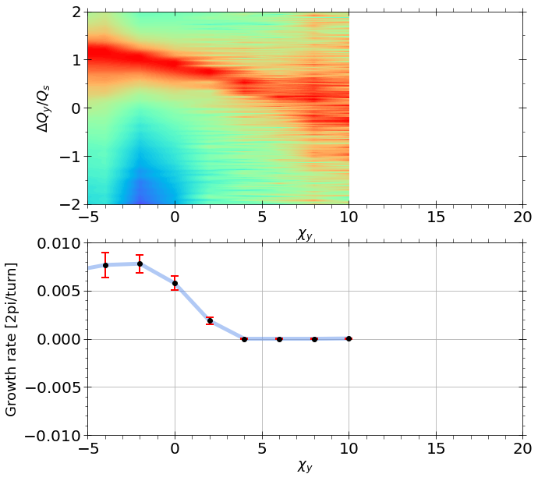
Impedance and beam-beam effects for FCC-ee
Vertical plane instabilities due to impedance and beam-beam
  Mitigation methods
Chromaticity was studied in Xsuite and CMM. Both agree that chromaticity is a mitigation method to consider. However, tracking is necessary to carry out studies on mitigation.
FCC-ee (Z) chromaticity scan at nominal intensity N₀ = 2.16x10¹¹
CMM
Xsuite
Different chromaticity value was found, could be explained by the Landau damping (not present in CMM), [5].
Tune shift variation versus the chromaticity identical.
Tune shift is different due to the Crab sextupoles.
A chromaticity > 5 was find to be enough to mitigate effectively the instability.
Roxána SOÓS
Thursday 6 of March 2025

Slide 21
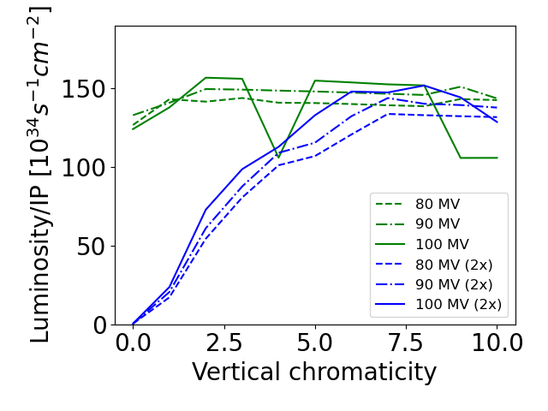
Impedance and beam-beam effects for FCC-ee
Vertical plane instabilities due to impedance and beam-beam
  Mitigation methods
Chromaticity was studied in Xsuite and CMM. Both agree that chromaticity is a mitigation method to consider. However, tracking is necessary to carry out studies on mitigation.
Xsuite
Chromaticity (needed to stabilise the vertical motion) needs to be highly increased if impedance is doubled.
Too high chromaticity can practically unacceptable due to its impact on beam quality.
Impedance is therefore an intensity limiting contributor, a careful design is necessary to limit instabilities.
Roxána SOÓS
Thursday 6 of March 2025

Slide 22
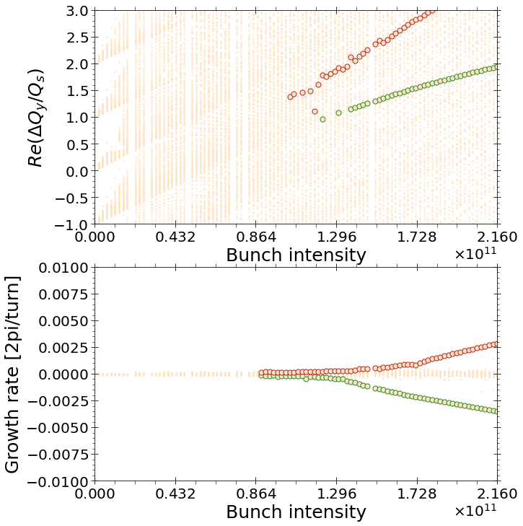
Impedance and beam-beam effects for FCC-ee
Vertical plane instabilities due to impedance and beam-beam
  Mitigation methods
Damper was studied in CMM. Resistive damper’s impact visible on the most unstable mode but is very slight. Reactive damper must be investigated too.
FCC-ee (Z), no Damper
FCC-ee (Z), with Damper (g_{x}=1, phi = 0)
The impact of a purely resistive damper seems limited.
Ongoing study on different types of dampers!
Roxána SOÓS
Thursday 6 of March 2025

Slide 23
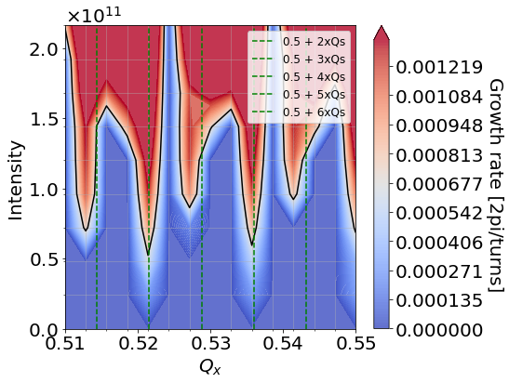
Impedance and beam-beam effects for FCC-ee
Horizontal plane instability driven by beam-beam
Horizontal plane is dominated by the beam-beam driven, coherent <x-z> instability. [5,6]
FCC-ee (Z) at V_{RF} = 79MV (Table s.3)
CMM is a fast (~few hours on cluster) and adequate tool to simulate <x-z> instabilities.
The effect of different parameters such as the Q_{s} , bunch length, energy spread, … on the <x-z> can be studied with CMM
The longitudinal wakefields are being implemented in the model so that their effect can also be studied.
Mitigation methods (damper, chromaticity, …) can be studied with CMM
CMM
Roxána SOÓS
Thursday 6 of March 2025

Slide 24
Impedance and beam-beam effects for FCC-ee
Conclusion and outlook
The mode coupling instability of the colliding beams driven by impedance becomes a Transverse mode repulsion instability (TMRI) in the presence of strong hourglass.
  Mitigation methods have been discussed. Chromaticity is a good candidate; the corresponding impedance budget is tight. Further investigation involves various setup of transverse dampers.
  The mechanism of damping with chromaticity is not reproduced by the linear model; tracking simulations must be used to determine precise threshold (Landau damping).
CMM shows to be efficient for the study of the coherent <x-z> instabilities in the horizontal plane.
  Longitudinal impedance is being added to the CMM model and will be used to study its impact on the coherent <x-z> instability. (Further information available soon at IPAC 2025)
Possibility to simulate asymmetric beam-beam interaction requires an adjustment in CMM. Concurrent studies could be conducted for SuperKEKB in the future.
Roxána SOÓS
Thursday 6 of March 2025

Slide 25


THANK YOU FOR LISTENING!
Work funded, in parts, by the EU under Horizon-Europe Grant agreement nr. 101086276 (EAJADE)

Slide 26
Impedance and beam-beam effects for FCC-ee
REFERENCES
[1] X. Buffat, The Circulant Matrix Model and the Role of Beam-beam Effects in Coherent Instabilities, CERN Yellow Reports: Conference Proceedings , 25 Pages (2018), artwork Size: 25 Pages Publisher: CERN.
[2] Iadarola et al., Xsuite: An Integrated Beam Physics Simulation Framework, JACoW , 8 pages, 1.757 MB (2023), artwork Size: 8 pages, 1.757 MB ISBN: 9783954502530 Medium: application/pdf Publisher: JACoW Publishing, Geneva, Switzerland.
[3] https://indico.global/event/9305/contributions/90666/
[4] Hirata et al., A symplectic beam-beam interaction with energy change, Part. Accel. 40, 205 (1993)
[5] Ohmi, K., N. Kuroo, K. Oide, D. Zhou, and F. Zimmermann. ‘Coherent Beam-Beam Instability in Collisions with a Large Crossing Angle’. Physical Review Letters 119, no. 13 (26 September 2017): 134801. https://doi.org/10.1103/PhysRevLett.119.134801.
[6] Lin, Chuntao, Kazuhito Ohmi, and Yuan Zhang. ‘Coupling Effects of Beam-Beam Interaction and Longitudinal Impedance’. Physical Review Accelerators and Beams 25, no. 1 (24 January 2022): 011001. https://doi.org/10.1103/PhysRevAccelBeams.25.011001.
[7] Lin, Chuntao, Kazuhito Ohmi, and Yuan Zhang. ‘Coupling Effects of Beam-Beam Interaction and Longitudinal Impedance’. Physical Review Accelerators and Beams 25, no. 1 (24 January 2022): 011001. https://doi.org/10.1103/PhysRevAccelBeams.25.011001.
Roxána SOÓS
Thursday 6 of March 2025

Slide 27
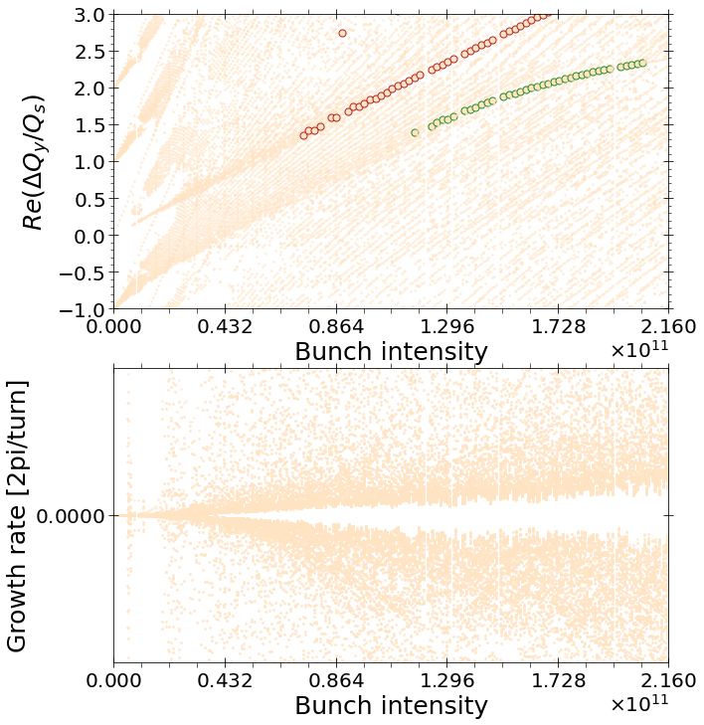
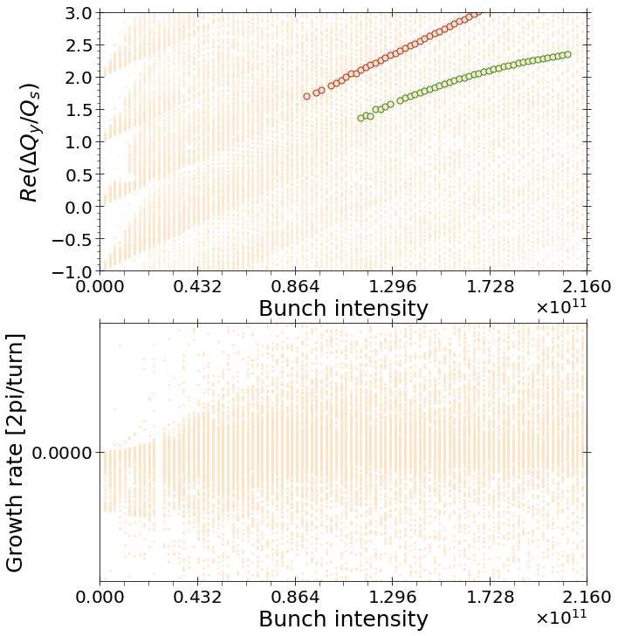
Impedance and beam-beam effects for FCC-ee
BACKUP
Roxána SOÓS
Thursday 6 of March 2025

Slide 28
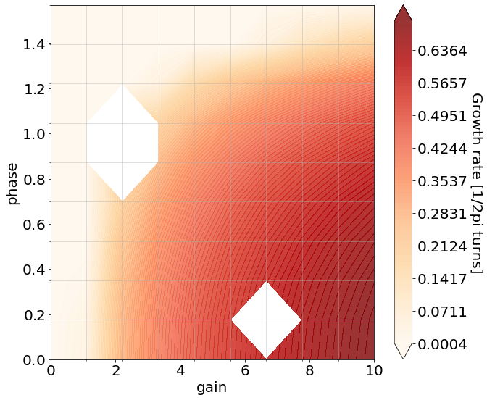
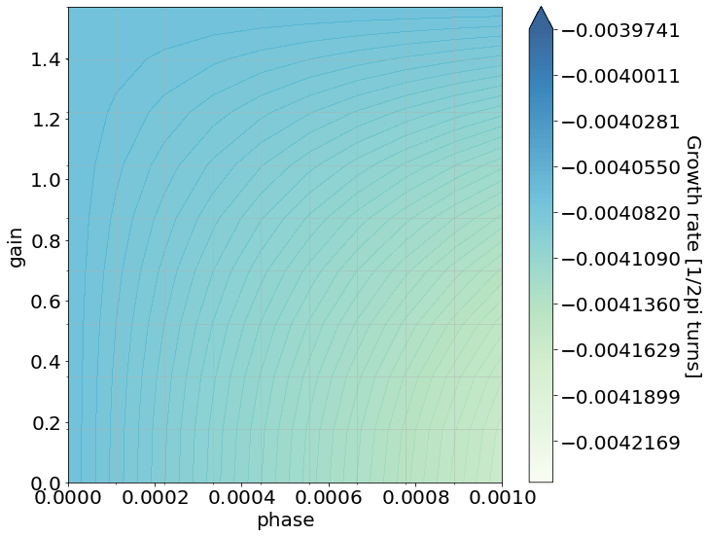
Impedance and beam-beam effects for FCC-ee
BACKUP
Work in progress: Investigation to be done on wider areas, on mode evolutions etc!!!
FCC-ee (Z), Maximum growth rate at N₀ = 2.16x10¹¹
FCC-ee (Z), Minimum growth rate at N₀ = 2.16x10¹¹
CMM
CMM
Damper has an impact on the most stable mode too
Damper has effect on the most unstable mode!
Reactive damper could be used?
Roxána SOÓS
Thursday 6 of March 2025

Slide 29
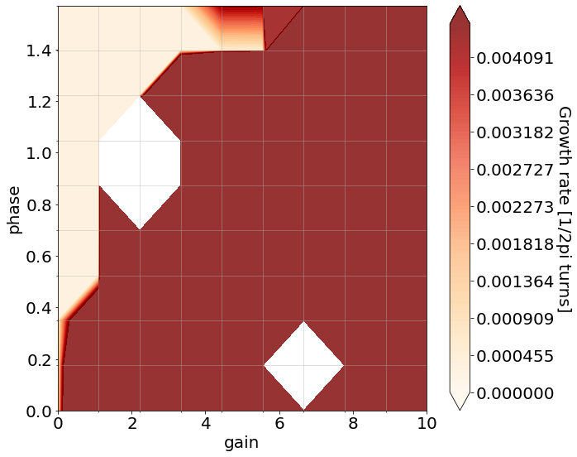
Impedance and beam-beam effects for FCC-ee
BACKUP
Work in progress: Investigation to be done on wider areas, on mode evolutions etc!!!
FCC-ee (Z), Maximum growth rate at N₀ = 2.16x10¹¹
FCC-ee (Z), Minimum growth rate at N₀ = 2.16x10¹¹
CMM
CMM
Damper has an impact on the most stable mode too
Damper has effect on the most unstable mode!
Reactive damper could be used?
Roxána SOÓS
Thursday 6 of March 2025

Slide 30
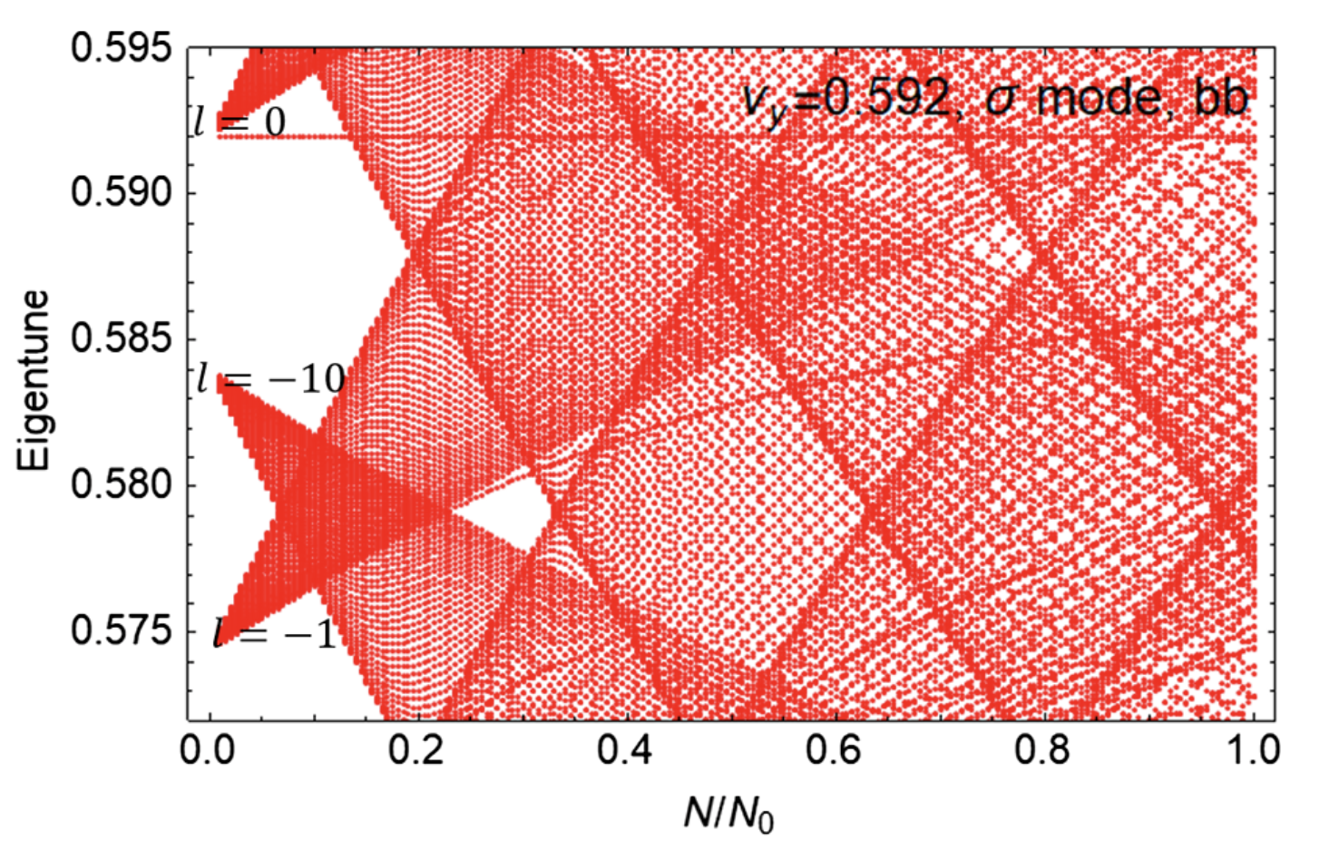
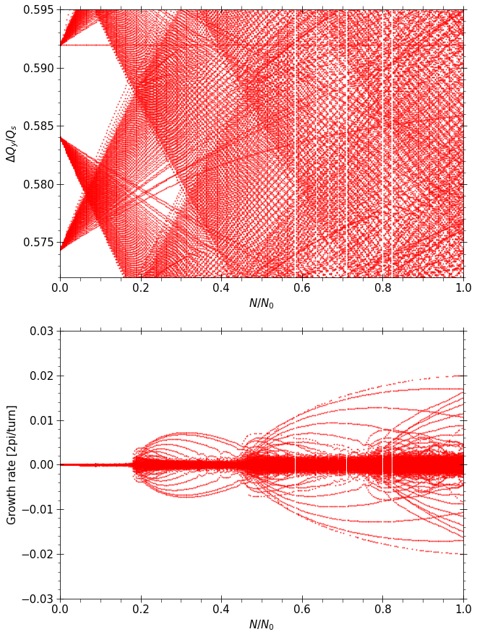
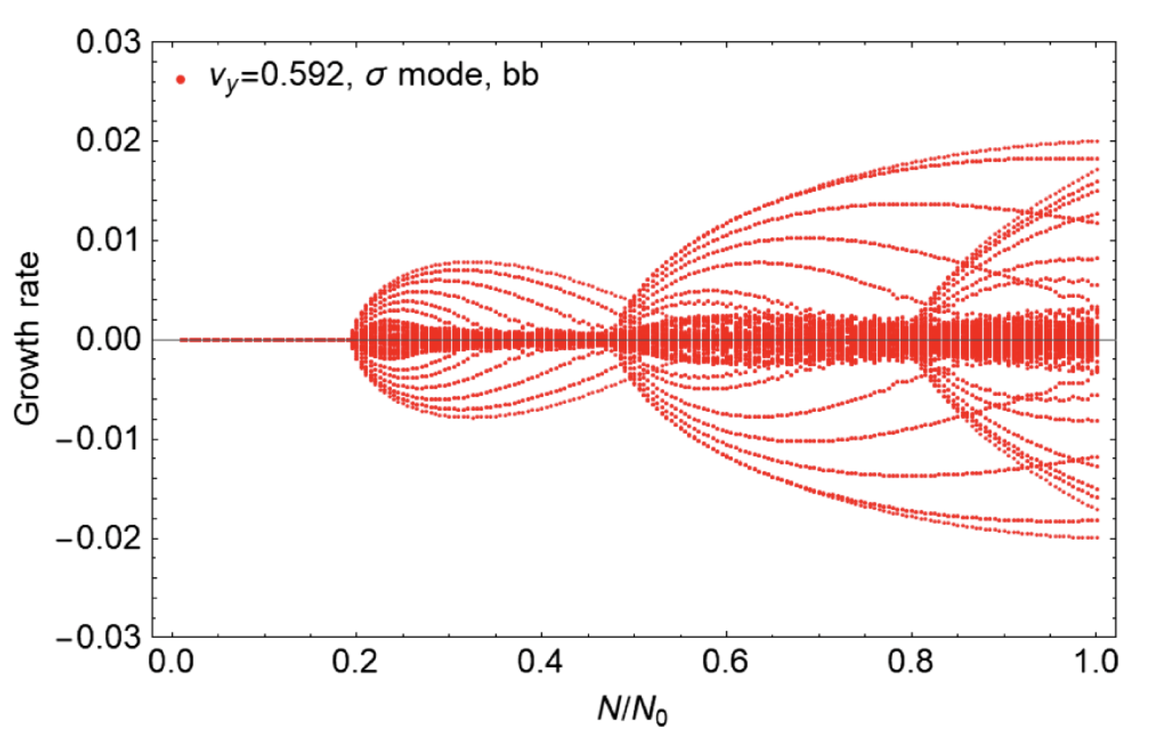
Impedance and beam-beam effects for FCC-ee
BACKUP
Roxána SOÓS
Thursday 6 of March 2025

Slide 31
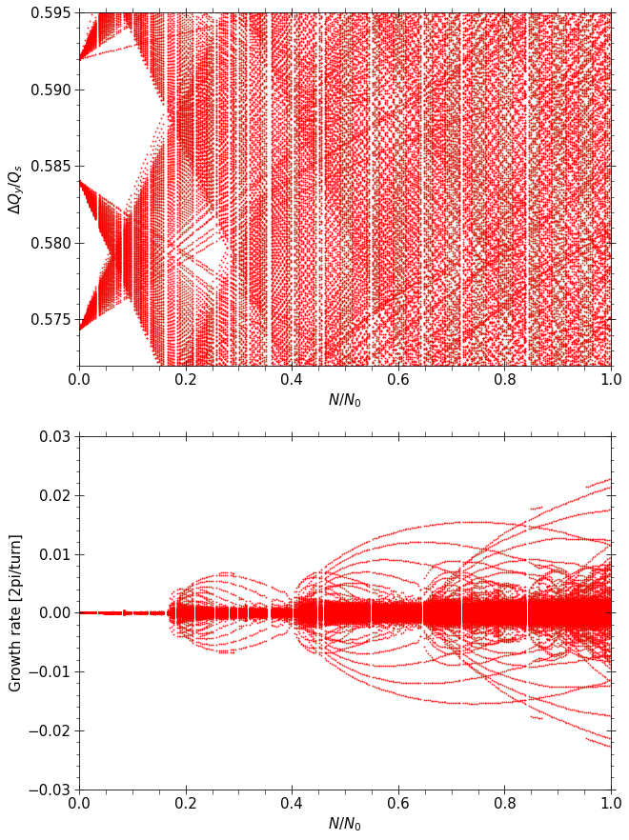
Impedance and beam-beam effects for FCC-ee
BACKUP
Roxána SOÓS
Thursday 6 of March 2025

Slide 32
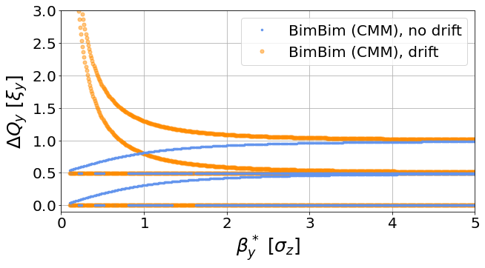

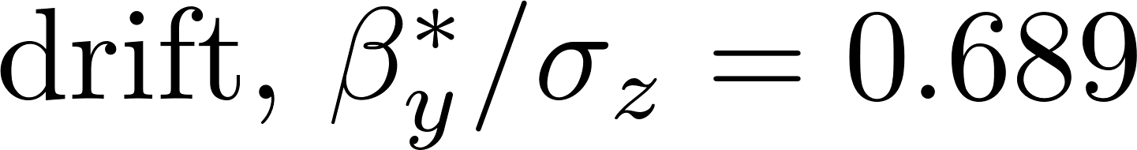
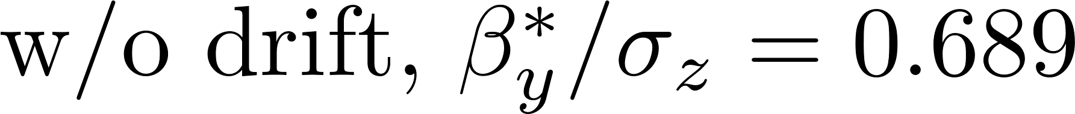
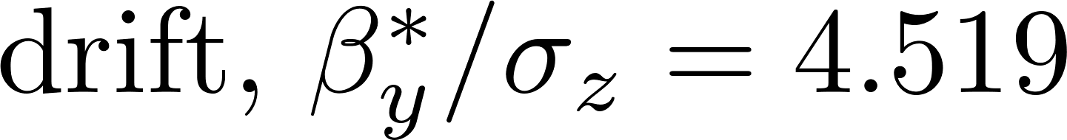
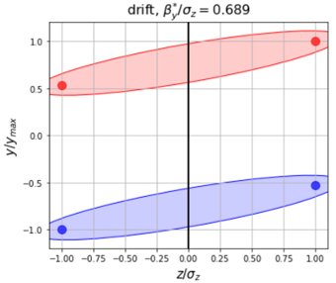
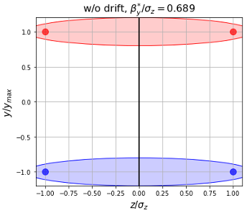
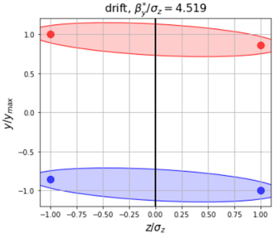

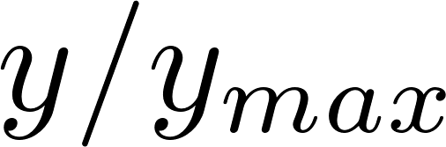

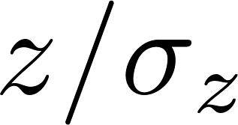
Impedance and beam-beam effects for FCC-ee
BACKUP
mode (out of phase oscillation)
Roxána SOÓS
Thursday 6 of March 2025

Slide 33
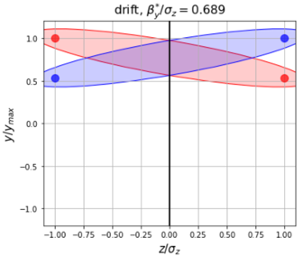
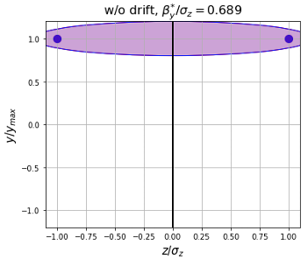
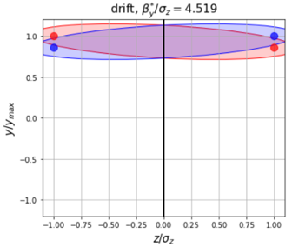
Impedance and beam-beam effects for FCC-ee
BACKUP
Roxána SOÓS
Thursday 6 of March 2025

