Slide 1
EIC Interaction Region Design and Magnets
Christoph Montag
BNL
eeFACT 2025
March 3 – 7, 2025

Slide 2
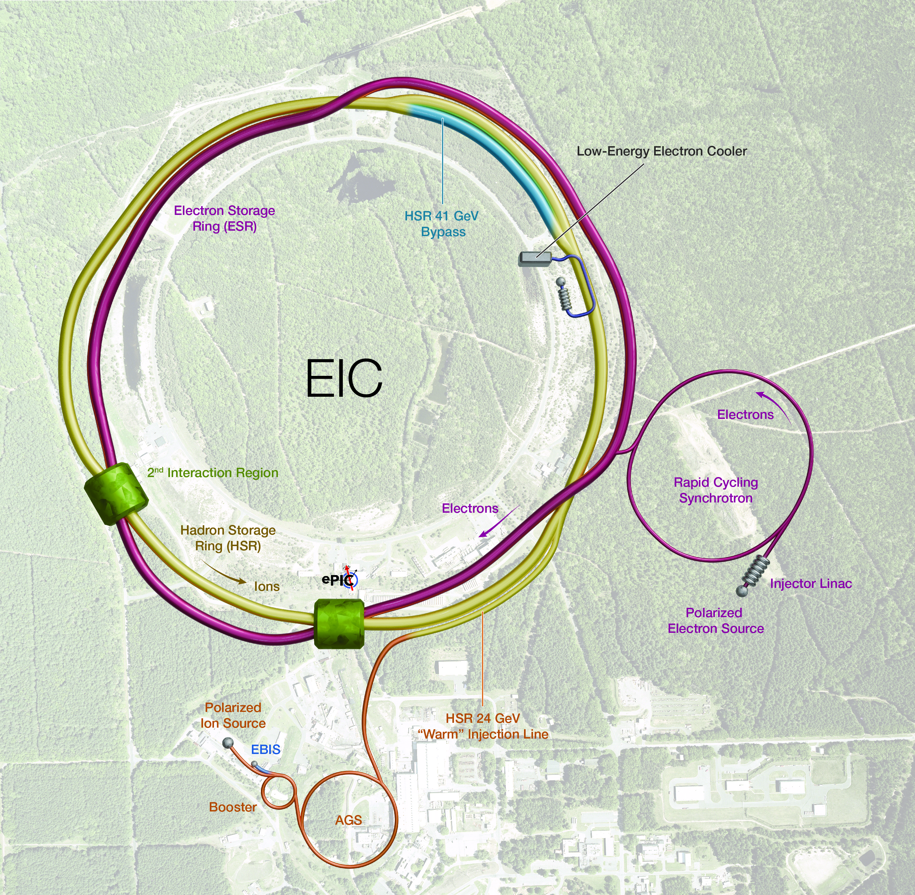
Outline
EIC IR Requirements
IR Overview
Crab Crossing
IR Magnets
Spin Rotators
Summary

Slide 3
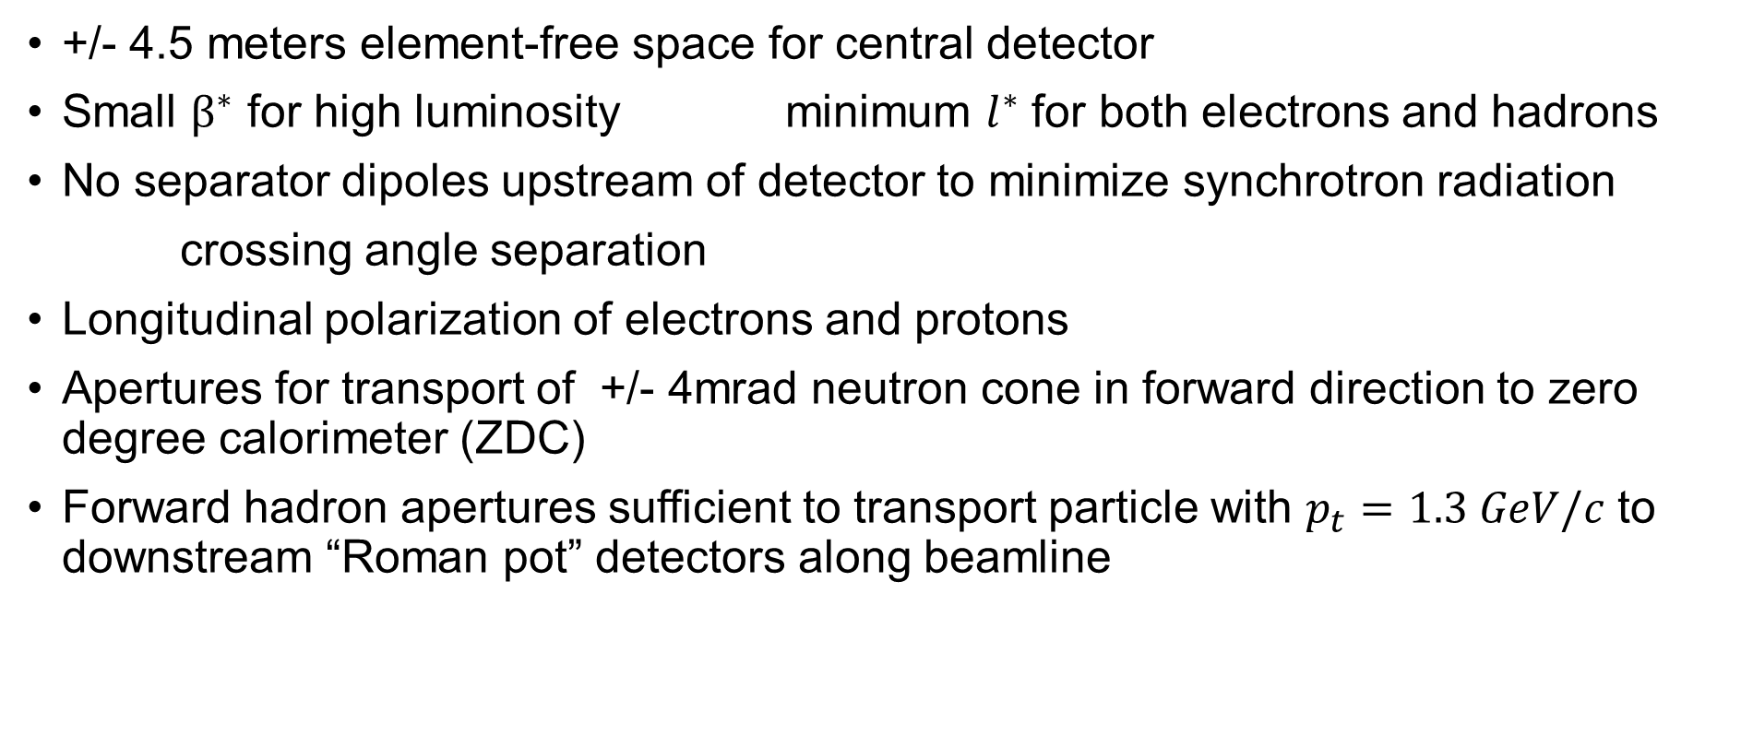
EIC IR Requirements
+/- 4.5 meters element-free space for central detector
Small $β^{∗}$ for high luminosity minimum $l^{∗}$ for both electrons and hadrons
No separator dipoles upstream of detector to minimize synchrotron radiation
crossing angle separation
Longitudinal polarization of electrons and protons
Apertures for transport of +/- 4mrad neutron cone in forward direction to zero degree calorimeter (ZDC)
Forward hadron apertures sufficient to transport particle with $p_{t}=1.3 GeV/c$ to downstream “Roman pot” detectors along beamline

Slide 4
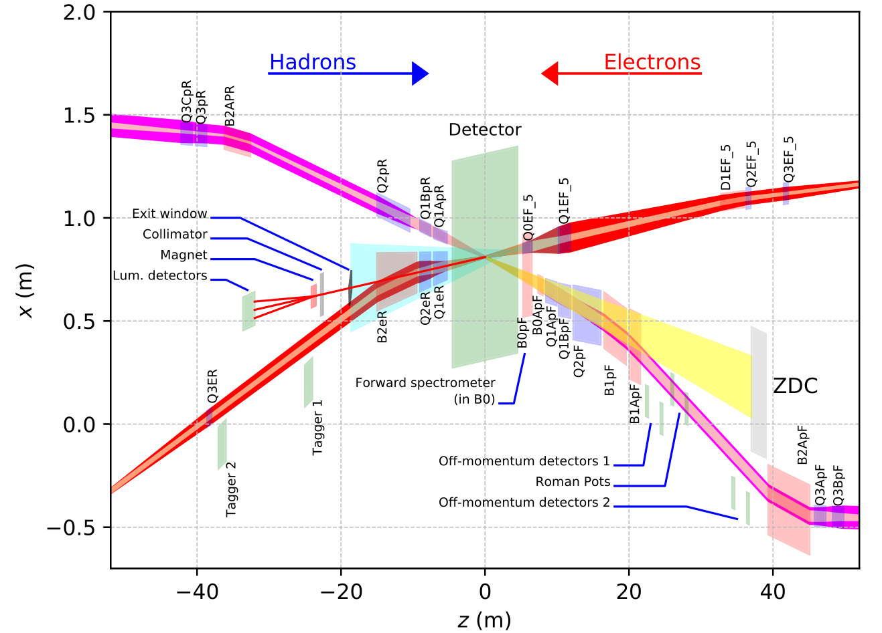
EIC Near-detector IR Layout
High luminosity:
  Small β* for high luminosity
  Limited IR chromaticity contributions
  Large final focus quadrupole aperture
  Physics requirements:
  Large detector acceptance for forward-scattered particles, and safe passing of synchrotron radiation fan – even larger magnet apertures
  Forward spectrometer
  No machine elements within +/- 4.5m from the IP
  Space for luminosity detector, neutron detector, “Roman Pots”
Multi-stage separation:
Electrons from protons – 25 mrad crossing angle
Protons from neutrons – separator dipole
Electrons from Bethe-Heitler photons for luminosity monitoring – separator dipole

Slide 5
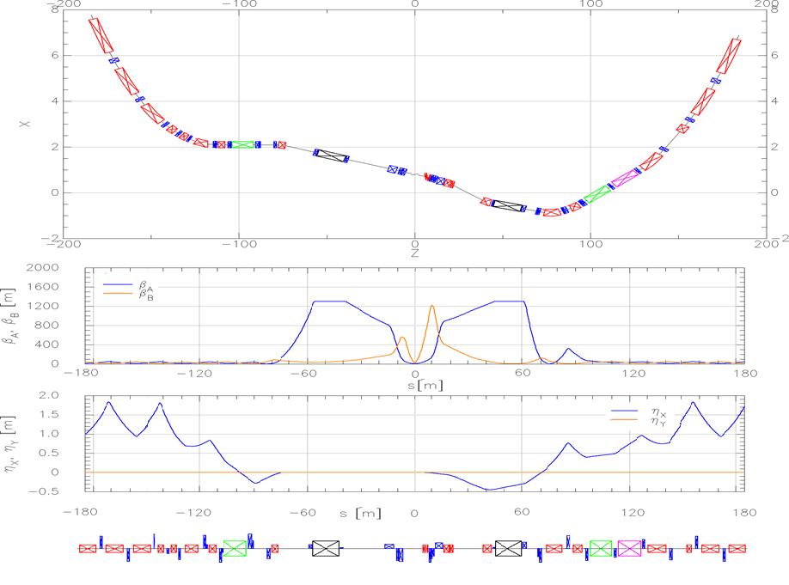
Crab Crossing
25 mrad total crossing angle needs to be compensated by crab cavities for BOTH beams
Local crabbing scheme with crab cavities on either side of the IP constrains IR optics – 90 degree phase advance between IP and crab cavity, and large β to reduce required voltage
Hadron IR optics with β = 1300 m at crabs

Slide 6
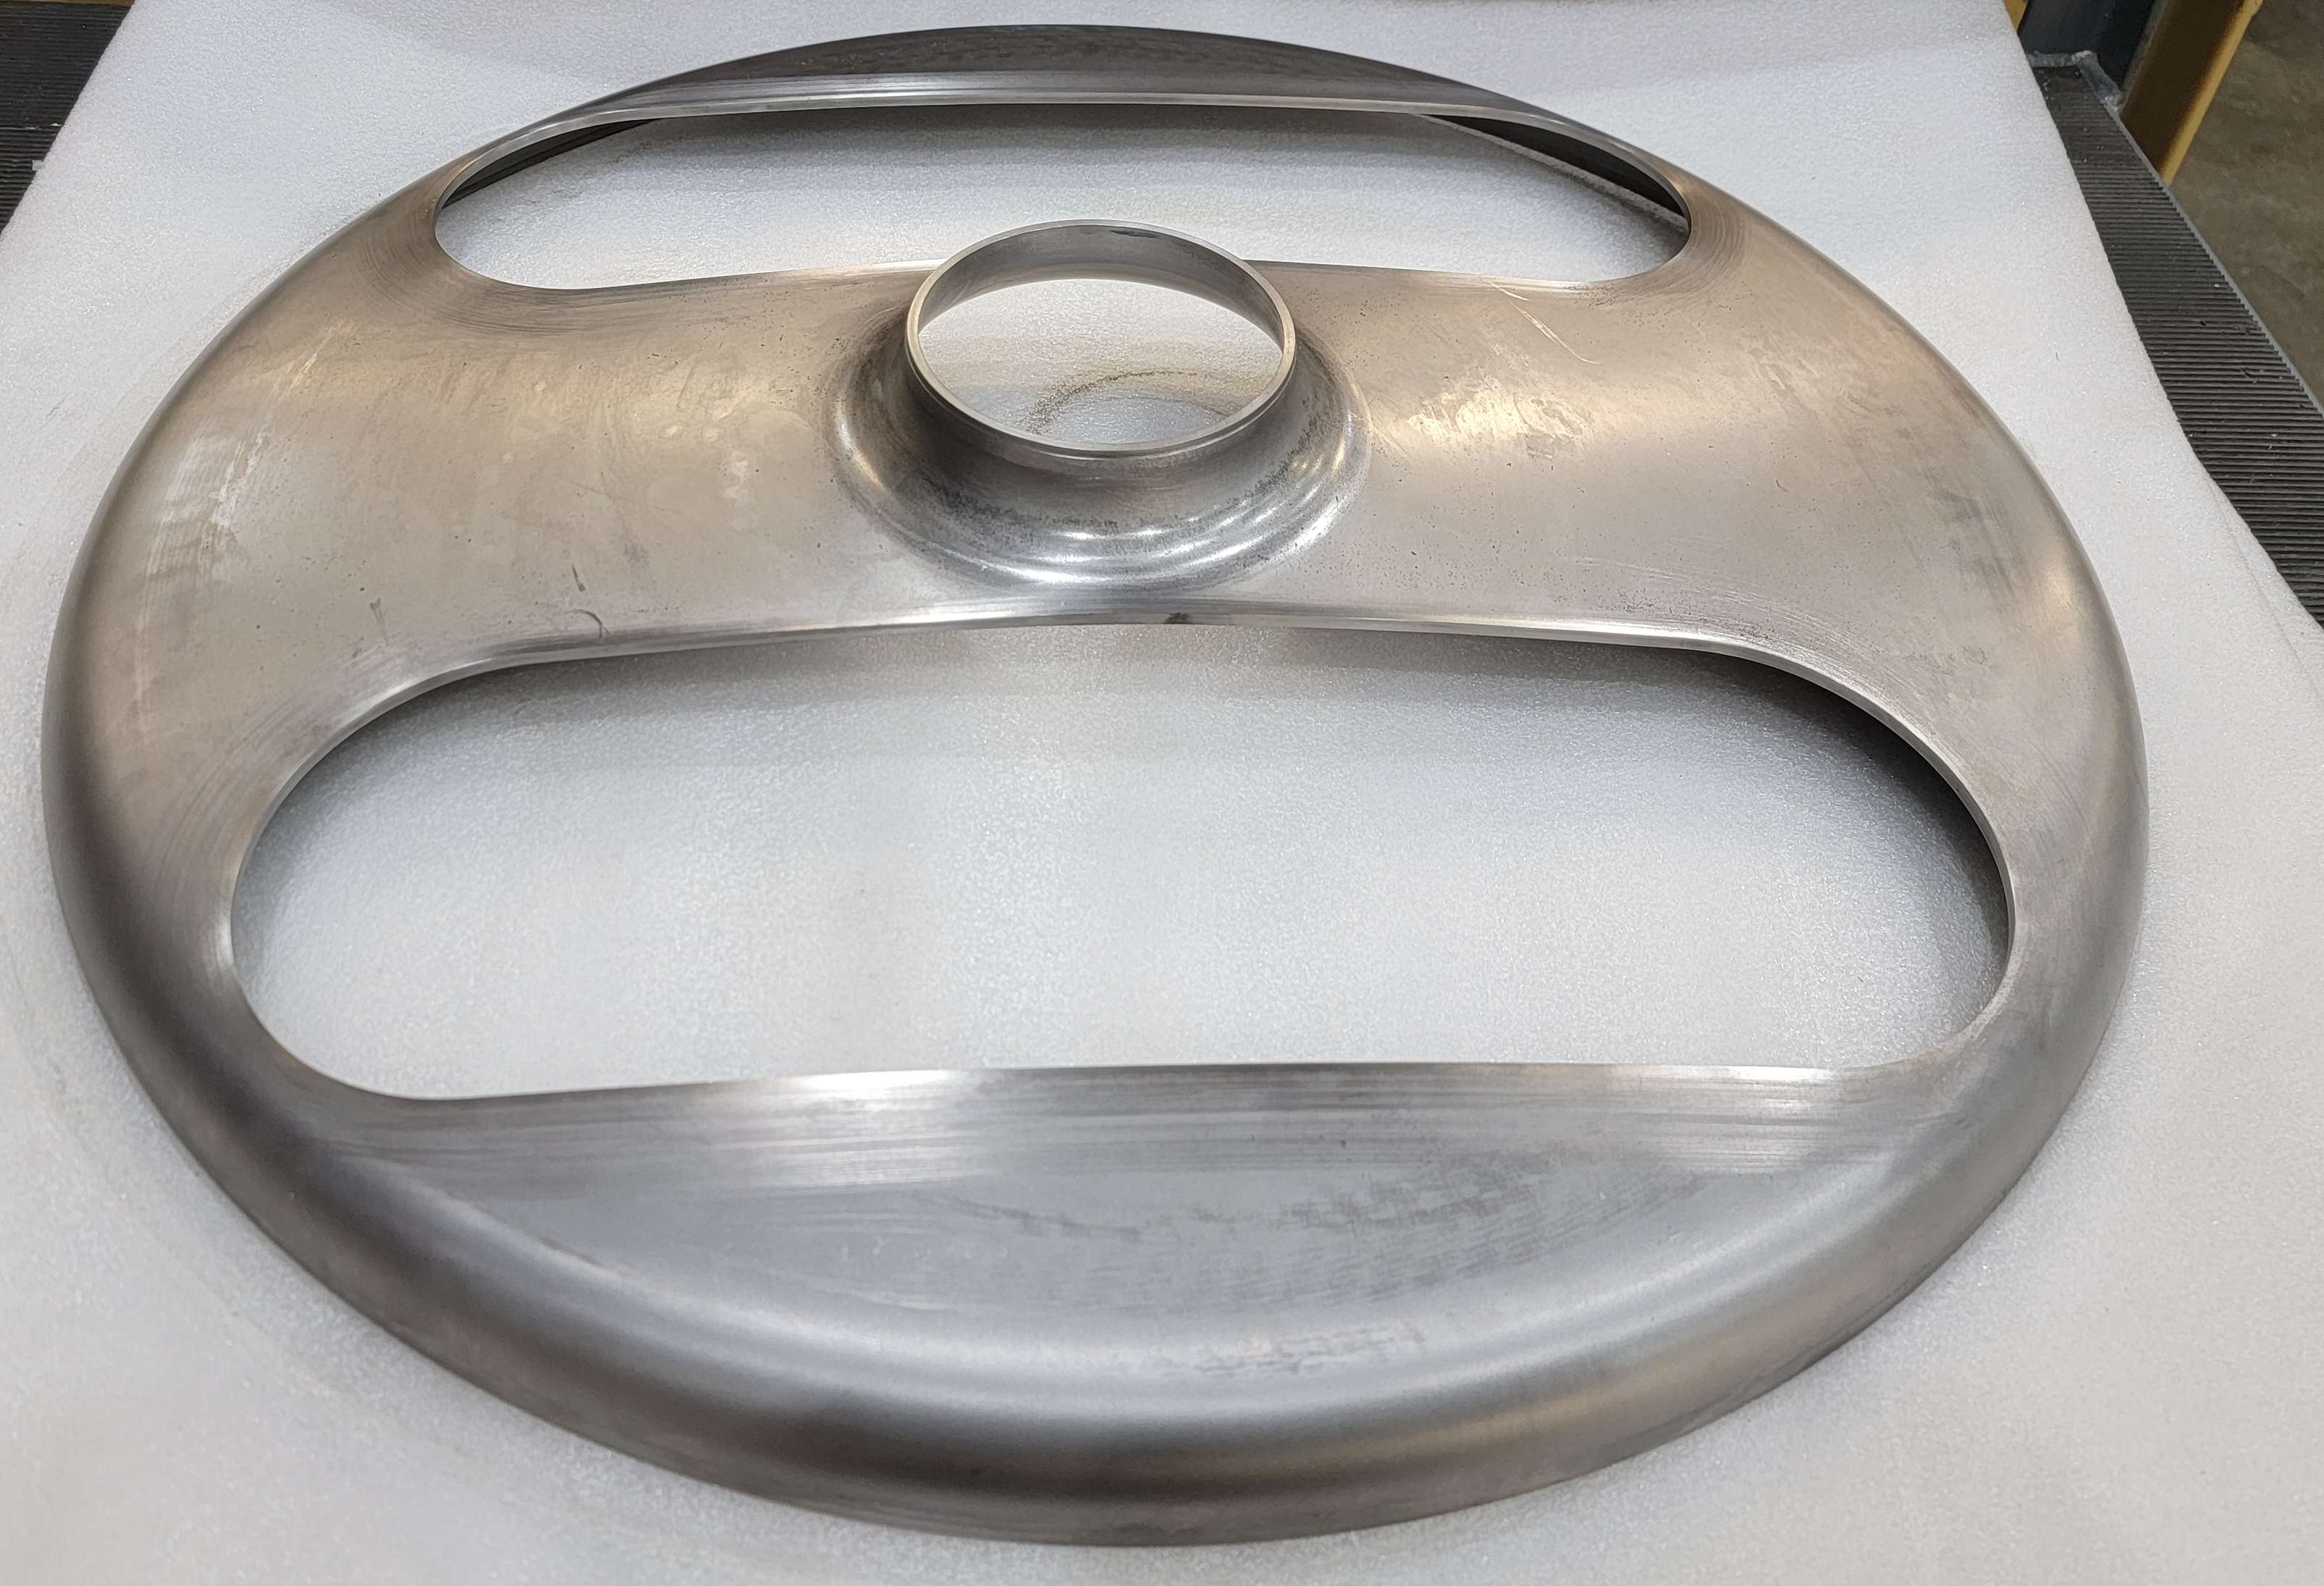
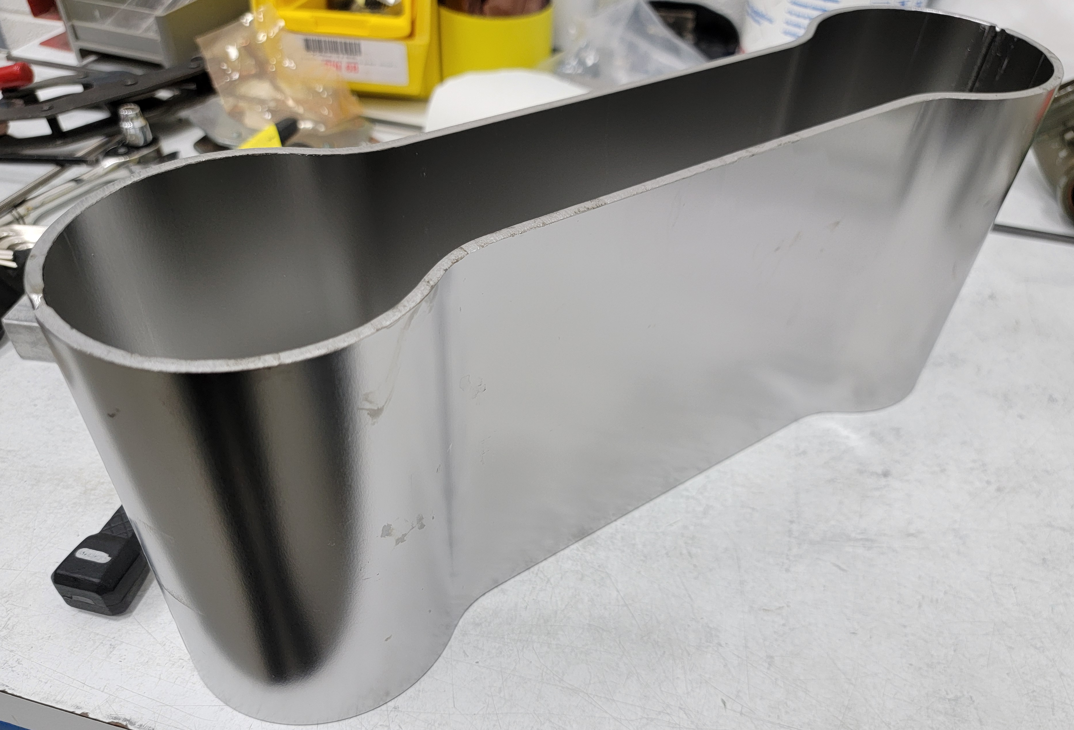
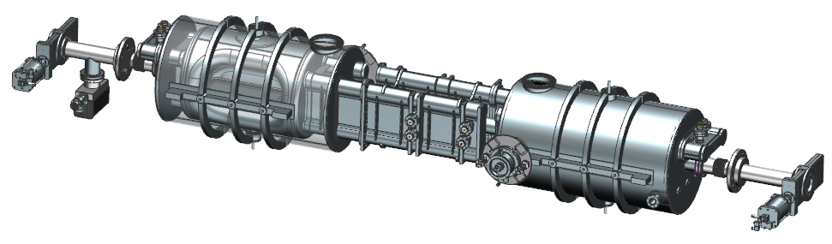
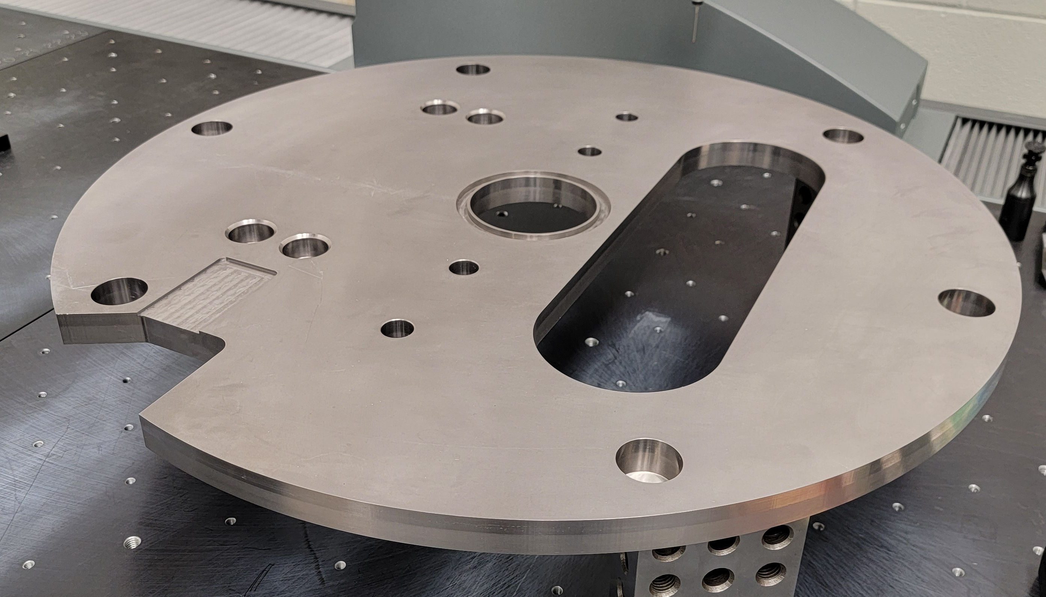
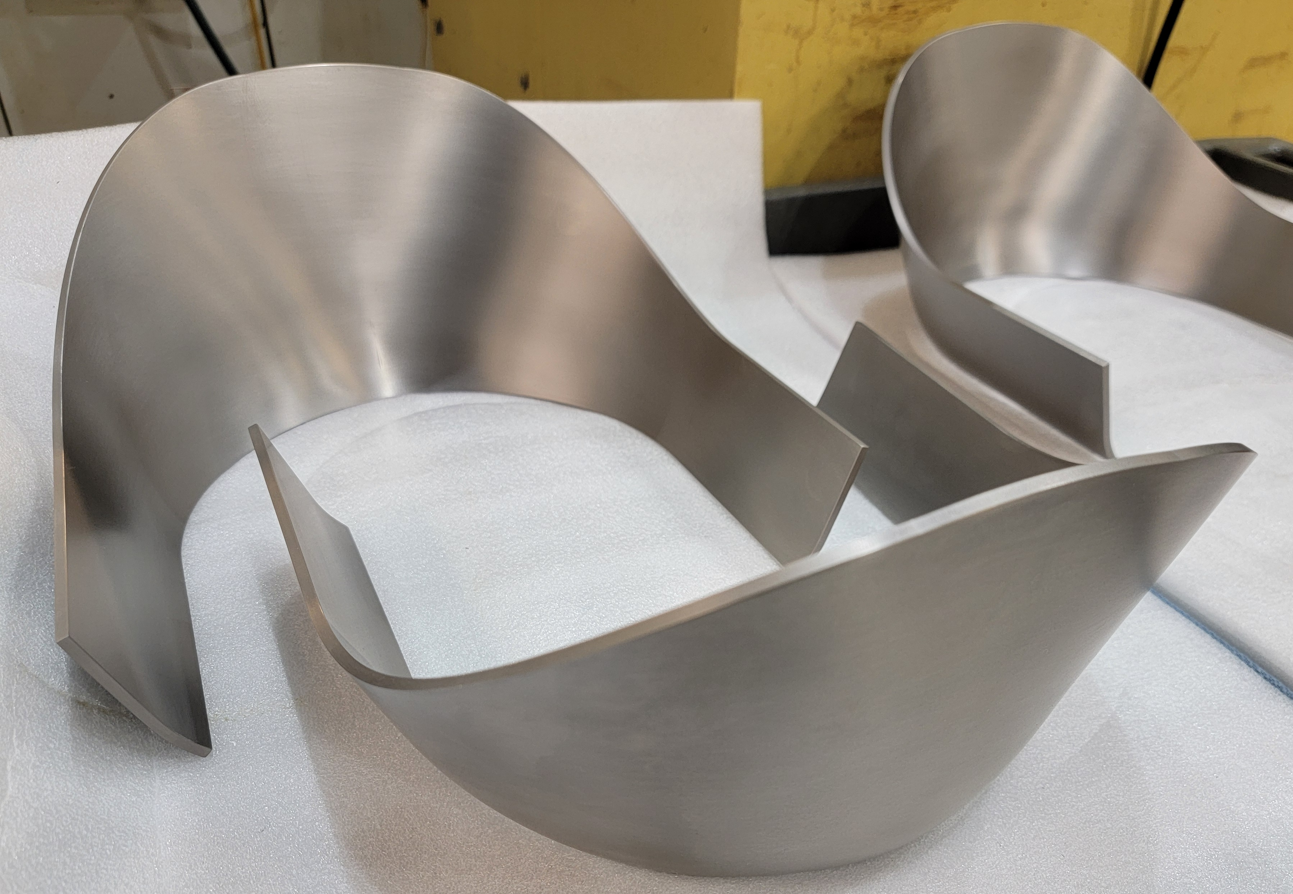
197 MHz Crab Cavity - Design & Prototyping
Cryomodule
Each cryomodule has two 197 MHz crab cavities
HOM Dampers are installed on superconducting ‘dogbone’ waveguides, shown between the cavities
The size of the cavities and cryomodule create challenges in assembly and integration into the tunnel
The cavity string went through a Preliminary Design Review in 2024
Design Verification Component (DVC)
A prototype (DVC) cavity is being fabricated in-house at JLab
The cavity will be tested at 2K in the JLab VTA
EBW of niobium parts for the cavity is currently underway
197 MHz Cavity String

Slide 7
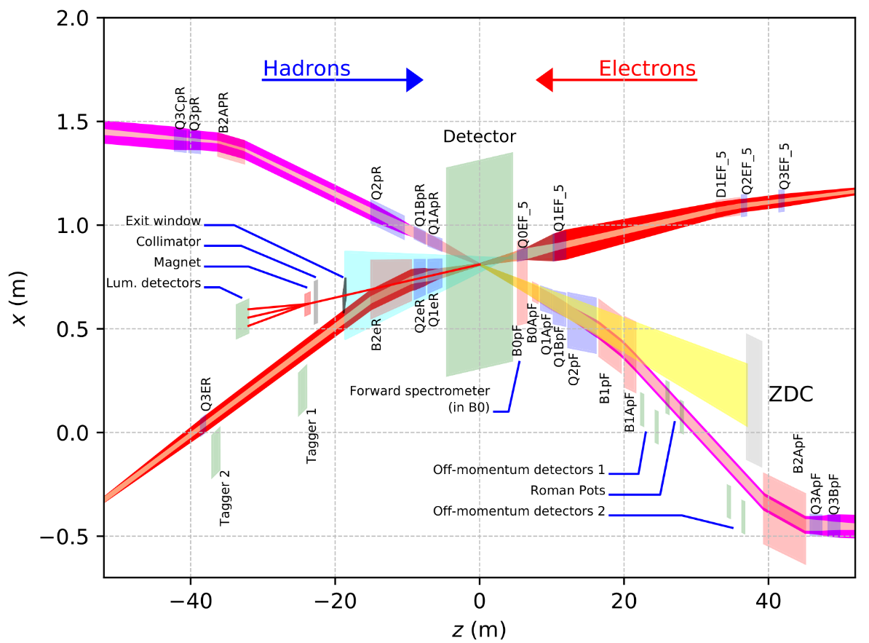
EIC IR Magnet Overview
Rear
Forward
Collared magnets: Q1ApF, Q1BpF, Q2pF, B1pF, B1ApF
CCT Magnets: Q1ApR, Q1eR, B0ApF
Other magnets: serpentine pattern
Each rectangle: required minimum aperture, not magnet size
Things are tight – Tapered CCT magnets to solve (some) of the issues

Slide 8
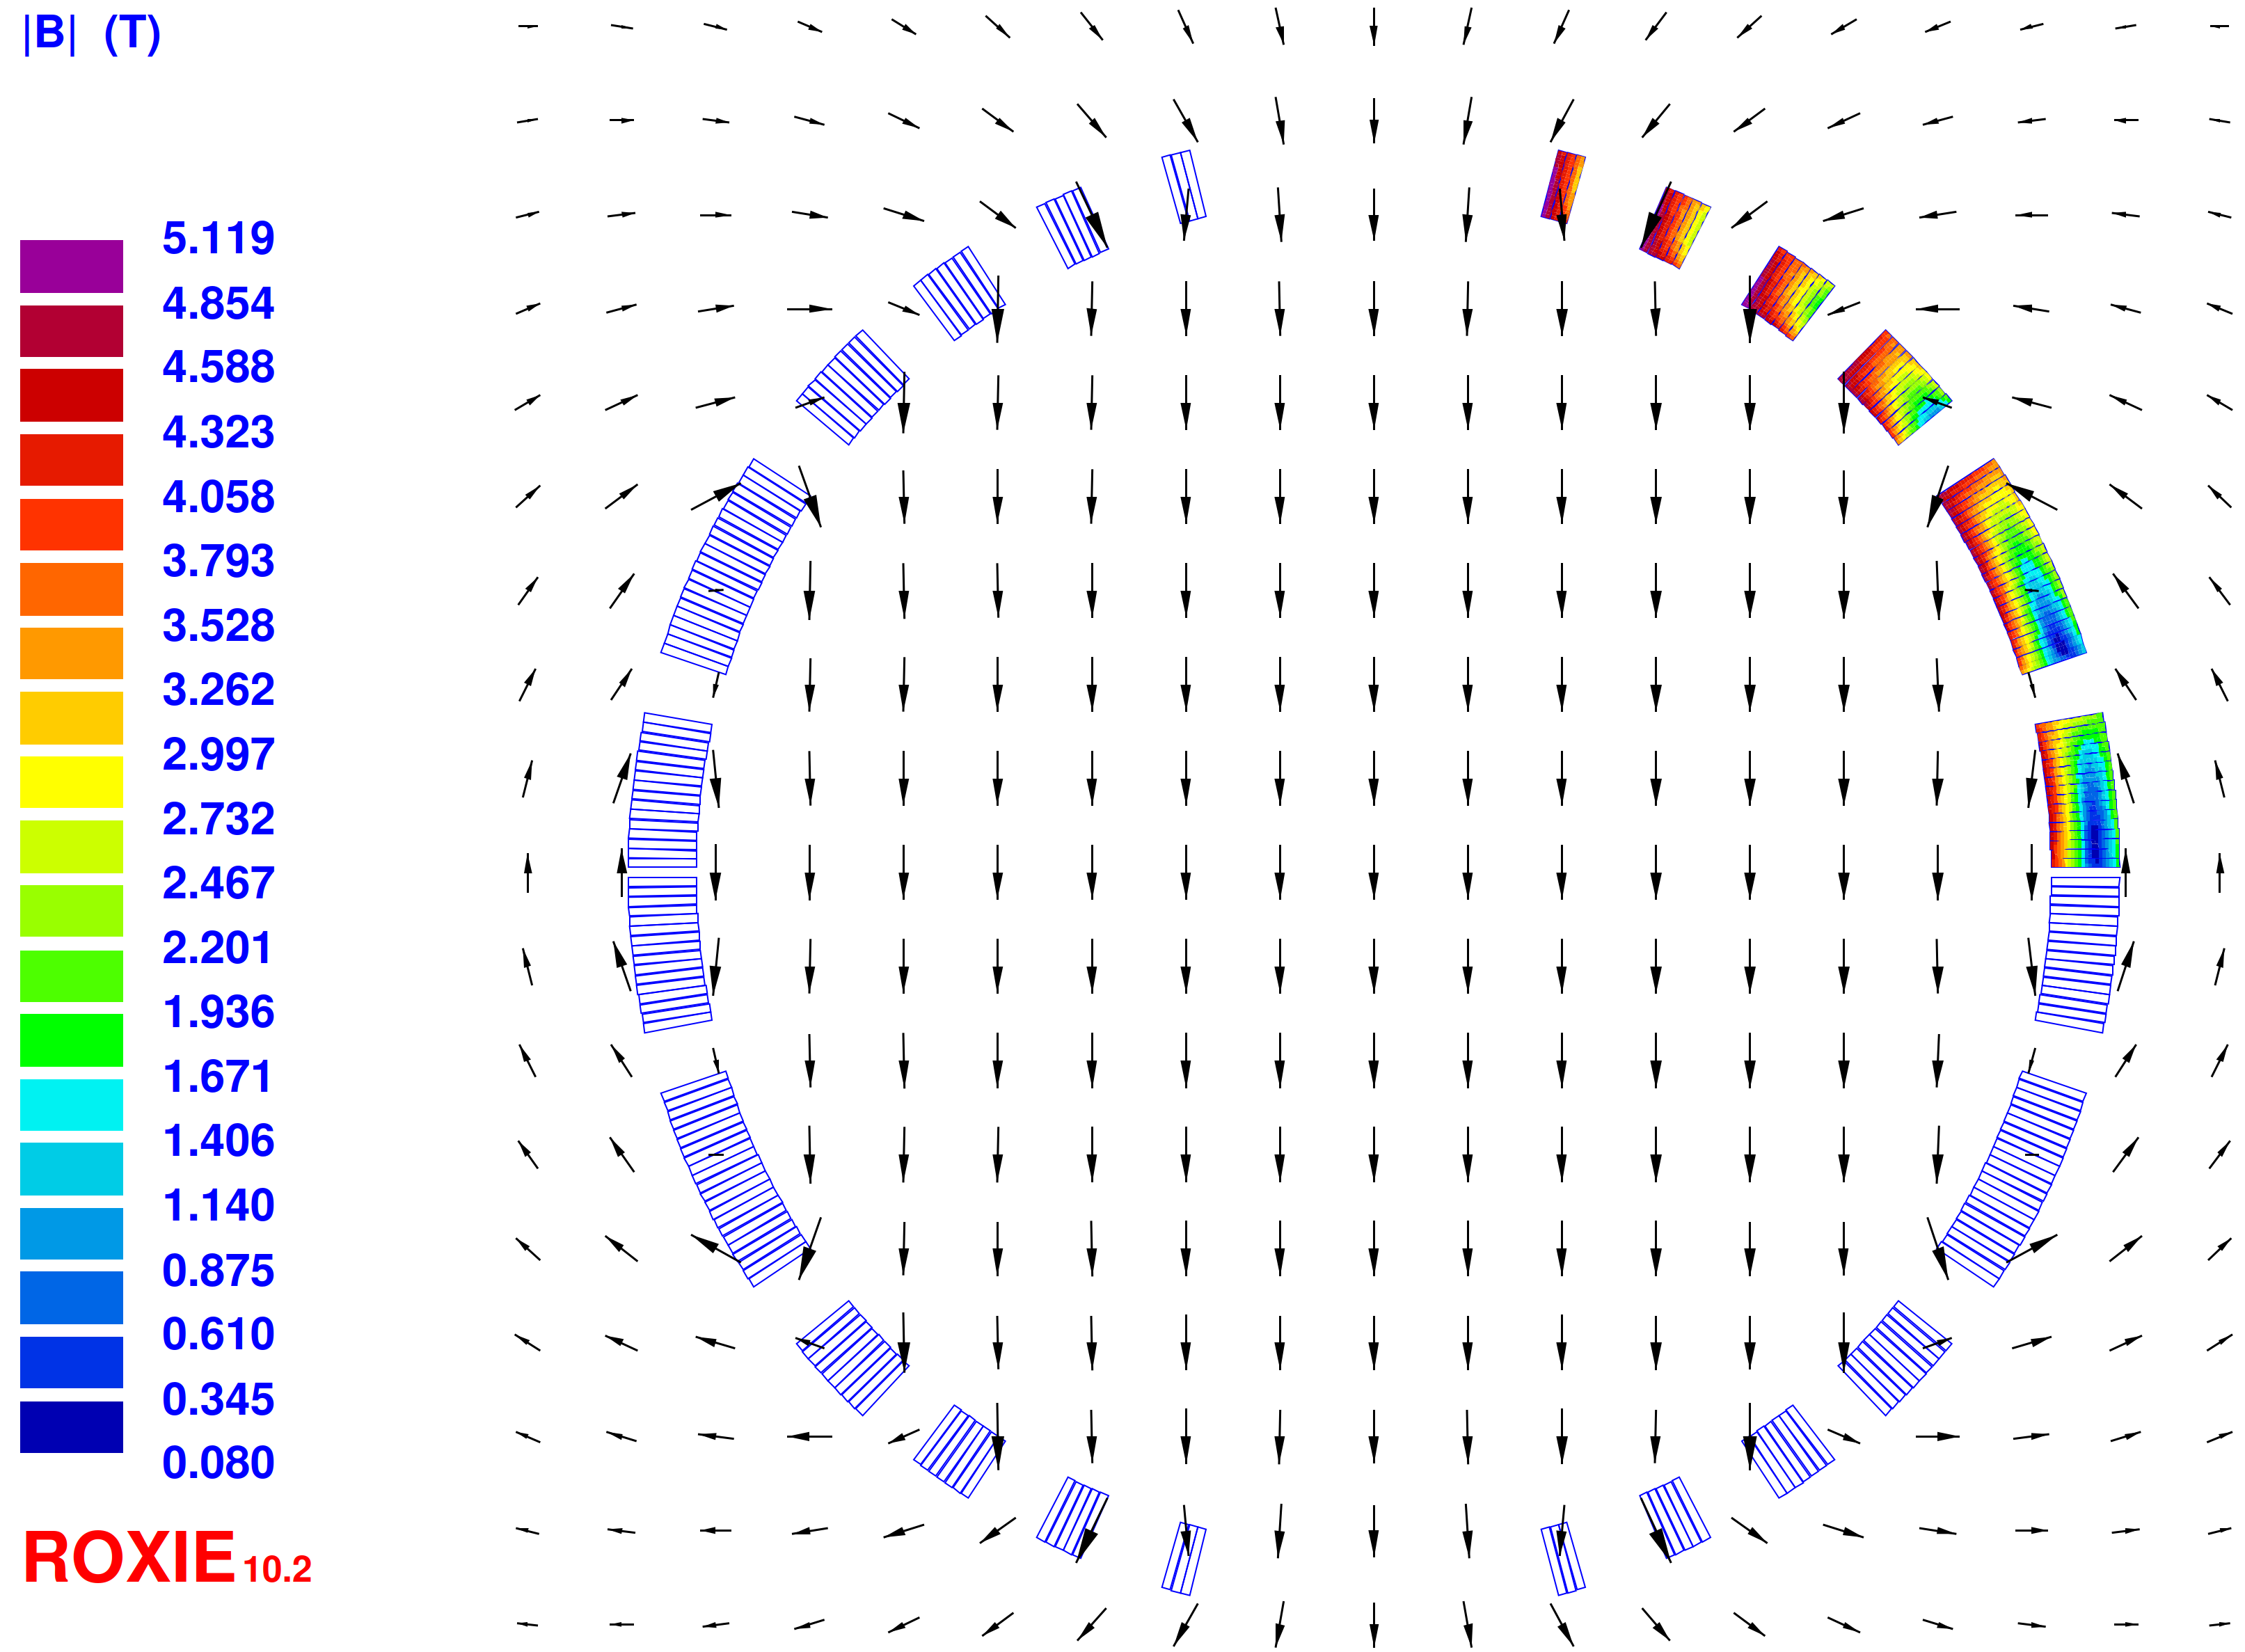
B1pF – Prototype Collared Magnet
Design Goals
Parameter | Requirement
Nominal Integrated Field | 10.344 T.m
Total slot length | 3.0 m
Aperture radius | 150 mm
Reference Radius | 75 mm
Operating Temperature | 1.9 K
Harmonics | All <1 unit
Field in electron beam tube | As low as possible
Optimized coil specs
Magnet Cross-section | Value
Number of Conductors per quadrant | 63
Margin on the loadline | 42.4 %
Reference Radius | 75 mm
Nominal Current | 11900 A
Central Field (R_{ref}=75 mm) | 4.128 T
Diff. Inductance | 26.7 mH
Max. peak field (on block 6) | 5.1 T
Stored energy | 1.89 MJ

Slide 9
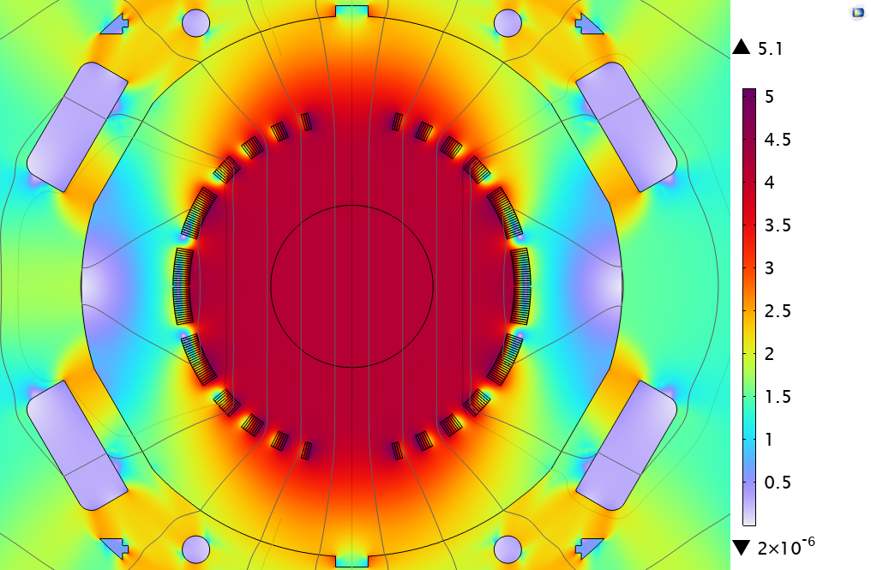
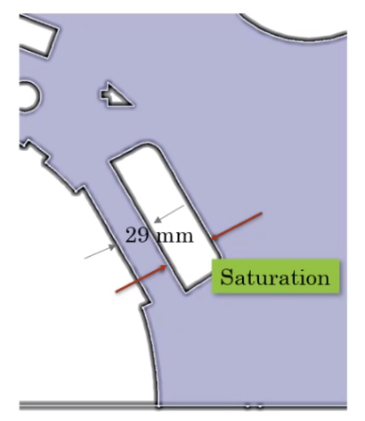
Shimming – Tunability
Using two shims in dedicated cutouts, b3 can be tuned by a range of (+9.8→ -8.6) units
B5 can be tuned to (+0.5→-1.0) units
Additional tunability can be achieved by adding further shims on the coil wedges
Harmonics as a function of Shim 1 depth

Slide 10
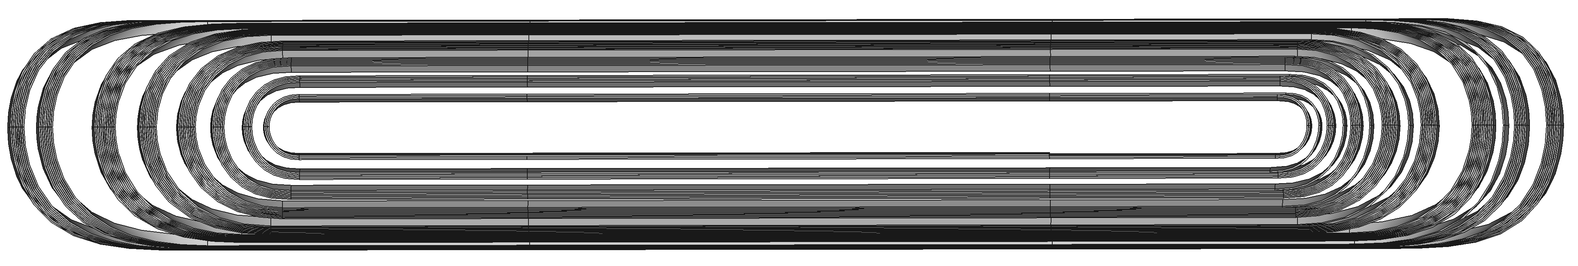
3D Coil End Design
Magnetic length = 2613 mm
Notes:
https://brookhavenlab-my.sharepoint.com/personal/fkurian_bnl_gov/Documents/Documents/EIC/B1pF/Review_April24/OperaHarmonics.xlsx?web=1

Slide 11
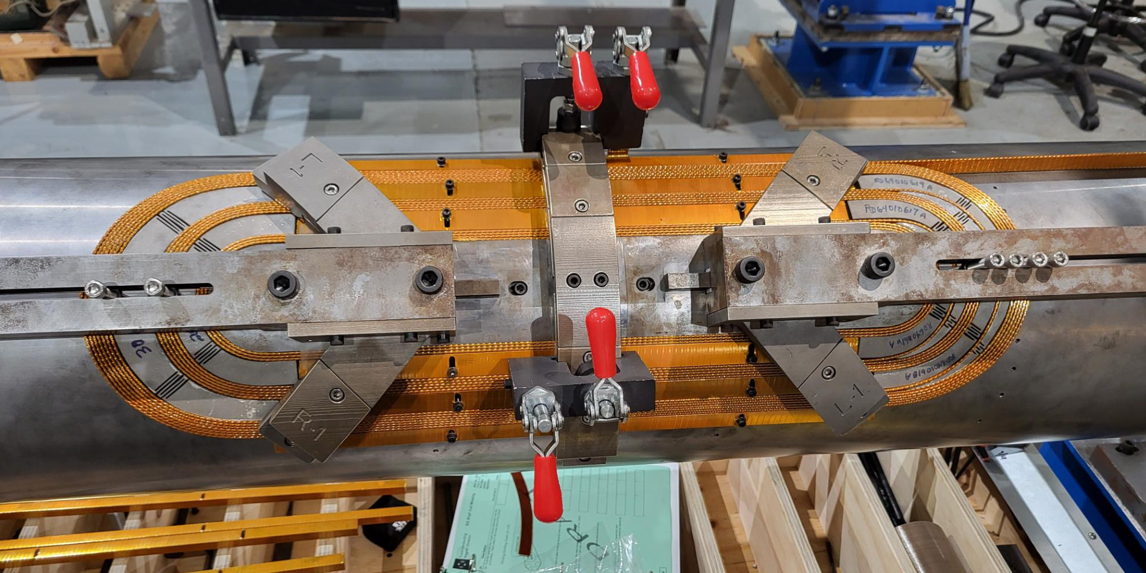
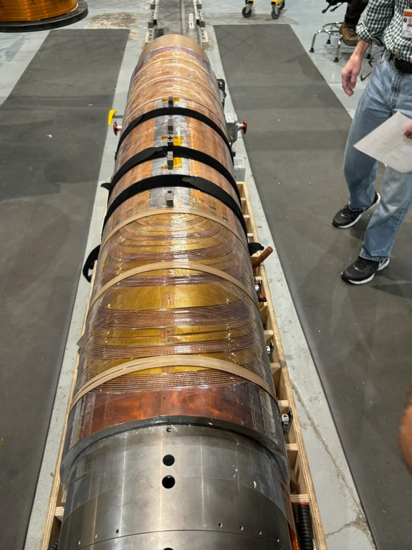
SC Magnet Updates: Current status of B1pF prototype
Shown below are pictures of the B1pF Cable magnet prototyping effort underway at SMD.
The image on the right is a complete half length coil just prior to being moved into the curing press.
Shown above is a test wind that was performed in July/Aug 2024

Slide 12
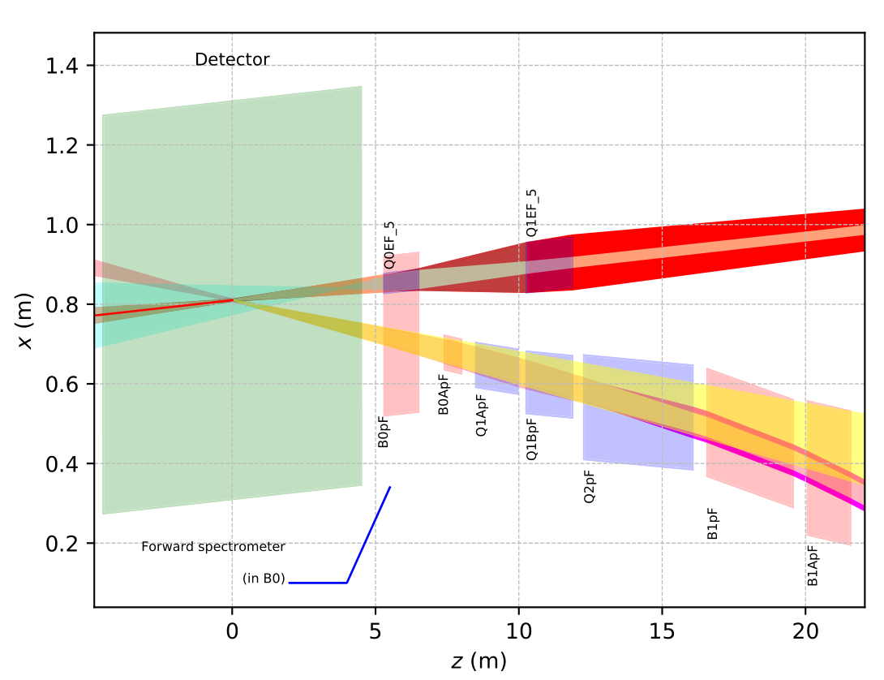
Tapered CCT Magnets Hadron Forward Side
Idea: replace hadron forward collared magnets
Instead of 5 collared magnets: 3 tapered CCT magnets
  Q1ABpF
  Q2pF
  B1/B1ApF
Technically and financially attractive
  Eliminates/reduces beam going through quads at an angle/off center
  Frontloading of gradient
  Reduces crosstalk
Electrons
IP
Hadrons

Slide 13
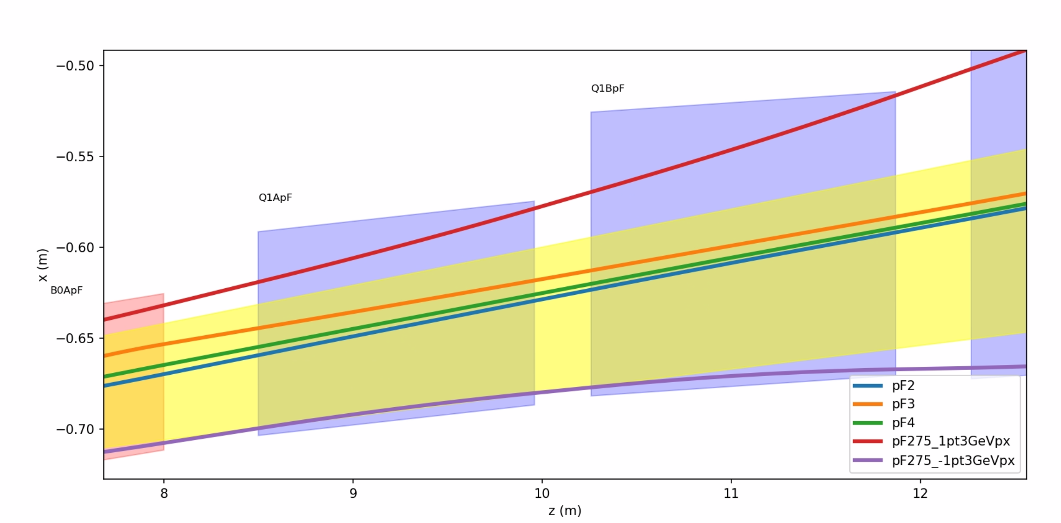
Q1ABpF – New Magnet Concept
Recombining Q1ApF and Q1BpF
(similar for other magnets)
 | L (m) | G (T/m)
Q1ApF | 1.46 | -77.903
Q1BpF | 1.61 | -63.028
275 GeV
41 GeV
100 GeV
275 GeV +1.3 GeV p_{x}
275 GeV -1.3 GeV p_{x}
New magnet – Q1ABpF
Advantages: No end plates, making use of additional space between magnets
Smaller aperture at IP side, can tune field/gradient for crosstalk

Slide 14
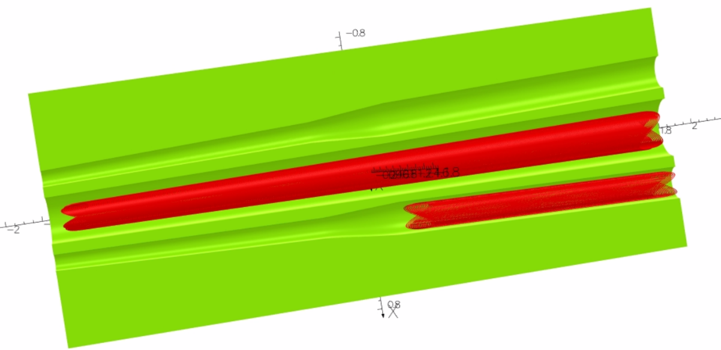
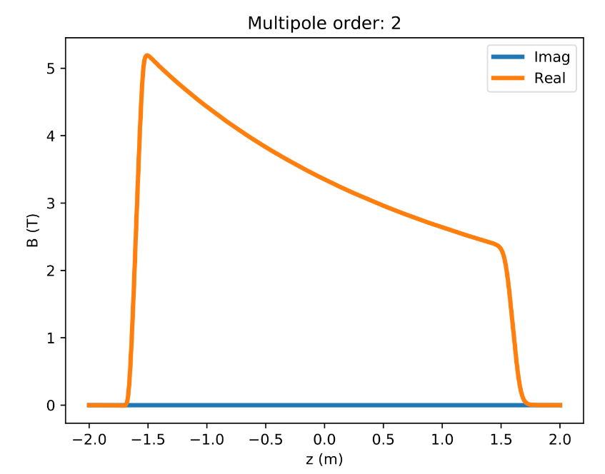
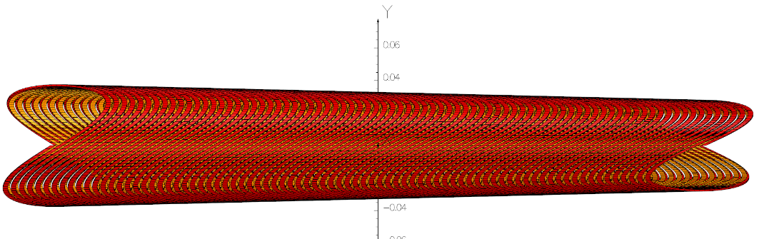
Q1ABpF: Implementation
CCT
  Allows to cancel unwanted harmonics
  Modulation of gradient
Frontloading of gradient
Helps crosstalk / field quality
  Better utilization of space
  Can tailor maximum gradient
Challenges
  Need to prove that this works mechanically
  (no collar)
Requirements
  Integrated gradient 215T
  Very good field quality
Design needs to be updated
  Q1ABpF prototype experience
3.5m
Q1ABpF
Q1eF
Radius=59mm..93mm
J_{Σ}
100 → 50 T/m
J₁
J₂
R=50mm

Slide 15
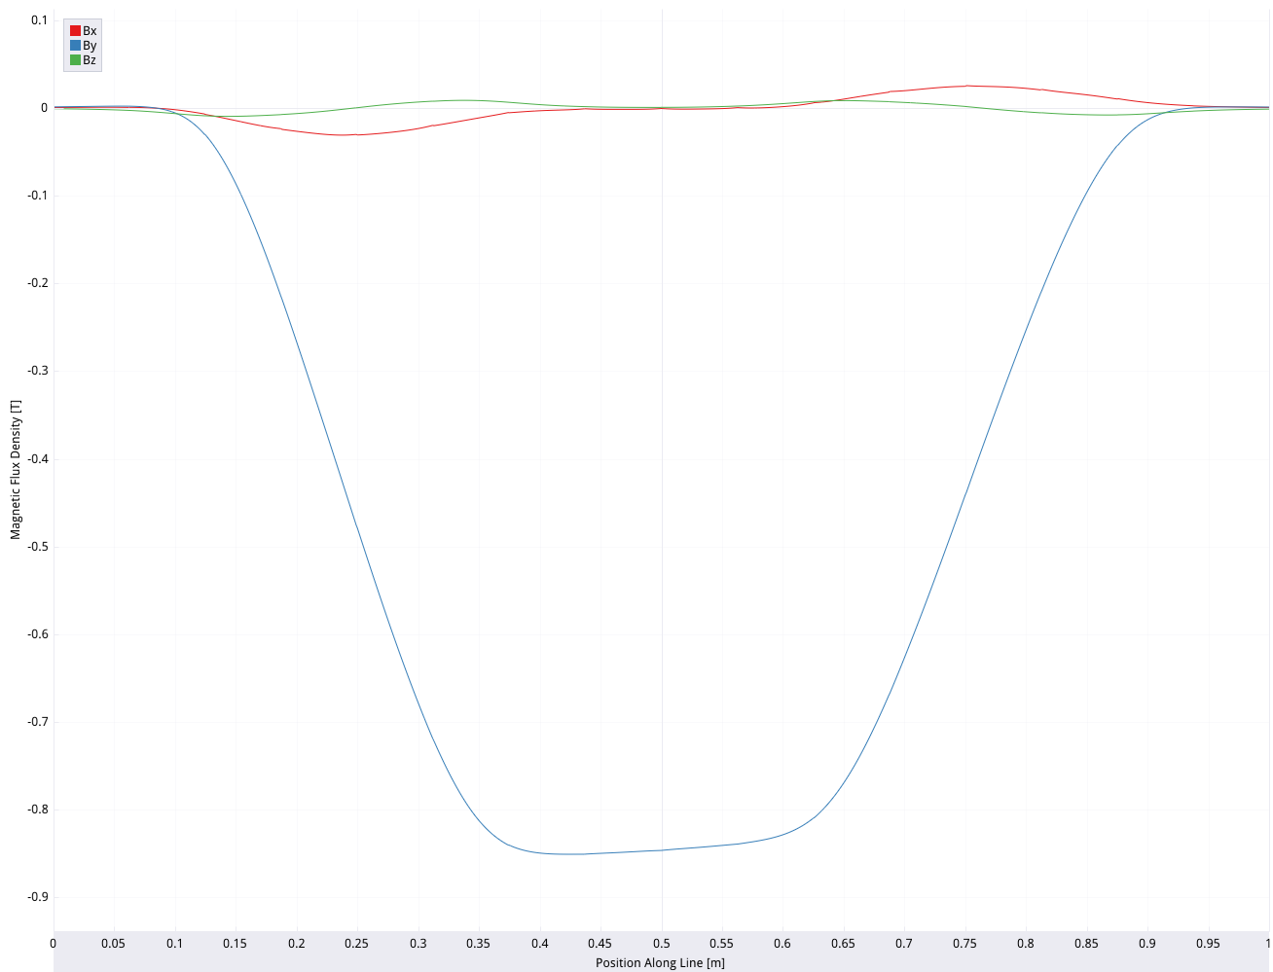
Q1ABpF – Short Prototype
Short Q1ABpF: driven by schedule considerations
Design features
  ~0.84m from IP end
    High gradient/field
  Can be done with cable/strand at hand
  Reduction of layers from 16 to 12
    Accomplished by adjusting spacing/tilt angle
    Reduces winding time
    Crosstalk
Goals
  Demonstrate feasibility of Q1ABpF (full length version)
  Feasibility of large aperture, high gradient direct wind quadrupole
0.8m
Length=0.8m
L=86.7mH
I=1360A
E=80kJ
87T/m

Slide 16
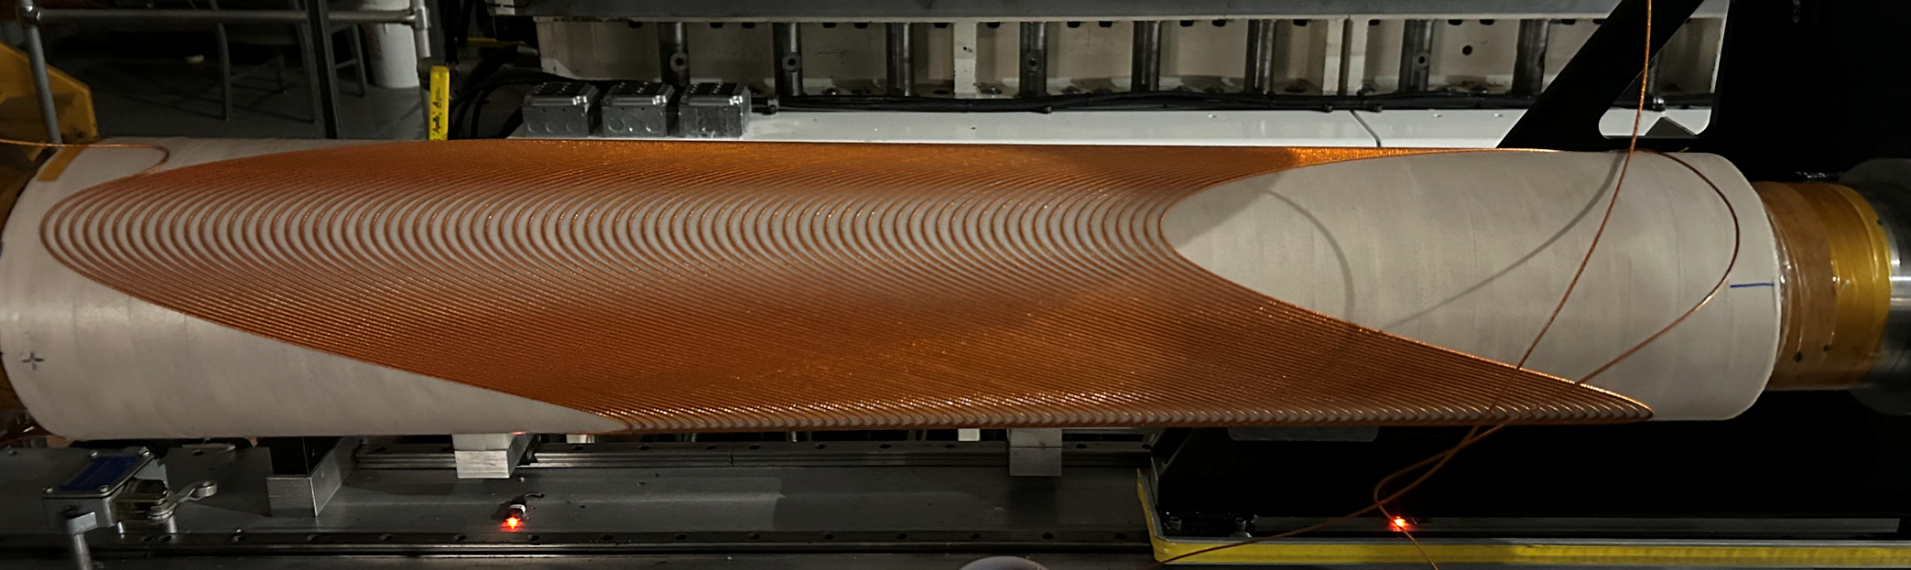
SC Magnet Updates : Current status of Q1ABpF
Tapered dipole
All 12 layers successfully completed in February
First layer

Slide 17
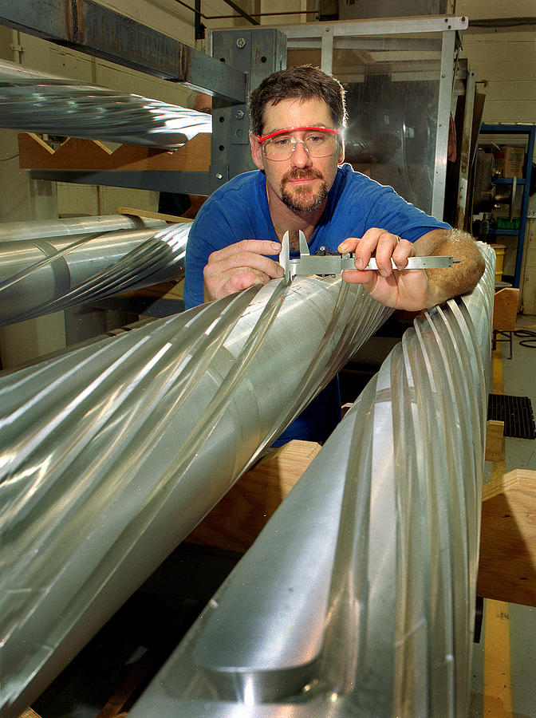
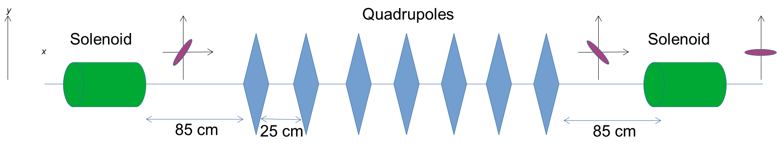
Spin Rotators
Hadron spin rotators are based on helical dipoles – same as RHIC
Electron spin rotators are based on superconducting solenoids – one set for 5 GeV (lowest energy) and one set for 18 GeV (highest)
Each solenoid is split into two halves with normal-conducting quads in-between for local decoupling (no skew quads)

Slide 18
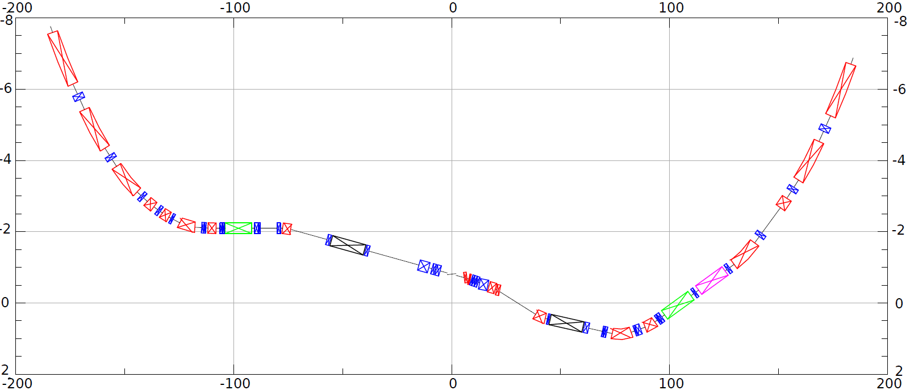
HSR layout in IR6
h
HSR Arc
Crab–in
HSR Arc
Crab –out
Spin
Rotator
Snake
Off momentum Detectors
Spin Rotator
matching
matching
ESR Lumi-Monitor
Zero Deg Calorimeter
Approximate ESR path
Nov 2021 layout

Slide 19
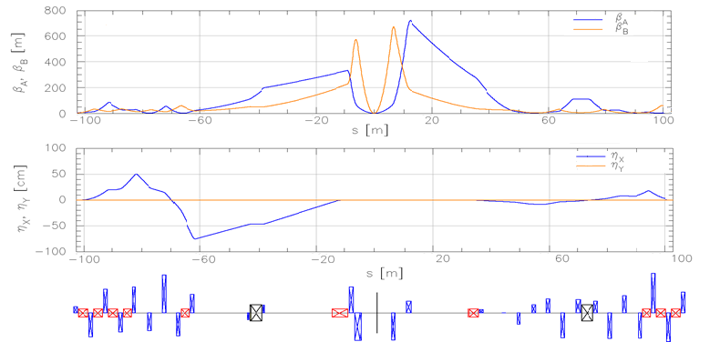
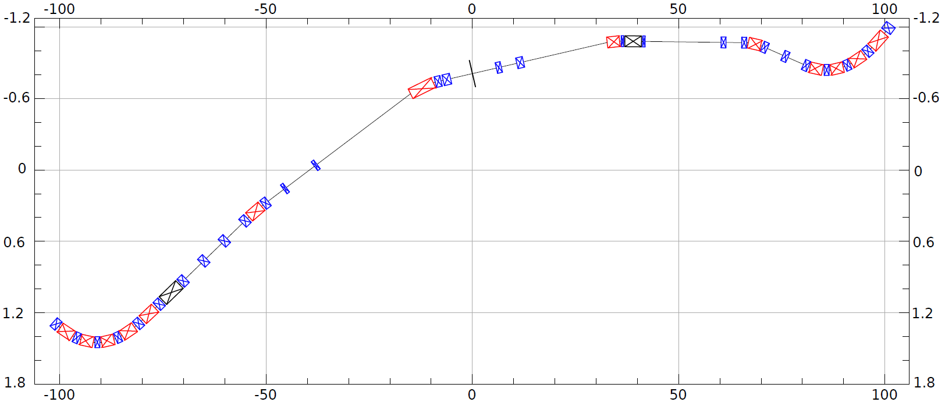
ESR layout in IR6
e
~130m
Spin Rotation Solenoids
6GeV
Crab –in
IP Focusing
18GeV
Lumi-Monitor
B2eR
~130m
Spin Rotation Solenoids
E-taggers
Polarimeter Laser
Detector region
B1eF
Crabbed beam.
Crab–out

Slide 20
Summary
EIC Interaction Region is challenging due to:
High luminosity
+/- 5 m machine-element free zone around interaction point
Large forward acceptance requirements
Large 25 mrad crossing angle
Crab crossing of hadrons (up to 275 GeV protons)
Geometric constraints for electron spin rotators - in an existing tunnel with the hadron ring already largely in place
Thank you!

Slide 21
Backup Slides

Slide 22
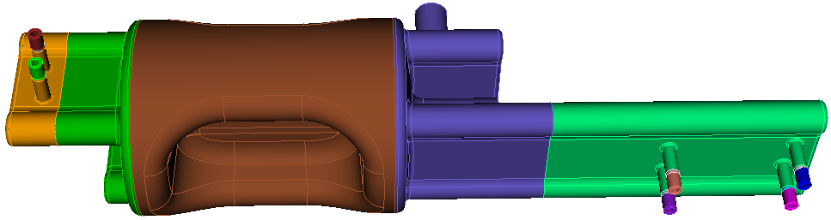
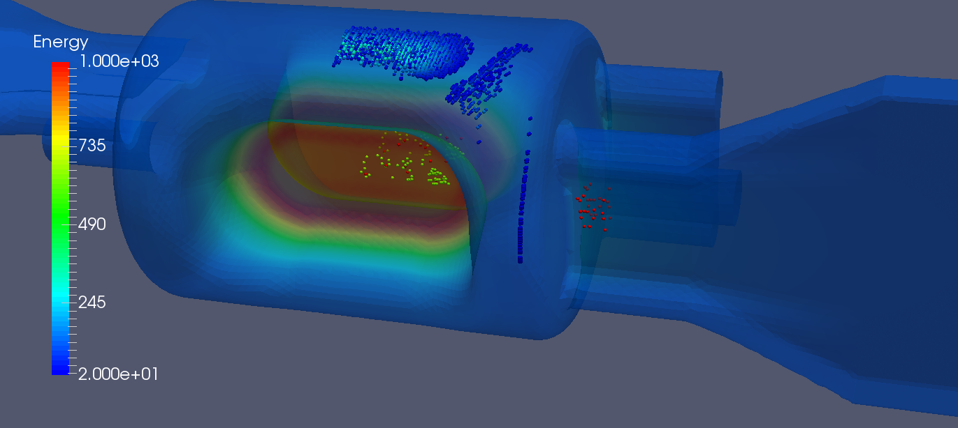
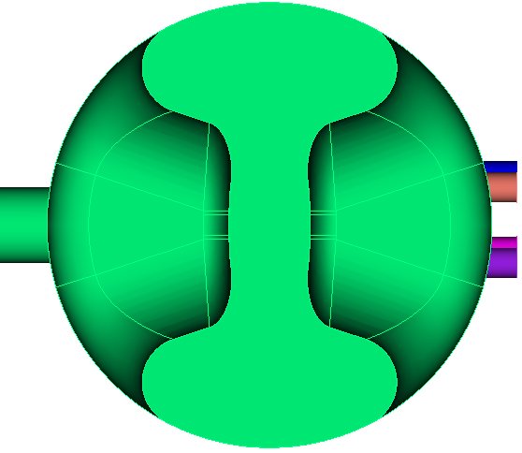
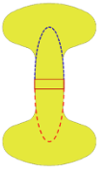
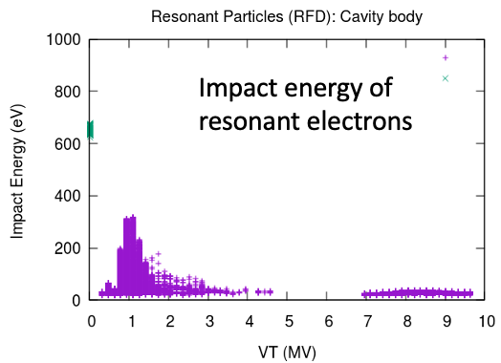
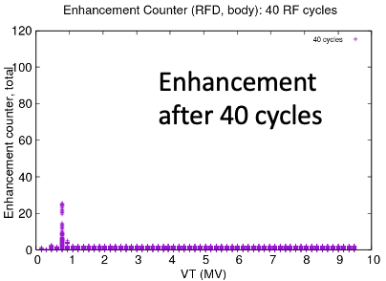
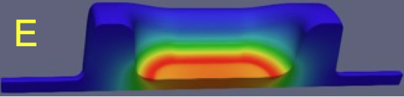
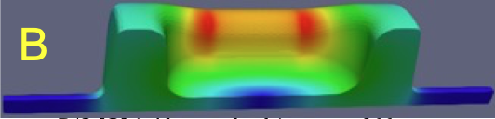
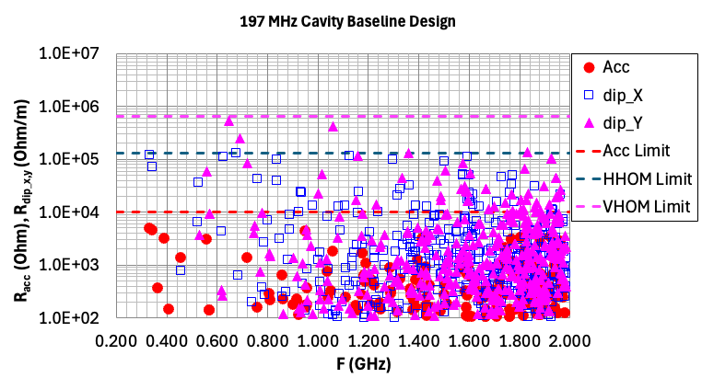
197 MHz Crab Cavity – RF Design
RFD cavity with couplers
Geometry optimized to suppress multipacting
Multipole fields minimized with a curved pole profile
VHOM couplers
FPC
HHOM couplers
Pickup couplers
Multipole field definition
$V_{acc}$(r,$φ)=\sum_{n}{V_{acc}^{n}r^{n}cos⁡(nφ)}$
$V_{⊥}$(r,$φ)=\sum_{n}{\frac{nc}{ω}V_{acc}^{n}r^{n−1}({\hat{u}}_{r}\cos\left(nφ\right)+{\hat{u}}_{∅}sin⁡(nφ}))$
$$b_{n}=\frac{nc}{ω}V_{acc}^{n}$$
RFD cavity parameters
HOM damping and impedance
Parameter | Value
Operating frequency [MHz] | 197
1st longitudinal HOM [MHz] | 392
1st transverse HOM [MHz] | 342
R/Q [Ω] (with curved pole) | 966
V_{T} (MV/cavity) | 11.5
E_{p} (at VT=11.5 MV) [MV] | 45
B_{p} (at VT=11.5 MV) [mT] | 81
Beam pipe aperture [mm] | 100
Transverse dimension [mm] | 587
Longitudinal dimension [mm] | 922
Multipole Component | Requirement at 33.8 MV (T) | Design results V_{T}=33.8 (T)
b₁ (def) |  | 0.1127
b₂ | 0.016 | 0.0004
b₃ (T/m) | 0.32 | 0.1524
b₄ (T/m^2) | 15.2 | 0.0107
b₅ (T/m^3) | 820 | 248.31

Slide 23
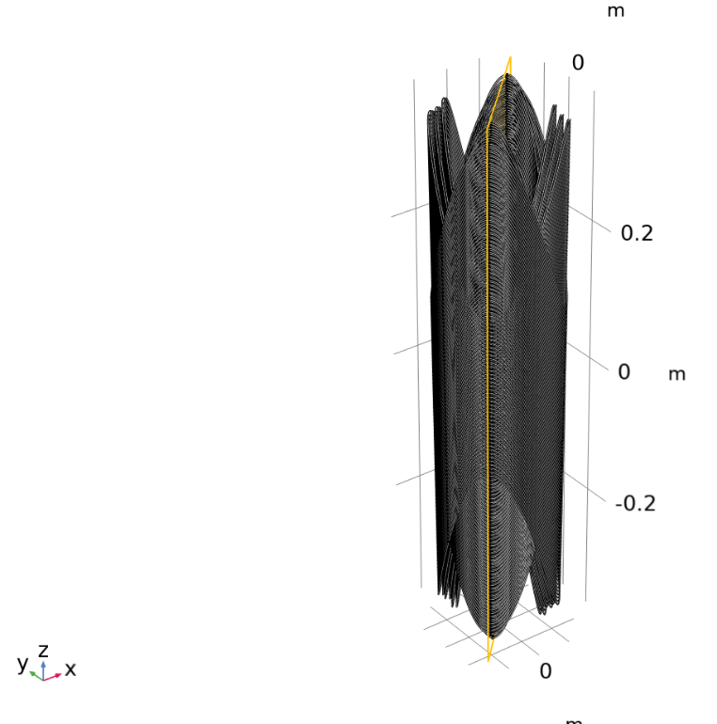
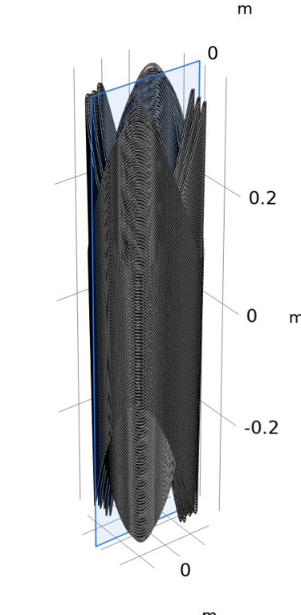
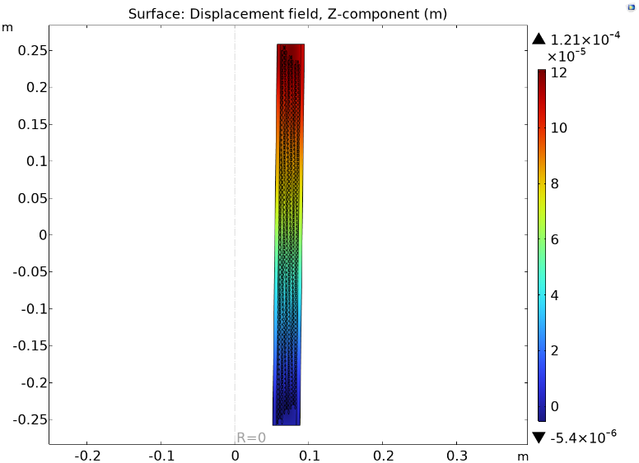
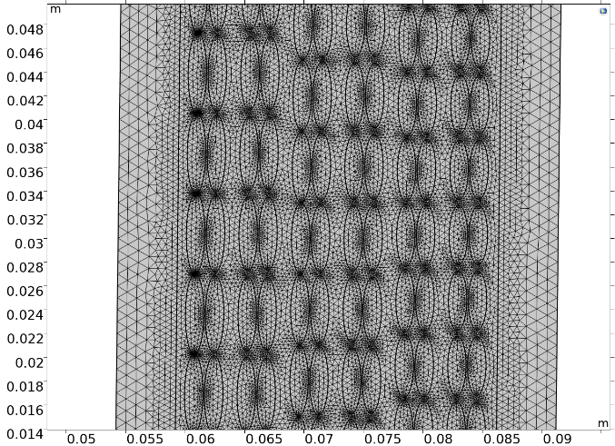
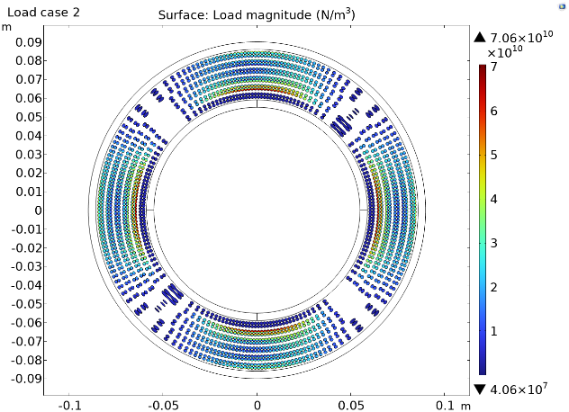
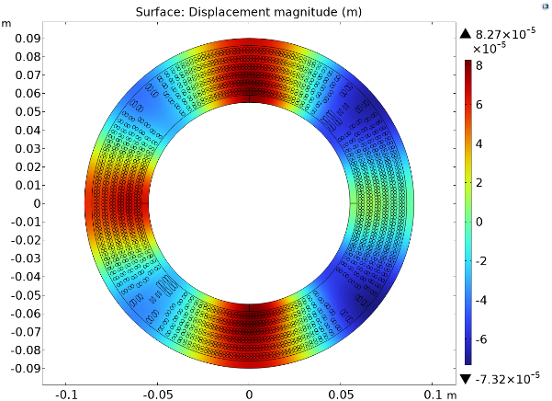
Mechanical 2D Analysis
P. Xu
Series of simulations, slices in transverse and longitudinal direction
Simulations consider pre-stress, thermal contraction and EM load
Concern: large displacements due to forces, particularly in long. direction (~100um). Quenches?
More in Andy’s talk
45 deg cross-plane
0 deg cross-plane
Displacement
Applied load
Displacement

Slide 24
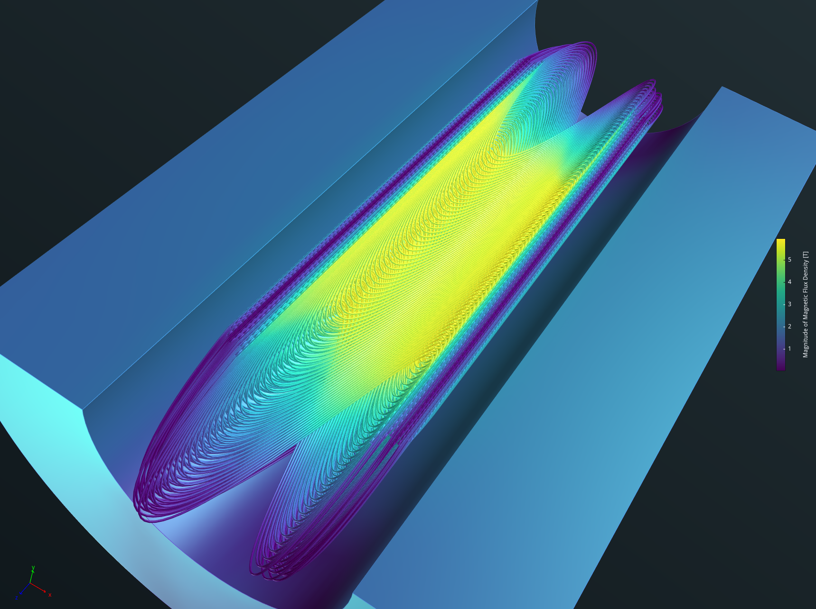
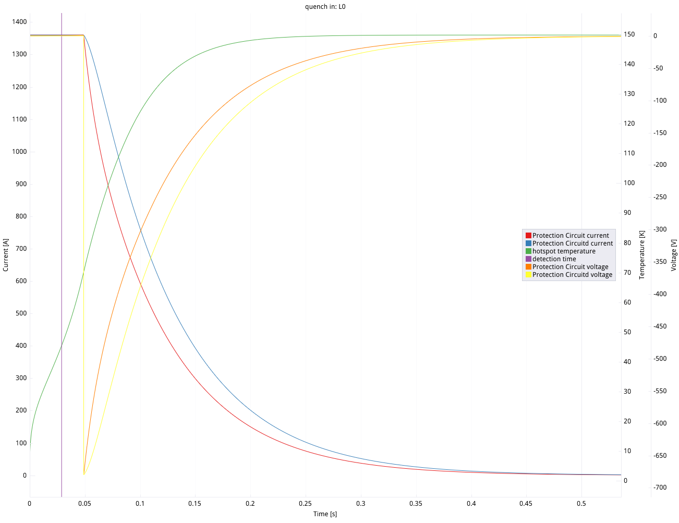
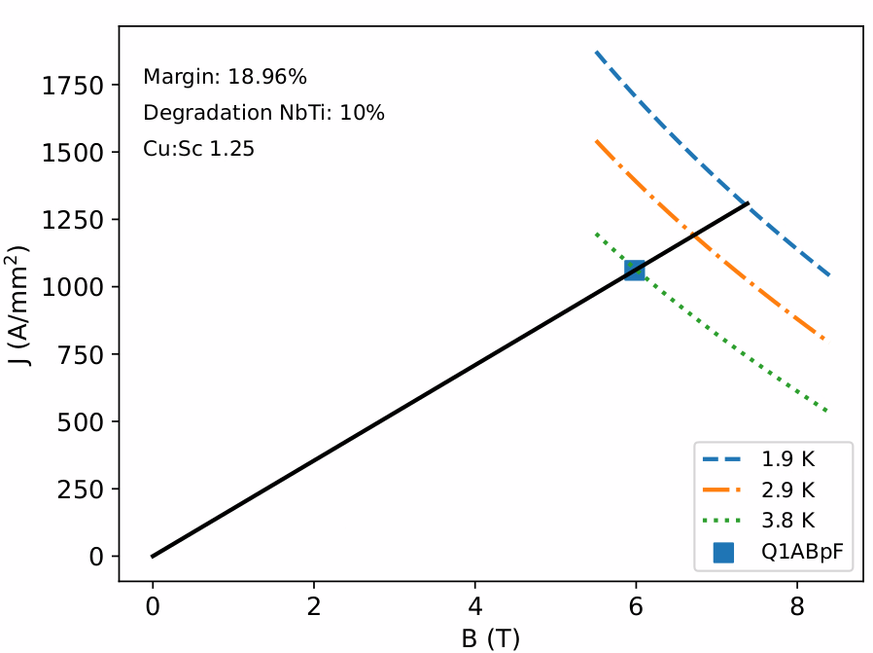
Peak Field
Peak field: <6T
Design allows for healthy margin
Quench protection:
  Two circuits, T<200K
B_{peak}=5.981T

Slide 25
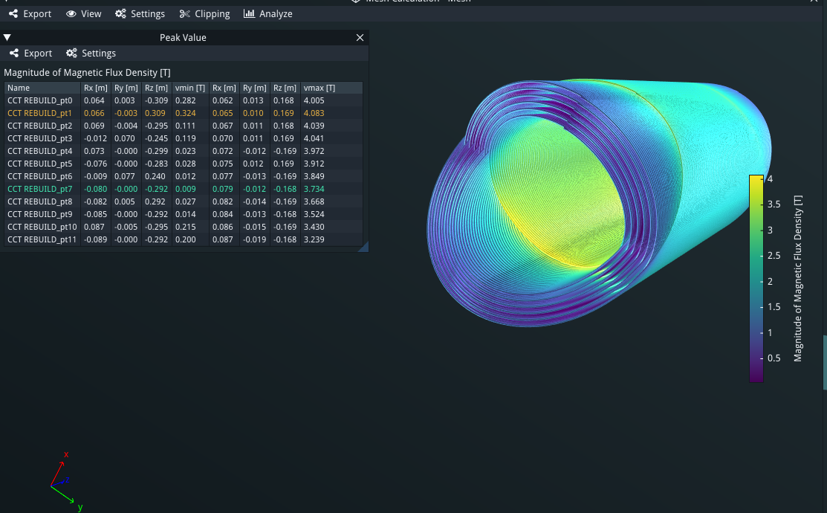
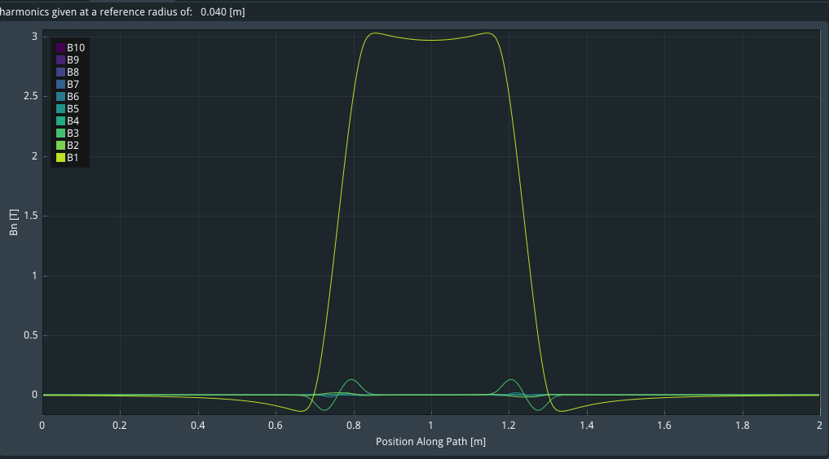
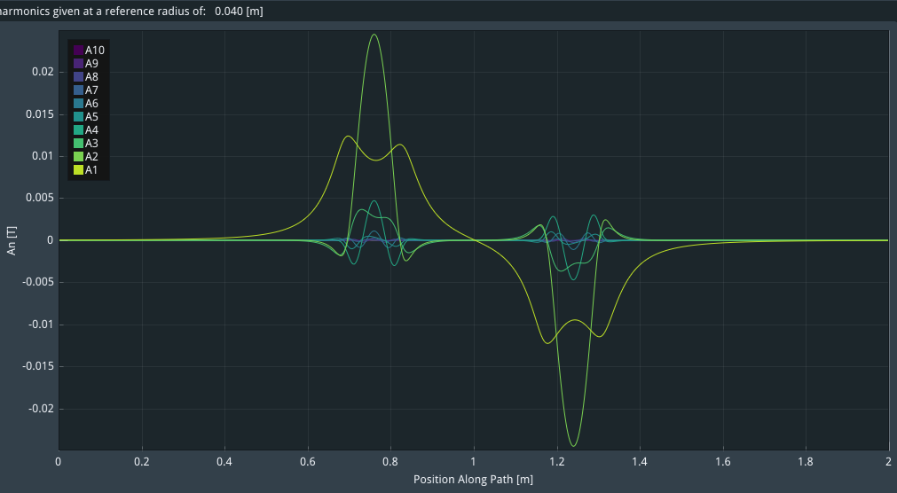
Persistent current simulations B0ApF model
Y. Bai
Normal field components distribution along axial direction
Peak field is 4.08T, compared with 4.07T from OPERA 3D
First successful run for B0ApF
Computationally involved
Similar results using Opera
04/03/2024
Skew field components distribution along axial direction
25

Slide 26
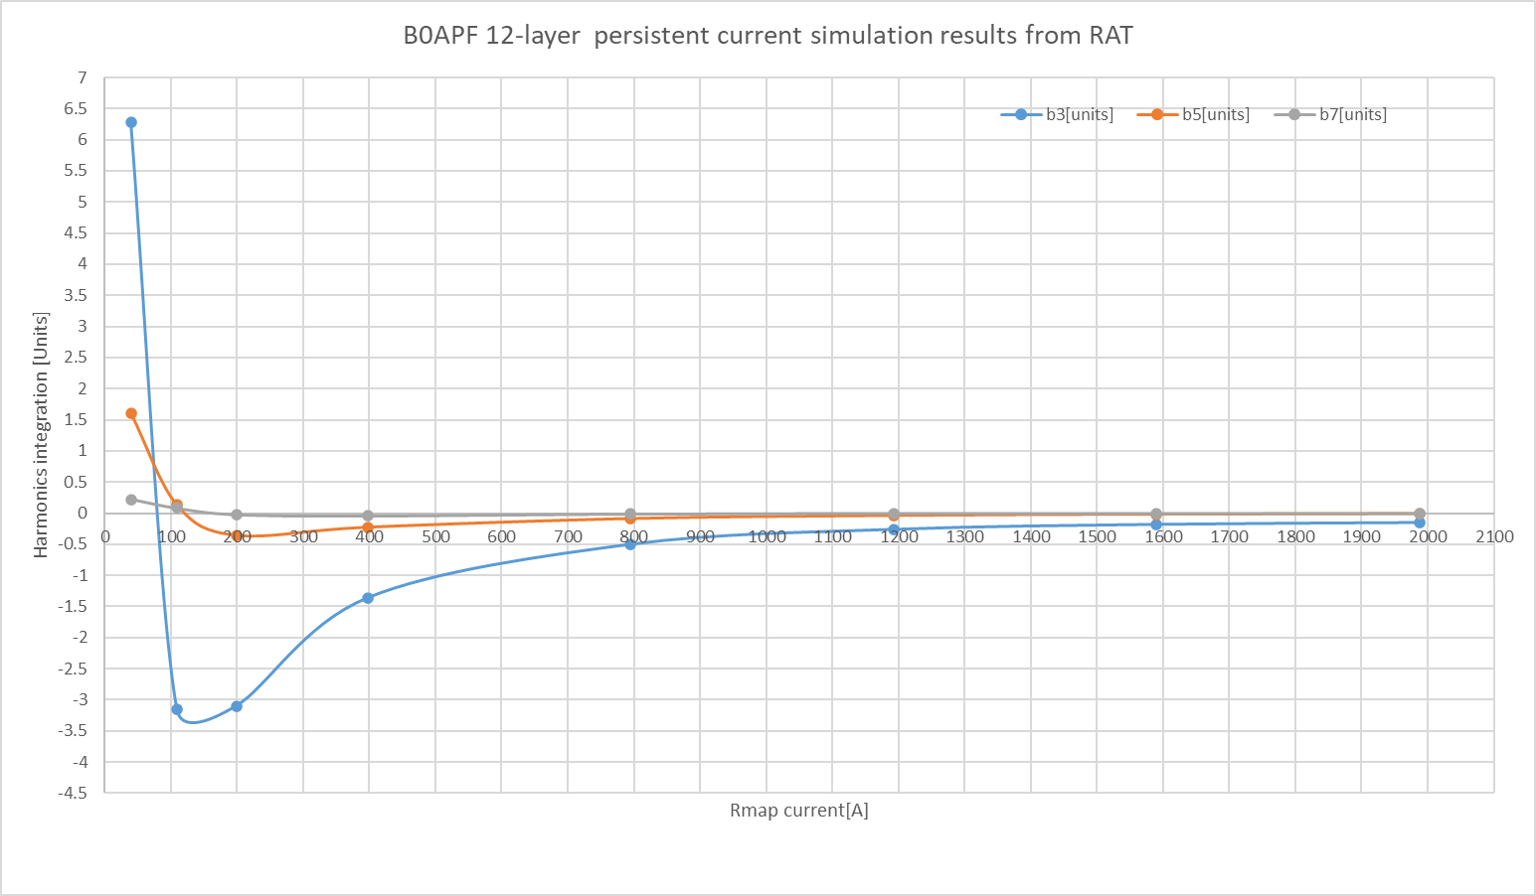
Persistent current simulations B0APF model
(Integrated harmonics @ Rref=40mm, Z from 1m to -1m)
26

Slide 27


Q1ABpF - Harmonics
Compact size – allows to keep turns away from iron
R=50mm

Slide 28



Layer Transition

