Slide 1

Cryogenics system for ILC
Kota Nakanishi, Hirotaka Nakai, Takahiro Okamura
eeFACT2025
March 5, 2025

Slide 2
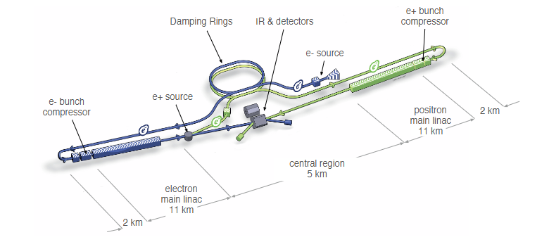
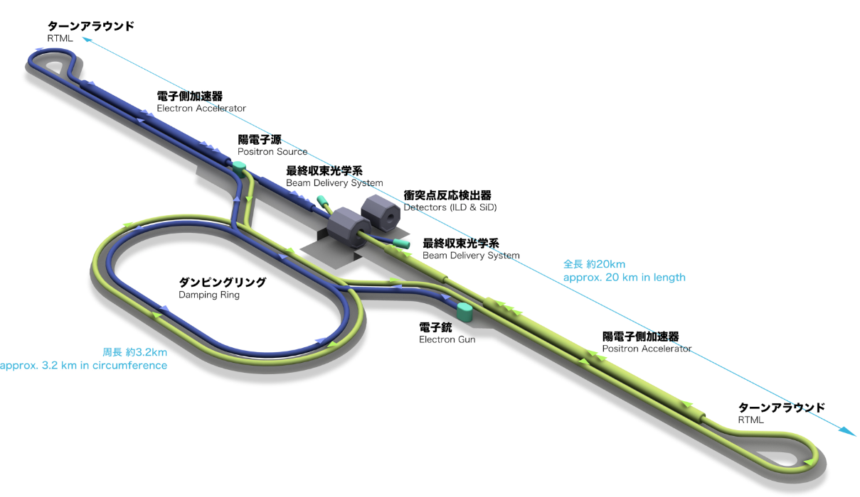
ILC250
The original plan (ILC500) for the ILC (The International Linear Collider) can be seen in the Technical Design Report (TDR) published in 2013.
To reduce initial costs, a proposal has been made to lower the center of mass energy to 250 at the start of operation.
The total length of the facility was reduced from approximately 30km to 20km.

Slide 3
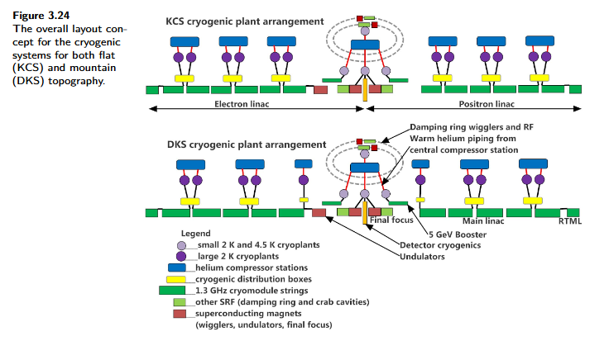
How to reduce the center of mass energy
Flat site
Large cryo plants
10 → 6
For Mountain site plan
Mountain site

Slide 4
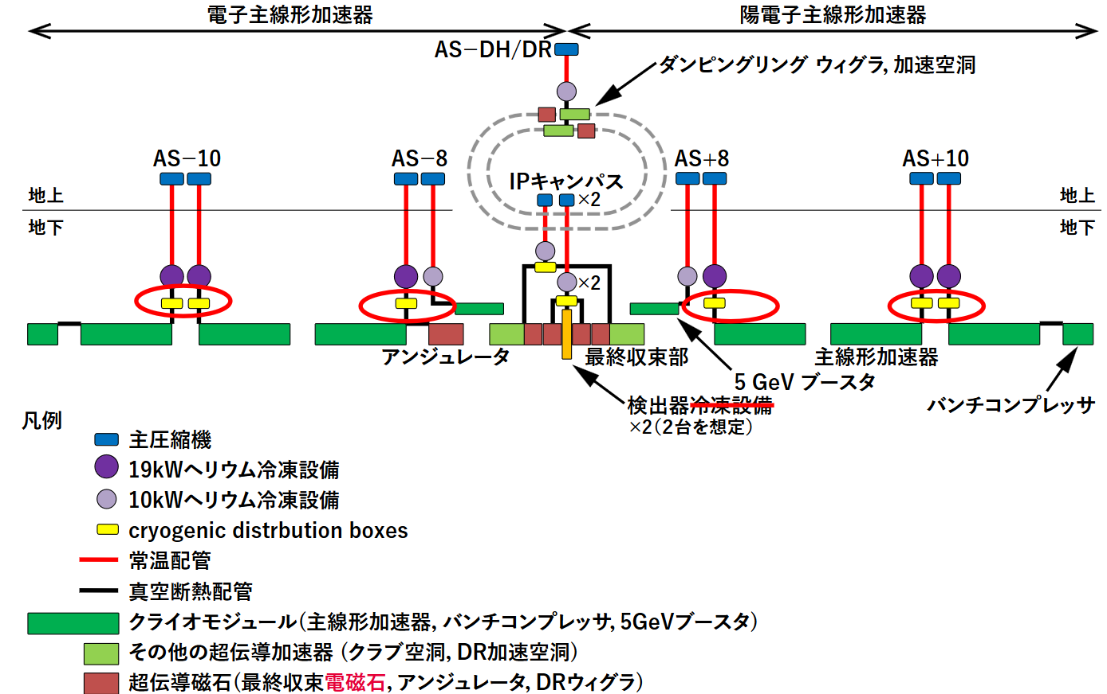
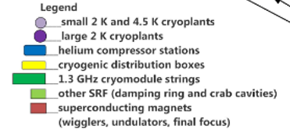

Electron linac
Positron linac
Damping ring, wiggler and RF
Ground level
Final focus
Main Linac
RTML
5GeV Booster
IP
Configuration for the mountain site
warm pipe
Isolated transfer line
An unit of main linac
2.5km

Slide 5
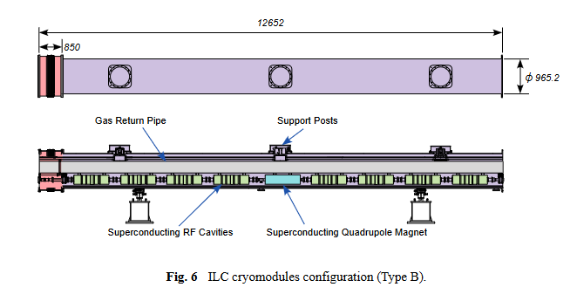
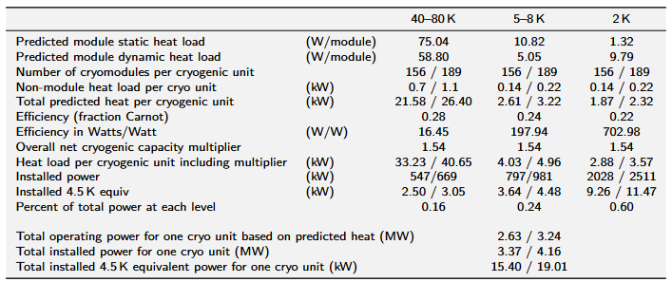
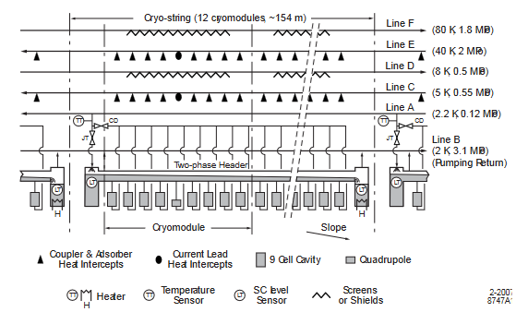
Heat load for main linac
12→9 (for mountain site)
x21 cryo-strings
Flat/Mountain
The required cooling capacity is 19kW@4.5K for each cryo plant for main linac for mountain site.
A refrigerator up to 25kW@4.5K can be purchased from experienced refrigerator manufacturers.
2.5km

Slide 6
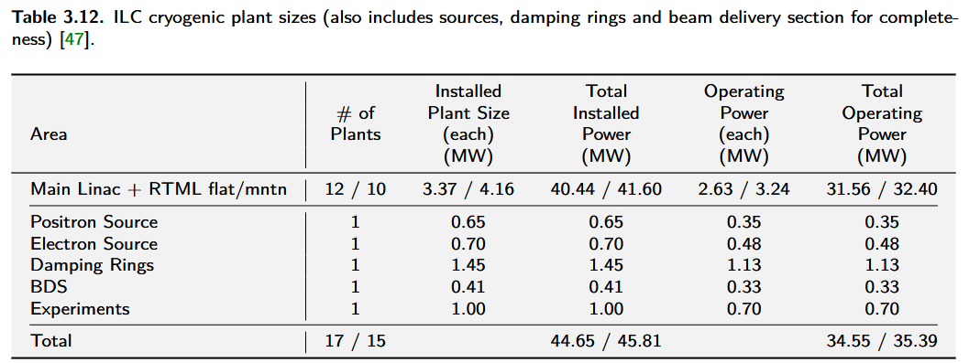
Efficiency of refrigerators
The efficiency in watts / watt of refrigerators for main linac are not only high at 219 but is also required to consume less power during steady-state operation.
19.01kW@4.5K

Slide 7
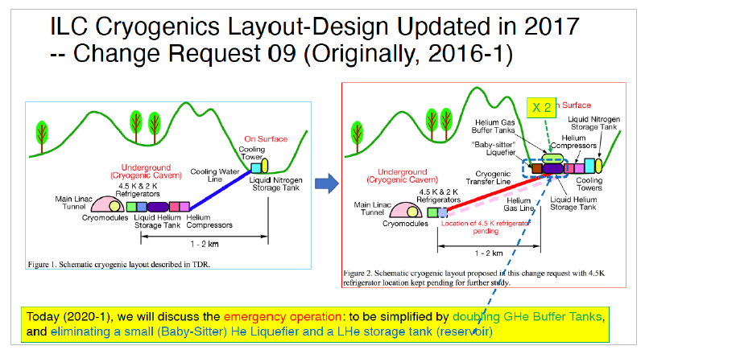
19kW refrigerator
A.Yamamoto
(2013) All inventory is stored in the tunnel.
(2017) Helium inventory is stored on the ground as 50% liquid and 50% gas.
(Now) All of the inventory is stored on the surface as gas.
Cryogenic transfer line is not required.

Slide 8
Access tunnel
The lengths are at least 1km.
4 room-temperature pipes connect compressors on the ground and a cold box in the tunnel.
No vacuum isolated transfer line are installed in the access tunnel. We can’t use liquid nitrogen to boost cooling power of the refrigerators.

Slide 9
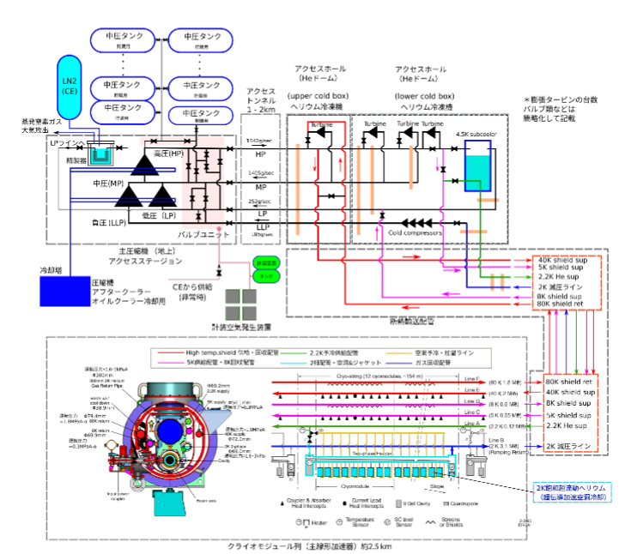
Tentative design
Buffer tanks
Under ground
Access tunnel
The number of expansion turbines, valves, etc. are simplified.
Detailed design has not yet been done.
On surface
Cooling water
GN₂ from CE
2K Vacuum line
Air
2K Vacuum line
He II 2K

Slide 10
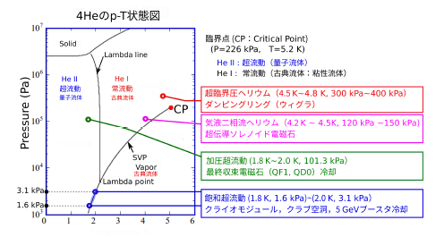
Various refrigerator
All refrigerators have a similar configuration.
(The compressors will be installed on the ground. The cold boxes will be installed in the tunnel.)
The detail of small refrigerators are not decided yet.
The required status for cryogens are vary.
(The requirements are not so special. Bath cooling, pipe cooling, saturated, subcooled… etc)
Multiple refrigerators will be installed near the IP. A compressor array will be installed on the ground, and the helium pipes will be branched in the accelerator tunnel to connect those refrigerators.
Damping ring (wiggler)
Solenoid
Final focusing
Cavities

Slide 11
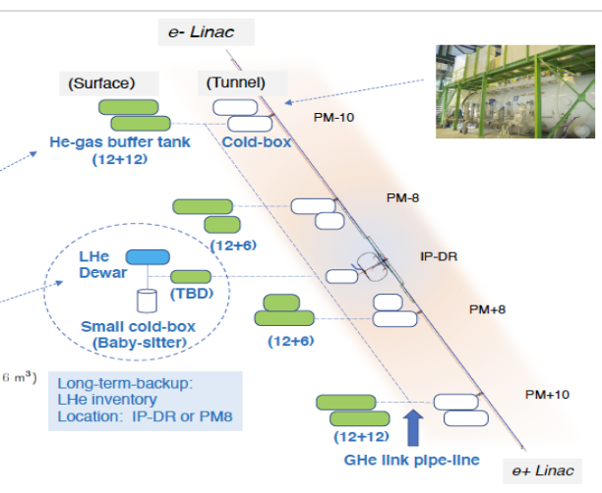
Inventory control (delivery system)
Pipe(OD165.2mm)
All of plants are connected via stainless pipe (150A=OD165.2)
Inventory control system should be connected to the pipe to feed helium gas.
The pressure drop is very low. It is better to decide where to install it for ease of logistics.

Slide 12
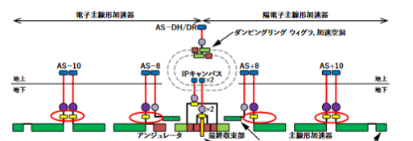
Additional pipes (150A)
Electron Linac
Positron Linac
Recover line
Delivery line
2.5km
5km
5km
5km
2.5km

Slide 13
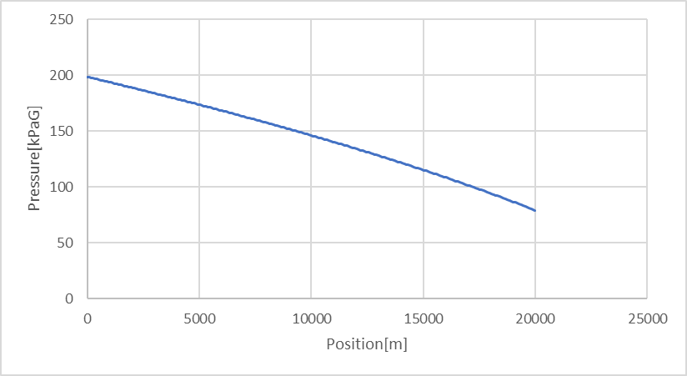
Inventory control system
According to TDR, the cryo-plant at the mountain site have 8.2 tons of helium.
When helium gas is sent from the inventory control system to each cryo-plant at a rate of 100 g/s, the transport is completed in one day.
20km
300K, 100g/s, ID150mm
Pressure distribution during transportation.

Slide 14
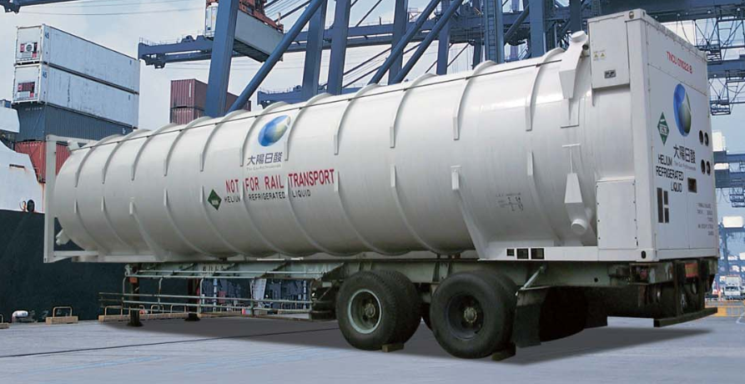
Helium inventory control system
Helium gas is delivered at low temperatures. We need the equipment to accept them.
The helium containers can hold liquids helium for one month without release.
An inventory control system to receive helium can be installed anywhere along the linac.
Buffer Tank
Buffer Tank
Dewar
100,000L
Dewar
100,000L
Buffer Tank
Buffer Tank
Buffer Tank
Buffer Tank
refrigerator
refrigerator
1~2km
Delivery line
OD 165mmPipes
2.5km
20km

Slide 15
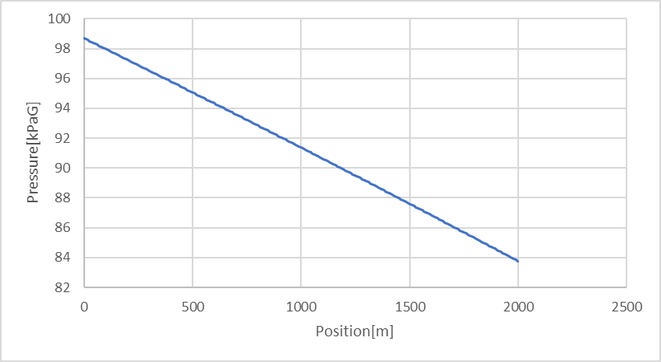
Inventory control
Emergency PS
Emergency PS
Emergency PS
Emergency PS
Emergency PS
Emergency PS
Buffer Tank
compressor
compressor
compressor
compressor
Exist or dedicated
Dewar
100,000L
Buffer Tank
Buffer Tank
Buffer Tank
Buffer Tank
exist
refrigerator
1~2km
Recover line
Delivery line
OD 165mmPipe
20km
During a power outage, an emergency power supply must be used to recover helium from the tunnel.
300K, 100g/s, ID150mm
2km

Slide 16
Recovery compressor
Every cryo-plant has about 8 tons of helium.
Assuming compressor power consumption of 350 kW, isothermal efficiency of 60%, and pressure is from 0.1 to 2.1 MPa (abs), the flow rate of the recovery compressor is expected to be about 100 g/s. It’s bigger than 30g/s.
30g/s → 3 day to recover 8 tons
30g/s means 600W of heat load for cavity jackets ~3W/CM
(In TDR, the static heat load of 2K was estimated at 1.32W/CM.)
The emergency power supply must provide 350 kW of power for at least three days for the recovery compressor.

Slide 17
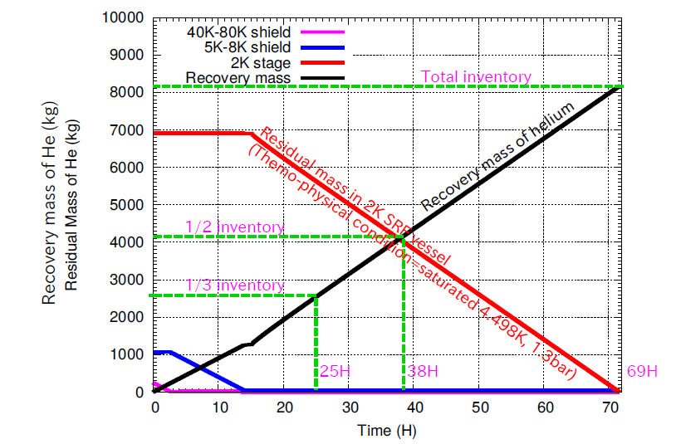
Recovery rate of the liquid helium
Evaporated helium gas will be passed through the pipes for other temperature regions to cool the thermal radiation shield and thermal anchor.
This will reduce the evaporation rate of the liquid helium.

Slide 18
Someone say that emergency power can be provided by cogeneration, while others say that it should be a dedicated facility.
Someone say that the recovery compressor can be one of the compressors used during normal operation, while others believe that a dedicated facility should be installed.
Recovery system
Emergency PS
Emergency PS
Emergency PS
Emergency PS
Emergency PS
Emergency PS
110kPa
(abs)
compressor
compressor
compressor
compressor
ID 150mm
300K
Buffer Tank
Buffer Tank
Buffer Tank
Buffer Tank
2km
30g/s
60g/s
118kPa
(abs)
113kPa
(abs)
118kPa
(abs)
113kPa
(abs)
Cryomodule
Cryomodule
Cryomodule
Cryomodule
Cryomodule
Cryomodule

Slide 19
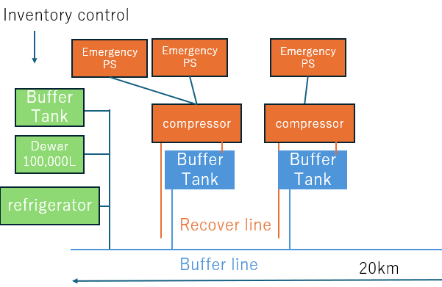
The countermeasures of power outage for inventory control system
The allowable pressure of this dewar should be designed to keep liquid helium without release for one month.
It is realized in a helium shipping container.

Slide 20
Summary
The design of refrigerators for ILC has been updated as needed.
The largest refrigerators for the ILC is for the main linac. Their capacity is less than 25kW@4.5K, so they are commercially available.
All of the equipment of the refrigerator on the surface will be operated at room temperature. Gas helium is stored in the buffer tank, not in Dewar.
The cryogenic system is designed so that helium gas will not be lost in a one-month power outage.

Slide 21
