Slide 1

Beam-Ion Instability in the EIC electron storage ring
Boris Podobedov, M. Blaskiewicz

Slide 2
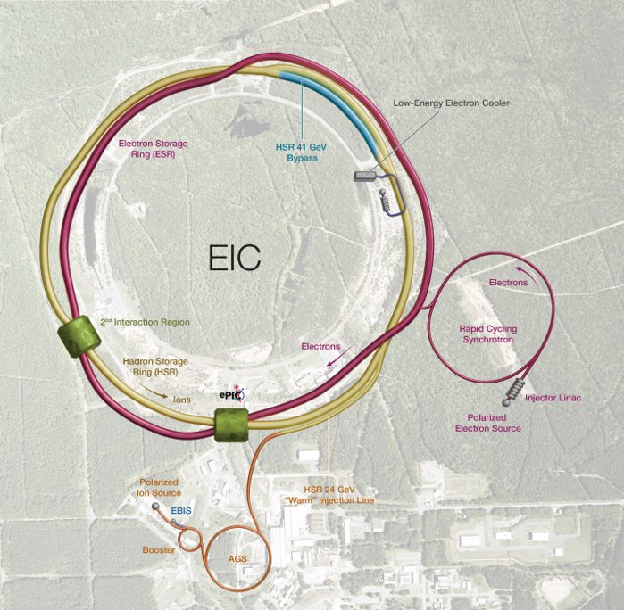
Talk outline
Outline and EIC introduction
Beam-ion instability in general
Beam-ion instability in the EIC ESR
BEAMBEAM element in Elegant
Latest instability simulation results
What happens below instability threshold?
Summary
ESR - Electron Storage Ring (5,10, and 18 GeV)
HSR - Hadron Storage Ring (40-275 GeV)
IR - Interaction Region(s)
Boris Podobedov
March 7, 2025

Slide 3
Introduction to beam-ion instability
Caused by e-beam interaction with residual ions in the vacuum chamber
Important for low-emittance, high-current rings
Two kinds of instability:
  With multi-turn ion trapping (“classical”)
  Fast-ion instability (ions accumulate during e-beam passage but are cleared by the ion-clearing gap)
Effects:
  Coherent centroid beam motion, usually vertical (typically saturates at about one σ)
  Incoherent effects – emittance growth, tune shift, etc.
Cures: very good vacuum, long ion-clearing gap(s), ion-clearing electrodes, bunch-by-bunch feedback (centroid motion only!), “guard” bunches²
Fast-Ion Instability Measurements at NSLS-II¹
Vertical tuneshift along the train
BxB feedback on
No centroid motion
Lifetime growth along the train (via beam size)
Many cures are not applicable or impractical at EIC!
W. Cheng, Y. Li, B. Podobedov, NIM-A 861 (2017) 38–45
J. Calvey, M. Borland, PRAB 22, 114403 (2019)
Boris Podobedov
March 7, 2025

Slide 4
Instability relevance for the EIC ESR
EIC ESR is a high-current, relatively low emittance ring – ion instability is expected, especially at 5 and 10 GeV
Out of many EIC configurations this talk will show results for 275GeV(p)/10GeV(e)
Nominal fill pattern is 1160 uniform bunches (1260 bunches is symmetric fill) to suppress ion-trapping
Major parameters affecting the instability in 4 groups:
  Lattice-related: ε_{x,y}, β_{x,y}(s), etc., define σ_{x,y}(s)
  Intensity per bunch and fill pattern
  Vacuum pressure (s-dependent)
  Beam-beam parameter (creates tune spread and Landau damping)
Parameter table from EIC CDR (2019)
Boris Podobedov
March 7, 2025

Slide 5
Early EIC studies and motivation for this work
Earlier analytical³ and tracking⁴ studies for the ESR confirmed significant suppression of instability due to Landau damping from the beam-beam tune spread
But they did not predict stability at the design intensity and comfortable vacuum pressures
Both studies had significant approximations & limitations
We needed a new tool for more detailed studies
We decided to use Elegant⁵ which by that time had IONEFFECTS element and allowed for very sophisticated simulations of instability (e.g. a realistic lattice, many ion species, s-dependent vacuum pressures, flexible fill patterns, and more) and provided for parallel computations
Except it lacked the critical element needed for the EIC simulations – the beam-beam tune spread
G. Stupakov, MCBI 2019, arXiv:1910.09659
M. Blaskiewicz, NAPAC’19, TUPLM11
M. Borland, Rep. LS-287, 2000.
Boris Podobedov
March 7, 2025

Slide 6
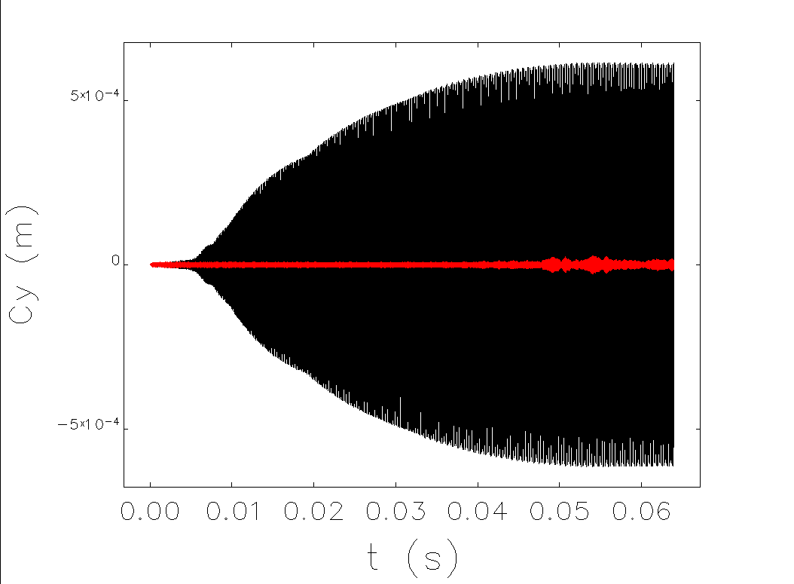
BEAMBEAM element in Elegant
We asked Michael Borland and he has kindly agreed to add another element to Elegant
From Elegant manual:
  This element provides a simple model of beam-beam kicks from a stiff opposing beam defined by the bunch charge, transverse centroids, and transverse sizes. Three transverse distribution types are supported, “gaussian”, “uniform”, and “parabolic”. For gaussian computations are based on the Bassetti-Erskine formula.
We first confirmed that the element introduces the expected beam-beam tuneshift with amplitude
Then we started tracking the ESR lattices with the BEAMBEAM element placed at the IP
We use Gaussian distribution, X/YSIZE parameters match the e-beam at IP, CHARGE matches the beam-beam parameter
Further optimization included placing several BEAMBEAM elements (slices) around the IP
7 to 9 slices distributed over the distance equal to the proton bunch length was found to be optimum
The rest of the instability simulations for the ESR was done as is typically done in light sources (IONEFFECTS element)
Vertical centroids of 1160 bunches over 5 kTurns
no beam-beam
with beam-beam
Observe instability damping due to beam-beam-introduced tune spread!
Boris Podobedov
March 7, 2025

Slide 7
Beam-ion instability simulations in Elegant
Performed with IONEFFECTS element:
  simulates ion generation, ion motion between bunches, beam/ion kicks
  allows for Gaussian (or bi-Gaussian or others) ion beam and the kick is derived from Bassetti- Erskine formula
  Not the preferred option compared to the self-consistent Poisson solver, but we used it for speed
  allows for multiple ionization processes (not used for the ESR so far)
Inputs: full machine lattice, location of ion elements, pressure profiles, ion properties, bunch intensity and fill pattern
Challenges for the EIC ESR
  Large machine => many magnets => longer tracking
  Many IONEFFECTS elements needed due to sharply varying β-functions near IP => longer tracking
  Large number of bunches (1160 nominal) => longer tracking
Running on a fast parallel cluster, the maximum number of macroparticles per e-bunch for practical run-times was 1-3 thousand
We believe this is enough to predict the instability threshold with reasonable accuracy
Boris Podobedov 02-13-25

Slide 8
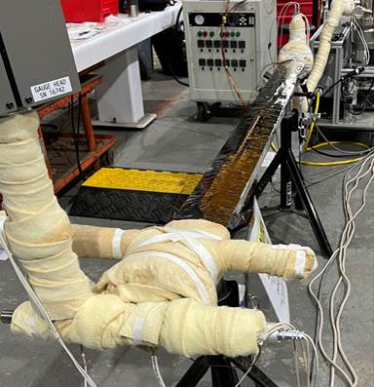
Residual ion pressure and gas composition
New ESR vacuum design relies on distributed NEG coating and predicts ~1 nTorr average residual gas pressure
(Old design with higher P, problematic for instability, lifetime, ...)
Pressures assumed in simulations for the “old” and “new” designs are shown below
All simulations to date performed with uniform pressure distribution around the ring (to be improved in the future)
ESR NEG coated chamber prototype being activated
see C. Hetzel’s talk in WG9
Boris Podobedov
March 7, 2025

Slide 9
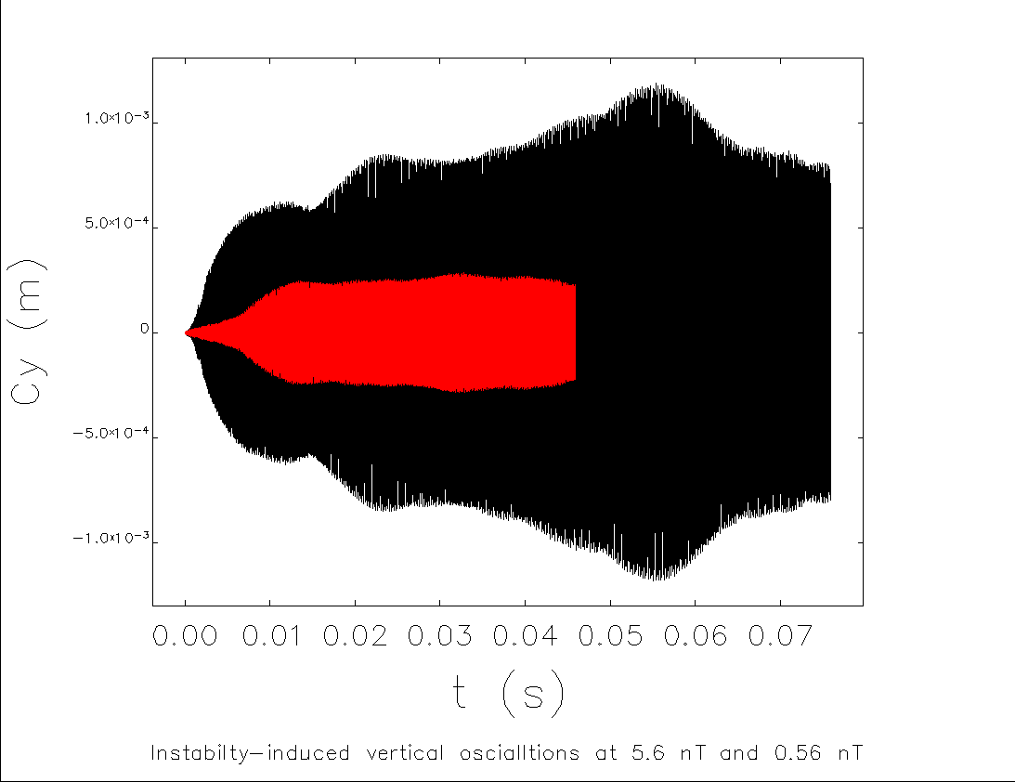
Results without Beam-Beam
Y-centroids of 1160 bunches vs. time
5.6 nTorr
1.12 nTorr
Instability is present even for the new vacuum system design
Growth rate is slow enough to be damped by a conventional BxB feedback
We will likely need to run BxB feedback when there are no collisions
Boris Podobedov
March 7, 2025

Slide 10
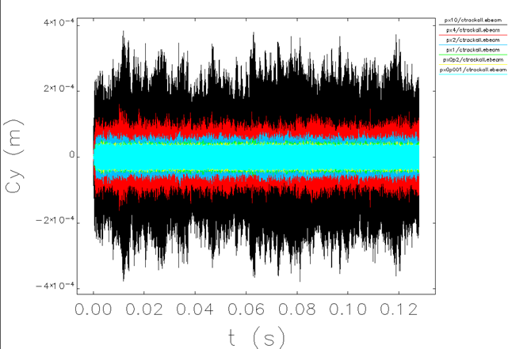
Results with Beam-Beam
Y-centroids of 1160 bunches vs. time
56 nTorr
22.4 nTorr
11.2 nTorr
5.6 nTorr (=old vacuum design)
1.12 nTorr (=new vacuum design)
no ions
Pressure-induced amplitude increase is obvious at P≥5.6 nT
At lower pressures, the difference between traces is ~small
=> Need a different view to determine the threshold more accurately
Boris Podobedov
March 7, 2025

Slide 11
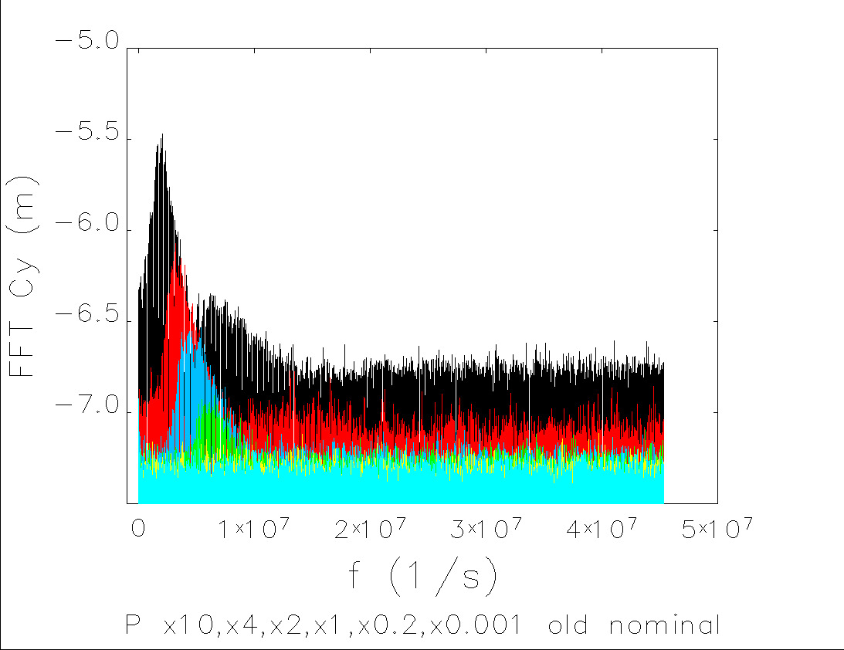
Results with Beam-Beam in frequency domain
Log of FFT of Y-centroids of 1160 bunches vs. frequency
56 nTorr
22.4 nTorr
11.2 nTorr
5.6 nTorr (=old vacuum design)
1.12 nTorr (=new vacuum design)
no ions
Instability-induced ion-frequency sidebands above the threshold
No instability for the new design, but one clearly present for the old design
1.12 nTorr < Threshold < 5.6 nTorr (from figure), ~2.8 nTorr (from more refined analysis)
Comfortable with >factor of 2 stability margin, but more work is needed
Boris Podobedov
March 7, 2025

Slide 12
We are stable against ions – now what?

Slide 13
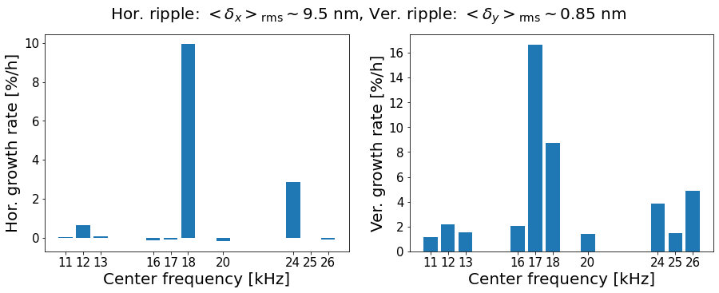
Amplitude of beam motions we care about
Hadrons have no damping. They are unforgiving to very small modulations from e-beam via beam-beam kick (can come from position or size jitter)
Any system or beam dynamics effect causing beam motions at the IP leads to the hadron emittance growth. At high frequencies they may include
  Crab RF phase noise
  Main RF phase noise (+ ideal crab cavity)
  Beam-ion or other instabilities
Positional jitter at ν_{y} with rms magnitude Δ >10⁻⁴ σ is unacceptable for the ESR (σ_{x}=100μm, σ_{y}=10 μm at IP)
Theory estimates¹ and weak-strong simulations² agree
Beam-beam results for proton emittance growth due to e-beam position oscillations at the IP with bandwidth ~bb tuneshift and
amplitude Δ_{x,y}= 10⁻⁴σ_{x,y}
ν_{y}=0.21
proton tune
  rms=Δ
e-
p+
M. Blaskiewicz, NAPAC’19, TUPLM11
D. Xu et. al, IPAC’23, MOPA39
Boris Podobedov
March 7, 2025

Slide 14
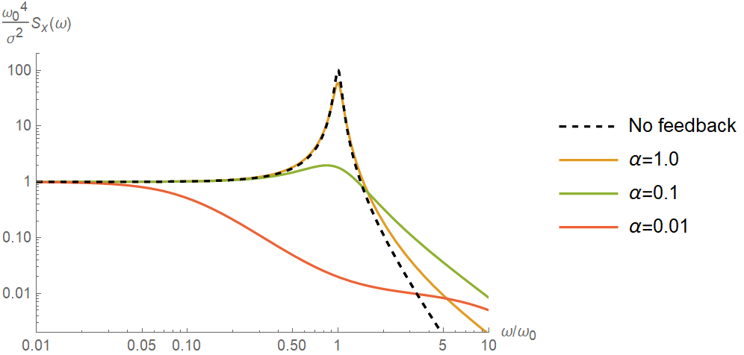

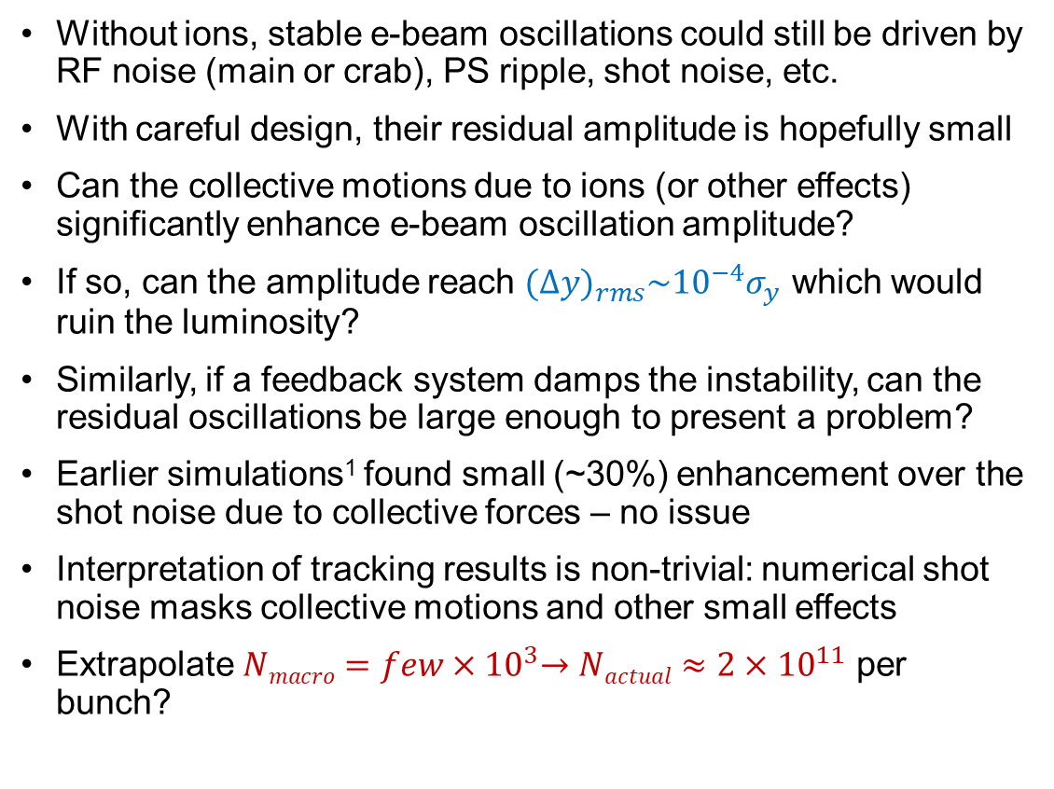


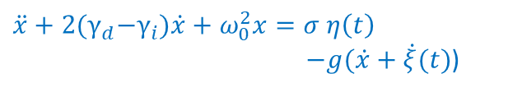
Residual beam oscillations – a problem?
Without ions, stable e-beam oscillations could still be driven by RF noise (main or crab), PS ripple, shot noise, etc.
With careful design, their residual amplitude is hopefully small
Can the collective motions due to ions (or other effects) significantly enhance e-beam oscillation amplitude?
If so, can the amplitude reach ${(∆y)}_{rms}\sim {{10}^{−4}σ}_{y}$ which would ruin the luminosity?
Similarly, if a feedback system damps the instability, can the residual oscillations be large enough to present a problem?
Earlier simulations¹ found small (~30%) enhancement over the shot noise due to collective forces – no issue
Interpretation of tracking results is non-trivial: numerical shot noise masks collective motions and other small effects
Extrapolate $Nmacro{=few×10}^{3}→Nactual≈{2×10}^{11}$ per bunch?
Analogy: white-noise-driven oscillator with derivative feedback²
noise
$$\ddot{x}+2{(γ}_{d}−γ_{i})\dot{x}+ω_{0}^{2}x=σ η\left(t\right)$$
$−g(\dot{x}+\dot{ξ}(t)$)
damping
growth rate
feedback gain
sensor noise
Expected Power Spectral Density of $x$
$$\sim \frac{1}{{{(γ_{d}−γ}_{i})}^{2} }$$
Set optimum $g$ at each sensor noise value α=α(ξ)
Caution, work in progress!
M. Blaskiewicz, NAPAC’19, TUPLM11
B. Podobedov, M. Blaskiewicz, BNL-215885-2020-TECH
Boris Podobedov
March 7, 2025

Slide 15
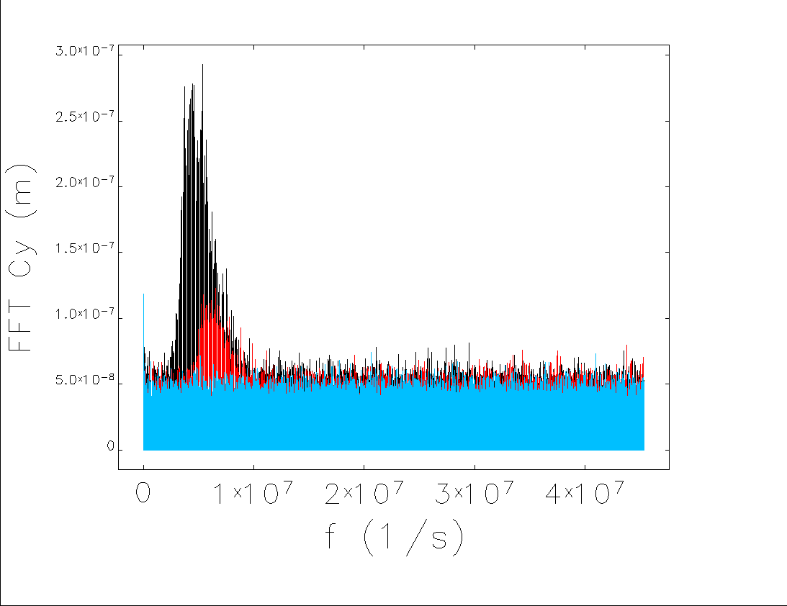
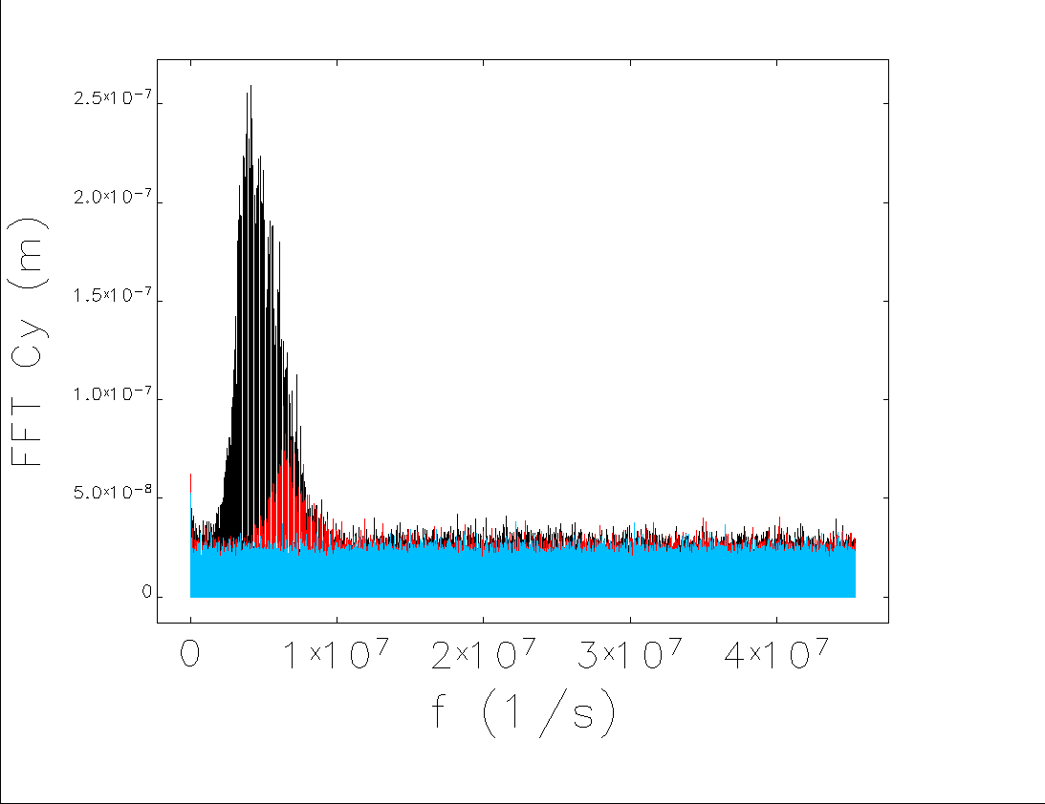
Excess instability noise vs. N of macro-particles
Compare 3 cases: without ions, 5.6 nTorr, and 10.2 nTorr
Use two values for the number of electron (macro-) particles per bunch (ppb) N
Look at FFT of 1160 bunches y-centroids over 10k turns
Observe the ion instability peak getting slightly lower with N, while noise ~N^{-1/2}
And excess high-frequency noise above N^{-1/2} outside of instability peak
This excess noise can also be seen below instability threshold (not plotted)
N = 400 ppb
N = 1600 ppb
10.2 nTorr
10.2 nTorr
5.6 nTorr
5.6 nTorr
no ions
no ions
Boris Podobedov
March 7, 2025

Slide 16
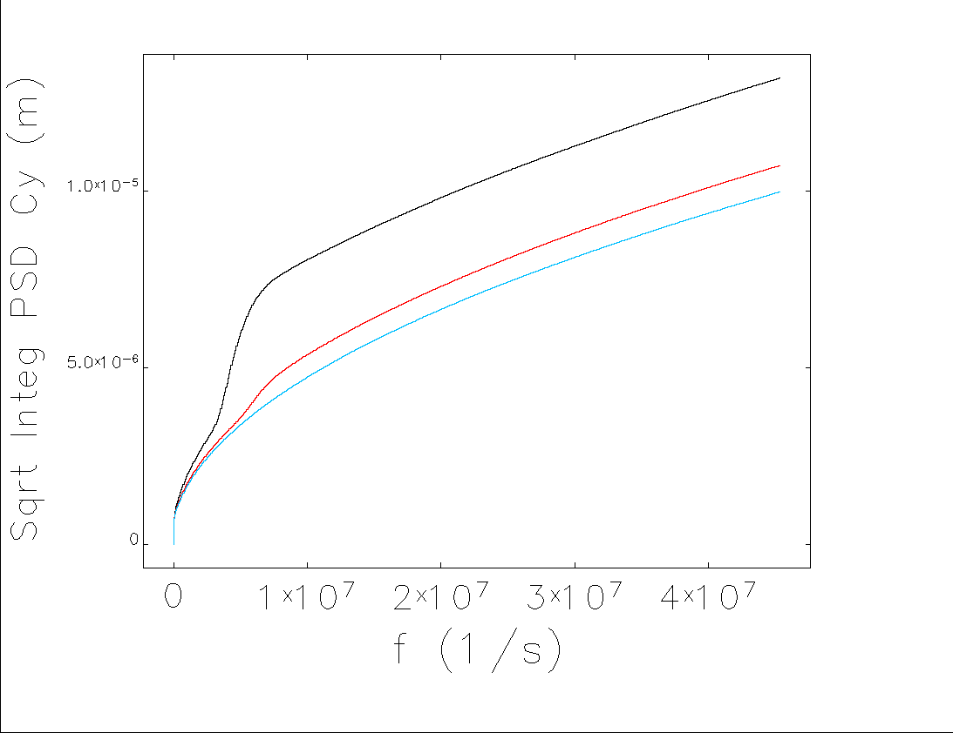
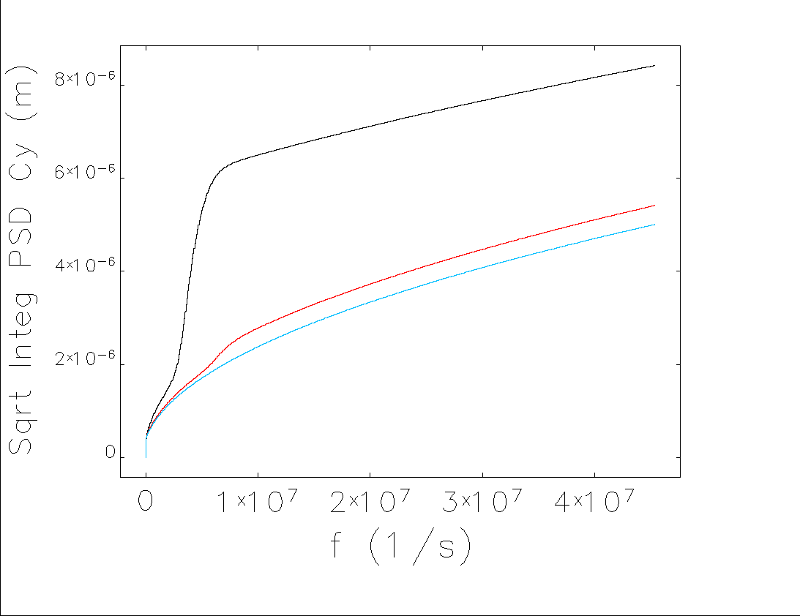
Excess instability noise vs. N of macro-particles
Same data, plot square root of the integrated PSD
Difference with the no-ions curve is the excess noise due to ions
One can scale out the N-dependence of the excess noise
This simple scaling shows that we are O.K. (for shot-noise drive and below the instability threshold)
More in-depth study in progress
 | sqrt(Integrated PSD) [microns] | 5.6 nTorr | 11.2 nTorr
 | No ions | 5.6 nTorr | 11.2 nTorr
400 ppb | 9.983 | 10.729 | 13.207
1600 ppb | 5.005 | 5.413 | 8.420
Total ion effect @ 11.2 nTorr
Total ion effect @ 5.6 nTorr
N = 400 ppb
N = 1600 ppb
Boris Podobedov
March 7, 2025

Slide 17
Summary
Beam-ion instability is a concern for the EIC electron storage ring
It partially stimulated the design update for the EIC vacuum system to achieve lower residual gas pressure ~1 nTorr
Detailed instability tracking simulations were performed with Elegant
To capture the essential physics of the instability – Landau damping from beam-beam tune spread - new BEAMBEAM element was added to Elegant by M. Borland
Results obtained so far predict stability at collisions with a reasonable margin
Without collisions we may need a bunch-by-bunch feedback to stabilize the beam
Driven beam oscillations, when below the instability threshold but still under the influence of collective forces, are still being investigated
We are grateful for the help from Michael Borland and Joseph Calvey (Argonne) for the BEAMBEAM element and help with beam-ion instability simulations
Boris Podobedov 02-13-25

