Slide 1








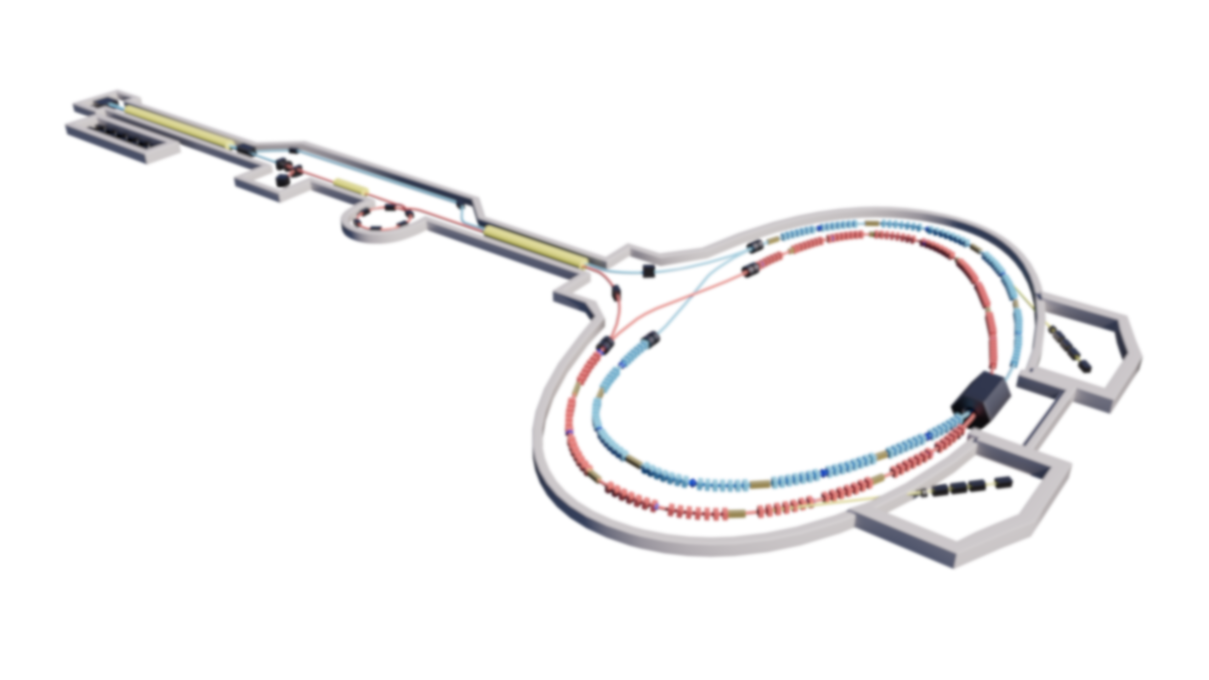
STCF injector and positron source design
Ailin Zhang，Duan Gu, Tongning Hu, Guoxi Pei,
Jingyu Tang, Youjin Yuan
The IJPD group of STCF
eeFACT 2025 Workshop, Tsukuba, Japan

Slide 2







OUTLINE
C O N T E N T S
1
Introduction
2
Injector design for Off-Axis injection
3
Injector design for Swap-Out injection
4
The positron source design of STCF
5
Summary

Slide 3
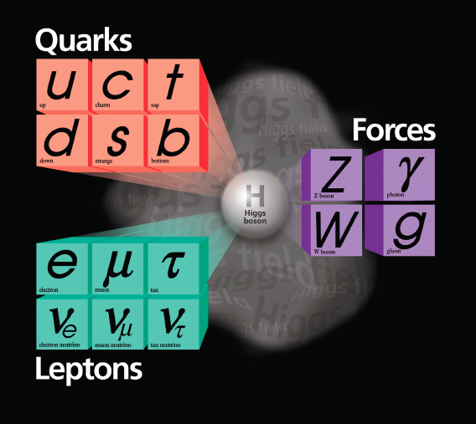

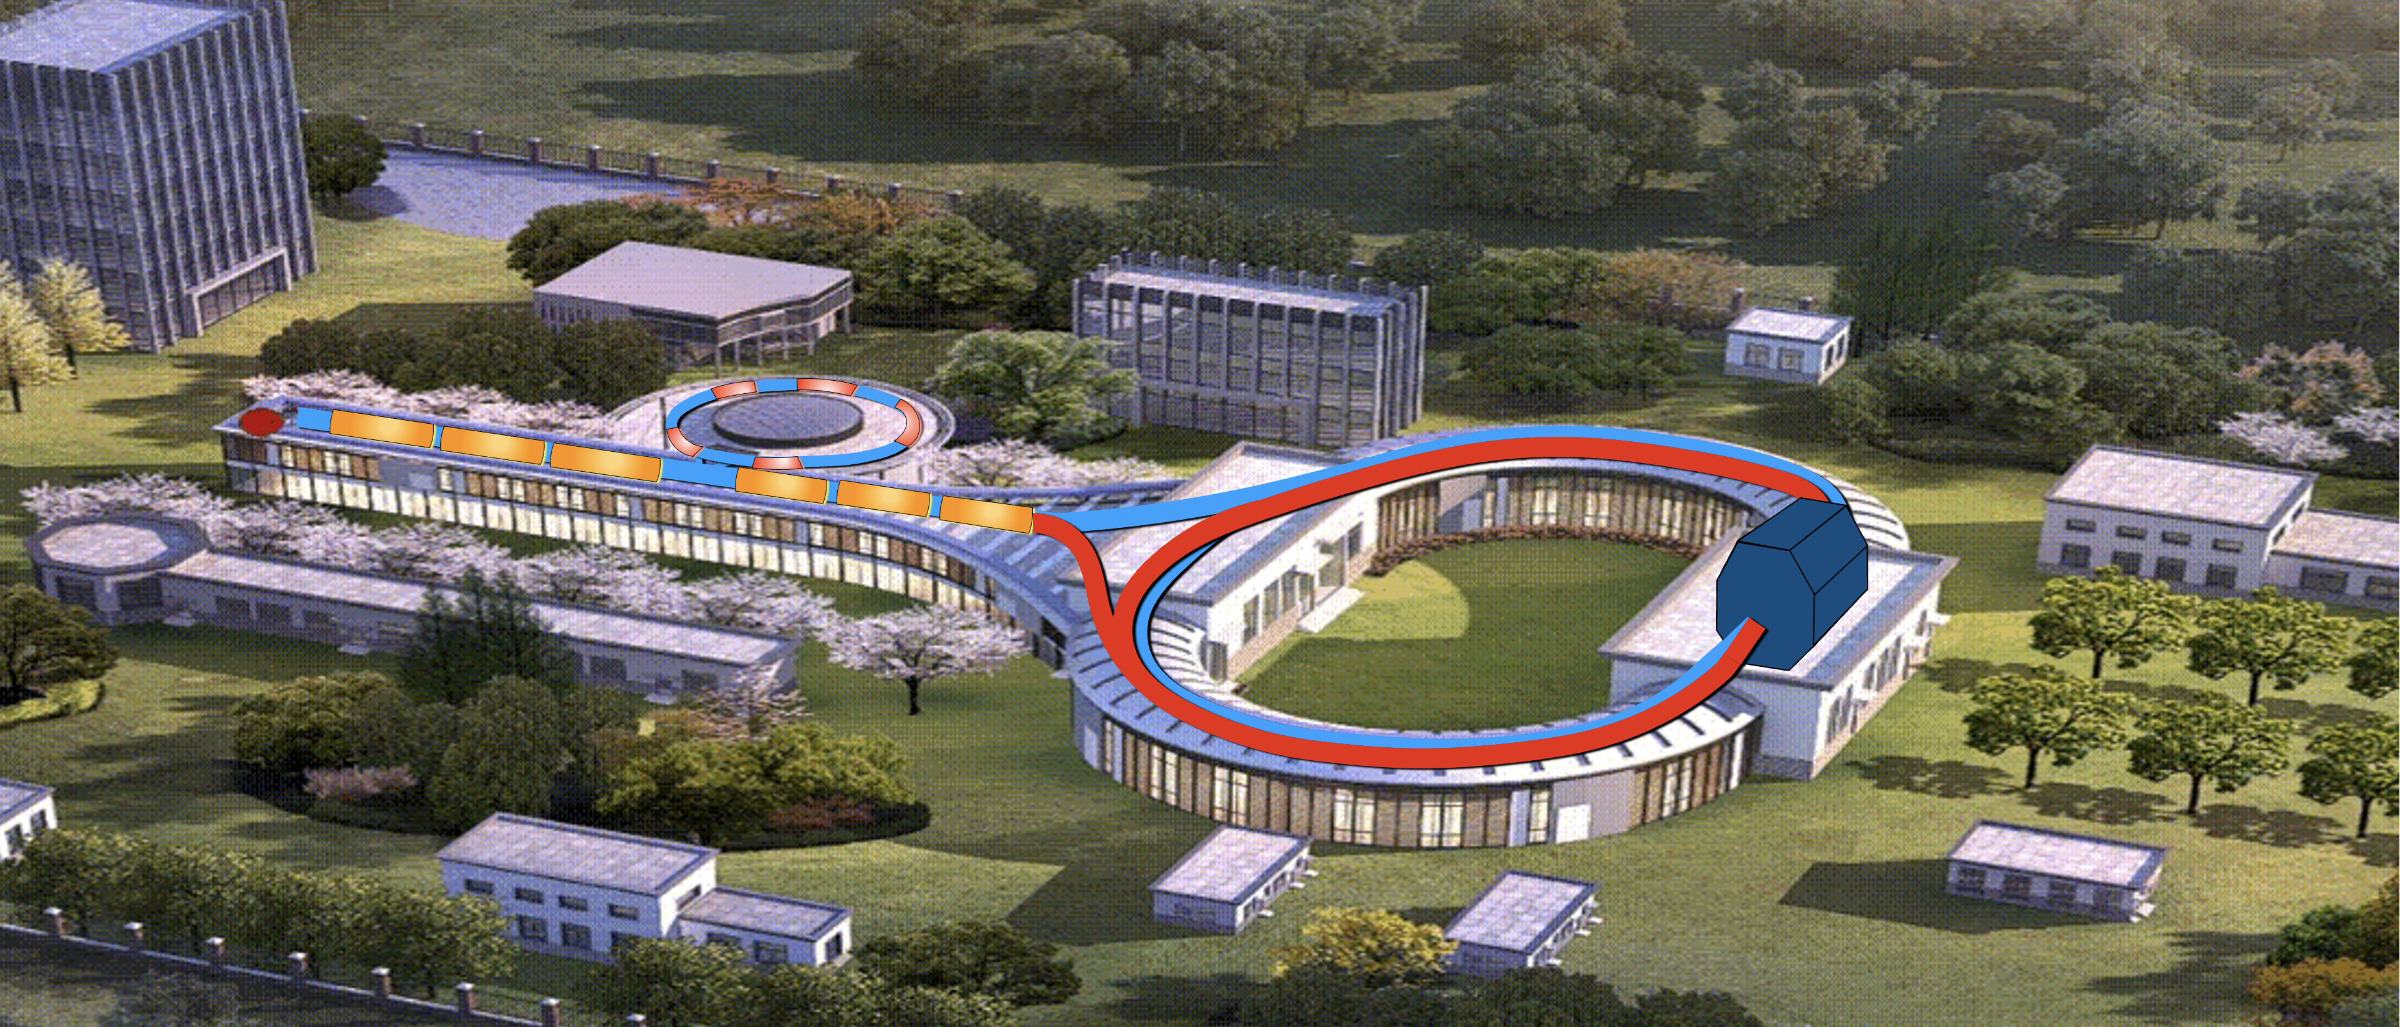
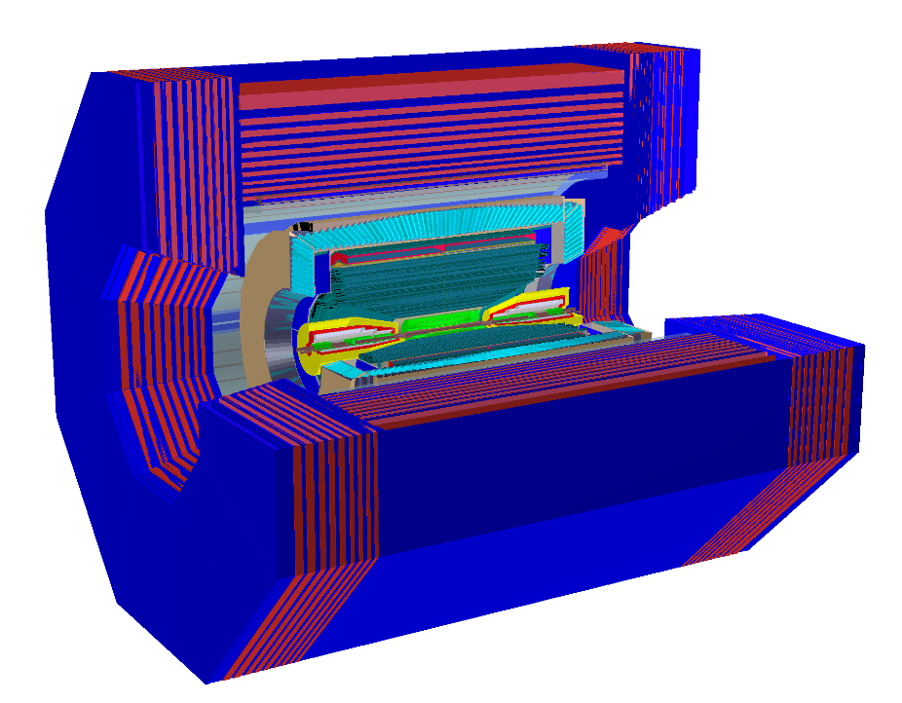
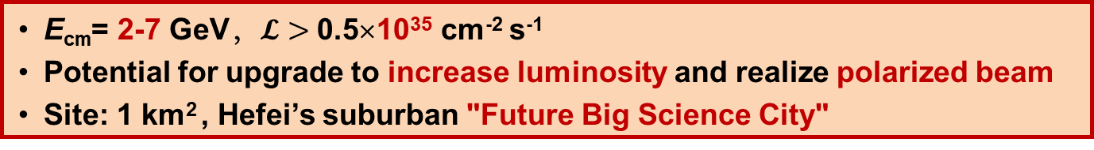
Super Tau Charm Facility (STCF)
A factory producing massive tau lepton and hadrons, to unravel the mystery of how quarks form matter and the symmetries of fundamental interactions
Damping Ring
150 m
Collier Rings
800-1000 m
Linear Accelerator
400 m
New generation Spectrometer
E_{cm}= 2-7 GeV，$𝓛>$ 0.5×10³⁵ cm⁻² s⁻¹
Potential for upgrade to increase luminosity and realize polarized beam
Site: 1 km² , Hefei’s suburban "Future Big Science City"

Slide 4
Main parameters of the STCF injector Main parameters of injector for each injection scheme were studied Difference on bunch charge, emittance and injection frequency
 | Parameters | Value |  | Unit |  | Parameters | Value |  | Unit
 | Collider ring injection scheme | Off-axis | Swap-out |  |  | e- linac energy for direct injection e- energy for e+ production e+ energy Main linac energy for e-/e+ e+ DR/AR bunch numbers e+ DR/AR RF frequency e+ DR/AR injection charge e+ DR/AR injection frequency e+ DR/AR injection emittance (X/Y) e+ DR/AR extraction emittance (X/Y) | 1.0 | 1.0 | GeV
 | E-gun type | Photo /Therm. | Therm. /Therm. |  |  |  | 1.0 + 0.5 | 2.5 | GeV
 |  |  |  |  |  |  | 1.0 | 1.0 | GeV
 | E-gun charge | 1.5/10 | 8.5/11.5 | nC
 |  |  |  |  |  |  | 0-2.5 | 0-2.5 | GeV
 | Injection e- bunch charge | 1.5 | 8.5 | nC
 |  |  |  |  |  |  | - | -
 | Injection e+ bunch charge | 1.5 | 8.5 | nC
 |  |  |  |  |  |  | 499.7 | 499.7 | MHz
 | Injection energy | 1.0-3.5 | 1.0-3.5 | GeV
 |  |  |  |  |  |  | 1.5 | 2.5 | nC
 | Optimal energy | 2.0 | 2.0 | GeV
 |  |  |  |  |  |  | 30 | 90 | Hz
 | MW frequency | 2998.2 | 2998.2 | MHz
 | Injection emittance (X/Y, Geo, rms) | ≤6 | ≤30 | nm-rad |  |  | ≤1400/1400 | ≤1400/1400 | nm-rad
 |  |  |  |  |  |  | ≤11/0.12 | ≤30/30 | nm-rad
 | Injection energy spread (rms) | ≤0.1 | ≤0.5 | %
 | Injection frequency e-/e+ | 30/30 | 30/30 | Hz
5
2

Slide 5
Challenges
For Off-Axis injection scheme：
  Merger design for two beam generated by different guns, with different bunch charge, bunch length and emittance, share the 1st linac section
  Positron generation and transportation (target material, capture efficiency…)
  Damping ring design to reduce the positron emittance and energy spread
  Beam transportation and emittance preservation
For Swap-Out injection scheme：
  Get high charge electron bunch (up to 10 nC) for positron production
  Injector repetition rate (Modulator limitation)
  Accumulator ring (AR) for positron
  Transportation and injection of high bunch charge electron
  and more …

Slide 6
OUTLINE
C O N T E N T S
1
Introduction
2
Injector design for Off-Axis injection
3
Injector design for Swap-Out injection
4
The positron source design of STCF
5
Summary

Slide 7


Overview of injector for off-axis scheme
For off-axis injection scheme, the injector needs to provide at least 30Hz/1.5nC electron and
Positron bunches. Strict demands for beam qualities (emittance, energy spread)
>1.5nC electron bunch generated with Photo-cathode gun, further boosted and prepared to inject into the collider ring
>1.5nC positron bunch generated by motional target with 1GeV high charge (~10nC) electron bunch provided by Thermionic gun and linac
Damping ring is needed to prepare low emittance and energy spread positron bunch
Bypass
e-/e+ main linac 1-3.5GeV
1.5nC e⁻ / 1.5nC e⁺
1.5nC
photo-gun
Positron target
10nC
Thermionic Gun
Collider Ring
e⁻ booster
e⁻ booster
e⁺ booster
1.0 GeV
1.5nC/10nC
1.5 GeV/10nC
1GeV/1.5nC
Damping Ring 1 GeV / 1.5nC

Slide 8
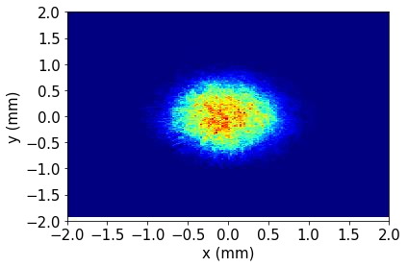
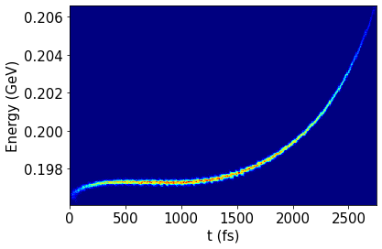
Photo-cathode gun line
S-band photo-cathode gun, with acc. gradient >100MV/m, beam energy ~4MeV at gun exit
Lower energy part (L0&L1) consists of 2 S-band accelerating tube, 120MeV at exit
L2 section consists of 2 S-band tube, powered by one klystron with SLED, further boost the beam to 200MeV and provide the energy chirp for compression
One X-band (12 GHz) tube is used for phase space linearization
One magnetic chicane is used to compress the beam to ~1 ps ( S-band 1°）
Photo- cathode Gun
Bunch Compressor
L0 (S-band)
L1 (S-band)
L2
Linearizer
chirp
X

Slide 9
Thermionic gun line
The mature thermionic gun is used to provide at least 10nC electrons
Consist of 2 sub-hormonic bunchers, 1 buncher and S-band accelerating tube
Multiple solenoids are used to match and keep the beam envelope and emittance
 | Type/Frequency(MHz) | Length(m) | Distance(m) | Parameters
Cathode/grid | Y-796 |  |  | 150kV，7A，1.6ns
SOL1 |  |  | 0.182
SHB1 | 166.56 |  | 0.667(center) | 1/18th of fundamental wave period 6ns, compression ratio ~3.7
SHB2 | 499.7 |  | 2.03(center) | 1/6th of fundamental wave period 2ns, compression ratio ~2.8
BUNCHER | 2998.2 | 1.3144 | 2.26 | fundamental wave period 333.6ps，energy gain~11MeV
ACC. Tube（A1） | 2998.2 | 3.0667 | 4.10 | fundamental wave period 333.6ps，energy gain~50MeV

Slide 10
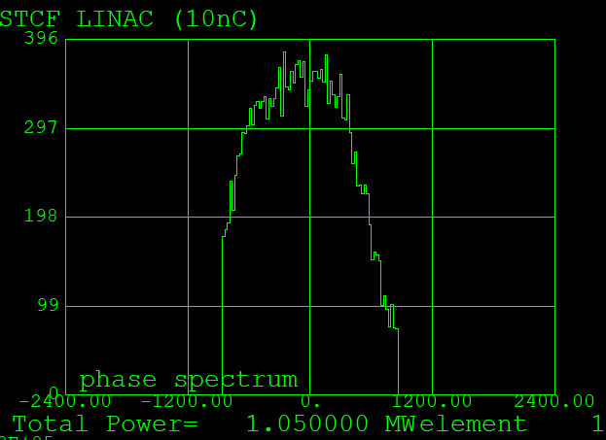
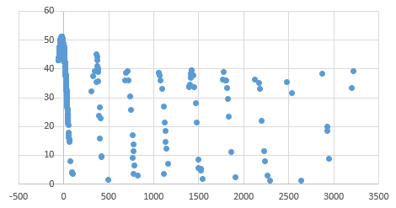
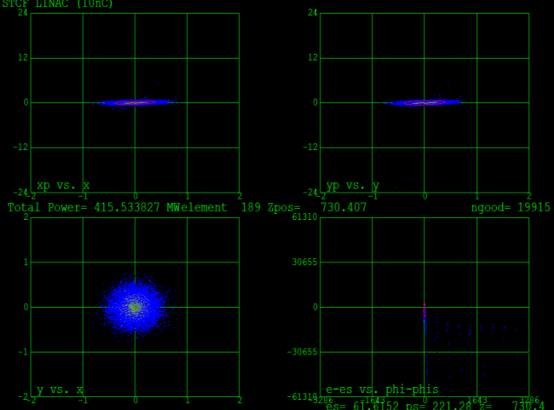
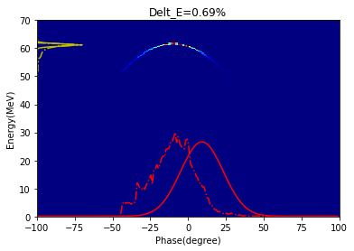
Thermionic gun line
Charge in main bunch is >10 nC, tailing bunch ~0.1%，with emittance ~41um and energy spread<1%, according to the start-to-end simulation
Main parameters of the thermionic gun booster
Bunch charge, Q | 10.9 nC
Energy, E | 61.2 MeV
Transmission efficiency, η | 99.6%
main bunch ratio, η | 99.1%
Energy Spread, ΔE | 0.69%
Bunch Length, σ | 13 ps
Nor. projection emittance, ε | 41 mm·mrad
Bunch distributions
main bun | bun 1 | bun 2 | bun | bun 4 | bun 5
99.11% | 0.14% | 0.06% | 0.07% | 0.04% | 0.03%
Phase space at exit

Slide 11
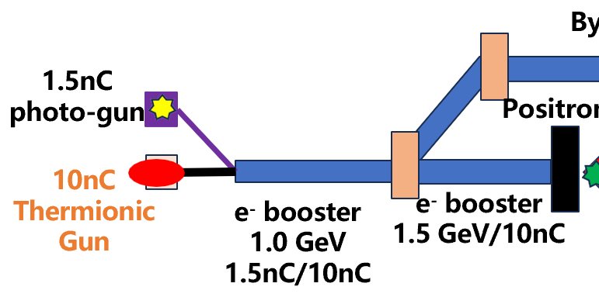
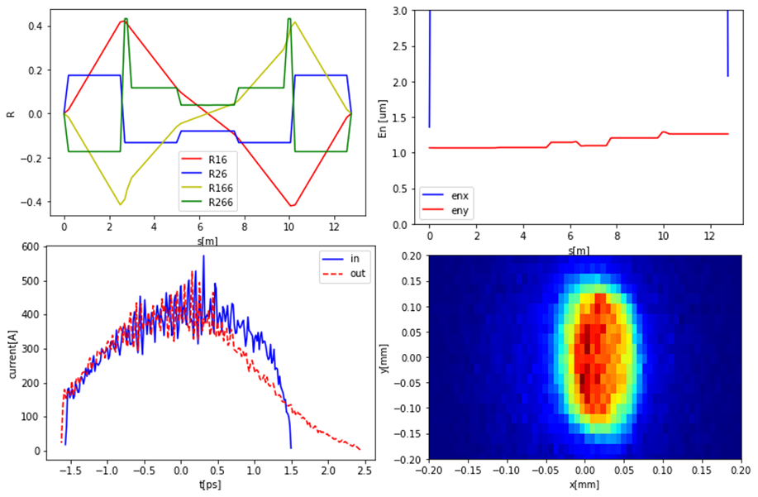
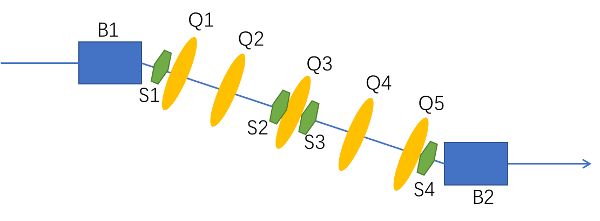
Merging Section
Merger is used to match the two electron beams from different guns to linac
The quality of the beam from photo-cathode gun has higher priority
To eliminate the effects of CSR and high order effects when beam passes the merger, a double-bend-
achromat (DBA) dogleg is designed. Bend angle <20°, vertical distance ~2.5 m, total length ~8 m
5 quadrupoles and 4 sextuples are used to cancel R16/R26/T166/T266, suppress the emittance growth
S2E shows the emittance growth <20%, no significant change on energy spread or bunch length
Merger
Merger Layout

Slide 12
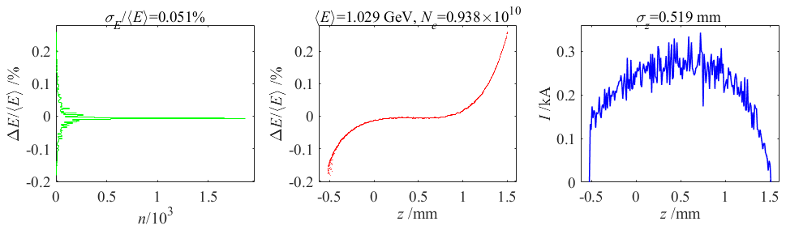



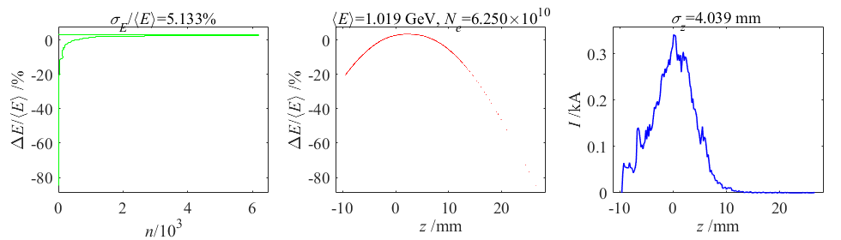
Merge point selection
Beams from two guns merger at same energy to facilitate the linac design
According to optimization, the merge point is selected at 200MeV beam energy
At Photo-cathode gun line exit, the normalized emittance <2 um, energy spread <0.1% @ 1.5nC
At Thermionic gun line exit, the normalized emittance <50 um, energy spread <5 % @ 10 nC
200MeV
Bend
Photo- cathode gun line exit
Photo Gun
A1
A2
A3
A4
LX
BC
Pulsed
bend
1 GeV
Therm Gun
SHB 1&2
BUN A1
A2 A3
A4
200MeV
Thermio nic gun line exit

Slide 13
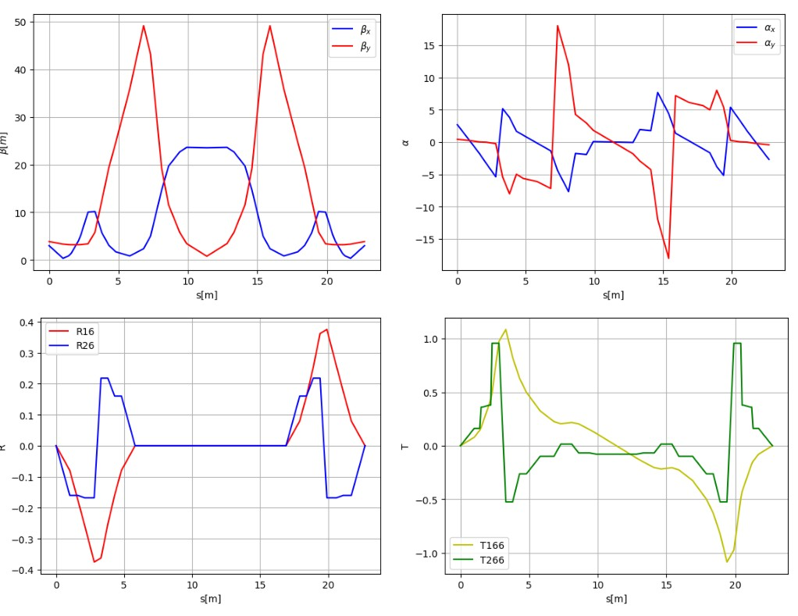
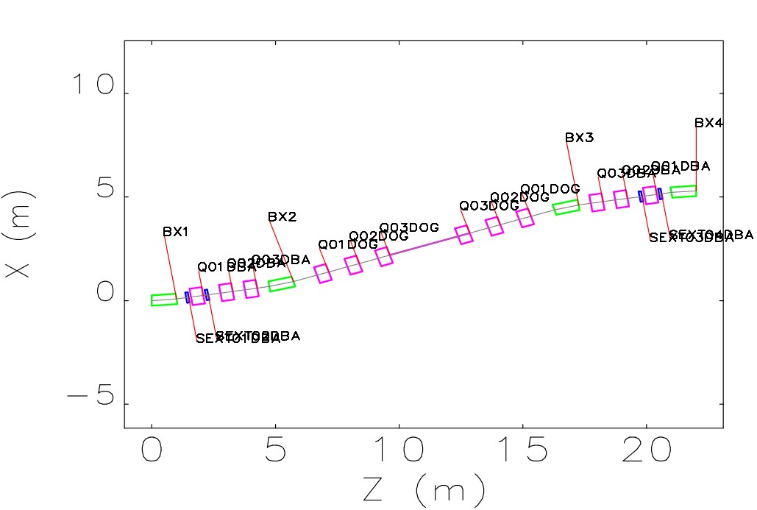
Bypass line
Bypass line transports e beam from the Photo-cathode gun, to be further accelerated in main linac
The design is based on the double DBA dispersion-free scheme, 4 bends with 6° bend angle each, the total length ~150 m
At the exit of the second DBA, the R16/R26/T166/T266 are all eliminated to cancel the second order
dispersion, the emittance growth <10%

Slide 14
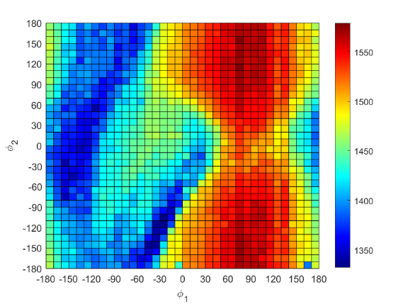
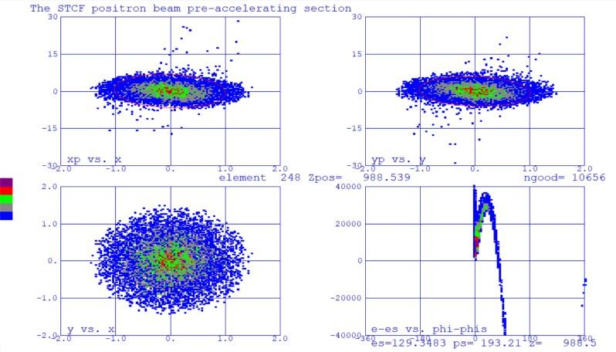
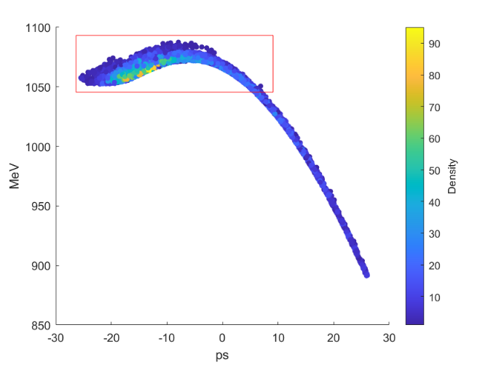
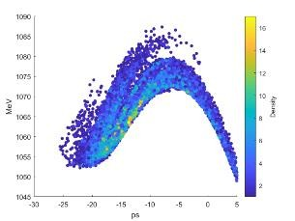
Positron generation and acceleration
Detailed studies were conducted on positron generation and acceleration
After positron generation and acceleration, a damping ring is needed
Phase optimization of Capture Section
Parameter | Off-axis | Swap-out
yield | 0.16 | 0.252
Energy spread | 0.068% | 0.068%
Bunch length | 1.92mm | 1.95mm
Beam size | 1.2mm | 1.2mm
𝜺_{𝒙}/𝒏𝒎 · 𝒓𝒂𝒅 | 795 | 769
𝜺_{𝒚}/𝒏𝒎 ·rad | 1168 | 1185
Phase space of 1GeV positron beam
Main parameter of positron beam

Slide 15
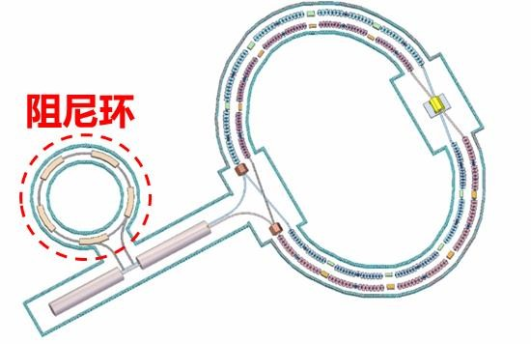




Damping ring for positron bunch
After positron bunch generation, 𝜀_{𝑥} >1400 nm·rad, the damping ring should reduce the emittance and energy spread to acceptable level (𝜀_{𝑥} ≤ 11 nm·rad)
Several bunches are stored in DR to get sufficient damping before extraction
Positron: 1.5nC/30Hz 1400 nm·rad
Damping Ring
1
Bunch space 100ns Store time 100 ms Damping time 30ms
2
5
3
4
Collider Ring 1.5nC/30Hz 11 nm·rad
STCF Positron Damping Ring

Slide 16
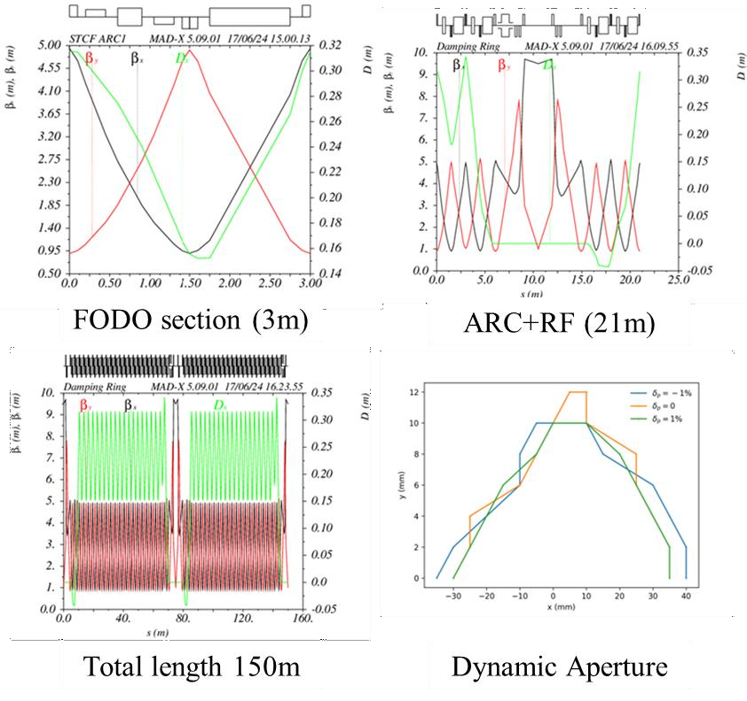
Damping ring for positron bunch
Preliminary lattice design for DR, C=150m，damping time~30ms, natural emittance~8 nm·rad
Reverse bending tech. is used to reduce the damping time
Preliminary results meets the requirements, further studies on DA is ongoing
Main Parameters of STCF DR
Energy (GeV) | 1.0
Circumference (m) | 149.986
Number of bunches | 5
Total current (mA) | 15
Bending radius (m) | 4.456
Dipole strength B0 (T) | 0.749
Damping time τx/τy/τz (ms) | 28.8/28.6/14.2
Natural emittance (nm·rad) | 8.25
Natural energy spread (%) | 0.031
Momentum compaction | 0.0064
Chromaticity x/y | -15.0/-15.3

Slide 17
Summary of injector design for off-axis injection
Two guns to generate different bunch charge：
  P-gun line exit, Q~1.5nC, 𝜀_{𝑛𝑥}<2 mm·mrad, 𝜎_{𝐸} <0.1%, fulfill the requirement of direct injection
  T-gun line exit, Q~10 nC, 𝜀_{𝑛𝑥}<50 mm·mrad, 𝜎_{𝐸} <5 %, fulfill the requirement of positron production
Merger and Bypass line：
  Dispersion-free DBA design to reduce emittance growth in bending section
Positron generation：
  Complete the design of 200MeV positron production and 1GeV acceleration
Damping Ring：
  Complete preliminary design
In general, the injector design faces little challenges.

Slide 18
OUTLINE
C O N T E N T S
1
Introduction
2
Injector design for Off-Axis injection
3
Injector design for Swap-Out injection
4
The positron source design of STCF
5
Summary

Slide 19
Overview of injector for swap-out scheme
The injector need to provide at least 30Hz/8nC electron bunches and 30Hz/8nC positron bunches , which poses great challenges to the design of injector
High charge (> 8 nC) positron bunch with proper quality can not be produced directly from target, so Accumulator Ring (AR) is necessary.
The thermionic gun and the linacs for positron bunch production have a repetition rate over 90Hz. It is near the limitation of commercial klystrons, so a Double-Pulse scheme is under consideration
The electron beam energy is increased to 2.5GeV for production of >2.5 nC positron bunch
Main parameters of injector for swap-out scheme
Bunch charge | 8 | nC
Lifetime | 200 | s
Bunches in CR | 707
Injection bunch charge in AR | 2.5 | nC
Refill current | 90 | %
Refilling Charge | Beam lifetime | Refilling time for | Extraction freq | Injector freq | Injector freq of AR with 2
% | in CR τ(s) | 707 bunches (s) | of AR (Hz) | of AR (Hz) | bunches (Hz)
 | 100 | 10.54 | 67.1 | 268.4 | 134.2
 | 150 | 15.80 | 44.7 | 178.9 | 89.5
90 | 200 | 21.07 | 33.6 | 134.2 | 67.1
 | 300 | 31.61 | 22.4 | 89.5 | 44.7

Slide 20
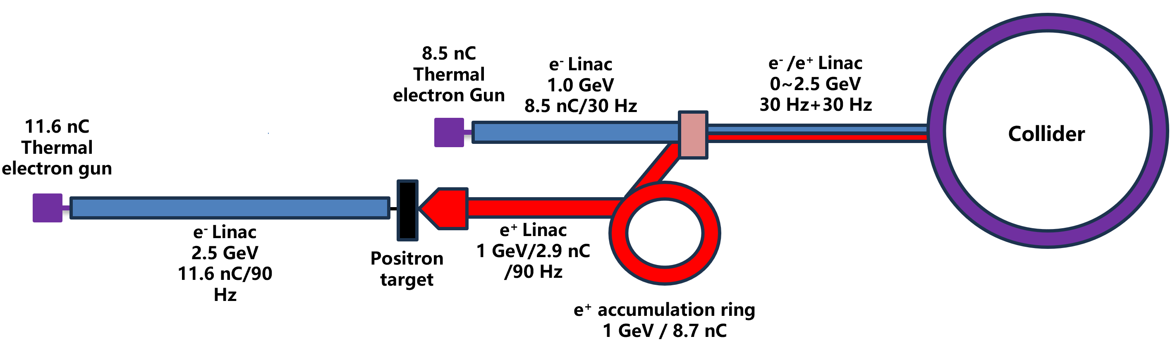
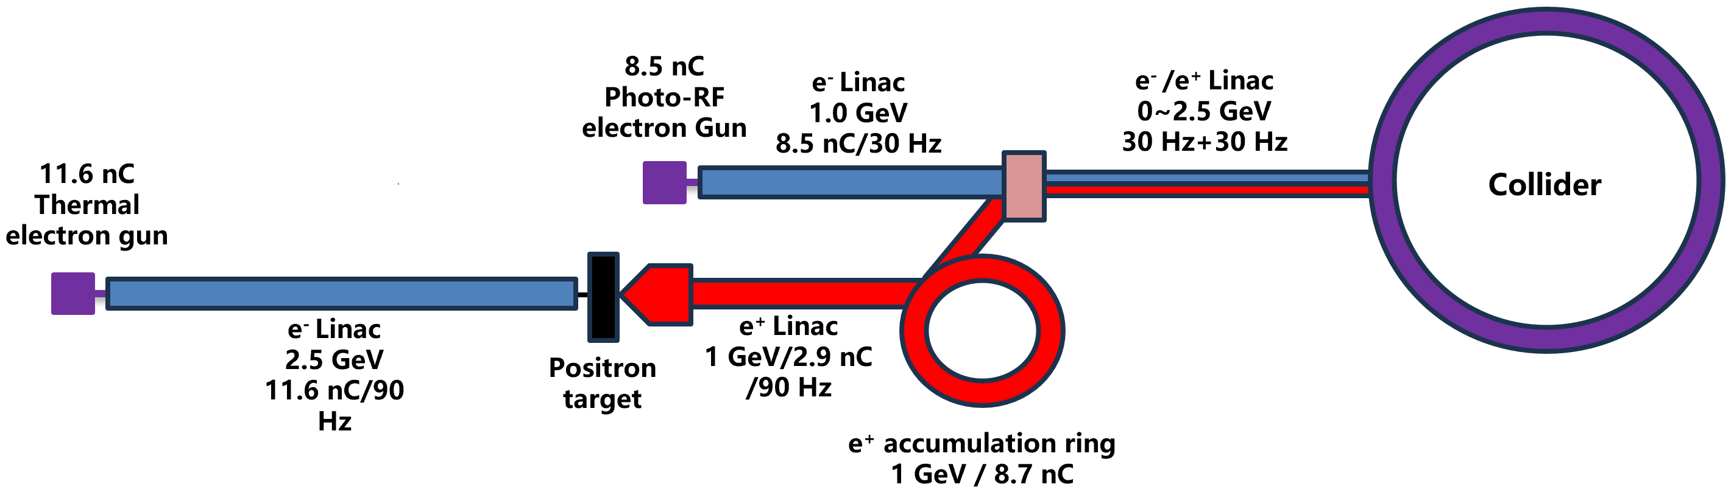
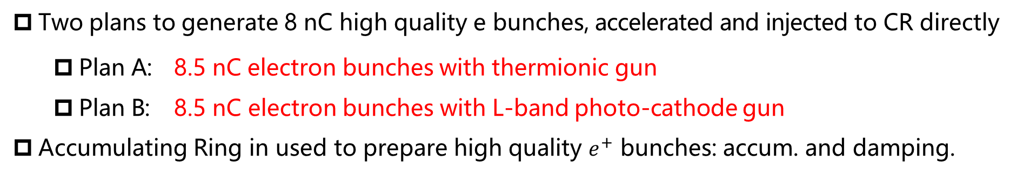
Injector Plan
Two plans to generate 8 nC high quality e bunches, accelerated and injected to CR directly
        Plan A: 8.5 nC electron bunches with thermionic gun
        Plan B: 8.5 nC electron bunches with L-band photo-cathode gun
Accumulating Ring in used to prepare high quality $e^{+}$ bunches: accum. and damping.

Slide 21
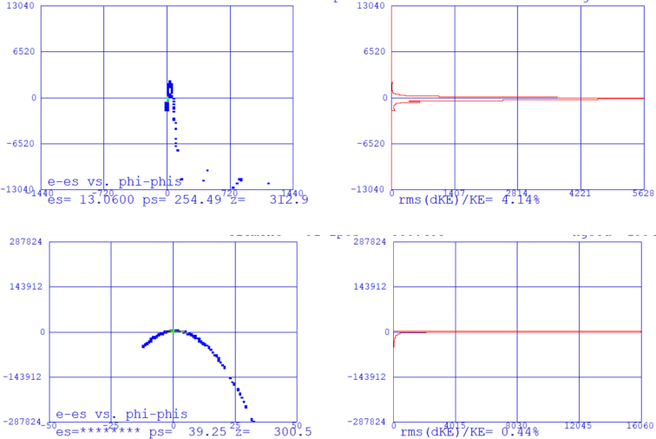
e Injector Plan A
Advantage: Thermionic gun easy to produce electrons over 8nC
Disadvantage: Beam qualities are hard to control, emittance/energy spread need to be verified
Based on the S2E, at the injector exit, the 𝜀_{𝑛} ~42 um,
𝜎_{𝐸} <0.5% (RMS)， 𝜎_{𝐸} ~0.15% (within 6 𝜎), meet the
requirements of swap-out injection
 | Frequency | Voltage/Gain
Gun | DC | 200 kV
SHB1 | 1/18 RF | 100kV
SHB2 | 1/6 RF | 100kV
TW Buncher | 2.998GHz | 12.8MeV
ACC*39 | 2.998GHz | 51 MeV*39
Position | Energy(MeV) | Charge(nC) | Energy Spread(%)
Gun | 0.2 | 10
ACC-1 | 63.84 | 99.74% | 1.61
ACC-2 | 113.29 | 99.74% | 1.61
ACC-3 | 163.41 | 99.74% | 1.72
Injector End | 2002.0 | 9.974 | 0.44
Phase space as buncher and injector exit

Slide 22
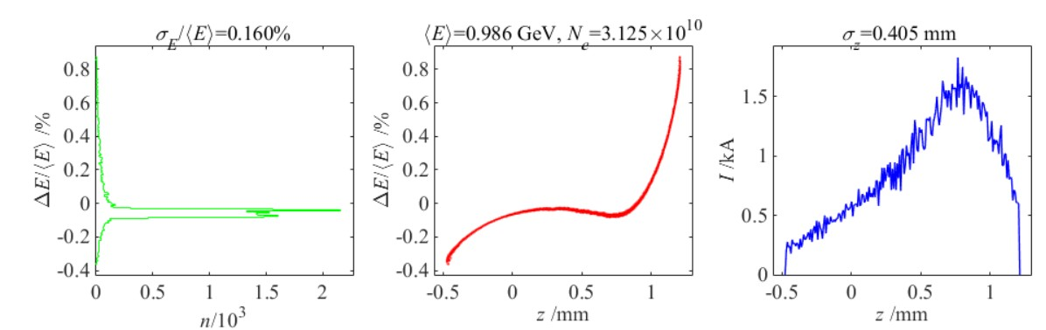
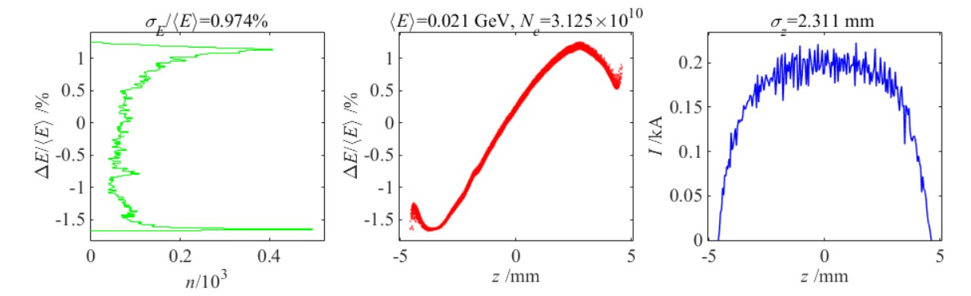
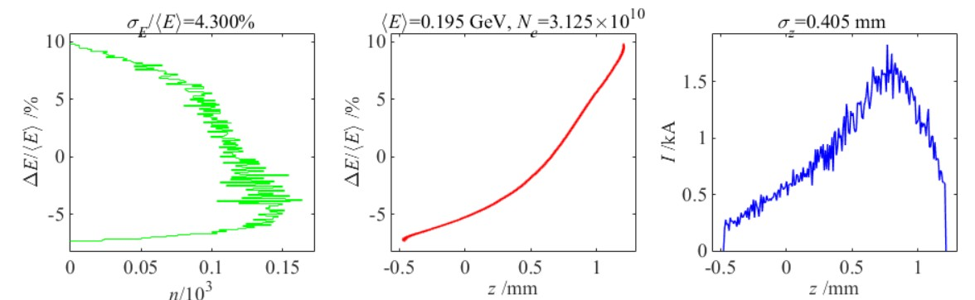
e Injector Plan B
Advantage: L-band photon-gun can provide much better emittance and energy spread
Disadvantage: High demands on vacuum, laser, cathode and lack of experiences of large
bunch charge generation, long term stability
Based on the S2E, at the injector exit, the 𝜀_{𝑛} ~6 um, 𝜎_{𝐸} <0.16 % (RMS)
Much better results compared with plan A (𝜀_{𝑛} ~42 um, 𝜎_{𝐸} <0.5%) → higher luminosity!
BC
L-band Gun
L1
2*Lband
Booster
L2
2*Sband
chirp
X band
X
L3
20 * Sband
S-band
7 MeV
40 MeV
140 MeV
130 MeV
1GeV

Slide 23
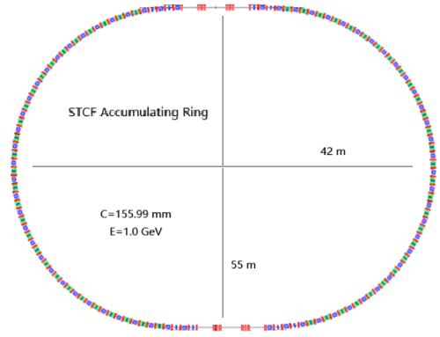
Accumulating Ring design
After positron bunch generation, 𝜀_{𝑥,y} >1400 nm·rad, multiturn injection requires high acceptance and large kicker strength. Difficult.
Large beam emittance needs more damping time to reduce the emittance and energy spread to acceptable level (𝜀_{𝑥} ≤ 11 nm·rad). Many bunches should be stored.
Better to be after a Damping Ring.
Design of DR+AR scheme is ongoing.
Main Parameters of STCF DR
Energy (GeV) | 1.0
Circumference (m) | 155.99
Number of bunches | >4
Total current (mA) | 65.4
Bending radius (m) | 3.37
Dipole strength B0 (T) | 0.998
Damping time τx/τy/τz (ms) | 28.8/28.6/14.2
Natural emittance (nm·rad) | 3.52/0.1
Natural energy spread (%) | 0.0465
Momentum compaction | 0.0027
Chromaticity x/y | -21.4/-22.3

Slide 24
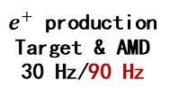
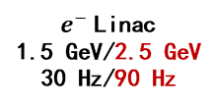
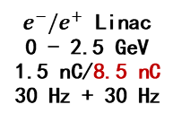

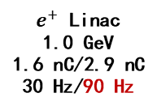
A compatible injector design
Compatible for both Off-Axis and Swap-Out injection of Colliding Rings
Project construction can be two stages
Accumulation of high quality bunches from DR into AR
No obvious challenges in layout and hardware components
1.5 nC/8.5 nC
Photo-
Cathode Gun
30Hz
$e^{−}$ Linac
1.0 GeV
1.5 nC/8.5 nC
30 Hz
$e^{−}/e^{+}$ Linac
0 - 2.5 GeV
1.5 nC/8.5 nC
30 Hz + 30 Hz
10nC/11.6 nC
Thermionic-
Cathode Gun
30Hz/90 Hz
$e^{+}$ production
Target & AMD
30 Hz/90 Hz
$e^{−}$Linac
1.5 GeV/2.5 GeV
30 Hz/90 Hz
$e^{+}$ Linac
1.0 GeV
1.6 nC/2.9 nC
30 Hz/90 Hz
AR
1.0 GeV
8.5 nC
DR
1.0 GeV
~700 m

Slide 25
OUTLINE
C O N T E N T S
1
Introduction
2
Injector design for Off-Axis injection
3
Injector design for Swap-Out injection
4
The positron source design of STCF
5
Summary

Slide 26
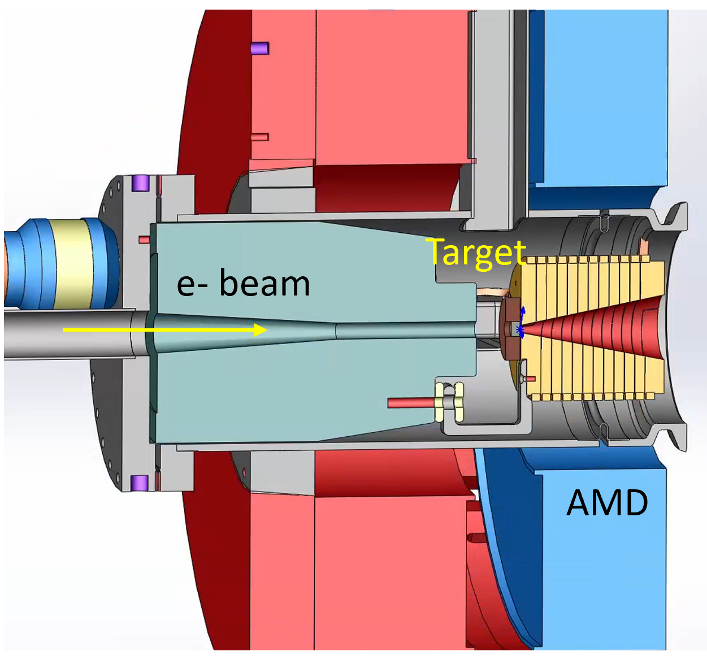
Positron source design
Simulation tools ：Geant4、Fluka
Tungsten, with thicknesses of 13mm and 15mm respectively, and PEDD less than 35J/g.
The peak deposition power, may cause metal lattice changes and affect the yield.
Parameter | Off-axis | Swap-out
Electron bunch | 10 nC | 11.6 nC
Electron energy | 1.5 GeV | 2.5 GeV
Rep. rate | 30 Hz | 90 Hz
Beam size | 0.5 mm | 0.5 mm
Magnetic field | 5↘0.5 T | 5↘0.5 T
Target thickness | 13 mm | 15 mm
Target material | Tungsten | Tungsten
e+ yield efficiency | 0.15 | 0.25
PEDD | 6.3 J/g | 11.5 J/g
Deposit power(w) | 141 w | 495 w
Peak deposit power density | 6.09 kw/cm^3 | 22.34 kw/cm^3

Slide 27
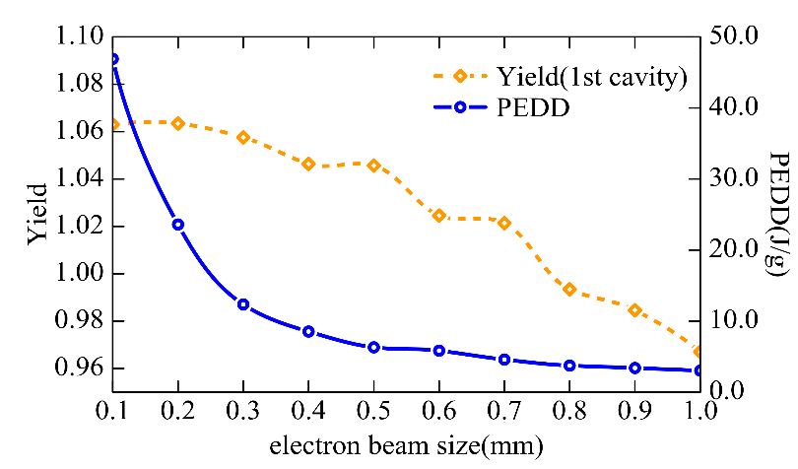
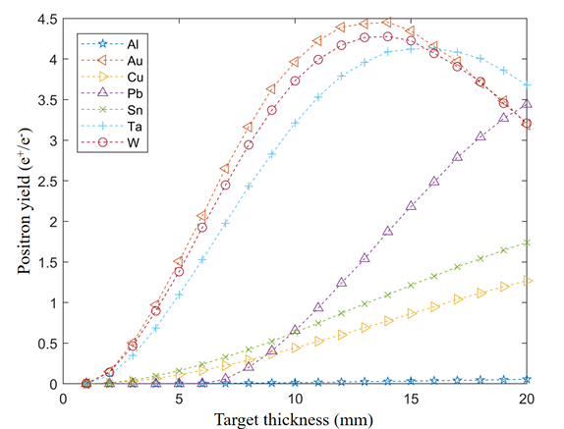
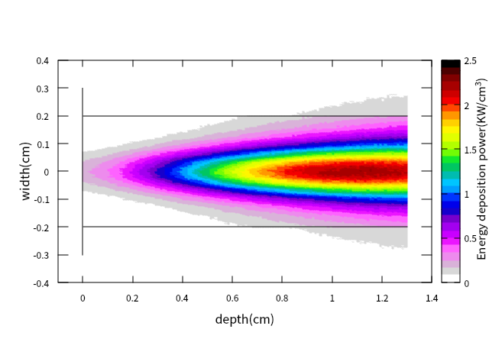
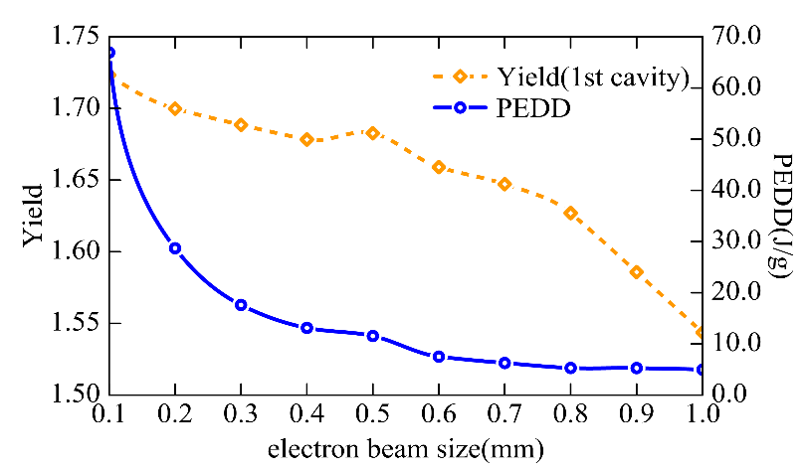
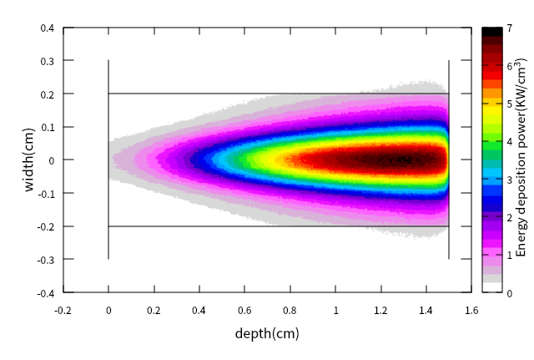
Positron source design：Positron production
Beam size(1mm): thereby reducing PEDD
The average deposition power of the two injection methods is 141w and 495w, resp.
Positron yield and PEDD of different electron size(1.5Gev)
Positron yield under 1.5 GeV electron
Energy deposition of a 1.5 GeV electron beam in a 13 mm thick tungsten
Positron yield and PEDD of different electron size(2.5Gev)
Positron yield under 2.5 GeV electron
Energy deposition of a 2.5 GeV electron beam in a 15 mm thick tungsten

Slide 28
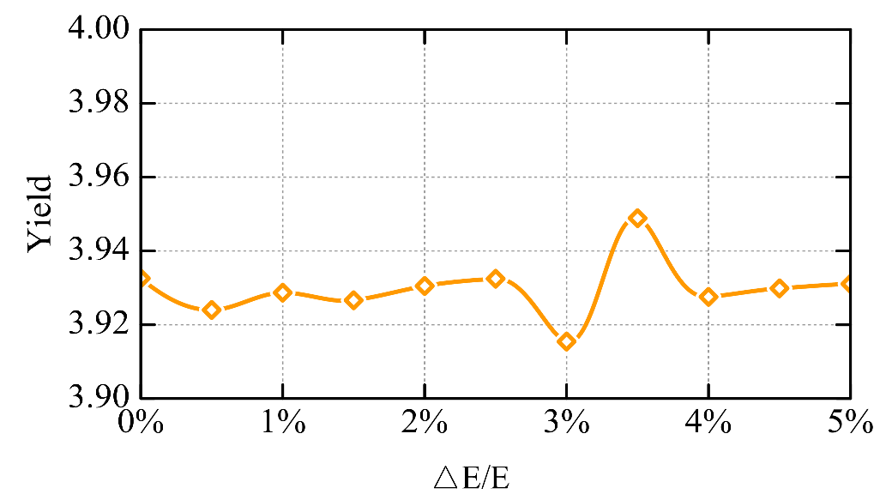
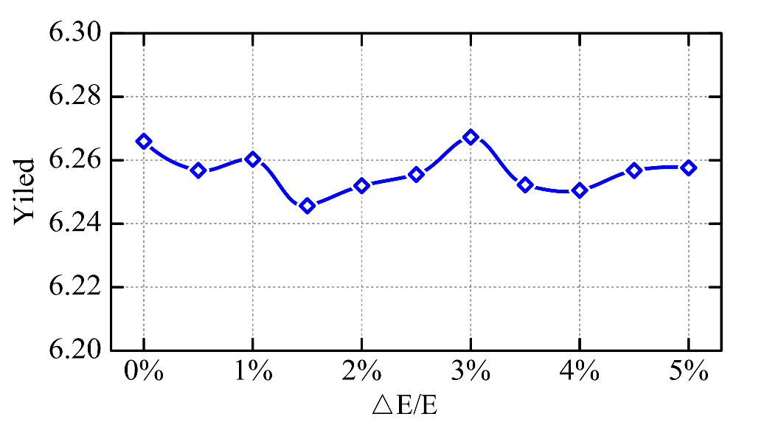
Positron source design ：Positron production
The energy spread of the electron has small impact on the electron yield
Eccentric distance of electron beam should <0.3mm
Positron yield of different electron energy spread(1.5Gev)
Positron yield of different electron energy spread(2.5Gev)
The effect of electron beam target displacement on positron yield

Slide 29
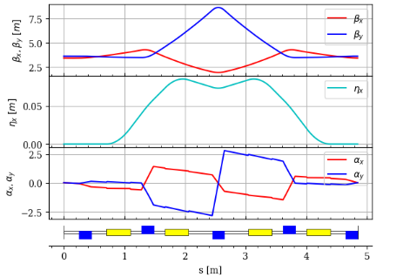
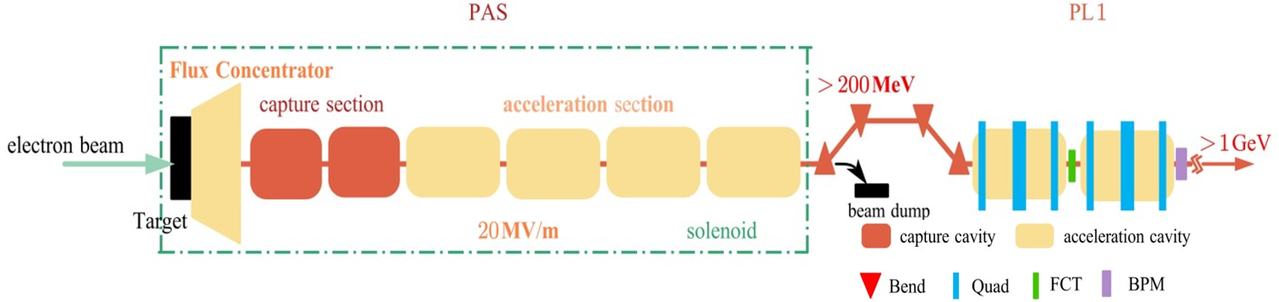
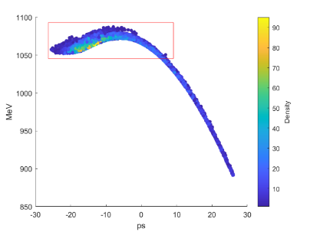
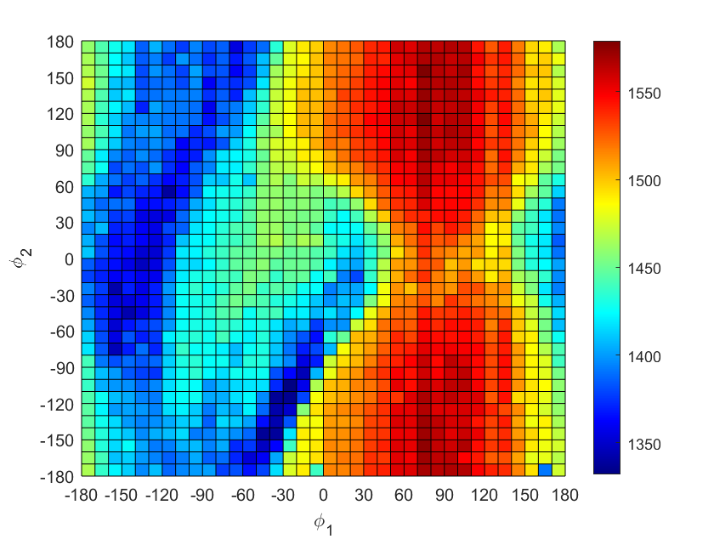
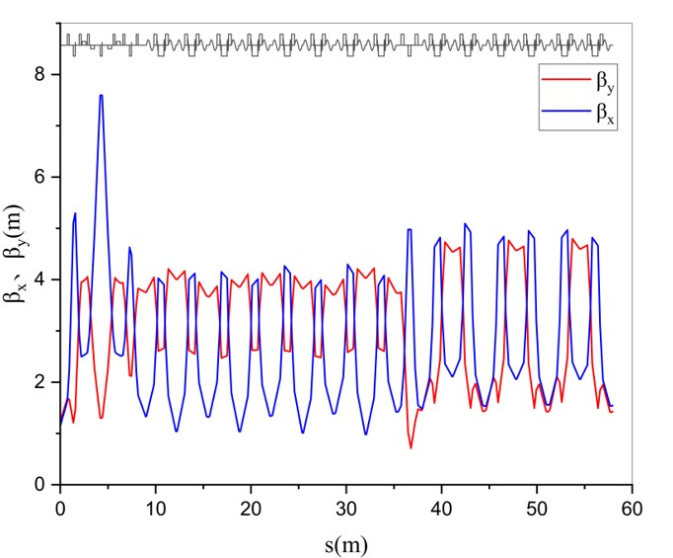
Positron source design: Capture section
1m acceleration sections, four 3m acceleration sections, φ30mm tube.
The peak magnetic field of AMD is 5T, and solenoid is 0.5T
Acceleration gradient : 20MV/m

Slide 30
OUTLINE
C O N T E N T S
1
Introduction
2
Injector design for Off-Axis injection
3
Injector design for Swap-Out injection
4
The positron design of STCF
5
Summary

Slide 31
Summary
Two injector designs for both off-axis and swap-out injection scheme.
For off-axis scheme, the injector with two beams generated by two guns was studied, together with Damping Ring, both the electron and positron bunches can meet the requirements.
For swap-out scheme, we studied two plans (thermionic gun / L band gun) for electron injector, L band photocathode gun is preferred. Accumulation Ring for positron beam is necessary and challenging.
A compatible design for off-axis and swap-out injection schemes is proposed. DR+AR scheme is chosen to easily realize both injection schemes for positron beam.
Positron bunch production and preparation is studied for both injection schemes.
Further studies are ongoing.

Slide 32
Thank you!

