Slide 1
Polarization Status at the EIC
Vahid Ranjbar
L2 Manager, WBS 6.03 Electron Injector
eeFACT 2025
Tsukuba, Japan
March 3-7, 2025

Slide 2
CoAuthor’s
Christoph Montag (Brookhaven National Laboratory)
Eiad Hamwi (Cornell University (CLASSE))
Erdong Wang (Brookhaven National Laboratory)
Georg Hoffstaetter (Cornell University (CLASSE))
Haixin Huang (Brookhaven National Laboratory)
Henry Lovelace III (Brookhaven National Laboratory)
Kiel Hock (Brookhaven National Laboratory)
Matthew Signorelli (Cornell University (CLASSE))
Sergei Nagaitsev (Brookhaven National Laboratory (BNL))
Vadim Ptitsyn (Brookhaven National Laboratory (BNL))
Vincent Schoefer (Brookhaven National Laboratory)
William Bergan (Brookhaven National Laboratory)

Slide 3
Outline
Updated to EIS Layout
  Moving RCS out of RHIC tunnel
  New EIS approach
Spin Dynamics Review
RCS Electron Polarization
  Design Principle
  Polarization Loss analysis and counter measures
ESR Electron Polarization
Hadron Polarization
  AGS
  HSR

Slide 4
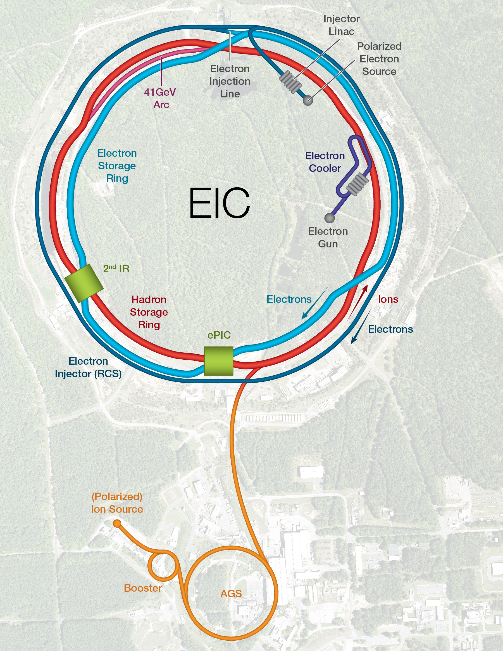
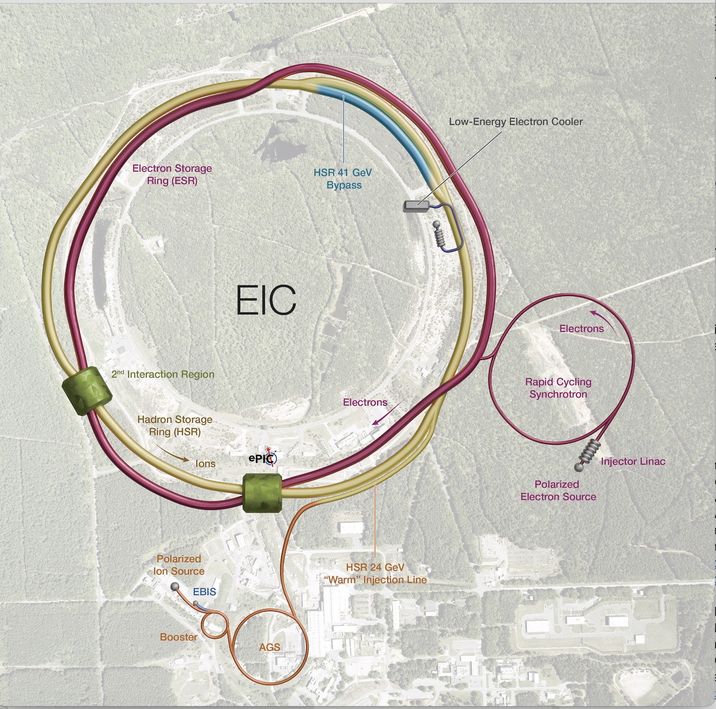
Moving RCS out of RHIC Tunnel

Slide 5
EIS Approach with RCS out of RHIC tunnel
Pre-injector: Front End → delivers up 1 nC of bunch charge with 88% polarization
  Source already exists need to build buncher and transport line to LINAC
Pre-injector: S-Band LINAC → accelerates 1 bunch to 750 MeV
  Capable of being cycled up to 28 times per acceleration cycle (30Hz):
BAR (Beam Accumulator Ring)→ to achieve 28 nC/bunch in the RCS we will use an accumulator ring
RCS will accelerate from 750 MeV to 5 and 10 GeV energy delivering one bunch of 7 nC every second. This will fill ESR in under 20 mins.
Path to 18 GeV :
6 additional RF installation

Slide 6

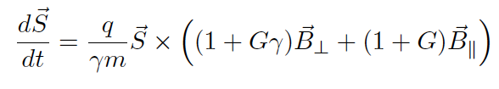
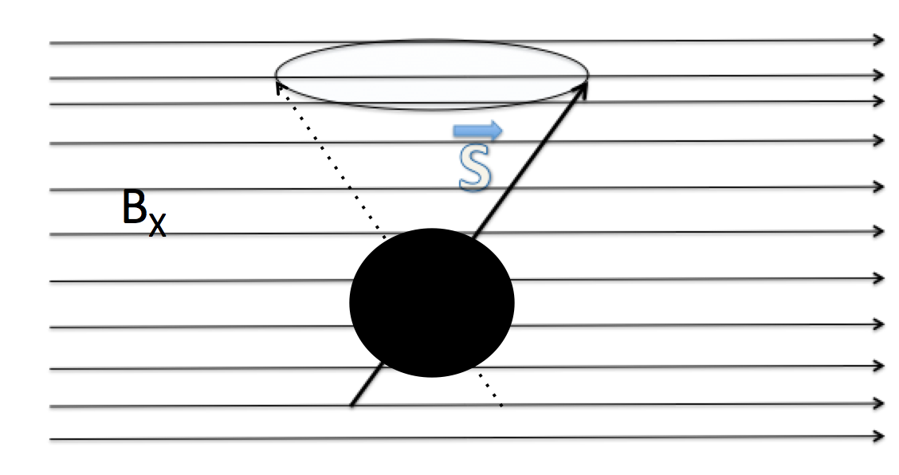
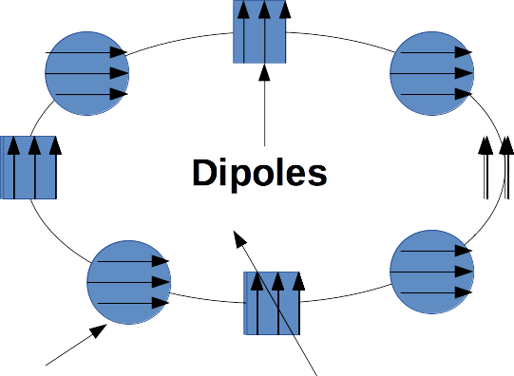
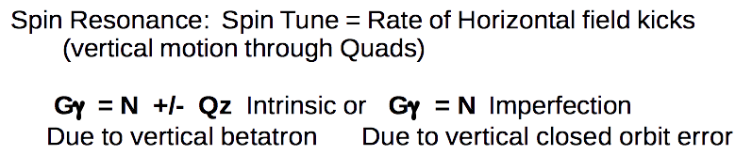
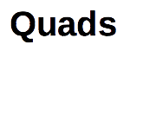
Spin Resonance Review

Slide 7
Periodicity and Tune Considerations
Both the strong intrinsic and imperfection resonances occur at:
  K = nP +/- Qy
  K = nP +/- [Qy] (integer part of tune)
  P is lattice periodicity and n any positive integer.
To accelerate from 750 MeV to 18 GeV requires the spin tune ramping from
  1.702 < Gϒ < 41.
We need to choose vertical tune and P = periodicity to avoid intrinsic spin resonance in this energy range.
To keep RCS compact we also like to minimize periodicity while also keeping phase advance per cell < 120 degrees for decent beam dynamics. These constraints can be summarized:
  Qy/P < 1/3 → to keep phase advance per cell < 120 degrees
  Qy > 41 → to avoid 0+Qy intrinsic spin resonance in energy range
  Or 41*3 = 123 < P

Slide 8
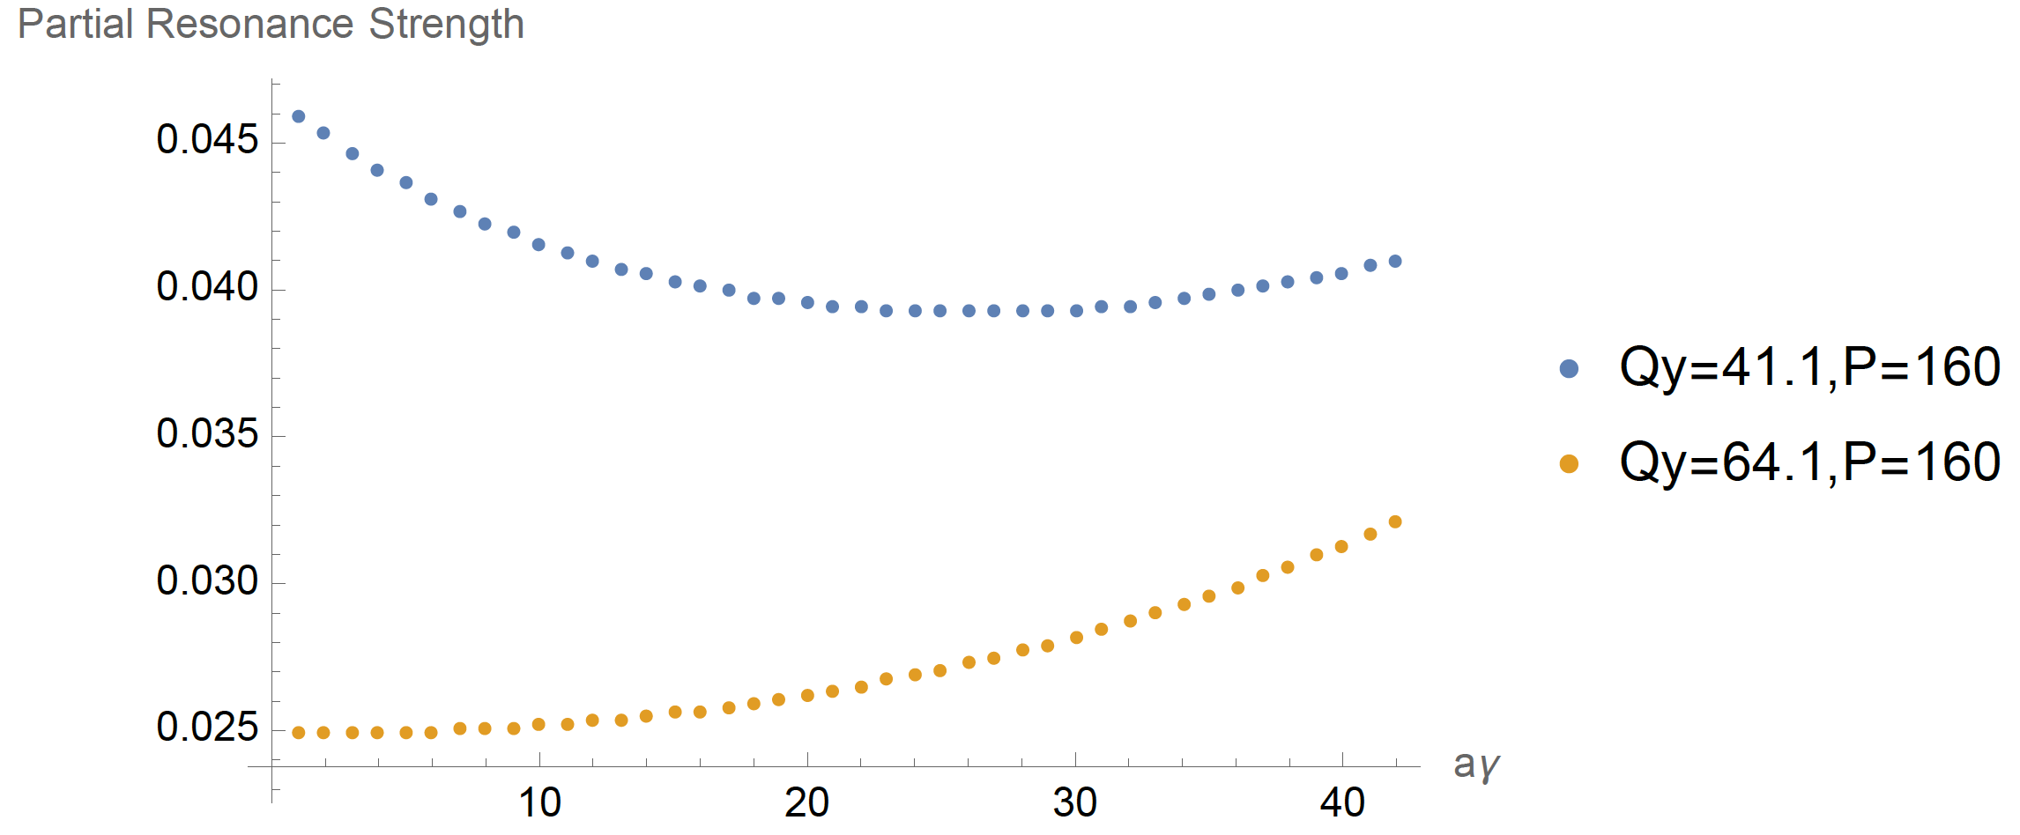
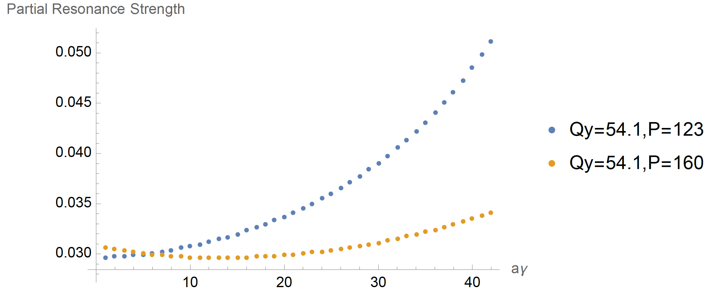
Importance of High Tune and Periodicity
Studies of lattices with various tunes and periodicities have shown that the response to imperfections for a fixed level of quadrupole misalignments scale with the tune and periodicity.
  The higher the tune and number of arc FODO cells the better the polarization response
This is confirmed by thin lens resonance analytical approximations
We choose Qy= 58 and P=160

Slide 9
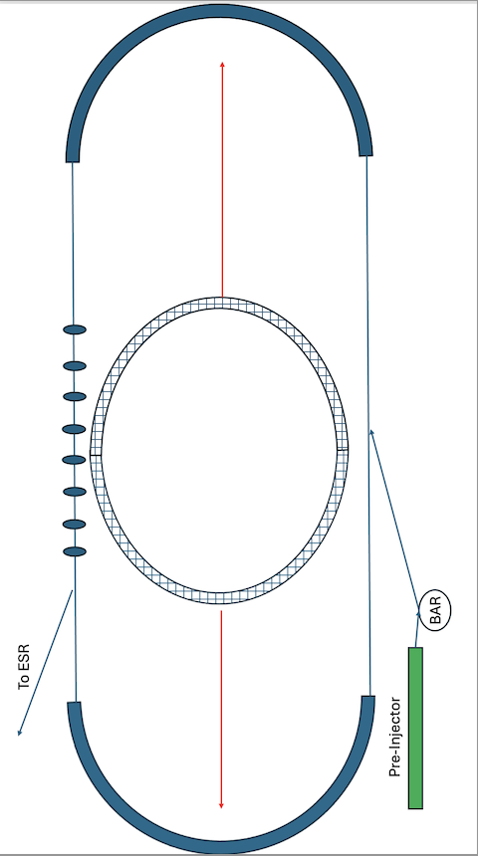
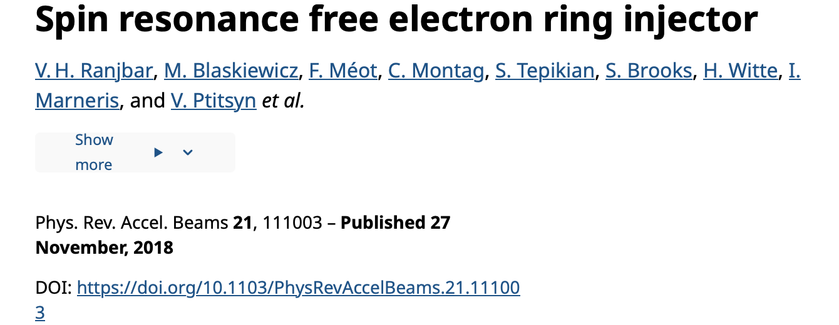
RCS Lattice Layout and Spin Transparent Design
Need room for the ability to install up to 130 MV of RF voltage and accommodate injection and extraction
However this will spoil the high periodicity of we need to avoid the impact of depolarizing spin resonances i.e. with a race track design the periodicity “P” would be 2 and we would see intrinsic and strong imperfections in our range of energy acceleration.
To avoid breaking spin periodicity the vertical phase advance across straight to 2πN. (the original RCS spin transparent concept). We choose 4π.

Slide 10
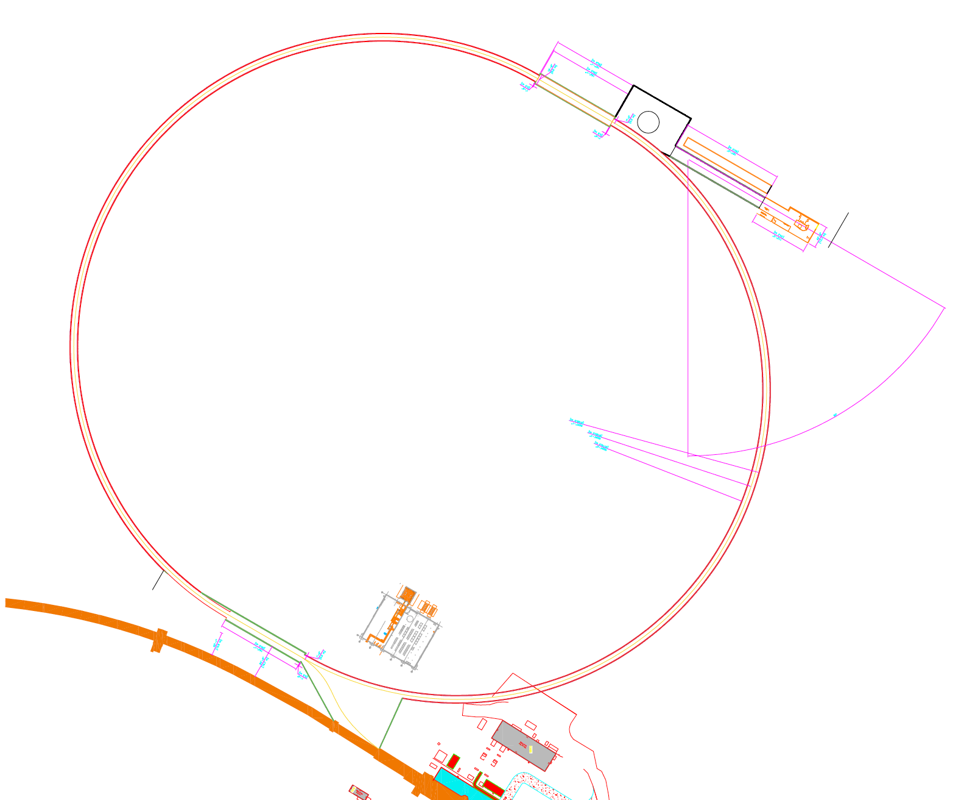
RCS lattice Parameters
Circumference = 1421.25 m
Qx = 35 – 41
Qy = 58
Ɣ_{T} = 31.82 – 37.37
Natural Chrom X,Y = -53.92, -92.61
β_{x} max = 23 - 26.78 m
β_{y} max = 24.24-30 m
Dx max = 0.46 - 0.564 m
rho = 91.67 m
NCells = 160 with 80 per arc
Dipole Magnet length = 1.8 m
Quadrupole Magnet Length = 0.6 m
Muy = 0.3383 → 121.78 degrees
Mux = 0.225 → 81 degrees
  Chosen to make arc = integer to keep dispersion close to zero in straights
  80*0.225 = 18

Slide 11
Ramp to 18 GeV
100 msec ramp to 18 GeV (6.5 T/s) will permit ramping with 85% polarization delivered to the ESR ~ 0.4 mm rms vertical orbit distortion
Additional corrections possible via imperfection bumps guided by RCS Compton polarimeter capable of measuring polarization loss on the ramp
Avg. Orbit RMS (mm) | Avg. Max Orbit (mm) | Pol. at 5 GeV (%) | Pol. at 10 GeV (%) | Pol. Eff. to 18 GeV (%) | Pol. at 18 GeV (%)
0.423 | 1.22 | 87 | 87 | 96.7 | 85
0.635 | 1.83 | 87 | 87 | 92.8 | 81.6
0.848 | 2.44 | 87 | 87 | 87.7 | 77.2
1.277 | 3.68 | 87 | 87 | 74.4 | 65.4
Table of Polarization delivered to ESR up to 18 GeV assuming 88% from pre-injector averaged over 100 random seeds. Using 100 msec ramp rate to 18 GeV

Slide 12
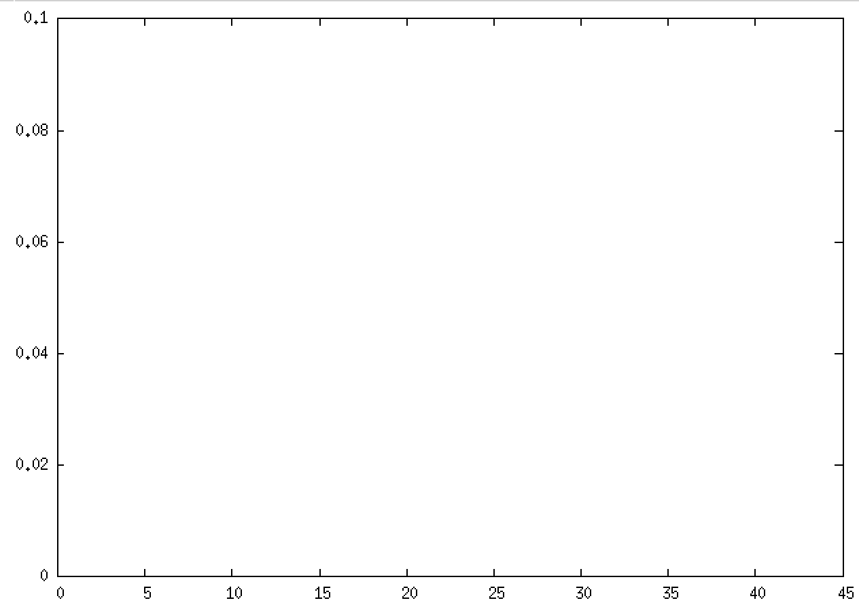
Imperfection Bump → In case Orbit Smoothing isn’t enough
Using Correctors can create imperfection spin resonances to cancel out existing imperfection spin resonances
Measure Polarization continuously during the acceleration ramp to identify polarization drops.
Tune them out using these bumps.
Similar to harmonic bumps → Sin(10*θ) used in AGS for many years
Get imperfection at every Gɣ=n*10
Using SVD to invert Imperfection to corrector response matrix, I can create resonance “bump” exactly at Gɣ=15 and nowhere else.
|𝝐|
Gɣ

Slide 13
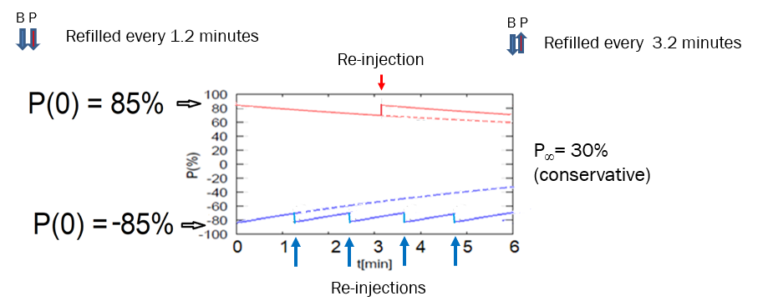
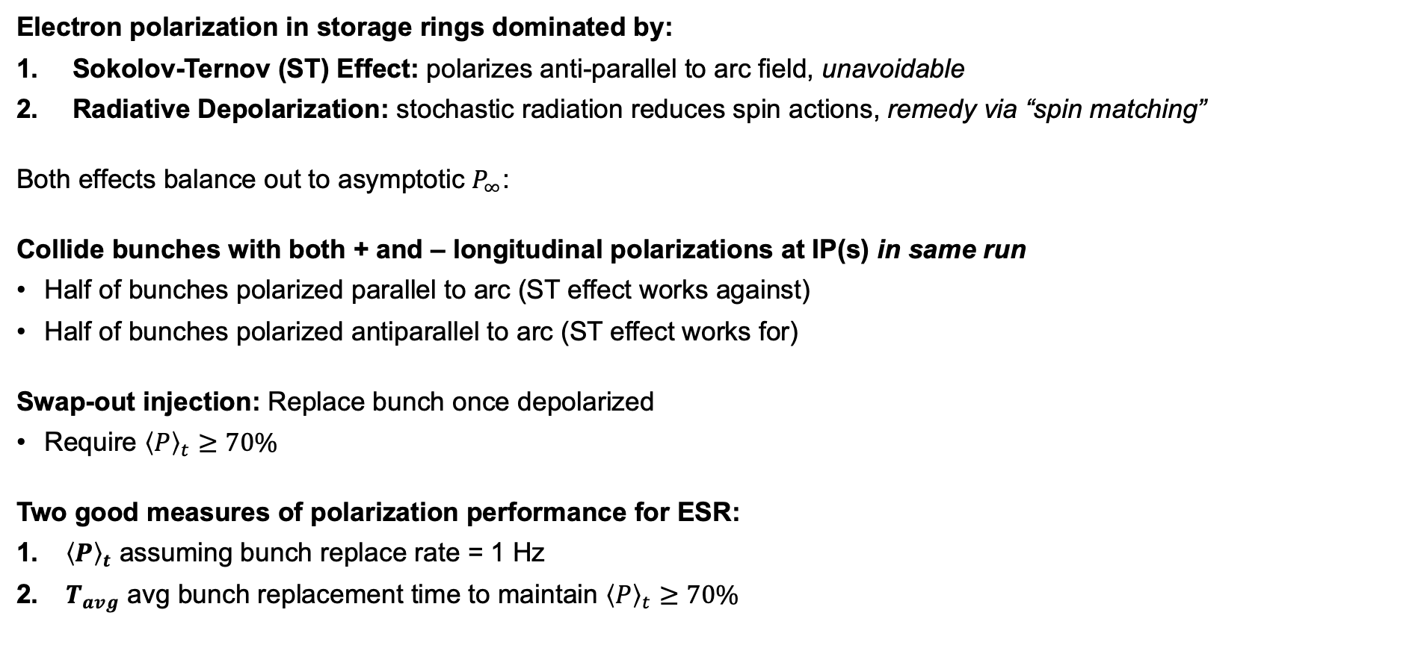
ESR Polarization: Background
Thanks :Matt Signorelli
Electron polarization in storage rings dominated by:
Sokolov-Ternov (ST) Effect: polarizes anti-parallel to arc field, unavoidable
Radiative Depolarization: stochastic radiation reduces spin actions, remedy via “spin matching”
Both effects balance out to asymptotic $P_{∞}$:
Collide bunches with both + and – longitudinal polarizations at IP(s) in same run
Half of bunches polarized parallel to arc (ST effect works against)
Half of bunches polarized antiparallel to arc (ST effect works for)
Swap-out injection: Replace bunch once depolarized
Require ${\left\langle P\right\rangle }_{t}≥70\%$
Two good measures of polarization performance for ESR:
${\left\langle P\right\rangle }_{t}$ assuming bunch replace rate = 1 Hz
$T_{avg}$ avg bunch replacement time to maintain ${\left\langle P\right\rangle }_{t}≥70\%$
$$P\left(t\right)=P_{∞}\left(1−e^{−t/τ_{eq}}\right)+P_{0}e^{−t/ τ_{eq}}, τ_{eq}^{−1}=τ_{ST}^{−1}+τ_{dep}^{−1}$$

Slide 14
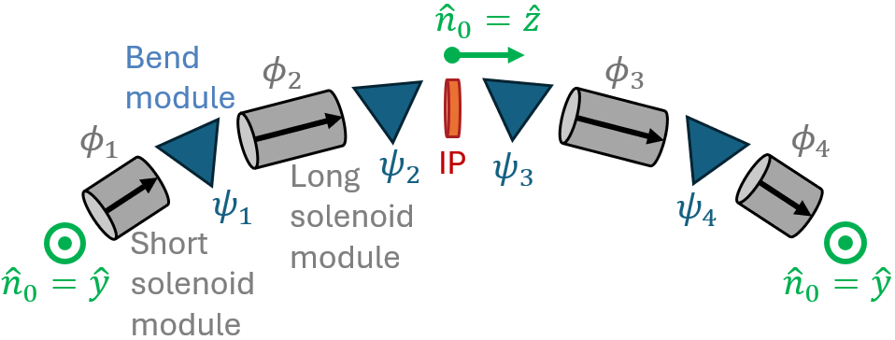
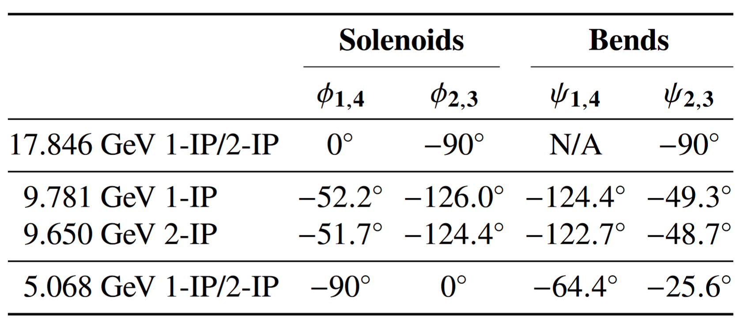
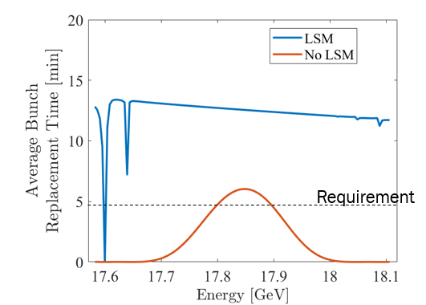
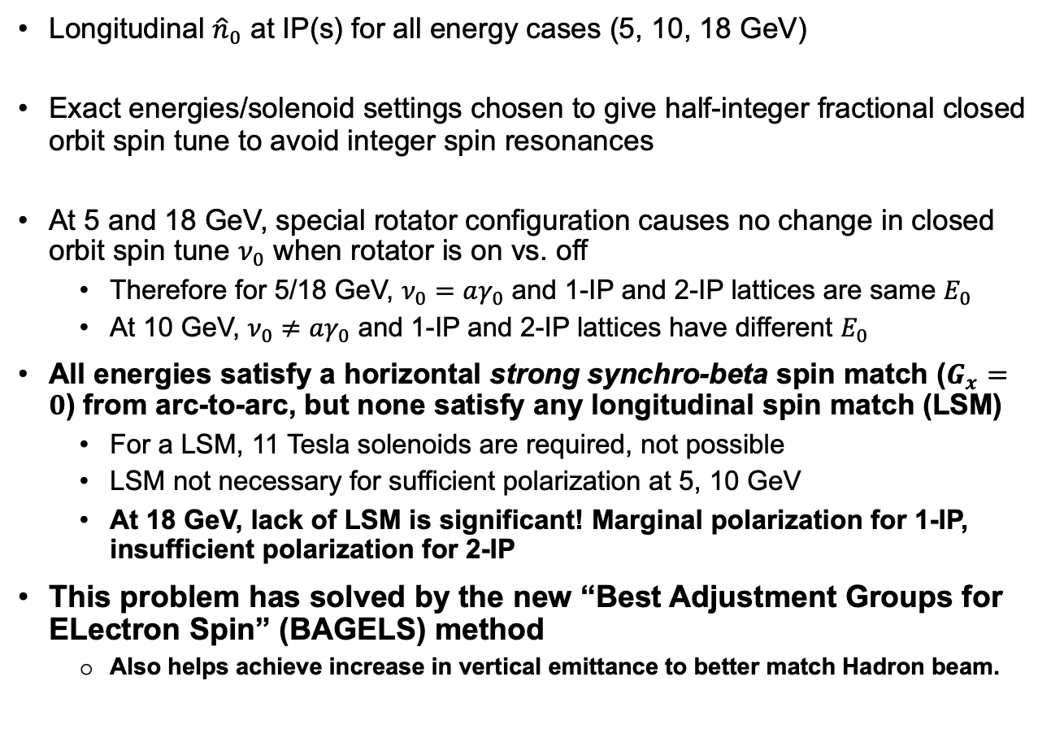
Background
Thanks :Matt Signorelli
Longitudinal ${\hat{n}}_{0}$ at IP(s) for all energy cases (5, 10, 18 GeV)
Exact energies/solenoid settings chosen to give half-integer fractional closed orbit spin tune to avoid integer spin resonances
At 5 and 18 GeV, special rotator configuration causes no change in closed orbit spin tune $ν_{0}$ when rotator is on vs. off
  Therefore for 5/18 GeV, $ν_{0}=aγ_{0}$ and 1-IP and 2-IP lattices are same $E_{0}$
  At 10 GeV, $ν_{0}≠aγ_{0}$ and 1-IP and 2-IP lattices have different $E_{0}$
All energies satisfy a horizontal strong synchro-beta spin match ($G_{x}=0$) from arc-to-arc, but none satisfy any longitudinal spin match (LSM)
  For a LSM, 11 Tesla solenoids are required, not possible
  LSM not necessary for sufficient polarization at 5, 10 GeV
  At 18 GeV, lack of LSM is significant! Marginal polarization for 1-IP, insufficient polarization for 2-IP
This problem has solved by the new “Best Adjustment Groups for ELectron Spin” (BAGELS) method
  Also helps achieve increase in vertical emittance to better match Hadron beam.

Slide 15
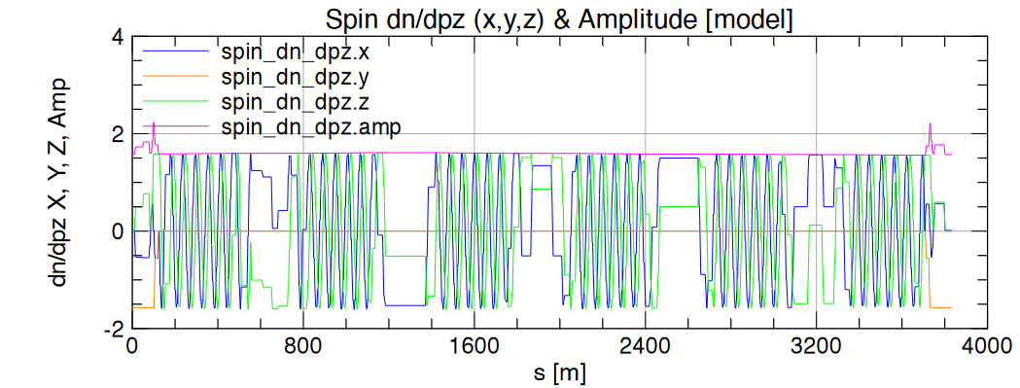
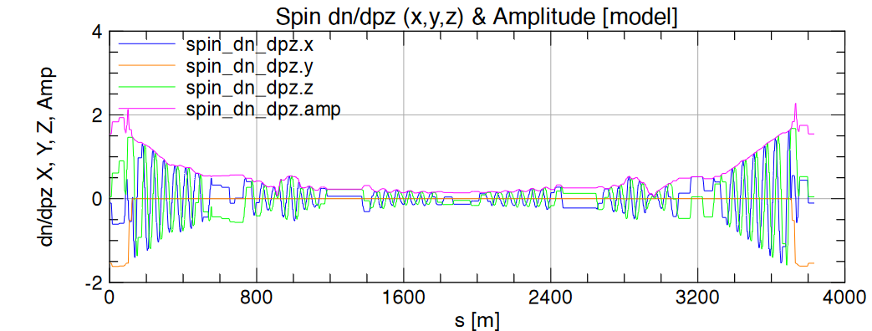
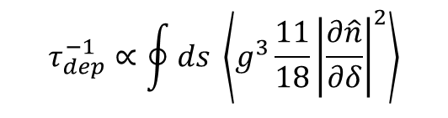
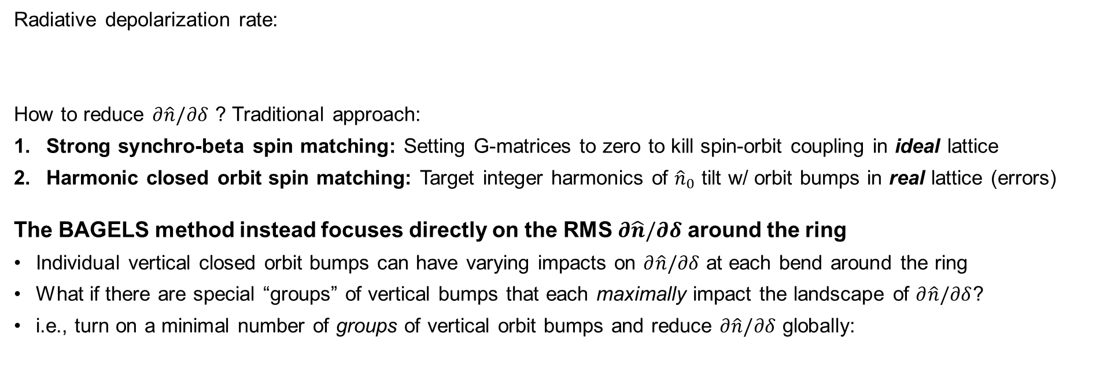
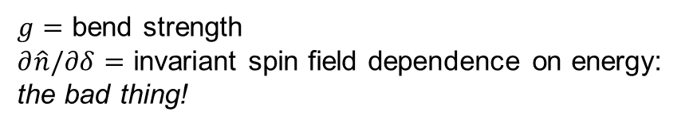
The BAGELS Method
Thanks :Matt Signorelli
Radiative depolarization rate:
How to reduce $∂\hat{n}/∂δ$ ? Traditional approach:
Strong synchro-beta spin matching: Setting G-matrices to zero to kill spin-orbit coupling in ideal lattice
Harmonic closed orbit spin matching: Target integer harmonics of ${\hat{n}}_{0}$ tilt w/ orbit bumps in real lattice (errors)
The BAGELS method instead focuses directly on the RMS $∂\hat{n}/∂δ$ around the ring
Individual vertical closed orbit bumps can have varying impacts on $∂\hat{n}/∂δ$ at each bend around the ring
What if there are special “groups” of vertical bumps that each maximally impact the landscape of $∂\hat{n}/∂δ$?
i.e., turn on a minimal number of groups of vertical orbit bumps and reduce $∂\hat{n}/∂δ$ globally:
$$τ_{dep}^{−1}∝\oint{ds} \left\langle g^{3}\frac{11}{18}{\left|\frac{∂\hat{n}}{∂δ}\right|}^{2}\right\rangle$$
$g=$ bend strength
$∂\hat{n}/∂δ=$ invariant spin field dependence on energy: the bad thing!
Orbit bumps (??)

Slide 16
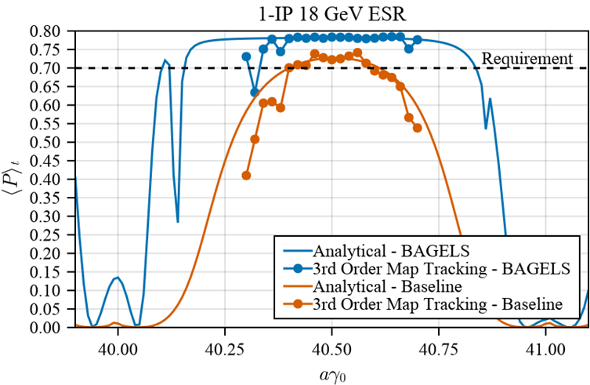
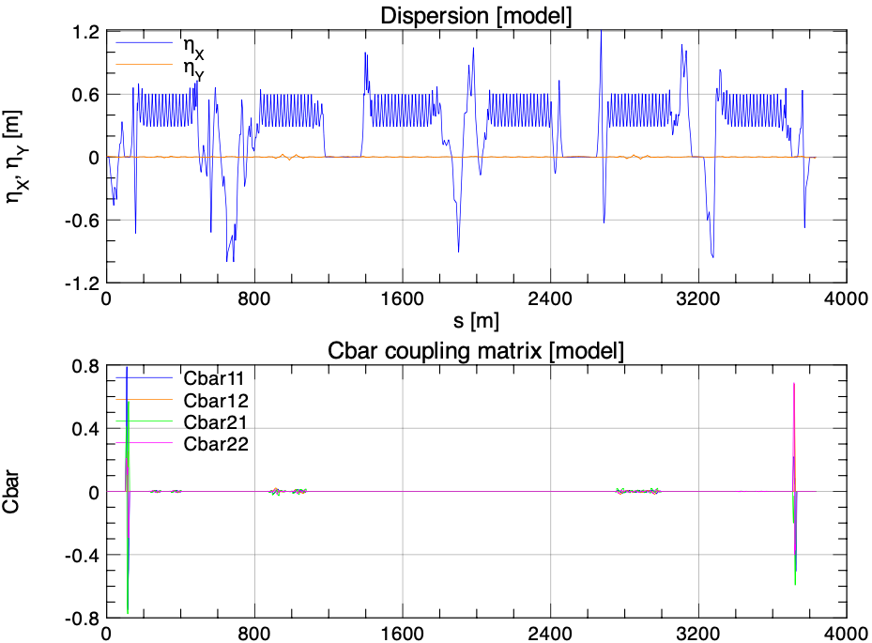
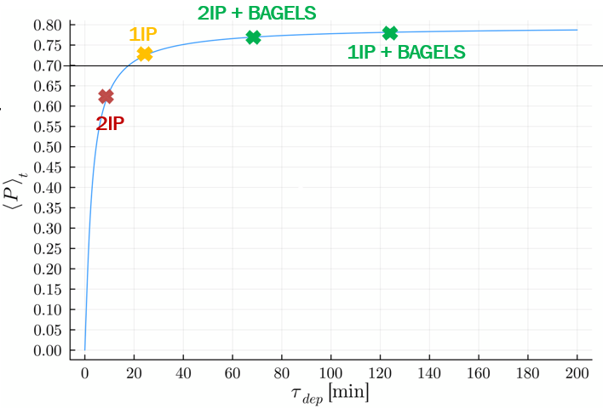
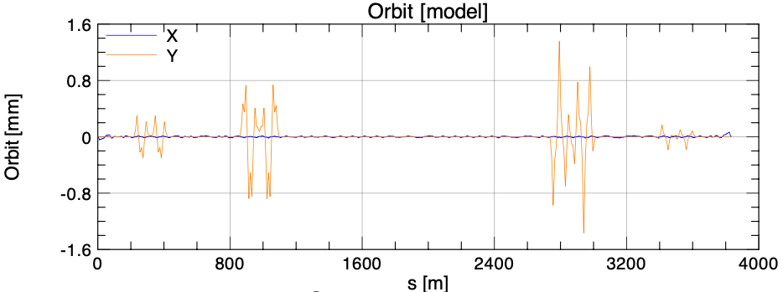
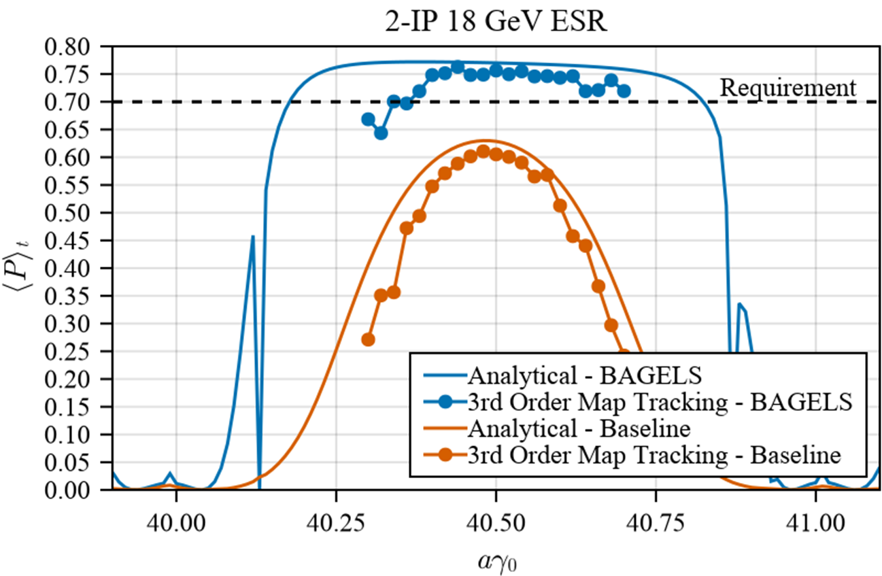
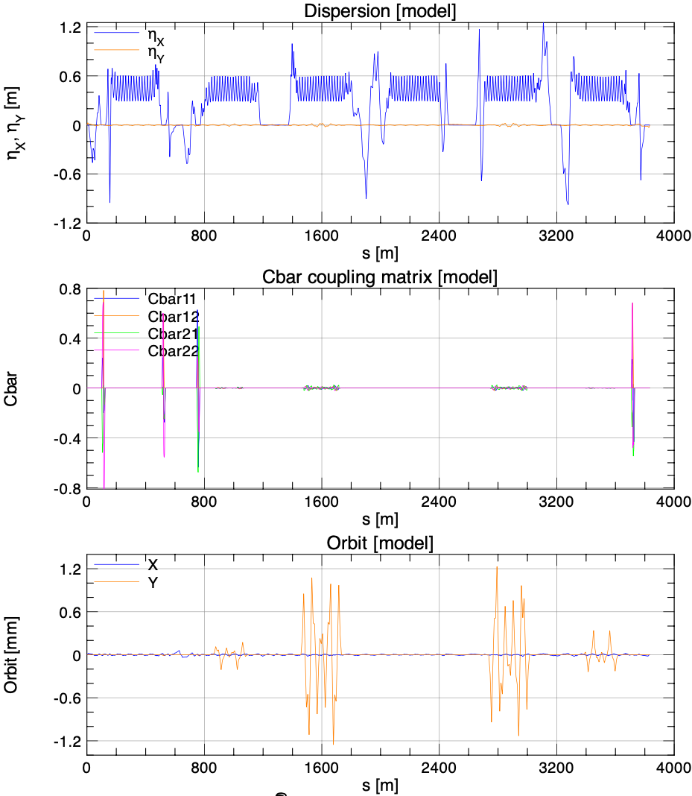

High Polarization at 18 GeV
Thanks :Matt Signorelli
Choice of unit bump: “Opposing $2πn$-bumps” for no delocalized coupling & no delocalized vertical dispersion
Turning only 4 knobs until polarization is maximal:
Max orbit excursion < 1.4 mm
Polarization requirements now exceeded for both 1- and 2-IP 18 GeV lattices

Slide 17
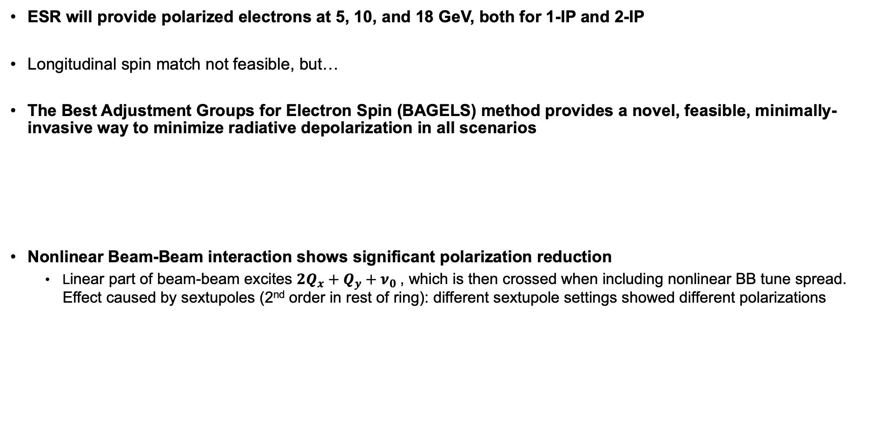
Conclusions and Future Study
Thanks :Matt Signorelli
ESR will provide polarized electrons at 5, 10, and 18 GeV, both for 1-IP and 2-IP
Longitudinal spin match not feasible, but…
The Best Adjustment Groups for Electron Spin (BAGELS) method provides a novel, feasible, minimally-invasive way to minimize radiative depolarization in all scenarios
Nonlinear Beam-Beam interaction shows significant polarization reduction
  Linear part of beam-beam excites $2Q_{x}+Q_{y}+ν_{0}$, which is then crossed when including nonlinear BB tune spread. Effect caused by sextupoles (2nd order in rest of ring): different sextupole settings showed different polarizations
  18 GeV 1-IP lattice far exceeds requirements
  18 GeV 2-IP lattice now exceeds requirements
  Global coupling correction scheme exceeds requirements for 10 error seeds
  Vertical emittance creation using BAGELS bumps exceeds requirements

Slide 18
Hadron Polarization
2 Siberian Snakes/ring
 | Max Energy [GeV] | Pol. At Max Energy [%]
Source+Linac | 1.1 | 82-84
Booster | 2.5 | ~80-84
AGS | 23.8 | 67-70 | p-Carbon
RHIC | 255 | 55-60 | Jet, full store avg*
Spin flipper
Absolute Polarimeter (H jet)
RHIC pC Polarimeters
PHENIX
STAR
Spin Rotators
(longitudinal polarization)
Spin Rotators
(longitudinal polarization)
LINAC
BOOSTER
Existing RHIC ion accelerator complex will be re-used for EIC.
Yellow RHIC ring will be used for EIC hadron beam with some modifications (additional 4 snakes, modified injection and IR region, by-pass to achieve 41 GeV operations) → Now called HSR
On-going upgrade of ion source EBIS will provide capability of polarized ³He.
The present injector chain will be entirely re-used. (EBIS, Linac, Booster, AGS)
  AGS Horizontal spin resonance cancelation → pulsed skew quads
Pol. H⁻ Source
Helical Partial
Siberian Snake
200 MeV Polarimeter
AGS
AGS Polarimeter
Strong AGS Snake
Upgrades Should boost Polarization 60%→ 70%
  6 Snakes and cooling HSR transmission →100%
  AGS can only give 70% at low intensity
    work is needed to achieve at high Intensity

Slide 19
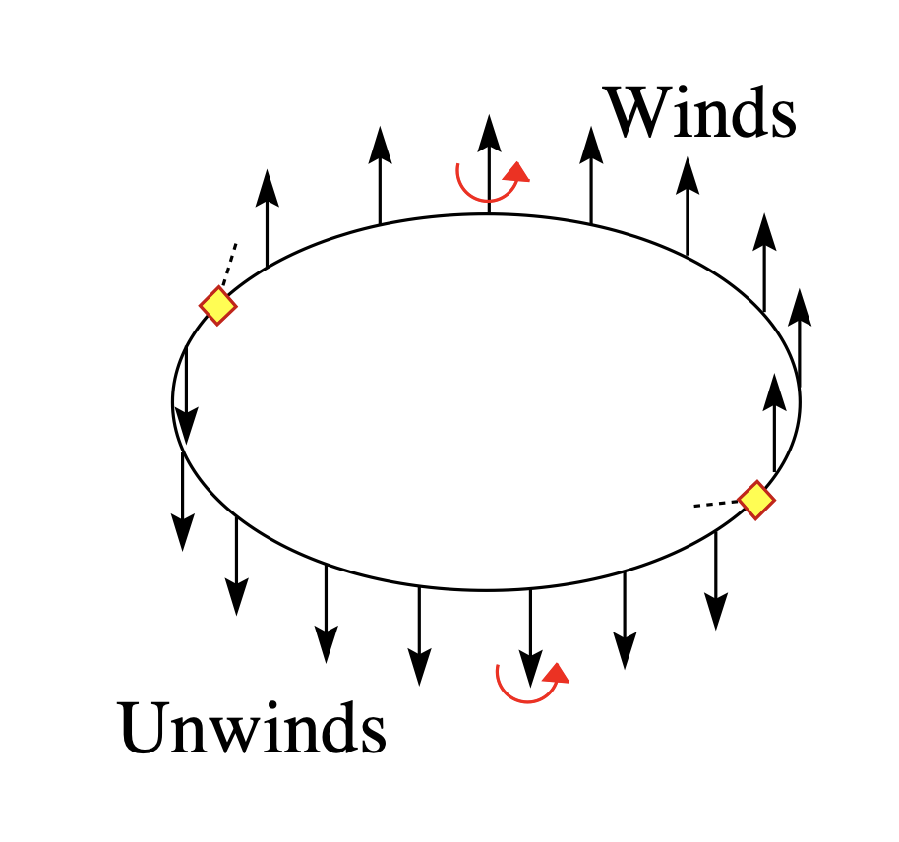
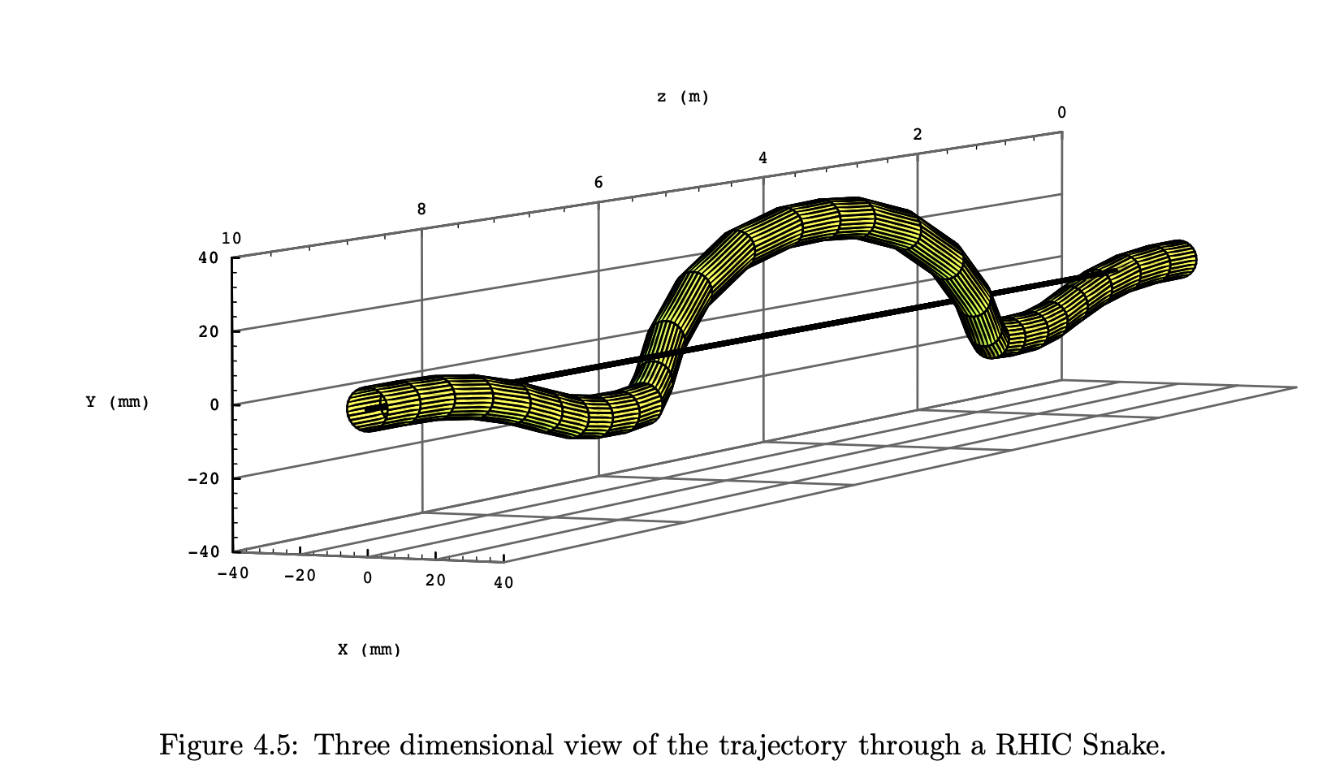
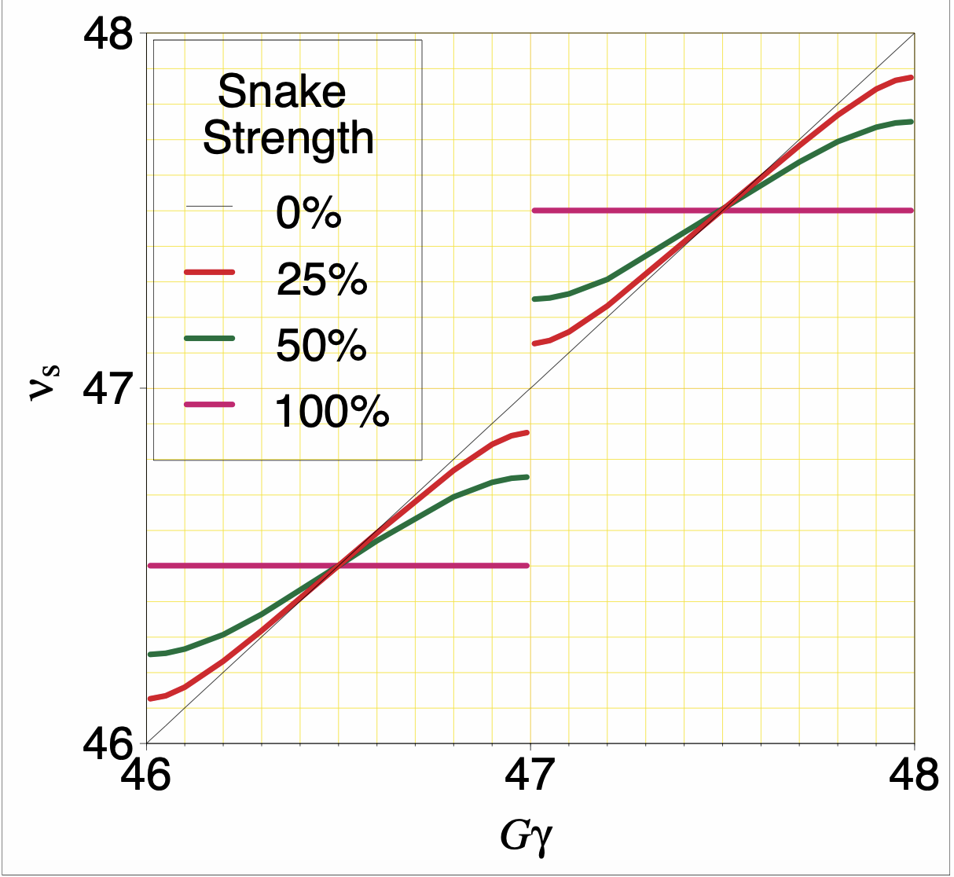
Snakes for Hadron Polarization
Thanks: Waldo MacKay
Full Snakes
  RHIC and HSR
  keep spin tune ½
  Avoids First Order Spin Resonances
  Higher order spin resonances remain
    Snake Resonances
    Amplitude dependent (near strong first order spin resonances caused by spin resonance overlap)
Partial Snakes
  AGS
  Avoids imperfection
  If Strong Enough & tunes high enough avoids intrinsic vertical Spin resonances
  Introduces Horizontal Intrinsic Spin resonances

Slide 20
AGS Polarization loss due to Horizontal Resonance
With no mitigation: ~15-20% relative polarization loss
Horizontal tune jump (used since 2011):
Performance Strongly depends on intensity → increased emittance and energy spread
Remaining polarization loss from residual crossing rate, spin tune spread comparable to tune jump size
At high intensity AGS delivers < 70% polarization using tune jump methods → need approach to give > 70%
Zgoubi simulation of polarization loss with and without tune jump, agrees well with measured tune jump performance
With jump
NO dp/p spread
With tune jump
+ dp/p spread
No mitigation
Plot courtesy of Y. Dutheil

Slide 21
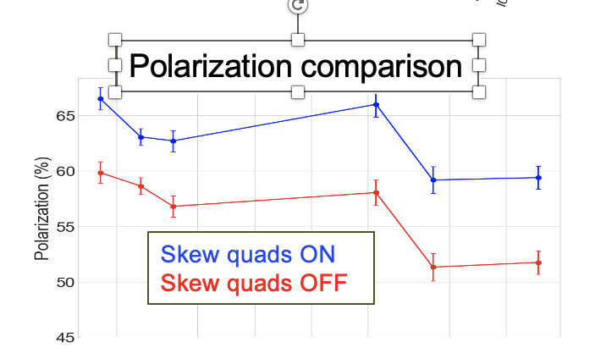
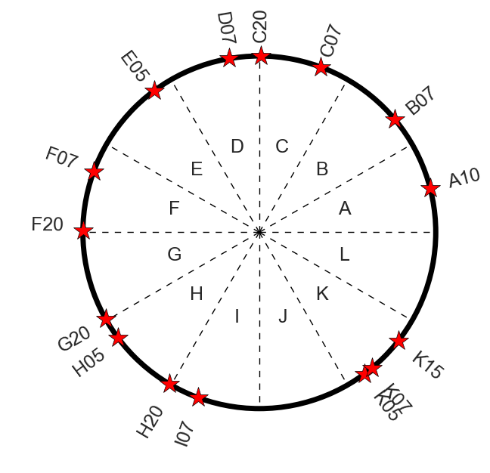
Skew Quad Spin Resonance Canceling:
Polarization increase from skew quad resonance correction
Thanks: V. Schoefer
AGS RING
15 skew quads
Using Betatron Coupling to cancel Horizontal spin resonance → V. Schoefer
Pulse skew quads during the ramp to cancel horizontal spin resonance
  Number of enabled pulses limited mostly by orbit effects
    Tune shift from coupling, ΔQ_{y}< 0.005
    Vertical |M_{orm}*(k_{skew}*x_{skew})|_{max} < 1 mm
Tested for first time 2024 Run
Up to 15% relative gain from skew quads (compared with 8-10% from tune jump)
More fine tuning necessary → orbit and optics control
Magnet Param |  | unit
Length (mech.) | 0.17 | m
Bore diameter | 0.16 | m
Pole tip field (max) | 0.15 | T
Int grad (max) | 0.32 | T
Current (max) | 275 | A
Current (rms,max) | 60 | A
Lamination thick. | 0.635 | mm

Slide 22
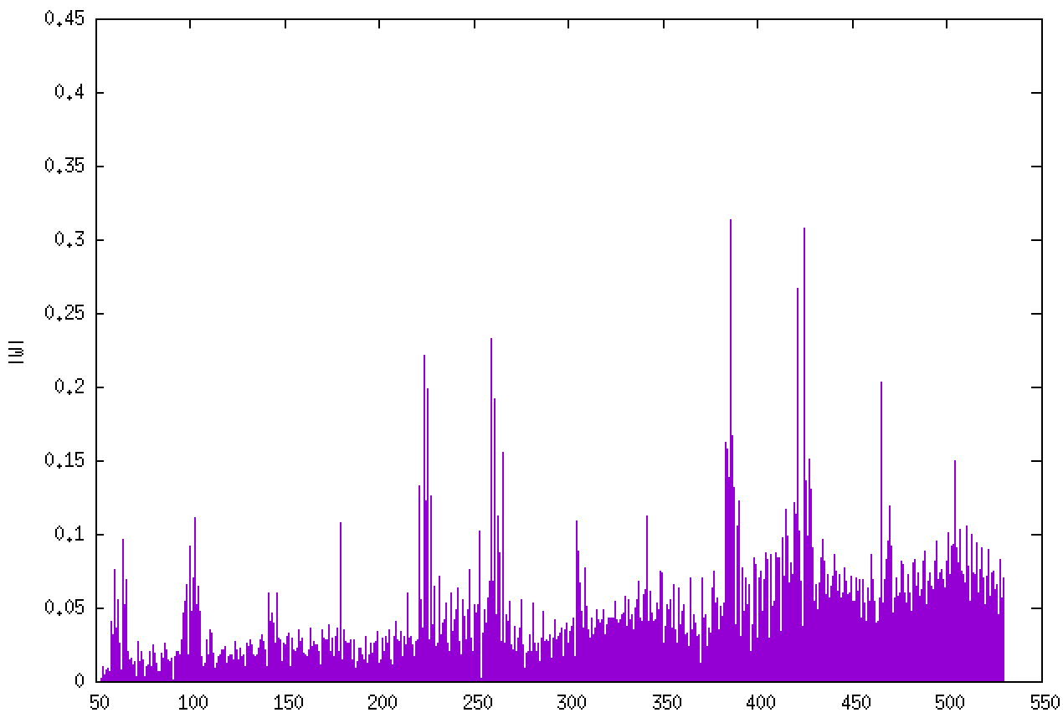
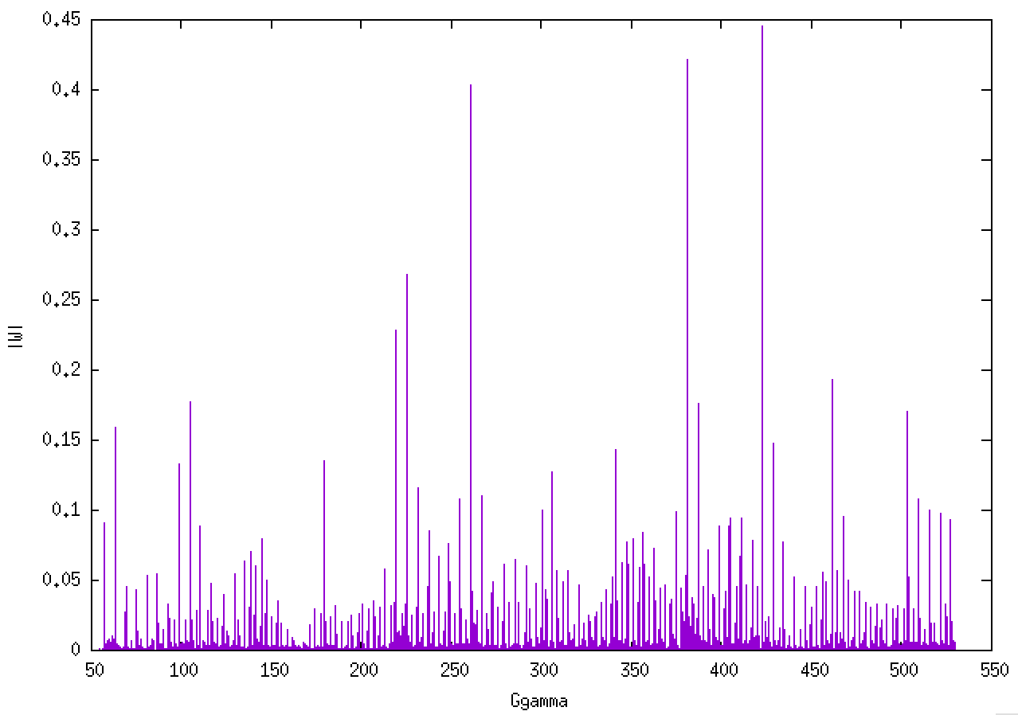
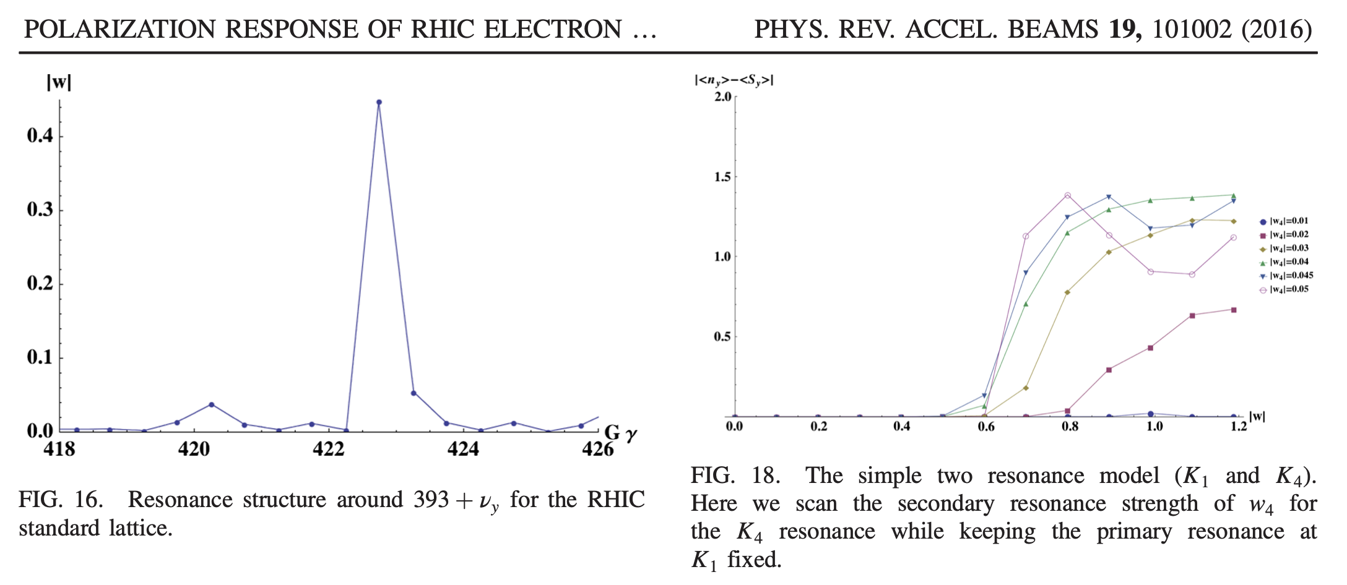
HSR Proton and ³He Polarization
Polarization requirements:
  Polarized proton (up to 275 GeV), ³He⁺² (up to 183 GeV/u)
  Polarization goal: 70%
Increasing the number of Snakes from 2 to 6
  Good polarization transmission has been demonstrated for protons up to 275 GeV
³He good polarization transmission has been shown up to 140 GeV/u.
    HSR lattice require significant changes to the symmetry of the RHIC yellow ring which impacts the intrinsic spin resonance structure
    Above 140 GeV/u injection cooling is needed for smaller vertical emittances
    Spin Resonance Interference introduce more possibility for higher-order spin resonance effects
HSR Lattice
RHIC Yellow RING
Studies with 2 snake RHIC lattice showed 0.01 threshold for interference with strong Res~0.4

Slide 23
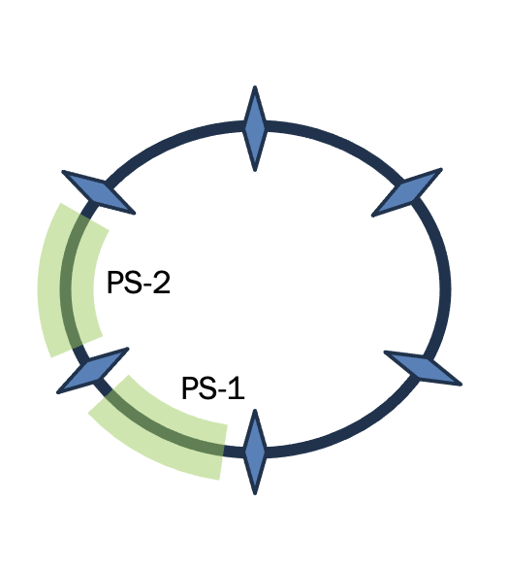
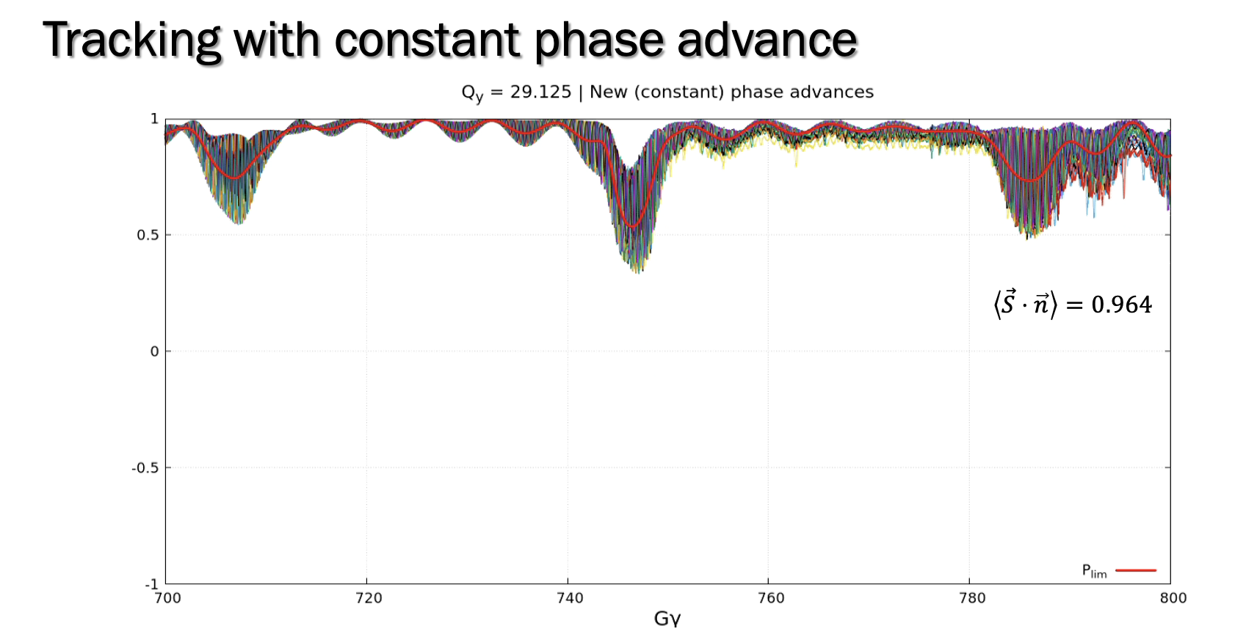
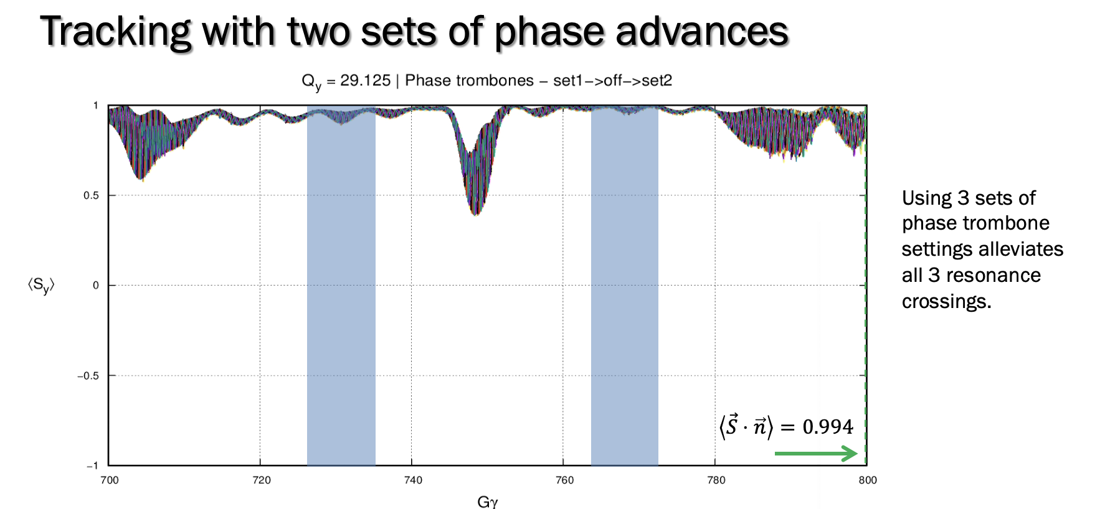
Uncooled He3 Polarization Transmission
Phase trombone matching:
  constant
  dynamic
Snake matching → identifying snake rotation axis for each snake that minimizes higher-order spin resonances
Revisit optics → better solution that minimizes overlapping resonances.
Thanks: Eiad Hamwi

Slide 24
Summary
RCS and whole Electron Injector System now out-side RHIC tunnel
  New Racetrack RCS design using same spin transparent principle
  Polarization Performance meets EIC’s requirements
ESR lattice mature
  BAGEL’s approach maximizes polarization lifetime
  Vertical Emittance matching
  Need to study beam-beam depolarization effects more
AGS Polarization
  Need work to achieve >70% polarization
  Pulsed skew quads test and shows promise
HSR Polarization
  Proton transmission to 275 GeV good
  He3 transmission needs vertical emittance cooled
    Working on snake and lattice approaches to improve

Slide 25
Backup

Slide 26
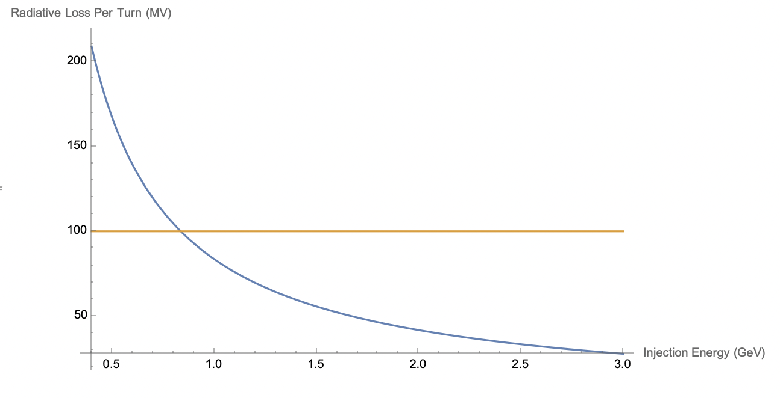
RCS Design Considerations
Selection of Bending radius
  Limit radiation at 18 GeV ~ 100 MeV/turn. Requires 7 cryo-modules
  Limit dipole field at injection ~ 300 Gauss
We find ~ 90 m rho achieves both 300 Gauss at 800 MeV and 100 MeV/turn loss.
Assuming injection field = 0.03 T
rho = Einj GeV * 3.3357/0.03 T
800 MeV

Slide 27
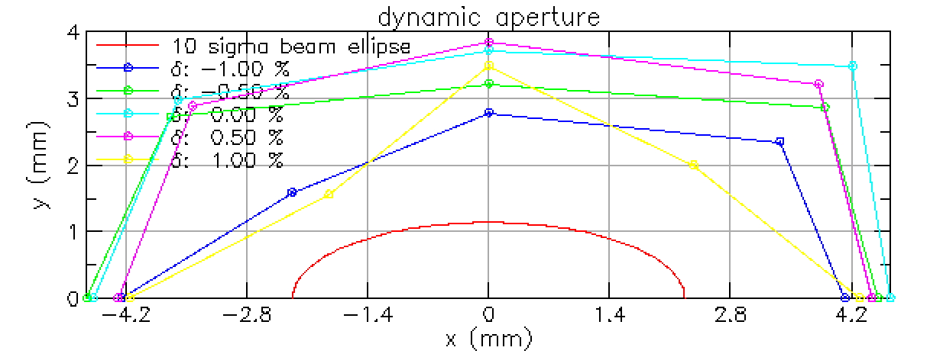
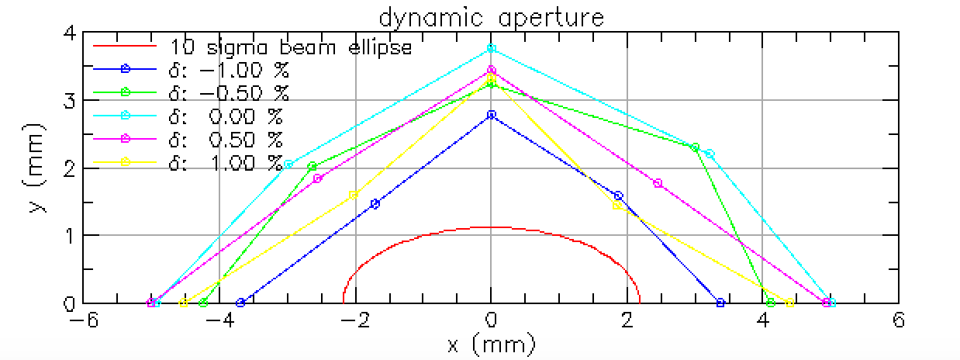
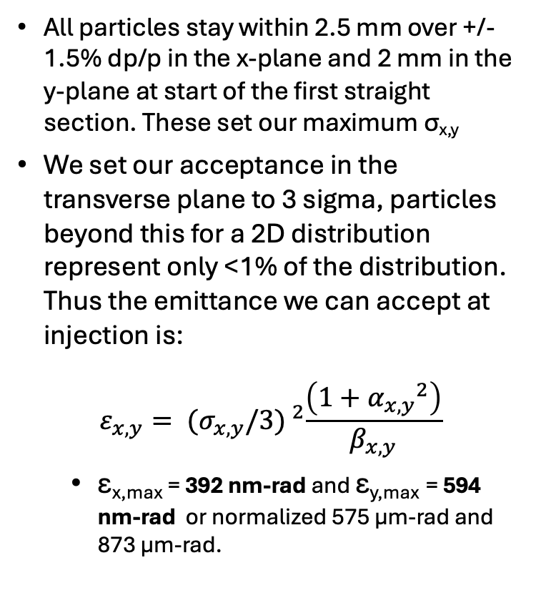
Acceptance of RCS
With Physical aperture r=18.6 mm
All particles stay within 2.5 mm over +/- 1.5% dp/p in the x-plane and 2 mm in the y-plane at start of the first straight section. These set our maximum σ_{x,y}
We set our acceptance in the transverse plane to 3 sigma, particles beyond this for a 2D distribution represent only <1% of the distribution. Thus the emittance we can accept at injection is:
$$ε_{x,y}= {(σ_{x,y}/3) }^{2}\frac{\left(1+{α_{x,y}}^{2}\right)}{β_{x,y}}$$
  ε_{x,max} = 392 nm-rad and ε_{y,max} = 594 nm-rad or normalized 575 µm-rad and 873 µm-rad.
Qx=35.36
Qx=39.069
Measured at beginning of the first straight section:
Beta X = 13.741 m, alpha X = -2.602
Beta Y = 1.45 m, alpha Y = 0.492
3-sigma ellipse based on expected emittance (sigma)
from pre-injector of ε_{x}=300 nm-rad and ε_{y}=120 nm-rad

Slide 28
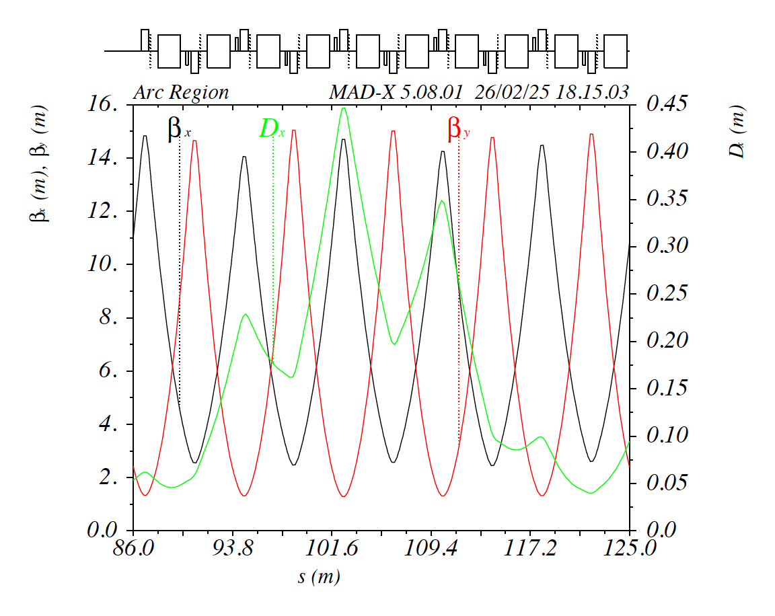
Preliminary RCS ARC Cell Optics
rho = 91.67 m
NCells = 160 with 80 per arc
Dipole Magnet length = 1.8 m
Quadrupole Magnet Length = 0.6 m
Muy = 0.3383 → 121.78 degrees
Mux = 0.225 → 81 degrees
  Chosen to make arc = integer to keep dispersion close to zero in straights
  80*0.225 = 18

Slide 29
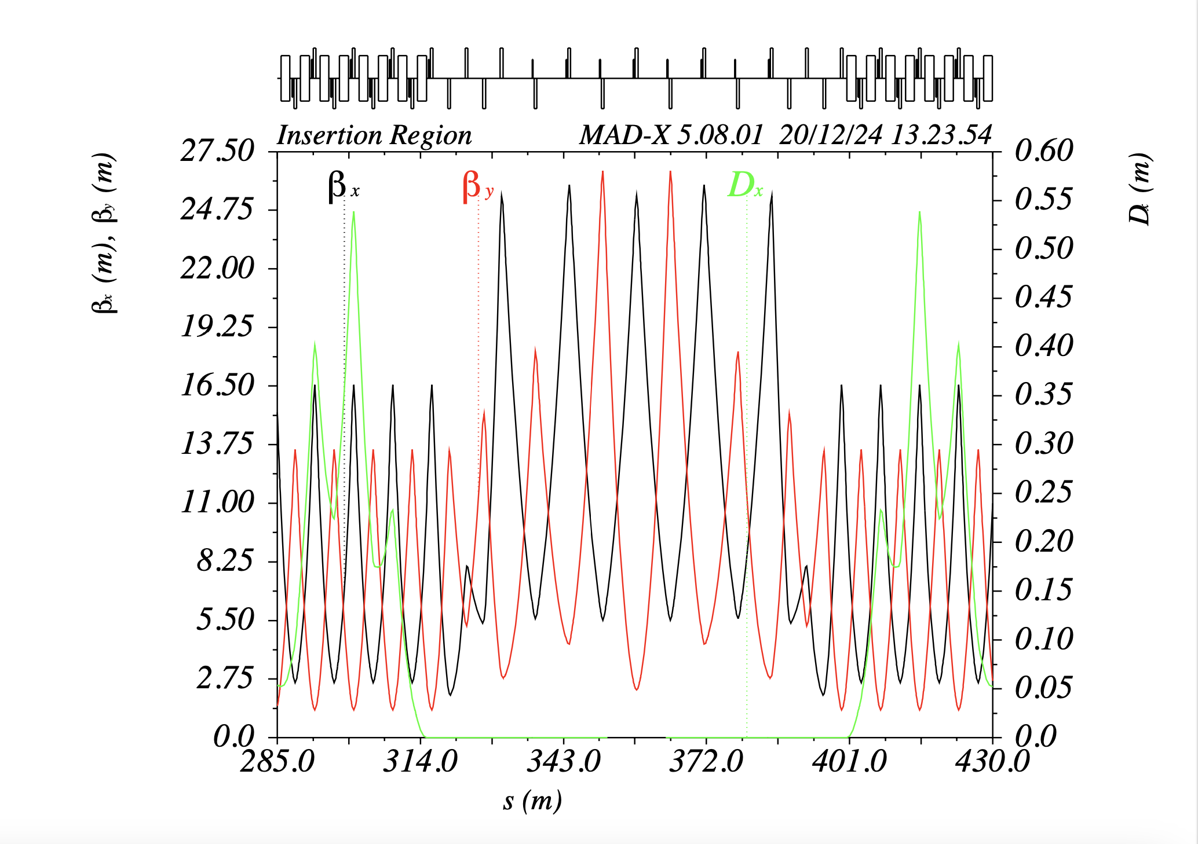
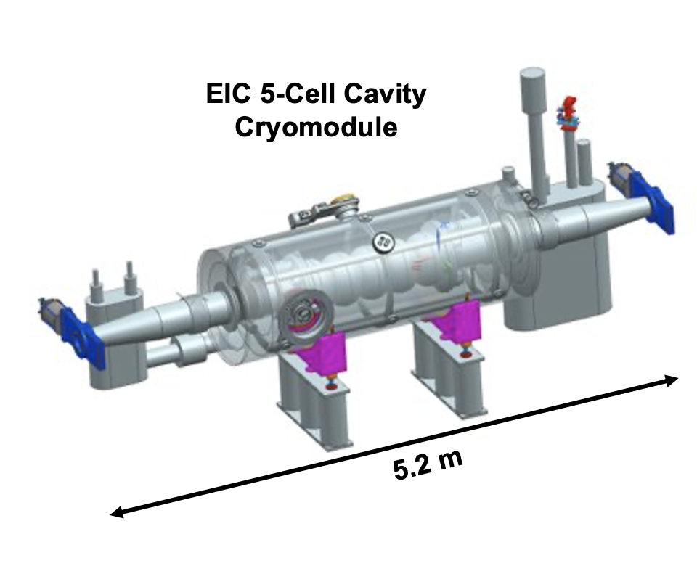
Preliminary Straight Section Optics
Dispersion kept to zero via using integer arc tunes with the horizontal phase advance across the straights tuned to achieve the desired fractional tune
Each Cryomodule needs 5 m and delivers 16.7 MV. To allow for correctors, sextupoles and BPMS we allow for 5.8m
  Need one cryomodule for 7nC at 10 GeV operations
  However will need room for 8 cryomodules
  Accomplish this using 4 FODO cells with 5.8 m drifts between quads
We also need four additional “matching” quads at the entrance and exit of the straight section
The total length is 83.136 m

Slide 30


Emittance Matching
Thanks Alexandra Seletskaya
Using 0.01 mrad kick at 18 GeV

