Slide 1
FCC Polarimeter
6th march 2025, eeFACTS
Robert Kieffer, on behalf of the EPOL working group and of the CERN BI group.

Slide 2
Mandate of the FCCee
Inverse Compton Polarimeters
Detect the resonant depolarization (RDP) transition of the dedicated energy calibration polarized pilot bunches.
Measure the absence of polarization of the colliding bunches with great precision (0 ± 10⁻⁵) to insure no bias in the physics cross sections at the IP.

Slide 3
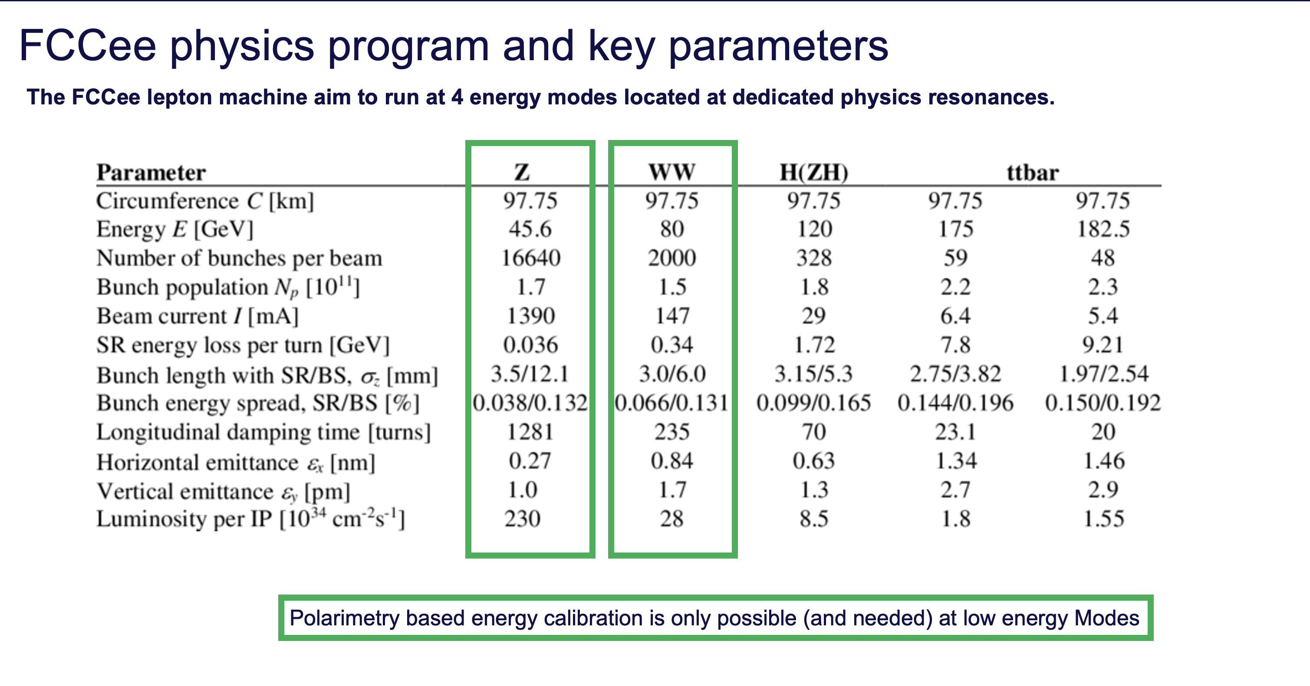

Slide 4
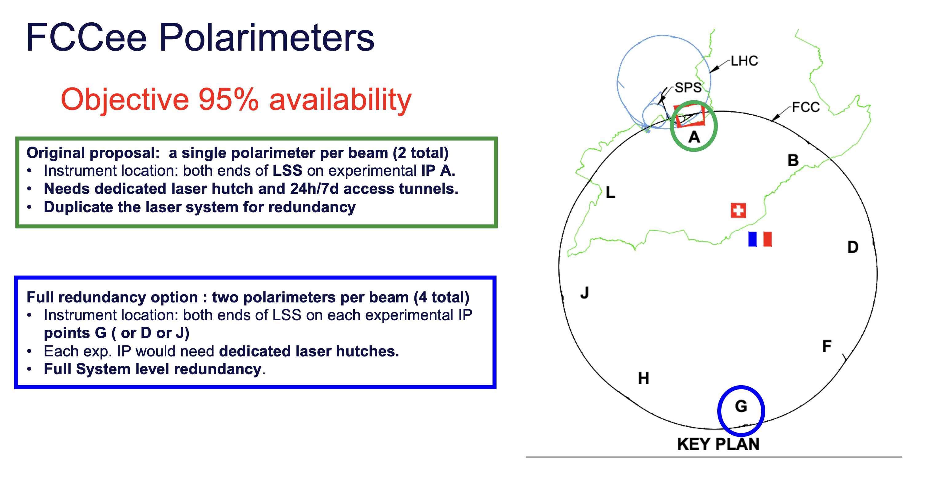

Slide 5
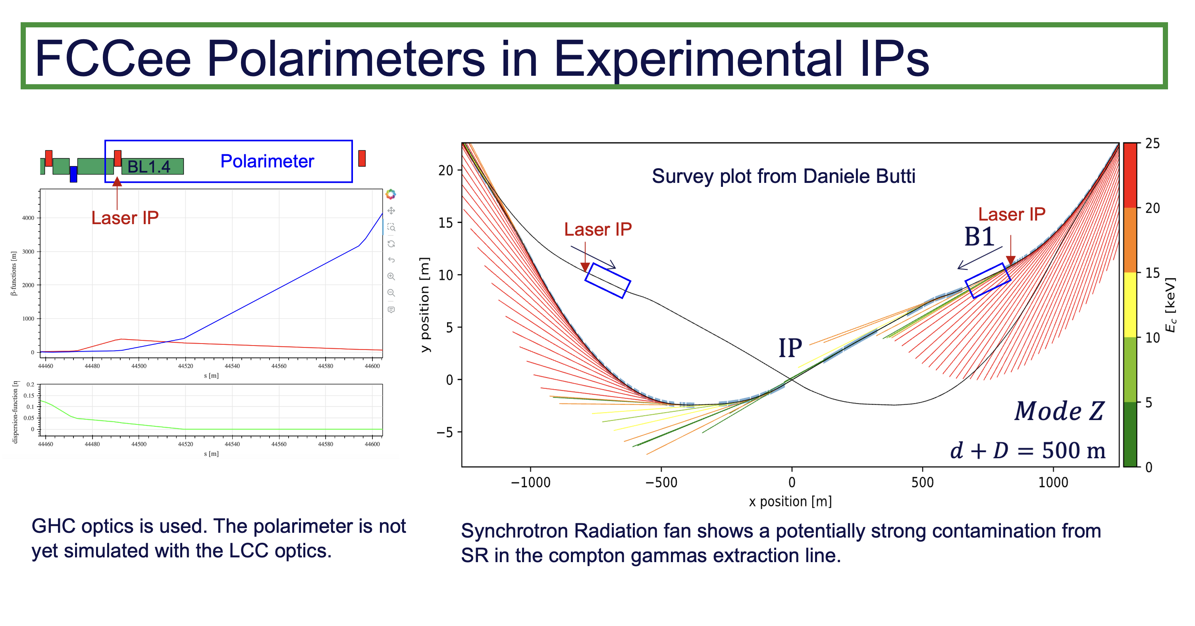

Slide 6
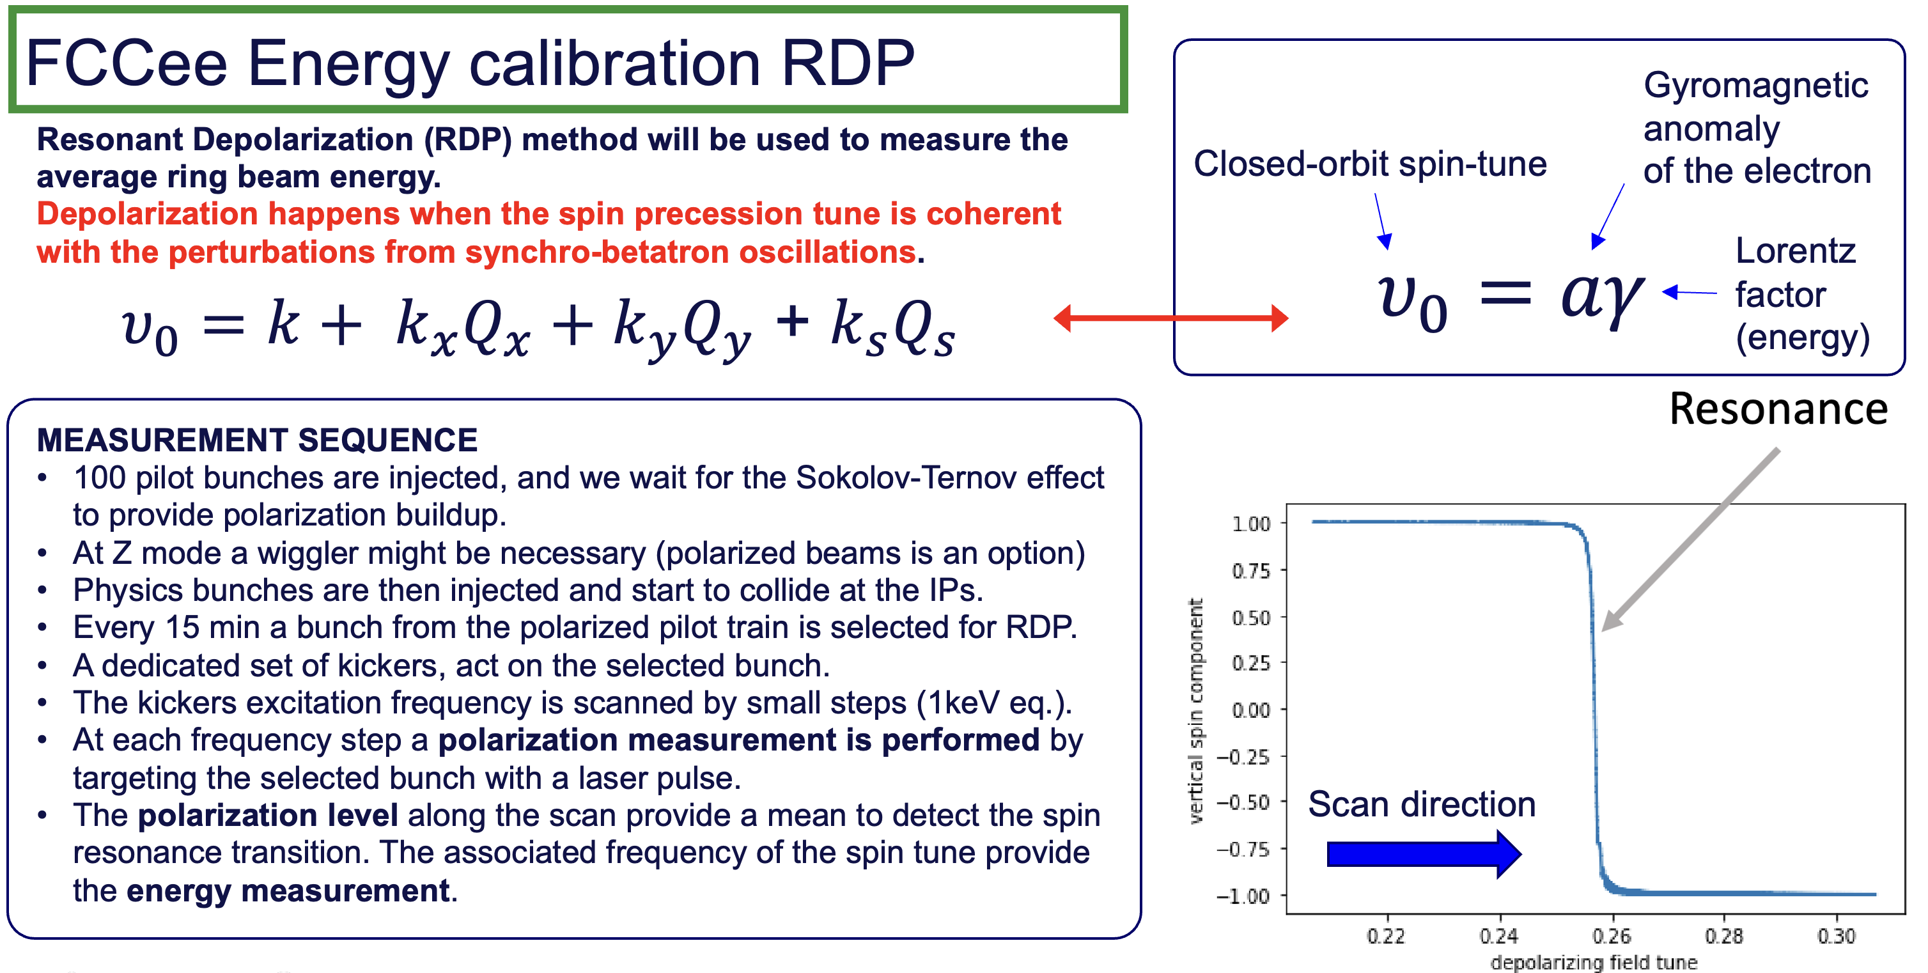

Slide 7
Inverse Compton Polarimeter
Instrument development

Slide 8
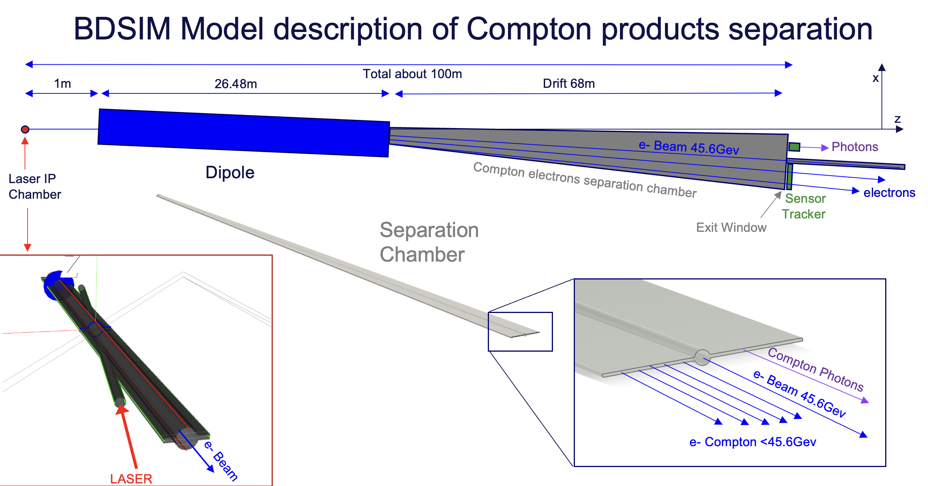
Robert Kieffer

Slide 9
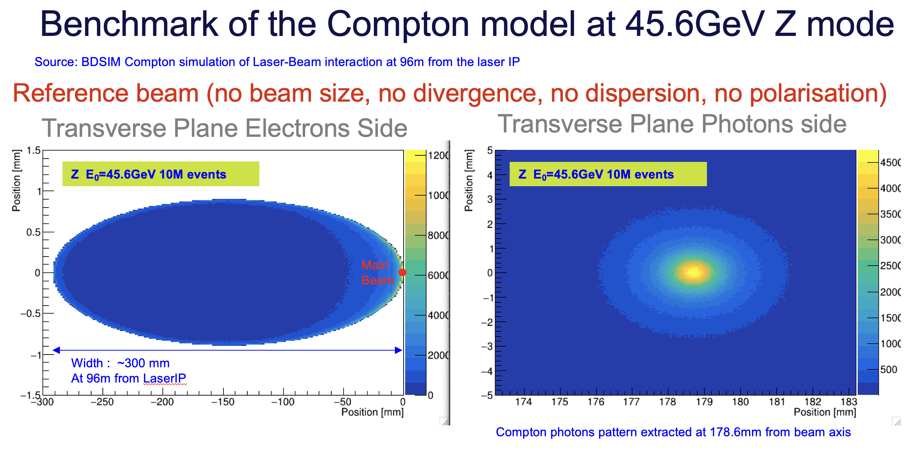
Robert Kieffer

Slide 10
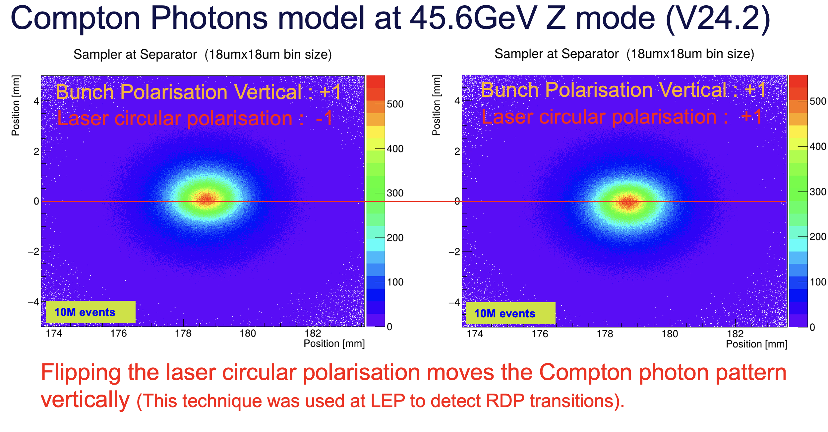
Robert Kieffer

Slide 11
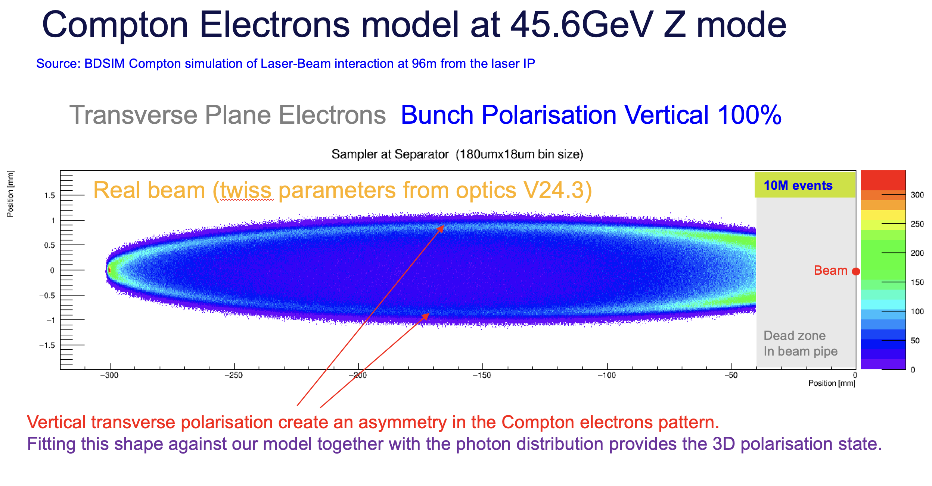
Robert Kieffer

Slide 12
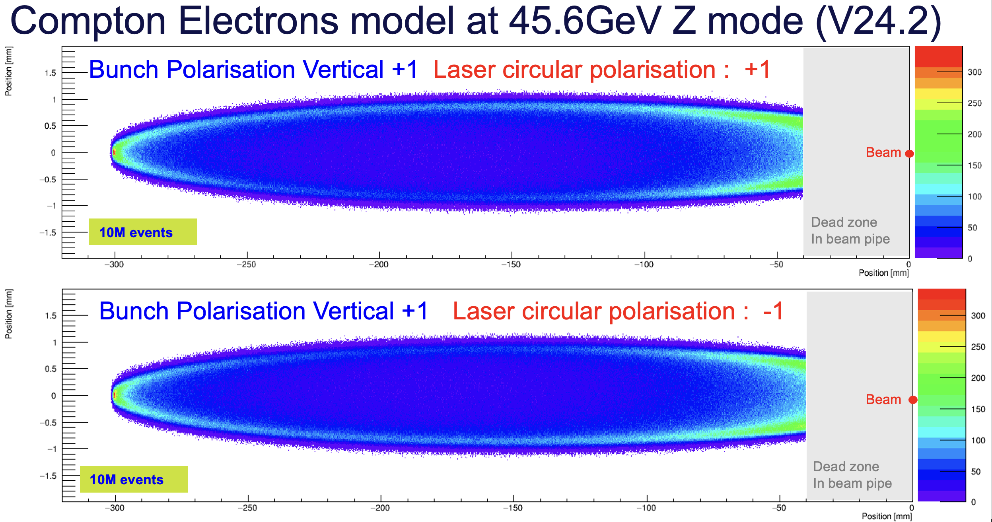
Robert Kieffer

Slide 13
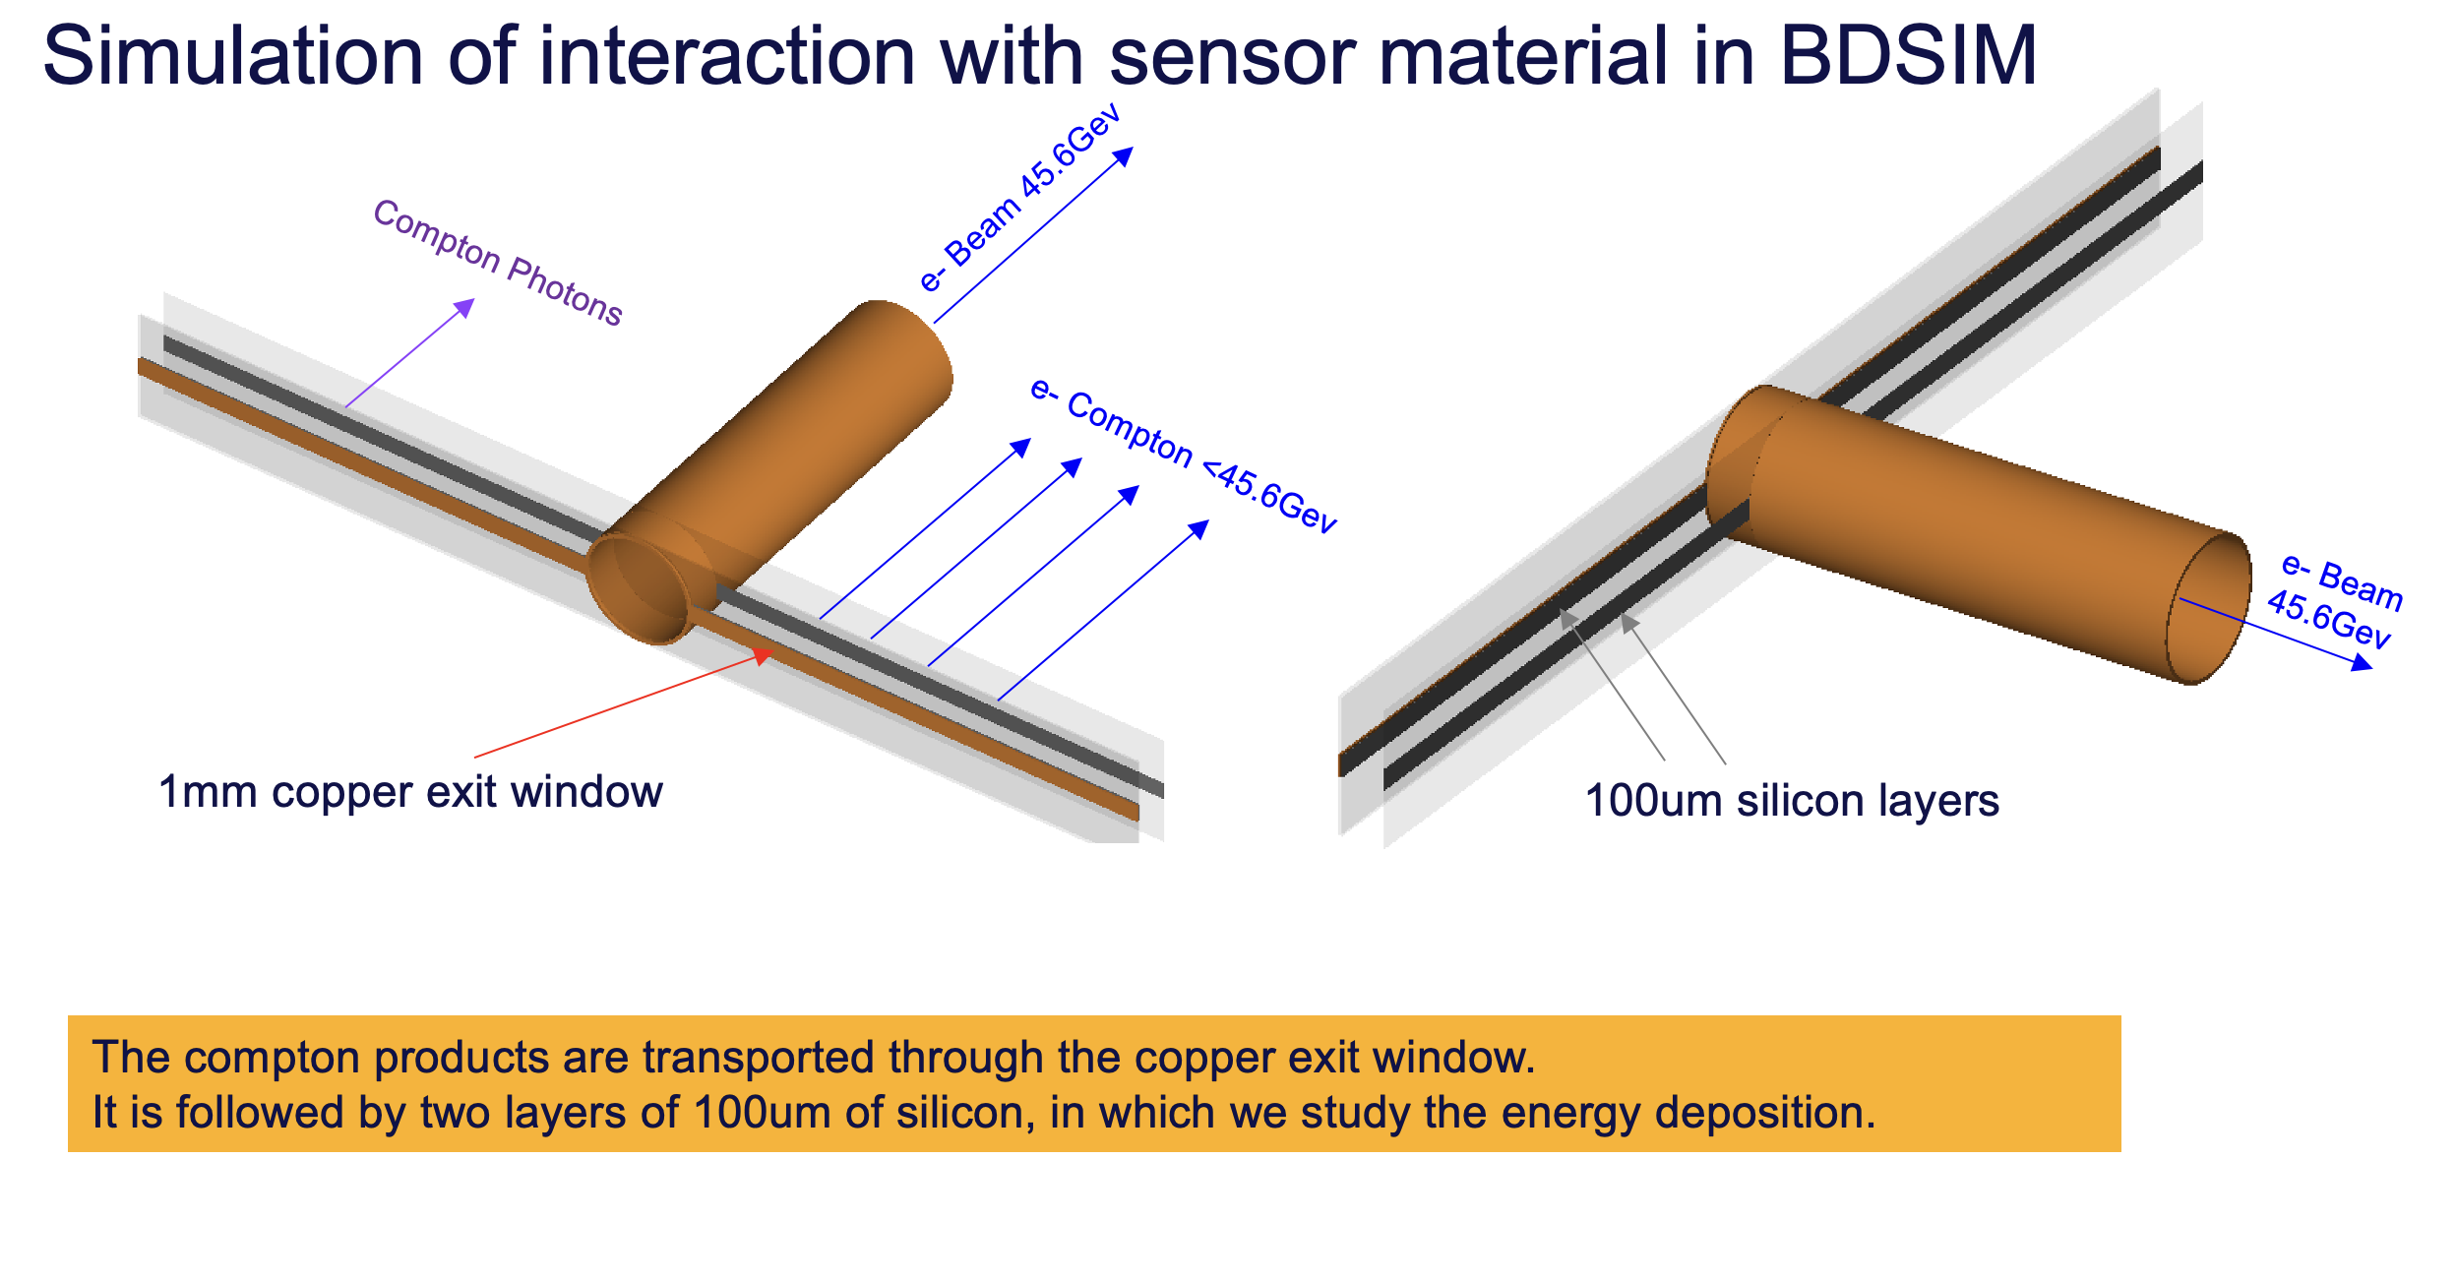
Robert Kieffer

Slide 14
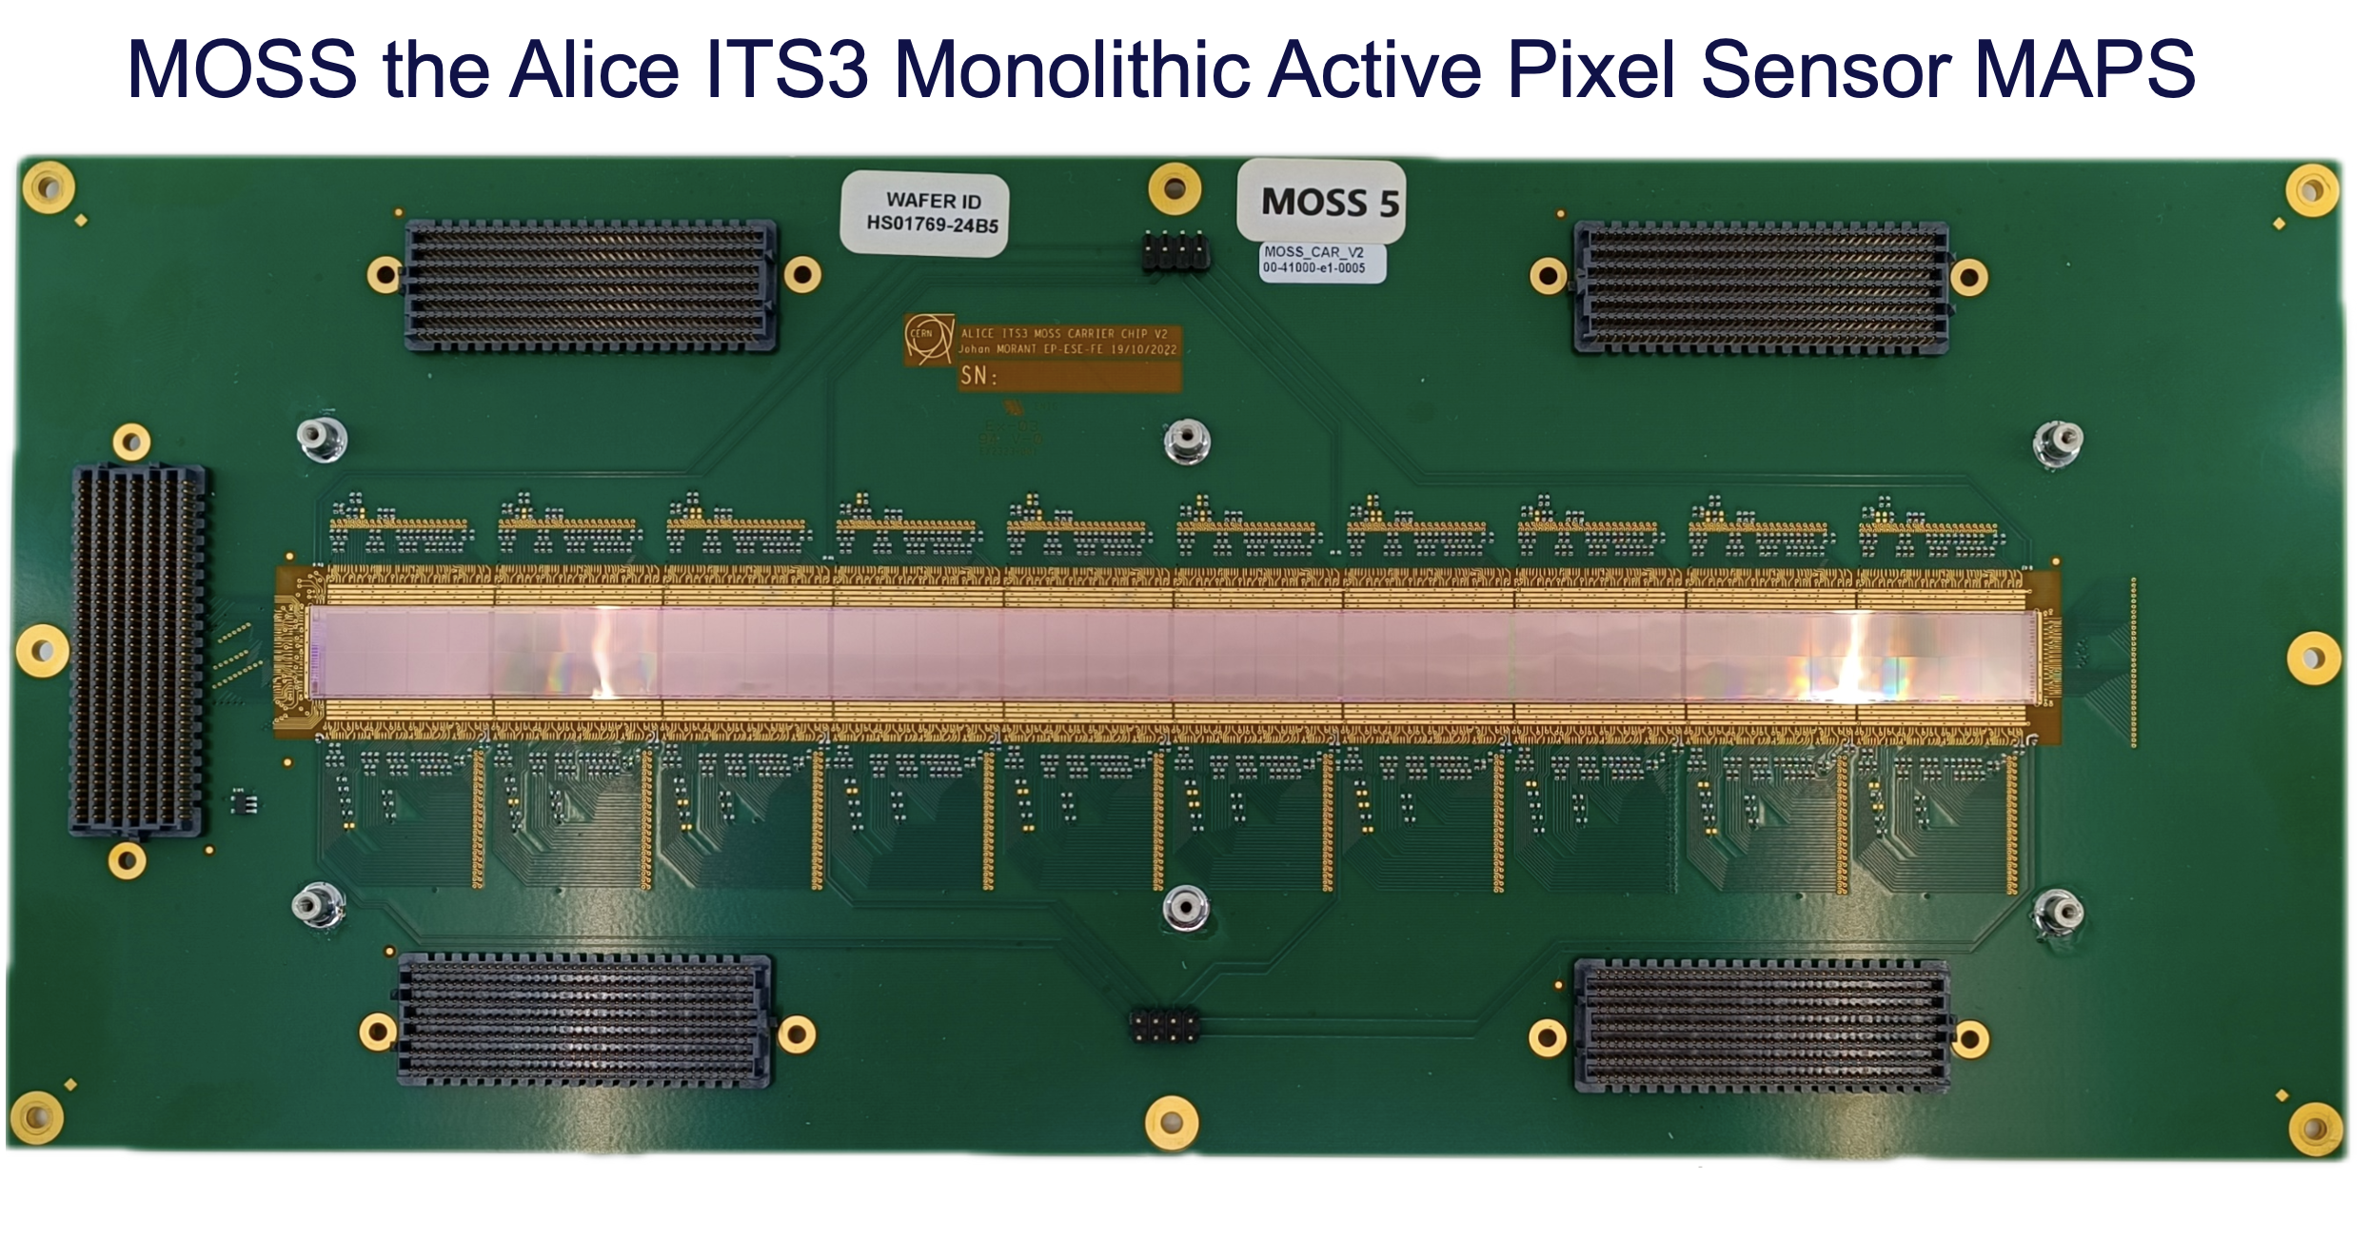
Robert Kieffer

Slide 15
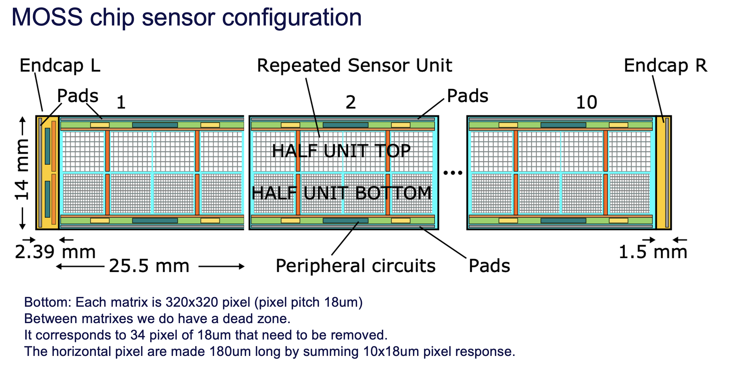
Robert Kieffer

Slide 16
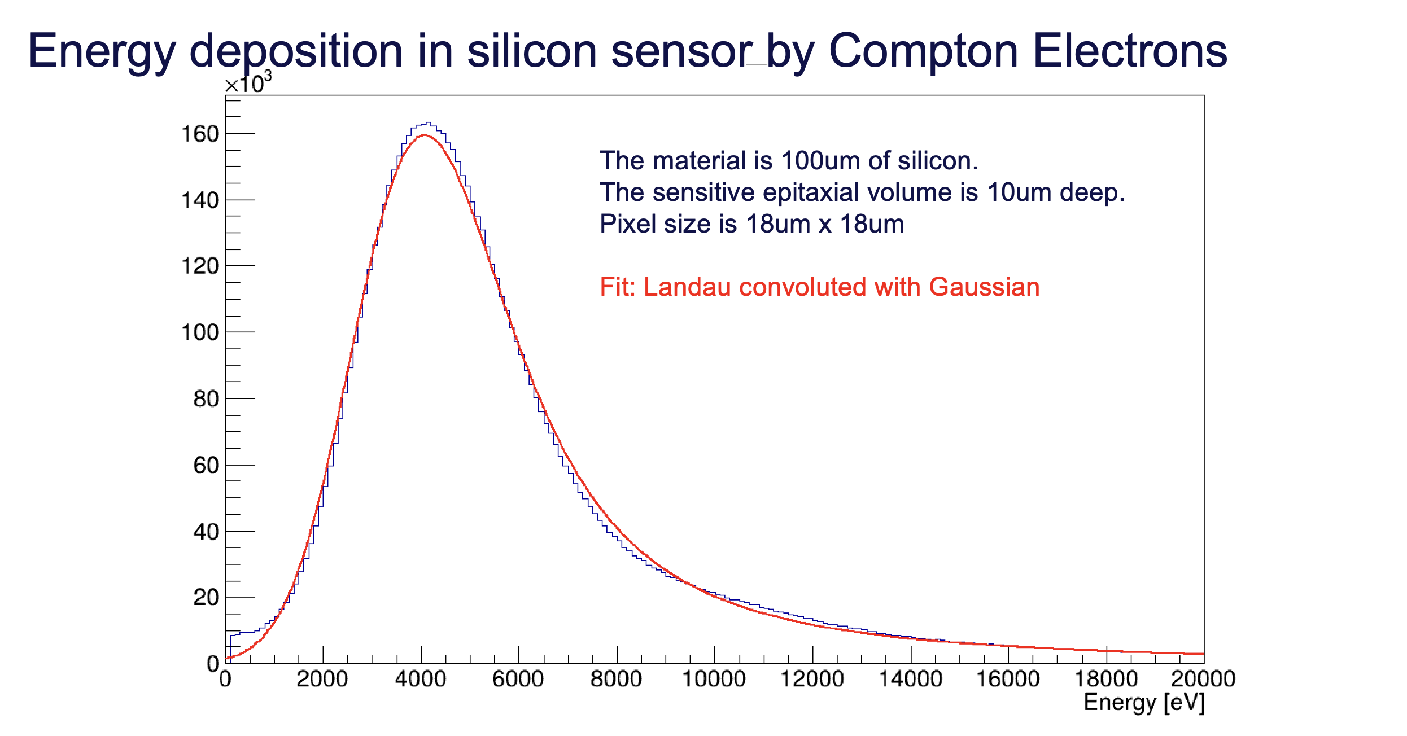
Robert Kieffer

Slide 17
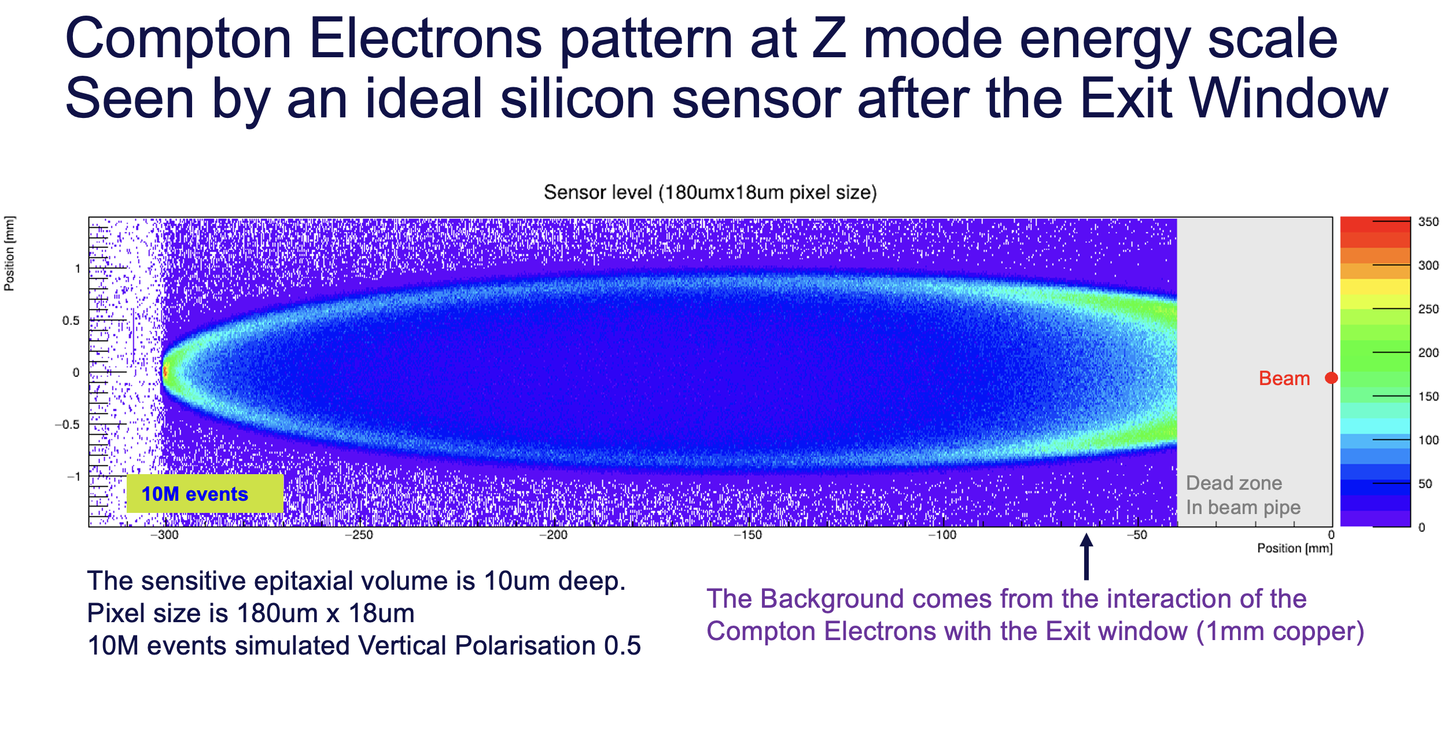
Robert Kieffer

Slide 18
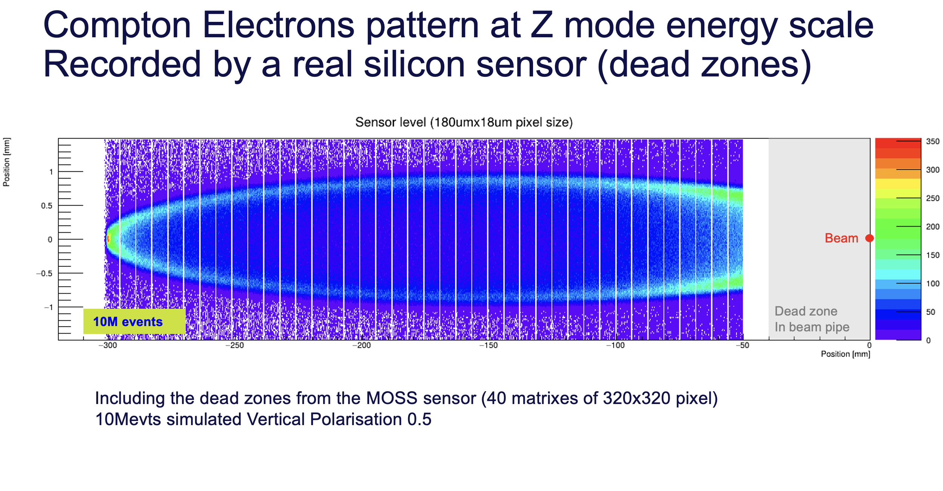
Robert Kieffer

Slide 19
SR Background impacting the Polarimeter

Slide 20
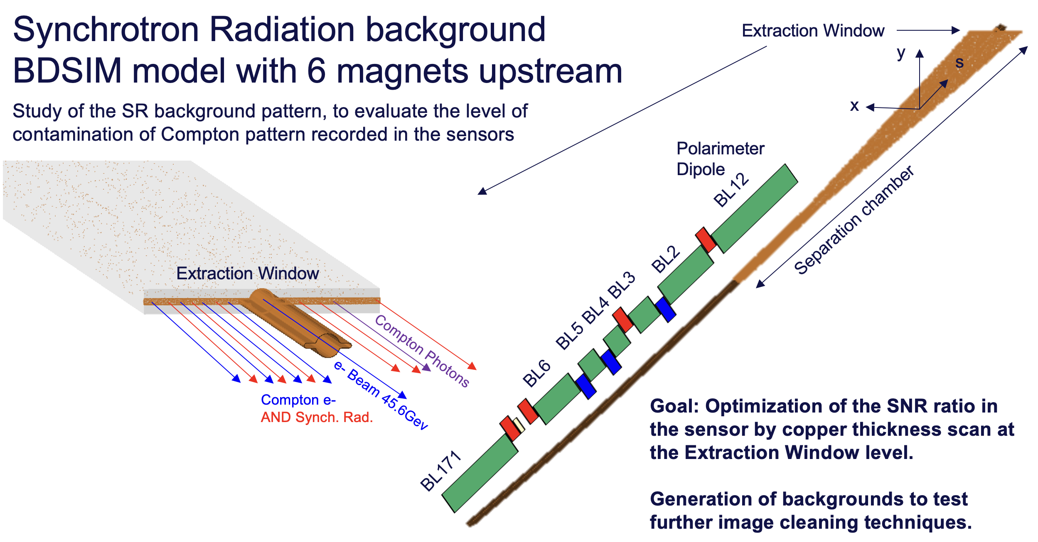
Robert Kieffer

Slide 21
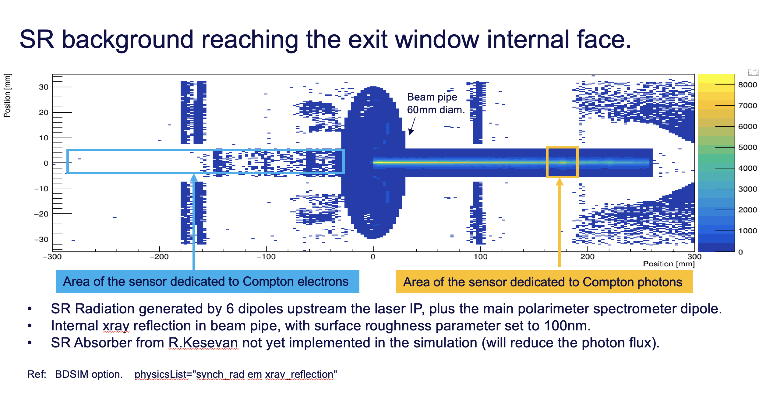
Robert Kieffer

Slide 22
Polarimeter Integration

Slide 23
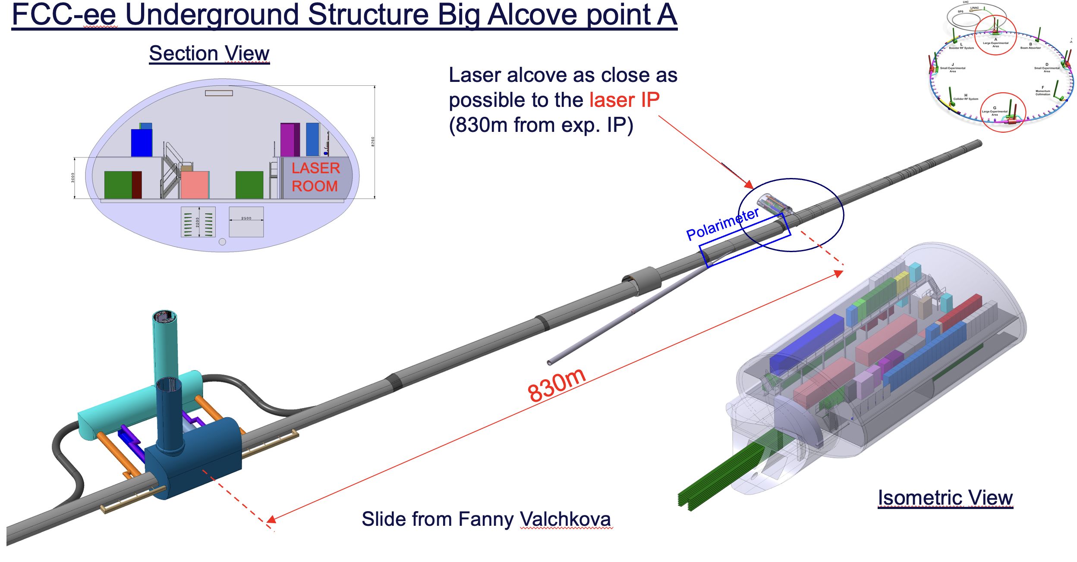

Slide 24
Impedance budget

Slide 25
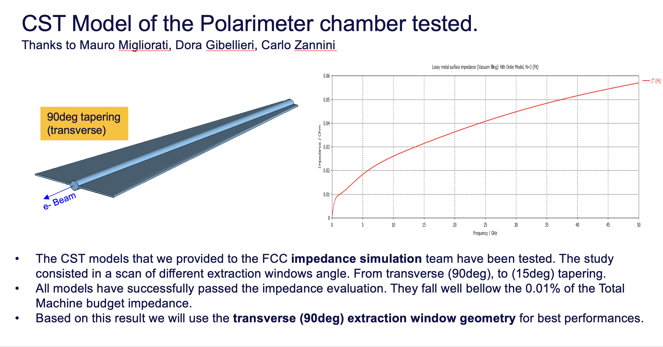
Robert Kieffer

Slide 26
Outlook and plans
The main tools to simulate the Inverse Compton Polarimeter are being developed under BDSIM.
Main focus has been on the Compton electron sensor.
Complementary models to evaluate the SR background.
Completion of the Feasibility Study report (under review).
Dedicated EPOL support note (50 pages) to be soon published on CDS.
NEXT
The fitting algorithms tools are being developed by IJClab colleagues.
The Compton Gamma tracking-calorimeter will soon be addressed.
More backgrounds will be simulated (thermal photons, beam-gas).

Slide 27
Thank you for your attention.
Robert Kieffer
27

Slide 28
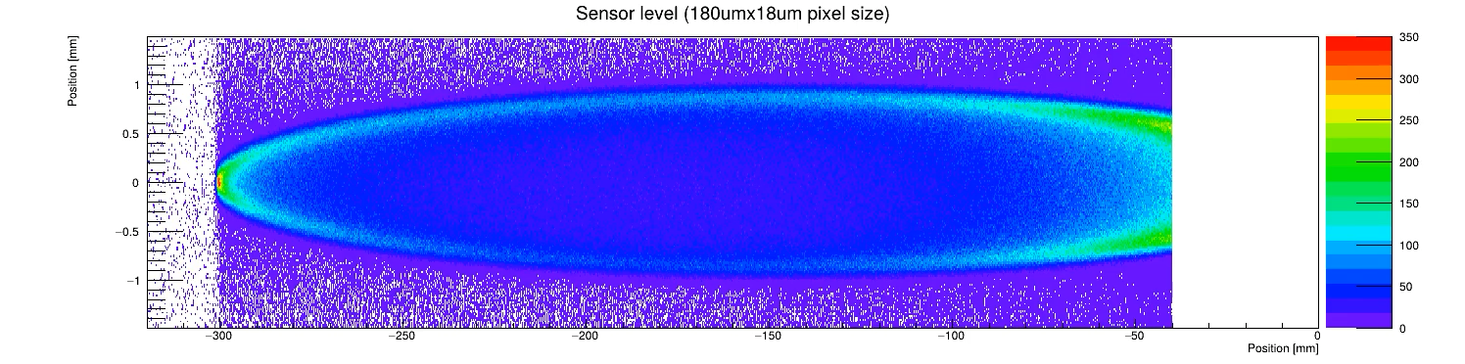
Compton Electrons model at 45.6GeV Z mode
Robert Kieffer
Source: BDSIM Compton simulation of Laser-Beam interaction at 96m from the laser IP
Transverse Plane Electrons Bunch Polarisation from 1 to 0
Z E₀=45.6GeV 10M events
Beam
Dead zone
In beam pipe
The asymmetry vanishes in the Compton electrons pattern.

Slide 29
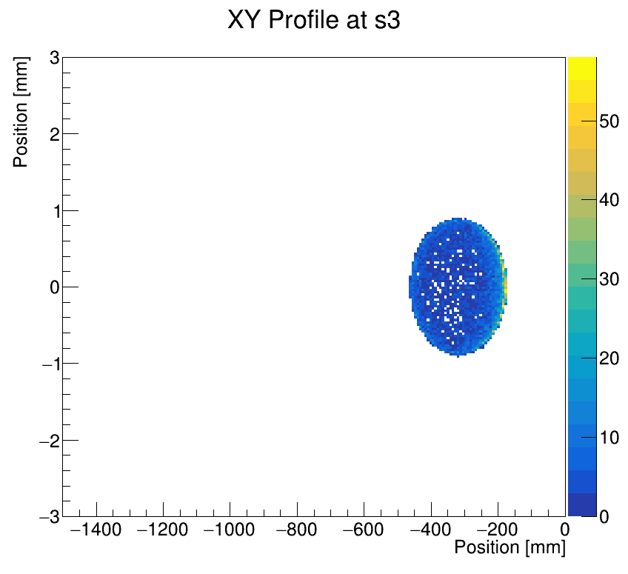
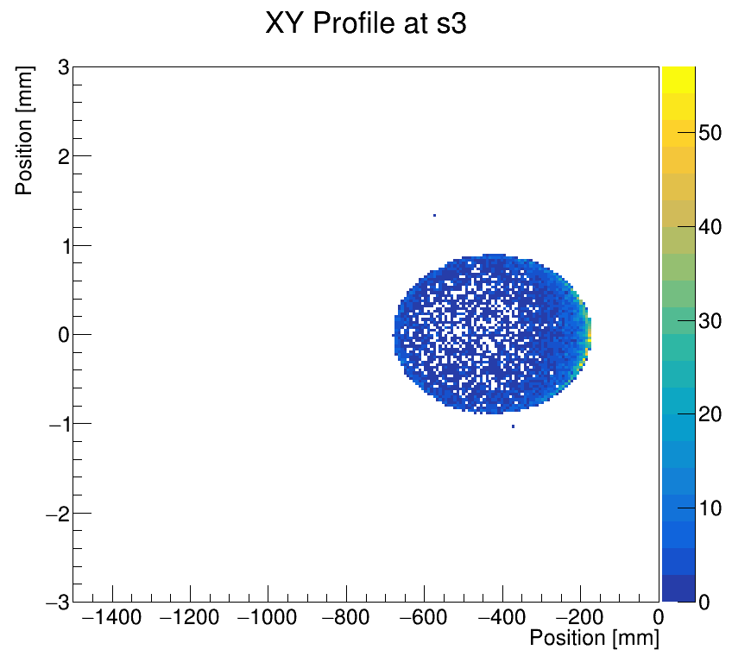
Compton electron pattern at different run energies
Exiting the Separation Chamber (96m from LIP)
Robert Kieffer
Z E₀=45.6GeV
WW E₀=80.0GeV
Main Beam
Main Beam
Transverse Plane
Transverse Plane
Photon Beam
Photon Beam
Width 300 mm
@ 96m from LaserIP
Width 500 mm
@ 96m from LaserIP
To allow running the polarimeter for both Z and WW modes without hardware changes,
the Compton electron sensor transverse acceptance need to reach about 500mm

Slide 30
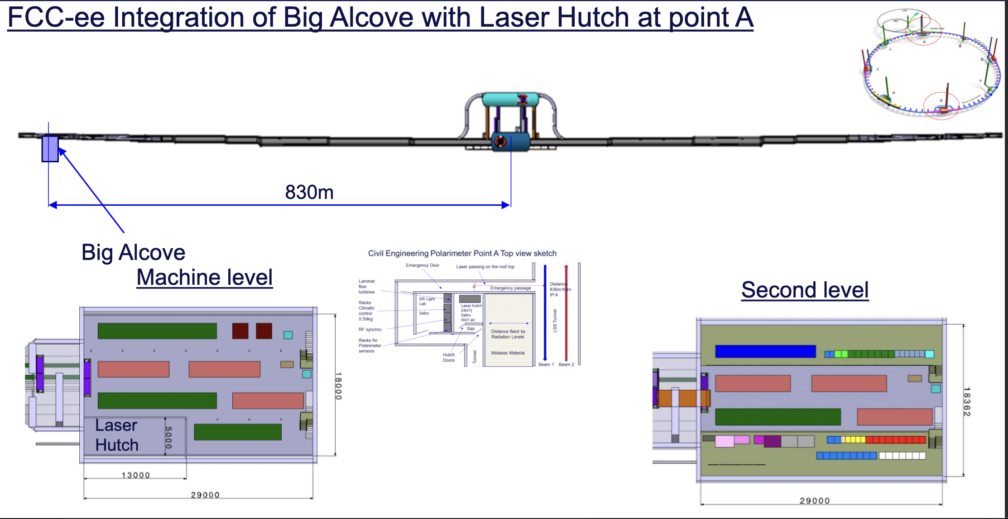
Robert Kieffer
Proposal Slide from Fanny
https://indico.cern.ch/event/1429623/
Our initial proposal for the polarimeter Feasibility Study included two critical integration aspects.
  24h/7d Access tunnel to the laser hutch to ensure required polarimeter availability of 95%. (not validated at this stage)
  Laser alcove as close as possible to the laser IP (830m from exp. IP) To reduce costs, proposal of displacement of the first big alcove by 300m to be located at 830m from IP

Slide 31
Robert Kieffer
Space reservation volume in the collider tunnel
Total about 100m fully dedicated to the polarimeter
2m
26.48m
Drift 68m
x
1.5m
z
e- Beam 45.6Gev
Laser IP
Chamber at 830m from IP both sides (electron / positron)
Laser safety isolating box
1.5m large
2.0m long (as the LIP chamber)
1.8m height
Dipole
Compton electrons separation chamber
Separation Chamber
Sensor
Tracker
Exit Window
Volume of the chamber
FCC beam pipe shape
Winglets aperture extention
0.5m large exiting the Dipole
1.5m large at the Exit window
Box containing the instruments
1.5m large 1.5m long (along beam)
1.8m height
Laser Transport pipes
Needed volume to be defined by STI

Slide 32
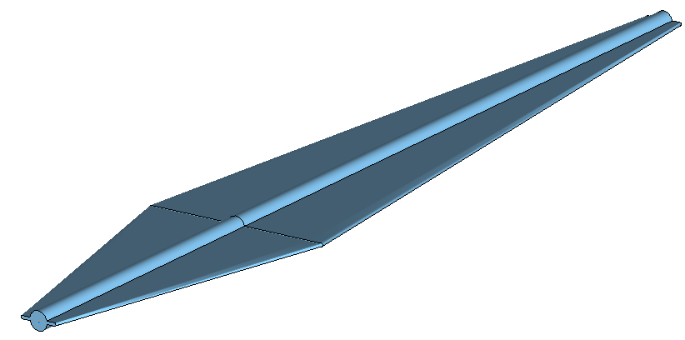
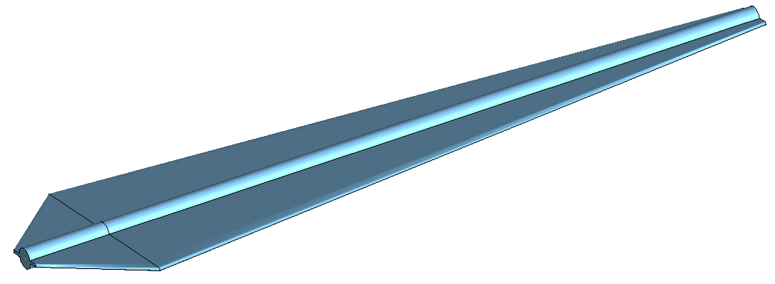
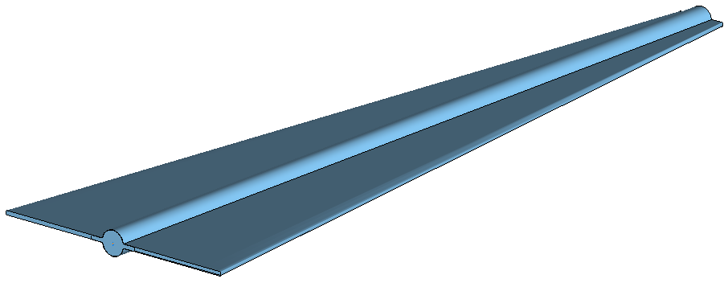
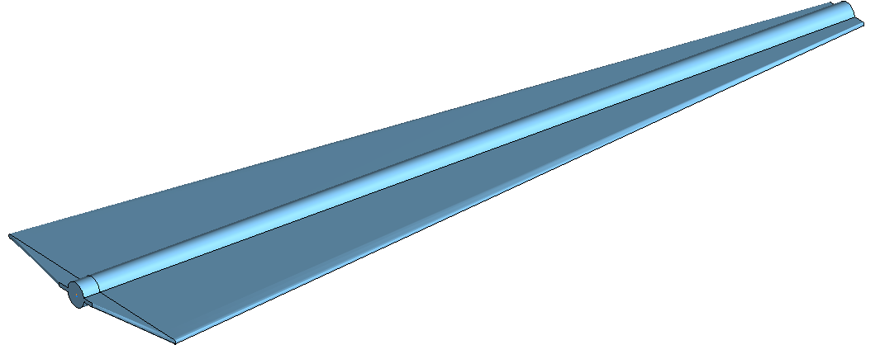
Robert Kieffer
First CST Models of the Polarimeter chamber tested.
Thanks to Mauro Migliorati, Dora Gibellieri, Carlo Zannini
15deg tapering
45deg tapering
e- Beam
e- Beam
90deg tapering
(transverse)
80deg tapering
e- Beam
e- Beam

Slide 33
Robert Kieffer
Compton electrons extraction spectra
Z mode 45.6GeV beam energy
Extraction window at 15 deg angle
Window thickness 2mm copper.
Makes a 7.7mm seen by the particles along the track.
We can see that the Compton electrons are undergoing electromagnetic interaction when crossing the exit window.
Compton Edge
Window crossing
zone
In vacuum
zone

Slide 34
Robert Kieffer
Aluminium 1 mm at 15 degrees
Copper 1 mm at 15 degrees
Extraction window
material/thickness
Study at Z pole sampling plane is 1mm after the extraction window.
Aluminium and Copper
Two ticknesses 1-2 mm
1 mm Aluminium is the most transparent solution.
Aluminium 2 mm at 15 degrees
Copper 2 mm at 15 degrees

Slide 35
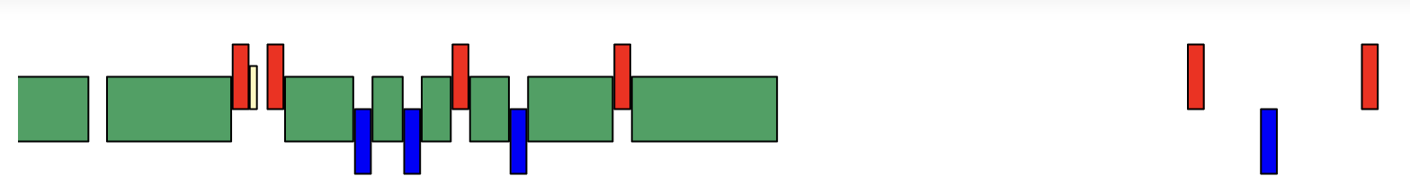
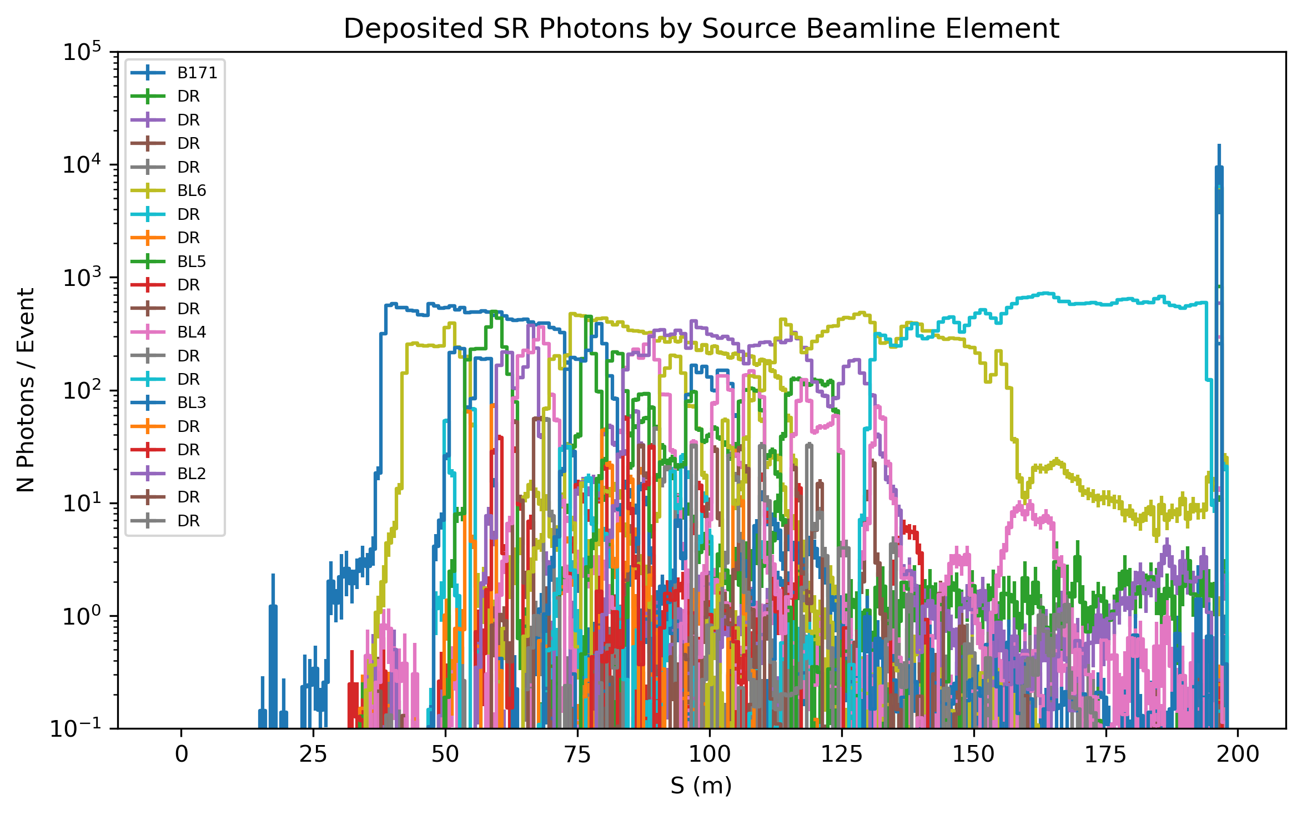
Robert Kieffer
Power deposited by All elements (Dipoles, Quads, Drift)
BL12
BEAMLINE FOR THE STUDY
Thanks to the toolkit of Kevin Andre, I was able to simulate SR generation at the polarimeter location including reflections in the beam pipe from upstream magnets.
In average a power dissipation of 1kW/m is expected.
We might reach 10kW on the exit window surface (to be confirmed) .
Special cooling of the exit window would eventually be needed.
Extraction
Windows
W/m

