Slide 1



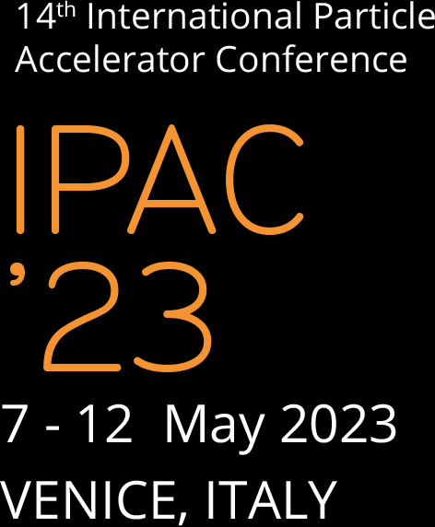



Hosting institutions

Slide 2
Accelerator Based Neutron Sources
Ciprian Plostinar - ESS

Slide 3
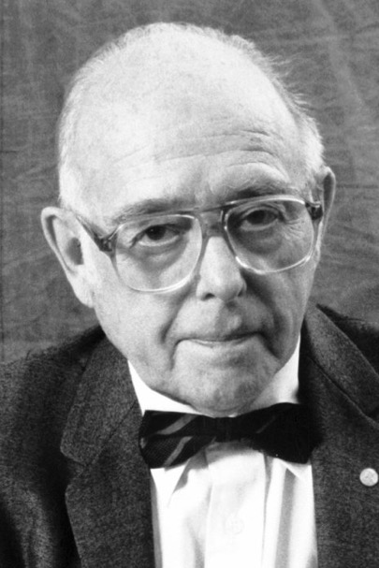
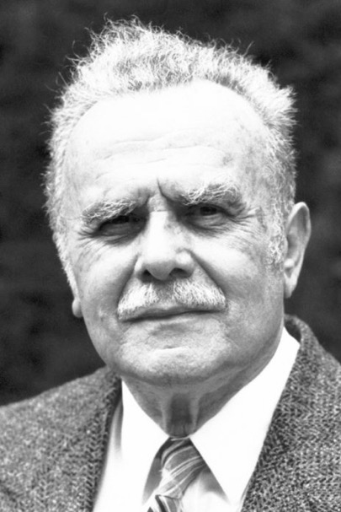
Neutron Science
“For pioneering contributions to the development of neutron scattering techniques for studies of condensed matter”
“Where are the atoms and what do they do?”
  Diffractometers: Structure
  Spectrometers: Dynamics
1994 Nobel Prize 1994:
  Clifford Shull – neutron diffraction
  Betram Brockhouse – neutron spectroscopy
Some Neutron Properties:
  Charge neutral: deeply penetrating ... except for some isotopes
  Nuclear interaction: cross section depending on isotope (not Z), sensitive to light elements.
  Spin S = 1/2: probing magnetism
See the 1994 Physics Nobel Prize Press Release

Slide 4
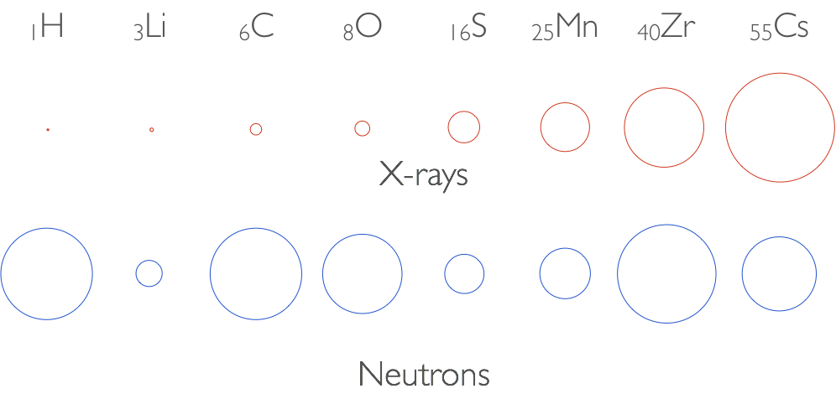
Neutron Science
See Synchrotron Light Sources Tutorial
Ryutaro Nagaoka
Cross-sections of different atoms with photons and neutrons
Neutrons and X-Rays are complementary

Slide 5

Why Neutrons?
Because “planes, trains and dinosaurs (and ice-cream)”!

Slide 6
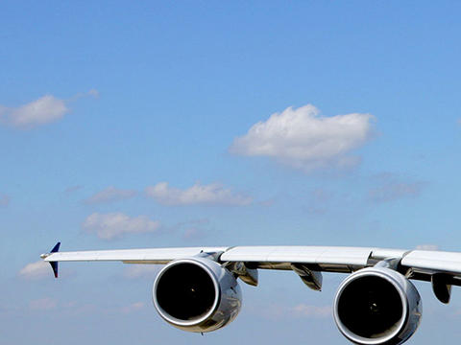

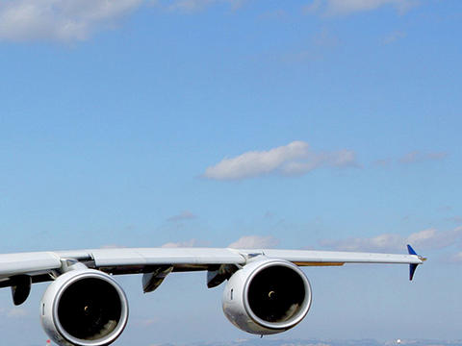
Mapping stress and fatigue in aircraft wings
– Airbus research @ISIS Spallation Neutron Source
Source: airbus.com

Slide 7
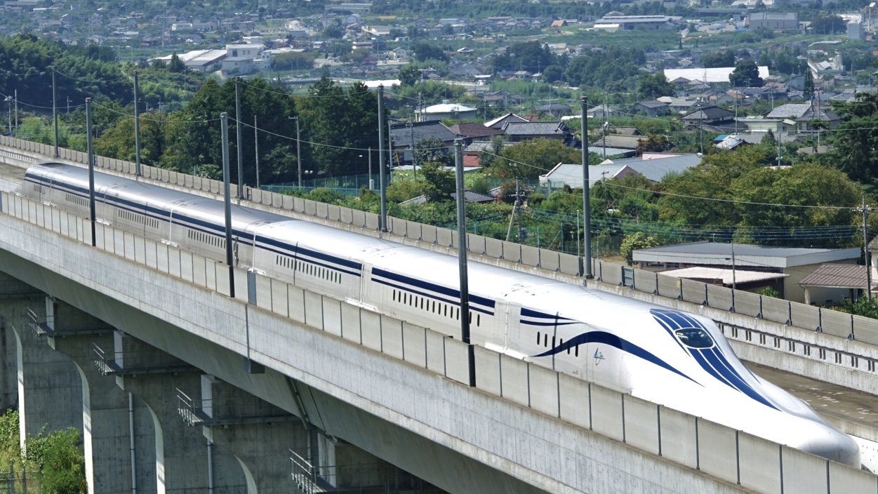
Exploring unconventional superconductors using neutron spectroscopy
Source: wikipedia.org

Slide 8
Neutron characterisation reveals fossilised Titanosaurus embryo – G. Grellet-Tinner et al.

Slide 9
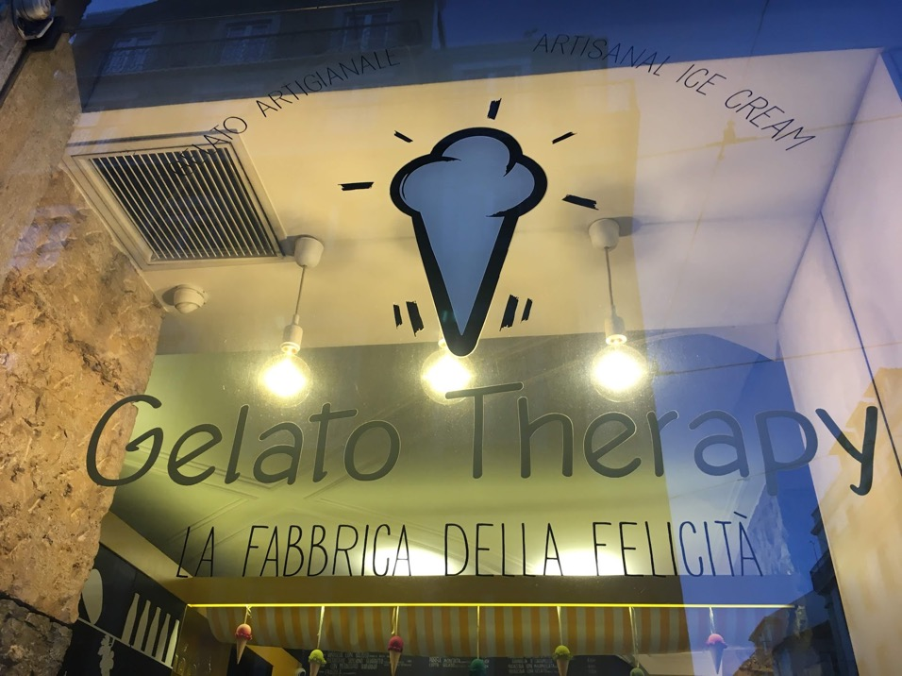
Using neutrons to study the crystallisation of ice cream in real time

Slide 10
Neutron Production
  Small:
    Alpha (i.e. ⁹Be + 𝜶 -> ¹²C + n + 𝛾)
    Gamma
    Spontaneous fission sources
  Reactors
  Accelerators

Slide 11
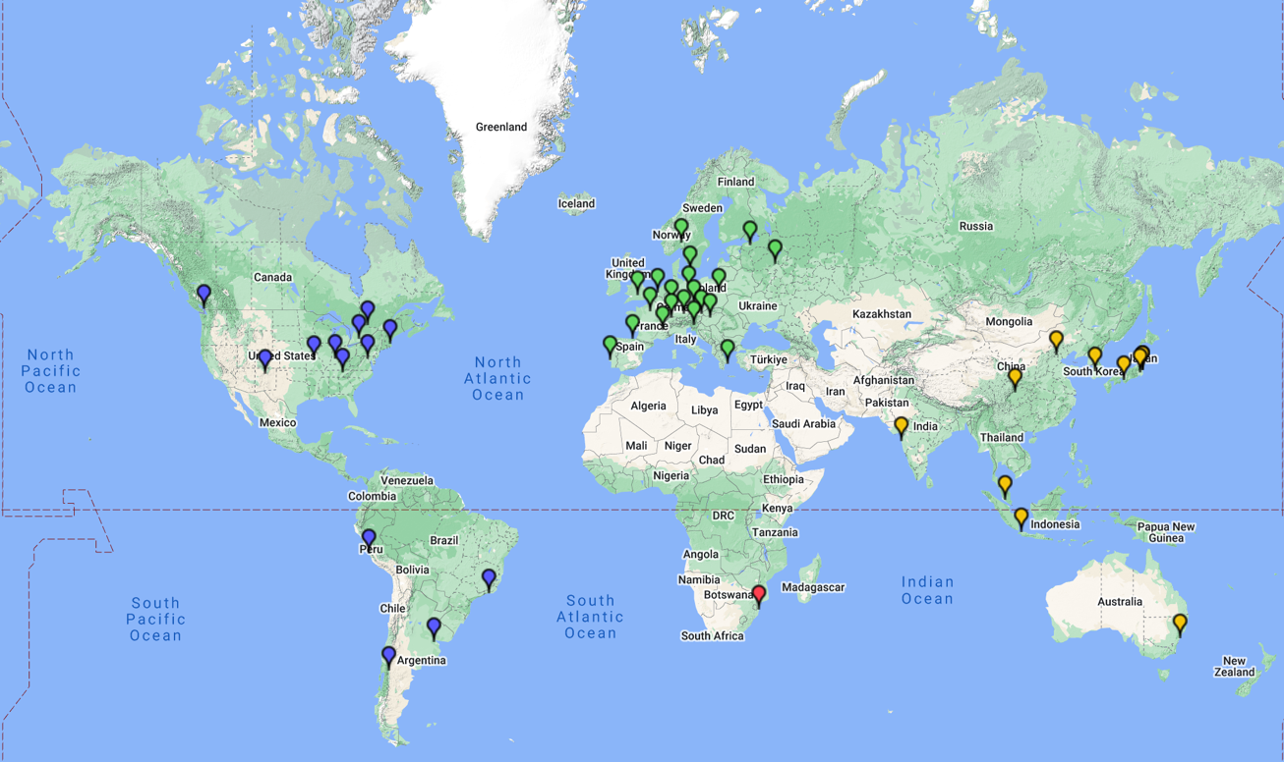
Neutron Production

Slide 12
Spallation Principles
  High energy protons hit a heavy nuclei target
    Neutrons at different energies emitted
  Complex system:
    Accelerator, Target, Moderators, Instruments, etc.
  Spallation: most effective neutron production method

Slide 13
Global Demand for High Power Beams
Spallation Neutron Sources
  ISIS (UK), SINQ@PSI (CH), SNS (USA), J-PARC (JP), LANSCE (USA), CSNS (CN), ESS (SE)
Radioactive Ion Beams (RIB)
  FAIR@GSI (DE), FRIB (USA), EURISOL (Europe), ISOLDE (CH), RIKEN (JP), SPIRAL2 (FR), SPES (IT), SARAF (IL), etc.
Material Irradiation Facilities (MIF)
  IFMIF-EVEDA, IFMIF and FAFNIR(Global effort).
Secondary Beams (Neutrino/Muon/Kaon Factories)
  Linac4/SPL@CERN (CH), PIP-II at Fermilab, (IDS-NF (Global effort), UKNF (UK))
Accelerator Driven Subcritical Reactors (ADSR).
  ADS (CN), MYRRHA (BE), ThorEA (UK).
Accelerator Driven Transmutation of Radioactive Waste (ATW)
  TRASCO (IT)
Accelerator Production of Tritium (APT).
  APT@LANL (USA)

Slide 14
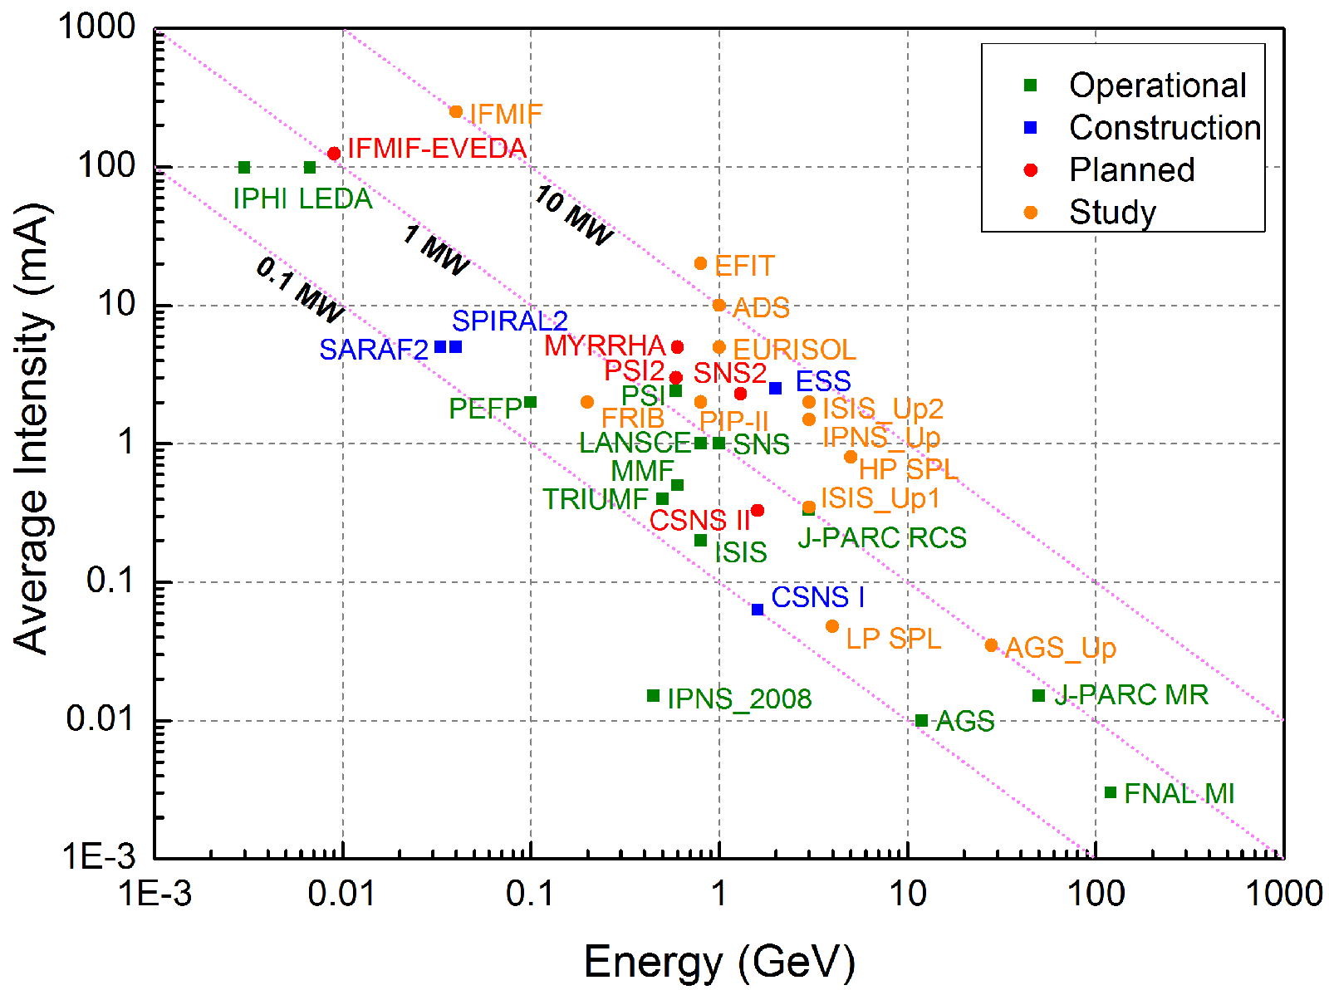
Global Demand for High Power Beams
Secondary Beams (Muon/Neutrino/Kaon Factories)
Accelerator Driven Subcritical Reactors (ADSR)
Accelerator Driven Transmutation of Radioactive Waste (ATW)
Radioactive Ion Beams (RIB)
Material Irradiation Facilities (MIF)
Accelerator Production of Tritium (APT).
Spallation Neutron Sources

Slide 15
Accelerator Beam Power
Optimisation

Slide 16
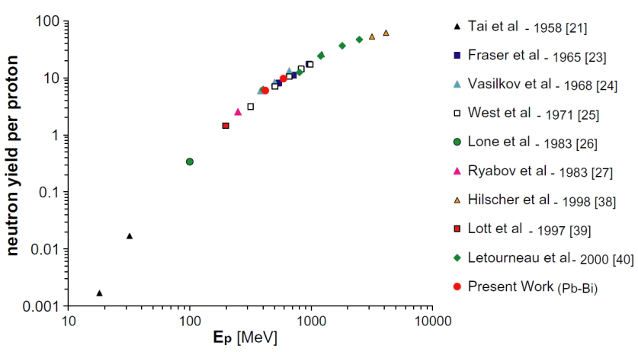
Spallation Neutron Sources
Optimisation
High neutron flux
  High Beam Power:
    Intensity
    Energy
  Target and moderator design
  Instruments
  Practicality
K. van der Meer, et al., NIM B 217, pp 202 – 220.

Slide 17
Spallation Neutron Sources
Short Pulse
  Synchrotrons or compressor rings
  Pulse length: ~μs
Long Pulse
  Linacs
  Pulse length: ~ms
Continuous
  Cyclotrons

Slide 18
Short Pulse Spallation Neutron Sources
Linac-RCS or Linac-Compressor Ring
ZING-P – First Spallation Neutron Source Prototype
  Argonne National Laboratory (ANL) – 1974
  “Recycled”: Built from decommissioned ZGS parts
  ZING-P’ – Second Prototype - 1977
Intense Pulsed Neutron Source (IPNS)
  ANL – 1981 - 2008
  450 MeV, 6.4 kW, 30 Hz RCS
KENS
  @KEK, Tsukuba, 1980
  500 MeV, 3.5 kW, 20 Hz RCS
ISIS, SNS, J-PARC, CSNS – operational
And many other “unsuccessful” proposals along the way

Slide 19
ISIS @ RAL
Inaugurated in 1984
Accelerator:
  H⁻ Ion Source
  LEBT
  0.665 MeV RFQ, 202.5 MHz
  70 MeV Linac (4 DTL Tanks)
  800 MeV proton synchrotron
~230 μA (2.9*10^13 ppp)
50 Hz, 184 kW (~25*IPNS)
  148 kW to TS-1 (40 Hz)
  36 kW to TS-2 (10 Hz)

Slide 20
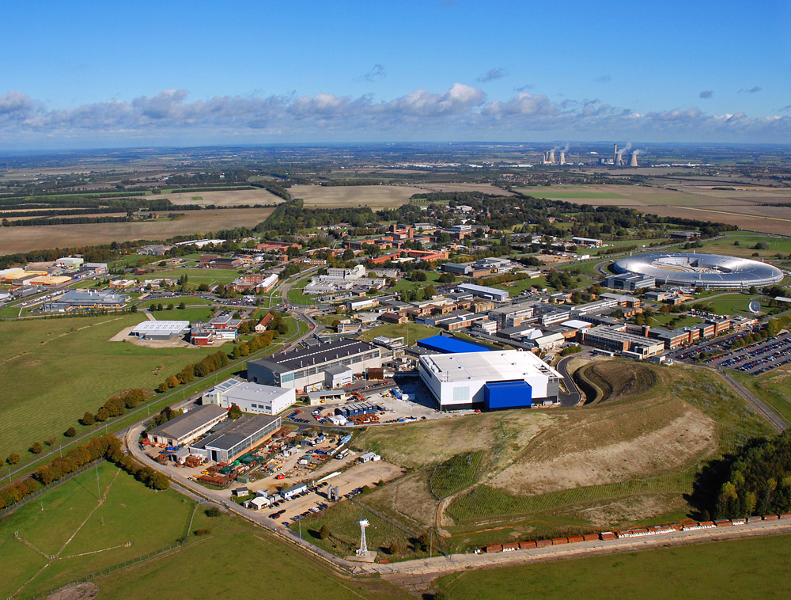
ISIS @ RAL

Slide 21
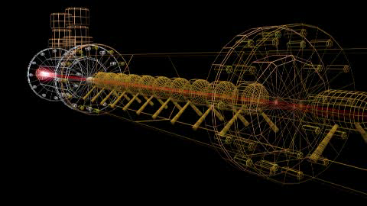
ISIS @ RAL

Slide 22
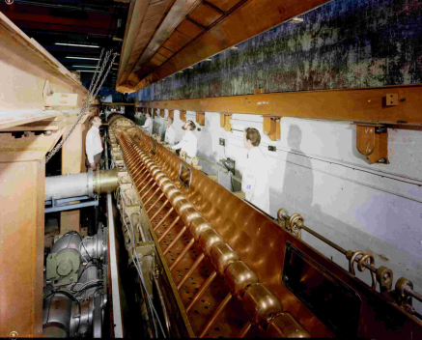
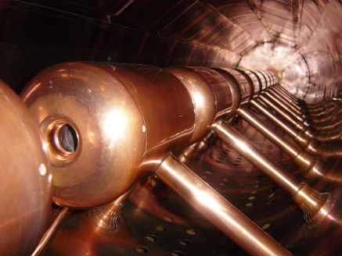
ISIS @ RAL
Some “recycled” components
ISIS was originally expected to have an operational life of 20 years
Its continued success will probably double its expected lifetime.
  Neutron demand from users
  Maintenance, refurbishment, investment.
ISIS is the prototype for modern spallation facilities.

Slide 23
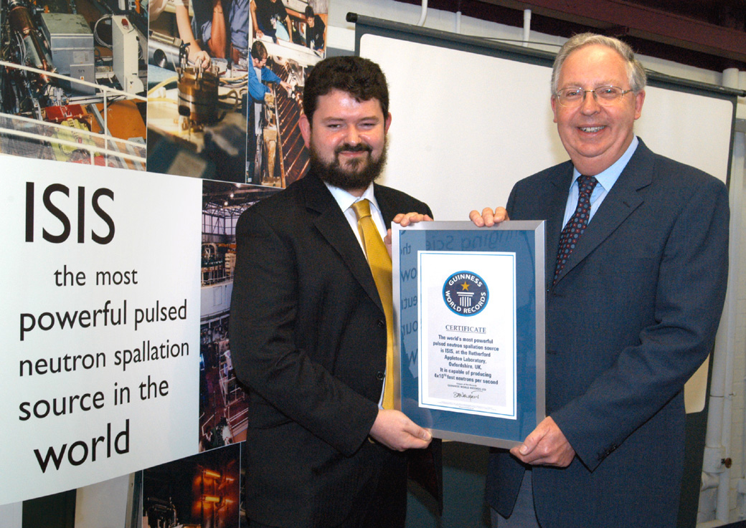
(Beam) Power Supremacy!

Slide 24
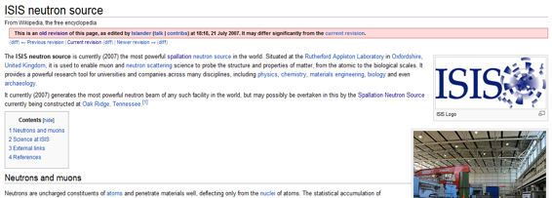
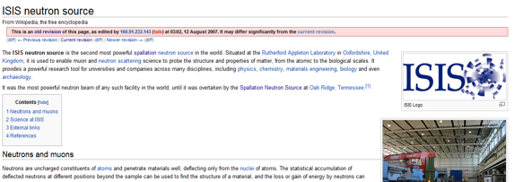
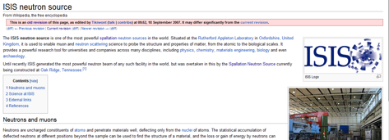
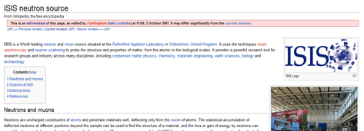
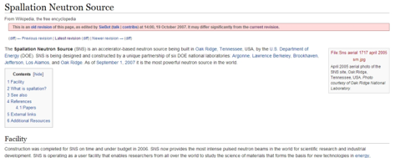
(Beam) Power Supremacy! – A Wiki Story
18:18, 21 July 2007, Wikipedia:
ISIS is ”…the most powerful spallation neutron source in the world…”
03:02, 12 August 2007:
ISIS is ”…the second most powerful…”
09:52, 18 September 2007:
ISIS is ”…one of the most powerful…”
09:52, 03 October 2007:
ISIS is ”…a world leading neutron source…”
14:00, 19 October 2007:
SNS is ”…the most powerful neutron source in the world…”

Slide 25
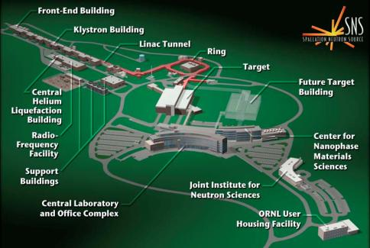
Spallation Neutron Sources
SNS, 2007

Slide 26
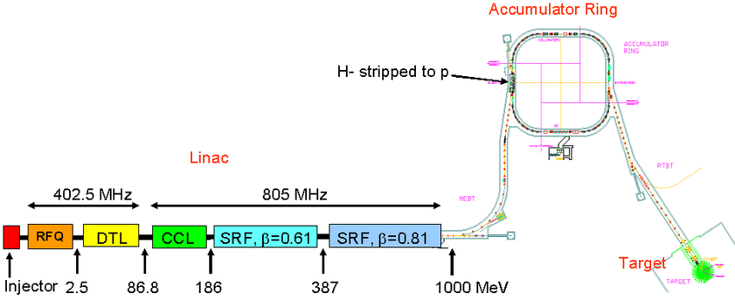
Spallation Neutron Sources
SNS: Currently at ~1.55 MW
1 GeV, NC-SC Linac: DTL,CCL, ELL
Accumulator Ring: 60 Hz, 1.5 MW
Upgrades to follow

Slide 27
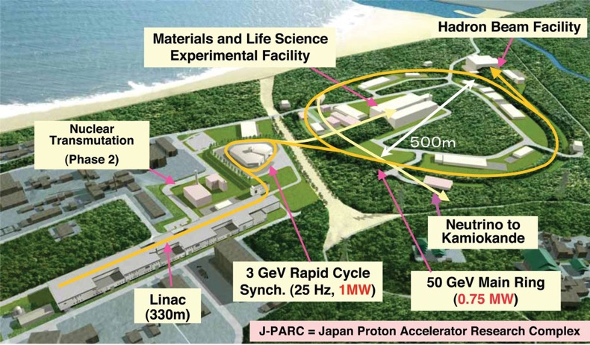
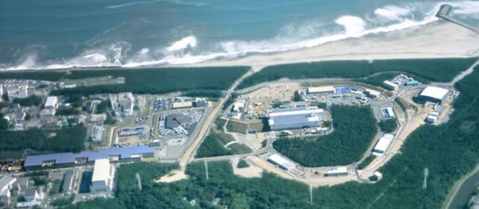
Spallation Neutron Sources
J-PARC, Multi-purpose facility, 2008: ~1 MW
Phase 1
  180 MeV H- Linac
  25 Hz, 3 GeV RCS, 0.5 MW
  30 GeV Main Ring
  Phase 2
    400 MeV H- Linac (completed 2014),
    25 Hz, 3 GeV RCS, 1.0 MW
    50 GeV Main Ring

Slide 28
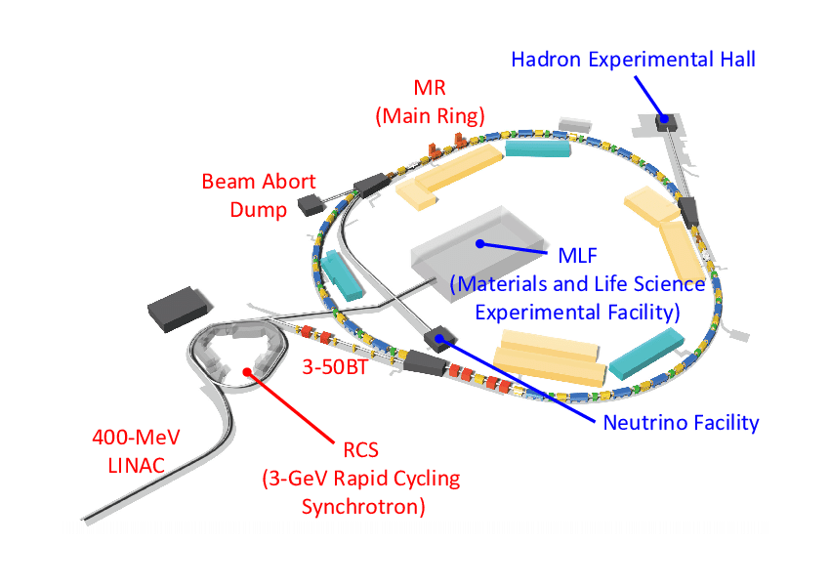
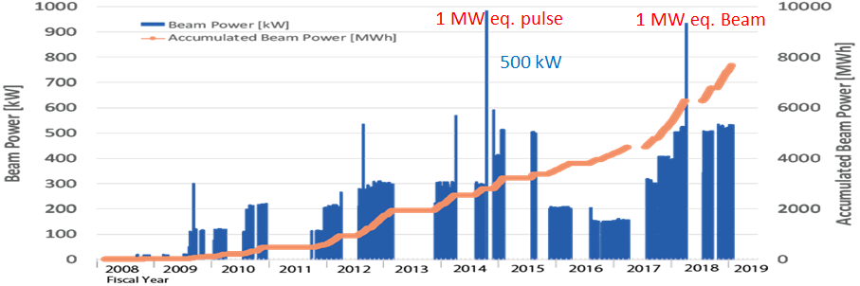
Spallation Neutron Sources
J-PARC: ~1 MW

Slide 29
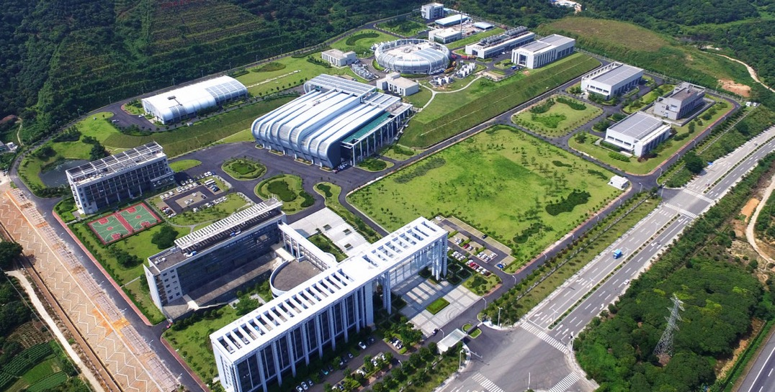
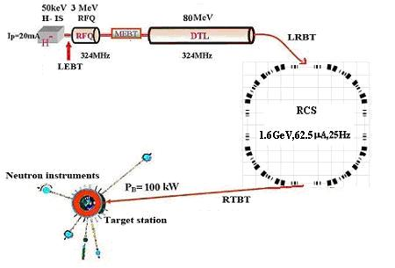
Spallation Neutron Sources
CSNS: 100 kW -> 500 kW (upgrade)

Slide 30
Long Pulse Spallation Neutron Sources
Linac + Target
LAMPF (LANSCE) – first facility
  Los Alamos, 1977 – WNR Centre
  800 MeV NC Linac (DTL 202.25 MHz, SCL 805 MHz)
High Power Operation
  Beam Intensity:
    space charge, resonances, halo, losses (1 W/m), front end design, etc.
  Beam Energy:
    NC, SC, RF Frequency choice, Efficiency (tunnel length), etc.

Slide 31
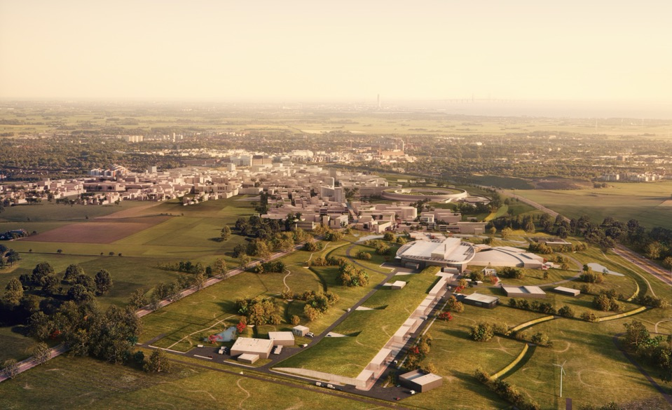
The European Spallation Source - ESS
A 5 MW Facility!!!

Slide 32
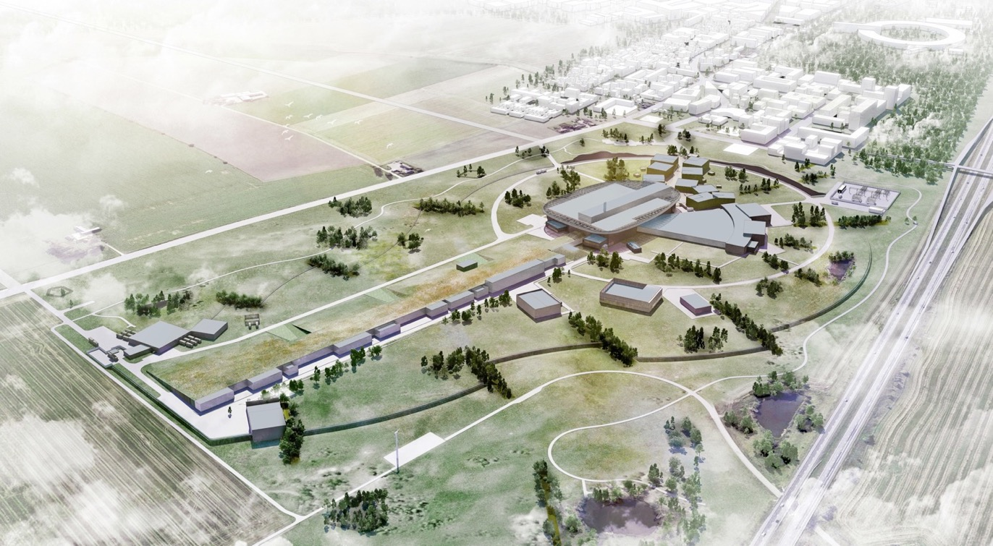
The European Spallation Source - ESS
A 5 MW Facility!!!

Slide 33
The European Spallation Source - ESS
In Kind Partners
Aarhus University
Atomki - Institute for Nuclear Research
Bergen University
CEA Saclay, Paris
Centre for Energy Research, Budapest
Centre for Nuclear Research, Poland, (NCBJ)
CNR, Rome
CNRS Orsay, Paris
Cockcroft Institute, Daresbury
Elettra – Sincrotrone Trieste
ESS Bilbao
Forschungszentrum Jülich
Helmholtz-Zentrum Geesthacht
Huddersfield University
IFJ PAN, Krakow
INFN, Catania
INFN, Legnaro
INFN, Milan
Institute for Energy
Research (IFE)
ISIS - Rutherford-Appleton Laboratory, Oxford
Laboratoire Léon Brilouin (LLB)
Lund University
Nuclear Physics Institute of the ASCR
Oslo University
Paul Scherrer Institute (PSI)
Polish Electronic Group (PEG)
Roskilde University
Tallinn Technical University
Technical University of Denmark (DTU)
Technical University Munich (TUM)
Science and Technology Facilities Council
University of Copenhagen (KU)
University of Tartu
Uppsala University
Wigner Research Centre for Physics
Wroclaw University of Technology
Warsaw University of Technology
Zurich University of Applied Sciences (ZHAW)

Slide 34
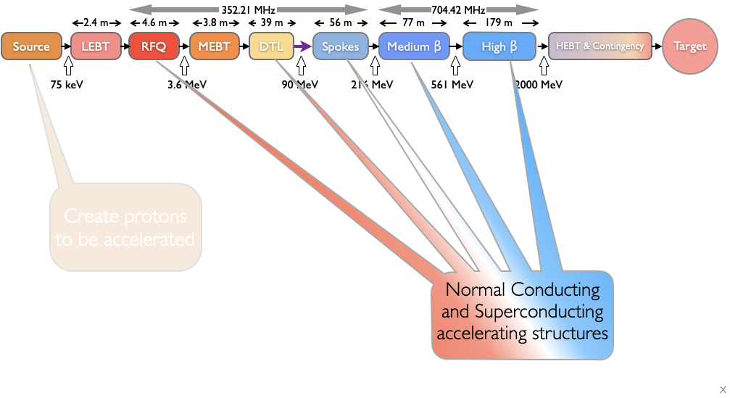
The European Spallation Source - ESS
Ion Species | Protons
Output Energy | 2 | GeV
Frequency | 352.21/704.42 | MHz
Pulse Length | 2.86 | Ms
Peak Current | 62.5 | mA
Protons per Pulse | 1.1 x 10¹⁵
Repetition Rate | 14 | Hz
Duty Cycle | 4 | %
Average Beam Power | 5 | MW
Accelerating Structures | RFQ, DTL, SC Spokes/Elliptical
Accelerator Length | ~365 | m

Slide 35
The European Spallation Source - ESS
  IK Partners

Slide 36
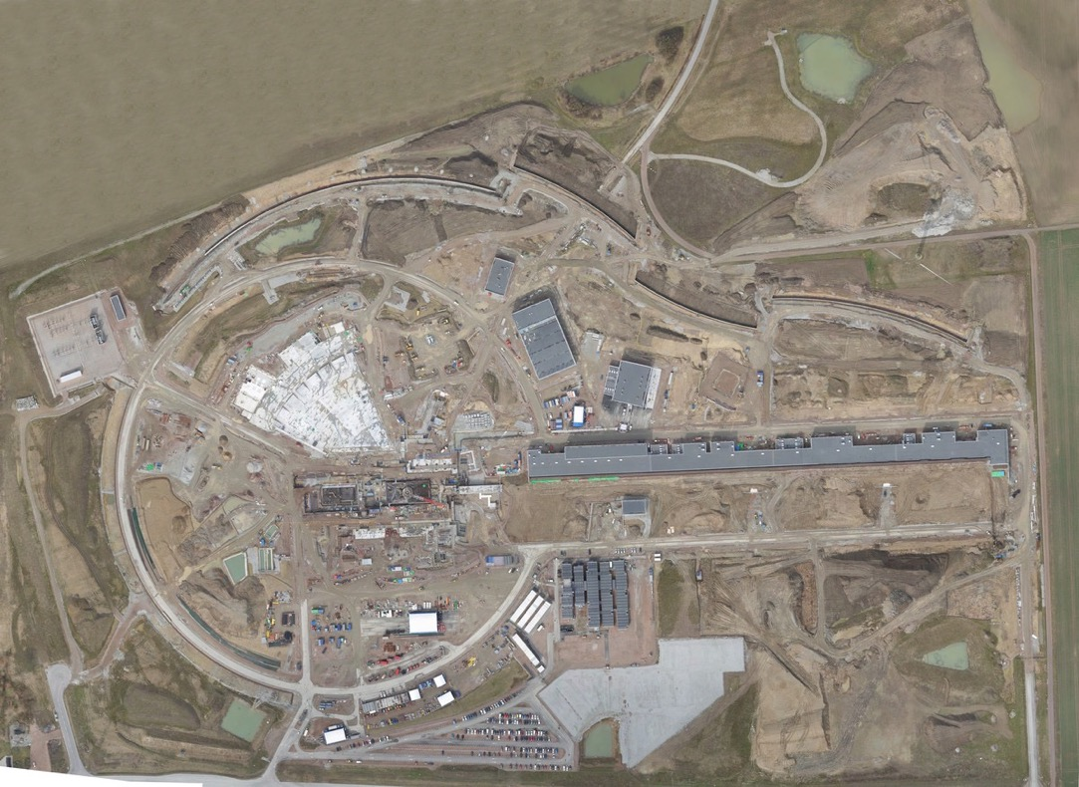
The European Spallation Source: 2017

Slide 37
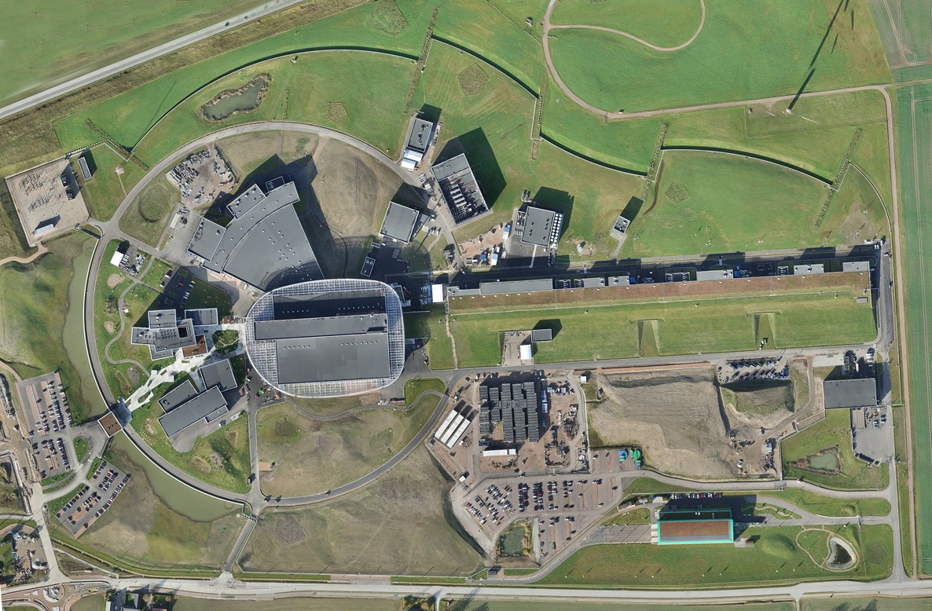
The European Spallation Source: 2022

Slide 38
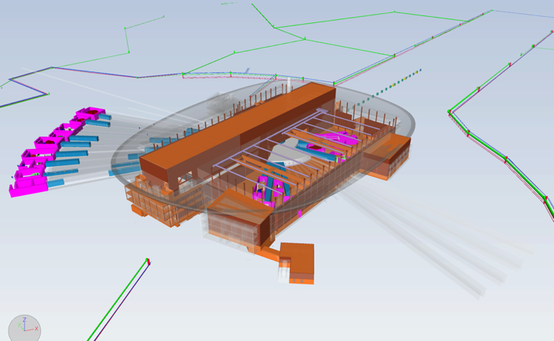
The European Spallation Source - Science

Slide 39
The European Spallation Source - Science
21st Century Challenges
Medicine and biotechnology
Energy
Fuels
Batteries
Environment
New materials/Intelligent Materials
Day to Day Chemistry
Food
Etc.

Slide 40
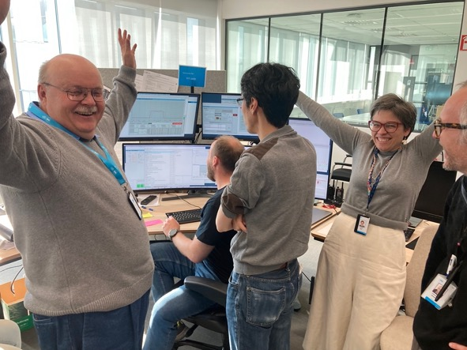
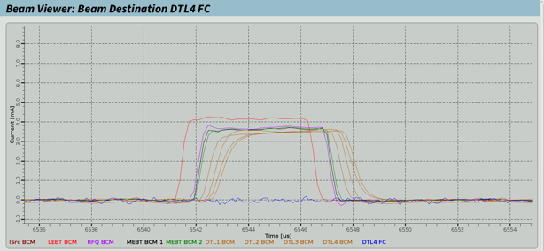
The European Spallation Source - ESS
18 April 2023: First Beam to DTL4

Slide 41
CW Spallation Neutron Sources
Cyclotrons
  Long history (1931)
  Many applications
  CW injection, acceleration and extraction
  High beam power
  Sector Magnets, RF Cavities, Injection, Extraction, etc.
    No frequency sweeping or field ramping
    Magnets rather heavy and complex
  Issues
    Beam loss
    Clean extraction
    Space charge forces can limit high intensity operation
    For high power, larger diameter is needed

Slide 42
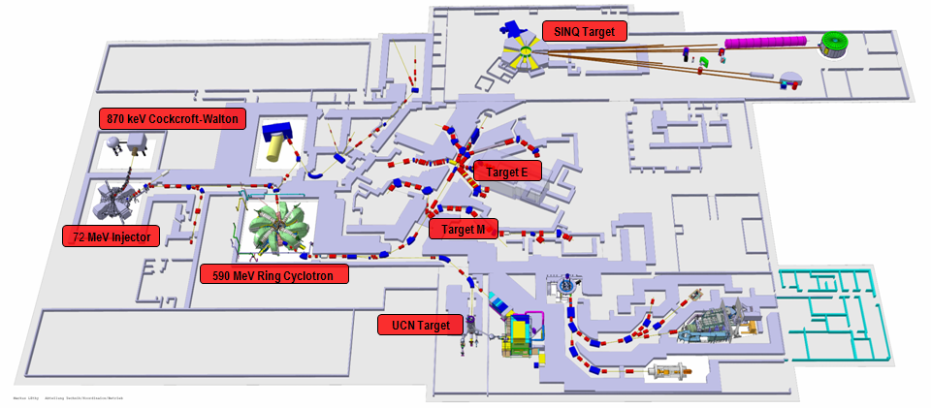
PSI
Multipurpose facility (1974)
1.3 MW beam power
  0.86 MW for spallation (SINQ)
Accelerator: 2.2 mA CW
  CW, 72 MeV Injector (Cyclotron), 590 MeV Cyclotron

Slide 43
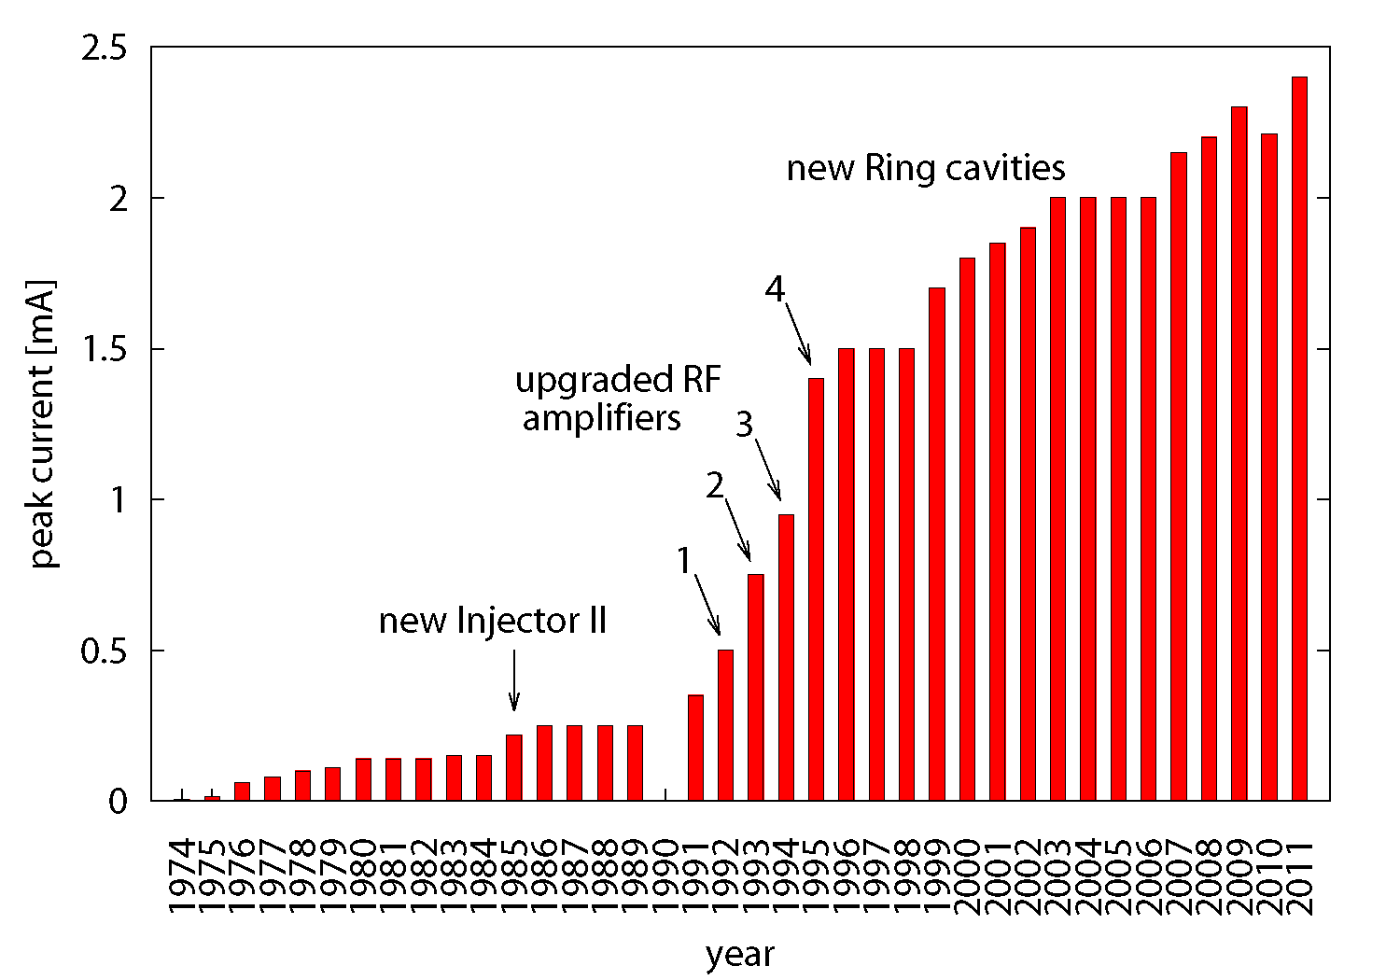
PSI

Slide 44
Compact accelerator based neutron sources (CANS)
From large facilities (SNS, ISIS, ESS, etc) to small local machines
  Important cost aspects, users/community needs
Neutrons are produced by the nuclear capture reaction between a low energy beam and light elements as beryllium or lithium.
Some examples:
Jülich Centre for Neutron Science: electrostatic tandem accelerator producing a pulsed proton beam of 10 MeV at 1 mA peak current and an average power of 400 W. Beryllium target.
PC-CANS (proposed – Canada): IS, LEBT, RFQ, MEBT, DTL. 10 MeV proton beam.

Slide 45
Conclusion
https://www.youtube.com/watch?v=VESMU7JfVHU

Slide 46
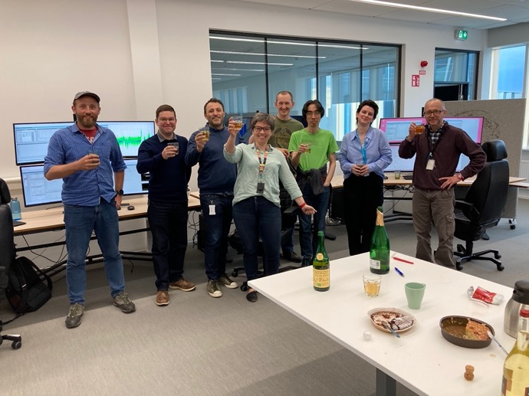
PhD and Postdoc position at ESS
We are looking for motivated students and young scientists to work, together with the ESS team, on future high intensity hadron machines.
We have a PhD position already open (see ESS vacancies website) to work on high intensity effects and a simulator package for linac and rings.
We will open soon a Postdoc position to work directly on the design and simulation of an accumulator and compressor ring for a future Muon Collider Facility (this is a EU project in connection with CERN and many other EU labs.)
Contacts:
  Natalia Milas (Natalia.milas@ess.eu)
  Emanuele Laface (Emanuele.laface@ess.eu)

