Slide 1







Hosting institutions

Slide 2
Michele Comunian (INFN – LNL)
Facilities for Radioactive Ion Beams

Slide 3
Facilities for Radioactive/Rare Ion Beams
What is a RiBs Facilities
Overview of main RiBs Facilities
Some specific topics:
  Beam generation (driver, target)
  Beam selection (hrs, cooler)
  Beam acceleration (charge breeder, post)
  SPES as example of RiBs facility

Slide 4
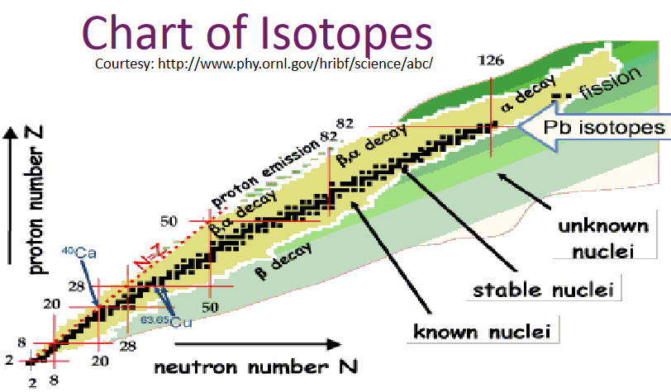
What is a RiBs facilities
Radioactive Ion Beams are beams of atomic nuclei that are radioactive, meaning that they spontaneously decay and emit radiation. These beams are generated by accelerating artificially created isotopes to high energies using particle accelerators.
The resulting beam of radioactive ions can be used for a variety of scientific applications,
including nuclear physics research, astrophysics studies, and medical applications such as cancer treatment.
The unique properties of these beams allow scientists to study and control the behavior of individual atomic nuclei,
providing insights into the fundamental nature of matter and energy.
You are here!

Slide 5
Practical use of RiBs:
Radioactive isotopes have a variety of practical uses, including:
Dating fossils and rocks: Scientists use radioactive isotopes to determine the age of rocks and fossils by measuring the rate of decay of isotopes such as Carbon-14 and Uranium.
Medical imaging: Radioactive isotopes such as Technetium-99m are used to create images of the body during medical procedures such as bone scans and PET scans.
Cancer treatment: Radiation therapy uses high-energy ionizing radiation, often delivered through radioactive isotopes such as Iodine-131 and Cobalt-60, to kill cancer cells and shrink tumors.
Industrial applications: Radioactive isotopes are used in a variety of industrial applications such as oil exploration, quality control in manufacturing, and detecting leaks in pipes and containers.
Energy production: Nuclear power plants use radioactive isotopes such as Uranium-235 and Plutonium-239 to generate electricity through nuclear reactions.
Agriculture: Radioactive isotopes are used to study soil erosion and plant nutrient uptake, as well as to control insect and pest populations in agriculture.
All these practical use need a better “know how” (Theory) on the RiBs ions
Cross sections of ions (problems with extremely low production cross sections, force between nucleons)
Decay time (problems with very short lifetime, hadrons properties)
Decay modes (problems of unwanted species in the same nuclear reaction, complexity of nucleons interactions)
New ions identification (problems of high energy beams, stability limits?)

Slide 6
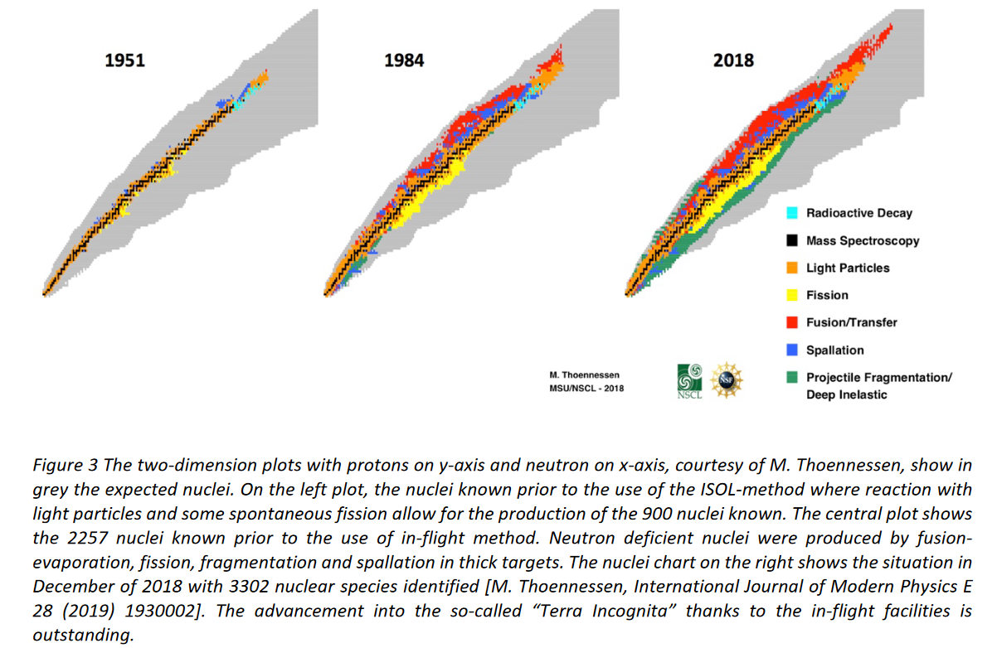
Chart of isotopes evolution

Slide 7
How to generate RiBs
ISOL
Isotope Separation On-Line
Thick and hot
Production target
Driver Accelerator
Low Energy
Experiment
p/d Cyclotron/Linac
High Energy
Experiment
Ion Source
Isotope
Separator
Post Accelerator
Transport
Line
Charge
Breeder
Heavy Ion Linac
Thin
Production
target
In-Flight
High Energy
Experiment
Driver Accelerator
High Energy
Experiment
Heavy Ion Cyclotron/Linac
Fragment
Separator
Transport
Line
Post Accelerator
Isotope
Separator
Heavy Ion Linac
Gas
Ion-stopper

Slide 8
ISOL METHOD
In-Flight METHOD
Pro:
Small Beam emittance
Small energy Spread
High quality pure beams (Spectrometer/Laser source)
Parasitic use of main facility beam time
Cons:
Low Energy beam
Need post accelerator
Slow production method (decay losses)
Chemistry needed
Pro:
High Energy
Fast production method (no decay losses)
No Chemistry
Cons:
Cocktail of beams
Difficult to decrease energy
Uneasy to purify the beam
High emittance/energy spread
Need a specific facility

Slide 9
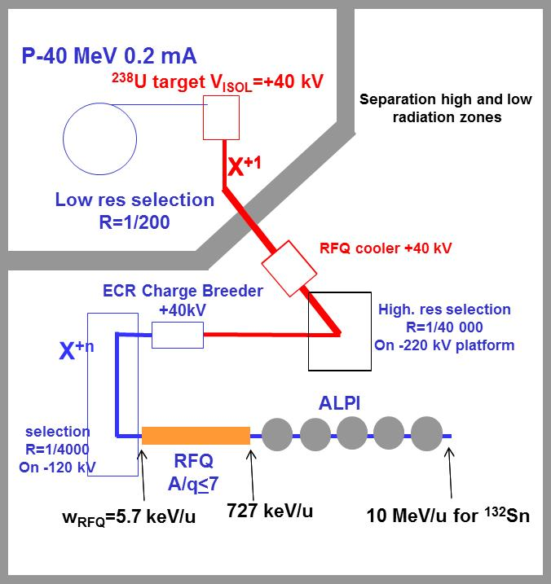
Example of ISOL facility (SPES)
The beam preparation scheme satisfies various requirements:
the zone with worst radiation protection issues is reduced by means of the first isobar selection (resolution R=1/200).
after that with an RFQ cooler the beam energy spread and transverse emittance are reduced both for further separation and to cope with the charge breeder acceptance (about 1 eV).
HRMS and MRMS (high and medium resolution mass spectrometers, R=1/20000 and R=1/1000 respectively) are used to select the RNB (with good transmission) and to suppress the contaminants from the charge breeder source.
Both the HRMS and the MRMS are installed on a negative voltage platform, to decrease the beam geometrical emittance, the relative energy spread and to keep the dipole field in a manageable range (>0.1 T).
The 7 m long RFQ has an internal bunching and relatively high output energy; this easies the setting and allows 90% transmission into ALPI longitudinal acceptance (constraint deriving from quite long ALPI period, 4 m).
An external 5 MHz buncher before the RFQ will be available for specific experiments (at the price of about 50% beam transmission).
The dispersion function is carefully managed in the various transport lines; where possible the transport is achromatic, otherwise the dispersion is kept low (in particular at RFQ input D=0, D’ is about 50 rad).
High res. Selection
R=1/20 000
On -120kV platform
MRMS
R=1/1000
On -120kV platform

Slide 10
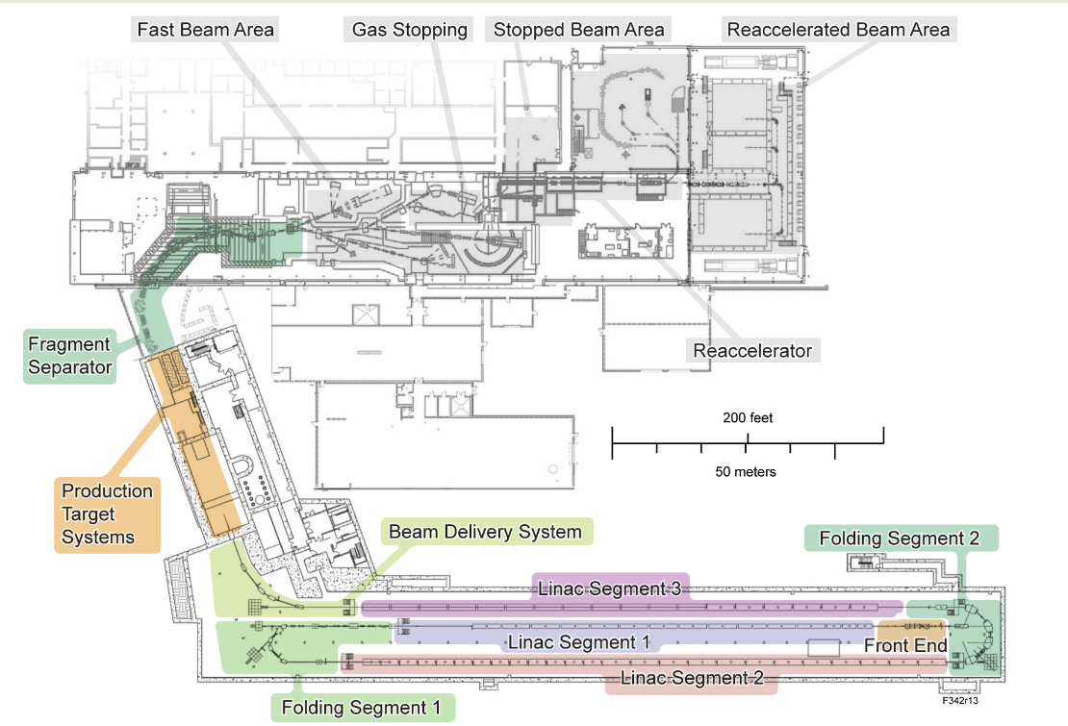
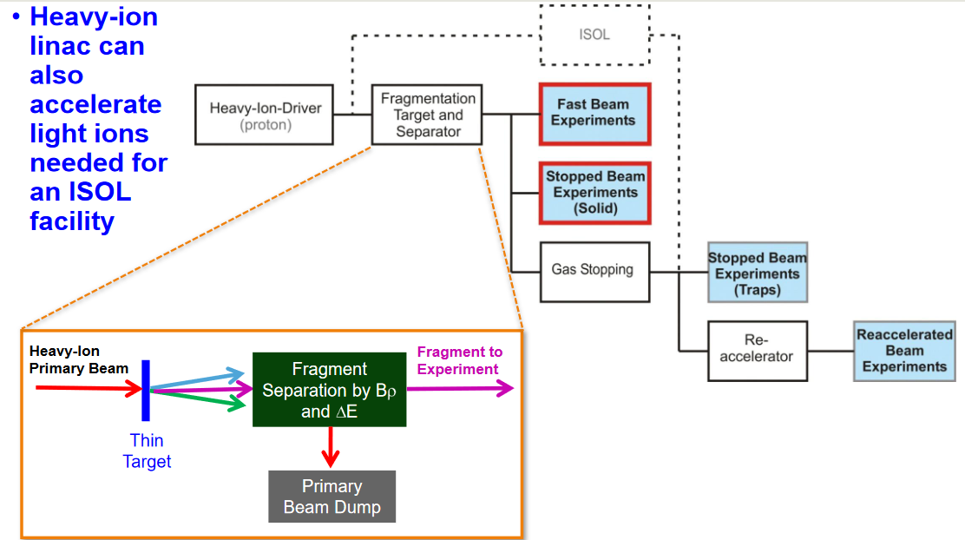
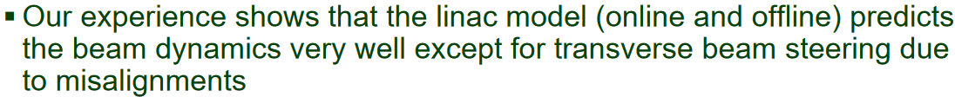
Example of In-Flight facility (FRIB)

Slide 11
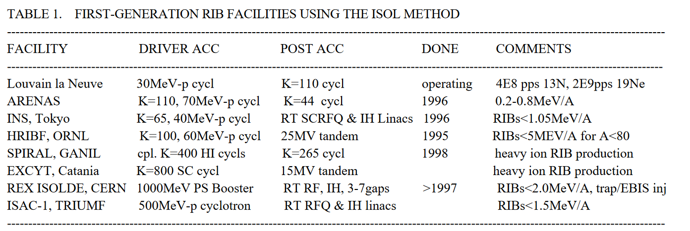
First generation RiBs Facilities
2E9 pps=0.3 pA
However, they are all limited in some way with respect to what is technically
feasible, either in RIB species, RIB intensity, or RIB energy.

Slide 12
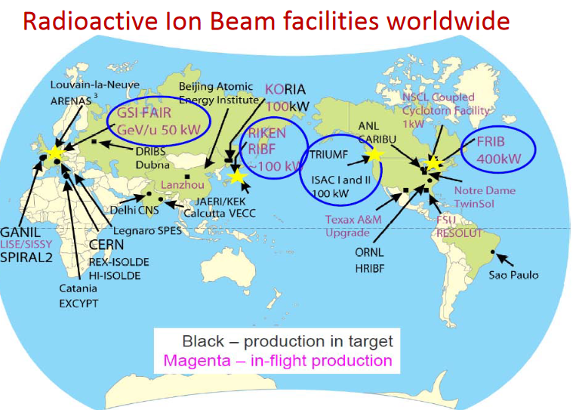
Present-day RiBs Facilities

Slide 13
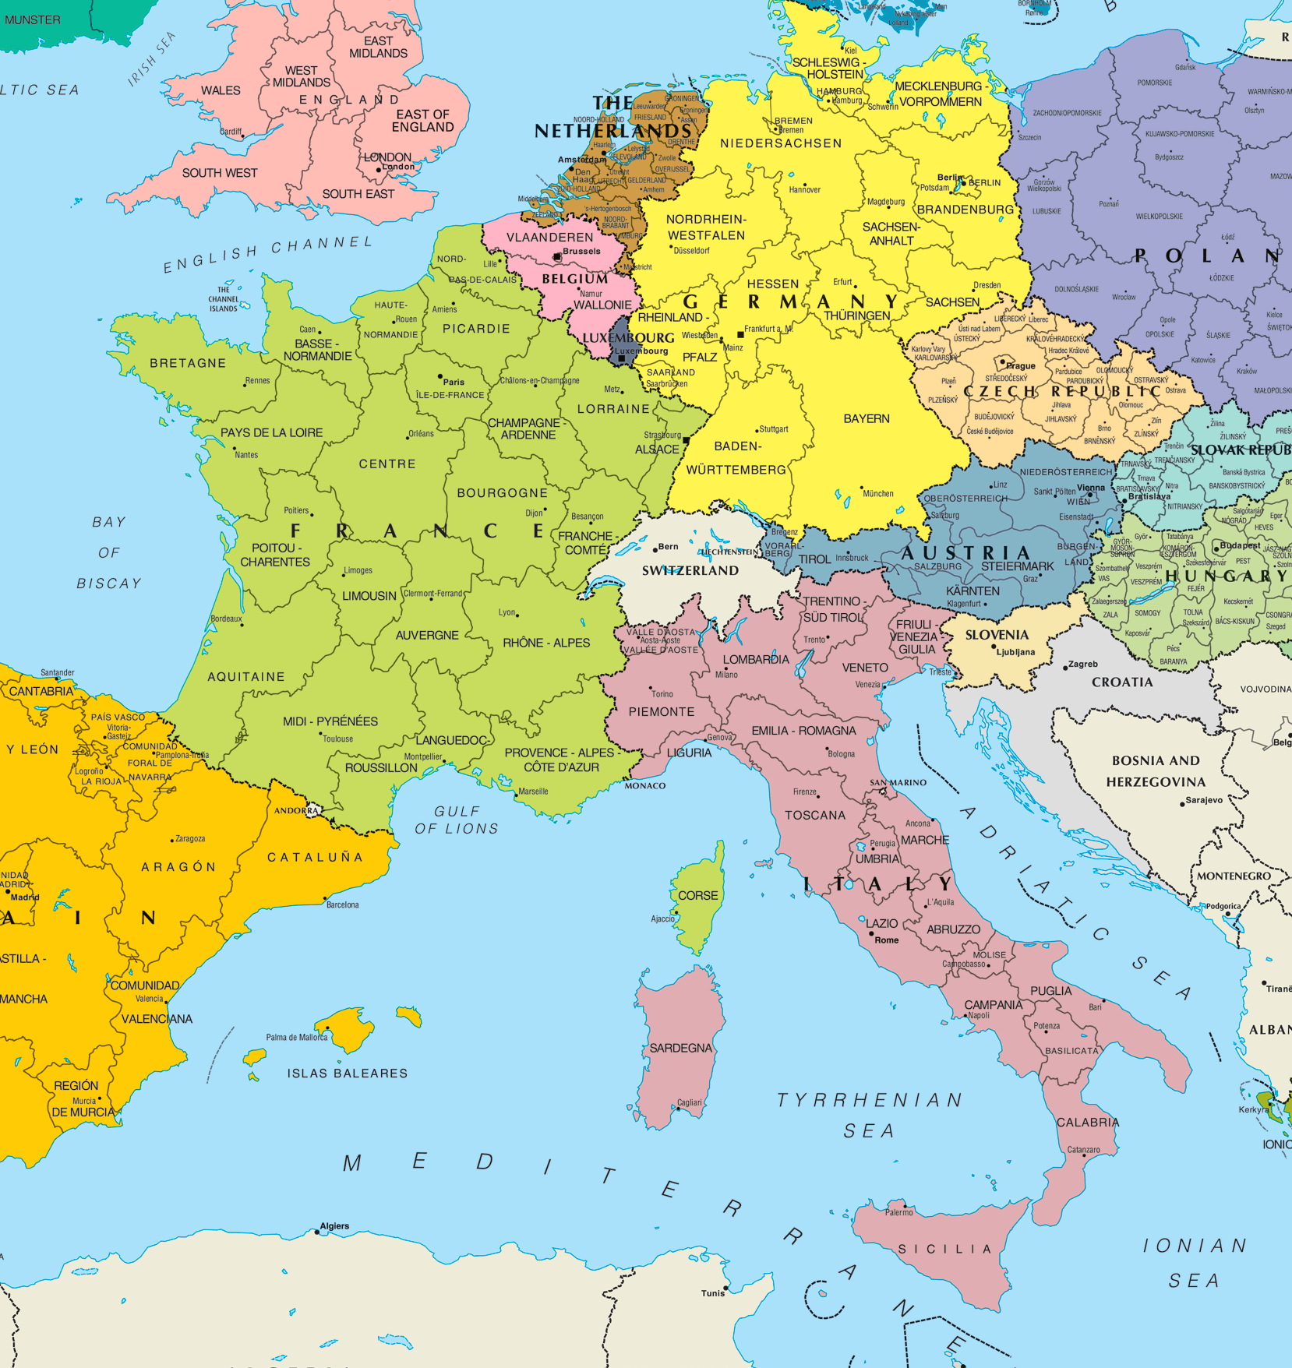
RiBs Facilities (European)
FAIR
SPIRAL2
ISOLDE
SPES
LNS

Slide 14
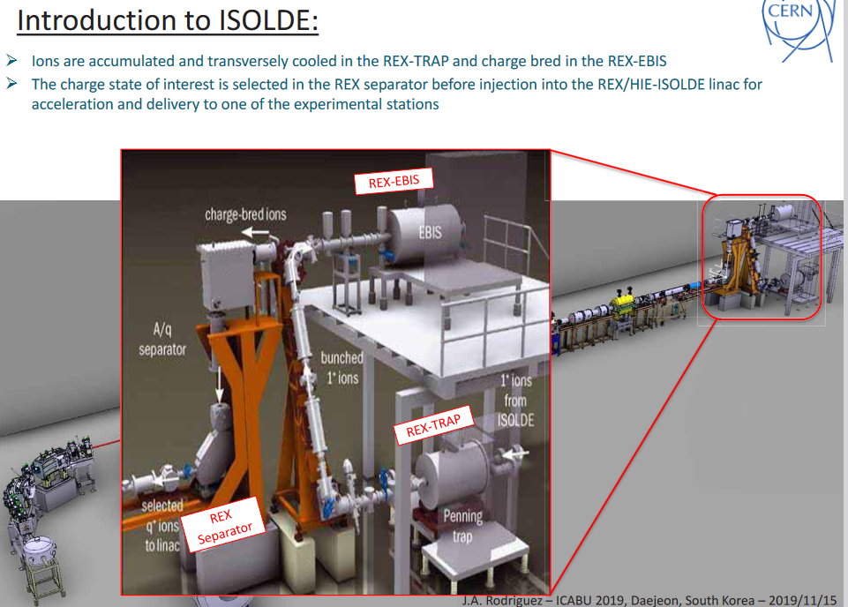
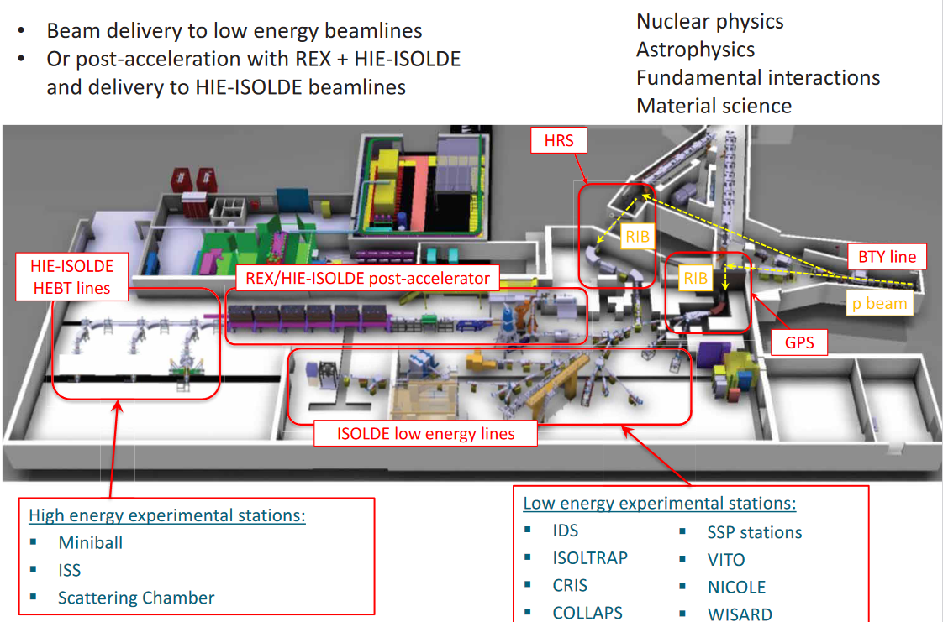
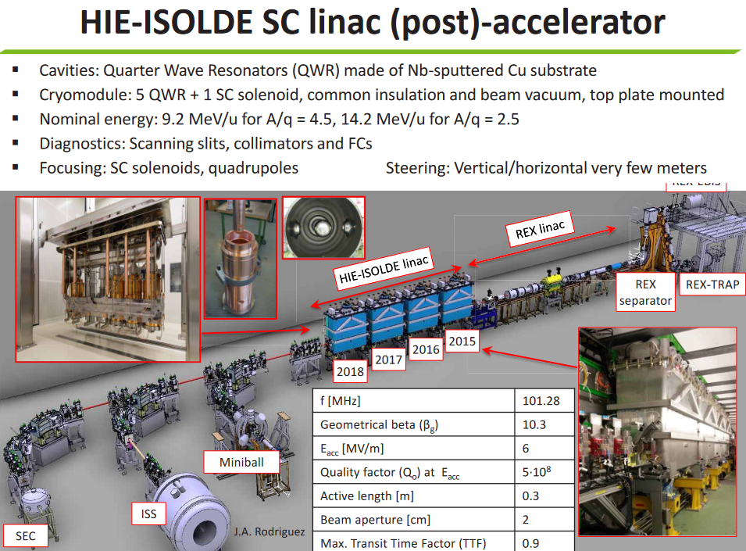
HIE ISOLDE

Slide 15
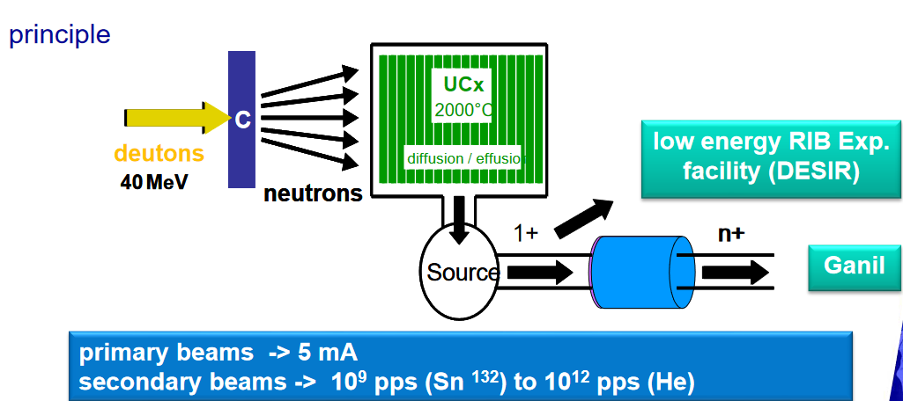
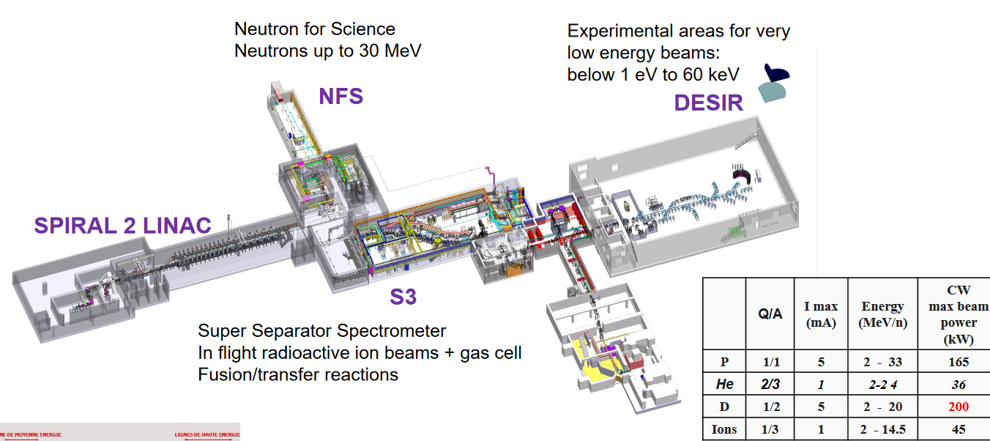
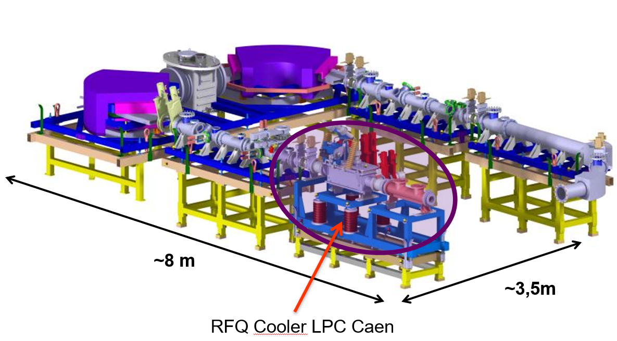
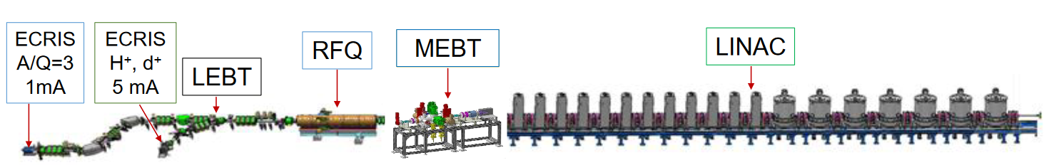
GANIL-SPIRAL1-2
HRS

Slide 16
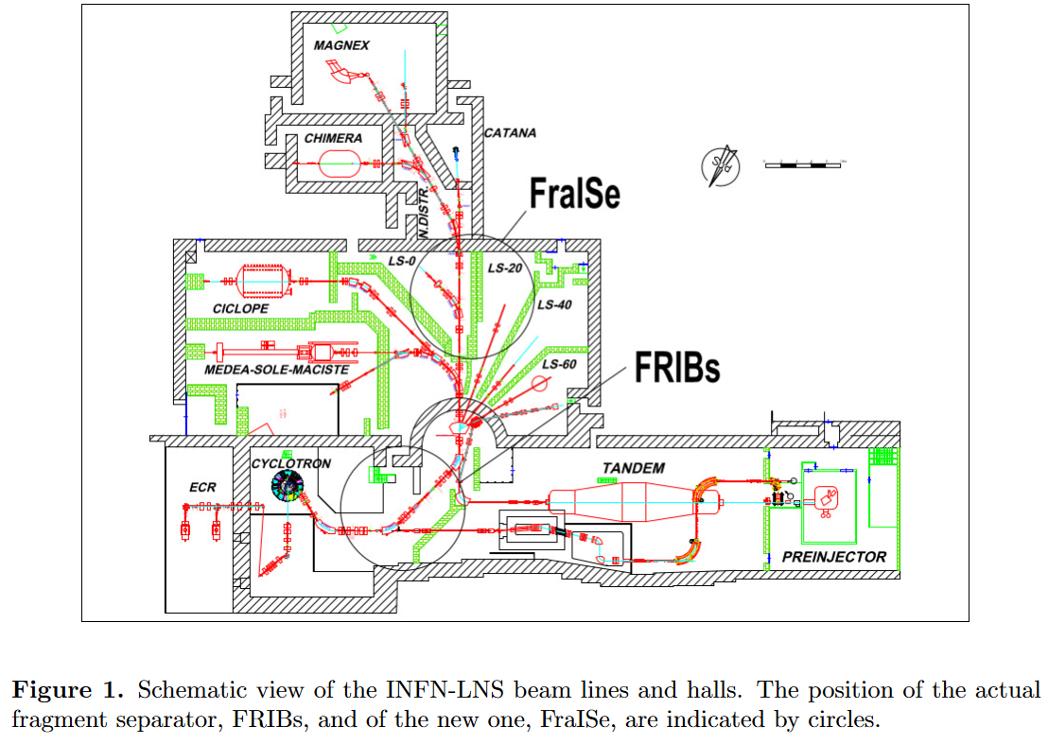
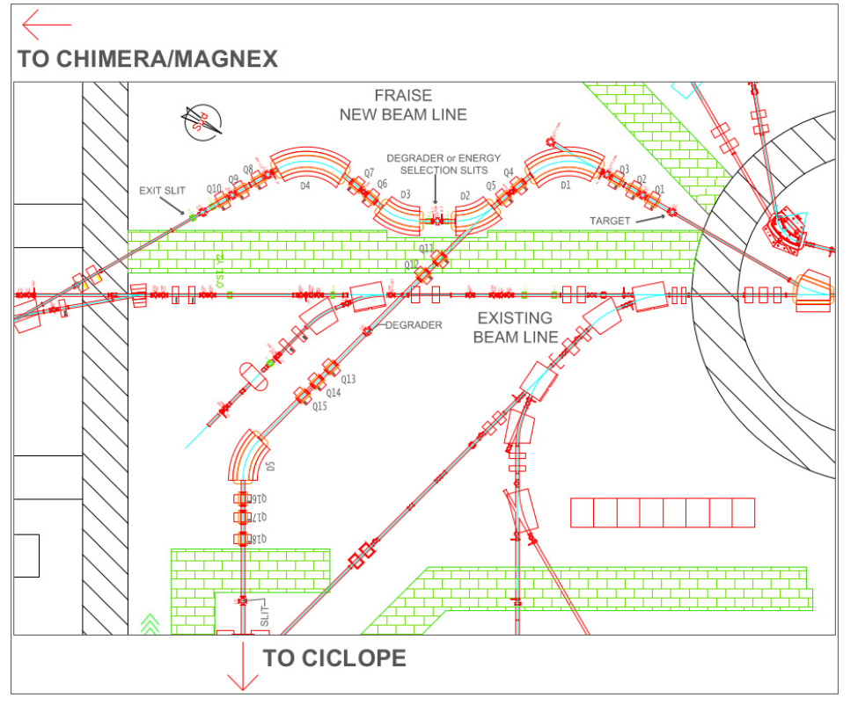
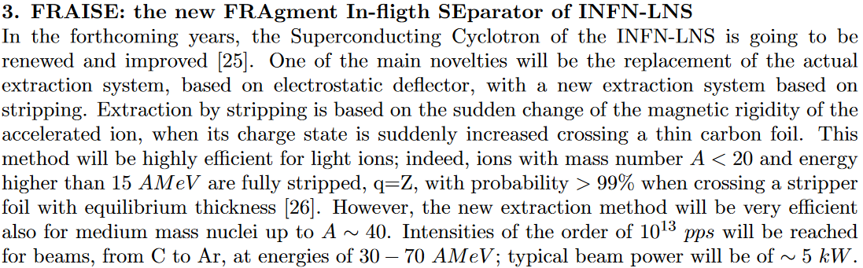
LNS

Slide 17
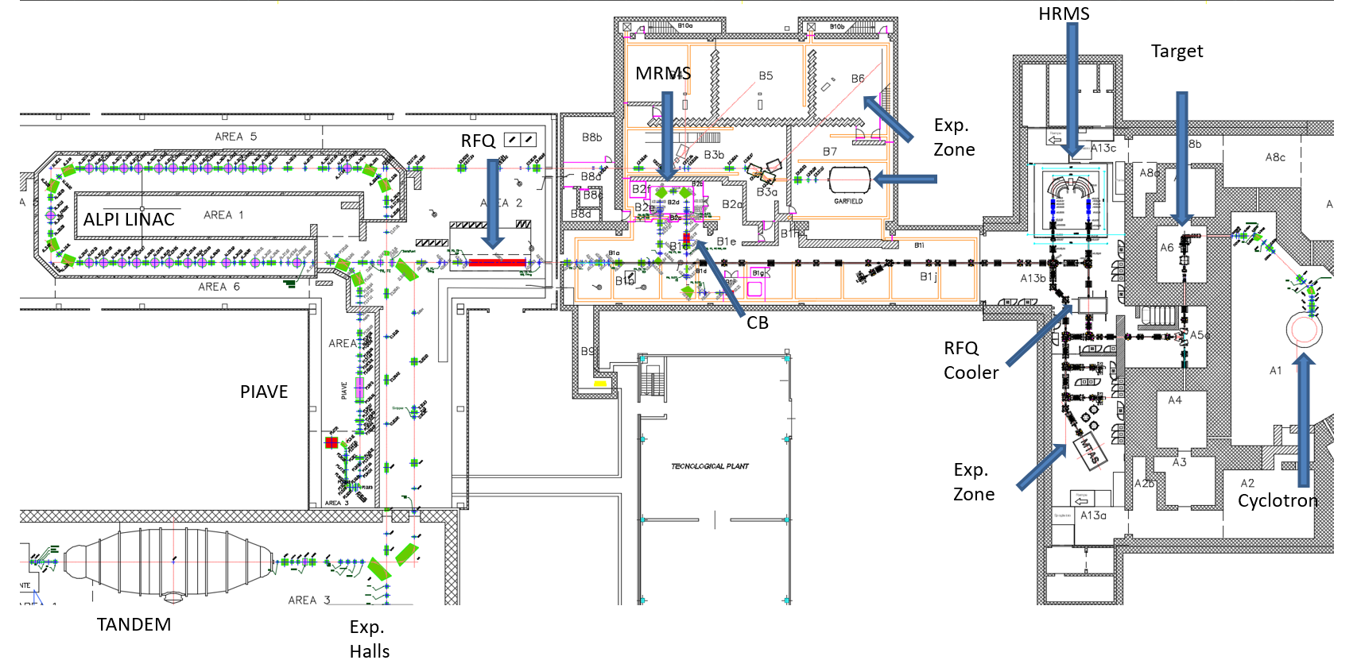
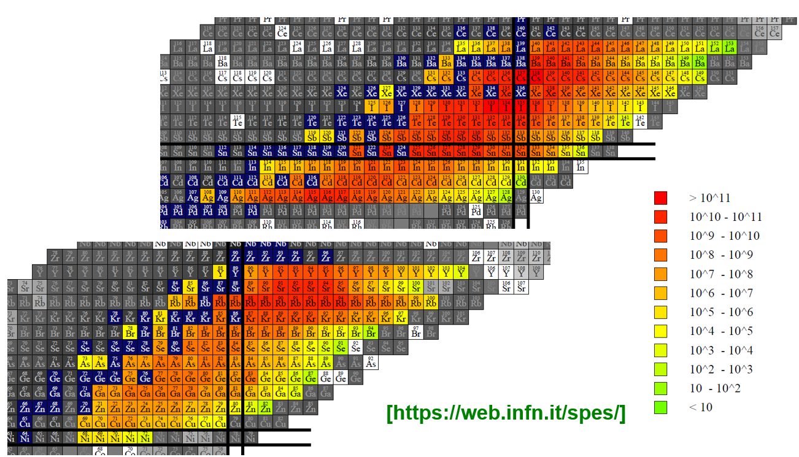
SPES
8 kW 10^13 f
Post Acceleration Linac max 14 MeV/A
Primary Beam
p 30 - 70 MeV 750 uA

Slide 18
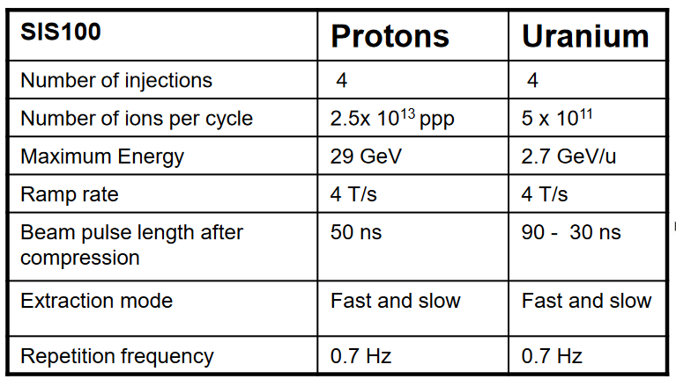
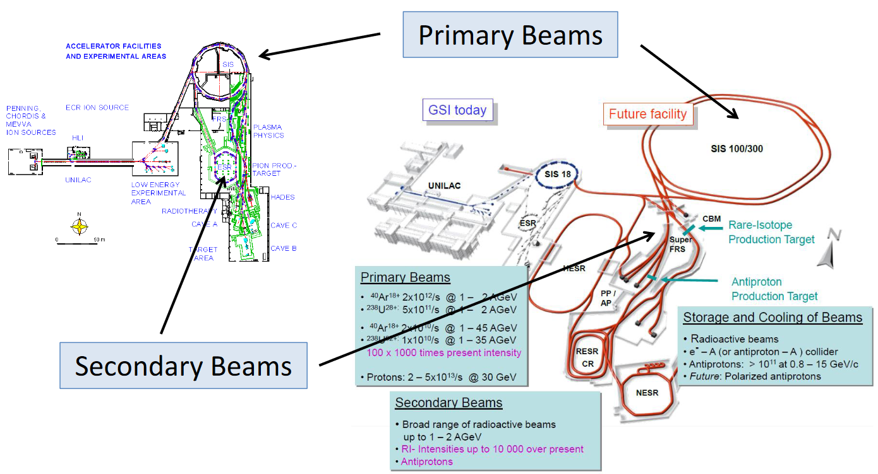
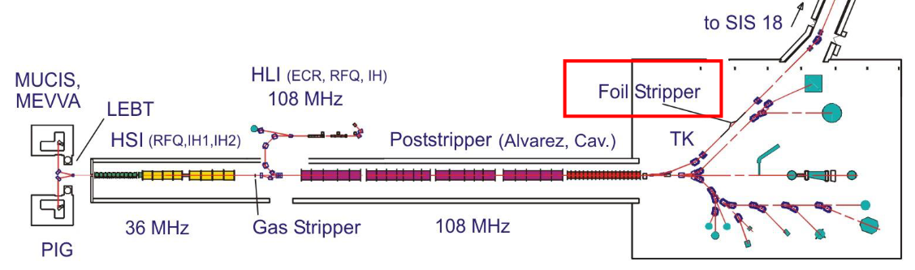
FAIR

Slide 19

Present RiBs Facilities (World)
ISAC
CARIBU
RAON
FRIB
RIKEN/RIBF
TEXAS A&M
BRIF
VECC
iThemba

Slide 20
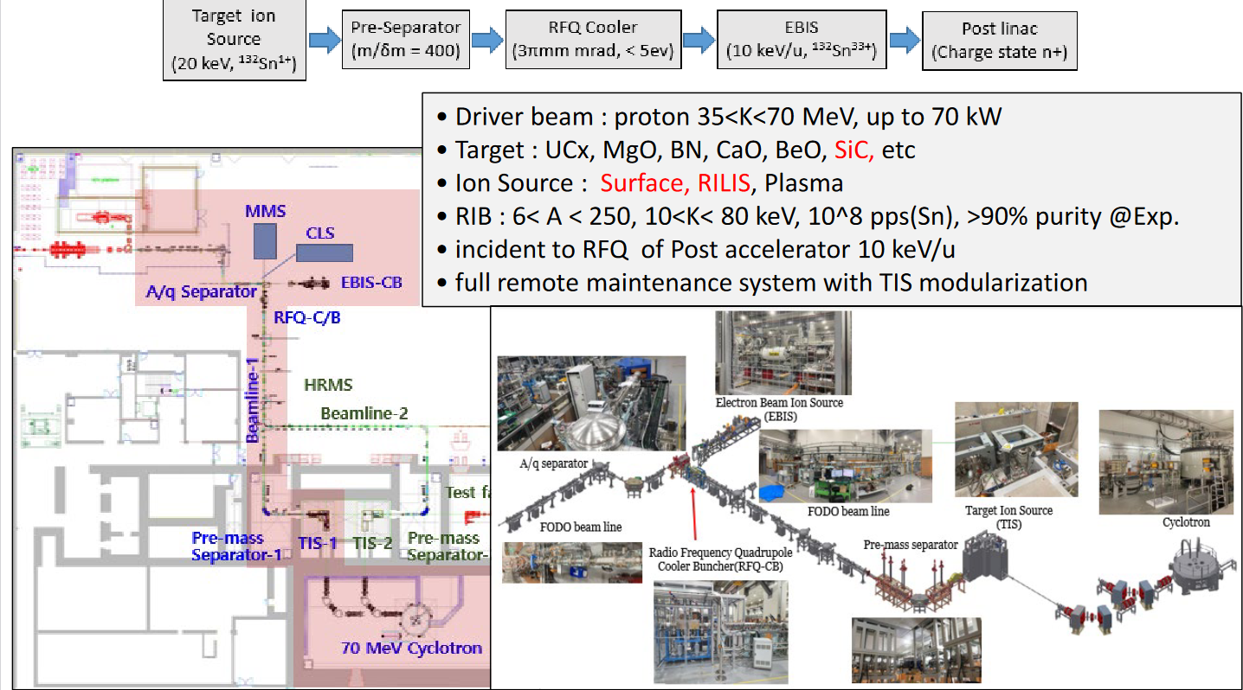
RAON

Slide 21
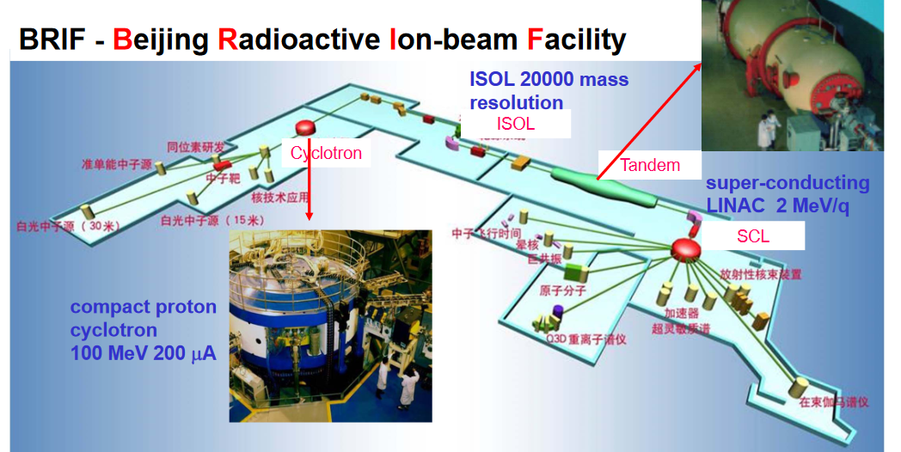
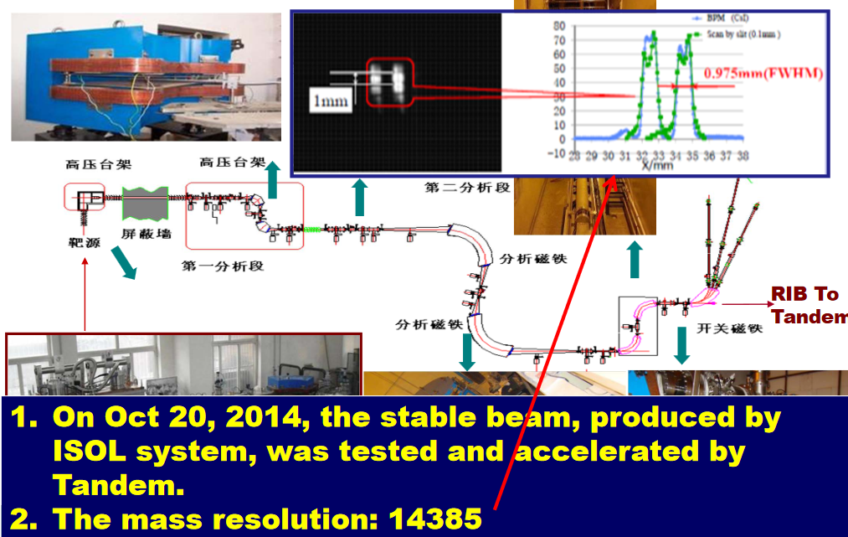

Slide 22
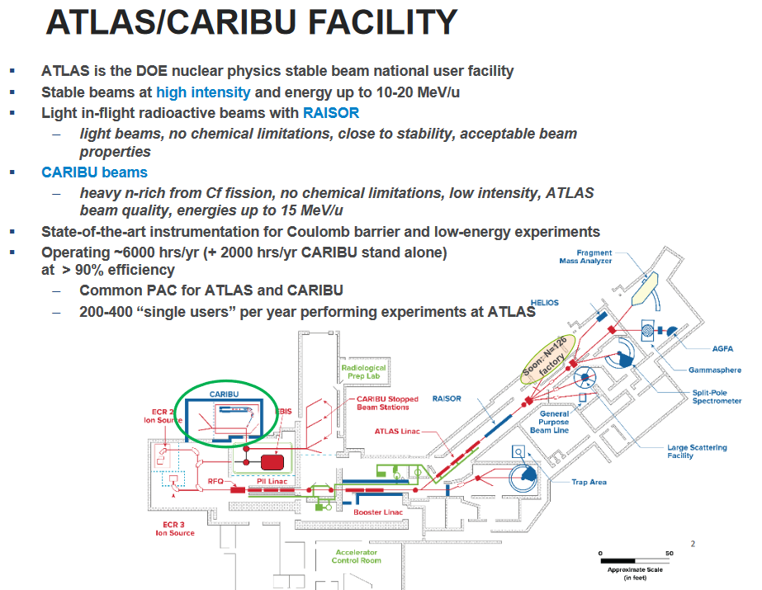
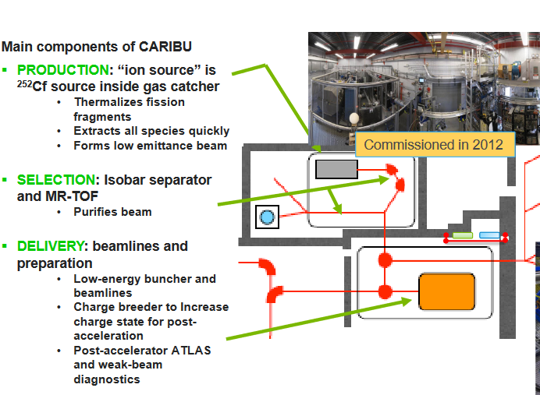
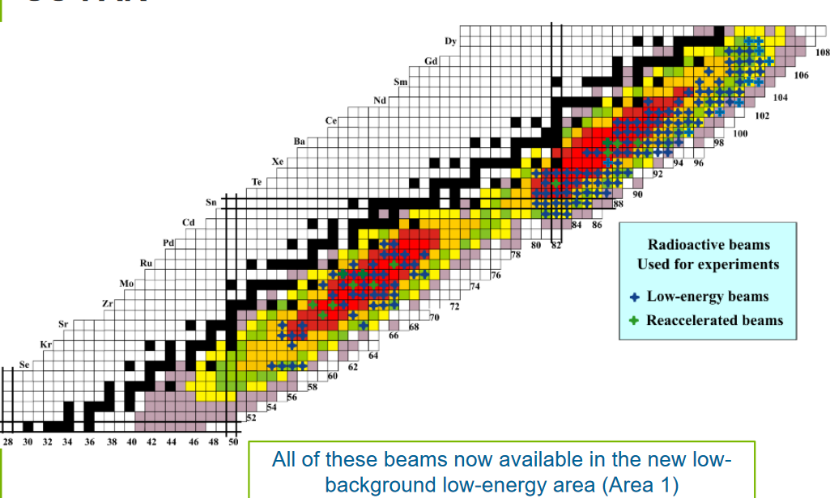

Slide 23
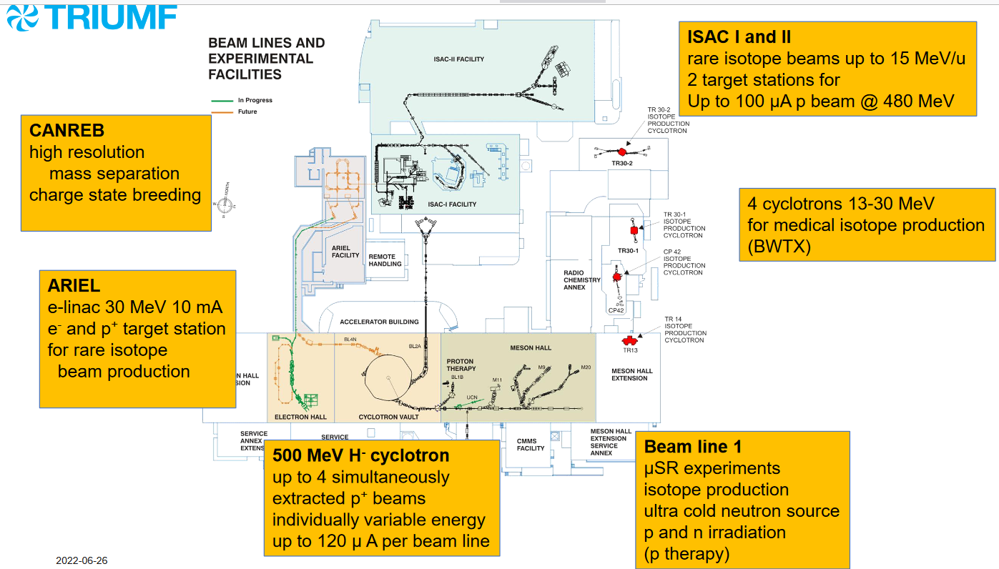
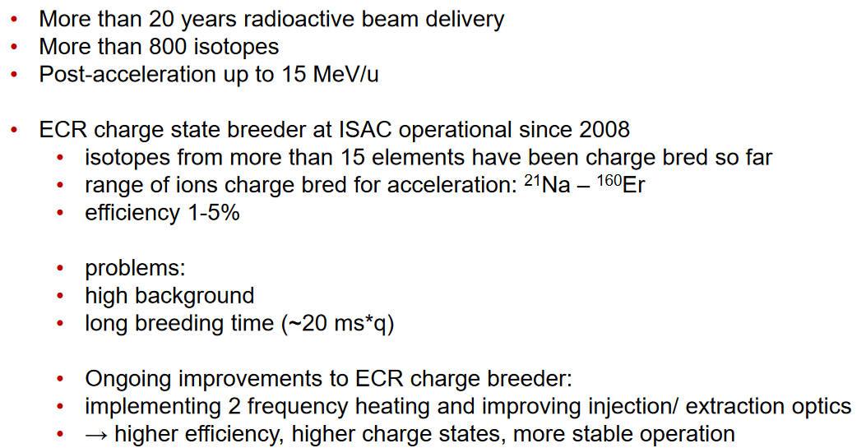
ISAC

Slide 24
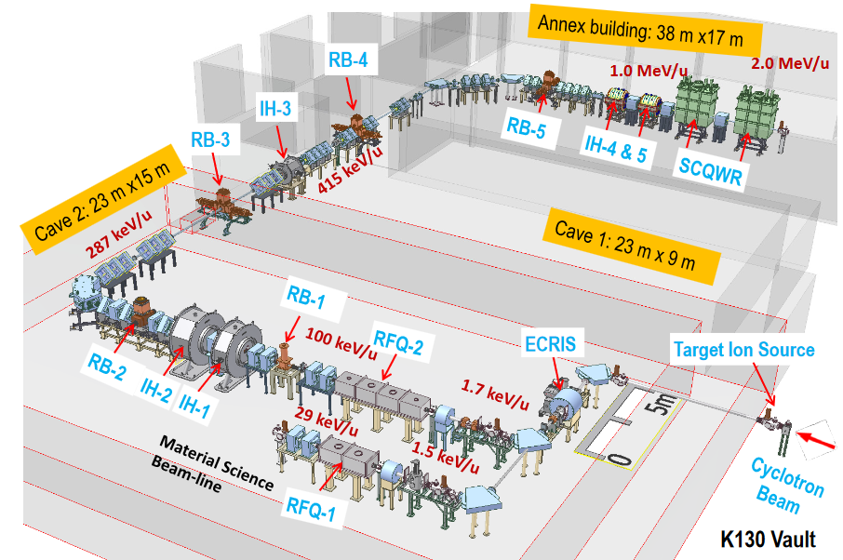
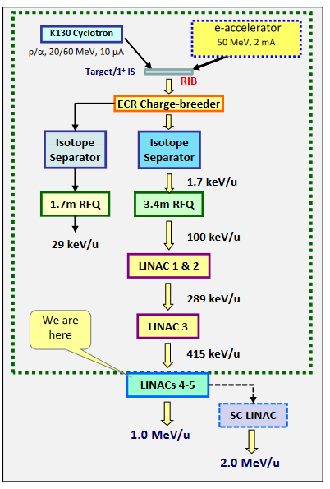
VECC

Slide 25
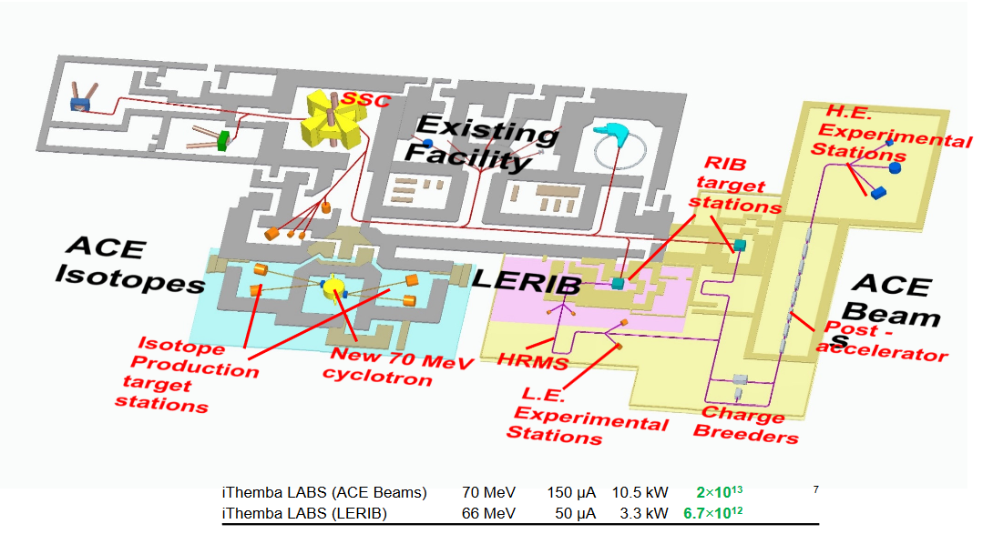
iThemba
SPES Target test Area

Slide 26
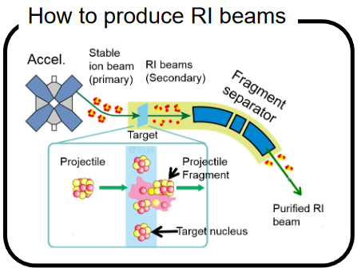
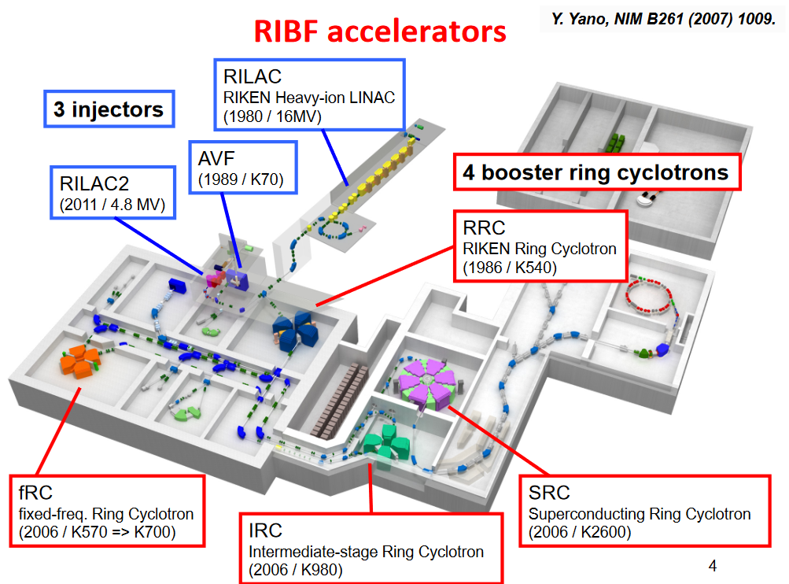
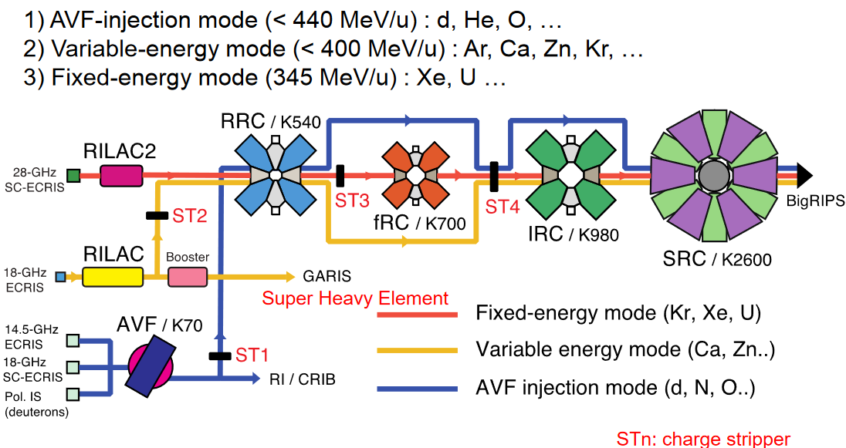
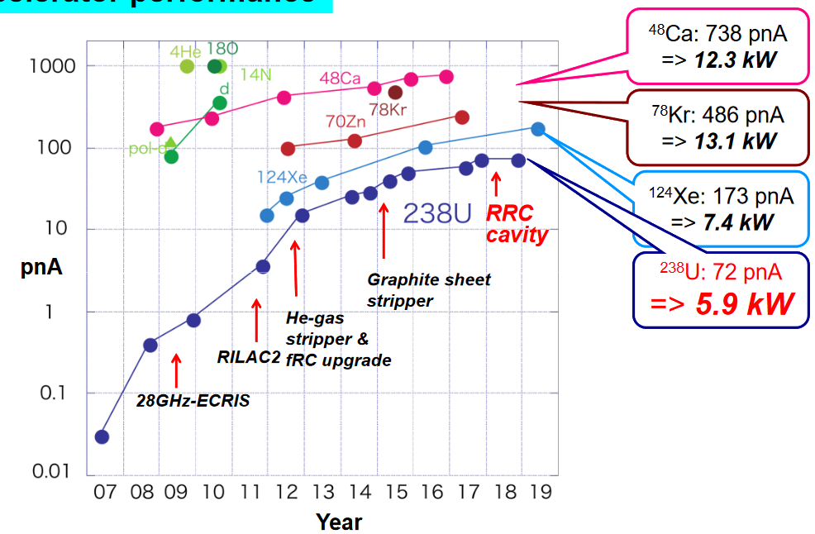
RIKEN/RIBS

Slide 27
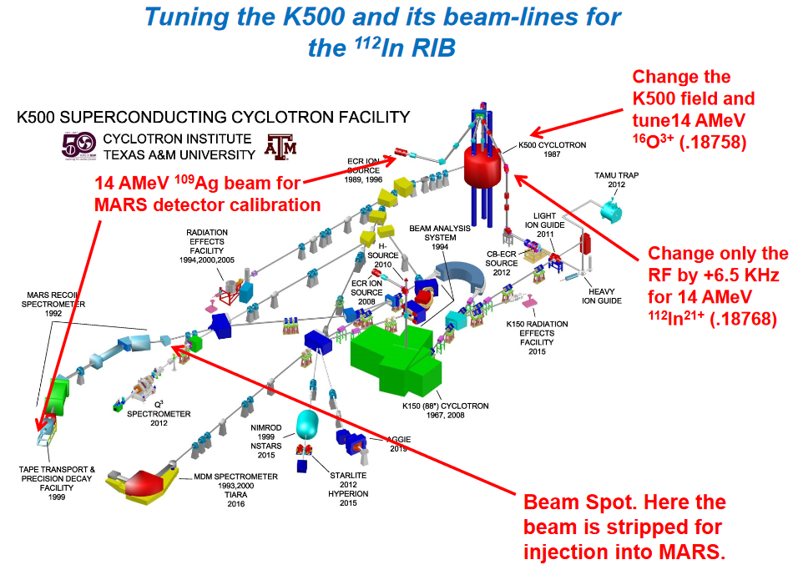
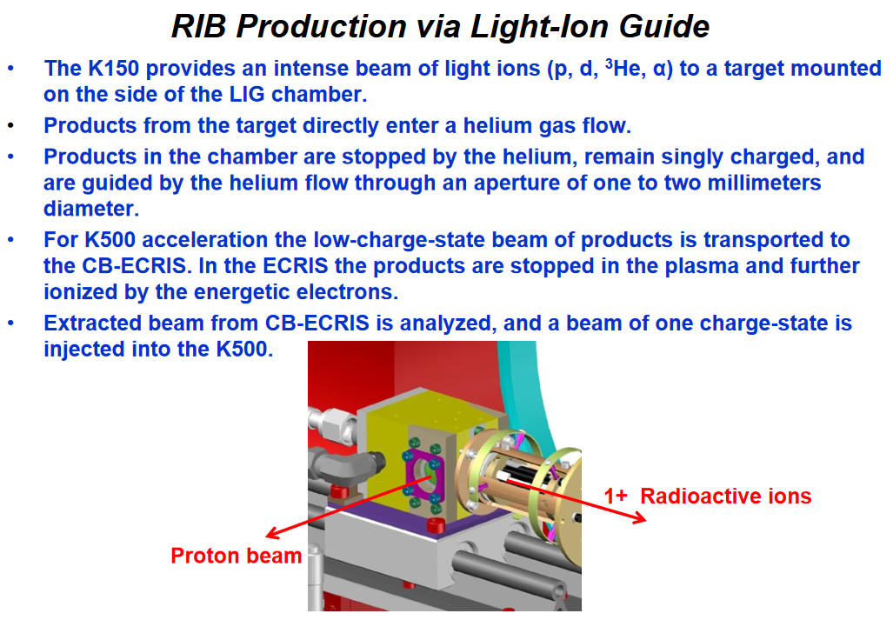
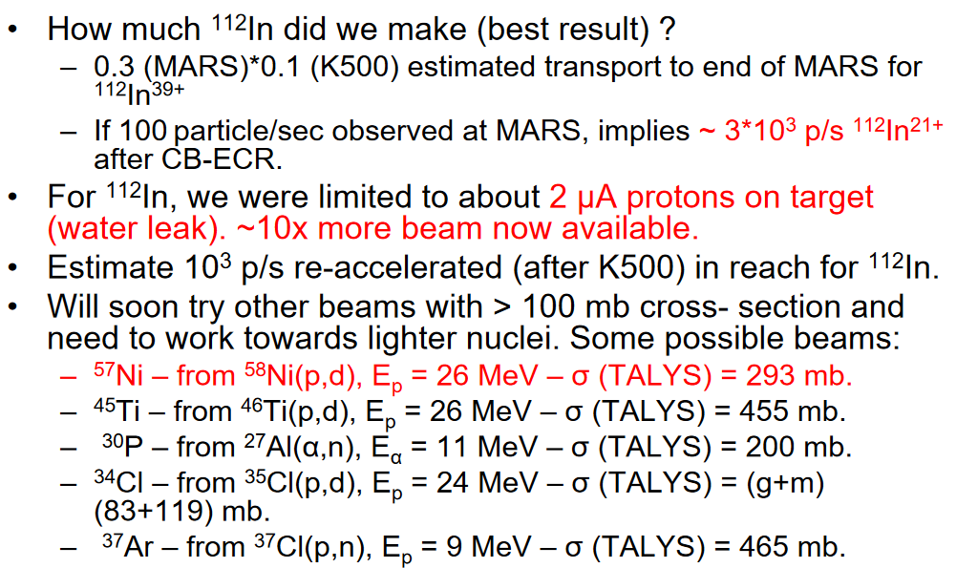

Slide 28
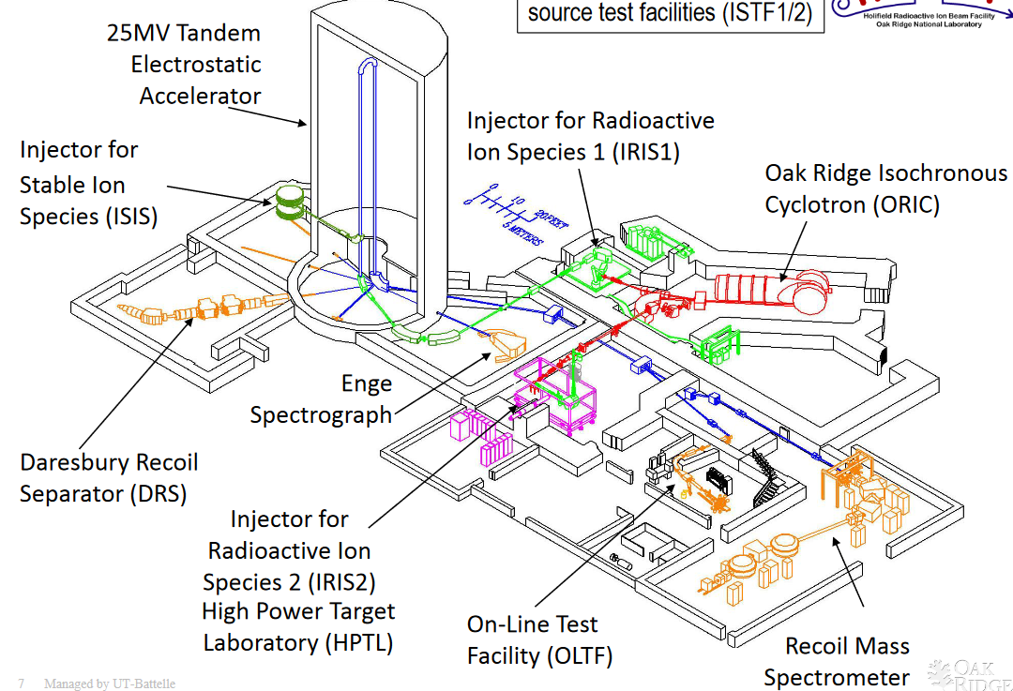
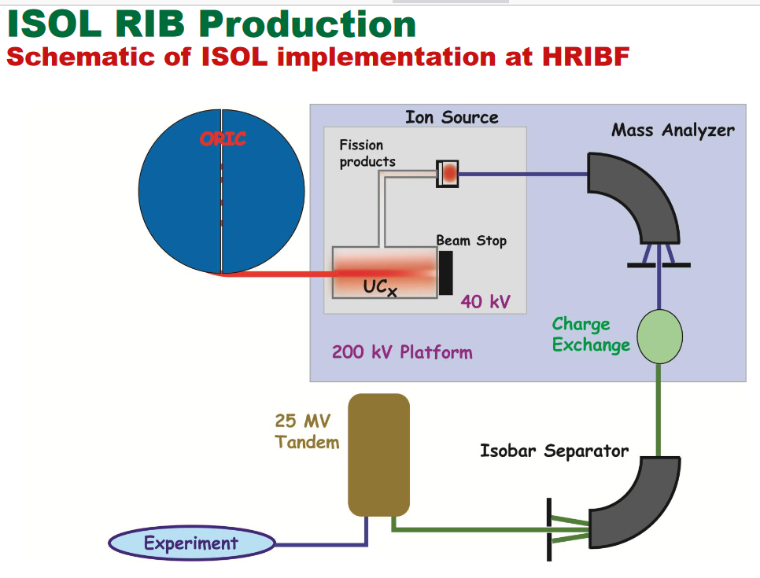
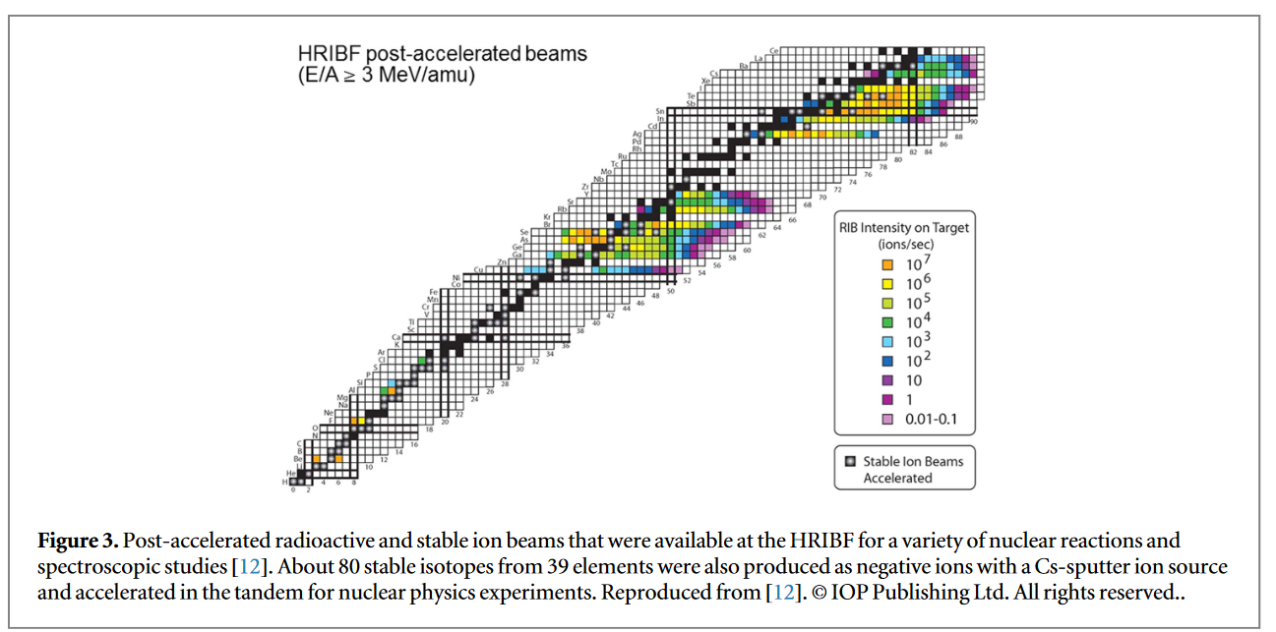
ORNL/HRIBF

Slide 29
Facilities overview
Facility | Method | Driver Acc | Post Acc | Status | Fission/s (total) | Resolution | Target
CERN/ISOLDE | ISOL | p (PS Ring) | SC-Linac | Operating | 10^12 (1/uC) | 1/20000 (HRS) | Various Direct
GANIL/SPIRAL2 | ISOL | d (Linac) | Cyclotron | Future | 10^12 | 1/20000 (DESIR) | Two Stage n->UCx
LNL/SPES | ISOL | p (Cyclotron) | SC-Linac | Future | 10^13 | 1/20000 (HRMS) | Various/UCx Direct discs
GSI/FAIR | In-Flight | Ions (SIS Ring) | Ring | Future | 10^12 (U SIS100) | 1/1500 (dp/p) | Gas/foil stripper
MSU/FRIB | In-Flight | Ions (Linac) | SC-Linac | Commissioning | 10^7 (to experiment) | 1/1720 (dp/p) | Liquid Stripper
IBS/RAON | ISOL | p (Cyclotron) | SC-Linac | Commissioning | 10^8 | 1/10000 (dp/p KOBRA) | Ucx Direct
CIAE/BRIF | ISOL | p (Cyclotron) | Tandem+SC-Linac | Commissioning | 10^6 | 1/20000 | MgO Direct
ANL/CARIBU | ISOL | - | SC-Linac | Operating | 10^7 | 1/10000 | 252Cf source
TRIUMF/ISAC | ISOL | p (Cyclotron) e (Linac) | SC-Linac | Operating | 10^13 (ARIEL) | 1/20000 | Various Direct discs
HBNI/VECC | ISOL | p (Cyclotron) | SC-Linac | Commissioning | 10^4 | HRS | Various Direct
NRF/iThemba | ISOL | p (Cyclotron) | Linac | Future | 10^13 | HRS | Various Direct
RIKEN/Ribs | In-Flight | Ions (Cyclotrons) | Cyclotron | Operating | 10^12 | 1/3300 (dp/p) | Gas/Rotating stripper
Texas/A&M | ISOL | p (Cyclotron) | Cyclotron | Operating | 10^4 | - | Gas He Direct
ORNL/HRIBF | ISOL | p (Cyclotron) | Tandem | Operating | 10^7 | 1/3000 | Ucx Direct

Slide 30
How to generate RiBs
ISOL
Isotope Separation On-Line
Thick and hot
Production target
Driver Accelerator
Low Energy
Experiment
p/d Cyclotron/Linac
High Energy
Experiment
Ion Source
Isotope
Separator
Post Accelerator
Transport
Line
Charge
Breeder
Heavy Ion Linac
Thin
Production
target
In-Flight
High Energy
Experiment
Driver Accelerator
High Energy
Experiment
Heavy Ion Cyclotron/Linac
Fragment
Separator
Transport
Line
Post Accelerator
Isotope
Separator
Heavy Ion Linac
Gas
Ion-stopper

Slide 31
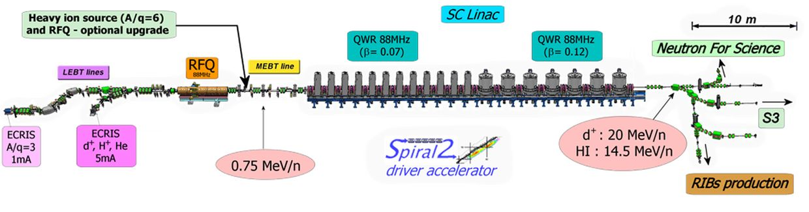
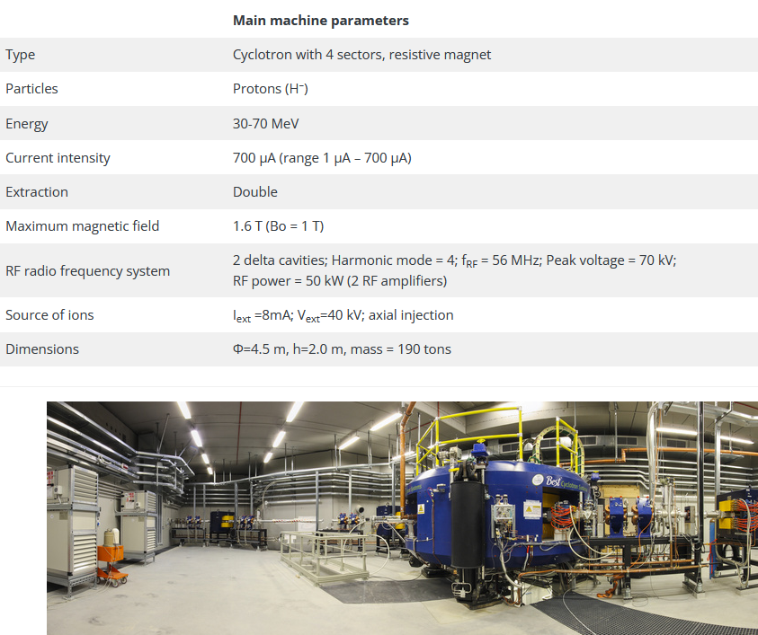
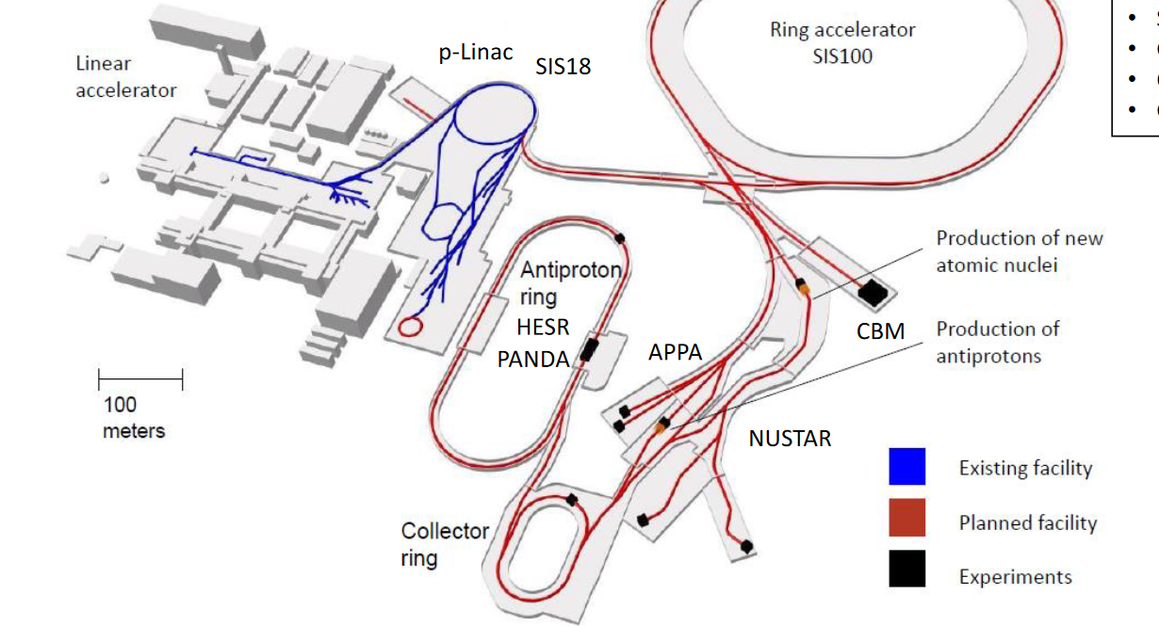
DRIVER Accelerator for the Primary beam
Spiral2 Linac
SPES Cyclotron
FAIR rings
Target
1 m

Slide 32
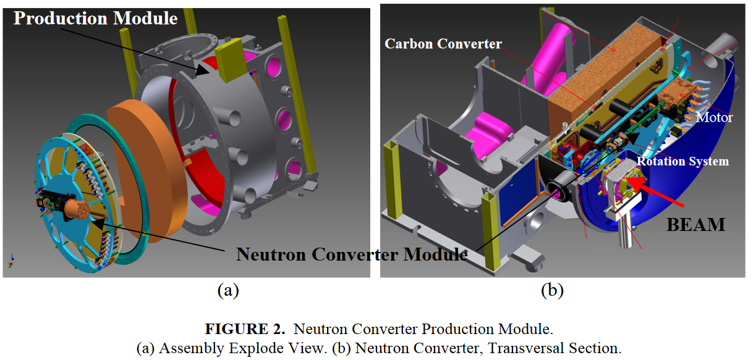
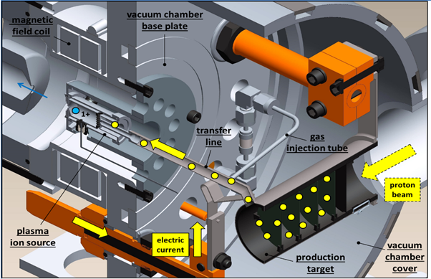


TARGET
SPIRAL2 Neutron Converter
SPES Direct Target
FAIR: H2 gas-cell stripper
FRIB: Li liquid stripper
Beam test at iThemba lab. (2014): 66MeV protons, 60 μA
on full scale SiC prototype at 1600 ºC (FEM sim. Validation)
Former beam tests: ORNL (2007, 2010-2011) SiC, Ucx; ISOLDE(2009) UCx, IPNO (2013) UCx.

Slide 33




Slide 34



SPECTROMETER (low energy)
U shape

Slide 35




Beam Energy spread effect on resolution
Different resolutions @ the image point for 3 1/20000 separated in mass beams, due to the larger energy spread.
$$±1 eV$$
$$±5 eV$$

Slide 36




Why the spectrometer on HV platform?
Increasing the energy of the beam reduces the effect of the energy spread term and shrinks the geometric emittance (x’ component). This means an easier transport through the separator dipoles.
The energy spread set a theoretical limit for the maximum resolution. For the case of the HRMS we get:
The situation worsen immediately: if we have 5 eV, 20 eV of energy spread we get:
$$\frac{∆E}{E}=\frac{1 eV}{160 keV}=\frac{1}{160000}$$
$$\frac{∆E}{E}=\frac{1 eV}{40 keV}=\frac{1}{40000}$$
without HV platform
$$\frac{∆E}{E}=\frac{5 eV}{160 keV}=\frac{1}{32000}$$
$$\frac{∆E}{E}=\frac{20 eV}{160 keV}=\frac{1}{8000}$$
without Beam Cooler

Slide 37

Main parameters of Spectrometers

Slide 38



Fragment Separator (HIGH Energy) S+U shape
ARIS
Slits position

Slide 39





CHARGE BREEDER: from 1+ to N+ beam
ISOLDE
SPES ECRIS

Slide 40




RFQ BEAM COOLER: reduce the emittance and energy spread
Other type of beam cooler

Slide 41



POST ACCELERATOR
SPES SC LINAC
GANIL CIME Cyclotron
RiBs input
Folded independent cavity linac
Design and built 80’-90’
One of the first prototypes in Europe.
77 QWs cavities at 4 K
  80 MHz low beta (0.045)
  160 MHz medium beta (0.1)
  160 MHz high beta (0.12)
Low energy ions of about 10 MeV/amu

Slide 42

RiBs efficiency
Minimum useful intensity for RiBs at experiment
With 10^8 pps rib production we fast get below
10^6 pps post-accelerated at the experiment
6.25*10^9 pps = 1 pnA

Slide 43

Whole Beam Optics Design of SPES
The SPES cyclotron as primary driver.
The target .
The high-resolution stage: RFQ Cooler and the HRMS.
The transfer lines to the Low energy Experimental areas and to the Charge Breeder.
The post acceleration stage: charge breeder and the MRMS with the purity issue.
The matching line from CB to the SPES RFQ injector for ALPI LINAC
ALPI LINAC as post-accelerator with Rare Beams.

Slide 44


SPES layout
Exp. areas
MRMS
HRMS
RFQ
Target
ALPI
CB
LRMS
Beam cooler
PIAVE
Cyclotron
XTU-Tandem
1+ Exp. areas
The cyclotron accelerates 70 MeV proton beam of 750 $μA$ onto a UCx target, heated at 2000 C°. The radioactive ions produced are extracted @ 20-40 keV, depending on the RFQ’s $β_{s}$ of the n+ beams.
There are three separation stages: the LRMS, composed by a Wien filter and a 90° magnetic dipole 1/200 resolution in mass (isobar selection); the HRMS, with a capability of 1/20000 resolution (isotope separation) in mass and the MRMS of 1/1000, which removes the CB contaminants.
The beam gains 1+ -> n+ charge and, after the removal of the CB contaminants is sent to an internal bunching RFQ, which accelerates the beam up to 727.3 keV/A (for A/q=7).
The beam is longitudinally matched with the linac via a MEBT line (with two bunchers). The ALPI linac accelerates the beam up to 10 MeV/A .
There are two experimental areas: the 1+ experimental areas down to the HRMS complex and the experimental areas down to ALPI for the post accelerated beams.
The SPES facility may be divided in three stages: the RIB production, the magnetic isotope separation and the charge breeding with the post-accelartion.
Low current beams (nA-fA) and transfer line with high dispersion require a careful manage of the beam optics.
Several localised separation stages are needed for separate the nominal beam from the isotopes and fit the safety requirements.
Very long transfer lines are needed in order to fit the new building with the existing linac ALPI.

Slide 45
Cyclotron
TARGET

Slide 46


From cyclotron to HRMS
HRMS
Target
Cyclotron
Beam Cooler
To CB andPost-acceleration
Tape system
Target2
SPES facility
Experimental Zone

Slide 47


Beam Transport Line from Target to Charge Breeder
Target with
RIB production and LRMS
Magnetic dipoles
Electrostatic dipoles
Experimental Zone
HRMS on
HV platform
RFQ Cooler
Electrostatic Triplets
To Charge Breeder

Slide 48

SPES RFQ Cooler
Parameters | Requested values
Transmission | >80%
Output beam Transverse Emittance (RMS norm) | < 1.5 E-3 pi.mm.mrad
Output Beam Energy Spread (FWHM) | < 0.7 eV
Input Beam maximum/nominal Current | 100 nA / 50 nA
Energy of Beams at RFQC Output (*) | V_{platform}
Reduction factor of emittance ε_{in}/ε_{out} | >10
Beam
Beam
Element | Mass | Beam Current | Transmission | Energy spread FWHM | RMS Emittance @ 5keV | RMS normalised Emittance
Lithium | 7 uma | 50 nA | 61% | 0,82 eV | 7,79 pi.mm.mrad | 9,64 E-3 pi.mm.mrad
Potassium | 39 uma | 50 nA | 70% | 0,9 eV | 5,37 pi.mm.mrad | 2,82 E-3 pi.mm.mrad
Potassium | 39 uma | 100 nA | 82% | 1,05 eV | 7,25 pi,mm.mrad | 3,80 E-3 pi.mm.mrad
Cesium | 133 uma | 50 nA | 63% | 1,15 eV | 7,25 pi.mm.mrad | 2,06 E-3 pi.mm.mrad
Cesium | 133 uma | 100 nA | 67% | 1 eV | 7,78 pi.mm.mrad | 2,21 E-3 pi.mm.mrad

Slide 49




HRMS Multiparticle Beam envelope
48 electrodes multipole
Cooler exit,
beam at 40 keV
Object point
Image point
The beam dynamics from the RFQ Cooler through the HRMS to the EMU device is show.

Slide 50




HRMS Beam Separation without slits at image point with a gaussian beam (cut at 4σ) and 1eV (rms) as energy spread
+$\frac{1}{20000}$
Total beam size=2 mm
-$\frac{1}{20000}$
+$\frac{1}{20000}$
-$\frac{1}{20000}$
+$\frac{1}{20000}$
1 eV
-$\frac{1}{20000}$
2.5 mm Beam separation
The output of TraceWin has been
post-proceed with ROOT to calculate
the beams separation and the common area
The output of TraceWin has been
compared with COSY 5° order (red dots)
and the results are the same.
The output of TraceWin has been
compared with GIOS 3° order (Brown lines)
and the results are the same.

Slide 51


From the 1+ transport line to RFQ
Mass separator to avoid contaminants (1/1000)
High Voltage
Platform -120kV
Multi
MRMS
Dipole
Pole
Dipole
Singlet
Singlet
Singlet
Diag
Singlet
Diag
Dec
Col
.
Acc
.
.
Col
.
Mag
.
Sol
Trip
20-40 keV/q
3.5<A/Q<7
Sol
Magnetostatic beamline
Mag
CB
Charge Breeder
New RFQ
.
Trip
Einz
Lens
Emi
Emi
.
Box
20-40 keV
A/Q<140
RFQ
Box
1+ RIBs
Mag
Dipole
Mag
Triplet
Diagnostic
Mag
.
.
Mag
.
Mag
Plate
Sol
Diag
Triplet
Diag
LEB
Triplet
LEB
Diag
.
Triplet
Diag
Triplet
Charges multiplication to allow post-acceleration
El. Triplet
To ALPI LINAC
Diag
Chopper
Stable
1+ Source
Dipole
Diag
El
.
Triplet
Source
Electrostatic beamline

Slide 52



End to end simulation from the CB to end of ALPI
L. Bellan, “New techniques for the LNL superconductive Linac ALPI beam dynamics simulations and commissioning” TUODA3
MRMS
RFQ
ALPI
Case of ${}_{ }^{132}{Sn ^{19+}}$@ 0.76 MeV with 0.1 mm mrad from the CB and +-15 eV of energy spread.
The total losses in the nominal case are less than 14%, the final energy is 1200 MeV

Slide 53



References
https://www.dacm-logiciels.fr/ (TraceWin Beam Dynamic Code)
https://www.jacow.org/Main/Proceedings (Conference Proceedings)
https://uspas.fnal.gov/materials/materials-table.shtml (Particle Accelerator School)

Slide 54
How to generate RiBs
ISOL
Isotope Separation On-Line
Thick and hot
Production target
Driver Accelerator
Low Energy
Experiment
p/d Cyclotron/Linac
High Energy
Experiment
Ion Source
Isotope
Separator
Post Accelerator
Transport
Line
Charge
Breeder
Heavy Ion Linac
Thin
Production
target
In-Flight
High Energy
Experiment
Driver Accelerator
High Energy
Experiment
Heavy Ion Cyclotron/Linac
Fragment
Separator
Transport
Line
Post Accelerator
Isotope
Separator
Heavy Ion Linac
Gas
Ion-stopper

Slide 55
Backup Slides

Slide 56




Multipole tuning for MRMS and HRMS
Tuning is performed onto $ε_{rms,n}$ and $H_{x}$[1] looking into diagnostics BI.07 at 40 keV for HRMS.
  Very large variation of emittance ($\sim 10ε_{rms,n, optimum}$)
  No needed to have specific beam phase space shape as soon as the Allison scanner can measure it.
  Run time of hours.
  Modification of $A_{n}$ coefficients via Down Hill algorithm.
  The procedure may stack in a relative minimum.
Image point slits open.
Tested in simulation with error of the multipole components of 30%-50%.
EM
BI.06
BI.03
ET3
ET2
BI.07
BI.02
ET4
ET1
Python script or TraceWin VA via EPICS variables
BC exit
[1] C. K. Allen and T. P. Wangler, Phys. Rev. ST Accel. Beams, vol. 5, p. 124202, 2002.
Courtesy of L. Bellan

Slide 57



SPES RFQ: Main parameters
Paramater [units] | Design value
Frequency [MHz] | 80
In/out. Energy [keV/u] | 5.7-727 (β=0.0035-0.0359)
V_{iv}[kV] | 63.76-85.85
Beam current [μA] | 100
Vane Length [m] | 6.95
R₀[mm] | 5.29-7.58
ρ/R₀ | 0.76
Synchronous phase (deg.) | -90 ÷ -20
Focusing Strength B | 4.7 ÷ 4
Shunt impedance [kΩ*m] | 419-438 (30% margin)
Stored Energy [J] | 2.87
RF Power [kW] | 115 (with 30 %margin for 3D details and RF joint, and 20% margin for LLRF regulation)
Q₀ value (SF) | 16100 (30% margin)
Max power density [W/cm²] | 0.31 (2D), 13 (3D)
max δV_{iv}/V_{iv} [%] | ±3
Transmission [%] | 94
Output Long RMS Emit [keV deg /u] | 4.35
The SPES RFQ is designed in order to accelerate beams in CW with A/q ratios from 3 to 7. The RFQ is composed of 6 modules about 1.2 m long each.
Phase and beam size
inside the SPES RFQ
Courtesy of A. Palmieri

Slide 58




The MRMS: nominal separation 1/1000
Spectrometer on High Voltage Platform: -120 kV.
The optics is composed by 4 electrostatic quadrupoles, 2 dipoles and a 12° order multipole.
Dipole characteristics: 0.750 m bending radius, 90° bending angle. External edge curvature: 2.6 m. Edge angles $β$=33.35°. Horizontal aperture 0.4 m. Vertical aperture 0.08 m.
Both the four quadrupoles are x defocusing.
BD Benchmarking with COSYINFINITY.
Required Platform stability of the order of 0.01% in voltage.
Beam separated
on A/q of 1/1000

