Slide 1







Hosting institutions

Slide 2


Anne-Marie Valente-Feliciano
Superconducting RF Cavities for Particle Accelerators

Slide 3

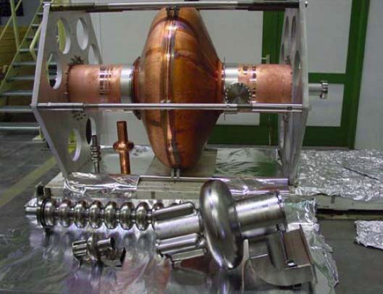
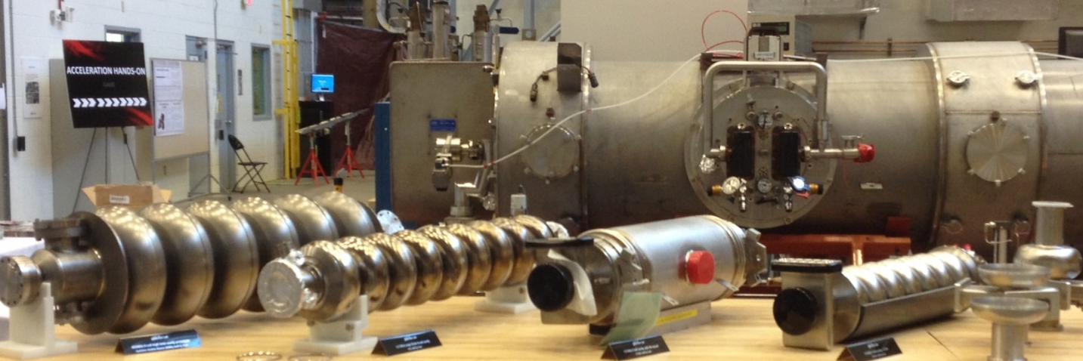
OUTLINE
Introduction to RF Cavities
Normal-conductors
Superconductors
Surface impedance
    Two-fluid model and BCS theory
Residual resistance
Superheating field
Field dependence of the surface resistance due to thermal feedback
Design Considerations
Example of SRF Cavities
SRF Cavities, A-M Valente-Feliciano, 6 May 2023

Slide 4
TECHNICAL MOTIVATION FOR SUPERCONDUCTING RF CAVITIES
The principle motivations for using superconducting RF cavities, are:
          High duty cycle or cw operation.
SRF cavities allow the excitation of high electromagnetic fields at high duty cycle, or even cw, in such regimes that a copper cavity's electrical loss could melt the copper, even with robust water cooling.

Slide 5
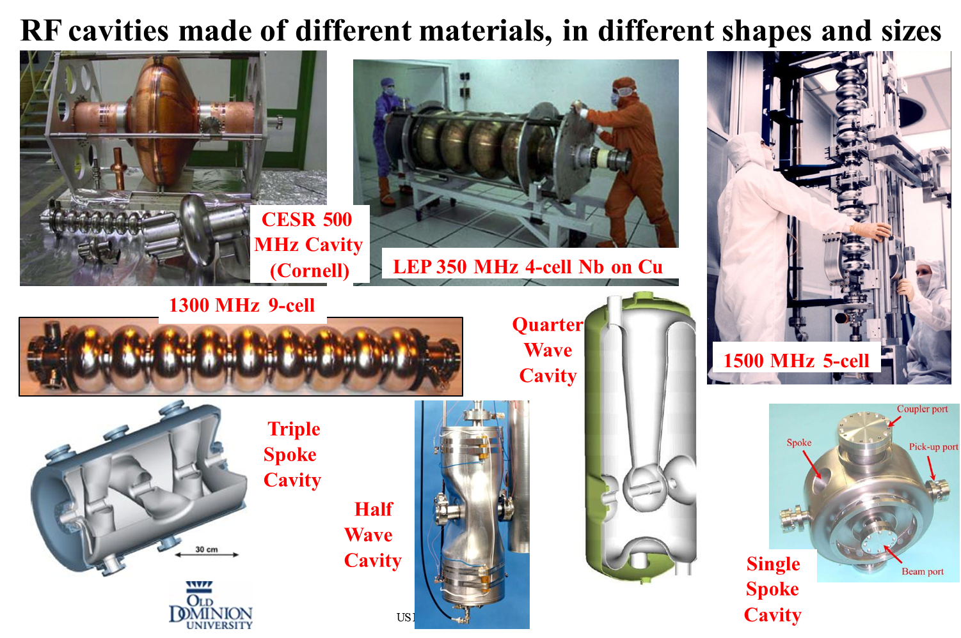
SRF Cavities
Large variety, depending on:
  Type of accelerator
  Particle velocity
  Current and Duty factor
  Gradient
  Acceleration or deflecting mode
Modern SRF cavities cover wide range of particles beta (0.05..1),
operating frequencies (0.072..4 GHz) and beam currents (1mA..100mA, CW & Pulsed)

Slide 6

RF Cavities
Space enclosed by conducting walls that can sustain an infinite number of resonant electromagnetic modes
Shape is selected so that a particular mode can efficiently transfer its energy to a charged particle
An isolated mode can be modeled by an LRC circuit
Lorentz force
An accelerating cavity needs to provide an electric field (E) longitudinal with the velocity of the particle
Magnetic fields (H) provide deflection but no acceleration

Slide 7
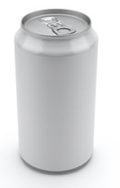


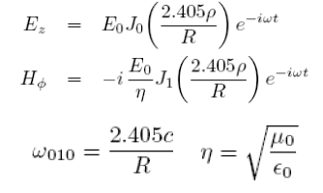
RF Cavities
Devices that store e.m. energy and transfer it to a charged particle beam
  enclosed by conducting walls that can sustain an infinite number of resonant electromagnetic modes
E.m. field in the cavity is solution to the wave equation
H
H
E₁
E₂
q
q
E
Solutions are two family of modes with different eigenfrequencies
  TE_{mnp} modes have only transverse electric fields
  TM_{mnp} modes have only transverse magnetic fields (but longitudinal component for E)
E
φ
z
ρ
L = βcT_{RF}/2
Accelerating mode: TM₀₁₀
Example: 2 GHz cavity and speed of light e⁻ → L = 7.5 cm, R = 5.7 cm

Slide 8



Figures of merit (1)
What is the energy gained by the particle?
Let’s assume a relativistic e⁻
Integrate the E-field at the particle position as it traverses the cavity
We can define the accelerating field as:
Important for the cavity performance are the ratios of the peak surface fields to the E_{acc}. Ideally, these should be small to limit losses and other troubles at high fields

Slide 9

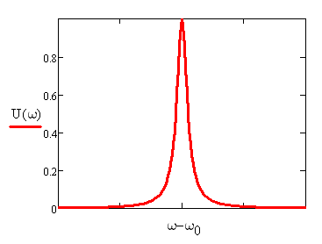
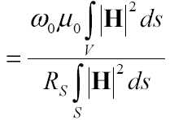
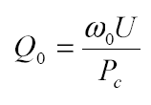
Figures of merit (2)
The power dissipated in the cavity wall due to Joule heating is given by:
The energy stored in the cavity is given by:
The cavity quality factor is defined as:
dv
Δω
= G
Geometry Factor
  Independent of size and material
  Depends only on shape of cavity and electromagnetic mode
0
very useful for comparing different cavity shapes.
Notes:
Breit-Wigner function

Slide 10
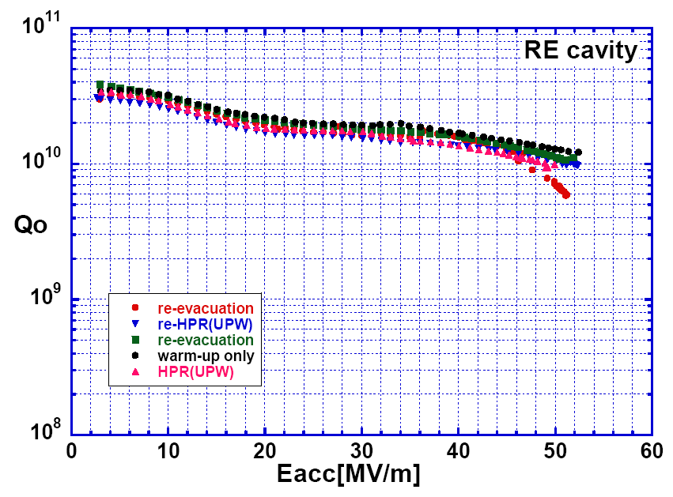
SRF cavity performance – Q vs. E_{acc}
R_{s} ≅ 8 nΩ
B_{p} ≅ 185 mT
T=2.0 K
f = 1.3 GHz
F. Furuta et al., Proc. EPAC’06, p. 750

Slide 11

Surface Impedance
The electromagnetic response of a metal, whether normal or superconducting, is described by a complex surface impedance:
surface reactance
For a good conductor and ω < ~10¹⁶ Hz
surface resistance
The impedance of vacuum is:
For accelerator applications, the rate of oscillation of the e.m. field falls in the radio-frequency (RF) range
(3 kHz – 300 GHz)
Notes:
Ratio of electric field at the surface to the total current flowing across a unit line in the surface.

Slide 12
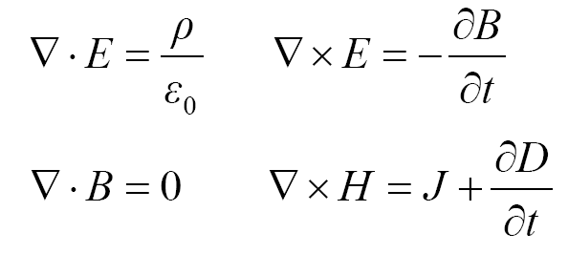
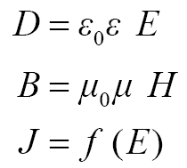
Electrodynamics of normal conductors
Electrons in real metals show Ohmic loss
(linear and isotropic) material’s equations
Maxwell’s equations
From Drude’s model (“nearly free electrons”), macroscopic phenomenology :
Imperfections causes local scattering
τ = l/v_{F} ≈ 10⁻¹⁴ s is the electrons’ scattering time
Ohm’s law, local relation between J and E
Electrical conductivity 𝜎
ωτ << 1 at RF frequencies
σ

Slide 13


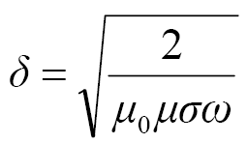
Surface impedance of normal conductors
From previous slide you obtain:
Solution (semi-infinite slab):
E_{z}(x,t)
skin depth:
H_{y}(x,t)
z
y
x
Example: Cu at 1.5 GHz, 300 K (σ = 5.8×10⁷ 1/Ωm, μ₀=1.26×10⁻⁶ Vs/Am, μ=1)
δ = 1.7 μm, R_{s} = 10 mΩ

Slide 14
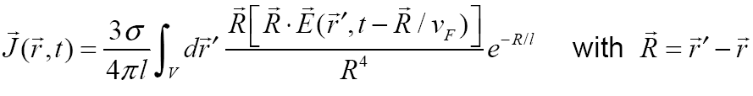
What happens at low temperature?
σ(T) increases, δ decreases The skin depth (the distance over which fields vary) can become less than the mean free path of the electrons (the distance they travel before being scattered)
Introduce a new relationship where J is related to E over a volume of the size of the mean free path (l)
Effective conductivity
= τ
Contrary to the DC case higher purity (longer l) does not increase the conductivity → anomalous skin effect

Slide 15

So, how good is Cu at low T?
“Extreme” anomalous limit (OK for Cu in RF and low T)
for Cu
Does not compensate for the refrigerator efficiency!!!

Slide 16
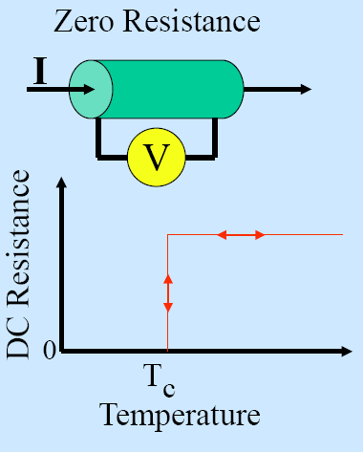
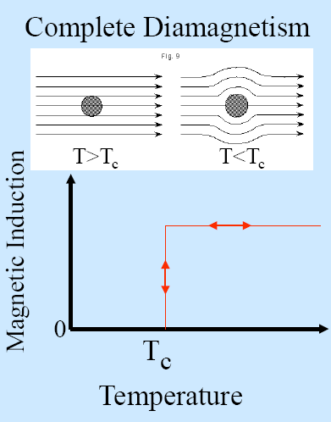
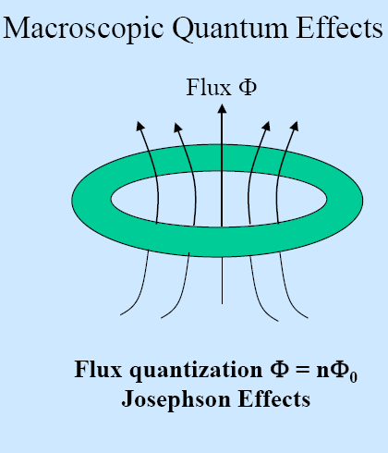
Superconductivity - reminder
The 3 Hallmarks of Superconductivity

Slide 17
London equations - Reminder
E=0: J_{s} goes on forever
E is required to maintain an AC current
B is the source of J_{s}
Spontaneus flux exclusion

Slide 18
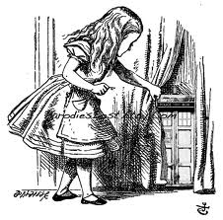
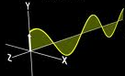
Enter RF Superconductivity

Slide 19
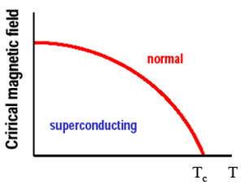
RF Superconductivity
H_{c}(T)=H_{c}(0)·[1-(T/T_{c})²]
Superconducting electrons are paired in a coherent quantum state, for DC resistivity disappears bellow the critical field.
In RF, there is the BCS resistivity, arising from the unpaired electrons.
For copper
σ = 5.8·10⁷ Ω⁻¹ m⁻¹ so at 1.5 GHz, R_{s} = 10 mΩ
For superconducting niobium
R_{s} = R_{BCS} + R_{residul} and at 1.8K, 1.5 GHz, R_{BCS} = 6 nΩ R_{residual} ~ 1 to 10 nΩ

Slide 20
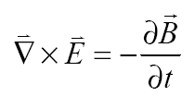
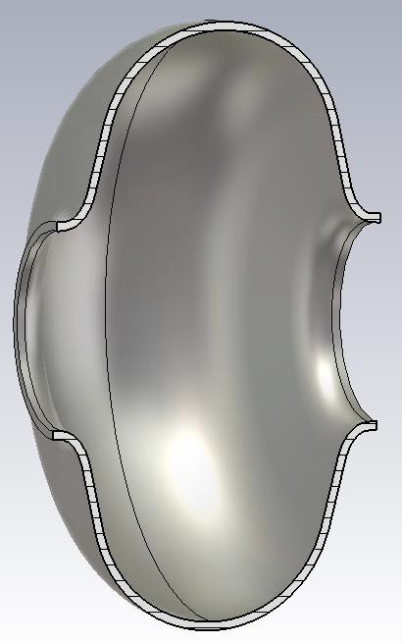
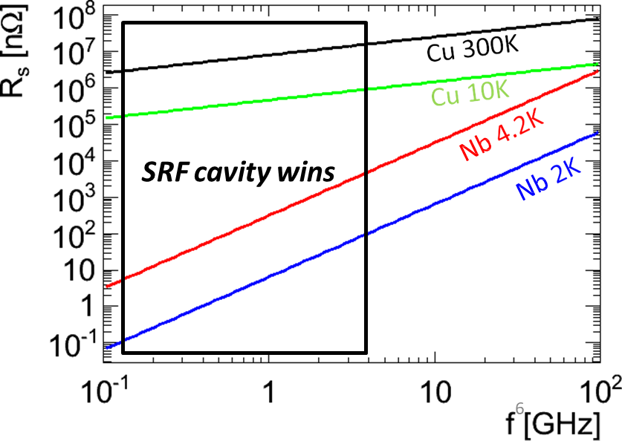
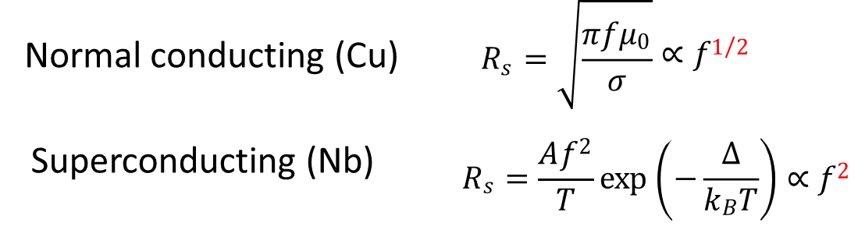
RF resistance is non zero
In AC fields, the time-dependent magnetic field in the penetration depth will generate an electric field:
Because Cooper pairs have inertia (mass=2m_{e}) they cannot completely shield nc electrons from this E-field → R_{s} > 0
Materials provide boundary conditions with finite power dissipation
Local surface resistance
vacuum
surface
𝐸_{𝑥}(𝑧 = 0)
x
So, how does R_{s} for a superconductor compare to that of a normal conductor?
y
z
𝐽_{𝑥}(𝑧)
Superconducting 𝑹_{𝒔} is small but non zero

Slide 21
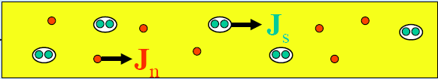
Two-fluid model
Gorter and Casimir (1934) two-fluid model: charge carriers are divided in two subsystems, superconducting carriers of density n_{s} and normal electrons of density n_{n}.
The superconducting carriers are the Cooper pairs (1956) with charge -2e and mass 2m
The normal current J_{n} and the supercurrent J_{s} are assumed to flow in parallel. J_{s} flows with no resistance.
J = J_{n} + J_{s}
Vacuum
SC
H₀

Slide 22
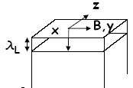
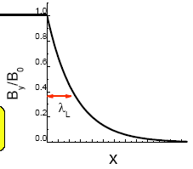
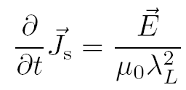
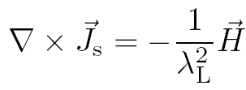
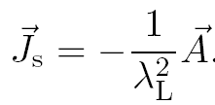
Electrodynamics of superconductors (at low field)
London equations:
London penetration depth
Currents and magnetic fields in superconductors can exist only within a layer of thickness λ_{L}
Note:
Local condition between current and field. Valid if ξ₀ << λ_{L} or l << λ_{L}

Slide 23

Surface impedance of superconductors
= σ₂
σ
Electrodynamics of sc is the same as nc, only that we have to change σ → σ₁ – i σ₂
Penetration depth:
σ₁ << σ₂ for sc at T<<T_{c}
For Nb, λ_{L} = 36 nm, compared to δ = 1.7 μm for Cu at 1.5 GHz

Slide 24

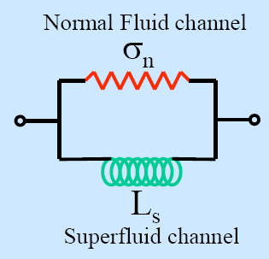
Surface impedance of superconductors
For a sc σ₁ << σ₂ → y <<1
L_{s}: kinetic inductance

Slide 25
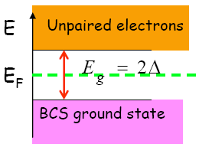
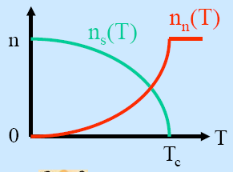
Surface resistance of superconductor
R_{s} ∝ σ₁ ∝ l → longer m.f.p (higher conductivity) of unpaired e⁻ results in higher R_{s} !
R_{s} ∝ ω² → use low-frequency cavities to reduce power dissipation
Temperature dependence:
n_{s}(T) ∝ 1-(T/T_{c})⁴
σ₁(T) ∝ n_{n}(T) ∝ e^{-Δ/kBT}
Unpaired electrons are created by the thermal breakup of Cooper pairs
T < T_{c}/2
Notes:
Intuitive explanation: if unpaired electrons have higher conductivity they draw a relatively higher fraction of the total current

Slide 26

Material purity dependence of R_{s}
If ξ₀ >> λ_{L} and l >> λ_{L}, the local relation between current and field is not valid anymore (similarly to anomalous skin effect in normal conductors)
Pippard (1953):
The dependence of the penetration depth on l is approximated as
if l >> ξ₀ (“clean” limit)
if l << ξ₀ (“dirty” limit)
Optimal
l~ξ₀/2
R_{s} has a minimum for l = ξ₀/2

Slide 27

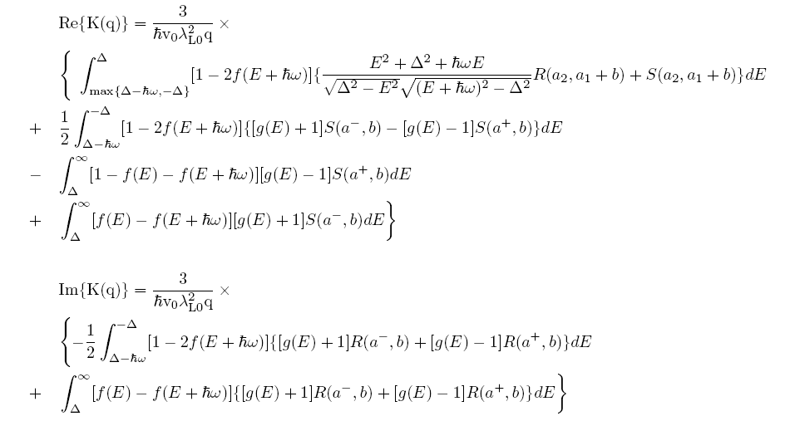

BCS surface resistance (1)
From BCS theory of sc, Mattis and Bardeen (1958) have derived a non-local equation between the total current density J and the vector potential A
can be converted in a product in Fourier domain:
J(q) = -K(q)A(q)
The surface impedance can be derived in term of the Kernel K(q):
for diffuse scattering of electrons at the metal surface

Slide 28
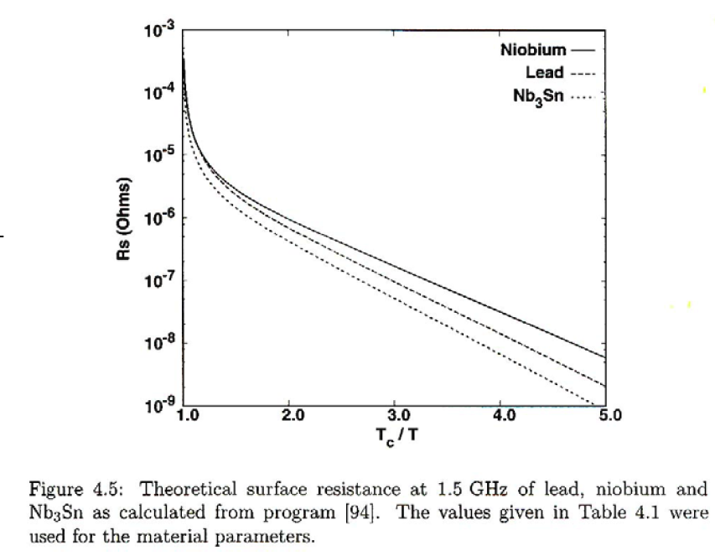

BCS surface resistance (2)
There are numerical codes (Halbritter (1970)) to calculate R_{BCS} as a function of ω, T and material parameters (ξ₀, λ_{L}, T_{c}, Δ, l)
For example, check http://www.lepp.cornell.edu/~liepe/webpage/researchsrimp.html
A good approximation of R_{BCS} for T < T_{c}/2 and ω < Δ/ħ is:
R_{BCS} ≅
C₁ = 2.246
Let’s run some numbers: Nb at 2.0 K, 1.5 GHz → λ = 40 nm, σ_{n} = 3.3×10⁸ 1/Ωm, Δ/k_{B}T_{c} = 1.85, T_{c} = 9.25 K
R_{BCS} ≅ 20 nΩ X_{s} ≅ 0.47 mΩ
Nb
Cu

Slide 29
Not so fast…
Time to celebrate !
Refrigeration isn’t free:
Carnot efficiency: η_{C} = 2 K/(300 K – 2 K) = 0.007
Technical efficiency of cryoplant: η_{T} ≅ 0.2
Total efficiency: η_{tot} ≅ 0.0014 ≅ 1/700
Power reduction from Cu(300K) to Nb(2K) is ≅ 10³

Slide 30
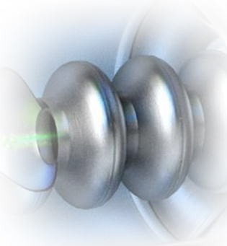
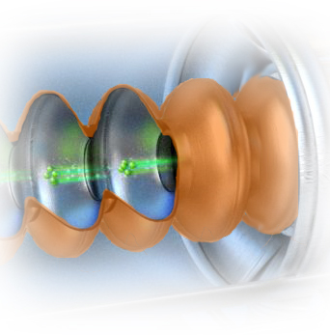
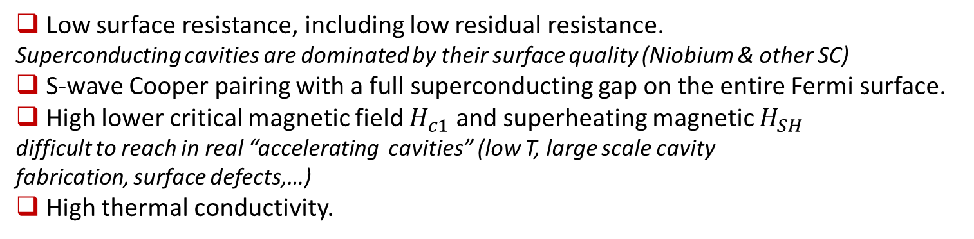
SRF Material Requirements
Low surface resistance, including low residual resistance.
Superconducting cavities are dominated by their surface quality (Niobium & other SC)
S-wave Cooper pairing with a full superconducting gap on the entire Fermi surface.
High lower critical magnetic field $H_{c1}$ and superheating magnetic $H_{SH}$
difficult to reach in real “accelerating cavities” (low T, large scale cavity
fabrication, surface defects,…)
High thermal conductivity.
Grain boundaries transparent to high RF screening currents in polycrystalline material.
Minimal degradation of superconducting properties by local chemical non-stoichiometry and precipitation of non-superconducting second phases.
Good formability & sustainability to fabrication/preparation processes
SRF Cavities, A-M Valente-Feliciano, 6 May 2023

Slide 31
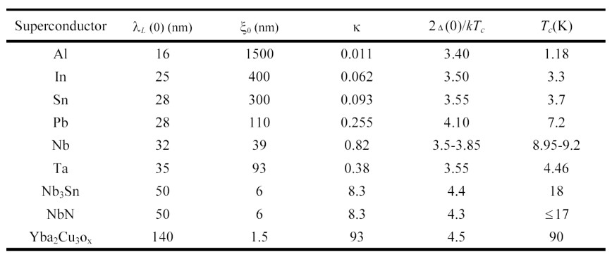
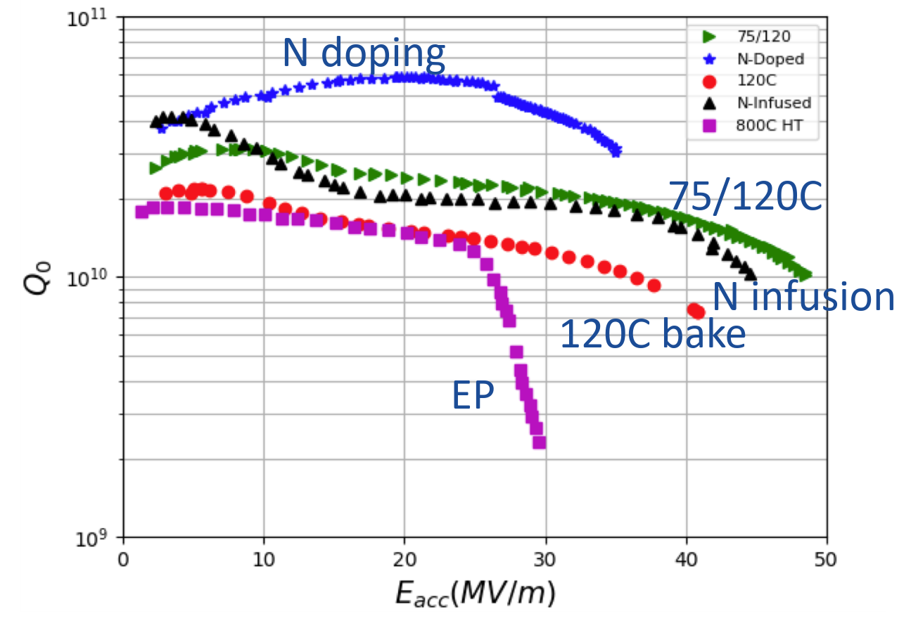
Various Superconducting materials
– only one practical and commonly used
Currently Nb provides the best compromise to all requirements.
Low surface resistance, including low residual resistance.
S-wave Cooper pairing with a full superconducting gap on the entire Fermi surface.
High lower critical magnetic field H_{c1} and superheating magnetic H_{SH}
High thermal conductivity.
Uniform composition, no phase transition in the domain of interest
Very large ξ: makes it less sensitive to small crystalline defects (e.g. GB)
Grain boundaries transparent to high RF screening currents in polycrystalline material.
Minimal degradation of superconducting properties by local chemical non-stoichiometry and precipitation of non-superconducting second phases.
Good formability
“Superheating” field for niobium at 0 K is 2.4 kGauss

Slide 32
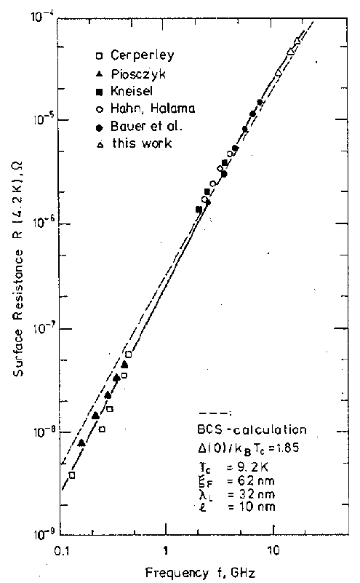
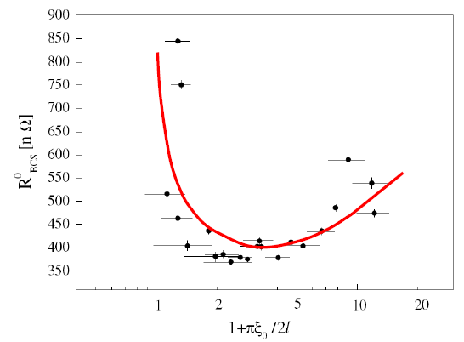
Experimental results
Frequency dependence
Dependence on material purity
Nb,1.5 GHz, 4.2 K
C. Benvenuti et al., Physica C 316 (1999) 153.
“clean”
“dirty”
Nb, 4.2 K
A. Phillip and J. Halbritter, IEEE Trans. Magn. 19(3) (1983) 999.
Nb films sputtered on Cu
By changing the sputtering species, the mean free path was varied
Small deviations from BCS theory can be explained by strong coupling effects, anisotropic energy gap in the presence of impurity scattering or by inhomogeneities
R_{BCS} can be optimized by tuning the density of impurities at the cavity surface.

Slide 33
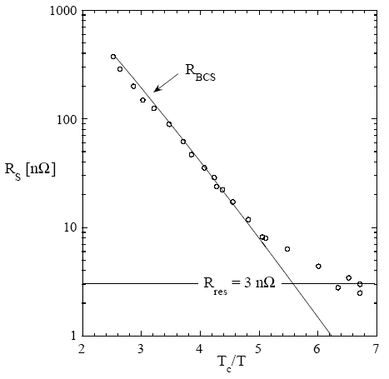
Residual resistance
B. Aune et al., Phys. Rev. STAB 3 (2000) 092001.
R_{s} = R_{BCS}(ω, T, Δ, T_{c}, λ_{L}, ξ₀, l) + R_{res}(?)
Nb, 1.3 GHz
Possible contributions to R_{res}:
Trapped magnetic field
Normal conducting precipitates
Grain boundaries
Interface losses
Subgap states
2 K
For Nb, R_{res} (~1-10 nΩ) dominates R_{s} at low frequency (f < ~750 MHz) and low temperature (T < ~2.1 K)

Slide 34
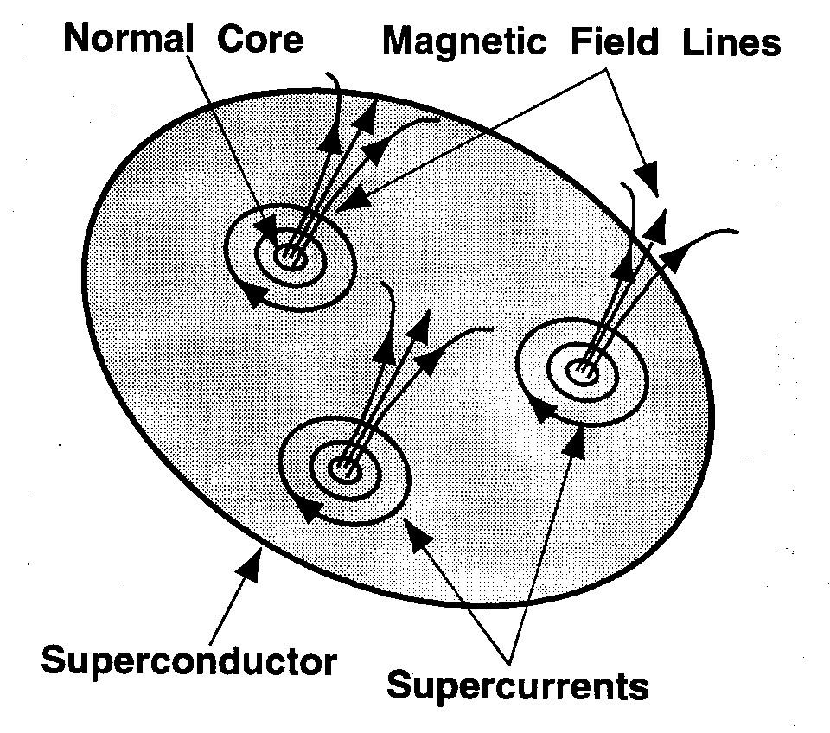
Possible contributions to R_{res} in Nb (1)
Trapped magnetic field
In technical materials, the Meissner effect is incomplete when cooling below T_{c} in the presence of a residual magnetic field due to pinning
Fluxoids: normal conducting core of area ~πξ₀² and normal-state surface resistance, R_{n}
if 100% flux pinning
R_{res} due to Earth’s field (~500 mG) at 1.5 GHz: ~120 nΩ (~6×R_{BCS}(2K))
Apply magnetic shielding around cavities

Slide 35
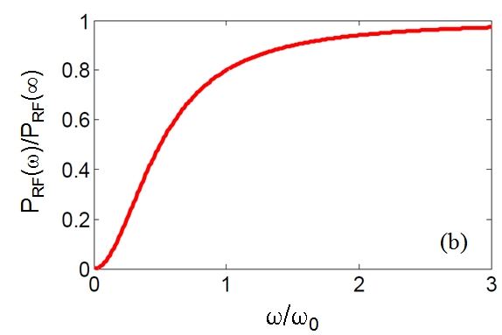

Possible contributions to R_{res} in Nb (2)
Trapped magnetic field
Including the oscillatory motion of a fluxoid due to the Lorentz force:
∝ ω²
A. Gurevich and G. Ciovati, Phys. Rev. B. 87, 054502 (2013)
In the frequency limit where only the tip of the fluxoid vibrates:
Anisotropy parameter
For Nb: ρ_{n}~5×10⁻¹⁰ Ωm, H_{c}=2000 Oe, 2g=1

Slide 36
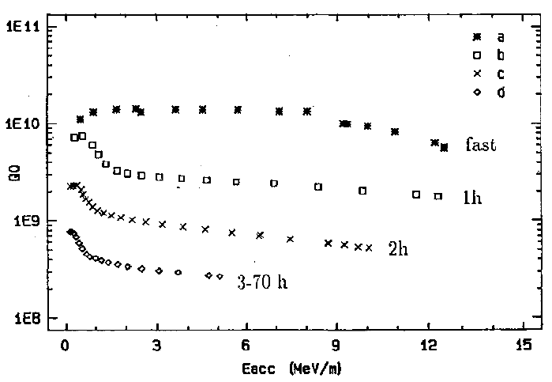
Possible contributions to R_{res} in Nb (3)
Normal conducting precipitates
If the bulk H content in high-purity (RRR~300) Nb is > ~5 wt.ppm, precipitation of normal-conducting NbH_{x} islands occurs at the surface if the cooldown rate is < ~1 K/min in the region 75-150 K
Nb cavities are heat treated at 600 – 800 °C in a UHV furnace to degas H
B. Aune et al., Proc. 1990 LINAC Conf. (1990) 253.

Slide 37
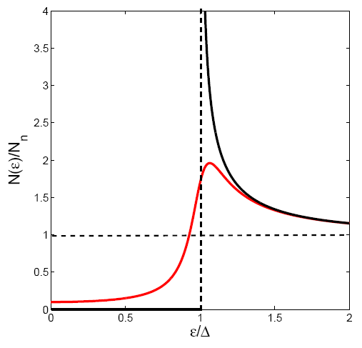

Possible contributions to R_{res} in Nb (4)
Subgap states
Tunneling measurements show that the BCS singularity in the electronic density of states is smeared out and subgap states with finite N(ε) appear at energies below ∆.
Grain boundaries
Interface losses
Results are still inconclusive
Results are still inconclusive
Phenomenological formula [Dynes (1978)]:
BCS
γ: damping parameter
subgap
states
Finite density of states at the Fermi level:
Residual resistance (σ₁→ σ_{n}γ/Δ):
R_{res} ~10 nΩ at 1.5 GHz for γ/Δ = 10⁻³
A. Gurevich, Rev. Accel. Sci. Tech. 5, 119 (2012)
Notes:
Mechanisms for subgap states can be intrinsic such as due to strong impurity scattering or strong electron-phonon coupling or extrinsic such as normalconducting precipitates or trapped vortices

Slide 38
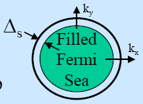
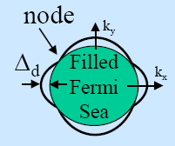
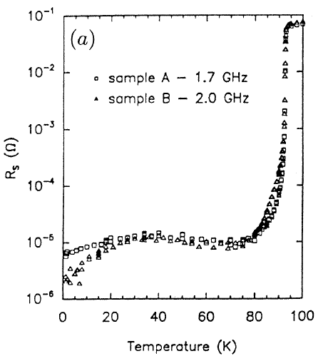
About HTS…
LTS
HTS
HTS materials have nodes in the energy gap. This leads to power-law behavior of λ(T) and R_{s}(T) and high residual losses
YBCO
ξ ~ 1 – 2 nm (<< λ) → superconducting pairing is easily disrupted by defects (cracks, grain boundaries)
“Granular” superconductors: high grain boundary resistance contributing to R_{res}
We are stuck with LHe!
Hein M A 1996 Studies in High Temperature Superconductors vol 18 ed A Narlikar (Nova Science Publishers) pp 141–216

Slide 39
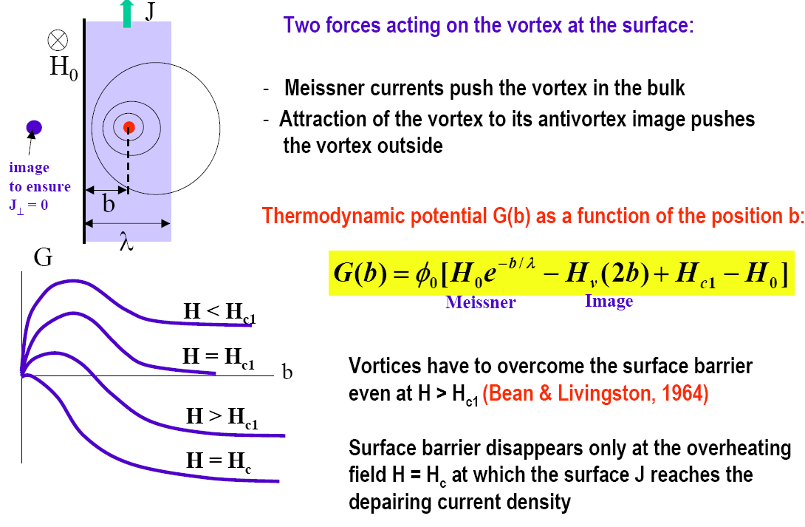
Surface barrier
How do vortices get in a superconductor?
Two forces acting on the vortex at the surface:
Meissner currents push the vortex in the bulk
Attraction to the antivortex image pushes the vortex out
Thermodynamic potential G(b) as a function of the position b:
Vortices have to overcome the surface barrier even at H > H_{c1}
Surface barrier disappears only at H=H_{sh}
Surface barrier is reduced by defects
H_{sh}

Slide 40
What is the highest RF field applicable to a superconductor?
Type-II SC
Penetration and oscillation of vortices under the RF field gives rise to strong dissipation and the surface resistance of the order of R_{s} in the normal state
the Meissner state can remain metastable at higher fields, H > H_{c1} up to the superheating field H_{sh} at which the Bean-Livingston surface barrier for penetration of vortices disappears and the Meissner state becomes unstable
H
H_{c2}(0)
Normal State
Abrikosov Vortex Lattice
H_{sh}(0)
H_{c1}(0)
Meissner State
T_{c}
T
H_{sh} is the maximum magnetic field at which a type-II superconductor can remain in a true non-dissipative state not altered by dissipative motion of vortices.
At H = H_{sh} the screening surface current reaches the depairing value J_{d} = n_{s}eΔ/p_{F}

Slide 41


Superheating field: theory
Calculation of H_{sh}(κ) from Ginzburg-Landau theory (T≈T_{c}) [Matricon and Saint-James (1967) ]:
Time evolution of the spatial pattern of the order parameter
in a small region around the boundary where a vortex entrance
is taking place, calculated from time-dependent GL-equations.
t
A. D. Hernandez and D. Dominguez, Phys. Rev. B 65, 144529 (2002)
Plot from Padamsee

Slide 42

Superheating field: theory
Calculation of H_{sh}(T, l) for κ >> 1 from Eilenberger equations (0<T<T_{c}) [Pei-Jen Lin and Gurevich (2012)]:
α = πξ₀/l
Impurity scattering parameter
F. Pei-Jen Lin and A. Gurevich, Phys. Rev. B 85, 054513 (2012)
Weak dependence of H_{sh} on non-magnetic impurities

Slide 43
Alternative Materials to Nb
Material | T_{c} (K) | H_{c} [T] | H_{c1} [mT] | H_{c2} [T] | λ(0) [nm] | Δ [meV]
Nb | 9.2 | 0.2 | 170 | 0.4 | 40 | 1.5
B_{0.6}K_{0.4}BiO₃ | 31 | ∼0.44 | 30 | 30 | 160 | 4.4
Nb₃Sn | 18 | ∼0.5 | 40 | 30 | 85 | 3.1
NbN | 16.2 | ∼0.23 | 20 | 15 | 200 | 2.6
MgB₂ | 40 | ∼0.32 | 20-60 | 3.5-60 | 140 | 2.3; 7.1
Ba_{0.6}K_{0.4}Fe₂As₂ | 38 | ∼0.5 | 20 | >100 | 200 | >5.2
Example: 4 layers 30 nm thick of Nb₃Sn on Nb → H_{a} up to ~400 mT [~H_{sh}(Nb₃Sn)] with H_{i} ~ 100 mT << H_{sh}(Nb)
Global surface resistance:
R₀^{Nb3Sn}(2 K) ≅ 0.1 R_{b}^{Nb}(2 K) → R_{s} ≈ 0.15 R_{b}

Slide 44

Superheating field: experimental results
Use high-power (~1 MW) and short (~100 μs) RF pulses to achieve the metastable state before other loss mechanisms kick-in
Highest H_{p} ever measured in CW!!!
Nb H_{c1}
Nb₃Sn H_{c1}
T. Hays and H. Padamsee, Proc. 1997 SRF Workshop, Abano Terme, Italy, p. 789 (1997) .
RF magnetic fields higher than H_{c1} have been measured in both Nb and Nb₃Sn cavities.
However max H_{RF} in Nb₃Sn is << predicted H_{sh}…

Slide 45

However…
In “real” surfaces, the surface barrier can be easily suppressed locally by “defects” such as roughness or impurities, so that vortices may enter the sc already at H_{RF} ≈ H_{c1}
1.5 GHz, Nb₃Sn film deposited on Nb
G. Muller et al., Proc. 1996 EPAC, Spain, p. 2085 (1996)
H_{p} ∼ 30 mT ~ H_{c1}

Slide 46


Multilayer Films
If H_{c1} is indeed a major practical limit for RF application of high-κ materials, a possible solution consists of S-I-S multilayers [Gurevich (2006)]:
Suppression of vortex penetration due to the enhancement of H_{c1} in a thin film with d < λ
[Abrikosov, (1964)]
= exp(-Nd/λ)
A. Gurevich, Appl. Phys. Lett. 88, 012511 (2006)

Slide 47


Global thermal instability
Uniform thermal breakdown field
The exponential temperature dependence of R_{s}(T) provides a strong positive feedback between RF Joule power and heat transport to the coolant → thermal instability above the breakdown field H_{b}
κ: thermal conductivity
h_{K}: Kapitza conductance

Slide 48


Uniform thermal breakdown field
Nb, 2 K, same parameters as previous slide
B_{sh}
Higher frequencies not only reduce the cavity Q₀ (↑ R_{s}) but also the breakdown field
μ₀H_{b} (mT)
For 1.5 μm thick Nb on 3 mm thick Copper (h_{K,Cu}=8.4 kW/m² K, κ_{Cu}=200 W/m K)
f (GHz)
In case of multilayers the thermal conductance is:
Nb₃Sn coating with Nd_{s} = 100 nm, κ_{s} = 10⁻² W/m K
Insulating Al₂O₃ layers, Nd_{i} = 10 nm, κ_{i} = 0.3 W/m K
d_{i}/κ_{i} = 1/300(d_{s}/κ_{s}) → Insulating layers are negligible
d/κ = 3Nd_{s}/κ_{s} → TFML adds ~30% to the thermal resistance of the Nb shell

Slide 49

Q₀(B₀) curve
Because of the T_{m}(H₀) dependence, R_{s} acquires a H₀-dependence
Surface treatments
Nb, 2 K, 1.5 GHz, G=280 Ω, R_{s} and thermal parameters as in previous slides
Q₀
Intrinsic non-linearities
B₀ (mT)

Slide 50
SRF applications and cavity requirements
Also New Developments for Accelerators for Societal Needs
- See Kazuya Osaki Lecture, Accelerators for medical and industrial applications
The specific application, facility requirements and mode of operation will define the choice of the cavity type, operating frequency, other parameters to optimize.
SRF Cavities, A-M Valente-Feliciano, 6 May 2023

Slide 51



Design Considerations
Residual resistivity: R_{actual}≡R_{BCS}+R_{residual}
Dependence on field – shape, material, preparation
      “Q slope” Electropolishing, baking
      Field emission- cleanliness, chemical processing
      Thermal conductivity, thermal breakdown – High RRR
Multipacting – cavity shape, cleanliness, processing
Higher Order Modes – loss factor, couplers
Mechanical modes– stiffening, isolation, feedback
ERL 704 MHz 7-cell cavity
SRF cavity is a complicated electro-mechanical assembly and consist of:
bare cavity shell with power and HOM couplers
stiffening elements (ring, bars)
welded LHe vessel
Slow and fast frequency tuners
vacuum ports
ILC 1.3 GHz 9-cell cavity
HWR 162.5 MHz cavity for PIP-II
The design of SRF cavity requires a complex, self consistent electro-mechanical analysis in order to minimize microphonics and/or Lorentz force detuning phenomena and preserving a good cavity tenability simultaneously !

Slide 52
SRF system design is an intricate process
_{Cryomodule design}
What shall we consider when designing a cavity?
Cavity design
Machine parameters
Effects/cavity parameters
Mechanical design
stiffness, vibration modes, tunability, thermal analysis
Pulsed operation
Lorentz force detuning
Material (impacts losses and operating gradient)
Frequency (impacts size of the cavity, cost, surface resistance, assembly technique, …)
Number of cells (impacts field flatness, tunability, HOM extraction, linac fill factor, mechanical resonances, …)
Aperture size (impacts beam stability, peak fields, HOM damping, …)
Cavity shape (impacts peak surface fields, power dissipation, multipacting, tunability, …)
…
CW operation
RF power dissipation in cavity walls
RF design
frequency & operating temperature choice, optimal gradient, cavity shape optimization,
number of cells, cell-to-cell coupling,
HOM extraction, RF power coupling
Beam stability (HOMs)
High beam current
Heavy beam loading
Low Qext
High beam power
Availability of
high-power RF sources
Cryostat design
Beam quality (emittance) preservation
Parasitic interactions
(input coupler kick, alignment)
Input coupler design
HOM damper design
Low beam power
High Qext, microphonics
Tuner design
RF controls
The cavity design is intimately coupled with that of other cryomodule components.

Slide 53





RF simulations tools
As the real cavity cannot be modeled analytically, we use computer codes
Electromagnetic field calculations
  Fundamental & High Order Modes spectrum, R/Q, G, fields
    2D simulation tools: SUPERFISH, SLANS/CLANS
    3D simulation tools: CST Microwave Studio, HFSS, Omega3P, Comsol Multiphysics, ANSYS
Multipacting simulations
  Determine the areas and voltage levels prone to multipacting
    CST Particle Studio (Particle In Cell, Tracking), SPARK3D, Track3P, MultiPac, MultP-M
Wakefield simulations
  Wake potential, wake impedance
    CST Microwave Studio, ABCI, ECHO, GdfidL
Mechanical simulations
  Mechanical modes and frequencies, thermal deformations, Lorentz force detuning, mechanical stresses
    ANSYS, Comsol Multiphysics, CST, TEM3P

Slide 54




Types of SRF cavities
TM cavities
There are two distinct types of superconducting RF cavities.
The first type, elliptical TM-mode cavities, is for accelerating charged particles that move at nearly the speed of light, such as electrons in high- energy linacs or storage rings.
The second type, TEM-mode cavities, is for particles that have velocities v much smaller than the speed of light c (e.g., β = 0.01…0.5, where β = v/c), such as the heavy ions or protons at the early stages of acceleration.
At intermediate velocities, both types of structures could be used, depending on application.
TEM cavities
Some practical geometries for different particle velocities

Slide 55






Low β Resonators
Split Loop Resonator
Spoke cavity
Multi-spoke
Quarter Wave
Resonator
Elliptical
Critical applications:
Heavy ion accelerators, e.g. RIA
High power protons, e.g. SNS, Project-X
Radio Frequency Quadrupole

Slide 56


High acceleration gradient
Critical applications:
Linear colliders e.g. ILC
X-ray FELs e.g. DESY XFEL, LCLS-II

Slide 57










Variety of elliptical cavities
LEP: 352 MHz
SNS: 805 MHz, β = 0.61 and 0.81
CESR: 500 MHz
TESLA: 1.3 GHz
KEKB: 508 MHz
CEBAF: 1.5 GHz
Fermilab: 3.9 GHz
TRISTAN: 508 MHz

Slide 58



Deflecting Cavities
Critical applications:
Crab crossing (luminosity) e.g. KEK-B, LHC
Short X-ray pulses from light sources

Slide 59

High current ERL cavities
Multi-ampere current possible in ERL
Critical applications:
High average power FELs (e.g. Jlab)
High brightness light sources (e.g. Cornell)
High luminosity e-P colliders (e.g. eRHIC)

Slide 60

High current SRF photo-injector
Low emittance at high average current is required for FEL.
The high fields (over 20 MV/m) and large acceleration (2 MV) provide good emittance.
High current (0.5 ampere) is possible thanks to 1 MW power delivered to the beam.
Starting point for ERL’s beam.

Slide 61
Highlights
Unlike in the DC case, dissipation occurs in SC in RF because of the inertia of Cooper-pairs
The surface resistance can be easily understood in terms of a two-fluid model and is due to the interaction of the E-field (decaying from the surface) with thermally excited normal electrons
R_{s} = R_{BCS} + R_{res}
The maximum theoretical RF field on the surface of a SC is the superheating field ≈ thermodynamic critical field
Multilayer films may be a practical way to reach H_{sh} in SC with higher T_{c} than Nb
Thermal feedback couples R_{s} at low field to the breakdown field
Residual DC magnetic field
Normal-conducting precipitates (NbH)
…
Increases quadratically with frequency
Decreases exponentially with temperature
Has a minimum as a function of material purity

Slide 62
Highlights
Elliptical shape cavities are de facto standard for TM mode SRF structures for high β particle accelerators.
The cavity shape shall be optimized for new accelerators based on the machine requirements. A plethora of computer simulation tools is available for multi-variable optimization.
One should pay careful attention to the cavity interfaces with other components of a cryomodule.
Mechanical aspects of cavity design are very important and should be carefully modeled using appropriate codes.
High purity bulk Nb (RRR > 250), typically in the form of several mm thick sheets, is used for fabricating the majority of SRF cavities nowadays.
The fabrication processes are well understood and developed. Some alternative fabrication techniques are being pursued.
Nb/Cu is used for SRF cavities in several machines, e.g., LEP2, LHC, SOLEIL, HIE-ISOLDE (not covered in this tutorial).
Nb₃Sn is a promising material, but still in an early R&D stage and demonstrated fields only up to 25 MV/m.

Slide 63
Further Remarks
SRF technology applied to accelerators is wonderfully complex
  Inherently multi-disciplinary
  Huge number of coupled parameters – everything matters
  If you like simplicity – find other work
  Remember that cost-effectiveness drives everything
    Research, design, fabrication, processing, maintenance, operation
    Nothing is cheap
    We only do this because there is no better way to meet the need
  Designs build upon previous design and operation experience
  Learn from the insights, successes, and difficulties of others
  Accumulated physical understanding is required for engaging unexpected problems
  Contamination can spoil everything.
  But when it works right, it makes the amazing possible.

Slide 64

Basic SRF cavity…
Quality factor
Q₀ ∝ G / R_{s}
G = geometry factor
i.e. E_{acc} depends on the shape
Surface resistance R_{S}
R_{S}(Nb) ~ 1 nΩ @ 2K
<< R_{s}(Cu) ~ 100 µΩ
E_{surf} ~ 10⁶-10⁷ V/m
J_{surf} ~ 10⁹-10¹⁰ A/m²
H_{surf} ~ 100 mT or more
λ_{L} ~ 50 nm
Region of highest
magnetic field
Region of highest
electric field

Slide 65
Acknowledgments
Inspiration and material from earlier lectures from:
Prof. G. Ciovati, Jlab; Prof. A. Gurevich, ODU; Prof. Steven M. Anlage, UMD; Prof. J. Knobloch, BESSY; Prof. H. Padamsee, Cornell U.; S. Belomestnykh, FNAL.
Tutorials on SRF can be found on the webpages of SRF Conferences: http://accelconf.web.cern.ch/accelconf/

Slide 66
References
Standard textbooks on SRF
  H. Padamsee, J. Knobloch and T. Hays, RF Superconductivity for Accelerators, J. Wiley & Sons, New York, 1998
  H. Padamsee et al “RF superconductivity for accelerators”, 2nd edition, WILEY-VCH (2008)
  H. Padamsee, RF Superconductivity. Science, Technology, and Applications, Wiley-VCH, Weinheim, 2009
Reviews on SRF
  J. P. Turneaure et al “The surface impedance of superconductors and normal conductors: the Mattis-Bardeen theory”, J. Supercond. 4, 341-355 (1991)
  A. Gurevich “Theory of RF superconductivity for resonant cavities”, Supercond. Sci. Technol. 30 034004 (2017)
  CERN Accelerator School – 1955 – 2016 (https://cds.cern.ch/collection/CERN%20Yellow%20Reports?ln=en)
Introduction to solid state physics (before second quantization)
  N. W. Ashcroft and N. D. Mermin, “Solid State Physics” Thomson Learning (1976)
Introduction to superconductivity + minimal knowledge on condensed matter physics (but lack of SRF…)
  S. Fujita and S. Godoy “Quantum statistical theory of superconductivity”, Springer, (1996)
Dictionary of superconductivity
  M. Tinkham “Introduction to superconductivity”, 2nd edition, Dover (2004)
More advanced textbook on superconductivity
  N. Kopnin “Theory of Nonequilibrium Superconductivity”, Oxford Science Publications (2001)

Slide 67
References
BCS resistance
  J. Bardeen, L. N. Cooper, and J. R. Schrieffer,Phys. Rev.108, 1175 (1957). [Matrix elements for static magnetic field were calculated
here]
  D. C. Mattis and J. Bardeen, Phys. Rev.111,412 (1958). [1st order perturbation of RF response and nonlocality, substituting matrix elements modified for RF]
  J. Halbritter, Z. Physik266, 209 (1974) [Fermi‘s golden rule applied for constant martix element and two fluid approximation ]
  J. Halbritter, KFK-Ext.03/70-06 (1970) [FORTRAN66 code for BCS resistance of f<τ1/2 and arbitrary 𝜉₀, 𝜆_{𝐿}, 𝑙]
Residual resistance due to flux oscillation
  J. Bardeen and M. J. Stephen, Phys. Rev.140, A1197(1965). [Phenomenological model to describe trapped flux as a string]
  J. I. Gittleman and B. Rosenblum, Phys. Rev. Lett.16,734 (1966). [driven-damped ordinary differential equation for flux oscillation driven by Lorentz force]
  M. Checchin, M. Martinello, A. Grassellino, A. Roma-nenko, and J. F. Zasadzinski, Supercond. Sci. Technol.30, 3 (2017). [application of
Gittleman & Rosenblum for SRF cavities]
  A. Gurevich and G. Ciovati, Phys. Rev. B87, 054502 (2013). [keeping tension term and solved partial differential equation instead]
Quench field
  J. Matricon and D. Saint-James Phys Lett A 24 241 (1967). [solving Ginzburg-Landau equation to estimate superheating field]
  F. P.-J. Lin and A. Gurevich, Phys. Rev. B 85, 054513 (2012). [solving Eilenberger equations to estimate superheating field in arbitrary impurity]
  Vudtiwat Ngampruetikorn and J. A. Sauls, Phys. Rev. Research 1, 012015(R) (2019). [including inhomogeneity at the surface]

Slide 68
BACK-UPS

Slide 69
Figures of Merit

Slide 70




Accelerating voltage and transit time
For efficient acceleration, choose a cavity geometry and a mode where:
  Electric field is along the particle trajectory
  Magnetic field is zero along the particle trajectory
  Velocity of the electromagnetic field is matched to particle velocity
d
Assuming charged particles moving along the cavity axis, one can calculate
accelerating voltage as
For the pillbox cavity we can integrate this analytically:
where T is the transit time factor.
To get maximum acceleration:
2
^{𝑇}(,-./&( ^{= 𝑡}01&( ^{− 𝑡}0.(0,
= ^{𝑇*} ⇒ 𝑑 = ^{𝛽𝜆}
₂ ⇒ 𝑉! = _{𝜋} 𝐸*𝑑
2
Thus, for the pillbox cavity T = 2/ν .

Slide 71
Accelerating Gradient (E_{acc})
Accelerating field (gradient) is defined as the voltage gained by a particle divided by a reference length
E
₌ ^{V}c
acc
d
For velocity of light particles:
N – no. of cells
_{d =} Nλ
2
For less-than-velocity-of-light cavities (β < 1), there is no universally adopted definition of the reference length
However multi-cell elliptical cavities with β < 1
Length per cell
_{d =} βλ
2
Unfortunately, the cavity length is not easy to specify for shapes other than pillbox so usually it is assumed to be d = βλ/2. This works OK for multi-cell cavities, but poorly for single-cell cavities or low β cavities

Slide 72



Stored energy & quality factor
Energy density in electromagnetic field:
Measures cavity performance as to how lossy cavity material is for given stored energy
Because of the sinusoidal time dependence and 90° phase shift, the energy oscillates back and forth between the electric and magnetic field. Then the total stored energy in a cavity is given by
An important figure of merit is the quality factor, which for any resonant system is
We are assuming that the surface resistance R_{s} does not vary over the cavity surface and has no field dependence.
or roughly 2π times the number of RF cycles it takes to dissipate the energy stored in the cavity. It is determined by both the material properties and cavity geometry and is ~10⁴ for NC cavities and ~10¹⁰ for SC cavities at 2 K.
Recall that the surface resistance is the internal resistance for a unit length and unit width and for NC materials is 𝑅/ = ⁴ ,
OP
where 𝜎 is the material conductivity and 𝛿 is the skin depth.

Slide 73



Peak surface fields
E, H
r
0
R
Peak surface fields are important for the SRF cavity performance. They should be made as small as possible in ”real” cavities. Pillbox will serve as a reference.
The peak surface electric field is responsible for field emission.
The peak surface magnetic field has fundamental limit: critical field of SC state.

Slide 74







Power Dissipation (P_{diss})
Surface current results in power dissipation proportional to the surface resistance (R_{s})
Power dissipation per unit area
Total power dissipation in the cavity walls
To minimize the losses, one needs to maximize the denominator. By modifying the formula, one can make the denominator material-independent: G⋅R/Q – this new parameter depends only on the cavity geometry and can be used during cavity shape optimization.
Frequency dependence
For superconductors →
  per unit length
  per unit area
For normal conductors →
  per unit length
  per unit area
NC cavities favor high frequencies, SC cavities favor low frequencies.

Slide 75

Geometrical Factor (G)
Geometrical factor [Ω]
  Product of the qualify factor (Q₀) and the surface resistance (R_{s})
  Independent of size and material
  Depends only on shape of cavity and electromagnetic mode
very useful for comparing different cavity shapes.
For the pillbox cavity we get G = 257 Ω. If the cavity is made of copper (σ = 5.8×10⁷ S/m) and operates at 1.5 GHz, we get δ = 1.7 μm, R_{s} = 10 mΩ, and Q₀ = G/R_{s} = 25,700

Slide 76



Shunt Impedance (R_{sh}) and R/Q
Shunt impedance (R_{sh}) [Ω]
Maximize shunt impedance to get maximum acceleration
Note: Sometimes the shunt impedance is defined as or quoted as impedance per unit length (Ω/m)
A related quantity is the ratio of the shunt impedance to the quality factor, which is independent of the surface resistivity and the cavity size:
R/Q [Ω]: Measures of how much of acceleration for a given power dissipation
characterizers losses in a cavity
This parameter is frequently used as a figure of merit and is useful in determining the level of mode excitation by bunches of charged particles passing through the cavity. Sometimes it is called the geometric shunt impedance. For the pillbox cavity R/Q = 196 Ω
Optimization parameter:
R R = ^{Rsh} QR = ^{R} G
In practice for elliptical cavities
  R/Q ~ 100 Ω per cell
  R_{sh}R_{s} ~ 33,000 Ω² per cell
sh s s
Q Q
R/Q and R_{sh}R_{s}
  Independent of size (frequency) and material
  Depends on mode geometry
  Proportional to no. of cells

Slide 77
























TM₀₁₀ Mode in a Pill Box Cavity
Energy content
Energy Gain
L
W E₀ sin
U E² J ² ( x
)LR²
0 0 1 01
2
Power dissipation
Gradient
W
L
_{E 2} R_{s}
E
E ² sin
P
J ² ( x
)(R L)R
acc
/2
0
0
2
1 01
^{x}01
2.40483
Shunt impedance
J₁ ( x₀₁ ) 0.51915
2
1
2
L
Geometrical factor
^{R}sh
sin
) R(R L)
2
R ³ J ² ( x
s
1 01
^{x}01
L
G
2 (R L)

Slide 78

Types of SRF cavities
Cavity families (low-β , middle-β & high-β )

Slide 79
SRF Cavity Limitations

Slide 80

Real Performance - Q vs. accelerating field
Magnetic fields of 1.7 kGauss (multi-cell) to 1.9 kGauss (single cell)
Can be achieved, and recently 2.09 kGauss achieved at Cornell.

Slide 81


Limit on Fields
Field emission – clean assembly
Magnetic field breakdown (ultimate limit) - good welds, reduce surface fields
Thermal conductivity – high RRR material
Local heating due to defects
Fields of 20 to 25 MV/m at Q of over 10¹⁰ is routine

Slide 82

Choice of material and preparation
High “RRR” material (300 and above)
Large grain material is an old “new” approach
Buffered Chemical Polishing (BCP) (HF – HNO₃ – H₂PO₄ , say 1:1:2)
Electropolishing (HF – H₂SO₄)
UHV baking (~800 ºC)
Low temperature (~120 ºC).
High pressure rinsing
Clean room assembly

Slide 83

Multipacting
Multipacting is a resonant, low field conduction in vacuum due to secondary emission
Easily avoided in elliptical cavities with clean surfaces
May show up in couplers!
Multipacting in Stanford SCA cavity,
1973 PAC

Slide 84

Higher Order Modes (HOM)
Energy is transferred from beam to cavity modes
The power can be very high and must be dumped safely
Transverse modes can cause beam breakup
Energy lost by charge q to cavity modes:
Longitudinal
and Transverse
Solution: Strong damping of all HOM,
Remove power from all HOM to loads
Isolated from liquid helium environment.

Slide 85



Electromechanical issues
Lorentz detuning
Pondermotive instabilities
Pressure and acoustic noise
Solutions include
  broadening resonance curve
  feedback control
  good mechanical design of cavity and cryostat

Slide 86


Miscellaneous hardware
Fundamental mode couplers
Pick-up couplers
Higher-Order Mode couplers
Cryostats (including magnetic shields, thermal shields)
Helium refrigerators (1 watt at 2 K is ~900 watt from plug)
RF power amplifiers (very large for non energy recovered elements

Slide 87
Cavity Fabrication & Preparation

Slide 88
Fabrication and surface preparation steps
Typical superconducting RF cavities are made of high purity niobium, either in a bulk form or as a thin layer deposited on the inner surface of copper structure.
To achieve good performance, the high purity of niobium must be maintained throughout the fabrication process.
In addition, the inner surface of the cavity, exposed to strong electromagnetic fields, must be carefully prepared.
The bulk niobium cavities are fabricated by electron beam welding of formed or machined parts.
Typical fabrication and surface processing steps include:
  Surface inspection and cutting niobium sheets of high RRR material.
  Forming half-cells by deep drawing, spinning or hydroforming.
  Forming or machining other parts of the structure: beam pipes, various ports, parts for HOM couplers, etc.
  Mechanical polishing imperfections and dipping in an HCl or H₂SO₄ bath to eliminate metal impurities; rust checking by dipping overnight in a water bath.
  Light chemical etching
  Electron beam welding sub-assemblies.
  RF testing and tuning of sub-assemblies.
  Mechanical trimming sub-assemblies as necessary.
  Light chemical etching
  Electron beam welding the complete structure from sub-assemblies.
  Cavity inspection, grinding off imperfections on the inner welding seams, where impurities or micro-cracks might be apparent.
  Heavy chemical etching (BCP or EP) to remove the mechanically damaged surface layer and other imperfections.
  High-temperature hydrogen degassing in an all-metal vacuum furnace in a temperature range between 600 and 950◦C
  RF measurements of the cavity frequency. Tuning of the structure to achieve the desired field flatness.
  Final surface preparation (e.g., nitrogen doping, light EP and HPR) before acceptance testing in a vertical dewar.

Slide 89


Material inspection
The material must be fully recrystallized, otherwise mechanical properties are affected. Sheet metal forming is sensitive to mechanical properties. In particular, a uniform grain size is essential.
Nb sheets are inspected upon receiving, visually and using eddy-current or SQUID scanning (more sensitive). The basic principle is to detect the alteration of the eddy currents with a double coil sensing probe to identify inclusions and defects embedded under the surface.
Usually, a very small fraction of sheets is rejected at this stage.
Technical Specification to Niobium Sheets for XFEL Cavities
Concentration of impurities in ppm |  |  |  | Mechanical properties
Ta | ≤ 500 | H | ≤ 2 | RRR | ≥ 300
W | ≤ 70 | N | ≤ 10 | Grain size | ≈ 50 μm
Ti | ≤ 50 | O | ≤ 10 | Yield strength, σ_{0.2} | 50 < σ_{0,2} < 100 N/mm² (MPa)
Fe | ≤ 30 | C | ≤ 10 | Tensile strength | > 100 N/mm² (Mpa)
Mo | ≤ 50 |  |  | Elongation at break | 30 %
Ni | ≤ 30 |  |  | Vickers hardness HV 10 | ≤ 60

Slide 90

Overview of cavity fabrication flow

Slide 91




Cavity fabrication: forming half-cells
The most common fabrication techniques are deep drawing, hydroforming or spinning half-cells.
Beam pipes and other ports are then fabricated, some parts can be made of a lower grade Nb.
Alternative techniques (not commonly used): hydroforming and spinning an entire cavity out of single sheet or tube.
10 ton
Deep
drawing
Spinning
Niobium sheet
male die
female die
mandrel

Slide 92


Dumb-bell fabrication steps

Slide 93




Electron beam welding
After forming and trim machining, the parts are electron beam welded together. Welding must be under vacuum, better than 10⁻⁵ Torr. Things to check:
Broad welding seam
Operate with defocused beam
Smooth underbead
Overlap at end of welding to avoid accumulation of impurities
Wait to cool down before opening chamber
Some parts, e.g., flanges, can be brazed to cavity ports.
Microstructure of the EB welding area grain size (50 – 2000) μm

Slide 94



Cavity welding steps

Slide 95






Tuning for field flatness
Cavity frequency and field flatness then checked and tuned. Usually, the goal is to achieve 98% field flatness.
Set-up for field profile measurements: a metallic needle or bead is perturbing the RF fields while it is pulled through the cavity along its axis. Due to the volume occupied by the bead, the resonance frequency of an eigenmode j is shifted by
Since the TM₀₁₀ mode has vanishing magnetic field on axis, we can neglect the first term. Thus, measuring the frequency shift due to the metal bead moving from cell to cell will give us an estimate of the storage energy in each cell.
Then one proceeds with deforming cells until the desired field flatness is achieved. A couple of iterations with an automated tuning machine is sufficient.
Before tuning. FF 65%, slope +28 %
After tuning. FF 98%, slope +0.64 %

Slide 96


RF measurements
3.9 GHz, 1.3 GHz, 650 MHz dumb-bell measurement fixtures

