Slide 1


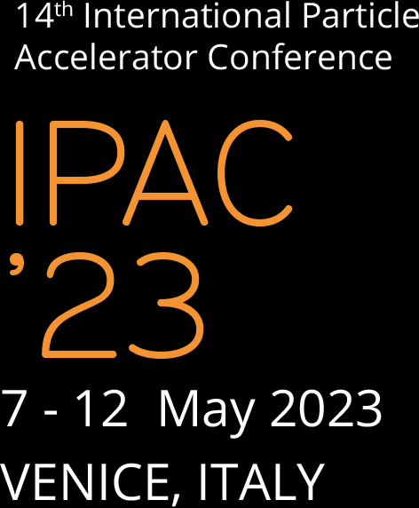



Hosting institutions

Slide 2
Overview of history and types of accelerators
Na Wang
Institute of High Energy Physics, CAS, China

Slide 3
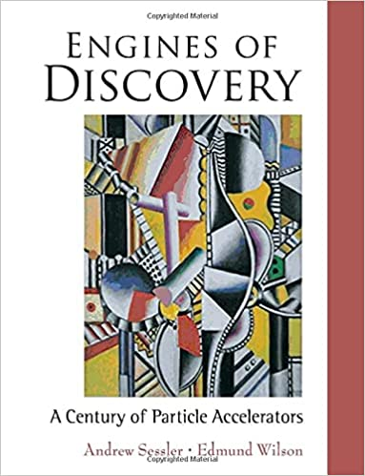
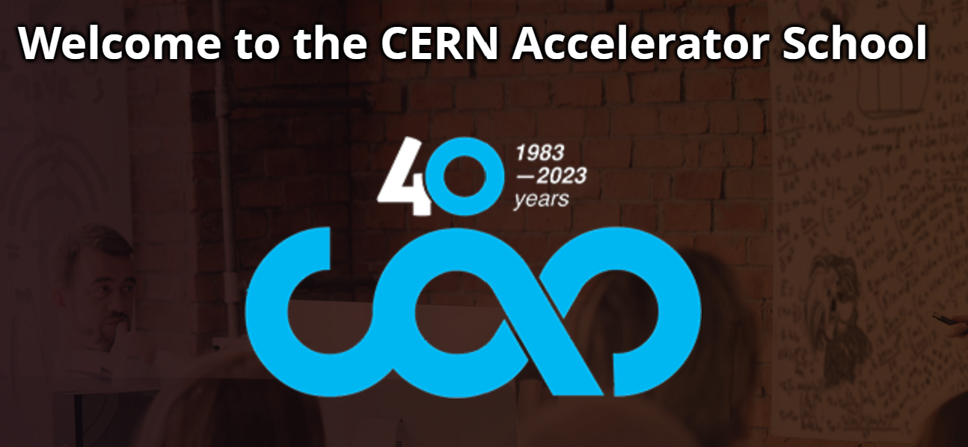
Acknowledgements
Referred to many reports or articles of others.
Courtesy of Y. Zhang, Y. Jiao, H.X. Xu, Q. Qin, Z. Duan, J. Peng, etc. for helping prepare the slides.

Slide 4
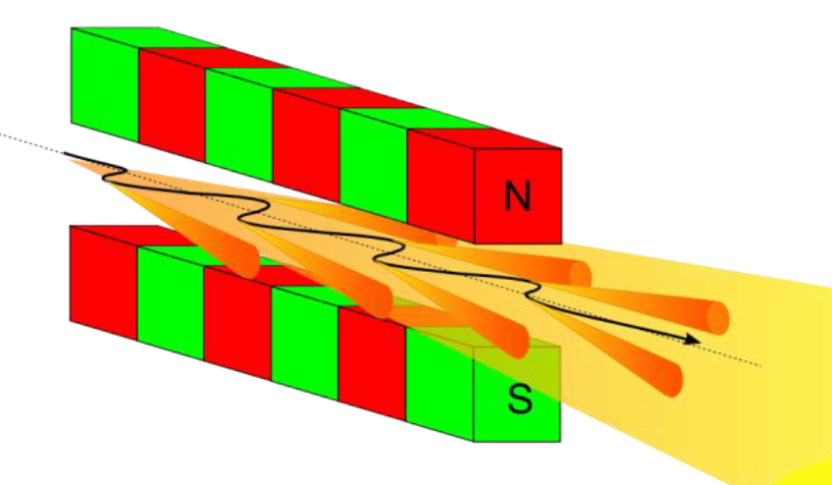
What is an accelerator?
Electric field
Magnetic field
stationary target
× × × × ×
× × × × ×
× × × × ×
× × × × ×
Colliding with another high speed beam
+
+
+
+
+
+
Protons
Electrons
Atoms (like gold or uranium)
…
Linac
Synchrotron
Cyclotron
…
Producing synchrotron radiations
…

Slide 5
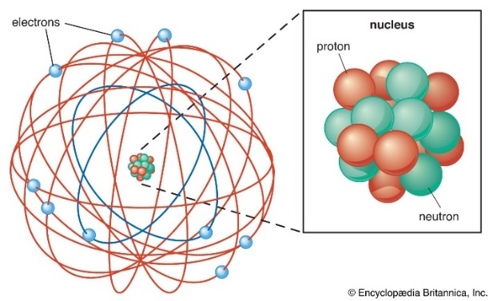
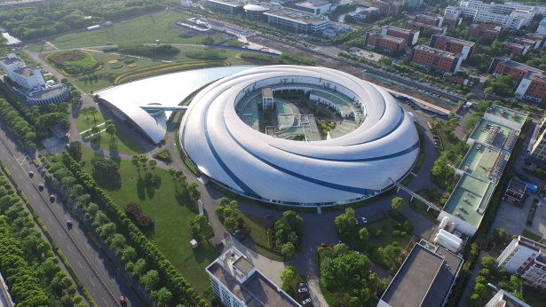
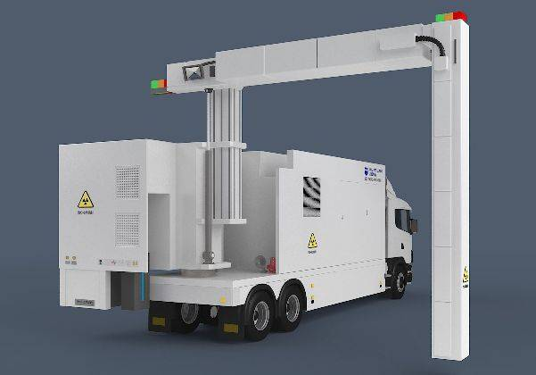
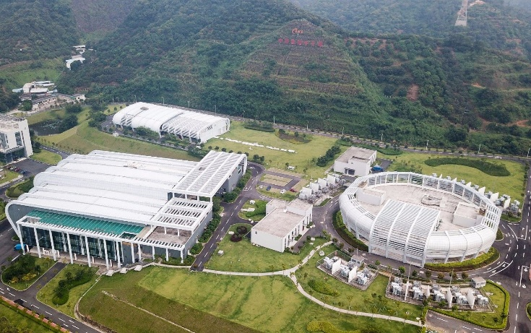
Why accelerators?
Industrial and medical applications
Huge microscopes for particle physics
(Study smallest constituents of matter and basic forces governing the behavior)
Material Research
(Photon Sources/Neutron Sources
Chemistry, biology, medicine…)
Container Scanning Machine
SSRF
Verify and improve the Standard Model
CSNS
Varian medical systems

Slide 6
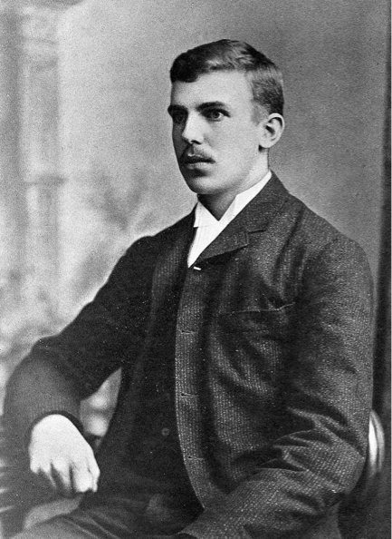
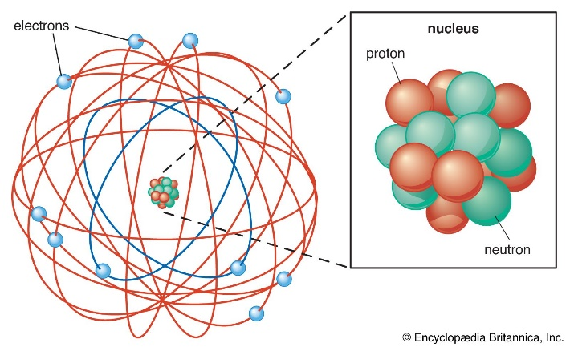
How did everything begins?
Before accelerators, experiments on subatomic particles were largely based on natural radioactive sources and cosmic rays.
Reporting to the Royal Society in London:
“I have long hoped for a source of positive particles more energetic than those emitted from natural radioactive substances”
Starts the race to build accelerators of ever increasing energy, as well as ever higher beam current
Rutherford atomic model
Nobel price, 1908
Ernest Rutherford
The father of nuclear science

Slide 7
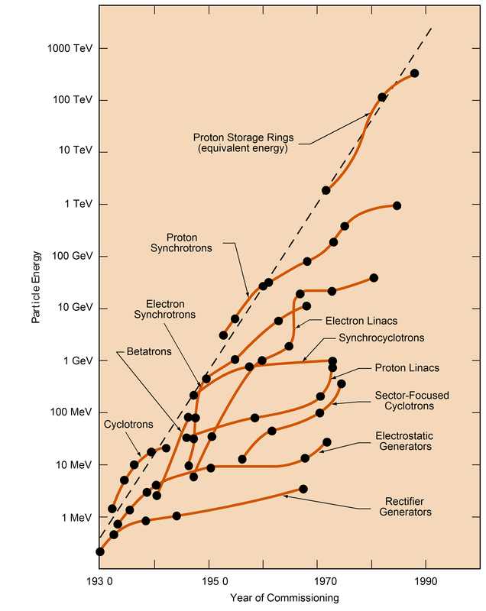
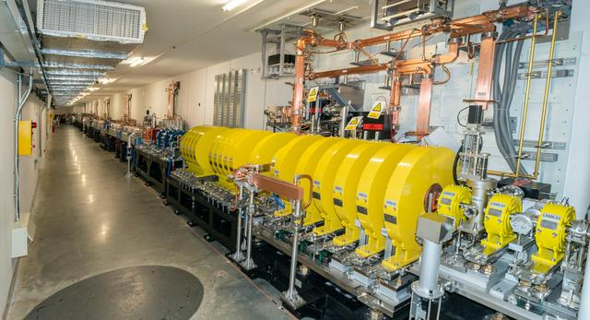
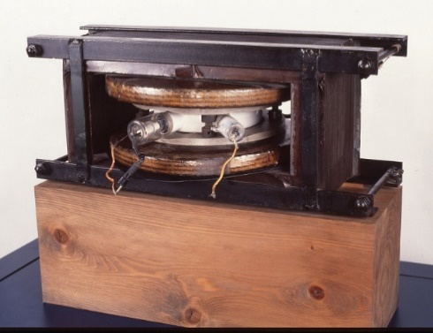
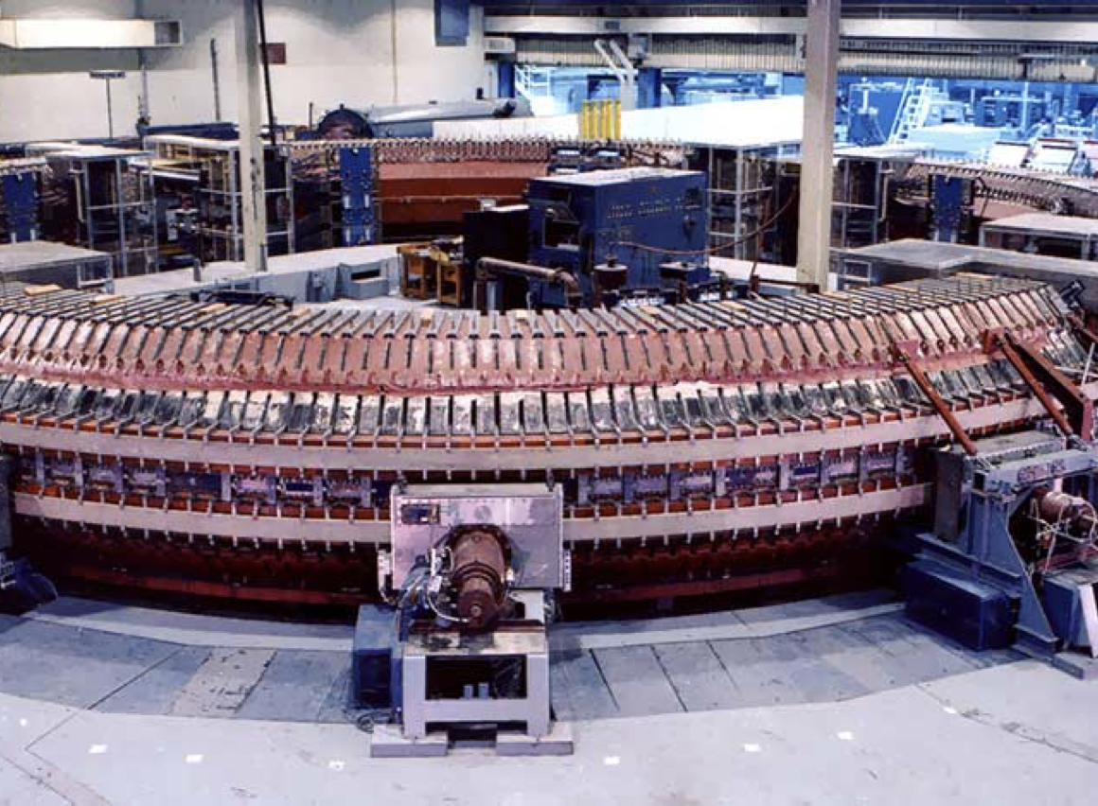
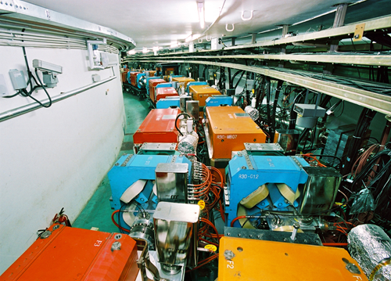
Different types of accelerators
Electrostatic Accelerators
Cyclotrons
Linear accelerators
Livingston plot
Colliders
Synchrotrons
Betatrons
Originally produced by M. Stanley Livingston in 1954
Also many other fancy accelerators not included.

Slide 8
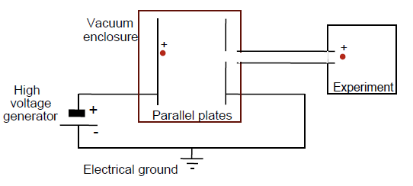
Electrostatic Accelerators
Static voltage accelerator
Simple concept is using electric field to increase the speed of a charged particle
Energy gain of an elementary charge: 1eV=e*1Volt

Slide 9
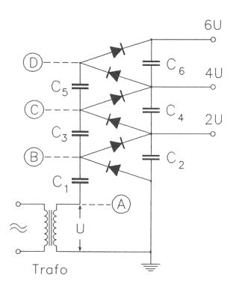
Early Electrostatic Accelerators
In the 1930s, Cockcroft, Walton and Graaff pushed this simple idea to high voltages.
Cockcroft-Walton accelerator
Single passage: 160~700keV
Based on the idea of voltage multiplying column.
Normal alternating current was first rectified
Apply the current to a number of condensers
Connect the condensers in series
Connect to an accelerating column
Accelerate particles

Slide 10
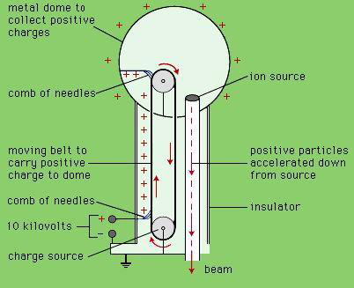
Early Electrostatic Accelerators
Van de Graaff generator
Tandem Van de Graaff generator
(clever idea to use the voltage twice)
Charge sprayed on a moving belt
Transported to a upper terminal and removed
Build up voltage on the terminal
Apply to an accelerating column
Accelerate particles
Cheap and clean.
Energy limited due to voltage breakdown, less used in modern particle physics experiments.
Continue to provide a useful source of low energy particles, applied to a wide range of scientific and industrial tasks.

Slide 11
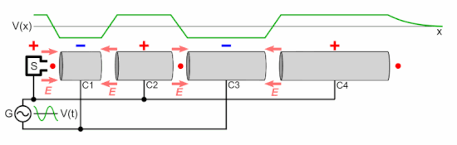
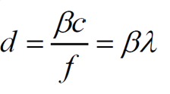
Oscillating field accelerators
Linear accelerators
- Repetitive acceleration in a straight line
~ V sinωt
cyclotrons
Synchrotrons
Repeatedly pass through an accelerating structure
Less space for acceleration
Need bending magnet
Loss energy by SR
 
Applying smaller voltages that oscillate in direction

Slide 12
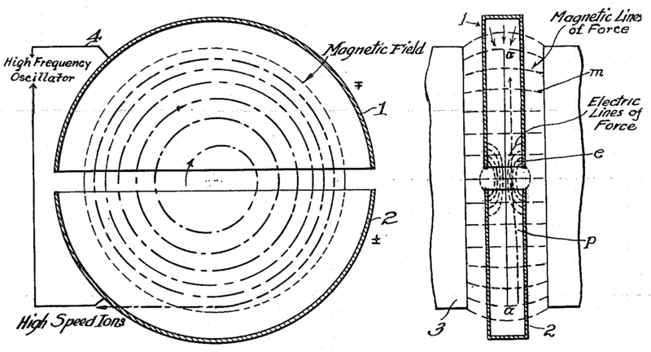
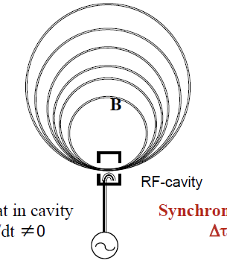


Cyclotrons
First circular accelerators
Work for particles whose velocity was much less than c
Centripetal force
Lorentz force
$$\frac{mv^{2}}{R}=qBv$$
$$ω_{0}=\frac{v}{R}=\frac{qB}{m}$$
Constant magnetic field, alternating voltage, increasing particle orbit radius
Constant revolution frequency ⇒ particles in time with the accelerating voltage
Compact design, huge dipole, low energy
E. Lawrence’s 1934 patent
Ernest Orlando Lawrence
Inventor of the cyclotron
Nobel prize, 1939

Slide 13
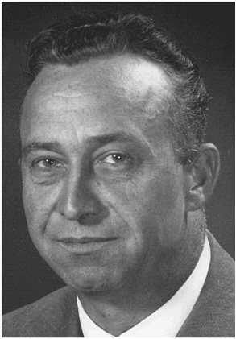
Classical Cyclotron
Not a easy task to built a real machine.
By the end of 1930, Milton Livingston constructed the first cyclotron.
Milton Stanley Livingston
Constructed the cyclotron
First 4-inch cyclotron, 80keV protons
A number of cyclotrons of increasing size followed.
Relativistic limitation: As velocity increases, the protons began to feel the effect of relativity ⇒the revolution frequency varies and couldn't match the accelerating frequency anymore

Slide 14
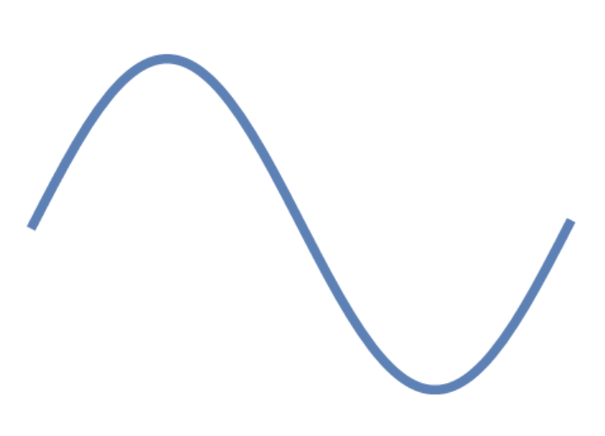
Synchro-Cyclotron (Phase focusing)
Allow cyclotrons to overcome the relativistic limitation and accelerate to much higher energies.
Proposed by Ed McMillan and V. Veksler independently in 1940s.
eV
Gets more energy
eV_{s}
Synchronous particle
Gets less energy
t
Interrupt steady stream of particles into bunches.
Accelerating frequency decreases with the beam revolution frequency ⇒ keep the particles in synchronism with the RF by “phase focusing”
Important concept also for synchrotrons and linacs

Slide 15
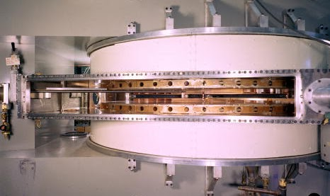
Modern cyclotrons
Spiral sector cyclotrons for nuclear physics
  With separated magnets and resonators
  Introduce additional focusing with alternating contribution at entry and exit of the sector fields.
  Raise the average magnetic field with γ.
PSI Ring
88-inch cyclotron at LBNL
TRIUMF

Slide 16
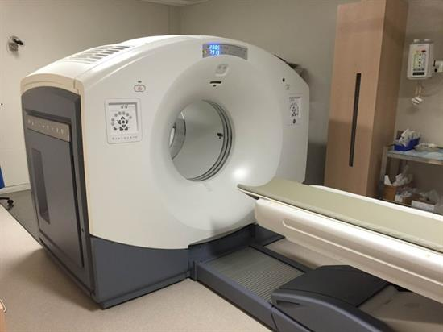
Other applications
Synchro-cyclotrons for medical applications
Compact cyclotrons for isotope production or dating purpose
Cancer therapy
IBA S2C2
PET Cyclotron and Radiopharmacy Facility

Slide 17



Linear accelerators (Linacs)
In 1924, Gustav Ising proposed the linac idea
Avoided the breakdown problems of electrostatic machines and opened the door to all modern accelerators
In 1928, Rolf Wideroe demonstrated RF acceleration for the first time with radio frequency oscillator⇒ limited by the low frequency radio transmitters
$$L\sim βλ$$
Condition for Synchronicity:
$$β=v/c$$
$$λ=c/f$$
Particles passing through a sequence of cylindrical metal “drift tube”, hosted in a vacuum tube of nonconducting material.
Energy gain with a rather modest voltage.
n gaps: the particle reaches an energy of neV.
Pulses vs. oscillating voltages with one powered drift tube
A drawing from Ising’s paper in 1924

Slide 18
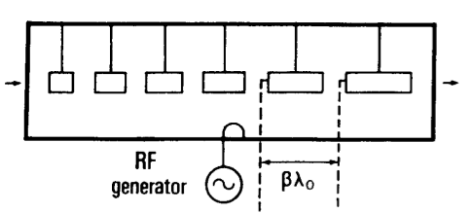
Proton Linac
A new linear accelerator by using the powerful high frequency radio sources developed for radar.
Lius W. Alvarez
Constructed the first proton linac – a 32-MeV drift tube linac (DTL)
Drift tubes suspended in a copper cylinder – a kind of waveguide.
The length of the tubes was chosen so that the particles arrive at each gap just right and gain energy from the oscillating electric field between the tubes.
Many proton linacs constructed in the years followed Alarez’s work.
Today still serve as the first stage in many accelerator complexes.
Limited by energy due to length and single pass.
DTL (Alvarez structure 1945)

Slide 19
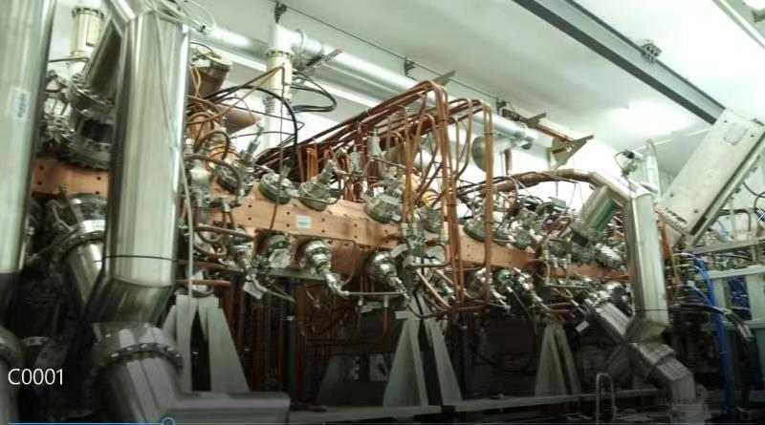
Radio Frequency Quadrupole (RFQ)
Invented in 1970 by I.M. Kapchinskii and V.A. Teplyakov and promoted by Los Alamos.
With four-vaned with appropriately spaced radial modulations, instead of drift tubes.
Focuses, bunches and accelerates the beam at the same time.
Fine periodicity ⇒specially suited to low-velocity, high current beams (keV~ MeV).
Soon replaced the large electrostatic injectors of synchrotrons.
Excited in an electrical quadrupole mode
Natural transverse focusing
Bunching and acceleration from radial van modulation
CSNS RFQ accelerate the proton from 50 keV to 3 MeV

Slide 20
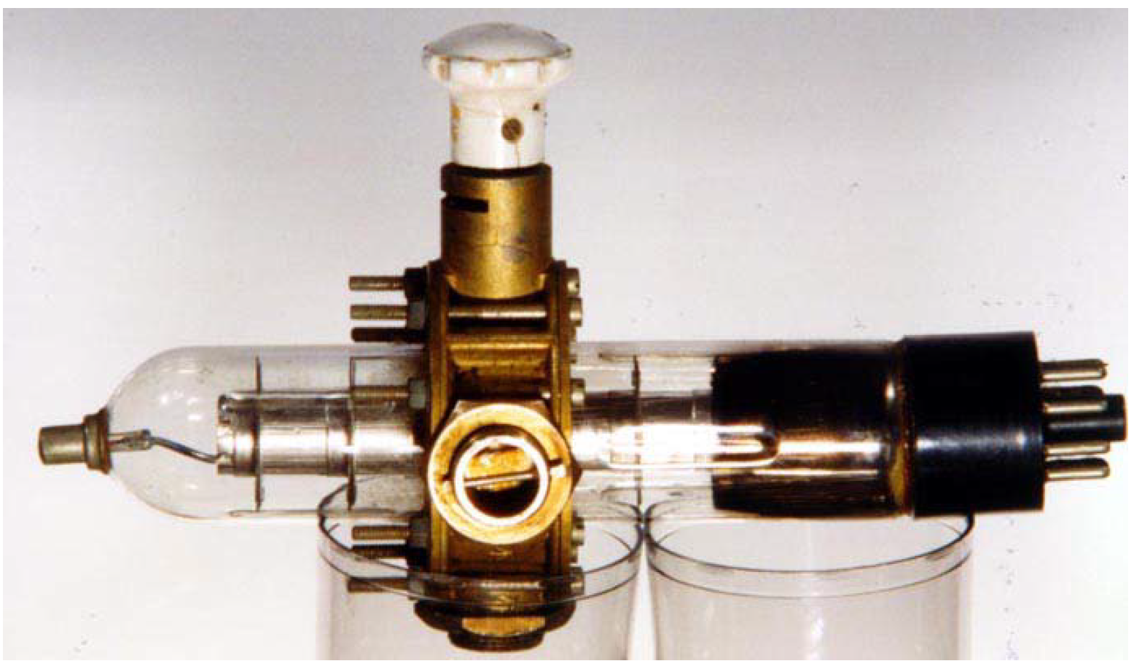
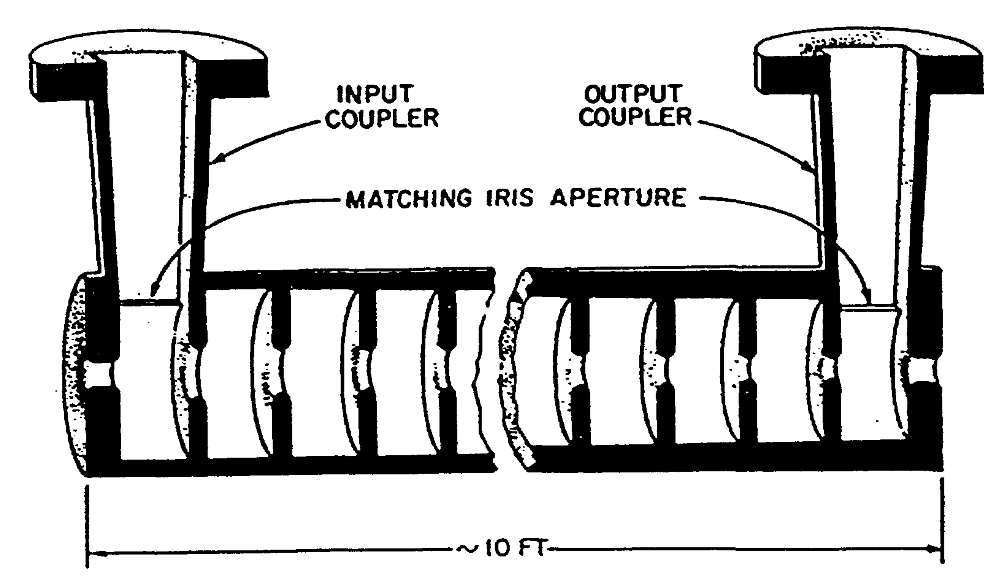
Story begins with klystron
Klystron, invented in 1937, high frequency power tubes (GHz range) available, and linacs for relativistic particles became feasible.
frequency 200 MHz (radar) ⇒ 1~3 GHz (klystron)
wavelength 1.5m ⇒ 30 cm~10 cm
Practical electron linacs were first developed at Stanford University.
A WW2 3 GHz klystron
Distance travel in one cycle barely change.
Conducting tube with periodic diaphragms with central holes – fulfill the function of drift tubes of Alvarez structure.
Washers ensure ccelerating wave in phase with the particles.
Sketch of SLAC 3 m section

Slide 21
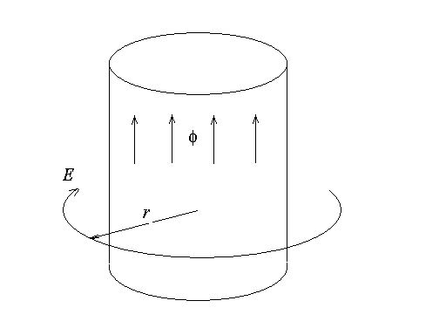


Betatrons
Cyclotron was for heavy particles but not work with electrons due to the relativistic effect.
At early times, electrons are not very interesting for physics, and mainly used to produce X-rays with energy of hundred keV (within the range of electrostatic generator).
Later needs for intense, higher energy electron beams to treat tumors → Betatrons
$$\frac{mv^{2}}{r}=qBv$$
Circular accelerator accelerate electrons.
Rising magnetic field serve for both acceleration and bending.
With constant obit radius.
Insensitive to relativistic effects.
Robust and simple.
First circular machines to have a rising field in step with the rising energy.
$$E=\frac{\dot{φ}}{2πr}$$
Magnet
Electrons
Vacuum chamber

Slide 22
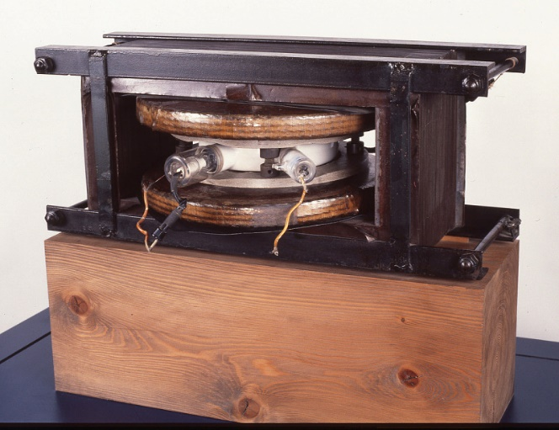
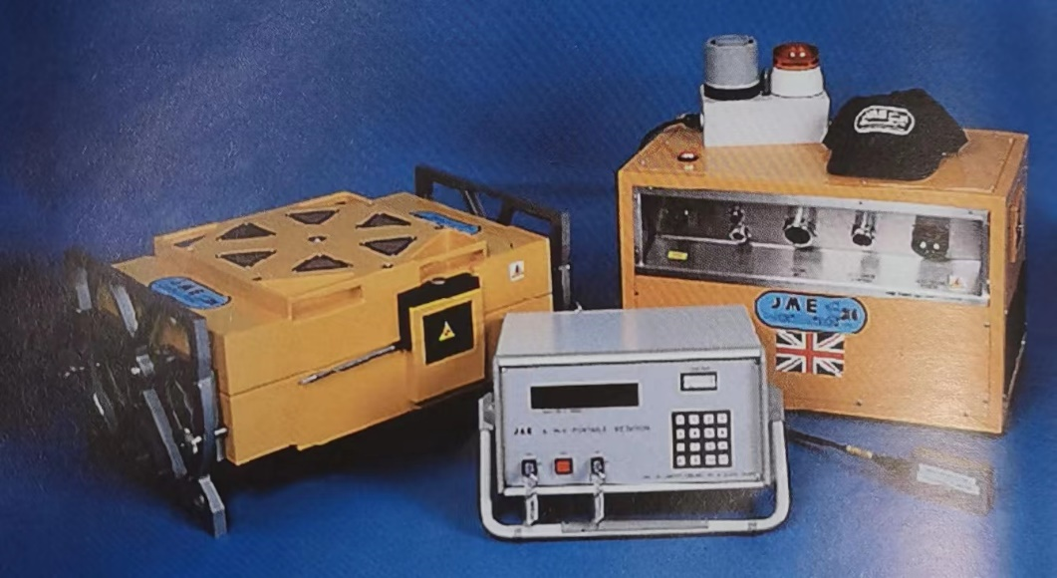
Development of Betatrons
In 1940, Donald William Kerst operated the first successful betatron.
The popularity was shortly lived in 1940s, in the energy range 5MeV~300MeV, soon replaced by the more compact and less expensive synchrotrons and linacs.
Widely used for medicine applications in the early days.
Nowadays, mainly used for portable x-ray sources up to 6 MeV.
First betatron of Danald Kerst, 1940.
Compact betatrons to produce X-rays for defect detection

Slide 23
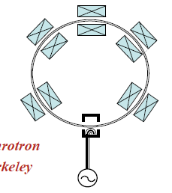

Synchrotrons
For cyclotrons and betatrons, their size and cost grew with their output energy.
Solution:
  Use only the outer rim of the magnet for all energies
  Particles injected into the machine in pulses
  Keep the radius constant and to ramp B to match the momentum of beam
  Synchronize both the rise in field and the accelerating frequency
Bending radius
Suitable for hadron and lepton
Large size, small magnets
High energy
Fixed target
Paved the way to colliders
Beam momentum
$$Bρ=\frac{p}{e}$$
Bending magnetic field

Slide 24
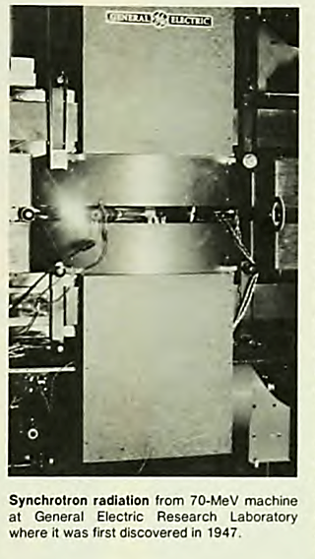
Early history of Synchrotrons
1943: Marcus Oliphant proposed the idea:
“Particles should be constrained to move in a circle of constant radius thus enabling the use of an annular ring of magnetic field … which would be varied in such a way that the radius of curvature remains constant as the particles gain energy through successive accelerations by an alternating electric field applied between coaxial hollow electrodes.”
1947: Frank Goward converted the Betatron into the first “proof of principle” synchrotron.
The first purpose-built synchrotron was built one or two month later - first to produce synchrotron radiation in a visible form.

Slide 25
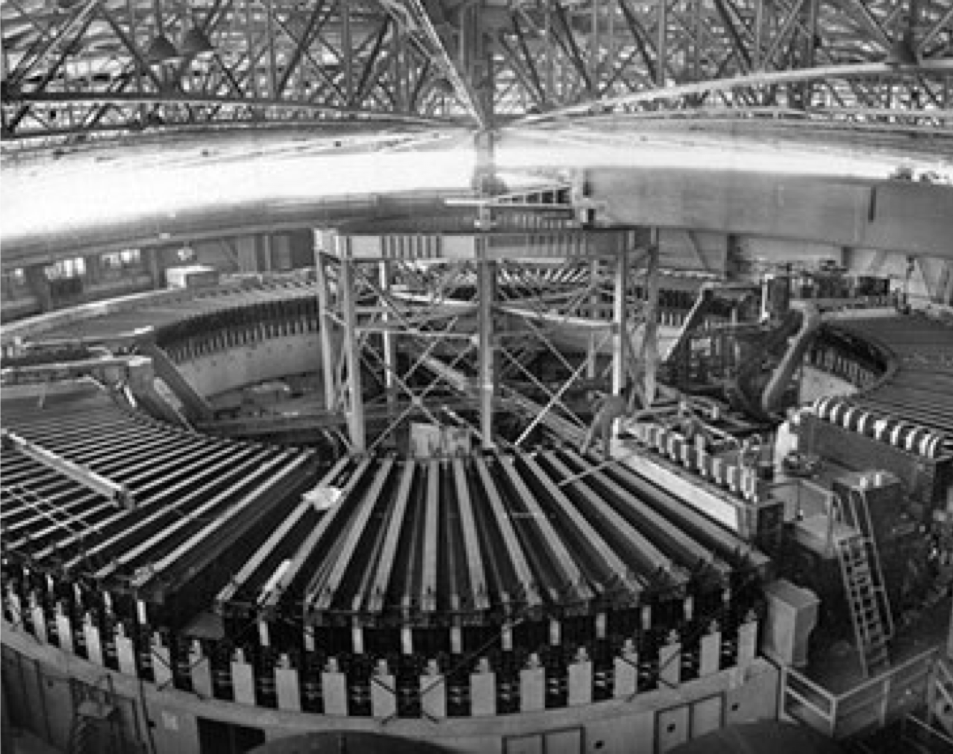
Early Proton Synchrotrons
Oliphant’s machine reached just short of 1 GeV for the first time in 1953.
A few month later, Cosmotron at Brookhaven reached 3 GeV.
Closely followed Bevatron at Berkeley reached 6 GeV (found the antiproton).
Cosmotron, BNL
3GeV, 1953
Bevatron, Berkeley
6 GeV, 1954

Slide 26
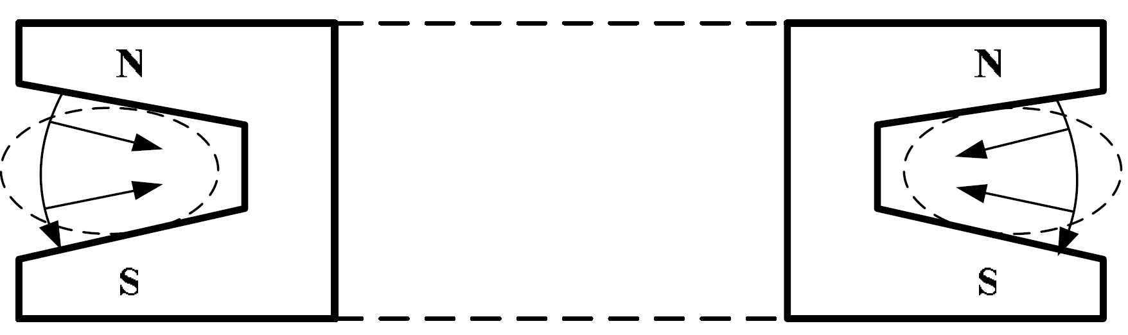
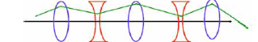
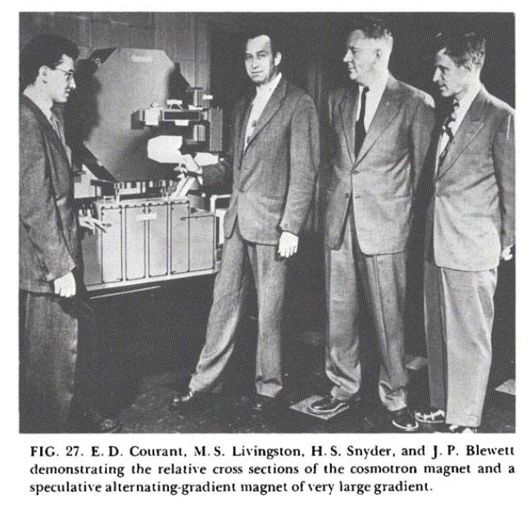
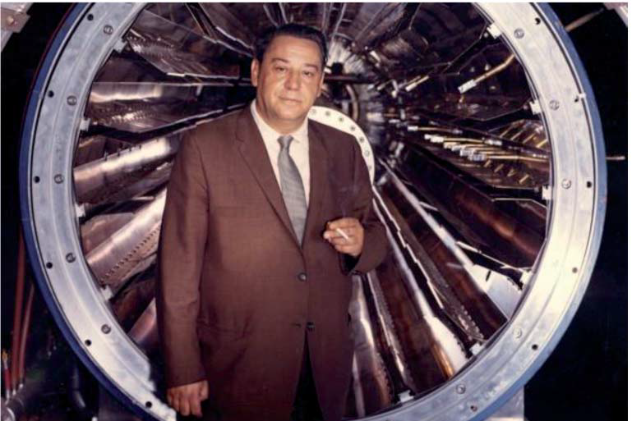
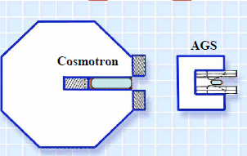
Wake focusing → Strong focusing
1952, Stan Livingston proposed the idea of alternating the yokes of the Cosmotron.
Later, Courant, Livingston and Snyder published the Alternating Gradient focusing idea.
Then it was found that the strong focusing scheme had actually been patented earlier by Nick Christofilos.
More compact ⇒ lower cost
Nicholas Christofilos

Slide 27
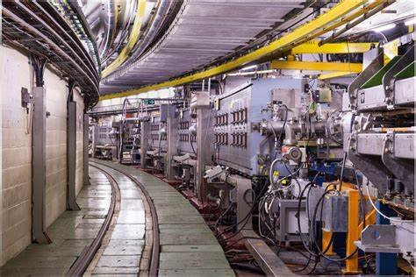
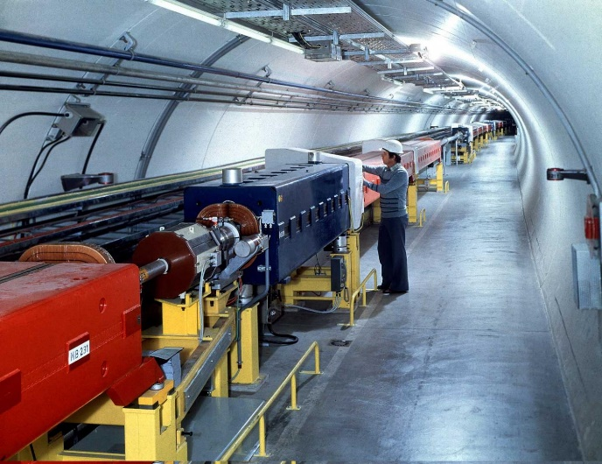
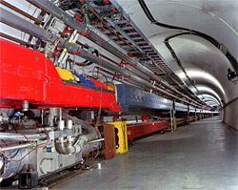
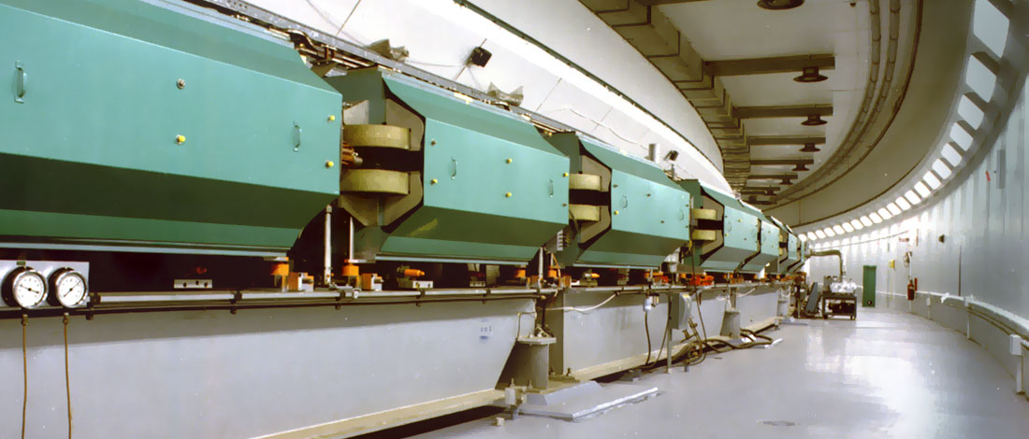
Strong focusing Synchrotrons
1950s, ~30GeV
1970s, ~500 GeV, separate function of quad & dipole →squeeze more bending power
CERN’s PS
CERN’s SPS
Fermilab
Brookhaven’s AGS
1980s, Tevatron, 1 TeV, superconducting →higher magnetic field

Slide 28
Colliders – Science motivation
Seek mathematical descriptions of elementary particles and the interaction forces governing them.
Often predict a new particle as the model improves.
Theorists
Particle physicists
Find the new particle by firing one beam at another.
Measure its property and test the validity of the theory.
Experimenters
New particle discovered ☺
Nothing found ☹
(missed from analysis? not exist? energy not equate?)
Choice of collider species
  Proton – Proton/antiproton (higher energy, one of the three quarks involved in the interaction)
  Electron – Positron/electron (Lower energy, full energy involved in the interaction)
  Heavy ions
  Gamma rays
Build a new machine with high enough energy!
⇒ All contribute to a full picture of the forces that govern the interaction of particles

Slide 29
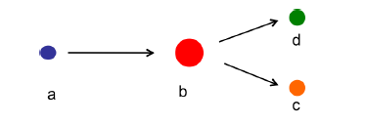
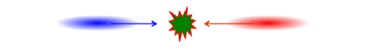
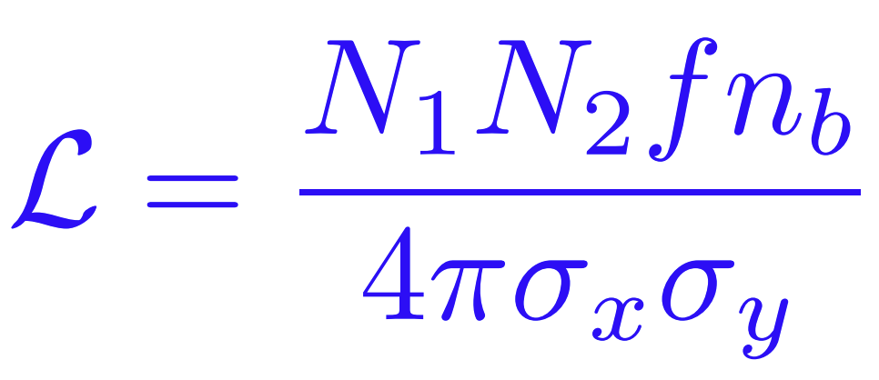
Colliders
Needs from the atomic nucleus study:
  Sufficient energy to allow two nuclei to be brought close enough to interact.
The collider concept was first proposed by Rolf Wideröe in1940s.
Fixed target，U_{cm} ~ (2U_{a} × U_{b})^{1/2}
Circular (double/single ring) or linear
Maximize center-of-mass energy
Luminosity: the likelihood of seeing something interesting from a collision
Colliding beams, U_{cm} ~ 2U_{a}
Proton-proton collider with Ek of 2×100 GeV
= proton beam with Ek of 20000 GeV heat a stationary target

Slide 30
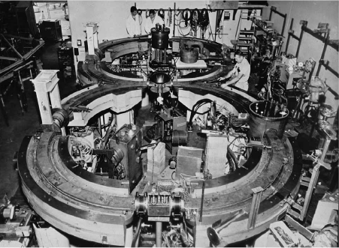
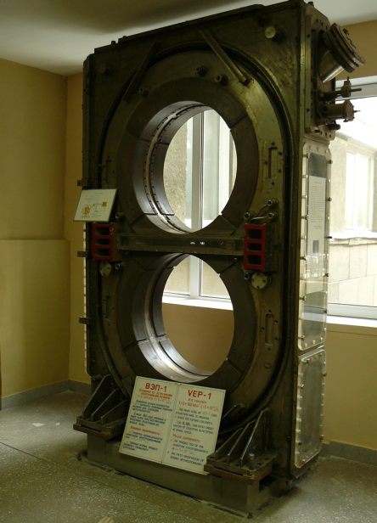
Early Colliders
First successful e⁻e⁺ collider, ADA, at Frascati, Italy, proposed by Bruno Touschek (1960)
CBX e-e- collider, Stanford
Stored 1 A/beam
Beam-beam tune shift observed
Discovered Touschek lifetime
VEP-1 e-e- collider, Novosibirsk
Beam-beam effects found
Beam-beam tune shift observed

Slide 31


Hadron Colliders
Developed since 1970s, with increasing energy and luminosity.
Discovery reach determined by the beam energy (dipole magnetic field, size of machine).
Likely to determine the pace of particle-physics progress and essential for establishing the standard model of particle physics.
Luminosity vs. center-of-mass energy
Hadron collider peak luminosity as a function of year

Slide 32

Electron-Positron Collider Family
Asymmetric Energy B Factories
Intermediate Energy Colliders
Phi-Tau-Charm Colliders
Z Colliders
Low Energy Colliders
These facilities essentially shaped modern particles physics.

Slide 33




Future Electron-Positron Colliders
SuperKEKB
CLIC
ILC

Slide 34
Livingston chart
Livingston plot
Keep construction of bigger and better machines, not a given type, for particle physics research.
Show evolution of accelerator energy in the over 70 years ⇒ 12 orders of magnitudes increase on the accelerator energy.
Accelerators have become indispensable in the quest to understand nature at smaller and smaller scales.
Higher energy ⇒ shorter wavelength ⇒ probe deeper into the structure:
Examine at the scale of atom: keV
At the scale of nucleus: MeV
Fine structure of the basic constituents of matter: GeV

Slide 36
Accelerator related subjects
Hinge upon many different physics subjects and advanced technologies
Physics
Technologies
Vacuum
Radio frequency
Magnet
Power supply
Mechanics
Superconducting
Electronics
Computers
…
Relativistic dynamics
Electrodynamics
Plasma physics
…

Slide 37



Recommended books

Slide 38
Thank you for your attention!

