Slide 1
Tutorial on
Processing Slides and Embedding Animations
Michaela Marx
DESY, Hamburg, Germany
JACoW Team Meeting, Dec. 2021, Trieste, Italy

Slide 2
Processing slides
… means producing PDF files of transparencies
The aim of the Presentation Processing Editor is to produce JACoW compliant PDF files of the presentations for inclusion in the proceedings.
You do not have to edit the type setting or layout, but you still have to make sure of the following:
All Fonts Must be Embedded
All Missing Characters Should be Fixed
Slides Should be Free of Overlapping Issues
Movie Animations Content Should be Embedded

Slide 3

Contents of this Tutorial
Documentation (JACoW wiki)
SPMS environment (download/upload)
Prerequisites: what to do before you start
Processing PDF slides (check and fix missing fonts)
Processing PowerPoint slides (fix overlaps)
how to convert slides to PDF
Tips & Tricks (extracting media files, trouble-shooting)
embedding videos and animations
Statistics (ppt vs. pdf files)
answering questions

Slide 4
Processing slides:
Documentation

Slide 5
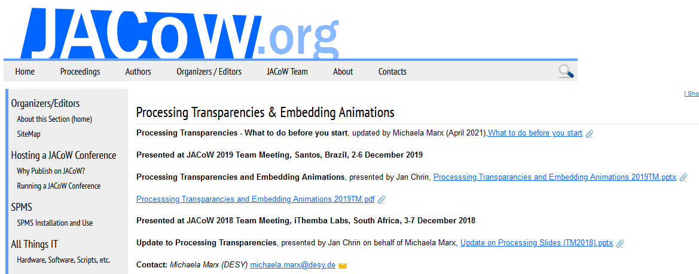
Processing slides: Documentation
►Guidelines and a manual are available on the JACoW-Wiki pages:
https://www.jacow.org/JTM2016/ProcessingTransparenciesEmbeddingAnimations
► the wiki page will be updated regularly

Slide 6
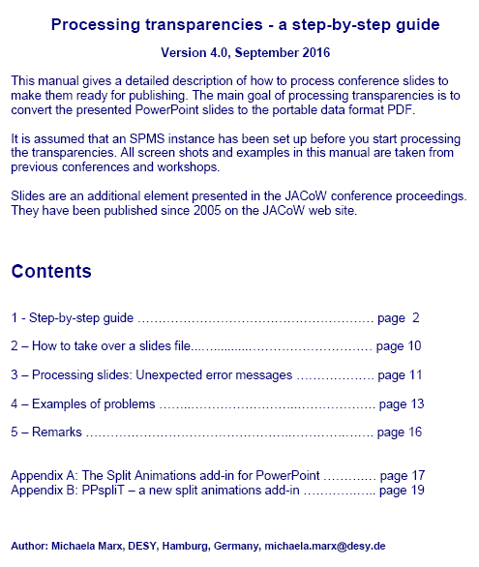

Contents of the slides processing manual
Processing slides: Manual
Link: www.jacow.org/uploads/Editors/Slides_Processing_Manual_V4
the working environment in the SPMS
the upload/download procedure
the different ways to convert PPT files to PDF
the split animations add-in for PowerPoint

Slide 7
Processing slides:
The presentations management in the JACoW-SPMS

Slide 8
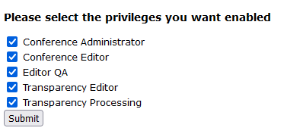
Processing slides: SPMS privileges
In the SPMS (Scientific Program Management System)
the conference administrator needs to setup the access privileges for you
after login to the SPMS, check the boxes named
‘Transparency Editor’ and ‘Transparency Processing’

Slide 9
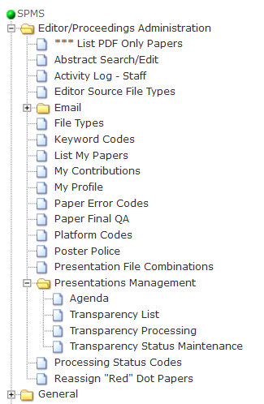
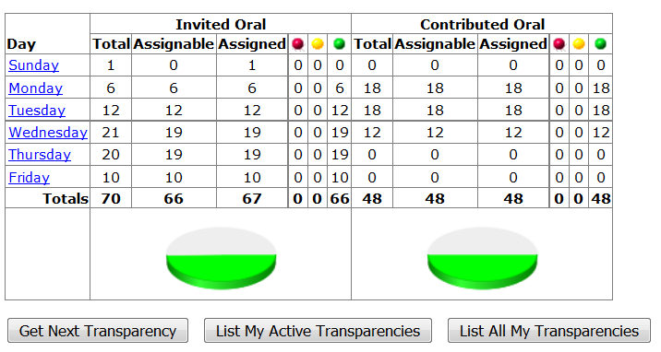
Processing slides: the SPMS environment
SPMS
Editor/Proc. Admin  Presentations Management  Transparency Processing
Note: slides should only be processed after the talk has been given to make sure
that it is the final version without last minute changes.

Slide 10
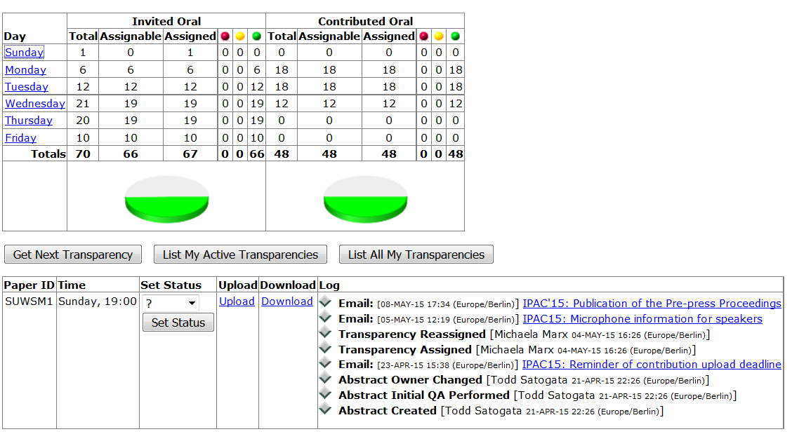
Processing Slides: the SPMS environment
◆ select a day to download the slides

Slide 11
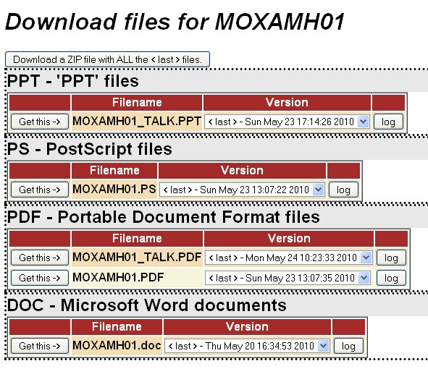
Processing Slides: download screen
The download screen shows all files which have already been uploaded to the database by the author or by an editor.
► talks are named *_TALK.PPT, *_TALK.PPTX, *_TALK.PDF, *_TALK.ODP
ODP = open document presentation (Open Office)

Slide 12

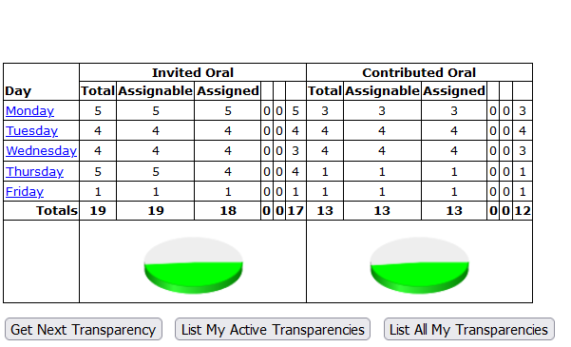
Processing slides: Prerequisites
Preparing your workstation in the proceedings office
Transparency Maintenance
The conference organizer is responsible for the PC set-up, but for processing slides some extra work is required.

Slide 13

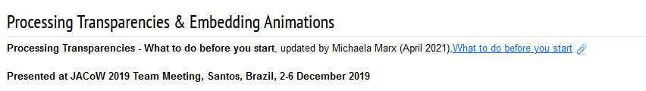
Processing PowerPoint slides: Prerequisites
What to do before you start
install video transcoders (Handbrake & Virtual Dub)
install Lightshot (tool for making screenshots)
◆ install PPspliT (PowerPoint Add-in)
◆ modify PowerPoint print options: print slides in High Quality
◆ install Macintosh Fonts on a Windows PC
Prerequisites are available in detail on the JACoW-wiki pages:
https://www.jacow.org/JTM2016/ProcessingTransparenciesEmbeddingAnimations
Notes:
In general, the conference organizers will prepare and setup the PCs in the proceedings office. Just check, before you start, if the mentioned software is installed. Don’t forget to install the Macintosh fonts.

Slide 14





Processing PowerPoint slides: Prerequisites
Software you need: Video transcoders and a screen capture tool
Virtual Dub
VLC media player
◆ Handbrake - video transcoder to convert video files (avi, wmv etc) to MPEG-4
https://handbrake.fr/downloads.php
◆ Virtual Dub (free video processing software to convert animated gifs to avi)
https://sourceforge.net/projects/virtualdub/
◆ Adobe Flash Player
other useful tools
◆ VLC Player (free cross-platform multimedia player)
https://sourceforge.net/projects/vlc/
◆ Lightshot (to take customizable screenshots)
https://app.prntscr.com/en/index.html
Adobe stopped the support for the Flash Player – web browsers are able to play videos as well

Slide 15
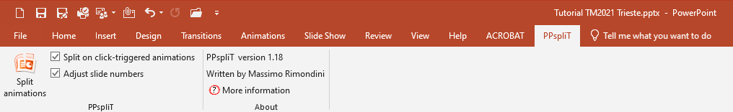
Processing PowerPoint slides: Prerequisites
PPspliT – A Split Animations Add-In for PowerPoint
► useful tool to separate overlapping objects in PowerPoint (PPT) transparencies
► Download the PPsplitT installer from Massimo Rimondini’s web page:
http://www.maxonthenet.altervista.org/ppsplit.php
and use the supplied password “ppsplit” to unzip the file
► After the add-in has been installed, PowerPoint offers a new tab named PPspliT.
To run the add-in just click the Split animations button on the left.
◆ the PPspliT Add-In is available on the JACoW website as well:
https://www.jacow.org/JTM2016/ProcessingTransparenciesEmbeddingAnimations
15

Slide 16

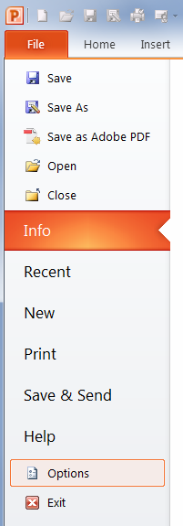
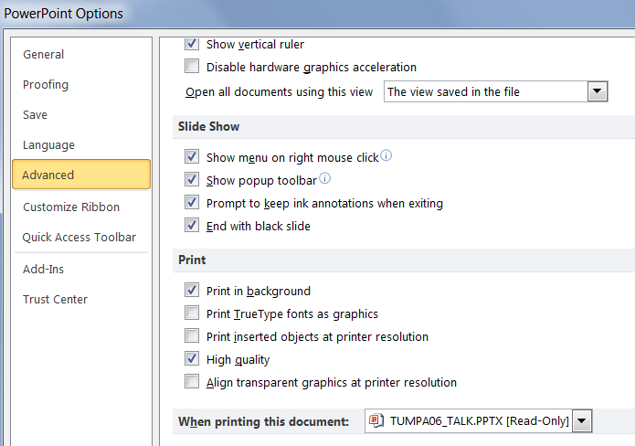
Processing PowerPoint slides: Prerequisites
►Enable High quality print option
check here
16

Slide 17
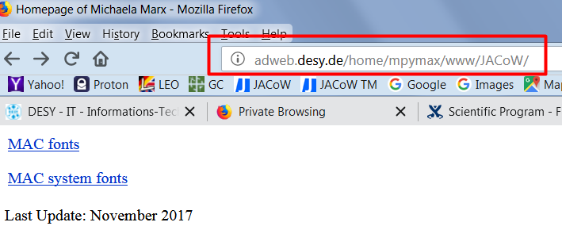
Processing PowerPoint slides: Prerequisites
Install Macintosh fonts on a Windows PC
 MAC fonts are typically not installed on a Windows PC in the proceedings office,
but necessary for processing Macintosh slides on a Windows PC
 the transparency editor needs to install the MAC fonts by himself,
destination folder is C:\Windows\fonts
 MAC fonts can be downloaded from my web page
http://adweb.desy.de/home/mpymax/www/JACoW/
 download both zip files and do a right-mouse-click to extract the files
 select all font files and do a right-mouse-click to install the fonts
17
 copy the MAC fonts into folder C:\Windows\fonts on the Windows PC

Slide 18

Processing Slides:
Slides in PDF format
upload
check
download

Slide 19
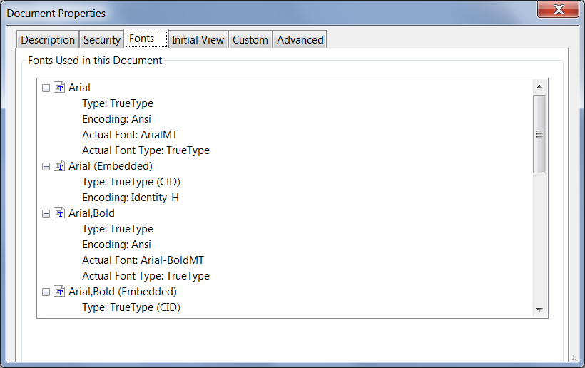
Processing PDF Slides
◆ If the author uploaded a PDF slides file …
… great ☺
◆ download the PDF slides file, do a visual inspection and
check for missing fonts in Acrobat Pro with CTRL-D
in this case
Arial and Arial, Bold
are not embedded
in the PDF document
CTRL-D

Slide 20
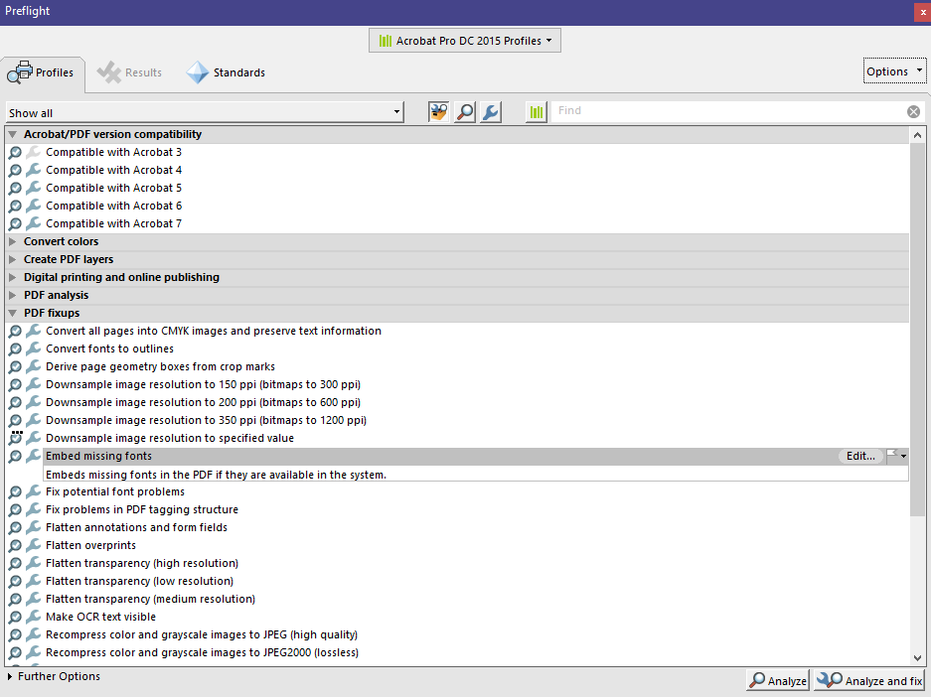
Processing PDF slides: how to embed missing fonts
◆ in Acrobat Pro (example is version 2017) do SHFT-CTRL-X
and look under PDF fixups for ‘Embed missing fonts’.
Click the ‘Analyze and fix’ button and you are done ☺.

Slide 21
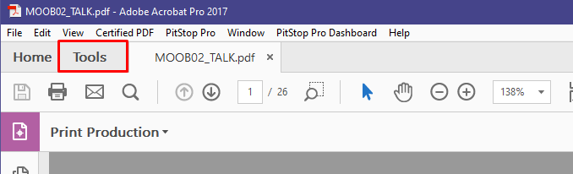
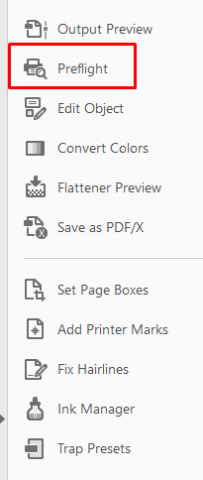
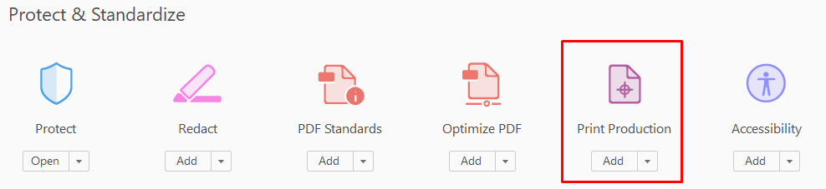
Processing PDF slides: how to embed missing fonts
alternative way, but does the same job:
◆ click on Tools  Print Production  Preflight (SHFT-CTRL-X)

Slide 22
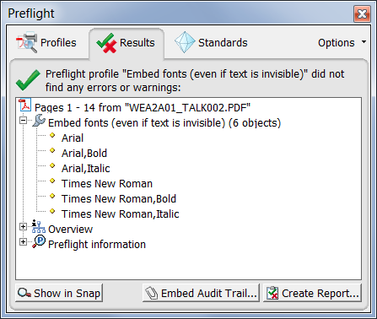
Processing PDF slides: how to embed missing fonts
◆ the preflight tool results in a list of fonts which have been embedded
save the PDF file, upload it to the database, leave a comment – and you are done ☺

Slide 23
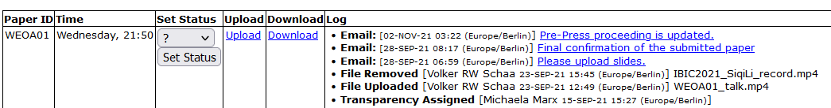
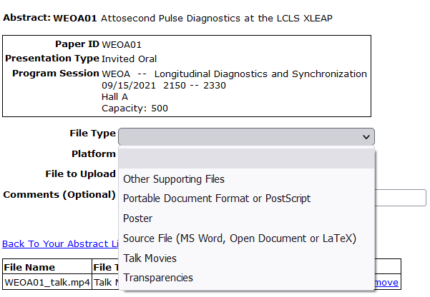
Processing slides: how to upload a slides file in the SPMS
◆ click the Upload button and select file type ‘Transparencies’

Slide 24
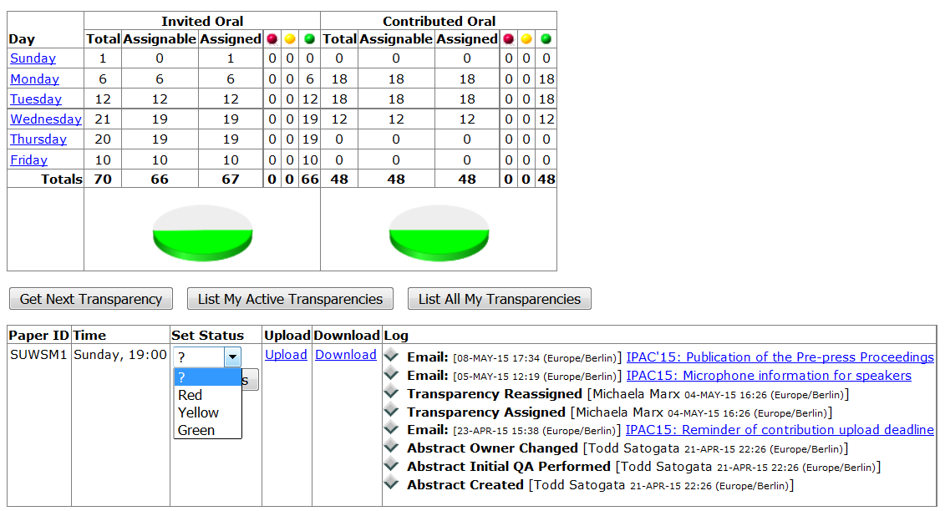
Processing slides: status and comments
◆ after the upload, set the processing status (red or green), and leave a comment
GREEN: Perfect! Leave a nice comment and you are done ☺
RED: There is a problem and further action is required!
Describe the problem in the comment field –
an email with your comment will be send by the SPMS to the speaker

Slide 25
Processing slides: status and comments
some example comments when status is green
◆ Your PowerPoint slides were successfully converted to PDF for publication on JACoW.
Overlapping objects on several slides have been separated. Please download the PDF
slides file (papercode_TALK.pdf) and check. In case of trouble please reply to
[email address]. Thank you.
◆ The uploaded PDF slides were checked. Missing fonts have been embedded.
Please download your slides and check. In case of trouble just send an email
to [email address]. Thank you.
◆ The uploaded PDF slides have been checked - talk looks perfect. Thank you.
some examples comments when status is red
◆ A bad character has been detected on slide #13 which displays as an empty box.
Please fix and resubmit the slides. Thank you.
◆ A character is missing on slide #5.
Please come to the proceedings office to see the slides editor.

Slide 26

Processing Slides:
PowerPoint slides
upload
check
download

Slide 27
Now the challenge: Processing PPT slides
If the author uploaded PPT (PowerPoint) slides only …
◆ download the PPT slides file, start the slide show (press F5)
for a visual inspection and check for:
 overlapping images or text
 bad or missing characters
 animations and embedded videos
 the slides format (4:3, widescreen or whatever)
◆ In case everything looks fine, convert the PPT slides to PDF
and upload them to the database.
◆ In case you detect overlaps or animations some extra work is
needed before the slides can be converted to PDF.

Slide 28

Processing Slides: extra work
How to fix overlaps

Slide 29

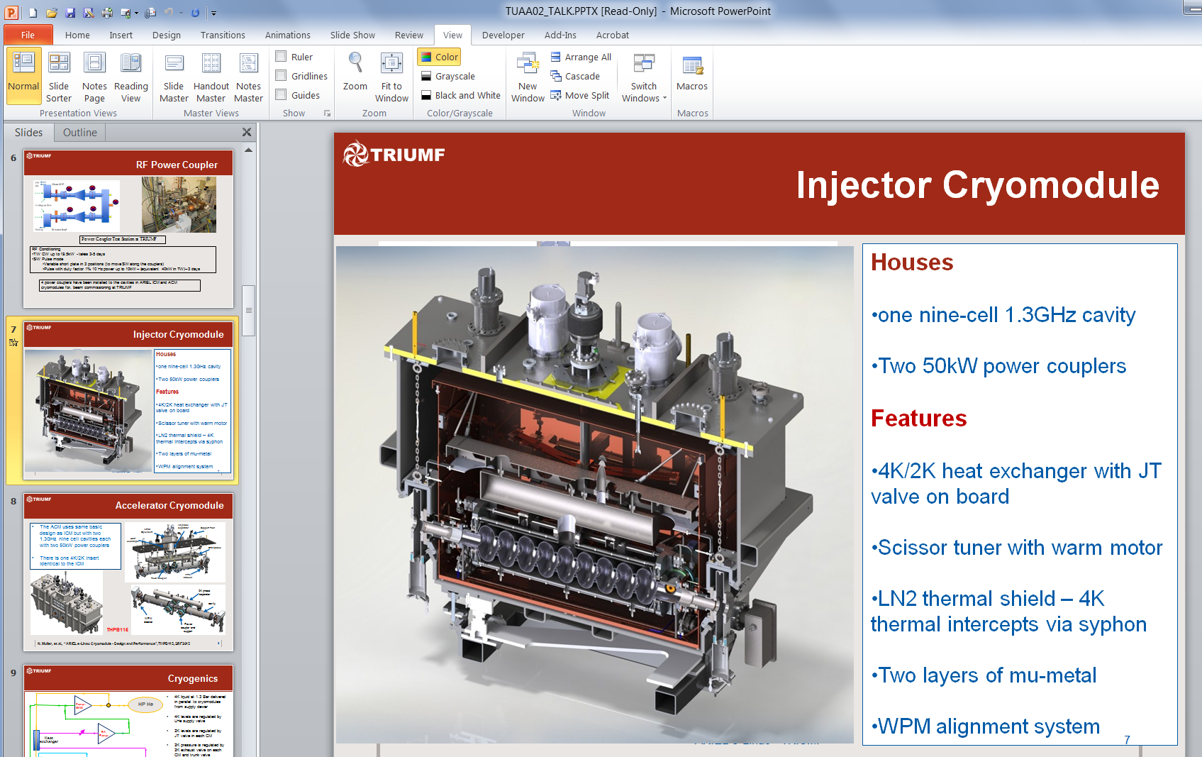
Simple overlaps can be separated manually
◆ slides containing overlaps or animations are indicated with a star symbol

Slide 30
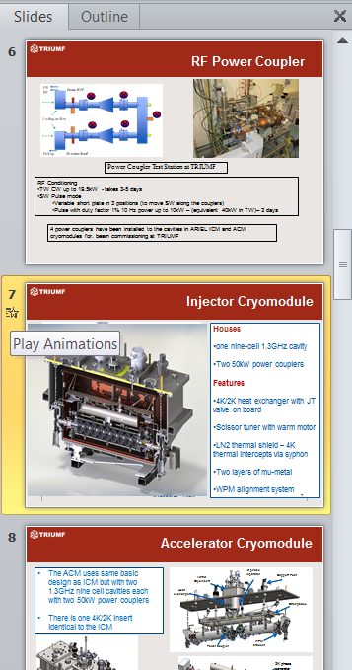
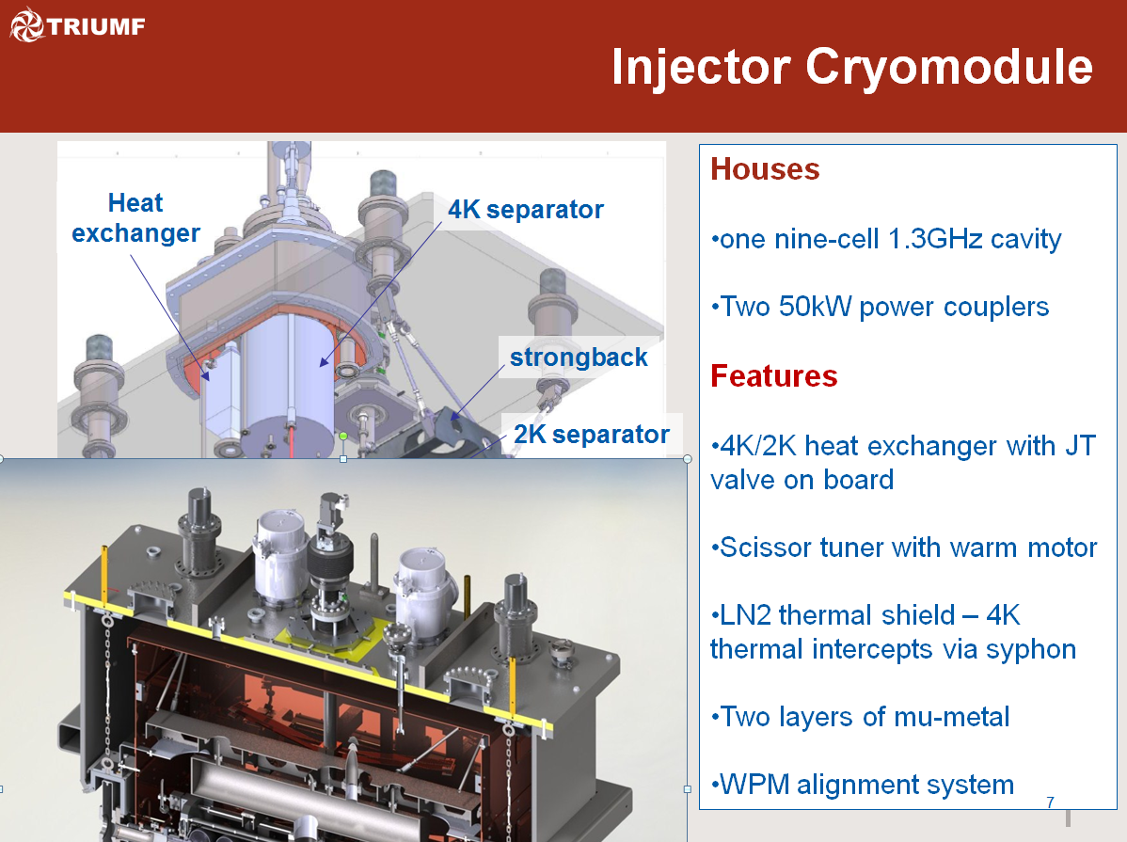
How to fix simple overlaps manually?
◆ click on that little star icon to Play the Animations
◆ you see an image covering another image

Slide 31
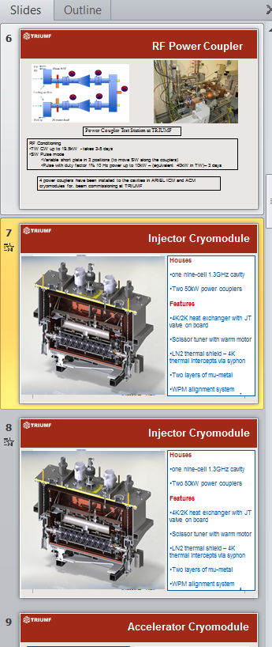
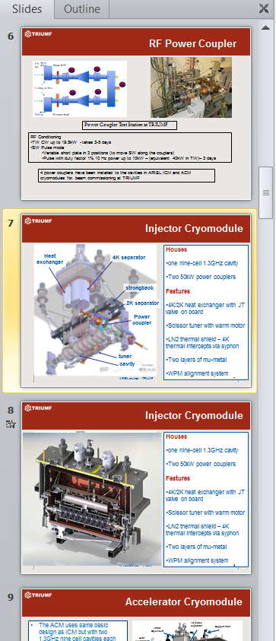
How to fix simple overlaps manually?
◆ copy the slide to get the same slide twice
◆ remove the overlapping image from the original slide
◆ leave the overlap on the copy and your are done ☺

Slide 32
Processing Slides:
fixing overlaps with PPspliT

Slide 33
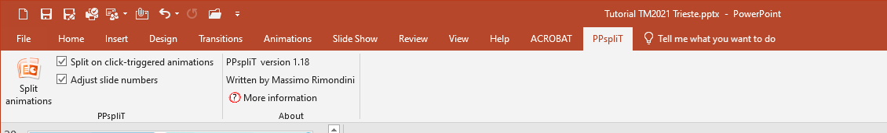
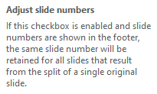
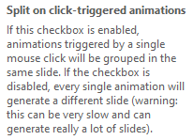
Second way: Fix overlaps using PPspliT
◆ the PowerPoint Add-in named PPspliT is used for slides where the amount
of overlapping contents is confusing or far too much
◆ you can select just one slide, a range of slides or all slides
► use default settings (leave the checkboxes as they are)
33

Slide 34
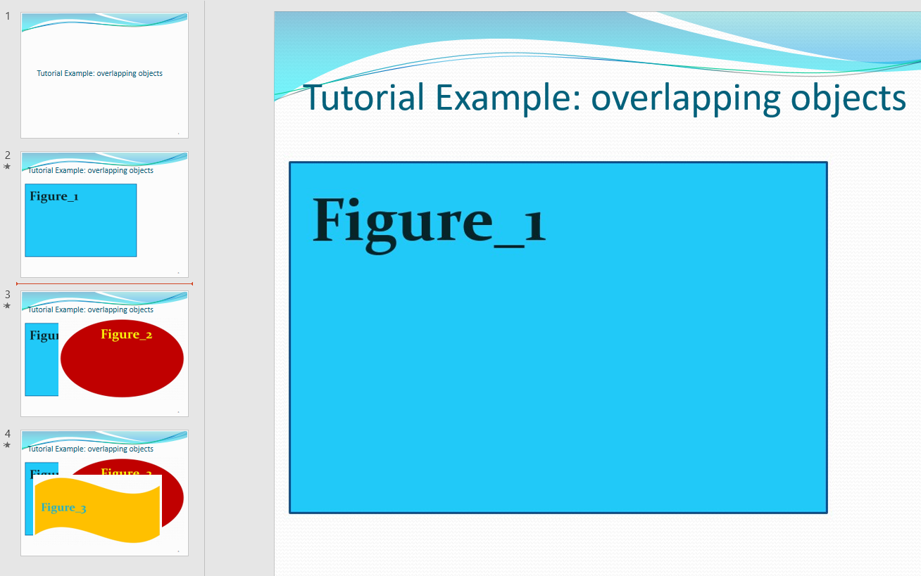
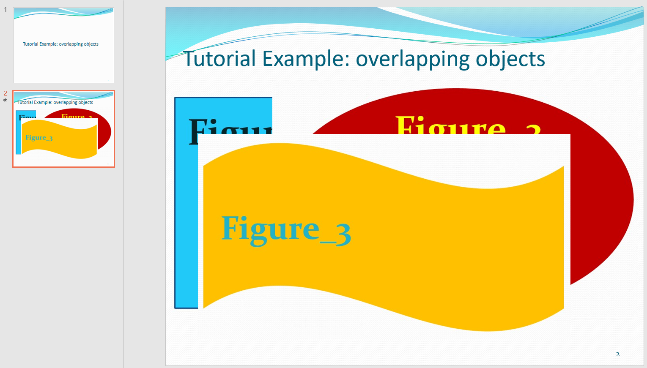
Fix overlaps using PPspliT: Example
◆ in this example the macro separated the overlaps and
split one slide into three
► save the split slides as <filename>_TALK_split.pptx
and do not forget to upload it to the SPMS as well as the converted PDF file

Slide 35
Processing Slides:
How to convert PowerPoint slides to PDF?

Slide 36
Processing Slides: how to convert PPT to PDF
There are different ways to convert the PPT slides to PDF – but there is only one way recommended:
◆ print the slides to the Adobe PDF printer
Not recommended:
◆ save as type PDF directly from PowerPoint
◆ create PDF using Acrobat PDFMaker
◆ only this way makes sure to embed all fonts

Slide 37
Processing Slides:
How to adjust the slides format

Slide 38

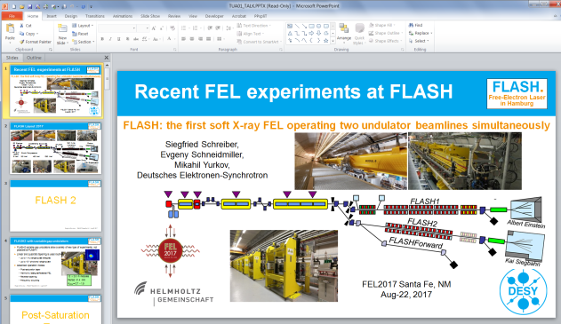
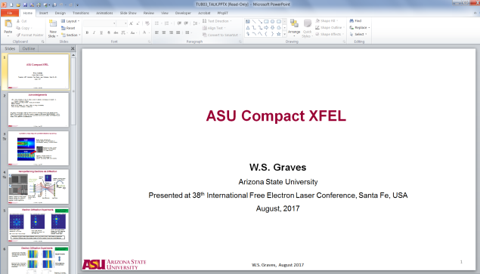
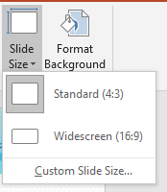
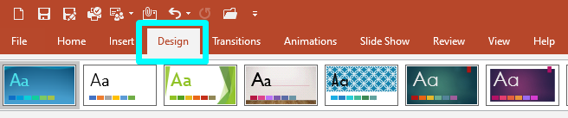
Processing slides: different formats
Standard (4:3) Widescreen (16:9) Custom Slide Size
◆ to check the format → select Design → Slide Size
◆ the slide size is highlighted in grey,
if not, click on Custom Slide Size to
get the size

Slide 39
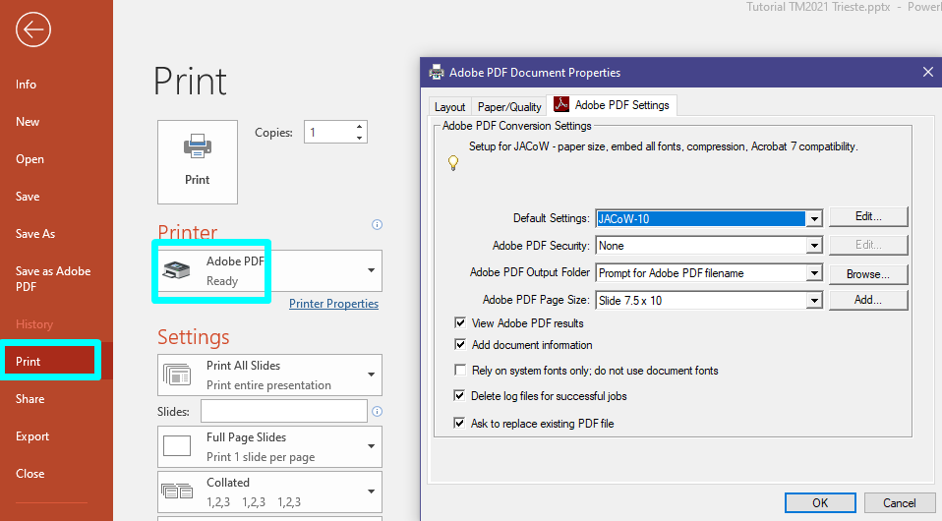

Processing slides: Standard format (4:3)
◆ Print the slides to the Adobe PDF printer and modify Printer Properties:
JACoW-10 is a Distiller option, set up in advance
standard format
uncheck here
check this box
◆ the JACoW-10 options make sure that all fonts will be embedded
◆ for the standard format select Slide 7.5 x 10 from the list of available page sizes

Slide 40
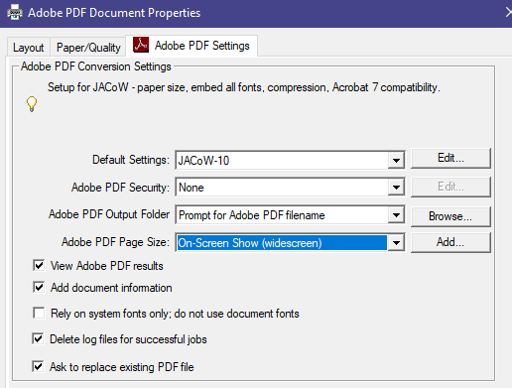
Processing slides: Widescreen format (16:9)
► choose On-Screen Show (widescreen) from the list
of available page sizes to convert slides in widescreen format

Slide 41
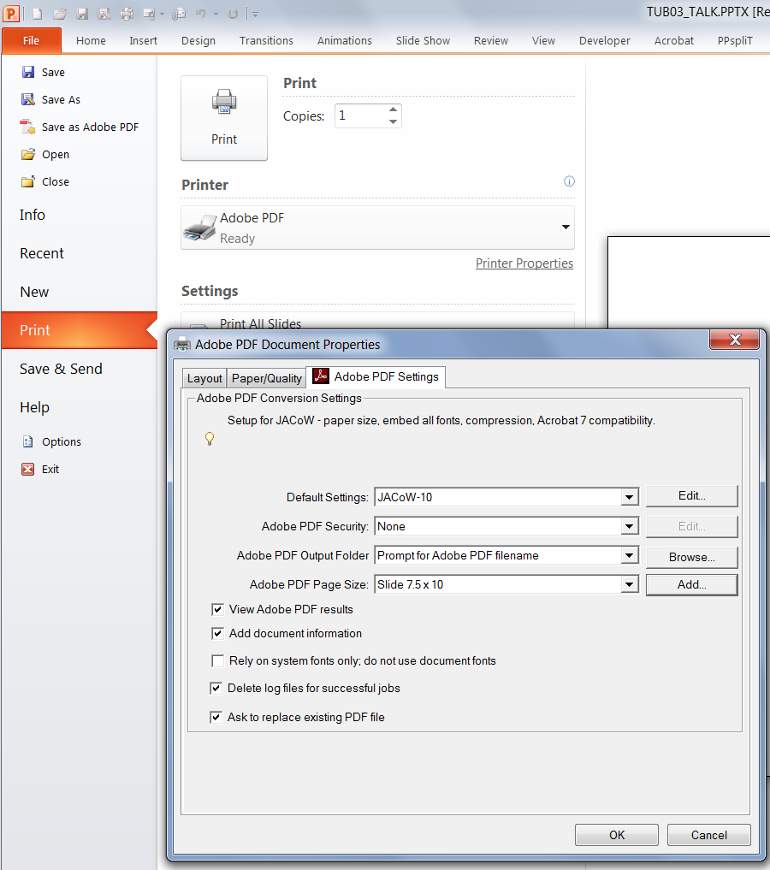
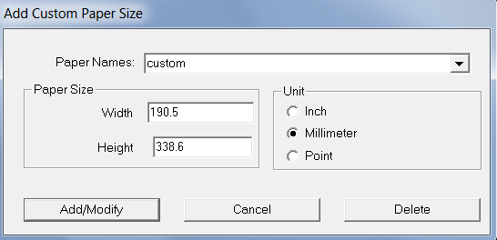
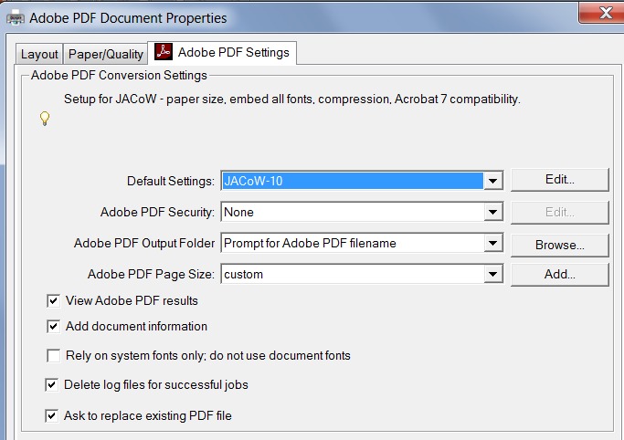
Processing slides: Custom format
◆ Give the new PDF page size a name, e.g. “custom”
and take over the size values for width and height
the other way round, which means width will be
height and height will be width…
◆ select “custom” for the page size to print the slides

Slide 42
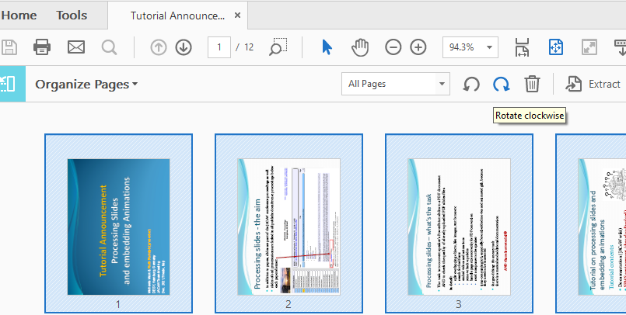
Convert PPT to PDF: Organize pages
After conversion to PDF, the page orientation needs to be corrected in Acrobat Pro!
◆ Click on Tools  Organize Pages  choose first All pages, then rotate clockwise
◆ save the PDF file, check the fonts and upload the slides to the database

Slide 43
Processing Slides:
File upload in the SPMS

Slide 44
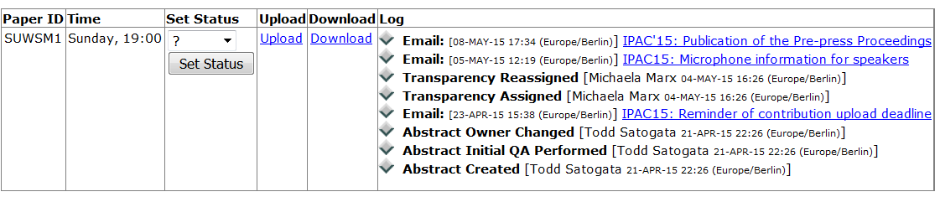
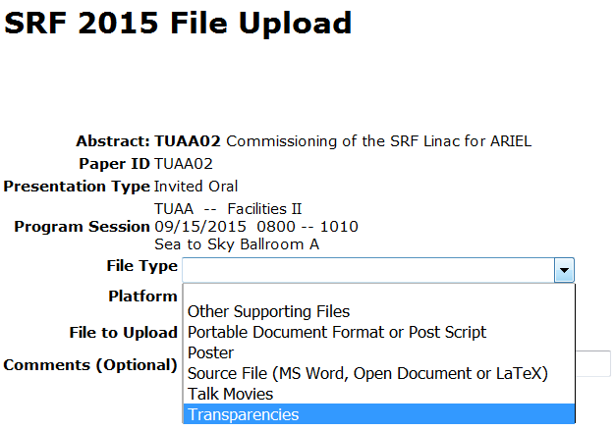
SPMS File upload: upload both, pdf and split slides
◆ save the new PPT file with split objects as Filename_TALK_split.pptx
◆ convert the PPT slides to PDF and save as Filename_TALK.pdf
◆ upload both files to the database
for uploading the split slides
select Other Supporting Files
as File Type
for uploading the PDF slides file
select Transparencies

Slide 45
Processing Slides: trouble-shooting
Missing characters

Slide 46
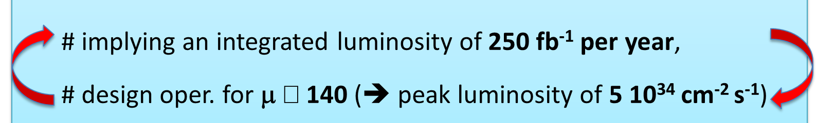

Example: PPT slide containing text, symbols and numbers
◆ when running PowerPoint, not embedded characters appear as a blank box which is a placeholder for a missing font - quite hard to detect!
◆ when you are not sure how to fix it, set status to RED and contact the author. The missing character in this example was a less than or equal sign!

Slide 47

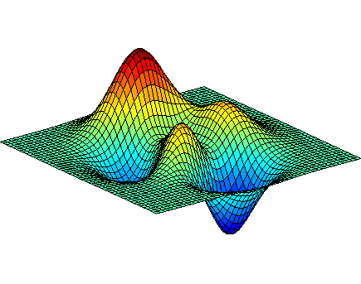
Processing Slides:
Embedding videos and
animated gifs in PDF files

Slide 48

Embedding videos and animations in PDF files
If the PowerPoint presentation contains videos or animated gifs …
◆ extract the media files
◆ transform video files (*.avi) to MPEG-4 (*.mp4)
◆ transform animated gifs from gif to AVI and from AVI to MPEG-4
◆ convert the PPT slides to PDF by printing to Adobe PDF
◆ after all these steps, open the PDF slides file and embed the videos and animations

Slide 49


Embedding videos and animations in PDF files
◆ Adobe Acrobat supports the MPEG-4 video format
◆ not supported video formats like avi or wmv files need to be converted
free converter tools are HandBrake and Virtual Dub
web page and user manual:
http://handbrake.fr/downloads.php
download Virtual Dub from http://sourceforge.net/projects/virtualdub/

Slide 50
Processing Slides:
How to extract media files like videos and animated gifs from PowerPoint

Slide 51
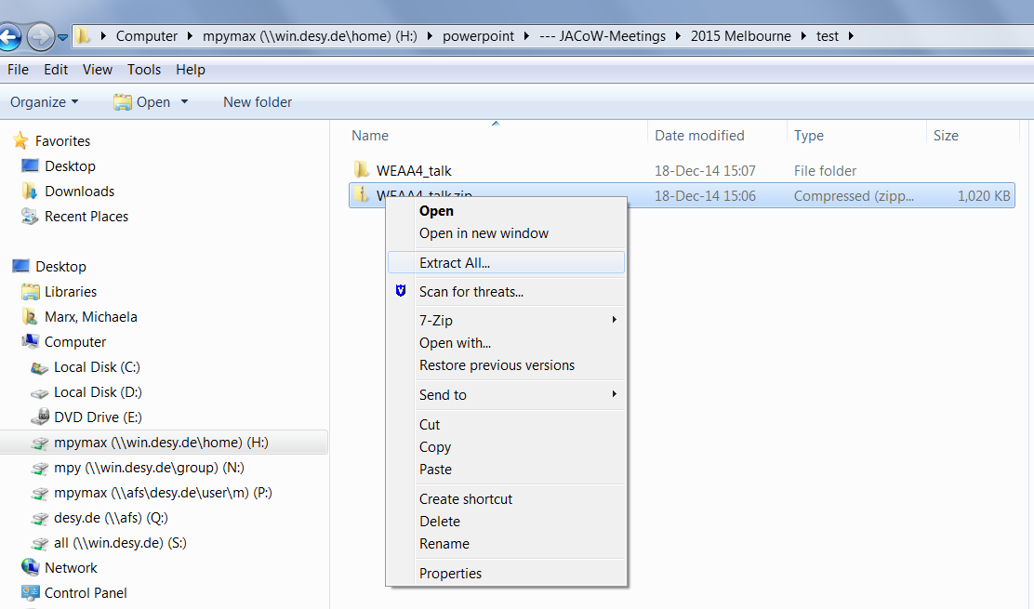
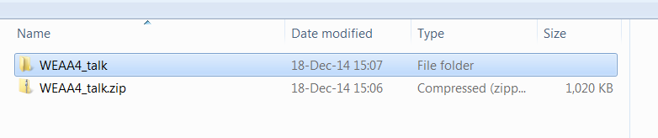
How to extract Media Files from PowerPoint Presentations
In PowerPoint go to File and click Save As. Make sure you choose the .pptx format
Go to the directory where you saved the presentation and rename the .pptx file to .zip
Use an archive extractor tool, e.g. 7-zip, WinZip or (easier) just do a
right-mouse-click to extract the .zip file contents
new folder

Slide 52
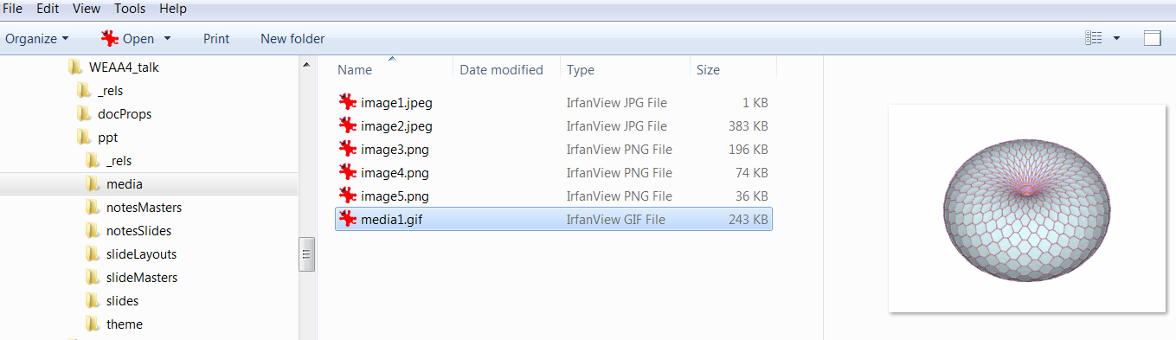
How to extract Media Files from PowerPoint Presentations
All images, videos and animated gifs are saved in a subfolder named media:
► these media files (.gif, .avi, .wmv or whatever) must be converted to mpeg-4 for
embedding in the PDF file
► Note: to reduce the size of extracted mpeg-4 files just use Handbrake and
convert from mpeg-4 to mpeg-4 ☺

Slide 53
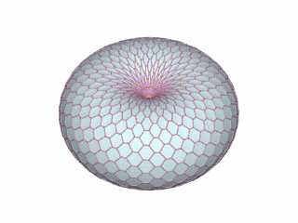


animated gifs
Example
Reference:
http://visualizingmath.tumblr.com/post/52743559077/a-torus-consists-of-a-central-axis-with-a-vortex
an animated gif is a type of gif image that can be animated by combining several images into a single file, like a flip-book
https://www.labbe.de/blog/Mond-Daumenkino

Slide 54



Transforming animated gifs (from gif to avi)
Animated gifs must be converted twice before they can be embedded in a
PDF document: from gif to AVI in a first step using Virtual Dub and in a
second step from AVI to MPEG-4 using Handbrake
◆ open the *.gif file in Virtual Dub and save it as type AVI ☺

Slide 55


Transforming animated gifs (from avi to mpeg-4)
► in a second step convert the AVI file to MPEG-4 by using Handbrake
open AVI file
give destination folder
hit Start
Done! Animated gif has been converted to MPEG-4

Slide 56

Processing slides:
How to deal with motion path animations

Slide 57


Motion Path Animations
◆ motion path animations are a very special visual gimmick in PowerPoint presentations
◆ for embedding in PDF files they must be recorded and saved as a video file
PowerPoint
can record
a slide show
◆ Separate the movie slide, start and record the slide show, click on File/Export and
select ‘Create a Video’. Hit the button ‘Create Video’ and save as type MPEG-4 video.

Slide 58
Processing Slides:
How to insert mpeg-4 videos
in PDF documents

Slide 59


How to insert videos in PDF documents
◆ in Acrobat Pro click on Tools and select Rich Media
◆ click on ‘Add Video’

Slide 60

How to insert videos in PDF documents
draw a place marker on the PDF slide or double-click the page to open the ‘Insert Video’ dialog box
rectangular place marker

Slide 61


How to insert videos in PDF documents
browse the file
Select Snap to content proportions to maintain
the movie’s original size
Show Advanced Options to configure the appearance and behavior of the video.

Slide 62



Modify videos in PDF documents
►to modify the position or the size of the video use the Select Object tool

Slide 63

Statistics
PPT vs PDF slides

Slide 64



Statistics: PPT vs PDF
midsize conference
small conference
IBIC’21 was a virtual conference.
Speakers uploaded their
presentations as prerecorded
mp4 files, additionally to their
transparencies.
big conference
► instruct the speakers about the
type of slides you want
► PDF is less effort

Slide 65
Questions?

Slide 66

Thank you for your attention
In case you need help please contact me ☺ michaela.marx@desy.de

