Slide 1


Single Pass High Efficiency THz FEL
Fisher¹, Y. Park¹, M. Lenz¹, A. Ody¹, R. Agustsson², T. Hodgetts², A. Murokh², and P. Musumeci¹
¹UCLA Department of Physics, Los Angeles, CA
²RadiaBeam Technologies, Santa Monica, CA
FEL 2022
Trieste, Italy
August 23, 2022

Slide 2
Outline
THz sources and FIR-FELs
Waveguide “zero-slippage” condition
Experiment design
Beam and THz measurements
Current work
Summary
Notes:
First we’re going to discuss the limitations of Far-infrared free electron lasers as a THz source that can provide high peak and average power.
Next we’ll talk about the waveguide zero-slippage condition used in our experiment to produce high gain.
We’ll go over the experiment design of the Pegasus beamline at UCLA as well as the undulator design.
Then we’ll present the results of the experiment and show how they agree with the theory of the zero-slippage condition.
Finally we’ll talk about our current work to target higher efficiencies at higher frequency and finish with a brief summary.

Slide 3
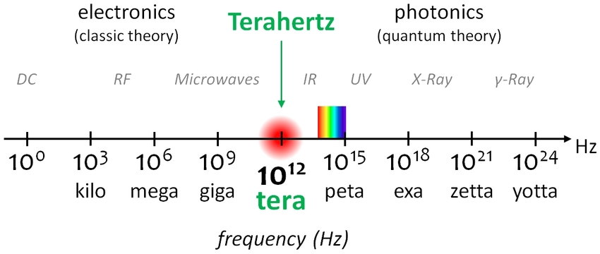
THz Gap
Wide variety of applications
  Time domain spectroscopy
  Material science
  Medical and security imaging
  Communications
Sources
  Gyrotrons
  Quantum cascade lasers
  Laser-based sources
  Accelerator-based sources
Notes:
The THz gap is a region of the electromagnetic spectrum where radiation sources are scare. It falls between the range of electronic sources at lower frequencies and photonic sources at higher frequencies.
But there is a wide variety of applications in science and industry and so a lot of effort has been put into creating sources that can fill the gap.

Slide 4
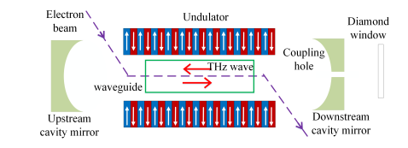
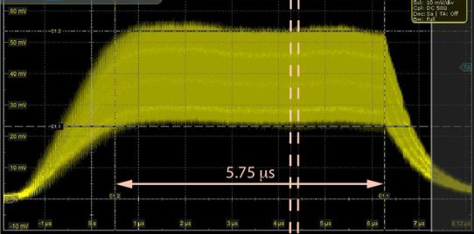
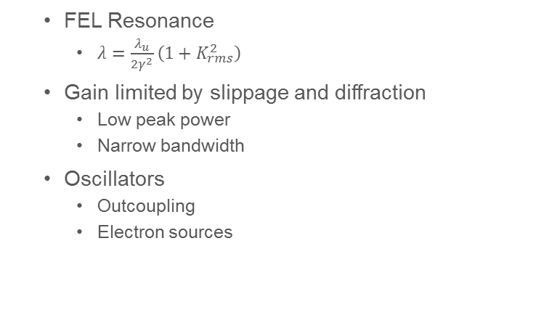
FIR-FELs
FEL Resonance
  $λ=\frac{λ_{u}}{2γ^{2}}\left(1+K_{rms}^{2}\right)$
Gain limited by slippage and diffraction
  Low peak power
  Narrow bandwidth
Oscillators
  Outcoupling
  Electron sources
Notes:
A free electron laser is based on the interaction between an electron beam and radiation in a sinusoidal magnetic field.
The resonant wavelength of the interaction is determined by the FEL resonance condition.
To over come these limitations, many THz facilities use an oscillator cavity configuration where gain can be built up over hundreds of micropulses within a macropulse.
But this comes with it own technical challenges including outcoupling and the availability of high-rep rate electron sources, and also still doesn’t convert a lot of the electron beam energy to radiation.
Instead of using an oscillator configuration, we can increase the single pass gain using two different FEL concepts.

Slide 5
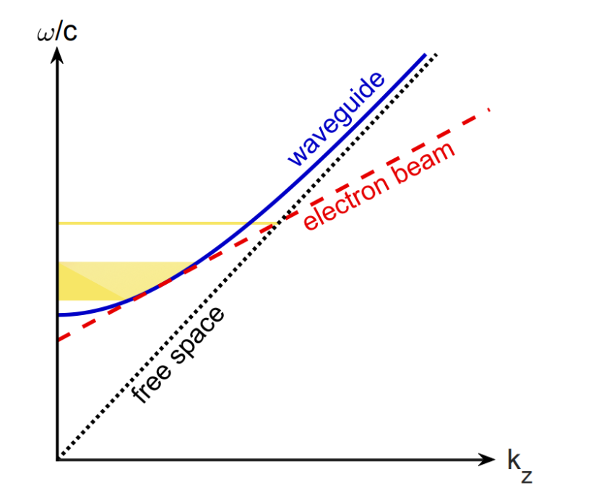




Waveguide “zero-slippage”
Match radiation group velocity to average e-beam velocity
No limitations on bunch length
  Increase beam current
  Using bunching factor to seed interaction
Constraints
Waveguide: $\frac{ω^{2}}{c^{2}}=k_{z}^{2}+k_{⊥}^{2}$
FEL phase resonance: $k_{z}+k_{u}=\frac{ω}{{cβ}_{z}}$
Zero-slippage: $cβ_{z}=c^{2}\frac{k_{z}}{ω}=v_{g}$
THz Pulse
Electrons

Slide 6

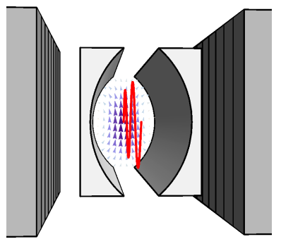
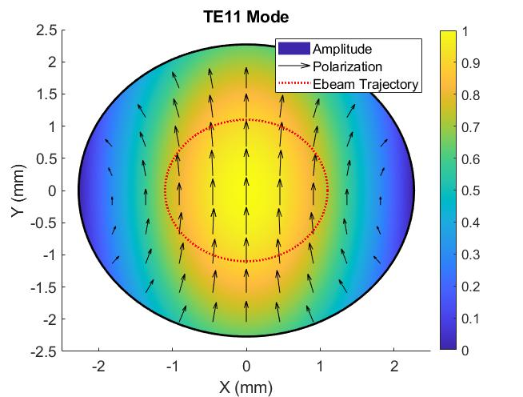
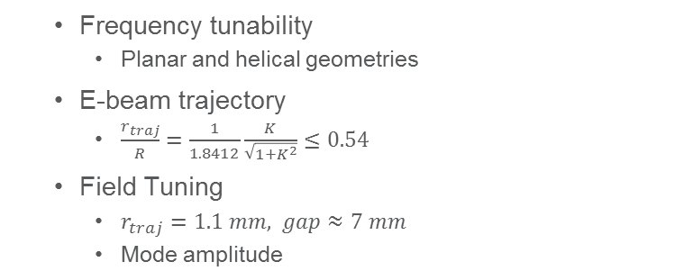
Consequences
Frequency tunability
  Planar and helical geometries
E-beam trajectory
  $\frac{r_{traj}}{R}=\frac{1}{1.8412}\frac{K}{\sqrt{1+K^{2}}}≤0.54$
Field Tuning
  $r_{traj}=1.1 mm, gap≈7 mm$
  Mode amplitude
Magnets
Curved-parallel-plate
Waveguide
Notes:
In order to tune the output frequency, you need to vary the waveguide parameters.

Slide 7
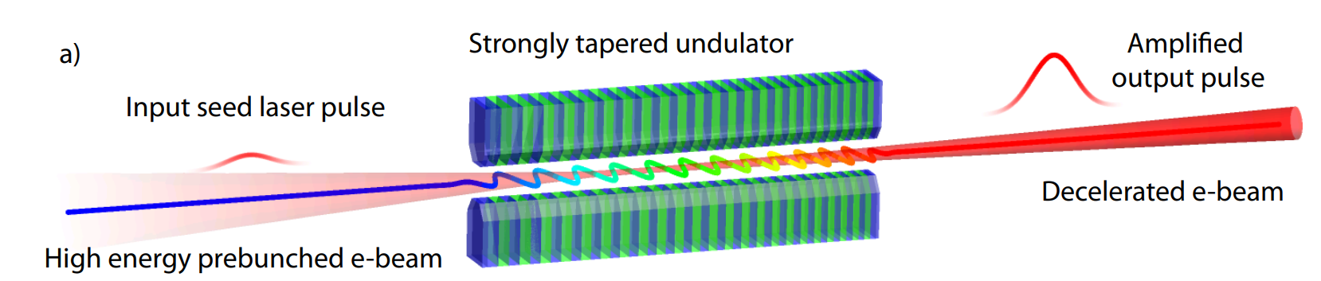
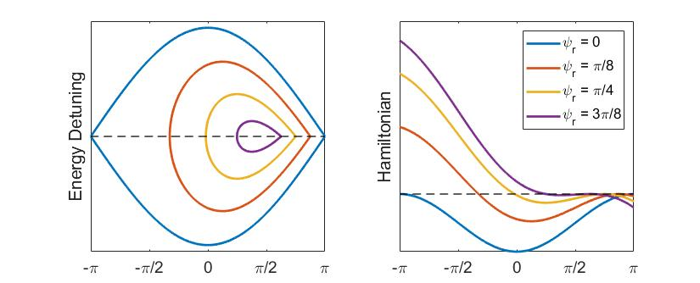
Tapering Enhanced Stimulated Superradiant Amplification (TESSA)
No seed laser
Compressed low energy e-beam
Taper undulator to maintain high gradient deceleration past saturation
  J Duris et al 2015 New J. Phys. 17 063036
  Cannot vary period and maintain zero-slippage
FASTGREENS experiment
  Target 10% efficiency at 515 nm
Notes:
TESSA: bunch with prebuncher and chicane
Tapering: Vary field or period, only field will maintain zero slippage
Cite other high efficiency experiments
The tradeoff for undulator designs is that as you increase the strength of the tapering, the area and potential well of the ponderomotive bucket decrease making it easier for electrons to become detrapped and fall out of resonance during the interaction.

Slide 8
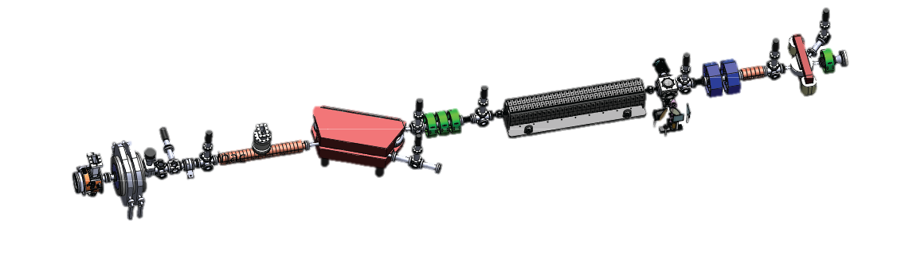
Pegasus Beamline (UCLA)
Spec. 2
Quad Doublet
Quad Triplet
Undulator
Spec. 3
e-beam
Photoinjector
Deflector
THz Diagnostics
Linac
Spec. 1
Nominal Parameters
Beam Charge | 200 pC
Norm. Emittance | 2 mm-mrad
Beam Energy | 5.5 MeV
Undulator Field | 0.73 T
Undulator Period | 3.2 cm
Waveguide Radius | 2.27 mm
Frequency | 160 GHz
Solenoid
Spec. 2 and Spec. 3 are high and low resolution, respectively
Undulator vacuum pipe doubles as waveguide
Advanced photocathodes, laser shaping
Notes:
Which did introduce some ohmic power losses but made the design much simpler.
The vacuum pipe had a radius of 2.27mm which allowed us to target a resonant frequency of 160GHz.
It should also be mentioned that our photoinjector is compatible with advanced photocathode designs, which can give the flexibility to use laser shaping while still creating high charge beams.
In fact we tested photocathodes from Cornell with this THz FEL setup.

Slide 9
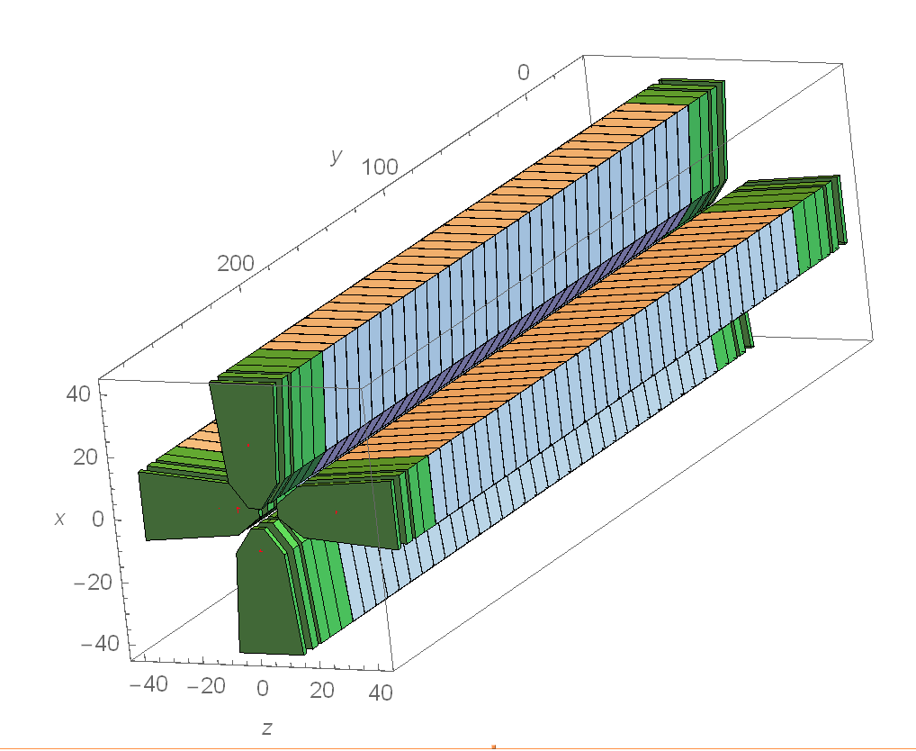
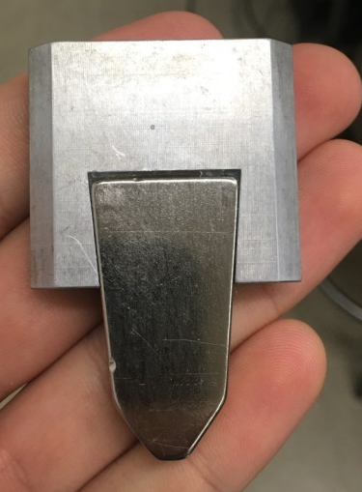
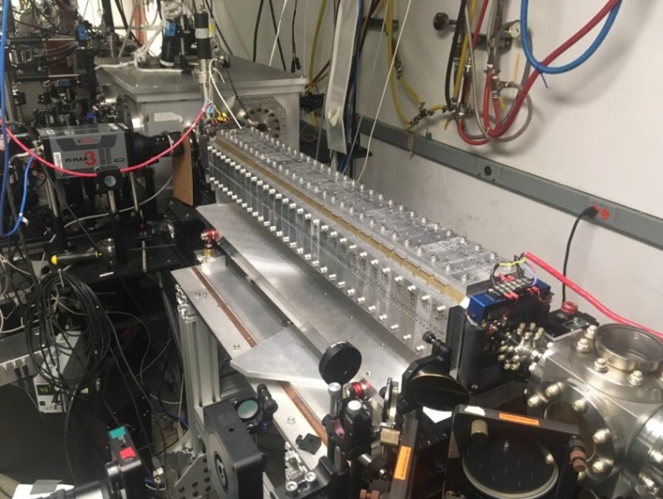
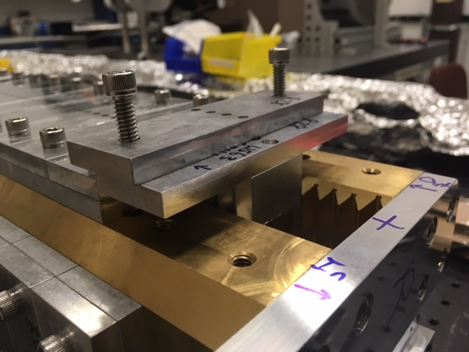
THESEUS Undulator design
Designed with RADIA
Commissioned for TESSA Experiment
Helical geometry composed of two permanent magnet Halbach arrays
28 full periods
Individual magnet tuning capability
Magnet
Holder
Tuning screws

Slide 10
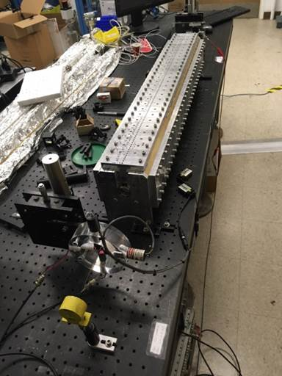
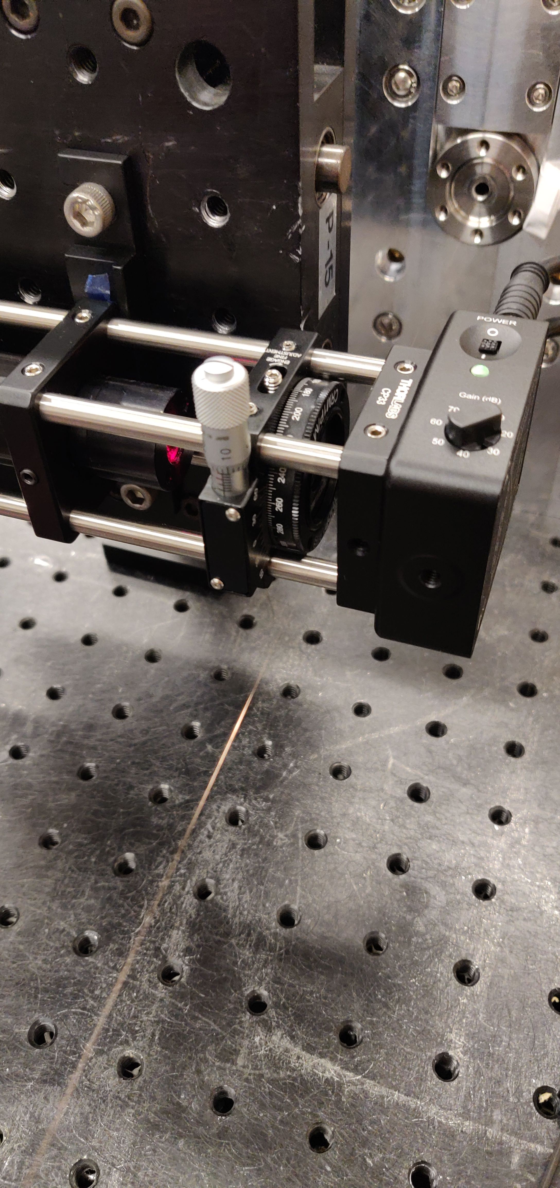
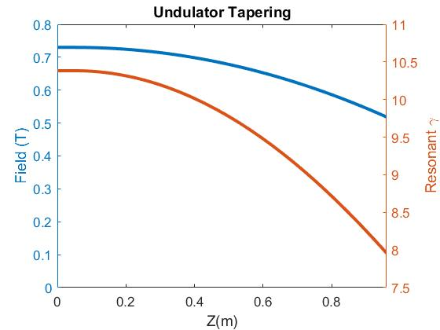
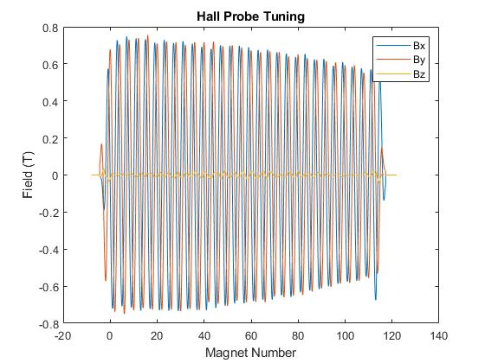
Undulator Tuning
Measured fields with 3-axis Hall Probe
Straightened trajectory in entrance/exit periods with pulsed-wire measurements
  Performed wire-scans off-axis
Recently improved pulsed-wire sensitivity with new design
  50um slit to block excess laser
  Si Amplified Detector
  Oil dampers
Redesigned laser-diode pair
Pulsed-wire setup - 2020
Notes:
Tuning the body of the undulator to minimize slippage between the electrons and radiation.

Slide 11
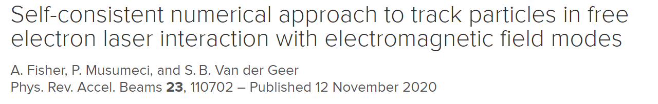
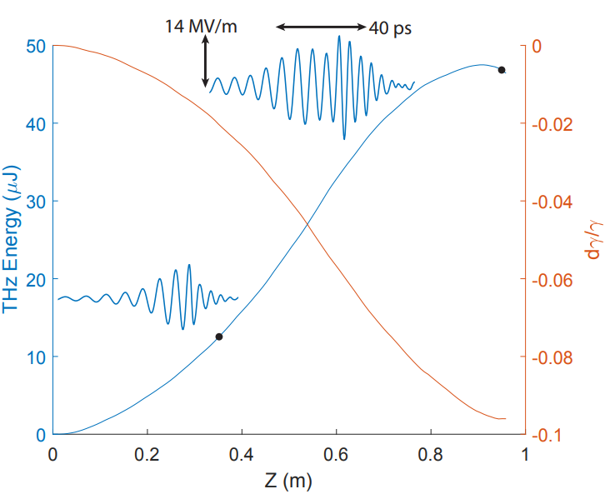
Tapering Design
FEL interaction simulated with GPTFEL, a custom element extension for GPT code.
  Frequency domain
  Simulates free space and waveguide modes
Utilize GPT functionality
  Space charge (Long. and transverse)
  CSR calculations
  Interface with photoinjector/beam transport
    Start-to-end with single code
Design Tapering
  No effect from higher order modes
  Decelerate resonant electrons >20%
GPTFEL
Notes:
Picture for GPTFEL?

Slide 12
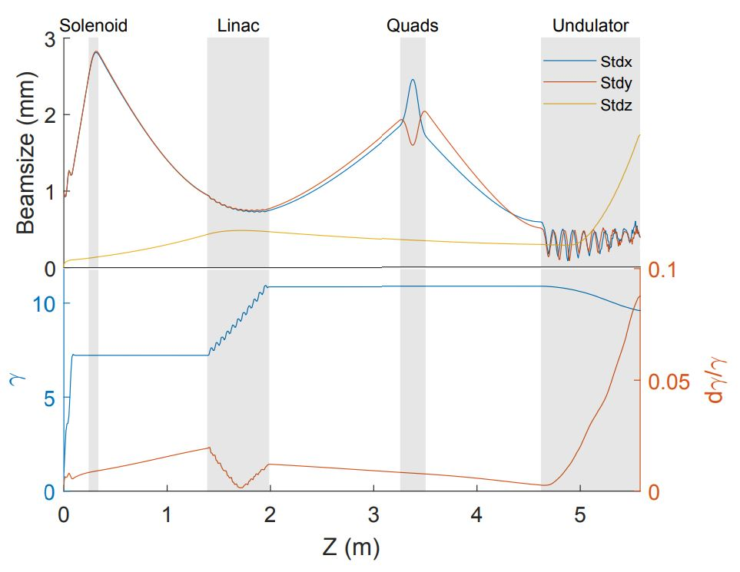
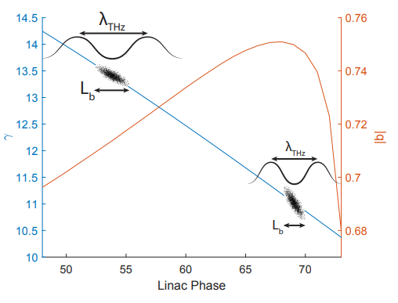
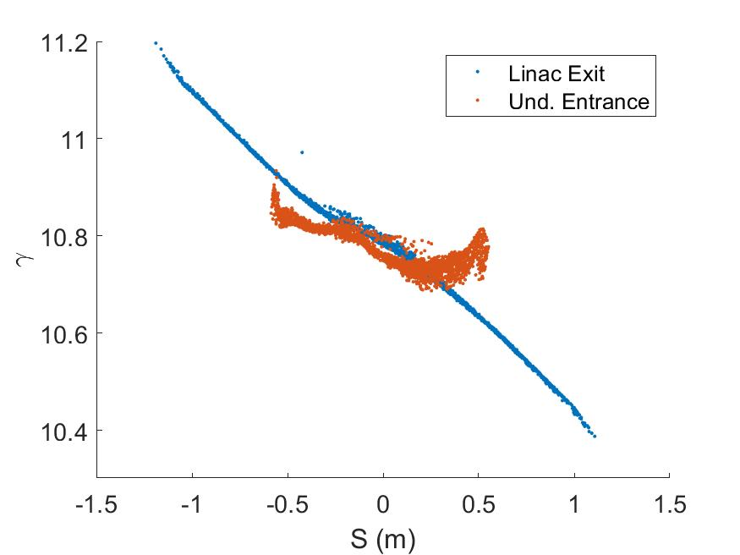
Seeding the Interaction
Accelerate and compress with linac
  Limited by maximum accelerating gradient
  Bunching factor varies little with energy
Match beam into undulator with quad triplet
  Strong space charge
  Minimum separation limited by beamline real-estate
Notes:
In reality, we maximized the linac gradient and only adjusted phase. Didn’t achieve full compression at higher energy, but it also happens that high energy produces longer wavelength radiation such that the bunching factor remains essentially constant.

Slide 13
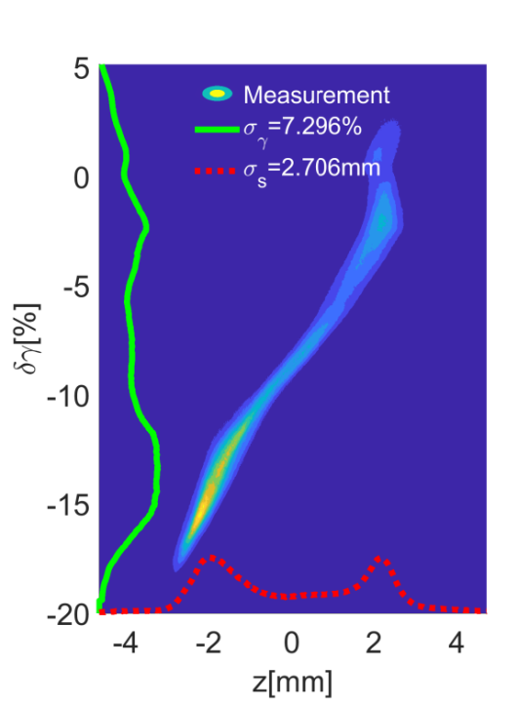
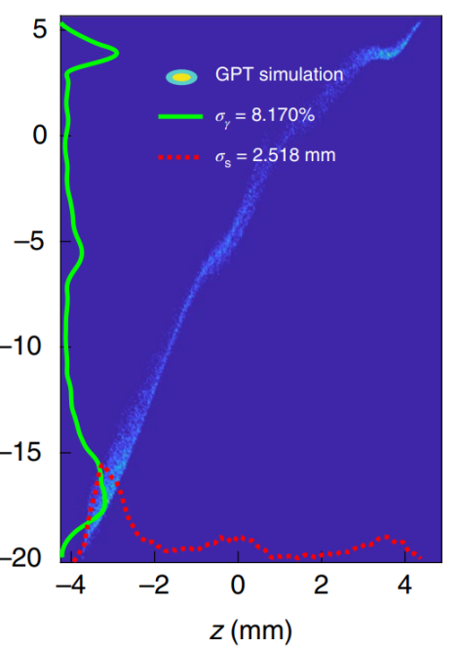
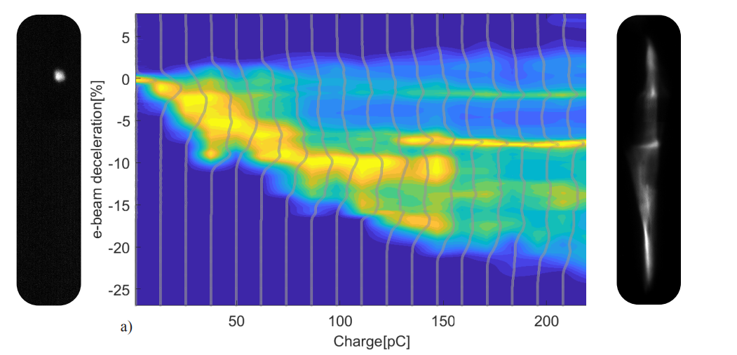
Spectrometer Measurements
Establish FEL interaction
  Charge scan showing maximum 10% efficiency
  Energy undulations
Streaking with deflector
  Single LPS ponderomotive bucket
Limited Charge Transmission
150 pC

Slide 14
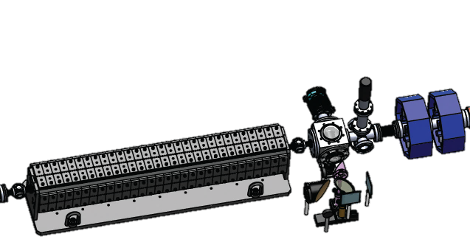
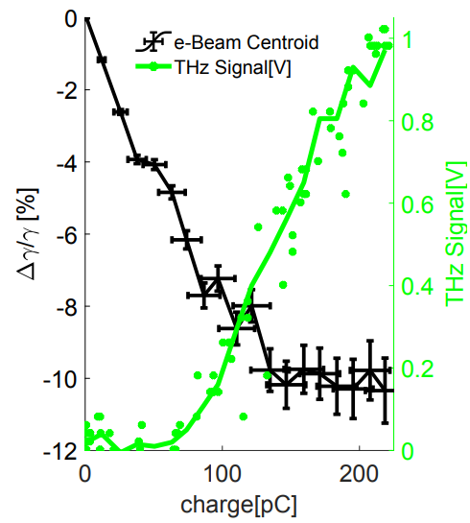
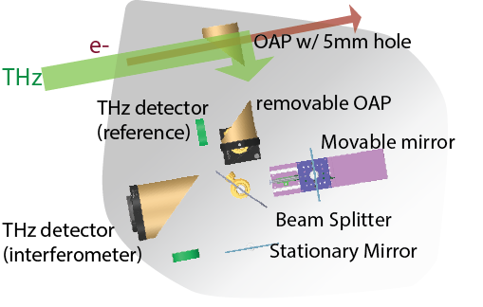
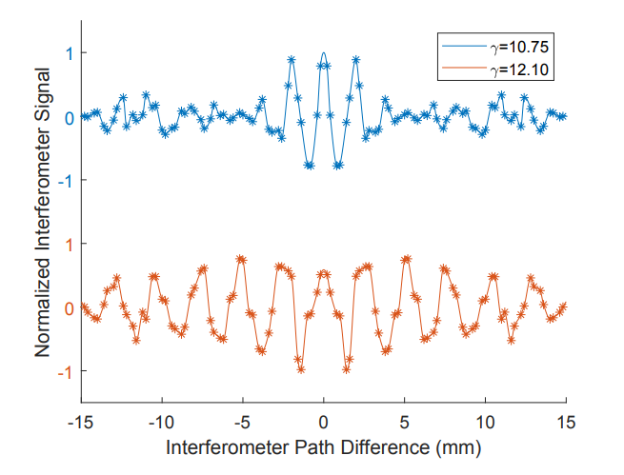
THz Diagnostics
Quad Doublet
THz Diagnostics
  Able to measure total energy and spectrum
Energy measurement consistent with spectrometer data
THz losses
Undulator
Notes:
Emphaside quadratic growth of THz signal, then linear growth when efficiency saturates.

Slide 15
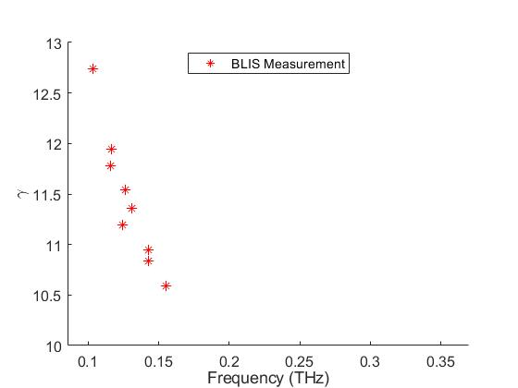
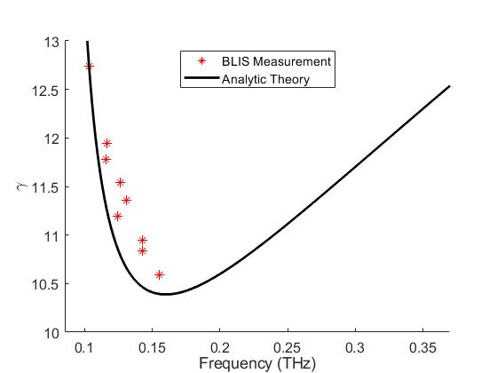
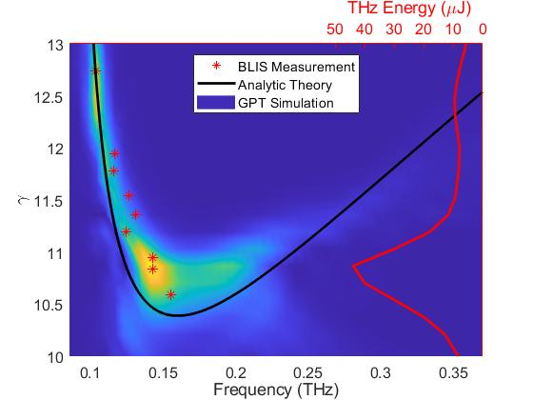
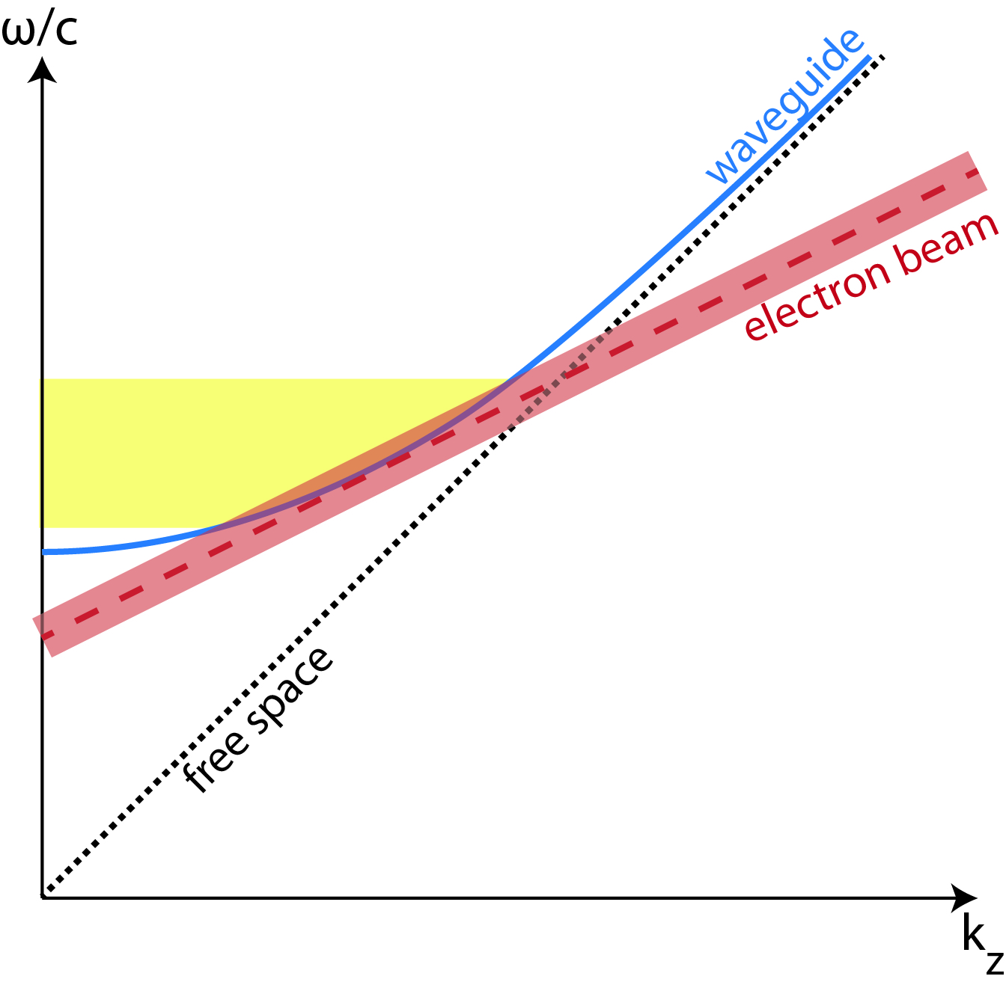
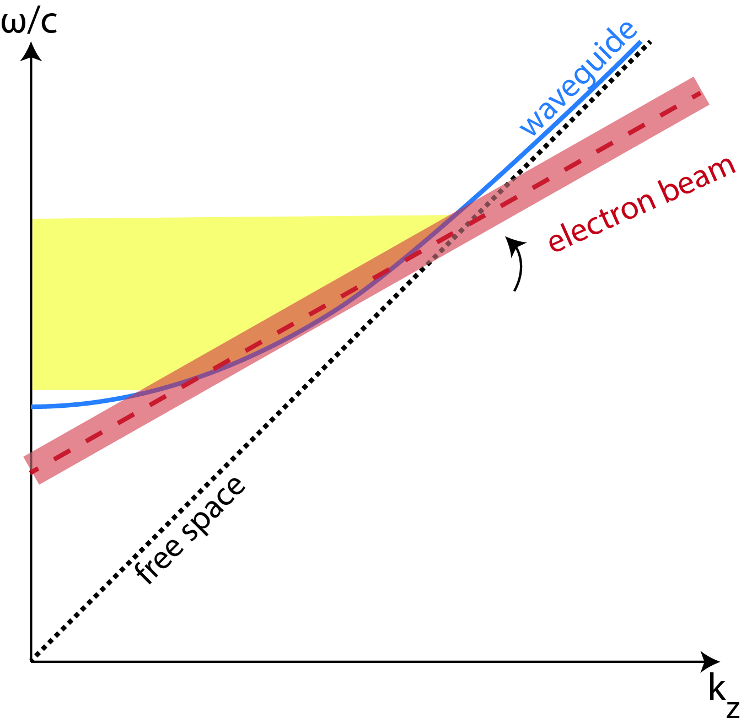
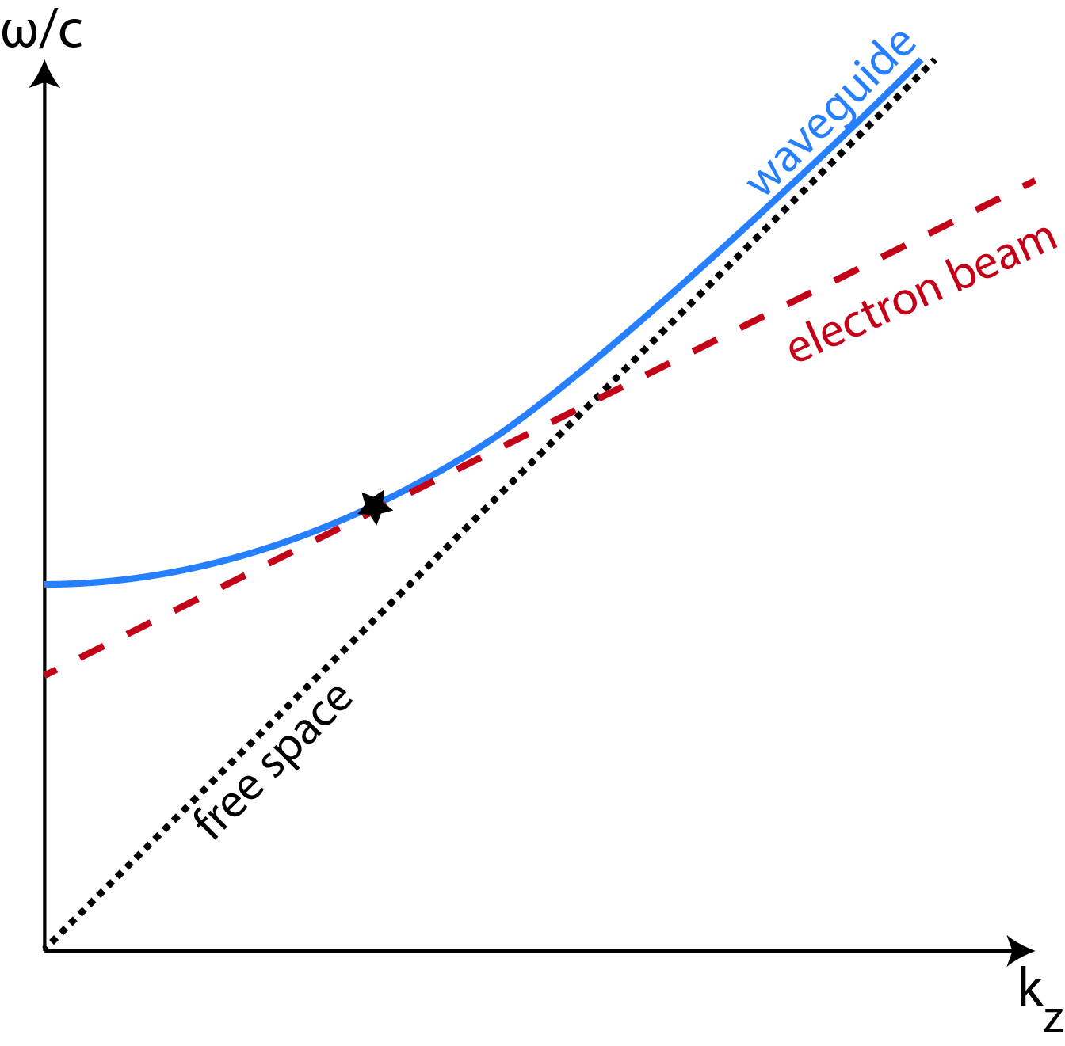
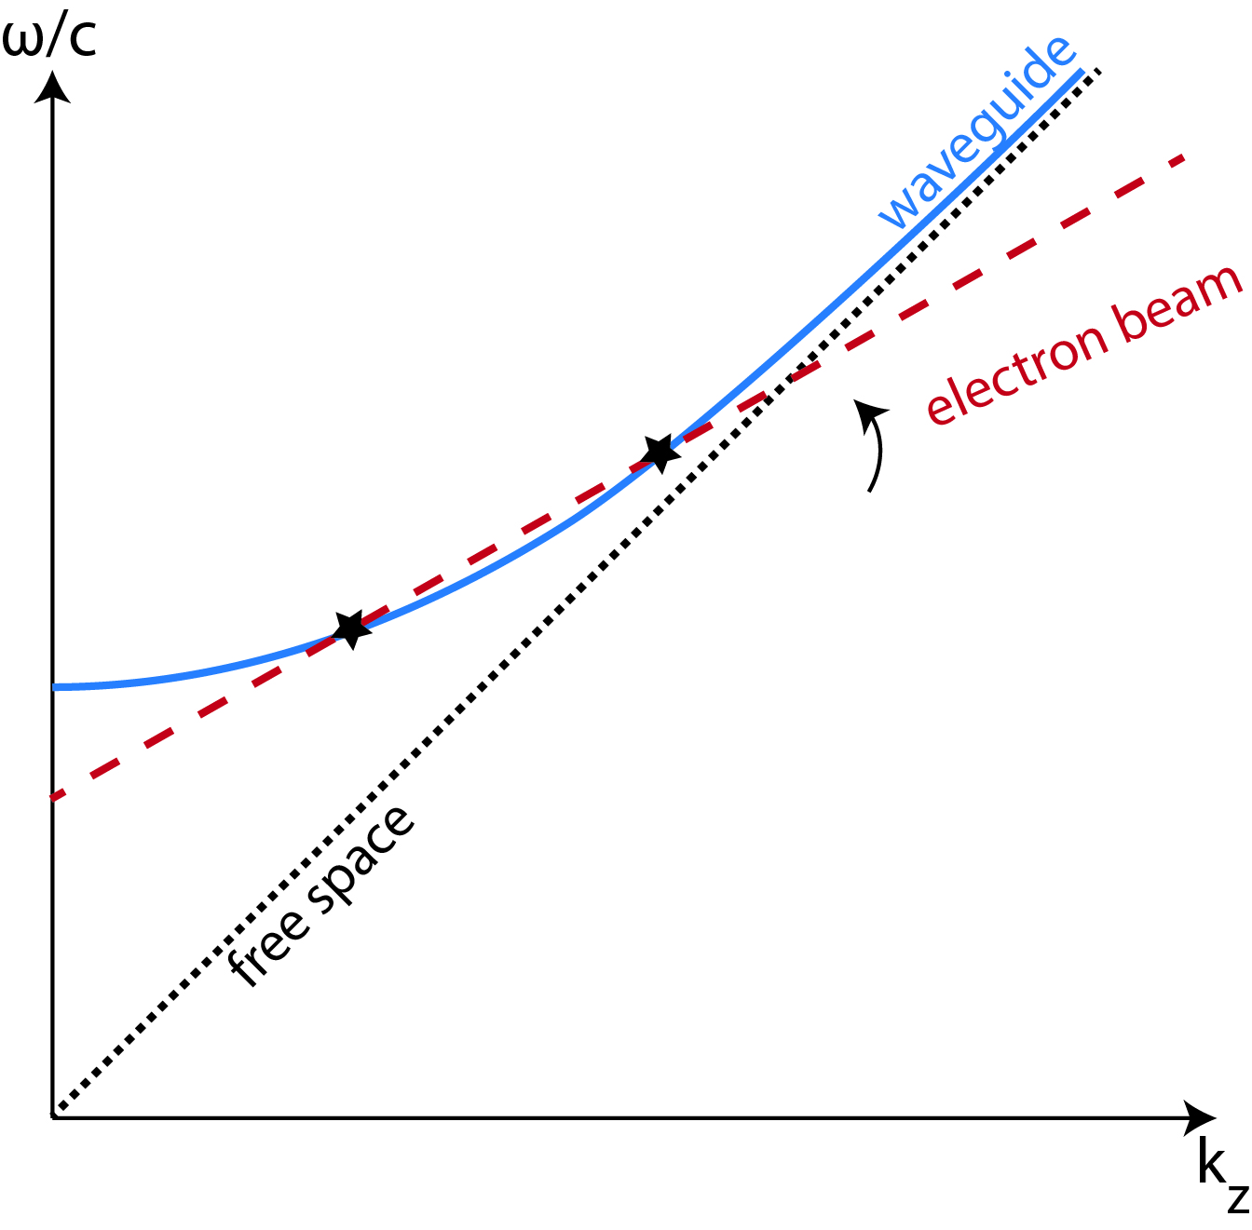
Energy Resonance
As energy increases, frequency decreases
Energy detuning
  Energy spread and transverse emittance
Notes:
Add black star

Slide 16
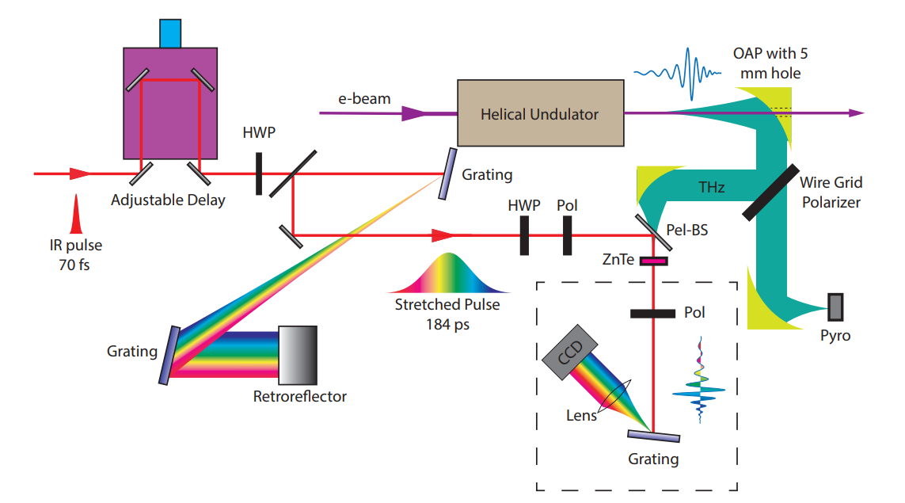
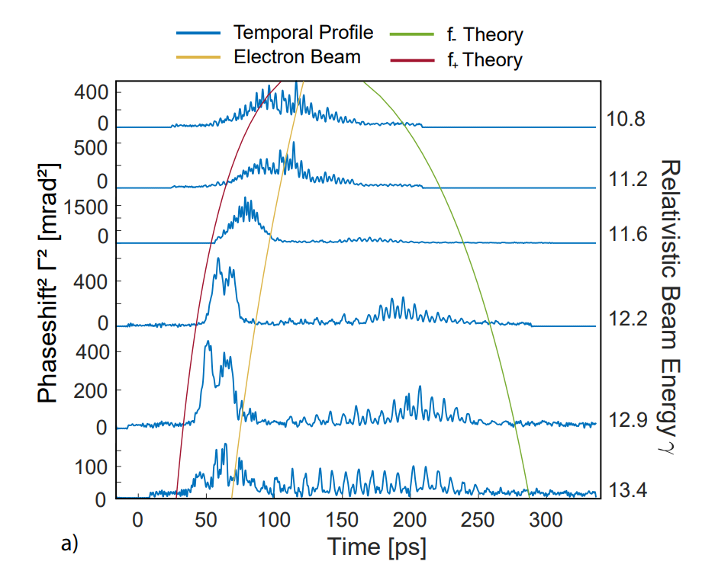
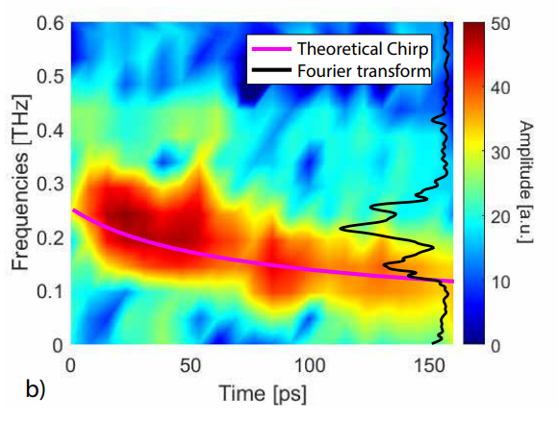
Electro-optic Sampling (EOS)
Utilizes crystal birefringence induced by an applied electric field.
Measure pulse in time domain
  Multi-shot with short IR pulse
  Single-shot with stretched IR pulse
Single-shot setup
Notes:
Talk about electron beam line and positive and negative group velocity lines.

Slide 17
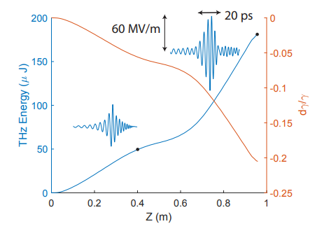
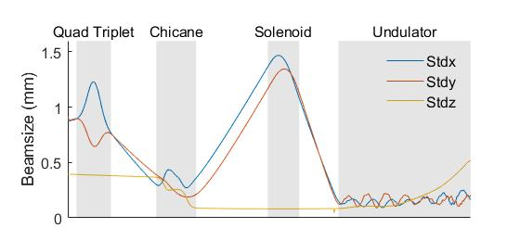
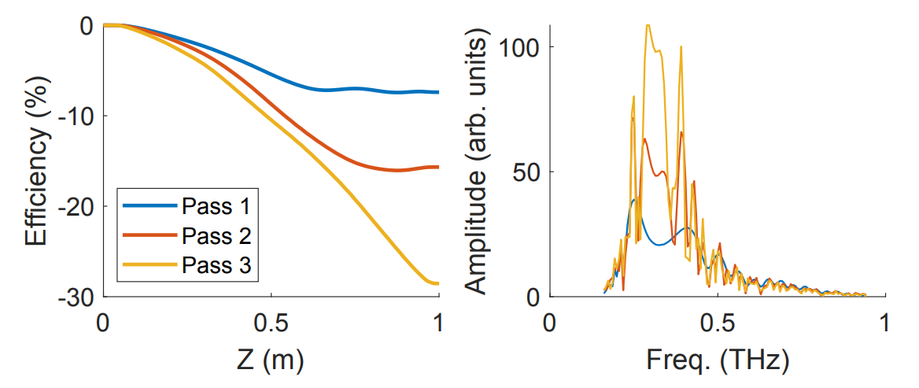
Looking forward…
Experiment to target 330 GHz
  E-beam trajectory closer to axis
Beam Transport
  PM Chicane for compression
  Added focusing solenoid
Recirculation
7cm
13cm
Notes:
Add looking forward: to titles to be clear

Slide 18

Summary
Achieve large efficiency with waveguide “zero-slippage” and strong undulator tapering
Start to end with single code
Experiment results show high (10%) efficiency as well as frequency branching and energy detuning
Follow up experiment at 330 GHz with improved beam transport and compression.
Cover Artwork: Youna Park

Slide 19


Thank you for your attention!
RadiaBeam Technologies
Work supported by NSF grant PHY-1734215 and DOE grants DE-SC0009914 and DE-SC0021190 and Julian Schwinger Foundation Fellowship.
Undulator construction funded by SBIR/STTR DE-SC0017102 and DE-SC0018559

