Slide 1
Joint Accelerator Conferences Website Chair’s report and report from the Board of Directors
13th JACoW Stakeholders’ Meeting
IPAC’26, Deauville, France
Adriana Rossi (CERN) as 2025-27 JACoW Chair

Slide 2
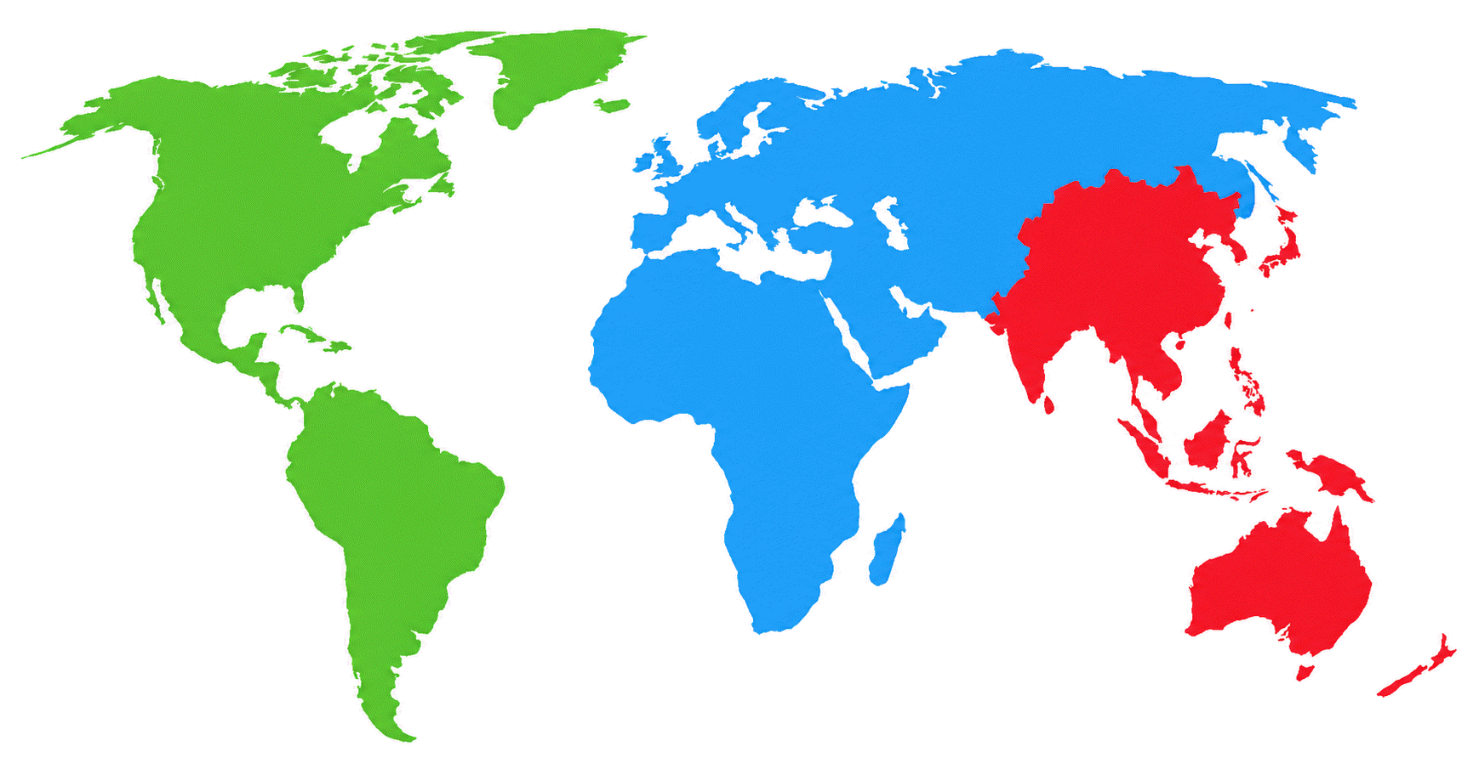
Outiline
JACoW goals and stakeholders
Short history and overview on how JACoW operates
Sustainability and needs for support
Conference representatives
Institute representatives
BoD
Team
Users

Slide 3
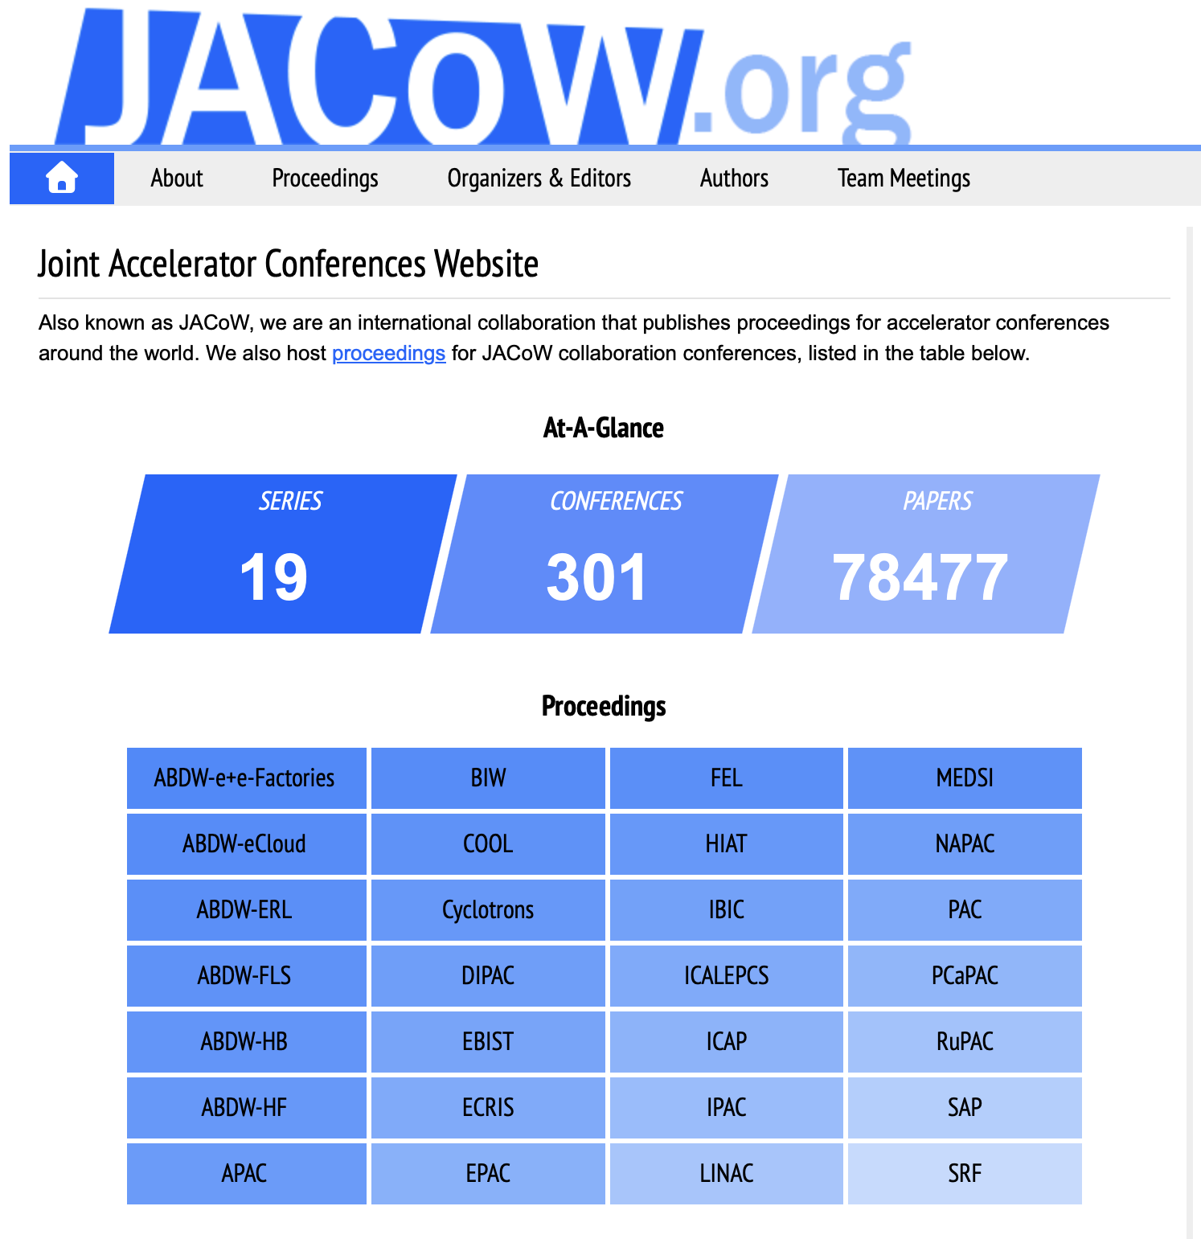
Goals
19 active conference series :
IPAC (unifying PAC, EPAC, APAC from 2010)
NA-PAC (formerly PAC)
IBIC (Unifying DIPAC and BIW from 2012)
COOL, CYCLOTRONS, EBIST, ECRIS, EIC, FEL, HIAT, ICAP, ICALEPCS, ICFA ABDW, LINAC, MEDSI, PCaPAC, RUPAC, SAP, SRF
Publish open and free access
Series ISSN
Proceedings ISBN
Article DOI
Archive (Opt. Char. Recognition PDF)
Central repository
Indico profiles unique per author
Maintains mailing lists for announcements & communication
Conference Tool
Delegate registration/communication
Papers handling
Please send feedback to content@jacow.org
or
https://mattermost.web.cern.ch/jacow/channels/wiki-website--md-docs
Scopus for LINAC and IBIC

Slide 4
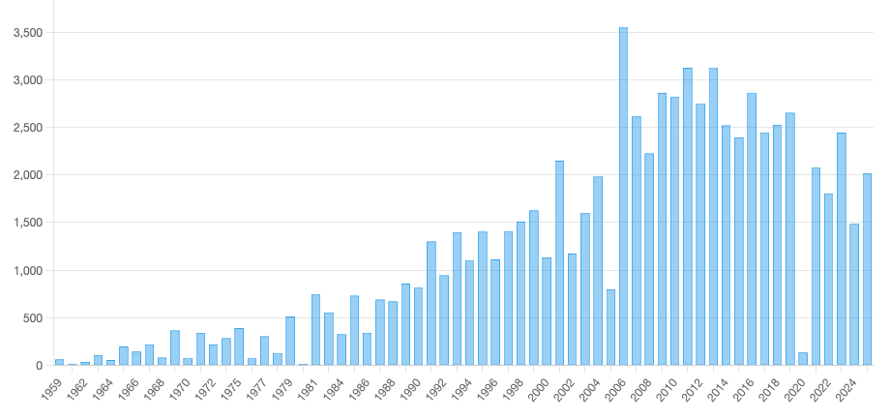
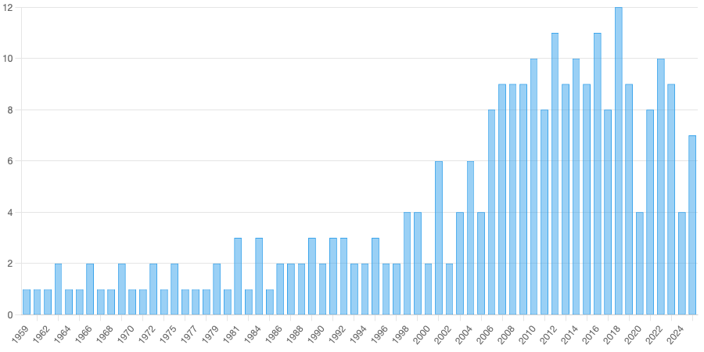
Volume of published paper
Average TOT number
~ 2400 papers/ y (50% IPAC)
Published by JACOW
9 JACoW conferences / y
IPAC
IPAC
 |  |  |  | Published
IPAC’23 | 17.3% | 61.2% | 21.5% | 1402
IPAC’24 | 42.2% | 36.7% | 21.0% | 1040
IPAC’25 | 12.2% | 43.7% | 44.1% | 868
average | 23.9% | 47.2% | 28.9% | 1103

Slide 5
Stakeholders
A collaboration (gentleman agreement . . .)
NOT a service
Conference representatives
Institute representatives
BoD
Team
Users
https://jacow.org/Organizers/HomePage
We have read and understood the JACoW boundary conditions relating to publication on jacow.org and in particular the attendance of the Scientific Secretary/Editor-in-Chief/IT Manager at the annual JACoW Team Meetings

Slide 6
Governing body
Tools
Year | Chair | Deputy chair | Coordinator
1998 | John Poole | - | Christine Petit-Jean-Genaz
1999 | John Poole | - | Christine Petit-Jean-Genaz
2000 | John Poole | - | Christine Petit-Jean-Genaz
2001 | John Poole | - | Christine Petit-Jean-Genaz
2002 | John Poole | - | Christine Petit-Jean-Genaz
2003 | John Poole | - | Christine Petit-Jean-Genaz
2004 | John Poole | - | Christine Petit-Jean-Genaz
2005 | John Poole | - | Christine Petit-Jean-Genaz
2006 | John Poole | - | Christine Petit-Jean-Genaz
2007 | Volker RW Schaa | Ivan Andrian | Christine Petit-Jean-Genaz
2008 | Volker RW Schaa | Ivan Andrian | Christine Petit-Jean-Genaz
2009 | Volker RW Schaa | - | Christine Petit-Jean-Genaz
2010 | Volker RW Schaa | Ivan Andrian | Christine Petit-Jean-Genaz
2011 | Volker RW Schaa | Ivan Andrian | Christine Petit-Jean-Genaz
2012 | Volker RW Schaa | Ivan Andrian | Christine Petit-Jean-Genaz
2013 | Volker RW Schaa | Ivan Andrian | Christine Petit-Jean-Genaz
2014 | Volker RW Schaa | Ivan Andrian | Christine Petit-Jean-Genaz
2015 | Ivan Andrian | Todd Satogata | Christine Petit-Jean-Genaz
2016 | Ivan Andrian | Todd Satogata | Christine Petit-Jean-Genaz
2017 | Ivan Andrian | Todd Satogata | Christine Petit-Jean-Genaz
2018 | Ivan Andrian | Todd Satogata | Christine Petit-Jean-Genaz
2019 | Ivan Andrian | Todd Satogata | Christine Petit-Jean-Genaz
2020 | Ivan Andrian | Dave Button | Christine Petit-Jean-Genaz
2021 | Ivan Andrian | Dave Button | Christine Petit-Jean-Genaz
2022 | Meghan McAteer | Dave Button | Jana Thomson
2023 | Meghan McAteer | Rob Apsimon | Jana Thomson
2024 | Meghan McAteer | Caitlin Hoffman | Jana Thomson
2025 | Adriana Rossi | Caitlin Hoffman | Jana Thomson
2026 | Adriana Rossi | Johan Olander | Jana Thomson
File Maker Pro
CERN
SPMS (FNAL) ready for deployment
supported
GSI
Adoption of Charter with BoD
max. role mandated = 6 y
separation IPAC/JACoW
ELETTRA
CERN
ELETTRA
Start of JACoW Indico development
JLAB
ELETTRA
(proposal 2019, implementation 2022) EPS-AG (IPAC23), APS-DPB (IPAC24), NSRRC (IPAC25)
CAT (ELETTRA)
ANSTO
HZB
JACoW Indico ready for deployment
Lancaster U
BNL
TRIUMF
JACoW Indico Central Repository
CERN
ESS

Slide 7
IT tools for conference&proceedings
BREVO mailing lists
General coordination
Templates
Webpage and documentation
JACoW Coordinator
JACoW Officer
JACoW Central Rep. Manager
JACoW Indico Manager
proceedings.jacow.org
JACoW Proc.
Webmaster
indico.jacow.org
JACoW proceedings website
JACoW indico
Repository
Conference Instance
Account Profiles&Affil.
Conf. Pref.
Profiles, Multiple Affiliations, Abstracts, Meta Data, Editing logs
JACoW Proceedings Webmaster
Editors & Conf. Admin
JACoW Conference Annoucemenets
JACoW JICT*
JACoW CAT*
* JICT JACoW-Indico Conference Toolbox (utilities) * CAT Conference Assembly Tool (proceeding production)
JACoW User
JACoW CAT Scan & Refs Search

Slide 8
What/who makes things work
JACoW Board of Directors (including Coordinator)
– mail to bod@jacow.org
WG1 Templates – mail to template@jacow.org
WG2 Documentation & Wiki – mail to content@jacow.org
WG3 IT tools
WG4 Central Repository Manager – mail to repository-manager@jacow.org
WG5 Proceeding publication – mail to proceedings@jacow.org
WG6 JACoW international collaboration – contact Chairperson chair@jacow.org
JACoW Board of Directors (including Coordinator)
– mail to bod@jacow.org
WG1 Templates – mail to template@jacow.org
WG2 Documentation & Wiki – mail to content@jacow.org
WG3 IT tools
WG4 Central Repository Manager – mail to repository-manager@jacow.org
WG5 Proceeding publication – mail to proceedings@jacow.org
WG6 JACoW international collaboration – contact Chairperson chair@jacow.org
CERN, ESS, TRIUMF (coordinator) GSI (retiree), LANL, SLRI, INFN
JACoW → LinkedIn
GSI (retiree), PSI (retiree), ……
ORNL, GSI, with ANSTO, ANL, …
ELETTRA, ESS, INFN, CERN, IJCLAB?
INFN, --China
ELETTRA
CERN, ESS, INFN
Connect with us on https://mattermost.web.cern.ch/jacow/

Slide 9
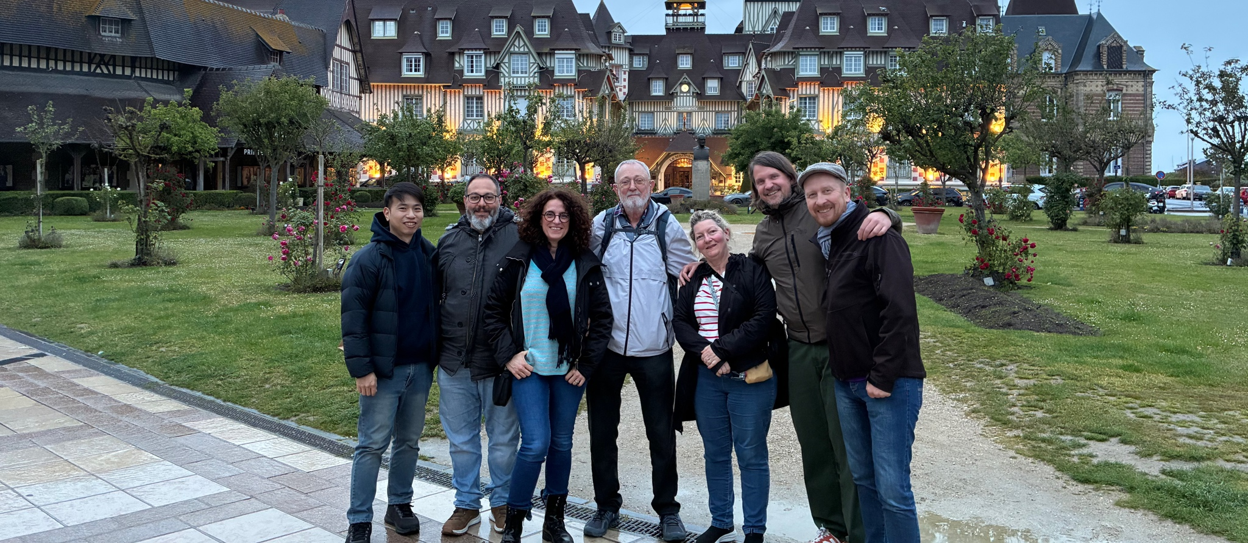
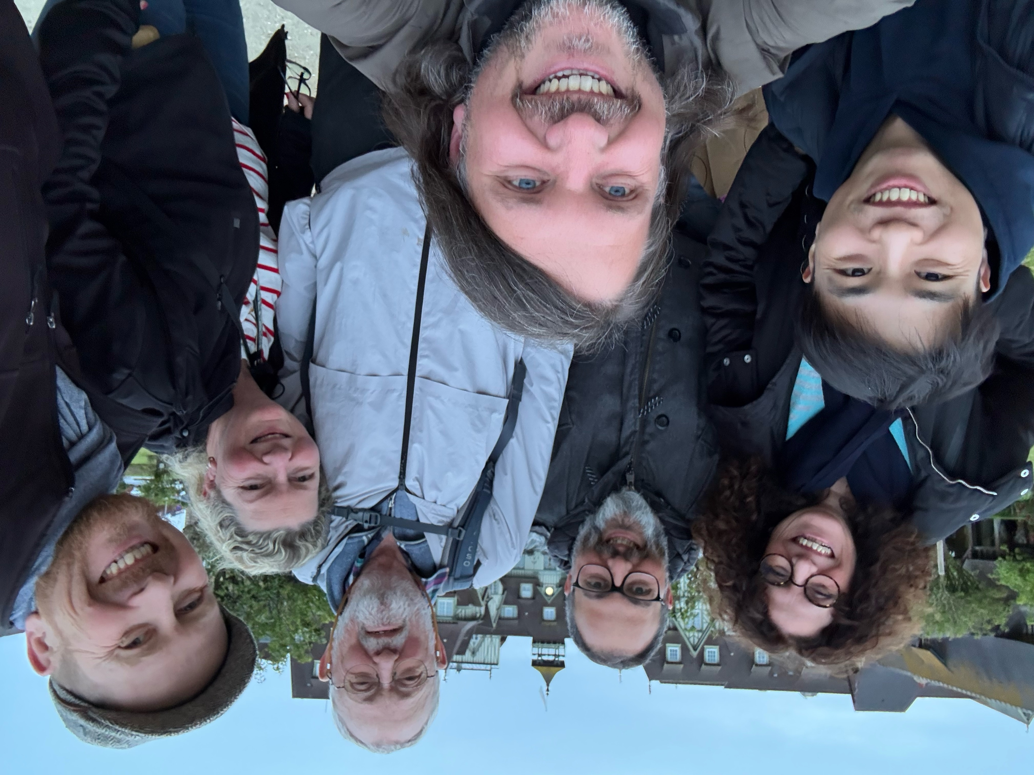
JACoW BoD @ IPAC’26
Monthly meetings with reports from WGs
notes available from www.jacow.org
Elections coming at JTM26 for Deputy chair and 3 members

Slide 10
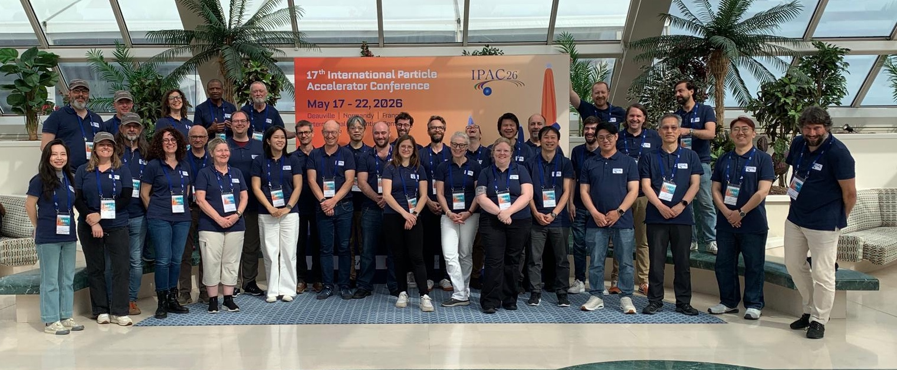
JACoW Editors @ IPAC’26

Slide 11
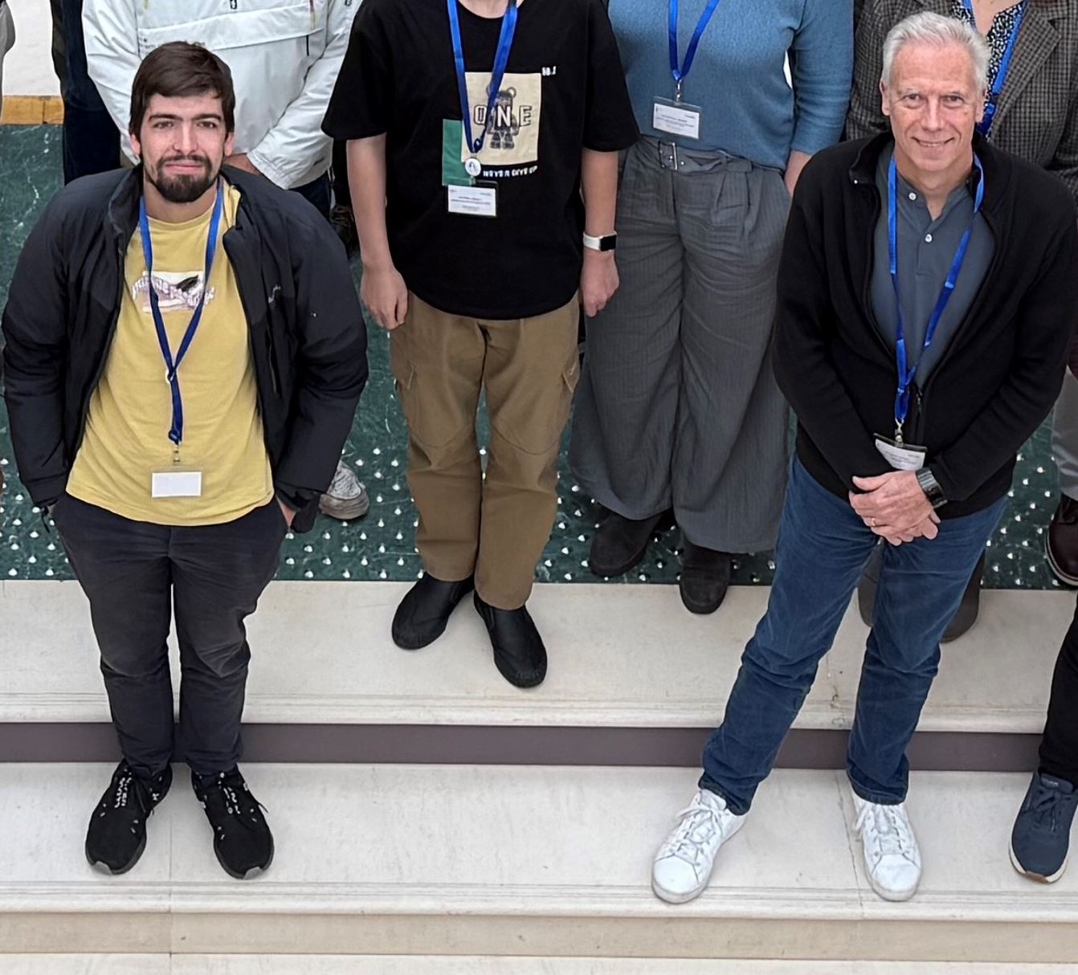
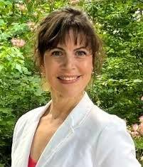

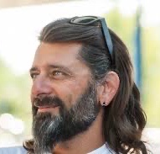
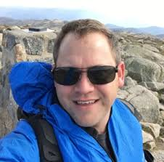
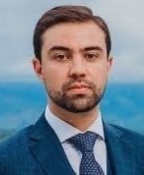
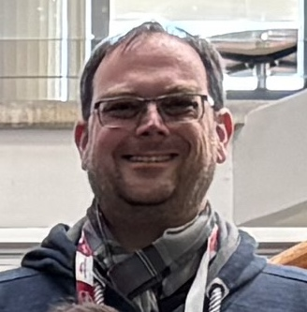
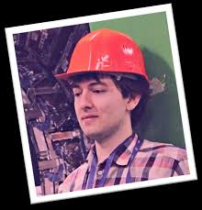
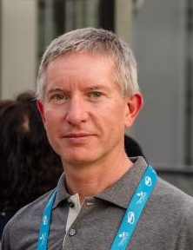

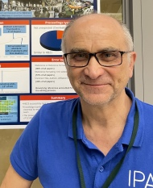
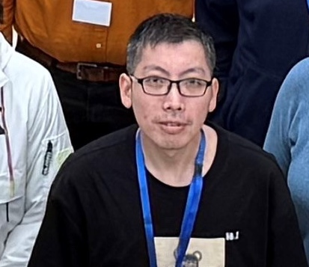
Active Team members
Duarte Galvão
Ronny
Billen
Josh Peters
Sumner Brown Gibbs
Ivan Andrian
David Button
Michel Succar
Raphael Müller
Adrian Monnich
Stefano Deiuri
Long term editors
Giulia Vinicola
Jan Chrin
Zhichu Chen (Ross)

Slide 12
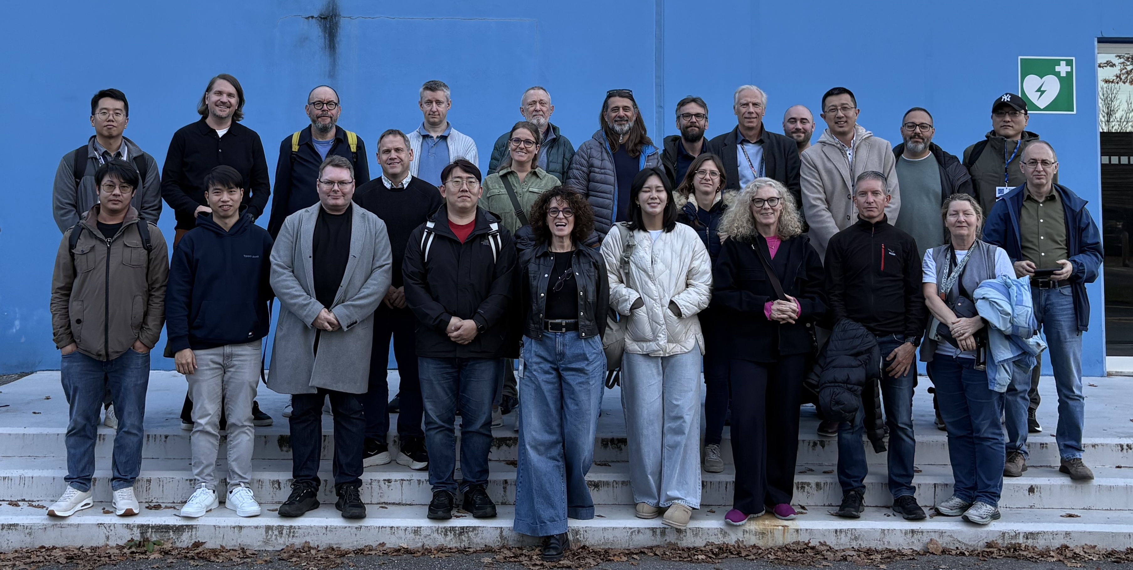
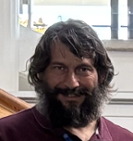

Report of activities 2025-26
Meetings:
8 BoD meetings in 2025+ 1 with Stakeholders @IPAC25
5 BoD meetings (1 per month) in 2026
Notes from meetings available from www.jacow.org
JACoW Team Meeting 2025 CERN – Nov. 3 – 7, 2025 https://indico.jacow.org/event/104/
Next JACoW Team Meeting, Tsukuba, Japan – Oct. 19 – 23, 2026 https://indico.jacow.org/event/119/

Slide 13
Report of activities 2025-26
In place
JACoW conference series organised via Indico (since 2023)
JACoW Central Repository entirely on Indico (March 2025)
JACoW Mailing from CERN to private (paying) provider Brevo (March 2025)
NEW
JACoW Proceedings publishing/long term archive moved to Elettra (Sept. 2025)
Proceedings Search Engine developed and released (Elettra)
www.jacow.org restyled (March 2026) with IT and conference guidance in https://docs.jacow.org
New templates issued for IPAC’26 (fixing bugs). New versions agreed to be issued only yearly and by Feb./Mar. before IPAC
Give feedback
To be improved

Slide 14
Report of activities 2025-26
Ongoing
Privacy Policy with CERN legal service (still ongoing . . .)
FAQ in the wiki (please fill free to contribute)
JACoW dynamic mailing lists (with Brevo) = users to set preferences for conference announcement
Light Peer Review module
Planned
Tool consolidation
Consolidation of templates
International collaboration
What to do with affiliations ? ROR ?
OrcID ?

Slide 15
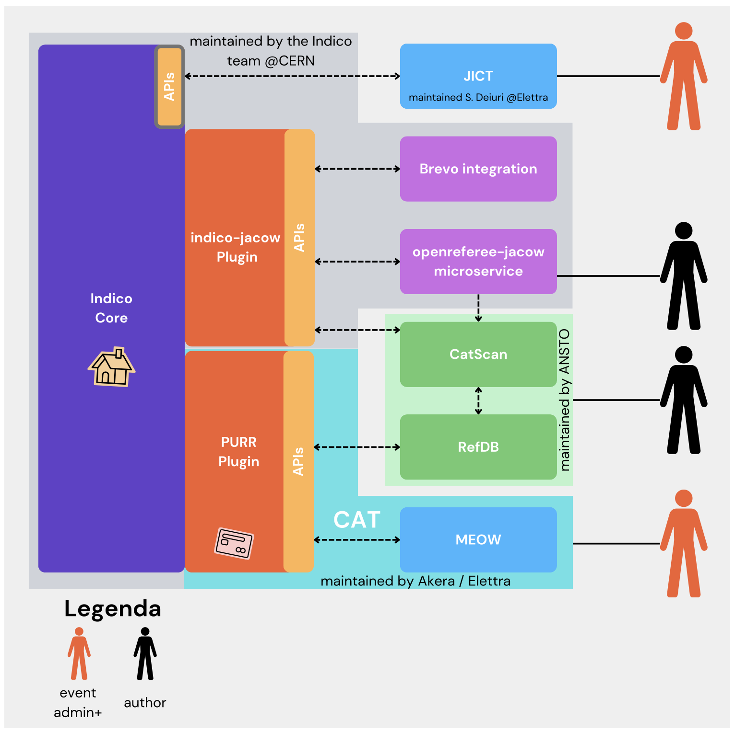
Associated costs
Working to reduce or suppress
CAT maintenance | – |  | 7500 €
Pitstop (PDF) licence | – |  | 1000 €
BREVO mailing server | – | 444 CAD ≅ | 285 €
ISBN | – | ≅ | 30 €
CatScan & RefSearch platform | – | 1200 USD ≅ | 1032 €
 |  | ≅ | 9850 €

Slide 16
Sustainability & Proposals
IPAC
Editor-in-Chief elected by OC + JACoW ?
Experience could be gained at smaller conferences ? Involve LINAC, IBIC, HB ?
Editor-in-Chief staying on with conference series for > 1 cycle ?
To ensure fixing problems or adding new features developed for the conference
Should happen also with smaller conferences
JACoW
Scientific Secretary of IPAC-N staying with JACoW as coordinator for IPAC-(N+1) ?
Proposed at IPAC-CC, return at JTM’26 in Japan (hosted by IPAC’28)
Editors, EiC, IT, … from conferences contributing in JACoW in any capacity
Indico support at CERN

Slide 18
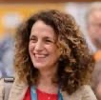
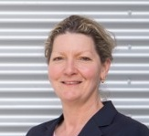
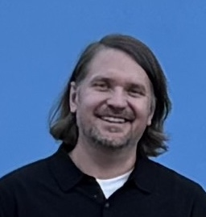
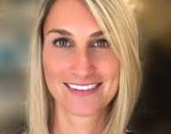

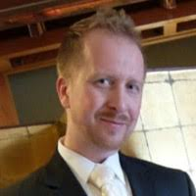
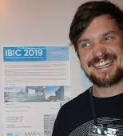
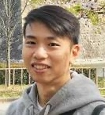
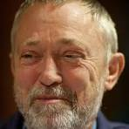
JACoW Board of Directors
Chair
Coordinator
DChair resigned
2025
DChair Interim
until JTM26
Adriana Rossi CERN
Jana Thomson TRIUMF
(2025-27)
Caitlin Hoffman, BNL
Johan Olander ESS
3 members coming to end of mandate in 2025 will remain until next elections at JTM26
Maurizio Montis INFN
Petr Anisimov LANL
Volker Schaa GSI
Johan Olander ESS
Thakonwat Chanwattana
SLRI
2 new co-opted members (2026-29)

