Slide 1
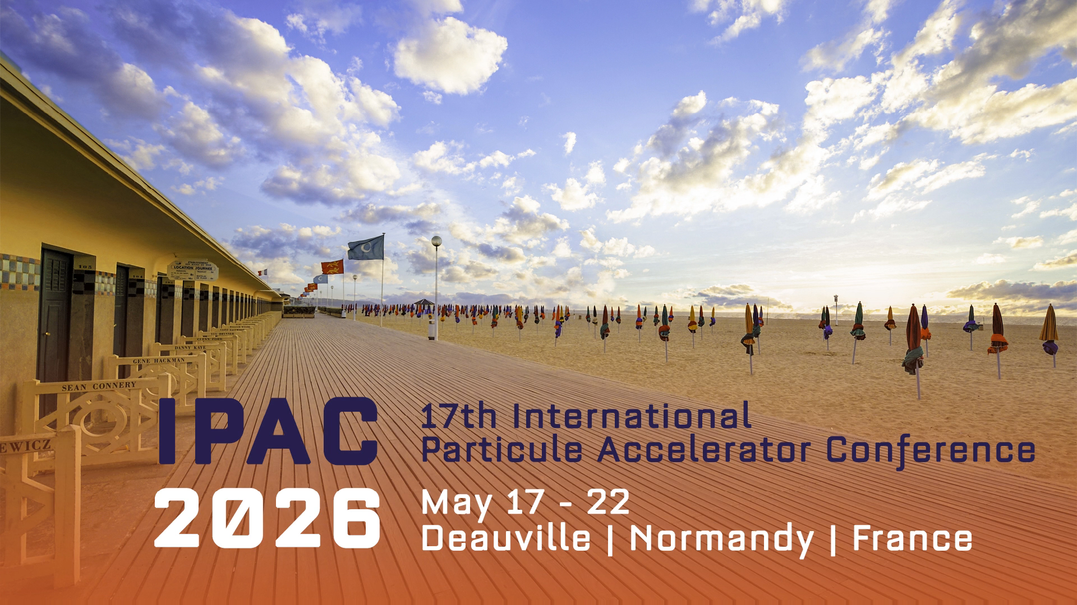
Duties for Students with Grants
Pierre Korysko (University of Oxford)
Julien Michaud (IJCLab)

Slide 2
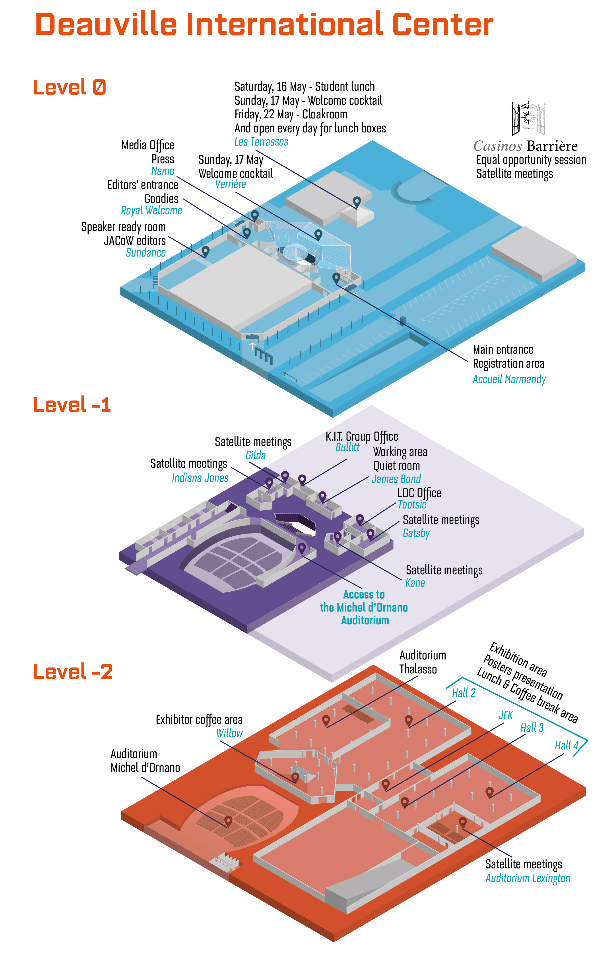
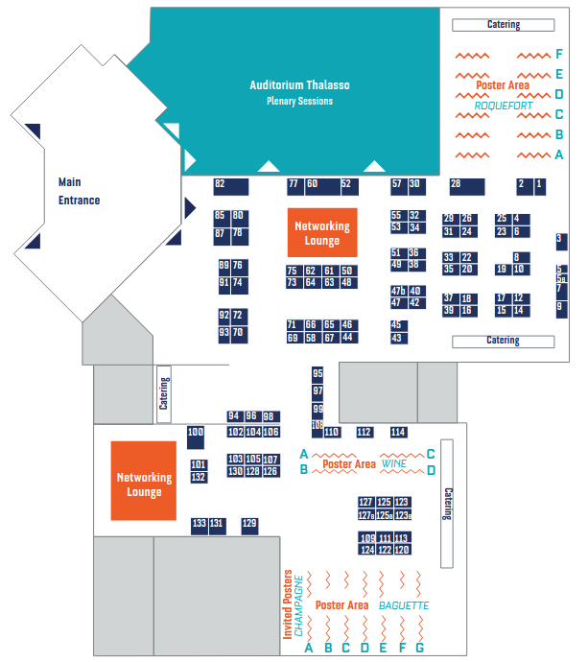

Map of the CID | Deauville Convention Center
Thalasso
Auditorium
Industrial Parters Area
Student Poster Area
Sunday 14:00 – 18:00
P. Korysko, J. Michaud – Student Tutorials

Slide 3
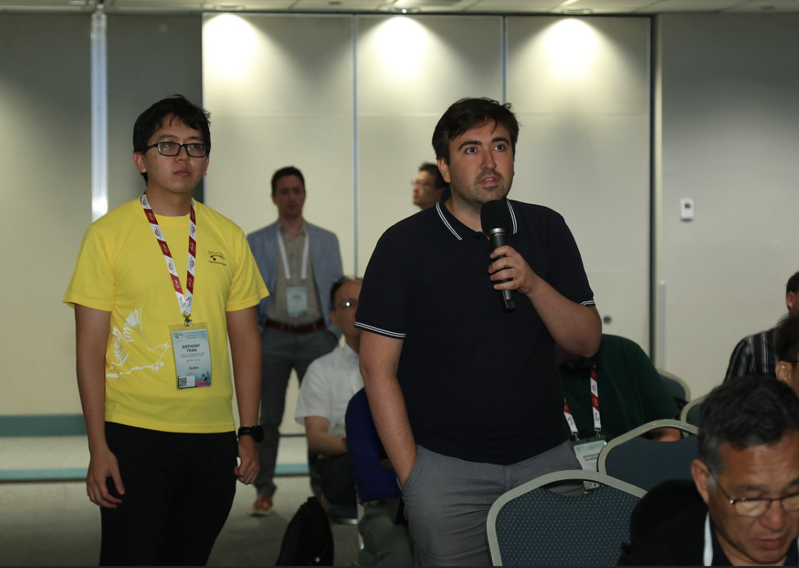
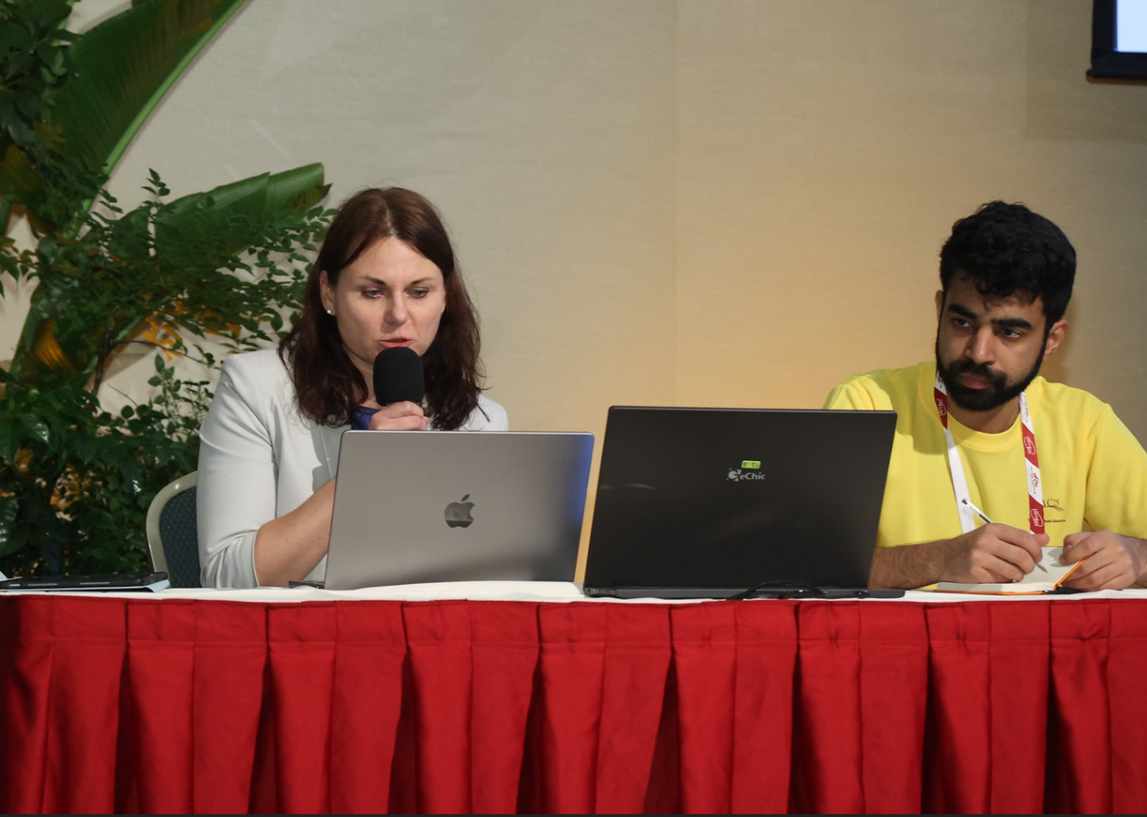
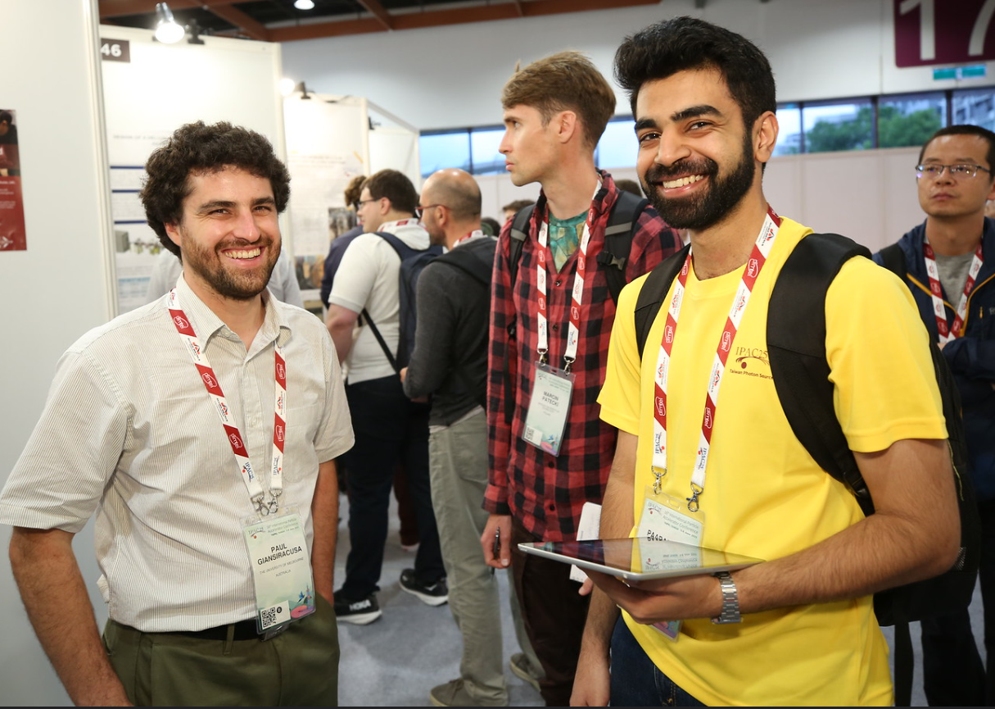
Your Duties
Microphone:
Assist with audience questions by bringing microphones to participants during the session.
Chairperson Assistants:
Assist the session chair in managing the session, including introducing speakers, monitoring the schedule, and helping keep presentations on time.
Poster Police & Installation:
Verify that poster presenters are present during the poster session and actively presenting their work at their assigned posters.
P. Korysko, J. Michaud – Student Duties

Slide 4
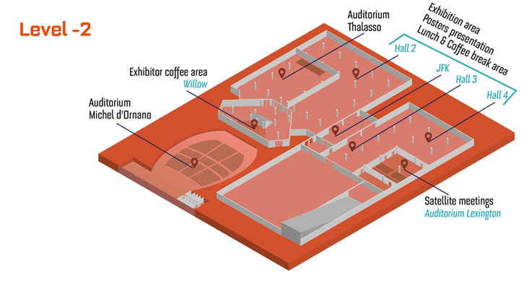
Microphone Duty
What: Assist with audience questions by bringing microphones to participants.
Where: Auditorium Thalasso (parallel sessions).
or Auditorium Michel d’Ornano (plenary sessions).
When: Each listed student will be assigned to one or two sessions.
Please arrive 15 minutes before the start of your assigned session
and gather in front of the stage.
Wear your IPAC’26 student T-shirt.
During the Session:
  Keep your microphone muted while the speaker is presenting.
  During the Q&A session, bring the microphone to audience members wishing to ask questions.
  Ensure microphones are evenly distributed throughout the room.
Thalasso
Michel d’Ornano
P. Korysko, J. Michaud – Student Duties

Slide 5
Chairperson Assistants
What: Assist the session chair in managing the session, including introducing speakers, monitoring the schedule, and helping keep presentations on time.
Where: On stage in Auditorium Thalasso (parallel sessions).
or on stage in Auditorium Michel d’Ornano (plenaries).
When: Each listed student will be assigned to one session.
Please arrive 15 minutes before the start of your assigned session to meet the chairperson.
You may also be asked to assist speakers with presentation equipment, such as the slide clicker or laser pointer.
Thalasso
Michel d’Ornano
P. Korysko, J. Michaud – Student Duties

Slide 6
Poster Installation
What: Help with the installation of the poster setup.
When: 09:00 – 10:00
Where: at one or two of the 3 poster areas: Roquefort, Wine and Baguette to set up the poster numbers.
Roquefort
Wine
Baguette
P. Korysko, J. Michaud – Student Duties

Slide 7
Poster Installation
What: Help with the installation of the poster setup.
When: 09:00 – 10:00
Where: at one or two of the 3 poster areas: Roquefort, Wine and Baguette to set up the poster numbers.
Roquefort
Wine
Baguette
P. Korysko, J. Michaud – Student Duties

Slide 8
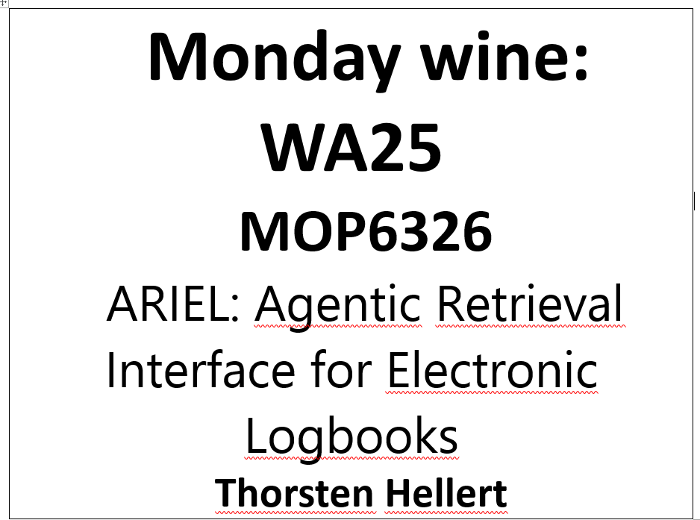
Poster Installation
P. Korysko, J. Michaud – Student Duties

Slide 9
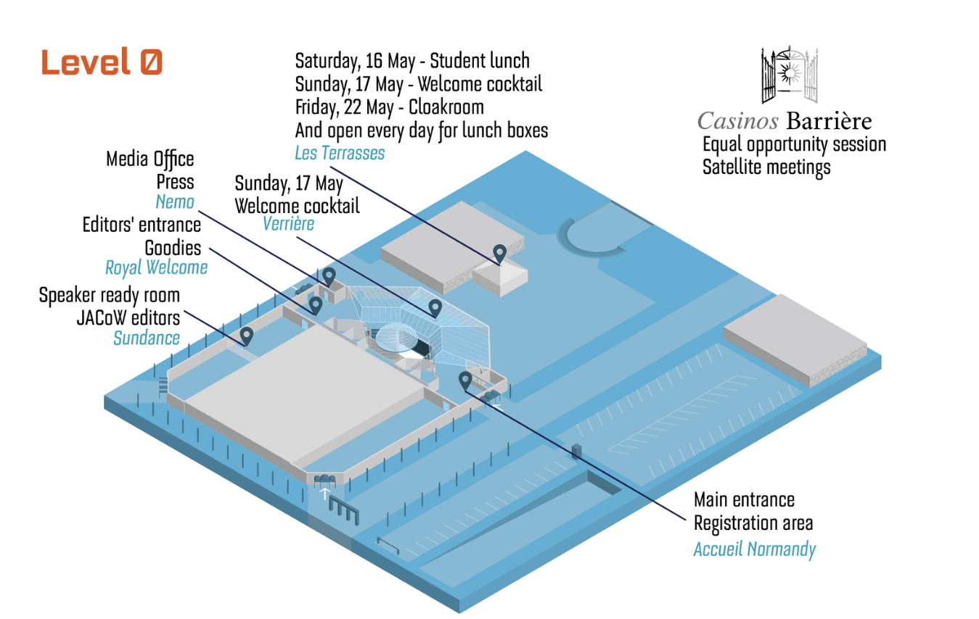
Poster Police
What: Verify that poster presenters are present during the poster session and actively presenting their work at their assigned posters.
Where: Meet at the poster police desk (Nemo room) to collect your tablet then go to one of the 3 poster areas: Roquefort, Wine and Baguette
When: 16:00 – 18:00.
Verify that poster titles and presenter information are correct.
Presenters may occasionally step away from their poster or be responsible for multiple posters, so please check back periodically if they are temporarily absent.
Nemo
P. Korysko, J. Michaud – Student Duties

Slide 10
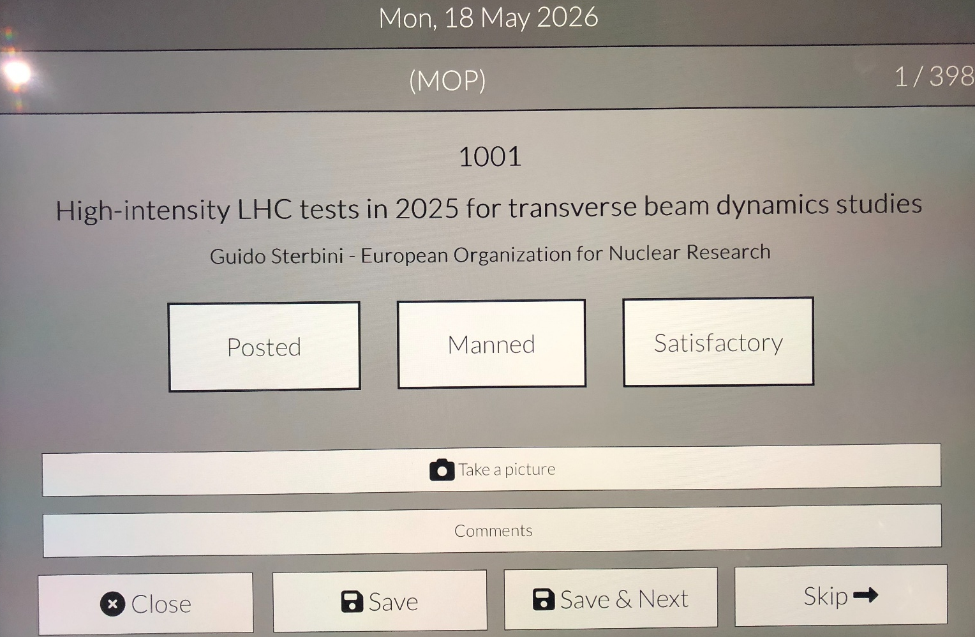
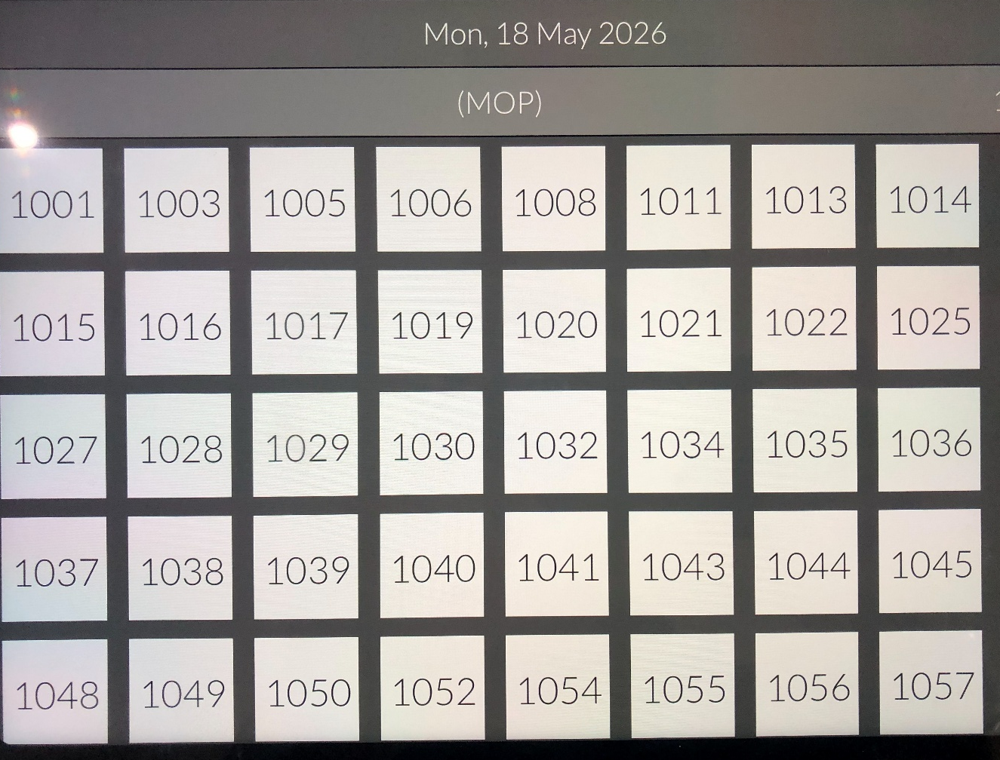
Poster Police Application
P. Korysko, J. Michaud – Student Duties

Slide 11
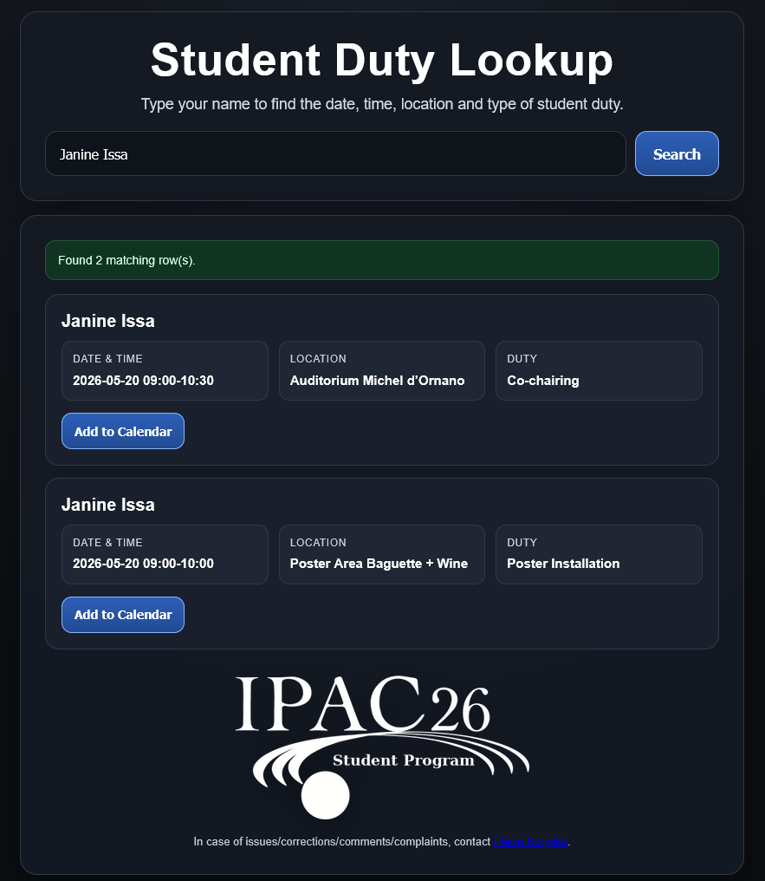
What do I do and when?
You can find your assigned duties on the following page:
https://pkorysko.web.cern.ch./IPAC26/Student_Duties.html
Type you name in the research bar.
Find your duties, time and location.
Add the duty to your calendar.
Contact me by email in case of issues:
pierre.korysko at cern.ch
P. Korysko, J. Michaud – Student Duties

Slide 12
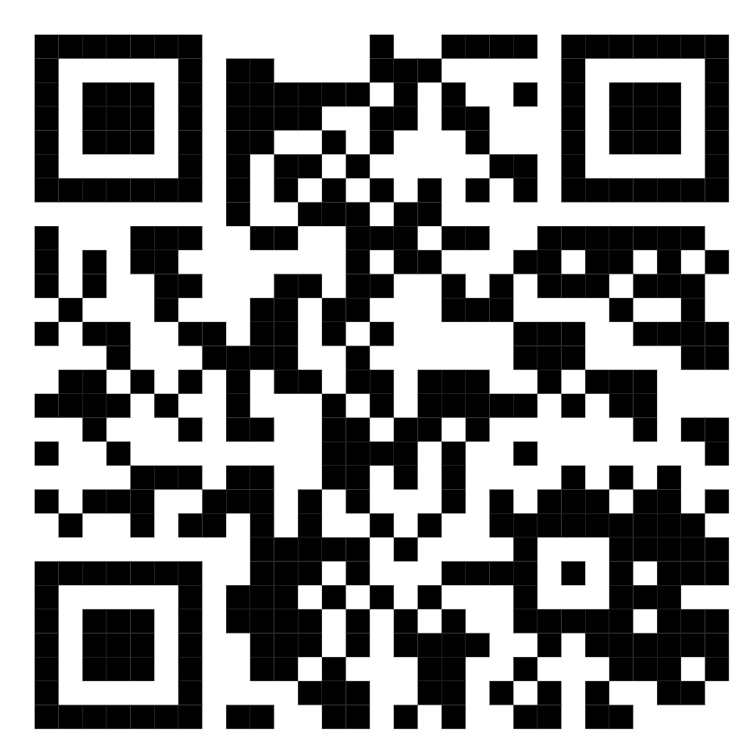
What do I do and when?
P. Korysko, J. Michaud – Student Duties

Slide 13
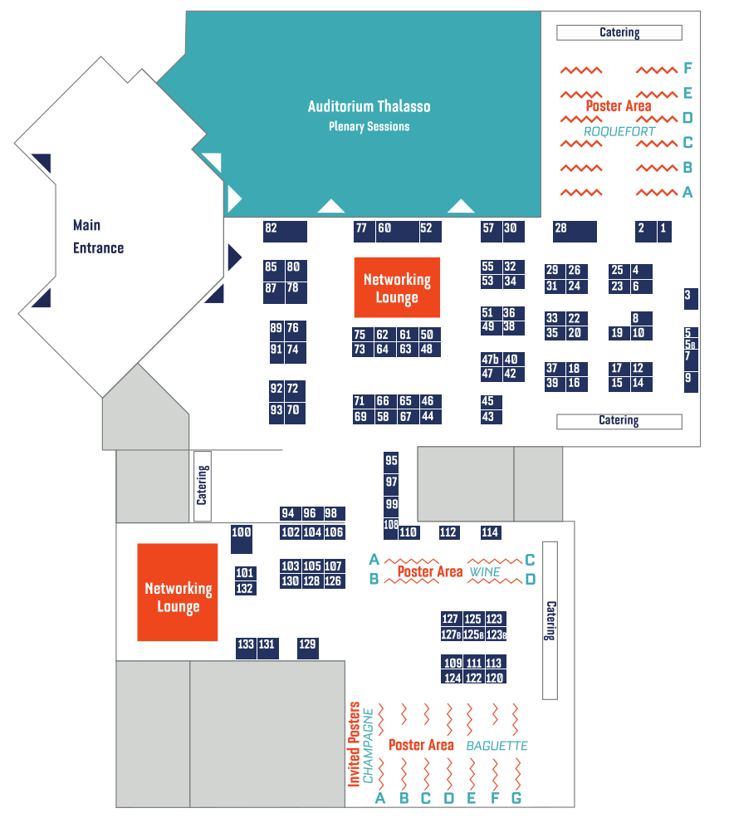
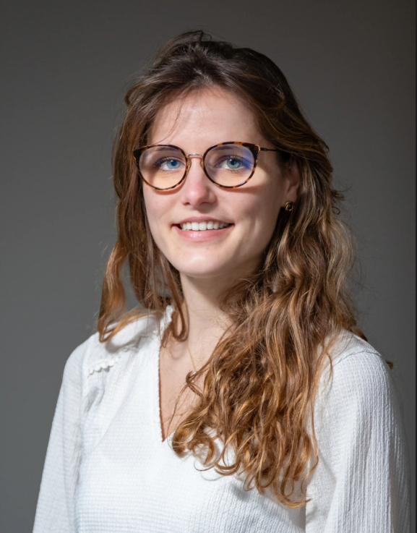
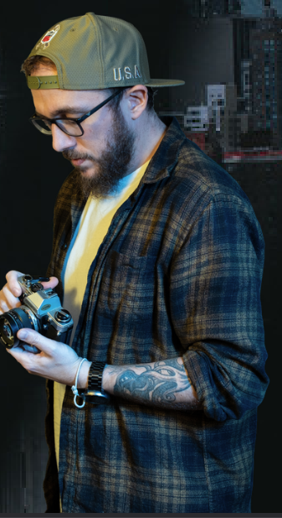
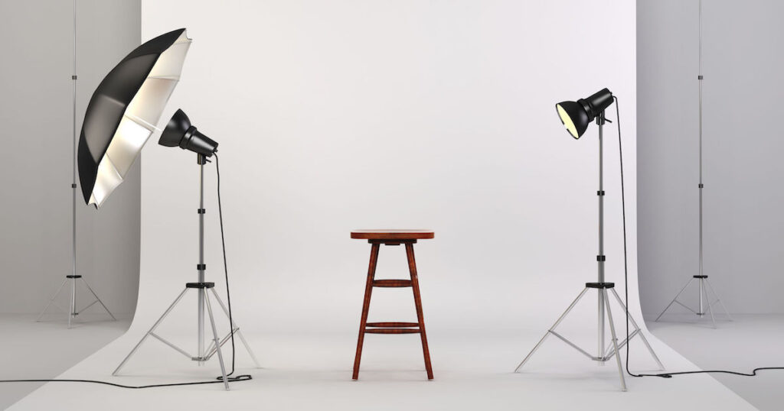
Sunday Activities: Photographer (1/3)
What: Photographer for professional portrait picture.
When: Sunday, May 17th from 11:15 to 13:15.
Where: CID – Demonstration (JFK) area
Free
Photographer
P. Korysko, J. Michaud – Student Tutorials

Slide 14
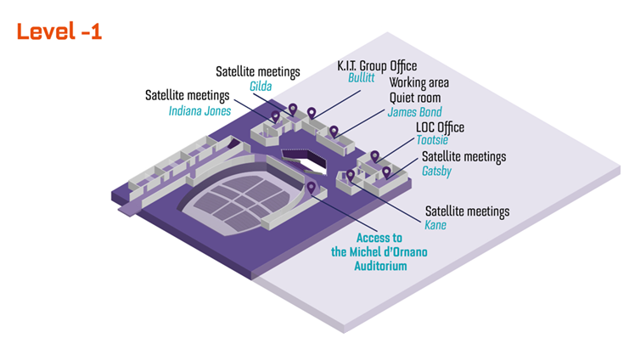

Sunday Activities: Hackathon (2/3)
What: IPAC’26 Hackathon.
When: Sunday, May 17th from 11:00 to 12:00
Where: Level -2 Gatsby.
Gatsby
Foster collaboration between Students and Industrial Partners, by addressing real-world challenges.
Key accelerator-related themes, including applications in Environment & Materials, Life Sciences and Energy.
Work with real datasets from ESS , MAX IV and CERN, ScandiNova , Cosylab , Hopsworks , etc.
P. Korysko, J. Michaud – Student Tutorials

Slide 15
Sunday Activities: Student Poster Session (3/3)
When: Sunday, May 17th from 14:00 to 18:00.
Where: Wine and Baguette Poster Areas.
Jury Process:
A jury composed of experts in the field will visit each student twice during the session to assess their poster presentation and work.
Presentation Format:
Each student will have 4 minutes to present their work.
The jury will have 4 minutes to ask questions about your work.
Awards Ceremony:
The best posters will be awarded on Thursday, May 21, 2026, during the Accelerator Prizes Special Session at 2:00 p.m. in the Michel d’Ornano Room (CID). Winning posters will be exhibited on Friday morning in the main hall.
P. Korysko, J. Michaud – Student Tutorials

Slide 16
Summary – Your Duties
Roquefort
Microphone Duty
& Chairperson Assistants
Thalasso
Nemo (iPads)
Poster Police
Wine
Michel d’Ornano
Baguette
P. Korysko, J. Michaud – Student Tutorials

Slide 17
Summary – Sunday Activities
Students with grants Training:
Today 09:30 – 11:00
Welcome Cocktail:
Today at 18:00
Photographer:
Sunday 11:15 – 13:15
IPAC’26 Hackathon:
Sunday 11:00 – 12:00
Student Poster Session:
Sunday 14:00 – 18:00
P. Korysko, J. Michaud – Student Tutorials

Slide 18
Questions?
P. Korysko, J. Michaud – Student Duties

