Slide 1

Beam Instrumentation, Controls, Feedback and Operation Aspects
(Main Classification 6)
IPAC 2026 Student Programme 2026
Peter Forck
Gesellschaft für Schwerionenforschung (GSI), p.forck@gsi.de

Slide 2
Demands on Beam Diagnostics and Control
Beam diagnostics is the ’sensory organs’ for a real beam in a real environment.
Beam control is the active influence on beam parameters by a person or machine.
Different demands lead to different installations:
Quick, non-destructive measurements leading to a single number or simple plots
Used as a check for online information.; reliable technology is required
Example: Beam position (=center-of-mass) by Beam Position Monitor BPM
Complex instruments for severe malfunctions, accelerator commissioning & development
The instrumentation might be destructive and complex
Example: Emittance determination, tune etc. measurement
General usage of beam instrumentation:
Monitoring of beam parameters for operation, beam alignment & accel. development
Instruments for automatic, active beam control mostly by a feedback system
Example: Closed orbit feedback at synchrotrons using position measurement by BPMs

Slide 3
Demands on Beam Diagnostics
Beam diagnostics is the ’sensory organs’ for a real beam in a real environment.
Beam control is the active influence on beam parameters by a person or machine.
Non-invasive ( = ’non-intercepting’ or ‘non-destructive’) methods are preferred:
The beam is not influenced ⇒ at transfer line: the same beam at several locations
⇒ at synchrotron: properties of the stored beam are monitored
The instrument is not destroyed due to high beam power
Instruments could be different for:
Transfer lines with single passage ↔ synchrotrons with multi-passages
Electrons are mostly relativistic ↔ protons are at the beginning non-relativistic
Remark:
Most instrumentation is installed outside of rf-cavities to prevent for signal disturbance

Slide 4
Outline of the Tutorial
Part 1 of the lecture on Beam Position Monitors:
Beam position monitors for bunched beams
Position measurements and feedback system
Measurement of tune, chromaticity etc.
Part 2 of the lecture on transverse and longitudinal diagnostics:
Profile measurement methods
Transverse emittance measure, incl. tomography
Measurement of longitudinal parameters

Slide 5
Measurements with BPMs
Outline for BPM measurements:
Signal generation and basic usage:
transfer impedance, button BPM
Electronics basics
Cavity BPM at FELs
Trajectory measurement, close orbit feedback
Tune and lattice function measurement

Slide 6
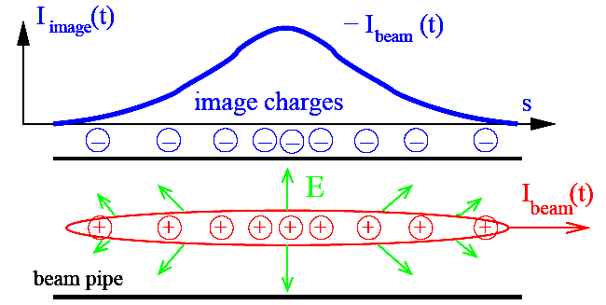
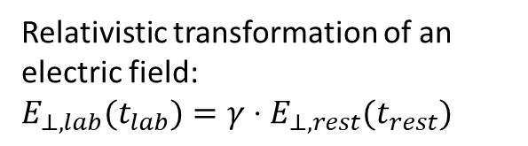
Pick-Ups for bunched Beams
The image current at the beam pipe is monitored on a high frequency basis
i.e. the ac-part given by the bunched beam.
Beam Position Monitor BPM is the most frequently used instrument!
Relativistic transformation of an electric field:
$$E_{⊥,lab}(t_{lab})=γ⋅E_{⊥,rest}(t_{rest})$$
A Beam Position Monitor is an non-destructive device for bunched beams.
It delivers information about the transverse center of the beam:
Trajectory: Position of an individual bunch within a transfer line or synchrotron
Closed orbit: Central orbit averaged over a period much longer than a betatron oscillation
Single bunch position: Determination of parameters like tune, chromaticity, β-function
Remarks: - BPMs have a low cut-off frequency ⇔ dc-beam can’t be monitored
- The abbreviation BPM and pick-up PU are synonyms

Slide 7
Principle of Signal Generation of a BPMs: off-center Beam
The image current at the wall is
monitored on a high frequency basis
i.e. ac-part given by the bunched beam.
V
-
+
-
+
-
-
+
-
+
-
+
-
-
+
-
+
-
+
-
+
-
-
+
-
+
-
+
-
+
-
+
-
-
+
-
+
+
-
-
-
-
+
-
+
-
-
-
-
+
+
-
+
-
-
+
-
+
-
-
-
-
-
-
-
-
-
+
-
+
+
-
+
+
-
+
-
-
+
-
+
-
+
-
+
-
+
+
+
+
-
+
-
-
+
-
+
+
+
+
+
+
+
+
+
+
+
+
+
+
+
+
+
+
+
+
+
+
+
+
+
+
+
+
+
+
+
+
+
+
+
+
+
+
+
+
+
+
+
+
+
+
+
+
+
+
+
+
+
+
+
+
+
+
+
+
+
+
+
+
+
+
+
+
+
+
+
+
+
+
+
+
+
+
+
+
-
+
+
-
+
+
-
-
-
-
+
-
-
+
-
-
+
+
+
-
-
+
-
+
+
-
-
-
+
-
+
-
-
-
-
-
-
+
-
+
+
+
+
-
+
-
-
+
Animation by Rhodri Jones (CERN)

Slide 8
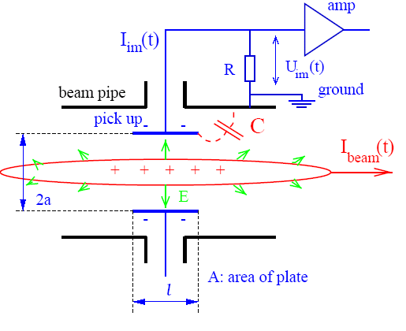

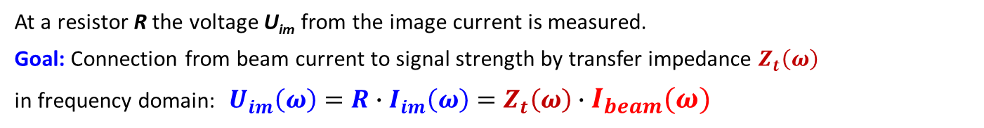
Model for Signal Treatment of capacitive BPMs
The wall current is monitored by a plate or ring inserted in the beam pipe:
Equivalent circuit
C_{C}
I_{beam}
C
R
U_{im}
U_{beam}
capacitive coupling
→ image current
ground
electronics elements
At a resistor R the voltage U_{im} from the image current is measured.
Goal: Connection from beam current to signal strength by transfer impedance $Z_{t}\left(ω\right)$
in frequency domain: $U_{im}\left(ω\right)=R∙I_{im}\left(ω\right)=Z_{t}\left(ω\right)∙I_{beam}\left(ω\right)$
Result: $Z_{t}\left(ω\right)= \frac{A}{2π a} ∙ \frac{1}{βc}∙\frac{1}{C} ∙ \frac{iωRC}{1+iωRC} ∈ℂ$ i.e. complex function
geometry
stray capacitance
frequency response

Slide 9
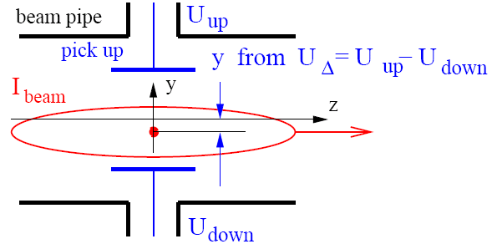
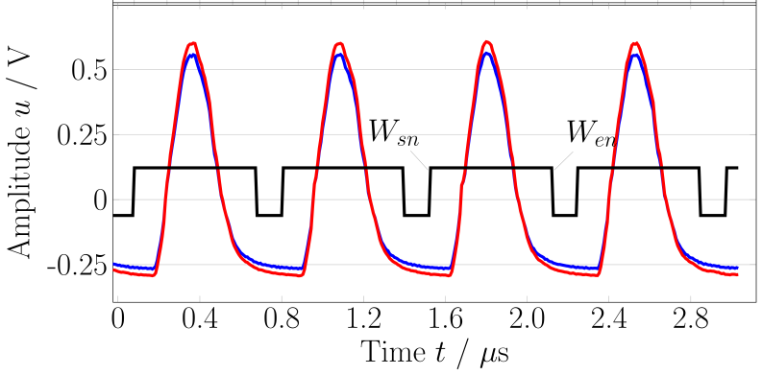

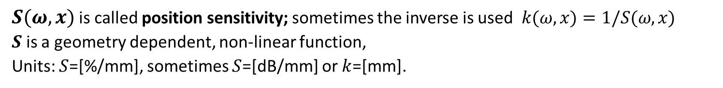
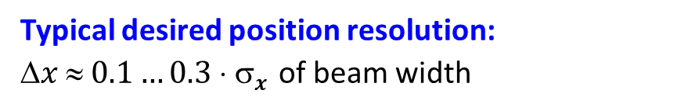
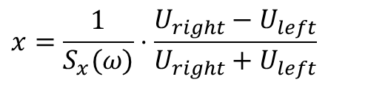

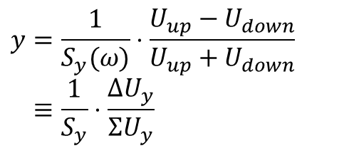
Principle of Position Determination by a BPM
The difference voltage between plates gives the beam’s center-of-mass
most frequent application
$$y=\frac{1}{S_{y}(ω)}⋅\frac{U_{up}−U_{down}}{U_{up}+U_{down}} \\ ≡\frac{1}{S_{y}}⋅\frac{ΔU_{y}}{ΣU_{y}}$$
$y$from $ΔU=Uup −Udown$
$$x=\frac{1}{S_{x}(ω)}⋅\frac{U_{right}−U_{left}}{U_{right}+U_{left}}$$
$S(ω,x)$is called position sensitivity; sometimes the inverse is used $k(ω,x)=1/S(ω,x)$
$S$ is a geometry dependent, non-linear function,
Units: $S$=[%/mm], sometimes $S$=[dB/mm] or $k$=[mm].
Example: One turn = 4 bunches @ 35 MeV/u
Typical desired position resolution:
$x  0.1…0.3  x$of beam width
U_{right}
U_{reft}
It is at least: $∆U ≪ \frac{1}{10} ΣU$

Slide 10
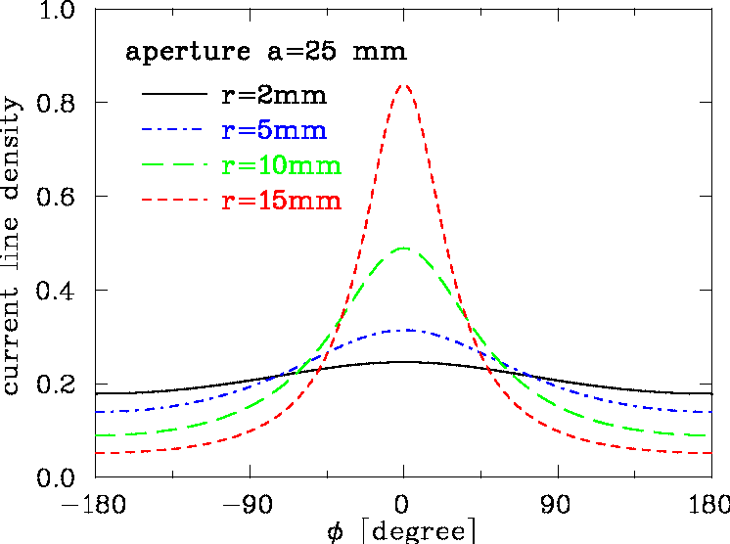
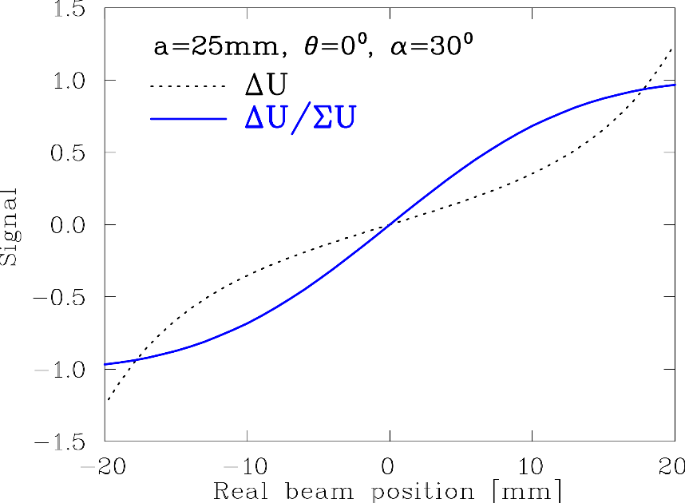


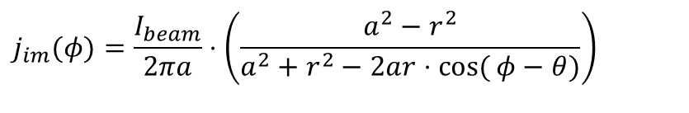
2-dim Model for a Button BPM
‘Proximity effect’: larger signal for closer plate
Ideal 2-dim model: Cylindrical pipe → image current density
via ‘image charge method’ for ‘pencil’ beam:
a
button
φ
α
$$j_{im}(φ)=\frac{I_{beam}}{2πa}⋅\left(\frac{a^{2}−r^{2}}{a^{2}+r^{2}−2ar⋅\cos{(}φ−θ)}\right)$$
r
θ =0
Image current: Integration over finite button size: $I_{im}=a∙ \int_{−α/2}^{α/2}{j_{im}\left(φ\right) dφ}$
, θ = 0º
$$ΔU=U_{right}−U_{left}$$

Slide 11
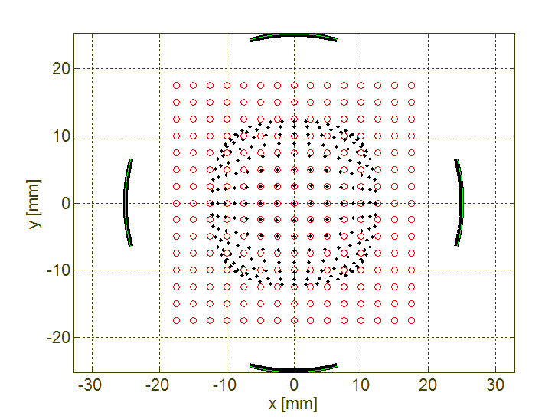
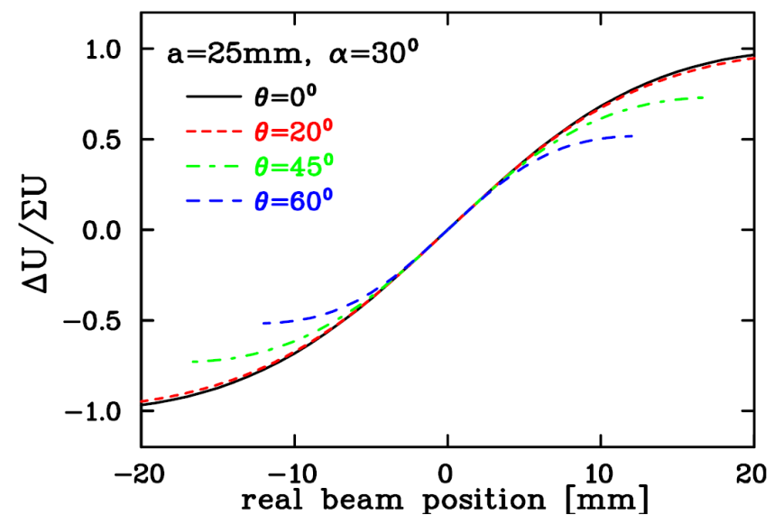
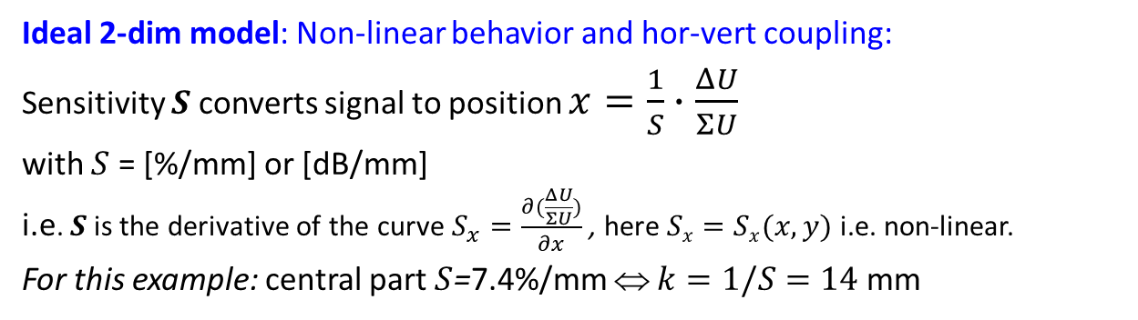
2-dim Model for a Button BPM
a
Ideal 2-dim model: Non-linear behavior and hor-vert coupling:
Sensitivity $S$ converts signal to position $x=\frac{1}{S}∙\frac{ΔU}{ΣU}$
with $S$ = [%/mm] or [dB/mm]
i.e. $S$ is the derivative of the curve $S_{x}=\frac{∂(\frac{ΔU}{ΣU})}{∂x}$ , here $Sx=Sx(x, y)$ i.e. non-linear.
For this example: central part $S$=7.4%/mm ⇔ $k=1/S=14$ mm
button
φ
α
θ
r
Horizontal plane
Position Map
button
○ real position
• measured position

Slide 12
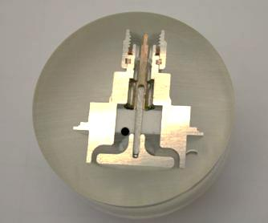
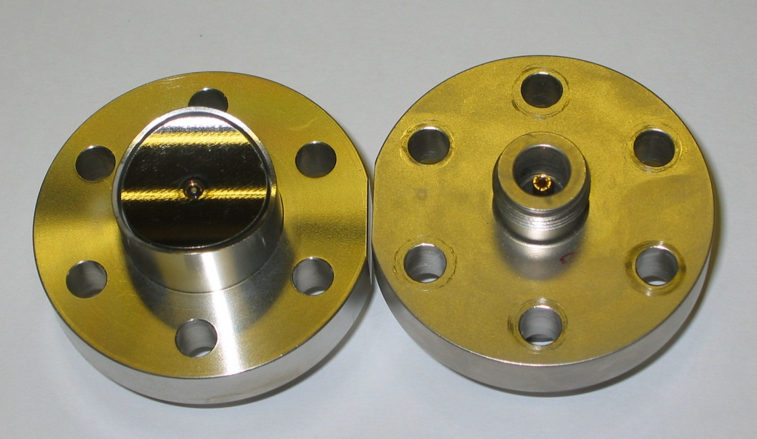
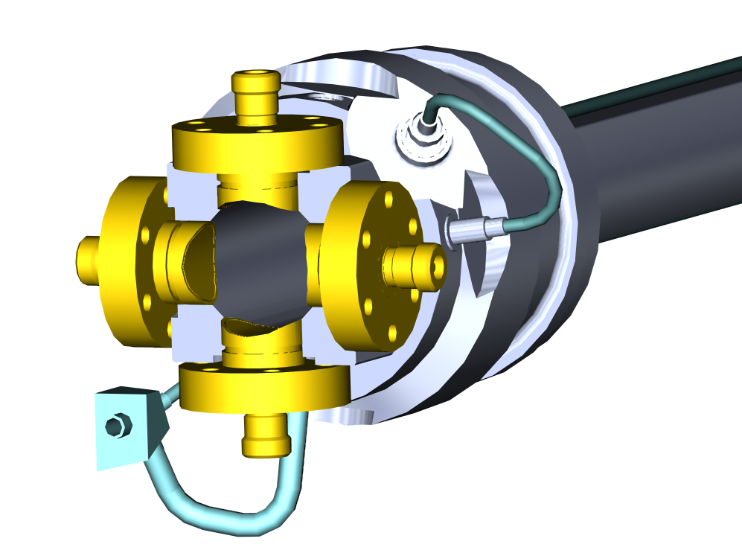
Button BPM Realization
LINACs, e⁻-synchrotrons: 100 MHz < f_{rf} < 3 GHz → bunch length ≈ BPM length
→ 50 Ω signal path to prevent reflections
Example: LHC-type inside cryostat:
24 mm, half aperture a = 25 mm, C = 8 pF
⇒ f_{cut}= 400 MHz, Z_{t} = 1.3 Ω above f_{cut}
N-Connector
Ceramic vacuum insulation
Button electrode
Ø24 mm
∅
5cm
Courtesy C. Boccard (CERN)

Slide 13
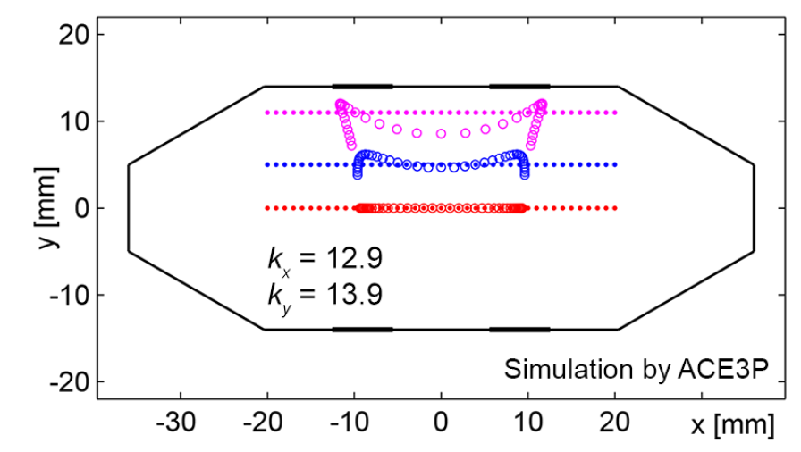
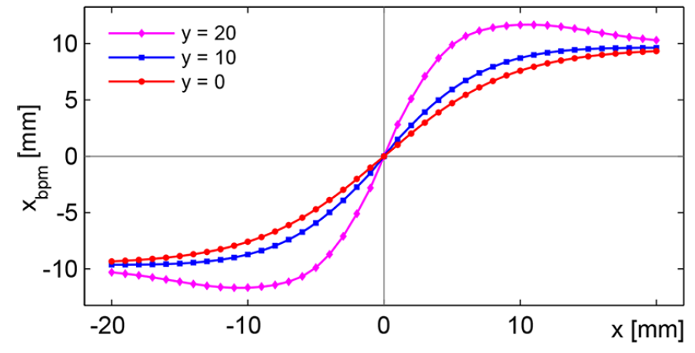
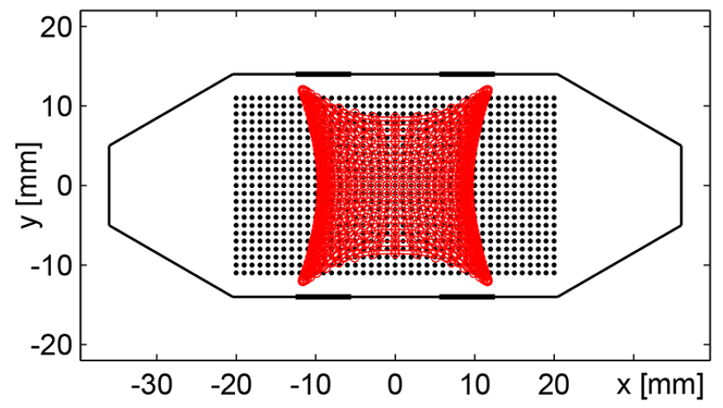
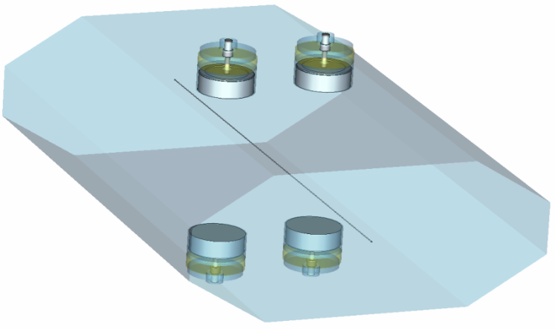
Simulations for Button BPM at Synchrotron Light Sources
Example: Simulation for ALBA light source for 72 x 28 mm² chamber
Horizontal: $x∝ \frac{1}{S_{x}} \left(left −right\right)$ ⇔ $x=\frac{1}{S_{x}} ∙ \frac{\left(U_{2}+ U_{3}\right)−\left(U_{1}+U_{4}\right) }{U_{1}+U_{2}+U_{3}+U_{4}}$
Vertical: y$∝ \frac{1}{S_{y}} \left(top −bottom\right)$ ⇔ y$=\frac{1}{S_{y}} ∙ \frac{\left(U_{1}+ U_{2}\right)−\left(U_{3}+U_{4}\right) }{U_{1}+U_{2}+U_{3}+U_{4}}$
button 2
button 1
y = 20 mm
y = 10 mm
y = 0 mm
y = 20 mm
y = 10 mm
y = 0 mm
1 mm steps
S_{x}(center) = 7.8 %/mm
for |x|<5mm & y=0mm
S_{y}(center) = 7.2 %/mm
for |y|< 5mm & x=0mm
button 3
button 4
30
20
position x [mm]
real beam position x [mm]
button 2
button 1
18 mm
Optimization:
Horizontal distance
Size of buttons
button 2
button 1
1 mm
steps
y
∅ 7 mm
x
28 mm
button 3
button 4
A.A. Nosych et al.,
IBIC’14
button 3
button 4
72 mm
30
position x [mm]
Result: - Non-linearity and xy-coupling occur in dependence of button size and position
- Can be corrected by polynomial interpolation for beams much smaller than chamber

Slide 14
Measurement with BPMs
Outline for BPM measurements:
Signal generation and basic usage:
transfer impedance, button BPM
Electronics basics:
schemes for signal processing
Cavity BPM at FELs
Trajectory measurement, close orbit feedback
Tune and lattice function measurement

Slide 15
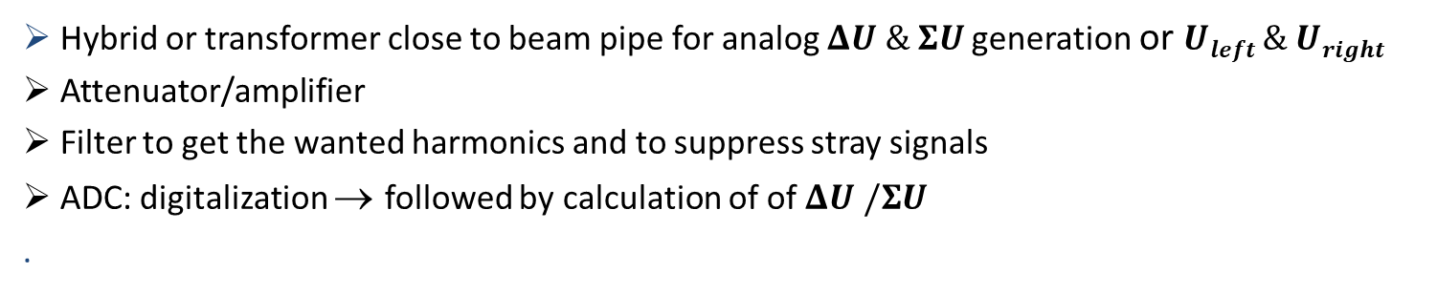
Broadband Signal Processing
Hybrid or transformer close to beam pipe for analog $ΔU \& ΣU$generation or $Uleft \& Uright$
Attenuator/amplifier
Filter to get the wanted harmonics and to suppress stray signals
ADC: digitalization → followed by calculation of of $ΔU /ΣU$
.
Advantage: Bunch-by-bunch observation possible, versatile post-processing possible
Disadvantage: Resolution down to ≈ 100 µm for large aperture, i.e. ≈ 0.1% of aperture,
resolution is worse than narrowband processing, see below
Challenge: Precise analog electronics with very low drift of amplification

Slide 16
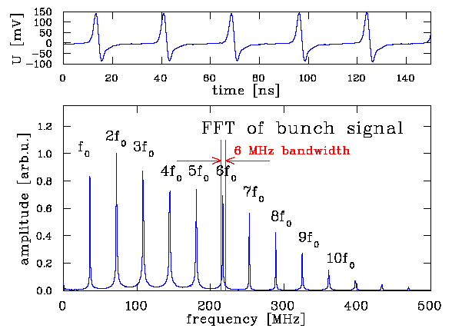
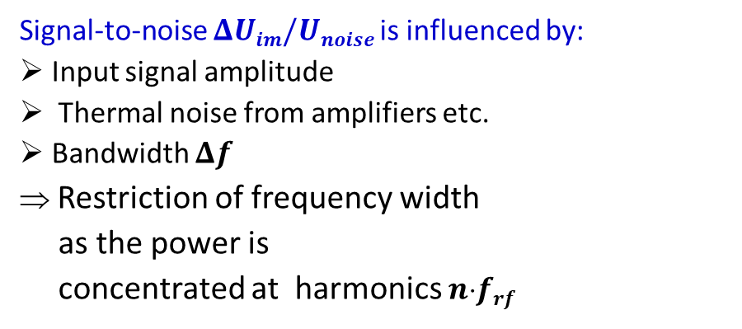
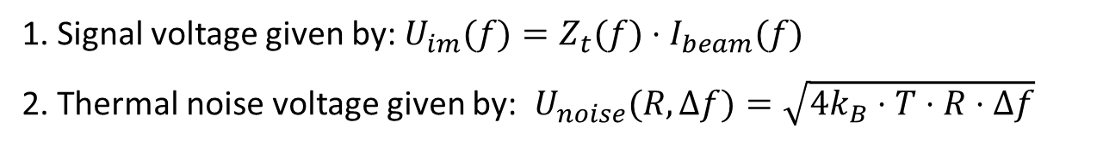
General Noise Consideration
1. Signal voltage given by: $U_{im}(f)=Z_{t}(f)⋅I_{beam}(f)$
2. Thermal noise voltage given by: ${ U}_{noise}(R,Δf)=\sqrt{4k_{B}⋅T⋅R⋅Δf}$
Signal-to-noise $ΔUim/Unoise$is influenced by:
Input signal amplitude
Thermal noise from amplifiers etc.
Bandwidth $Δf$
⇒ Restriction of frequency width
as the power is
concentrated at harmonics $nfrf$
Example: GSI-LINAC with f_{rf}=36 MHz

Slide 17
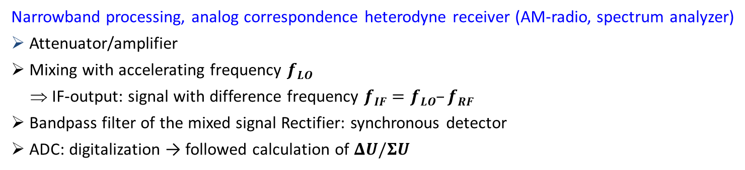
Narrowband Processing for improved Signal-to-Noise
Narrowband processing, analog correspondence heterodyne receiver (AM-radio, spectrum analyzer)
Attenuator/amplifier
Mixing with accelerating frequency $fLO$
⇒ IF-output: signal with difference frequency $fIF=fLO–fRF$
Bandpass filter of the mixed signal Rectifier: synchronous detector
ADC: digitalization → followed calculation of $ΔU/ΣU$
Digital
correspondence:
I/Q de-modulation
As today’s technology
Advantage: Spatial resolution about 100 time better than broadband processing
Disadvantage: No turn-by-turn diagnosis, due to mixing = ’long averaging time’

Slide 18
Measurement with BPMs
Outline for BPM measurements:
Signal generation and basic usage:
transfer impedance, button BPM
Electronics basics:
Schemes for signal processing
Cavity BPM at FELs:
information storage for short pulses
Trajectory measurement, close orbit feedback
Tune and lattice function measurement

Slide 19
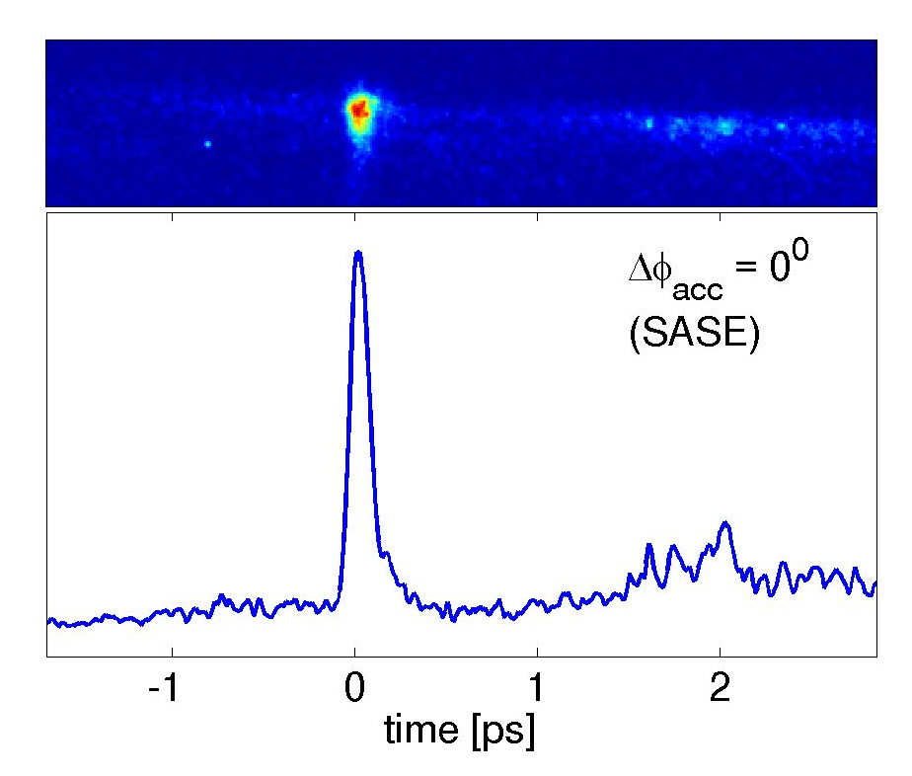
4th Generation Light Sources & Beam Delivery
LINAC-based Light Sources:
E_{electron} ≈ 1 … 18 GeV, coherent light from undulator, E_{γ} < 1000 keV, temporally short pulse
Flash, Hamburg
f_{acc} = 1.3 GHz
Goal: Short bunches with high number of particles
short, intense laser pulses for electron generation
Requirement: Position stability ⇒ resolution < 1 µm
Single bunch duration < 100 fs:
2σ = 110 fs
B. Steffen et al, DIPAC 2009, B. Steffen et al., Phys. Rev. AB 12, 032802 (2009)

Slide 20

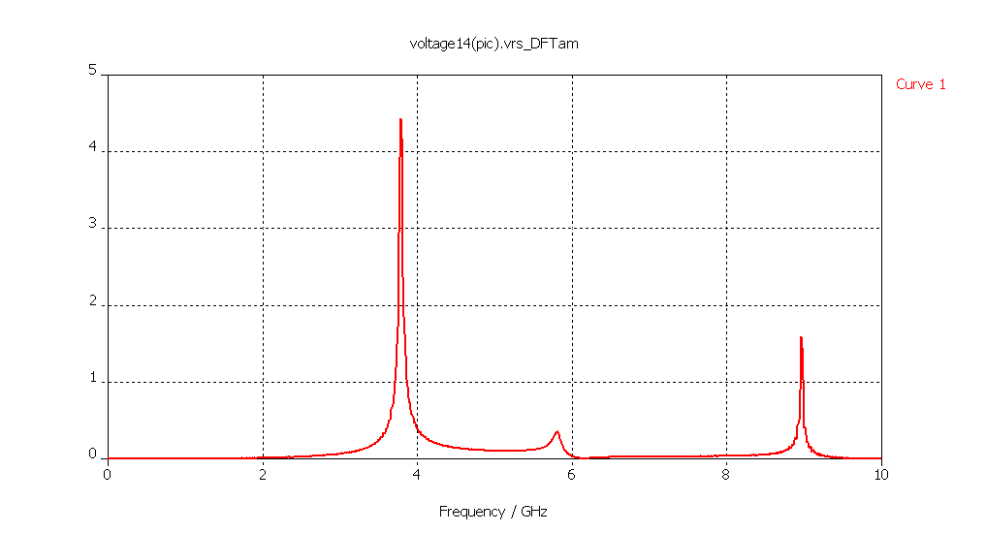
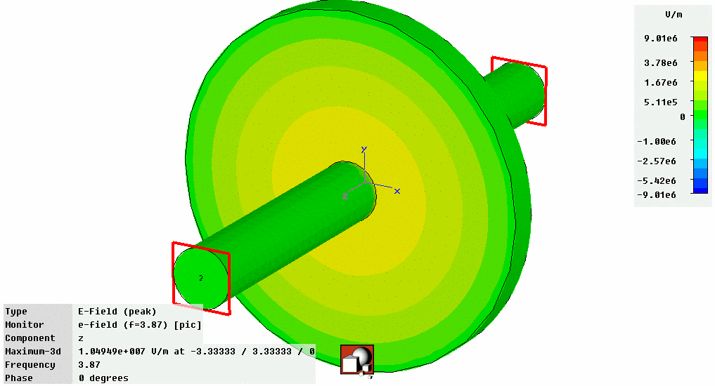
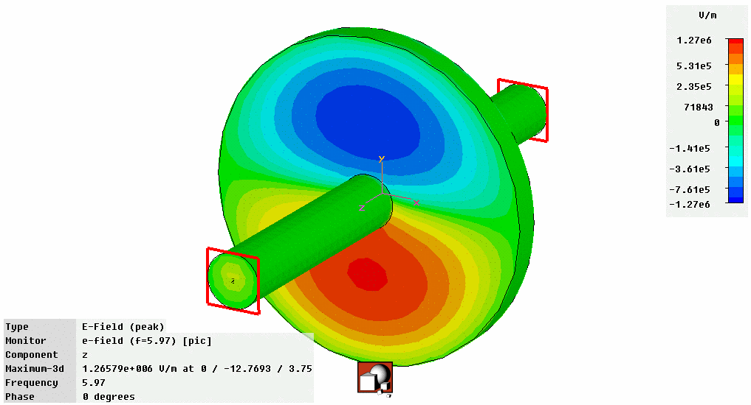
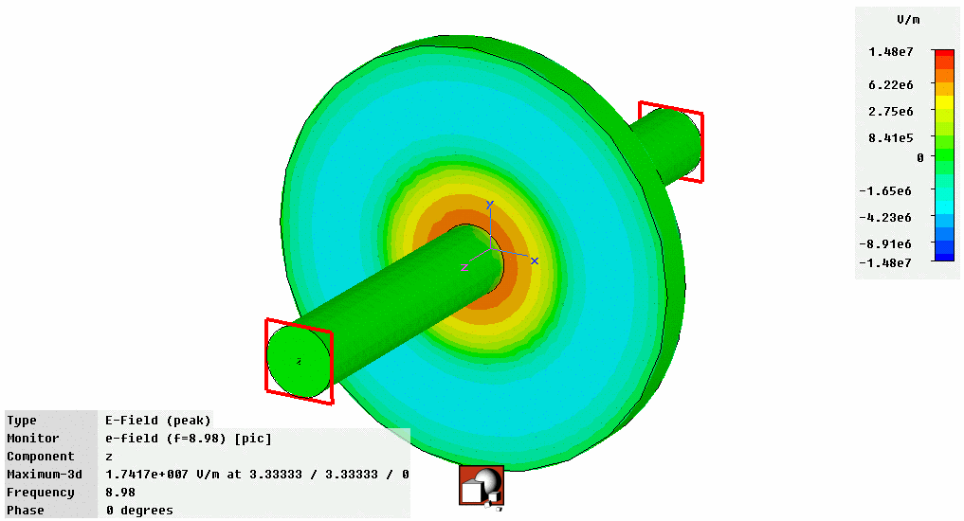
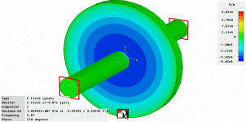
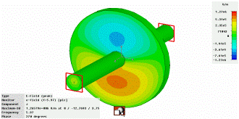
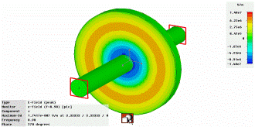
Cavity BPM for FEL-LINACs: Principle
High resolution on t << 1 μs time scale can be achieved by excitation of a dipole mode
Depictive statement: ‘The position information is stored due to cavity mode excitation’
pillbox cavity
For pill box the resonator modes given by geometry:
Monopole mode TM₀₁₀ with f₀₁₀
→ maximum at beam center ⇒ strong excitation
Dipole mode TM₀₁₁ with f₀₁₁
→ minimum at center ⇒ excitation by beam offset
Detection of dipole mode amplitude
antenna 1
dipole
TM₁₁₀
Δx
beam
monopole
TM₀₁₀
TM₀₁
U / V
antenna 2
voltage U
monopole TM₀₁₀
U ∝ I_{beam}
dipole TM₀₁₁
U ∝ I_{beam}∗Δx
monopole TM₀₂₀
TM₀₂
‘δ-excitation’ followed by
oscillation with Q ≈ 1000
and τ =2Q/2πf ≈ 100 ns
⇒ ‘0.1 μm resolution
within 100 ns‘
From D. Lipka,
DESY, Hamburg
TM₁₁
frequency f [GHz]

Slide 21
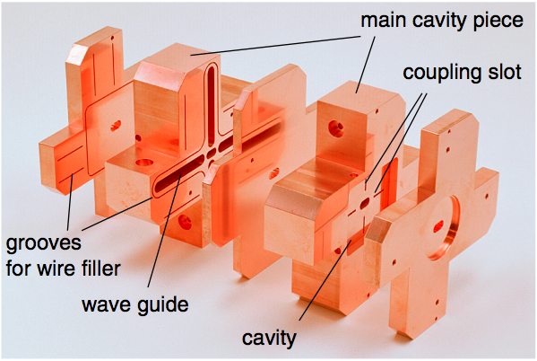
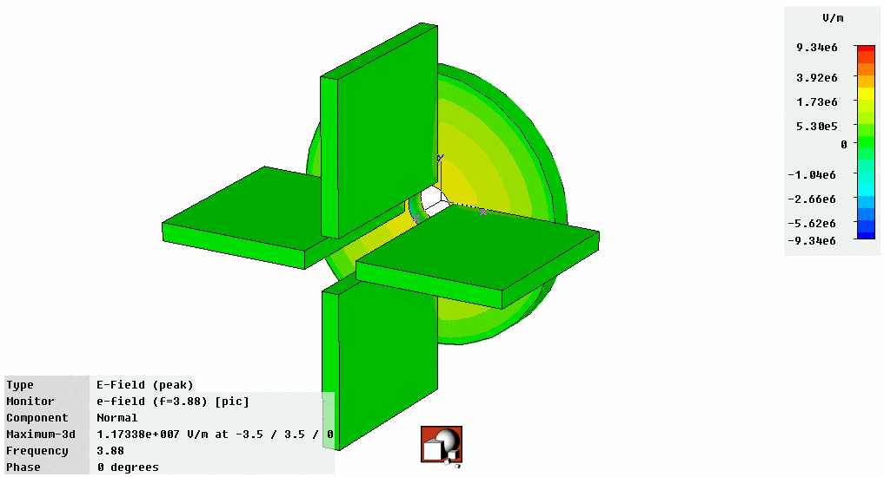
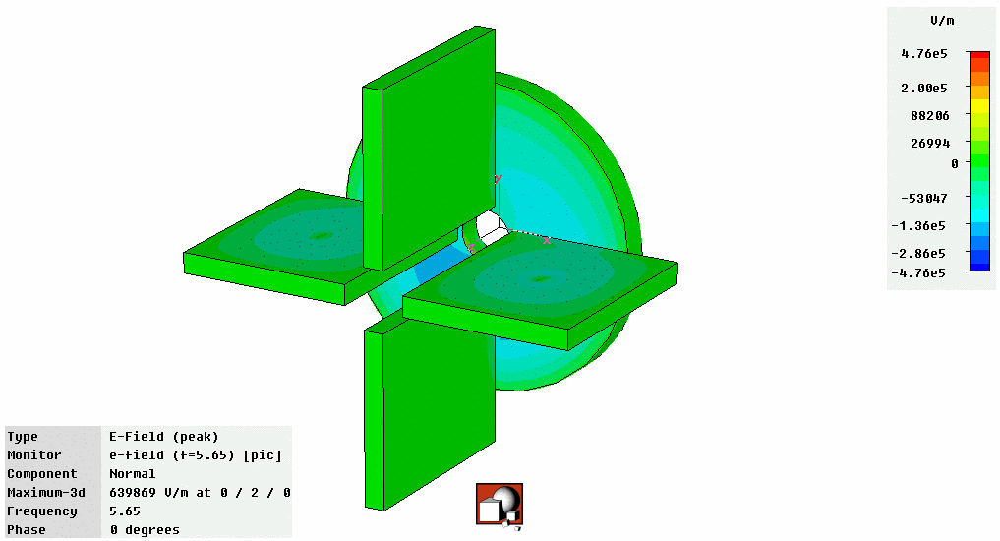
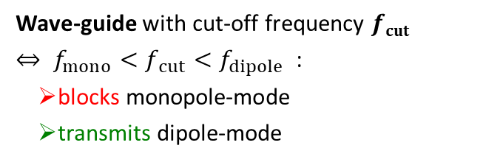
Courtesy of D. Lipka & Y. Honda
Cavity BPM: Suppression of monopole Mode
Suppression of mono-pole mode: waveguide only for dipole-mode transmission
Example: f_{dipole,hori}= 5.7 GHz, f_{dipole,vert}= 6.4 GHz
Wave-guide with cut-off frequency $fcut$
$⇔ f_{mono}<f_{ cut}<f_{dipole}$ :
blocks monopole-mode
transmits dipole-mode
Monopole mode
Dipole mode
Monopole Mode
Dipole Mode
wave guide
Courtesy of D. Lipka,
DESY, Hamburg
Courtesy of D. Lipka,
DESY, Hamburg
Prototype BPM for ILC Final Focus:
Achieved resolution (i.e. 3 BPM relative) of 8.7 nm in a 6 × 12 mm beam pipe at ATF2 (KEK, Japan)
Remark: Separated, smaller cavity for monopole mode to have same frequency for normalization
Courtesy of D. Lipka and Y. Honda et al., Phys. Rev. Accel. Beams 11, 062801 (2008)
Notes:
21

Slide 22
Measurement with BPMs
Outline for BPM measurements:
Signal generation and basic usage:
transfer impedance, button BPM
Electronics basics:
Schemes for signal processing
Cavity BPM at FELs
information storage for short pulses
Trajectory measurement, close orbit feedback:
Beam stabilization methods via real-time control
Tune and lattice function measurement

Slide 23
Trajectory Measurement with BPMs
Trajectory:
The position delivered by an individual bunch within a transfer line or a synchrotron.
Main task: Control of matching (center and angle), first-turn diagnostics
Example: LHC injection 10/09/08 i.e. first day of operation !
10
horizontal
0
x [mm]
-10
-10
10
vertical
0
y [mm]
-10
-10
Monitor number (530 BPMs on 27 km)
Courtesy R. Jones (CERN)
Tune values at LHC: Q_{h} = 64.3, Q_{v} = 59.3

Slide 24
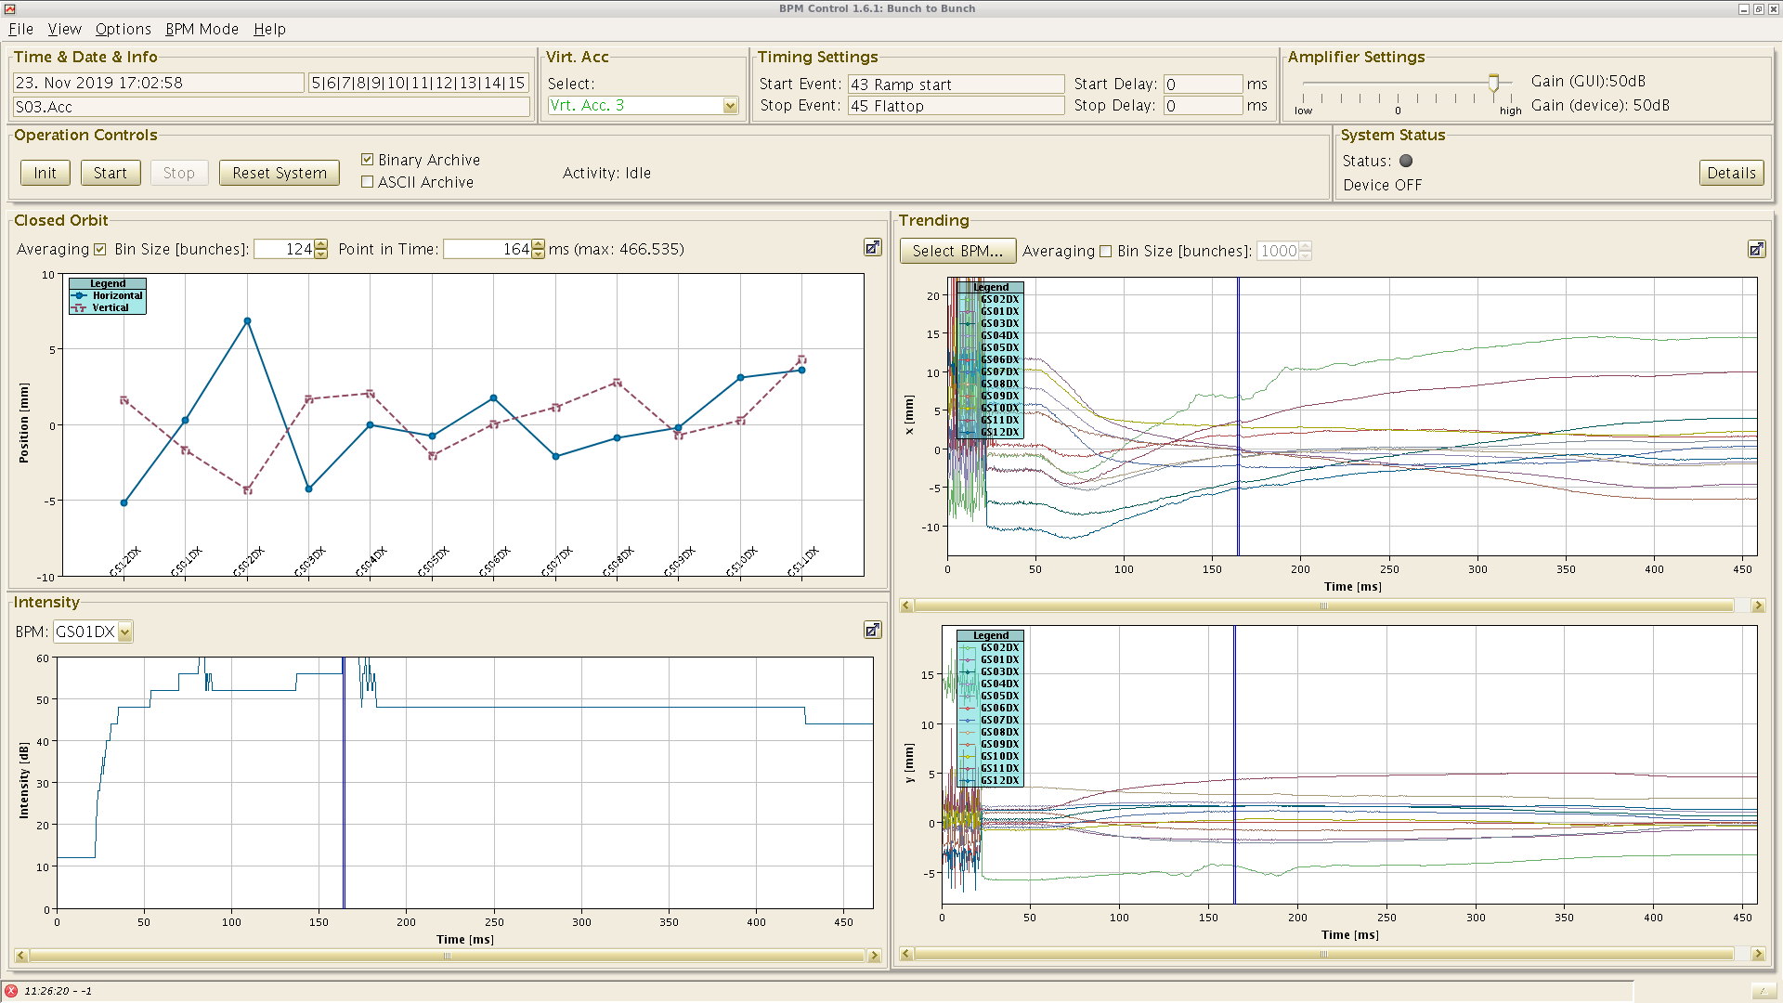
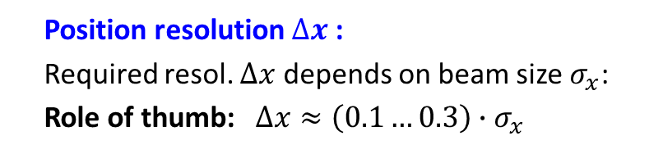
Close Orbit Measurement with BPMs
Orbit measurement:
Example: 12 beam positions at GSI-SIS during ramping from $E_{kin}=$8.6 to 500 MeV/u for Ar¹⁸⁺
Closed orbit:
Beam position averaged over many turns
(i.e. betatron oscillations).
The result is the basic tool for alignment & stabilization
20
feedback off
10
position [mm]
0
-10
position x(t) at 12 BPMs
Position resolution $∆x$ :
Required resol. $∆x$ depends on beam size $σ_{x}$:
Role of thumb: $∆x≈\left(0.1…0.3\right)∙σ_{x}$
0
100
200
300
400
time [ms]

Slide 25
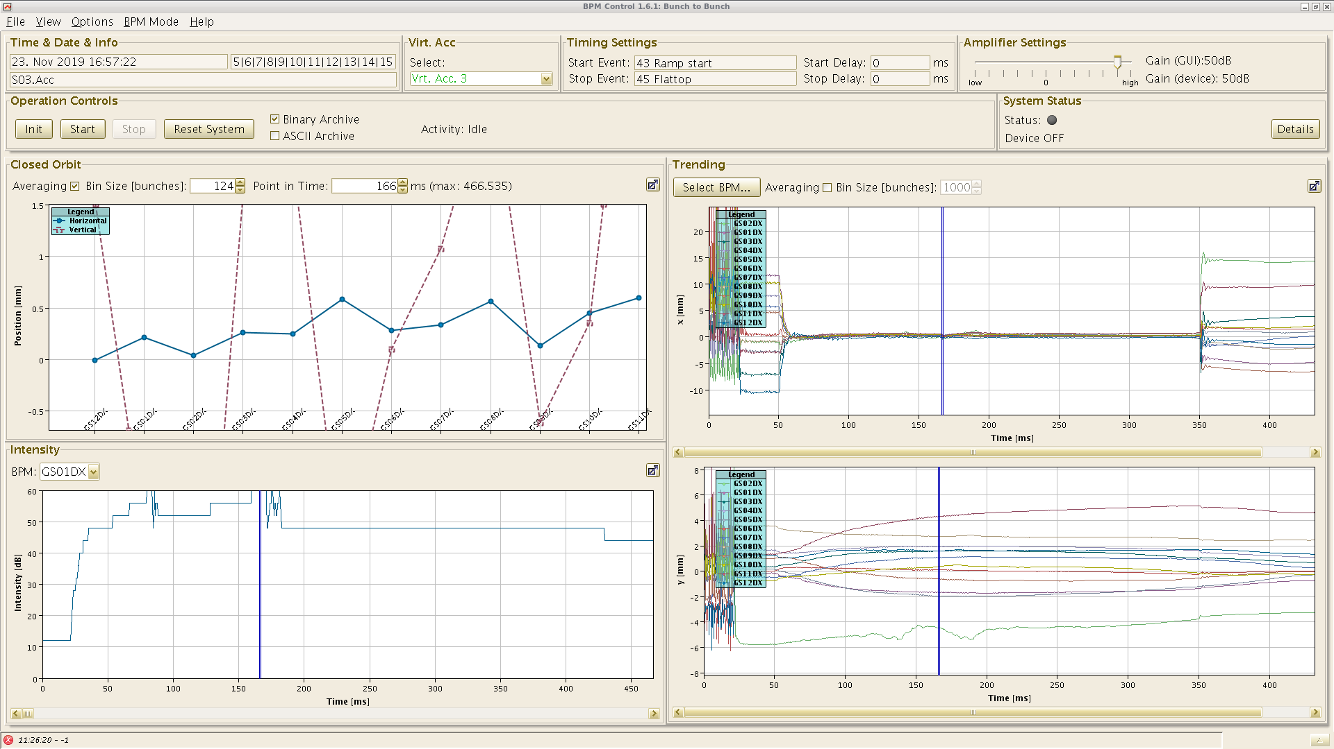
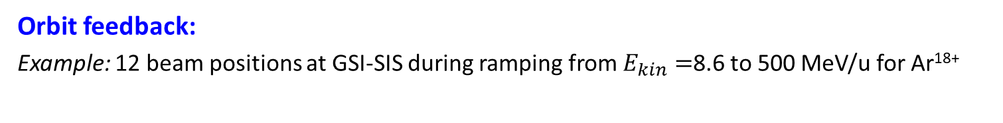
Close Orbit Feedback: Results
Orbit feedback:
Example: 12 beam positions at GSI-SIS during ramping from $E_{kin}=$8.6 to 500 MeV/u for Ar¹⁸⁺
20
feedback off
20
feedback on
10
10
position [mm]
position [mm]
0
0
-10
position x(t) at 12 BPMs
-10
0
100
200
300
400
0
100
200
300
400
time [ms]
time [ms]
Procedure:
1. Position digitalization of all 12 BPMs
2. Calculation of corrector setting on fast (FPGA-based) electronics
3. Submission to corrector magnets
4. New position measurement
⇒ regulation time down to 10 ms
Rule of thumb:
Movement related to tune i.e. ‘natural oscillations by periodic focusing’
To determine the ‘sine-like’ oscillation 4 BPMs per oscillation are required
⇒ 4 BPMs per tune value (but detailed investigation required to determine the # of BPMs)

Slide 26
Closed Orbit Feedback: Typical Noise Sources
Beam movement:
Short term (min to 10 ms):
Traffic
Machine (crane) movements
Water & vacuum pumps
50 Hz main power net
Medium term (day to min):
Movement of chambers
due to heating by radiation
Day-night variation
Tide, moon cycle
Long term ( > days):
Ground settlement
Seasons, temperature variation
Power spectral density [mm²/Hz]
0.01
0.1
1
10
100
1000
Frequency [Hz]
Courtesy M. Böge (PSI) CAS 2008, N. Hubert (Soleil) DIAPC 2009

Slide 27
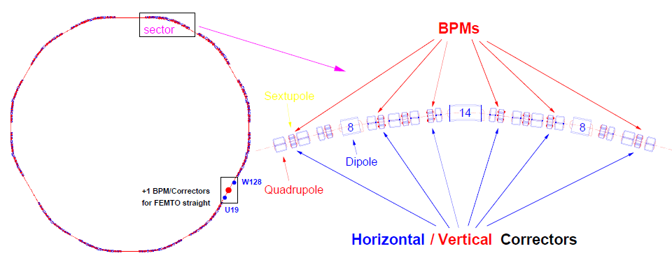

Close Orbit Feedback: BPMs and magnetic Corrector Hardware
Orbit feedback: Synchrotron light source → spatial stability of light beam
Example: SLS-Synchrotron at Villigen, Switzerland
From M. Böge, PSI
Feedback loop:
1. Position from all BPMs
2. Calculation of corrector setting via
Orbit Response Matrix
3. Change of magnet setting
1.’ New positon measurement …..
⇒ regulation time down to 10 ms
feedback
Acc. optics
Position from all BPMs
Calculation of corrector strength
Uncorrected orbit: typ. ${\left\langle x\right\rangle }_{rms }≈1 mm$
Corrected orbit: typ. ${\left\langle x\right\rangle }_{rms }≈1 µm$up to ≈ 100 Hz bandwidth!
Setting of correctors
Rule of thumb: 4 BPMs per tune value (to determine the ‘sine-like’ betatron oscillation)

Slide 28
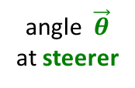

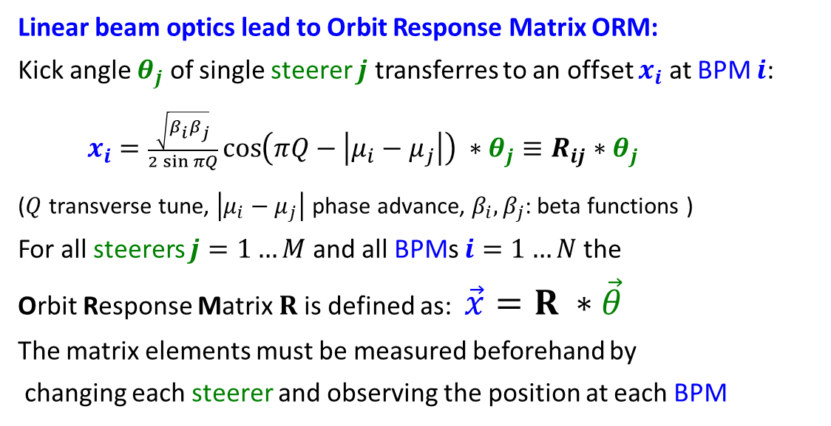
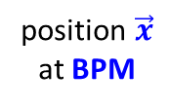








Close Orbit Feedback: Mathematical Treatment
Linear beam optics lead to Orbit Response Matrix ORM:
Kick angle $θ_{j}$ of single steerer $j$ transferres to an offset $x_{i}$ at BPM $i$:
$x_{i}=\frac{\sqrt{β_{i}β_{j}}}{2\sin{πQ}}\cos\left(πQ−\left|μ_{i}−μ_{j}\right|\right) ∗θ_{j}≡R_{ij}∗θ_{j}$
($Q$ transverse tune, $\left|μ_{i}−μ_{j}\right|$ phase advance, $β_{i}, β_{j}$: beta functions )
For all steerers $j=1…M$ and all BPMs $i=1…N$ the
Orbit Response Matrix $R$is defined as: $\vec{x}=R ∗\vec{θ}$
The matrix elements must be measured beforehand by
changing each steerer and observing the position at each BPM
position $\vec{x}$
at BPM
angle $\vec{θ}$
at steerer
ORM matrix $R$
$$=$$
$$∗$$
angle $\vec{θ}$
at steerer
position $\vec{x}$
at BPM
Closed orbit feedback:
Measurement of the position $x_{i}$ at all BPMs,
Determine offset to respect to set value
Calculation of new steerer kick${ θ}_{j}$ for correction
$⇒$ determination of pseudo-inverse ORM $\vec{θ}= R^{−1}∗\vec{x}$
frequently used method: Singular Value Decomposition
pseudo-inverse
ORM $R^{−1}$
$$=$$
$$∗$$

Slide 29
Close Orbit Feedback: Controller Principle
A feedback is modelled by Control Theory!
Visualization for a control loop:
Orbit
feedback
Synchrotron
Reference orbit
Deviation
Corrector
settings
Corrected
closed orbit
+
Σ
Controller
System
Reference
Error
Correction
-
System output
Newly measured
closed orbit
BPM
Sensor
Measurement output
Mathematical description for multi-input multi-output (MIMO) system:
Synchrotron optics: Orbit Response Matrix
System reaction: Model for power supplies, beam dynamics, tune spread etc.
BPM: Accuracy and noise
Using Laplace Transformation and frequency domain visualization for dynamic behavior
Courtesy Guenther Rehm (BESSY), IBIC 2019 & CAS 2026

Slide 30
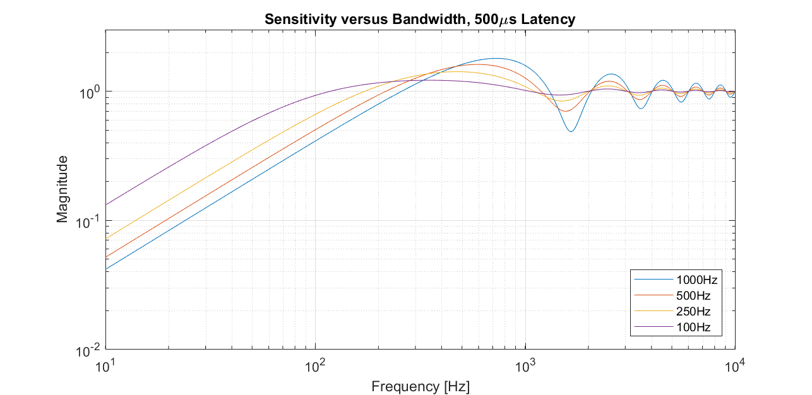




Close Orbit Feedback: System Bandwidth
Reaction depends on bandwidth and latency:
Performance measure by cross over frequency $f_{co}$ and latency $τ$:
Beam damping below $f_{co}$ by anti-phase correction of disturbance
Beam excitation above $f_{co}$ by in-phase excitation with respect to disturbance
Large bandwidth required to enable fast damping
Lower crossover $f_{co}$
⇔ lower bandwidth
⇒ slower damping
Magnitude
Higher latency $τ$
⇔ lower bandwidth
⇒ slower damping
damping region
excitation region
damping region
excitation region
10
100
1000
10⁴
Frequency [Hz]
Slow feedback: time step of orbit correction much lower than system delay
Fast feedback: time step of orbit correction comparable to system delay
Courtesy Guenther Rehm (BESSY), IBIC 2019 & CAS 2026

Slide 31
Close Orbit Feedback: Actual Challenges
Actual challenges (mainly for 4th generation light sources):
Measurement accuracy for BPMs
High bandwidth regulation
High bandwidth power supplies
Model inclusion of alignment errors
⇒ Technical improvements
Magnets with non-linear field contributions
Space charge and impedance contributions
Linear approx. by ORM might be insufficient
Proposal of Machine Learning
for non-linear problems
Lower crossover $f_{co}$
⇔ lower bandwidth
⇒ slower damping
Magnitude
Higher latency $τ$
⇔ lower bandwidth
⇒ slower damping
damping region
excitation region
damping region
excitation region
10
100
1000
10⁴
Frequency [Hz]
Slow feedback: time step of orbit correction much lower than system delay
Fast feedback: time step of orbit correction comparable to system delay
Courtesy Guenther Rehm (BESSY), IBIC 2019 & CAS 2026

Slide 32
Measurement with BPMs
Outline for BPM measurements:
Signal generation and basic usage:
transfer impedance, button BPM
Electronics basics:
Schemes for signal processing
Cavity BPM at FELs
information storage for short pulses
Trajectory measurement, close orbit feedback:
beam stabilization methods via real-time control
Tune and lattice function measurement

Slide 33


Tune Measurement: General Considerations
Coherent excitations are required for the detection by a BPM
Beam particle’s in-coherent motion ⇒ center-of-mass stays constant
Excitation of all particles by rf ⇒ coherent motion
⇒ center-of-mass variation turn-by-turn i.e. center acts as one macro-particle
Graphics by R. Singh, GSI

Slide 34



Tune Measurement: The Kick-Method in Time Domain
The beam is excited to
coherent betatron oscillation:
→ Beam position measured
each revolution (’turn-by-turn’)
→ Fourier Trans. gives non-integer tune q.
Short kick compared to revolution.
The de-coherence time limits the resolution:
N non-zero samples
⇒ General limit of discrete FFT:
Decay is caused by de-phasing,
not by decreasing
single particle amplitude.
Here: N = 200 turn ⇒ Δq > 0.003
(tune spreads can be Δq ≈ 0.001!)

Slide 35


Tune Measurement: Frequency Chirp Measurement
Principle: Slowly scan of the excitation frequency → beam acts as driven oscillator!
(sometimes refer to as Beam Transfer Function BTF or frequency chirp measurement)
SIS-synchrotron: A wide scan with
both sidebands at h=25th-harmonics:
A detailed scan for the lower sideband
→ beam acts like a driven oscillator:
⇒
From the position of the sidebands q = 0.306 is determined.
Advantage: High resolution, possibility of tune feedback by phase detection
Disadvantage: Long sweep time (up to several seconds).
Alternative: Excitation by band-limited noise with beam ‘picks’ the correct frequency

Slide 36


Chromaticity Measurement from Closed Orbit Data
Chromaticity ξ: Change of tune for off-momentum particle
Two step measurement procedure:
1. Change of momentum p by detuned rf-frequency $\frac{∆p}{p}=η^{−1}∙\frac{∆f_{acc}}{ f_{acc} }$
2. Excitation of coherent betatron oscillations
and tune measurement
(kick-method, BTF, noise excitation):
Example: Measurement at LEP:
Plot of ΔQ/Q as a function of Δp/p
⇒ slope is dispersion ξ.
From M Minty, F. Zimmermann,
Measurement and Control of charged Particle Beam,
Springer Verlag 2003

Slide 37
Actual Challenges for BPMs
Actual challenges for BPMs and COFB:
→ Position resolution requirement at 4th generation circular light sources : about 1 µm (!)
Low drift analog and digital electronics
Solution keywords: Pilot tone or channel multiplexing
Fast signal processing providing high bandwidth & low latency
Solution keywords: Parallel signal processing on powerful FPGAs
Improved accelerator model
Solution keywords: Machine Learning to include non-linearities
Actual challenges for tune etc. measurement:
Low excitation strength
Solution keywords: Phase-sensitive tracking (PLL-tracking)
Possible tune & chromaticity feedback
Solution keywords: Under development
Related talks at IPAC’26 within MC6:
Laura Torino (ALBA), Overview of the beam position monitors development for the next generation light sources

Slide 38
Measurement of Beam Profile
Outline for profile measurements:
Scintillation screens:
emission of light, universal usage, limited dynamic range
Optical Transition Radiation:
light emission due to crossing material boundary, mainly for relativistic beams
Ionization Profile Monitor and Beam Induced Fluorescence
Synchrotron Light Monitors

Slide 39


Scintillation Screen
Scintillation: Particle’s energy loss in matter causes emission of light
the most direct way of profile observation as used from the early days on!
Pneumatic drive with Ø70 mm screen:
beam
Screen
∅ 70 mm
Flange
∅200 mm
& window
Camera
≈ 1 m
Pneumatic
drive

Slide 40








Light output from various Scintillating Screens
Example: Color CCD camera: Images at different particle intensities determined for U at 300 MeV/u
Alumina: Al₂O₃
CsI:Tl
Chromox: Al₂O₃:Cr
P43
Type | Name | Material | Activ. | Max. λ | Decay
Cera- mics | Chromox | Al₂O₃ | Cr | 700nm | ≈ 10ms
 | Alumina | Al₂O₃ | Non | 380nm | ≈ 10ns
Crystal | YAG:Ce | Y₃Al₅O₁₂ | Ce | 550nm | 200ns
 | LYSO | Lu_{1.8}Y_{.2}SiO₅ | Ce | 420nm | 40ns
Powder of gains Ø≈10μm on glass | P43 | Gd₂O₃S | Tb | 545nm | 1ms
 | P46 | Y₃Al₅O₁₂ | Ce | 530nm | 300ns
 | P47 | Y₂SiO₅ | Ce&Tb | 400nm | 100ns
Quartz
Quartz:Ce
ZrO₂:Mg
YAG:Ce
Very different light yield i.e. photons per ion‘s energy loss
Different wavelength of emitted light

Slide 41
Optical Transition Radiation: Depictive Description
Optical Transition Radiation OTR for a single charge e:
Assuming a charge e approaches an ideal conducting boundary e.g. metal foil:
Image charge is created by electric field with dipole type field pattern
Field distribution depends on velocity β and Lorentz factor γ due to relativistic trans. field increase
Penetration of charge through surface within t < 10 fs: sudden change of source distribution
Emission of radiation with dipole characteristic
θ _{max}≈ 1/γ
vacuum
perfect
metal
vacuum
perfect
metal
vacuum
perfect
metal
charge e
velocity β
charge e
velocity β
θ
β
dipole
radiation
image
charge -e
velocity -β
image
charge -e
velocity -β
charge e
inside
metal
E-field
pattern
dipole type
Physics: sudden change charge distribution
rearrangement of sources ⇔ radiation
Other physical interpretation: Impedance mismatch at boundary leads to radiation

Slide 42


Technical Realization of Optical Transition Radiation OTR
OTR is emitted by charged particle passage through a material boundary.
Photon distribution:
within a solid angle dΩ and
Wavelength interval λ_{begin} to λ_{end}
Detection: Optical 400 nm < λ < 800 nm
Larger signal for relativistic beam γ $≫$ 1
Low divergence for γ $≫$ 1 ⇒ large signal
Well suited for e⁻ beams
p-beam used for E_{kin} $≳$ 10 GeV ⇔ γ $≳$ 10
Insertion of thin Al-foil under 45º
Observation of low light by CCD.

Slide 43
Measurement of Beam Profile
Outline:
Scintillation screens:
emission of light, universal usage, limited dynamic range
Optical Transition Radiation:
light emission due to crossing material boundary, mainly for relativistic beams
Ionization Profile Monitor and Beam Induced Fluorescence:
secondary particle detection from interaction beam-residual gas
Synchrotron Light Monitors

Slide 44


Interaction between Residual Gas and the Beams
Physics: Energy loss of ions in gas dE/dx
Profile determination from residual gas
Ionization:
in average roughly ≈ 100 eV/ionization
Excitation followed by photon emission:
in average roughly ≈ 300 eV/event e.g. N₂
However, depends strongly on gas molecule
beam pipe
res. gas atom
e⁻
e⁻
e⁻
ionization
e⁻
e⁻
beam
e⁻
e⁻
e⁻
excitation
e⁻
Energy loss in ${p=10}^{−7}$mbar N₂ by SRIM
²³⁸U
⁴⁰Ar
¹²C
LINAC, cycl.
source
synchr.
¹H

Slide 45


Ionization Profile Monitor at GSI Synchrotron
Non-destructive device for proton synchrotron:
Beam ionizes the residual gas by electronic stopping
Gas ions or e⁻ accelerated by E -field ≈1 kV/cm
Spatial resolved single particle detection
Realization at GSI synchrotron:
One monitor per plane
HV electrode
voltage divider
+ 6 kV
R
+ 5 kV
beam
+ 4 kV
$$\vec{E}$$
+ 3 kV
ion
e.g. H⁺
+ 2 kV
+ 1 kV
0 kV
MCP
anode
position readout
Abbreviation: Ionization Profile Monitor IPM or
at CERN Beam Gas Ionization BGI Monitor

Slide 46

Ionization Profile Monitor Realization
The realization for the heavy ion storage ring ESR at GSI:
Realization at GSI synchrotron:
One monitor per plane
Insertion 650 mm
IPM support
& UV lamp
Ø250 mm
Horizontal IPM:
Vertical IPM
E-field box
electrodes
beam
175mm
Vertical camera
MCP
E-field separation disks
View port Ø150 mm
Horizontal camera

Slide 47

Beam Induced Fluorescence for intense Profiles
Large beam power → Non-intercepting method:
Beam Induced Fluorescence BIF
N₂ + Ion → (N₂⁺)*+ Ion + e⁻ → N₂⁺ + γ + Ion + e⁻
With single photon detection scheme
390 nm < λ < 470 nm blue wavelength
non-destructive, compact installation.
Example: Installation of hor&vert. BIF Monitor:
Fluorescence gas:
Either from residual gas or extended gas bump
Or intersecting gas jet

Slide 48
Measurement of Beam Profile
Outline:
Scintillation screens:
emission of light, universal usage, limited dynamic range
Optical Transition Radiation:
light emission due to crossing material boundary, mainly for relativistic beams
Ionization Profile Monitor and Beam Induced Fluorescence:
secondary particle detection from interaction beam-residual gas
Synchrotron Light Monitors
standard for circular light sources, visible or X-ray range

Slide 49


Synchrotron Light Monitor
An electron bent (i.e. accelerated) by a dipole magnet emit synchrotron light.
This light is emitted
into a cone of
opening 2/γ in lab-frame.
Well suited for rel. e⁻
For protons:
Only for energies E_{kin} > 100 GeV
Rest frame of electron:
Laboratory frame:
orbit of electrons
orbit of electrons
dp/dt
dp/dt
radiation field
radiation field
power: P∝ γ ⁴/ ρ ²
The light is focused to a camera
Advantage:
Signal anyhow available!

Slide 50



Synchrotron Light Monitor overcoming Diffraction Limit
Problem: The diffraction limit is $σ_{diff}≈0.6 \sqrt[3]{λ^{2}/ρ } ≈100$µm for a typical case
Direct optical observation: σ ≈ 100 µm
→ Relative simple installation, but resolution insufficient for modern light sources
Direct X-ray observation with shorter λ : σ ≈ 10 µm
→ Medium complex but expensive installation,
installed at most synchr. light sources referred to as pinhole camera
Interference optical observation: σ ≈ 1 µm
→ Complex installation, seldom installed; basis: blurring of interference pattern

Slide 51
Actual Challenges for Profile Measurement
Actual challenges for profile measurement:
High resolution and dynamic range
Solution keywords: Material choice, complicated optical setup,
sensitive electronics and/or optics
Non-invasive methods
Reason: high beam power at hadron acc., multi-location observation
Solution keywords: Machine Learning based image reconstruction
Related talks at IPAC’26 within MC6:
Renjun Yang (CSNS), Achieve a record dynamic range of halo diagnostics with a novel fluorescence wire concept
Carsten Welsch (University of Liverpool), Progress in Data-Driven Beam Diagnostics within LIV.INNO
→ Conclusion

Slide 52
Measurement of transverse Emittance
Outline for transverse emittance diagnostics:
Quadrupole strength variation and position measurement
emittance from several profile measurement and beam optical calculation

Slide 53






Definition of Coordinates and basic Equations
$$\vec{x}= \left(\begin{matrix}x \\ x′ \\ y \\ y′ \\ l \\ δ\end{matrix}\right)= \left(\begin{matrix}hori. spatial deviation \\ horizontal divergence \\ vert.spatial deviation \\ vertical divergence \\ long. deviation \\ momentum deviation\end{matrix}\right)= \left(\begin{matrix}[mm] \\ [mrad] \\ [mm] \\ [mrad] \\ [mm] \\ {[10}^{−3}]\end{matrix}\right)$$
The basic vector is 6 dimensional:
The transformation of a single particle from a location s₀ to s₁ is given by the Transfer Matrix R:
$$\vec{x}\left(s_{1}\right)=R\left(s\right)∙\vec{x}\left(s_{0}\right)$$
The transformation of a the envelope from a location s₀ to s₁ is given by the
Beam Matrix σ :
$Σ\left(s_{1}\right)=R\left(s\right)∙Σ\left(s_{0}\right)∙R^{T}\left(s\right)$
6-dim Beam Matrix with decoupled hor., vert. and long. plane:
Horizontal
beam matrix:
$$σ_{11}=\left\langle { x}^{2} \right\rangle$$
$σ_{12}=\left\langle x x′ \right\rangle$
$σ_{22}=\left\langle { x′}^{2} \right\rangle$
Beam width for
the three
coordinates:
$x_{rms}= \sqrt{σ_{11}}$
$y_{rms}= \sqrt{σ_{33}}$
$l_{rms}= \sqrt{σ_{55}}$
$$Σ= \left(\begin{matrix}σ_{11} & σ_{12} & 0 & 0 & 0 & 0 \\ σ_{12} & σ_{22} & 0 & 0 & 0 & 0 \\ 0 & 0 & σ_{33} & σ_{34} & 0 & 0 \\ 0 & 0 & σ_{34} & σ_{44} & 0 & 0 \\ 0 & 0 & 0 & 0 & σ_{55} & σ_{56} \\ 0 & 0 & 0 & 0 & σ_{56} & σ_{66}\end{matrix}\right)$$
horizontal
vertical
longitudinal
hor.-long. coupling
→ 10 values

Slide 54





Definition of Beam Matrix: 6-dim versus 2-dim Matrices
$$Σ= \left(\begin{matrix}\left\langle xx\right\rangle & \left\langle xx′\right\rangle & \left\langle xy\right\rangle & \left\langle xy′\right\rangle & \left\langle xl\right\rangle & \left\langle xδ\right\rangle \\ \left\langle x′x\right\rangle & \left\langle x^{′}x′\right\rangle & \left\langle x′y\right\rangle & \left\langle x′y′\right\rangle & \left\langle x^{′}l\right\rangle & \left\langle x′δ\right\rangle \\ \left\langle yx\right\rangle & \left\langle yx′\right\rangle & \left\langle yy\right\rangle & \left\langle yy′\right\rangle & \left\langle yl\right\rangle & \left\langle yδ\right\rangle \\ \left\langle y^{′}x\right\rangle & \left\langle y^{′}x′\right\rangle & \left\langle y′y\right\rangle & \left\langle y^{′}y′\right\rangle & \left\langle y′l\right\rangle & \left\langle y′δ\right\rangle \\ \left\langle lx\right\rangle & \left\langle lx′\right\rangle & \left\langle ly\right\rangle & \left\langle ly′\right\rangle & \left\langle ll\right\rangle & \left\langle lδ\right\rangle \\ \left\langle δx\right\rangle & \left\langle δx′\right\rangle & \left\langle δy\right\rangle & \left\langle δy′\right\rangle & \left\langle δl\right\rangle & \left\langle δδ\right\rangle \end{matrix}\right)$$
$$Σ_{x}=$$
Generally, the beam matrix
contains all 6-dim variances
(i.e. correlations):
$Σ$ is symmetric matrix $Σ=Σ^{T}$
due to $\left\langle xx′\right\rangle = \left\langle x^{′}x\right\rangle$ etc.
$Σ ∈ℝ^{6x6}$ has 21 independent quantities if all directions are coupled.
For linear forces, the equation $Σ\left(s_{1}\right)=R\left(s\right)∙Σ\left(s_{0}\right)∙R^{T}\left(s\right)$ is valid for all dimensions
For linear forces, the 6-dim emittance is preserved: $ε_{6d}^{2}= det{Σ=const.}$
Remarks:
A 2-dim matrix $Σ_{x}∈ℝ^{2x2}$ was used in textbooks providing simpler formulas
Non-linear forces are e.g.: ➢ Sextupole, octupole etc. i.e. higher-order magnetic fields
➢ Non-linear contribution by longitudinal rf as it is a sine-wave
➢ Space charge forces for intense beams or cooled beams
➢ Impedance contributions

Slide 55




Emittance Measurement by Quadrupole Variation
From a profile determination, the emittance can be calculated via linear transformation,
if a well known and constant distribution (e.g. Gaussian) is assumed.
The basis is beam matrix transformation $σ \left(s_{1}\right)=R\left(s_{0}→s_{1}\right)∙ σ\left(s_{0}\right)∙R^{T}\left(s_{0}→s_{1}\right)$
Measurement of beam width
$x_{max}^{2}= σ11(1, k)$
With the drift matrix the transfer is
$R(ki )=Rdrift  Rfocus(ki )$
Transformation of the beam matrix
$Σ\left(1,k_{i}\right)=R\left(ki \right) ⋅ Σ\left(0\right) ⋅ RT (ki )$
Task: Calculation of matrix $(0)$
at entrance $s0$ i.e. all three elements

Slide 56

Measurement of transverse Emittance under ideal Conditions
Using the ‘thin lens approximation’ i.e. the quadrupole has a focal length of f:
$$R_{focus}(K)=\left(\begin{matrix}1 & 0 \\ −1/f & 1\end{matrix}\right)≡\left(\begin{matrix}1 & 0 \\ K & 1\end{matrix}\right) ⇒ R(L,K)=R_{drift}(L)⋅R_{focus}(K)=\left(\begin{matrix}1+LK & L \\ K & 1\end{matrix}\right)$$
Measurement of matrix-element $σ_{11}\left(s_{1},K\right)$ from matrices σ(s₁,K_{i}) = R(K_{i} ) ⋅ σ(s₀) ⋅ R^{T} (K_{i} )
Example: Square of the beam width at
ELETTRA 100 MeV e⁻ Linac, YAG:Ce screen:
For completeness: The relevant formulas
$$=a{∙\left(K−b\right)}^{2}+c$$
A fit delivers the beam matrix elements σ_{ij}(s₀)
Assumptions:
Well aligned beam, no steering
‘Regular’ phase space distribution
No emittance blow-up due to space charge
Improved methods:
Based on e.g. tomographic reconstruction
Focus
at screen
Focus
downstream
Focus
upstream
Focusing strength K= 1/f [m⁻¹]
G. Penco (ELETTRA) et al., EPAC’08
→ Emittance conclusion

Slide 57

Tomographic Reconstruction
Tomography: Generation of a n-dim image
from many lower-dim projections
Medical application: 2-dim reconstruction using sufficient 1-dim projections
1st back-
projection
original object
Iterative projection
& back-projection
after sufficient
iterations
Filtered back projection:
Iterative process by redistributing
the 2-dim image and considering the
differences to the previous iteration step.
Courtesy S. Hancock et al.

Slide 58
Tomographic Reconstruction
Tomography: Generation of a n-dim image
from many lower-dim projections
Medical application: 2-dim reconstruction using sufficient 1-dim projections
1st back-
projection
original object
Application at accelerators:
Transverse & longitudinal
emittance reconstruction in transfer lines
Longitudinal bunch evolution in synchr.
Iterative projection
& back-projection
after sufficient
iterations
Most often used:
FBP: Filtered Back-Projection
ART: Algebraic Reconstruction Technique
Other methods:
MENT: Maximum Entropy
Image recognition by Machine Learning
Courtesy S. Hancock et al.

Slide 59


Exemplary Results of 2-dim Emittance Reconstruction
Experiments at ALICE dedicated transfer line Daresbury Laboratory (UK):
Electron LINAC ALICE with $E_{kin}=12$ MeV
in the frame of EMMA FFAG (up to year 2016), then CLARA
Dedicated line with typ. 60⁰ betatron phase advance
between Yag:Ce screens (0.75 m distance each)
Several quadrupoles for flexible beam setting
for versatile experiments
YAG:Ce screens 1 to 3
5 cm
1.5 m
Typical 2-d trans. profile
@ YAG:Ce#1
Phase space at entrance of Quad 7
for low current (20 pC/bunch)
vert. y
≈ 8 mm
Typically 150 quad-setting Quad 7
(20⁰… 170⁰ betatron phase)
& profile measurements screen 1
tomography by FBP
hor. x
K.M. Hock, A. Wolski et al., NIM A 753, 38 (2014), M.G. Ibison et al., JINST 7, P04016 (2012), IPAC 2013

Slide 60
Exemplary Results of 2-dim Emittance Reconstruction
Experiments at ALICE dedicated transfer line Daresbury Laboratory (UK):
Beam current effect detected
Phase space in front of Quad 7
for low current (20 pC/bunch)
Phase space in front of Quad 7
for high current (80 pC/bunch)
Scan of Quad 7 &
measure at screen 1
Increase of current
Related to
Space charge defocusing upstream Quad 7
Consistency check:
Comparison of measured beam profile and reconstructed profile at reconstruction location

Slide 61
Actual Challenges for Emittance Measurement
Actual challenges for emittance measurement:
High resolution and dynamic range
Solution keywords: Material choice, sensitive electronics and/or optics
Reconstruction algorithms
Solution keywords: Tomography with optimized ‘traditional’ methods,
Machine Learning based image reconstruction
Related talks at IPAC’26 within MC6:
Sarah Geffroy (Université Paris-Saclay, CNRS/IN2P3, IJCLab),
Emittance measurement of the CERN antimatter beam for the GBAR experiment
Mayu Wada (The University of Tokyo),
Development of a new ultraslow muon beam diagnostic system for the J-PARC muon g-2/EDM experiment
Related talks at IPAC’26, MC6 on Machine Learning:
Eito Iwai (RIKEN), ML-driven automated tuning of SACLA XFEL: progress and future
Ysabella Kassandra Ong (INFN), AI and machine learning techniques for LNL accelerators
Thorsten Hellert (LBNL),
Bridging the Gap Between Control Systems and Natural Language: A Framework for Semantic Channel Finding
Fuhao Ji (SLAC), Intelligent scientific facility R&D: AI/ML developments at SLAC MeV-UED
→ Conclusion

Slide 62
Measurement of longitudinal Parameters
Measurement of longitudinal parameter:
Bunch length measurement at
FEL-LINACs
Circular synchrotron light facilities
Longitudinal ↔ transverse correspondences:
position relative to rf ↔ transverse center-of-mass
bunch structure in time ↔ transverse profile
momentum or energy spread ↔ transverse divergence
longitudinal emittance ↔ transverse emittance.

Slide 63





Longitudinal Emittance by linear Transformation using a Buncher
Longitudinal focusing:
Variation of the bunch shape by a rf-buncher
→ components 5 and 6 from 6-dim phase-space
Transversal correspondence: Quadrupole variation
➢ Transfer matrix of buncher & drift:
$$R_{buncher}=\left(\begin{matrix}1 & 0 \\ −1/f & 1\end{matrix}\right)$$
with focal length $\frac{1}{f}=\frac{2πf_{rf}}{Apv^{2}}⋅U$
$${\text{R}}_{drift}=\left(\begin{matrix}1 & L/γ^{2} \\ 0 & 1\end{matrix}\right)$$
➢ Variation of buncher amplitude $U$
⇒ different bunch width at monitor location
source
Bunch Shape Monitor
Buncher
RFQ
LINAC
B.
BSM

Slide 64


Bunch Length Measure by electro-optical spectral Decoding
For Free Electron Lasers → bunch length below 1 ps is achieved
Below the resolution of streak camera
Short laser pulses with t ≈ 10 fs and electro-optical modulator
Electro optical modulator: Birefringent, rotation angle depends on external electric field
Relativistic bunch: transverse elecitc field $E_{⊥, lab}= γE_{⊥, rest}$ carries the time information
Spectral decoding
Optical stretcher: Separation of colors by different path length
⇒ different colors at different time ⇒ single-shot observation
Bunch compressor
EO monitor
LINAC
LINAC
Undulator
Courtesy S.P.Jamison et al., EPAC 2006

Slide 65
Hardware of a spectral-decoded EOSD Scanning Setup
Laser: Commercial Ti:Sa or Yb-fibre,
10 fs duration, near IR,
Crystal: GaP or ZnTe, 100 µm thickness
Example: Bunch length at FLASH
100 fs bunch duration = 30 µm length!
S. Funkner et al., arXiv1912.01323 (2019)
vacuum flange
crystal
2σ = 110 fs
beam
B. Steffen et al, DIPAC 2009
B. Steffen et al., Phys. Rev. AB 12, 032802 (2009)
→ Long. conclusion

Slide 66
Results of tomographic Reconstruction at a Synchrotron II
Bunches from 500 turns at CERN PS and phase space for time slice of shortest bunch,
measured with a Wall Current Monitor WCM:
Fast rise of rf-amplitude for ‘bunch-rotation’:
Bunch is compressed in time
Filamentation due to amplitude- dependent synchrotron frequency
Current trans.
FCT or WCM
synchrotron
injection
extraction

Slide 67


Bunch Length Measurement for relativistic Electrons
Electron bunches are too short (σ_{t} < 100 ps) to be covered by the bandwidth of
pick-ups (f < 3 GHz ⇔ t_{rise} > 100 ps) for structure determination.
→ Time resolved observation of synchr. light with a streak camera: Resolution ≈ 1 ps.
Scheme of a streak camera
Streak camera
e⁻ synchrotron
acc.
freq. f_{rf}
rf cavity
injection
extraction
Streak tube
CMOS
camera
Input optics
≈ 60 cm

Slide 68
Bunch observation by Streak Camera
The streak camera delivers a fast scan in horizontal direction (here 441 ps full scale)
and a slower scan in vertical direction (here 9 ns).
Example: Bunch shape oscillations at Elettra, Trieste, $f_{acc}=500$ MHz :
→ Longitudinal mismatched injection leads to coherent synch. oscillations, coupled bunch motion
Streak camera
e⁻ synchrotron
acc.
freq. f_{rf}
rf cavity
injection
extraction
From M. Ferianis, CAS’07

Slide 69
Actual Challenges for Bunch Shape Measurements
Actual challenges for bunch shape measurement:
High resolution and dynamic range
Solution keywords: FEL-LINACs costly methods such as Transverse Deflecting Cavity
Reconstruction algorithms
Solution keywords: Tomography with optimized ‘traditional’ methods,
Machine Learning based image reconstruction
For FELs: Synchronization of cavities and experiential trigger
Solution keywords: Electro-optical signal transmission, ultra-accurate electronics
Related talks at IPAC’26 within MC6:
Frank Ludwig (DESY), From femtosecond to attosecond RF field control

Slide 70
Conclusion for Instrumentation and Control
Beam instrumentation is required to control the ‘real-world’ beam correctly
Beam Position Monitors:
Non-invasive, versatile application, sensor for feedback
Profile detectors:
Various detector types, non-invasive preferred
Emittance determination:
Reconstruction by beam optics and tomography, non-linear solutions e.g.by ML
Bunch length determination:
Various methods, partly complex or costly instruments, tomography
Thank you for your attention
Do you have questions or comments?

