Slide 1

Beam Dynamics in ElectroMagnetic Field Very first BASICS
Nicolas PICHOFF
CEA-Saclay
France

Slide 2
Contents
Particle representation
Accelerator representation
Longitudinal dynamics
Linear dynamics (6D)
Periodic structures
Beam representation
Matching
Mismatching
IPAC2026 – Deauville, France - Beam Dynamics in EM Fields (1h) - Nicolas Pichoff (CEA-Saclay) 2

Slide 3
Particle representation
1’
IPAC2026 – Deauville, France - Beam Dynamics in EM Fields (1h) - Nicolas Pichoff (CEA-Saclay) 3

Slide 4


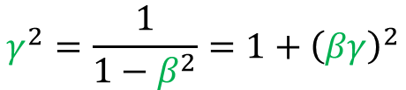





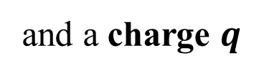

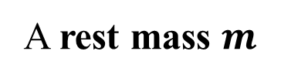





Particle definition
(considered as known)
A rest mass $m$
and a charge $q$
$$q/m$$
In 3D-dynamics world, the particle is a dot at :
Position : $\vec{r}$
Motion : change of $\vec{r}$ with respect to an independent variable (time: $t$)
Velocity : $\vec{v}=\frac{d\vec{r}}{dt}$
c $=299 792 458$ m/s
Momentum : $\vec{p}=γ∙m∙\vec{v}$
Total energy : $W$
$$W^{2}={\left(mc^{2}\right)}^{2}+\left(\vec{p}∙\vec{p}\right)c^{2}$$
Kinetic energy : $K$
$$={\left(mc^{2}+K\right)}^{2}$$
Motion
Velocity : $\vec{β}=\frac{\vec{v}}{c}$
Momentum : $\vec{βγ}=\frac{\vec{p}}{mc}$
$$γ^{2}=\frac{1}{1−β^{2}}=1+{\left(βγ\right)}^{2}$$
Reduced
Energy : $γ=\frac{W}{mc^{2}}$
IPAC2026 – Deauville, France - Beam Dynamics in EM Fields (1h) - Nicolas Pichoff (CEA-Saclay) 4

Slide 5
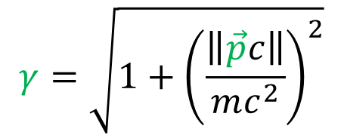
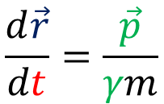
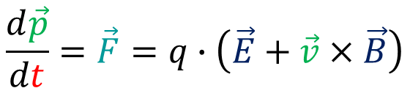
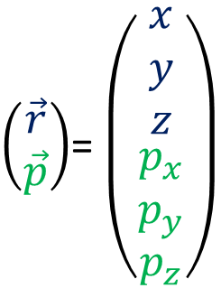
Particle Motion (Lorentz)
(considered as known)
$\left(\begin{matrix}\vec{r} \\ \vec{p}\end{matrix}\right)$= $\left(\begin{matrix}\begin{aligned}x \\ y \\ z\end{aligned} \\ \begin{aligned}p_{x} \\ p_{y} \\ p_{z}\end{aligned}\end{matrix}\right)$
At a given t , a particle is represented by a 6-coordinates vector :
The evolution (with independent variable t) of these vectors are given by :
$$\frac{d\vec{p}}{dt}=\vec{F}=q∙\left(\vec{E}+\vec{v}×\vec{B}\right)$$
$$γ=\sqrt{1+{\left(\frac{\left\|\vec{p}c\right\|}{mc^{2}}\right)}^{2}}$$
With :
$$\frac{d\vec{r}}{dt}=\frac{\vec{p}}{γm}$$
$\vec{E}$and $\vec{B}$are the electromagnetic fields produced by external sources and the particles (position and motion) themselves.
IPAC2026 – Deauville, France - Beam Dynamics in EM Fields (1h) - Nicolas Pichoff (CEA-Saclay) 5

Slide 6









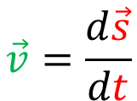
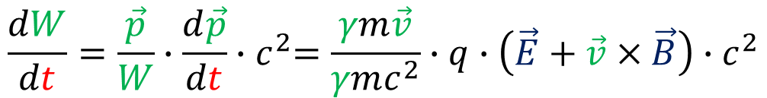
Energy gain
The energy evolution with time t is :
$$\left(W^{2}={\left(mc^{2}\right)}^{2}+\left(\vec{p}∙\vec{p}\right)c^{2}\right)$$
$$\frac{dW}{dt}=\frac{\vec{p}}{W}∙\frac{d\vec{p}}{dt}{∙c}^{2}=\frac{γm\vec{v}}{γmc^{2}}∙q∙\left(\vec{E}+\vec{v}×\vec{B}\right)∙c^{2}$$
$$=q∙\left(\vec{v}∙\vec{E}+\vec{v}∙\left(\vec{v}×\vec{B}\right)\right)$$
$$=0$$
Only the electric field gives (kinetic) energy to the beam
$=q∙$ $\vec{v}∙\vec{E}$
⇒
$$\vec{s_{1}}$$
$$\vec{v}=\frac{d\vec{s}}{dt}$$
$$d\vec{s}$$
$$\vec{s}$$
$$\vec{s_{0}}$$
$∆W\left(\vec{s_{0}}→\vec{s_{1}}\right)=$ $q∙\int_{\vec{s_{0}}}^{\vec{s_{1}}}{\vec{E}}\left(\vec{s},t\right)∙d\vec{s}$
The energy gain is the path integral of the electric field
⇒
IPAC2026 – Deauville, France - Beam Dynamics in EM Fields (1h) - Nicolas Pichoff (CEA-Saclay) 6

Slide 7
Particle accelerator
4’
IPAC2026 – Deauville, France - Beam Dynamics in EM Fields (1h) - Nicolas Pichoff (CEA-Saclay) 7

Slide 8
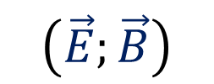


Acceleration/deviation
An accelerator is a set of technological components producing ElectroMagnetic fields allowing to accelerate and guide particles.
$$\left(\vec{E};\vec{B}\right)$$
Acceleration is produced (generaly) by time varying electric field
$$\vec{E} \left(\vec{r},t\right)$$
RF cavities
Plasma
Exception @ low energy : Electrostatic
Guiding is produced (generaly) by static magnetic field
$$\vec{B}\left(\vec{r}\right)$$
Deviation with Dipoles
Focalisation with Quadrupoles or Solenoids
Stabilisation with higher-order Multipoles
Exception @ low energy : Electrostatic
IPAC2026 – Deauville, France - Beam Dynamics in EM Fields (1h) - Nicolas Pichoff (CEA-Saclay) 8

Slide 9
Reference trajectory
An accelerator is designed around a reference trajectory (design orbit in circular accelerators), which is:
- A strait line in drift, focusing or accelerating elements,
- An arc of circle in dipole magnets.
Linac
line
s
Cyclotron
Synchrotron
s
s
s
~spiral
~circle
The beam dynamics is computed along the reference trajectory as a function of the curved abscissa : s, replacing t as the independent variable.
IPAC2026 – Deauville, France - Beam Dynamics in EM Fields (1h) - Nicolas Pichoff (CEA-Saclay) 9

Slide 10
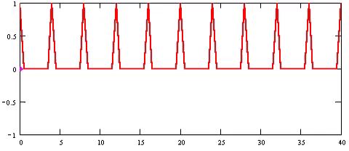
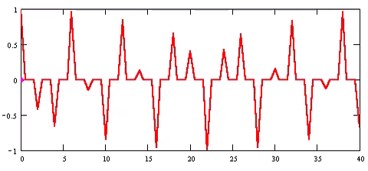
Synchronous particle
The synchronous particle is an hypothetical particle propagating along the reference trajectory.
It is used to synchronize the time-varying (RF) components.
It represents the accelerator and not the beam.
It gives the nominal arrival time and energy at a given s, by design.
All the beam particles will be represented with respect to this synchronous particle.
IPAC2026 – Deauville, France - Beam Dynamics in EM Fields (1h) - Nicolas Pichoff (CEA-Saclay) 10

Slide 11
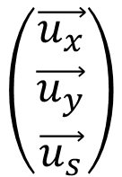




Moving frame
Particle motion is described in a moving frame, centered on the orthogonal projection of the particle on the reference trajectory.
$$\left(\begin{matrix}\vec{u_{x}} \\ \begin{aligned}\vec{u_{y}} \\ \vec{u_{s}}\end{aligned}\end{matrix}\right)$$
$$\vec{u_{s}}$$
: tangent to the reference trajectory
$$\vec{u_{x}}$$
: in rotation plan (pointing to the left)
transverse
plan
$$\vec{u_{y}}$$
: in vertical direction (pointing to the top)
M is the particle point at time t
s is absissa of the transverse plan, orthogonal to the reference trajectory containing M
$$\left(\begin{matrix}x \\ y\end{matrix}\right)$$
In this plan, the particle position is :
IPAC2026 – Deauville, France - Beam Dynamics in EM Fields (1h) - Nicolas Pichoff (CEA-Saclay) 11

Slide 12
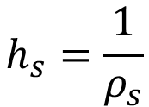
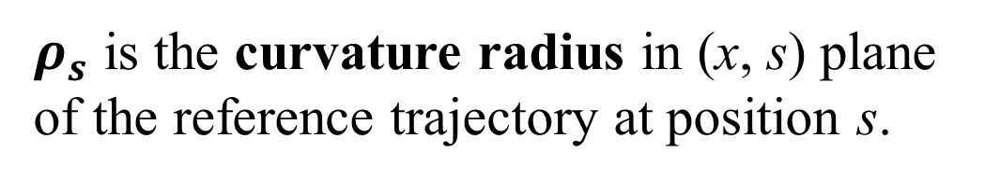
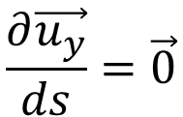
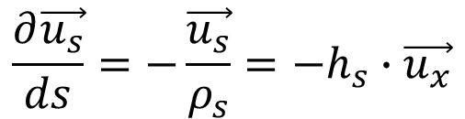
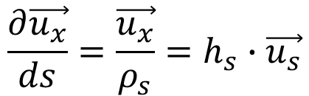
Moving frame change
The moving frame depends on s.
$$\frac{∂\vec{u_{x}}}{ds}=\frac{\vec{u_{x}}}{ρ_{s}}=h_{s}∙\vec{u_{s}}$$
$ρ_{s}$ is the curvature radius in (x, s) plane of the reference trajectory at position s.
$$\frac{∂\vec{u_{s}}}{ds}=−\frac{\vec{u_{s}}}{ρ_{s}}=−h_{s}∙\vec{u_{x}}$$
$$\frac{∂\vec{u_{y}}}{ds}=\vec{0}$$
with :
$$h_{s}=\frac{1}{ρ_{s}}$$
On a curved trajectory, moving frame vectors are not constant
IPAC2026 – Deauville, France - Beam Dynamics in EM Fields (1h) - Nicolas Pichoff (CEA-Saclay) 12

Slide 13
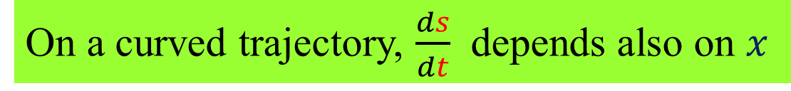
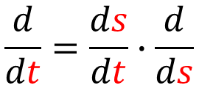
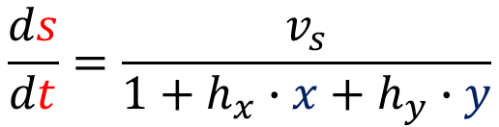

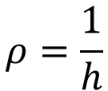
Derivative with s
Independent variable : t → s
$$\frac{d}{dt}=\frac{ds}{dt}∙\frac{d}{ds}$$
If there is bending in ($x$, $z$) plan with curvature radius:
$$ρ=\frac{1}{h}$$
l
x
s-ds/2
s
s+ds/2
One has :
$$\frac{ds}{dt}=\frac{v_{s}}{1+h∙x}$$
ds
ρ=1/h
More generally :
$$\frac{ds}{dt}=\frac{v_{s}}{1+h_{x}∙x+h_{y}∙y}$$
On a curved trajectory, $\frac{ds}{dt}$ depends also on $x$
IPAC2026 – Deauville, France - Beam Dynamics in EM Fields (1h) - Nicolas Pichoff (CEA-Saclay) 13

Slide 14
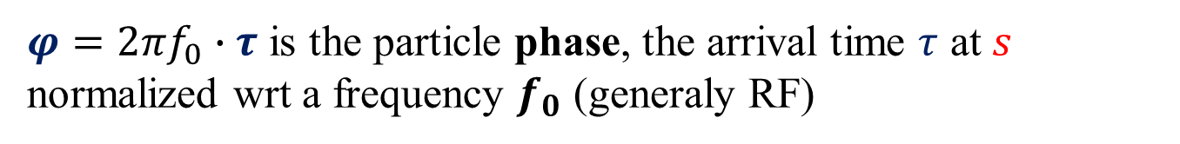
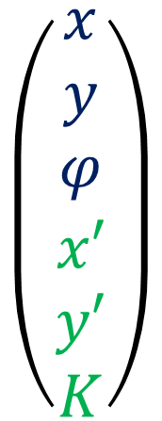
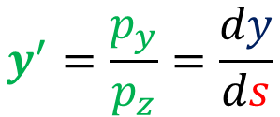
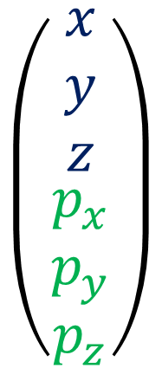
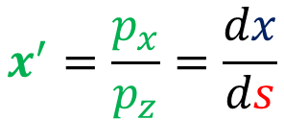

New particle representation
In this new frame and independent variable, a particle vector becomes:
t
→
s
-
(x, y) are (still) the particle transverse coordinates
↓
↓
-
$$x^{′}=\frac{p_{x}}{p_{z}}=\frac{dx}{ds}$$
$$y^{′}=\frac{p_{y}}{p_{z}}=\frac{dy}{ds}$$
and
$$\left(\begin{matrix}\begin{aligned}x \\ y \\ z\end{aligned} \\ \begin{aligned}p_{x} \\ p_{y} \\ p_{z}\end{aligned}\end{matrix}\right)$$
$$\left(\begin{matrix}\begin{aligned}x \\ y \\ φ\end{aligned} \\ \begin{aligned}x′ \\ y′ \\ K\end{aligned}\end{matrix}\right)$$
are the particle transverse slopes
→
-
$φ=2πf_{0}∙τ$ is the particle phase, the arrival time $τ$ at $s$ normalized wrt a frequency $f_{0}$ (generaly RF)
$$\vec{P}\left(s\right)$$
-
K is the particle kinetic energy
IPAC2026 – Deauville, France - Beam Dynamics in EM Fields (1h) - Nicolas Pichoff (CEA-Saclay) 14

Slide 15
RF acceleration & Longitudinal dynamics
9’30
IPAC2026 – Deauville, France - Beam Dynamics in EM Fields (1h) - Nicolas Pichoff (CEA-Saclay) 15

Slide 16


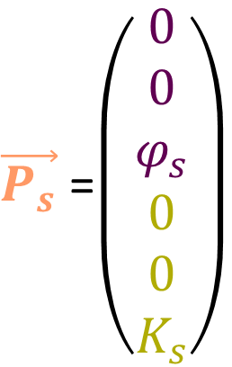


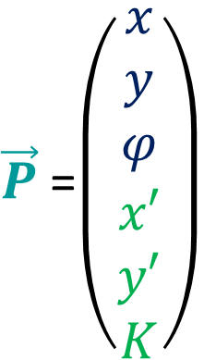





Longitudinal phase-space
$\vec{P_{s}}$=$\left(\begin{matrix}\begin{aligned}0 \\ 0 \\ φ_{s}\end{aligned} \\ \begin{aligned}0 \\ 0 \\ K_{s}\end{aligned}\end{matrix}\right)$
Each beam particle is represented relatively to the synchronous particle
$\vec{P}$=$\left(\begin{matrix}\begin{aligned}x \\ y \\ φ\end{aligned} \\ \begin{aligned}x′ \\ y′ \\ K\end{aligned}\end{matrix}\right)$
Phase or time:
$$δφ=φ−φ_{s}$$
Energy:
$$δK=K−K_{s}$$
Early particles
$$δK$$
Late particles
$$K$$
$$K_{s}$$
$$φ$$
$$φ_{s}$$
ϕ
$$δφ$$
$$\left(\begin{matrix}δφ \\ δK\end{matrix}\right)$$
The longitudinal dynamics describes particle trajectories in 2D phase-space
IPAC2026 – Deauville, France - Beam Dynamics in EM Fields (1h) - Nicolas Pichoff (CEA-Saclay) 16

Slide 17
RF cavity
Goal : Give kinetic energy to the beam
RF power supply
Basic principle
- Conductor enclosing a close volume,
- Maxwell equations + Boundary conditions allow possible electromagnetic field E_{n}/B_{n} configurations each oscillating with a given frequency f_{n} : a resonant mode. The field is a weighted superposition of these modes.
Wave guide
Power coupler
- The wanted (accelerating) mode is excited at the good frequency and position from a RF power supply through a power coupler,
Cavity
The phase of the electric field is adjusted to accelerate the beam.
$$\vec{E}\left(\vec{r},t\right)=\vec{E_{0}}\left(\vec{r}\right)∙sin⁡\left(2πf_{RF}t+φ_{0}\right)$$
$$\vec{B}\left(\vec{r},t\right)=\vec{B_{0}}\left(\vec{r}\right)∙cos⁡\left(2πf_{RF}t+φ_{0}\right)$$
IPAC2026 – Deauville, France - Beam Dynamics in EM Fields (1h) - Nicolas Pichoff (CEA-Saclay) 17

Slide 18

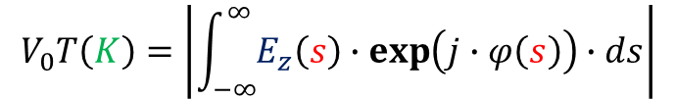
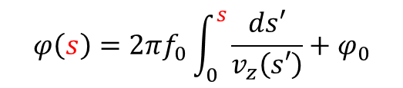

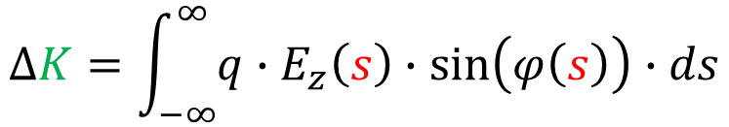
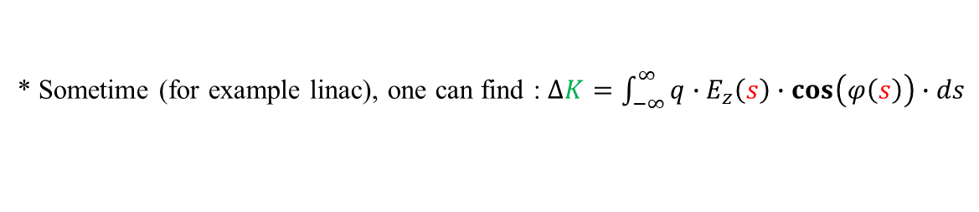
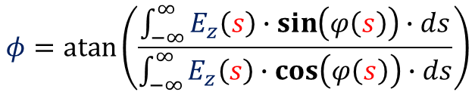
Energy gain
Energy gained by a particle in a cavity :
$$∆K=\int_{−∞}^{∞}{q∙E_{z}\left(s\right)∙\sin\left(φ\left(s\right)\right)∙ds}$$
$$φ\left(s\right)=2πf_{0}\int_{0}^{s}{\frac{ds′}{v_{z}\left(s′\right)}}+φ_{0}$$
*
with :
The field phase when the particle is at position $s$
⇒
$$∆K=q∙V_{0}T\left(K\right)∙\sin\left(φ\right)$$
$$V_{0}T\left(K\right)=\left|\int_{−∞}^{∞}{E_{z}\left(s\right)∙\exp\left(j∙φ\left(s\right)\right)∙ds}\right|$$
$$φ=atan⁡\left(\frac{\int_{−∞}^{∞}{E_{z}\left(s\right)∙\sin\left(φ\left(s\right)\right)∙ds}}{\int_{−∞}^{∞}{E_{z}\left(s\right)∙\cos\left(φ\left(s\right)\right)∙ds}}\right)$$
with :
The cavity effective voltage
The particle effective phase in the cavity
* Sometime (for example linac), one can find : $∆K=\int_{−∞}^{∞}{q∙E_{z}\left(s\right)∙\cos\left(φ\left(s\right)\right)∙ds}$
IPAC2026 – Deauville, France - Beam Dynamics in EM Fields (1h) - Nicolas Pichoff (CEA-Saclay) 18

Slide 19
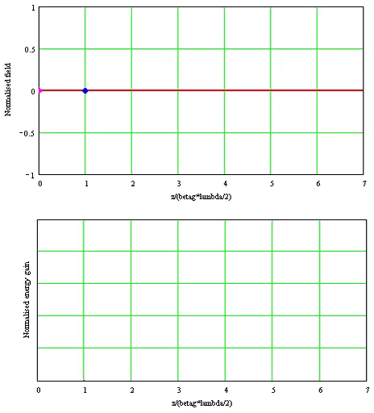



Energy gain in a multicell cavity
$$=1$$
$$∆K=q∙V_{0}T\left(K\right)∙\sin\left(φ\right)$$
Cavity Oscillating field
Electric field
Field seen by an optimal velocity particle
Field seen by a non-optimal velocity particle
Hypothetical max energy gain : $q∙V_{0}$
Energy gain
Energy gained by the optimal velocity particle
Energy gained by a non-optimal velocity particle
IPAC2026 – Deauville, France - Beam Dynamics in EM Fields (1h) - Nicolas Pichoff (CEA-Saclay) 19

Slide 20


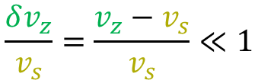
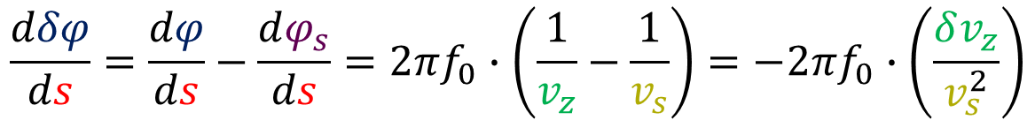
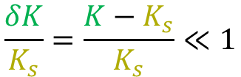
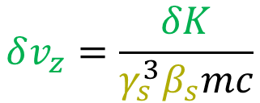
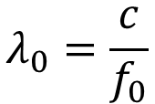
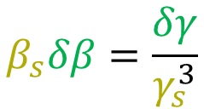
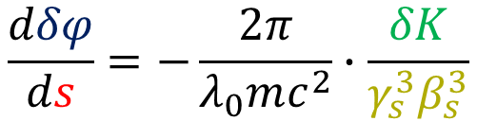
Relative phase change in drift (no bending)
$$\frac{dδφ}{ds}=\frac{dφ}{ds}−\frac{dφ_{s}}{ds}=2πf_{0}∙\left(\frac{1}{v_{z}}−\frac{1}{v_{s}}\right)=−2πf_{0}∙\left(\frac{δv_{z}}{v_{s}^{2}}\right)$$
$$\frac{δK}{K_{s}}=\frac{K−K_{s}}{K_{s}}≪1$$
$$v_{z}=\frac{v}{1+x^{′2}+y^{′2}}≈v$$
$$\frac{δv_{z}}{v_{s}}=\frac{v_{z}−v_{s}}{v_{s}}≪1$$
First order simplification :
$$β_{s}δβ=\frac{δγ}{γ_{s}^{3}}$$
$$δv_{z}=\frac{δK}{γ_{s}^{3}β_{s}mc}$$
$$1−β^{2}=γ^{−2}$$
→
→
One gets (at first order) :
$$\frac{dδφ}{ds}=−\frac{2π}{λ_{0}mc^{2}}∙\frac{δK}{γ_{s}^{3}β_{s}^{3}}$$
$$λ_{0}=\frac{c}{f_{0}}$$
IPAC2026 – Deauville, France - Beam Dynamics in EM Fields (1h) - Nicolas Pichoff (CEA-Saclay) 20

Slide 21
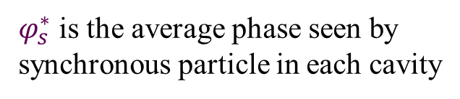


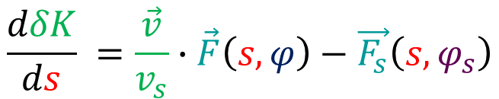
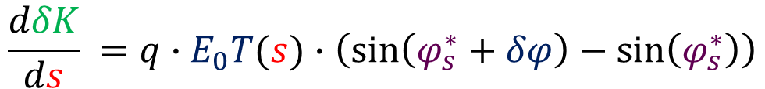

Relative energy change in RF cavity
$$\frac{dδK}{ds} =\frac{\vec{v}}{v_{s}}∙\vec{F}\left(s,φ\right)−\vec{F_{s}}\left(s,φ_{s}\right)$$
$$\vec{F}\left(s,φ\right)=q∙E_{0}T(s)∙\sin\left(φ−φ_{c}\right)$$
$$\vec{F_{s}}\left(s,φ_{s}\right)=q∙E_{0}T(s)∙\sin\left(φ_{s}−φ_{c}\right)$$
$$=q∙E_{0}T(s)∙\sin\left(φ_{s}−φ_{c}+δφ\right)$$
One gets (at first order) :
$$\frac{dδK}{ds} =q∙E_{0}T(s)∙\left(\sin\left(φ_{s}^{∗}+δφ\right)−\sin\left(φ_{s}^{∗}\right)\right)$$
$$φ_{s}^{∗}=φ_{s}−φ_{c}$$
$φ_{s}^{∗}$ is the average phase seen by synchronous particle in each cavity
IPAC2026 – Deauville, France - Beam Dynamics in EM Fields (1h) - Nicolas Pichoff (CEA-Saclay) 21

Slide 22
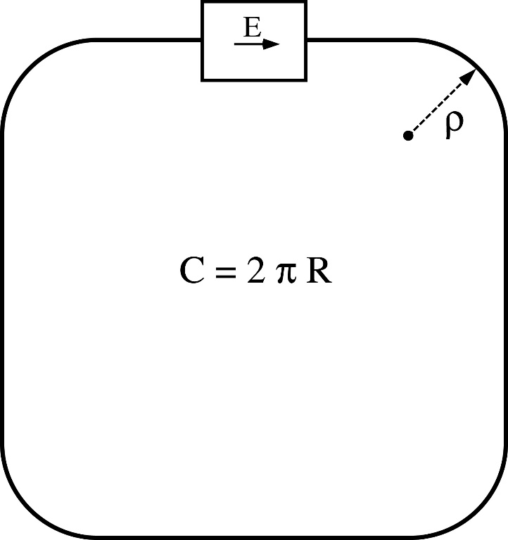


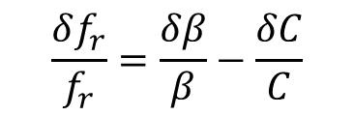





Specificity for circular machine
$$η=\frac{{δf_{r}}/{f_{r}}}{{δp}/p}$$
is the relative variation of revolution frequency with respect to the relative momentum
$$f_{r}=\frac{βc}{C}$$
$$\frac{δf_{r}}{f_{r}}=\frac{δβ}{β}−\frac{δC}{C}$$
⇒
⇒
$$η=γ^{−2}−α$$
$$f_{r}=\frac{βc}{C}$$
$$α=\frac{{δC}/C}{{δp}/p}$$
is the momentum compaction
It is specific to circular machine ($α=$0 in linac)
The beam revolution frequency.
$$η>0$$
Velocity dominated : A higher energy particle turns faster
→ linacs and low energy synchrotrons.
Trajectory dominated : A higher energy particle turns slower
→ high energy synchrotrons.
$$η<0$$
IPAC2026 – Deauville, France - Beam Dynamics in EM Fields (1h) - Nicolas Pichoff (CEA-Saclay) 22

Slide 23









Specificity for circular machine
In cavity, the electric field is oscillating with time :
$$E_{z}=E_{0}∙sin\left(φ\right)$$
‼ In some convention, one can have $E_{z}=E_{0}∙cos\left(φ\right)$
$$δK=q∙V_{0}T(s)∙\left(\sin\left(φ_{s}^{∗}+δφ\right)−\sin\left(φ_{s}^{∗}\right)\right)$$
Case 1: Velocity dominated
Case 2: Trajectory dominated
$$η>0$$
$$η<0$$
late
early
early
late
$$δK$$
$$δK$$
$$0°≤φ_{s}^{∗}≤90°$$
$$90°≤φ_{s}^{∗}≤180°$$
0°
90°
180°
0°
90°
180°
$$φ$$
$$φ$$
late
late
The late particle shall gain more energy
The early particle shall gain more energy
(to increase its speed)
(to elongate its trajectory)
IPAC2026 – Deauville, France - Beam Dynamics in EM Fields (1h) - Nicolas Pichoff (CEA-Saclay) 23

Slide 24





Correction in circular machine
In linac
In general
$$\frac{dδφ}{ds}=−\frac{2π}{λ_{0}mc^{2}}∙\frac{δK}{γ_{s}^{3}β_{s}^{3}}$$
$$η=\frac{1}{γ_{s}^{2}}−α$$
+
$$\frac{1}{γ_{s}^{2}}$$
$$η=\frac{1}{γ_{s}^{2}}−α$$
➔
Replace
by
$$\frac{dδφ}{ds}=−\frac{2π η}{λ_{0}mc^{2}}∙\frac{δK}{γ_{s}β_{s}^{3}}$$
➔
IPAC2026 – Deauville, France - Beam Dynamics in EM Fields (1h) - Nicolas Pichoff (CEA-Saclay) 24

Slide 25













Phase-space trajectories
In cavities
Between cavities
In accelerator
$$δK$$
$$δK$$
$$δK$$
$η$>0
$$δφ$$
$$δφ$$
$$δφ$$
$$δK$$
$$δK$$
$$δK$$
$η$<0
$$δφ$$
$$δφ$$
IPAC2026 – Deauville, France - Beam Dynamics in EM Fields (1h) - Nicolas Pichoff (CEA-Saclay) 25

Slide 26





Longitudinal motion equation
$$\frac{dδφ}{ds}=−\frac{2π η}{λ_{0}mc^{2}}∙\frac{δK}{γ_{s}β_{s}^{3}}$$
$$=−\frac{∂H\left(δφ,δK\right)}{∂δK}$$
$$\frac{dδK}{ds} =q∙E_{0}T(s)∙\left(\sin\left(φ_{s}^{∗}+δφ\right)−\sin\left(φ_{s}^{∗}\right)\right)$$
$$=\frac{∂H\left(δφ,δK\right)}{∂δφ}$$
$H\left(δφ,δK\right)$ is the motion Hamiltonian :
$$H\left(δφ,δK\right)=\frac{π η}{λ_{0}mc^{2}}∙\frac{δK^{2}}{γ_{s}β_{s}^{3}}$$
$$−q∙E_{0}T(s)∙\left(\sin\left(φ_{s}^{∗}\right)∙\left(δφ−\sin\left(δφ\right)\right)−cos\left(φ_{s}^{∗}\right)∙\left(1−\cos\left(δφ\right)\right)\right)$$
IPAC2026 – Deauville, France - Beam Dynamics in EM Fields (1h) - Nicolas Pichoff (CEA-Saclay) 26

Slide 27








Hamiltonian
The particle motion can be described using a function of phase and energy: the motion Hamiltonian $H\left(δφ,δK\right)$
$$\left(\begin{matrix}−\frac{∂H}{∂δK} \\ \frac{∂H}{∂δφ}\end{matrix}\right)$$
$$δK$$
Hamiltonian definition:
$$\left(\begin{matrix}\frac{∂H}{∂δφ} \\ \frac{∂H}{∂δK}\end{matrix}\right)$$
$$\frac{dδφ}{ds}=−\frac{∂H\left(δφ,δK\right)}{∂δK}$$
$$\frac{dδK}{ds} =\frac{∂H\left(δφ,δK\right)}{∂δφ}$$
iso-Hamiltonan cuves : $H$ = Cste
$$δφ$$
The Hamiltonian $H\left(δφ,δK\right)$ gives the particle trajectory in phase-space
IPAC2026 – Deauville, France - Beam Dynamics in EM Fields (1h) - Nicolas Pichoff (CEA-Saclay) 27

Slide 28







Phase-space trajectories
$φ_{s}=0°$ : no acceleration (storage), maximum stability
$φ_{s}=60°$ : acceleration, but reduced stability
$$δK$$
$$δK$$
$$δφ$$
$$δφ$$
IPAC2026 – Deauville, France - Beam Dynamics in EM Fields (1h) - Nicolas Pichoff (CEA-Saclay) 28

Slide 29
Linear dynamics
27’30
IPAC2026 – Deauville, France - Beam Dynamics in EM Fields (1h) - Nicolas Pichoff (CEA-Saclay) 29

Slide 30






Particle motion in an accelerator
$$\frac{d\vec{p}}{dt}=q∙\left(\vec{v}×\vec{B}+\vec{E}\right)=\vec{F}$$
$\vec{P}$=$\left(\begin{matrix}\begin{aligned}x \\ y \\ φ\end{aligned} \\ \begin{aligned}x′ \\ y′ \\ K\end{aligned}\end{matrix}\right)$
$\vec{P_{s}}$=$\left(\begin{matrix}\begin{aligned}0 \\ 0 \\ φ_{s}\end{aligned} \\ \begin{aligned}0 \\ 0 \\ K_{s}\end{aligned}\end{matrix}\right)$
+
$$\vec{p}=mc∙γ\vec{β}$$
$$\frac{ds}{dt}=\frac{β_{z}c}{\left(1+h\left(K,s\right)∙x\right)}$$
(p. 13)
$$\vec{δP}=\vec{P}−\vec{P_{s}}$$
IPAC2026 – Deauville, France - Beam Dynamics in EM Fields (1h) - Nicolas Pichoff (CEA-Saclay) 30

Slide 31








Motion equations
With :
$$\frac{dx}{ds}=x′$$
$$γ=1+\frac{K}{mc^{2}}$$
$$β_{z}=\sqrt{\frac{1−γ^{−2}}{1+{x′}^{2}+{y′}^{2}}}$$
$$\frac{dy}{ds}=y′$$
$$\frac{dφ}{ds}=\frac{2π}{λ_{0}}\frac{\left(1+h\left(K,s\right)∙x\right)}{β_{z}c}$$
$$\vec{F}=q∙\left(\vec{E}+\vec{v}×\vec{B}\right)$$
$$\frac{d\vec{P}}{ds}$$
$$\frac{dx′}{ds}= h_{s}\left(s\right) + \left(1+h\left(K,s\right)∙x\right)∙\frac{F_{x}\left(s\right)}{mc^{2}{γβ}_{z}^{2}} + x^{′}∙\frac{dγβ_{z}}{γβ_{z}ds}$$
$$\frac{dy′}{ds}= \left(1+h\left(K,s\right)∙x\right)∙\frac{F_{y}\left(s\right)}{mc^{2}{γβ}_{z}^{2}} + y^{′}∙\frac{dγβ_{z}}{γβ_{z}ds}$$
$$\frac{dK}{ds} = \left(1+h\left(K,s\right)∙x\right)∙\left(\vec{v}∙\vec{F}\left(s\right)\right)$$
Centrifugal force
Acceleration damping
EM force
IPAC2026 – Deauville, France - Beam Dynamics in EM Fields (1h) - Nicolas Pichoff (CEA-Saclay) 31

Slide 32







Linearisation
These equations are :
Non-linear
$$F_{x}\left(…,x,x^{2},…\right)$$
$$F_{y}\left(…,y,y^{2},…\right)$$
Coupled
$$F_{x}\left(…,y,φ,K,…\right)$$
$$F_{y}\left(…,x, φ,K,…\right)$$
$$\frac{dx′}{ds}∝x^{′}∙\frac{dγβ_{z}}{γβ_{z}ds}$$
$$\frac{dy′}{ds}∝y^{′}∙\frac{dγβ_{z}}{γβ_{z}ds}$$
Damped
In order to solve the particle dynamics, one shall compute (generally numerically) these complex equations.
Nevertheless the computation can by simplified (and understood) by linearising the forces around the synchronous particle and using a “simple” matrix formalism.
$$\vec{δP}=\vec{P}−\vec{P_{s}}$$
IPAC2026 – Deauville, France - Beam Dynamics in EM Fields (1h) - Nicolas Pichoff (CEA-Saclay) 32

Slide 33



Longitudinal dynamics linearisation
$$∆δK=q∙V_{0}T\left(s,K\right)∙\sin\left(φ_{s}^{∗}+δφ\right)−q∙V_{0}T\left(s,K_{s}\right)∙\sin\left(φ_{s}^{∗}\right)$$
$$δφ≪1$$
$$\sin\left(φ_{s}^{∗}+δφ\right)=\sin\left(φ_{s}^{∗}\right)+cos\left(φ_{s}^{∗}\right)∙δφ$$
$$V_{0}T\left(s,K\right)=V_{0}T\left(s,K_{s}\right)+\frac{∂V_{0}T}{∂K}\left(s,K_{s}\right)∙δK$$
$$δK≪K_{s}$$
$$∆δK=q∙V_{0}T\left(s,K_{s}\right)∙\cos\left(φ_{s}^{∗}\right){∙δφ}+q∙\frac{∂V_{0}T}{∂K}\left(s,K_{s}\right)∙\sin\left(φ_{s}^{∗}\right)∙δK$$
→
IPAC2026 – Deauville, France - Beam Dynamics in EM Fields (1h) - Nicolas Pichoff (CEA-Saclay) 33

Slide 34



Matrix formalism
$$\frac{dδP_{i}}{ds}=\sum_{j=1}^{6}{\frac{∂δP_{i}}{∂δP_{j}}(s)}∙{δP}_{j}$$
Linearised differential motion equations :
$${δP}_{i}\left(s+ds\right)={δP}_{i}\left(s\right)+\sum_{j=1}^{6}{\frac{∂δP_{i}}{∂{δP}_{j}}(s)∙ds∙{δP}_{j}}\left(s\right)$$
→
$${\left(\begin{matrix}\begin{aligned}x \\ y \\ δφ\end{aligned} \\ \begin{aligned}x^{′} \\ y^{′} \\ δK\end{aligned}\end{matrix}\right)}_{s+ds}=\left(I+\left[\frac{∂δP_{i}}{∂δP_{j}}(s)\right]∙ds\right)∙{\left(\begin{matrix}\begin{aligned}x \\ y \\ δφ\end{aligned} \\ \begin{aligned}x^{′} \\ y^{′} \\ δK\end{aligned}\end{matrix}\right)}_{s}$$
→
6×6 Matrix
IPAC2026 – Deauville, France - Beam Dynamics in EM Fields (1h) - Nicolas Pichoff (CEA-Saclay) 34

Slide 35


Transfer matrix
From an abscissa $s_{1}$ to an abscissa $s_{2}$:
$${\left(\begin{matrix}\begin{aligned}x \\ y \\ δφ\end{aligned} \\ \begin{aligned}x^{′} \\ y^{′} \\ δK\end{aligned}\end{matrix}\right)}_{s_{2}}=\left[T(s_{2}←s_{1})\right]∙{\left(\begin{matrix}\begin{aligned}x \\ y \\ δφ\end{aligned} \\ \begin{aligned}x^{′} \\ y^{′} \\ δK\end{aligned}\end{matrix}\right)}_{s_{1}}$$
$\left[T(s_{2}←s_{1})\right]$ is the transfer matrix from $s_{1}$to $s_{2}$.
Each accelerator element can be modeled (at first order) by a transfer matrix.
IPAC2026 – Deauville, France - Beam Dynamics in EM Fields (1h) - Nicolas Pichoff (CEA-Saclay) 35

Slide 36










Accelerator matrix
For an accelerator from an abscissa $s_{0}$ to an abscissa $s_{n}$
component 1
component 2
component n
$$…$$
$$s_{0}$$
$$s_{1}$$
$$s_{2}$$
$$s_{n−1}$$
$$s_{n}$$
$${\left(\begin{matrix}\begin{aligned}x \\ y \\ δφ\end{aligned} \\ \begin{aligned}x^{′} \\ y^{′} \\ δK\end{aligned}\end{matrix}\right)}_{s_{n}}=\left[T(s_{n}←s_{n−1})\right]∙ .. . ∙\left[T(s_{2}←s_{1})\right]∙\left[T(s_{1}←s_{0})\right]∙{\left(\begin{matrix}\begin{aligned}x \\ y \\ δφ\end{aligned} \\ \begin{aligned}x^{′} \\ y^{′} \\ δK\end{aligned}\end{matrix}\right)}_{s_{0}}$$
from $s_{0}$ to $s_{1}$
from $s_{0}$ to $s_{2}$
from $s_{0}$ to $s_{n}$
IPAC2026 – Deauville, France - Beam Dynamics in EM Fields (1h) - Nicolas Pichoff (CEA-Saclay) 36

Slide 37
















Transfer matrix of a drift
The drift is a length with no field.
Drift length : L
$$x′$$
$$y′$$
$$δK$$
$$x′∙L$$
$$y′∙L$$
$$k∙L$$
0
L
s
$$x$$
$$y$$
$$δφ$$
in
out
$$x_{o}=x_{i}+x_{i}^{′}∙L$$
$$\left[T\right]=\left(\begin{matrix}\begin{matrix}1 & 0 & 0 \\ 0 & 1 & 0 \\ 0 & 0 & 1\end{matrix} & \begin{matrix}L & 0 & 0 \\ 0 & L & 0 \\ 0 & 0 & 0 \end{matrix} \\ \begin{matrix}0 & 0 & 0 \\ 0 & 0 & 0 \\ 0 & 0 & 0\end{matrix} & \begin{matrix}1 & 0 & 0 \\ 0 & 1 & 0 \\ 0 & 0 & kL\end{matrix}\end{matrix}\right)$$
$$x_{o}^{′}=x_{i}^{′}$$
$$y_{o}=y_{i}+y_{i}^{′}∙L$$
$$y_{o}^{′}=y_{i}^{′}$$
$$δφ_{o}=δφ_{i}−\frac{2π }{λ_{0}mc^{2}}∙\frac{δK_{i}}{{γ_{s}^{3}β}_{s}^{3}}∙L=δφ_{i}+kL∙δK_{i}$$
$$δK_{o}=δK_{i}$$
IPAC2026 – Deauville, France - Beam Dynamics in EM Fields (1h) - Nicolas Pichoff (CEA-Saclay) 37

Slide 38



















Transfer matrix of a magnetic thin length
A thin length with focal lengths : $f_{x}$ and $f_{y}$
$$x$$
$$x′$$
$$y′$$
$$δK$$
$$−\frac{y\left(0\right)}{f_{y}}$$
$$−\frac{x\left(0\right)}{f_{x}}$$
$$x$$
$$y$$
$$δφ$$
0
$$f$$
s
$f_{x}$ > 0 : focusing
$f_{y}$ < 0 : defocusing
$$x_{o}=x_{i}$$
$$\left[T\right]=\left(\begin{matrix}\begin{matrix} 1 & 0 & 0 \\ 0 & 1 & 0 \\ 0 & 0 & 1\end{matrix} & \begin{matrix}0 & 0 & 0 \\ 0 & 0 & 0 \\ 0 & 0 & 0\end{matrix} \\ \begin{matrix}k_{x} & 0 & 0 \\ 0 & k_{y} & 0 \\ 0 & 0 & 0\end{matrix} & \begin{matrix}1 & 0 & 0 \\ 0 & 1 & 0 \\ 0 & 0 & 1\end{matrix}\end{matrix}\right)$$
$$x_{o}^{′}=x_{i}−\frac{x_{i}}{f_{x}}=x_{i}+k_{x}∙x_{i}$$
$$y_{o}=y_{i}$$
$$y_{o}^{′}=y_{i}^{′}−\frac{y_{i}}{f_{y}}=y_{i}^{′}+k_{y}∙y_{i}$$
$$δφ_{o}=δφ_{i}$$
$δK_{o}$= $δK_{i}$
IPAC2026 – Deauville, France - Beam Dynamics in EM Fields (1h) - Nicolas Pichoff (CEA-Saclay) 38

Slide 39
Periodic transport
31’
IPAC2026 – Deauville, France - Beam Dynamics in EM Fields (1h) - Nicolas Pichoff (CEA-Saclay) 39

Slide 40









Periodic uncoupled focusing
In the highest simplification level, the external force along direction w (x, y or δϕ) can be considered periodic, linear, uncoupled and undamped over one period :
$$\frac{d^{2}w}{ds^{2}}+k_{w}\left(s\right)∙w=0$$
Hill equation :
$$k_{w}\left(s+S\right)=k_{w}\left(s\right)$$
Giving :
$$w\left(s\right)=\sqrt{ε∙β_{wm}\left(s\right)}∙\text{cos}\left(μ\left(s\right)\right)$$
$ε$ constant,
with:
$μ\left(s\right)$= $μ_{0}+\int_{s_{0}}^{s}{\frac{ds}{β_{wm}\left(s\right)}}$
and:
$$β_{wm}\left(s+S\right)=β_{wm}\left(s\right)$$
In the (w, w’) phase-space, the particle is moving on an ellipse of equation :
$γ_{wm}\left(s\right)∙w^{2}+2∙α_{wm}\left(s\right)∙ww^{′}+β_{wm}\left(s\right)∙{w^{′}}^{2}=$ $ε$
$$α_{wm}\left(s\right)=−\frac{1}{2}∙\frac{dβ_{wm}}{ds}$$
$$γ_{wm}\left(s\right)=\frac{1+α_{wm}{\left(s\right)}^{2}}{β_{wm}\left(s\right)}$$
Courant-Snyder parameters
with :
and
The phase advance of the particle in a lattice is then :
$$σ=μ\left(s+S\right)−μ\left(s\right)$$
IPAC2026 – Deauville, France - Beam Dynamics in EM Fields (1h) - Nicolas Pichoff (CEA-Saclay) 40

Slide 41




Courant-Snyder parameters from matrix
The 2D (decoupled) transfer matrix of one lattice from $s$ to $s+S$ can be written :
$$\left[T_{w}(s+S←s)\right]=\left(\begin{matrix}\cos{σ}+α_{wm}\left(s\right)∙\sin{σ} & β_{wm}\left(s\right)∙\sin{σ} \\ −γ_{wm}\left(s\right)∙\sin{σ} & \cos{σ}−α_{wm}\left(s\right)∙\sin{σ}\end{matrix}\right)$$
$σ$ is the lattice phase advance and $α_{wm}$, $β_{wm}$ and $γ_{wm}$ are the Courant-Snyder at $s$:
$$\cos{σ}=\frac{1}{2}∙\left(T_{w_{11}}+T_{w_{22}}\right)$$
$$β_{wm}=\frac{T_{w_{12}}}{\sin{σ}}$$
$$γ_{wm}=−\frac{T_{w_{21}}}{\sin{σ}}$$
$$α_{wm}=\frac{T_{w_{11}}−T_{w_{22}}}{2∙sin{σ}}$$
IPAC2026 – Deauville, France - Beam Dynamics in EM Fields (1h) - Nicolas Pichoff (CEA-Saclay) 41

Slide 42

Example : motion in FODO lattice
Particle
Particle ellipse
Phase-space trajectory
Phase-space periodic looks
Foc. Quad. middle
Foc. Drift. middle
Ellipsis’ shapes are given by courant-Snyder parameters
Defoc. Quad. middle
Defoc. Drift. middle
Period after period, the particle is turning by an angle given by the phase advance (here 72°)
Particle trajectory
Particle ellipse maximum size
IPAC2026 – Deauville, France - Beam Dynamics in EM Fields (1h) - Nicolas Pichoff (CEA-Saclay) 42

Slide 43
Beam
37’30
IPAC2026 – Deauville, France - Beam Dynamics in EM Fields (1h) - Nicolas Pichoff (CEA-Saclay) 43

Slide 44






Beam distribution
A beam is a set of charged particles
It is represented by a distribution in 6D phase-space :
$$f\left(\vec{P},s\right)$$
$$f\left(\vec{P},s\right)∙d\vec{P}$$
is the average number of particles in $d\vec{P}$ phase-space cell.
$$\int{\int{f\left(\vec{P},s\right)∙d\vec{P}}}=N\left(s\right)$$
is the total number of particles in the beam
- Each dot is a (macro) particle
- The colour represents the particle density
- Statistics properties can be calculated from these distributions
2D projected phase-space distribution
1D projected phase-space evolution
IPAC2026 – Deauville, France - Beam Dynamics in EM Fields (1h) - Nicolas Pichoff (CEA-Saclay) 44

Slide 45



Beam statistics simplification
100 mA → $N$ = 6 10¹⁷ charges/s
1 nC → $N$ = 6 10⁹ charges
A beam should be represented by 6 times this huge number of particles.
Moreover, the exact 6D positions of each particle cannot be known precisely
The average value of a quantity $Q$, $\left\langle Q\right\rangle$, in the beam is defined by :
$$\left\langle Q\right\rangle \left(s\right)=\frac{1}{N}∙\int{\int{f\left(\vec{P},s\right)∙Q\left(\vec{P}\right)∙d\vec{P}}}$$
$Q$ can be a number, a vector, a matrix… the average applies to all components of $Q$.
→ The beam distribution can be simplified by its momenta
IPAC2026 – Deauville, France - Beam Dynamics in EM Fields (1h) - Nicolas Pichoff (CEA-Saclay) 45

Slide 46


Beam momenta
Order 0 :
$Q\left(s\right)=N\left(s\right)∙\left\langle q\right\rangle$, the bunch charge [C] or beam current [C/s]
Order 1 :
$\left\langle \vec{P}\right\rangle \left(s\right)$, the beam center of mass 6D vector
Order 2 :
$\left[Σ\right]\left(s\right)=\left\langle \vec{P}\left(s\right)∙{\vec{P}\left(s\right)}^{T}\right\rangle$, the beam 6×6 sigma matrix
$$\left[Σ\right]=\left[\left(\begin{matrix}\left\langle \left(P_{1}−\left\langle P_{1}\right\rangle \right)∙\left(P_{1}−\left\langle P_{1}\right\rangle \right)\right\rangle & ⋯ & \left\langle \left(P_{1}−\left\langle P_{1}\right\rangle \right)∙\left(P_{6}−\left\langle P_{6}\right\rangle \right)\right\rangle \\ ⋮ & ⋱ & ⋮ \\ \left\langle \left(P_{6}−\left\langle P_{6}\right\rangle \right)∙\left(P_{1}−\left\langle P_{1}\right\rangle \right)\right\rangle & ⋯ & \left\langle \left(P_{6}−\left\langle P_{6}\right\rangle \right)∙\left(P_{6}−\left\langle P_{6}\right\rangle \right)\right\rangle \end{matrix}\right)\right]$$
→
→ Order 0-2 are the most useful models of the beam
IPAC2026 – Deauville, France - Beam Dynamics in EM Fields (1h) - Nicolas Pichoff (CEA-Saclay) 46

Slide 47








RMS and 2D Ellipsis model
$$\tilde{P_{i}}=\sqrt{\left\langle \left(P_{i}−\left\langle P_{i}\right\rangle \right)∙\left(P_{i}−\left\langle P_{i}\right\rangle \right)\right\rangle }$$
$i$ RMS sizes
$$\tilde{P_{ij}}=\left\langle \left(P_{i}−\left\langle P_{i}\right\rangle \right)∙\left(P_{j}−\left\langle P_{j}\right\rangle \right)\right\rangle$$
$i$-$j$ RMS coupling
$$\tilde{ε_{ij}}=\sqrt{{\tilde{P_{i}}}^{2}∙{\tilde{P_{j}}}^{2}−{\tilde{P_{ij}}}^{2}}$$
RMS emittance
$$\tilde{γ_{j}}∙a_{i}^{2}+2∙\tilde{α_{ij}}∙a_{i}∙a_{j}+\tilde{β_{i}}∙a_{j}^{2}=n∙\tilde{ε_{ij}}$$
is the equation of an ellipsis fitting the distribution
$$\tilde{β_{i}}=\frac{{\tilde{P_{i}}}^{2}}{\tilde{ε_{ij}}}$$
$$\tilde{γ_{j}}=\frac{{\tilde{P_{j}}}^{2}}{\tilde{ε_{ij}}}$$
$$\tilde{α_{ij}}=\frac{\tilde{P_{ij}}}{\tilde{ε_{ij}}}$$
are the Twiss parameters of the beam distribution
IPAC2026 – Deauville, France - Beam Dynamics in EM Fields (1h) - Nicolas Pichoff (CEA-Saclay) 47

Slide 48
Matching
45’30
IPAC2026 – Deauville, France - Beam Dynamics in EM Fields (1h) - Nicolas Pichoff (CEA-Saclay) 48

Slide 49


Accelerator vs Beam
Accelerator
In non-linear forces, particles are moving in 6D phase-space following curves where motion Hamiltonian is (locally) constant
In periodic linearised forces, these curves are oscillating 6D ellipsoids
Beam
A beam can be described by a sigma matrix whose coefficients correspond to a description of a 6D ellipsoid
IPAC2026 – Deauville, France - Beam Dynamics in EM Fields (1h) - Nicolas Pichoff (CEA-Saclay) 49

Slide 50




Matched beam
The beam is matched to the accelerator when its sigma matrix fits the ellipsoid describing the particle linearised motion.
Phase-space trajectory
Phase-space periodic looks
beam
accelerator
$$\tilde{β_{w}} = β_{wm}$$
$$\tilde{α_{w}} = α_{wm}$$
$$\tilde{γ_{w}} = γ_{wm}$$
Matched beam
Bigger input beam
Smaller input beam
Phase-space scanned by the mismatched beams
50% mismatched beam
IPAC2026 – Deauville, France - Beam Dynamics in EM Fields (1h) - Nicolas Pichoff (CEA-Saclay) 50

Slide 51


Beam matching
The matching is done between sections by changing focusing force with quadrupoles (transverse) and cavities (longitudinal).
Calculations are made with « envelope codes » where the beam is modelled by its rms dimensions. This type of code calculates automatically the focusing strength that match the beam.
Non matched beam
Matched beam
IPAC2026 – Deauville, France - Beam Dynamics in EM Fields (1h) - Nicolas Pichoff (CEA-Saclay) 51

Slide 52
Mismatching
50’
IPAC2026 – Deauville, France - Beam Dynamics in EM Fields (1h) - Nicolas Pichoff (CEA-Saclay) 52

Slide 53


Non linear force
When the confinement force is non linear (multipole, longitudinal, space-charge), the particle oscillation period depends on the oscillation amplitude A.
$$\frac{d^{2}w}{ds^{2}}+k_{w}\left(s,w\right)∙w=0$$
This phenomenon is known as the tune spread.
Particle do not rotate at the same speed in the phase-space : possible filamentation
Linear force
Non linear force
IPAC2026 – Deauville, France - Beam Dynamics in EM Fields (1h) - Nicolas Pichoff (CEA-Saclay) 53

Slide 54


Emittance growth
Mismatching :
Emittance growth & Halo formation through :
non linear-forces (external or space-charge),
resonance (out of the scope here) of some particle motion with core oscillation.
Matched beam
Mismatched beam
IPAC2026 – Deauville, France - Beam Dynamics in EM Fields (1h) - Nicolas Pichoff (CEA-Saclay) 54

Slide 55
Conclusion
54’
Particle representation
→
A 6D vector (position, motion)
Accelerator representation
→
A synchronous particle
Longitudinal dynamics
→
(Phase, Energy) - Hamiltonian
Linear dynamics (6D)
→
Matrix formalism
Periodic structures
→
Courant-Snyder periodic parameters
Beam representation
→
Distribution + momentum (sigma, Twiss)
Matching
→
Twiss = Courant-Snyder parameters
Mismatching
→
Emittance growth
IPAC2026 – Deauville, France - Beam Dynamics in EM Fields (1h) - Nicolas Pichoff (CEA-Saclay) 55

